Slide 1
Deep Learning
Fundamentals of Artificial Intelligence

Slide 2
General Recipe of Statistical Learning
ML algorithm by combining:
model (e.g., linear function & Gaussian distribution)
objective function (e.g., squared residuals)
optimization algorithm (e.g., gradient descent)
regularization (e.g., L2, dropout)

Slide 3
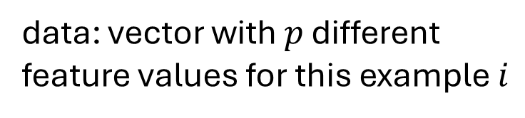
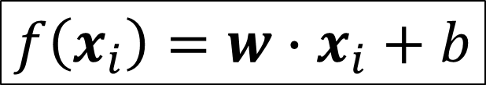
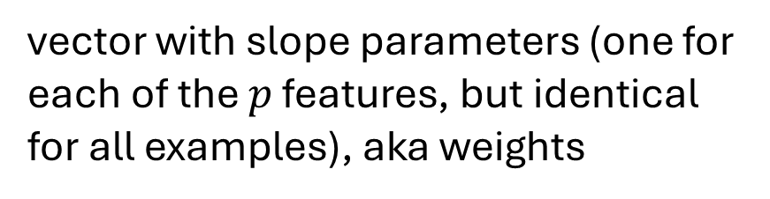
Linear Model
data: vector with $p$ different feature values for this example $i$
$$f\left(x_{i}\right)=w∙x_{i}+b$$
vector with slope parameters (one for each of the $p$ features, but identical for all examples), aka weights
single intercept parameter, aka bias

Slide 4
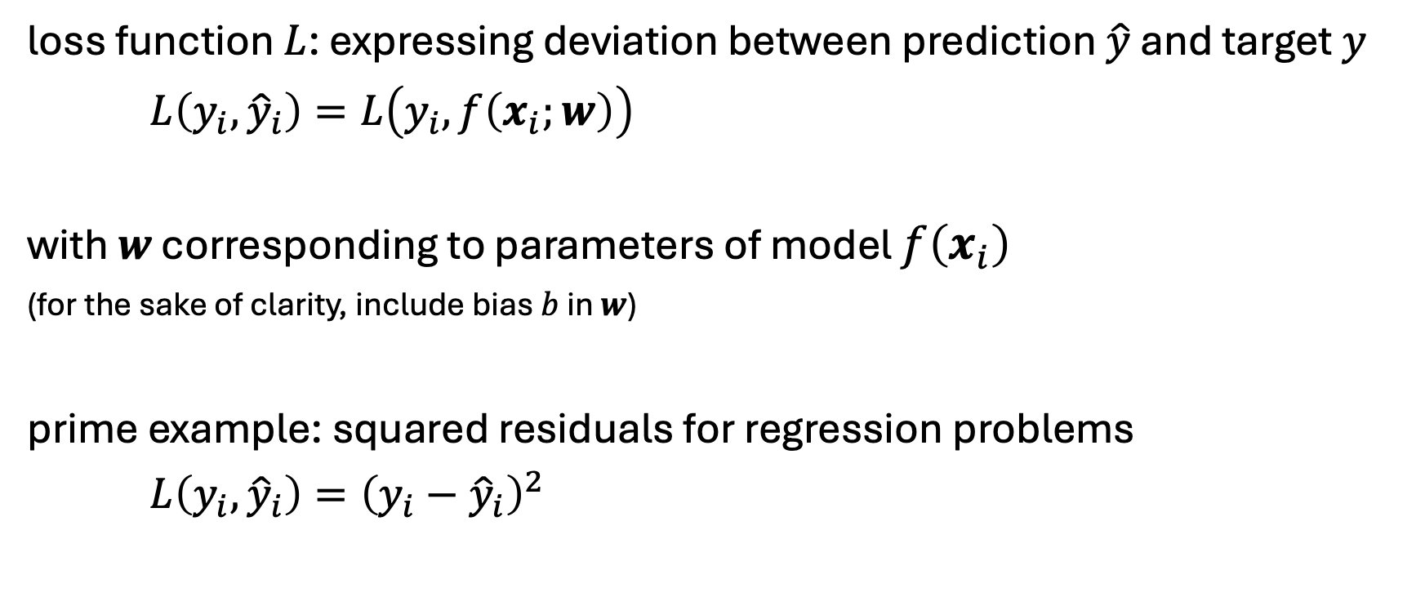
Loss Function
loss function $L$: expressing deviation between prediction $\hat{y}$ and target $y$
$L\left(y_{i},{\hat{y}}_{i}\right)=L\left(y_{i},f\left(x_{i};w\right)\right)$
with $w$ corresponding to parameters of model $f\left(x_{i}\right)$
(for the sake of clarity, include bias $b$ in $w$)
prime example: squared residuals for regression problems
$L\left(y_{i},{\hat{y}}_{i}\right)={\left(y_{i}−{\hat{y}}_{i}\right)}^{2}$

Slide 5
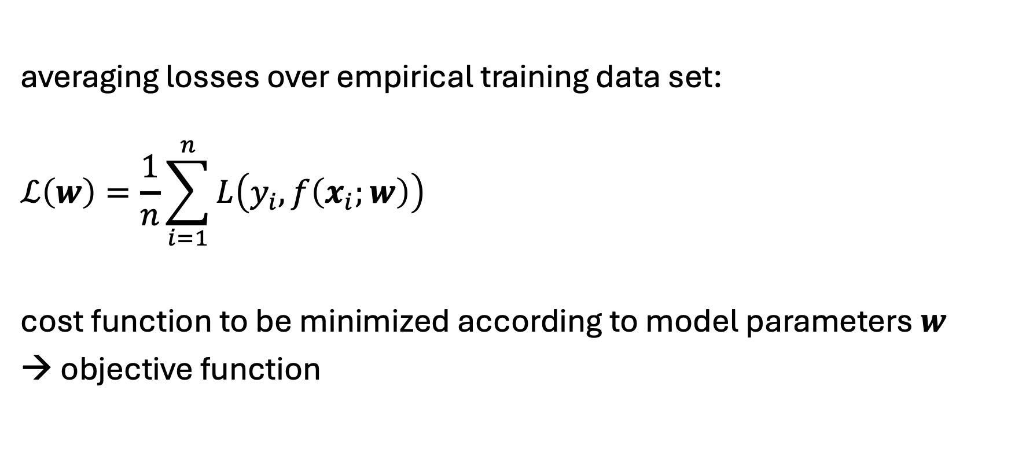
Cost Function
averaging losses over empirical training data set:
$$ℒ\left(w\right)=\frac{1}{n}\sum_{i=1}^{n}{L\left(y_{i}, f\left(x_{i};w\right)\right)}$$
cost function to be minimized according to model parameters $w$
→ objective function

Slide 6
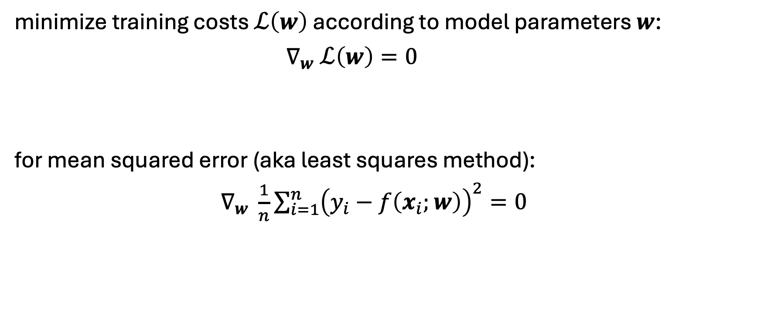
Cost Minimization
minimize training costs $ℒ\left(w\right)$ according to model parameters $w$:
$∇_{w} ℒ\left(w\right)=0$
for mean squared error (aka least squares method):
$∇_{w} \frac{1}{n}\sum_{i=1}^{n}{{\left(y_{i}−f\left(x_{i};w\right)\right)}^{2}}=0$

Slide 7
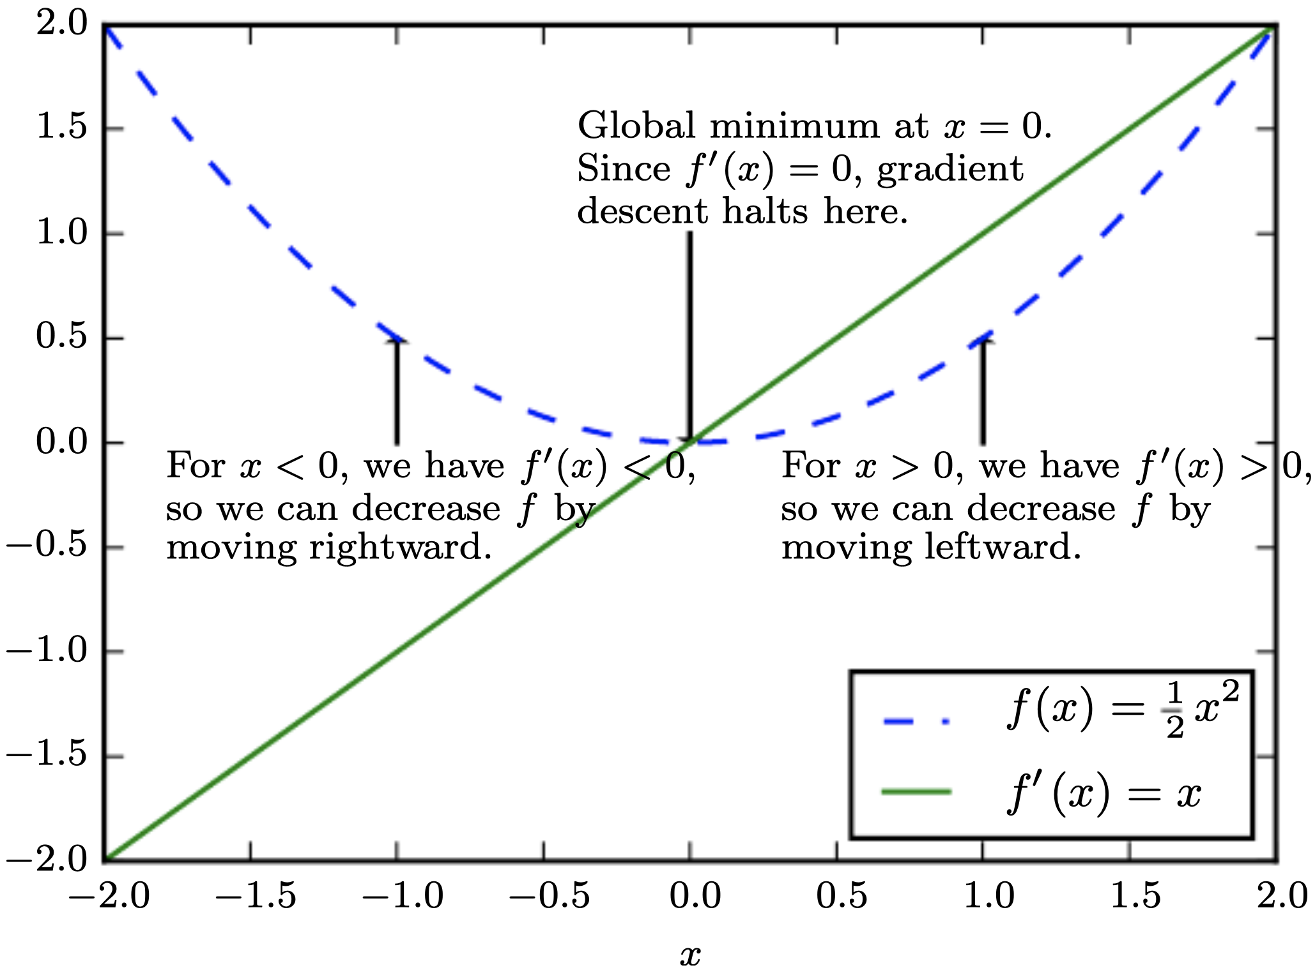
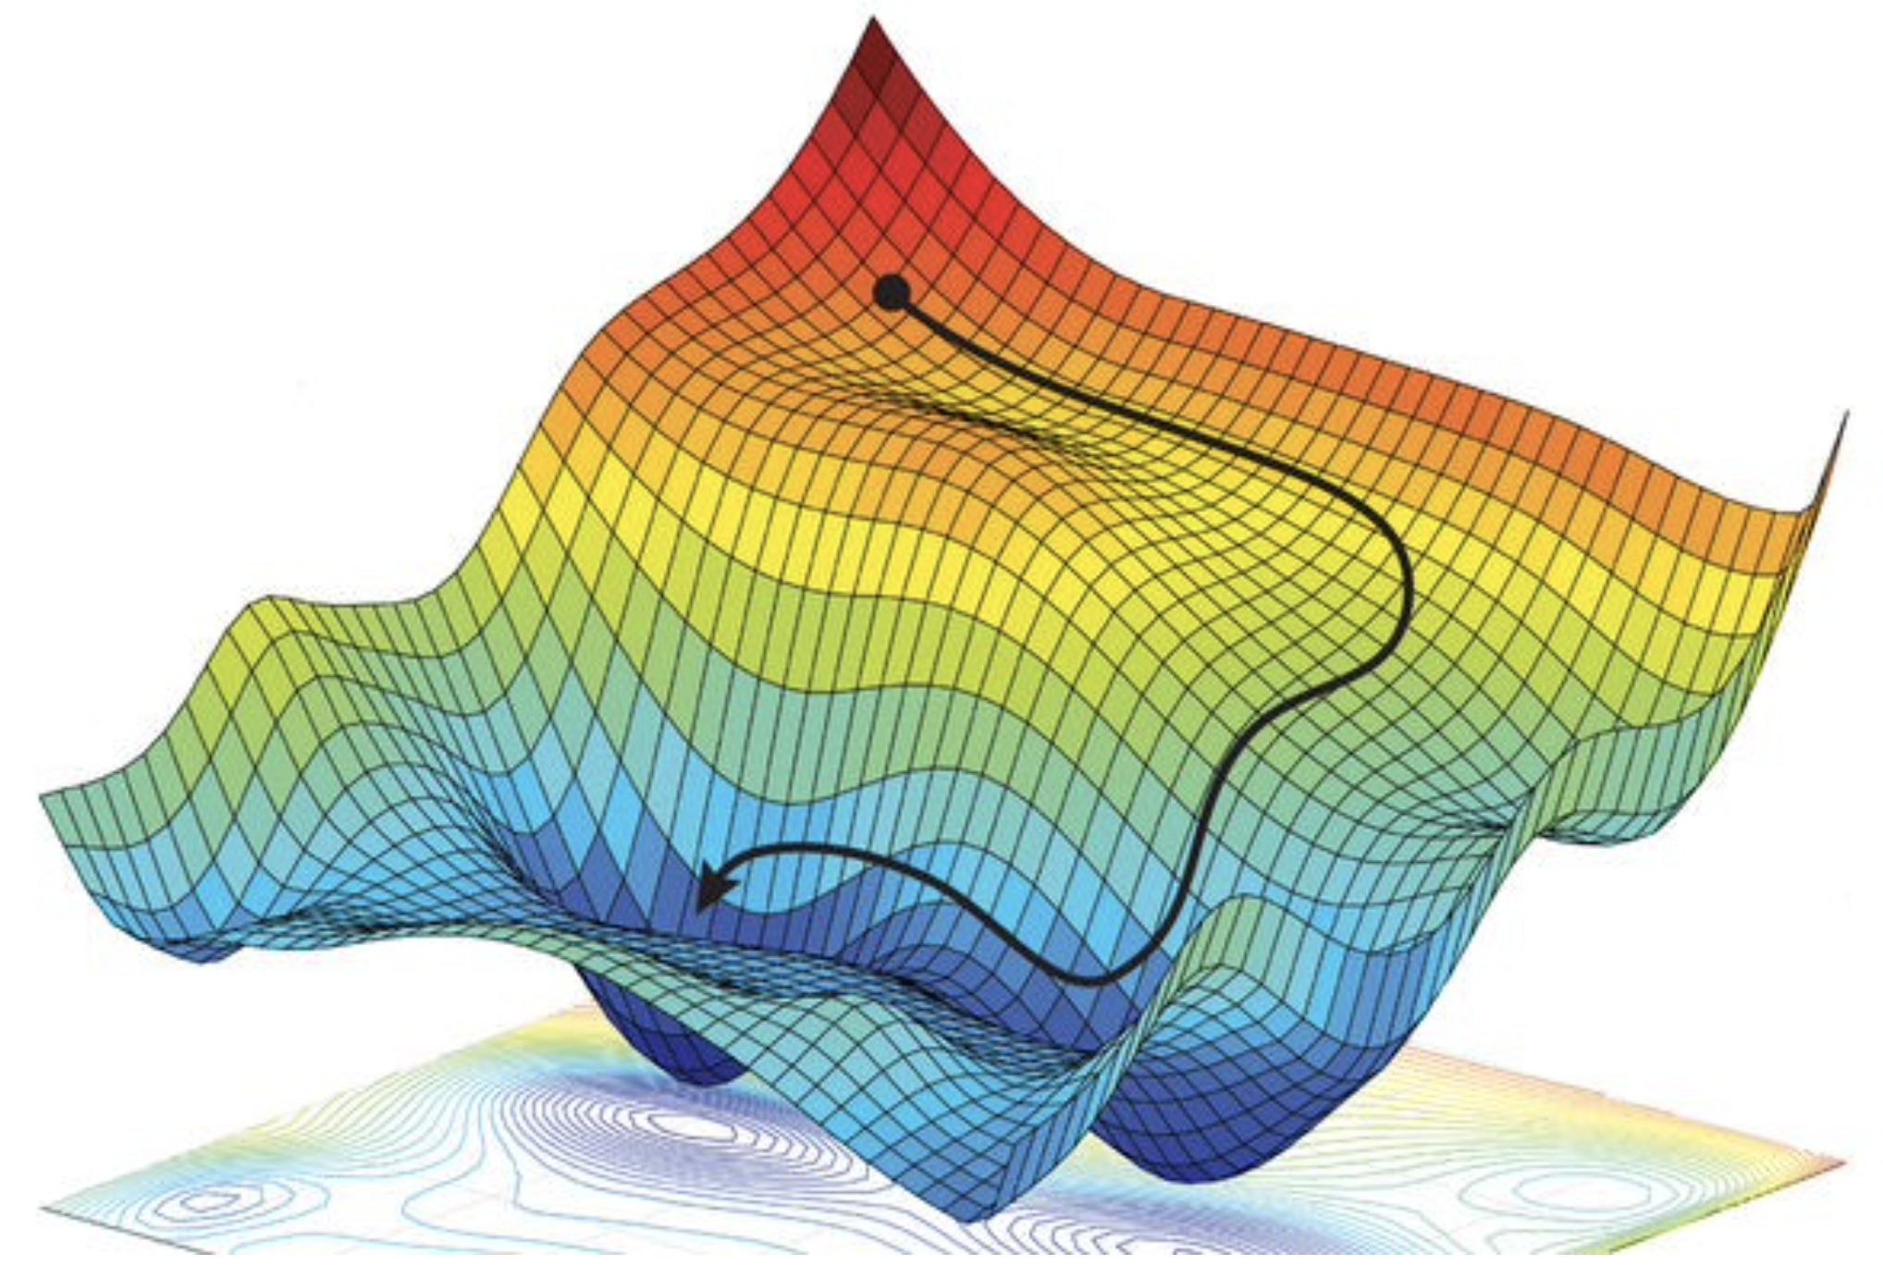
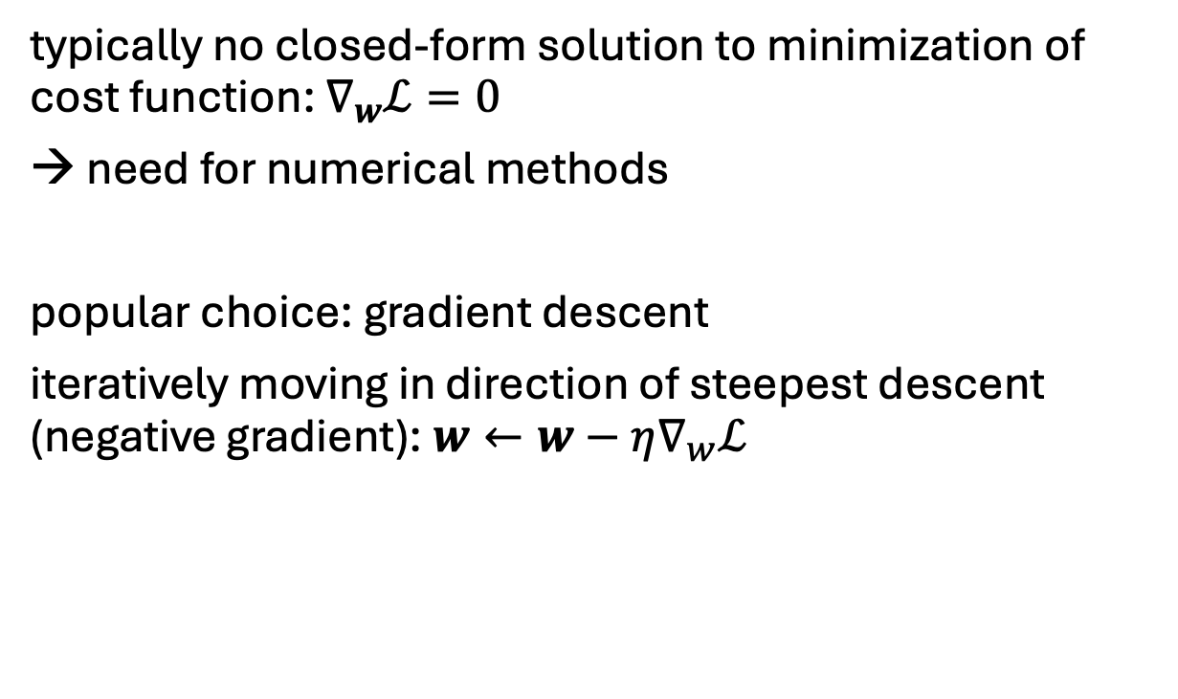
Gradient Descent
typically no closed-form solution to minimization of cost function: $∇_{w}ℒ=0$
need for numerical methods
popular choice: gradient descent
iteratively moving in direction of steepest descent (negative gradient): $w←w−η∇_{w}ℒ$
source
local minimum
global minimum
step size (learning rate)
vector containing all partial derivatives

Slide 8
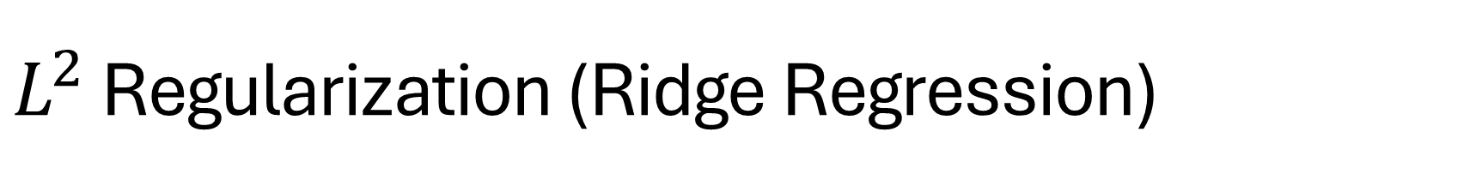
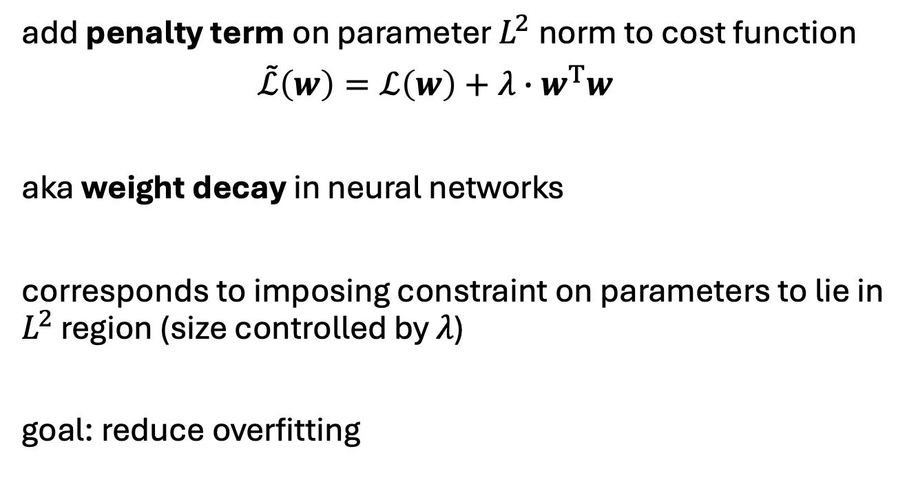
$L^{2}$ Regularization (Ridge Regression)
add penalty term on parameter $L^{2}$norm to cost function
$\tilde{ℒ}\left(w\right)=ℒ\left(w\right)+λ∙w^{T}w$
aka weight decay in neural networks
corresponds to imposing constraint on parameters to lie in $L^{2}$ region (size controlled by $λ$)
goal: reduce overfitting
hyperparameter controlling strength of regularization
source

Slide 9
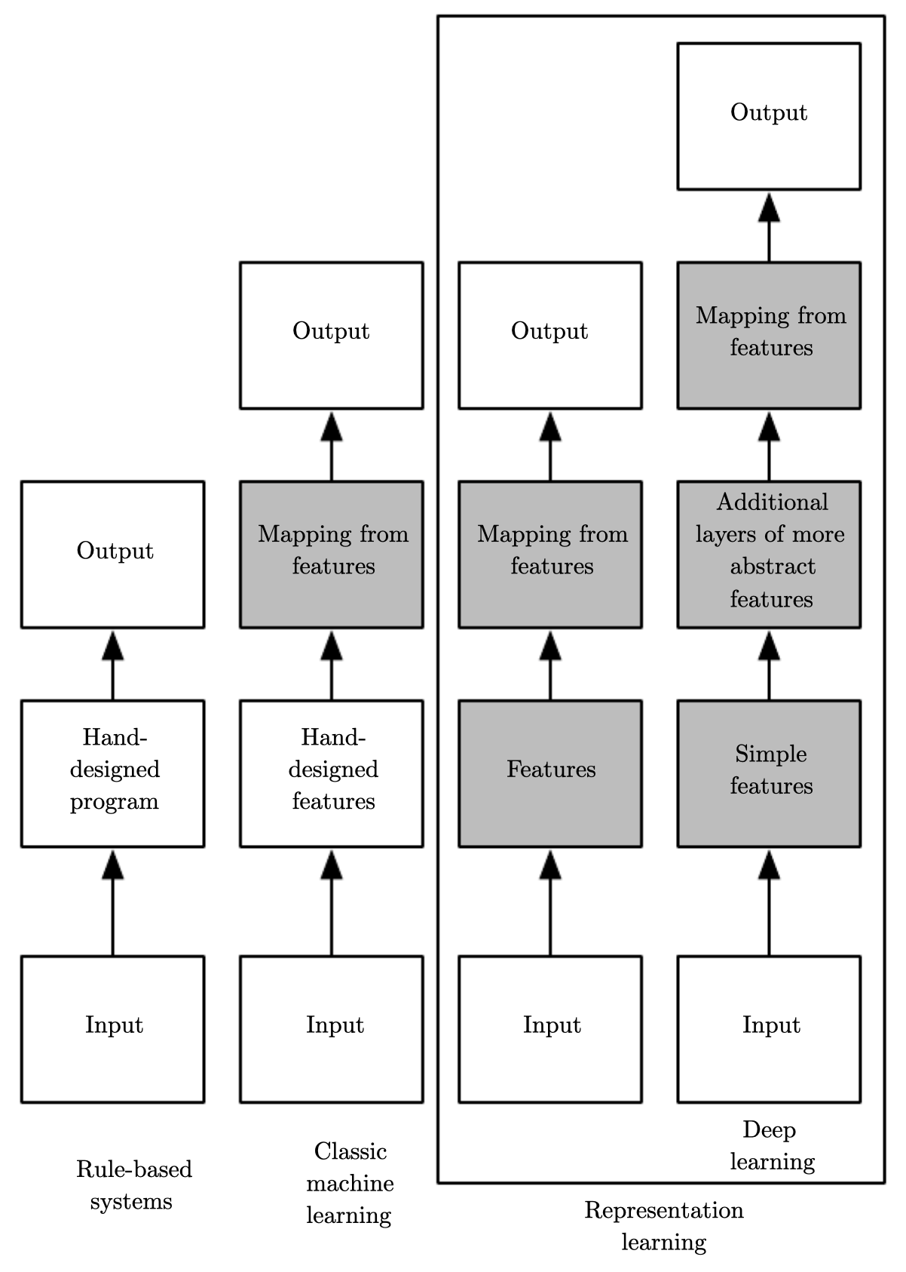
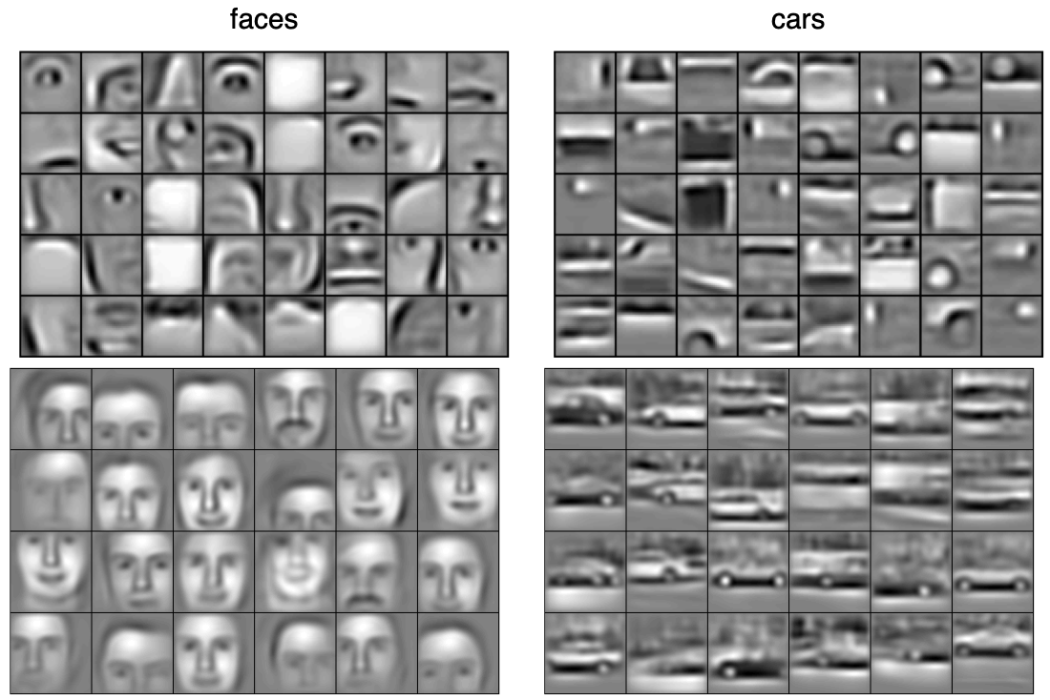
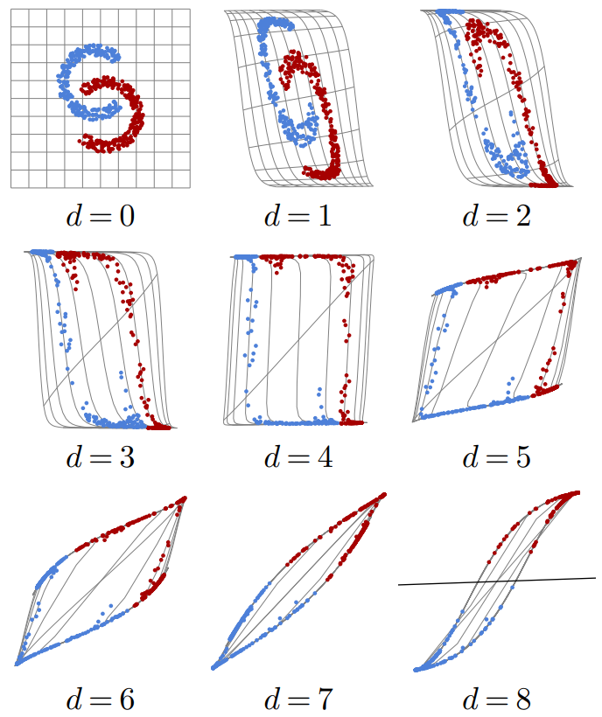
Ladder of Generalization
classic ML: feature engineering
deep learning: feature learning
(hierarchy of concepts learned from raw data in deep graph with many layers)
source
source
source

Slide 10
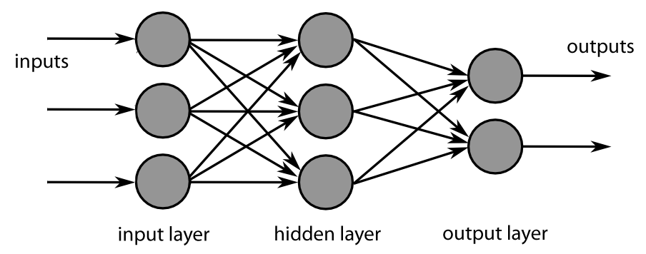


Neural Networks
idea: powerful algorithm by combining many linear building blocks
e.g., digital image
intensity pixel $1$
intensity pixel $2$
each node exchanges information only with directly connected nodes → parallel computation

Slide 11
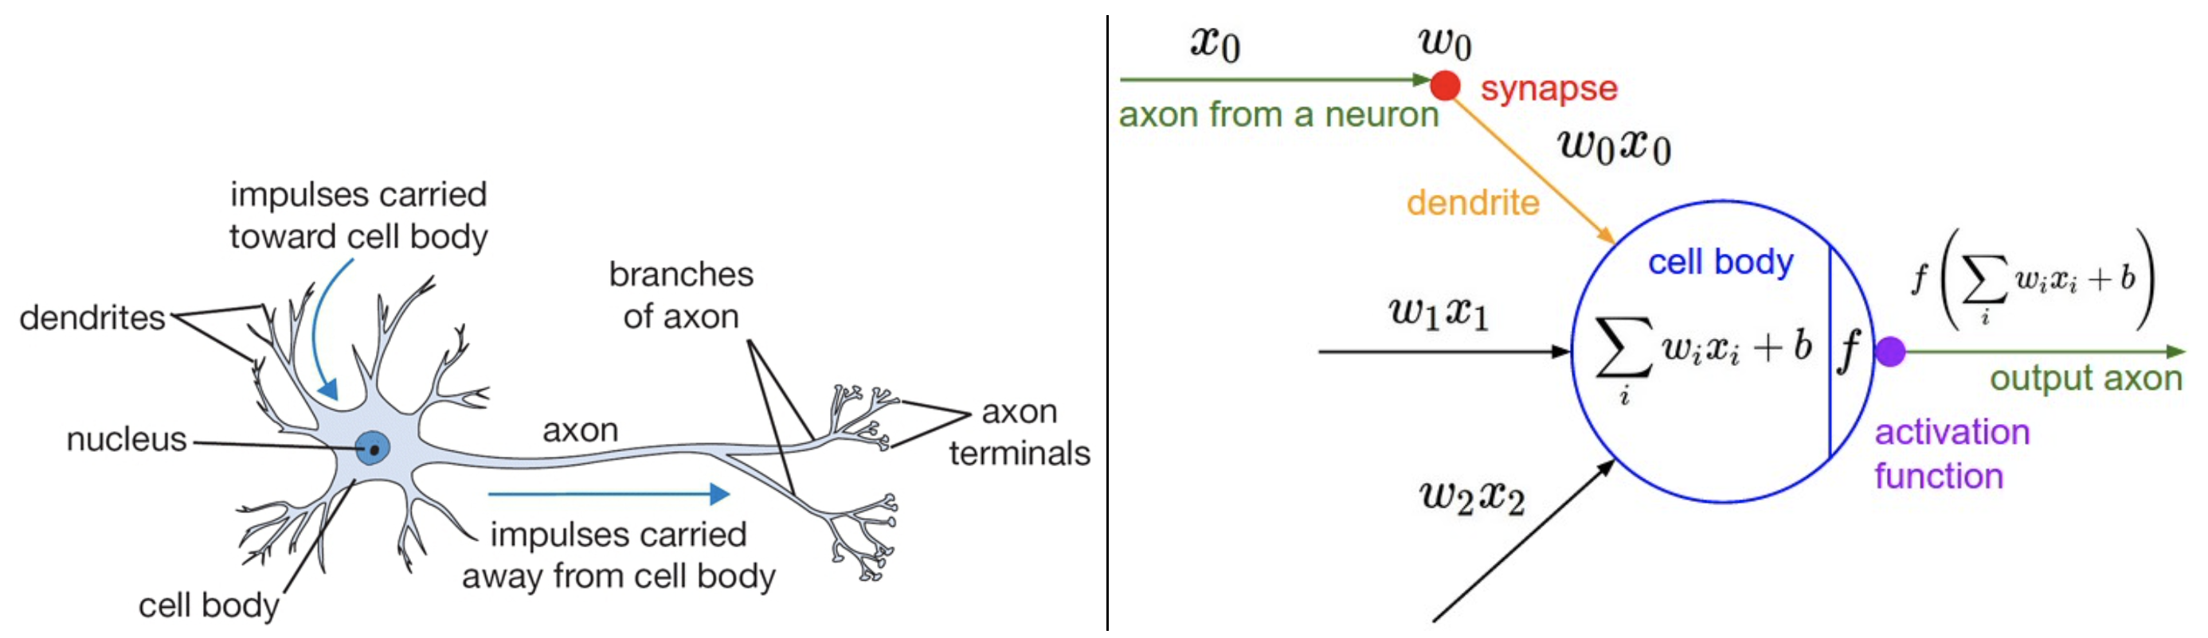
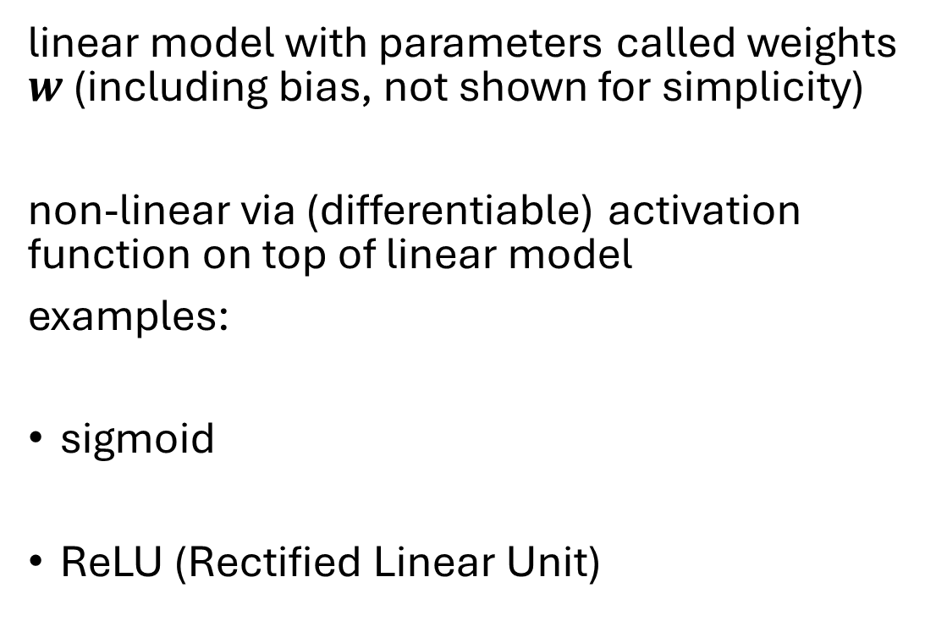
Artificial Neuron
artificial neuron (node in neural network):
linear model with parameters called weights $w$ (including bias, not shown for simplicity)
non-linear via (differentiable) activation function on top of linear model
examples:
sigmoid
ReLU (Rectified Linear Unit)
inspired from biological neurons:
source

Slide 12
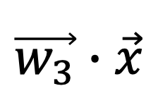

Neural Network as Nonlinear Function
parameters: learned from data
weights
(matrix)
Dog node
Cat node
e.g., node $3$
( )
probability for „cat“
(softmax instead of activation function)
linear transformation with nonlinear activation functions
$$\vec{w_{3}}∙\vec{x}$$

Slide 13
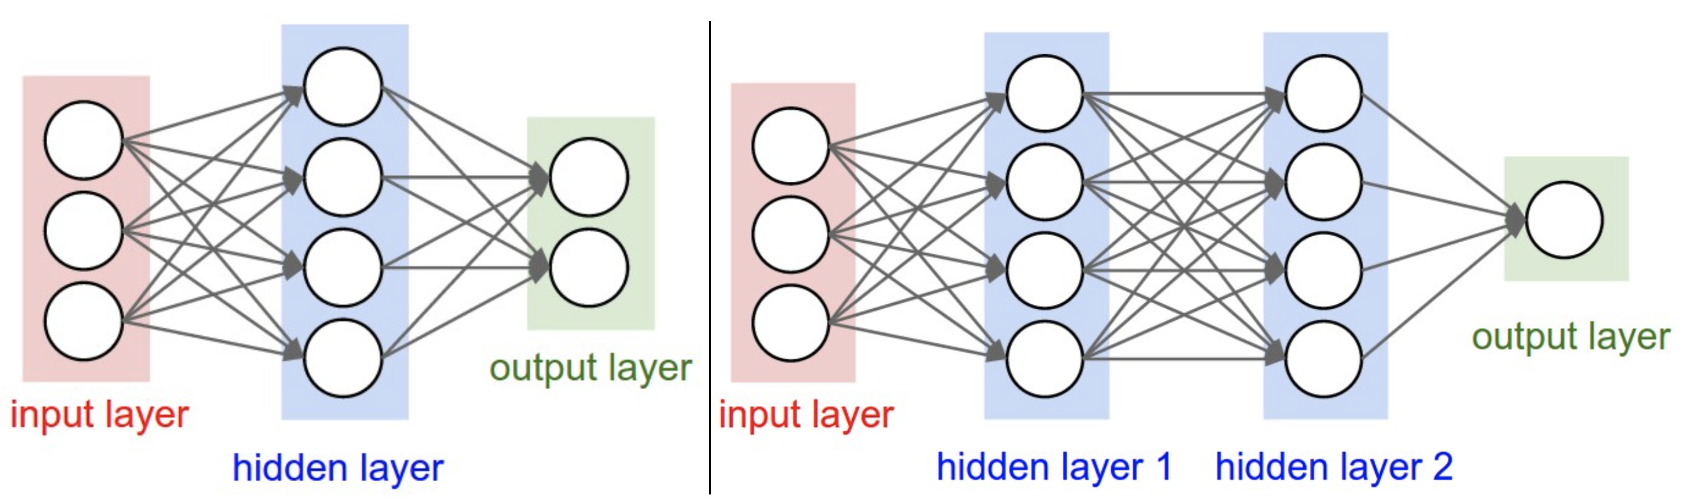
Multi-Layer Perceptron (MLP)
fully-connected feed-forward network with at least one hidden layer (universal function approximator)
toward deep learning: add hidden layers
more layers (depth) more efficient than just more nodes (width): less parameters needed for same function complexity
binary classification
regression

Slide 14

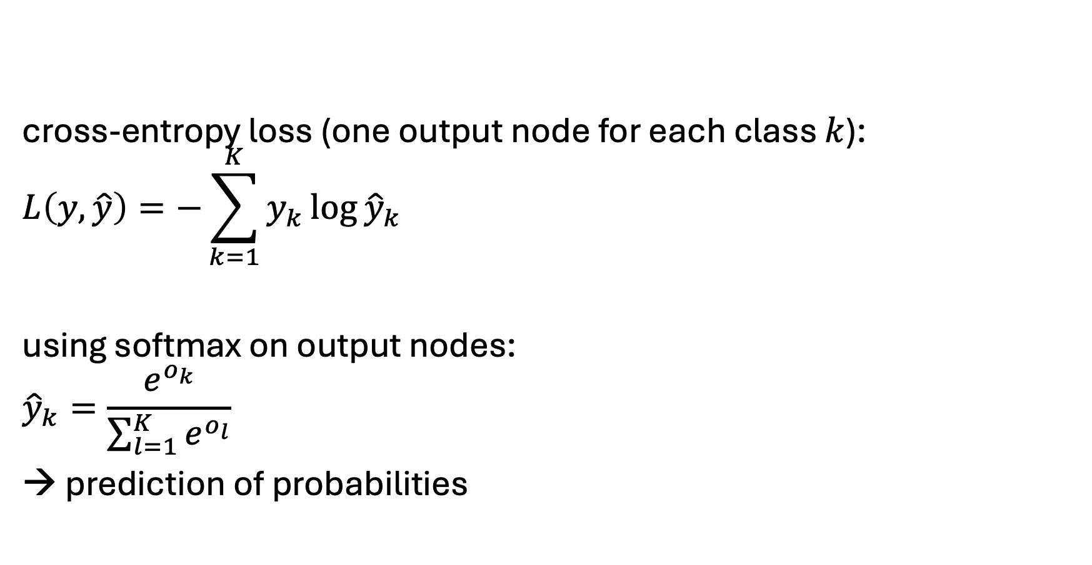
Classification Networks
cross-entropy loss (one output node for each class $k$):
$$L\left(y,\hat{y}\right)=−\sum_{k=1}^{K}{y_{k}\log{{\hat{y}}_{k}}}$$
using softmax on output nodes:
$${\hat{y}}_{k}=\frac{e^{o_{k}}}{\sum_{l=1}^{K}{e^{o_{l}}}}$$
→ prediction of probabilities
regression networks:
squared error loss: ${L\left(y,\hat{y}\right)=\left(y−\hat{y}\right)}^{2}$
just one output node
no function on output → prediction of real numbers

Slide 15
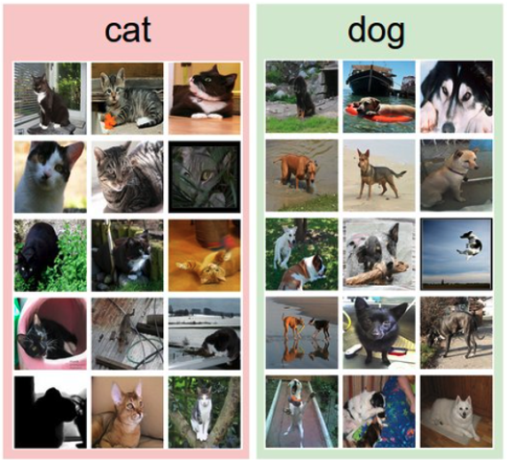
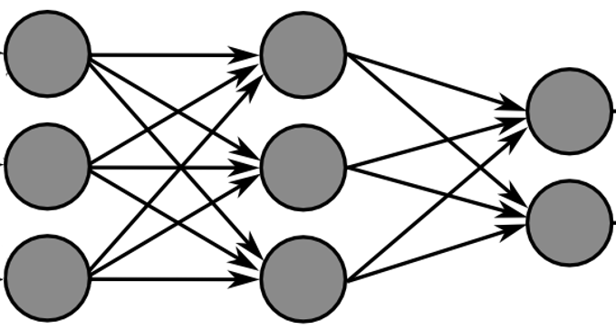
Training with Labeled Images
label:
forward pass
predictions

Slide 16
Training with Labeled Images
label:
forward pass
predictions
= ?
labels
error measurement
backpropagation
aim: minimization of errors

Slide 17
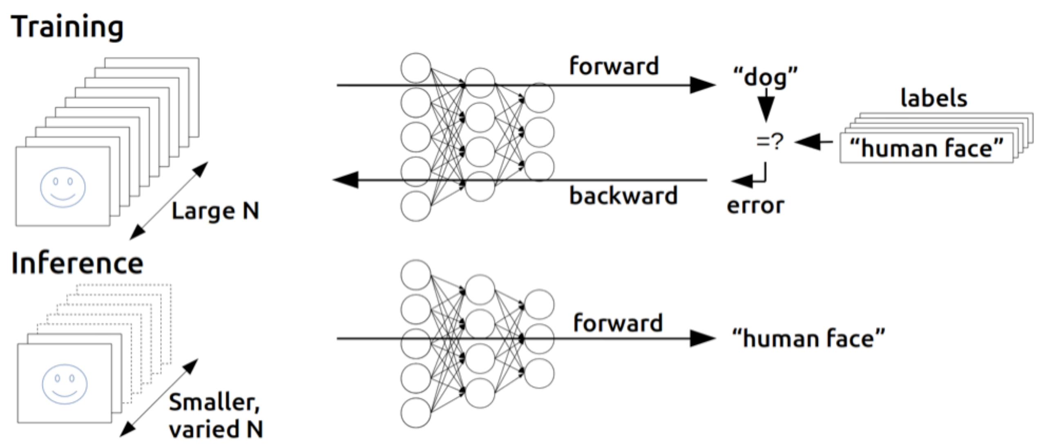
Find Gradients for (Deep) Neural Networks
backpropagation of errors through network layers via chain rule of calculus (enables learning of deep neural networks)
forward pass:
fix current weights
compute predictions
backward pass:
compute errors
calculate gradients (backpropagation of errors)
update weights accordingly (gradient descent)
source

Slide 18
Training: Iterative Adjustment of Weights
for epoch in range(epochs):
for X, y in mini_batches:
pred = model(X)
cost = loss(pred, y)
cost.backward()
optimizer.step()
quantification of error (here: cross entropy)
chain rule to calculate gradient (direction) of cost function with respect to weights
one step in direction of steepest descent: (stochastic) gradient descent

Slide 19
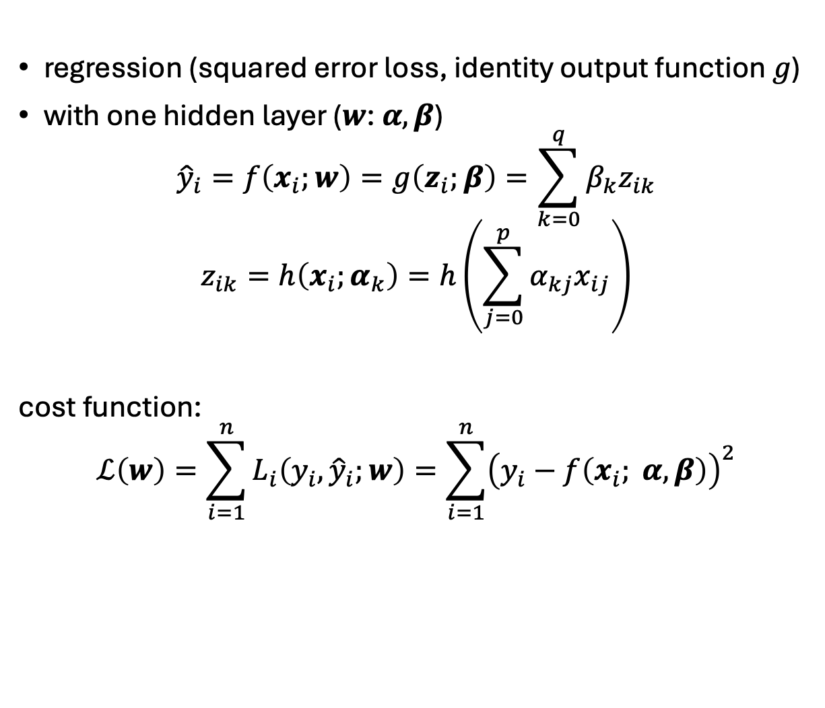
Example WOLOG
error measured here,
but not here
regression (squared error loss, identity output function $g$)
with one hidden layer ($w$: $α, β$)
$${\hat{y}}_{i}=f\left(x_{i};w\right)=g\left(z_{i};β\right)=\sum_{k=0}^{q}{β_{k}z_{ik}}$$
$$z_{ik}=h\left(x_{i};α_{k}\right)=h\left(\sum_{j=0}^{p}{α_{kj}x_{ij}}\right)$$
cost function:
$$ℒ\left(w\right)=\sum_{i=1}^{n}{L_{i}\left(y_{i},{\hat{y}}_{i};w\right)}=\sum_{i=1}^{n}{{\left(y_{i}−f\left(x_{i}; α,β\right)\right)}^{2}}$$
$$z_{1}$$
$p$ inputs
$$α_{1j}$$
$$z_{2}$$
$$x_{1}$$
$$z_{3}$$
$$y$$
$$x_{2}$$
$$z_{4}$$
activation function
$$α_{5j}$$
$$β_{k}$$
$$α_{kj}$$
$$z_{5}$$
$q$ nodes in hidden layer

Slide 20
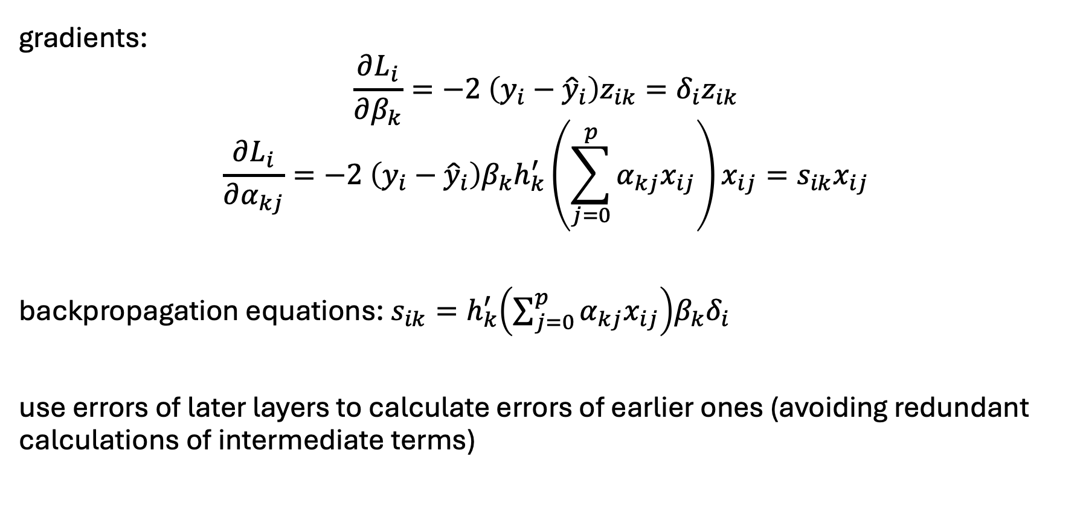
Example WOLOG
gradients:
$$\frac{∂L_{i}}{∂β_{k}}=−2 \left(y_{i}−{\hat{y}}_{i}\right)z_{ik}=δ_{i}z_{ik}$$
$$\frac{∂L_{i}}{∂α_{kj}}=−2 \left(y_{i}−{\hat{y}}_{i}\right)β_{k}h_{k}^{′}\left(\sum_{j=0}^{p}{α_{kj}x_{ij}}\right)x_{ij}=s_{ik}x_{ij}$$
backpropagation equations: $s_{ik}=h_{k}^{′}\left(\sum_{j=0}^{p}{α_{kj}x_{ij}}\right)β_{k}δ_{i}$
use errors of later layers to calculate errors of earlier ones (avoiding redundant calculations of intermediate terms)

Slide 21
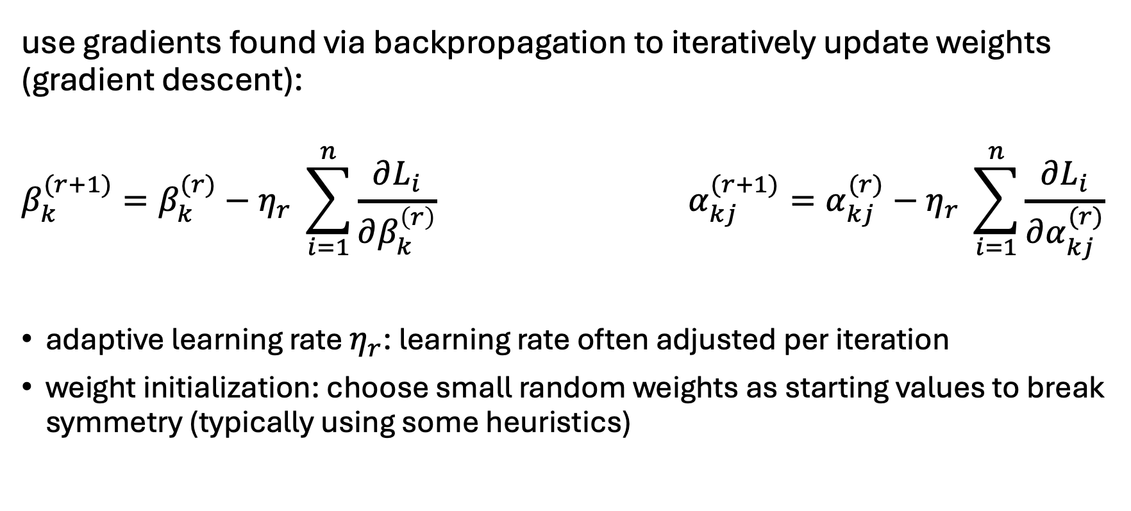
Using Gradients for Iterative Learning
use gradients found via backpropagation to iteratively update weights (gradient descent):
$$β_{k}^{(r+1)}=β_{k}^{(r)}−η_{r} \sum_{i=1}^{n}{\frac{∂L_{i}}{∂β_{k}^{\left(r\right)}}} α_{kj}^{(r+1)}=α_{kj}^{(r)}−η_{r} \sum_{i=1}^{n}{\frac{∂L_{i}}{∂α_{kj}^{(r)}}}$$
adaptive learning rate $η_{r}$: learning rate often adjusted per iteration
weight initialization: choose small random weights as starting values to break symmetry (typically using some heuristics)

Slide 22
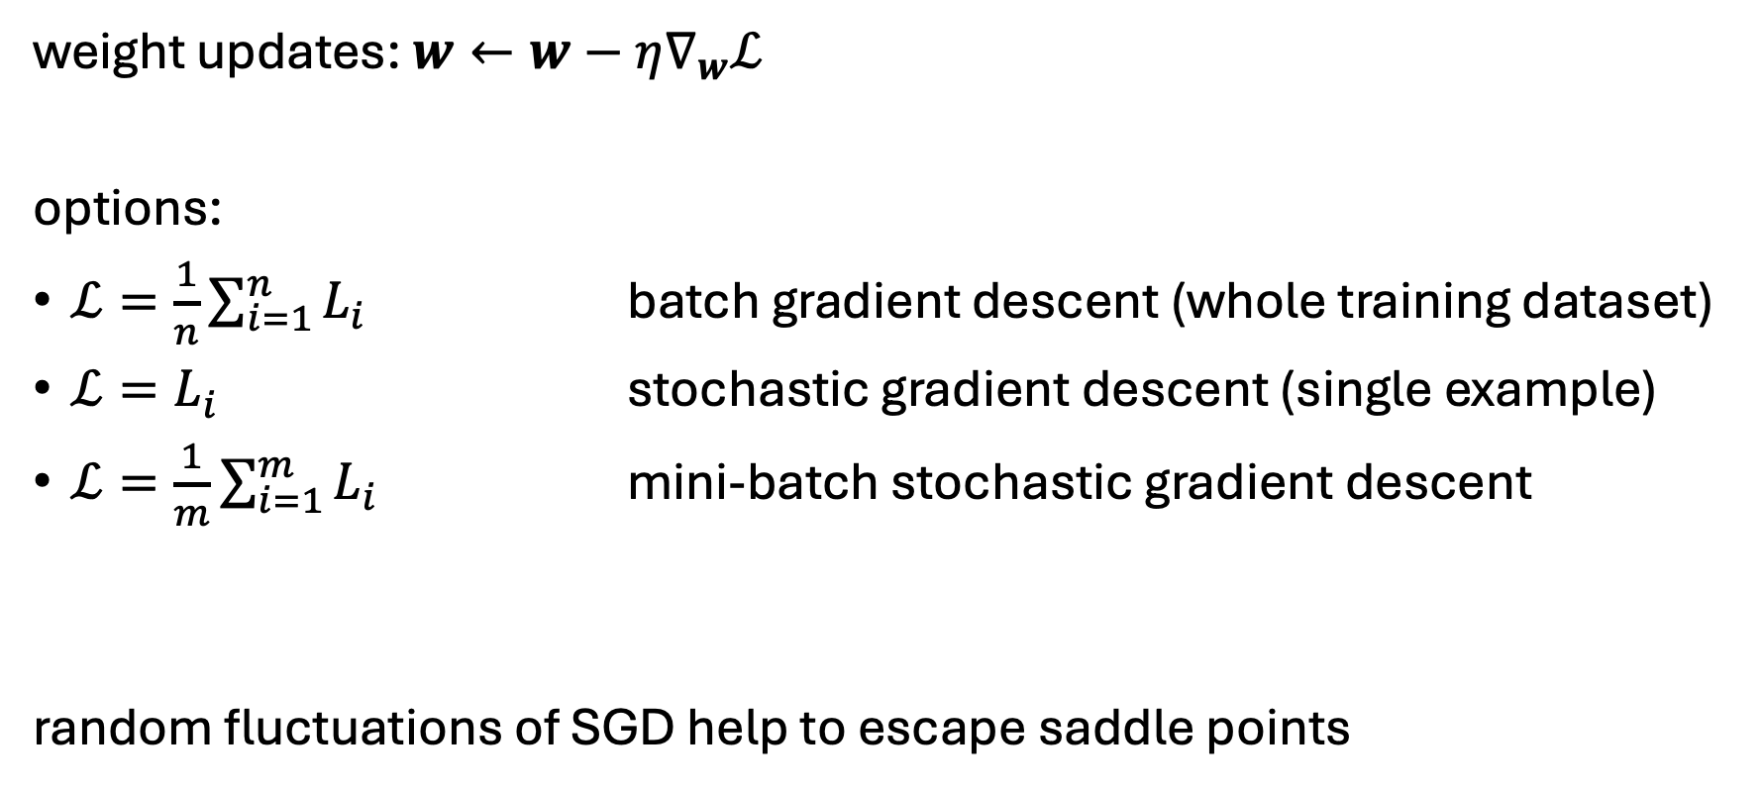
Stochastic Gradient Descent (SGD)
step size
cost function
weight updates: $w←w−η∇_{w}ℒ$
options:
$ℒ=\frac{1}{n}\sum_{i=1}^{n}{L_{i}}$ batch gradient descent (whole training dataset)
$ℒ=L_{i}$ stochastic gradient descent (single example)
$ℒ=\frac{1}{m}\sum_{i=1}^{m}{L_{i}}$ mini-batch stochastic gradient descent
random fluctuations of SGD help to escape saddle points
all training examples
mini-batch size → hyperparamter: tradeoffs between runtime & memory, convergence & generalization

Slide 23
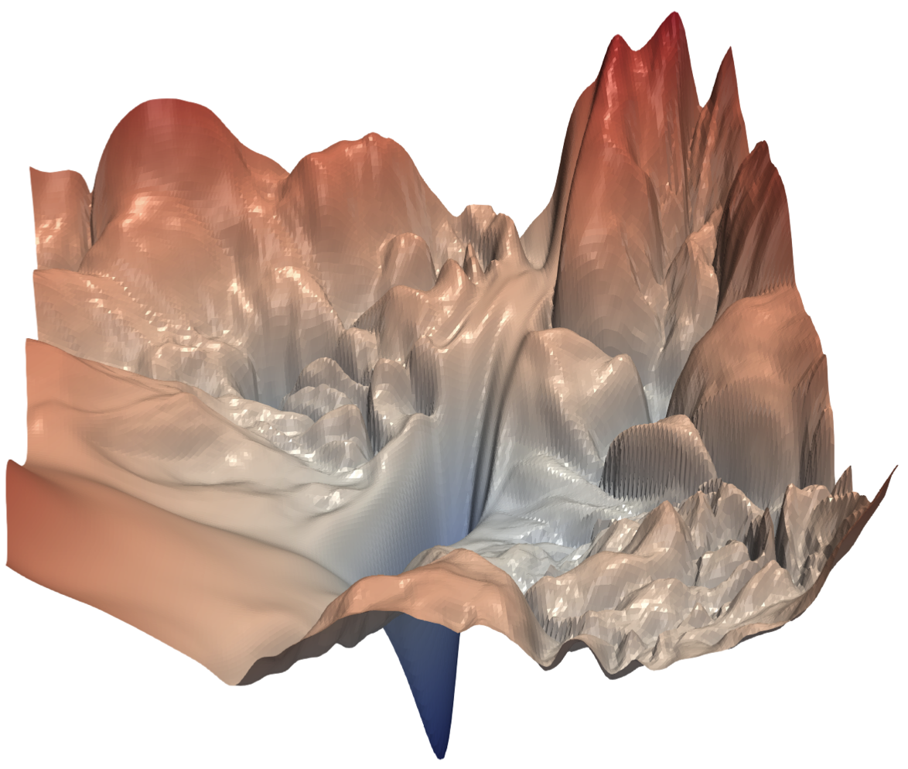
How to Train Deep Neural Networks Effectively?
typical loss surface:
optimization and regularization difficult
local vs global minima, saddle points, easily overfitting
many hyperparameters to tune
but many methods to get it working in practice (despite partly patchy theoretical understanding)
optimization: activation and loss functions, weight initialization, adaptive learning rate (e.g., Adam), learning rate schedulers
explicit regularization: weight decay, dropout, data augmentation
implicit regularization: early stopping, batch/layer normalization, SGD
source

Slide 24
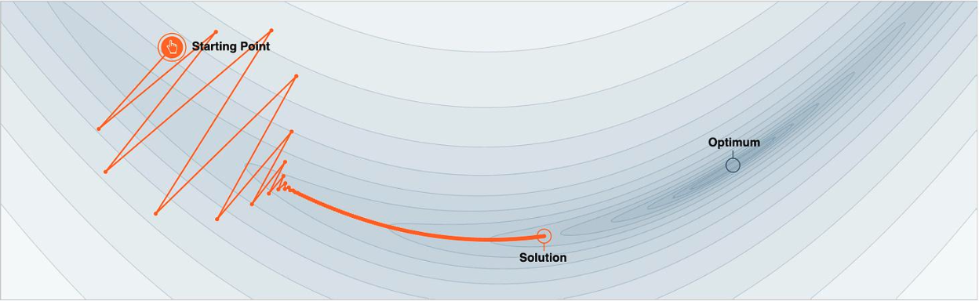
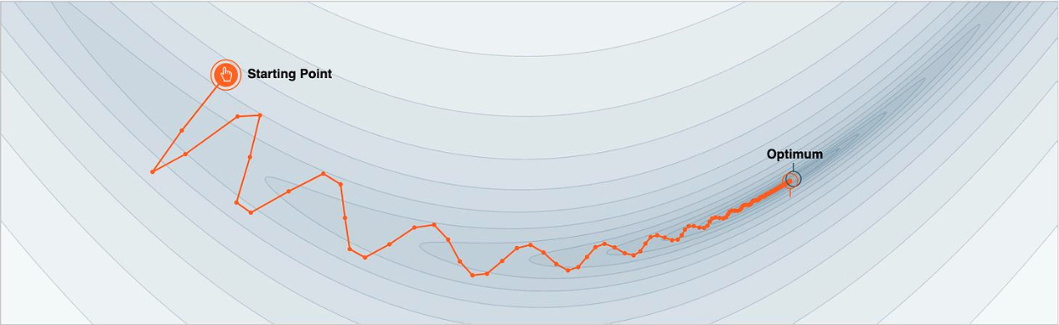
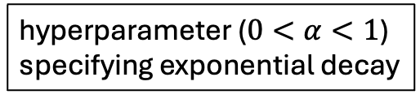
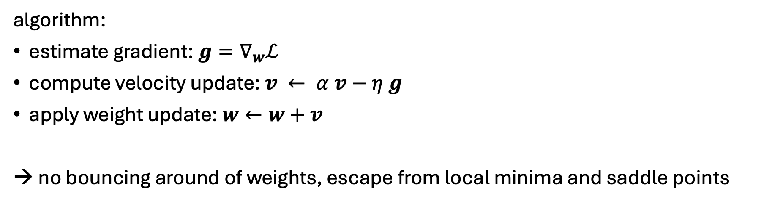
Gradient Descent with Momentum
hyperparameter ($0<α<1$) specifying exponential decay
algorithm:
estimate gradient: $g=∇_{w}ℒ$
compute velocity update: $v ← α v−η g$
apply weight update: $w←w+v$
→ no bouncing around of weights, escape from local minima and saddle points

Slide 25
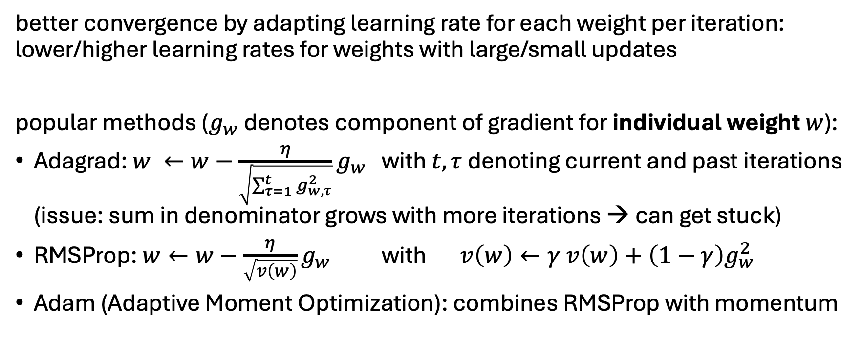
Adaptive Learning Rate
better convergence by adapting learning rate for each weight per iteration: lower/higher learning rates for weights with large/small updates
popular methods ($g_{w}$ denotes component of gradient for individual weight $w$):
Adagrad: $w ←w−\frac{η}{\sqrt{\sum_{τ=1}^{t}{g_{w,τ}^{2}}}}g_{w}$ with $t, τ$ denoting current and past iterations (issue: sum in denominator grows with more iterations → can get stuck)
RMSProp: $w←w−\frac{η}{\sqrt{v\left(w\right)}}g_{w}$ with $v\left(w\right)←γ v\left(w\right)+\left(1−γ\right)g_{w}^{2}$
Adam (Adaptive Moment Optimization): combines RMSProp with momentum

Slide 26
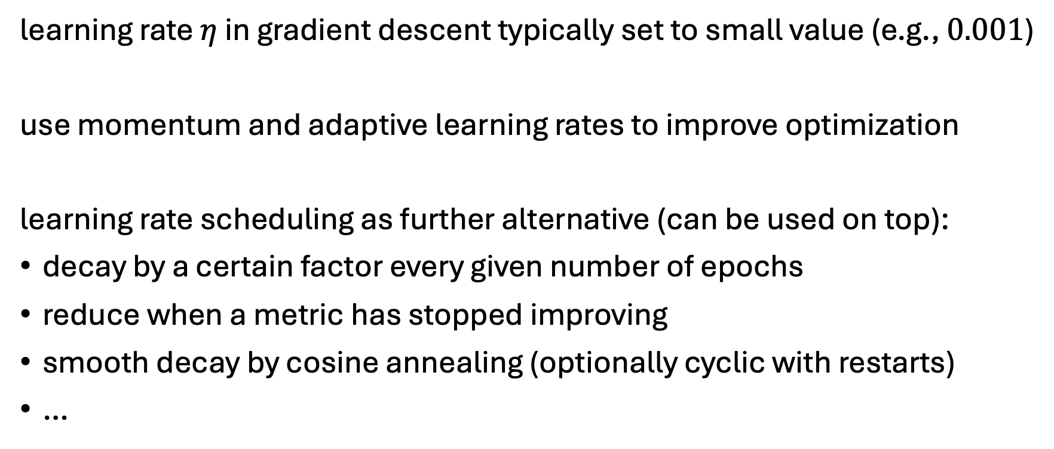
Learning Rate Schedulers
learning rate $η$ in gradient descent typically set to small value (e.g., $0.001$)
use momentum and adaptive learning rates to improve optimization
learning rate scheduling as further alternative (can be used on top):
decay by a certain factor every given number of epochs
reduce when a metric has stopped improving
smooth decay by cosine annealing (optionally cyclic with restarts)
…

Slide 27
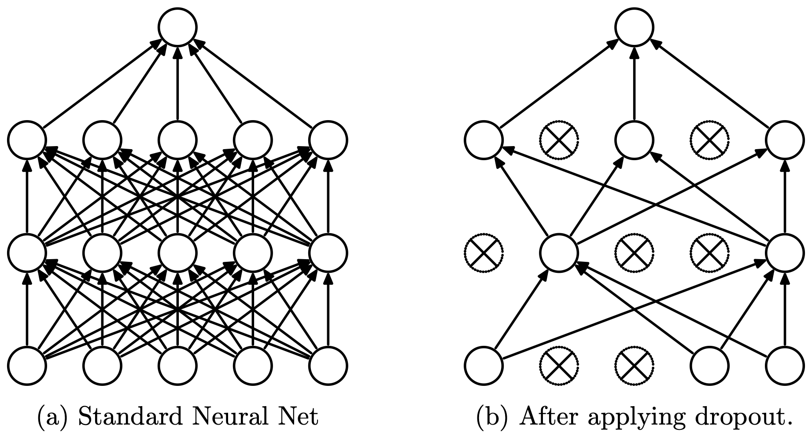
Dropout in Neural Networks
goal: prevent overfitting of large neural networks
randomly drop non-output nodes (along with their connections) during training (not prediction)
→ adaptability: regularizing each hidden node to perform well regardless of which other hidden nodes are in the model
for each mini-batch, randomly sample independent binary masks for the nodes
destroying extracted features rather than input values
source

Slide 28
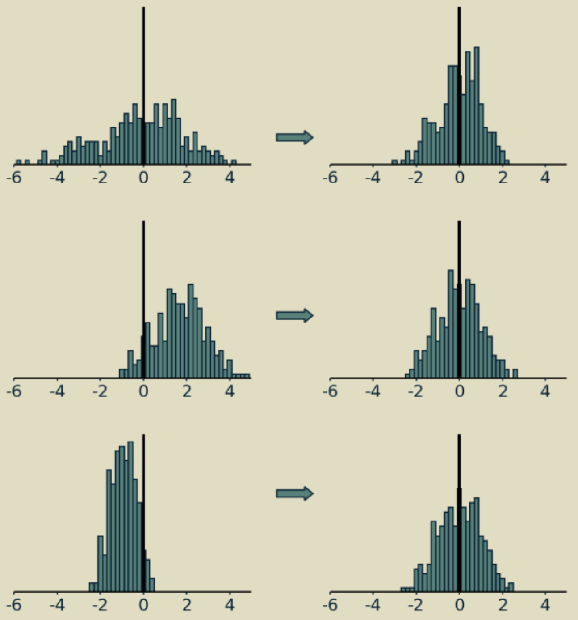
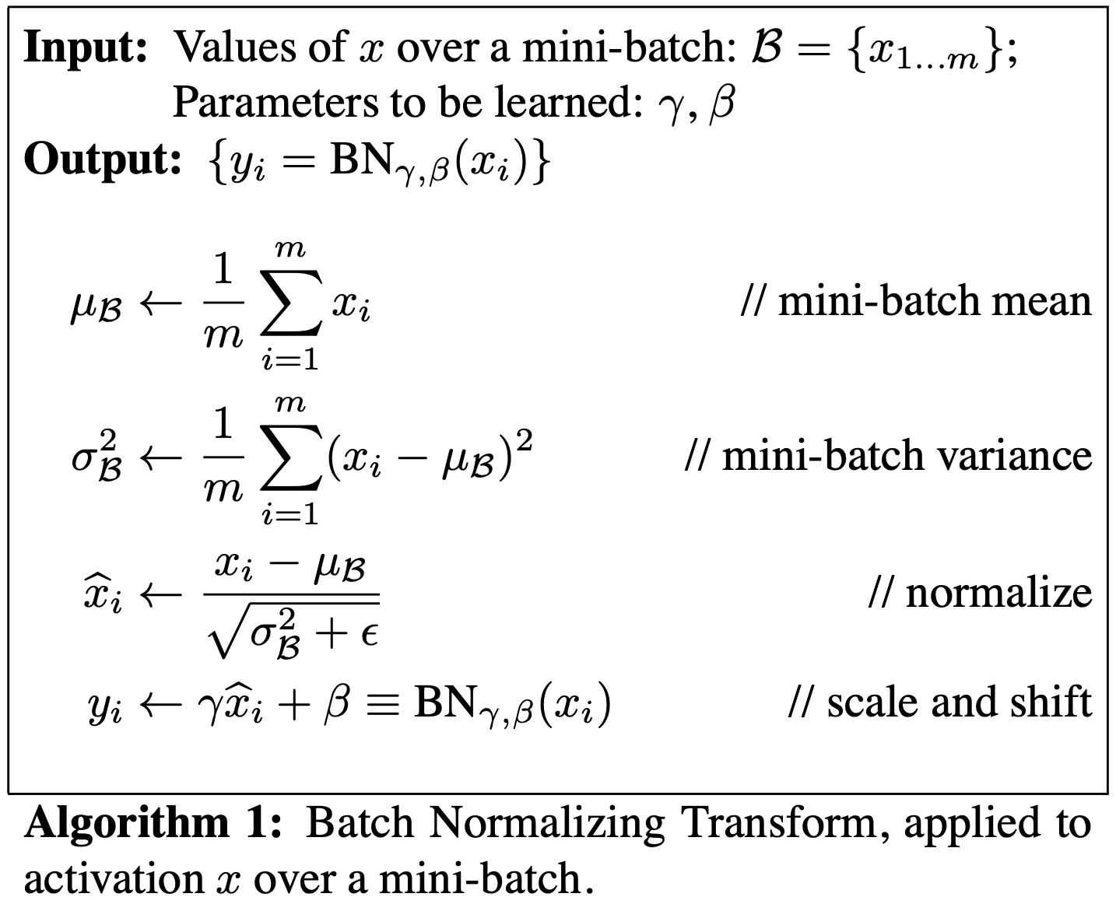
Batch Normalization
source
adaptive reparameterization of inputs to network layer (before or after activation)
independently for each feature
(implicit) regularization eﬀect
source

Slide 29
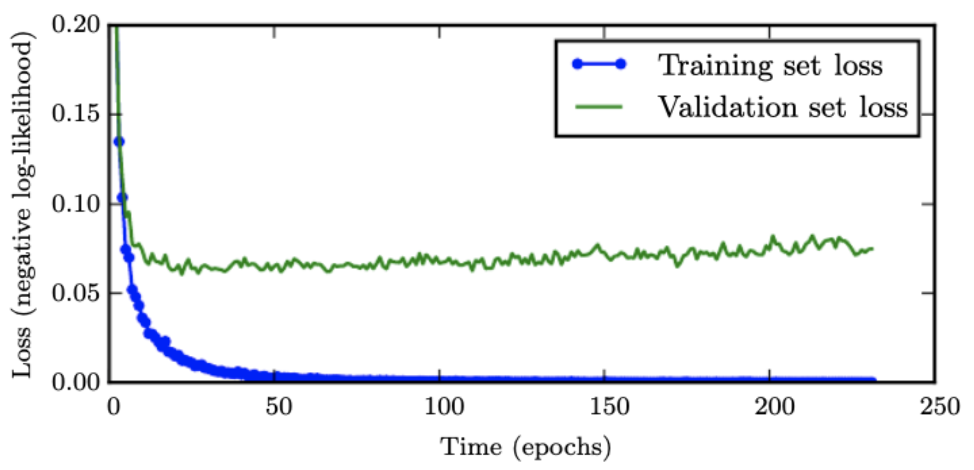
Early Stopping
loss independently measured on validation set
halting training when overﬁtting begins to occur
early stopping
source

Slide 30
Tabular vs Unstructured Data
Deep learning excels on unstructured data (images, text, audio), but not necessarily on tabular data.
challenges of tabular data for deep learning:
heterogeneous features (mixed numerical, categorical, sparse variables)
limited benefit from feature learning → feature engineering often still required
weak transfer learning / pretraining opportunities
Tree-based methods (e.g., gradient boosting) naturally handle these properties and often perform better on tabular tasks.

Slide 31
Practice Project
Kaggle competition: Leaf Classification

