Slide 1
Introduction
Fundamentals of Artificial Intelligence

Slide 2
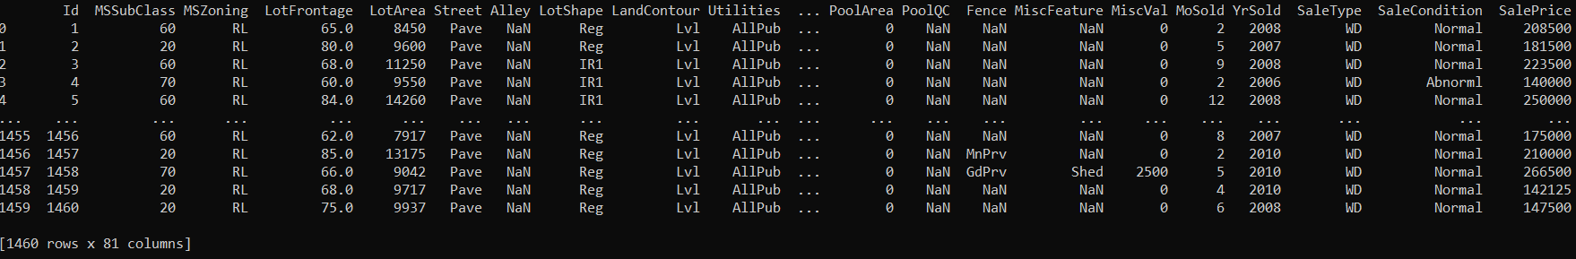
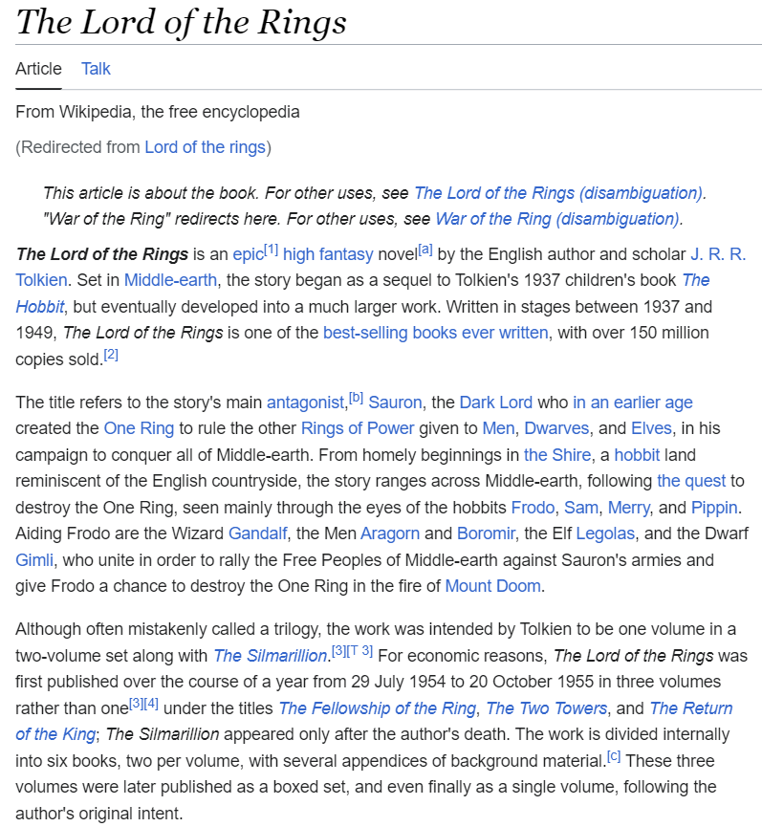
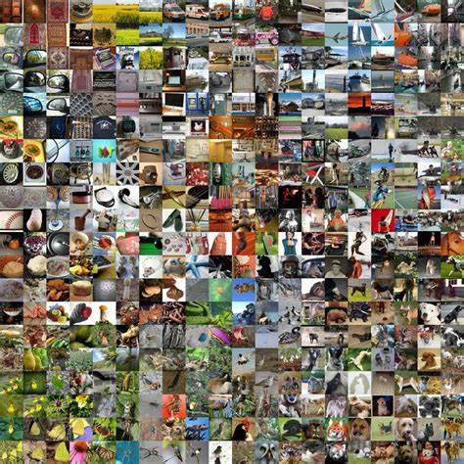
Main Areas of Artificial Intelligence (AI)
tabular data
language models
control
computer vision
all empowered by one key component: learning from data → Machine Learning (ML)

Slide 3
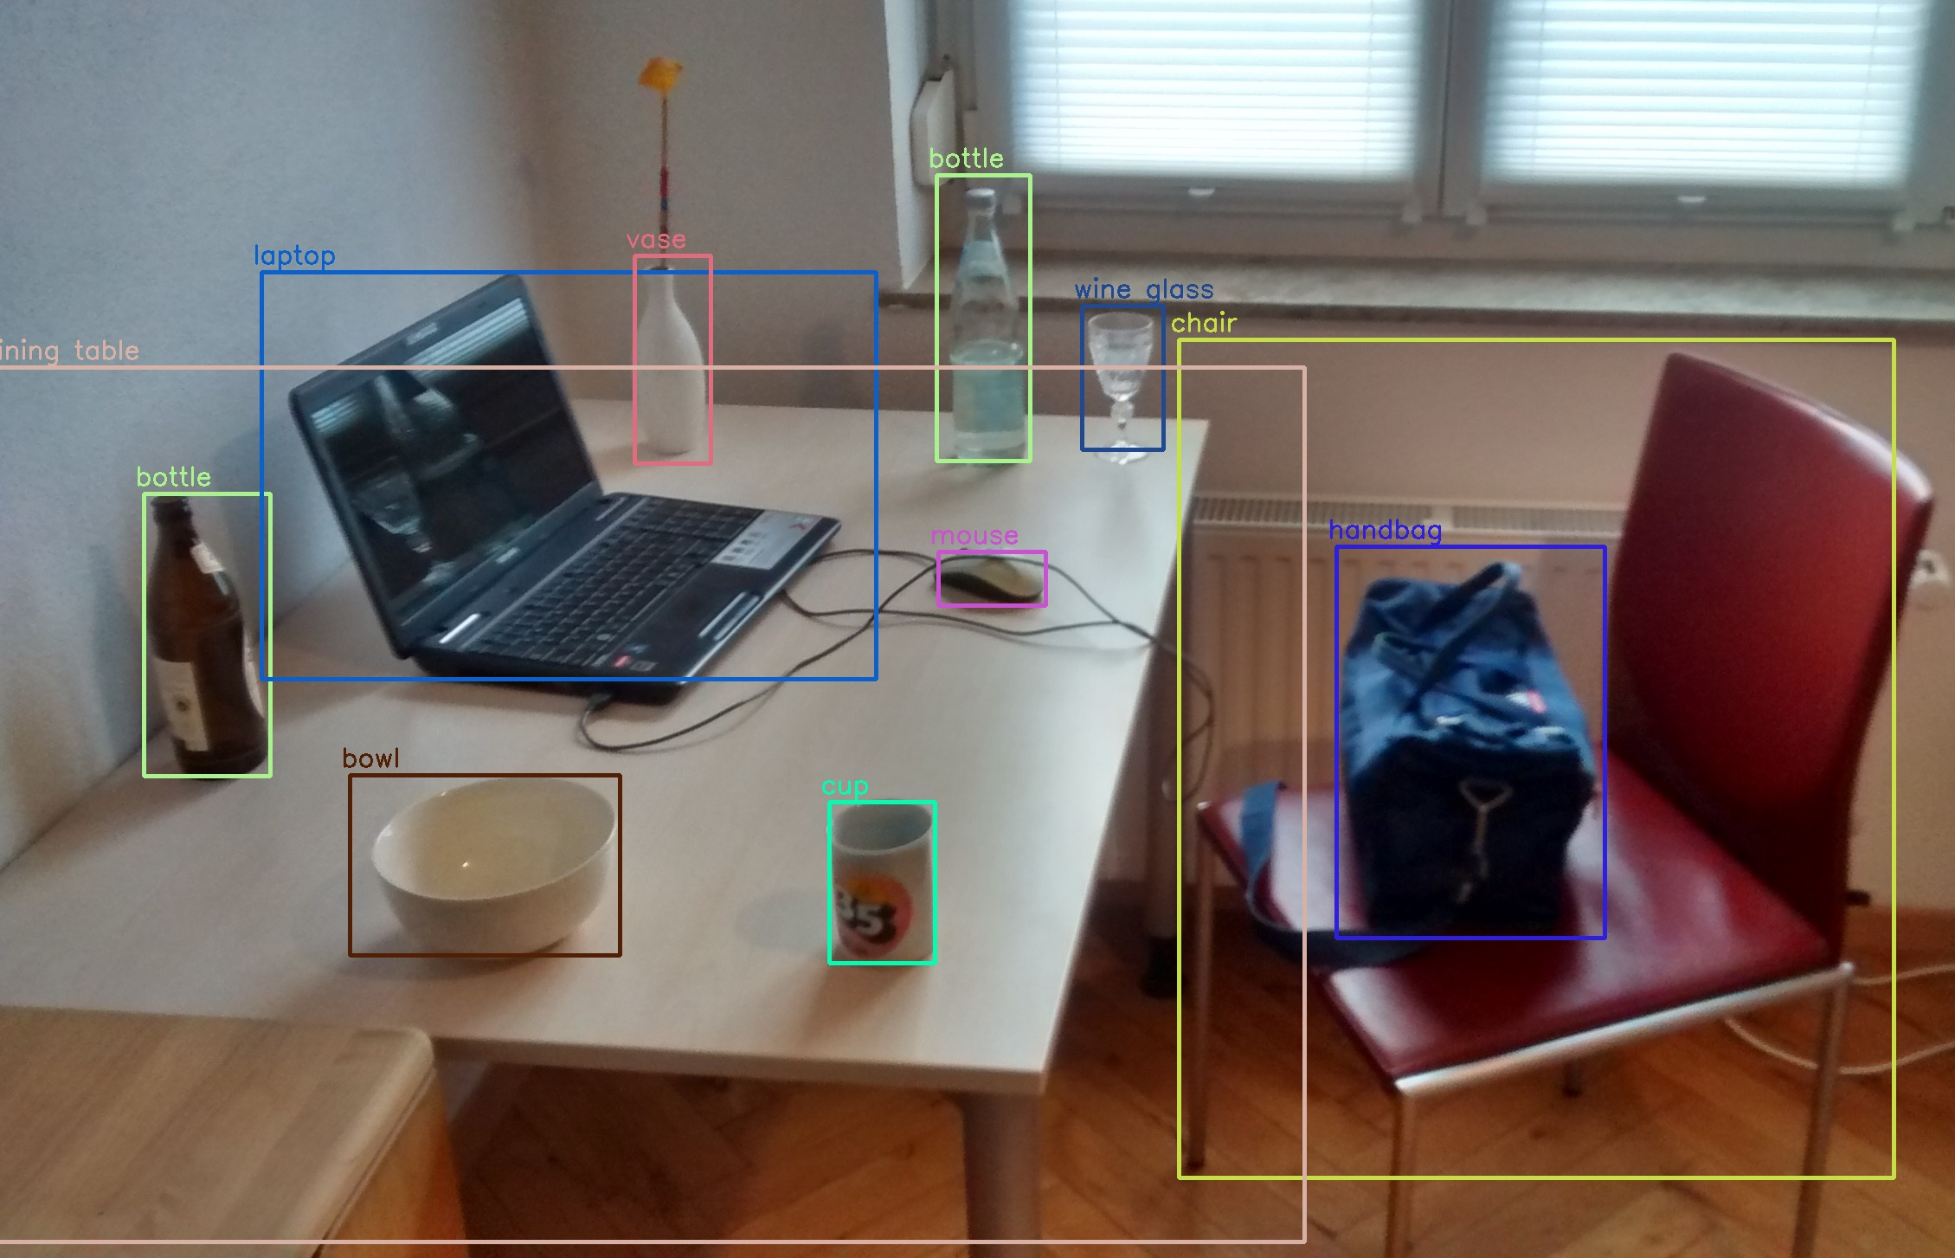
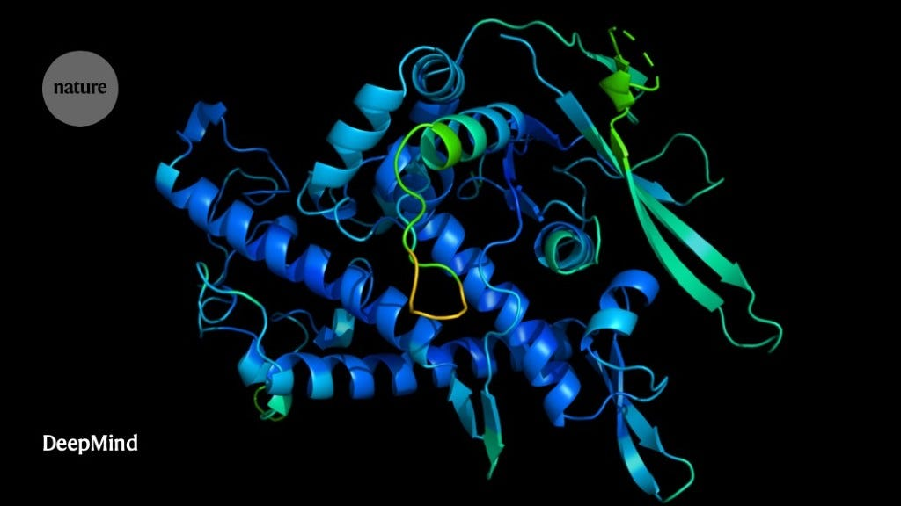
When to Use AI/ML
automation
too complex for rules
uncertainty
too complex for humans
AlphaFold
object recognition, chat bot, …
protein structure predictions, demand forecasting, …

Slide 4
blend of diverse components from different domains (statistics, optimization, computer science, …)
Artificial Intelligence
Machine Learning
Deep
Learning
Deep Learning: special kind of ML methods using deep neural networks (e.g., CNNs, transformers)

Slide 5
What Is Machine Learning?
learning from experience/data: exploiting statistical dependencies with the aim of generalization to new data
training: ML algorithm + data = explicit algorithm (to be used later)
reduction of complexity and much better generalizability compared to handcrafted algorithms
analogy: Humans do not hit the ground running (storage capacity of DNA limited) but have learning capabilities.

Slide 6
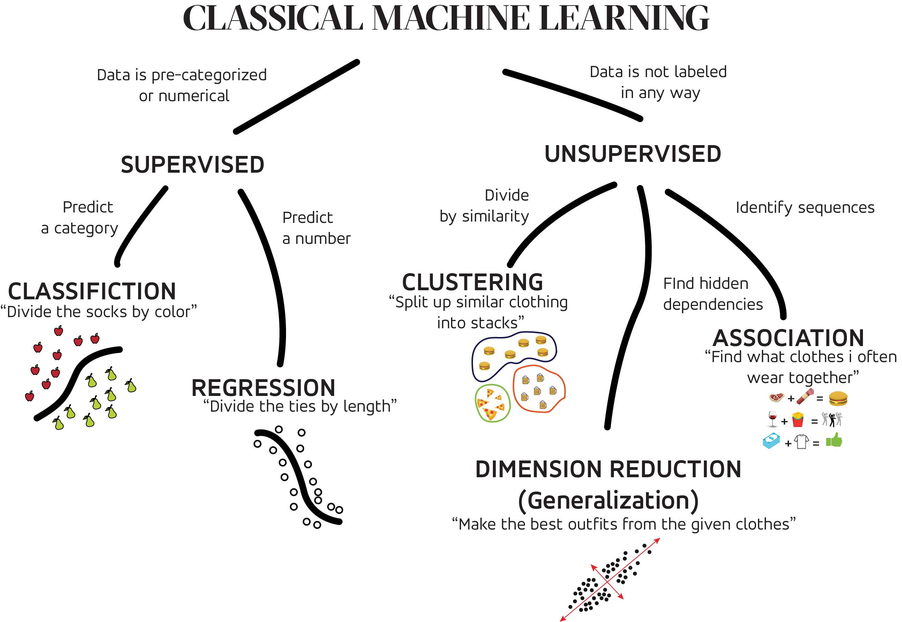
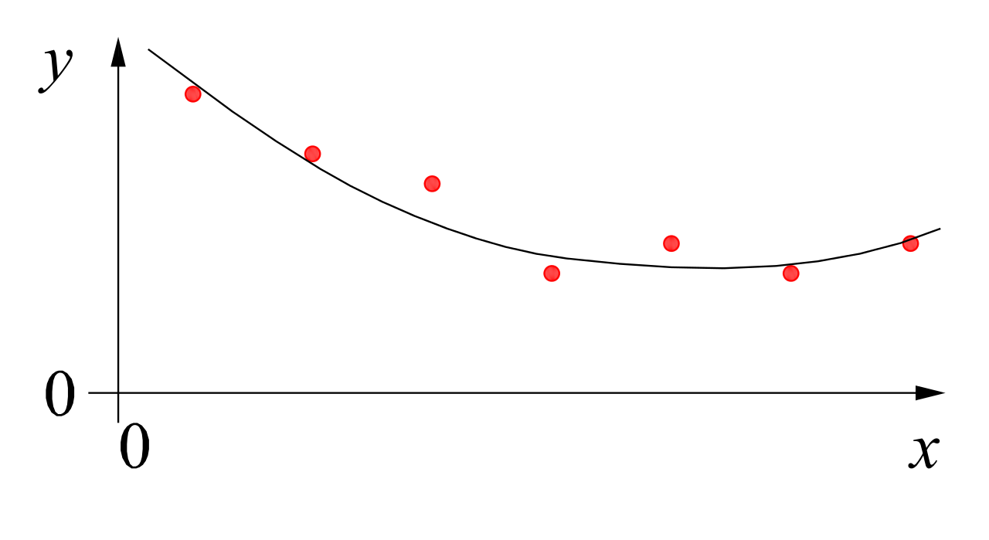
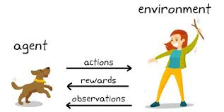
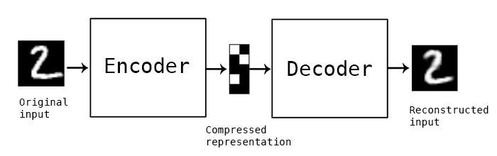
MACHINE LEARNING
no supervision, but goal-based interaction with environment
training target available (labeled or past data)
data not labeled in any way
SUPERVISED
REINFORCEMENT LEARNING
UNSUPERVISED
CLASSIFICATION
ASSOCIATION
CLUSTERING
LEARN STATE OR ACTION VALUES
LEARN POLICY DIRECTLY
REGRESSION
DIMENSIONALITY REDUCTION
SELF-SUPERVISED
learning by teacher
(high-dimensional curve fitting)
learning by observation
(pattern recognition)
learning by trial-and-error
(sequential decision making)

Slide 7
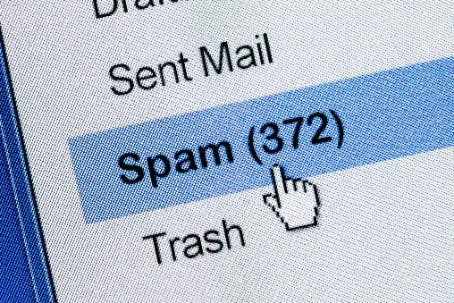
Supervised Learning
Target Quantity
Features
known in training: labeled samples or observations from past
to be predicted for unknown cases (e.g., future values)
(prepared) input information that is
correlated to target quantity
known at prediction time
features x1 and x2 spam, no spam
decision boundary
Example: Spam Filtering
classify emails as spam or no spam
use information like occurrence of specific words or email length as features
use accordingly labeled emails as training set

Slide 8


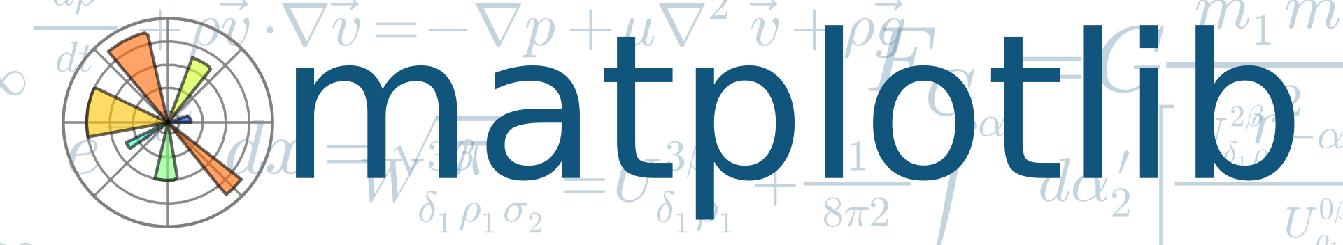



Used Programming Language: Python
good compromise between rapid prototyping and production
vast ecosystem
very popular for data processing and ML: scientific Python stack

Slide 9
Programming Environments
locally, best use
a virtual environment to flexibly install packages (e.g., venv)
an IDE of your choice (e.g., VS Code)
both plain Python files or Jupyter notebooks are fine
but cloud-based environments also fine (e.g., Google Colab)

Slide 10
Course Schedule
Part 1: Foundations (Theory + Classical ML)
AI/ML Overview Search & Optimization, Supervised & Unsupervised Learning
Python & scikit-learn
Data and Preprocessing
Supervised Learning Linear Models, k-Nearest Neighbors, Simple Neural Networks, Decision Trees
Model Evaluation & Selection
Part 2: Applications (Domains + Deep Learning)
Machine Learning for Tabular Data Random Forest, Gradient Boosting
Deep Learning with PyTorch
Computer Vision Convolutional Neural Networks, Image Classification, Object Detection, Segmentation, Image Synthesis
NLP & Large Language Models Transformers, Text Analysis, Generative AI, Chatbots, Agent Systems
Control & Reinforcement Learning

