Slide 1
Computerized Tomography
Deep Learning and Image Processing

Slide 2
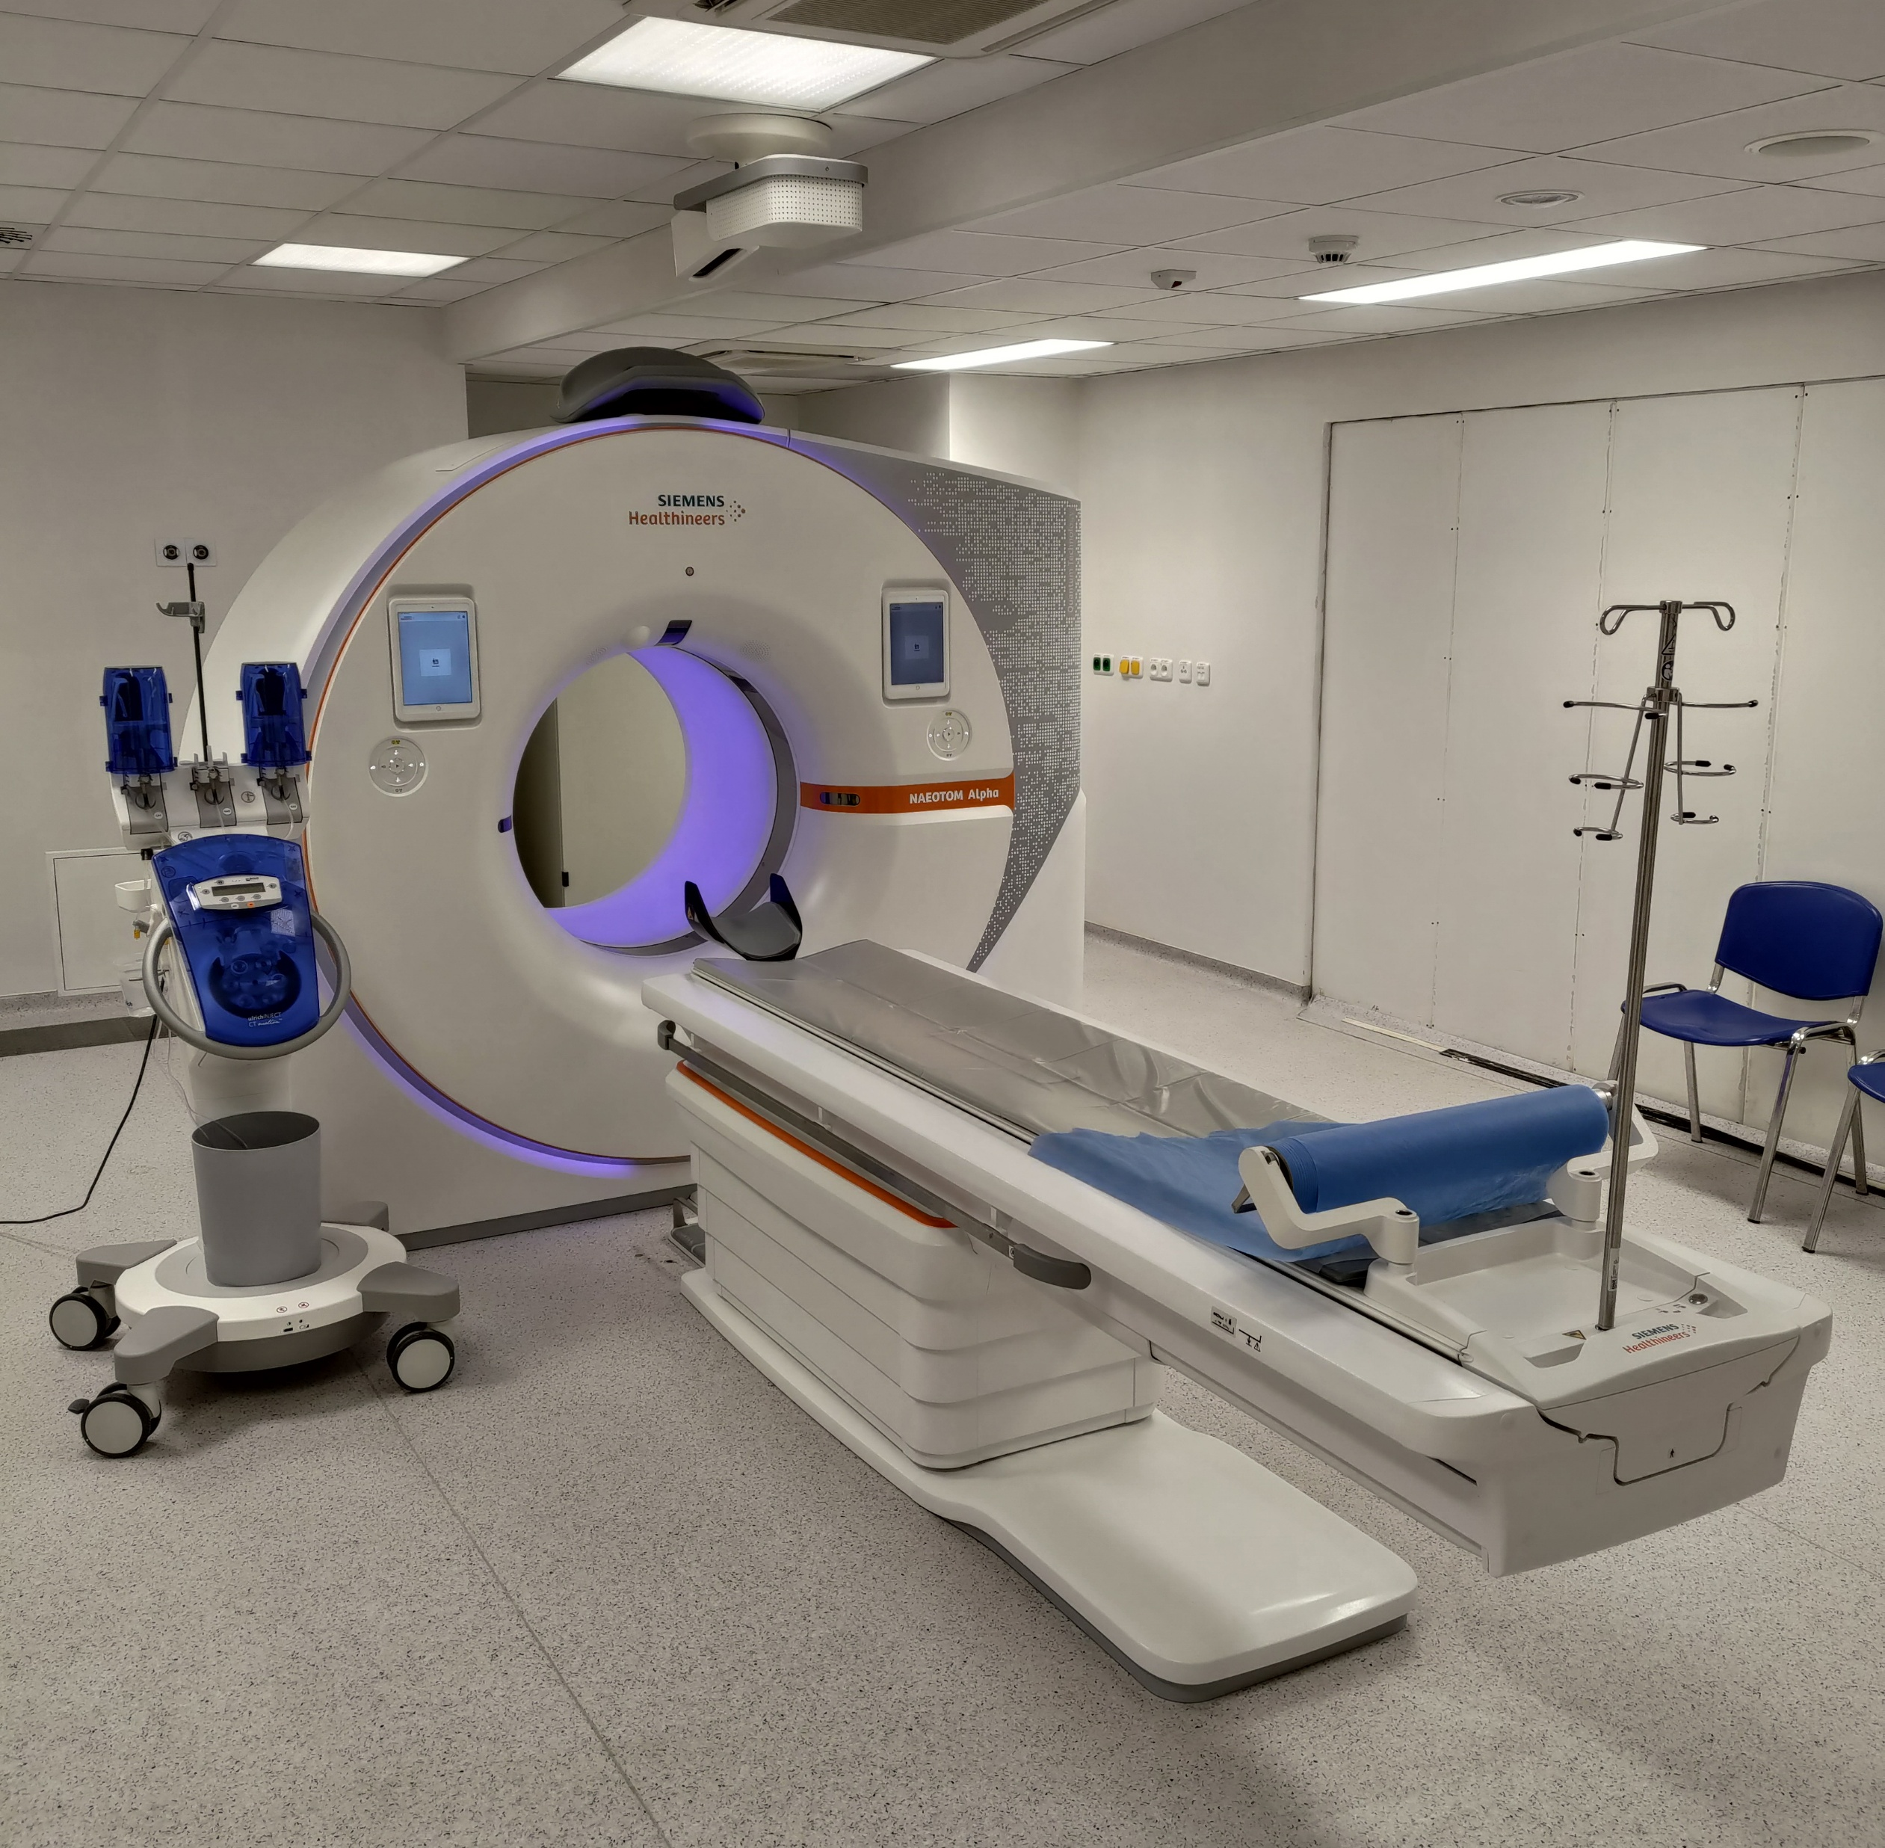
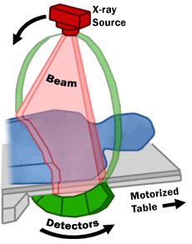
Computed Tomography (CT) Scan

Slide 3
Principle
or anything else
irradiate patient with X-rays from different directions
measure attenuations (absorption) of X-rays after passing through the body (different attenuations by different tissues)
use computer to reconstruct digital, cross-sectional images of the body interior, which are free from superpositions
move patient and repeat → 3D image (stacking of 2D slices)

Slide 4
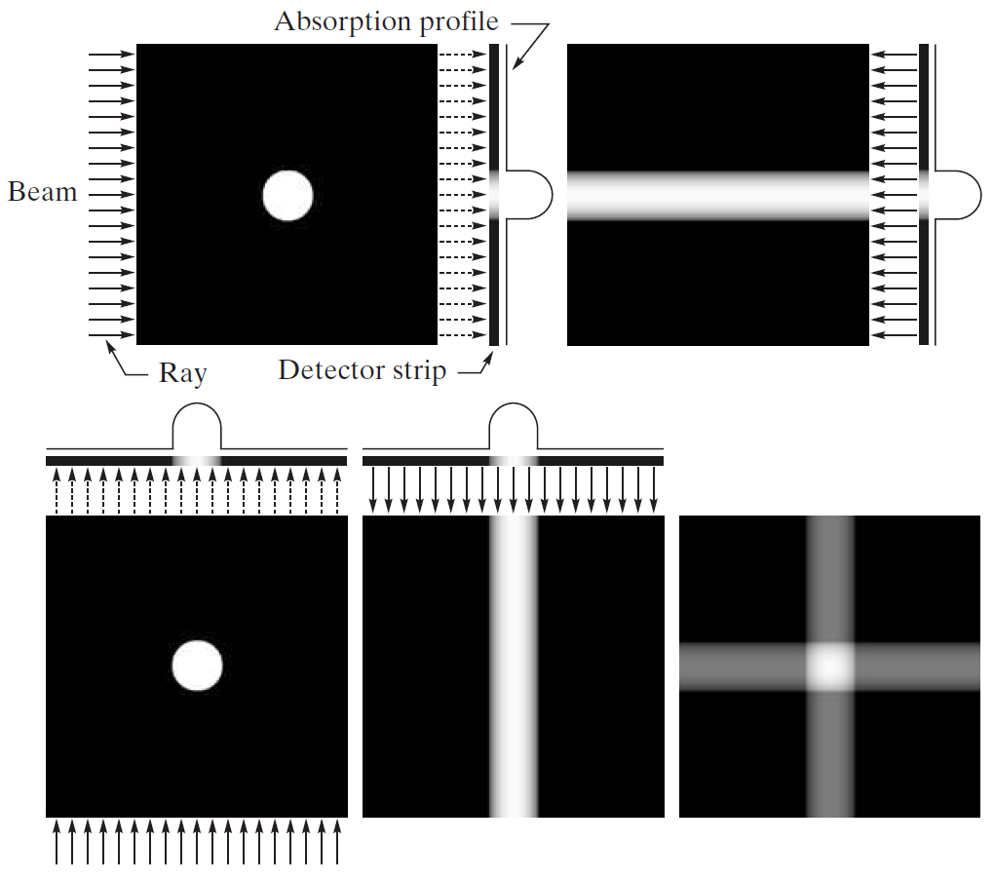
back projection

Slide 5
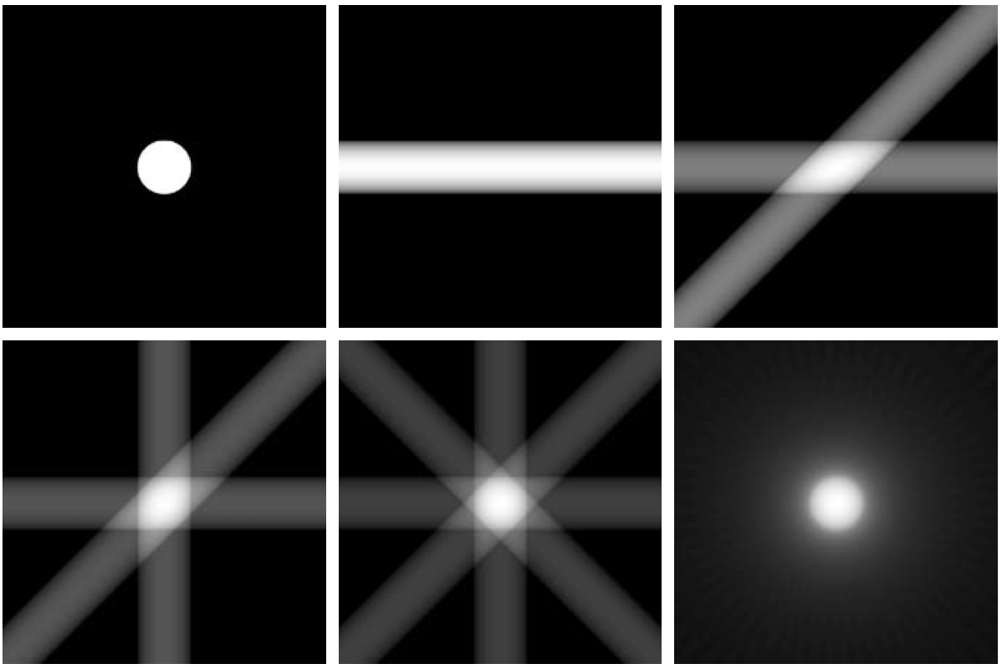
with 32 back projections

Slide 6
Tomographic Reconstruction
raw data from CT scan: multiple projections of the object (each projected point corresponds to superposition of specific direction)
in math terms: Radon transformation of the scanned structure
reconstruction: inverse Radon transformation (resulting in two-dimensional image → virtual slice)

Slide 7
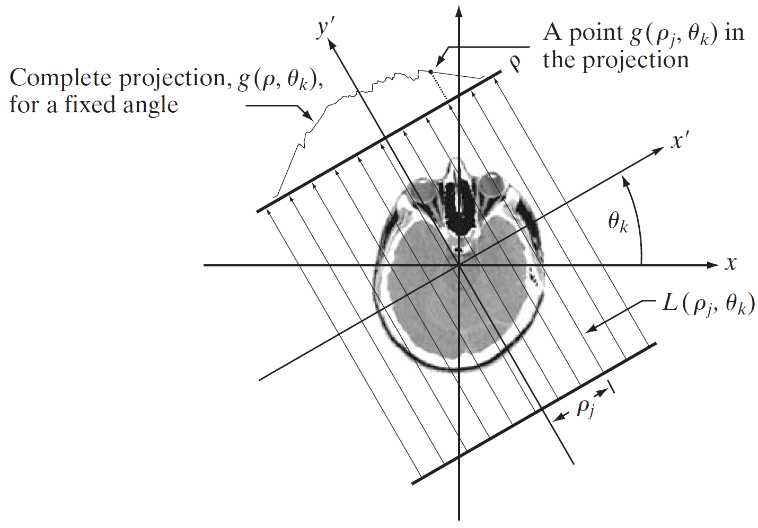
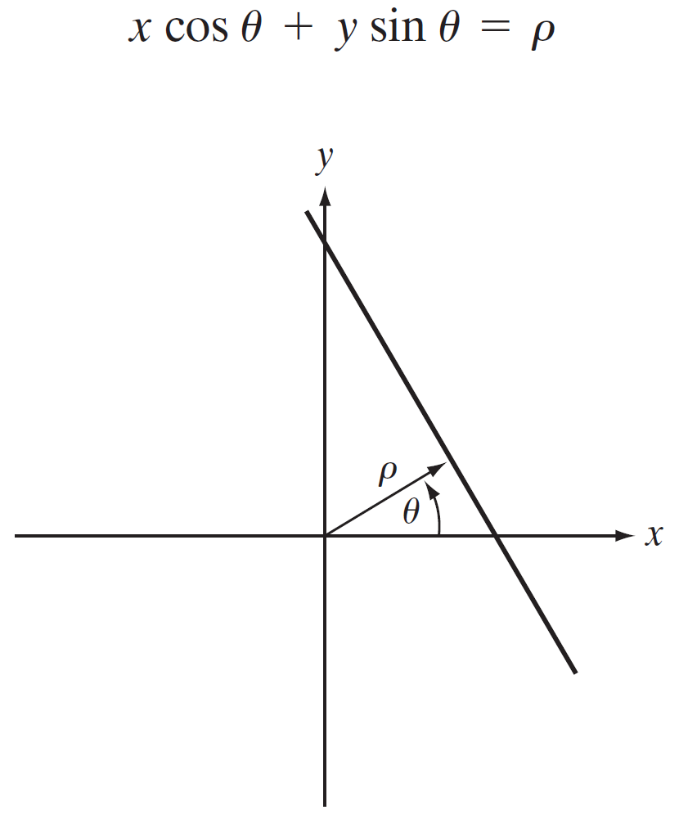
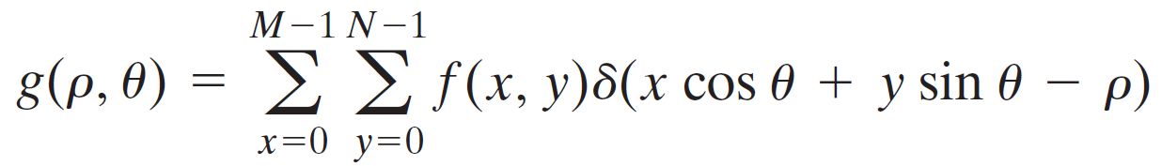
using normal representation of straight line
discrete Radon transform:

Slide 8
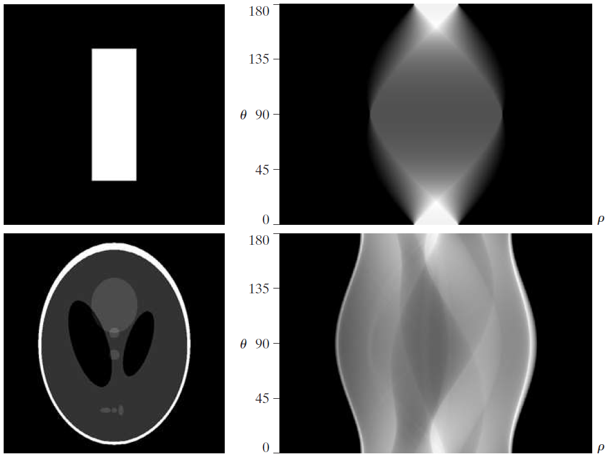
sinogram:
Radon transform displayed as image

Slide 9
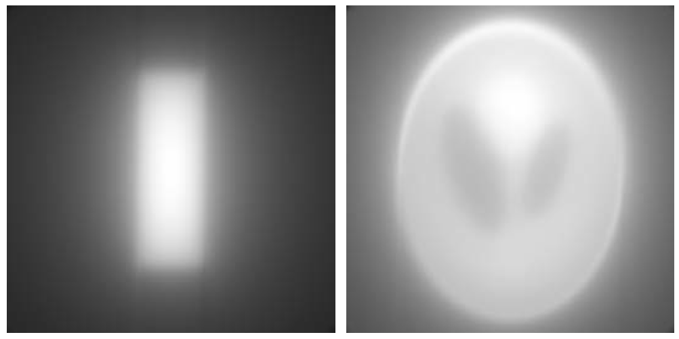
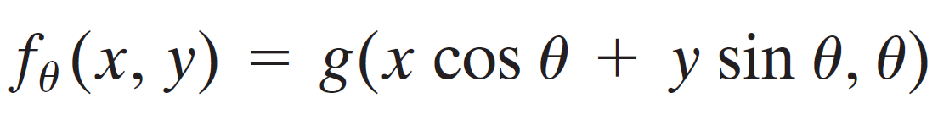
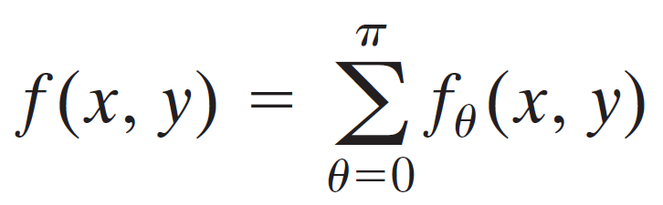
back projections of the sinograms
single back projection (one direction):
final image by summing over all back projections:

Slide 10

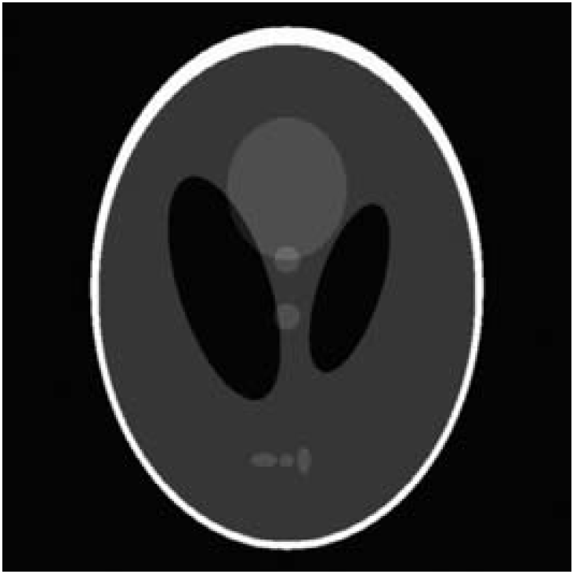
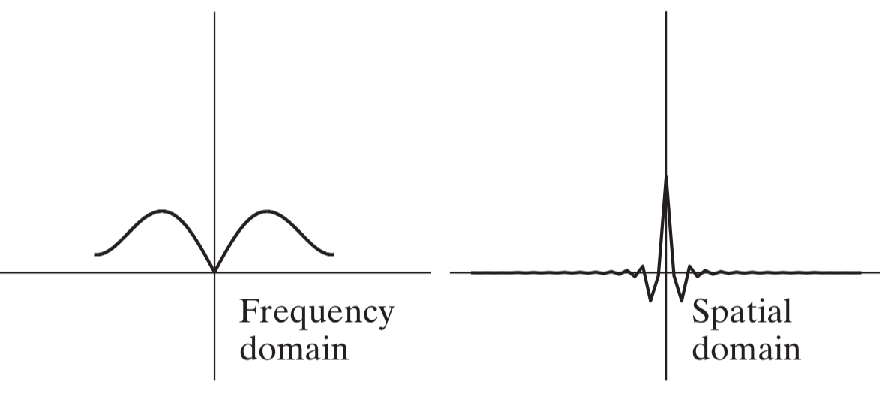
Filtered Back Projection
to reduce blurring effect: filter projections before back projection
need for high-pass filter
e.g., band-limited ramp filter using a Hamming windowing function:

Slide 11
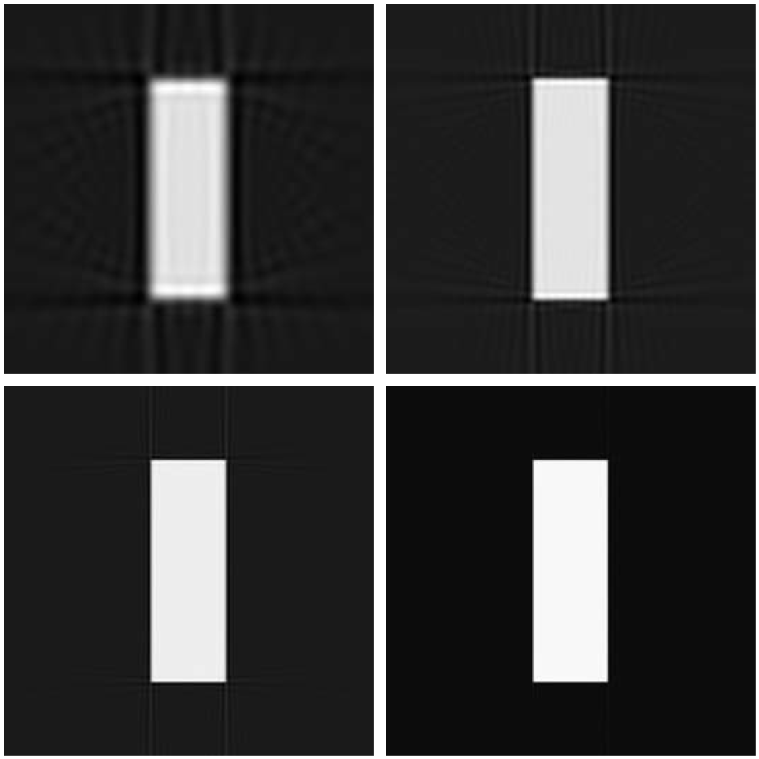
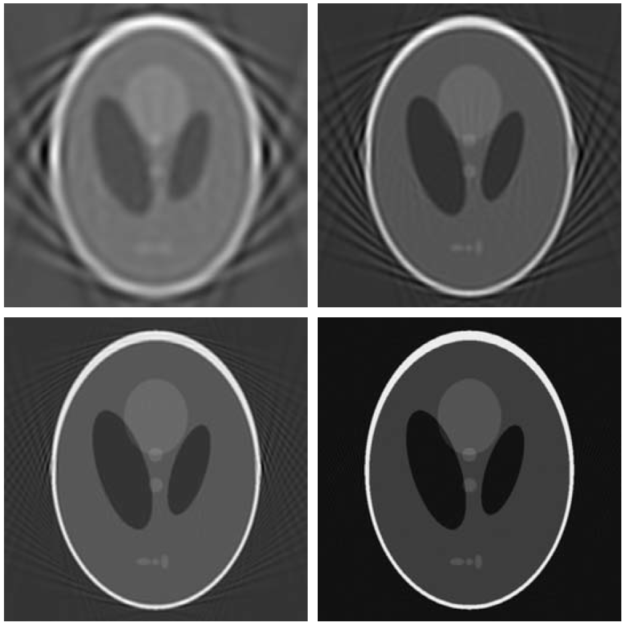
Fan-Beam Filtered Back Projection
so far looked at parallel beams
but modern CT systems use fan-beam geometry: need for many detectors
aliasing
decreasing angle increments (more detectors)

Slide 12
Radiation Dose
need for low-dose method
image quality of filtered back projection susceptible to noise
but large dose increases needed to lower noise (inverse quadratic dependency)
iterative and model-based reconstruction can be used to reduce noise level (regularization)
but worse performance at low doses

Slide 13
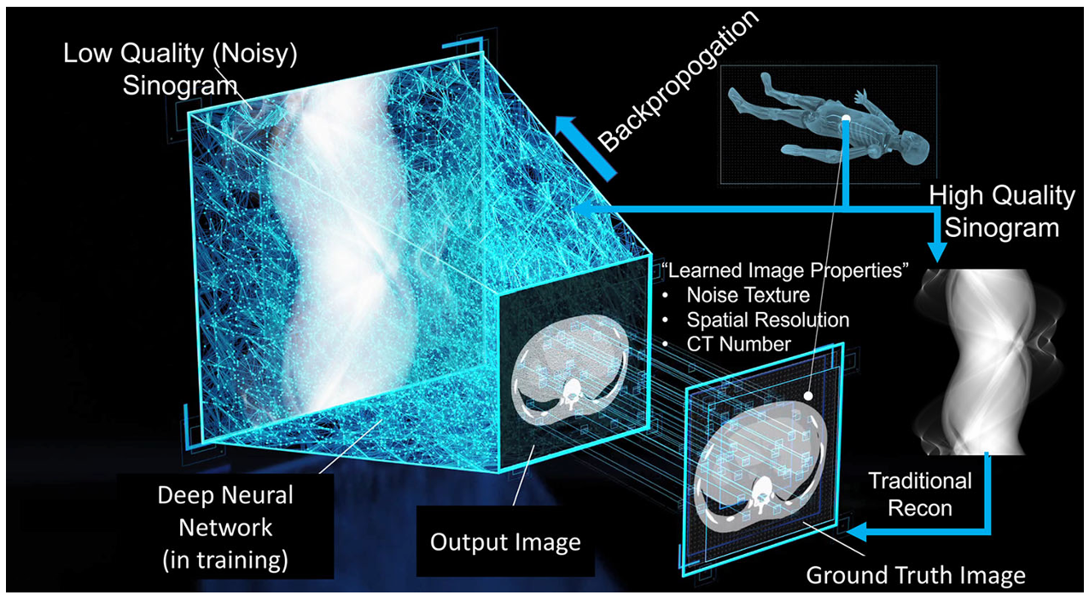
Deep Learning Reconstruction
idea: enhance noisy low-dose images to resemble high-dose ones
→ ~30% lower radiation dose at same image quality
source

Slide 14
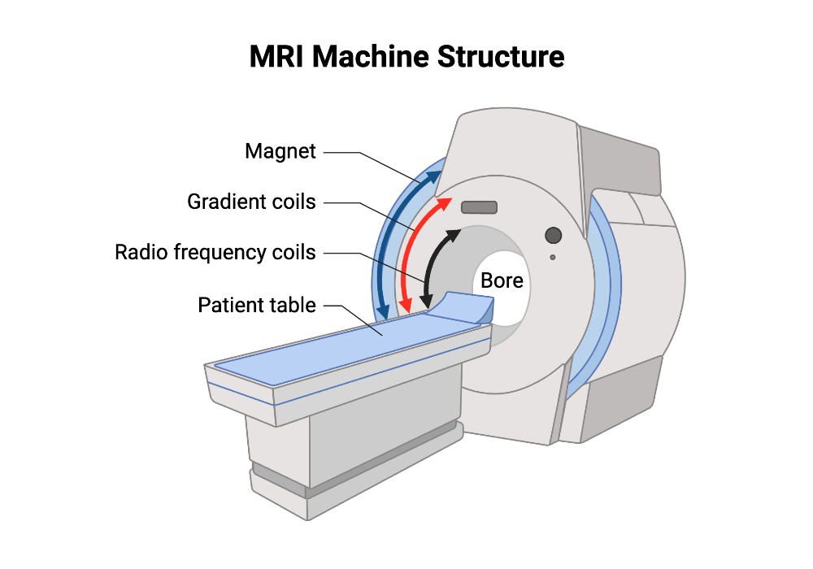
Magnetic Resonance Imaging (MRI)
MRI uses magnetic fields and radio waves (instead of X-rays), applying nuclear magnetic resonance of hydrogen nuclei → no ionizing radiation
observed objects directly induce electrical signals (instead of X-ray absorption) → high resolutions possible
drawback: long scan times
deep learning reconstruction also used for MRI
→ faster scans

Slide 15
Other Deep Learning Applications
besides reconstruction, deep learning can also be used for:
classification and detection (e.g., tumors)
semantic segmentation (e.g., organs)
noise reduction and image enhancement
image registration and fusion across modalities (e.g., CT and MRI)
quantitative analysis
anomaly detection

