Slide 1
Computerized Tomography
Deep Learning and Image Processing

Slide 2
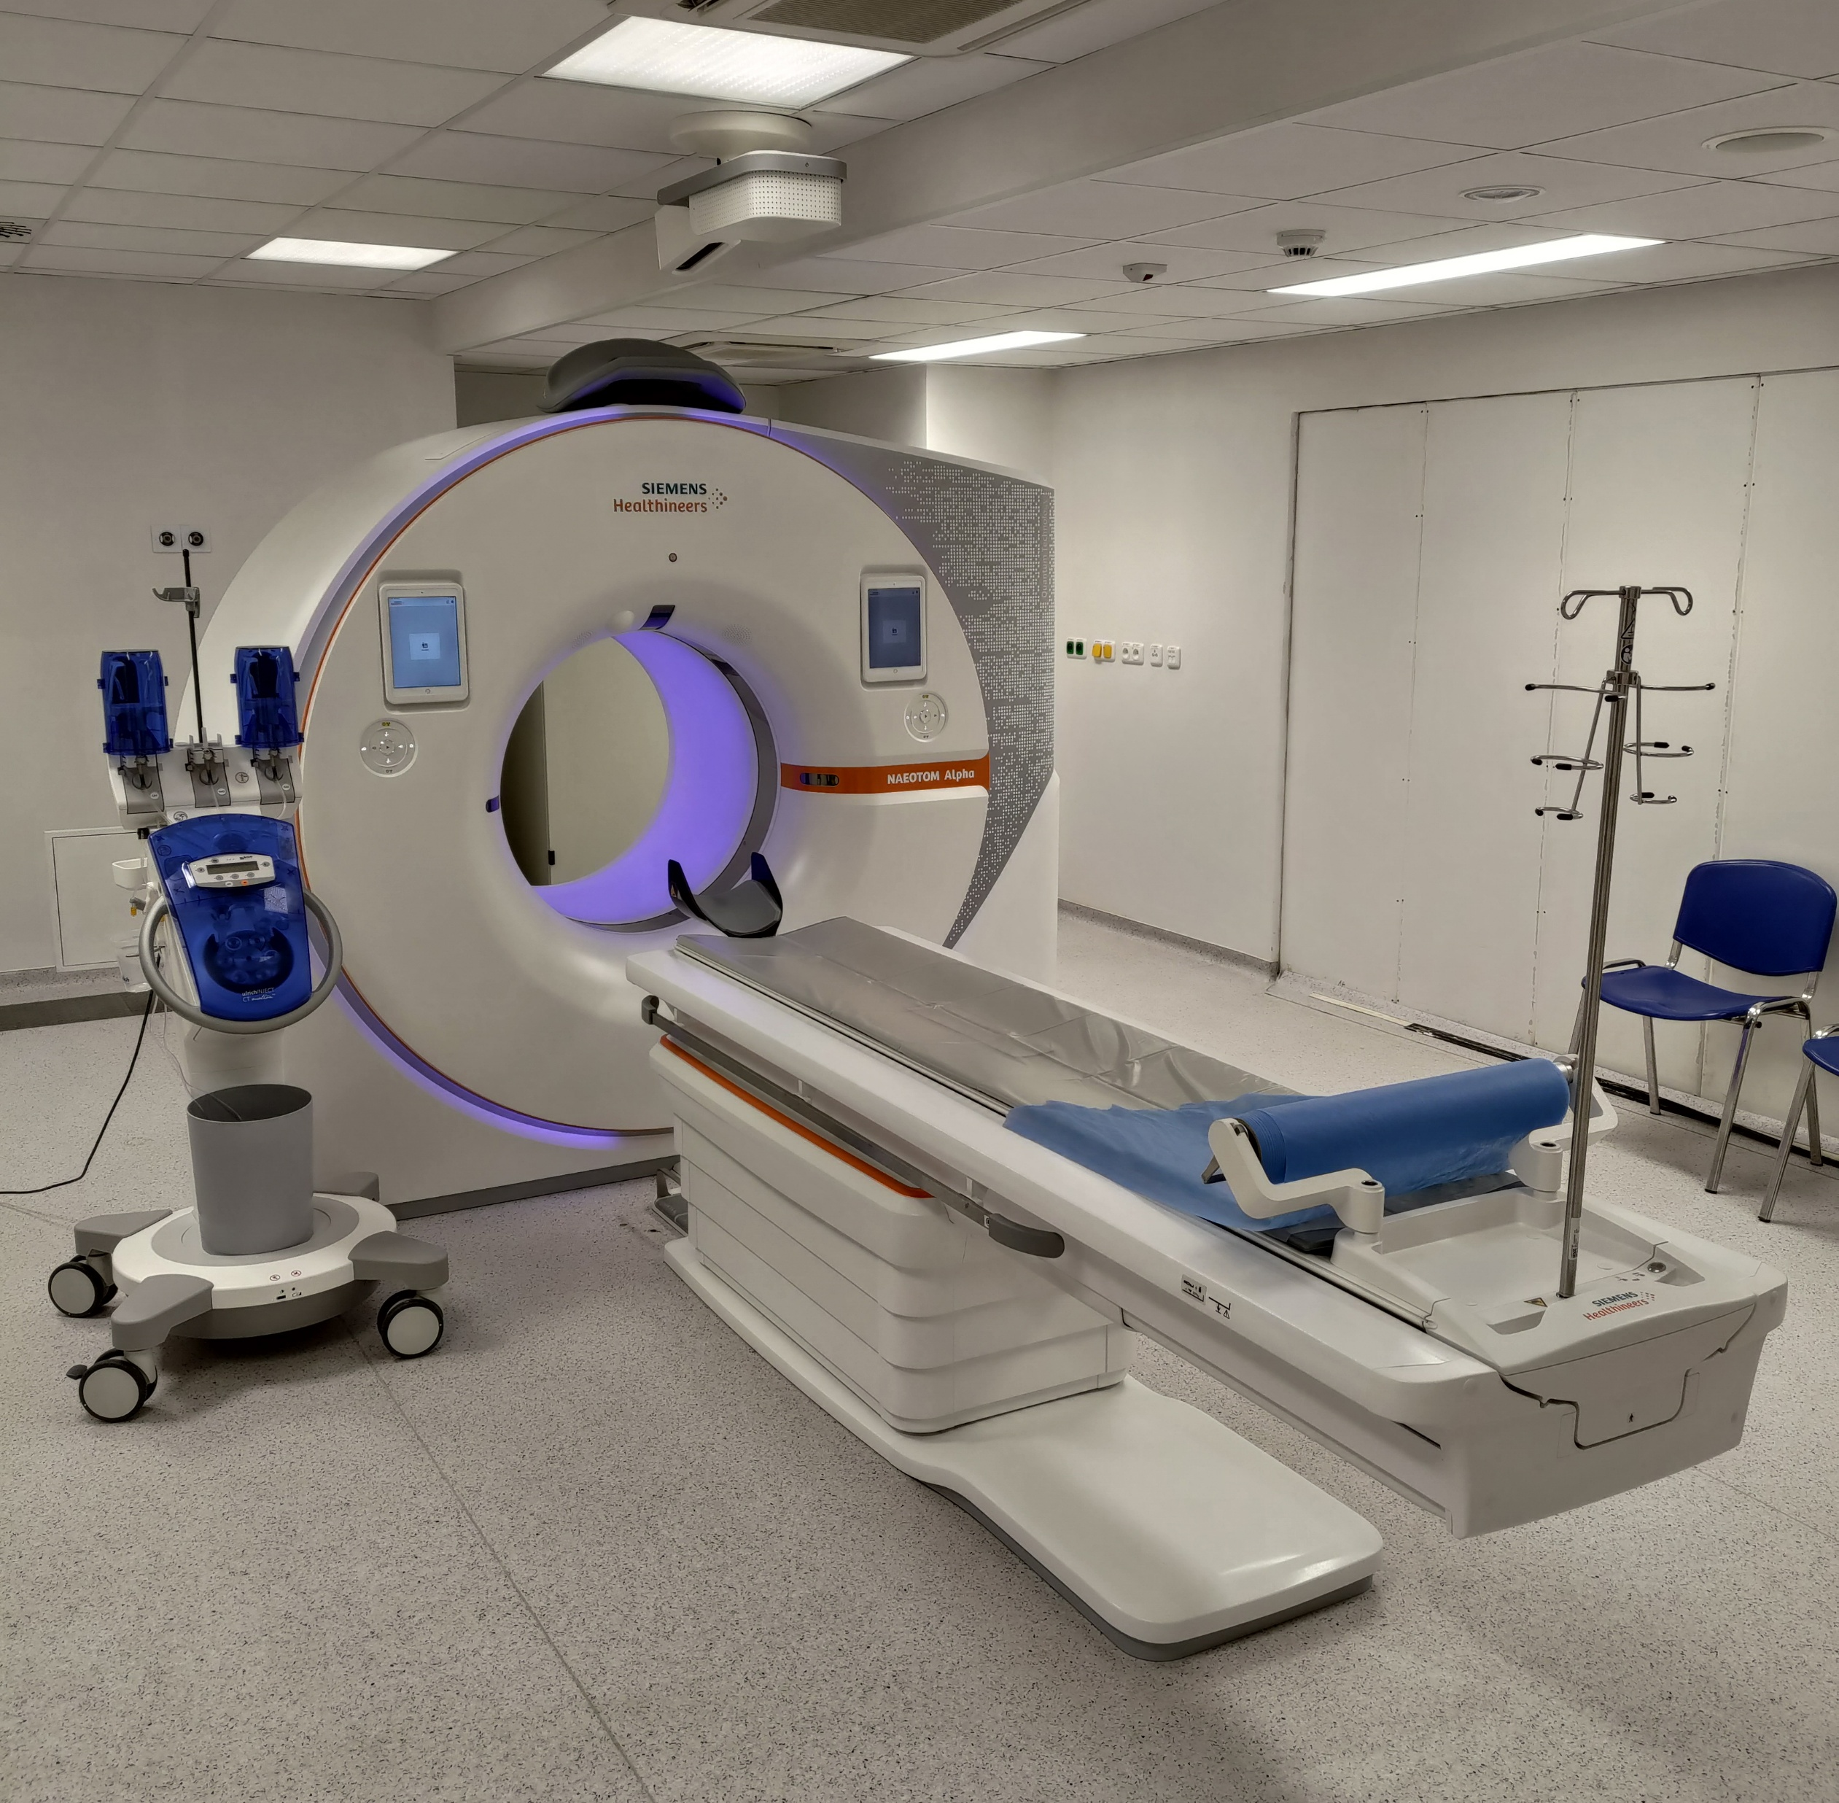
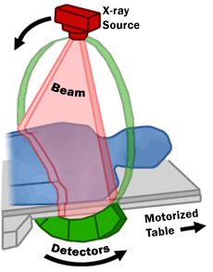
Computed Tomography (CT) Scan

Slide 3
Principle
or anything else
irradiate patient with X-rays from different directions
measure attenuations (absorption) of X-rays after passing through the body (different attenuations by different tissues)
use computer to reconstruct digital, cross-sectional images of the body interior, which are free from superpositions
move patient and repeat → 3D image

Slide 4
Tomographic Reconstruction
raw data from CT scan: multiple projections of the object (each projected point corresponds to superposition of specific direction)
in math terms: Radon transformation of the scanned structure
reconstruction: inverse Radon transformation (resulting in two-dimensional image → virtual slice)
practical implementation: filtered back projection

Slide 5
Filtered Back Projection

Slide 6
Deep Learning Reconstruction

Slide 7
~30% lower radiation dose at same image quality
also for MRI → faster acquisition

Slide 8
Magnetic Resonance Imaging (MRI)

