Slide 1
Computerized Tomography
Deep Learning and Image Processing

Slide 2
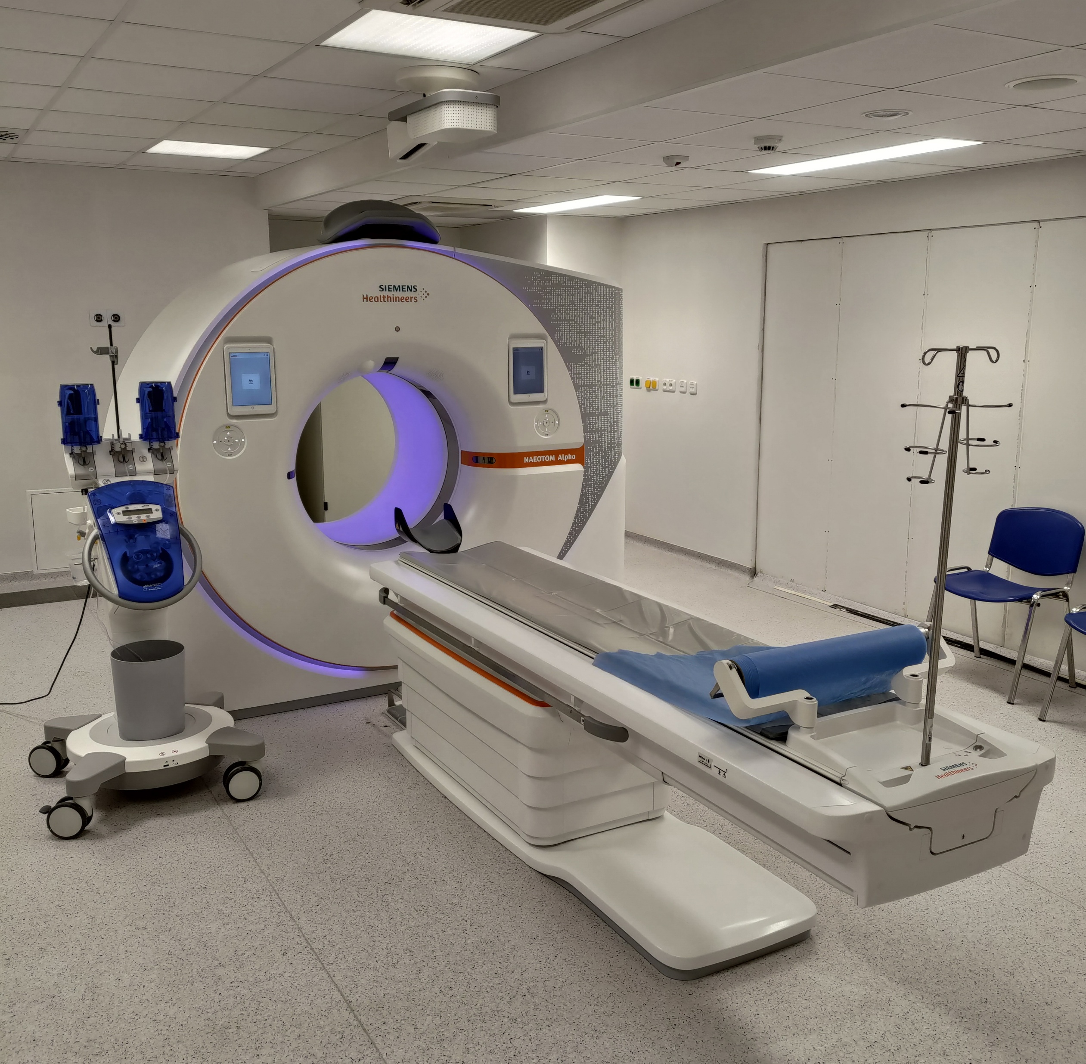
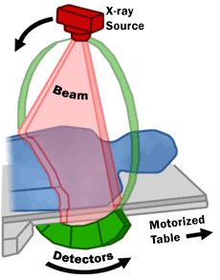
Computed Tomography (CT) Scan

Slide 3
Principle
or anything else
irradiate patient with X-rays from different directions
measure attenuations (absorption) of X-rays after passing through the body (different attenuations by different tissues)
use computer to reconstruct digital, cross-sectional images of the body interior, which are free from superpositions
move patient and repeat → 3D image (stacking of 2D slices)

Slide 4
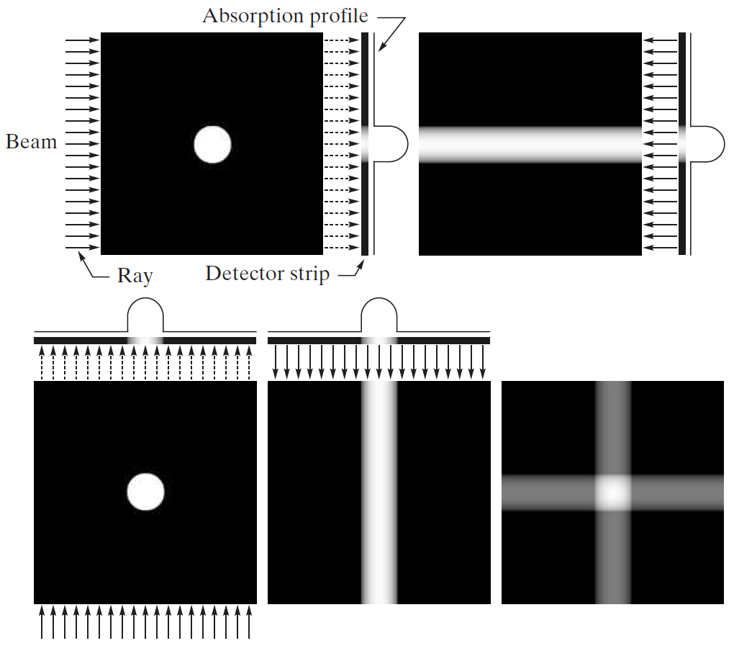
back projection

Slide 5
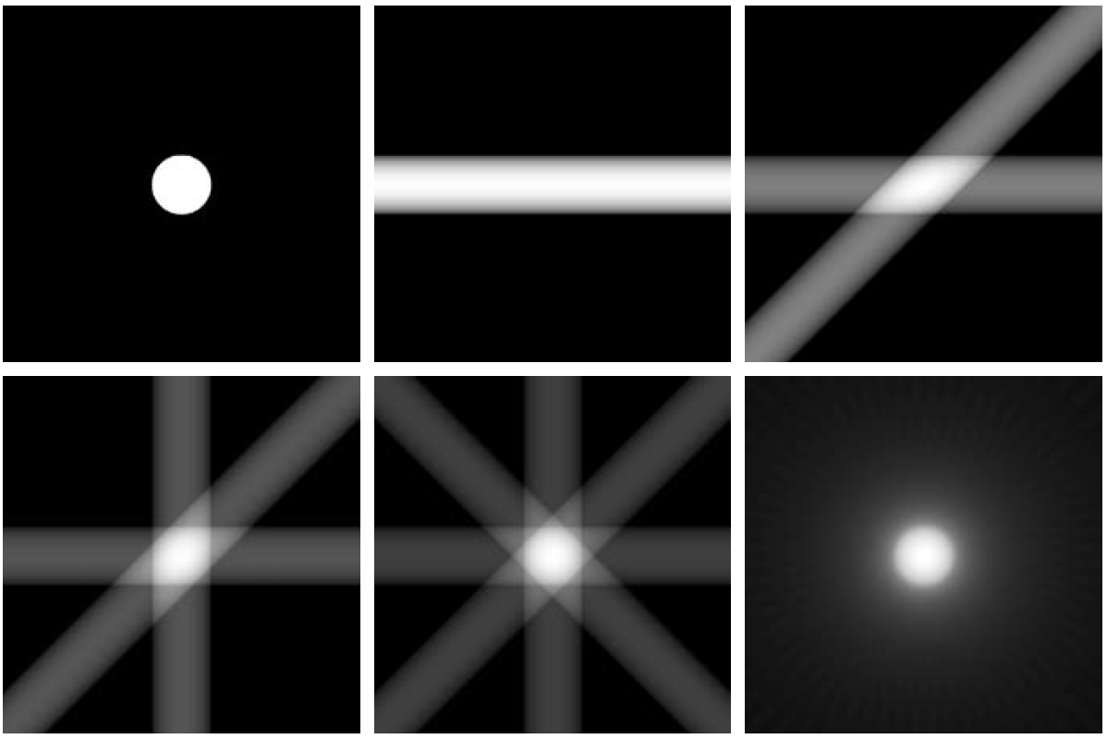
with 32 back projections

Slide 6
Tomographic Reconstruction
raw data from CT scan: multiple projections of the object (each projected point corresponds to superposition of specific direction)
in math terms: Radon transformation of the scanned structure
reconstruction: inverse Radon transformation (resulting in two-dimensional image → virtual slice)

Slide 7
Magnetic Resonance Imaging (MRI)
not only applicable for X-rays ...

Slide 8
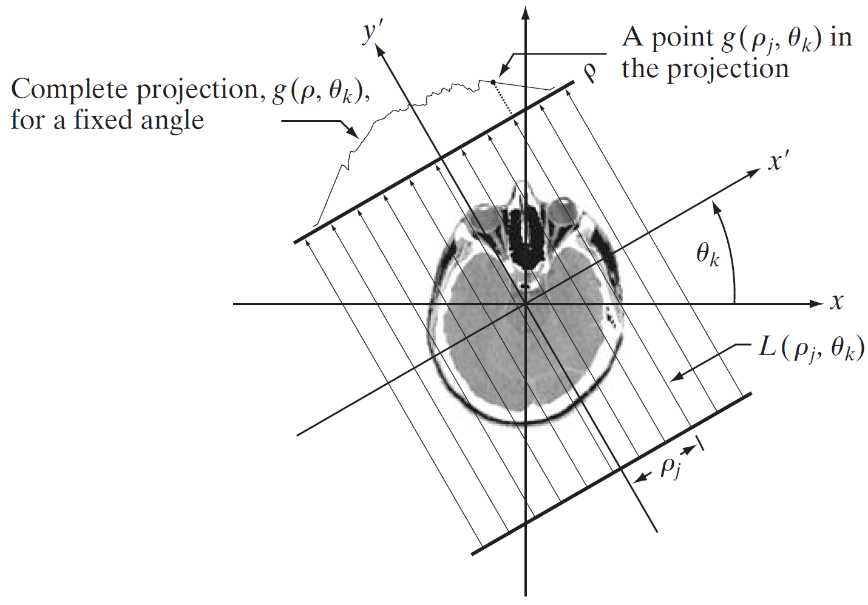
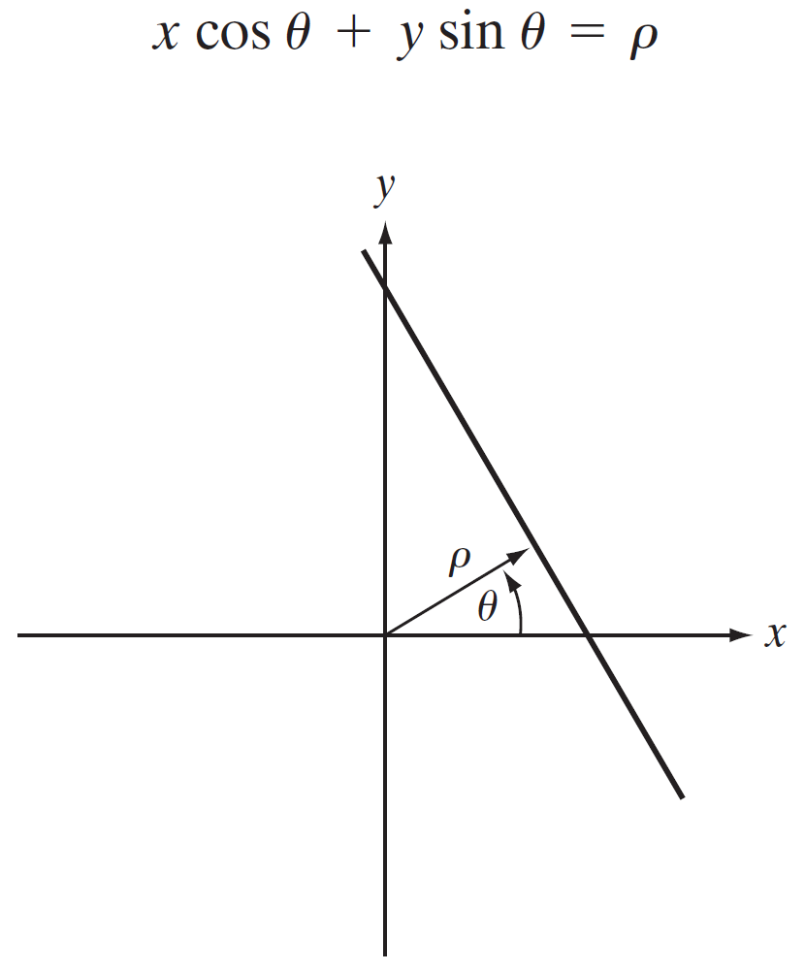
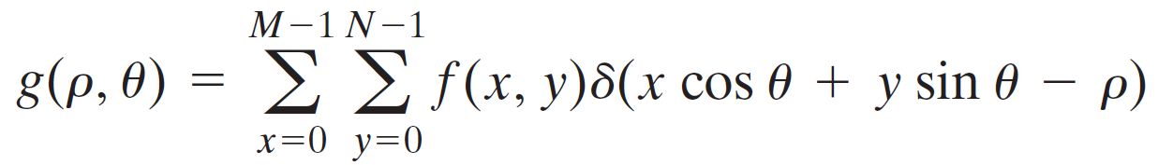
using normal representation of straight line
discrete Radon transform:

Slide 9
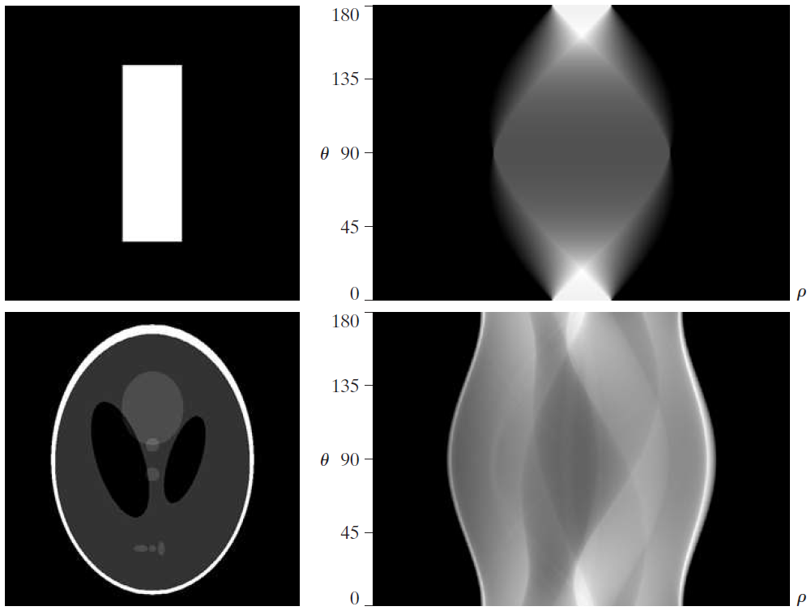
sinogram:
Radon transform displayed as image

Slide 10
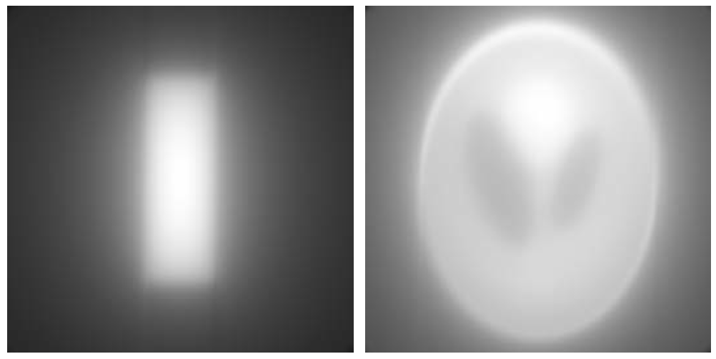
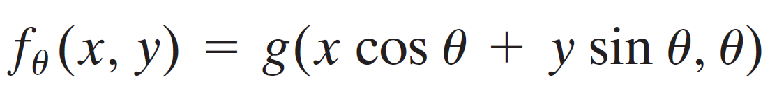
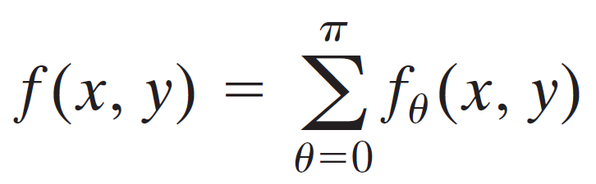
back projections of the sinograms
single back projection (one direction):
final image by summing over all back projections:

Slide 11

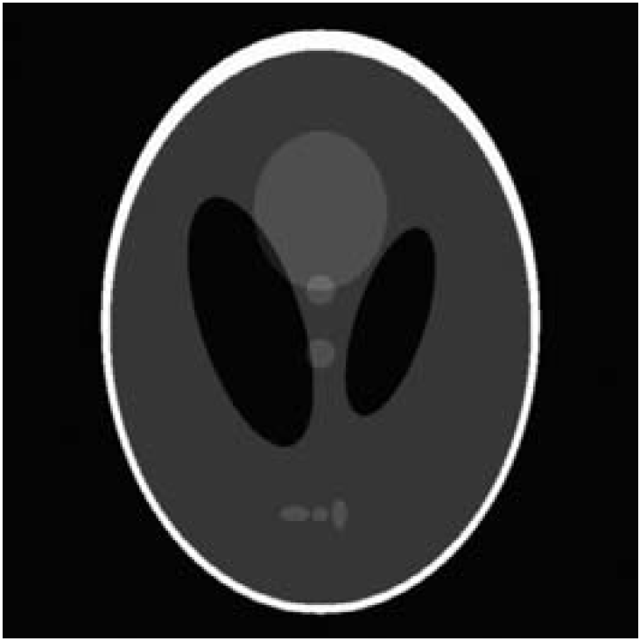
Filtered Back Projection
to reduce blurring effect: filter projections before back projection

Slide 12
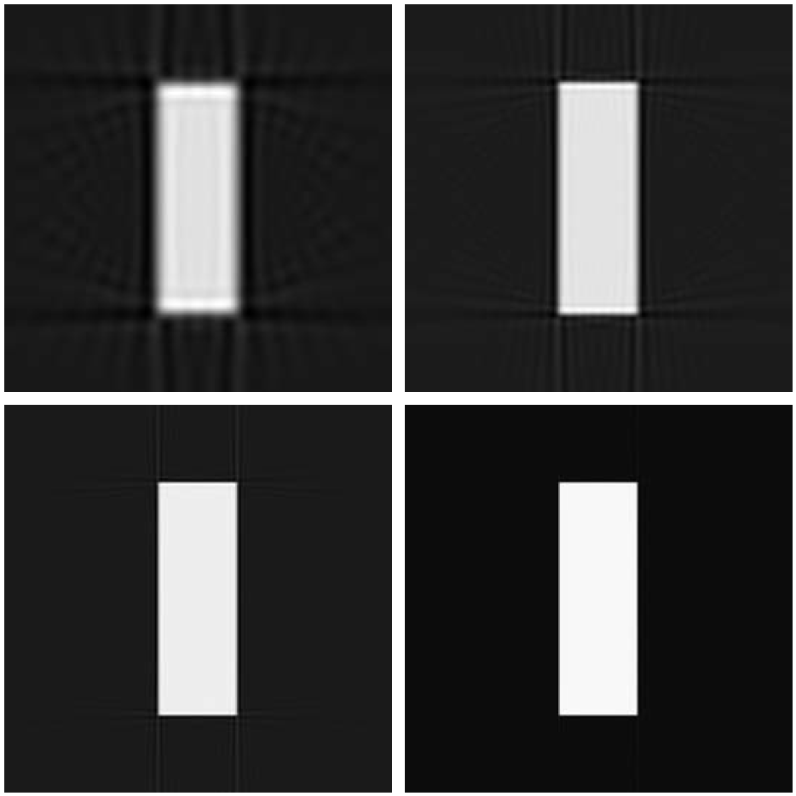
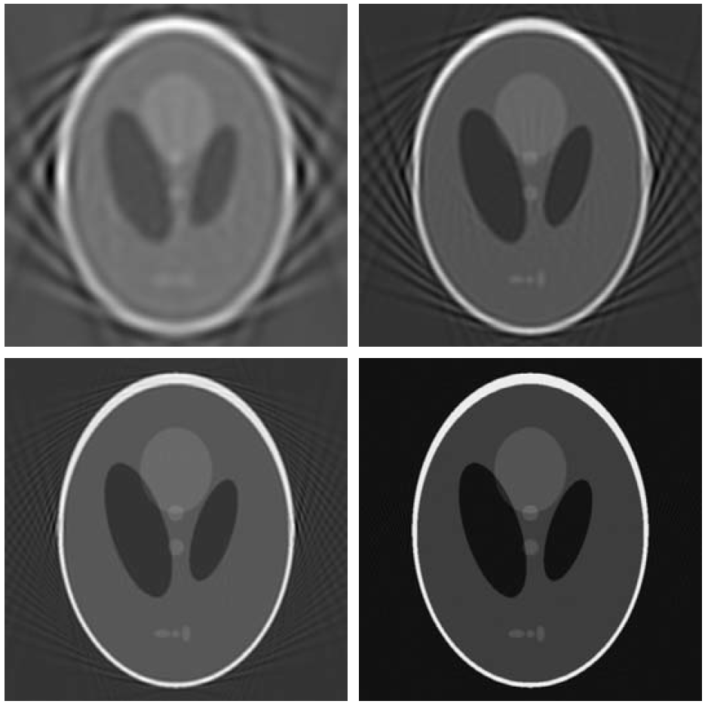
Fan-Beam Filtered Back Projection
so far looked at parallel beams
but modern CT systems use fan-beam geometry: need for many detectors
aliasing
decreasing angle increments (more detectors)

Slide 13
Issues with Filtered Back Projection
...

Slide 14
Iterative and Model-Based Reconstruction
...

Slide 15
Deep Learning Reconstruction
…
~30% lower radiation dose at same image quality
also for MRI → faster acquisition

