Slide 1
Object Detection
Deep Learning and Image Processing

Slide 2
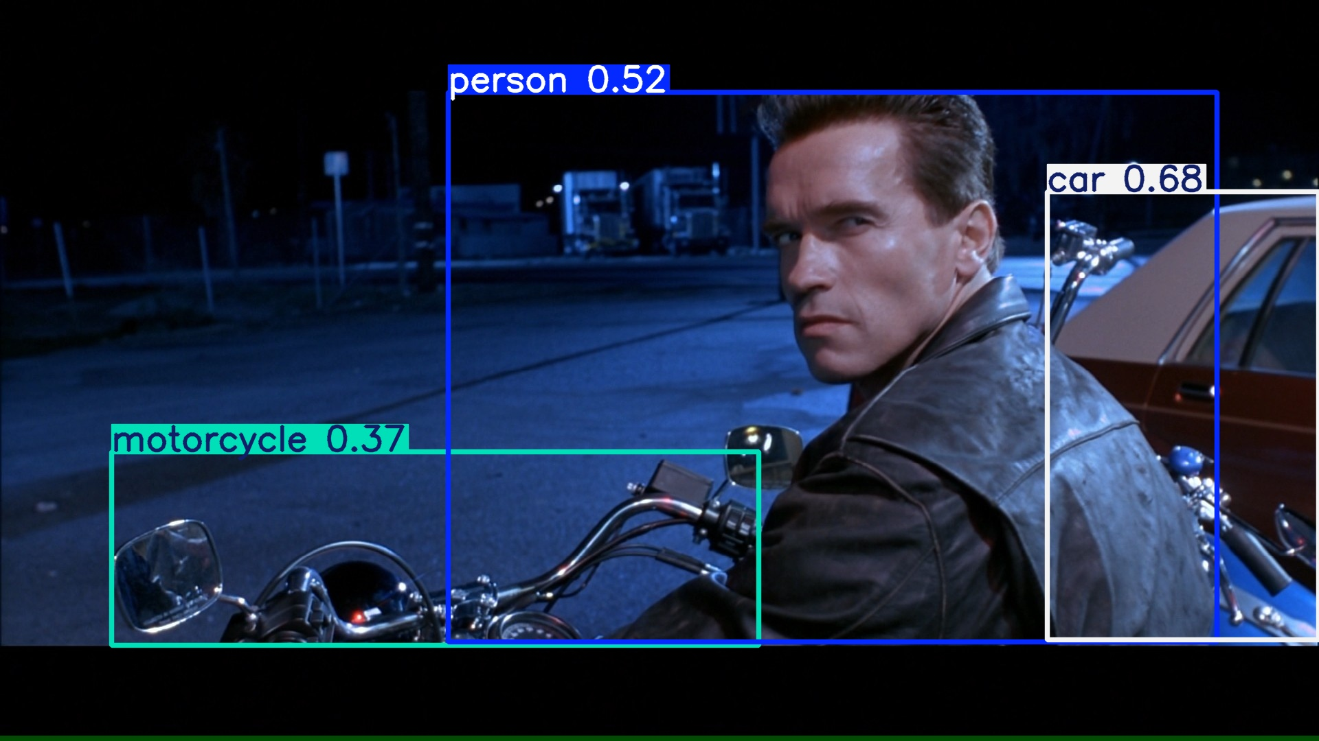
output: bounding boxes with category label and confidence

Slide 3
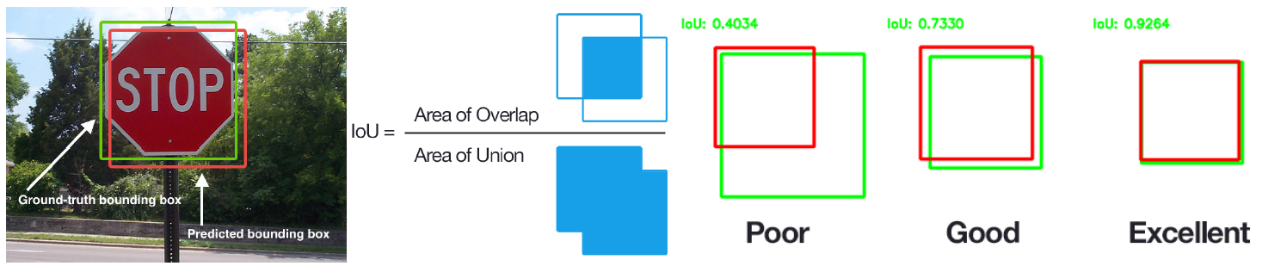
Performance Evaluation of Localization
Intersection-over-Union
images with multiple objects: number of detections dependent on used confidence threshold

Slide 4
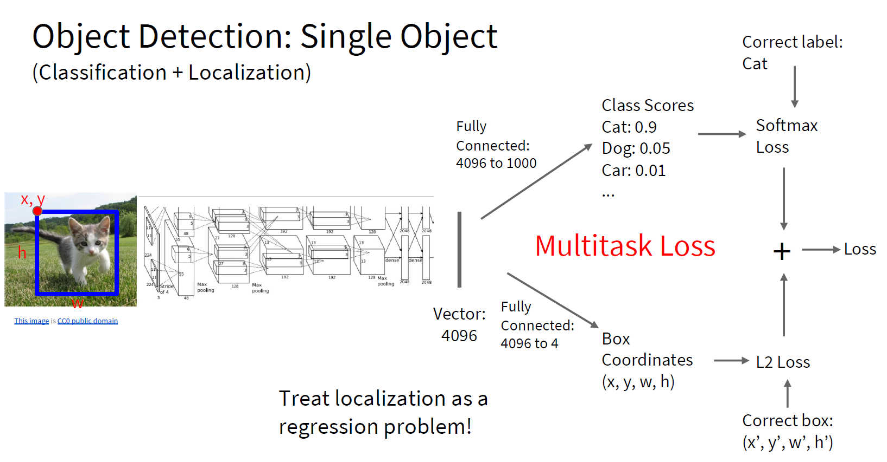
too complicated for multiple objects

Slide 5
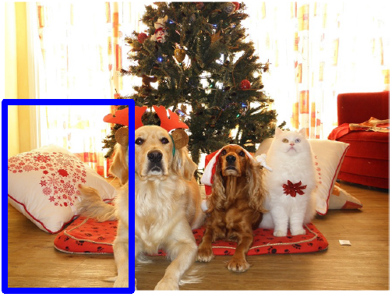
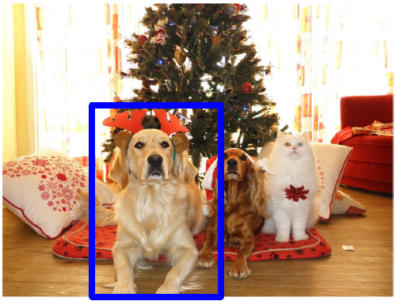
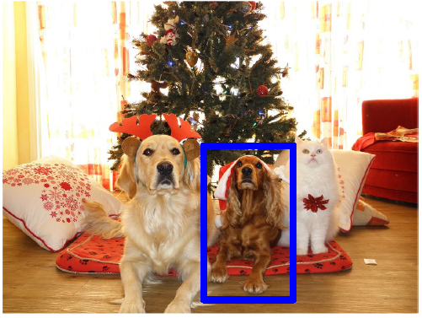
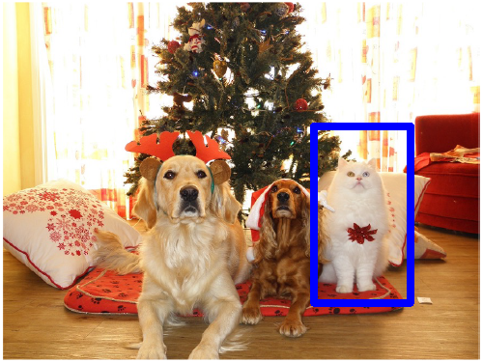
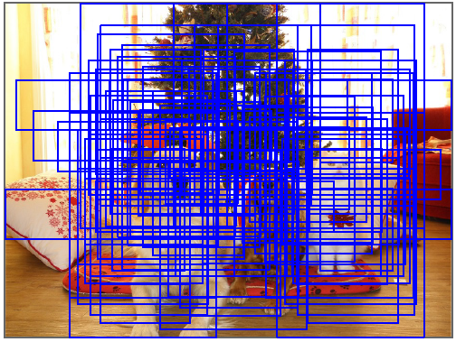
Localization for Multiple-Object Images
idea: classify many different crops of the image as object or background
(crops: sliding window over image, iterated at multiple window sizes)
Dog? No
Cat? No
Background? Yes
Dog? Yes
Cat? No
Background? No
Dog? Yes
Cat? No
Background? No
Dog? No
Cat? Yes
Background? No
issue: too many possible crops
→ need for region proposals

Slide 6
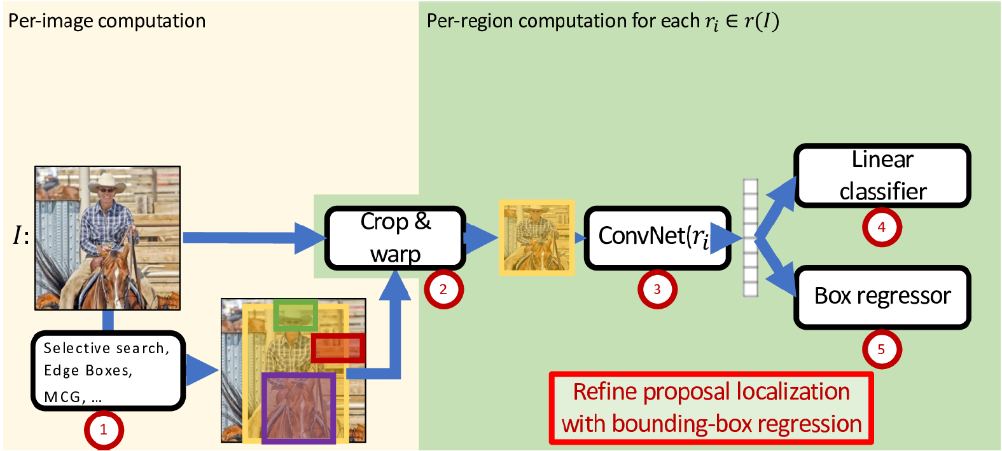

Region-Based Convolutional Neural Network (R-CNN)
task-specific heads:
two stages
object classification
feature representation
(forward-pass through pretrained CNN)
bounding-box refinement
region proposals by “classic” method (~2k)

Slide 7
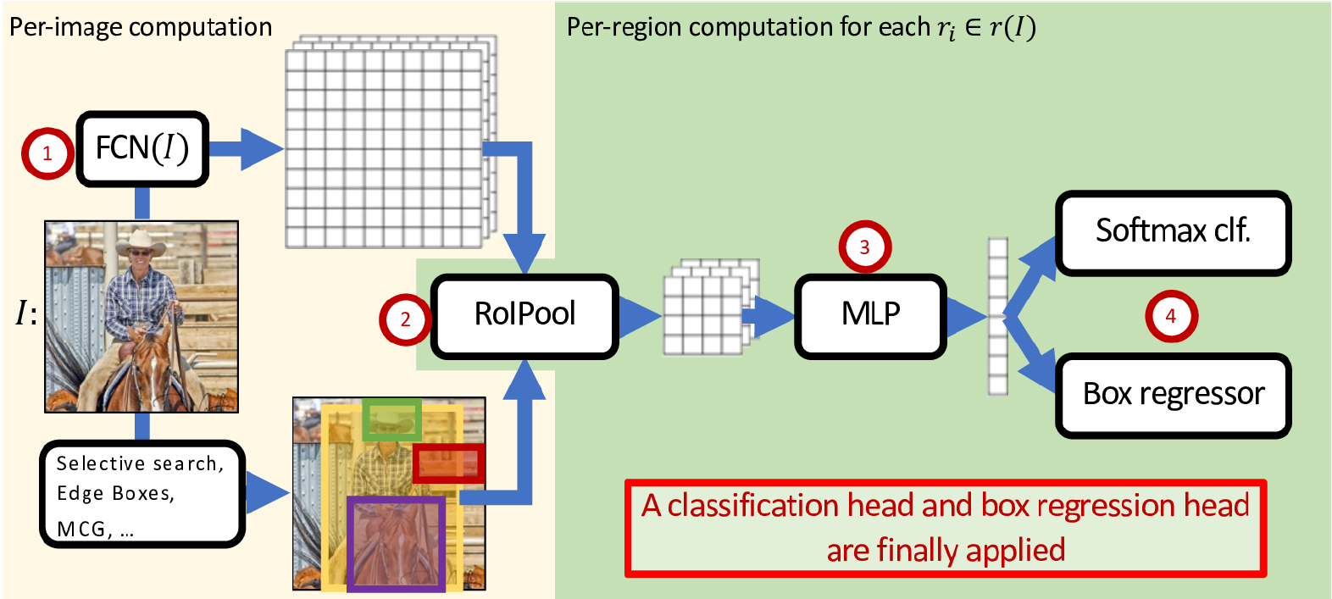
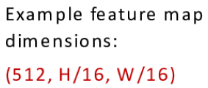
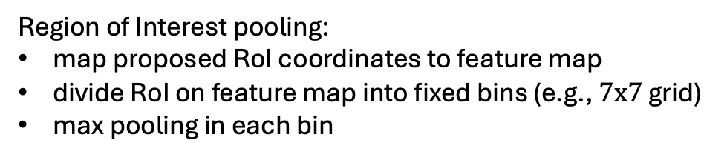
Fast R-CNN: Crop ConvNet Features
Fully Convolutional Network
(pretrained, e.g., VGG-16)
feature sharing
end-to-end trainable
fixed-dimensional representation for each proposed region
or CNN
more lightweight
Region of Interest pooling:
map proposed RoI coordinates to feature map
divide RoI on feature map into fixed bins (e.g., $7x7$ grid)
max pooling in each bin

Slide 8
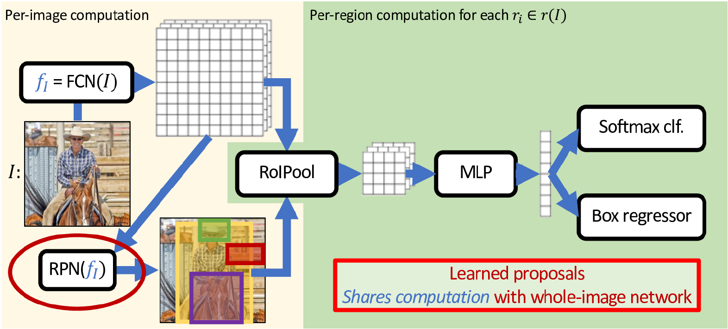
Faster R-CNN: Use Region Proposal Network
two RPN losses combined with two detection head losses during end-to-end training
binary classification (object or not) with sliding window (e.g., $3x3$) over feature map, refining predefined anchor boxes

Slide 9
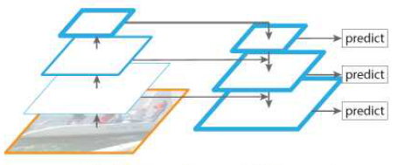
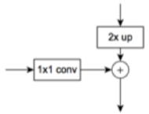
Feature Pyramid Network (FPN)
different intermediate layers of same backbone CNN
high-resolution features improve detection of small objects
using different anchor sizes for different pyramid levels

Slide 10
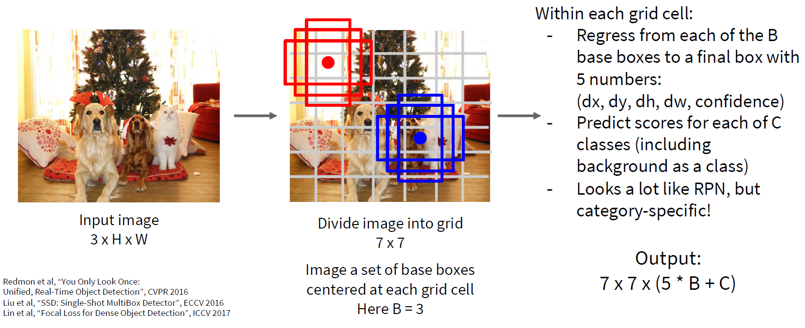
Single-Stage Detectors: Drop Per-Region Computation
or more
faster, but usually worse performance

Slide 11
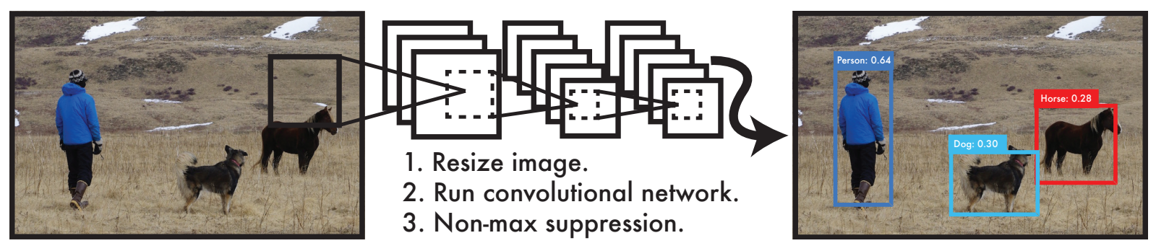
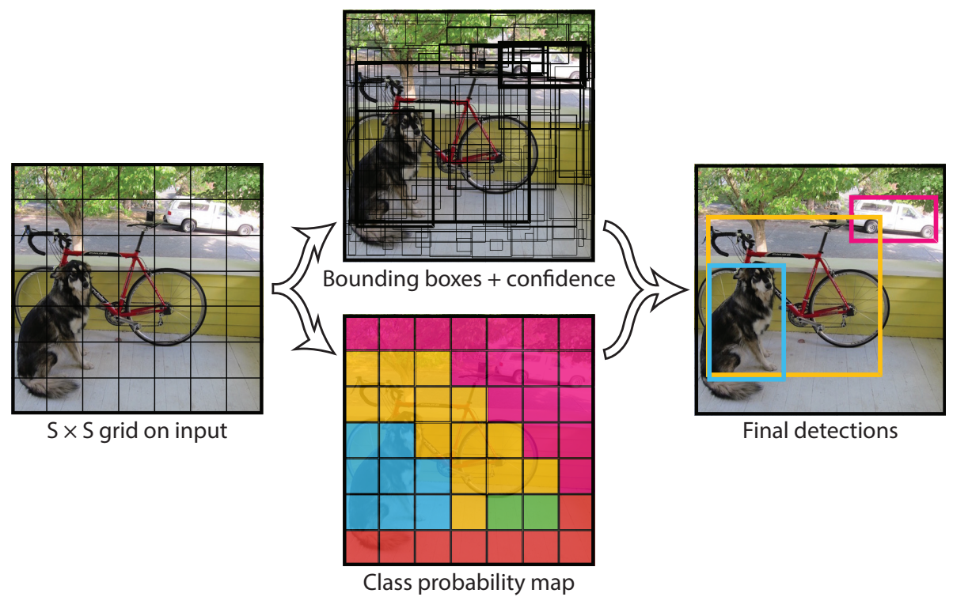
YOLO: Real-Time Object Detection
anchor-free approach in newer YOLO versions
You Only Look Once:
prediction of bounding boxes and class probabilities in one go

Slide 12
Object Tracking
task: locating an object in successive video frames
basic approach:
detection: localize target object(s) (e.g., YOLO)
motion estimation: predict next location (e.g., Kalman filter or optical flow)
appearance matching: comparison of previous and predicted next location (e.g., feature descriptor, CNN features)
detection repeated frequently to correct for accumulated deviations

Slide 13
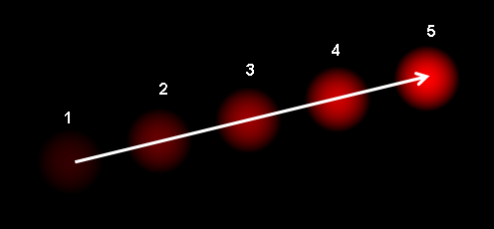
Optical Flow
dense optical flow:
estimate motion vector of every pixel
e.g., Horn-Schunck method or Lucas-Kanade (LK) method
sparse optical flow:
estimate motion vector of few image features
e.g., Kanade-Lucas-Tomasi (KLT) feature tracker

Slide 14
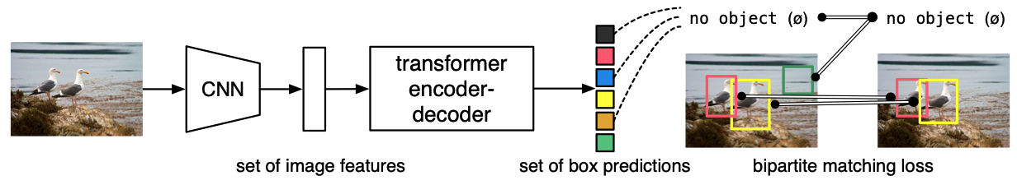
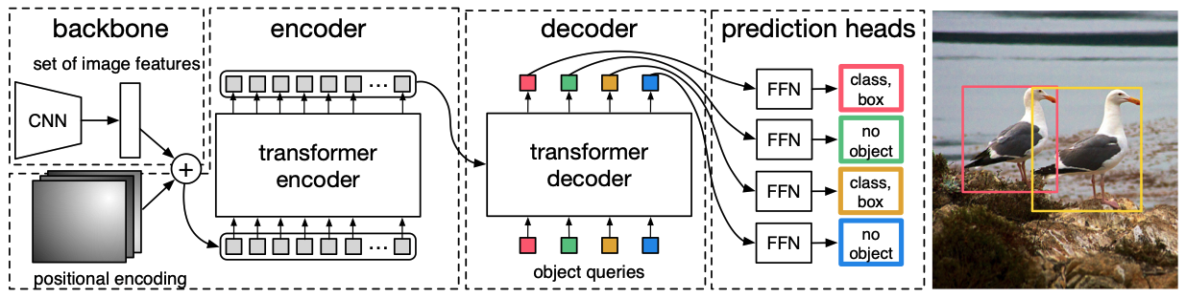
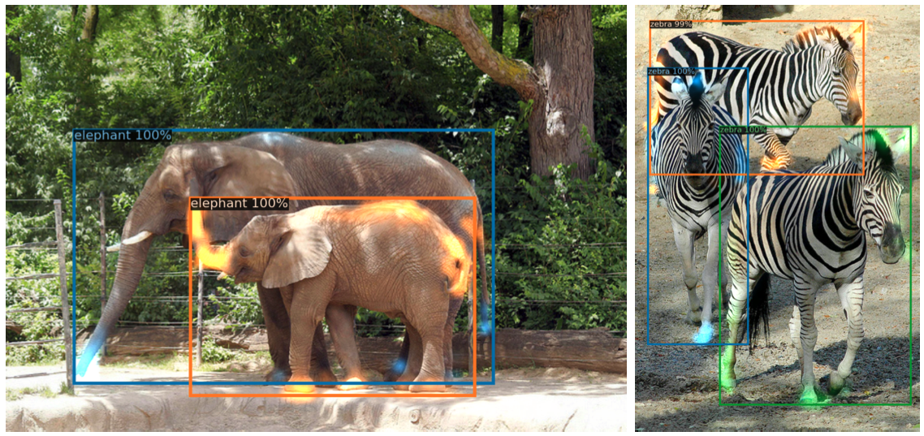
Detection with Transformers
Transformers
DETR:
idea: use a transformer to directly predict object bounding boxes and class labels from image features (no RPN)
backbone can also be vision transformer
→ popular combination: DINOv2 + DETR
parallel rather than autoregressive
slot for learnable vectors
(“Is there an object here?”)
visualized decoder attention for predicted objects:

Slide 15
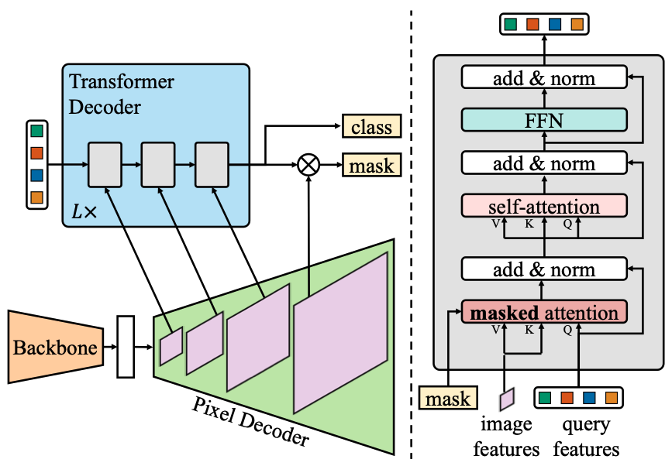
Segmentation with Transformers
predicts masks and labels jointly
segmentation head
Mask2Former
mask queries: learnable spatial masks
unlike pixel-wise classification, it predicts a set of masks, each tied to an object or region
(similar to DETR, but predicting segmentation masks instead of bounding boxes)
CNN or transformer
only attending to foreground region
attends over the multi-scale image features (including high-resolution ones)

Slide 16
Instance Segmentation

Slide 17
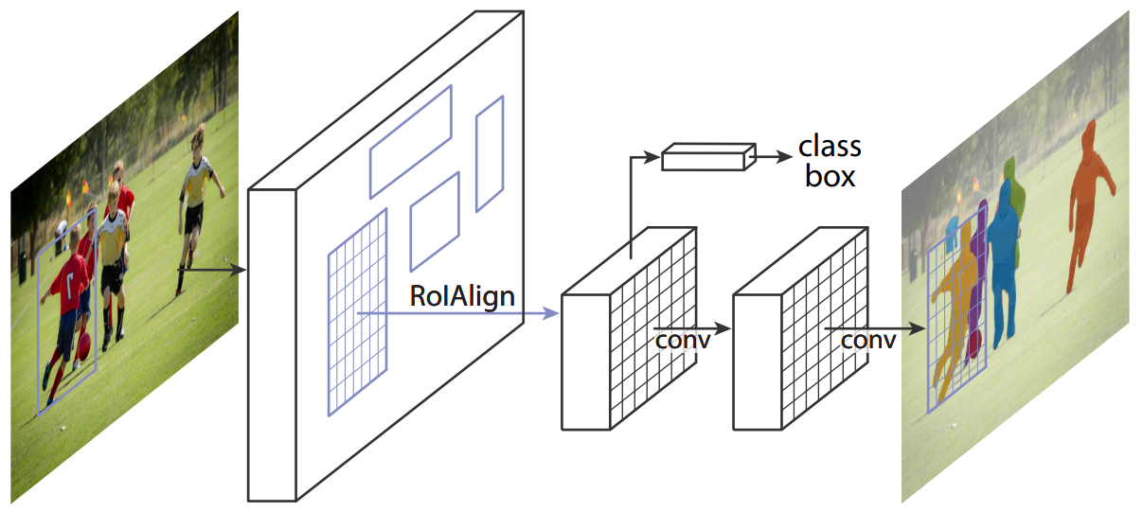
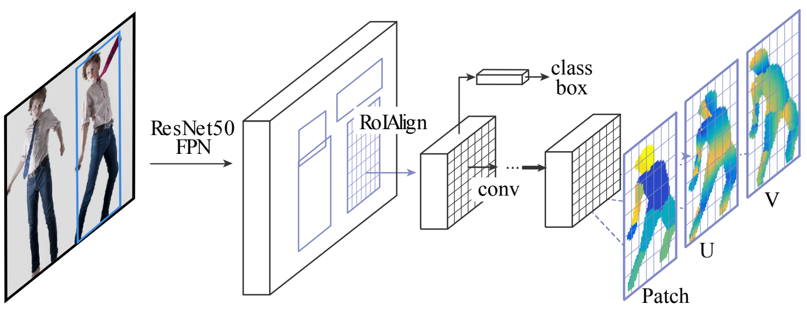
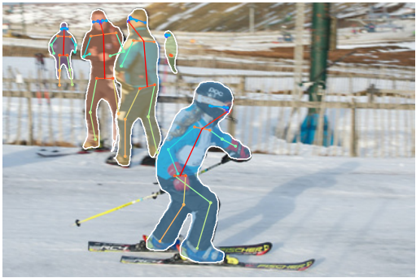
Add Additional Network Heads to R-CNN
instance segmentation (Mask R-CNN):
pose estimation (DensePose):
3D model’s surface to 2D

Slide 18
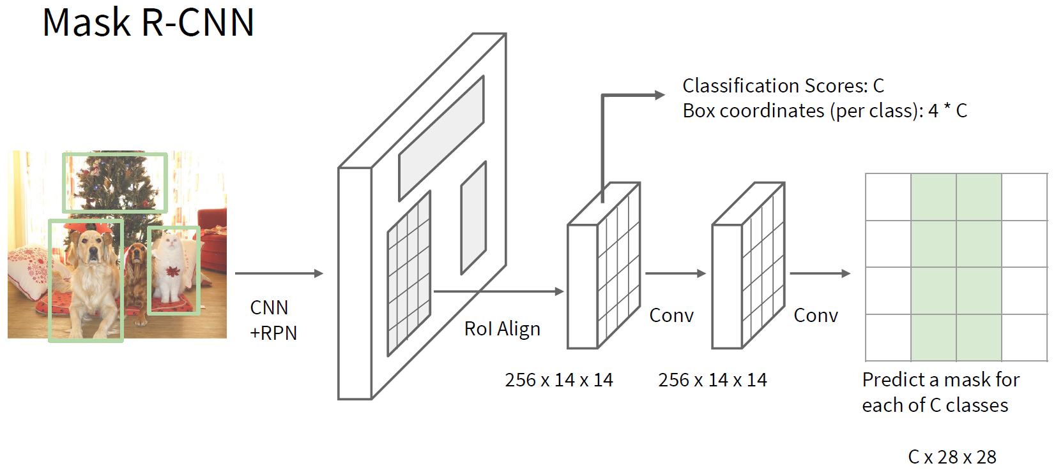
→ total loss is sum of RPN, detection-head, and mask-head losses
Faster R-CNN
detection head:
using bilinear interpolation to avoid quantization errors
object detection (boundary boxes)
prediction of separate binary masks for each detected object (specific instances)

Slide 19


image with training proposal
$28×28$ mask target
image with training proposal
$28×28$ mask target

Slide 20
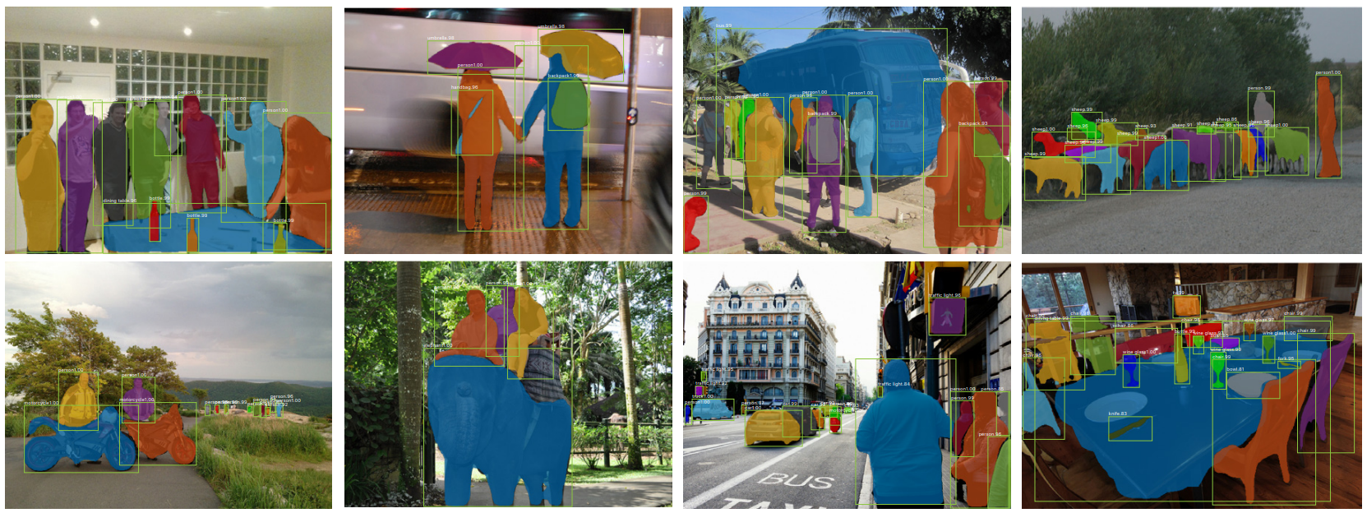
results on MS COCO data set

Slide 21
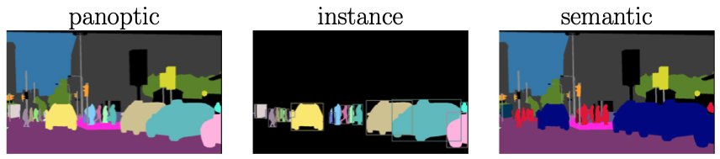
Panoptic Segmentation
unification of semantic sementation (labeling all pixels) and instance segmentation (identifying individual objects)
each pixel is assigned
a class label (e.g., road, car)
an instance ID, if it belongs to a “thing” class (e.g., car #1, car #2)
covering both “thing” classes (countable objects) and “stuff” classes (uncountable regions like sky, grass, road)
e.g., with combination of Mask R-CNN and fully-convolutional head (or DETR variants such as Mask2Former)
source

Slide 22
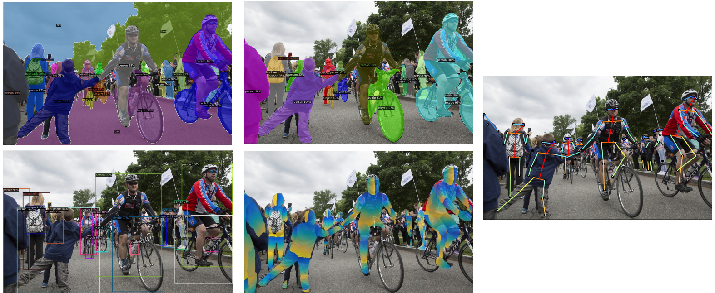
Detectron2: PyTorch Implementations

Slide 23
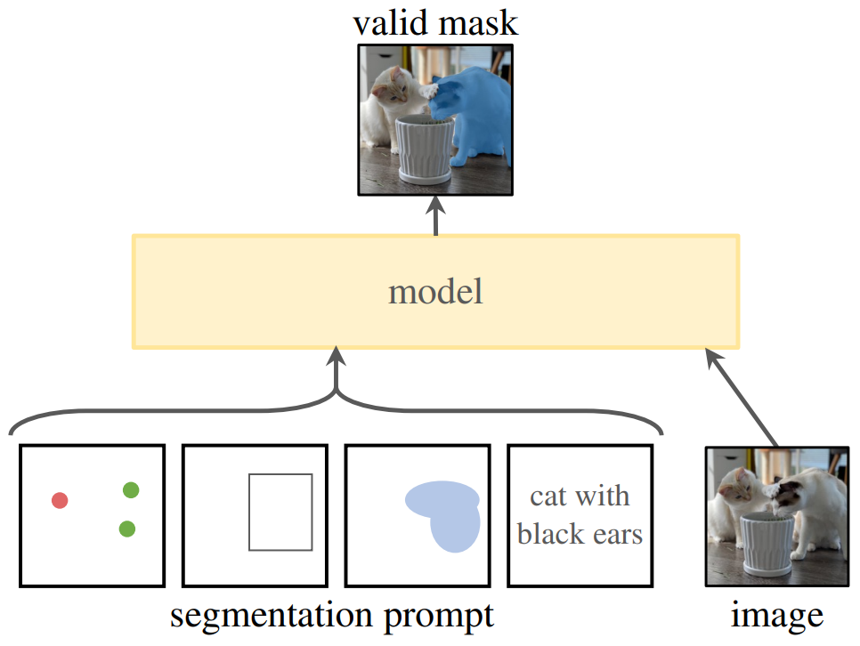
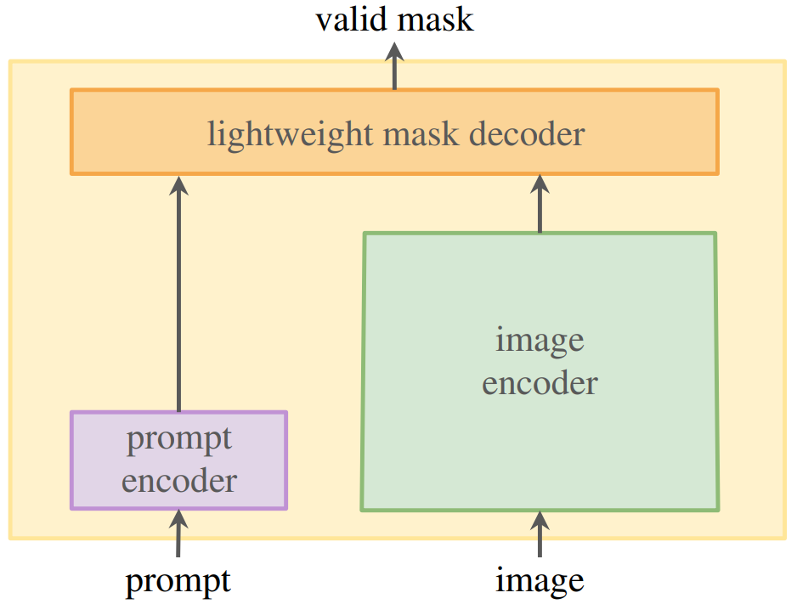
Promptable Segmentation with Transformers
Segment Anything Model (SAM)
SAM2 includes also video segmentation
transformer decoder
ViT
CLIP

Slide 24
Some Off-the-Shelf ML Methods
multivariate tabular data prediction: HistGradientBoosting from scikit-learn (regression, classification)
image classification: feature extraction from DINOv2 or finetune a ResNet/ViT from torchvision (zero-shot: CLIP)
object detection: Faster R-CNN ResNet-50 FPN from torchvision (zero-shot: YOLOv8)
semantic segmentation: FCN ResNet-50 from torchvision (zero-shot: YOLOv8-seg)
instance segmentation: Mask R-CNN ResNet-50 FPN from torchvision (zero-shot: YOLOv8-seg or SAM)
text classification: finetune DistilBERT from transformers (zero-shot: prompt an Ollama LLM)

