Slide 1
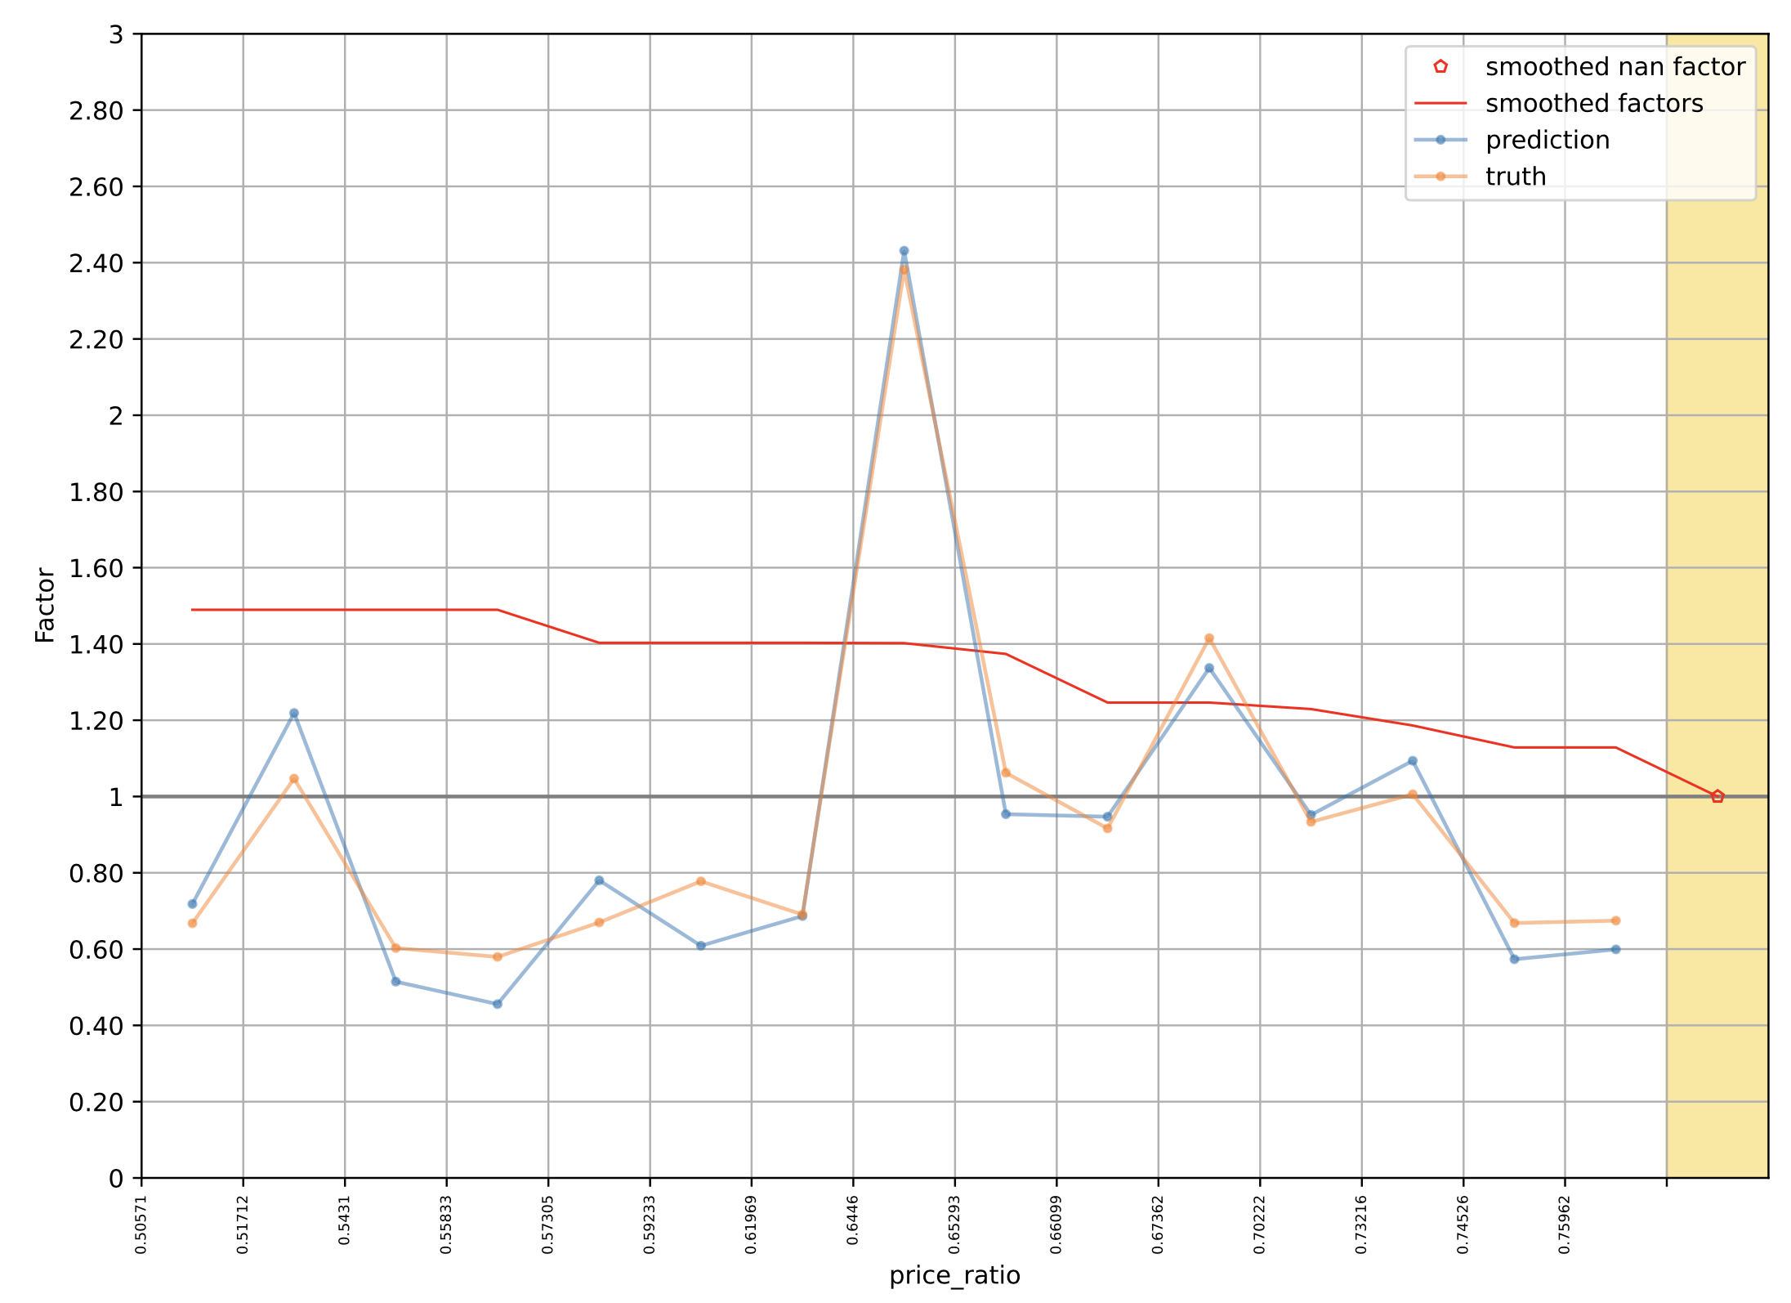
Cyclic Boosting
multiplicative mode → factors
target mean in each bin
binning → local optimization (low-bias method, capturing rare effects)
smoothing over different bins (reduction of variance)
forward-stagewise fitting (cyclic coordinate descent)
some similarity to Generalized Additive Models (e.g., link function, interaction terms)
→ individual explainability
Feature (bin) has an impact in the model, otherwise it will be 1.
no price reduction: set to uninformative value (natural support for missing values)

Slide 2

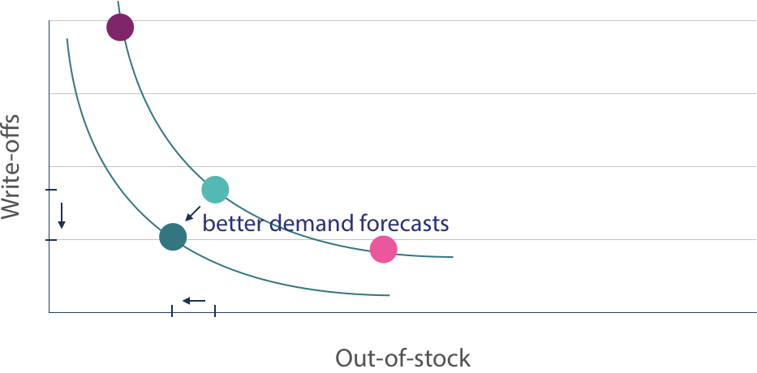
Retail Demand Forecasting & Replenishment
many individual time series to consider
typical retail grocery chain:
products (items): ~20k
locations (stores): ~500
daily/hourly aggregated sales
categorical features important:
products and locations → high cardinality
order optimization → choose demand quantile:
less out-of-stocks, but more write-offs
promotions
(price reductions)
Summed Units
less write-offs, but more out-of-stocks

Slide 3
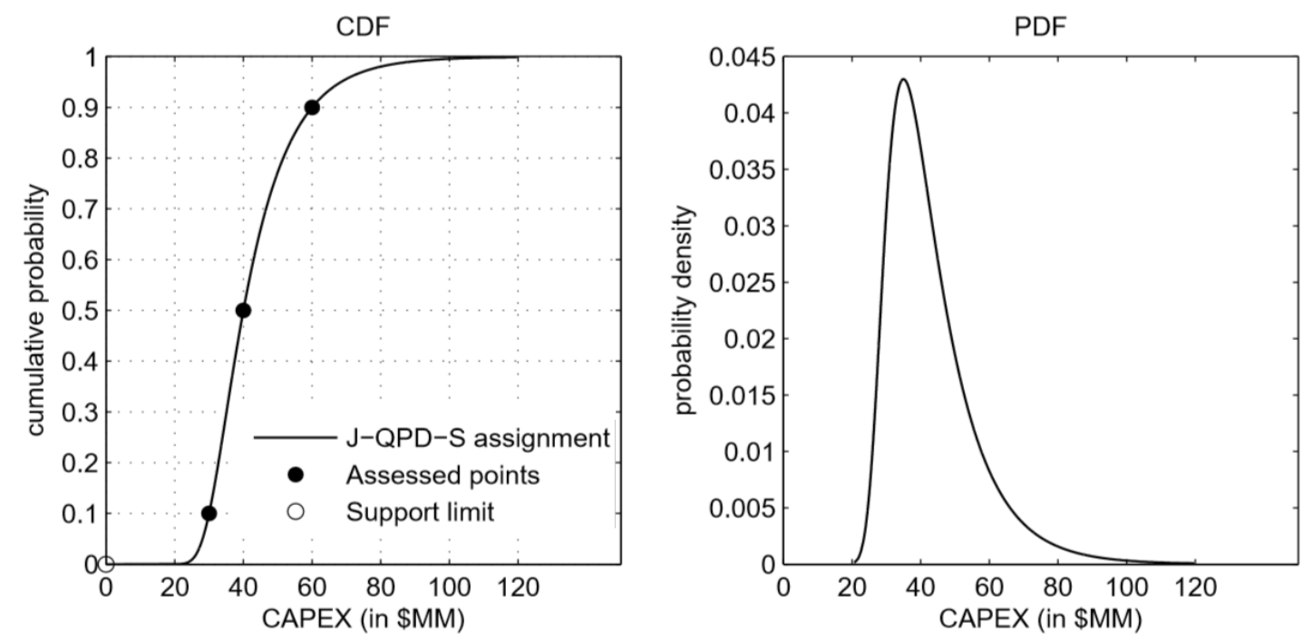
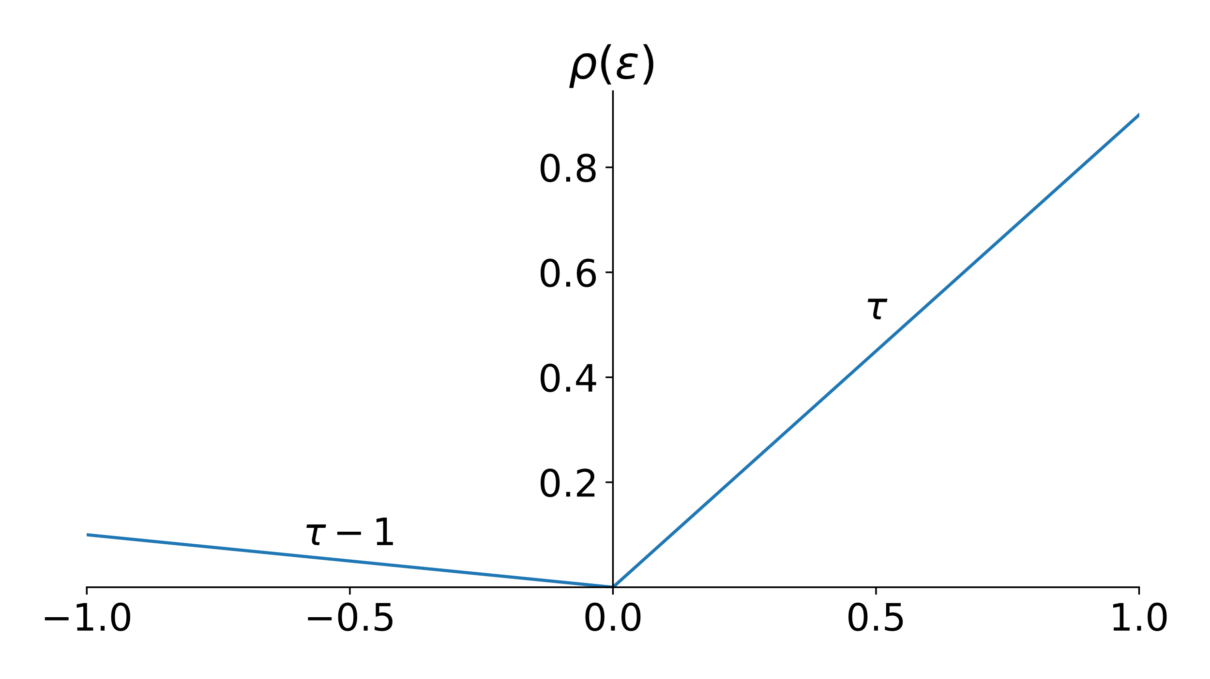
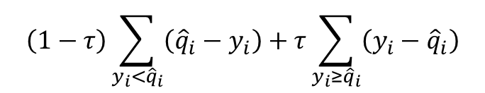
Prediction of Probability Distributions
use in quantile-parameterized distributions:
pinball loss for quantile predictions:
J-QPD
$$\left(1−τ\right)\sum_{y_{i}<{\hat{q}}_{i}}{\left({\hat{q}}_{i}−y_{i}\right)+τ\sum_{y_{i}≥{\hat{q}}_{i}}{\left(y_{i}−{\hat{q}}_{i}\right)}}$$
choose low demand quantile for ordering:
high understock risk
choose high demand quantile for ordering:
high overstock risk

Slide 4
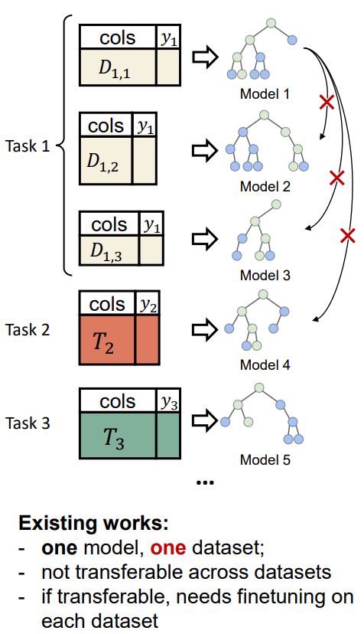
Idea of Tabular Foundation Models
foundation models prevalent in vision and language (unstructured, homogenous data)
but not (yet) in structured/tabular, heterogenous data
goal:
pre-training across data sets and even different tasks
finetuning on small data sets
benefit from world knowledge in LLMs, for example in terms of data imputation
source

Slide 5
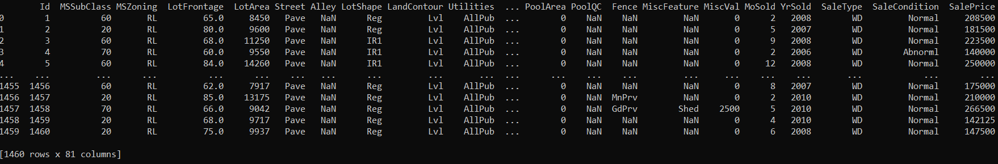
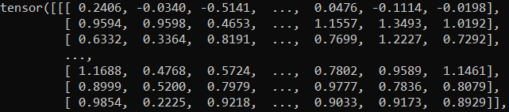
Concept Model: tabGPT
to overcome data integration challenge:
convert to prompts for LLM calls
MLP head
extract embeddings
transformer encoder
embeddings:
+
$$×$$
numerical value
column name or description
categorical value
column name or description

Slide 6
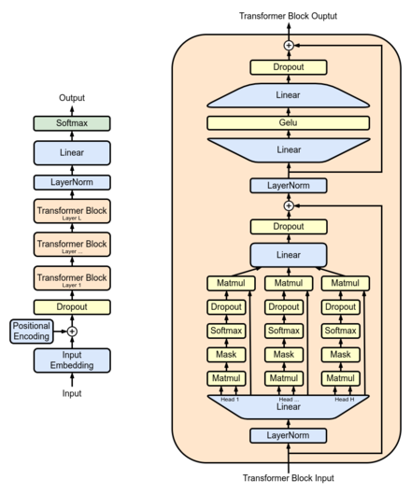
Transformer for Numerical Data
adaptions to GPT architecture:
replace language model head and loss function to reflect tabular prediction setup
also use average pooling over sequence instead of last element for prediction
drop positional encoding
(permutation invariance)
x
x
x
x
drop causal masking
(permutation invariance)
input previously generated column embeddings directly
from wikipedia

