Slide 1
Forecasting means dealing with time series

Slide 2
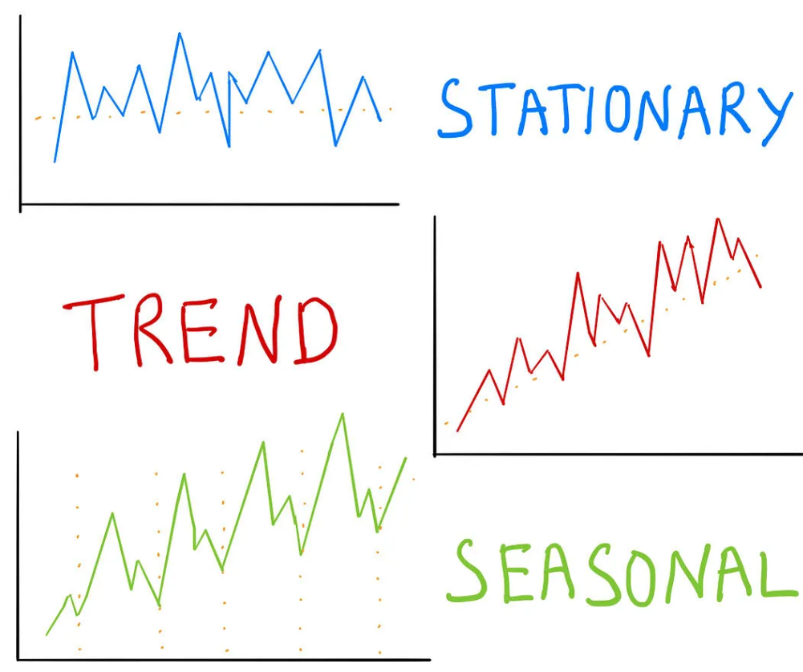
It works by statistically learning patterns

Slide 3
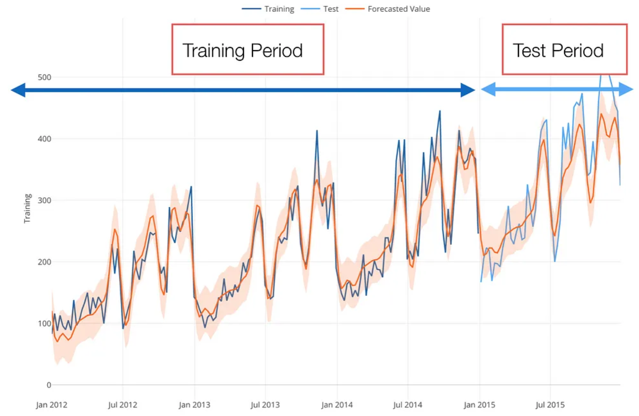
You need past data to learn from

Slide 4
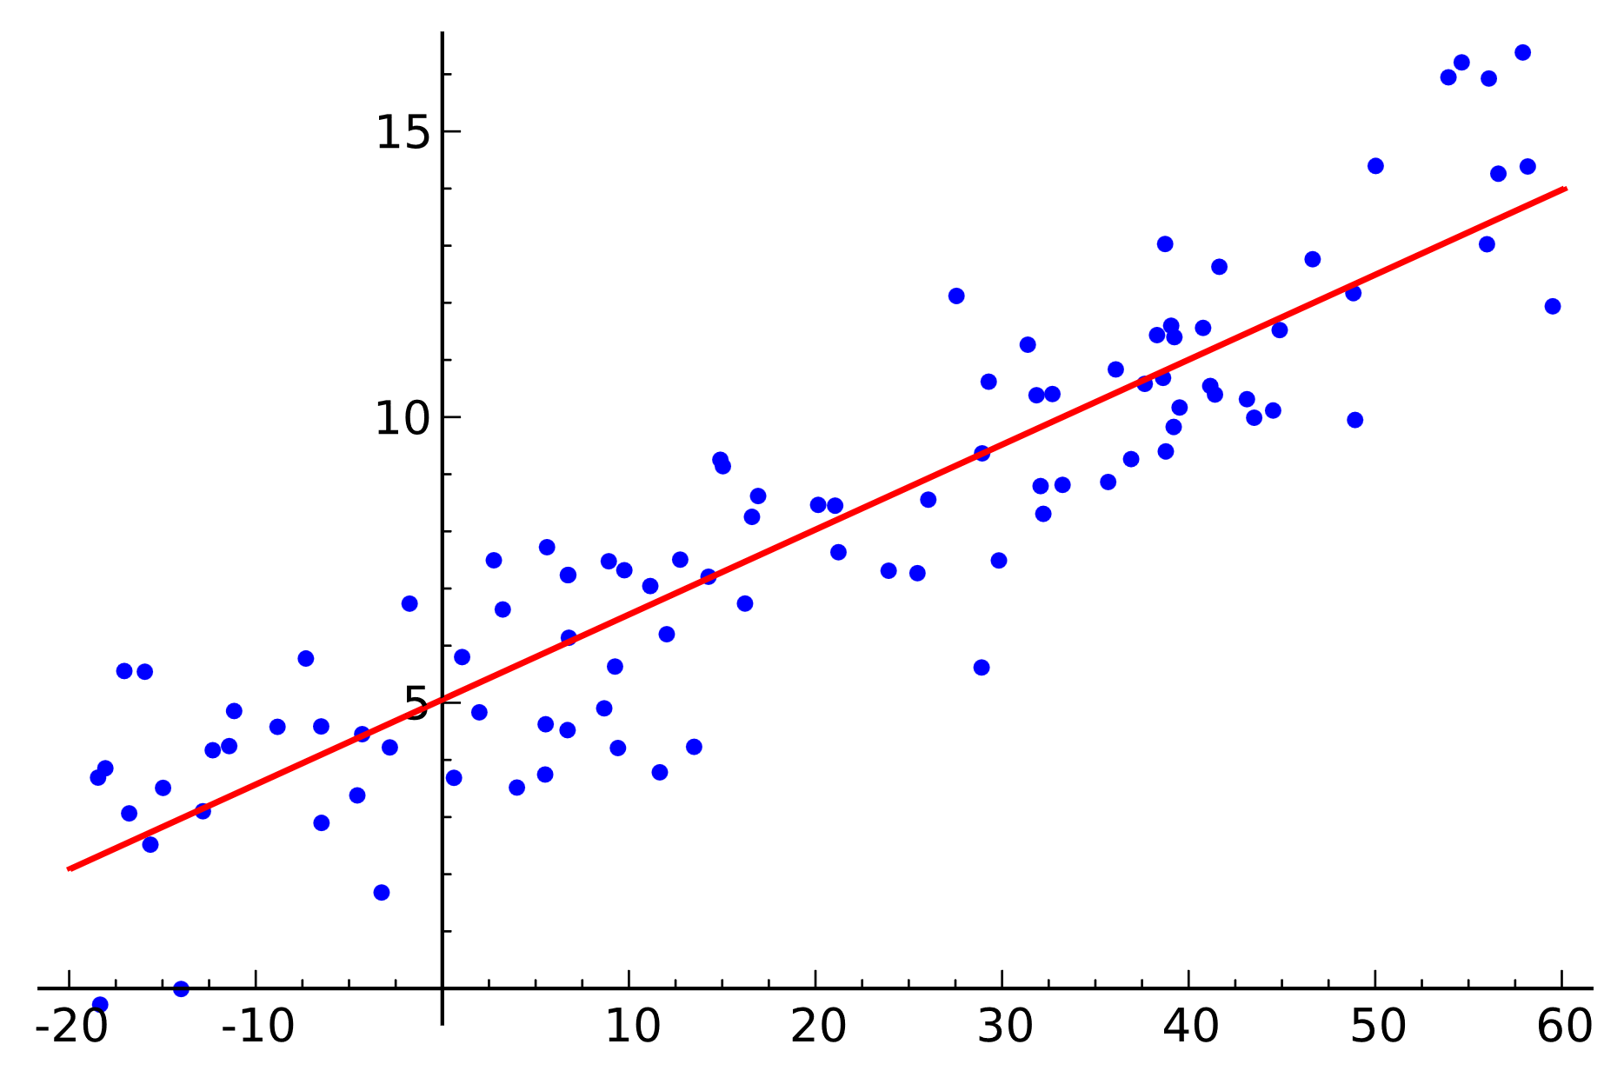
Perfect predictions are not possible

Slide 5
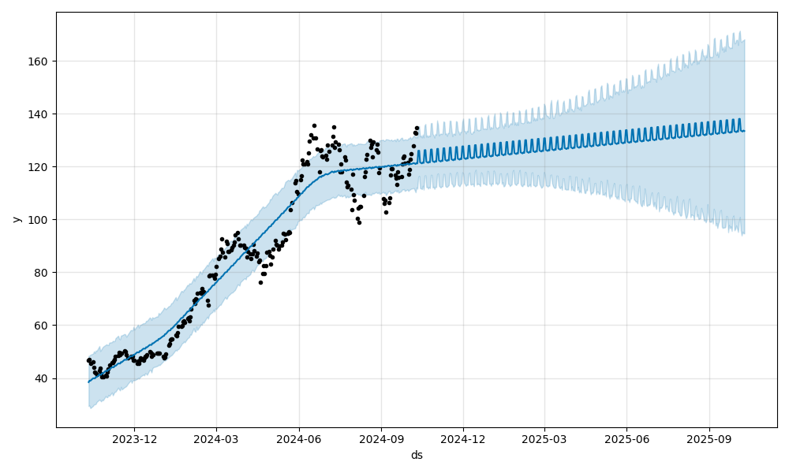
Uncertainty increases with forecast horizon
Nvidia stock prices

Slide 6
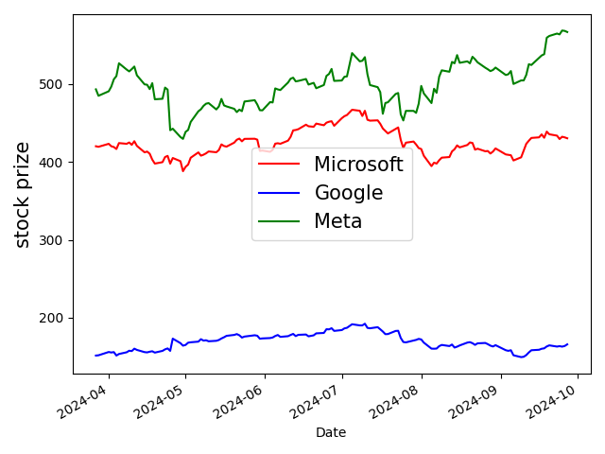
You can decrease uncertainty by looking at similar time series

Slide 7

You can predict effects of foreseeable events
promotions
(price reductions)
Summed Units

Slide 8
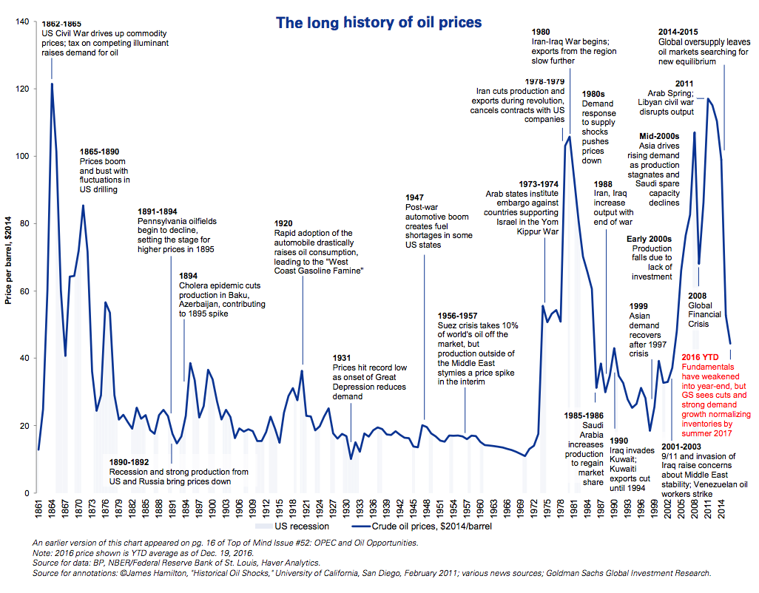
But you cannot predict effects of unforeseeable events

Slide 9
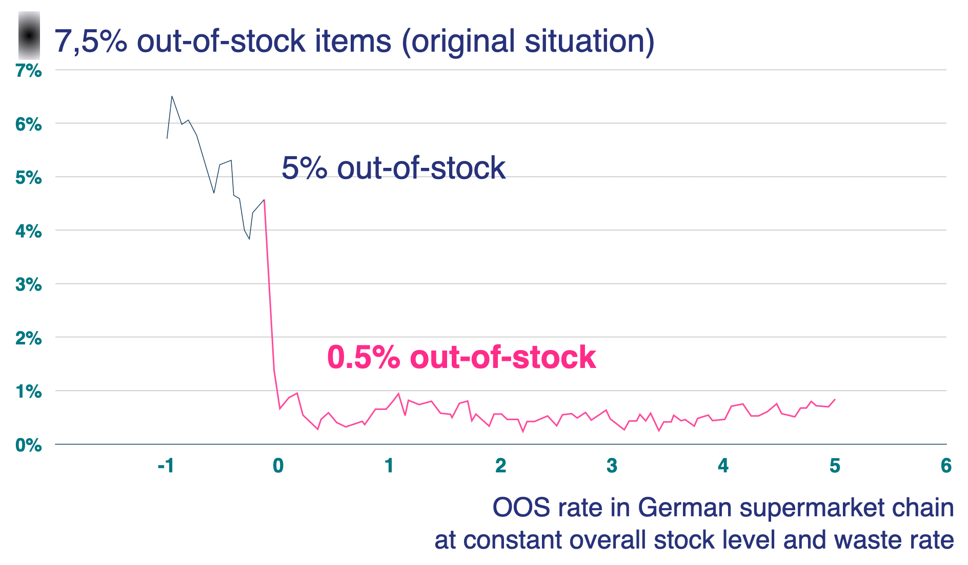
So it’s no magic, but better than your gut feeling
influence of automation

Slide 10
Examples for prediction accuracy

Slide 11
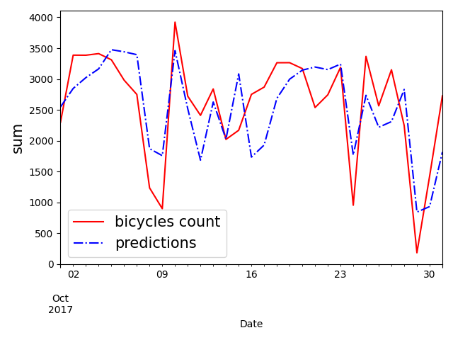
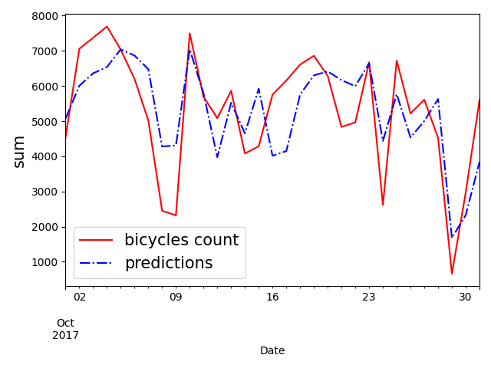
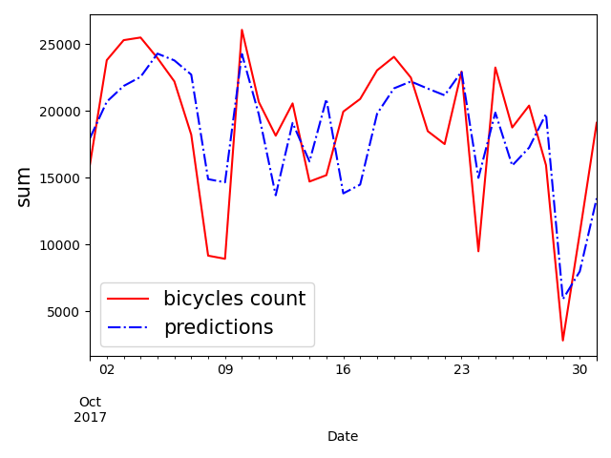
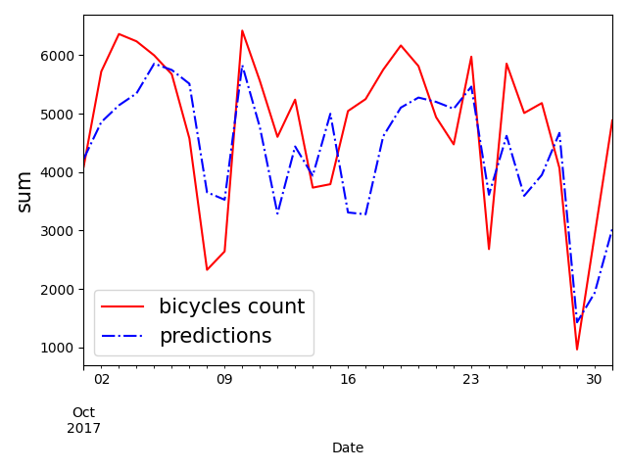
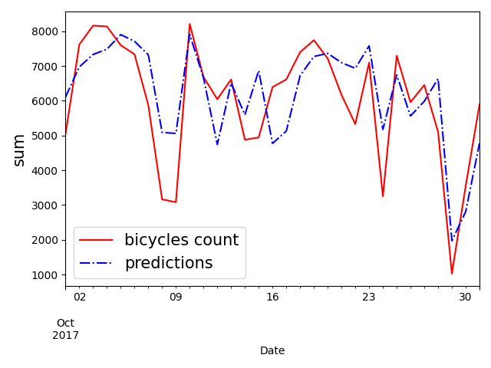
NY bridges bicycles count
total
Manhattan bridge
Brooklyn bridge
off by
~10%
Williamsburg bridge
Queensboro bridge

Slide 12
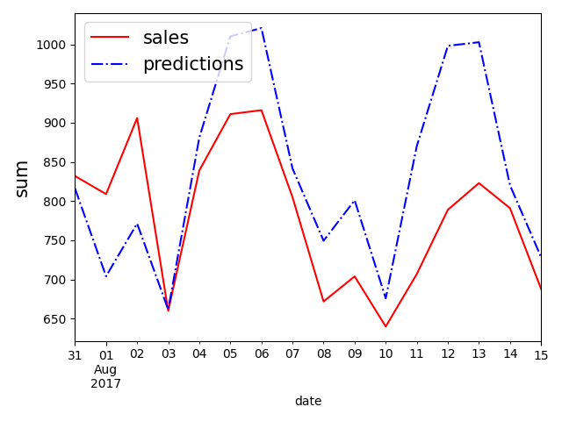
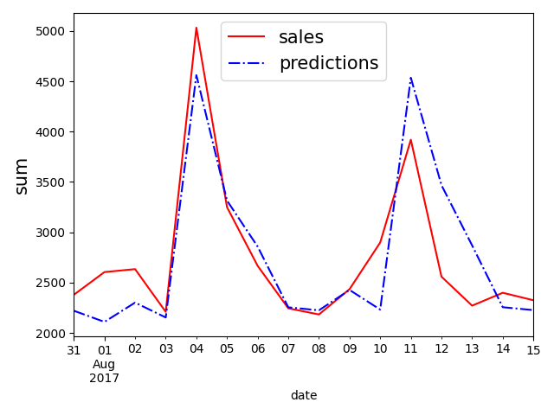
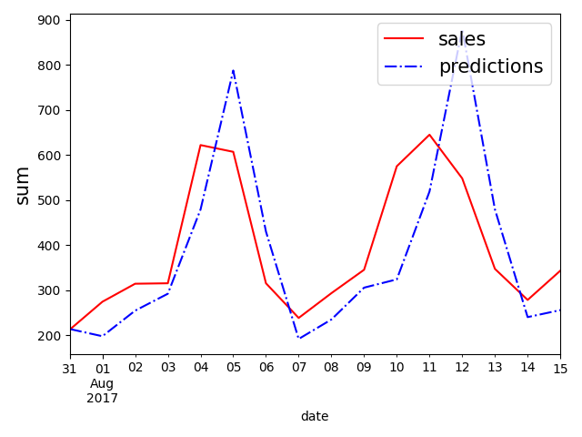
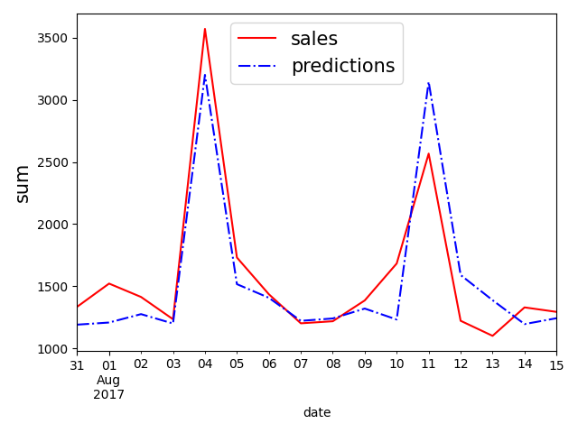
Store sales
sum over several stores
total
liquor, wine, beer
eggs
off by
~10%
off by
~40%
meats

Slide 13
Quiz time
How accurate can this be predicted?

Slide 14
Retail sales of toilet paper

Slide 15
Retail sales of toilet paper during COVID

Slide 16
Orders of an individual customer during a given week

Slide 17
Orders of all customers during a given week or orders of an individual customer during a full year

