Slide 1
Fundamentals of Image Processing - Lab
H2.083

Slide 2
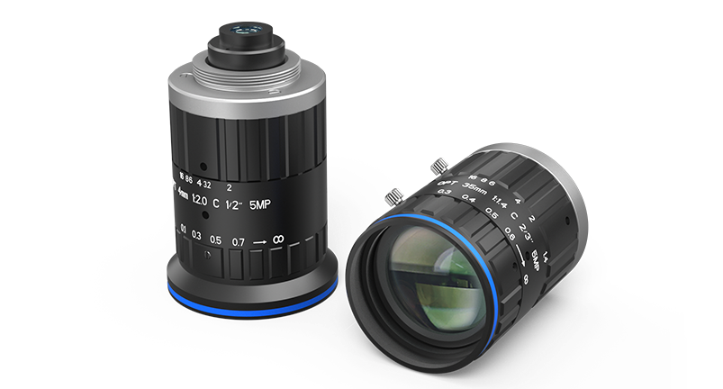
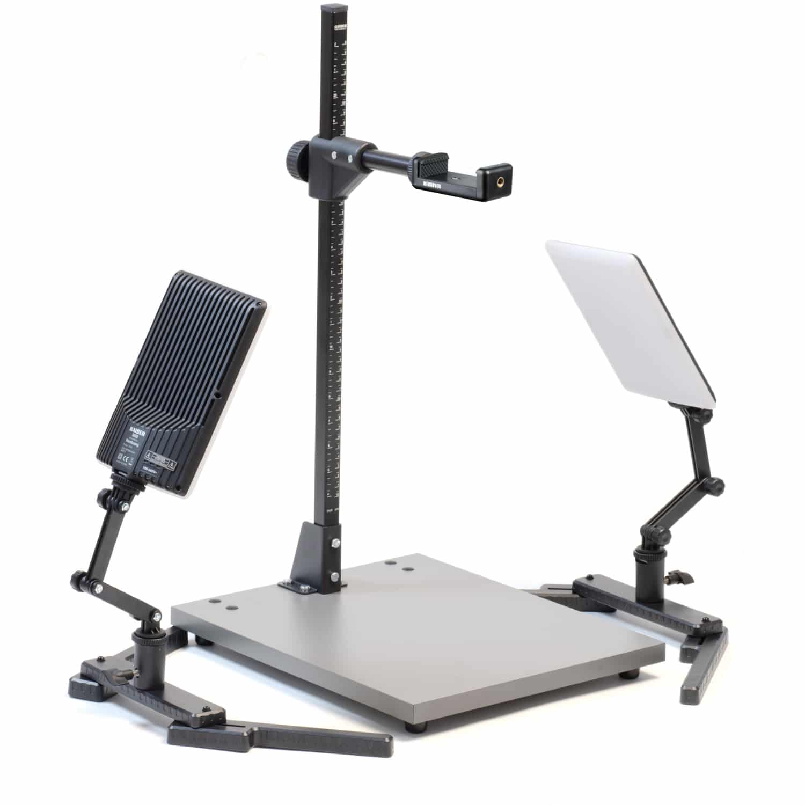
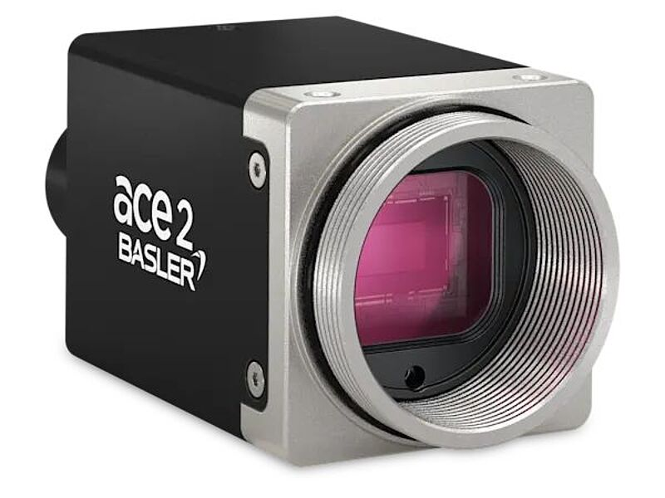
Equipment
Basler ace2 USB3

Slide 3
Camera
Basler ace 2 R
5 MP, 60 FPS
Get Images:
  UI: Basler pylon viewer
  Python: pypylon pip package

Slide 4
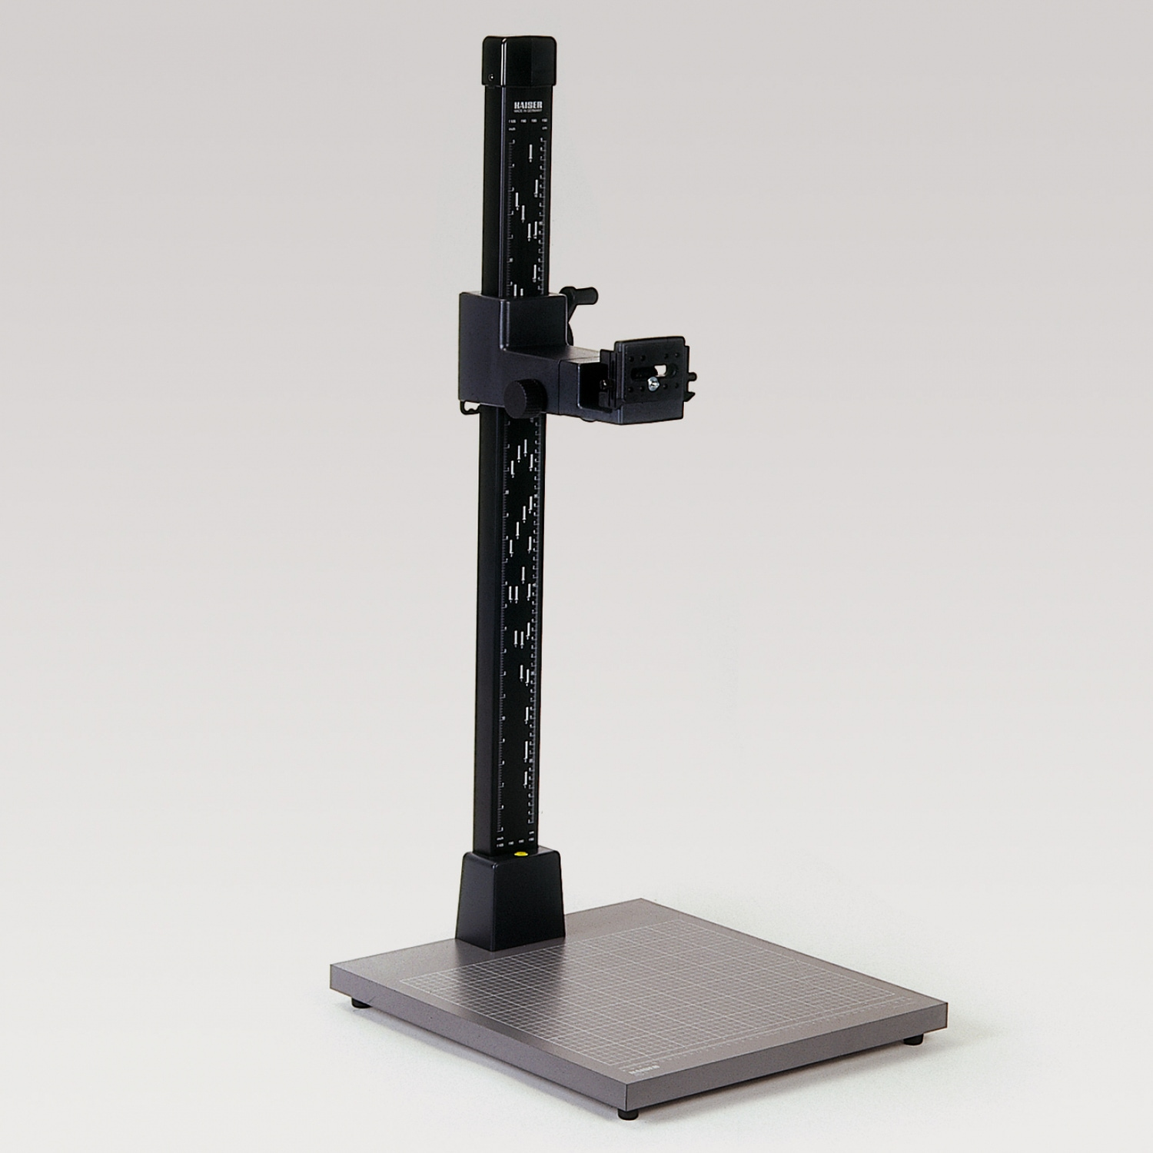
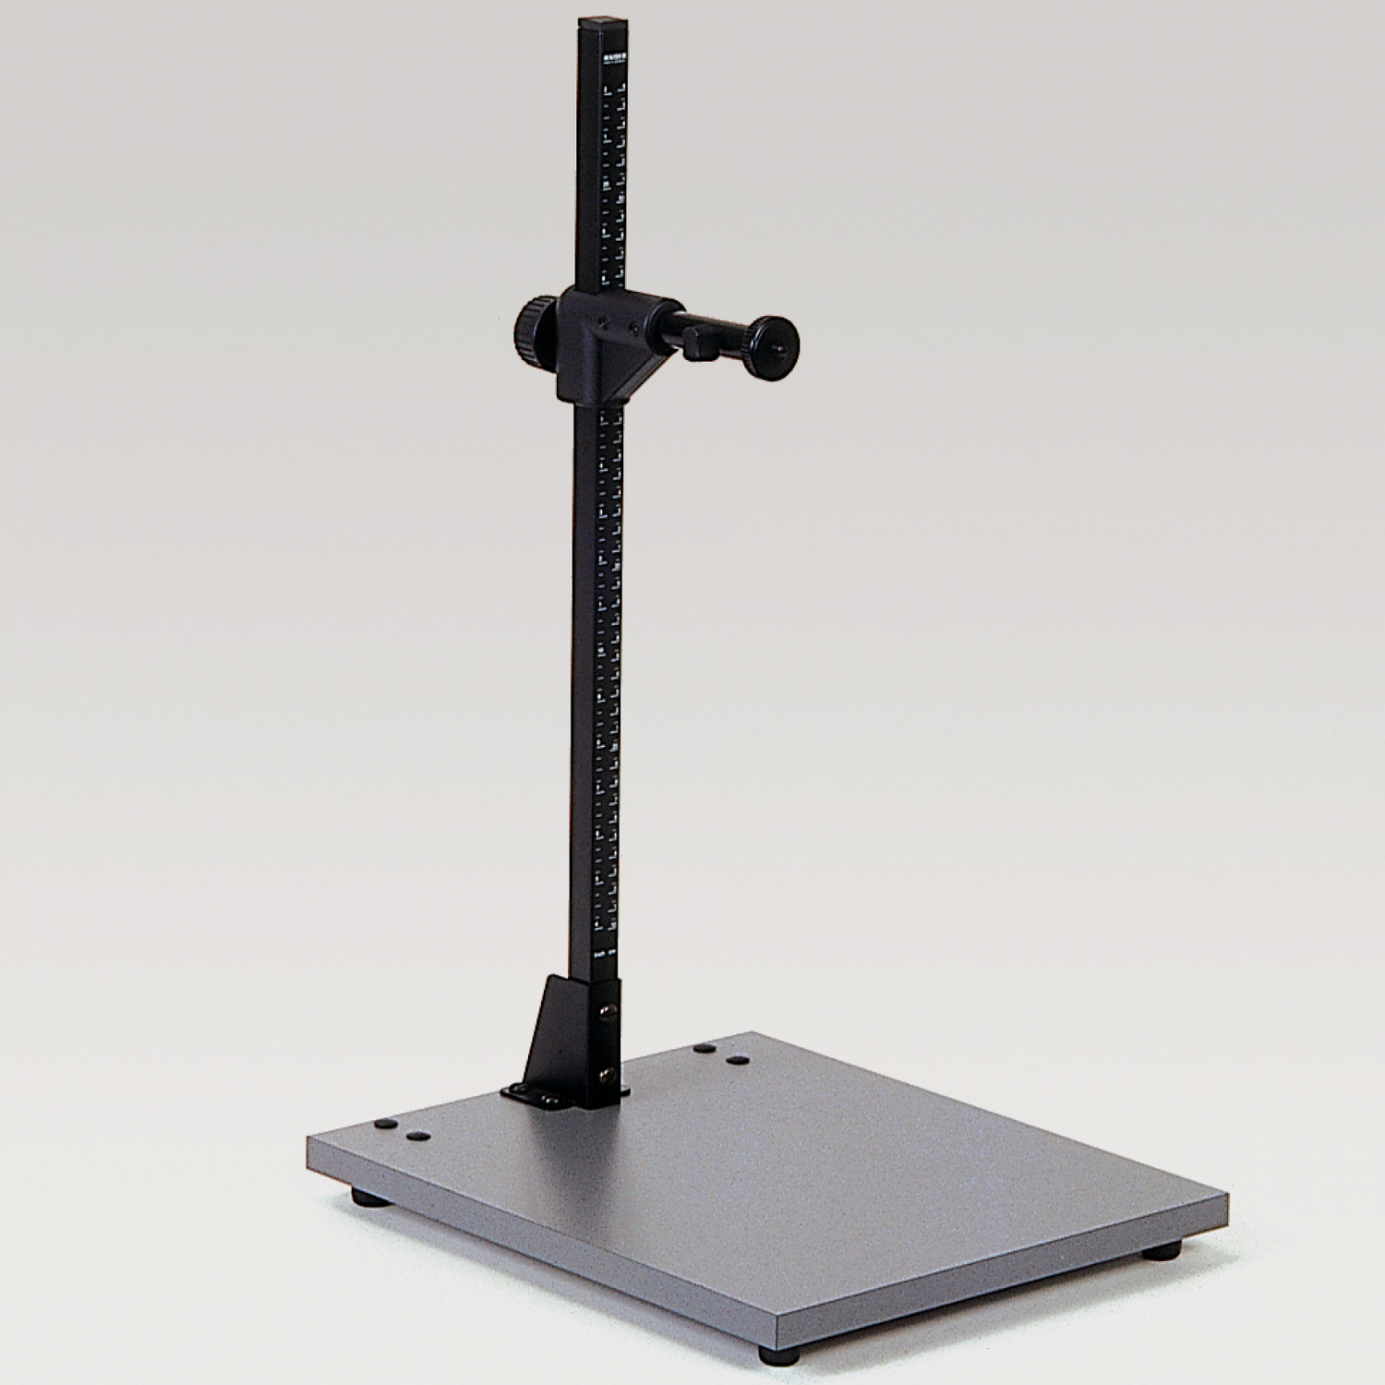
Stand
Adjust height

Slide 5
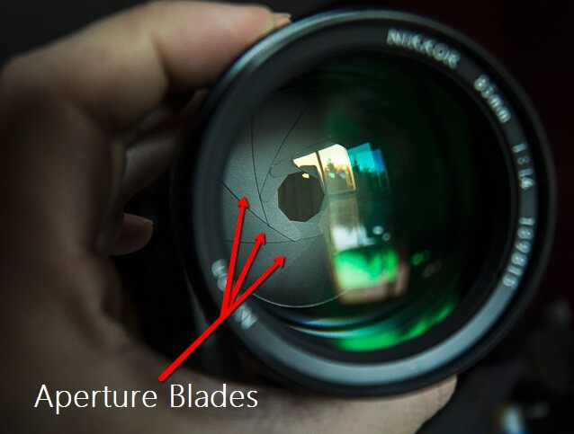
Lenses
5MP fixed focal length lenses (ranging from 5-75mm)
Aperture Ring:
  Controls aperture blades, which control how much light enters the camera.
Focus Ring:
  Controls the focusing distance of the image.
  No change in focal length.
Aperture Ring
Focus Ring

Slide 6
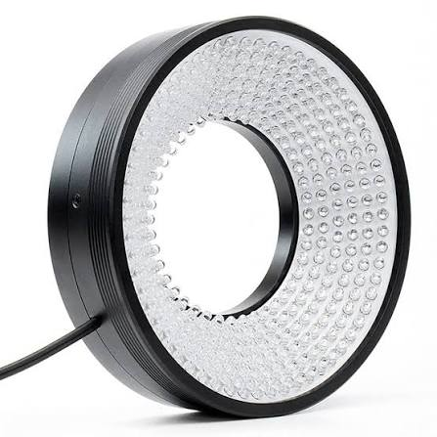
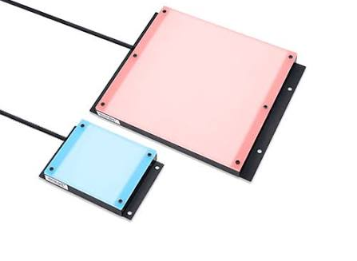
Lights
Ring Lights
Flat Lights

Slide 7
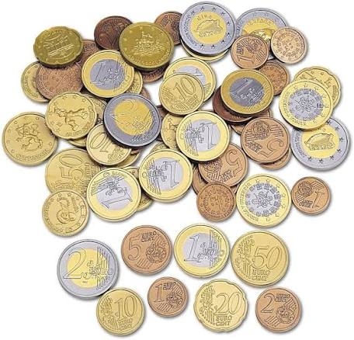
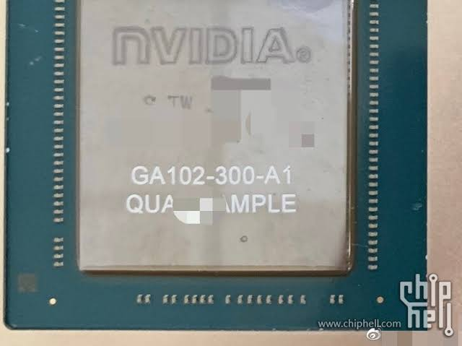
Materials for Tasks - I
Coin Detection
  Calibration Coin
  bring your own coins
SMD Detection
  GPU

Slide 8
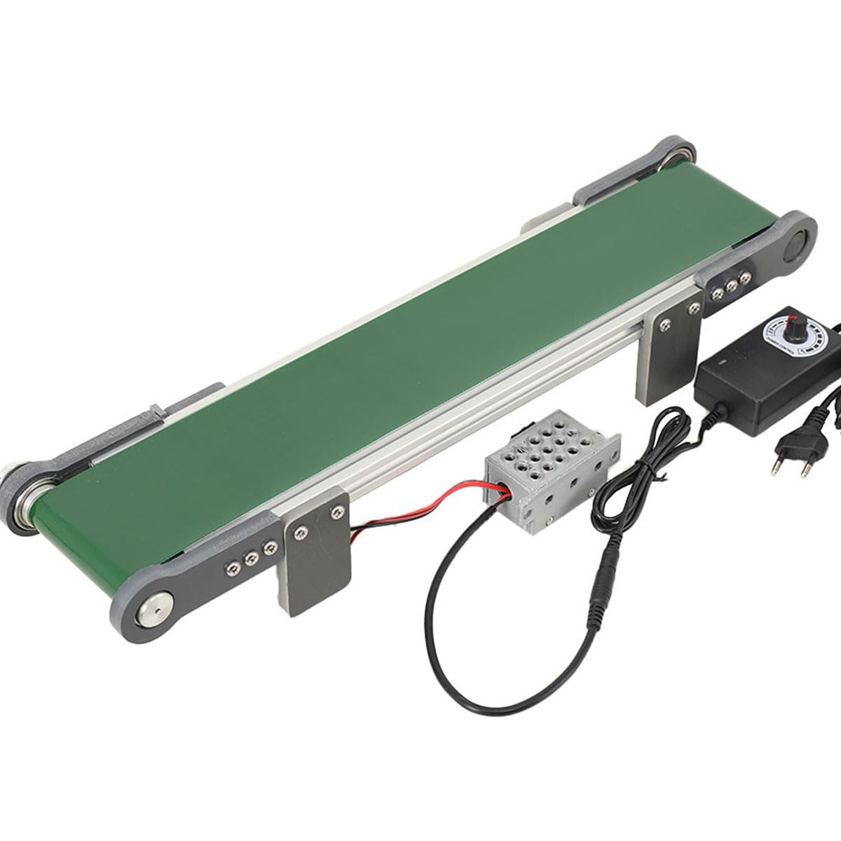
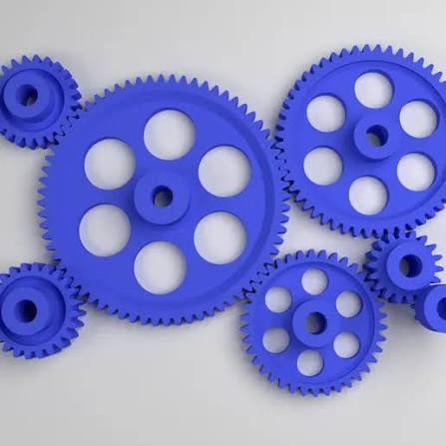
Materials for Tasks - II
Event Detection
  Pointing tools
  Conyeor belt
Gear Wheel Inspection
  3D printed gears

