Slide 1
Projective Geometry
Computer Vision

Slide 2
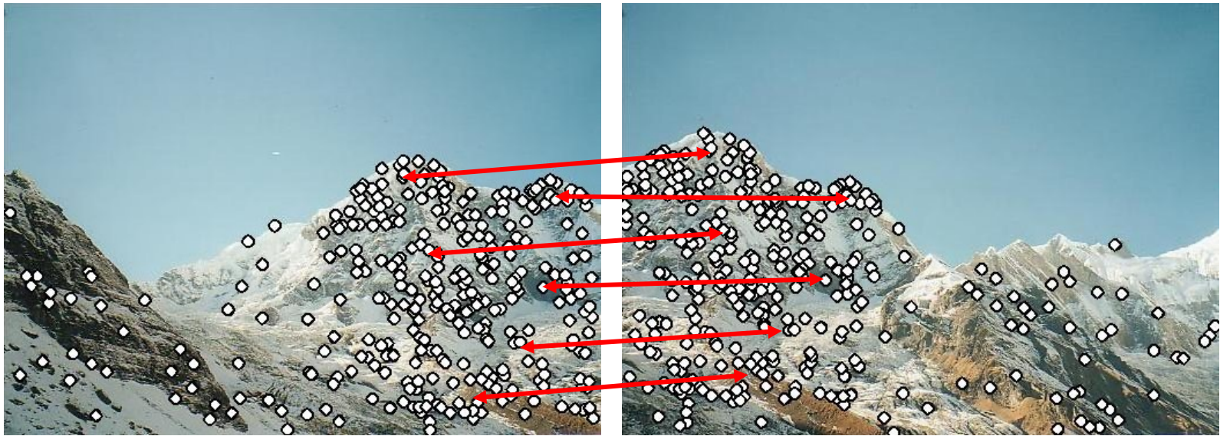
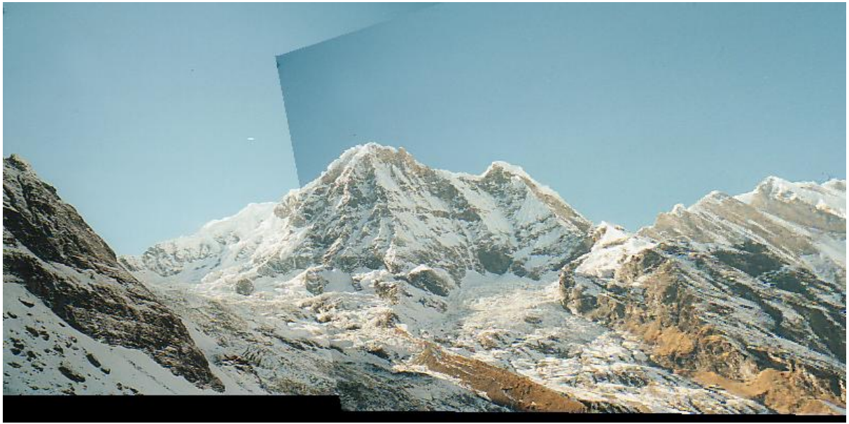
Application: Panorama Stitching
feature extraction and matching
→ homography

Slide 3
Geometric Transformations

Slide 4
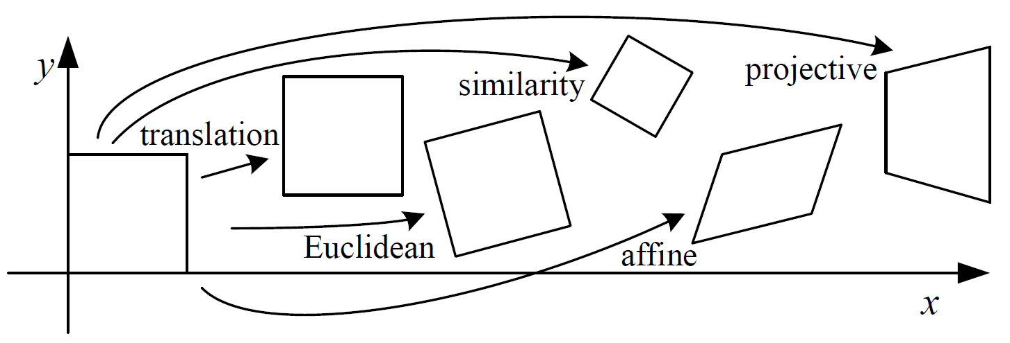
Geometric (Parametric) 2D Transformations
relocate individual pixels (without changing its intensity values)
calculate new intensity values through interpolation on neighborhood in original image

Slide 5

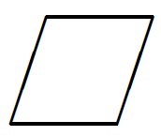
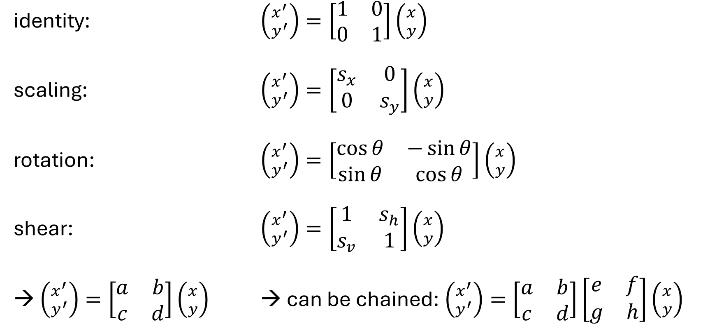
Linear Transformations
identity: $\left({x^{′} \atop y^{′}}\right)=\left[\begin{matrix}1 & 0 \\ 0 & 1\end{matrix}\right]\left({x \atop y}\right)$
scaling: $\left({x^{′} \atop y^{′}}\right)=\left[\begin{matrix}s_{x} & 0 \\ 0 & s_{y}\end{matrix}\right]\left({x \atop y}\right)$
rotation: $\left({x^{′} \atop y^{′}}\right)=\left[\begin{matrix}\cos{θ} & −\sin{θ} \\ \sin{θ} & \cos{θ}\end{matrix}\right]\left({x \atop y}\right)$
shear: $\left({x^{′} \atop y^{′}}\right)=\left[\begin{matrix}1 & s_{h} \\ s_{v} & 1\end{matrix}\right]\left({x \atop y}\right)$
→ $\left({x^{′} \atop y^{′}}\right)=\left[\begin{matrix}a & b \\ c & d\end{matrix}\right]\left({x \atop y}\right)$ → can be chained: $\left({x^{′} \atop y^{′}}\right)=\left[\begin{matrix}a & b \\ c & d\end{matrix}\right]\left[\begin{matrix}e & f \\ g & h\end{matrix}\right]\left({x \atop y}\right)$
parameters

Slide 6
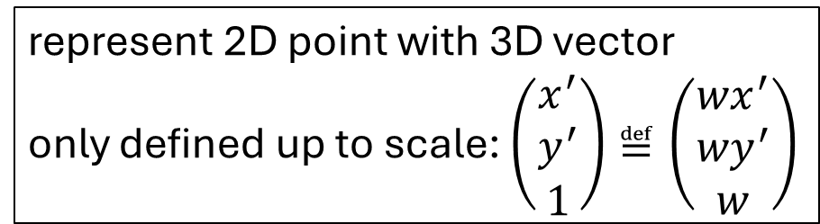
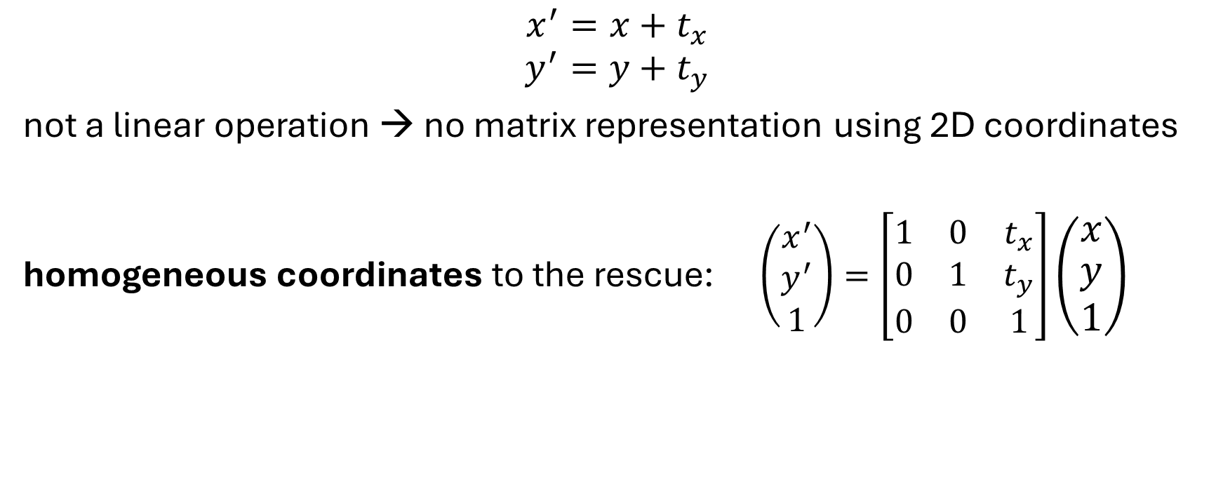
Translation
$$x^{′}=x+t_{x}$$
$$y^{′}=y+t_{y}$$
not a linear operation → no matrix representation using 2D coordinates
homogeneous coordinates to the rescue: $\left(\begin{matrix}x^{′} \\ y^{′} \\ 1\end{matrix}\right)=\left[\begin{matrix}1 & 0 & t_{x} \\ 0 & 1 & t_{y} \\ 0 & 0 & 1\end{matrix}\right]\left(\begin{matrix}x \\ y \\ 1\end{matrix}\right)$
represent 2D point with 3D vector
only defined up to scale: $\left(\begin{matrix}x^{′} \\ y^{′} \\ 1\end{matrix}\right)≝\left(\begin{matrix}{wx}^{′} \\ {wy}^{′} \\ w\end{matrix}\right)$

Slide 7

Affine Transformations
affine transformations:
linear transformations and translation
$$\left(\begin{matrix}x^{′} \\ y^{′} \\ 1\end{matrix}\right)=\left[\begin{matrix}a & b & c \\ d & e & f \\ 0 & 0 & 1\end{matrix}\right]\left(\begin{matrix}x \\ y \\ 1\end{matrix}\right)$$

Slide 8
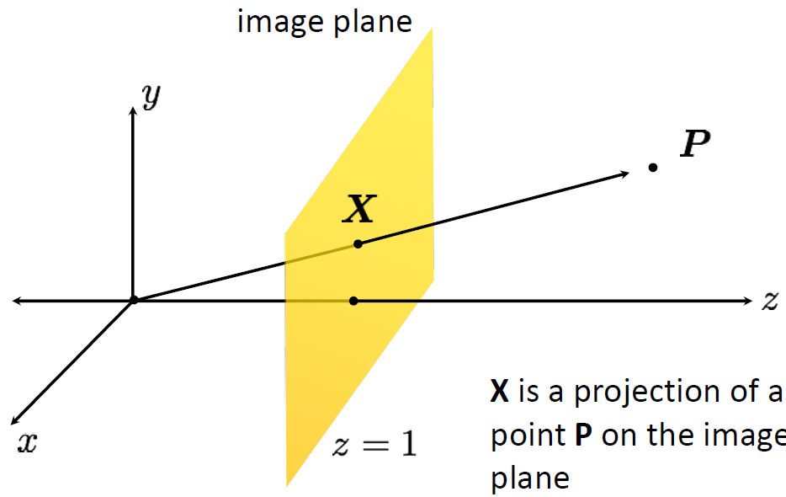
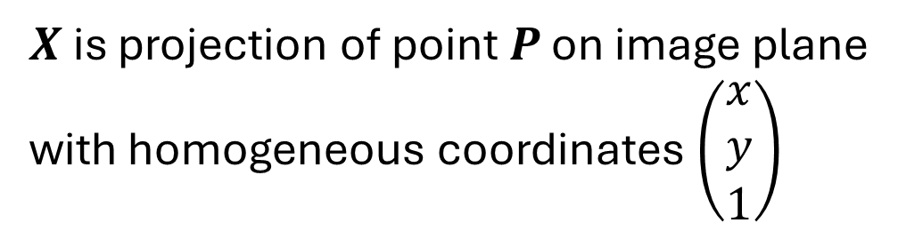
Projective Geometry
projective space: 3D scene → 2D image
$X$ is projection of point $P$ on image plane
with homogeneous coordinates $\left(\begin{matrix}x \\ y \\ 1\end{matrix}\right)$

Slide 9
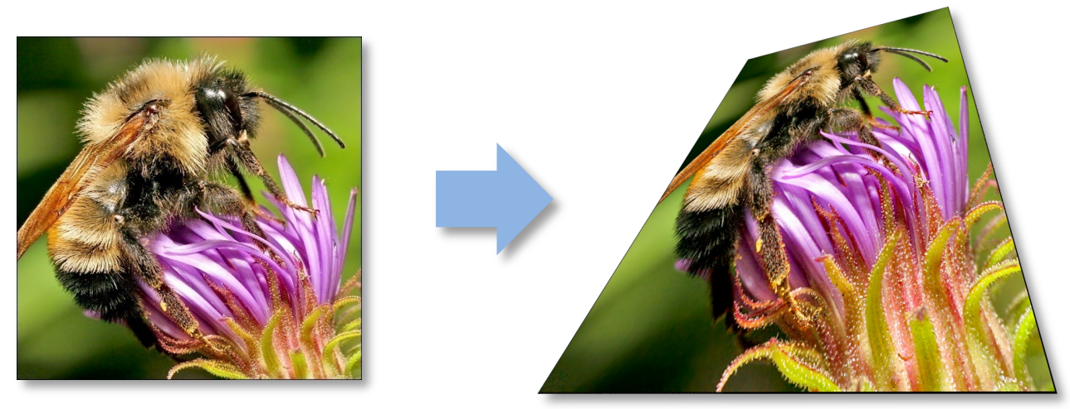
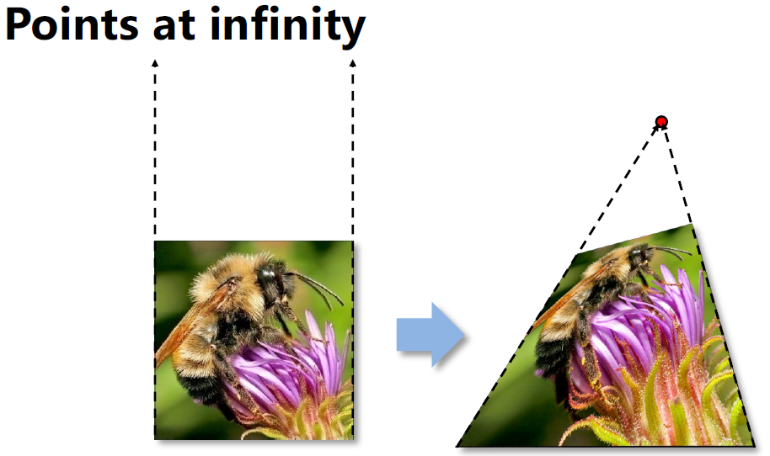


Projective Transformations: Homographies
$$\left(\begin{matrix}x^{′} \\ y^{′} \\ w^{′}\end{matrix}\right)=\left[\begin{matrix}a & b & c \\ d & e & f \\ g & h & 1\end{matrix}\right]\left(\begin{matrix}x \\ y \\ 1\end{matrix}\right)$$
homographies: affine transformations and “projective warps”
special points:
point at infinity: $\left(\begin{matrix}x \\ y \\ 0\end{matrix}\right)$
undefined: $\left(\begin{matrix}0 \\ 0 \\ 0\end{matrix}\right)$

Slide 10
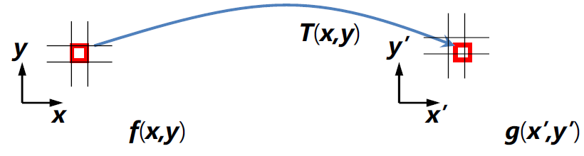
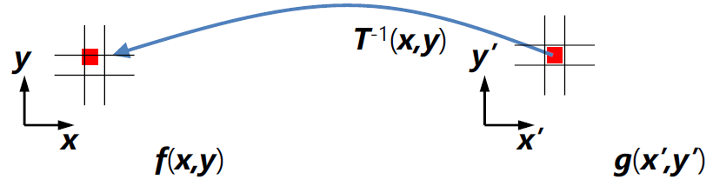
After Transformation: Intensity Interpolation
two possibilities:
forward mapping:
send each source pixel to its target location
inverse mapping:
get each target pixel from its source location
each pixel in original image can contribute to more than one pixel in transformed image
→ can result in holes
each pixel in transformed image can come from more than one pixel in original image
→ resampling from interpolated (filtered) original image

Slide 11

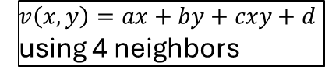
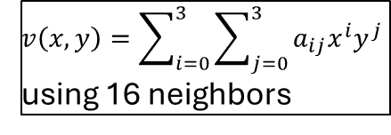
Example: Rotation
nearest-neighbor interpolation:
bilinear interpolation:
bicubic interpolation:
piecewise-polynomial function, aka spline
$$v\left(x,y\right)=ax+by+cxy+d$$
using 4 neighbors
$$v\left(x,y\right)=\sum_{i=0}^{3}{\sum_{j=0}^{3}{a_{ij}x^{i}y^{j}}}$$
using 16 neighbors

Slide 12
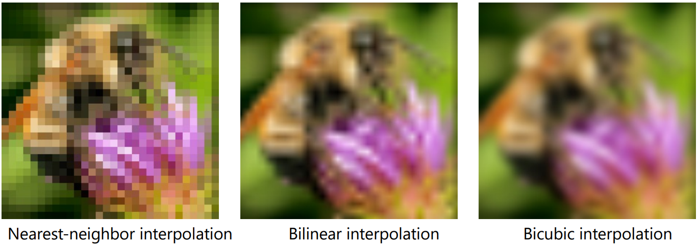

Example: Resizing
scaling means changing image size in terms of number of pixels
(Do not confuse this with pixel size, which depends only on the used display or printer.)
shrinking: sub- or downsampling (pixel deletion)
zooming: upsampling (pixel replication)
original to be upsampled:

Slide 13
Image Alignment

Slide 14
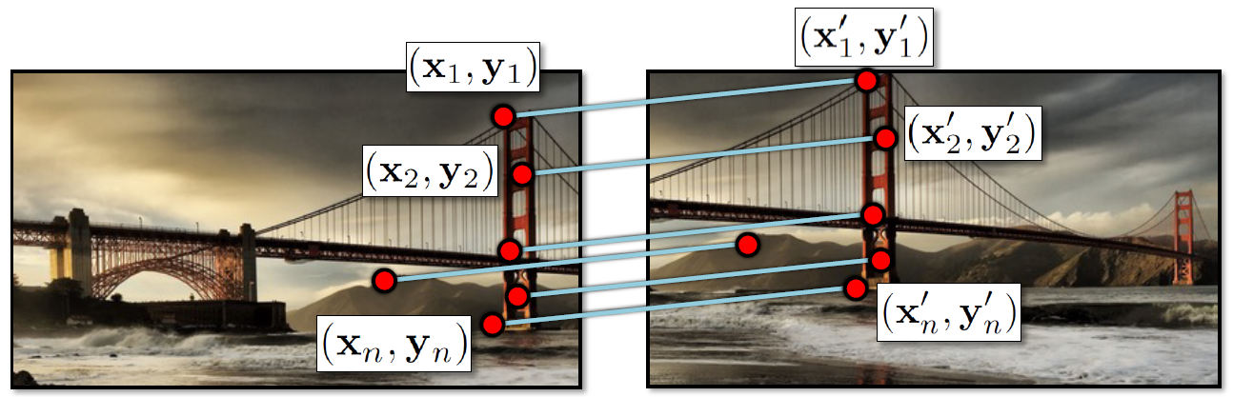
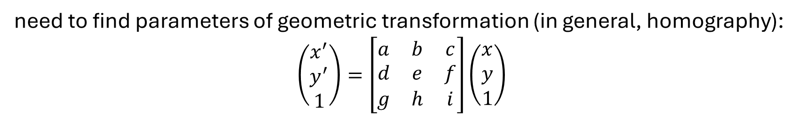
Image Registration
given a set of matches …
need to find parameters of geometric transformation (in general, homography):
$$\left(\begin{matrix}x^{′} \\ y^{′} \\ 1\end{matrix}\right)=\left[\begin{matrix}a & b & c \\ d & e & f \\ g & h & i\end{matrix}\right]\left(\begin{matrix}x \\ y \\ 1\end{matrix}\right)$$

Slide 15
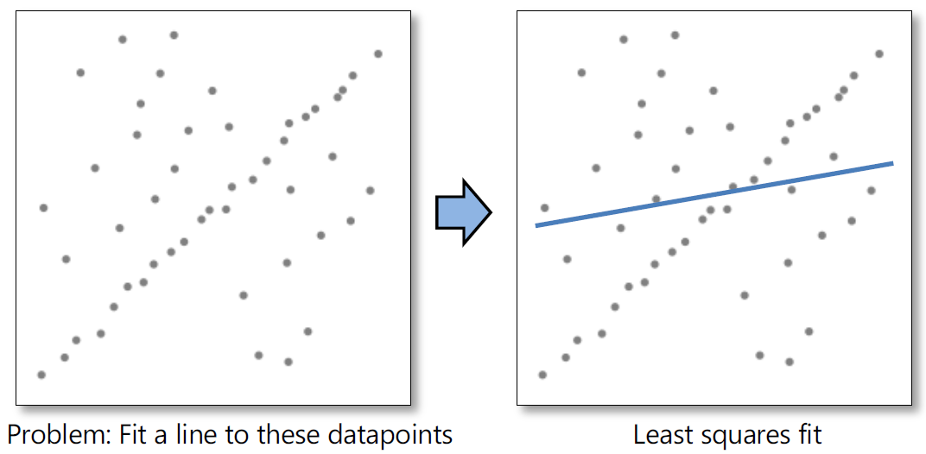
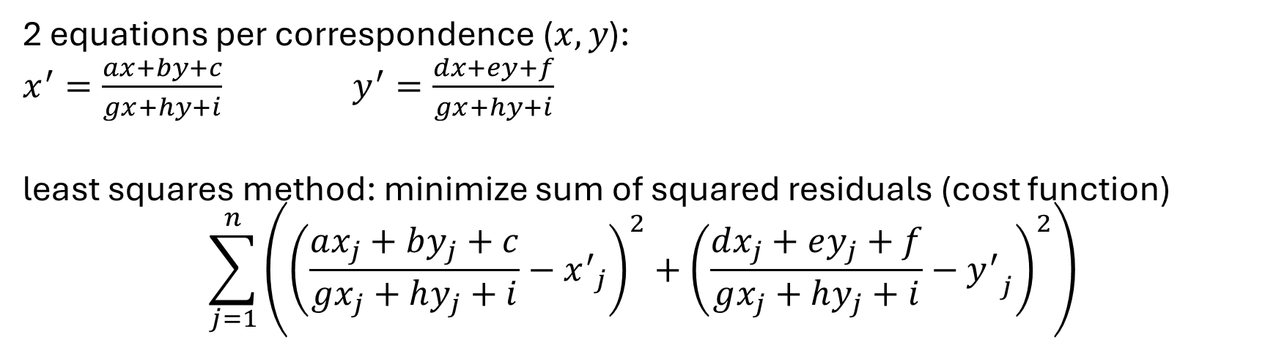
Fitting
2 equations per correspondence ($x,y$):
$x^{′}=\frac{ax+by+c}{gx+hy+i}$ $y^{′}=\frac{dx+ey+f}{gx+hy+i}$
least squares method: minimize sum of squared residuals (cost function)
$$\sum_{j=1}^{n}{\left({\left(\frac{ax_{j}+by_{j}+c}{gx_{j}+hy_{j}+i}−{x^{′}}_{j}\right)}^{2}+{\left(\frac{dx_{j}+ey_{j}+f}{gx_{j}+hy_{j}+i}−{y^{′}}_{j}\right)}^{2}\right)}$$
in general, non-linear
→ numerical (iterative) optimization
problem: typically, there are several outliers (wrong matches)

Slide 16
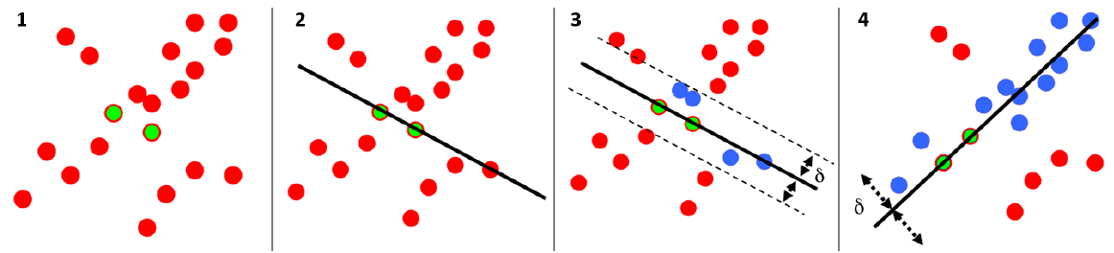
Random Sample Consensus (RANSAC)
alignment requirement: robustness against matched outliers
RANSAC approach:
randomly choose as many samples (i.e., matches) as needed for fit
fit a model to these samples (e.g., linear regression)
count number of inliers approximately fitting this model
repeat and finally choose the model with most inliers

Slide 17
Stereo Vision

Slide 18
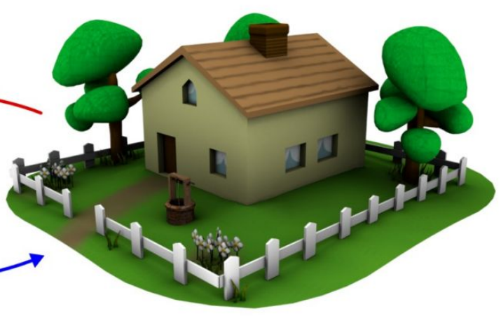
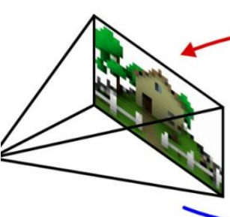
Depth is lost in imaging process.
So, how do we get it back?

Slide 19
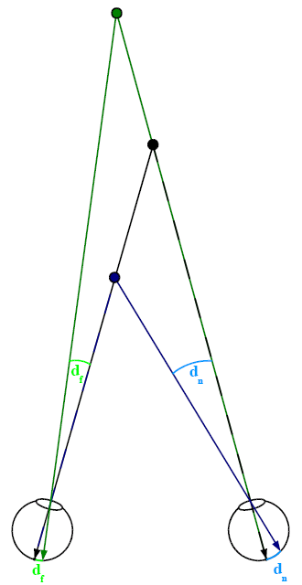
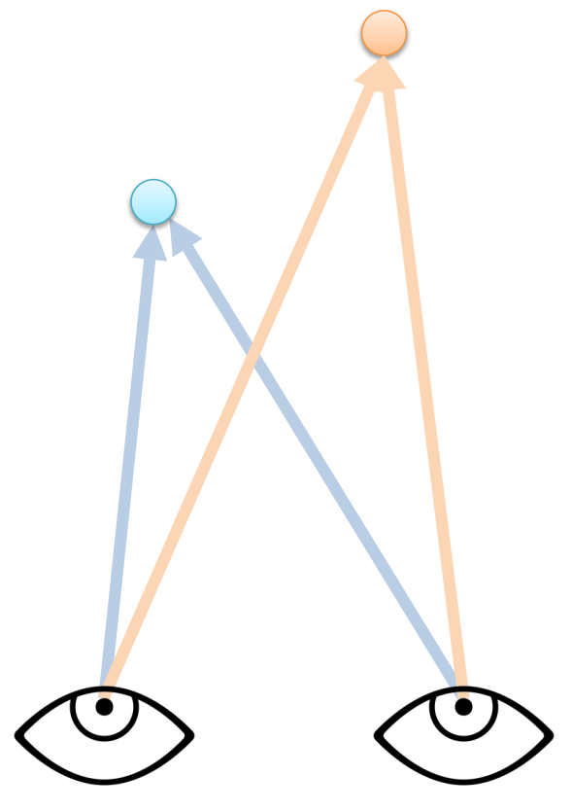
Binocular Disparity
almost all animals have (at least) two eyes
stereo vision:
(at least) two cameras in different views
with matched correspondences for the points for which the depth should be estimated (all pixels for a full depth map)

Slide 20
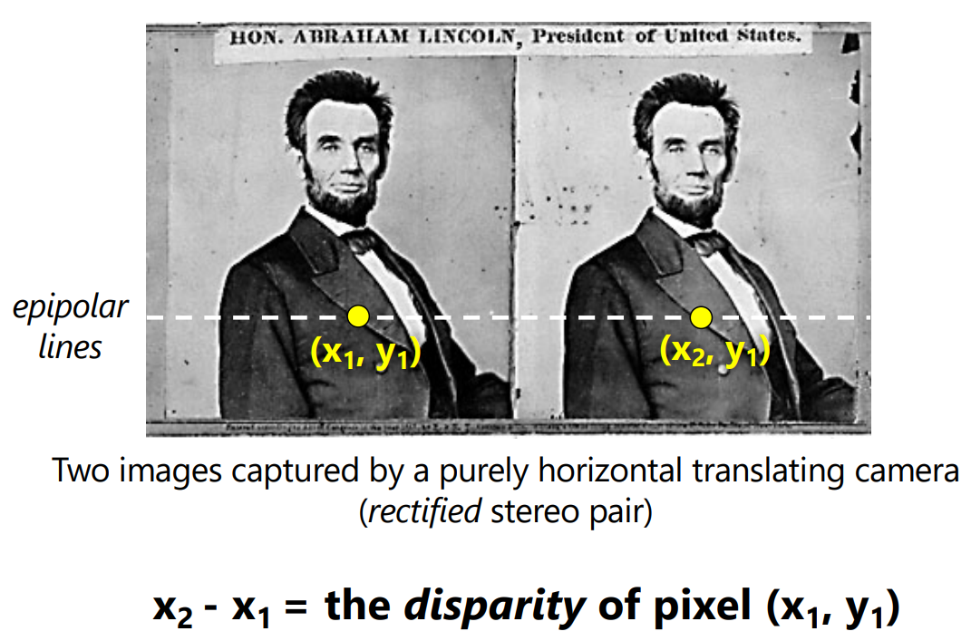

Slide 21
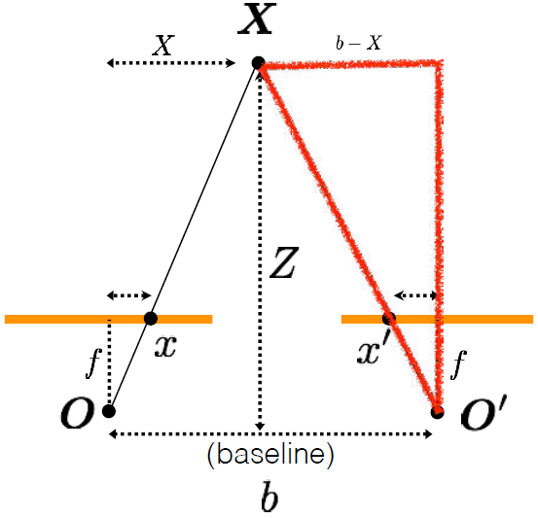
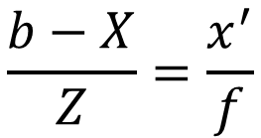
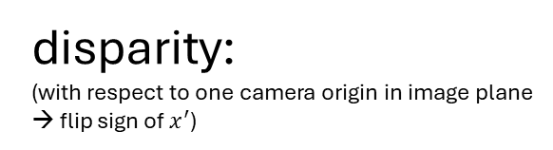
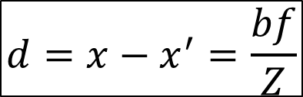
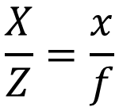
Triangulation
$$\frac{X}{Z}=\frac{x}{f}$$
$$\frac{b−X}{Z}=\frac{x^{′}}{f}$$
$$d={x−x}^{′}=\frac{bf}{Z}$$
→ inverse depth
disparity:
(with respect to one camera origin in image plane
→ flip sign of $x^{′}$)

Slide 22
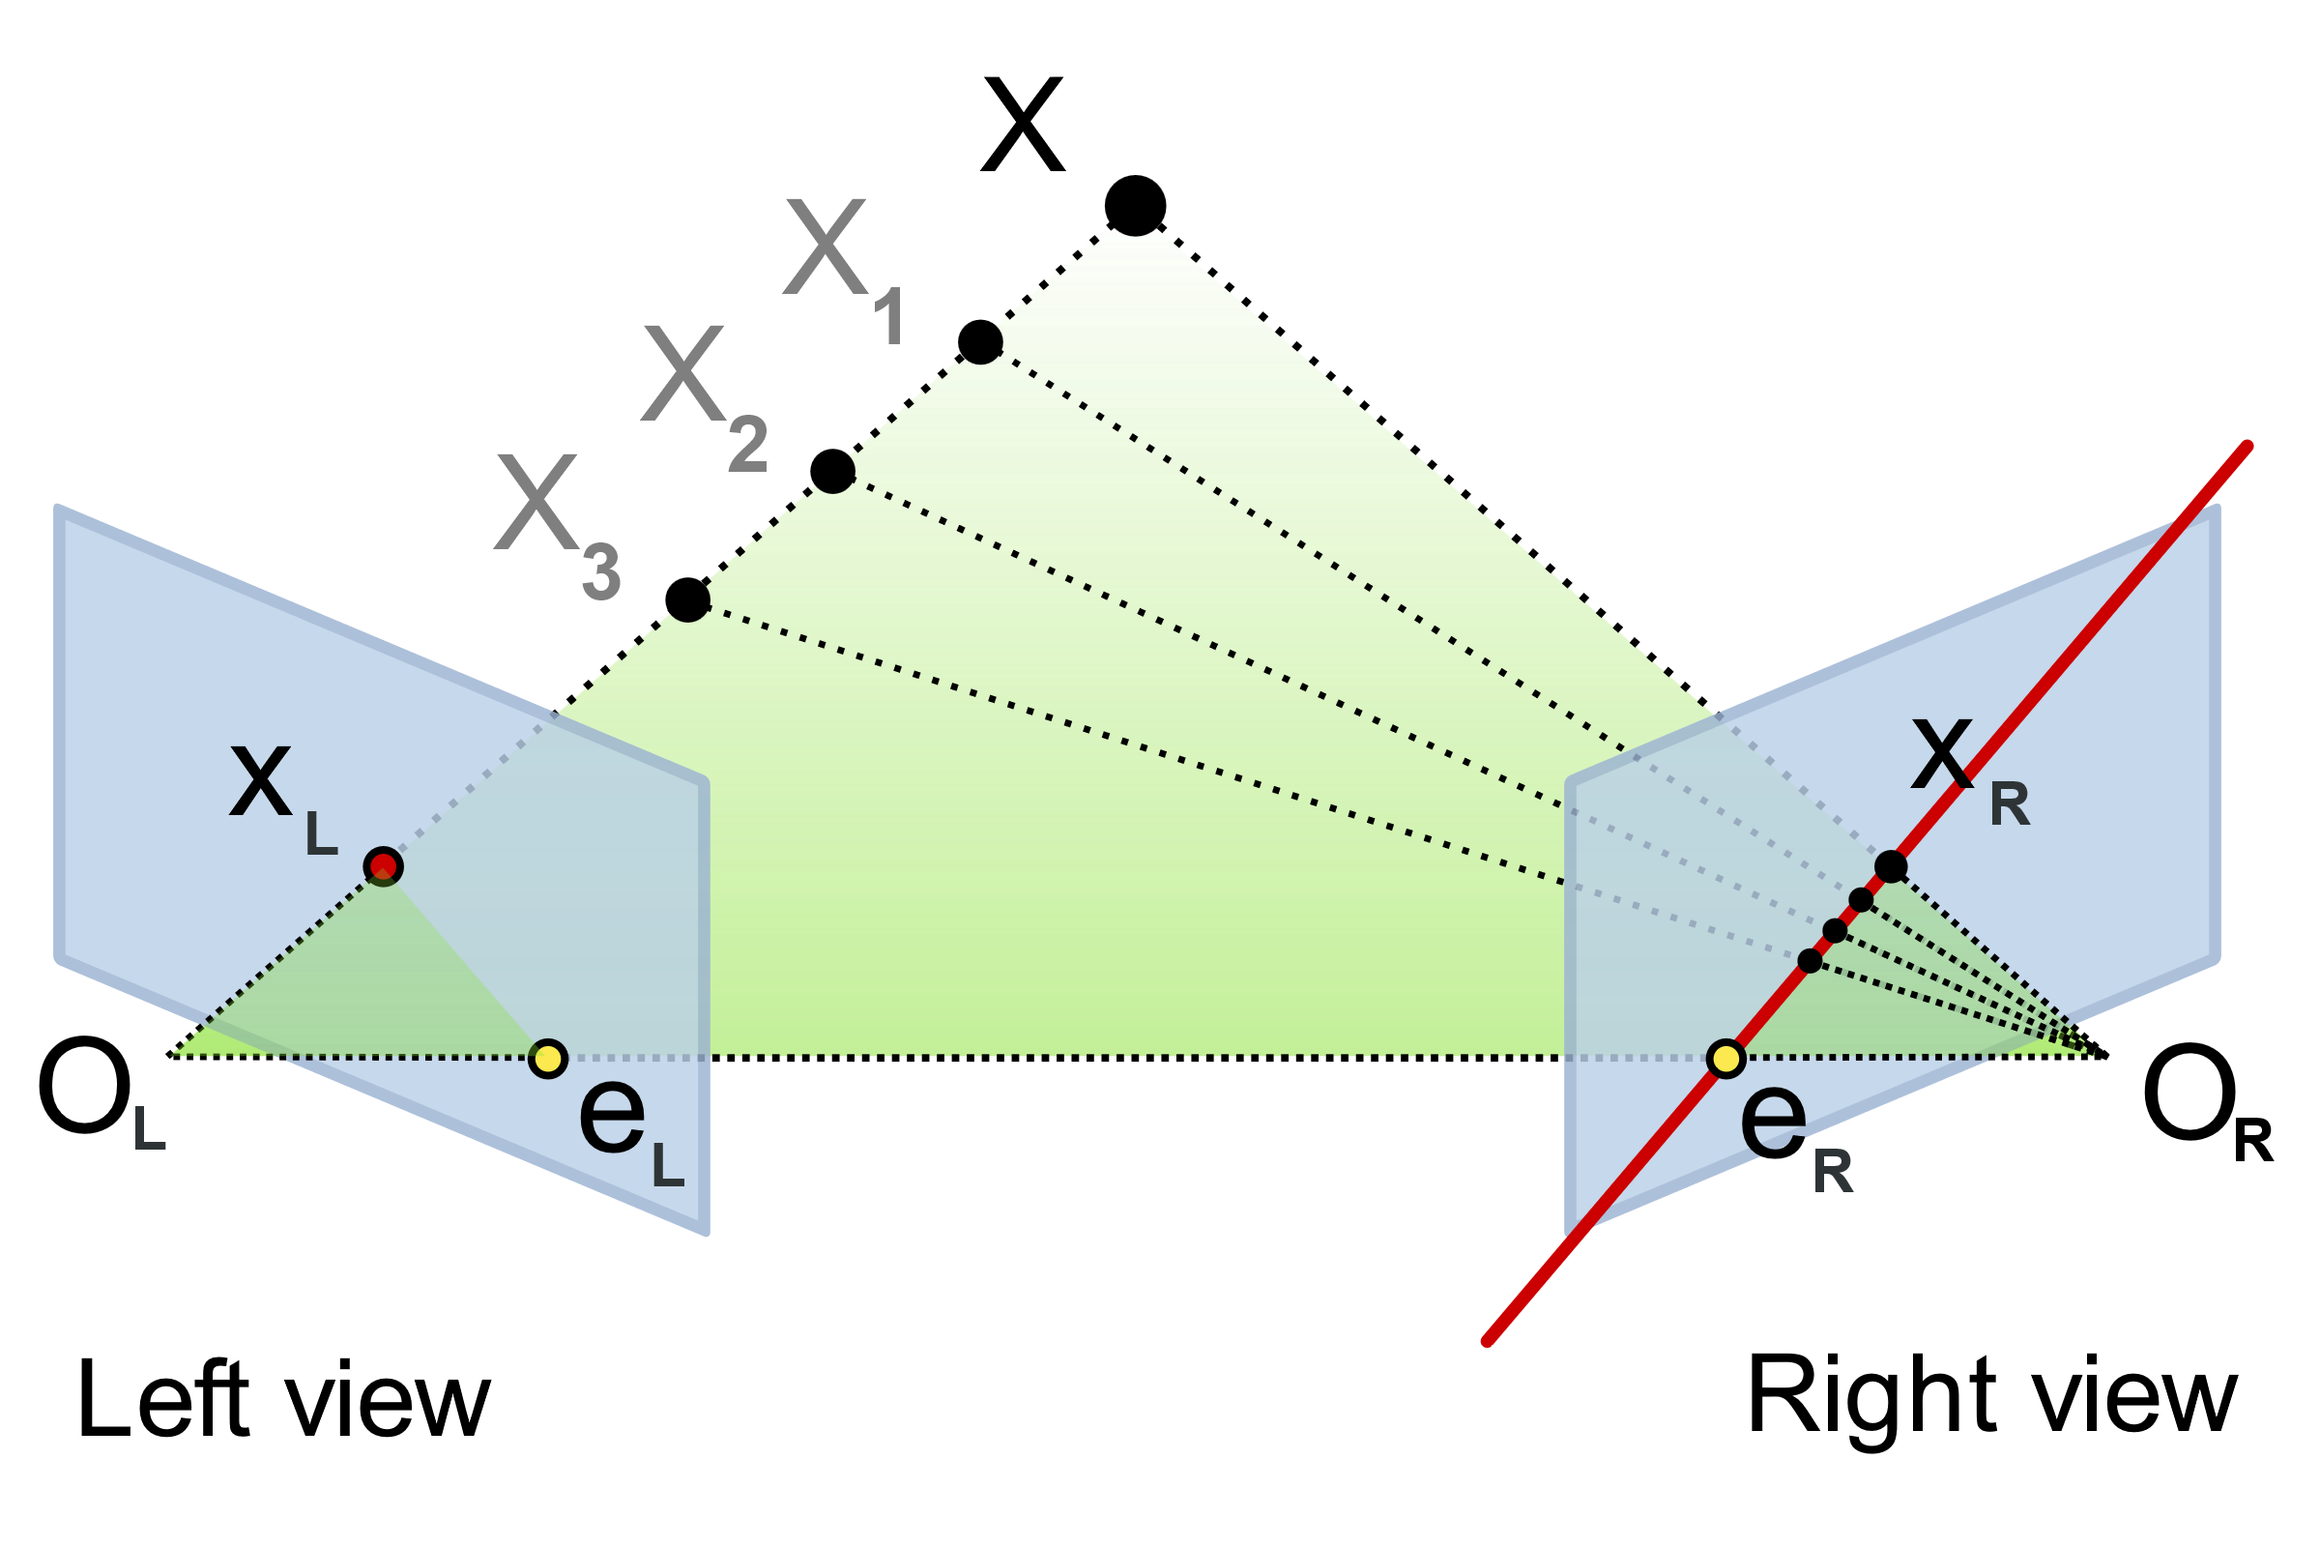
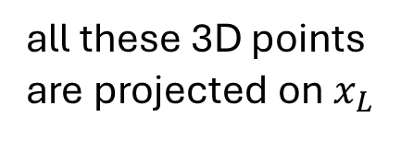
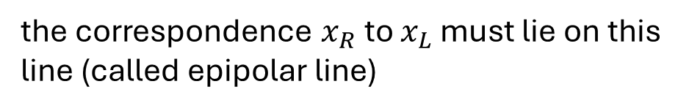
Epipolar Geometry
all these 3D points are projected on $x_{L}$
the correspondence $x_{R}$to $x_{L}$ must lie on this line (called epipolar line)

Slide 23
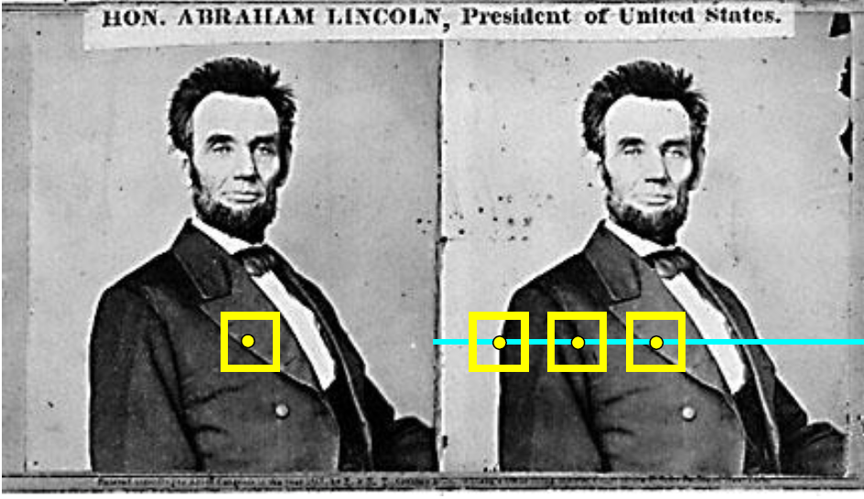
Find Best Match on Epipolar Line
for each pixel …

Slide 24
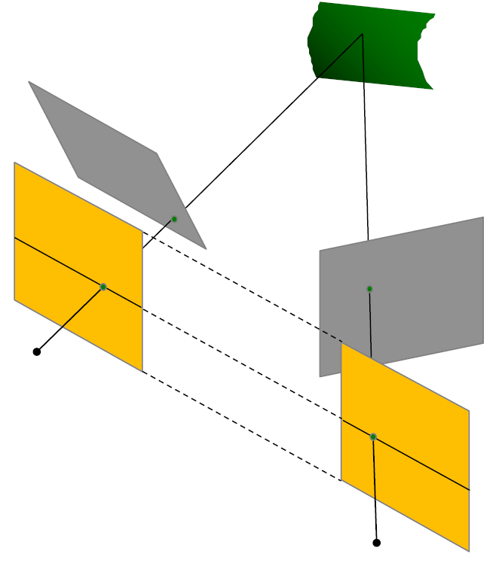
Image Rectification
epipolar lines become horizontal
→ simplifies triangulation process
homographies:

Slide 25
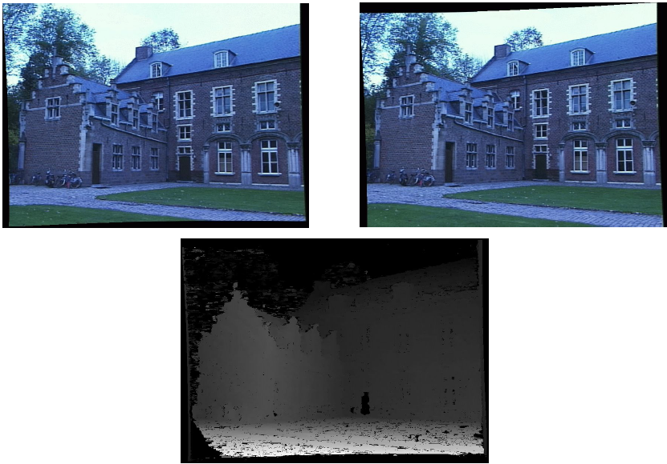
Basic Stereo Matching Pipeline
image rectification
for each pixel in image 1 find correspondence in image 2
calculate depth from disparity
create depth map

Slide 26
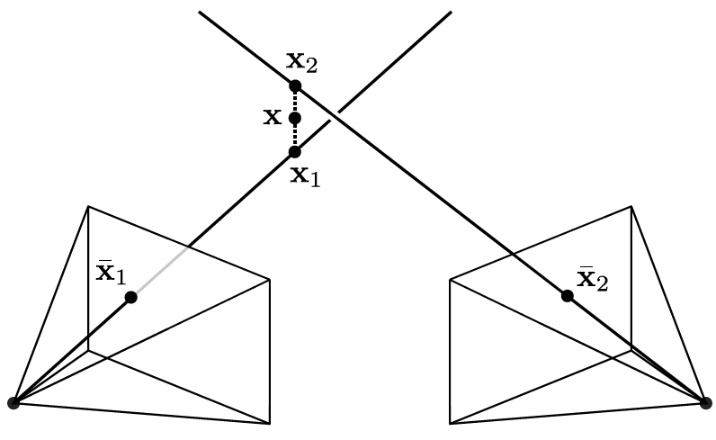
Issue: Noisy Images
might not intersect in one 3D point
→ optimization problem

Slide 27


Prerequisite for Triangulation
focal length ($f$), camera positions (for $b$), and camera coordinate systems (for $d$) need to be known
→ camera calibration
$$Z=\frac{bf}{d}$$

Slide 28
Geometric Camera Calibration

Slide 29
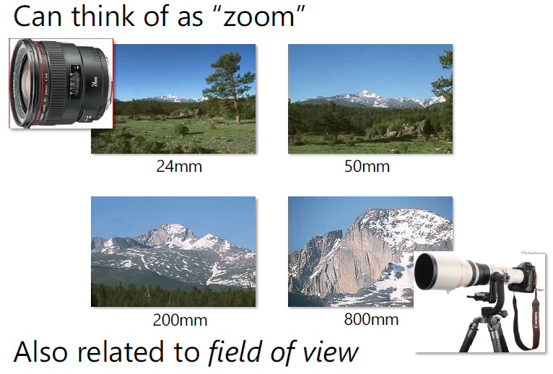
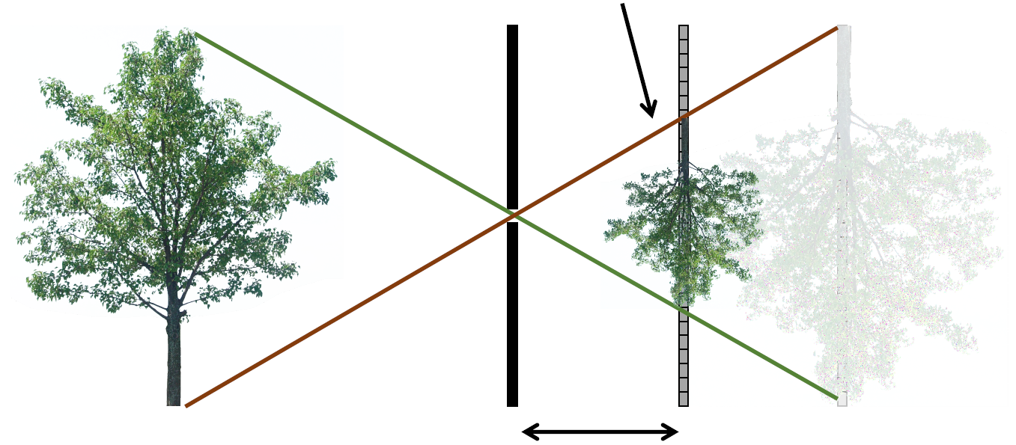
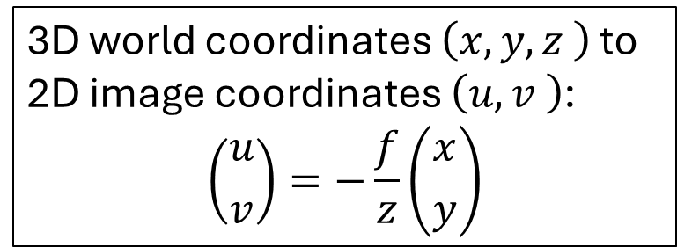
Pinhole Camera Model
focal length:
scaled object projection in image plane
object distance
$$z$$
$$x$$
$$u$$
3D world coordinates $\left(x,y,z \right)$ to 2D image coordinates $\left(u,v \right)$:
$$\left({u \atop v}\right)=−\frac{f}{z}\left({x \atop y}\right)$$
focal length
$$f$$

Slide 30
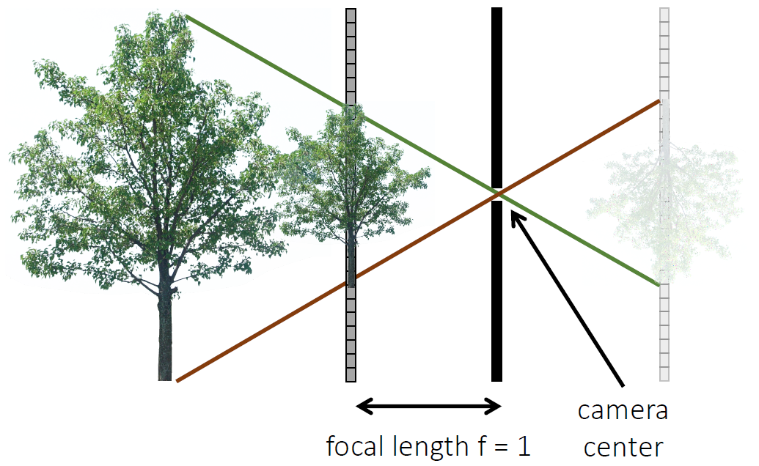

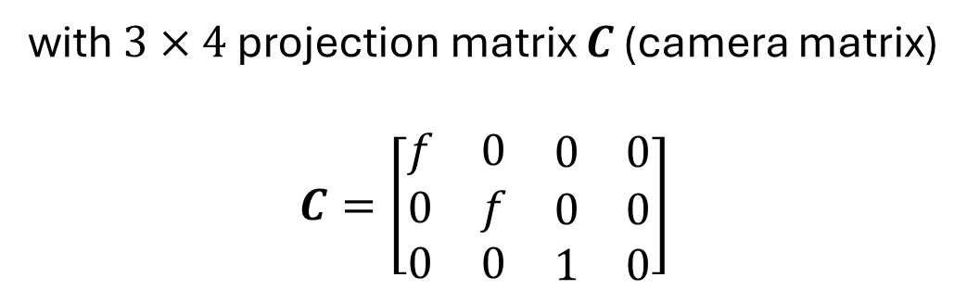
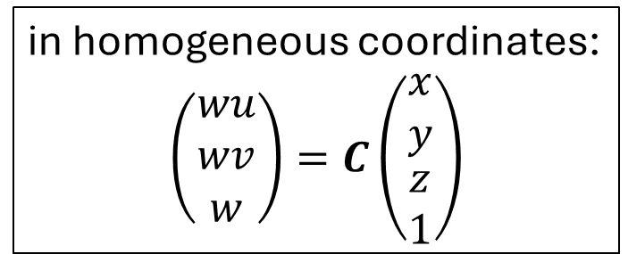
Rearranged Pinhole Camera Setup
in homogeneous coordinates:
$$\left(\begin{matrix}wu \\ wv \\ w\end{matrix}\right)=C\left(\begin{matrix}x \\ y \\ \begin{matrix}z \\ 1\end{matrix}\end{matrix}\right)$$
with $3×4$ projection matrix $C$ (camera matrix)
$$C=\left[\begin{matrix}f & 0 & \begin{matrix}0 & 0\end{matrix} \\ 0 & f & \begin{matrix}0 & 0\end{matrix} \\ 0 & 0 & \begin{matrix}1 & 0\end{matrix}\end{matrix}\right]$$
$$f$$
in general 11 degrees of freedom

Slide 31
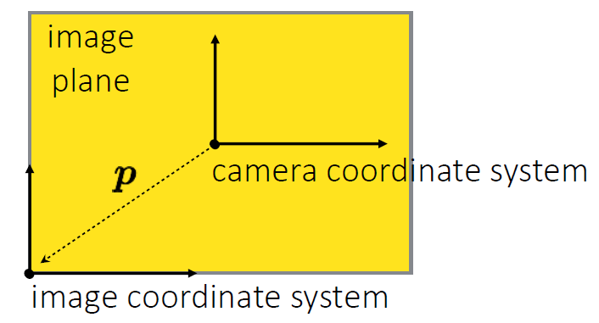




Generalized Camera Intrinsics
more potential generalizations:
pixels may not be square (aspect ratio $α$)
sensor may be skewed ($γ$)
$$\left({u_{0} \atop v_{0}}\right)$$
$$C=\left[\begin{matrix}f & γ & \begin{matrix}u_{0} & 0\end{matrix} \\ 0 & αf & \begin{matrix}v_{0} & 0\end{matrix} \\ 0 & 0 & \begin{matrix} 1 & 0\end{matrix}\end{matrix}\right]$$
→ $C=\left[\begin{matrix}f & 0 & \begin{matrix}u_{0} & 0\end{matrix} \\ 0 & f & \begin{matrix}v_{0} & 0\end{matrix} \\ 0 & 0 & \begin{matrix} 1 & 0\end{matrix}\end{matrix}\right]$

Slide 32


Decomposition of Camera Matrix
$$C=K\left[R|t\right]$$
$$C=\left[\begin{matrix}f & γ & u_{0} \\ 0 & αf & v_{0} \\ 0 & 0 & 1\end{matrix}\right]\left[\begin{matrix}r_{1} & r_{2} & r_{3} \\ r_{4} & r_{5} & r_{6} \\ r_{7} & r_{8} & r_{9}\end{matrix} \begin{matrix} { t}_{1} \\ { t}_{2} \\ { t}_{3}\end{matrix}\right]$$
camera pose:
3D translation (origin of world in camera coordinates)
3 parameters
intrinsic parameters
(camera-to-image transformation)
extrinsic parameters
(world-to-camera transformation)
3D rotation (camera orientation)
3 parameters (rotation angles)
5 parameters

Slide 33



Estimation of Camera Parameters
typically via images of known calibration target (e.g., checkerboard)
one alternative: use of vanishing points
both known
$$C$$

Slide 34

Pose Estimation = Inverse Triangulation

Slide 35

Structure from Motion
uncalibrated stereo: simultaneous calculation of both 3D locations and camera poses (typically using many images)
reprojection error
application: Visual SLAM (camera poses from video)

Slide 36
Alternatives for Depth Estimation

Slide 37



Not All Animals See Stereo
stereopsis: depth perception through binocular disparity
stereoblind: need to use motion parallax for depth perception
(wide field of view to spot predators)
→ move the camera, find matching correspondences

Slide 38


Active Depth Sensors
structured light
time-of-flight
( )
e.g., Kinect RGBD cameras

Slide 39


Shape from X
shape from shading and photometric stereo
shape from texture
shape from focus
humans:
using also perspective effects and familiar objects in scene

