Slide 1
Introduction
Computer Vision

Slide 2
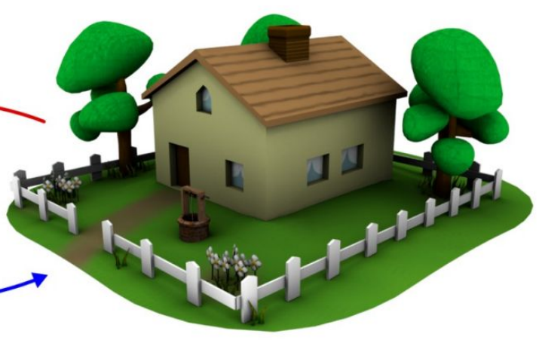
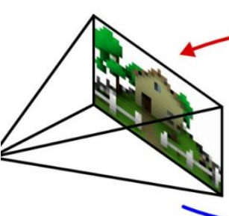
Goal of Computer Vision
extract semantic information from digital image data
to be used for decision making support or automated systems
challenging problem:
images are only 2D projections of the 3D world
nowadays heavily powered by artificial intelligence (AI), especially machine learning (ML)

Slide 3
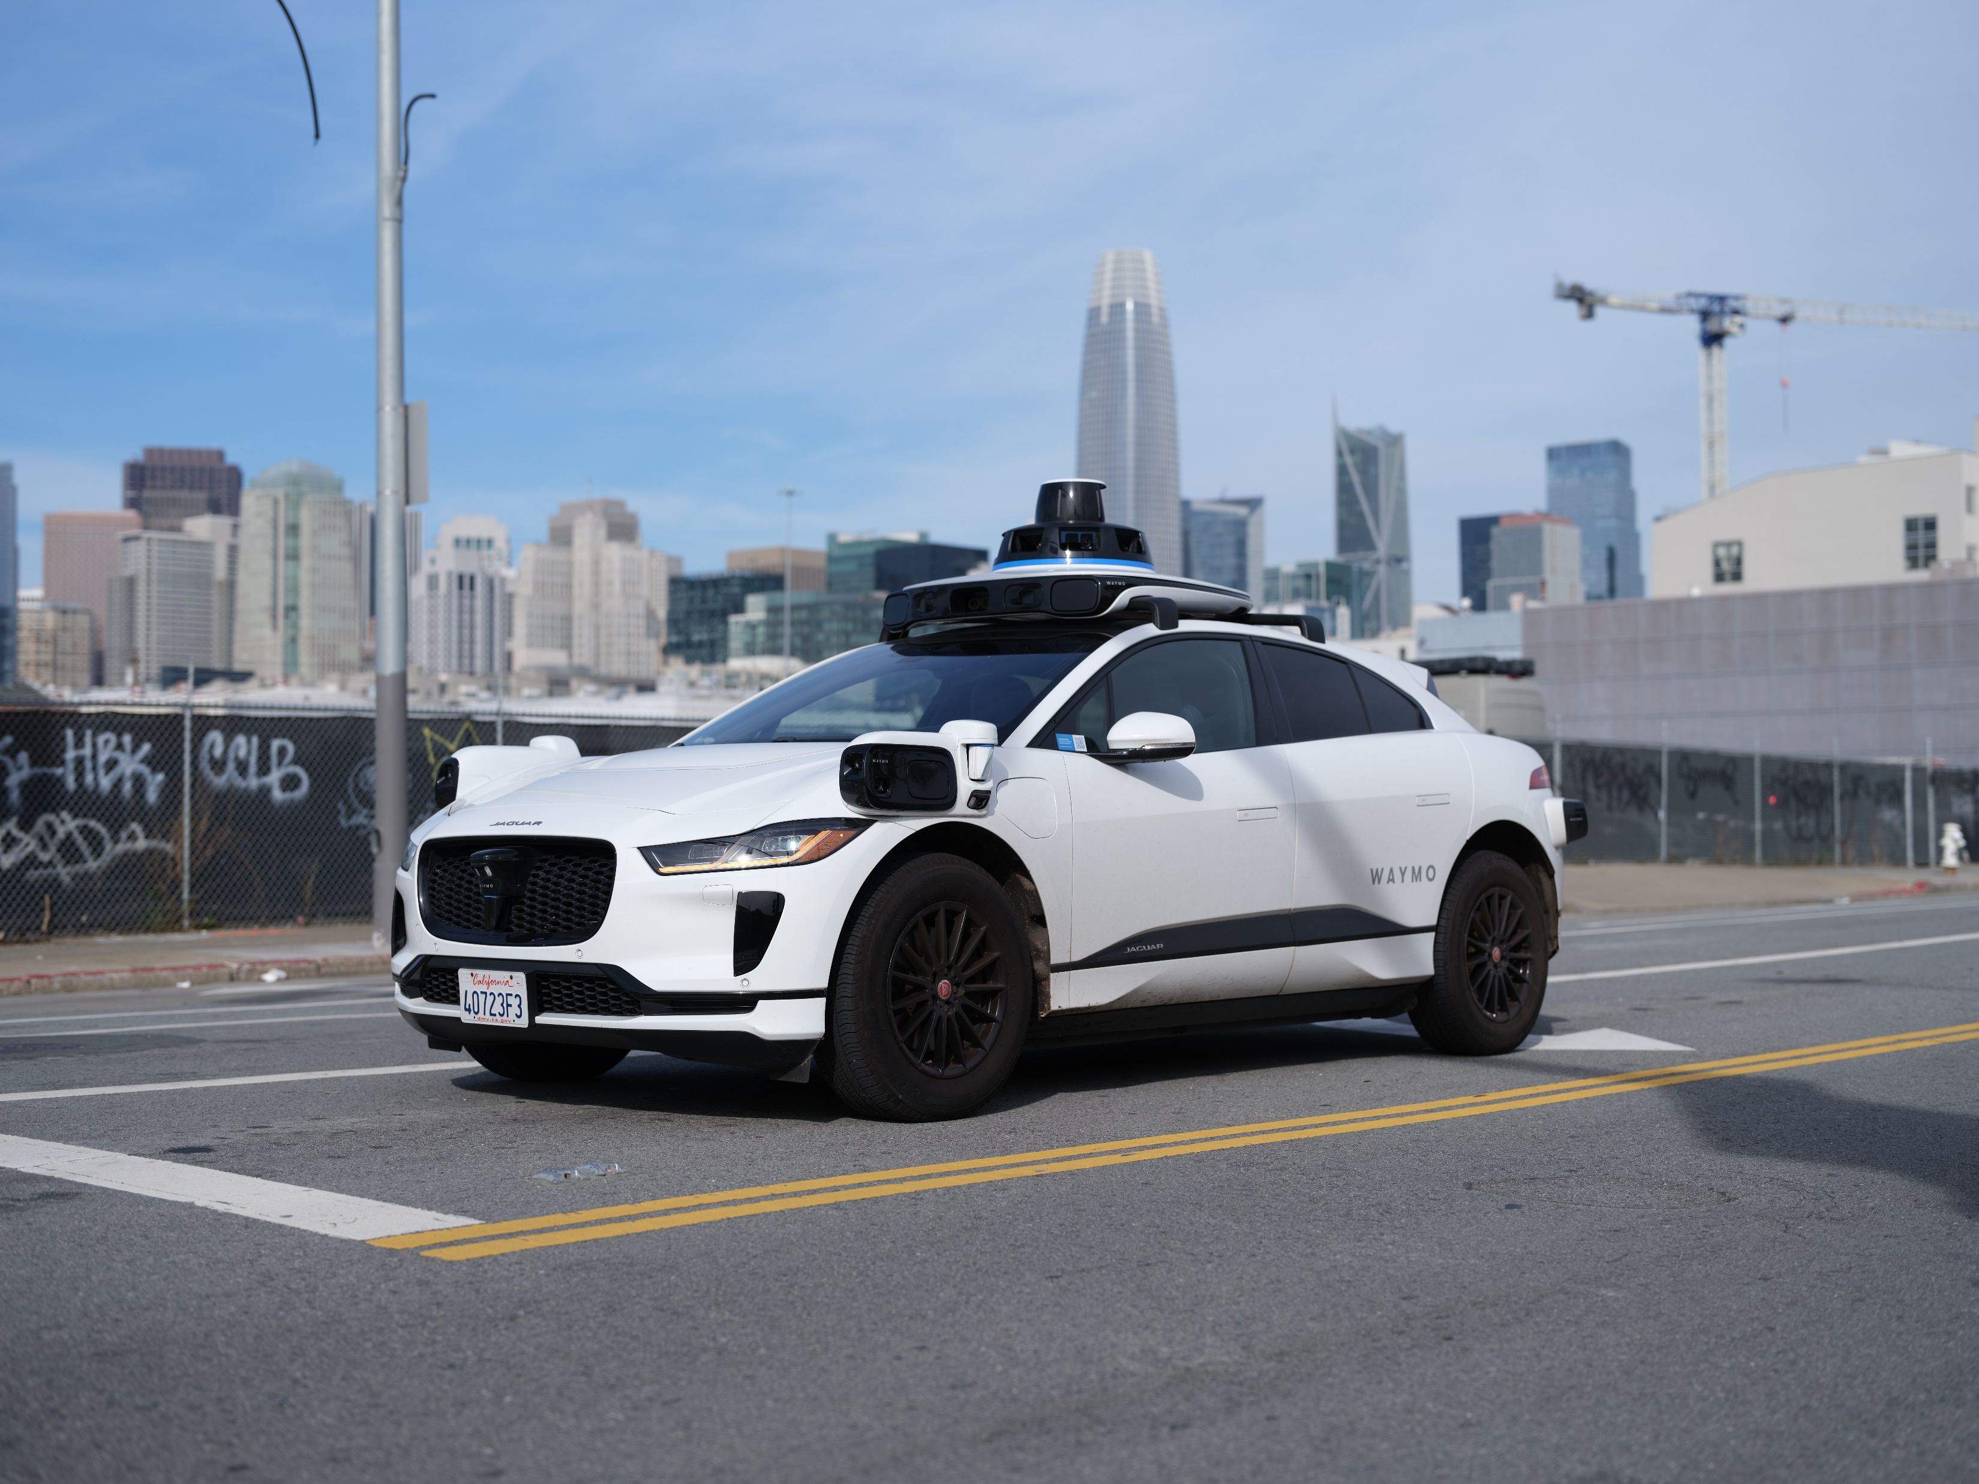
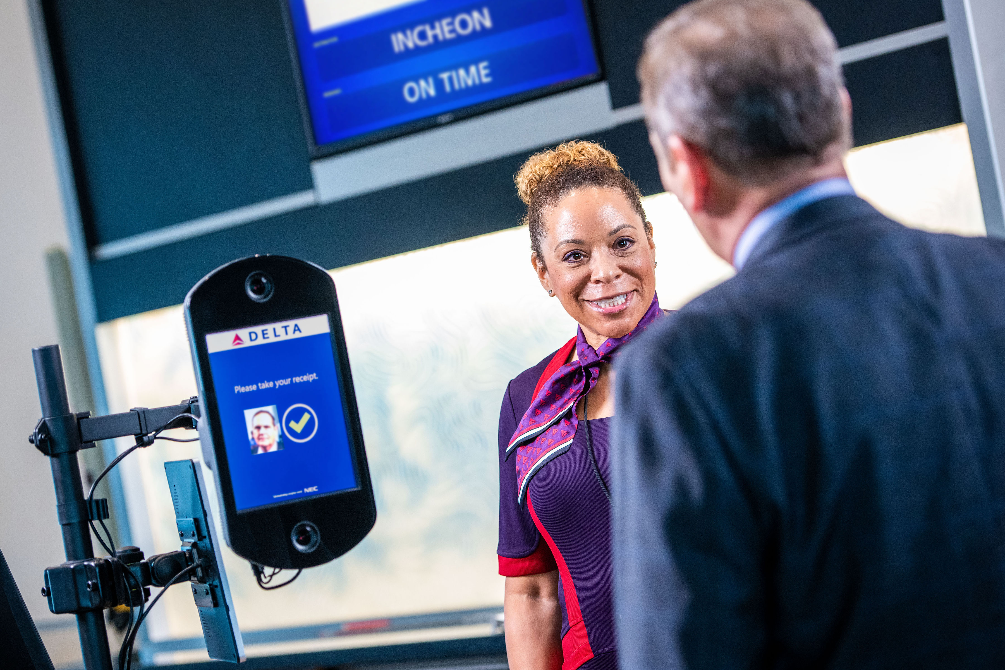
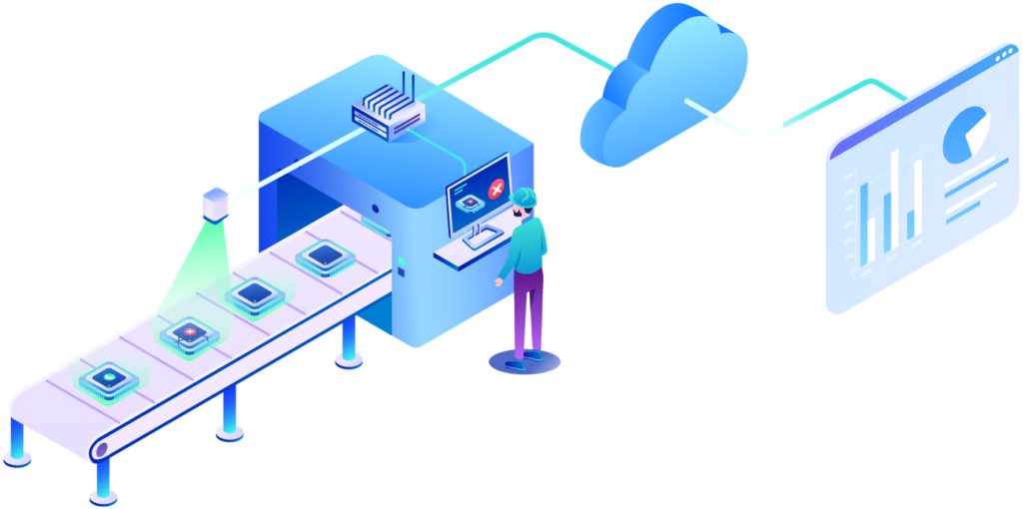
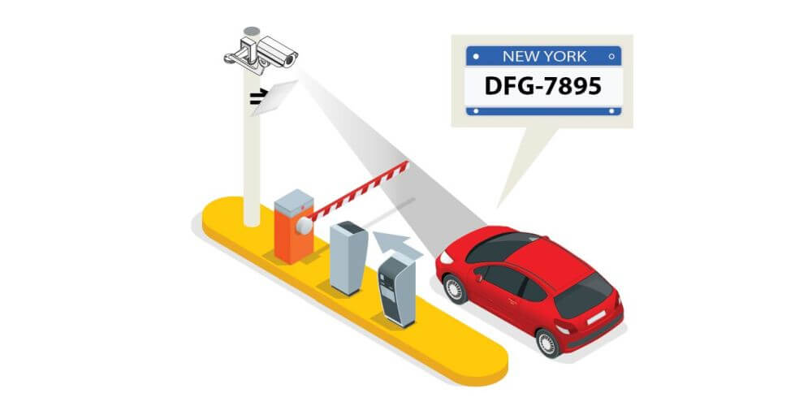
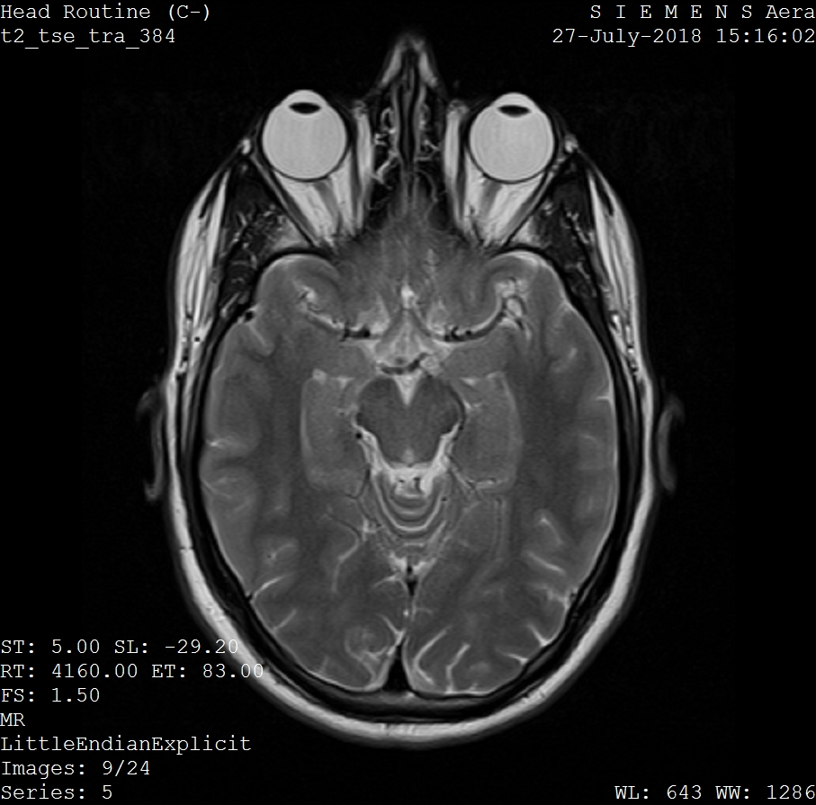
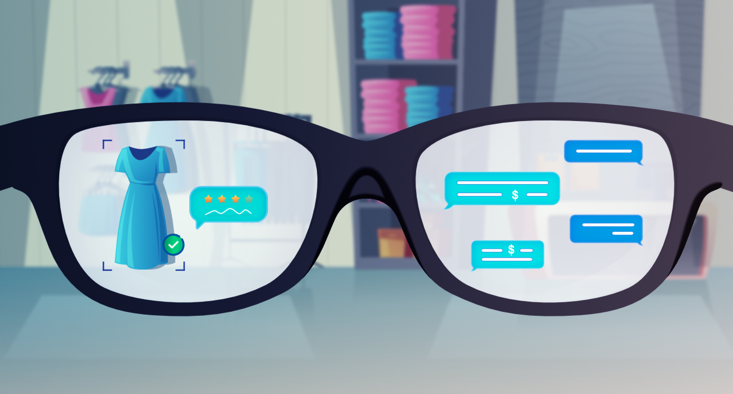
Applications of Computer Vision
autonomous driving
facial recognition
automated inspection
medical imaging
optical character recognition
augmented reality
and many more …

Slide 4
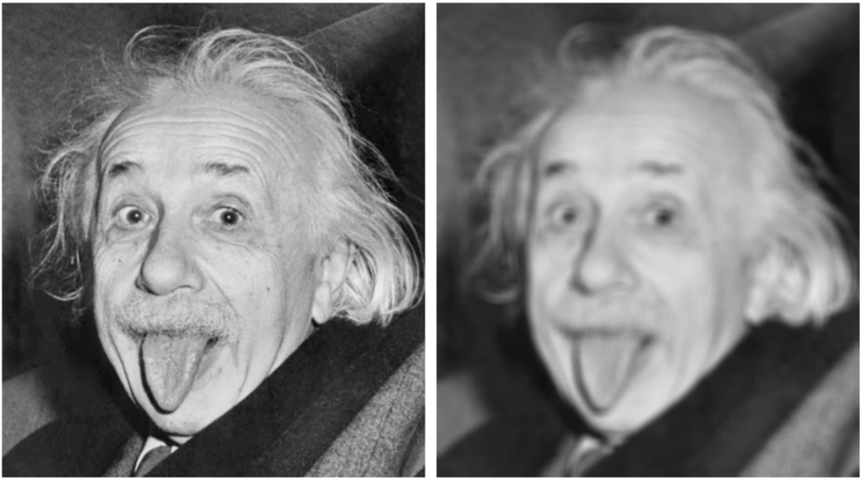
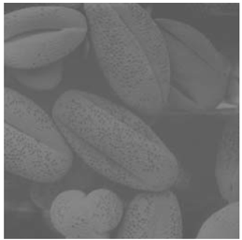
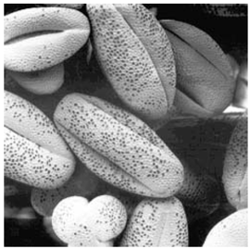
Image Processing
transformations from image to image
(such as scaling, smoothing, sharpening, or contrast stretching)
to facilitate either machine perception or just human interpretation

Slide 5
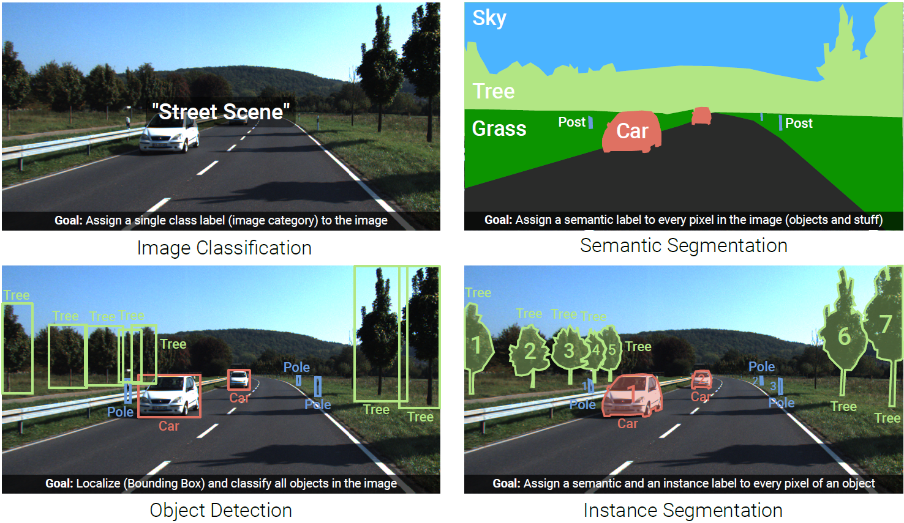
Image Understanding (Recognition)

Slide 6
Course Schedule
Digital Image Processing image formation, intensity transformations, compression, spatial filtering, Fourier transform, aliasing, image pyramids
Edges and Features Canny & Marr-Hildreth edge detectors, Hough transform, feature detection (Harris corner detector) and description (SIFT), feature matching, eigenfaces
Projective Geometry geometric transformations, image alignment, stereo vision, camera calibration
Image Classification supervised learning, linear regression, bias-variance tradeoff, neural networks, convolutional neural networks, transfer learning, transformers (language models, ViT, DINO, CLIP)
Segmentation and Detection semantic segmentation, object detection (R-CNN, YOLO), object tracking, instance segmentation, promptable segmentation
Image Synthesis generative models, GAN, VAE, diffusion

Slide 7
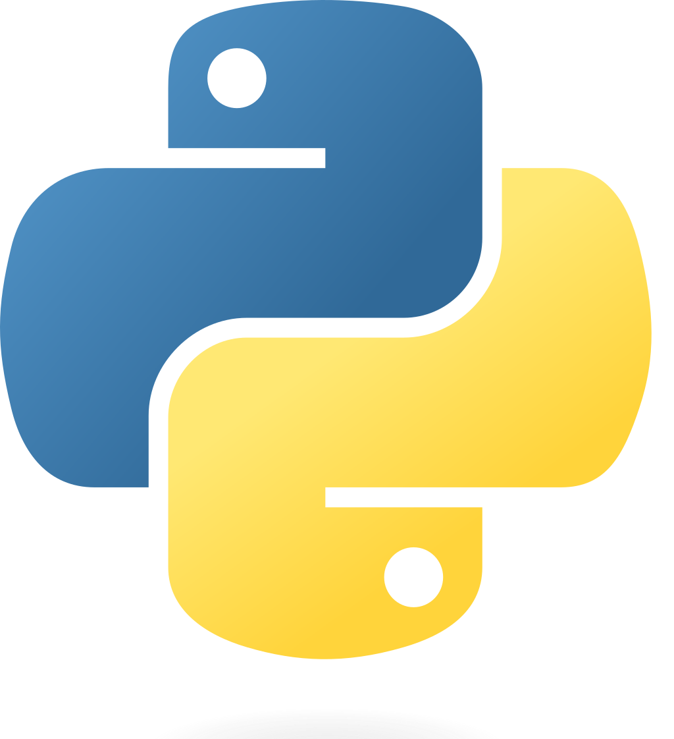


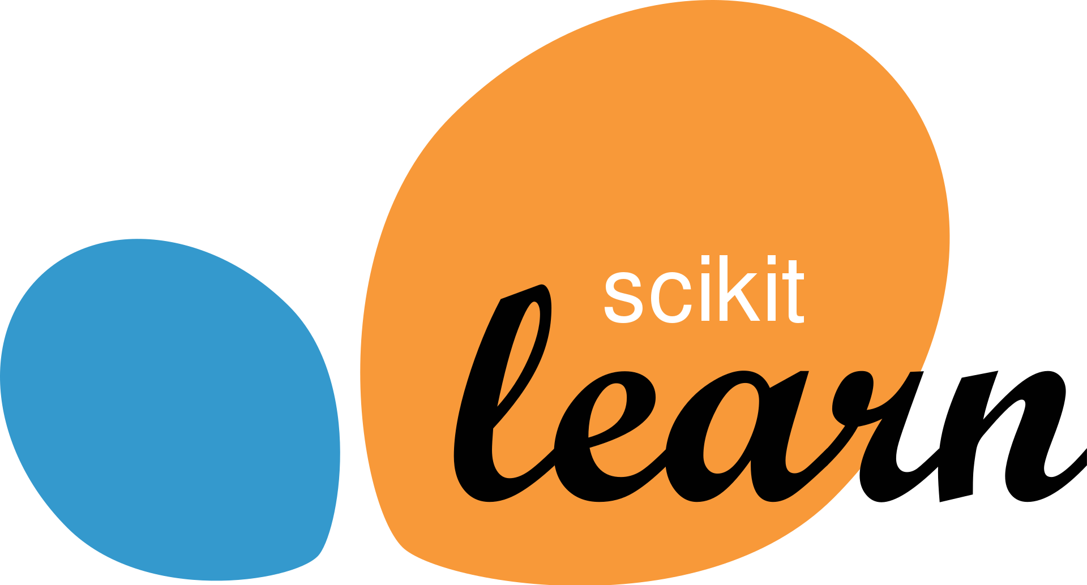
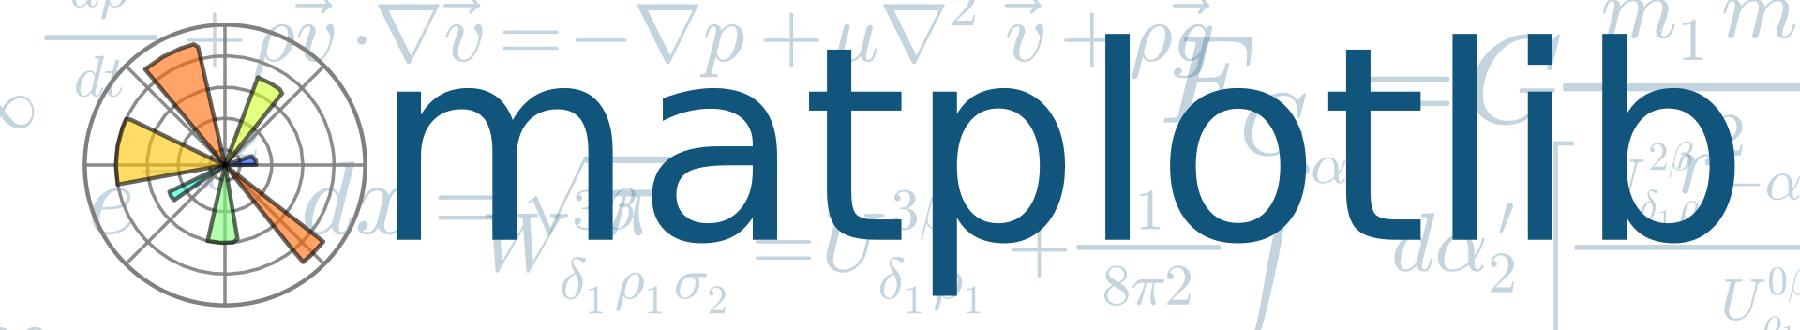
Used Programming Language: Python
good compromise between rapid prototyping and production
vast ecosystem
very popular for data processing and ML: scientific Python stack

Slide 8



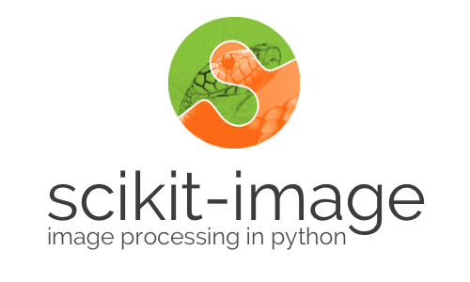
Used Python Libraries
computer vision:
deep learning:

Slide 9
Programming Environments
locally, best use
a virtual environment to flexibly install packages (e.g., venv)
an IDE of your choice (e.g., VS Code)
both plain Python files or Jupyter notebooks are fine
but cloud-based environments also fine (e.g., Google Colab)

Slide 10
Literature
Computer Vision: Algorithms and Applications
Digital Image Processing, Gonzales & Woods
Deep Learning
The Little Book of Deep Learning
Understanding Deep Learning

