Slide 1
Digital Image Processing
Computer Vision

Slide 2
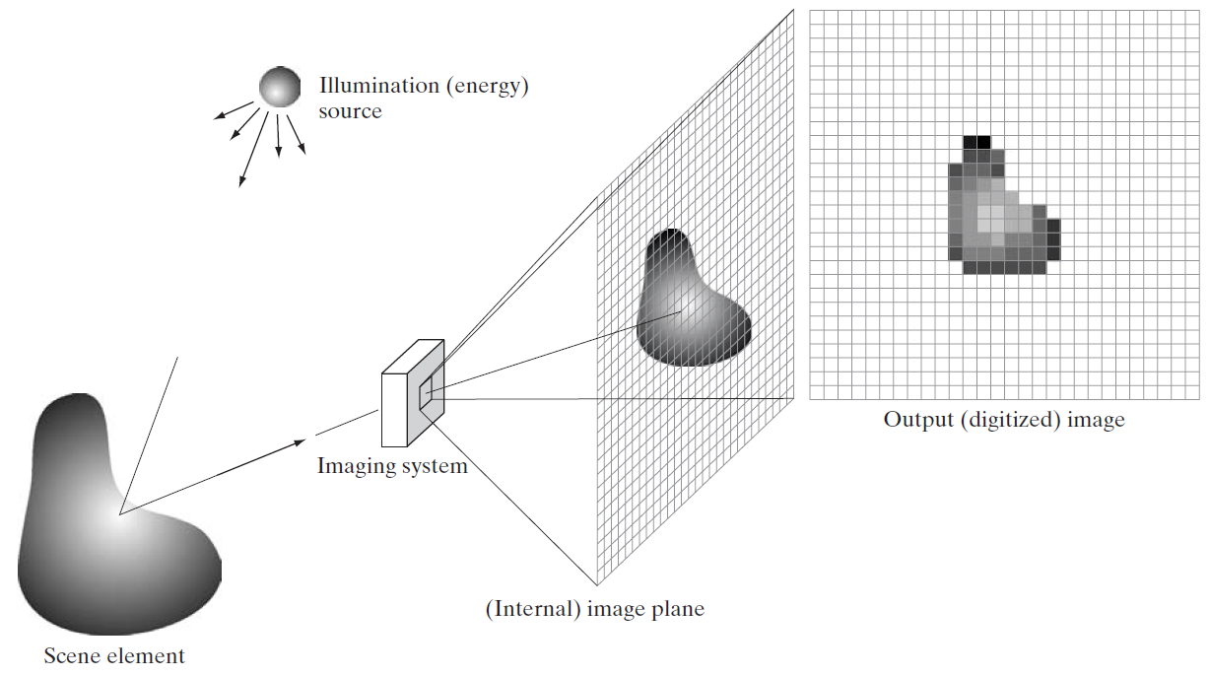
Digital Image Acquisition Process
e.g., lens to focus light on image plane
reflection or absorption (e.g., X-rays) of energy

Slide 3
Energy Sources

Slide 4
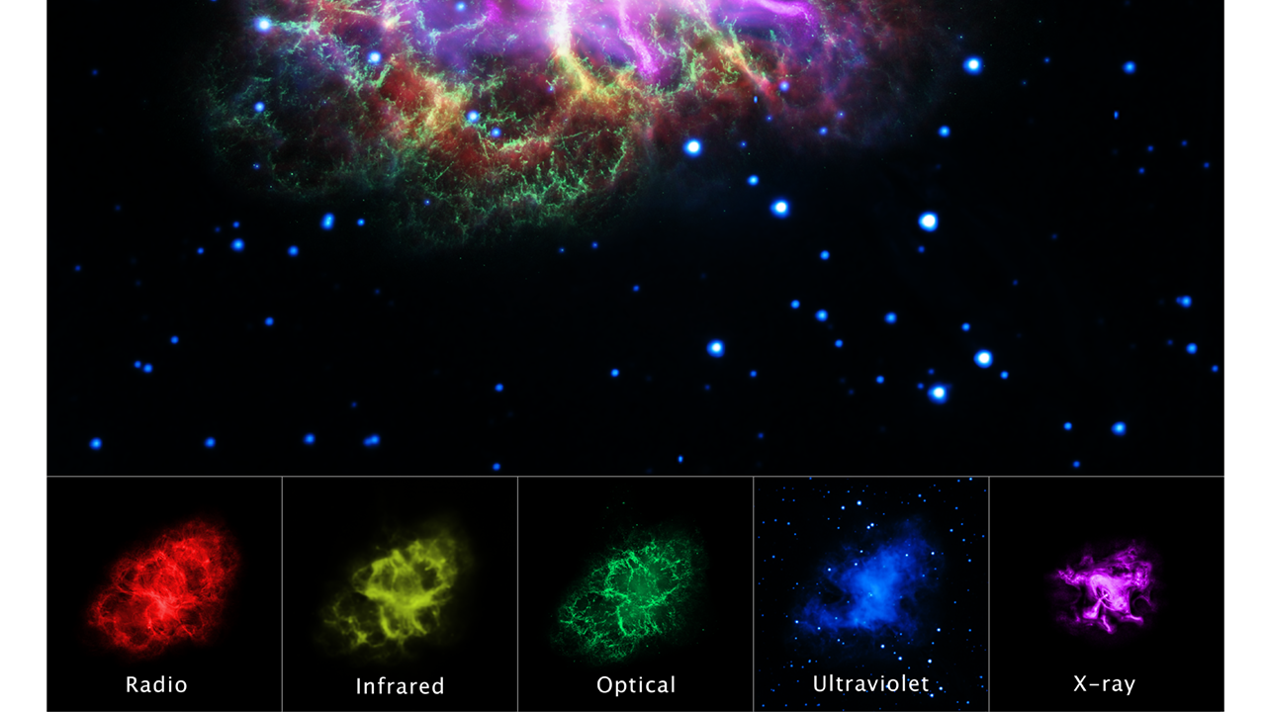
Electromagnetic Spectrum
examples:
visible band: digital camera
microwaves: radar
X-rays: computed tomography (CT)
radio band: magnetic resonance imaging (MRI)
gamma rays: positron emission tomography (PET)
Crab Nebula in multiple wavelengths
source

Slide 5
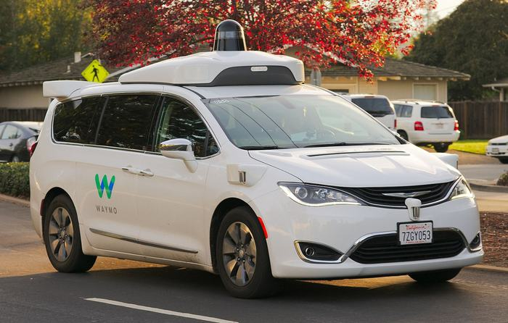

Lidar vs Cameras for Self-Driving Cars
Lidar:
similar to radar, but using lasers
very accurate
camera:
human-like perception
cost-effective

Slide 6
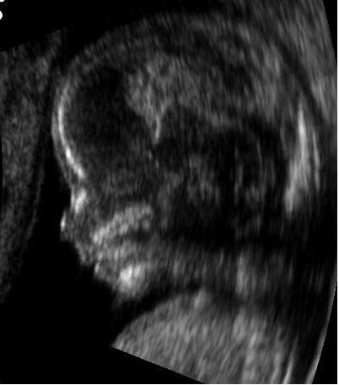
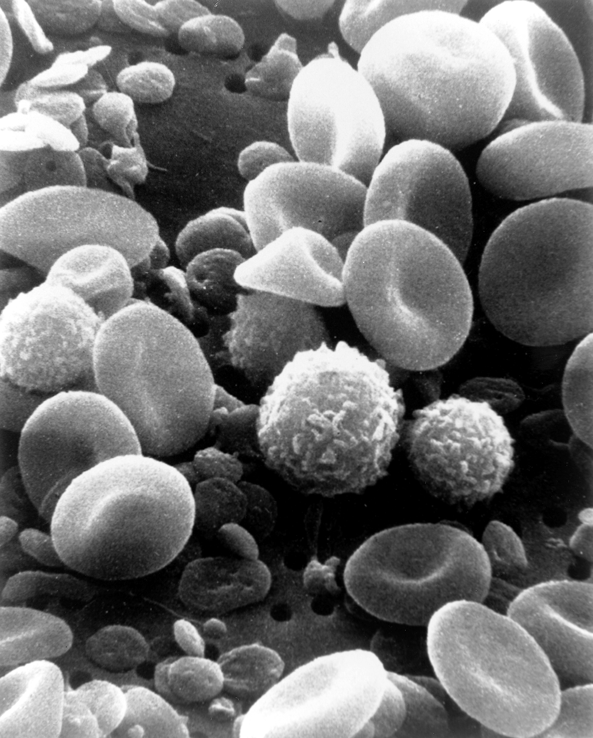
Examples for other Energy Sources
ultrasound
electron beams (electron microscopy)

Slide 7
Image Formation

Slide 8
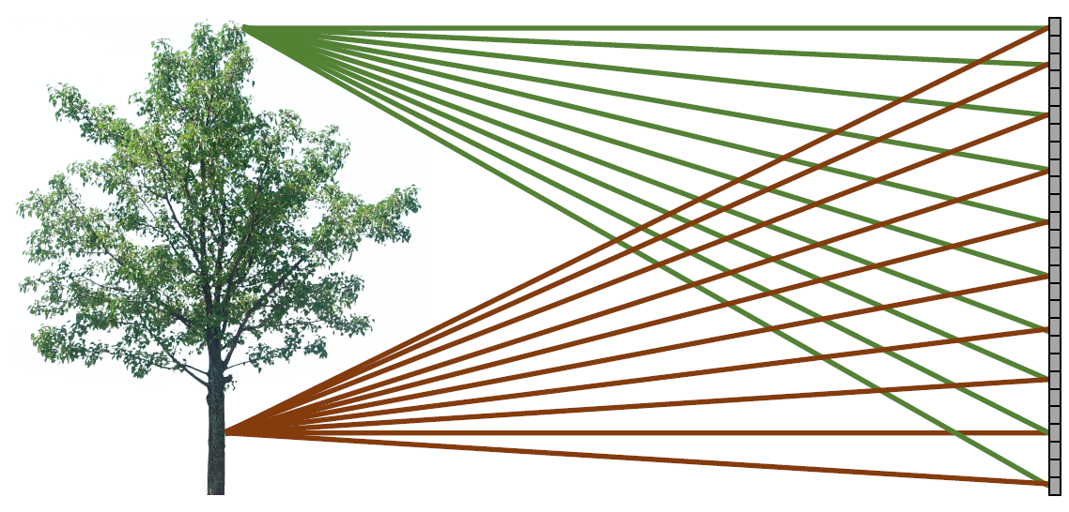

Bare-Sensor Imaging
digital sensor
all scene points contribute to all sensor pixels:
image plane

Slide 9
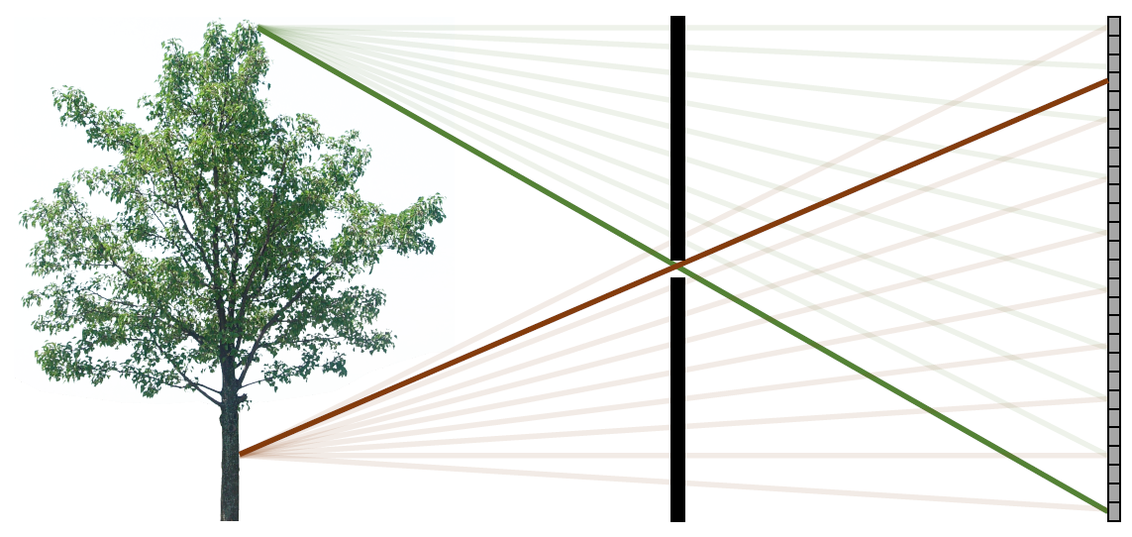
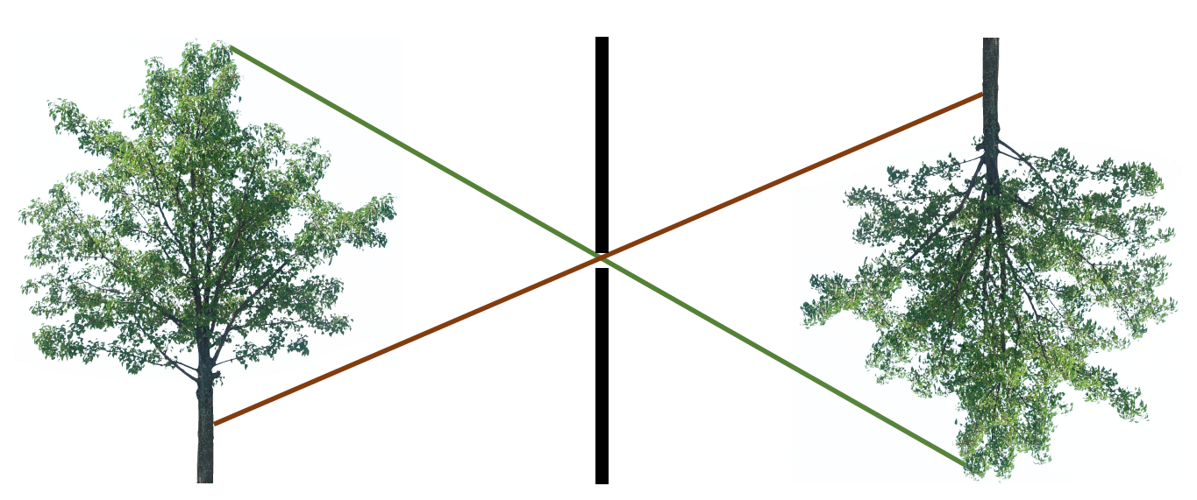
Pinhole Camera
camera: barrier with pinhole (aperture)
camera obscura
each scene point contributes to one pixel only

Slide 10
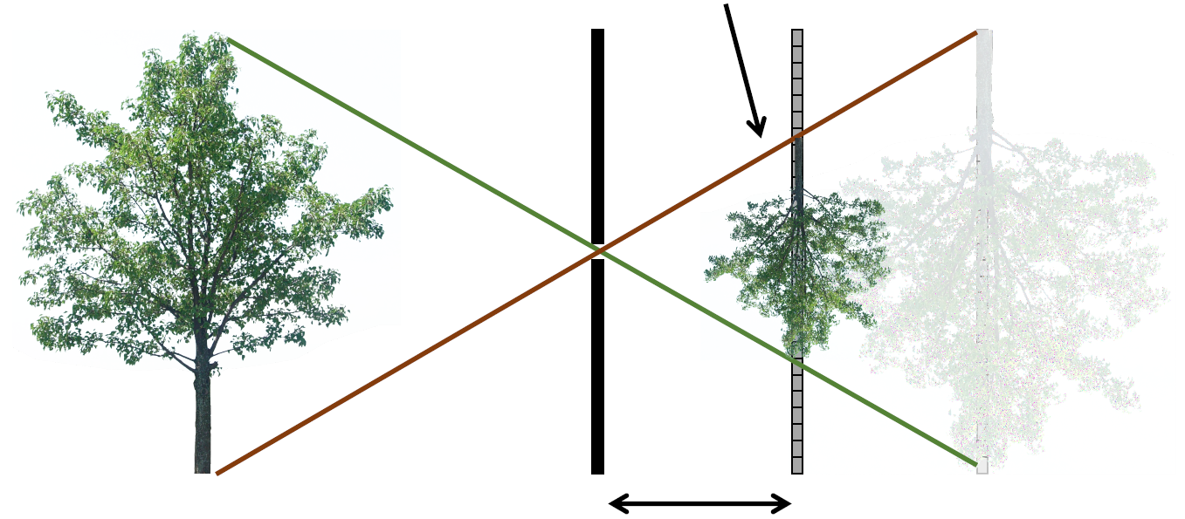
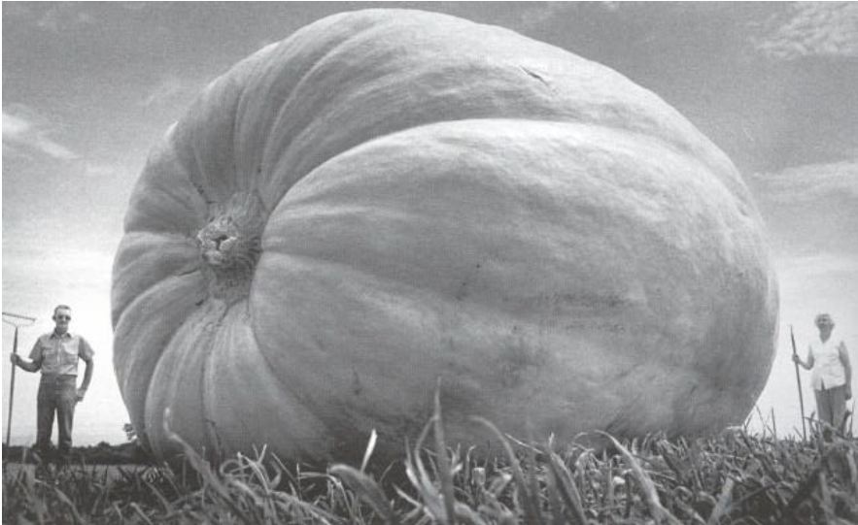
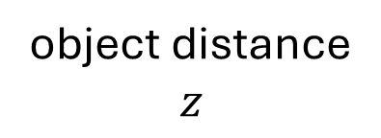
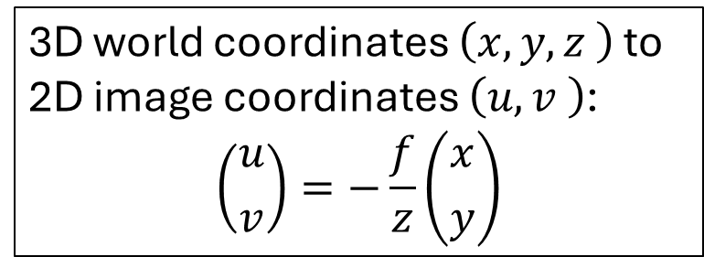



Pinhole Camera Model
3D world coordinates $\left(x,y,z \right)$ to 2D image coordinates $\left(u,v \right)$:
$$\left({u \atop v}\right)=−\frac{f}{z}\left({x \atop y}\right)$$
scaled object projection
object distance
$$z$$
losing depth …
$$x$$
$$u$$
focal length
$$f$$

Slide 11
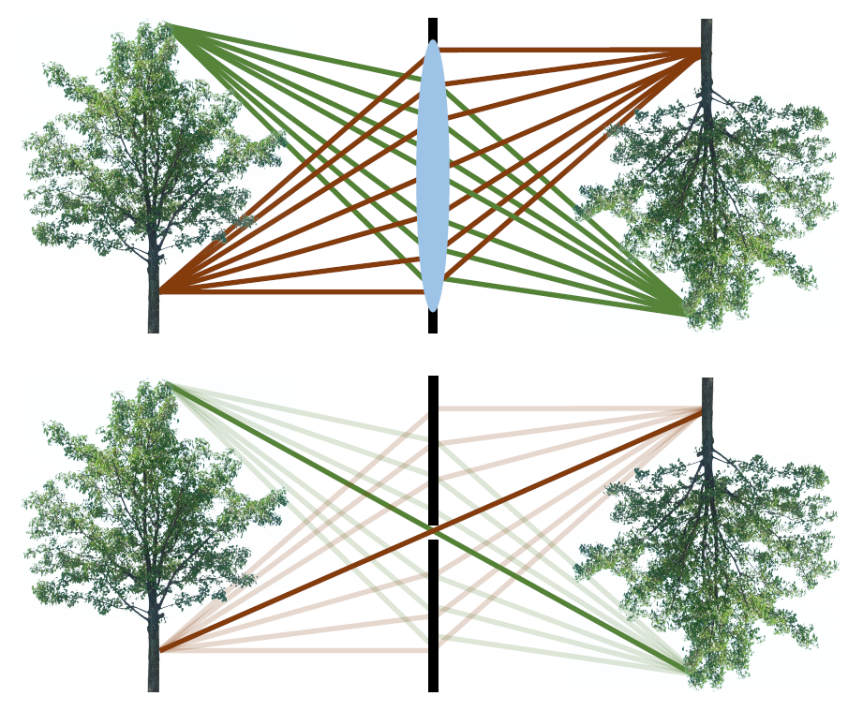
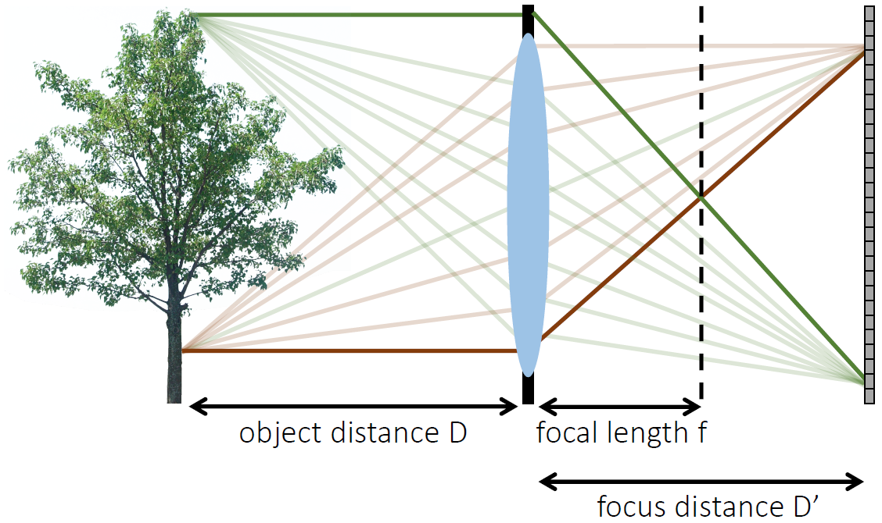
Lens Camera
ideal pinhole is infinitesimally small: larger diameter/aperture makes image blurrier (but also allows more light to pass through: higher intensity of image pixels)
→ use optical lens
lens camera can be described with pinhole camera model, if:
only central rays are considered
lens camera is in focus (focus distance of lens camera equal to focal length of pinhole camera)

Slide 12
Digital Image Sensors

Slide 13
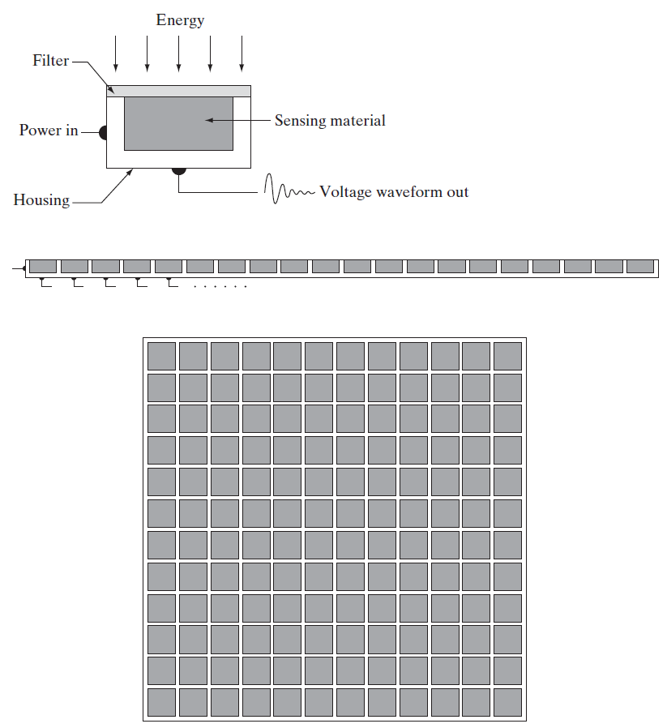
Photons to Electrons
largely replaced chemical and analog imaging
single sensor: photodiode
sensor strips: motion perpendicular to strip for imaging in other direction, used in CT
sensor arrays: used in digital cameras (in focal plane, outputs proportional to integral of light received at each sensor)
to be digitized

Slide 14
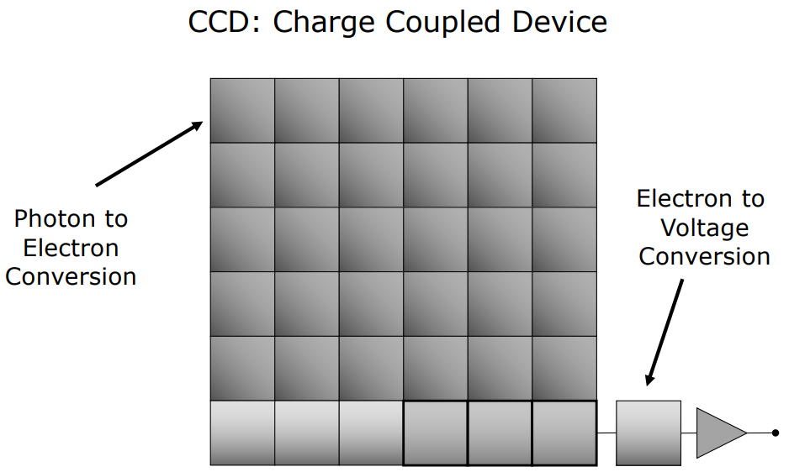
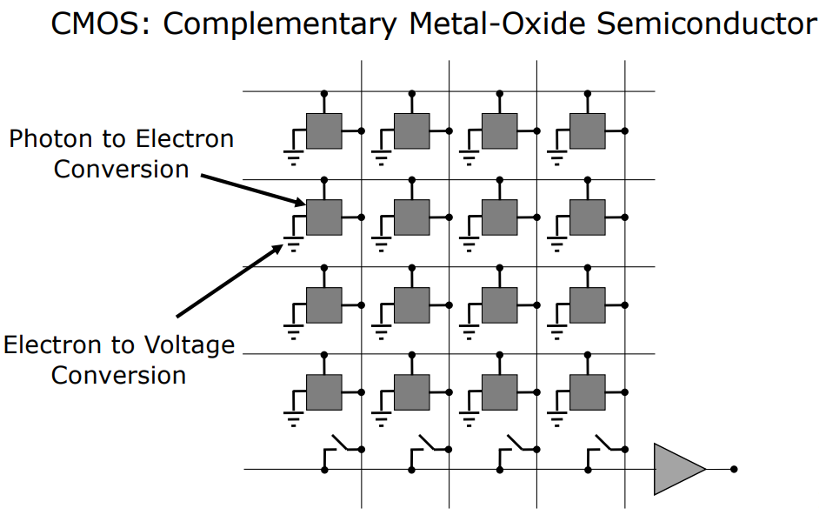
Most Popular Sensors: CCD and CMOS
active pixel sensor
pixel
charge transfer & sequential readout
larger light-sensitive areas, lower noise level
→ used in high-end video cameras
lower power consumption, typically smaller
→ used in most consumer product cameras
no individual silicon cells, but microlenses on top of each pixel to focus light on sensitive areas

Slide 15
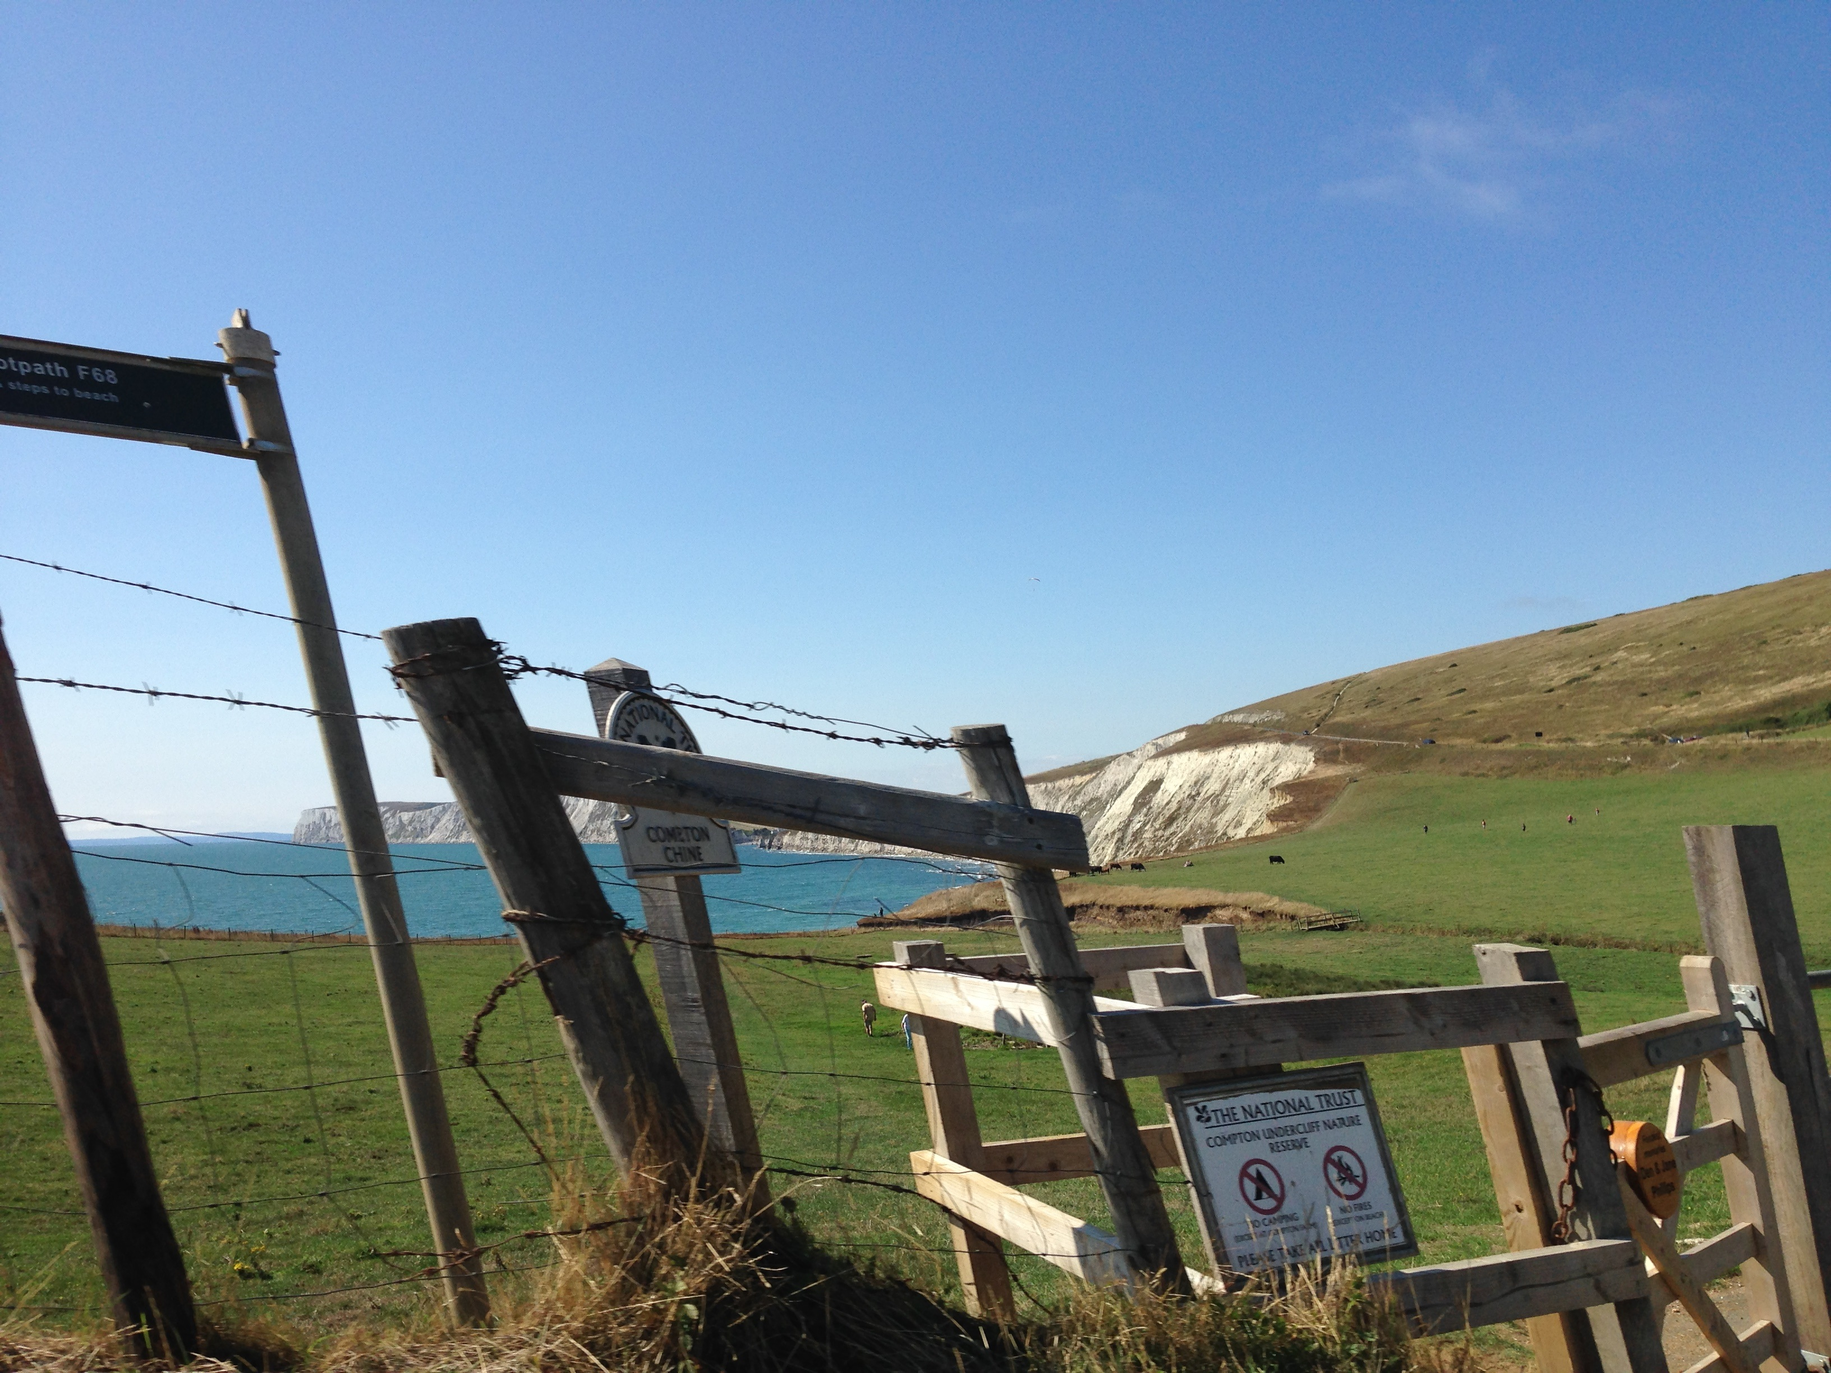
Global Shutter CMOS
in fact, no individual channels per CMOS-pixel: for reasons of space, pixels share lines and are read out row by row (rolling shutter)
→ potential skew (top part of the image captured slightly earlier than bottom part)
(more expensive) solution: global shutter
in-pixel storage enables simultaneous capture: all pixels expose together and instantly freeze data in tiny analog buffers, allowing row-by-row readout without motion distortion
global shutter CMOS replaces legacy CCDs: matches distortion-free motion tracking while drastically outperforming CCD in speed, power efficiency, and video resolution

Slide 16
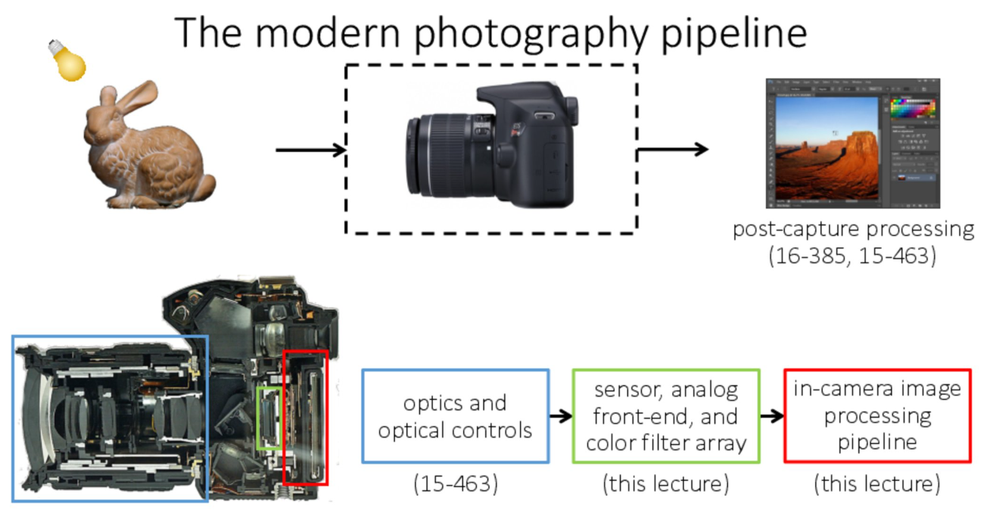
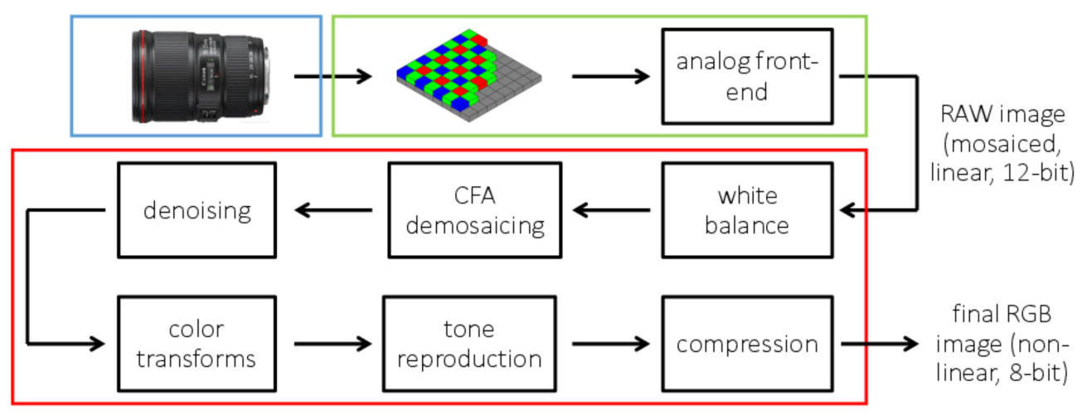
camera shutter opens
photodiodes: photons to electrons, store in potential well
camera shutter closes
readout of potential wells, conversion to analog signals
conversion to digital signals (intensity levels)

Slide 17
Pixels & Intensity

Slide 18
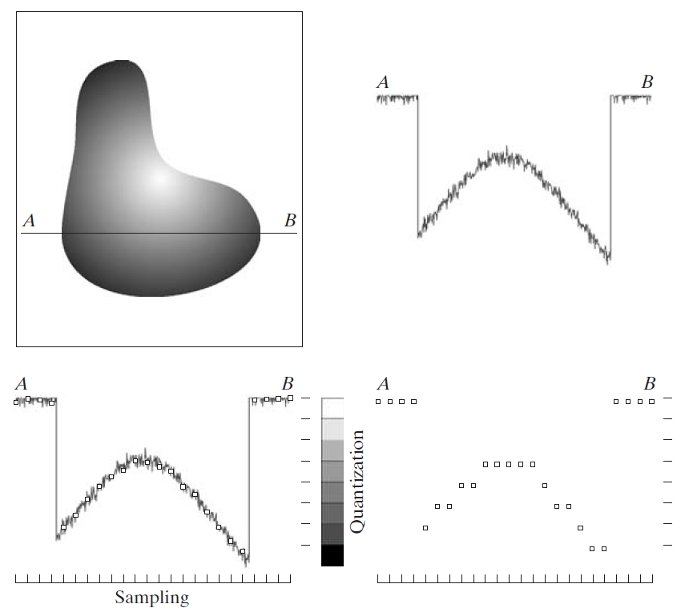
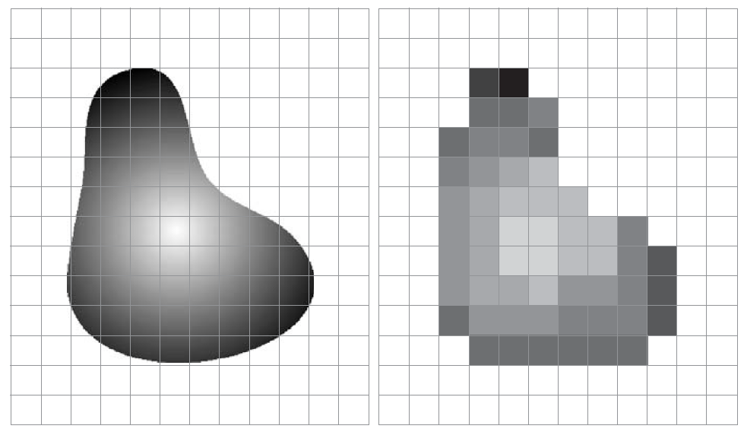
Digitizing: Sampling & Quantization
digitizing the coordinate values: pixels
digitizing the amplitude values: discrete intensity levels

Slide 19
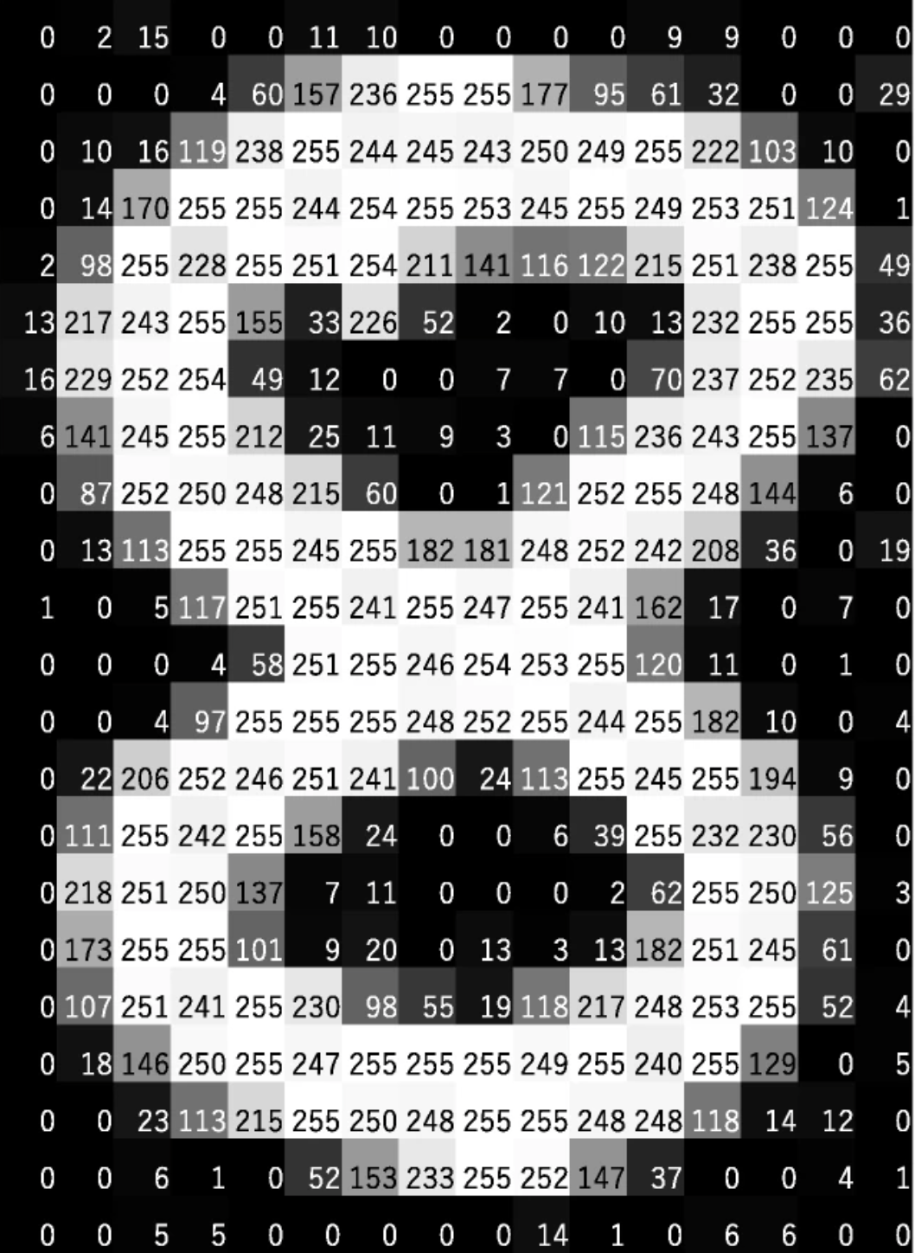
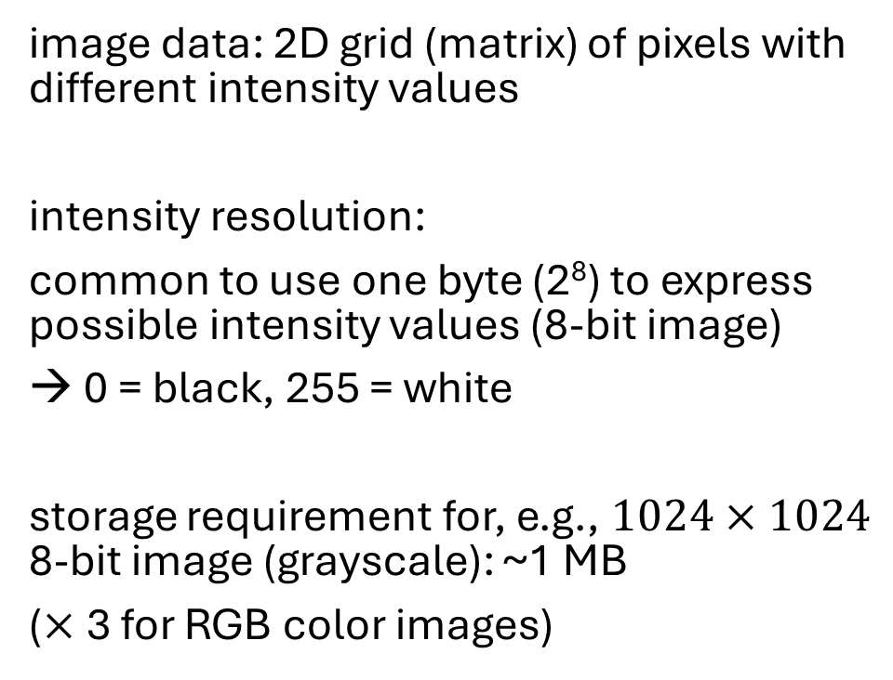
Discrete Intensity Levels
image data: 2D grid (matrix) of pixels with different intensity values
intensity resolution:
common to use one byte (2⁸) to express possible intensity values (8-bit image)
→ 0 = black, 255 = white
storage requirement for, e.g., $1024×1024$ 8-bit image (grayscale): ~1 MB
($×$3 for RGB color images)
source

Slide 20
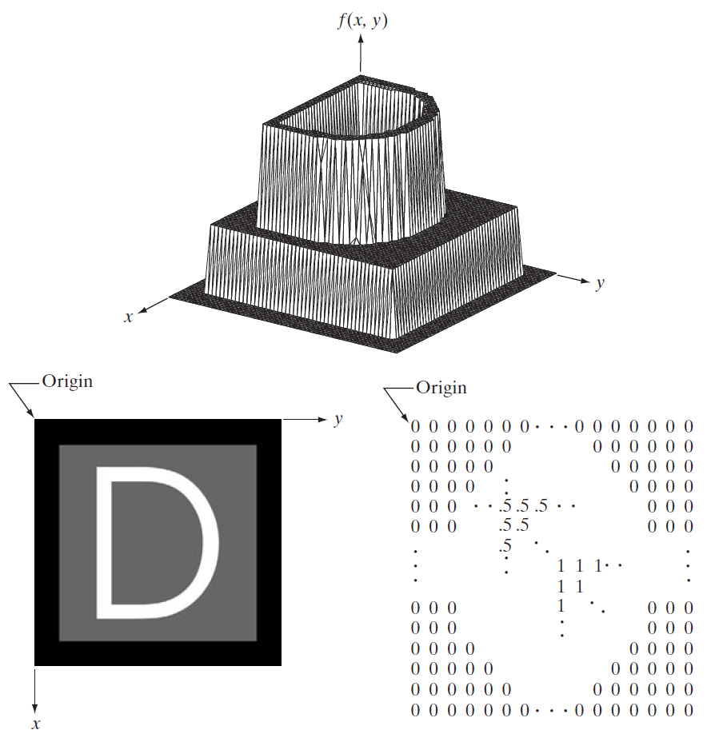
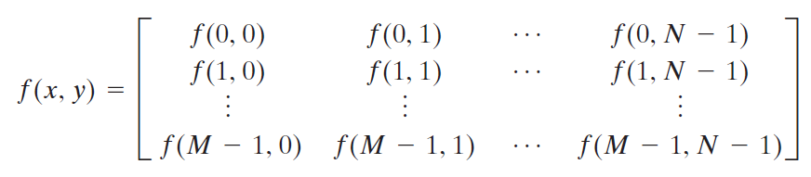
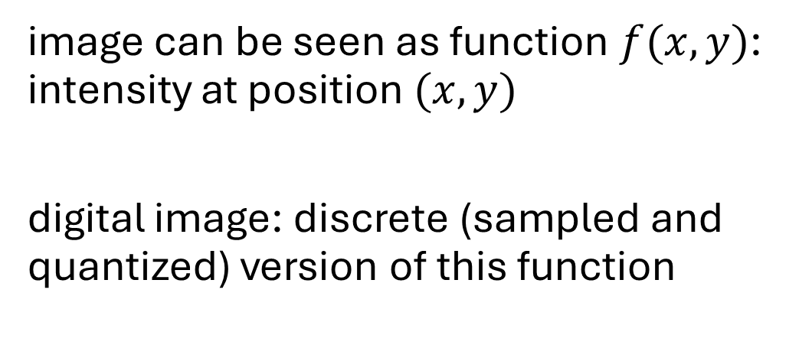
Image as Two-Dimensional Function
image can be seen as function $f(x,y)$: intensity at position $(x,y)$
digital image: discrete (sampled and quantized) version of this function

Slide 21
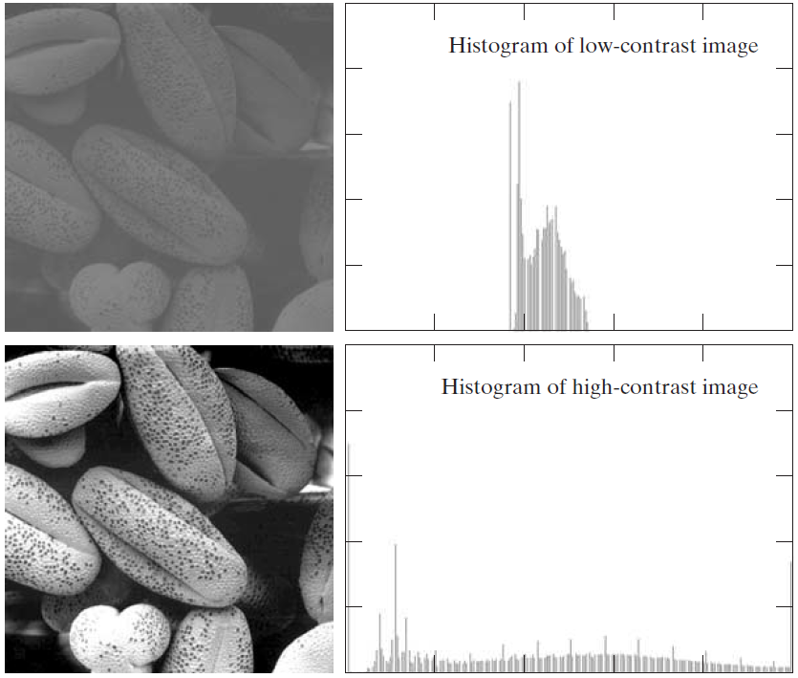
Contrast
intensity histograms:
range of intensity levels:
maximum measurable intensity determined by saturation
minimum detectable intensity determined by noise
contrast: difference in intensity between highest and lowest intensity levels in an image

Slide 22
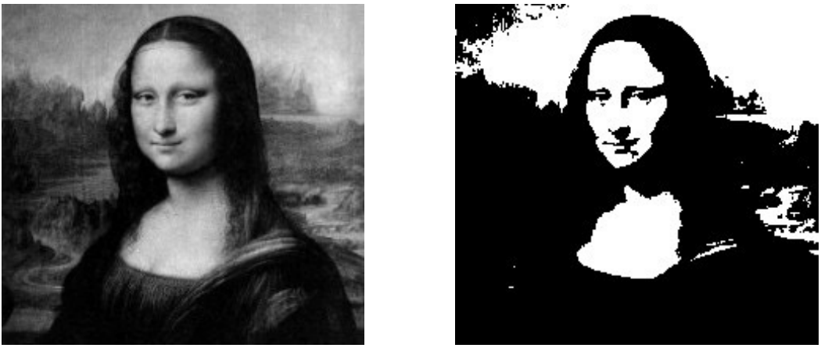
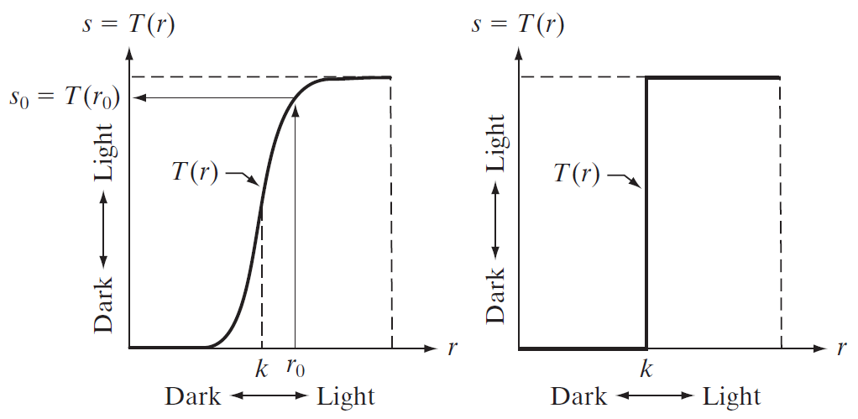
Intensity Transformations
lighten or darken image simply by adding or subtracting a fixed value from the pixel intensities
e.g., image enhancement through contrast manipulation
thresholding (differentiation of foreground and background regions):
contrast stretching (expanding range of intensity levels):

Slide 23
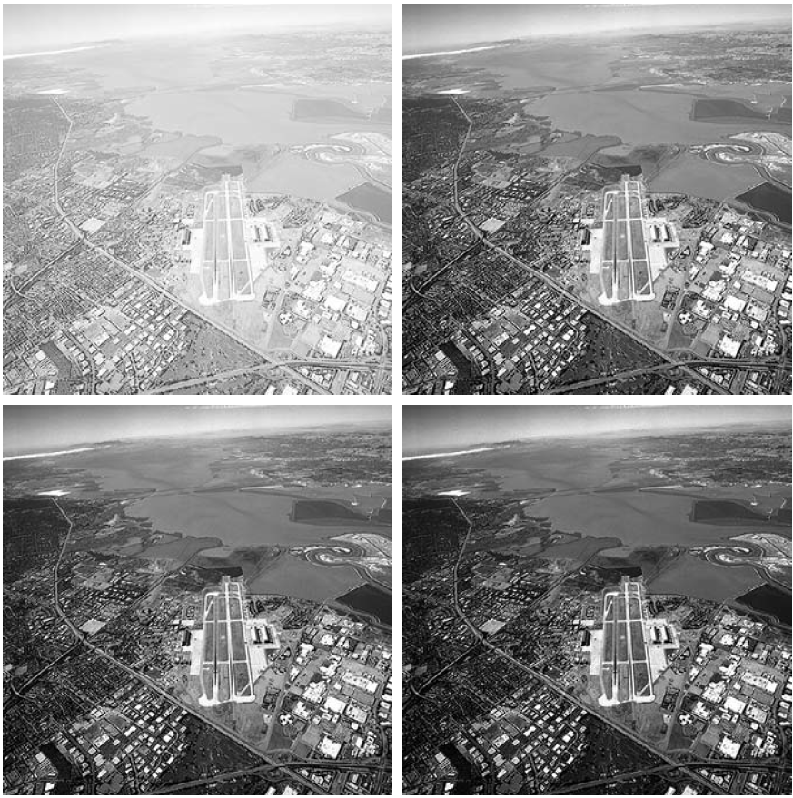
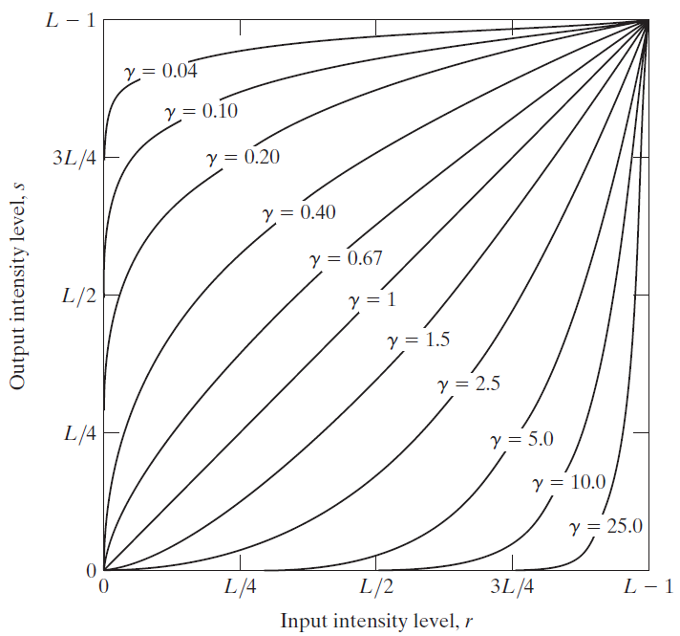




Power-Law Transformations
simultaneous spreading and compression of intensity levels
e.g., gamma correction:
$$γ=3.0$$
$$s=r^{γ}$$
$$γ=4.0$$
$$γ=5.0$$

Slide 24
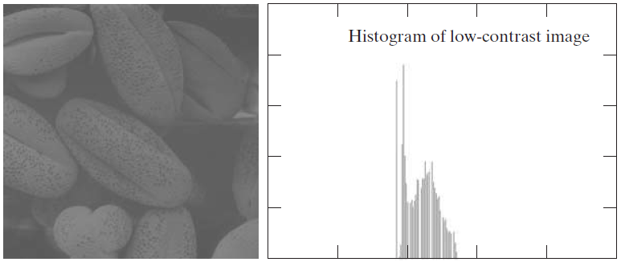
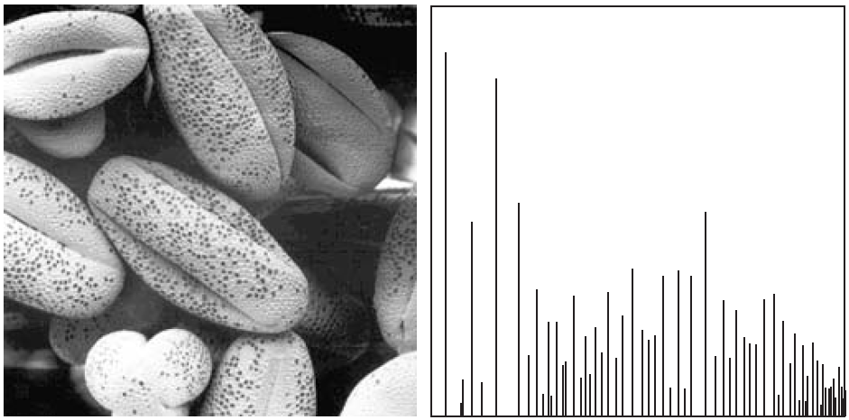
Histogram Equalization
automatic contrast stretching
global transformation function: based on intensity distribution of entire image
local histogram equalization by restricting transformation to pixel neighborhoods
after histogram equalization:

Slide 25
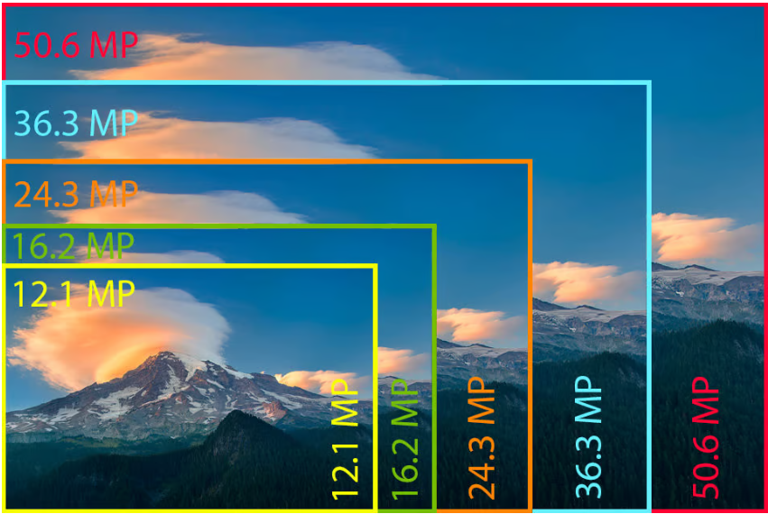
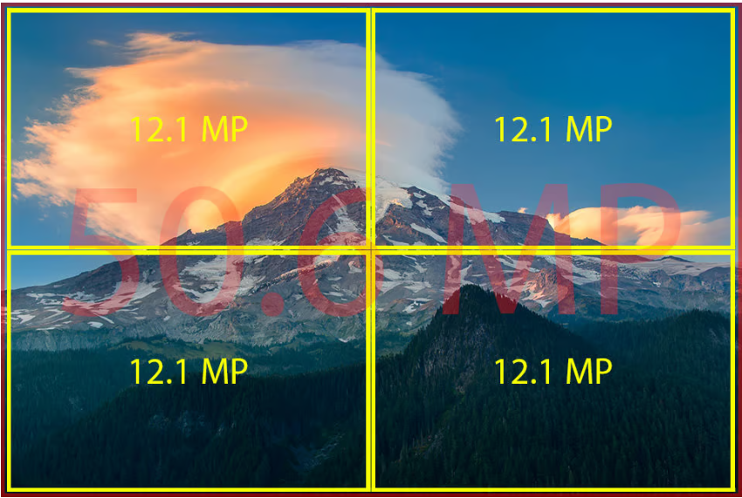
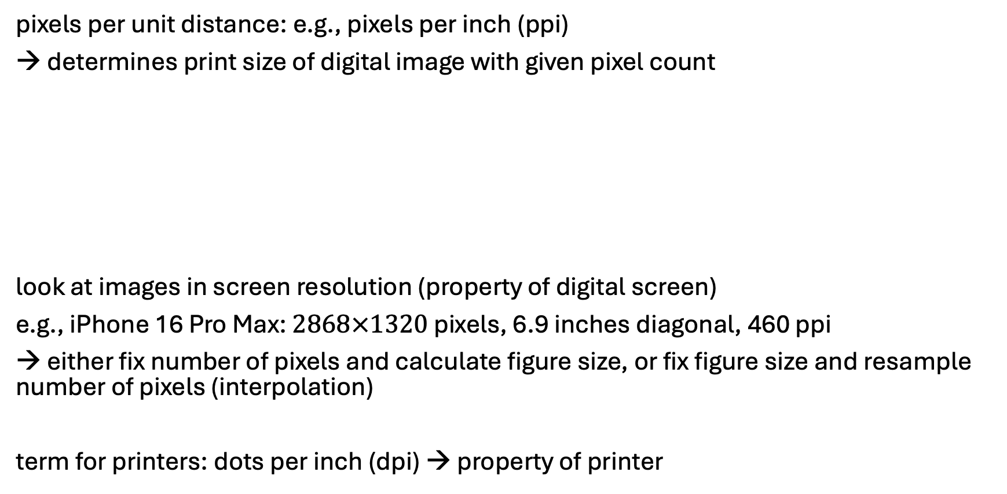
Spatial Resolution
image size: number of pixels
pixels per unit distance: e.g., pixels per inch (ppi)
→ determines print size of digital image with given pixel count
look at images in screen resolution (property of digital screen)
e.g., iPhone 16 Pro Max: $2868×1320$ pixels, 6.9 inches diagonal, 460 ppi
→ either fix number of pixels and calculate figure size, or fix figure size and resample number of pixels (interpolation)
term for printers: dots per inch (dpi) → property of printer
same resolutions

Slide 26
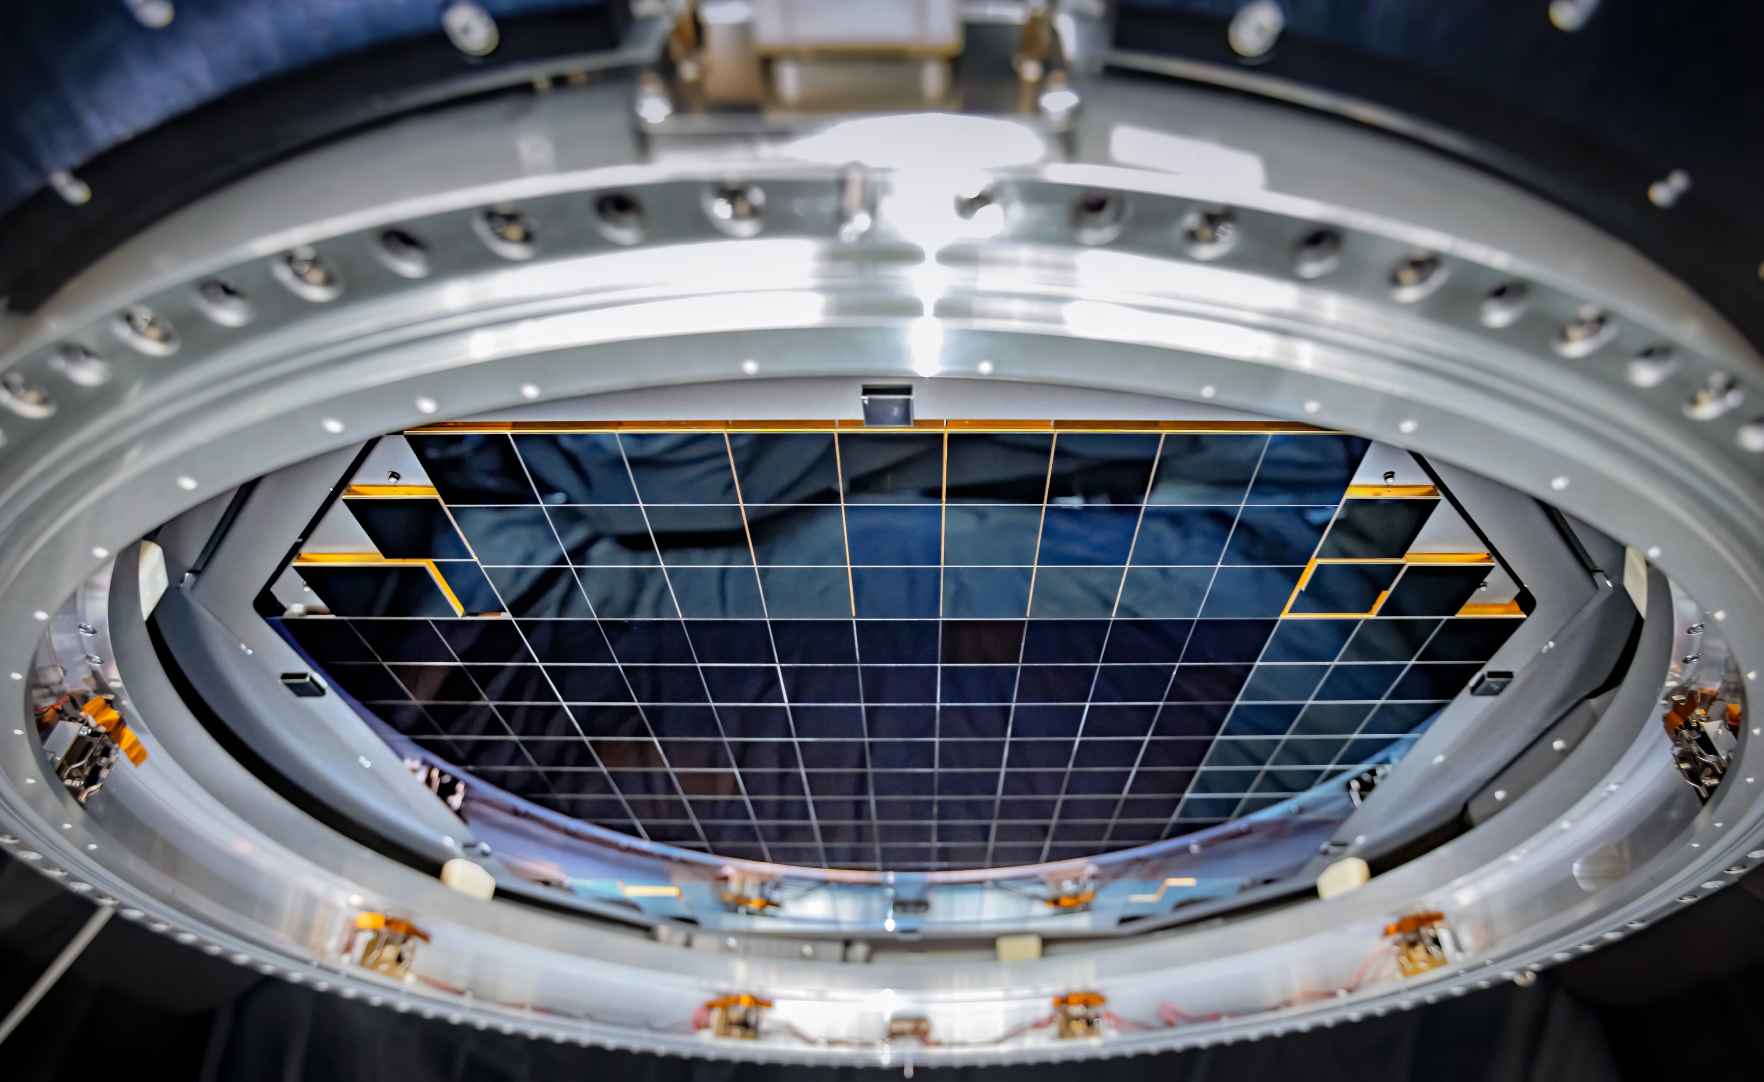
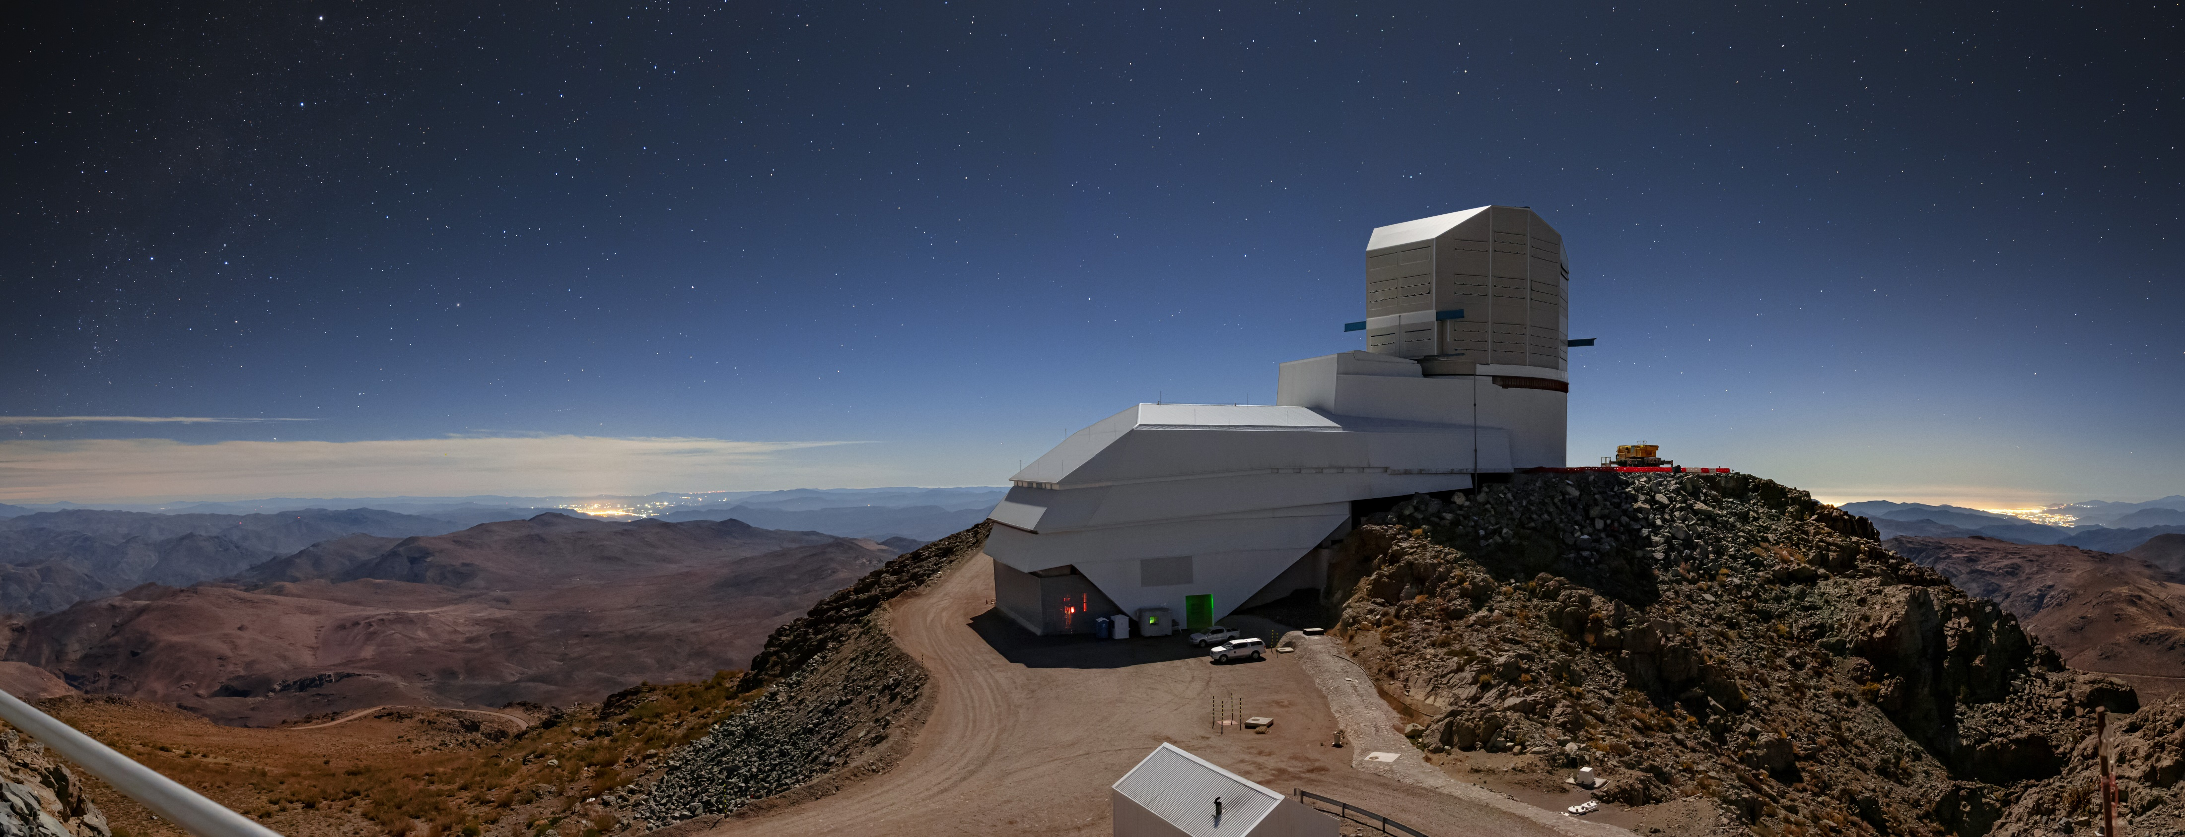
Example from Astronomy
Vera C. Rubin Observatory
first light in 2025
largest digital camera ever made: 3.2-gigapixel CCD

Slide 27
Color

Slide 28
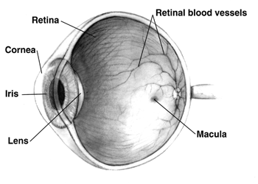
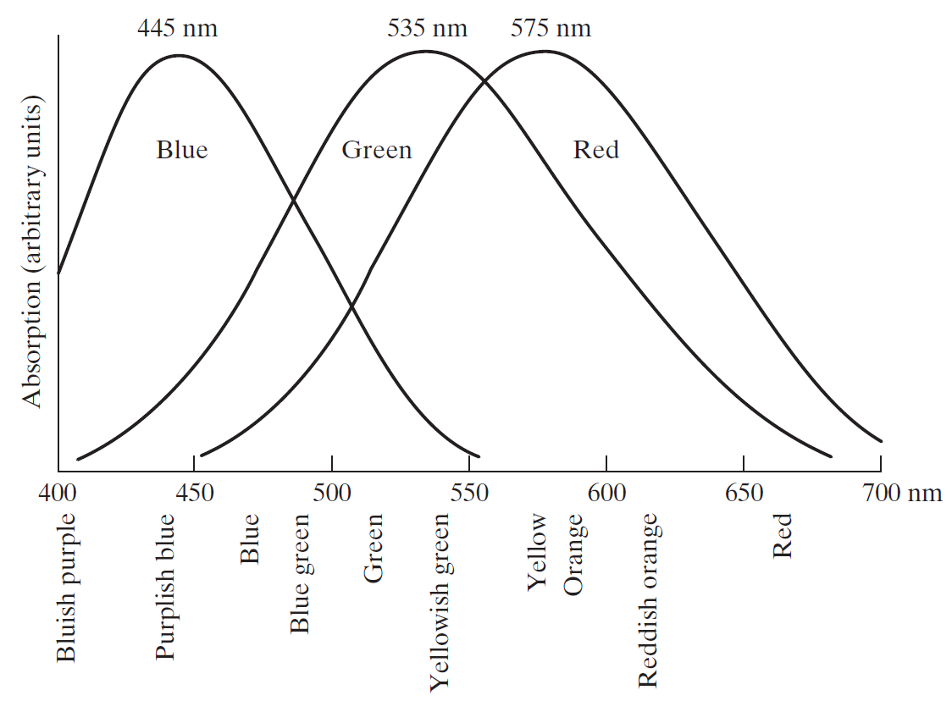
Colors in the Human Eye
retina: image sensor of human eye
two kinds of light receptors on surface of retina: rods (monochromatic vision) and cones (color-sensitve cells)
three types of cones: red, green, blue
→ combinations of red, green, and blue create perceived colors

Slide 29
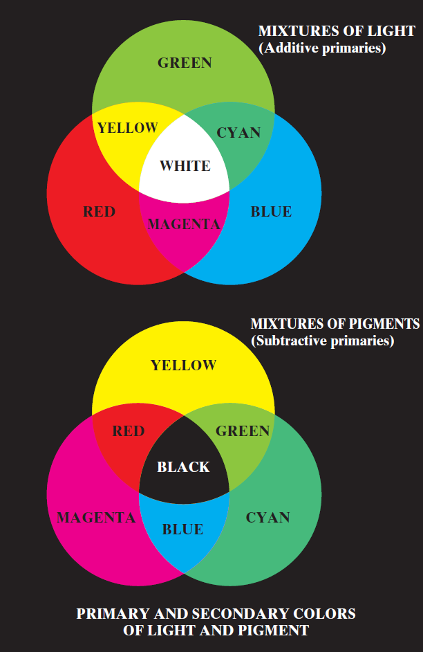
Primary Colors
standardization:
use of specific wavelengths for three primary colors red, green, and blue
→ can reproduce (almost) all visible colors by mixing with different intensities
for printing:
primary colors of pigments each absorb one primary color of light

Slide 30
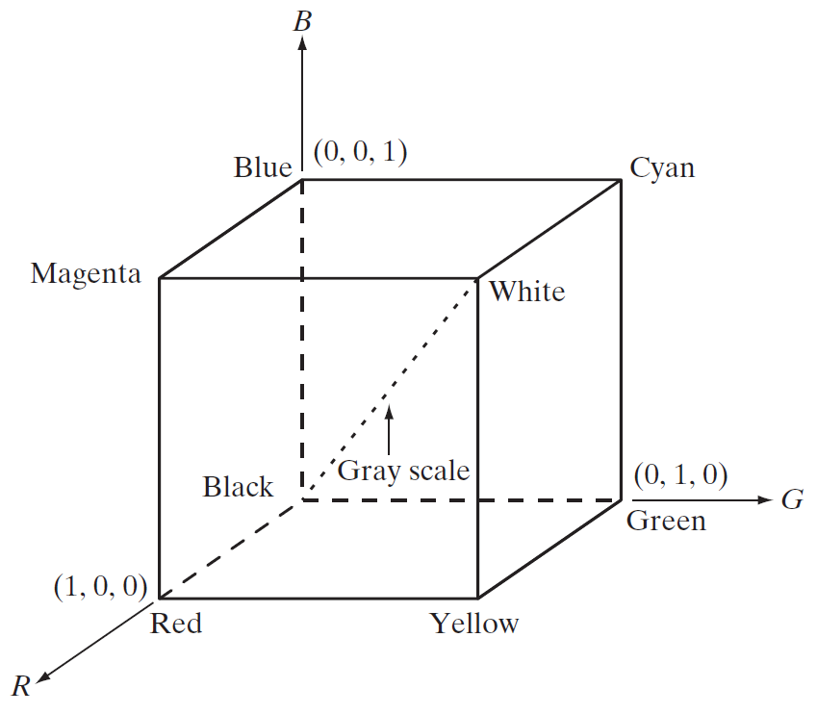
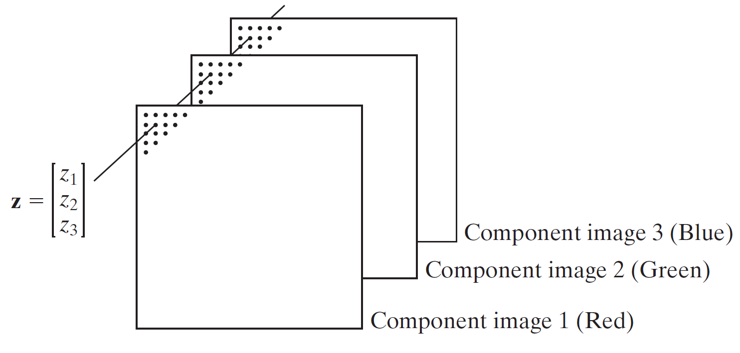
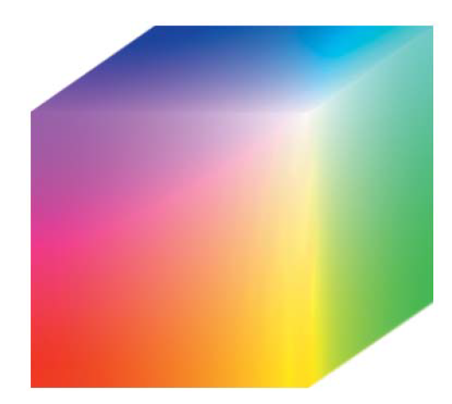
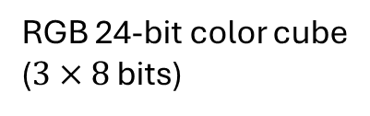
RGB Color Model
color model for monitors and cameras
(other color models: CMYK, HSV, ...)
color pixels:
3 intensity “channels”
RGB 24-bit color cube
($3×8$ bits)

Slide 31
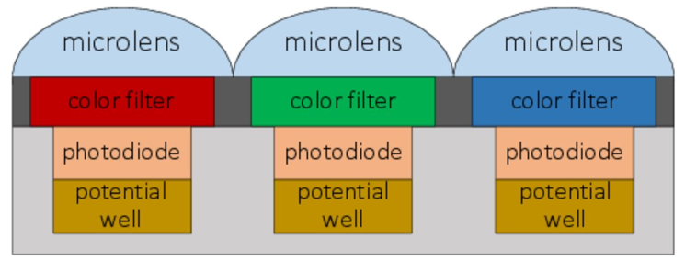
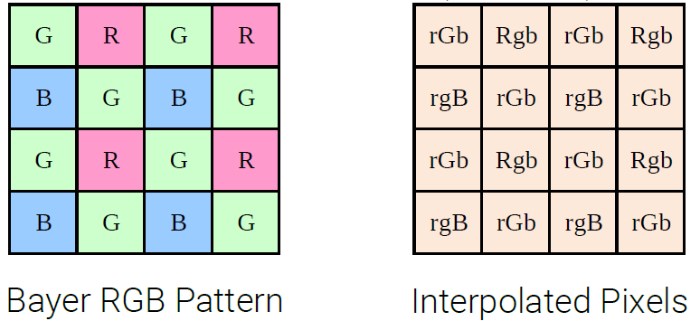
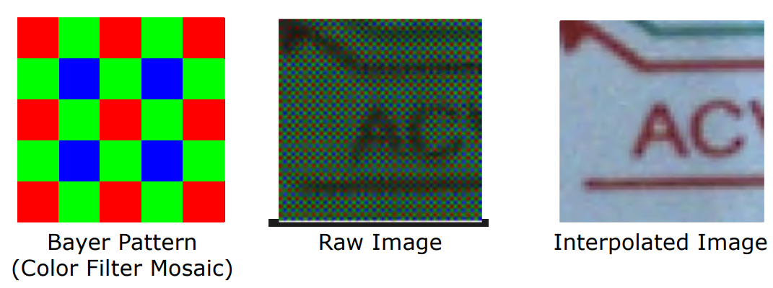
Color Sensing
single image sensor with one of three color filters in front of each pixel
estimation of missing color values for each pixel by interpolation from neighboring pixels
→ full-color image

Slide 32
Image Compression

Slide 33
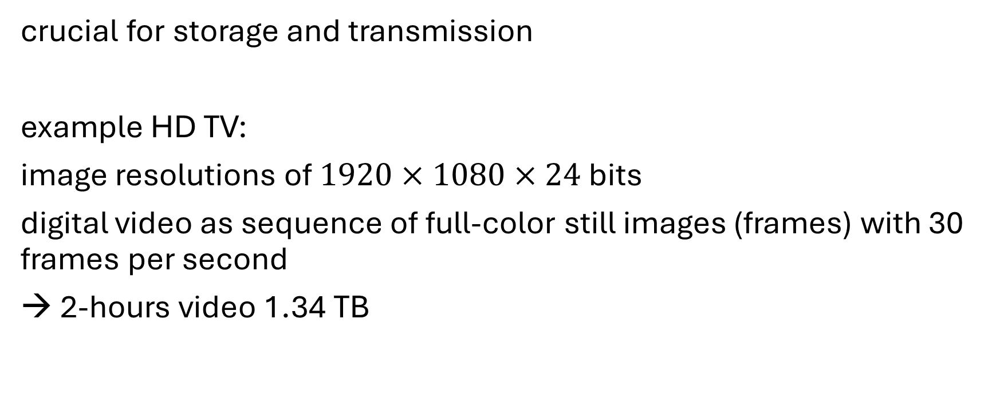
Need for Compression
crucial for storage and transmission
example HD TV:
image resolutions of $1920×1080×24$ bits
digital video as sequence of full-color still images (frames) with 30 frames per second
→ 2-hours video 1.34 TB

Slide 34

Compression & Decompression
remove “irrelevant visual” information → irreversible process (lossy compression)
minimizing coding redundancy: shortest code words assigned to most frequent intensity values (variable-length code)
reduce spatial and temporal redundancy: exploit correlations between pixels
JPEG, GIF, PNG, …

Slide 35



Example: Block Transform Coding
decorrelate pixels of each sub-image by means of discrete 2D transform
e.g., discrete cosine transform (DCT) or wavelet transform
DCT kind of approximated principal component analysis (PCA)
drop or coarsely quantize least important transform coefficients
encode quantized coefficients (e.g., Huffman coding)
DCT basis functions:
often $8×8$

Slide 36
Spatial Filtering

Slide 37

Single-Pixel/
intensity transformations

Slide 38


Spatial Filtering
linear shift-invariant operators:
replace each pixel’s intensity by weighted sum of its neighborhood
weights determined by a kernel (aka mask or filter)
same kernel shifted to all pixels
for example, filter of size $3×3$:
$$g\left(x,y\right)=\sum_{s=−1}^{1}{\sum_{t=−1}^{1}{w\left(s,t\right)f\left(x+s,y+t\right)}}$$

Slide 39


Example: Box Filter
We set the filter coefficients manually here.
Later, we will use a CNN for this.
the larger the kernel, the heavier the smoothing effect
$w=\frac{1}{9}\left[\begin{matrix}1 & 1 & 1 \\ 1 & 1 & 1 \\ 1 & 1 & 1\end{matrix}\right]$ $m×m$: $w=\frac{1}{m^{2}}\left[\begin{matrix}1 & ⋯ & 1 \\ ⋮ & ⋱ & ⋮ \\ 1 & ⋯ & 1\end{matrix}\right]$
results in local (moving) averages
→ blurring (smoothing) effect:
without normalization resulting image would be saturated
the larger the filter size, the heavier the blurring effect
filters of even size possible as well, but odd-sized ones easier to deal with

Slide 40

Definition: Correlation vs Convolution
using our example with filter of size $3×3$
correlation: $g\left(x,y\right)=\sum_{s=−1}^{1}{\sum_{t=−1}^{1}{w\left(s,t\right)f\left(x+s,y+t\right)}}$
convolution: $g\left(x,y\right)=\sum_{s=−1}^{1}{\sum_{t=−1}^{1}{w\left(s,t\right)f\left(x−s,y−t\right)}}$
convolution of a kernel with a discrete unit impulse yields copy of the kernel at location of the impulse (and impulse filter yields image copy)
corresponding correlation instead yields rotated version of the kernel (or rotated image)
corresponds to flip of filter

Slide 41





step 1:
step 4:
0 | 0 | 0 | 0 | 0
0 | 0 | 0 | 0 | 0
0 | 0 | 1 | 0 | 0
0 | 0 | 0 | 0 | 0
0 | 0 | 0 | 0 | 0
 | 0
0 | 0 | 0 | 0 | 0
0 | 0 | 0 | 0 | 0
0 | 0 | 1 | 0 | 0
0 | 0 | 0 | 0 | 0
0 | 0 | 0 | 0 | 0
 | 0 | -1 | -2
 | -1
1 | 2 | -1
1 | 1 | -1
-2 | -1 | 0
1 | 2 | -1
1 | 1 | -1
-2 | -1 | 0
$$⨂$$
=
$$⨂$$
=
step 2:
0 | 0 | 0 | 0 | 0
0 | 0 | 0 | 0 | 0
0 | 0 | 1 | 0 | 0
0 | 0 | 0 | 0 | 0
0 | 0 | 0 | 0 | 0
 | 0 | -1
correlation
1 | 2 | -1
1 | 1 | -1
-2 | -1 | 0
…
$$⨂$$
=
result:
step 3:
0 | 0 | 0 | 0 | 0
0 | 0 | 0 | 0 | 0
0 | 0 | 1 | 0 | 0
0 | 0 | 0 | 0 | 0
0 | 0 | 0 | 0 | 0
 | 0 | -1 | -2
 | -1 | 1 | 1
 | -1 | 2 | 1
0 | 0 | 0 | 0 | 0
0 | 0 | 0 | 0 | 0
0 | 0 | 1 | 0 | 0
0 | 0 | 0 | 0 | 0
0 | 0 | 0 | 0 | 0
 | 0 | -1 | -2
1 | 2 | -1
1 | 1 | -1
-2 | -1 | 0
$$⨂$$
=
1 | 2 | -1
1 | 1 | -1
-2 | -1 | 0
$$⨂$$
=

Slide 42





step 1:
step 4:
0 | 0 | 0 | 0 | 0
0 | 0 | 0 | 0 | 0
0 | 0 | 1 | 0 | 0
0 | 0 | 0 | 0 | 0
0 | 0 | 0 | 0 | 0
 | 1
0 | 0 | 0 | 0 | 0
0 | 0 | 0 | 0 | 0
0 | 0 | 1 | 0 | 0
0 | 0 | 0 | 0 | 0
0 | 0 | 0 | 0 | 0
 | 1 | 2 | -1
 | 1
flip
1 | 2 | -1
1 | 1 | -1
-2 | -1 | 0
1 | 2 | -1
1 | 1 | -1
-2 | -1 | 0
$$∗$$
=
$$∗$$
=
step 2:
0 | 0 | 0 | 0 | 0
0 | 0 | 0 | 0 | 0
0 | 0 | 1 | 0 | 0
0 | 0 | 0 | 0 | 0
0 | 0 | 0 | 0 | 0
 | 1 | 2
convolution
1 | 2 | -1
1 | 1 | -1
-2 | -1 | 0
…
$$∗$$
=
result:
step 3:
0 | 0 | 0 | 0 | 0
0 | 0 | 0 | 0 | 0
0 | 0 | 1 | 0 | 0
0 | 0 | 0 | 0 | 0
0 | 0 | 0 | 0 | 0
 | 1 | 2 | -1
 | 1 | 1 | -1
 | -2 | -1 | 0
0 | 0 | 0 | 0 | 0
0 | 0 | 0 | 0 | 0
0 | 0 | 1 | 0 | 0
0 | 0 | 0 | 0 | 0
0 | 0 | 0 | 0 | 0
 | 1 | 2 | -1
1 | 2 | -1
1 | 1 | -1
-2 | -1 | 0
$$∗$$
=
1 | 2 | -1
1 | 1 | -1
-2 | -1 | 0
$$∗$$
=

Slide 43

Padding
On last slides, we did not let the filter extend beyond image borders.
→ boundary effects: resulting image smaller than original
zero-padding to avoid this:
zero-padding darkens the image edges
other padding options:
set to constant border value
repeat edge values
…
0 | 0 | 0 | 0 | 0 | 0 | 0
0 | 0 | 0 | 0 | 0 | 0 | 0
0 | 0 | 0 | 0 | 0 | 0 | 0
0 | 0 | 0 | 1 | 0 | 0 | 0
0 | 0 | 0 | 0 | 0 | 0 | 0
0 | 0 | 0 | 0 | 0 | 0 | 0
0 | 0 | 0 | 0 | 0 | 0 | 0
0 | 0 | 0 | 0 | 0
0 | 1 | 2 | -1 | 0
0 | 1 | 1 | -1 | 0
0 | -2 | -1 | 0 | 0
0 | 0 | 0 | 0 | 0
1 | 2 | -1
1 | 1 | -1
-2 | -1 | 0
$$∗$$
=
can also be more zero rows/columns (depending on image and filter size)

Slide 44



Other Linear Smoothing Filters
sampled from 2D Gaussian function
(larger $σ$ requires larger kernel)
when constructing filters (not only smoothing filters, but in general), look for separable ones:
allow to compute 2D convolution as two subsequent 1D convolutions (horizontal and vertical)
for image of size $M×M$ and kernel of size $N×N$:
$M^{2}⋅N^{2}$ operations for non-separable filter
$M^{2}⋅2⋅N$ operations for separable filter
→ significant speedup possible
bilinear filter (tent):
Gaussian filter:
corresponding horizontal 1D kernels

Slide 45



Median Filter
same kind of neighborhood-shifting over image
but instead of weighted average, use median of intensity values in pixel neighborhood (no filter coefficients) → non-linear filter
very effective to reduce outliers, e.g., shot or salt-and-pepper noise
original:
average-filtered ($3×3$):
median-filtered ($3×3$):

Slide 46

Sharpening Filters
playground
goal of smoothing filters:
removal of small details, noise reduction
goal of sharpening filters:
highlight intensity transitions (e.g., edges)
averaging analogous to integration
→ sharpening by differentiation

Slide 47


First- and Second-Order Derivatives
1D visualization:
partial derivatives in discrete form:
$$\frac{∂f}{∂x}=f\left(x+1,y\right)−f\left(x,y\right)$$
$$\frac{∂f}{∂y}=f\left(x,y+1\right)−f\left(x,y\right)$$
$$\frac{∂^{2}f}{∂x^{2}}=f\left(x+1,y\right)+f\left(x−1,y\right)−2f\left(x,y\right)$$
$$\frac{∂^{2}f}{∂y^{2}}=f\left(x,y+1\right)+f\left(x,y−1\right)−2f\left(x,y\right)$$

Slide 48












Approximated Image Gradient
convolved with an image:
alternative formulation (1D): $\frac{∂f}{∂x}=\frac{f\left(x+1\right)−f\left(x−1\right)}{2}$
→ 1D derivative filter:
Sobel filters:
1 | 0 | -1
smoothing
1
2
1
horizontal
1 | 0 | -1
2 | 0 | -2
1 | 0 | -1
$$∗$$
-1 | 0 | 1
$$∙\frac{1}{8}$$
$$\frac{∂f}{∂x}$$
$$=$$
construct separable filters:
(convolution kernels)
-1
0
1
smoothing
1 | 2 | 1
0 | 0 | 0
-1 | -2 | -1
vertical
$$∗$$
1 | 2 | 1
$$=$$
$$∙\frac{1}{8}$$
$$\frac{∂f}{∂y}$$
→ gradient with smoothing

Slide 49


Magnitude of Image Gradient
for sharpening:
add this to original
magnitude/amplitude of gradient:
$$\left\|∇f\right\|=\sqrt{{\left(\frac{∂f}{∂x}\right)}^{2}+{\left(\frac{∂f}{∂y}\right)}^{2}}$$
magnitude is isotropic

Slide 50

Different Gradient Filters
the larger ones add smoothing components
(Sobel: convolution with bilinear filter)

Slide 51




Alternative: Laplacian
$$f$$
$$∇^{2}f$$
0 | 1 | 0
1 | -4 | 1
0 | 1 | 0
filter mask:
$$∇^{2}f=\frac{∂^{2}f}{∂x^{2}}+\frac{∂^{2}f}{∂y^{2}}$$
$$=f\left(x+1,y\right)+f\left(x−1,y\right)+f\left(x,y+1\right)+f\left(x,y−1\right)−4f\left(x,y\right)$$
isotropic for rotations in increments of 90°
to yield isotropic results for rotations in increments of 45°:
again, add to (or rather subtract from when using this filter definition here) original to get sharpened image:
$$g\left(x,y\right)=f\left(x,y\right)−∇^{2}f\left(x,y\right)$$
scaled to visualize negative values
zero-crossings → edges
1 | 1 | 1
1 | -8 | 1
1 | 1 | 1

Slide 52

Another Alternative: Unsharp Masking
use of smoothing filters for sharpening
smoothing of original image (e.g.,by Gaussian filter)
subtract the blurred image from the original → unsharp mask (similar to second-order derivative)
add unsharp mask to original image → sharpened image
similar to second-order derivative

Slide 53



Slide 54
Fourier Transform

Slide 55

Fourier analysis allows to determine frequency characteristics of images or filters
image
frequency content

Slide 56


Frequency Representation of Spatial Function
response of a spatial function (filter) $h\left(x\right)$to a sinusoid with frequency $ω$:
$$h\left(x\right)∗e^{iωx}=Ae^{i\left(ωx+φ\right)}$$
Fourier transform: tabulation of magnitude $A$ and phase $φ$ response at each frequency
$$H\left(ω\right)=ℱ\left\{h\left(x\right)\right\}=Ae^{iφ}$$
Fourier transform pair: $h\left(x\right)\underset{↔}{ℱ}H\left(ω\right)$
angular frequency $ω=2πf$
notation: $f$ sometimes $u$ or $μ$
complex: needs to capture both amplitude and phase
frequency domain

Slide 57



Fourier Transform Formulas
for continuous signals:
$$H\left(ω\right)=\int_{−∞}^{∞}{h\left(x\right)e^{−iωx}dx}$$
Discrete Fourier Transform (DFT):
$$H\left(k\right)=\sum_{x=0}^{N−1}{h\left(x\right)e^{−i\frac{2πkx}{N}}}$$
inverse Fourier transforms:
$$h\left(x\right)=\int_{−∞}^{∞}{H\left(ω\right)e^{iωx}dω}$$
$$h\left(x\right)=\frac{1}{N}\sum_{k=0}^{N−1}{H\left(k\right)e^{i\frac{2πkx}{N}}}$$
unique only in range $k∈\left[−\frac{N}{2},\frac{N}{2} \right]$

Slide 58

2D Fourier Transforms
$$H\left(ω_{x},ω_{y}\right)=\int_{−∞}^{∞}{\int_{−∞}^{∞}{h\left(x,y\right)e^{−i\left(ω_{x}x+ω_{y}y\right)}dxdy}}$$
$$H\left(k_{x},k_{y}\right)=\sum_{x=0}^{M−1}{\sum_{y=0}^{N−1}{h\left(x,y\right)e^{−i2π\left({k_{x}x}/M+{k_{y}y}/N\right)}}}$$
e.g., digital images ($M$ and $N$ as width and height in pixels)

Slide 59


Filtering in Frequency Domain
low-pass filtering:
magnitude
high-pass filtering:
→ smoothing
→ sharpening (if added to original)

Slide 60

Gaussian Filters in Frequency Domain
low-pass filter
high-pass filter

Slide 61

Importance of Phase

Slide 62




Convolution Theorem
spatial domain:
$$g\left(x\right)=f\left(x\right)∗h\left(x\right)$$
$$g\left(x\right)=f\left(x\right)∙h\left(x\right)$$
frequency domain:
$$G\left(ω\right)=F\left(ω\right)∙H\left(ω\right)$$
$$G\left(ω\right)=F\left(ω\right)∗H\left(ω\right)$$
$$↔$$
$$↔$$

Slide 63







Convolution via Fourier Transform
$$g\left(x\right)=f\left(x\right)∗h\left(x\right)$$
$$G\left(ω\right)=F\left(ω\right)∙H\left(ω\right)$$
$$ℱ^{−1}$$
$$↓$$
$$↓$$
$$ℱ$$
$$↓$$
$$ℱ$$
convolution of images with large spatial filters can be computationally heavy
→ more efficient in frequency domain, thanks to Fast Fourier Transform (enabling convolution times independent of filter size)
also, construction of filters often easier in frequency domain

Slide 64


Example: Gaussian Smoothing

Slide 65




Fourier Transform Pair: Box and sinc Function
in spatial domain, interpolations between samples (e.g., intensity values at image pixels) formed by infinite sum of sinc functions (approximated with bilinear or bicubic interpolations)
real part of $ω$ for visualization
$$↔$$
inverse scaling (valid for any function):
wider in spatial domain → more compressed in frequency domain (and vice versa)
(e.g., narrow and broad Gaussian)

Slide 66

approximated sinc
smoothing filters / low-pass filters
approximated Gaussian
some smoothing
sharpening filters / high-pass filters

Slide 67



Band-Reject and Band-Pass Filters
periodic noise can be effectively removed with band-reject filters in frequency domain
notch reject filter

Slide 68




Deconvolution
example: motion blur
application of convolution theorem: inverse filtering in frequency domain to get rid of degradation effect $H$
(image restoration)
more complicated in practice:
degradation function $H$ usually not known completely → need for estimation
usually also additive noise on top → need for noise suppression during deconvolution (Wiener filter)
point spread function

Slide 69
Aliasing

Slide 70

Sampling
remember: digital images sample intensity values at each pixel

Slide 71

Undersampling
aliasing: higher-frequency signal disguised as one of lower frequency

Slide 72

Moiré Effect
aliasing in digital images often manifests itself as ringing patterns
temporal aliasing can be observed as wagon-wheel effect (apparent backward motion) in image sequences (video): frame rate too low with respect to speed of wheel rotation

Slide 73




Sampling Theorem
Fourier transform of band-limited function:
$$μ_{\text{max}}$$
continuous signal can be recovered from its samples, if sampling rate exceeds Nyquist frequency:
$$\frac{1}{∆T}>2μ_{\text{max}}$$
→ no aliasing
digital images: no aliasing if $\frac{N}{2}>μ_{\text{max}}$,
with number of pixels $N$
(second dimension accordingly)

Slide 74
Anti-Aliasing in Digital Images
no problem if signal is oversampled: number of pixels higher than twice the maximum frequency of image (for both width and height)
if not oversampled: smooth the signal
→ removing some details (i.e., high frequencies,) that cause aliasing
optical anti-aliasing filter in digital cameras (on top of image sensor): cut out frequencies above Nyquist frequency

Slide 75

Example: Shrinking
smoothing crucial before subsampling (shrinking) to avoid aliasing: decreases Nyquist frequency of image (to counter less pixels)
average of black and white

Slide 76
Image Pyramids

Slide 77


Gaussian Image Pyramid
sequence of sub-sampled images (one use case: features at different scales)
apply smoothing before each down-sample step (to avoid aliasing), typically by convolution with binomial kernel (converging to Gaussian)

Slide 78



Laplacian Image Pyramid
retain only residuals at different levels (allows later upsampling, starting from highest-level image)
difference of Gaussians approximate Laplacian:

Slide 79






Wavelets
original ($512×512$):
four $128×128$ sub-bands
smallest image approximation
(only low-pass filters)
four $64×64$ sub-bands
discrete wavelet transform:
mapping of discrete function (e.g., a digital image) to sequence of coefficients (of a set of basis functions)
performing sub-band coding (decomposition of an image into set of band-limited components) combined with progressive down-sampling (similar to residual pyramid)
four $256×256$ sub-bands
low-low (further split in next level)
low-high (horizontal edges)
high-low (vertical edges)
high-high (mixed derivatives)

