Slide 1
Laplace Domain
Control Engineering

Slide 2
Course Schedule
Systems
Continuous-time Controllers
Laplace Domain
Poles/Zeros & Stability
Controller Design
Discrete-time Controllers
State Space Representation
Advanced Control Methods

Slide 3
Laplace Domain
Laplace transform
Transfer functions
Block diagrams
Closed-loop systems (feedback)
Frequency response
Bode plots
Bandwidth
Elements of control loops

Slide 4
Why the Laplace Transform?
Converts differential equations (dynamic systems) into algebraic equations → easier to solve
Simplifies analysis and design
Natural language of control theory

Slide 5
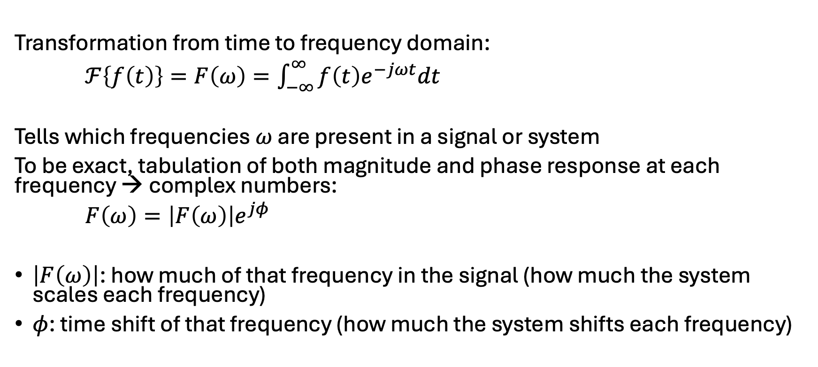
Reminder: Fourier Transform
Transformation from time to frequency domain:
$ℱ\left\{f\left(t\right)\right\}=F\left(ω\right)=\int_{−∞}^{∞}{f\left(t\right)e^{−jωt}dt}$
Tells which frequencies $ω$ are present in a signal or system
To be exact, tabulation of both magnitude and phase response at each frequency → complex numbers:
$F\left(ω\right)=\left|F\left(ω\right)\right|e^{jφ}$
$\left|F\left(ω\right)\right|$: how much of that frequency in the signal (how much the system scales each frequency)
$φ$: time shift of that frequency (how much the system shifts each frequency)

Slide 6
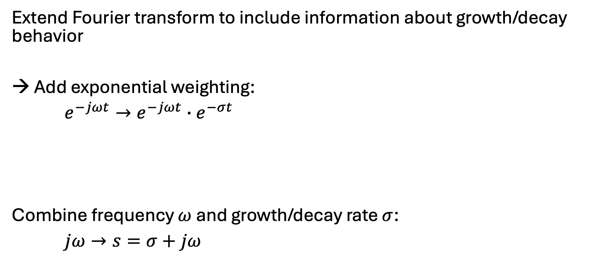
Idea of Laplace Transform
Extend Fourier transform to include information about growth/decay behavior
→ Add exponential weighting:
$e^{−jωt}→e^{−jωt}∙e^{−σt}$
Combine frequency $ω$ and growth/decay rate $σ$:
$jω→s=σ+jω$
oscillation
growth/decay

Slide 7
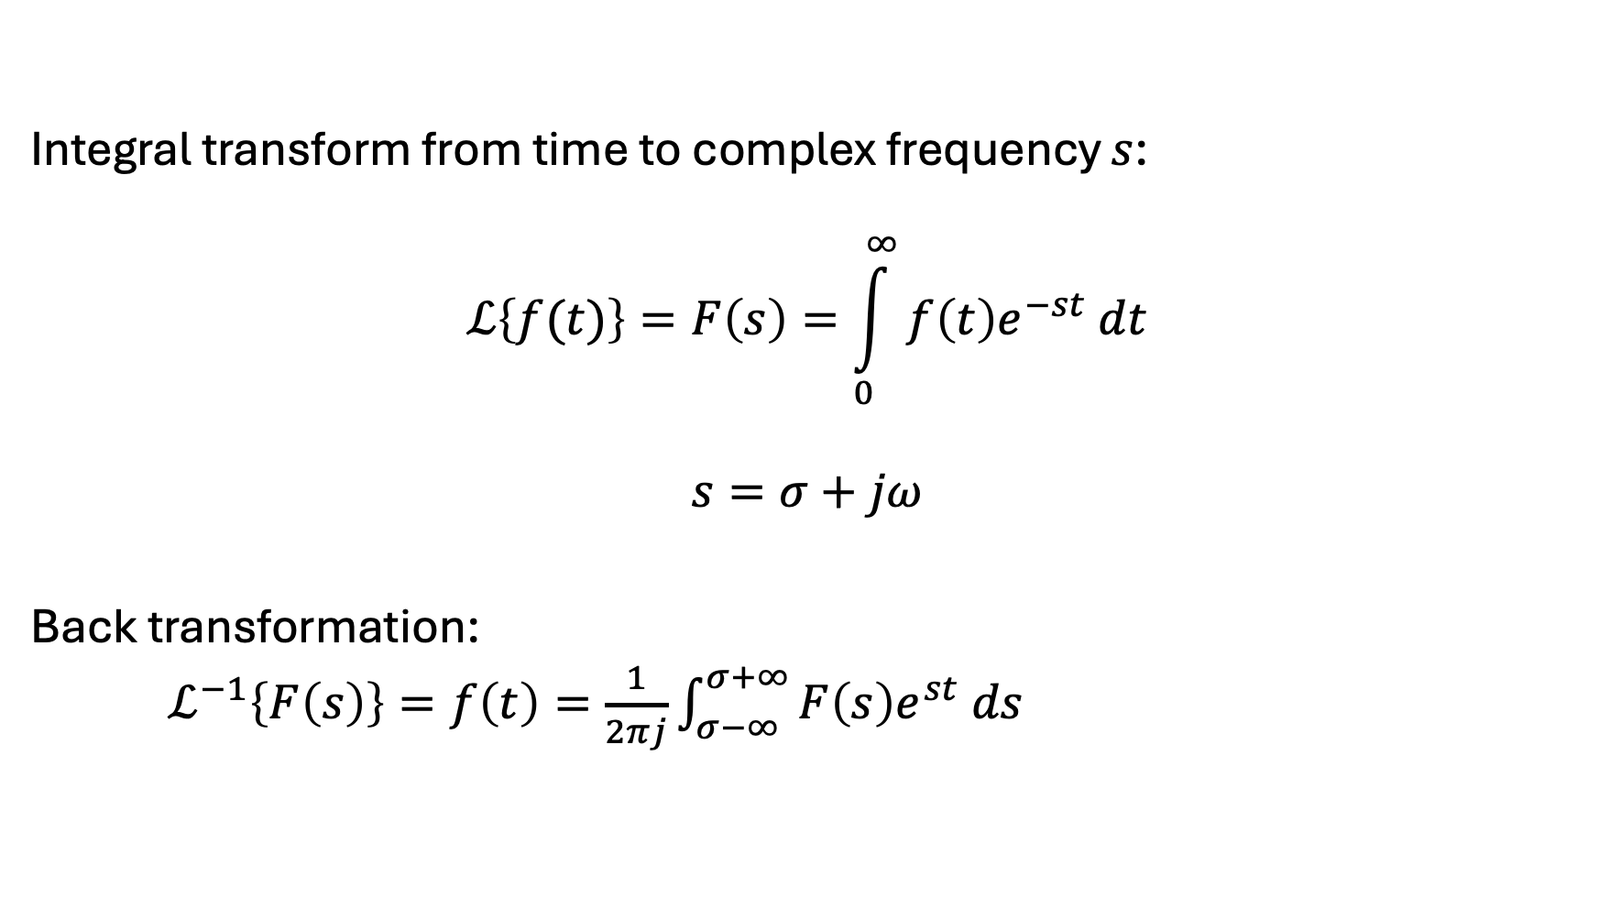
Definition of Laplace Transform
Integral transform from time to complex frequency $s$:
$$ℒ\left\{f(t)\right\}=F\left(s\right)=\int_{0}^{∞}{f\left(t\right)e^{−st} dt}$$
$$s=σ+jω$$
Back transformation:
$ℒ^{−1}\left\{F\left(s\right)\right\}=f\left(t\right)=\frac{1}{2πj}\int_{σ−∞}^{σ+∞}{F\left(s\right)e^{st} ds}$

Slide 8

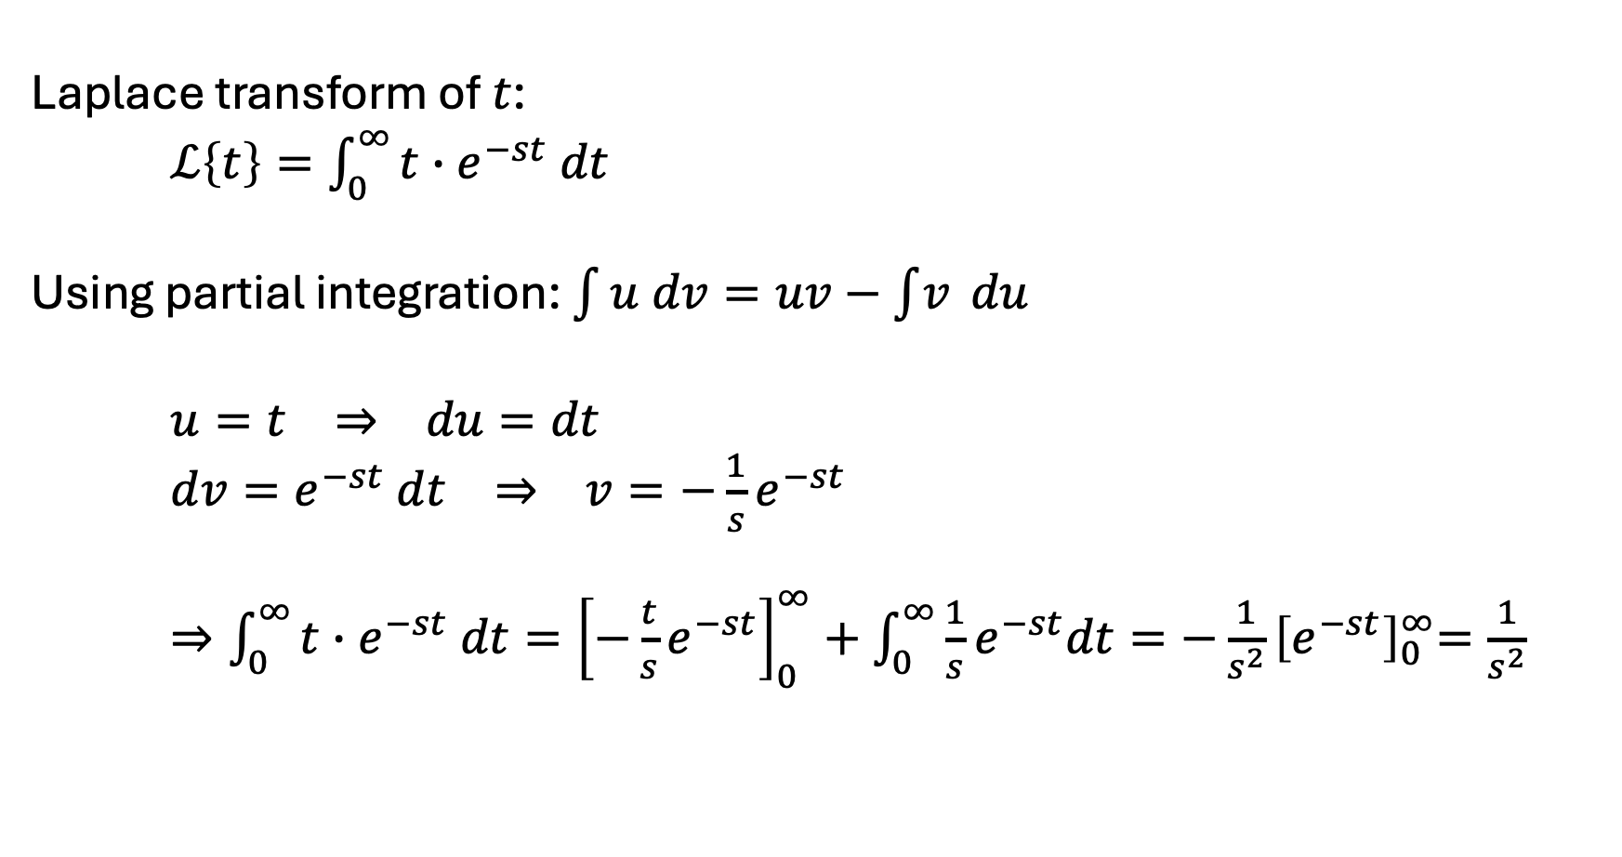
Example
Laplace transform of $t$:
$ℒ\left\{t\right\}=\int_{0}^{∞}{t∙e^{−st} dt}$
Using partial integration: $\int{u dv=uv−\int{v} du}$
$u=t ⇒ du=dt$
$dv=e^{−st} dt ⇒ v={−\frac{1}{s}e}^{−st}$
$⇒\int_{0}^{∞}{t∙e^{−st} dt}={\left[−{\frac{t}{s}e}^{−st}\right]}_{0}^{∞}+\int_{0}^{∞}{{\frac{1}{s}e}^{−st}dt}={−\frac{1}{s^{2}}\left[e^{−st}\right]}_{0}^{∞}=\frac{1}{s^{2}}$
$$=0$$

Slide 9
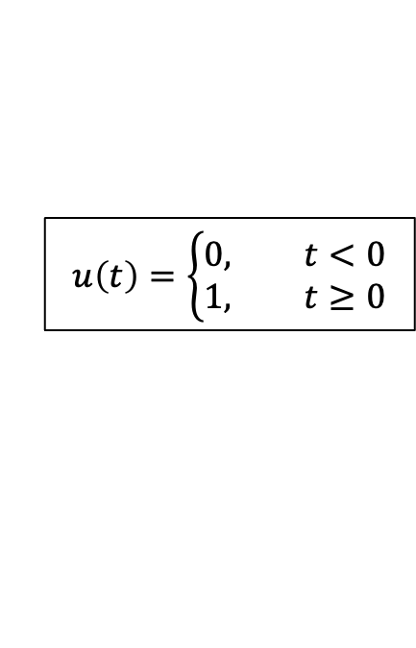
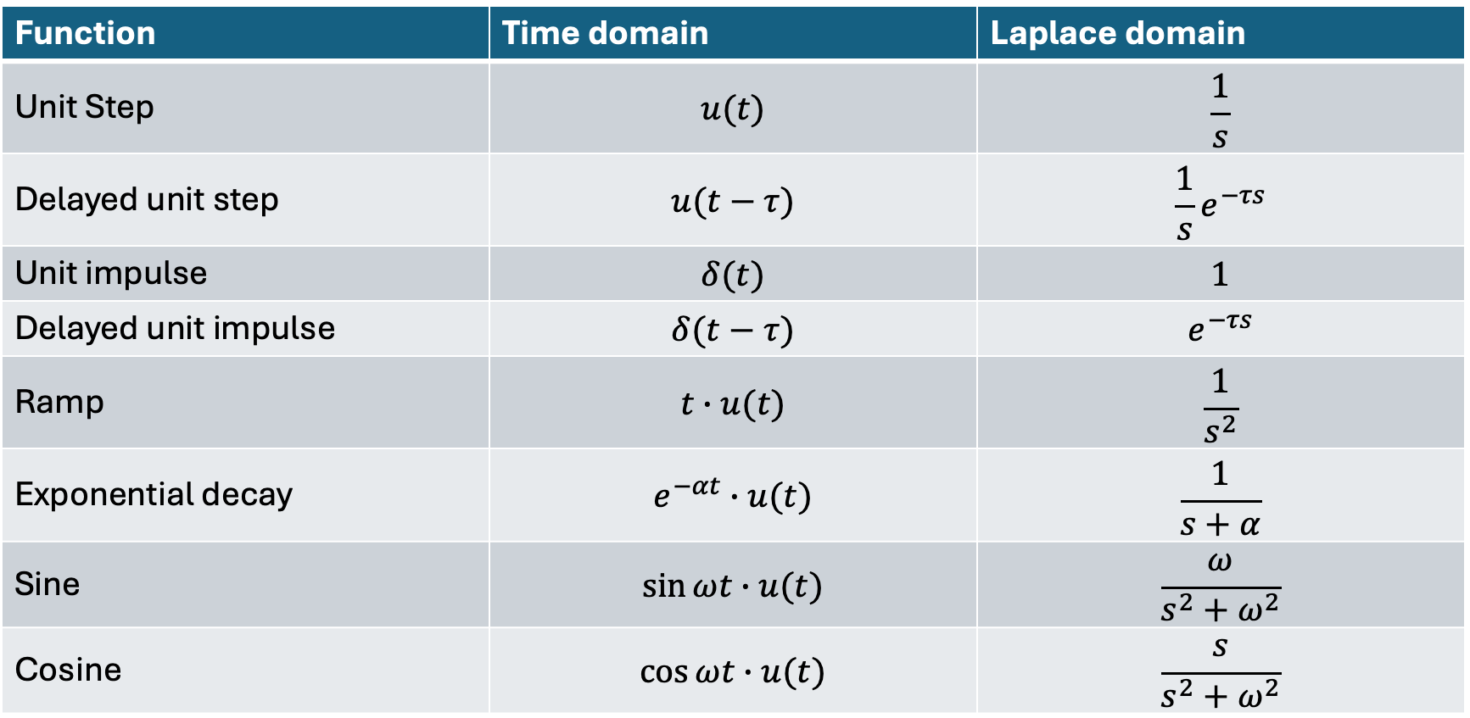
Laplace of Common Signals
$$u\left(t\right)=\left\{\begin{aligned}0, t<0 \\ 1, t≥0\end{aligned}\right.$$
Function | Time domain | Laplace domain
Unit Step | $$u(t)$$ | $$\frac{1}{s}$$
Delayed unit step | $$u(t−τ)$$ | $$\frac{1}{s}e^{−τs}$$
Unit impulse | $$δ(t)$$ | $$1$$
Delayed unit impulse | $$δ(t−τ)$$ | $$e^{−τs}$$
Ramp | $$t∙u(t)$$ | $$\frac{1}{s^{2}}$$
Exponential decay | $$e^{−αt}∙u(t)$$ | $$\frac{1}{s+α}$$
Sine | $$\sin{ωt}∙u(t)$$ | $$\frac{ω}{s^{2}+ω^{2}}$$
Cosine | $$\cos{ωt}∙u(t)$$ | $$\frac{s}{s^{2}+ω^{2}}$$

Slide 10
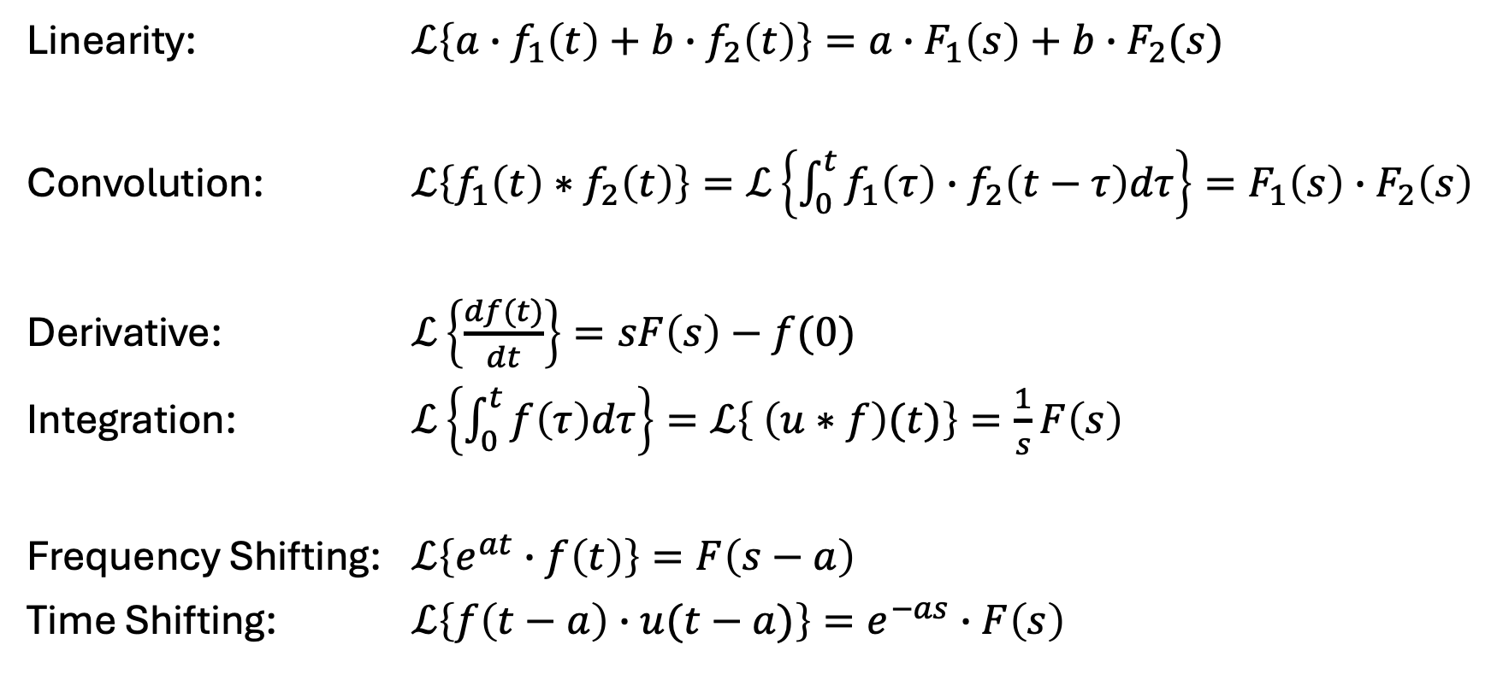
Properties of Laplace Transform
Linearity: $ℒ\left\{a∙f_{1}\left(t\right)+b∙f_{2}\left(t\right)\right\}=a∙F_{1}\left(s\right)+b∙F_{2}(s)$
Convolution: $ℒ\left\{f_{1}\left(t\right)∗f_{2}\left(t\right)\right\}=ℒ\left\{\int_{0}^{t}{f_{1}\left(τ\right)∙f_{2}\left(t−τ\right)dτ}\right\}=F_{1}\left(s\right)∙F_{2}\left(s\right)$
Derivative: $ℒ\left\{\frac{df(t)}{dt}\right\}=sF\left(s\right)−f(0)$
Integration: $ℒ\left\{\int_{0}^{t}{f\left(τ\right)dτ}\right\}=ℒ\left\{ \left(u∗f\right)(t)\right\}=\frac{1}{s}F\left(s\right)$
Frequency Shifting: $ℒ\left\{e^{at}∙f\left(t\right)\right\}=F\left(s−a\right)$
Time Shifting: $ℒ\left\{f\left(t−a\right)∙u(t−a)\right\}=e^{−as}∙F\left(s\right)$

Slide 11
From Differential Equation to Transfer Function
Example: PT2 system
Time domain:
Frequency domain:
Transfer function: $G\left(s\right)=\frac{Y(s)}{U(s) }=\frac{ω_{n}^{2}K}{s^{2}+2ζω_{n}s+ω_{n}^{2}}$ (assuming zero initial conditions)
$$u(t)$$
$$\ddot{y}(t)+2ζω_{n}\dot{y}(t)+ω_{n}^{2}y(t)=ω_{n}^{2}Ku(t)$$
$$y(t)$$
$$U(s)$$
$$s^{2}Y(s)+2ζω_{n}sY(s)+ω_{n}^{2}Y(s)=ω_{n}^{2}KU(s)$$
$$Y(s)$$

Slide 12
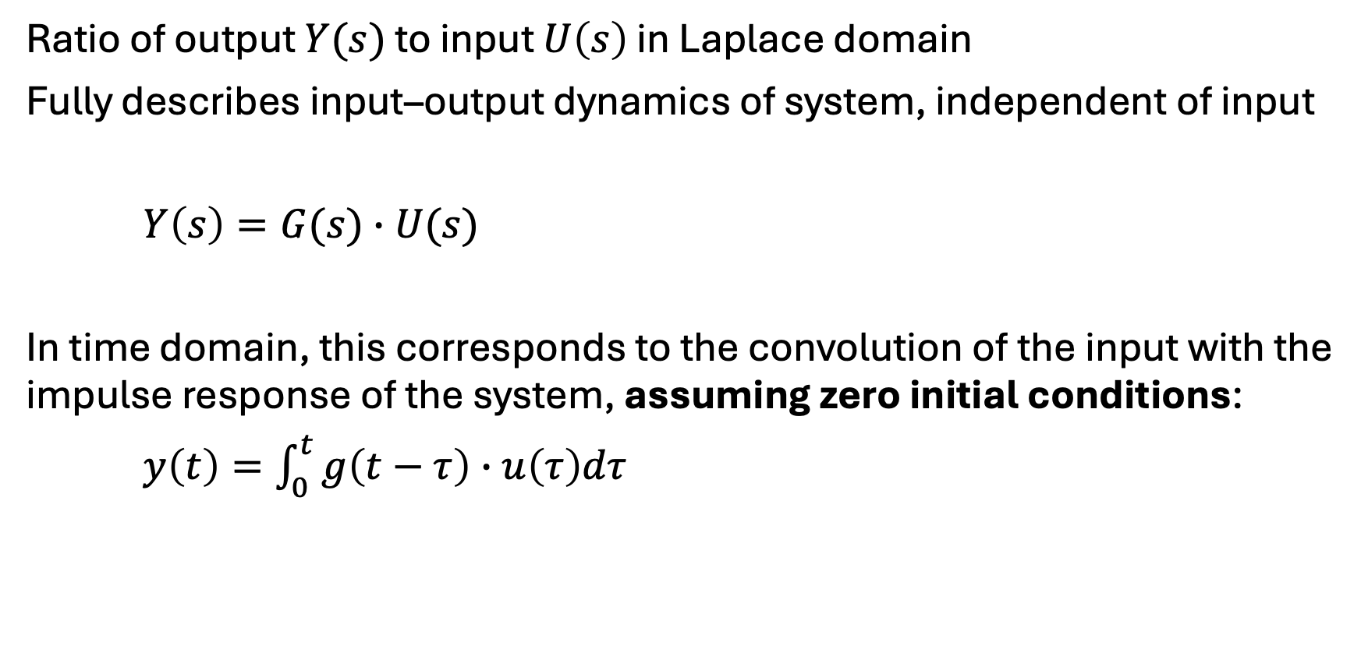
Transfer Function
Ratio of output $Y(s)$ to input $U\left(s\right)$ in Laplace domain
Fully describes input–output dynamics of system, independent of input
$Y\left(s\right)=G(s)∙U(s)$
In time domain, this corresponds to the convolution of the input with the impulse response of the system, assuming zero initial conditions:
$y\left(t\right)=\int_{0}^{t}{g\left(t−τ\right)∙u\left(τ\right)dτ}$

Slide 13
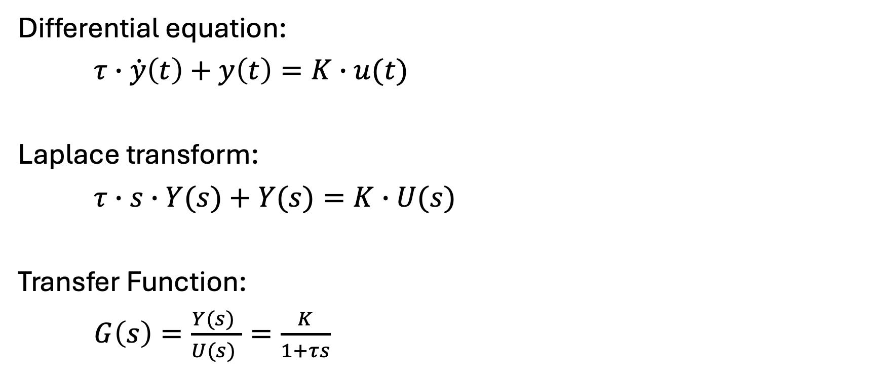
Transfer Function for PT1 System
Differential equation:
$τ∙\dot{y}\left(t\right)+y\left(t\right)=K∙u(t)$
Laplace transform:
$τ∙s∙Y(s)+Y(s)=K∙U(s)$
Transfer Function:
$G\left(s\right)=\frac{Y(s) }{U(s) }=\frac{K}{1+τs}$
independent of input

Slide 14

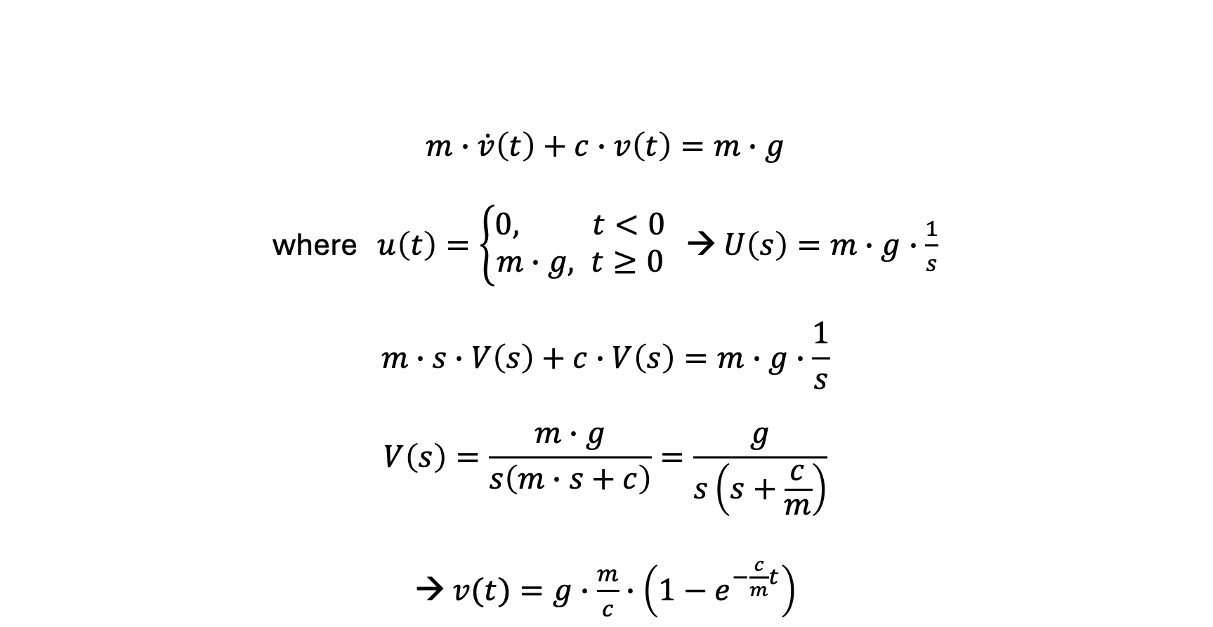

Example: Free Fall with Viscous Damping
$$m∙\dot{v}\left(t\right)+c∙v\left(t\right)=m∙g$$
where $u\left(t\right)=\left\{\begin{aligned}0, t<0 \\ m∙g, t≥0\end{aligned}\right.$ → $U\left(s\right)=m∙g∙\frac{1}{s}$
$$m∙s∙V\left(s\right)+c∙V\left(s\right)=m∙g∙\frac{1}{s}$$
$$V\left(s\right)=\frac{m∙g}{s\left(m∙s+c\right)}=\frac{g}{s\left(s+\frac{c}{m}\right)}$$
→ $v(t)=g∙\frac{m}{c}∙\left(1−e^{−\frac{c}{m}t}\right)$
Transformation table:
$$\frac{α}{s\left(s+α\right)}↦1−e^{−αt}$$
$$τ=K=\frac{m}{c}$$

Slide 15
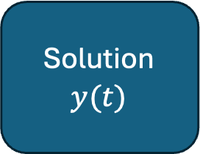
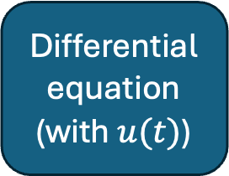


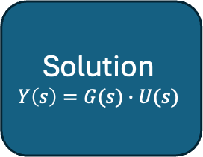
System Response with Transfer Function
Differential equation
(with $u(t)\text{)}$
Solution
$$y(t)$$
$$ℒ$$
$$ℒ^{−1}$$
most elaborate part
Algebraic equation
Solution
$$Y\left(s\right)=G(s)∙U(s)$$

Slide 16
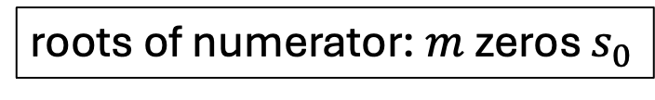
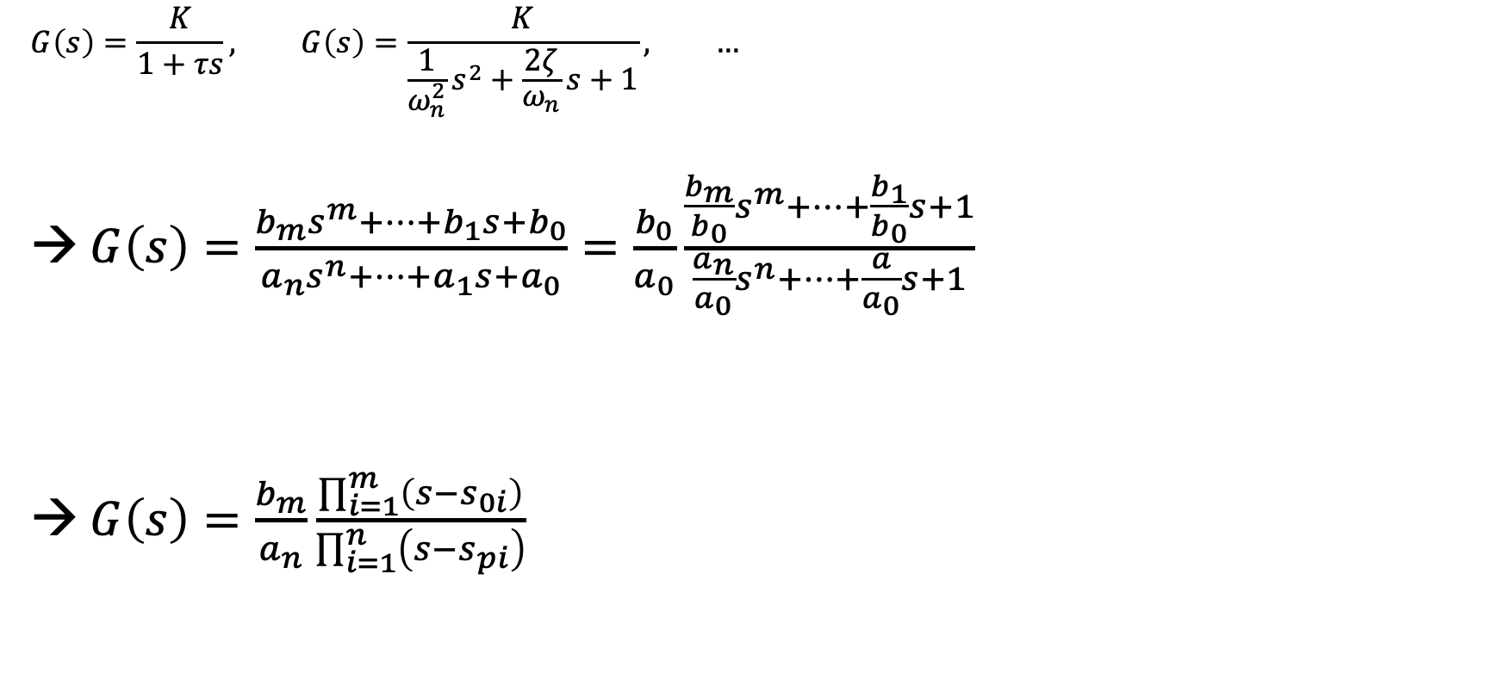

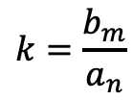
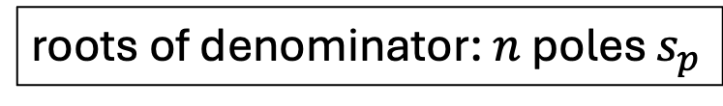
Transfer Function in Polynomial Form
$$G\left(s\right)=\frac{K}{1+τs}, G\left(s\right)=\frac{K}{\frac{1}{ω_{n}^{2}}s^{2}+\frac{2ζ}{ω_{n}}s+1}, …$$
→ $G\left(s\right)=\frac{b_{m}s^{m}+⋯+b_{1}s+b_{0}}{a_{n}s^{n}+⋯+a_{1}s+a_{0}}=\frac{b_{0}}{a_{0}}\frac{\frac{b_{m}}{b_{0}}s^{m}+⋯+\frac{b_{1}}{b_{0}}s+1}{\frac{a_{n}}{a_{0}}s^{n}+⋯+\frac{a}{a_{0}}s+1}$
→ $G\left(s\right)=\frac{b_{m}}{a_{n}}\frac{\prod_{i=1}^{m}{\left(s−s_{0i}\right)}}{\prod_{i=1}^{n}{\left(s−s_{pi}\right)}}$
Input coupling:
describes how the input enters the system (can contain time derivatives)
fundamental theorem of algebra
Intrinsic system dynamics:
characteristic polynomial of the system
$$K=\frac{b_{0}}{a_{0}}$$
roots of numerator: $m$ zeros $s_{0}$
roots of denominator: $n$ poles $s_{p}$
$$k=\frac{b_{m}}{a_{n}}$$
Causality requires $n≥m$ (output cannot depend on derivative of input)

Slide 17
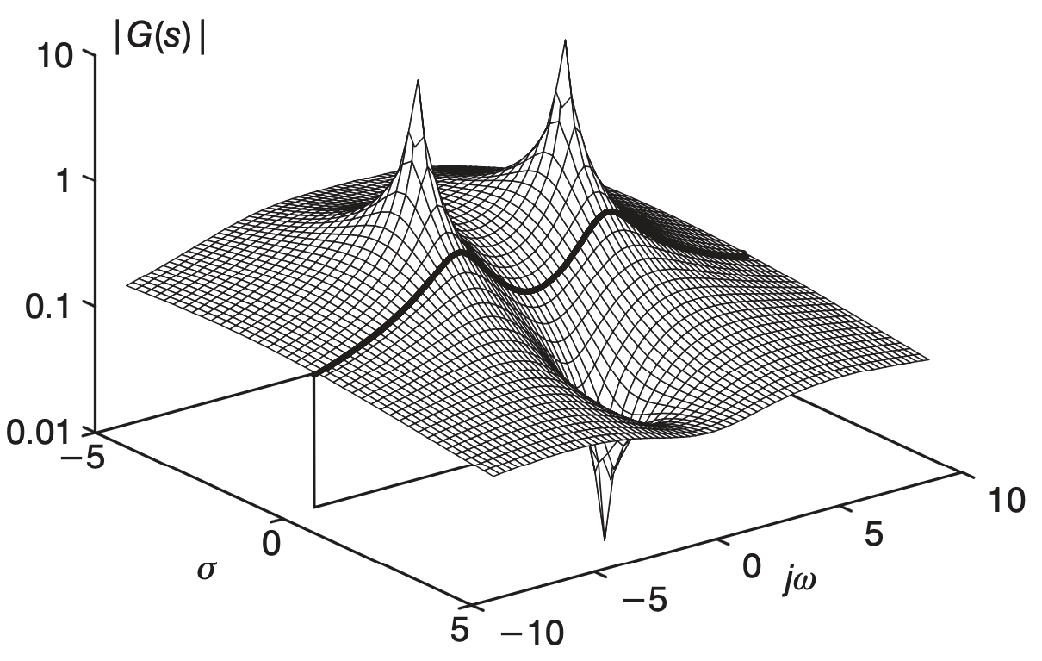
Graphical Interpretation of Transfer Function
conjugate pair
Contains (complex) poles and zeros

Slide 18
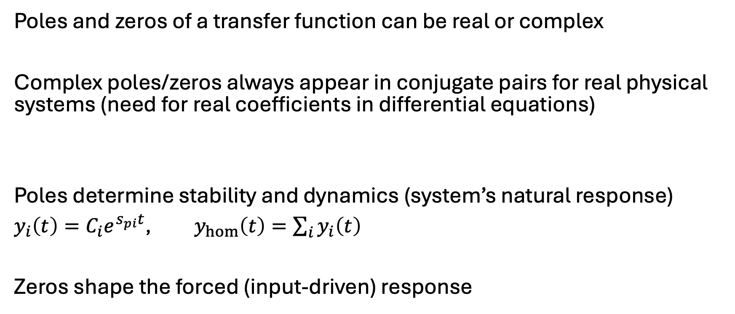
Poles and Zeros
PT1: one pole
PT2: two poles
Poles and zeros of a transfer function can be real or complex
Complex poles/zeros always appear in conjugate pairs for real physical systems (need for real coefficients in differential equations)
Poles determine stability and dynamics (system’s natural response)
$y_{i}\left(t\right)=C_{i}e^{s_{pi}t}$, $y_{hom}\left(t\right)=\sum_{i}{y_{i}\left(t\right)}$
Zeros shape the forced (input-driven) response
$$\left(s−\left(σ+jω\right)\right)\left(s−\left(σ−jω\right)\right)={\left(s−σ\right)}^{2}+ω^{2}$$
More about this later …

Slide 19
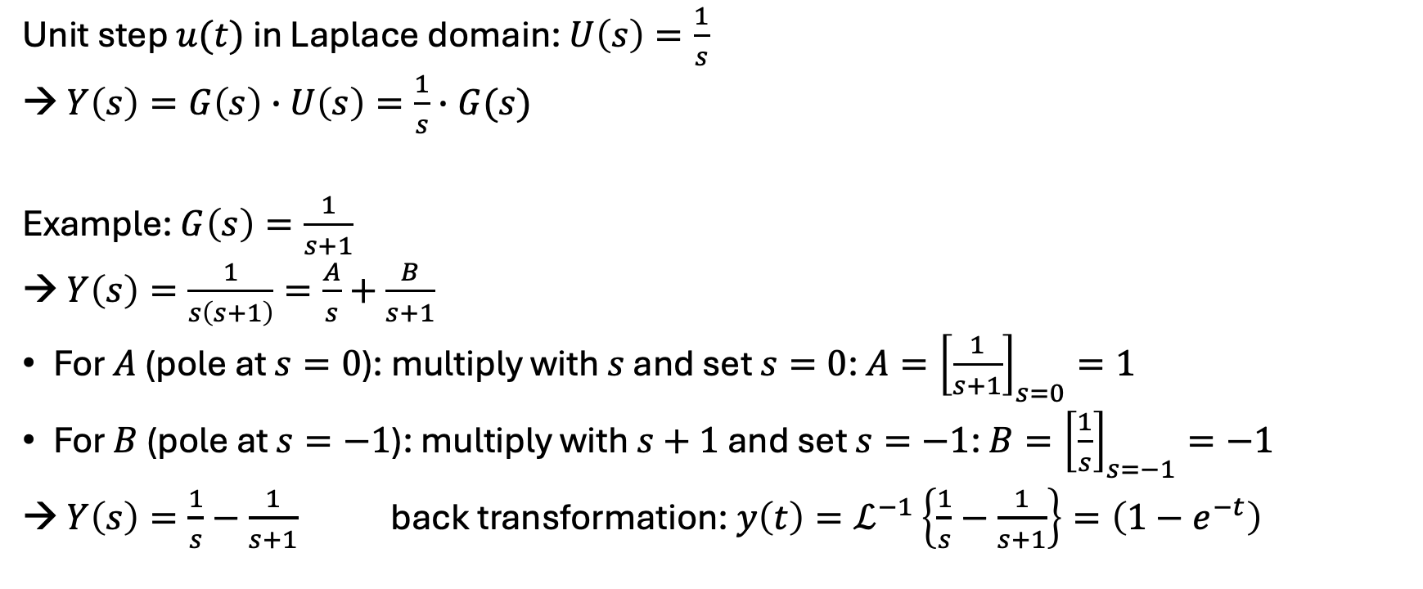
Step Response
Unit step $u(t)$ in Laplace domain: $U\left(s\right)=\frac{1}{s}$
→ $Y\left(s\right)=G\left(s\right)∙U\left(s\right)=\frac{1}{s}∙G(s)$
Example: $G\left(s\right)=\frac{1}{s+1}$
→ $Y\left(s\right)=\frac{1}{s\left(s+1\right)}=\frac{A}{s}+\frac{B}{s+1}$
For $A$ (pole at $s=0$): multiply with $s$ and set $s=0$: $A={\left[\frac{1}{s+1}\right]}_{s=0}=1$
For $B$ (pole at $s=−1$): multiply with $s+1$ and set $s=−1$: $B={\left[\frac{1}{s}\right]}_{s=−1}=−1$
→ $Y\left(s\right)=\frac{1}{s}−\frac{1}{s+1}$ back transformation: $y\left(t\right)=ℒ^{−1}\left\{\frac{1}{s}−\frac{1}{s+1}\right\}=\left(1−e^{−t}\right)$
partial fraction expansion

Slide 20
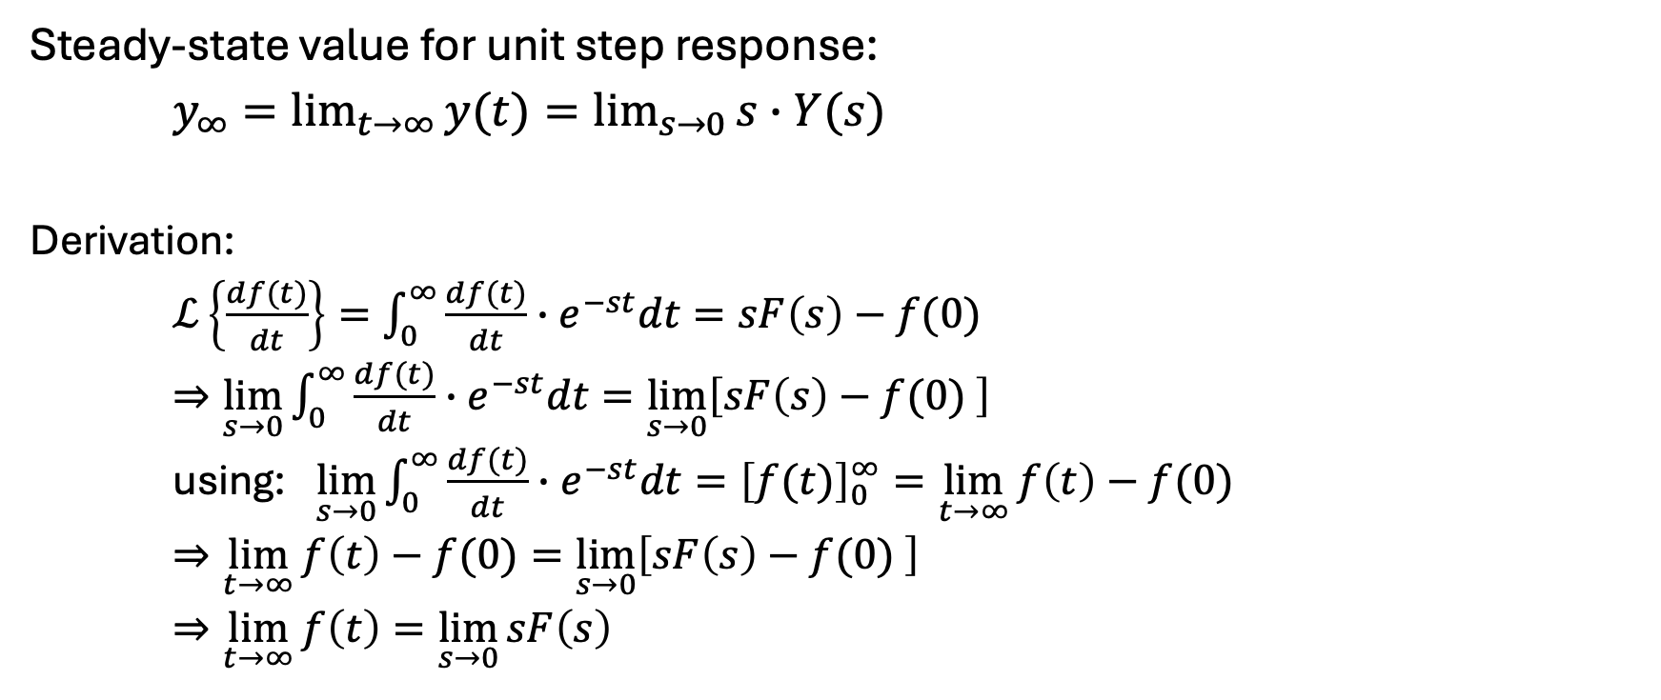
Final Value Theorem
Steady-state value for unit step response:
$y_{∞}=\lim_{t→∞}{y(t)}=\lim_{s→0}{s∙Y(s)}$
Derivation:
$ℒ\left\{\frac{df(t)}{dt}\right\}=\int_{0}^{∞}{\frac{df(t)}{dt}∙e^{−st}dt}=sF\left(s\right)−f(0)$
$⇒\lim_{s→0}\int_{0}^{∞}{\frac{df(t)}{dt}∙e^{−st}dt}=\lim_{s→0}\left[sF\left(s\right)−f(0) \right]$
using: $\lim_{s→0}\int_{0}^{∞}{\frac{df(t)}{dt}∙e^{−st}dt}={\left[f(t)\right]}_{0}^{∞}=\lim_{t→∞}{f\left(t\right)−f(0)}$
$⇒\lim_{t→∞}{f\left(t\right)−f(0)}=\lim_{s→0}\left[sF\left(s\right)−f(0) \right]$
$⇒\lim_{t→∞}{f\left(t\right)}=\lim_{s→0}{sF\left(s\right)}$

Slide 21
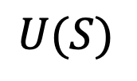
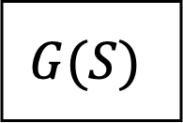
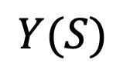
Block Diagrams
$$U(S)$$
$$G(S)$$
$$Y(S)$$
Modular representation

Slide 22
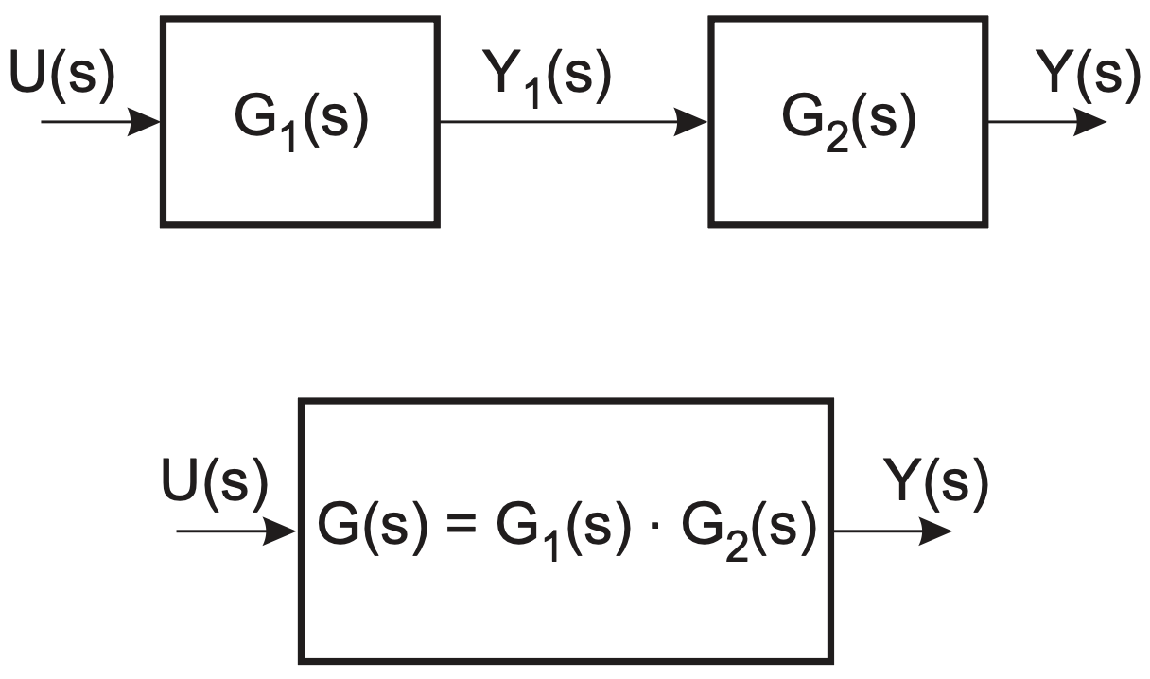
Series Connection
Example:
PT2
PT1
PT1

Slide 23
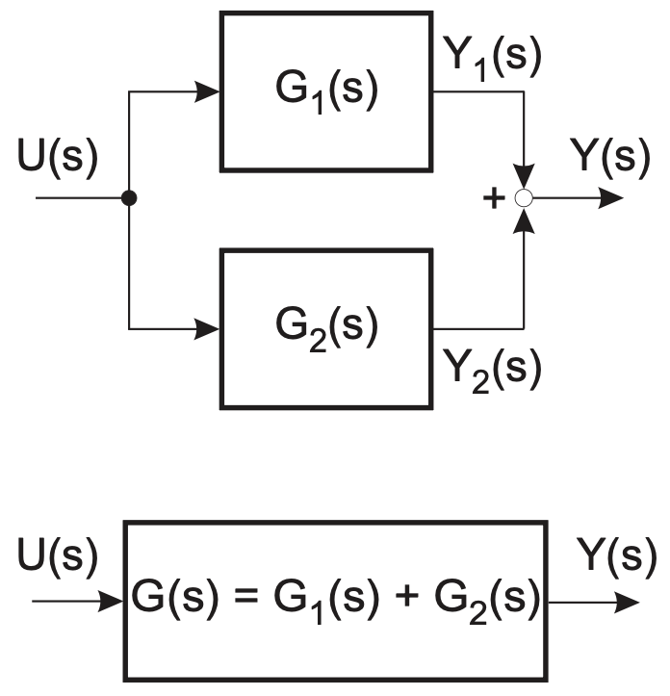
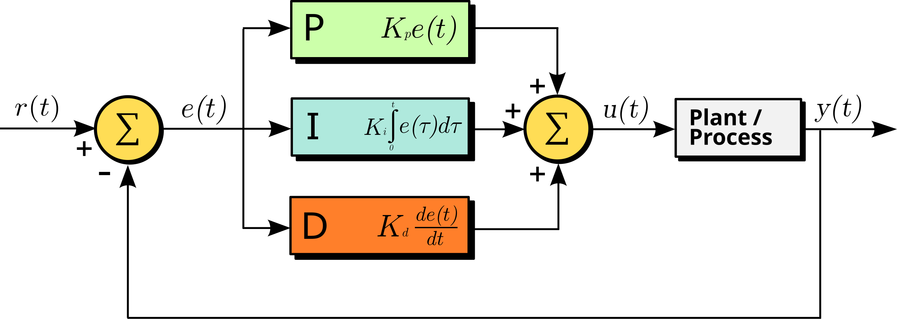
Parallel Connection

Slide 24
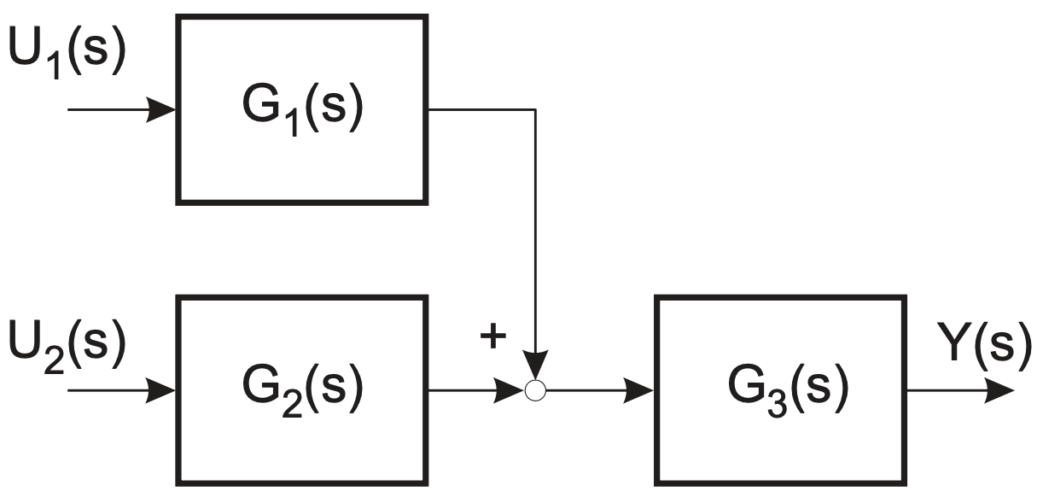
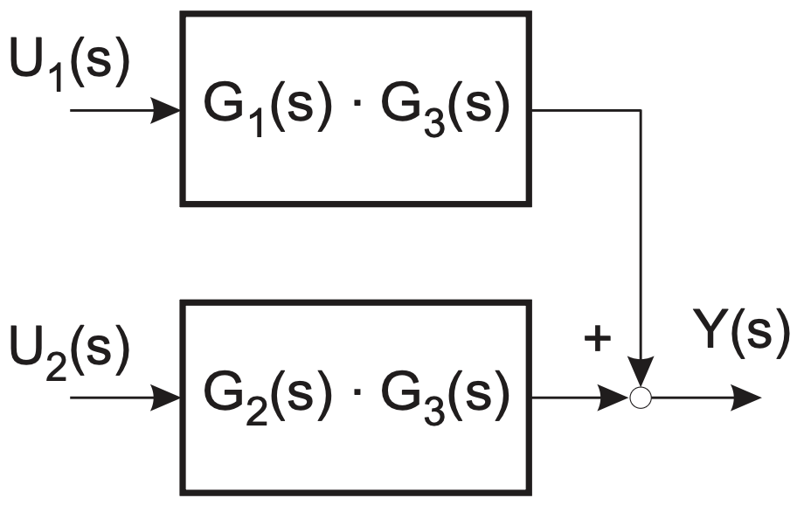
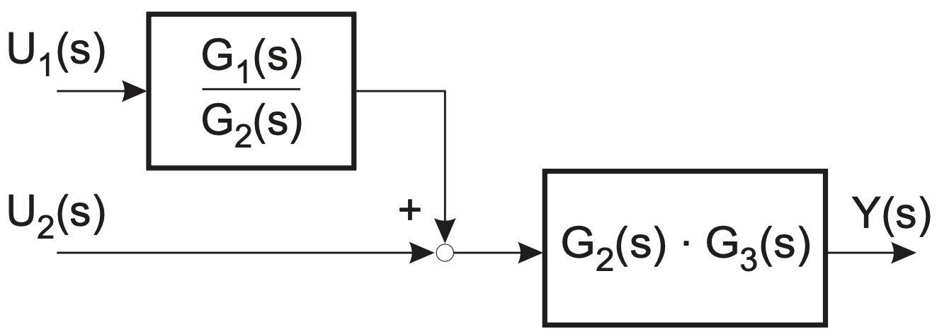
Block Diagram Algebra

Slide 25
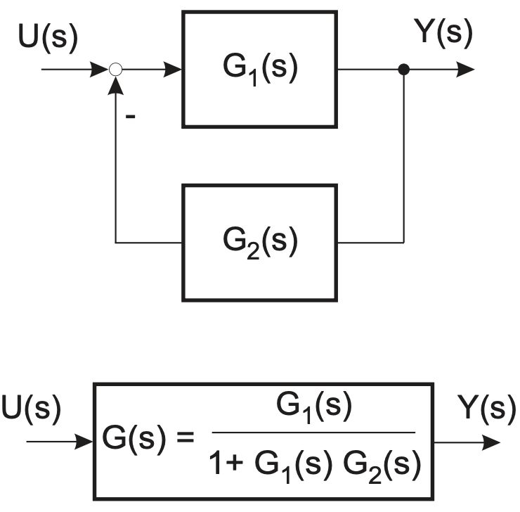
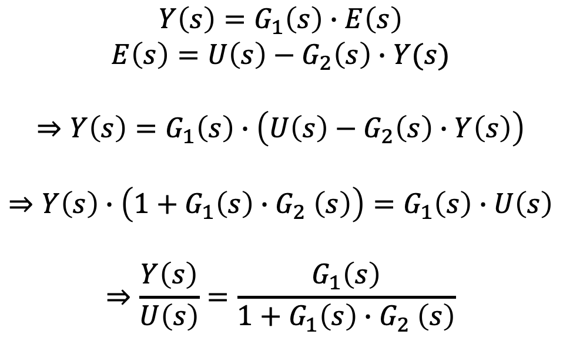
Feedback Connection
$$Y\left(s\right)=G_{1}\left(s\right)∙E\left(s\right)$$
$$E\left(s\right)=U\left(s\right)−G_{2}\left(s\right)∙Y(s)$$
$$⇒Y\left(s\right)=G_{1}\left(s\right)∙\left(U\left(s\right)−G_{2}\left(s\right)∙Y\left(s\right)\right)$$
$$⇒Y\left(s\right)∙\left(1+G_{1}\left(s\right){∙G}_{2}\left(s\right)\right)=G_{1}\left(s\right)∙U\left(s\right)$$
$$⇒\frac{Y\left(s\right)}{U\left(s\right)}=\frac{G_{1}\left(s\right)}{1+G_{1}\left(s\right){∙G}_{2}\left(s\right)}$$
often unity

Slide 26
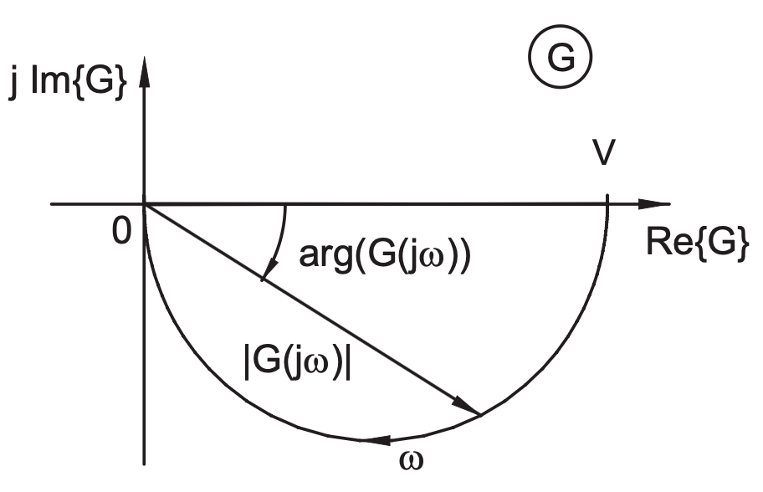

Frequency Response
response = transient part + steady-state part
Response to sinusoidal inputs: $G(jω)$
Amplitude and phase as function of frequency $ω$
Nyquist diagram:

Slide 27
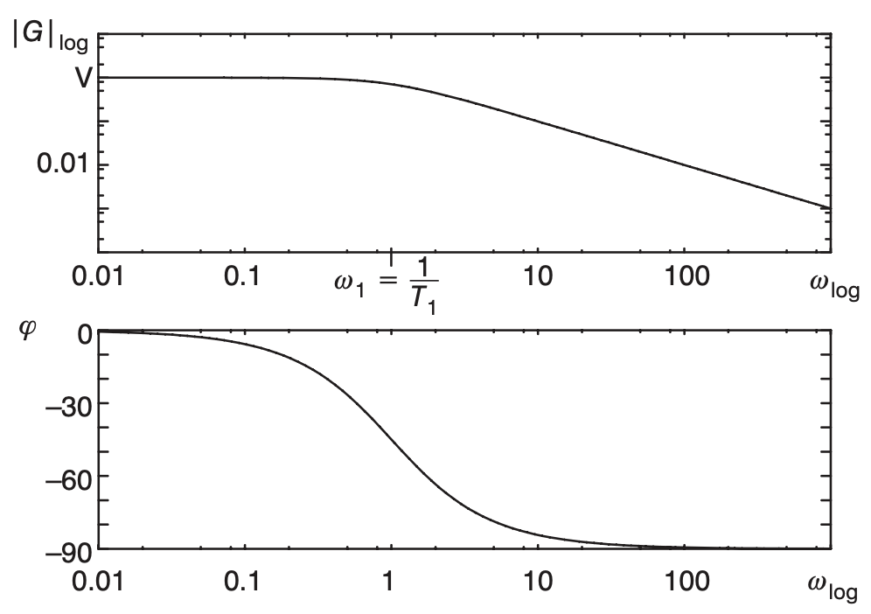
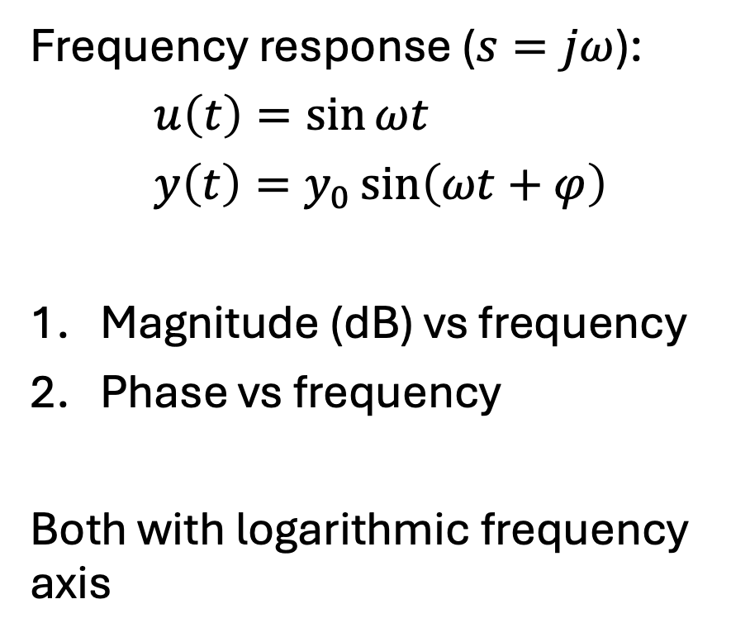



Bode Plots
Example PT1:
$G\left(jω\right)=\frac{K}{1+τjω}$
$\left|G(jω)\right|=\frac{K}{\sqrt{1+τ^{2}ω^{2}}}$
$φ=−\tan^{−1}\left(\frac{ωτ}{K}\right)$
Frequency response ($s=jω$):
$u\left(t\right)=\sin{ωt}$
$y\left(t\right)=y_{0}\sin\left(ωt+φ\right)$
Magnitude (dB) vs frequency
Phase vs frequency
Both with logarithmic frequency axis
$$y_{0}=\left|G(jω)\right|$$
$$φ=\arg{G(jω)}$$

Slide 28
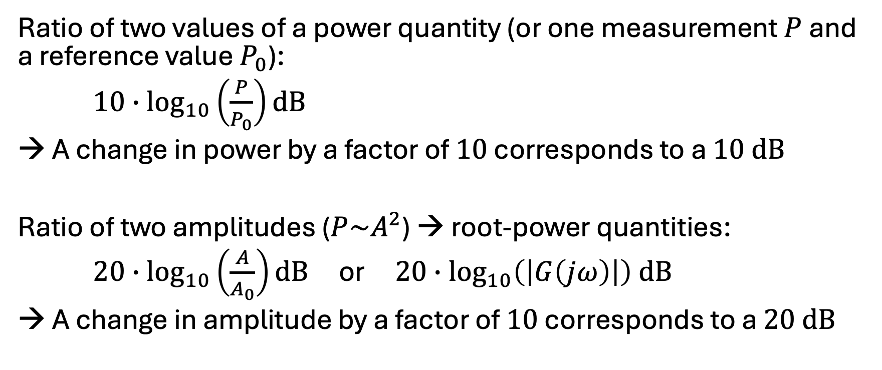
Common Magnitude Unit: Decibel
Ratio of two values of a power quantity (or one measurement $P$ and a reference value $P_{0}$):
$10∙\log_{10}\left(\frac{P}{P_{0}}\right)dB$
→ A change in power by a factor of $10$ corresponds to a $10 dB$
Ratio of two amplitudes ($P\sim A^{2}$) → root-power quantities:
$20∙\log_{10}\left(\frac{A}{A_{0}}\right)dB$ or $20∙\log_{10}\left(\left|G\left(jω\right)\right|\right) dB$
→ A change in amplitude by a factor of $10$ corresponds to a $20 dB$

Slide 29
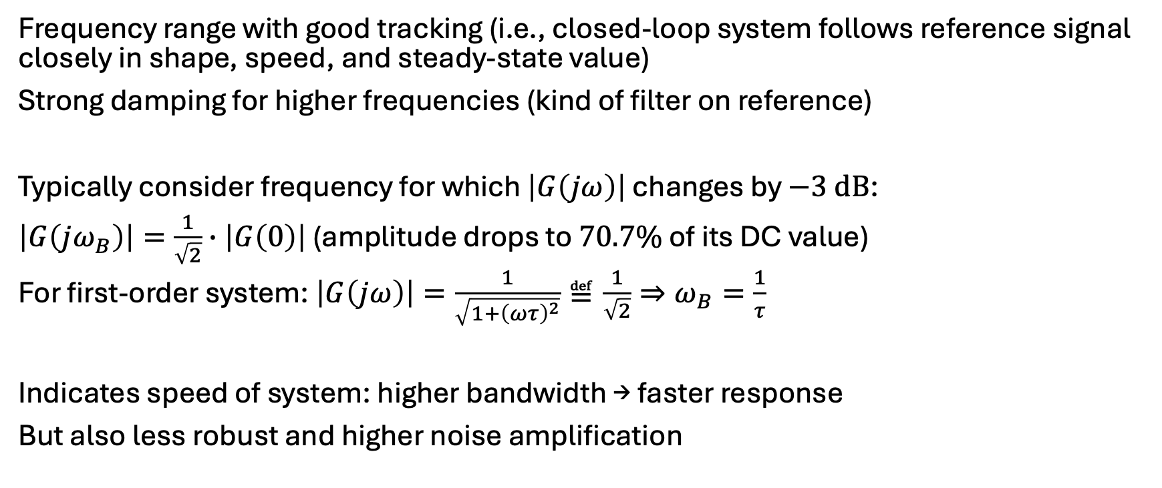
Bandwidth
Frequency range with good tracking (i.e., closed-loop system follows reference signal closely in shape, speed, and steady-state value)
Strong damping for higher frequencies (kind of filter on reference)
Typically consider frequency for which $\left|G\left(jω\right)\right|$ changes by $−3 dB$:
$\left|G\left(jω_{B}\right)\right|=\frac{1}{\sqrt{2}}∙\left|G\left(0\right)\right|$ (amplitude drops to $70.7\%$ of its DC value)
For first-order system: $\left|G\left(jω\right)\right|=\frac{1}{\sqrt{1+{\left(ωτ\right)}^{2}}}≝\frac{1}{\sqrt{2}}⇒ω_{B}=\frac{1}{τ}$
Indicates speed of system: higher bandwidth → faster response
But also less robust and higher noise amplification

Slide 30
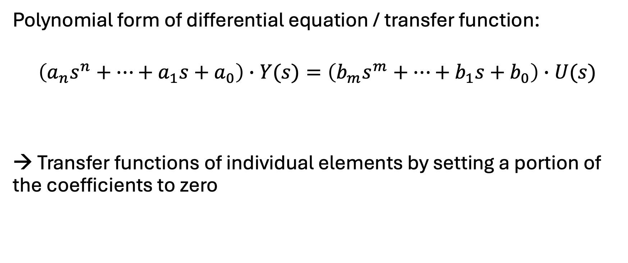
Individual Elements of Control Loops
Polynomial form of differential equation / transfer function:
$$\left(a_{n}s^{n}+⋯+a_{1}s+a_{0}\right)∙Y(s)=\left(b_{m}s^{m}+⋯+b_{1}s+b_{0}\right)∙U(s)$$
→ Transfer functions of individual elements by setting a portion of the coefficients to zero

Slide 31
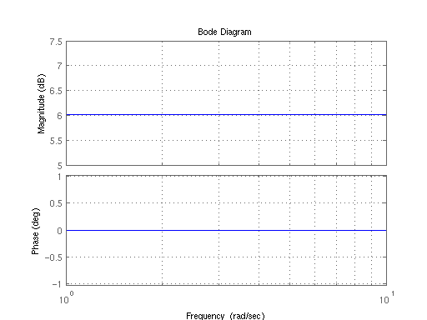
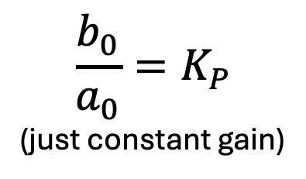

Proportional Element (P)
Consider $n=0$:
$y\left(t\right)=\frac{b_{0}}{a_{0}}∙u(t)$ or $Y\left(s\right)=\frac{b_{0}}{a_{0}}∙U(s)$
$$\frac{b_{0}}{a_{0}}=K_{P}$$
(just constant gain)
Step response:

Slide 32
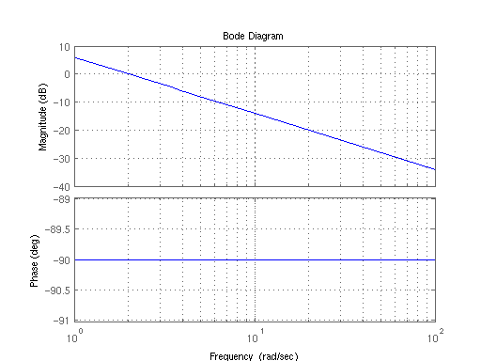
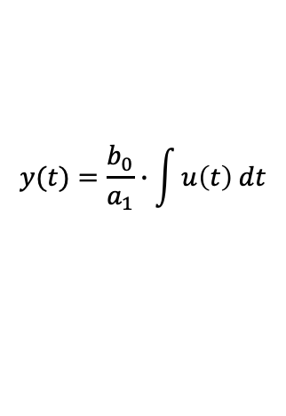
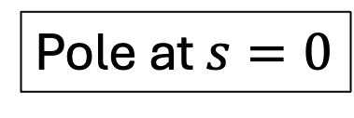
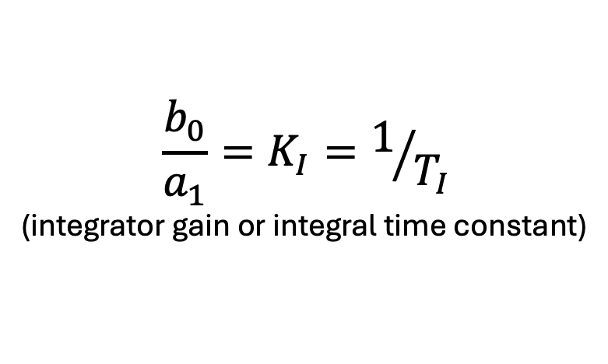


Integral Element (I)
Pole at $s=0$
Consider $n=1$, with $a_{0}=b_{1}=0$:
$\frac{dy\left(t\right)}{dt}=\frac{b_{0}}{a_{1}}∙u(t)$ or $Y\left(s\right)=\frac{b_{0}}{a_{1}}∙\frac{1}{s}∙U(s)$
$$y(t)=\frac{b_{0}}{a_{1}}∙\int{u\left(t\right) dt}$$
$$\frac{b_{0}}{a_{1}}=K_{I}=1/{T_{I}}$$
(integrator gain or integral time constant)
Energy storage,
memory
Step response:
$$\int{const dt=t}$$

Slide 33






First-Order Lag Element (PT1)
Consider $n=1$, with $b_{1}=0$:
$\frac{a_{1}}{a_{0}}∙\frac{dy\left(t\right)}{dt}+y(t)=\frac{b_{0}}{a_{0}}∙u(t)$ or $Y\left(s\right)∙\left(s∙\frac{a_{1}}{a_{0}}+1\right)=\frac{b_{0}}{a_{0}}∙U(s)$
$$G\left(s\right)=\frac{Y\left(s\right)}{U\left(s\right)}=\frac{K}{1+τs}$$
$$τ$$
$$K$$
Pole at $s=−\frac{1}{τ}$
$$τ$$
Step response:

Slide 34

PT1 Signal Flow Diagram
One energy storage

Slide 35


Derivative Element (D)
Amplifies high frequencies, i.e., noise
→ use filtered differentiator (DT1)
Consider $n=1$, with $a_{1}=b_{0}=0$:
$y\left(t\right)=\frac{b_{1}}{a_{0}}∙\frac{du\left(t\right)}{dt}$ or $Y\left(s\right)=\frac{b_{1}}{a_{0}}∙s∙U(s)$
$$\frac{b_{1}}{a_{0}}=K_{D}=T_{D}$$
(differentiator/derivative gain or derivative time constant)
Step response:
physically unrealizable → damping

Slide 36







Filtered Differentiator (DT1)
Used in PID controllers
Consider $n=1$, with $b_{0}=0$:
$\frac{a_{1}}{a_{0}}∙\frac{dy\left(t\right)}{dt}+y(t)=\frac{b_{1}}{a_{0}}∙\frac{du\left(t\right)}{dt}$ or $Y\left(s\right)∙\left(s∙\frac{a_{1}}{a_{0}}+1\right)=\frac{b_{1}}{a_{0}}∙s∙U(s)$
$$T_{1}$$
$$T_{2}$$
$$G\left(s\right)=\frac{T_{2}∙s}{T_{1}∙s+1}$$
$$\lim_{T_{1}→0}{G(s)}=T_{2}∙s$$
→ ideal D element
Step response:

Slide 37


Slide 38

DT1 Signal Flow Diagram

Slide 39






Second-Order Lag Element (PT2)
Resonance
(complex poles)
Consider $n=2$, with $b_{1}=b_{2}=0$:
$\frac{a_{2}}{a_{0}}\frac{d^{2}y(t)}{dt^{2}}+\frac{a_{1}}{a_{0}}\frac{dy\left(t\right)}{dt}+y(t)=\frac{b_{0}}{a_{0}}u(t)$
$Y\left(s\right)∙\left(\frac{a_{2}}{a_{0}}s^{2}+\frac{a_{1}}{a_{0}}s+1\right)=\frac{b_{0}}{a_{0}}∙U(s)$
$$\frac{1}{ω_{0}^{2}}$$
$$\frac{2ζ}{ω_{n}}$$
$$K$$
Step response:
$$G\left(s\right)=\frac{K}{\frac{1}{ω_{n}^{2}}s^{2}+\frac{2ζ}{ω_{n}}s+1}$$
$ζ$, $ω_{n}$

Slide 40

PT2 as Product of Two PT1 Elements
$G\left(s\right)=\frac{K}{\frac{1}{ω_{n}^{2}}s^{2}+\frac{2ζ}{ω_{n}}s+1}$ can be written as product of two PT1 elements:
$$G\left(s\right)=\frac{K}{\left(τ_{1}s+1\right)\left(τ_{2}s+1\right)}$$
$⇒ \frac{1}{ω_{n}^{2}}s^{2}+\frac{2ζ}{ω_{n}}s+1=τ_{1}τ_{2}s^{2}+\left(τ_{1}+τ_{2}\right)s+1$
$⇒ \frac{1}{ω_{n}^{2}}=τ_{1}τ_{2}$, $\frac{2ζ}{ω_{n}}=\left(τ_{1}+τ_{2}\right)$
$⇒ ζ=\frac{τ_{1}+τ_{2}}{2\sqrt{τ_{1}τ_{2}}}$
for real PT1 elements: $τ_{1}+τ_{2}≥2\sqrt{τ_{1}τ_{2}}$ (arithmetic-geometric mean inequality)
→ overdamped ($ζ<1$) or critically damped ($ζ=1$) for $τ_{1}=τ_{2}$
individual time constants
fastest non-oscillatory response

Slide 42

PT2 Signal Flow Diagram
Two energy storages

Slide 43





All-Pass Systems
first-order all-pass: $G\left(s\right)=\frac{s−a}{s+a}$
Magnitude constant for all frequencies ($\left|G\left(jω\right)\right|=1$), but phase depends on frequency
coefficients: $b_{k}={\left(−1\right)}^{n−k}a_{n−k}$
→ Zeros are mirror images of the poles with respect to the imaginary axis.
Important in signal processing, e.g., for runtime alignment
second-order all-pass: $G\left(s\right)=\frac{a_{2}s^{2}−a_{1}s+a_{0}}{a_{2}s^{2}+a_{1}s+a_{0}}$

Slide 44


Systems with Dead Time
The transfer function of a system can be extended by multiplying it with the exponential term that represents a time delay:
$G\left(s\right)=G_{0}\left(s\right)∙e^{−{s∙τ}_{D}}$
Example: PT1 with dead time
$G\left(s\right)=\frac{K}{1+τ∙s}∙e^{−{s∙τ}_{D}}$
Mainly suitable for frequency response analysis (e.g., Bode plots)
Dead time is one of the most common reasons for instability and poor control behavior.
Step response (P element with dead time):
original transfer function
time delay (aka dead time)
T_{D}
$$τ_{D}$$

Slide 45



Bode diagram for system with dead time:
Nyquist diagram for PT1 with dead time:
Nyquist diagram for system with dead time:
Delay = additional phase shift that grows linearly with $ω$
→ Dead time hides in the amplitude, but reveals itself in the phase.

Slide 46

System Identification with Bode Plots
Experiment: frequency response measurement → Bode plots
Magnitude plot: sum of $dB$ contributions of all components
Phase plot: sum of phase contributions
Decompose system into standard building blocks (integrator, PT1, gain, ...) → straight line segments
System identification procedure (construct transfer function):
Determine initial slope (low frequencies) → indicates integrators/differentiators
Identify corner frequencies → points where slope changes
Analyze slope changes: ${−20 dB }/{decade}$ → pole, ${+20 dB }/{decade}$ → zero
Determine time constants $ω_{c}=1/τ$
Determine gain K from absolute magnitude level
slope = structure, corner frequency = dynamics, level = gain

Slide 47




Example
Check magnitude plot:
For small frequencies: ${−20 dB }/{decade}$ → one more pole than zeros (often integrator)
For large frequencies: ${−40 dB }/{decade}$ → two poles overall
$20 dB$ at $ω=1$
→ Gain $K=10$ ($20 dB=20\log_{10}\left(K\right)$)
→ One pole always active → integrator $1/s$
→ One more pole comes later: kink with corner frequency at $ω_{c}≈10{rad}/s$→ PT1 $\frac{1}{1+0.1s}$
$⇒G(s)=\frac{10}{s\left(1+0.1s\right)}$
$${−20 dB }/{decade}$$
$${−40 dB }/{decade}$$
corner frequency

Slide 48









Control Loop
$$Y\left(s\right)=L(s)∙\left(R\left(s\right)−Y(s)\right)$$
$$⇒Y\left(s\right)∙\left(1+L(s)\right)=L(s)∙R(s)$$
$$⇒\frac{Y(s)}{R(s)}=\frac{L(s)}{1+L(s)}$$
$$R(s)$$
$$L(s)$$
$$Y(s)$$
$$−$$
closed-loop transfer function for negative feedback
$$R(s)$$
$$C(s)$$
$$G(s)$$
$$Y(s)$$
$$−$$
$$\frac{Y(s)}{R(s)}=\frac{C(s)∙G(s)}{1+C(s)∙G(s)}$$
$G(s)$ above combines controller $C(s)$ and plant $G(s)$

Slide 49

PID Controller Transfer Function
$$C\left(s\right)=K_{p}+\frac{K_{i}}{s}+K_{d}∙s$$
$K_{p}$: increases loop gain → faster response, smaller steady-state error, may increase overshoot
$K_{i}$: adds integrator → eliminates steady-state error, may reduce stability margin
$K_{d}$: adds damping → reduces overshoot, improves transient behavior
Controller design:
Shape the closed-loop poles to obtain the desired dynamics
Achieved by selecting and tuning controller parameters (move the closed-loop poles)

Slide 50
















Hidden Assumptions
$$\frac{Y(s)}{R(s)}=\frac{C(s)∙G(s)}{1+C(s)∙G(s)∙H(s)}$$
$$R(s)$$
$$C(s)$$
$$G(s)$$
$$Y(s)$$
$$−$$
sensor dynamics: If sensor is fast, one can assume unity feedback.
$$H(s)$$
reference prefilter: If reference shaping doesn’t affect stability, one can treat it separately.
actuator dynamics: If actuator bandwidth ≫ closed-loop bandwidth, one can ignore it.
$$R(s)$$
$$F(s)$$
$$C(s)$$
$$A(s)$$
$$G(s)$$
$$Y(s)$$
$$−$$
$$H(s)$$
$$\frac{Y(s)}{R(s)}=\frac{F(s)∙C(s)∙A(s)∙G(s)}{1+C(s)∙A(s)∙G(s)∙H(s)}$$
Always model what can affect poles

Slide 51






Disturbances
$$D_{1}(s)$$
$$D_{2}(s)$$
$$R(s)$$
$$C(s)$$
$$G(s)$$
$$Y(s)$$
$$−$$
$$Y\left(s\right)=\frac{C\left(s\right)∙G\left(s\right)}{1+C\left(s\right)∙G\left(s\right)}∙R\left(s\right)+\frac{G\left(s\right)}{1+C\left(s\right)∙G\left(s\right)}∙D_{1}\left(s\right)+\frac{1}{1+C\left(s\right)∙G\left(s\right)}∙D_{2}\left(s\right)$$
Output as superposition of input and disturbances

Slide 52

Exercise 1
Find the Laplace transform of the following signals:
$f\left(t\right)=\sin\left(4t\right)+5t$
$f\left(t\right)=\frac{d\left(3e^{−2t}\right)}{dt}$

Slide 53

Exercise 2
Given the differential equation:
$\ddot{y}\left(t\right)+3\dot{y}\left(t\right)+2y\left(t\right)=u\left(t\right)$
Determine the transfer function of this system.
Calculate the poles and zeros of this transfer function.
For a unit step input, calculate the solution in the time domain.

Slide 54

Exercise 3
Given the differential equation:
$\overset{⃛}{y}\left(t\right)+2\ddot{y}\left(t\right)+3\dot{y}\left(t\right)+2y\left(t\right)=2\dot{u}\left(t\right)+u\left(t\right)$
Determine the transfer function of this system.
Calculate the poles and zeros of this transfer function.

Slide 55

Exercise 4
Find the steady-state value of the unit step response for:
$G\left(s\right)=\frac{5}{s+5}$

Slide 56

Exercise 5
A system consists of:
Forward path: $G\left(s\right)=\frac{2}{s+1}$
Feedback: $H\left(s\right)=1$
Find the closed-loop transfer function.

Slide 57

Exercise 6
Given the transfer function:
$G\left(s\right)=\frac{1}{s+1}$
Find the magnitude of the frequency response at $ω=1$.

Slide 58

Exercise 7
Consider the Bode plots for the system:
$G\left(s\right)=\frac{10}{s}$
What is the slope of the magnitude plot?
What is the phase?

Slide 59

Exercise 8
Given a first-order system with the transfer function:
$G\left(s\right)=\frac{1}{1+0.1s}$
Estimate the bandwidth.

Slide 60

Exercise 9
Consider a plant with transfer function:
$G\left(s\right)=\frac{1}{s\left(s+1\right)}$
A PID controller in parallel form is used with parameters:
$K_{p}=3$, $K_{i}=2$, $K_{d}=1$
Assume unity feedback.
Determine the open-loop transfer function.
Derive the closed-loop transfer function.

