Slide 1
Introduction
Control Engineering

Slide 2
What Is Control Engineering?
Making processes behave as desired
Objective: regulate, track, and stabilize dynamic processes
Control is about decision-making over time
Input
Process
Output

Slide 3

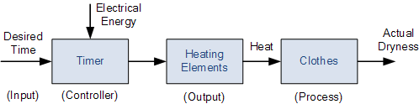
Open-Loop Control
Input
Controller
Actuator
Process
Output
Control action does not depend on output
No feedback
Simple, cheap, but inaccurate
Cannot correct disturbances or model errors
programmed to turn on at set times

Slide 4
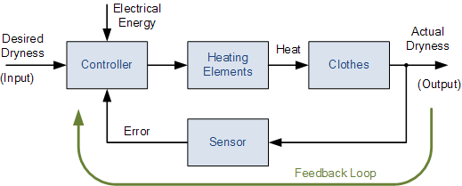
Closed-Loop Control
Output is measured and fed back

Slide 5
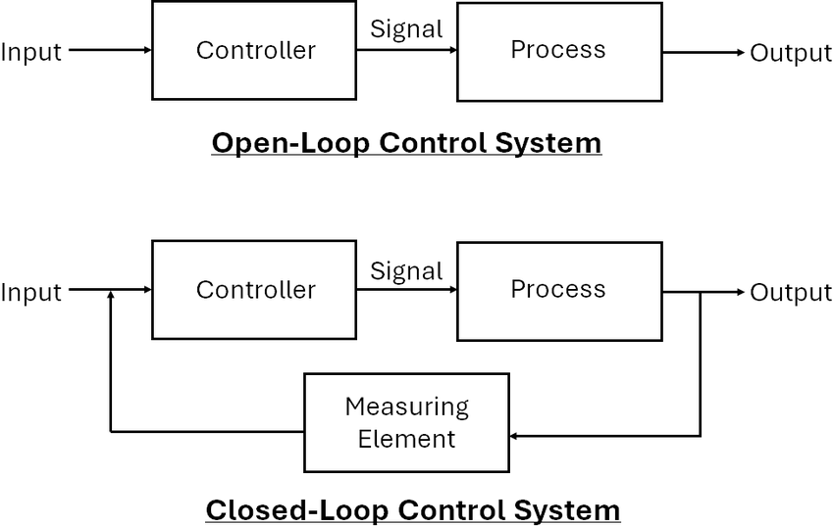
Control Deviation

Slide 6
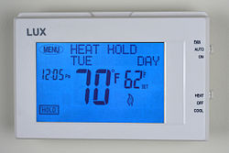
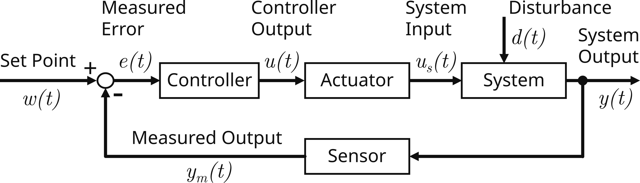
Closed-Loop Control
Controller compares reference and output
Error signal drives control action
→ Improves accuracy and robustness
maintains temperature near setpoint
Process
Process
Process

Slide 7
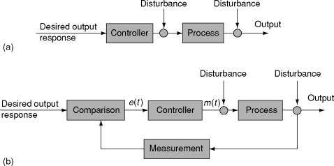
Sensors and Actuators
Sensors measure system output (position, speed, temperature)
Actuators apply control input (motor torque, valve opening)
Measurement noise and delays are unavoidable
Control design must account for imperfections

Slide 8
Feedback: Why It Works
Reduces sensitivity to disturbances
Reduces effect of model uncertainty
Improves tracking accuracy
But can also destabilize systems if poorly designed

Slide 9
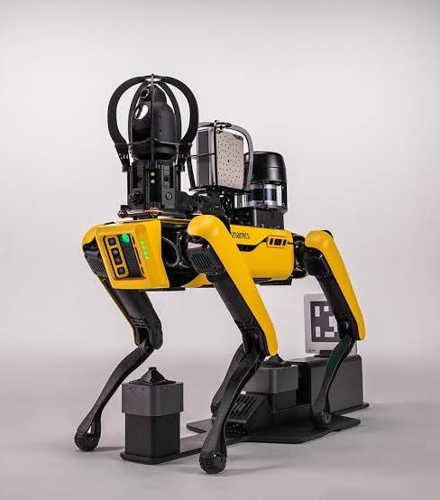
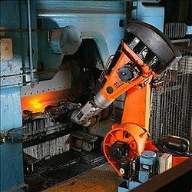
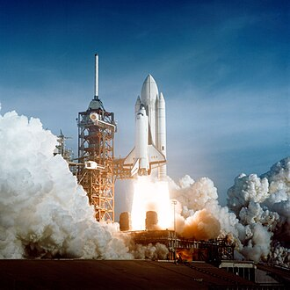
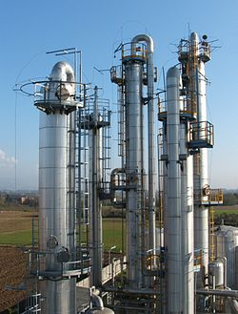
Control Engineering Applications
Robotics: motion control, balance, manipulation
Automation: process control, manufacturing lines
Automotive: cruise control, ABS, engine control
Energy systems, aerospace, biomedical engineering
…

Slide 10
Typical Control Engineering Workflow
Understand the physical process
Build a mathematical model
Design a controller (regarding the process behavior)
Simulate and analyze performance
Implement and test

Slide 11
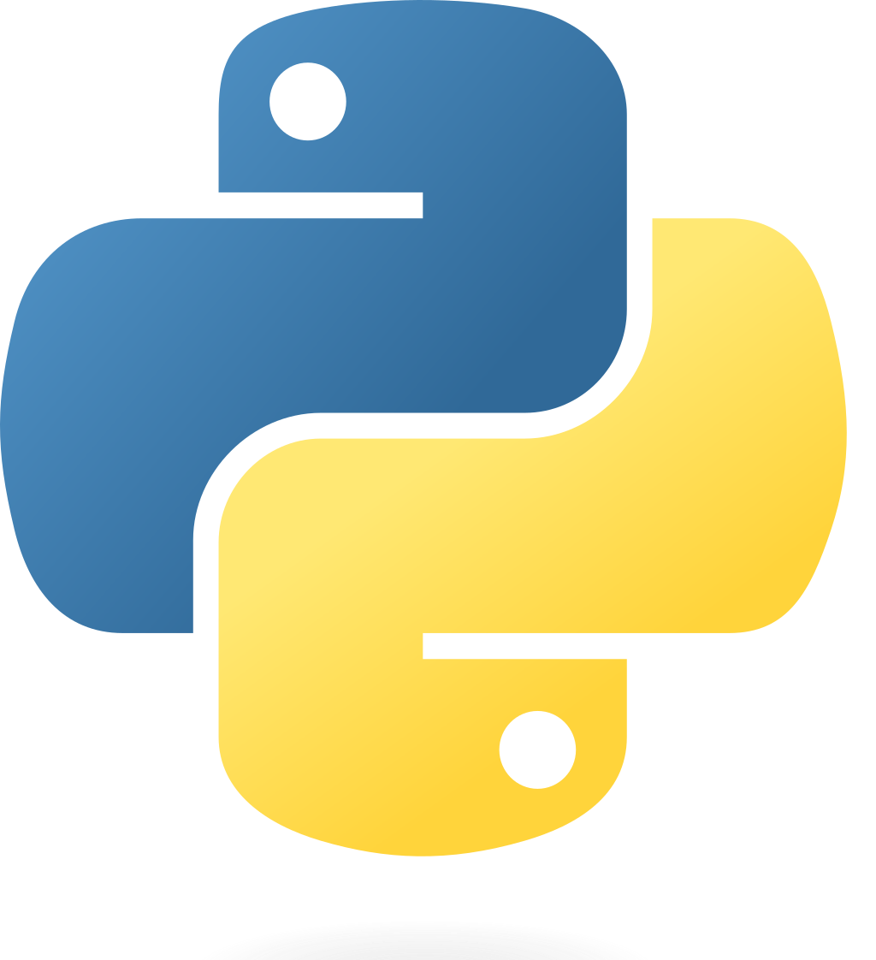


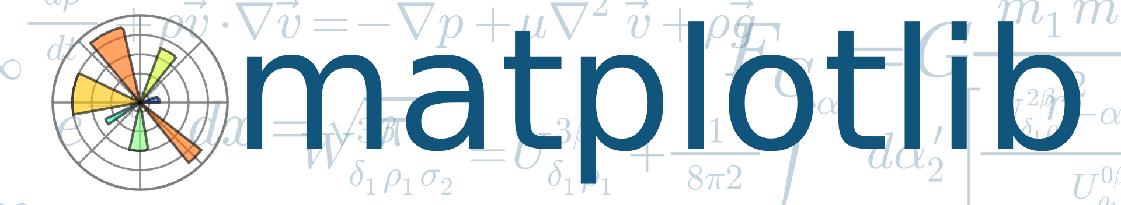
Software Tools for This Course
Python ecosystem:
numpy, scipy
matplotlib
python-control
Advantages: open-source, reproducible, widely used

Slide 12
Course Structure and Goals
Understand core control concepts
Analyze system behavior
Design classical and modern controllers
Bridge theory and implementation

Slide 13
Course Schedule
Systems
Continuous-time Controllers
Laplace Domain
Poles/Zeros & Stability
Controller Design
Discrete-time Controllers
State Space Representation
Advanced Control Methods

