Slide 1
Advanced Control Methods
Control Engineering

Slide 2
Course Schedule
Systems
Continuous-time Controllers
Laplace Domain
Poles/Zeros & Stability
Controller Design
Discrete-time Controllers
State Space Representation
Advanced Control Methods

Slide 3
Advanced Control Methods
Limitations of classical control methods
Model Predictive Control (optimization-based)
Reinforcement Learning (learning-based)

Slide 4
Why Go Beyond Classical Control?
Classical control methods: PID, linear state feedback (e.g., LQR)
Key limitations:
Limited scalability to complex systems: high-dimensional systems, coupled multivariable dynamics, time-varying behavior
Constraints not explicitly handled: actuator limits (saturation), safety constraints (position, temperature, pressure), rate limits→ typically handled after design (clipping, anti-windup)
Reliance on linear models: real systems often nonlinear, linearization only valid locally→ performance degrades away from operating point

Slide 5
How to control systems when models are imperfect and constraints matter?
Examples:
Autonomous driving: constraints + planning
Robotics: nonlinear + coupled
Energy systems: large-scale + constrained
→ Leads to two modern approaches:
Optimization-based control (e.g., model predictive control)
Learning-based control (e.g., reinforcement learning)

Slide 6
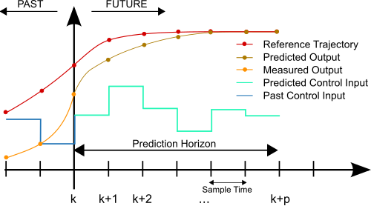
Model Predictive Control (MPC)
Predict future system behavior using an explicit system model
Optimize control inputs over a finite horizon (control sequence) → choose best future trajectory

Slide 7
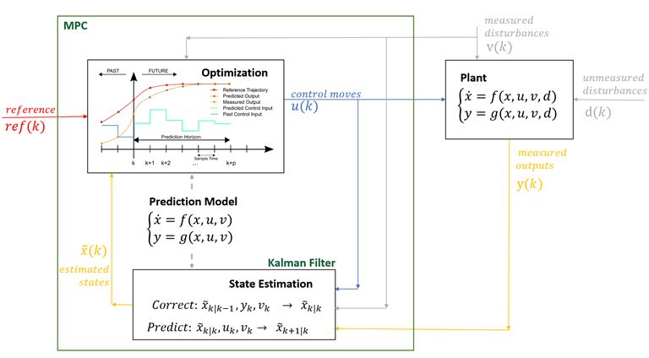
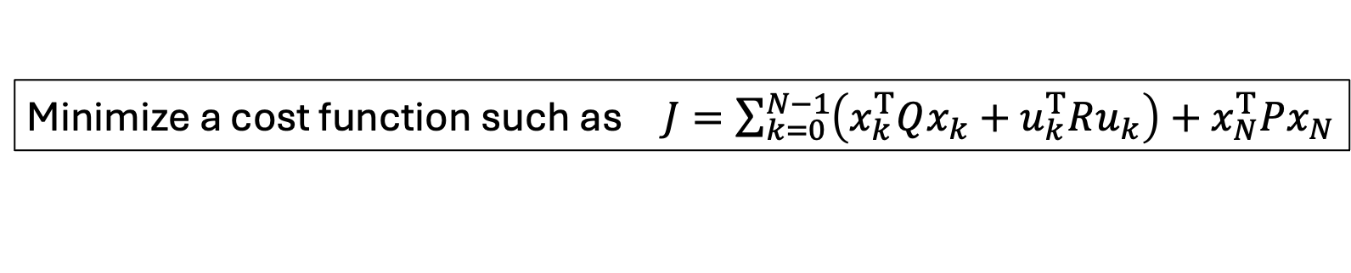
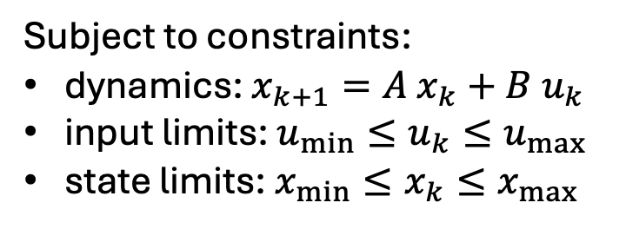
MPC Optimization Problem
Terminal cost
Minimize a cost function such as $J=\sum_{k=0}^{N−1}{\left(x_{k}^{T}Qx_{k}+u_{k}^{T}Ru_{k}\right)}+x_{N}^{T}Px_{N}$
Not restricted to linear dynamics + quadratic cost → can be any cost function reflecting the control objective
Subject to constraints:
dynamics: $x_{k+1}=A x_{k}+B u_{k}$
input limits: $u_{min}≤u_{k}≤u_{max}$
state limits: $x_{min}≤x_{k}≤x_{max}$

Slide 8
Constraint Handling in MPC
Constraints are explicitly included in the optimization problem
→ Only feasible control sequences are considered
Types of constraints:
Input constraints: actuator limits (e.g. max torque, saturation)
State constraints: position, temperature, pressure limits
Rate constraints: limits on how fast inputs can change

Slide 9
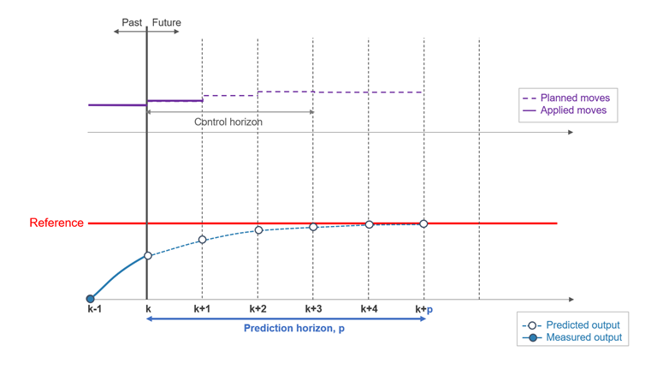
Receding horizon principle: at each time step, apply only the first input of the chosen control sequence, then re-optimize at next time step
(future is uncertain, model is imperfect, disturbances occur)

Slide 10
Intuition
MPC acts like a “smart planner”:
looks ahead into the future
chooses the best feasible trajectory
constantly updates the plan
MPC is like driving a car using a navigation system that constantly replans based on where you are.

Slide 11
Contrast to Classical Control
PID / LQR:
Reactive
Fixed feedback law
Constraints: compute control, then clip if needed
MPC:
Predictive
Solves an optimization problem online
Compute control within constraints from the start
Car approaching a curve:
PID: “Too fast → brake hard (too late)”
MPC: “Will be too fast in 2 seconds → start braking now”

Slide 12
Limitations of MPC
Requires an accurate model (model mismatch degrades performance, and modeling complex systems can be difficult)
Computational complexity (optimization problem solved at every time step → challenging for fast or high-dimensional systems)
What if the system is too complex to model accurately?
→ Learn behavior directly from data

Slide 13
Reinforcement Learning (RL)
Learning control from interaction → data-driven
Trial-and-error approach: no explicit model required
State: current situation of the system
Action: control input
Reward: measure of performance
Policy: mapping from state to action

Slide 14
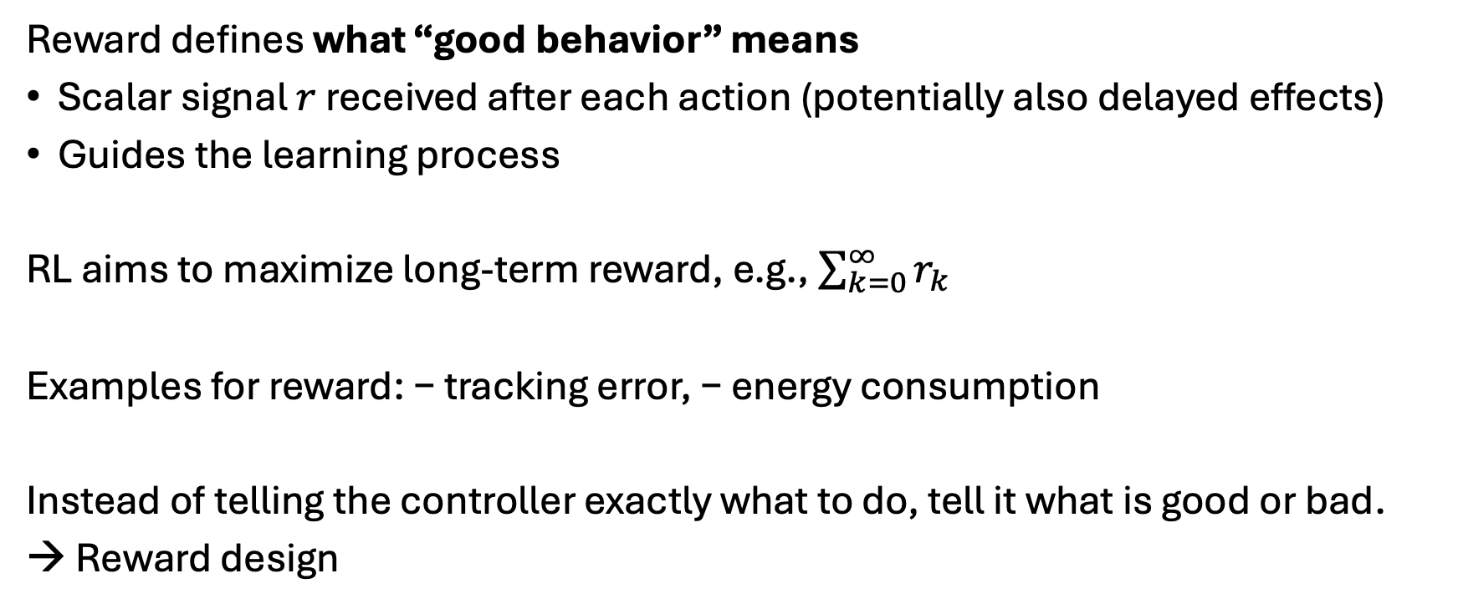
Reward Concept
Reward defines what “good behavior” means
Scalar signal $r$ received after each action (potentially also delayed effects)
Guides the learning process
RL aims to maximize long-term reward, e.g., $\sum_{k=0}^{∞}{r_{k}}$
Examples for reward: − tracking error, − energy consumption
Instead of telling the controller exactly what to do, tell it what is good or bad.
→ Reward design

Slide 15
Deep RL
tabular methods (calculating values for each state/action) simply memorize observed data
problem with tabular solution methods in practice: large state/action spaces (kind of curse of dimensionality)
→ need for generalization: supervised learning to the rescue
non-linear function approximation over state/action space
nowadays often deep learning methods → Deep RL

Slide 16
Contrast to MPC
MPC:
uses a known model
plans optimal actions
RL:
learns from interaction
discovers good actions over time
→ RL replaces modeling with learning from experience

Slide 17
Challenges of RL
Data inefficiency: requires large amounts of interaction data
Lack of guarantees: hard to ensure stability and constraint satisfaction
Computational complexity: training can be very expensive
Tuning and design choices: reward function, learning algorithm, exploration strategy have strong impact on performance
RL works well in simulation, but real systems are expensive and dangerous to experiment with (sim-to-real gap)

Slide 18
Three Perspectives on Control
Classical:
PID, LQR
Simple, efficient, well understood
Limited for complex, constrained systems
→ rule-based intelligence
Optimization-Based:
MPC
Handles constraints explicitly
Requires accurate system model
→ model-based intelligence
Learning-Based:
RL
Learns directly from data
Challenges in safety and reliability
→ data-driven intelligence
Modern control systems often combinations of the different ideas

