Slide 1
State Space Representation
Control Engineering

Slide 2
Course Schedule
Systems
Continuous-time Controllers
Laplace Domain
Poles/Zeros & Stability
Controller Design
Discrete-time Controllers
State Space Representation
Advanced Control Methods

Slide 3
State Space Representation
MIMO Systems
State variables and state equations
Controllability & Observability
State-space control
State estimation
Pole Placement
LQR
Kalman filter

Slide 4



Multi-Input Multi-Output (MIMO) Systems
So far: single-input single-output (SISO) systems
Systems with multiple inputs and outputs (MIMO) become cumbersome to describe using transfer functions (focus on input–output behavior, limited insight into internal dynamics)
→ Use of state-space representation (explicit representation of internal system dynamics)
$$\vec{u}$$
$$MIMO$$
$$\vec{y}$$

Slide 5
State Variables
State: minimal set of variables describing the system’s memory
→ all information needed to predict future behavior
State variables define the system completely: given the current state and inputs, the future evolution is uniquely determined
Often correspond to physical quantities, e.g., position, velocity, current, voltage, temperature
Not unique: different choices of state variables can describe the same system
Input + Current State → Future State + Output
(instead of only relating input to output)

Slide 6
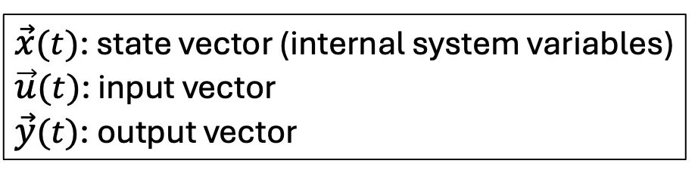
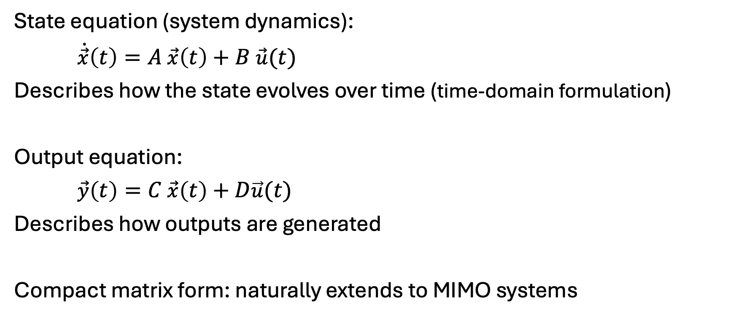

State Equations
$\vec{x}(t)$: state vector (internal system variables)
$\vec{u}(t)$: input vector
$\vec{y}(t)$: output vector
State equation (system dynamics):
$\dot{\vec{x}}\left(t\right)=A \vec{x}\left(t\right)+B \vec{u}(t)$
Describes how the state evolves over time (time-domain formulation)
Output equation:
$\vec{y}\left(t\right)=C \vec{x}\left(t\right)+D\vec{u}(t)$
Describes how outputs are generated
Compact matrix form: naturally extends to MIMO systems
System matrices:
$A$: system matrix (dynamics)
$B$: input matrix
$C$: output matrix
$D$: feedthrough (direct input → output)

Slide 7
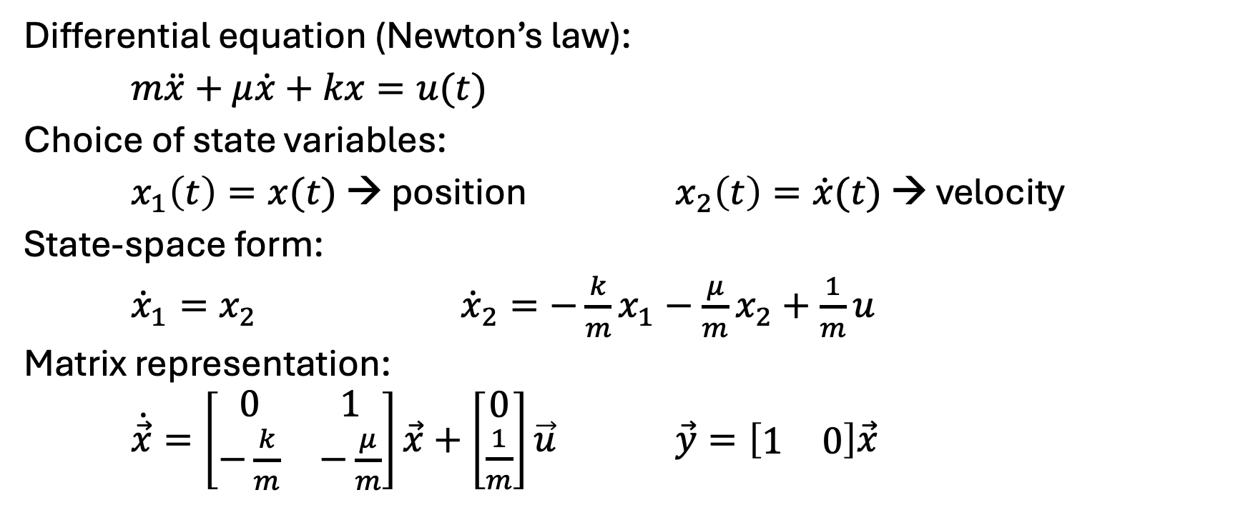
Example: Mass-Spring-Damper System
Differential equation (Newton’s law):
$m\ddot{x}+μ\dot{x}+kx=u(t)$
Choice of state variables:
$x_{1}\left(t\right)=x(t)$ → position $x_{2}\left(t\right)=\dot{x}(t)$ → velocity
State-space form:
${\dot{x}}_{1}=x_{2}$ ${\dot{x}}_{2}=−\frac{k}{m}x_{1}−\frac{μ}{m}x_{2}+\frac{1}{m}u$
Matrix representation:
$\dot{\vec{x}}=\left[\begin{matrix}0 & 1 \\ −\frac{k}{m} & −\frac{μ}{m}\end{matrix}\right]\vec{x}+\left[\begin{matrix}0 \\ \frac{1}{m}\end{matrix}\right]\vec{u}$ $\vec{y}=\left[\begin{matrix}1 & 0\end{matrix}\right]\vec{x}$
Physical modeling
For the sake of simplicity, we will no longer use vector arrows.

Slide 8
Physical Modeling or Construction
Two ways to get a state-space model:
From physics → define states → get matrices: physical states
From a transfer function → define matrices → get states: structured, useful for design (canonical forms)
→ Same system, just different coordinates

Slide 9
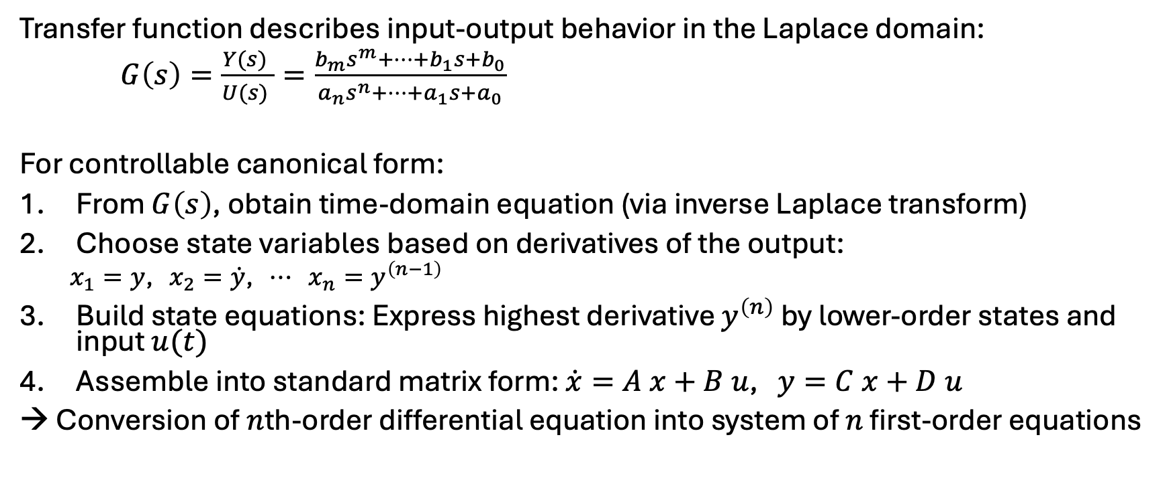
From Transfer Function to State Space
Transfer function describes input-output behavior in the Laplace domain:
$G\left(s\right)=\frac{Y(s) }{U(s) }=\frac{b_{m}s^{m}+⋯+b_{1}s+b_{0}}{a_{n}s^{n}+⋯+a_{1}s+a_{0}}$
For controllable canonical form:
From $G\left(s\right)$, obtain time-domain equation (via inverse Laplace transform)
Choose state variables based on derivatives of the output:
$x_{1}=y$, $x_{2}=\dot{y}$, $⋯$ $x_{n}=y^{\left(n−1\right)}$
Build state equations: Express highest derivative $y^{\left(n\right)}$ by lower-order states and input $u(t)$
Assemble into standard matrix form: $\dot{x}=A x+B u$, $y=C x+D u$
→ Conversion of $n$th-order differential equation into system of $n$ first-order equations

Slide 10

Example: Second-Order System
$G\left(s\right)=\frac{1}{s^{2}+3s+2}$
$\ddot{y}+3\dot{y}+2y=u$
$x_{1}=y$, $x_{2}=\dot{y}$ (not necessarily identical with the physical states)
${\dot{x}}_{1}=x_{2}$, ${\dot{x}}_{2}=−2x_{1}−3x_{2}+u$
$\dot{x}=\left[\begin{matrix}0 & 1 \\ −2 & −3\end{matrix}\right]x+\left[\begin{matrix}0 \\ 1\end{matrix}\right]u$, $y=\left[\begin{matrix}1 & 0\end{matrix}\right]x$

Slide 11
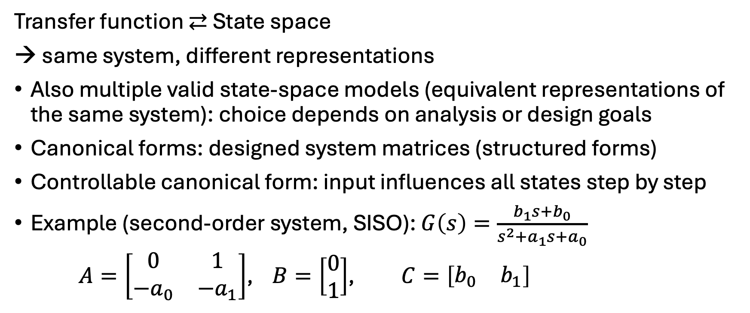
Controllable Canonical Form
Transfer function ⇄ State space
→ same system, different representations
Also multiple valid state-space models (equivalent representations of the same system): choice depends on analysis or design goals
Canonical forms: designed system matrices (structured forms)
Controllable canonical form: input influences all states step by step
Example (second-order system, SISO): $G\left(s\right)=\frac{b_{1}s+b_{0}}{s^{2}+a_{1}s+a_{0}}$
$A=\left[\begin{matrix}0 & 1 \\ −a_{0} & −a_{1}\end{matrix}\right]$, $B=\left[\begin{matrix}0 \\ 1\end{matrix}\right]$, $C=\left[\begin{matrix}b_{0} & b_{1}\end{matrix}\right]$

Slide 12
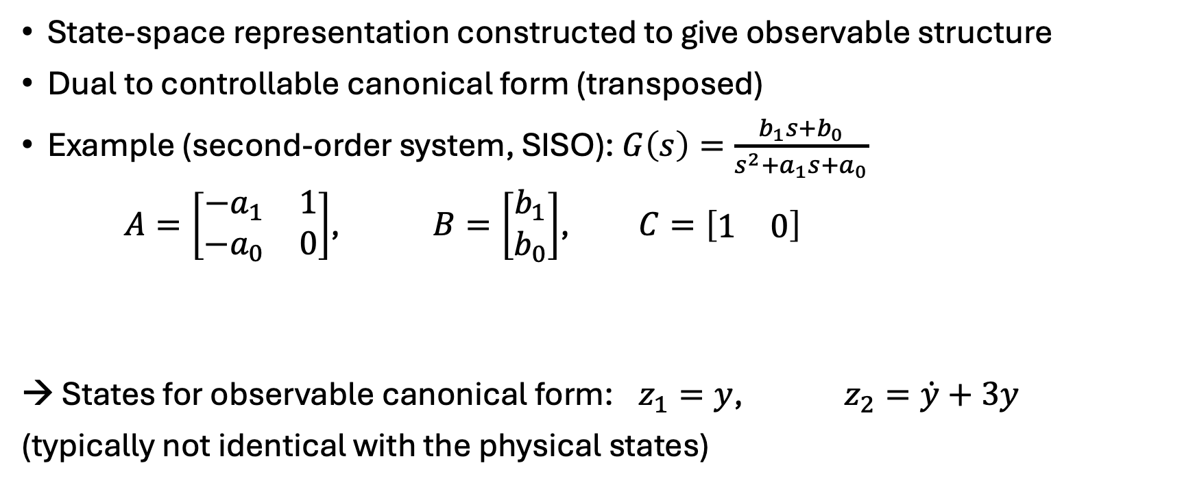
Observable Canonical Form
State-space representation constructed to give observable structure
Dual to controllable canonical form (transposed)
Example (second-order system, SISO): $G\left(s\right)=\frac{b_{1}s+b_{0}}{s^{2}+a_{1}s+a_{0}}$
$A=\left[\begin{matrix}−a_{1} & 1 \\ −a_{0} & 0\end{matrix}\right]$, $B=\left[\begin{matrix}b_{1} \\ b_{0}\end{matrix}\right]$, $C=\left[\begin{matrix}1 & 0\end{matrix}\right]$
→ States for observable canonical form: $z_{1}=y$, $z_{2}=\dot{y}+3y$
(typically not identical with the physical states)
Output directly depends on first state

Slide 13
Controllability & Observability
Controllability: Can we move the system anywhere we want using the input?
Reaching all states via input signals
If a state is not controllable: no input can influence it → cannot be stabilized
Naturally emphasized in controllable canonical form
Observability: Can we figure out internal states from outputs?
Diagnosing a system through measurements (outputs)
If a state is not observable: it affects nothing we measure → hidden behavior
Naturally emphasized in observable canonical form
→ A “good” system for control needs to be controllable + observable

Slide 14
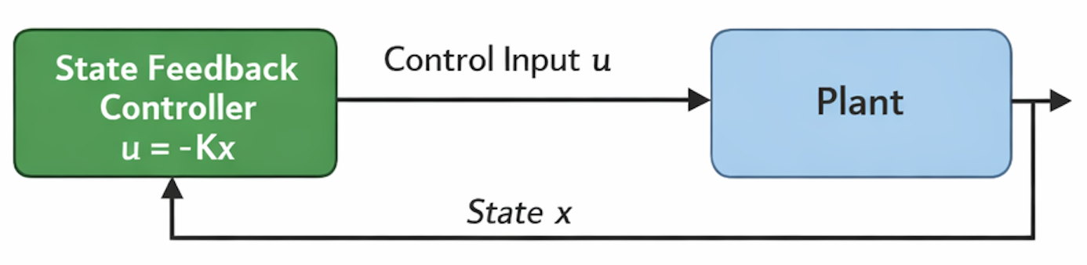
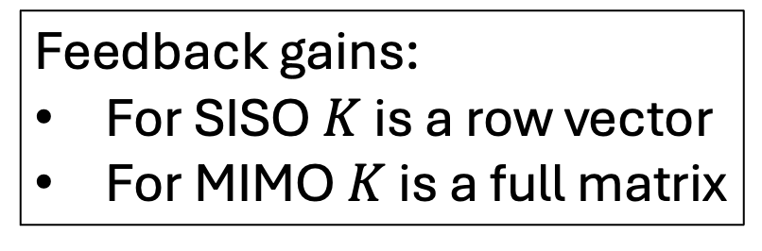
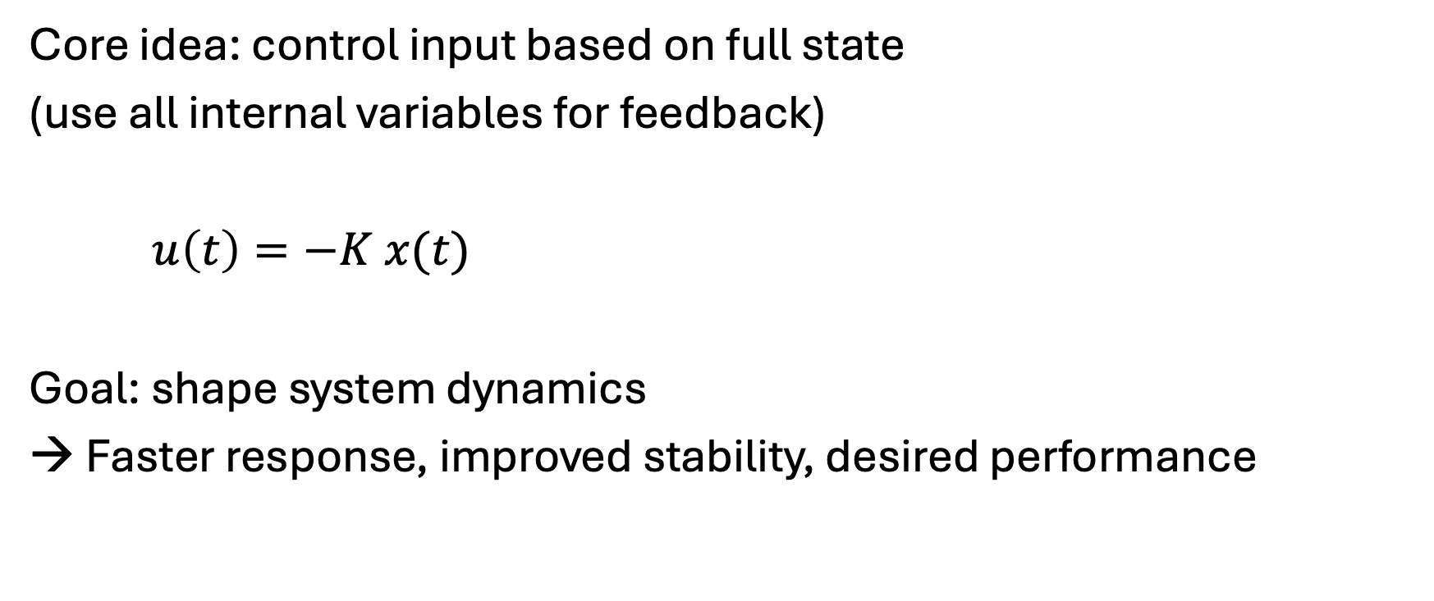
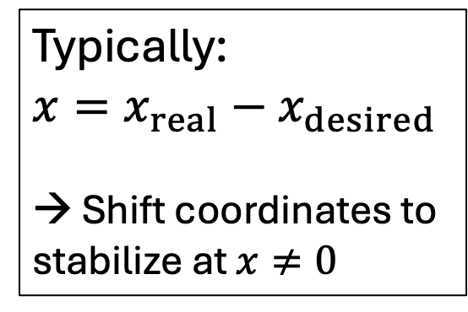
State Feedback Control
Typically:
$$x=x_{real}−x_{desired}$$
→ Shift coordinates to stabilize at $x≠0$
Core idea: control input based on full state
(use all internal variables for feedback)
$u\left(t\right)=−K x(t)$
Goal: shape system dynamics
→ Faster response, improved stability, desired performance
Feedback gains:
For SISO $K$ is a row vector
For MIMO $K$ is a full matrix

Slide 15
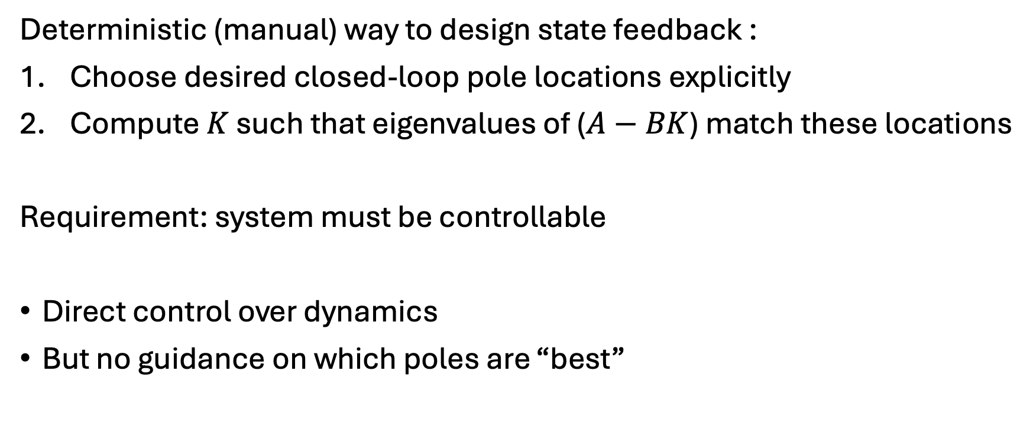
Pole Placement
Deterministic (manual) way to design state feedback :
Choose desired closed-loop pole locations explicitly
Compute $K$ such that eigenvalues of ($A−BK$) match these locations
Requirement: system must be controllable
Direct control over dynamics
But no guidance on which poles are “best”

Slide 16
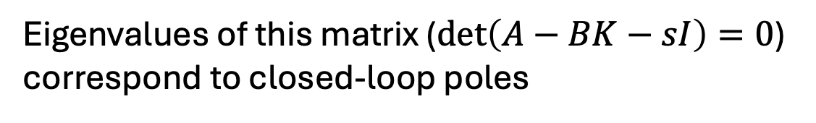
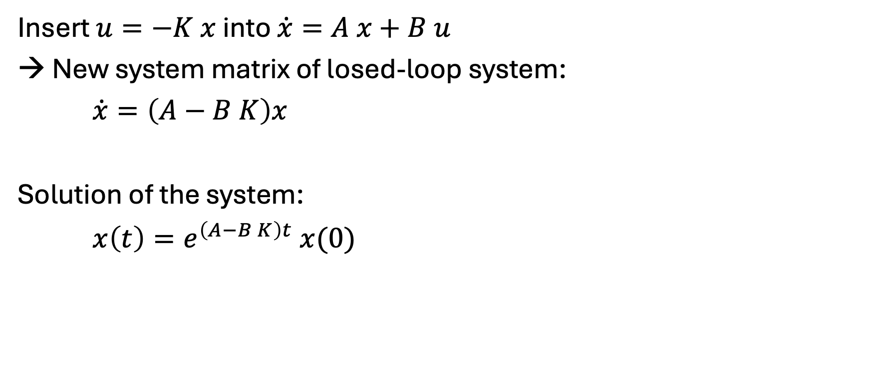
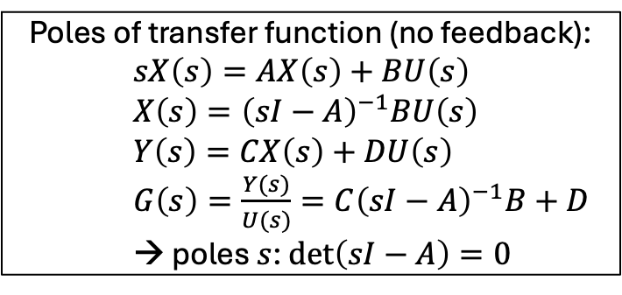
Matrix Exponential
Poles of transfer function (no feedback):
$sX\left(s\right)=AX\left(s\right)+BU\left(s\right)$
$X\left(s\right)={\left(sI−A\right)}^{−1}BU\left(s\right)$
$Y\left(s\right)=CX\left(s\right)+DU\left(s\right)$
$G\left(s\right)=\frac{Y(s)}{U(s)}=C{\left(sI−A\right)}^{−1}B+D$
→ poles $s$: $\det\left(sI−A\right)=0$
Insert $u=−K x$ into $\dot{x}=A x+B u$
→ New system matrix of losed-loop system:
$\dot{x}=\left(A−B K\right)x$
Solution of the system:
$x\left(t\right)=e^{\left(A−B K\right)t} x(0)$
Eigenvalues of this matrix ($\det\left(A−BK−sI\right)=0$) correspond to closed-loop poles
State transition matrix in form of matrix exponential (defined via power series): evolution of a vector of coupled states

Slide 17
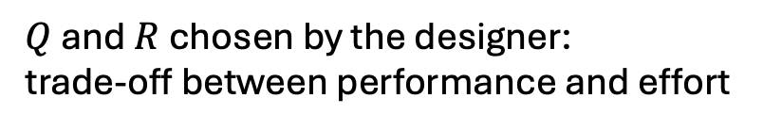
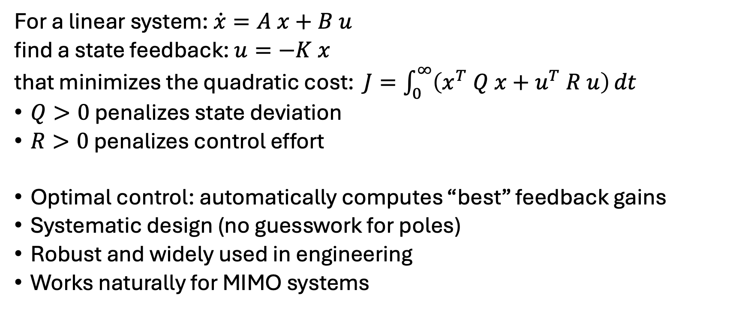
Linear Quadratic Regulator (LQR)
In practice, using numerical solvers
For a linear system: $\dot{x}=A x+B u$
find a state feedback: $u=−K x$
that minimizes the quadratic cost: $J=\int_{0}^{∞}{\left(x^{T} Q x+u^{T} R u\right)}dt$
$Q>0$ penalizes state deviation
$R>0$ penalizes control effort
Optimal control: automatically computes “best” feedback gains
Systematic design (no guesswork for poles)
Robust and widely used in engineering
Works naturally for MIMO systems
$Q$ and $R$ chosen by the designer:
trade-off between performance and effort

Slide 18
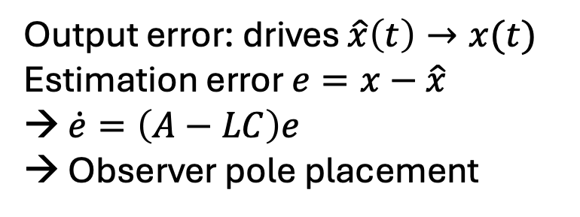
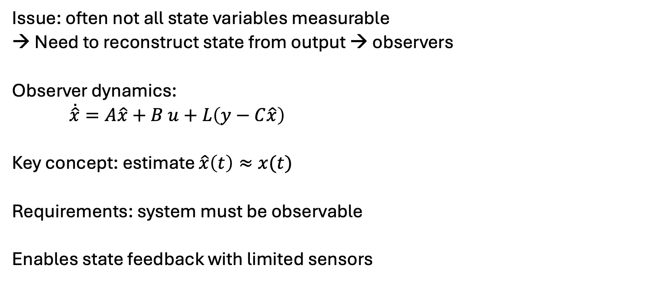
State Observers (State Estimation)
Issue: often not all state variables measurable
→ Need to reconstruct state from output → observers
Observer dynamics:
$\dot{\hat{x}}=A\hat{x}+B u+L\left(y−C\hat{x}\right)$
Key concept: estimate $\hat{x}\left(t\right)≈x(t)$
Requirements: system must be observable
Enables state feedback with limited sensors
observer gains
Output error: drives $\hat{x}\left(t\right)→x(t)$
Estimation error $e=x−\hat{x}$
→ $\dot{e}=\left(A−LC\right)e$
→ Observer pole placement

Slide 19
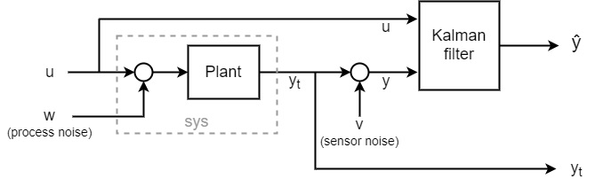
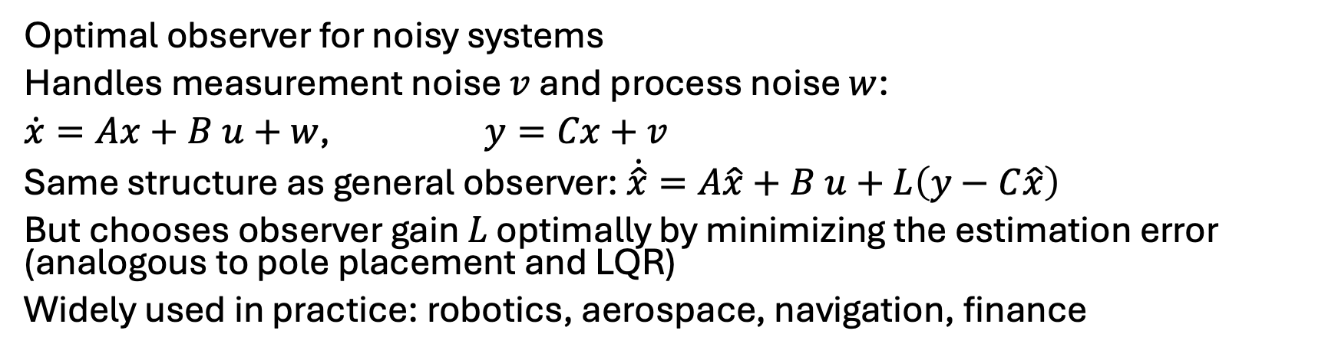
Kalman Filter: Optimal State Estimation
Optimal observer for noisy systems
Handles measurement noise $v$ and process noise $w$:
$\dot{x}=Ax+B u+w$, $y=Cx+v$
Same structure as general observer: $\dot{\hat{x}}=A\hat{x}+B u+L\left(y−C\hat{x}\right)$
But chooses observer gain $L$ optimally by minimizing the estimation error (analogous to pole placement and LQR)
Widely used in practice: robotics, aerospace, navigation, finance

Slide 20
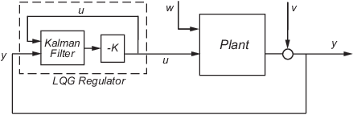

Linear Quadratic Gaussian (LQG) Control
Combination of both ideas (modern control architecture):
Observer (estimation) → $\hat{x}\left(t\right)$ → State Feedback (control)
Separation principle: controller design (LQR) and estimator design (Kalman) can be done independently
Kalman filter: estimates system state from noisy measurements
LQR: computes optimal control input

Slide 21
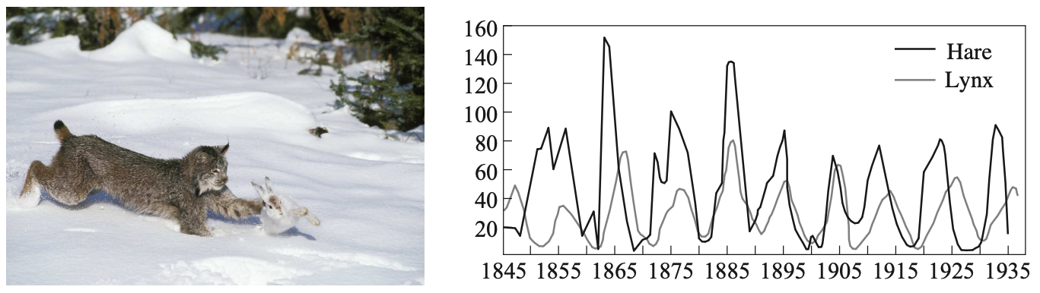
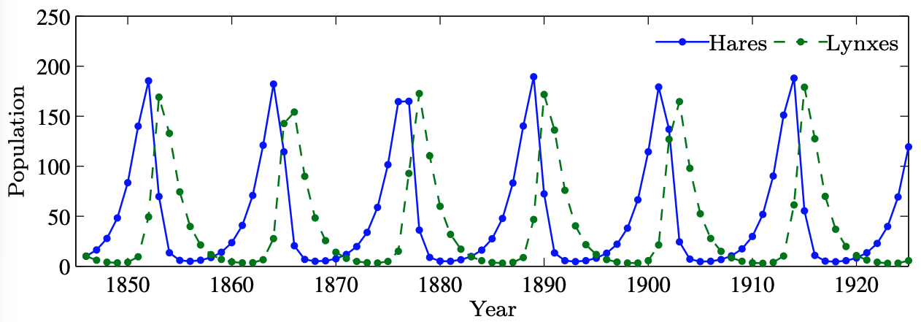

Discrete-Time Note
Everything also exists in discrete time:
$x_{k+1}=A x_{k}+B u_{k}$
Example: predator-prey

Slide 22
Key Takeaways
State space = internal system description
Enables MIMO + modern control
Controllability & observability are fundamental
State feedback + observers → full control
LQR & Kalman → optimal design

