Slide 1
Discrete-time Controllers
Control Engineering

Slide 2
Course Schedule
Systems
Continuous-time Controllers
Laplace Domain
Poles/Zeros & Stability
Controller Design
Discrete-time Controllers
State Space Representation
Advanced Control Methods

Slide 3
Discrete-time Controllers
Digital controllers
Sampling & Zero-Order Hold
Discrete-time modeling
z-transfer functions
Discretization methods

Slide 4
Why Digital Control?
Most modern controllers are implemented on:
Microcontrollers
DSPs (Digital Signal Processor)
Computers
Advantages:
Flexibility (software changes)
Cost efficiency
Advanced algorithms possible
Disadvantages:
Sampling effects
Quantization
Delays (latency)

Slide 5
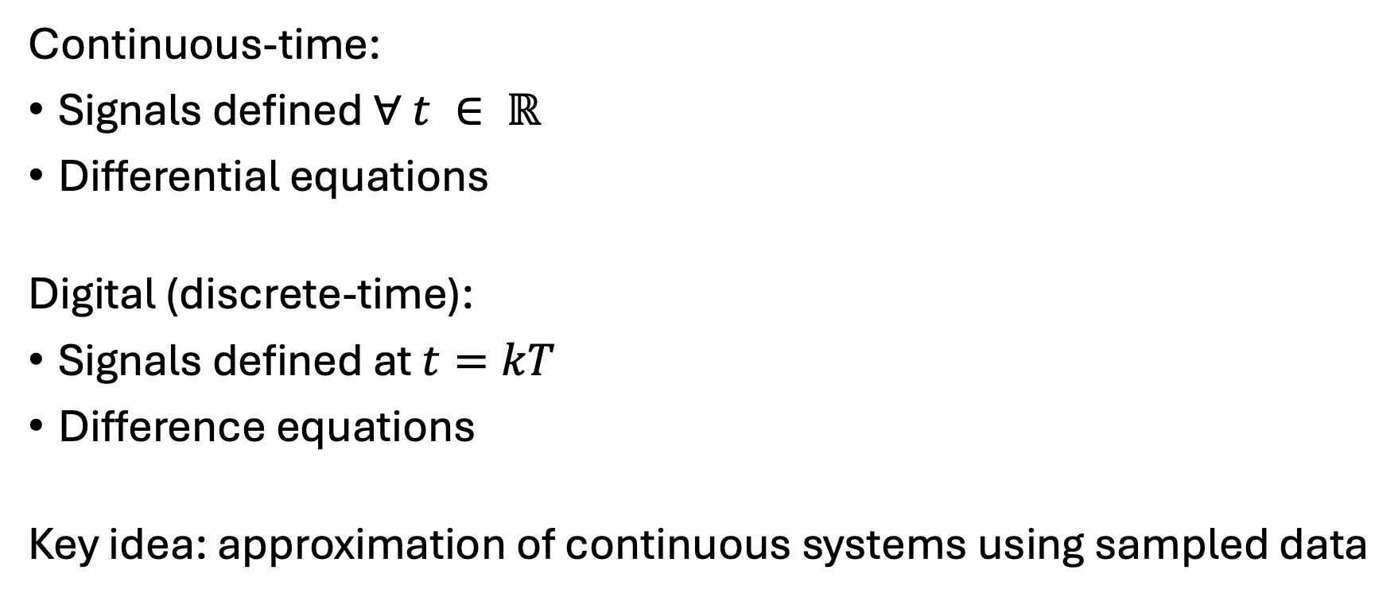
Continuous vs Digital Control
Continuous-time:
Signals defined $∀ t ∈ ℝ$
Differential equations
Digital (discrete-time):
Signals defined at $t=kT$
Difference equations
Key idea: approximation of continuous systems using sampled data

Slide 6
Idea:
controlling a continuous physical system using a digital computer

Slide 7
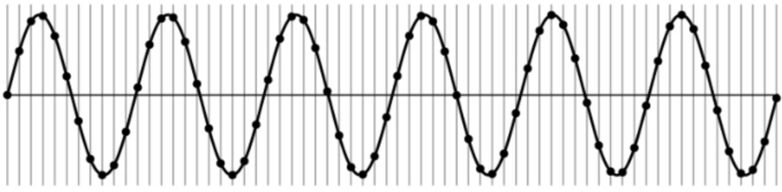

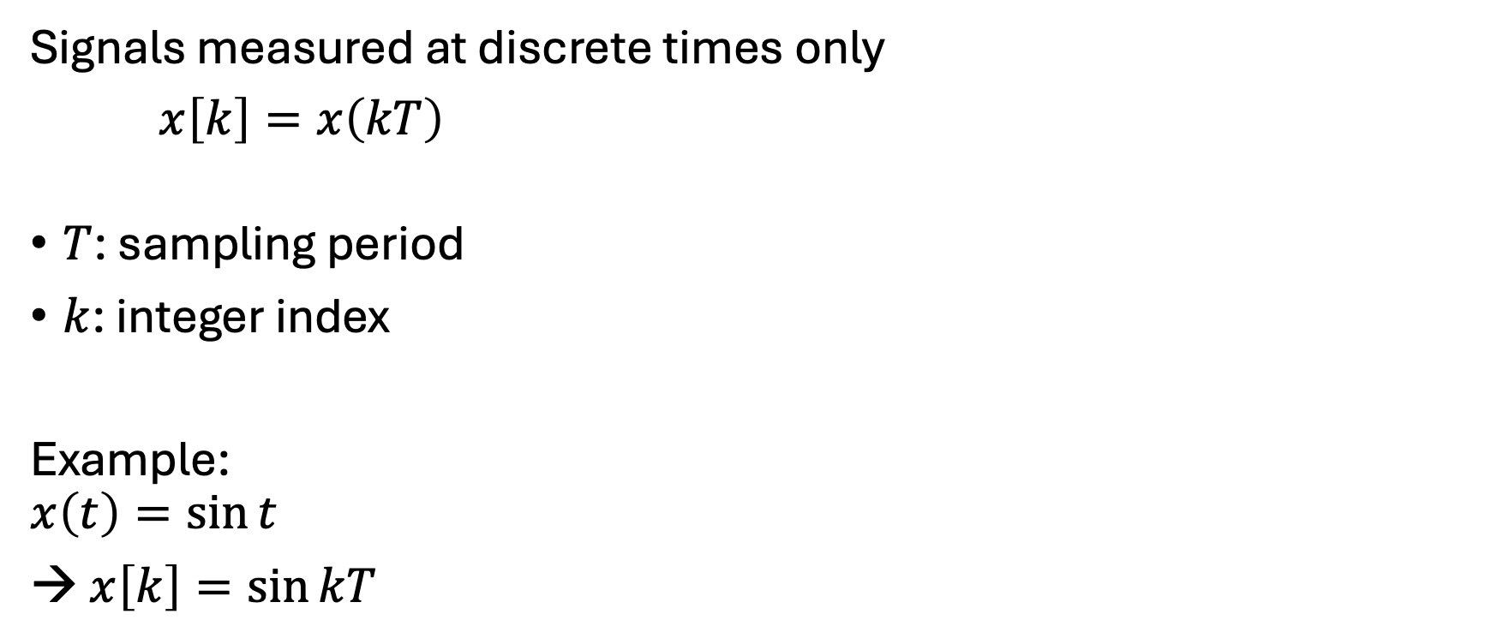
Sampling
Sampling frequency:
$f_{s}=\frac{1}{T}$
Angular frequency:
$ω_{s}=\frac{2π}{T}$
Signals measured at discrete times only
$x\left[k\right]=x\left(kT\right)$
$T$: sampling period
$k$: integer index
Example:
$$x\left(t\right)=\sin{t}$$
→ $x\left[k\right]=\sin{kT}$

Slide 8
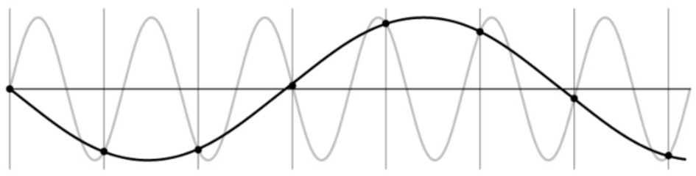
Undersampling
Aliasing: higher-frequency signal disguised as one of lower frequency

Slide 9
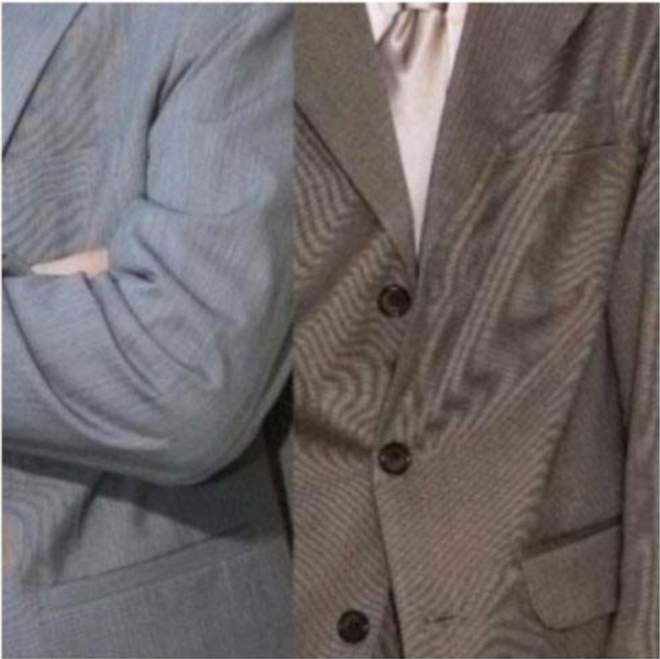
Example: Moiré Effect in Digital Images
Aliasing in digital images often manifests itself as ringing patterns
Temporal aliasing can be observed as wagon-wheel effect (apparent backward motion) in image sequences (video): frame rate too low with respect to speed of wheel rotation

Slide 10
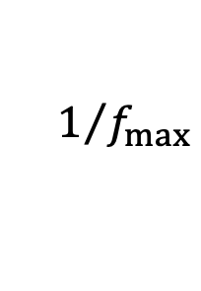
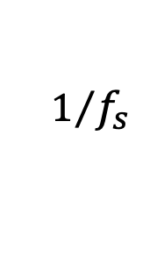
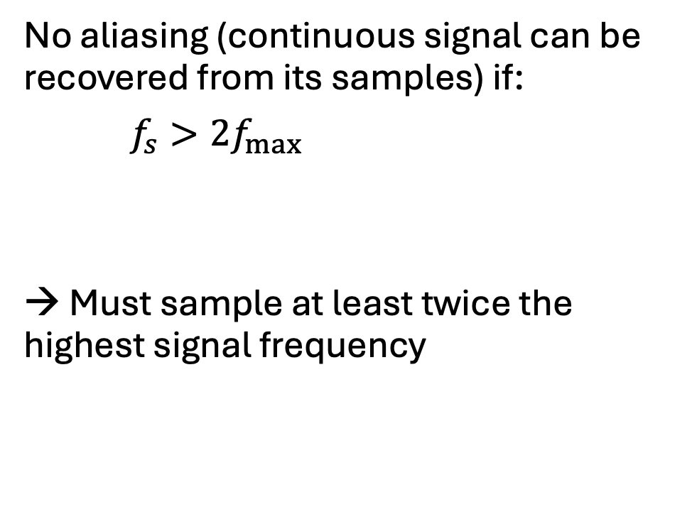
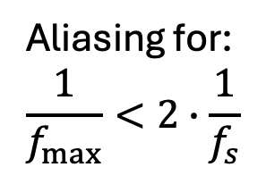
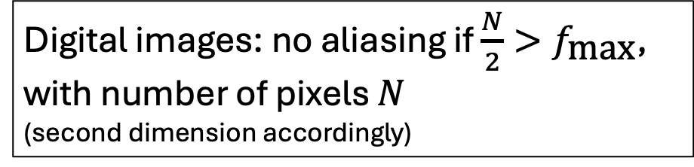
Nyquist-Shannon Sampling Theorem
No aliasing (continuous signal can be recovered from its samples) if:
$f_{s}>2f_{max}$
→ Must sample at least twice the highest signal frequency
$$1/{f_{s}}$$
$$1/{f_{max}}$$
Nyquist frequency
Aliasing for:
$$\frac{1}{f_{max}}<2∙\frac{1}{f_{s}}$$
Digital images: no aliasing if $\frac{N}{2}>f_{\text{max}}$,
with number of pixels $N$
(second dimension accordingly)

Slide 11
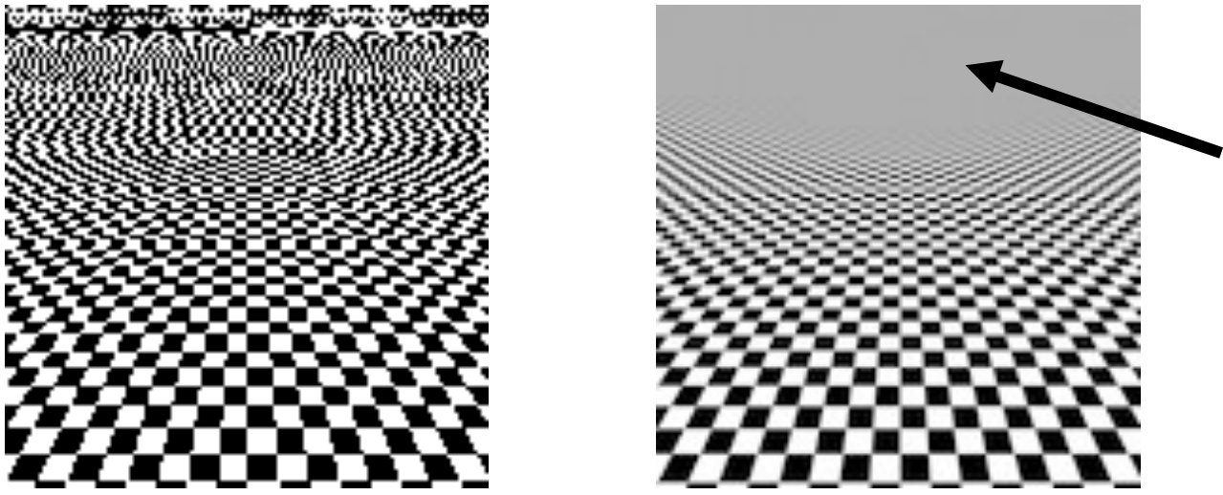
Anti-Aliasing Filter
Solution: use a low-pass filter (smoothing) before sampling
→ remove signal frequencies above Nyquist frequency
average of black and white

Slide 12
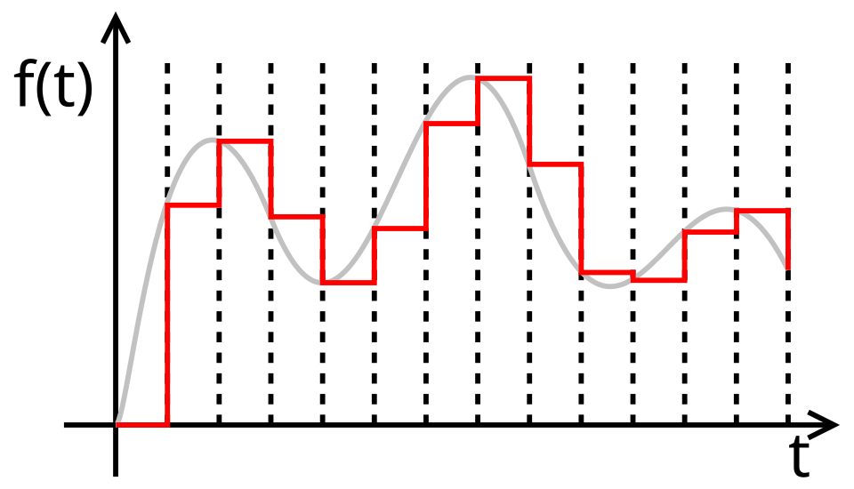
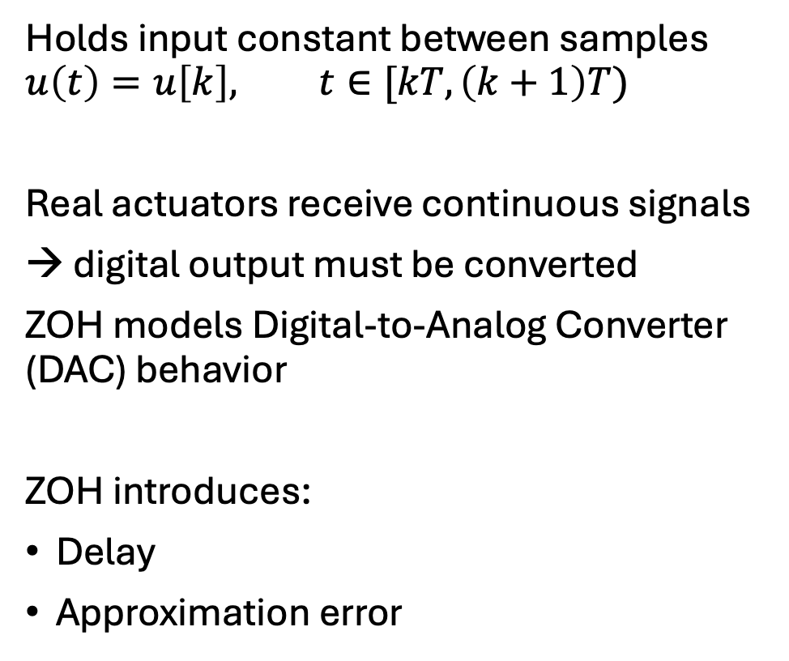
Zero-Order Hold (ZOH)
Holds input constant between samples
$$u\left(t\right)=u\left[k\right], t∈[kT,\left(k+1\right)T)$$
Real actuators receive continuous signals
→ digital output must be converted
ZOH models Digital-to-Analog Converter (DAC) behavior
ZOH introduces:
Delay
Approximation error
Signals are now sequences

Slide 13
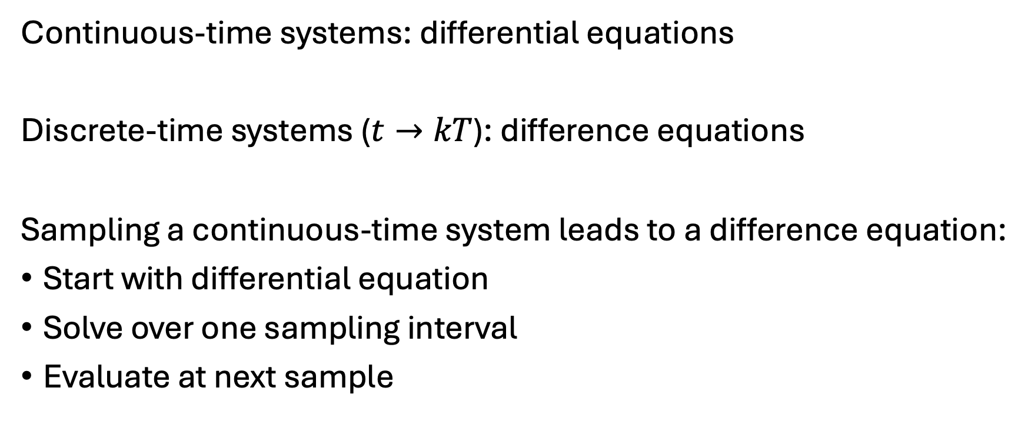
From Differential to Difference Equations
Continuous-time systems: differential equations
Discrete-time systems ($t→kT$): difference equations
Sampling a continuous-time system leads to a difference equation:
Start with differential equation
Solve over one sampling interval
Evaluate at next sample

Slide 14
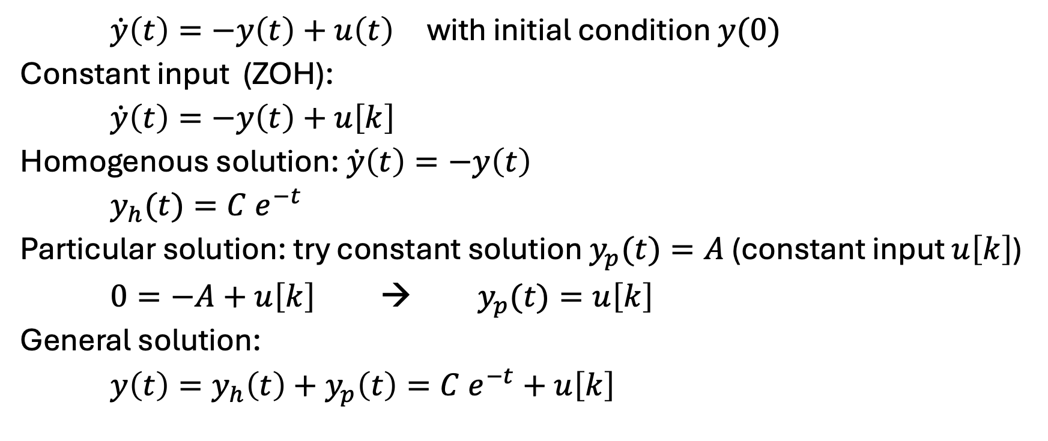
Example: First-Order System
$\dot{y}\left(t\right)=−y\left(t\right)+u\left(t\right)$ with initial condition $y(0)$
Constant input (ZOH):
$\dot{y}\left(t\right)=−y\left(t\right)+u\left[k\right]$
Homogenous solution: $\dot{y}\left(t\right)=−y\left(t\right)$
$y_{h}(t)={C e}^{−t}$
Particular solution: try constant solution $y_{p}(t)=A$ (constant input $u\left[k\right]$)
$0=−A+u\left[k\right]$ → $y_{p}(t)=u\left[k\right]$
General solution:
$y\left(t\right)=y_{h}\left(t\right)+y_{p}\left(t\right)={C e}^{−t}+u\left[k\right]$

Slide 15
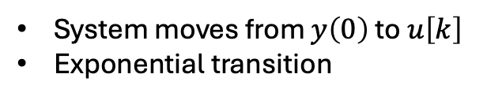
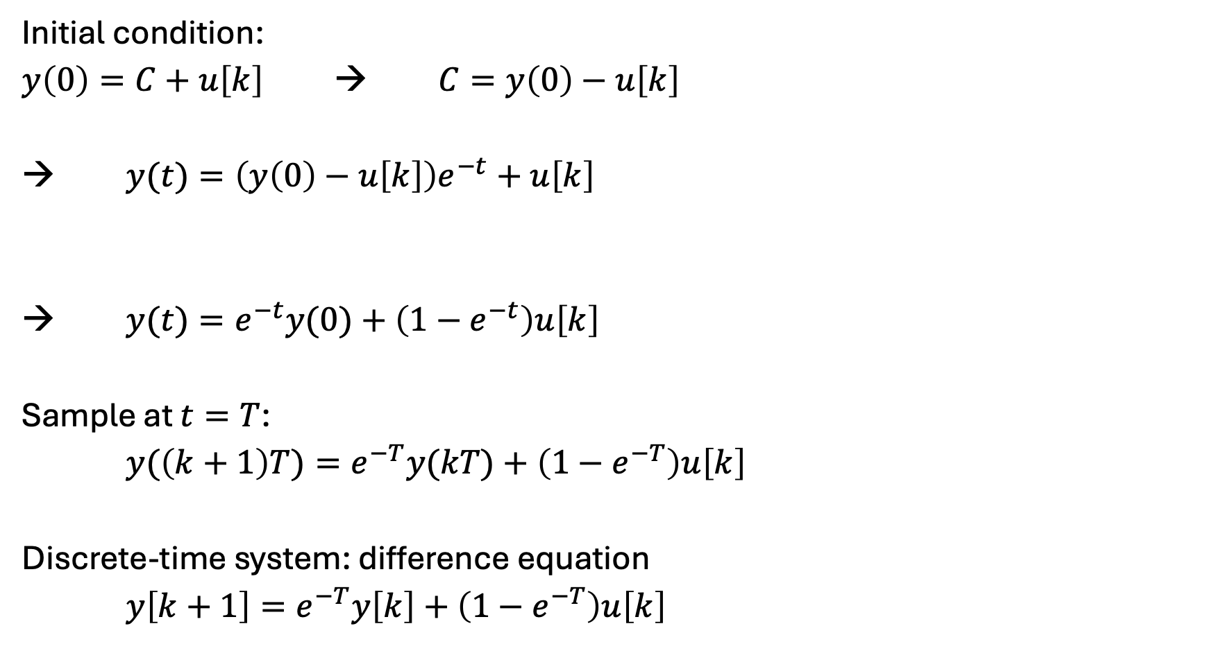
Initial condition:
$y\left(0\right)=C+u\left[k\right]$ → $C=y\left(0\right)−u\left[k\right]$
→ $y(t)=\left(y\left(0\right)−u\left[k\right]\right)e^{−t}+u\left[k\right]$
→ $y(t)=e^{−t}y(0)+\left(1−e^{−t}\right)u\left[k\right]$
Sample at $t=T$:
$y(\left(k+1\right)T)=e^{−T}y(kT)+\left(1−e^{−T}\right)u\left[k\right]$
Discrete-time system: difference equation
$y\left[k+1\right]=e^{−T}y\left[k\right]+\left(1−e^{−T}\right)u\left[k\right]$
System moves from $y\left(0\right)$ to $u\left[k\right]$
Exponential transition
transient
steady state

Slide 16
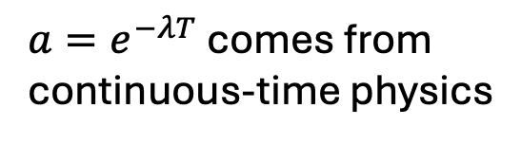
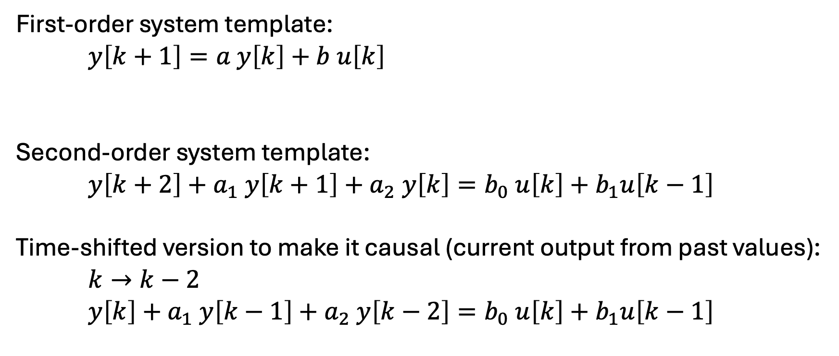
Difference Equations
First-order system template:
$y\left[k+1\right]=a y\left[k\right]+b u\left[k\right]$
Second-order system template:
$y\left[k+2\right]+a_{1} y\left[k+1\right]+a_{2} y\left[k\right]=b_{0} u\left[k\right]+b_{1}u\left[k−1\right]$
Time-shifted version to make it causal (current output from past values):
$k→k−2$
$y\left[k\right]+a_{1} y\left[k−1\right]+a_{2} y\left[k−2\right]=b_{0} u\left[k\right]+b_{1}u\left[k−1\right]$
$a=e^{−λT}$ comes from continuous-time physics
memory
input effect

Slide 17
Motivation for z-Transform
How to solve difference equations?
How to analyze stability?
How to design controllers?
Continuous-time systems:
differential equation → Laplace transform → algebra (transfer function)
Discrete-time systems:
difference equation → z-transform → algebra (z-transfer function)

Slide 18
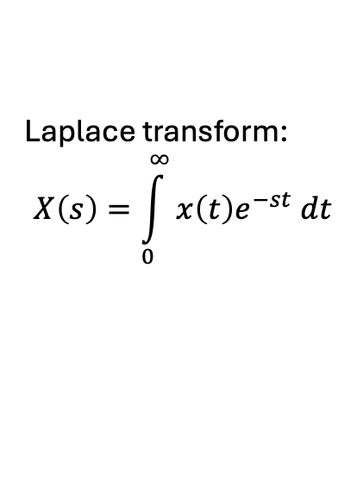

z-Transform Definition
Laplace transform:
$$X\left(s\right)=\int_{0}^{∞}{x\left(t\right)e^{−st} dt}$$
$X\left(z\right)=\sum_{k=0}^{∞}{x\left[k\right]z^{−k}}$
$x\left[k\right]$: discrete-time signal
$z$: complex variable
Interpretation:
Converts a sequence into a function of $z$
Discrete-time equivalent of the Laplace transform

Slide 19
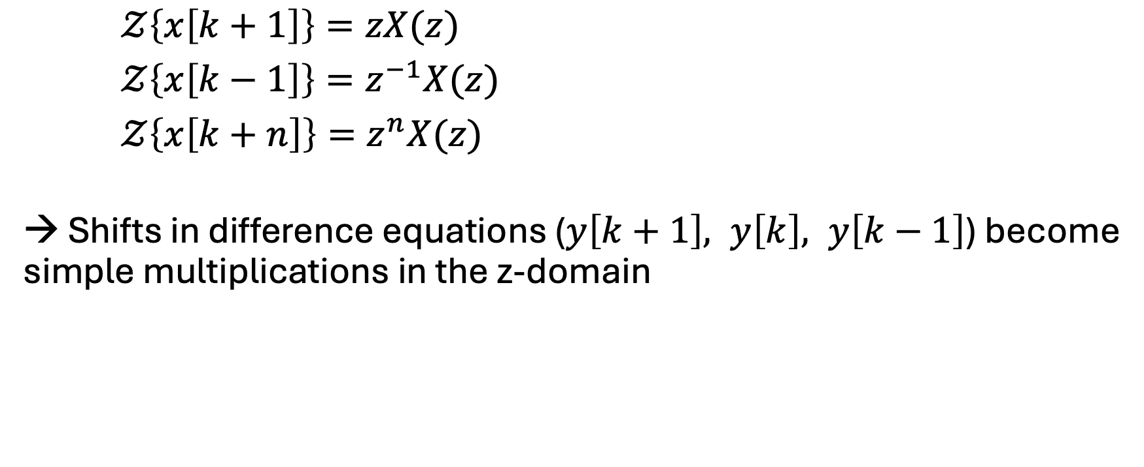
Time Shift Property
$𝒵\left\{x\left[k+1\right]\right\}=zX(z)$
$𝒵\left\{x\left[k−1\right]\right\}=z^{−1}X(z)$
$𝒵\left\{x\left[k+n\right]\right\}=z^{n}X(z)$
→ Shifts in difference equations ($y\left[k+1\right], y\left[k\right], y\left[k−1\right]$) become simple multiplications in the z-domain

Slide 20
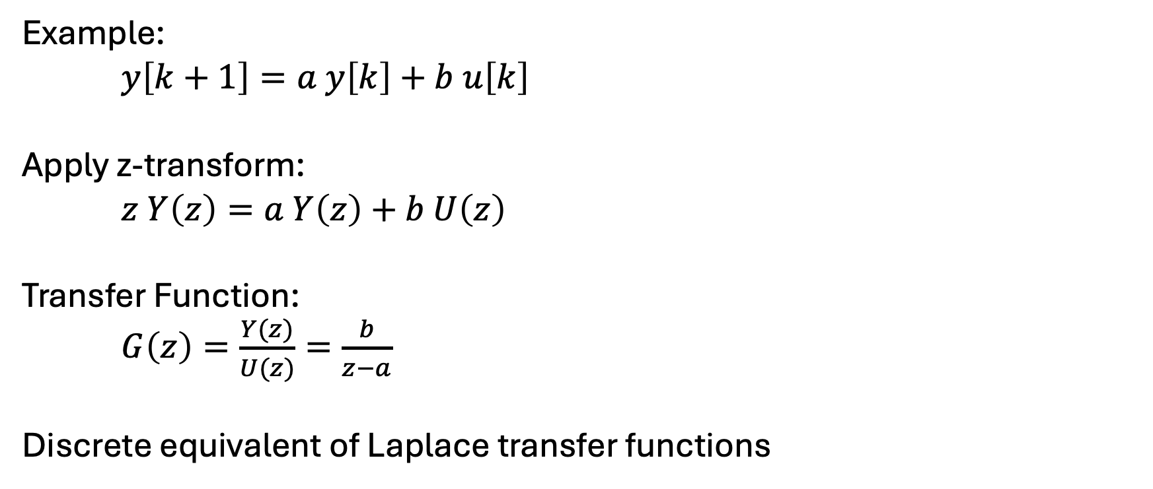
z-Transfer Functions
Example:
$y\left[k+1\right]=a y\left[k\right]+b u\left[k\right]$
Apply z-transform:
$z Y\left(z\right)=a Y\left(z\right)+b U\left(z\right)$
Transfer Function:
$G\left(z\right)=\frac{Y(z)}{U(z)}=\frac{b}{z−a}$
Discrete equivalent of Laplace transfer functions

Slide 21
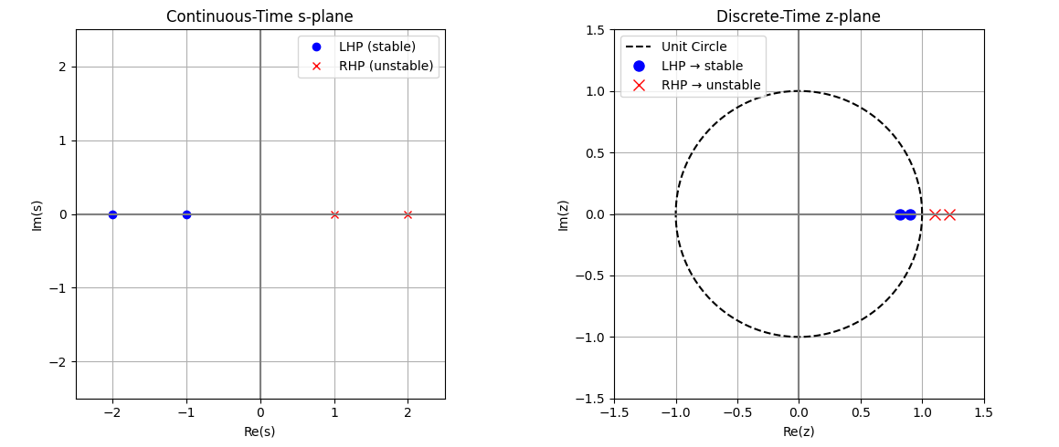
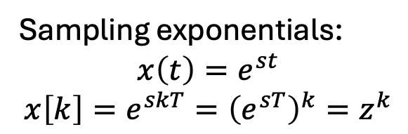



s-Plane Mapped to z-Plane
Sampling exponentials:
$$x\left(t\right)=e^{st}$$
$$x\left[k\right]=e^{skT}={\left(e^{sT}\right)}^{k}=z^{k}$$
→ Relation: $z=e^{sT}$
$$s=σ+jω$$
$$z=e^{σT}+e^{jωT}$$
$σ=0$ → unit circle

Slide 22
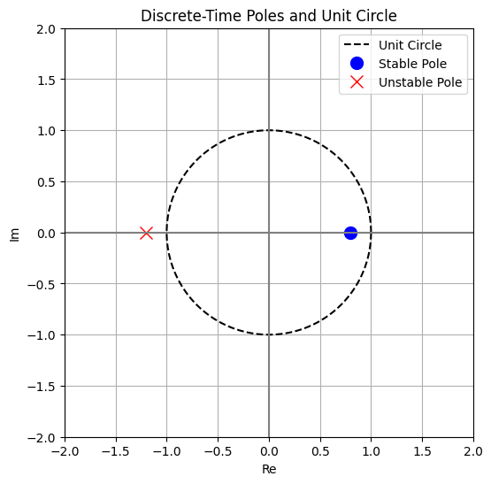
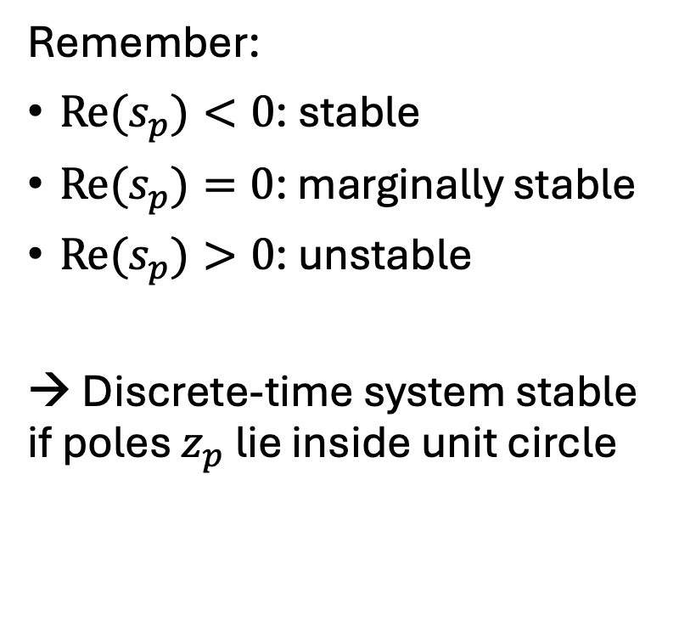
Stability in Discrete-Time Systems
Remember:
${Re(s}_{p})<0$: stable
${Re(s}_{p})=0$: marginally stable
${Re(s}_{p})>0$: unstable
→ Discrete-time system stable if poles $z_{p}$ lie inside unit circle

Slide 23
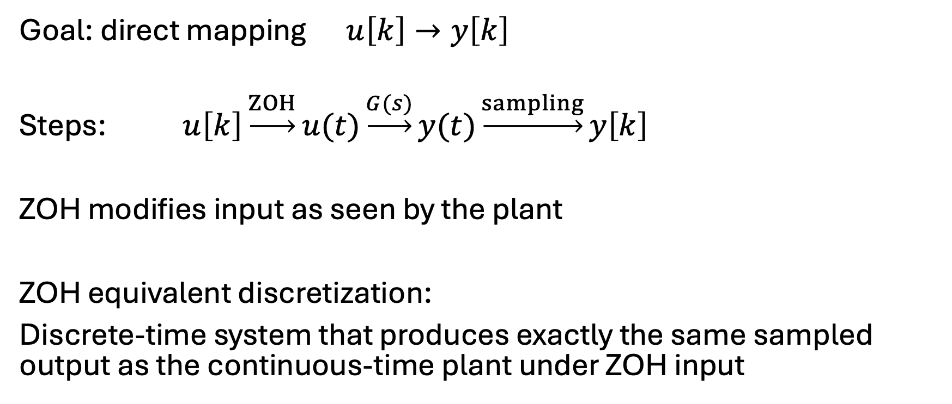
ZOH Equivalent Discretization
Goal: direct mapping $u\left[k\right]→y\left[k\right]$
Steps: $u\left[k\right]\underset{→}{ZOH}u(t)\underset{→}{G(s)}y(t)\underset{→}{sampling}y\left[k\right]$
ZOH modifies input as seen by the plant
ZOH equivalent discretization:
Discrete-time system that produces exactly the same sampled output as the continuous-time plant under ZOH input

Slide 24

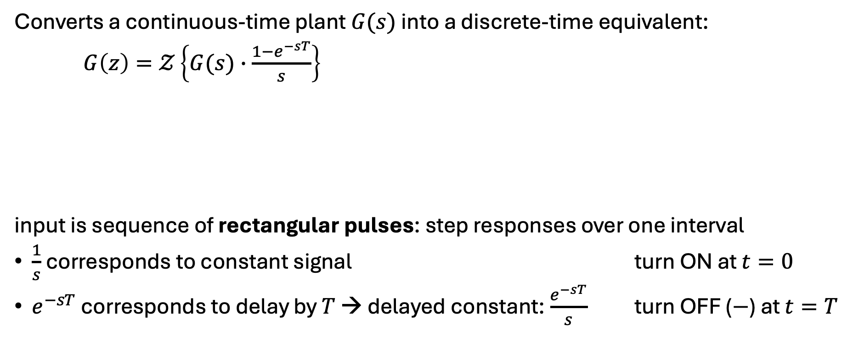
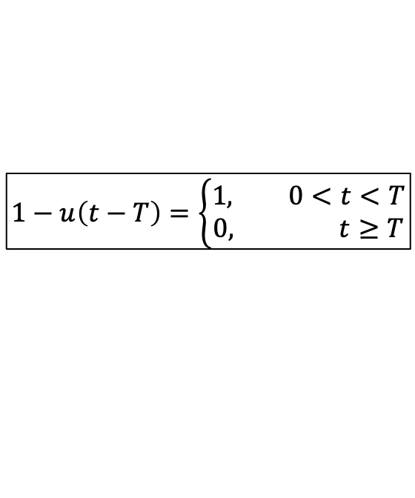
ZOH Equivalent Transfer Function
Converts a continuous-time plant $G(s)$ into a discrete-time equivalent:
$G\left(z\right)=𝒵\left\{G(s)∙\frac{1−e^{−sT}}{s}\right\}$
input is sequence of rectangular pulses: step responses over one interval
$\frac{1}{s}$ corresponds to constant signal turn ON at $t=0$
$e^{−sT}$ corresponds to delay by $T$ → delayed constant: $\frac{e^{−sT}}{s}$ turn OFF ($−$) at $t=T$
$$G_{ZOH}(s)$$
$$1−u\left(t−T\right)=\left\{\begin{aligned}1, 0<t<T \\ 0, t≥T\end{aligned}\right.$$

Slide 25
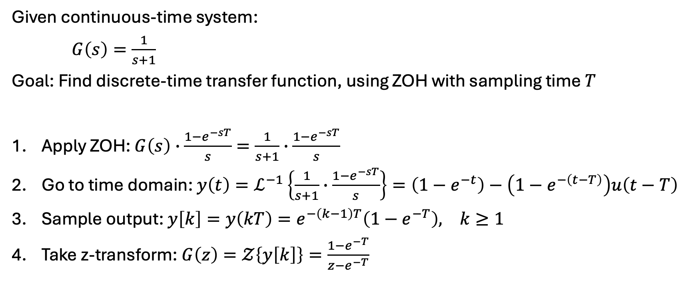
ZOH Discretization Example
Given continuous-time system:
$G\left(s\right)=\frac{1}{s+1}$
Goal: Find discrete-time transfer function, using ZOH with sampling time $T$
Apply ZOH: $G\left(s\right)∙\frac{1−e^{−sT}}{s}=\frac{1}{s+1}∙\frac{1−e^{−sT}}{s}$
Go to time domain: ${y\left(t\right)=ℒ}^{−1}\left\{\frac{1}{s+1}∙\frac{1−e^{−sT}}{s}\right\}=\left(1−e^{−t}\right)−\left(1−e^{−\left(t−T\right)}\right)u\left(t−T\right)$
Sample output: $y\left[k\right]=y\left(kT\right)=e^{−\left(k−1\right)T}\left(1−e^{−T}\right), k≥1$
Take z-transform: $G\left(z\right)=𝒵\left\{y\left[k\right]\right\}=\frac{1−e^{−T}}{z−e^{−T}}$

Slide 26
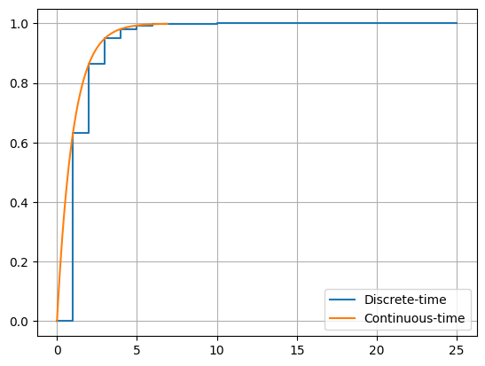
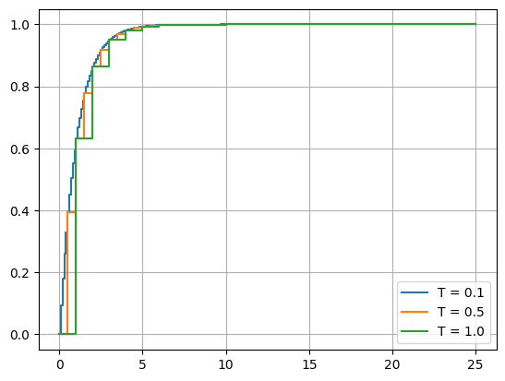
Step Response Comparison

Slide 27
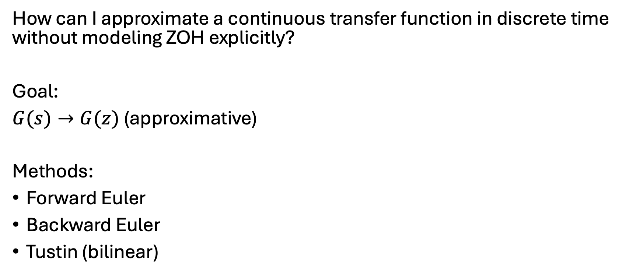
Alternative Discretization Methods
How can I approximate a continuous transfer function in discrete time without modeling ZOH explicitly?
Goal:
$G(s)→G(z)$ (approximative)
Methods:
Forward Euler
Backward Euler
Tustin (bilinear)

Slide 28
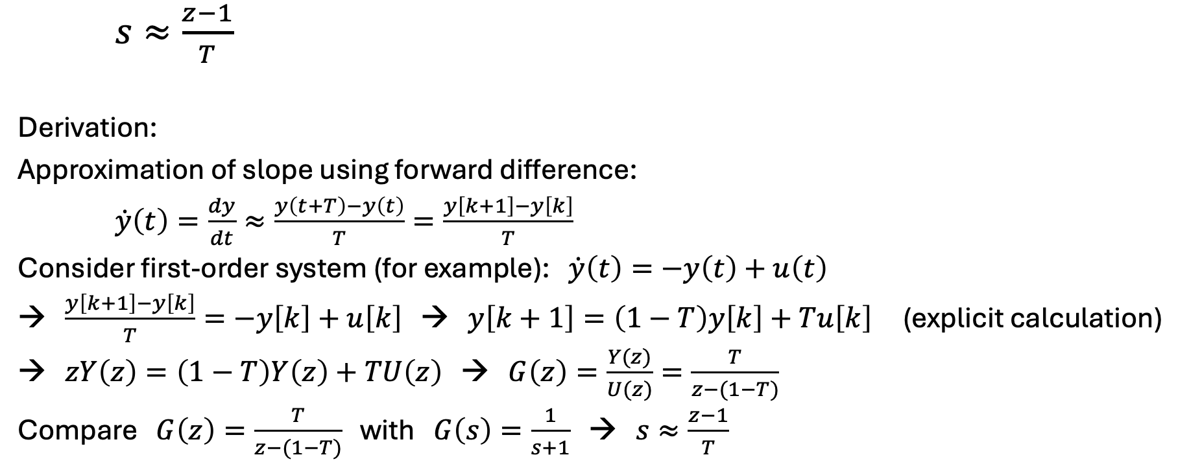
Forward Euler Method
$s≈\frac{z−1}{T}$
Derivation:
Approximation of slope using forward difference:
$\dot{y}\left(t\right)=\frac{dy}{dt}≈\frac{y\left(t+T\right)−y\left(t\right)}{T}=\frac{y\left[k+1\right]−y\left[k\right]}{T}$
Consider first-order system (for example): $\dot{y}\left(t\right)=−y\left(t\right)+u\left(t\right)$
→ $\frac{y\left[k+1\right]−y\left[k\right]}{T}=−y\left[k\right]+u\left[k\right]$ → $y\left[k+1\right]=\left(1−T\right)y\left[k\right]+Tu\left[k\right]$ (explicit calculation)
→ $zY\left(z\right)=\left(1−T\right)Y\left(z\right)+TU\left(z\right)$ → $G\left(z\right)=\frac{Y(z)}{U(z)}=\frac{T}{z−(1−T)}$
Compare $G\left(z\right)=\frac{T}{z−(1−T)}$ with $G\left(s\right)=\frac{1}{s+1}$ → $s≈\frac{z−1}{T}$

Slide 29
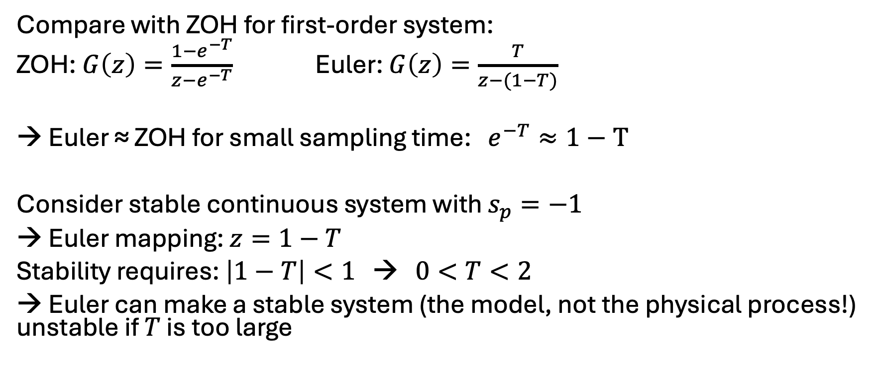
Forward Euler Stability
Compare with ZOH for first-order system:
ZOH: $G\left(z\right)=\frac{1−e^{−T}}{z−e^{−T}}$ Euler: $G\left(z\right)=\frac{T}{z−(1−T)}$
→ Euler ≈ ZOH for small sampling time: $e^{−T}≈1−T$
Consider stable continuous system with $s_{p}=−1$
→ Euler mapping: $z=1−T$
Stability requires: $\left|1−T\right|<1$ → $0<T<2$
→ Euler can make a stable system (the model, not the physical process!) unstable if $T$ is too large

Slide 30
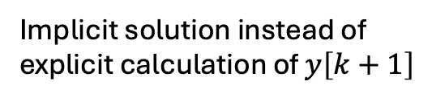
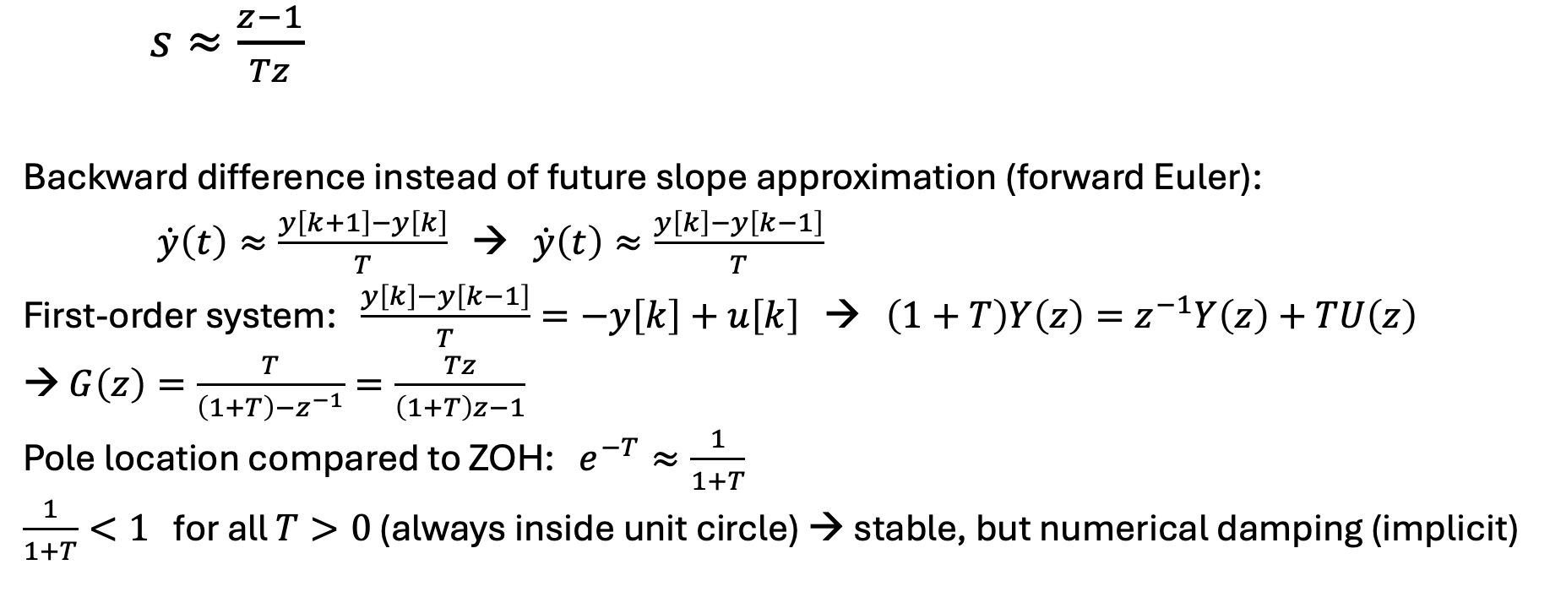
Backward Euler
$s≈\frac{z−1}{Tz}$
Backward difference instead of future slope approximation (forward Euler):
$\dot{y}\left(t\right)≈\frac{y\left[k+1\right]−y\left[k\right]}{T}$ → $\dot{y}\left(t\right)≈\frac{y\left[k\right]−y\left[k−1\right]}{T}$
First-order system: $\frac{y\left[k\right]−y\left[k−1\right]}{T}=−y\left[k\right]+u\left[k\right]$ → $\left(1+T\right)Y\left(z\right)=z^{−1}Y\left(z\right)+TU\left(z\right)$
→ $G\left(z\right)=\frac{T}{\left(1+T\right)−z^{−1}}=\frac{Tz}{\left(1+T\right)z−1}$
Pole location compared to ZOH: $e^{−T}≈\frac{1}{1+T}$
$\frac{1}{1+T}<1$ for all $T>0$ (always inside unit circle) → stable, but numerical damping (implicit)
Implicit solution instead of explicit calculation of $y\left[k+1\right]$

Slide 31
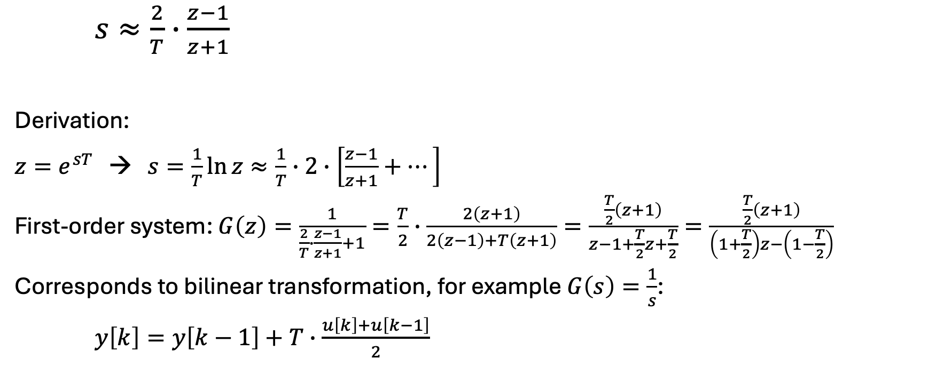
Tustin (Bilinear) Method
Maps entire LHP inside unit circle
$s≈\frac{2}{T}∙\frac{z−1}{z+1}$
Derivation:
$z=e^{sT}$ → $s=\frac{1}{T}\ln{z}≈\frac{1}{T}∙2∙\left[\frac{z−1}{z+1}+⋯\right]$
First-order system: $G\left(z\right)=\frac{1}{\frac{2}{T}∙\frac{z−1}{z+1}+1}=\frac{T}{2}∙\frac{2\left(z+1\right)}{2\left(z−1\right)+T\left(z+1\right)}=\frac{\frac{T}{2}\left(z+1\right)}{z−1+\frac{T}{2}z+\frac{T}{2}}=\frac{\frac{T}{2}\left(z+1\right)}{\left(1+\frac{T}{2}\right)z−\left(1−\frac{T}{2}\right)}$
Corresponds to bilinear transformation, for example $G\left(s\right)=\frac{1}{s}$:
$y\left[k\right]=y\left[k−1\right]+T∙\frac{u\left[k\right]+u\left[k−1\right]}{2}$
Series development and termination after the first term

Slide 32
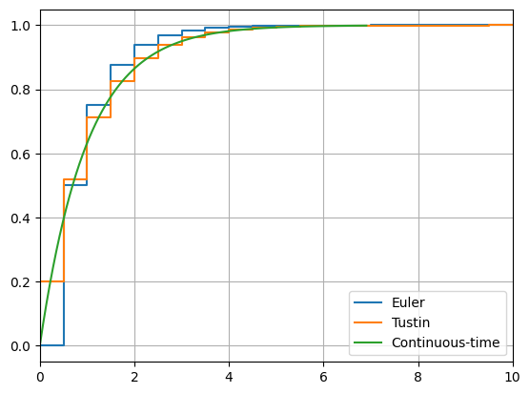
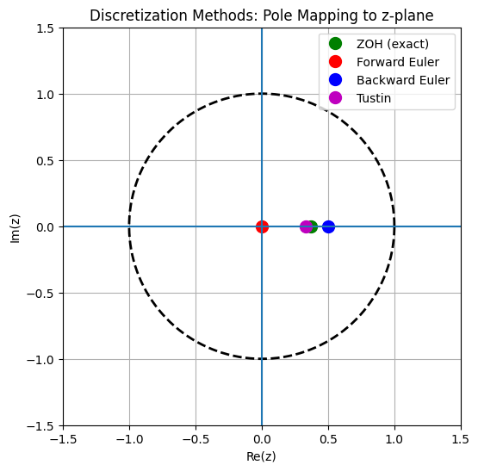
Comparison

Slide 33
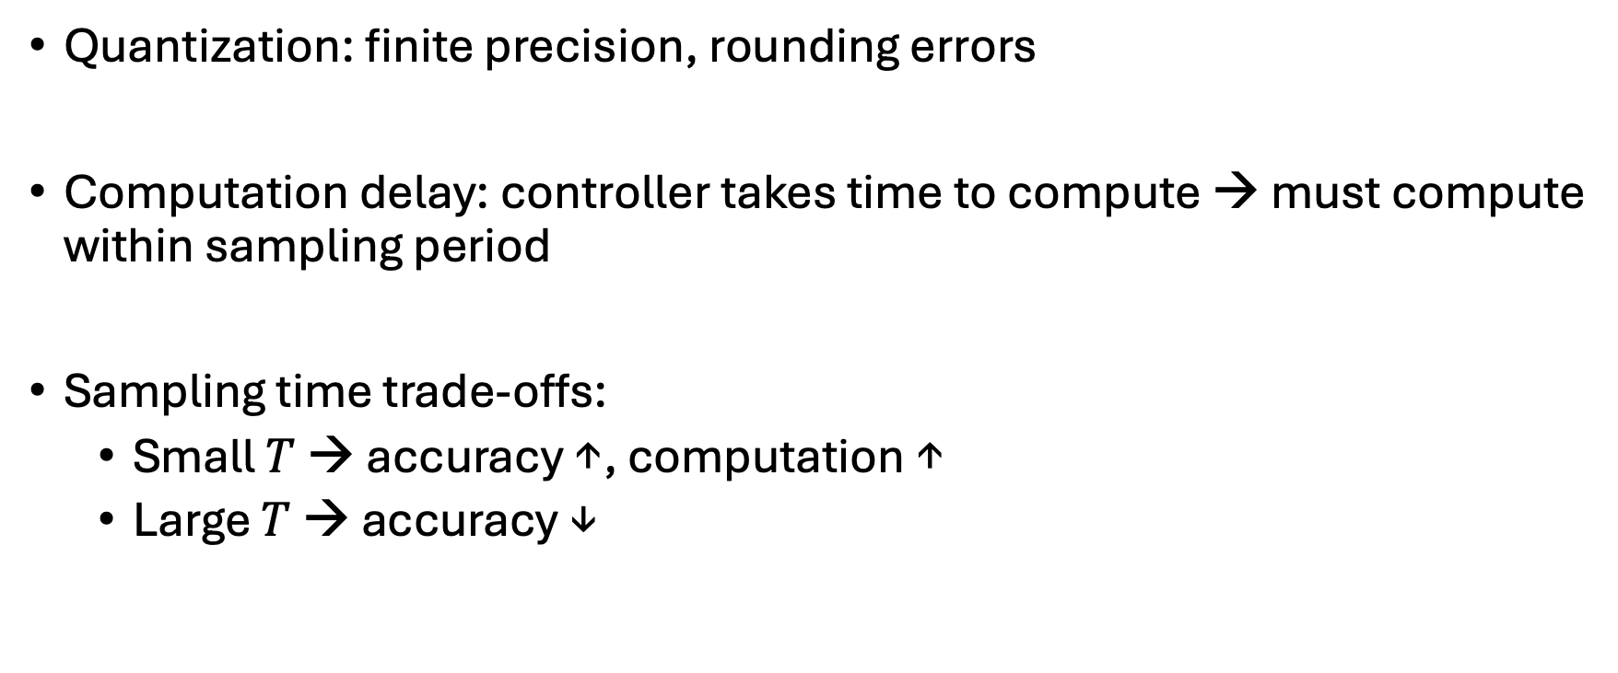
Implementation Issues
Quantization: finite precision, rounding errors
Computation delay: controller takes time to compute → must compute within sampling period
Sampling time trade-offs:
Small $T$ → accuracy ↑, computation ↑
Large $T$ → accuracy ↓

Slide 34
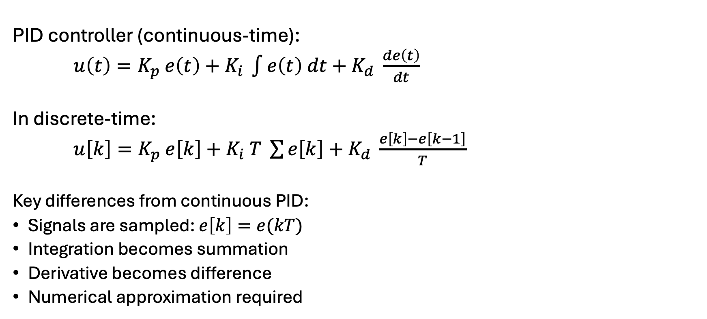
Discrete-Time PID Tuning
PID controller (continuous-time):
$u\left(t\right)=K_{p} e\left(t\right)+K_{i} \int{e\left(t\right) dt+K_{d} \frac{de\left(t\right)}{dt}}$
In discrete-time:
$u\left[k\right]=K_{p} e\left[k\right]+K_{i} T \sum{e\left[k\right]}+K_{d} \frac{e\left[k\right]−e\left[k−1\right]}{T}$
Key differences from continuous PID:
Signals are sampled: $e\left[k\right]=e(kT)$
Integration becomes summation
Derivative becomes difference
Numerical approximation required
Position form

Slide 35
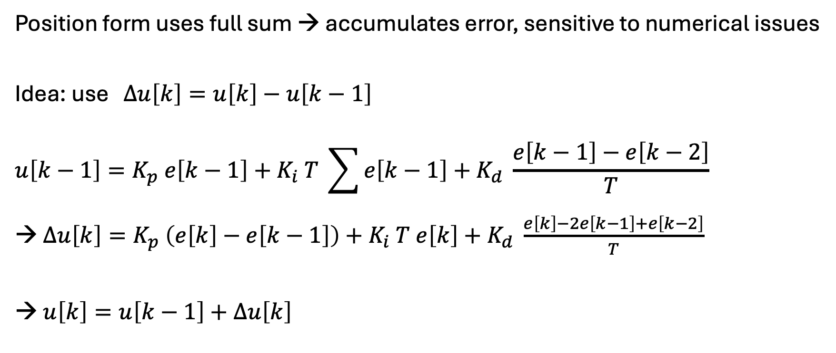
Incremental Form
Position form uses full sum → accumulates error, sensitive to numerical issues
Idea: use $∆u\left[k\right]=u\left[k\right]−u\left[k−1\right]$
$$u\left[k−1\right]=K_{p} e\left[k−1\right]+K_{i} T \sum{e\left[k−1\right]}+K_{d} \frac{e\left[k−1\right]−e\left[k−2\right]}{T}$$
→ $∆u\left[k\right]=K_{p} \left(e\left[k\right]−e\left[k−1\right]\right)+K_{i} T e\left[k\right]+K_{d} \frac{e\left[k\right]−2e\left[k−1\right]+e\left[k−2\right]}{T}$
→ $u\left[k\right]=u\left[k−1\right]+∆u\left[k\right]$
No explicit sum
Control updates instead of absolute values

Slide 36
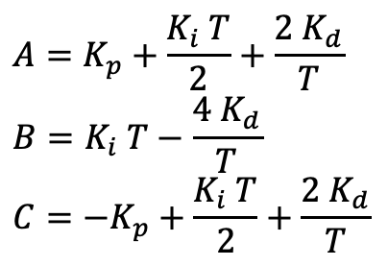
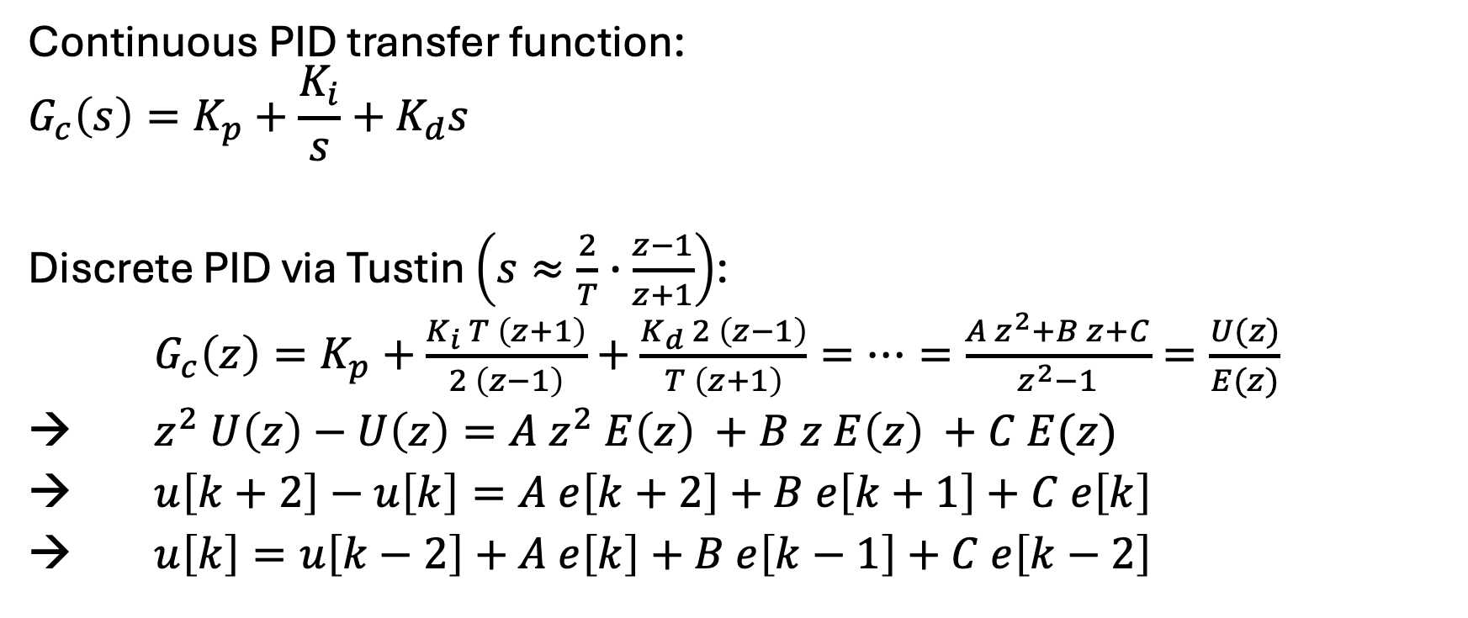

PID Transfer Function
Continuous PID transfer function:
$$G_{c}\left(s\right)=K_{p}+\frac{K_{i}}{s}+K_{d}s$$
Discrete PID via Tustin $\left(s≈\frac{2}{T}∙\frac{z−1}{z+1}\right)$:
$G_{c}\left(z\right)=K_{p}+\frac{K_{i} T \left(z+1\right)}{2 \left(z−1\right)}+\frac{K_{d} 2 \left(z−1\right)}{T \left(z+1\right)}=⋯=\frac{A z^{2}+B z+C}{z^{2}−1}=\frac{U(z)}{E(z)}$
$z^{2} U\left(z\right)−U\left(z\right)=A z^{2} E\left(z\right) +B z E\left(z\right) +C E(z)$
$u\left[k+2\right]−u\left[k\right]=A e\left[k+2\right]+B e\left[k+1\right]+C e\left[k\right]$
$u\left[k\right]=u\left[k−2\right]+A e\left[k\right]+B e\left[k−1\right]+C e\left[k−2\right]$
$$A=K_{p}+\frac{K_{i} T}{2}+\frac{{2 K}_{d}}{T}$$
$$B=K_{i} T−\frac{{4 K}_{d}}{T}$$
$$C={−K}_{p}+\frac{K_{i} T}{2}+\frac{{2 K}_{d}}{T}$$
$$k→k−2$$

Slide 37
Direct Discrete Tuning
Option 1: Tune directly in discrete-time
Option 2: Tune continuous PID → discretize
Most common: second approach
For example:
Ziegler–Nichols
Convert to discrete using Tustin

Slide 38

Filtered Derivative
Problem: $\frac{e\left[k\right]−e\left[k−1\right]}{T}$ amplifies noise
→ Use: $D\left(s\right)=\frac{K_{d} s}{1+τ s}$
Then apply Tustin for discrete-time

Slide 39
Summary
Digital control is essential in modern systems
Sampling introduces constraints
ZOH connects discrete and continuous worlds
z-transform is key analysis tool
Discretization method important for controller design

