Slide 1
Poles/Zeros & Stability
Control Engineering

Slide 2
Course Schedule
Systems
Continuous-time Controllers
Laplace Domain
Poles/Zeros & Stability
Controller Design
Discrete-time Controllers
State Space Representation
Advanced Control Methods

Slide 3
Poles/Zeros & Stability
Effect on transient response
Resonance
Frequency-domain stability analysis

Slide 4
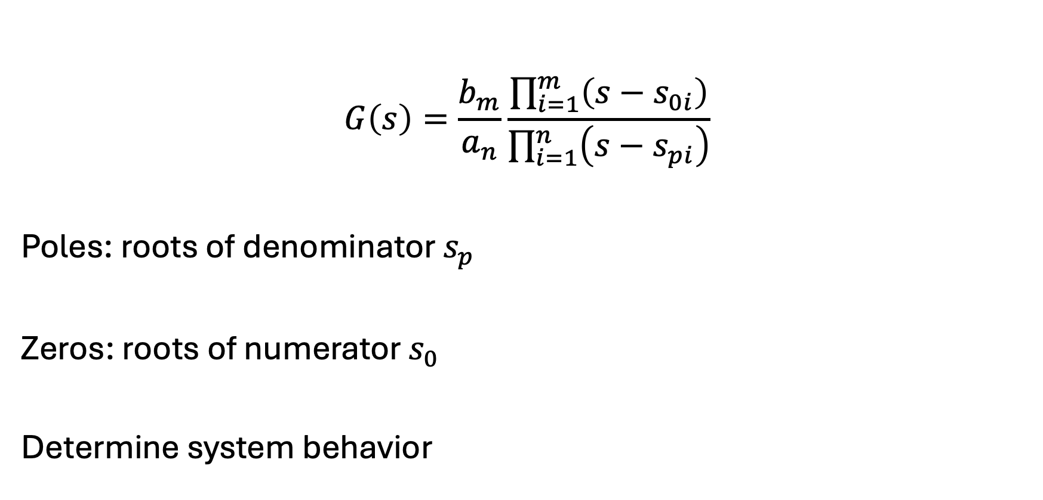
Poles and Zeros
$$G\left(s\right)=\frac{b_{m}}{a_{n}}\frac{\prod_{i=1}^{m}{\left(s−s_{0i}\right)}}{\prod_{i=1}^{n}{\left(s−s_{pi}\right)}}$$
Poles: roots of denominator $s_{p}$
Zeros: roots of numerator $s_{0}$
Determine system behavior

Slide 5
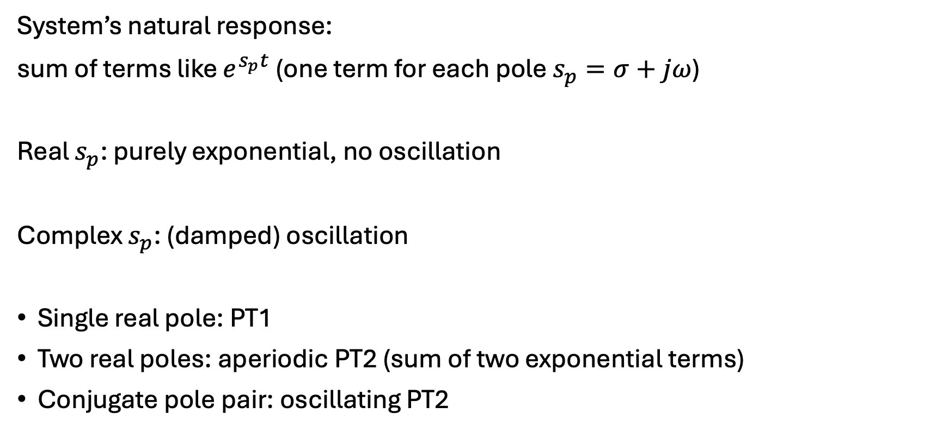
Interpretation of Poles
System’s natural response:
sum of terms like $e^{s_{p}t}$ (one term for each pole $s_{p}=σ+jω$)
Real $s_{p}$: purely exponential, no oscillation
Complex $s_{p}$: (damped) oscillation
Single real pole: PT1
Two real poles: aperiodic PT2 (sum of two exponential terms)
Conjugate pole pair: oscillating PT2

Slide 6
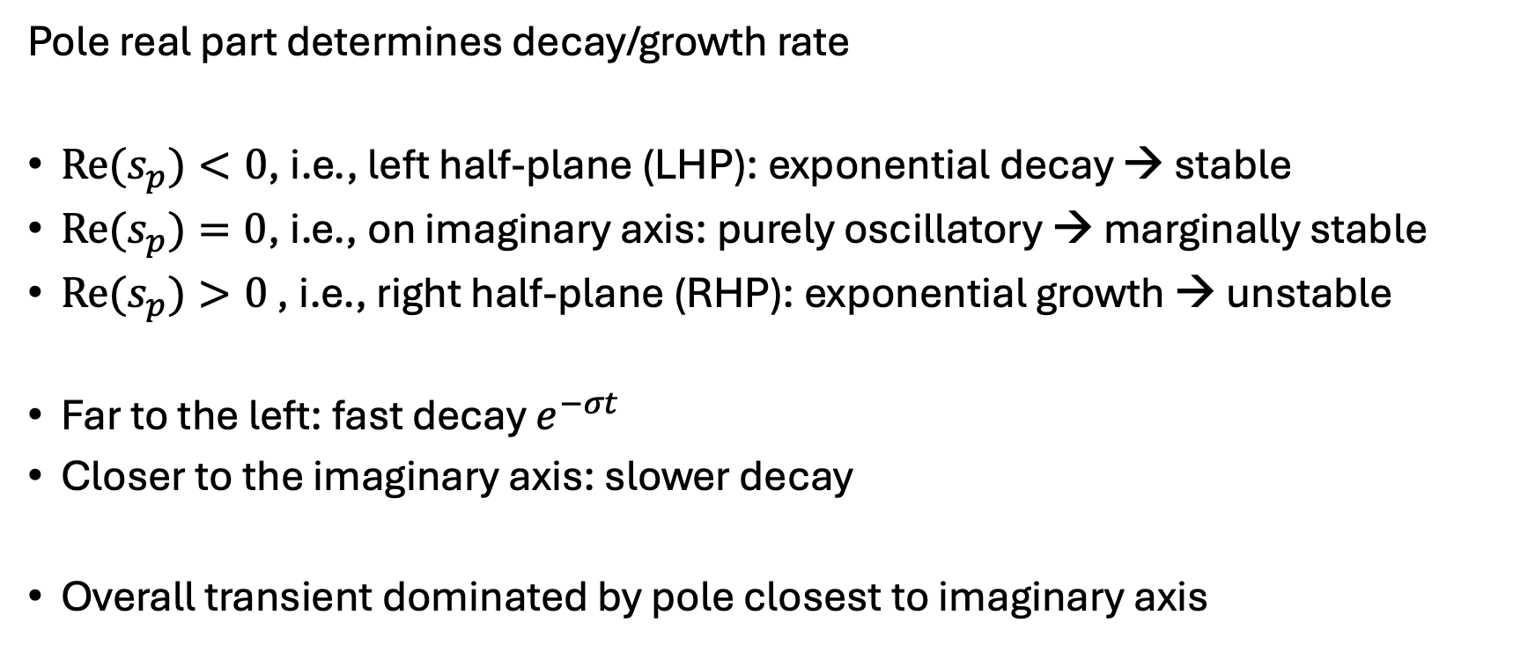
Pole Location
Pole real part determines decay/growth rate
${Re(s}_{p})<0$, i.e., left half-plane (LHP): exponential decay → stable
${Re(s}_{p})=0$, i.e., on imaginary axis: purely oscillatory → marginally stable
${Re(s}_{p})>0$ , i.e., right half-plane (RHP): exponential growth → unstable
Far to the left: fast decay $e^{−σt}$
Closer to the imaginary axis: slower decay
Overall transient dominated by pole closest to imaginary axis

Slide 7
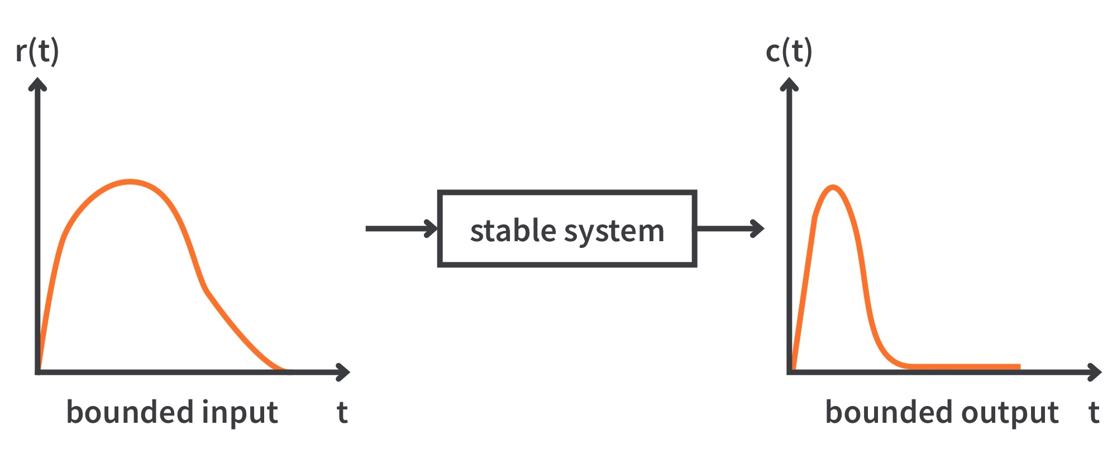
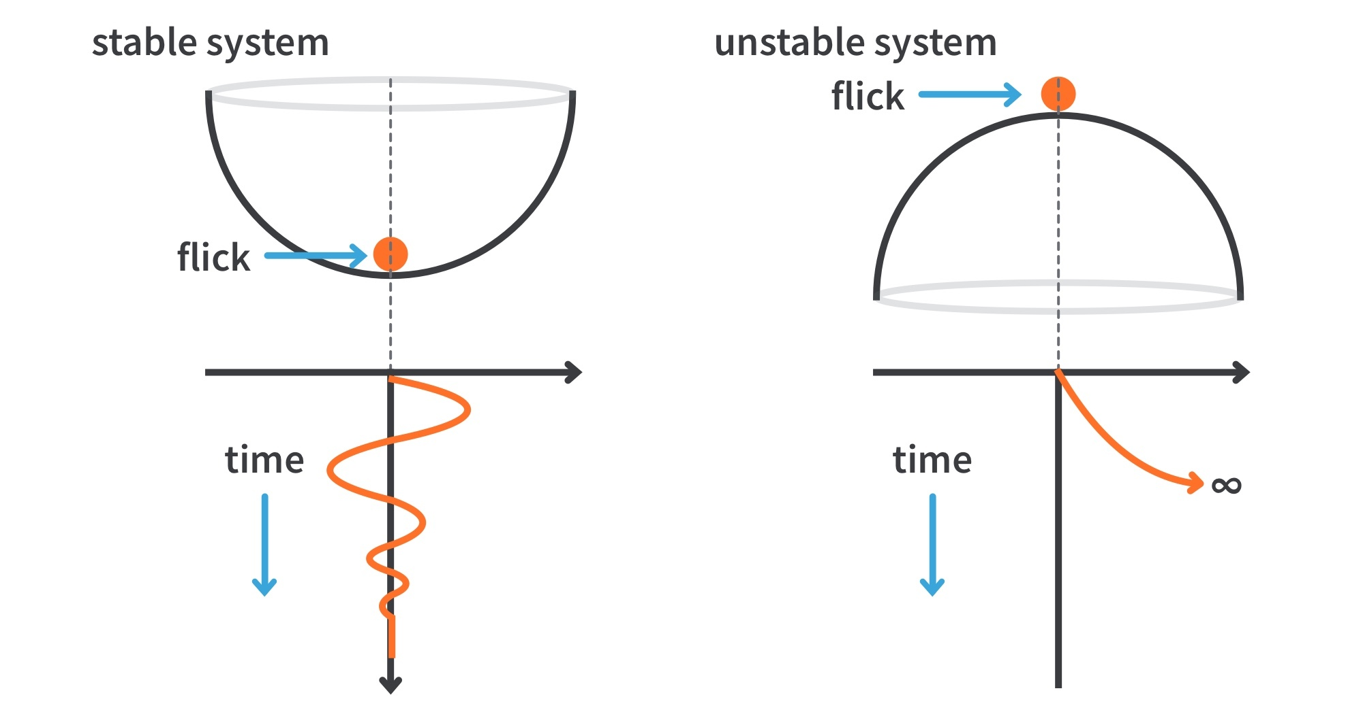
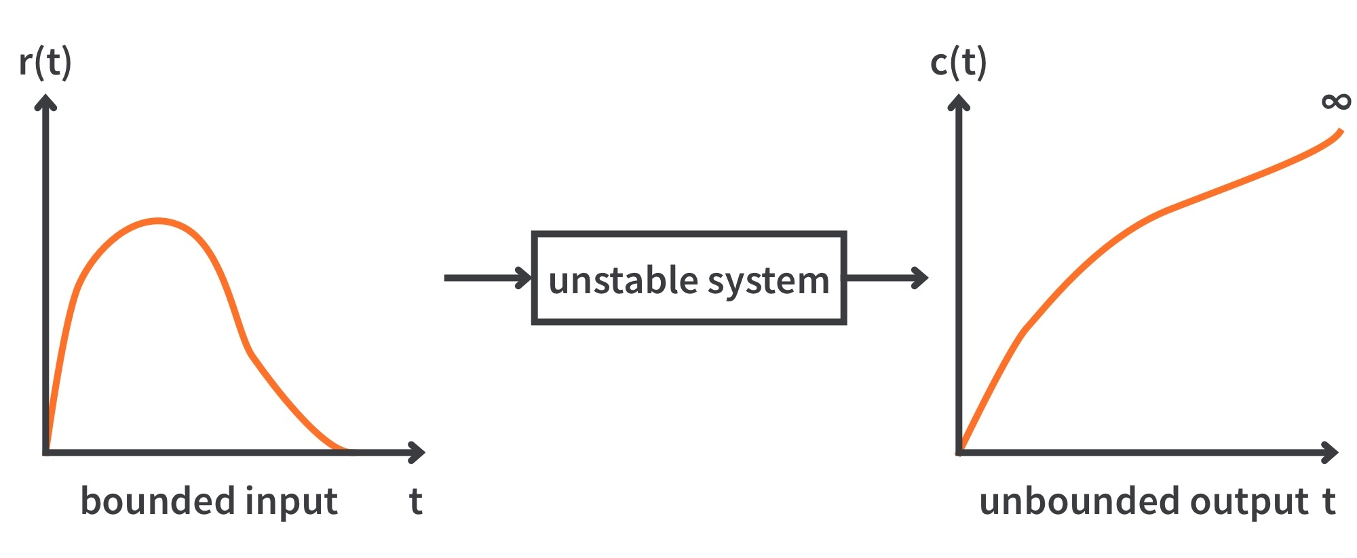
Bounded Input Bounded Output (BIBO) Stability

Slide 8
Stability of Continuous-Time Systems
Stable if all poles have negative real part
Marginally stable if poles on imaginary axis
Unstable otherwise
Stability checks for a known fixed transfer function of higher order:
Numerical solver for root finding: easiest and standard practice
Analytical alternatives without computing any roots, e.g., Hurwitz criterion (using determinants):
Are there any RHP poles?
Does stability change with a parameter? (root finding would require parameter scan)

Slide 9
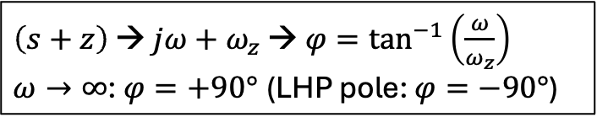
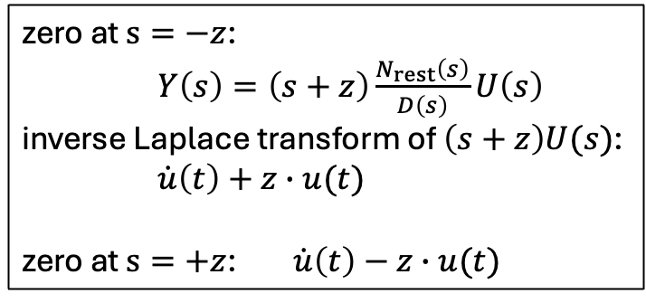
Zero Location
zero at $s=−z$:
$Y\left(s\right)=\left(s+z\right)\frac{N_{rest}\left(s\right)}{D\left(s\right)}U\left(s\right)$
inverse Laplace transform of $\left(s+z\right)U(s)$:
$\dot{u}\left(t\right)+z∙u(t)$
zero at $s=+z$: $\dot{u}\left(t\right)−z∙u(t)$
Zeros in LHP:
speed up response (derivative behavior)
can increase overshoot (caused by complex poles)
add phase lead (LHP poles have negative phase, so LHP zeros give the smallest possible phase lag → minimum-phase zeros)
Zeros in RHP:
cause inverse response (initial motion opposite to final steady-state direction)
add phase lag (→ non-minimum-phase zeros)
Zeros at the origin introduce differentiating behavior
Zeros near poles modify or cancel dynamic modes
An LHP zero close to the imaginary axis or a zero close to a dominant pole (slowest-decaying exponential, i.e., pole with least negative real part) can increase overshoot significantly.
$\left(s+z\right)$ → $jω+ω_{z}$ → $φ=\tan^{−1}\left(\frac{ω}{ω_{z}}\right)$
$ω→∞$: $φ=+90°$ (LHP pole: $φ=−90°$)

Slide 10
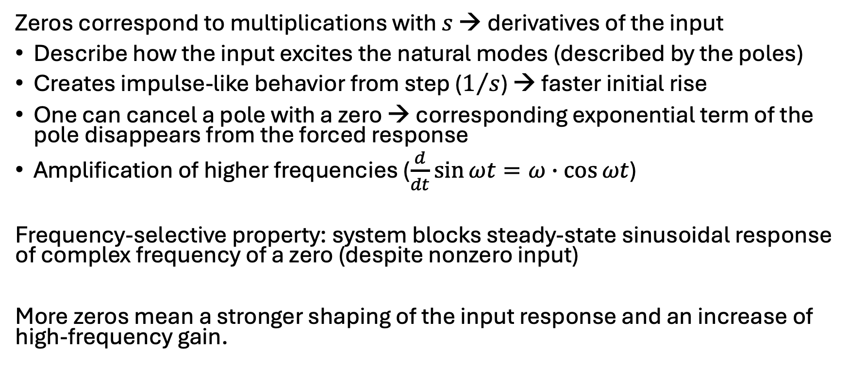
Interpretation of Zeros
Zeros alone do not make a system unstable, only poles in RHP do.
Zeros correspond to multiplications with $s$ → derivatives of the input
Describe how the input excites the natural modes (described by the poles)
Creates impulse-like behavior from step ($1/s$) → faster initial rise
One can cancel a pole with a zero → corresponding exponential term of the pole disappears from the forced response
Amplification of higher frequencies ($\frac{d}{dt}\sin{ωt}=ω∙\cos{ωt}$)
Frequency-selective property: system blocks steady-state sinusoidal response of complex frequency of a zero (despite nonzero input)
More zeros mean a stronger shaping of the input response and an increase of high-frequency gain.

Slide 11
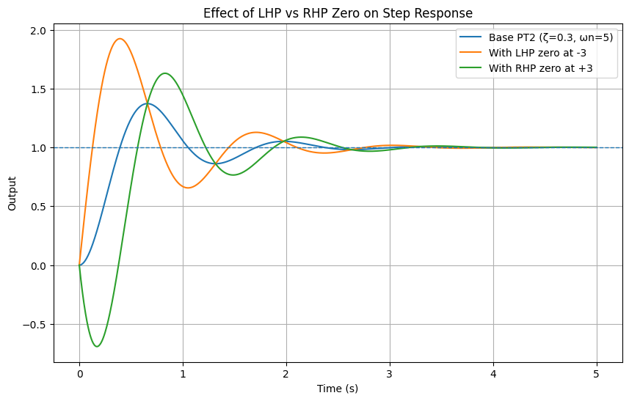
Example: PT2 with LHP and RHP Zero
LHP zero: faster response, increased overshoot
RHP zero: inverse response (initial dip)

Slide 12
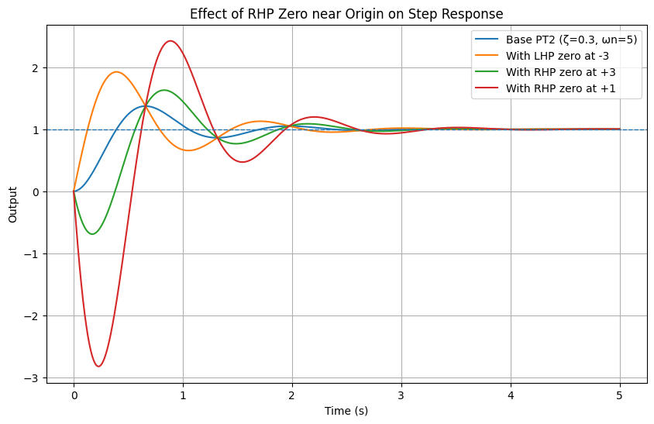
Example: PT2 with LHP and RHP Zero
RHP zero closer to origin:
stronger dip
higher overshoot
more sluggish

Slide 13
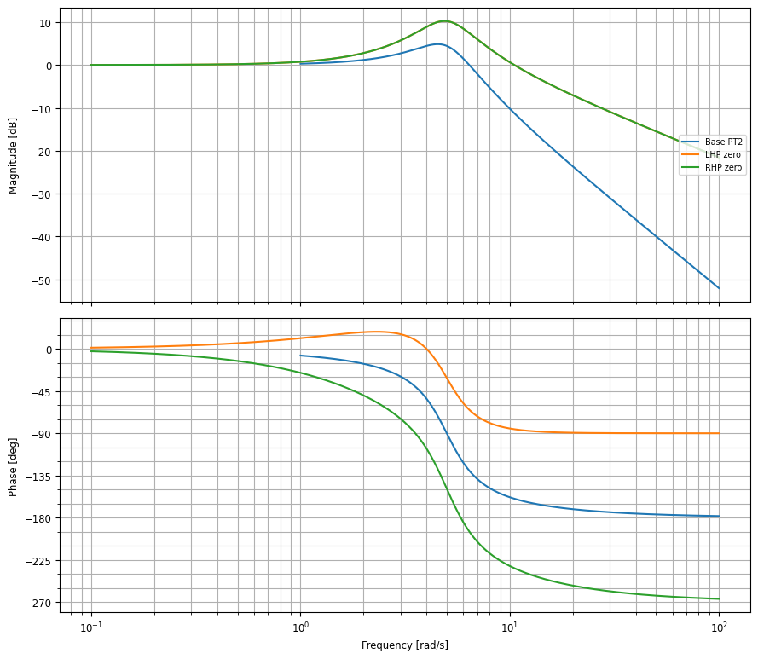
Example: PT2 with LHP and RHP Zero
Zeros increase high-frequency slope in the same way
LHP zero: phase lead +90°
RHP zero: phase lag -90°

Slide 14
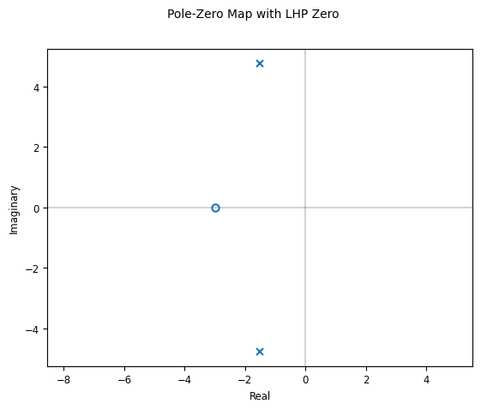
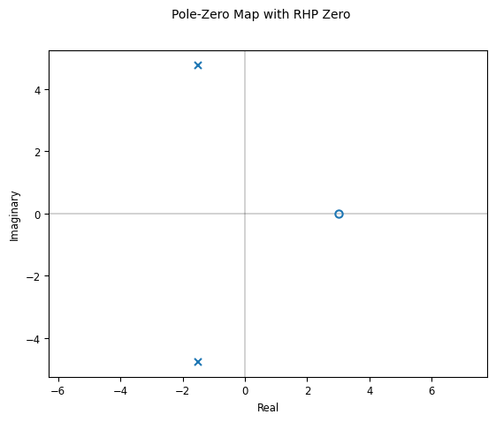
Pole-Zero Diagrams
Graphical representation in complex plane
Stability visible at a glance
Often calculated numerically
Example from last slides: both systems stable
(poles in LHP)

Slide 15
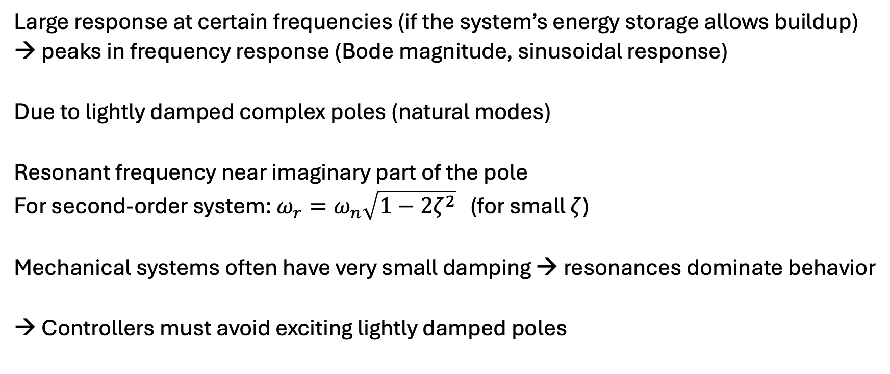
Resonance
Large response at certain frequencies (if the system’s energy storage allows buildup)
→ peaks in frequency response (Bode magnitude, sinusoidal response)
Due to lightly damped complex poles (natural modes)
Resonant frequency near imaginary part of the pole
For second-order system: $ω_{r}=ω_{n}\sqrt{1−2ζ^{2}}$ (for small $ζ$)
Mechanical systems often have very small damping → resonances dominate behavior
→ Controllers must avoid exciting lightly damped poles

Slide 16
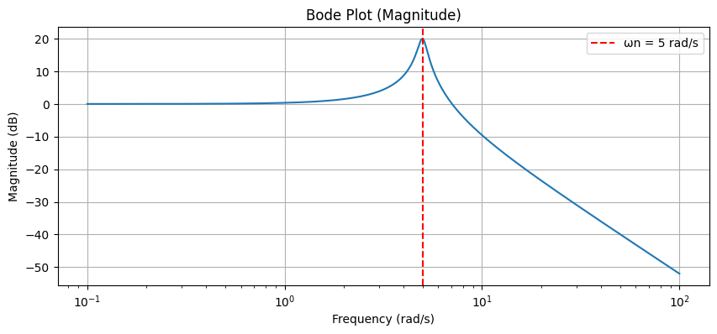
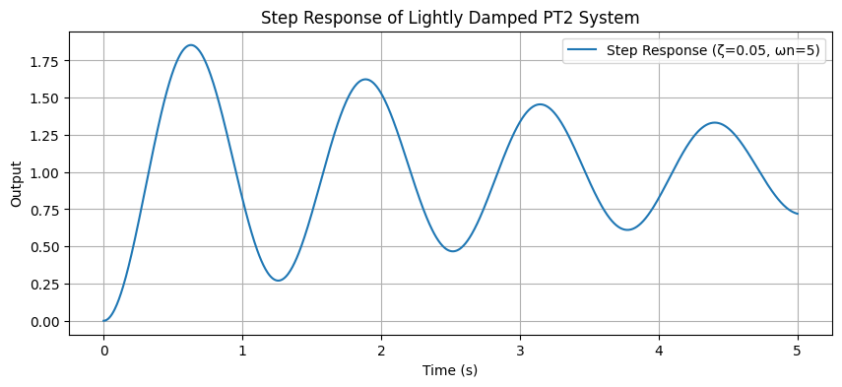
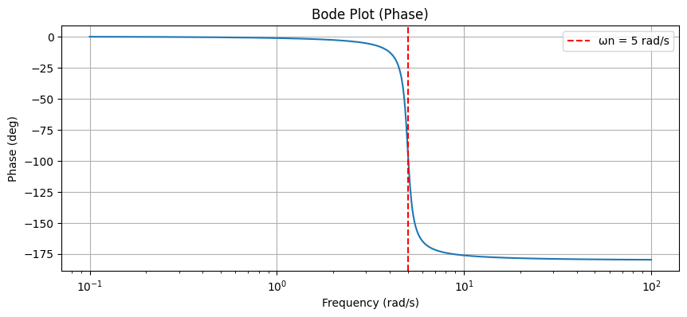

Slide 17
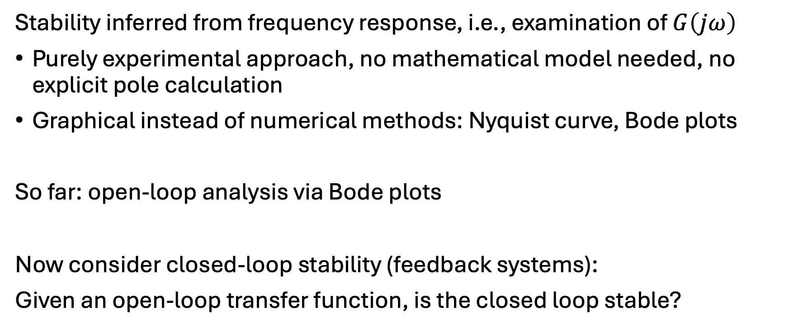
Frequency-Domain Stability
Stability inferred from frequency response, i.e., examination of $G\left(jω\right)$
Purely experimental approach, no mathematical model needed, no explicit pole calculation
Graphical instead of numerical methods: Nyquist curve, Bode plots
So far: open-loop analysis via Bode plots
Now consider closed-loop stability (feedback systems):
Given an open-loop transfer function, is the closed loop stable?

Slide 18
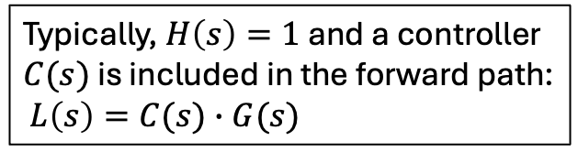


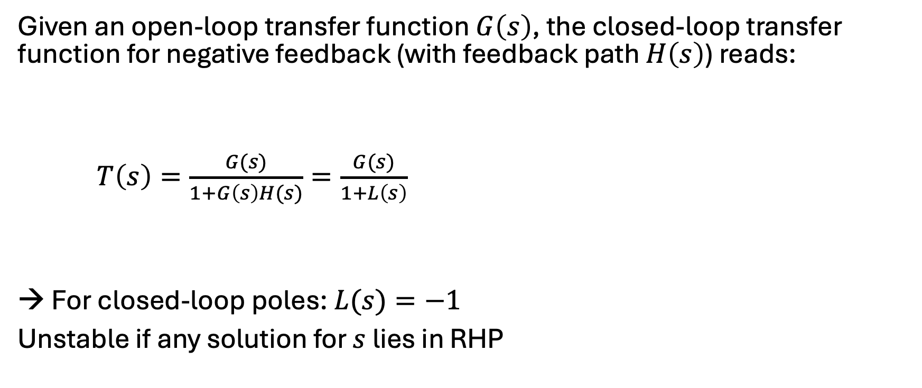



Closed-Loop Stability
$$R(s)$$
$$G(s)$$
$$Y(s)$$
$$−$$
$$H(s)$$
Given an open-loop transfer function $G\left(s\right)$, the closed-loop transfer function for negative feedback (with feedback path $H\left(s\right)$) reads:
$T\left(s\right)=\frac{G(s)}{1+G\left(s\right)H(s)}=\frac{G(s)}{1+L\left(s\right)}$
→ For closed-loop poles: $L(s)=−1$
Unstable if any solution for $s$ lies in RHP
forward path
Typically, $H\left(s\right)=1$ and a controller $C(s)$ is included in the forward path:
$L\left(s\right)=C(s)∙G(s)$
loop gain

Slide 19
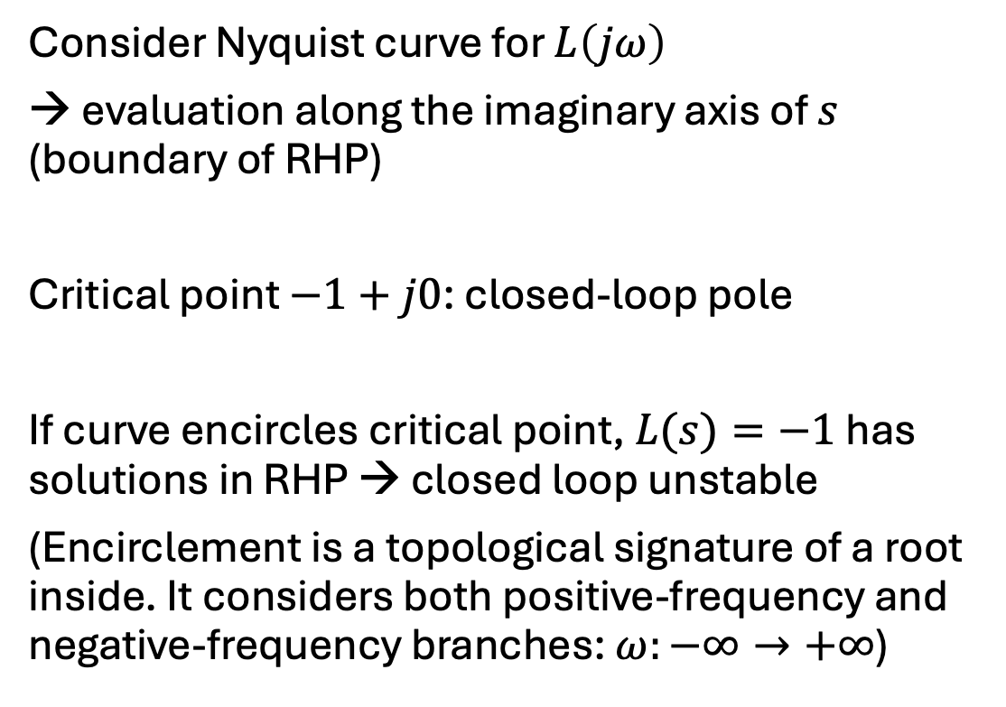


Nyquist Stability Criterion
Consider Nyquist curve for $L\left(jω\right)$
→ evaluation along the imaginary axis of $s$ (boundary of RHP)
Critical point $−1+j0$: closed-loop pole
If curve encircles critical point, $L(s)=−1$ has solutions in RHP → closed loop unstable
(Encirclement is a topological signature of a root inside. It considers both positive-frequency and negative-frequency branches: $ω:−∞→+∞$)
Stable PT2 system:
$$Im(L\left(jω\right))$$
$$Re(L\left(jω\right))$$

Slide 20
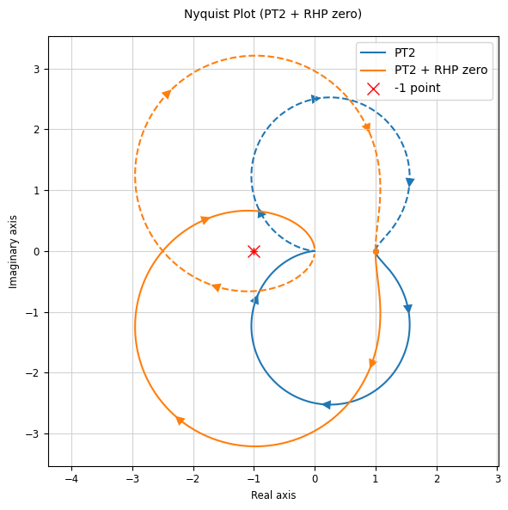
unstable

Slide 21
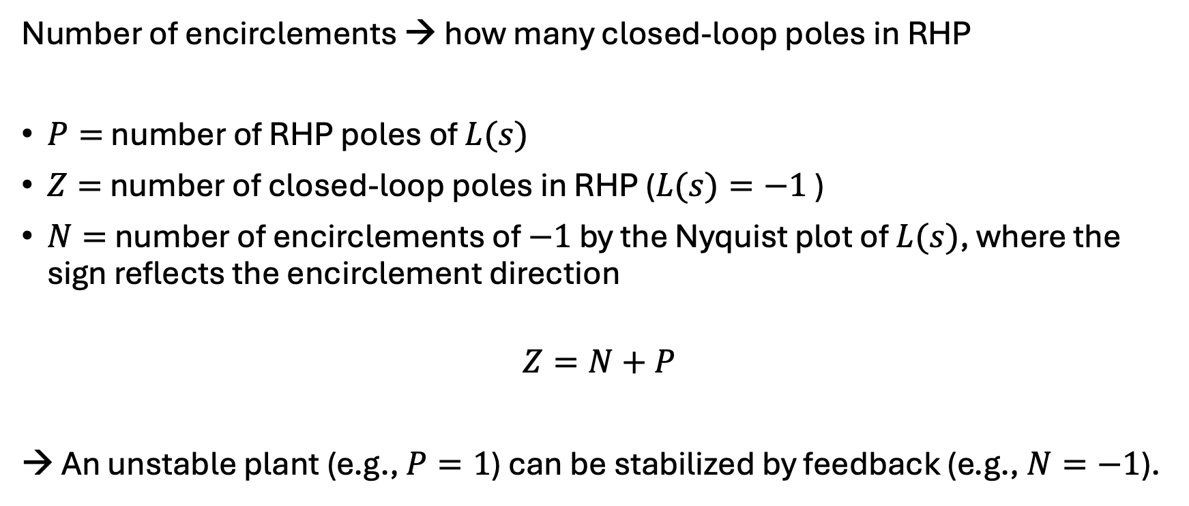
Nyquist Formula
Number of encirclements → how many closed-loop poles in RHP
$P=$ number of RHP poles of $L(s)$
$Z=$ number of closed-loop poles in RHP ($L(s)=−1$ )
$N=$ number of encirclements of $−1$ by the Nyquist plot of $L(s)$, where the sign reflects the encirclement direction
$$Z=N+P$$
→ An unstable plant (e.g., $P=1$) can be stabilized by feedback (e.g., $N=−1$).

Slide 22
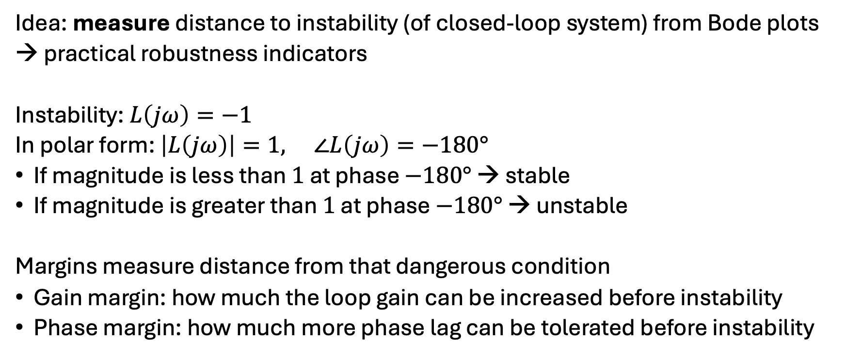
Gain and Phase Margins
Idea: measure distance to instability (of closed-loop system) from Bode plots
→ practical robustness indicators
Instability: $L\left(jω\right)=−1$
In polar form: $\left|L\left(jω\right)\right|=1, ∠L\left(jω\right)=−180°$
If magnitude is less than $1$ at phase $−180°$ → stable
If magnitude is greater than $1$ at phase $−180°$ → unstable
Margins measure distance from that dangerous condition
Gain margin: how much the loop gain can be increased before instability
Phase margin: how much more phase lag can be tolerated before instability

Slide 23
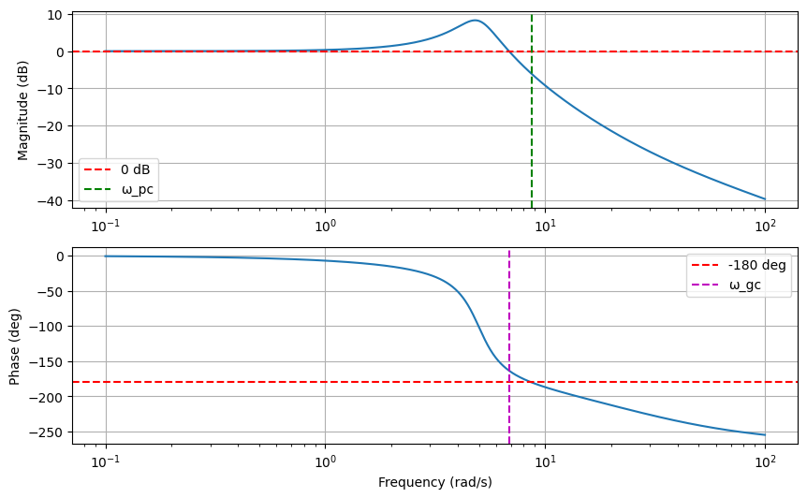
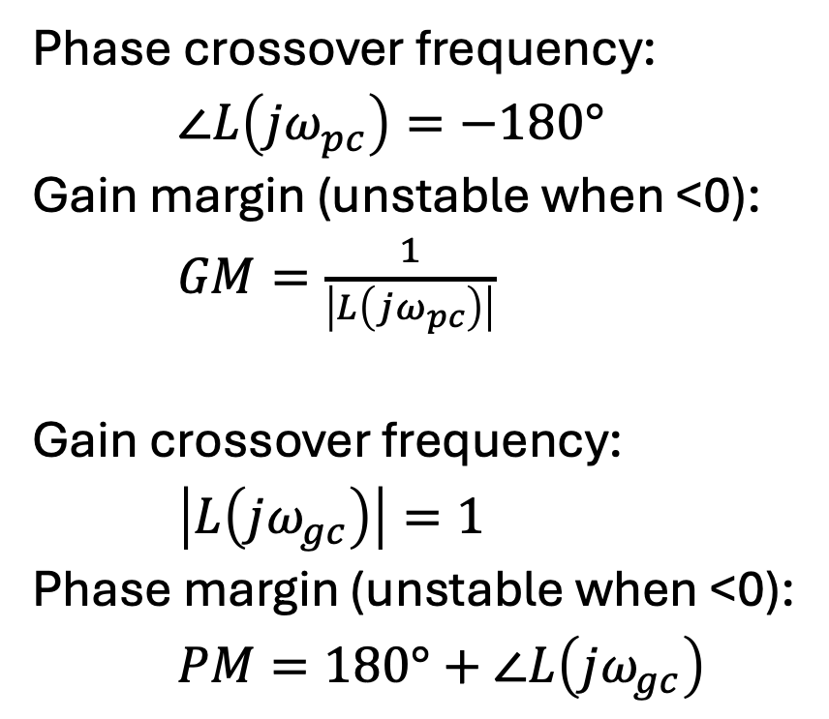
Crossover Frequencies
just barely stable:
Phase crossover frequency:
$∠L\left(jω_{pc}\right)=−180°$
Gain margin (unstable when <0):
$GM=\frac{1}{\left|L\left(jω_{pc}\right)\right|}$
Gain crossover frequency:
$\left|L\left(jω_{gc}\right)\right|=1$
Phase margin (unstable when <0):
$PM=180°+∠L\left(jω_{gc}\right)$

Slide 24
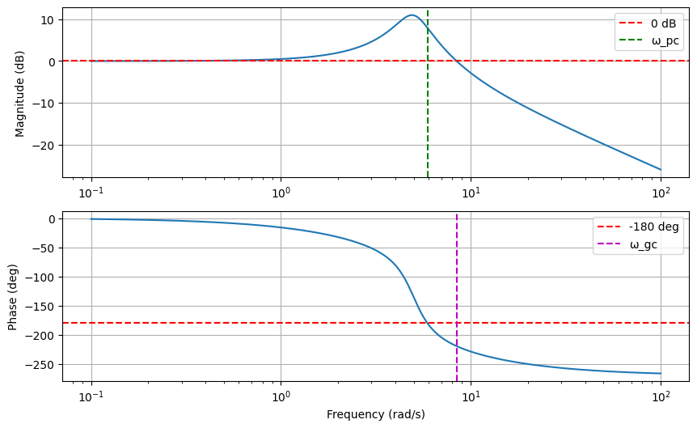
unstable:

Slide 25
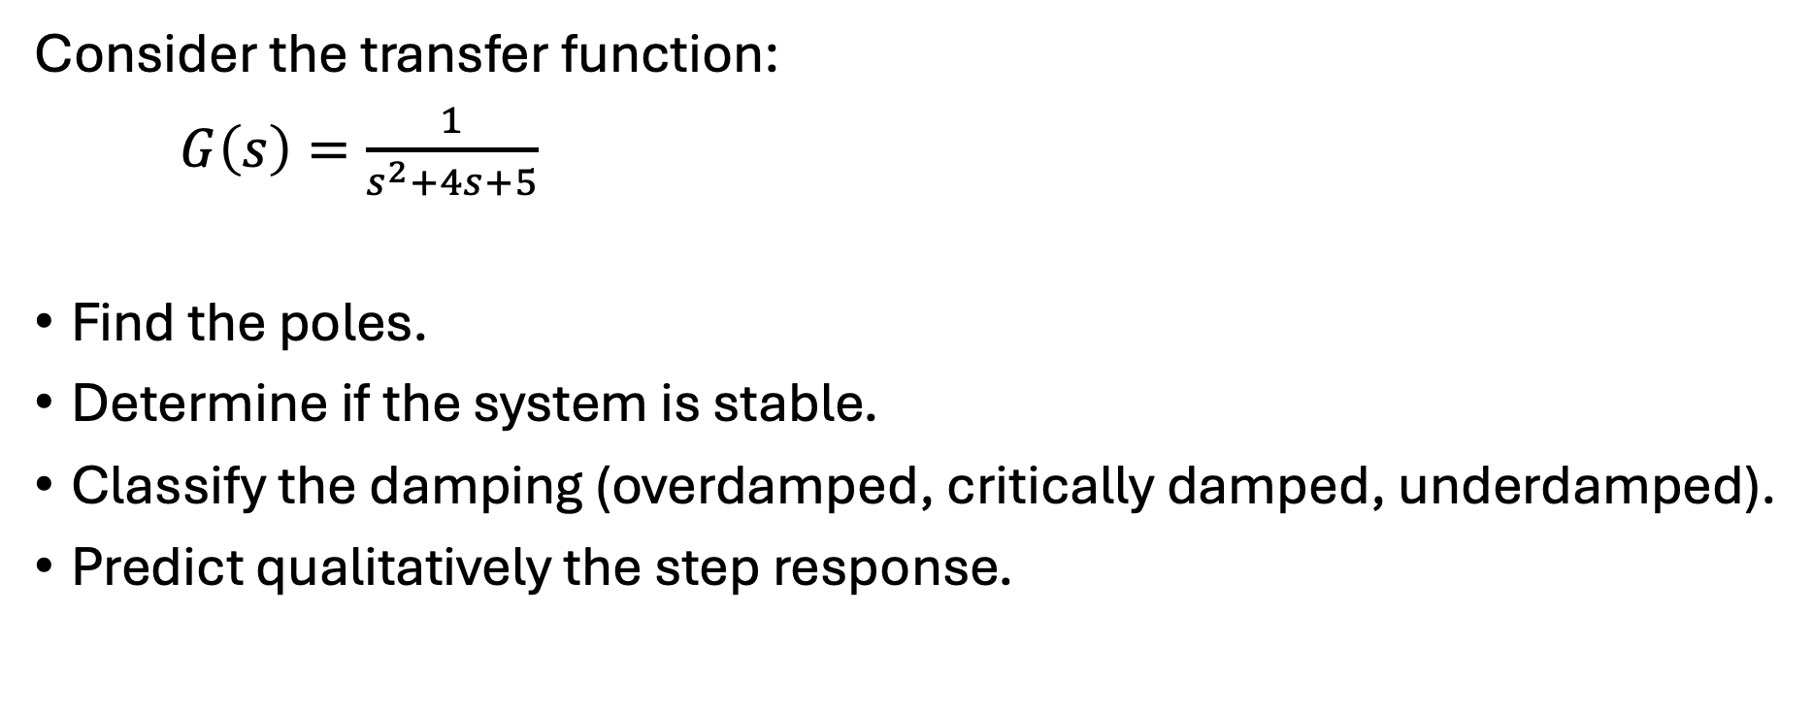
Exercise 1
Consider the transfer function:
$G\left(s\right)=\frac{1}{s^{2}+4s+5}$
Find the poles.
Determine if the system is stable.
Classify the damping (overdamped, critically damped, underdamped).
Predict qualitatively the step response.

Slide 26
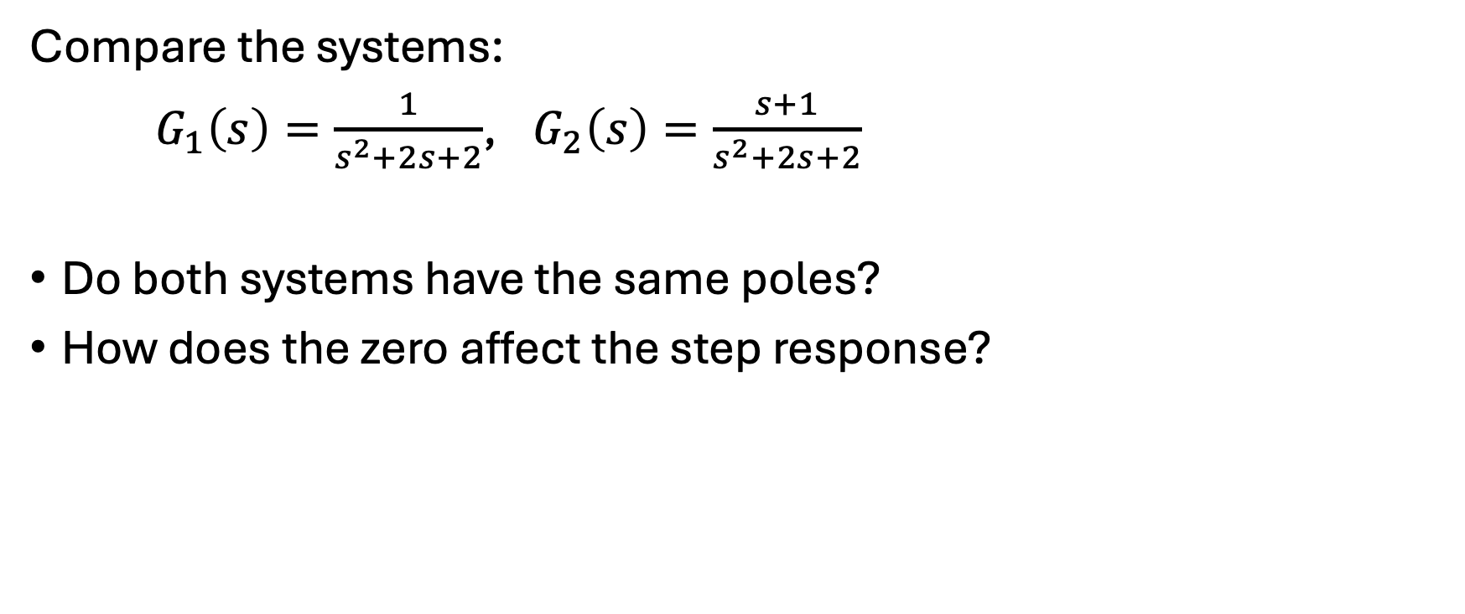
Exercise 2
Compare the systems:
$G_{1}\left(s\right)=\frac{1}{s^{2}+2s+2}$, $G_{2}\left(s\right)=\frac{s+1}{s^{2}+2s+2}$
Do both systems have the same poles?
How does the zero affect the step response?

Slide 27

Exercise 3
For each system, determine stability:
$G_{1}\left(s\right)=\frac{s+1}{(s+2)(s+3)}$
$G_{2}\left(s\right)=\frac{1}{(s−1)(s+2)}$
$G_{3}\left(s\right)=\frac{1}{s^{2}+2s+1}$

Slide 28

Exercise 4
Given poles:
$s=−1±j2$
$s=−10$
Which poles dominate?
Describe the system behavior.

Slide 29
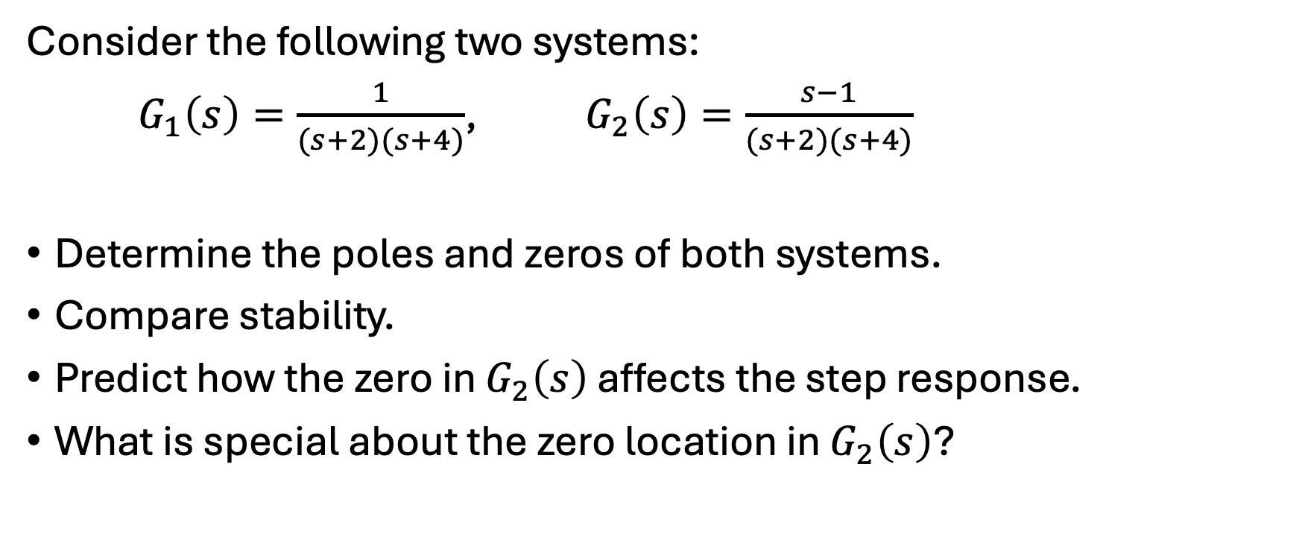
Exercise 5
Consider the following two systems:
$G_{1}\left(s\right)=\frac{1}{(s+2)(s+4)}$, $G_{2}\left(s\right)=\frac{s−1}{(s+2)(s+4)}$
Determine the poles and zeros of both systems.
Compare stability.
Predict how the zero in $G_{2}\left(s\right)$ affects the step response.
What is special about the zero location in $G_{2}\left(s\right)$?

Slide 30

Exercise 6
Given:
$G\left(s\right)=\frac{ω_{n}^{2}}{s^{2}+2ζω_{n}s+ω_{n}^{2}}$
Let $ω_{n}=10$, $ζ=0.2$
Is resonance expected?
Estimate if the peak is strong or weak.

Slide 31
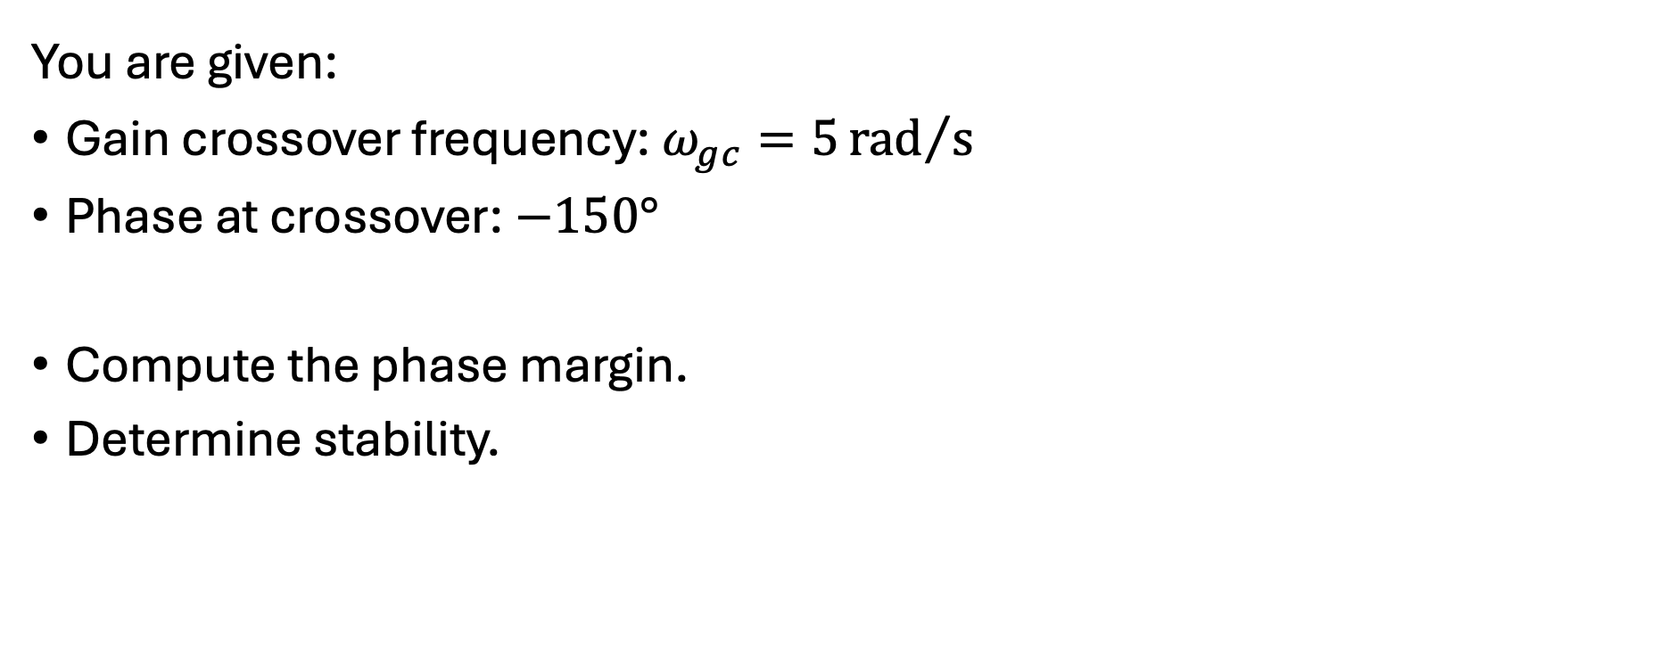
Exercise 7
You are given:
Gain crossover frequency: $ω_{gc}=5{rad}/s$
Phase at crossover: $−150°$
Compute the phase margin.
Determine stability.

