Slide 1
Controller Design
Control Engineering

Slide 2
Course Schedule
Systems
Continuous-time Controllers
Laplace Domain
Poles/Zeros & Stability
Controller Design
Discrete-time Controllers
State Space Representation
Advanced Control Methods

Slide 3
Controller Design
Feedback principles
PID tuning
Loop shaping
Lead and Lag Compensators
Root Locus
Cascade control
Ziegler–Nichols method
T-Sum method

Slide 4
The Control Design Problem
Given a plant
Find a controller
Meet stability, performance, and robustness requirements

Slide 5
Goals of Controller Design
Stabilization: stabilize unstable or poorly damped plants
Reference tracking: accurate and fast response to reference signals
Disturbance rejection: attenuate disturbances and unknown inputs
Robustness: tolerate modeling uncertainties while maintaining stability and acceptable performance

Slide 6
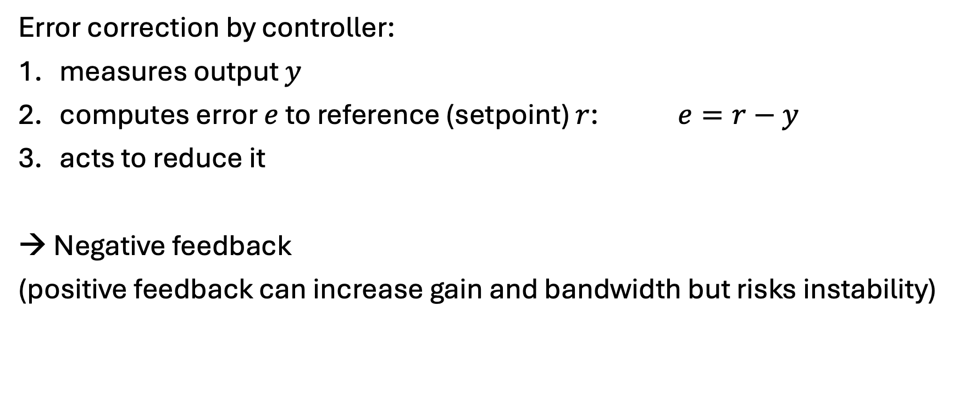
Feedback Control Principles
Error correction by controller:
measures output $y$
computes error $e$ to reference (setpoint) $r$: $e=r−y$
acts to reduce it
→ Negative feedback
(positive feedback can increase gain and bandwidth but risks instability)

Slide 7
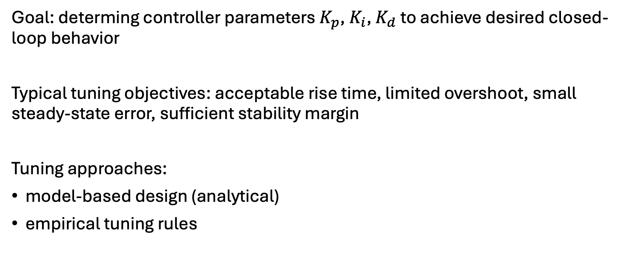
PID Tuning
Goal: determing controller parameters $K_{p}$, $K_{i}$, $K_{d}$ to achieve desired closed-loop behavior
Typical tuning objectives: acceptable rise time, limited overshoot, small steady-state error, sufficient stability margin
Tuning approaches:
model-based design (analytical)
empirical tuning rules

Slide 8
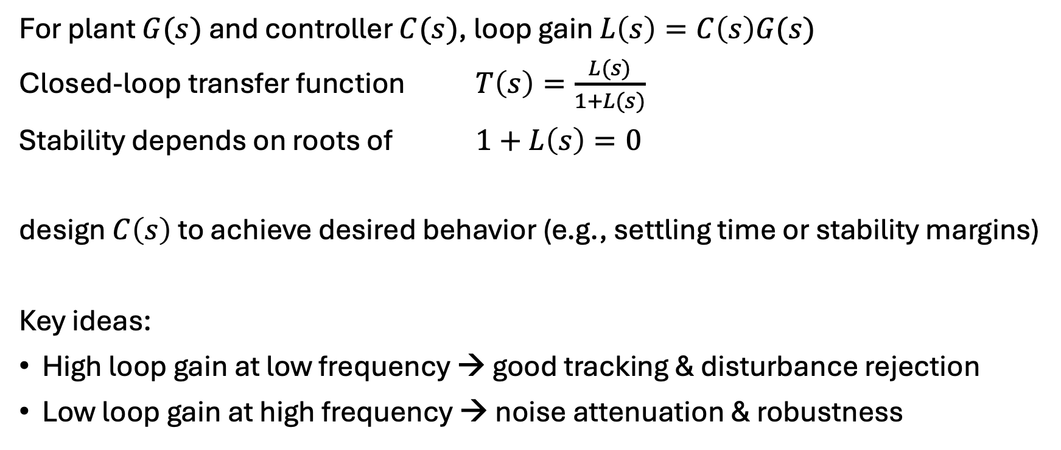
Model-Based Control Design: Shape Loop Gain
For plant $G(s)$ and controller $C(s)$, loop gain $L\left(s\right)=C\left(s\right)G(s)$
Closed-loop transfer function $T\left(s\right)=\frac{L(s)}{1+L(s)}$
Stability depends on roots of $1+L\left(s\right)=0$
design $C\left(s\right)$ to achieve desired behavior (e.g., settling time or stability margins)
Key ideas:
High loop gain at low frequency → good tracking & disturbance rejection
Low loop gain at high frequency → noise attenuation & robustness
needs to be known

Slide 9


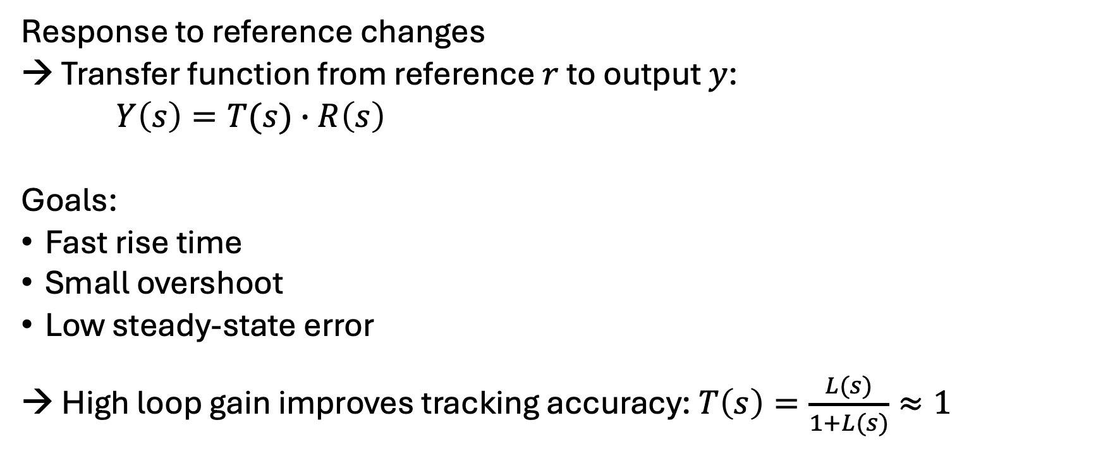



Setpoint Tracking
Response to reference changes
→ Transfer function from reference $r$ to output $y$:
$Y\left(s\right)=T(s)∙R\left(s\right)$
Goals:
Fast rise time
Small overshoot
Low steady-state error
→ High loop gain improves tracking accuracy: $T\left(s\right)=\frac{L(s)}{1+L(s)}≈1$
$$R(s)$$
$$C(s)$$
$$G(s)$$
$$Y(s)$$
$$−$$

Slide 10



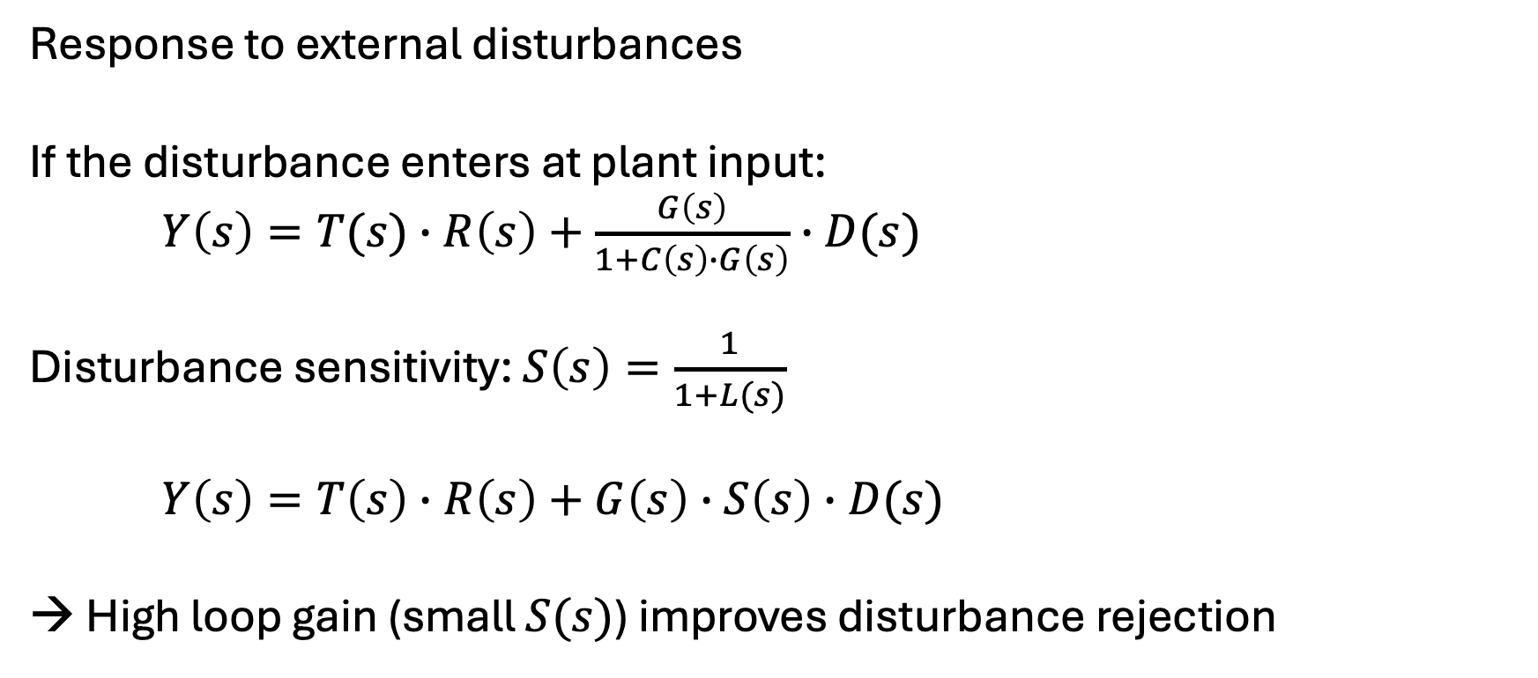



Disturbance Rejection
$$D(s)$$
$$R(s)$$
$$C(s)$$
$$G(s)$$
$$Y(s)$$
Response to external disturbances
If the disturbance enters at plant input:
$Y\left(s\right)=T(s)∙R\left(s\right)+\frac{G\left(s\right)}{1+C\left(s\right)∙G\left(s\right)}∙D(s)$
Disturbance sensitivity: $S\left(s\right)=\frac{1}{1+L(s)}$
$Y\left(s\right)=T\left(s\right)∙R\left(s\right)+G\left(s\right)∙S\left(s\right)∙D(s)$
→ High loop gain (small $S(s)$) improves disturbance rejection
$$−$$

Slide 11
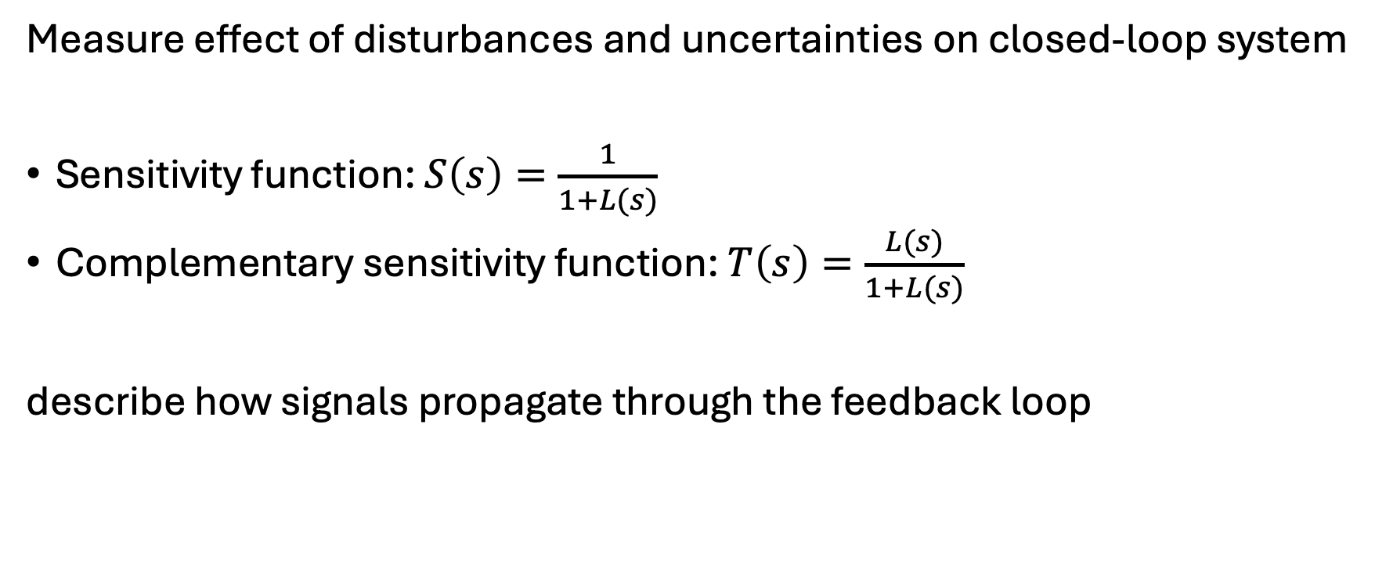
Sensitivity Functions
Measure effect of disturbances and uncertainties on closed-loop system
Sensitivity function: $S\left(s\right)=\frac{1}{1+L(s)}$
Complementary sensitivity function: $T\left(s\right)=\frac{L(s)}{1+L(s)}$
describe how signals propagate through the feedback loop

Slide 12



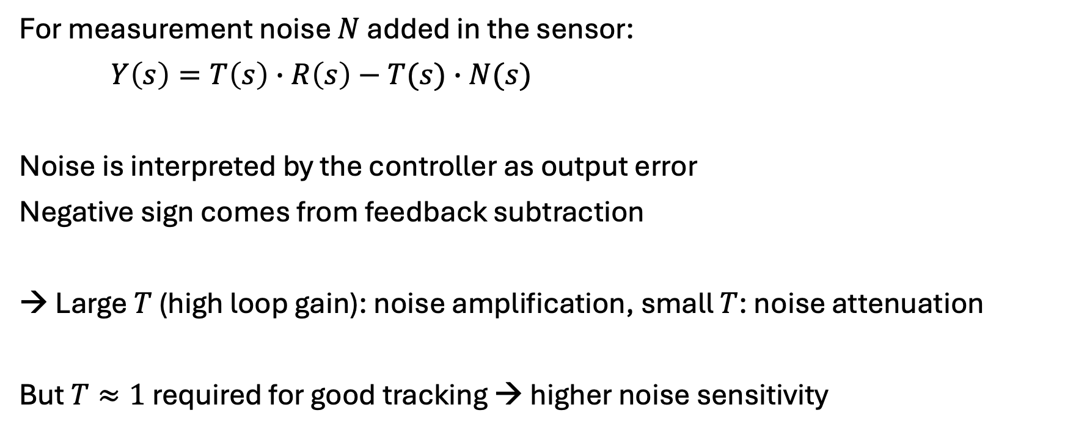
Measurement Noise
$$R(s)$$
$$C(s)$$
$$G(s)$$
$$Y(s)$$
$$−$$
For measurement noise $N$ added in the sensor:
$Y\left(s\right)=T\left(s\right)∙R\left(s\right)−T(s)∙N(s)$
Noise is interpreted by the controller as output error
Negative sign comes from feedback subtraction
→ Large $T$ (high loop gain): noise amplification, small $T$: noise attenuation
But $T≈1$ required for good tracking → higher noise sensitivity
$$N(s)$$

Slide 13
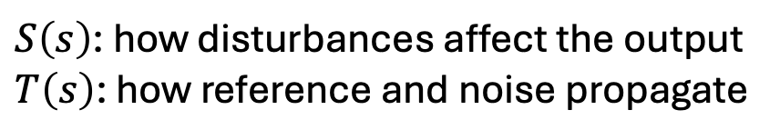
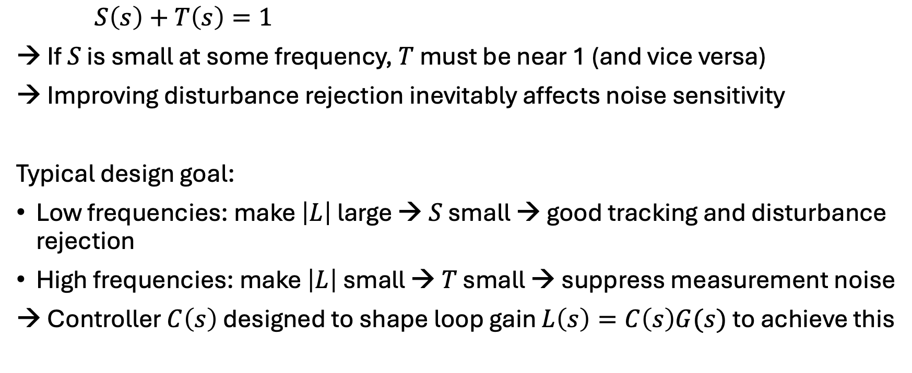
Trade-Off
$S\left(s\right)$: how disturbances affect the output
$T\left(s\right)$: how reference and noise propagate
$S\left(s\right)+T\left(s\right)=1$
→ If $S$ is small at some frequency, $T$ must be near 1 (and vice versa)
→ Improving disturbance rejection inevitably affects noise sensitivity
Typical design goal:
Low frequencies: make $\left|L\right|$ large → $S$ small → good tracking and disturbance rejection
High frequencies: make $\left|L\right|$ small → $T$ small → suppress measurement noise
→ Controller $C\left(s\right)$ designed to shape loop gain $L\left(s\right)=C\left(s\right)G(s)$ to achieve this

Slide 14
Robustness
Describes how well a closed-loop system tolerates modeling uncertainties in the plant with respect to:
robust stability (often assessed using stability margins)
robust performance (maintaining acceptable tracking and disturbance rejection)
Performance-robustness trade-off:
Aggressive control → fast tracking (and disturbance rejection) but reduced robustness (and higher noise sensitivity)
Conservative control → more robust but slower tracking (and disturbance rejection)
→ High tracking and disturbance rejection typically require high loop gain, which can reduce robustness and increase noise sensitivity.

Slide 15
Common Model-Based Techniques
Frequency response design (Bode plots)
Root locus
Internal Model Control (IMC) tuning
Pole placement
Optimization methods

Slide 16
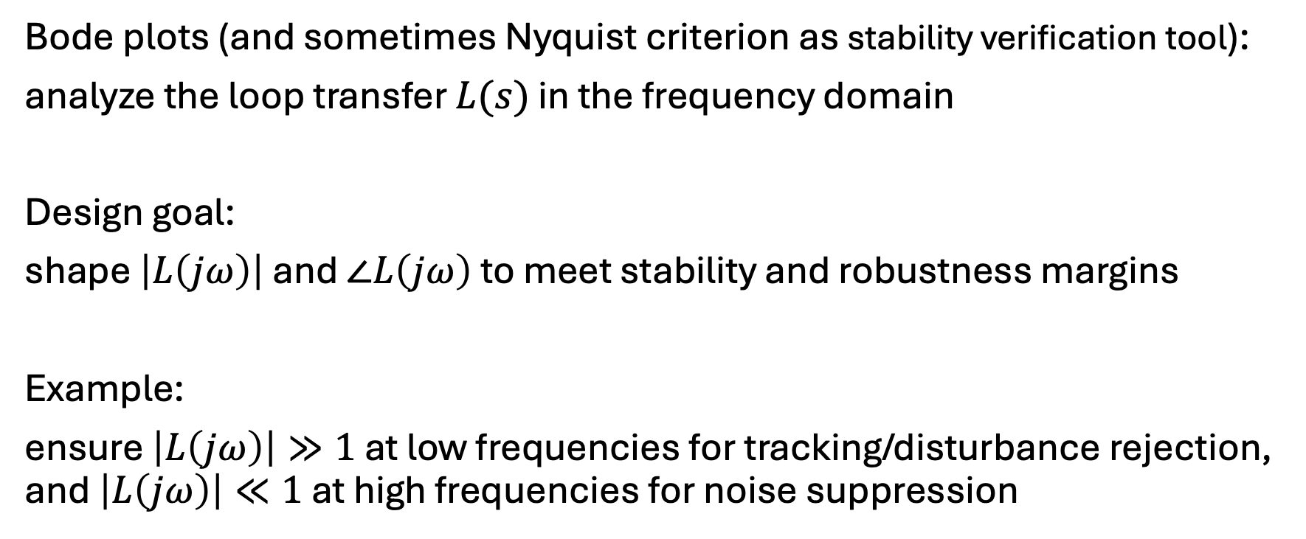
Frequency Response Design
Bode plots (and sometimes Nyquist criterion as stability verification tool):
analyze the loop transfer $L(s)$ in the frequency domain
Design goal:
shape $\left|L\left(jω\right)\right|$ and $∠L\left(jω\right)$ to meet stability and robustness margins
Example:
ensure $\left|L\left(jω\right)\right|≫1$ at low frequencies for tracking/disturbance rejection, and $\left|L\left(jω\right)\right|≪1$ at high frequencies for noise suppression

Slide 17
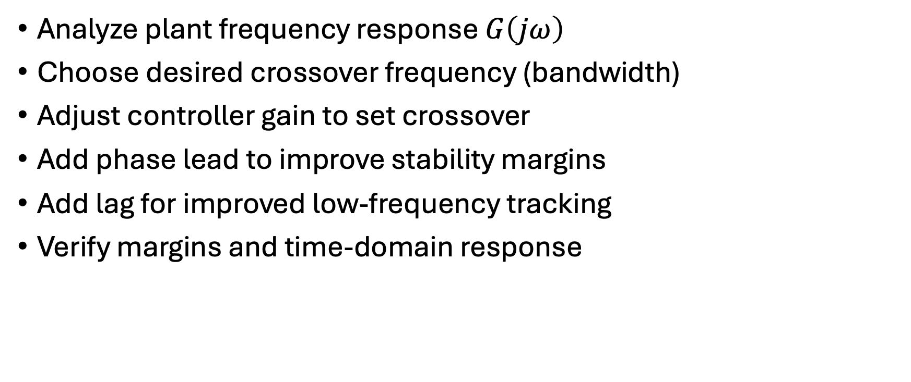
Typical Loop Shaping Workflow
Analyze plant frequency response $G\left(jω\right)$
Choose desired crossover frequency (bandwidth)
Adjust controller gain to set crossover
Add phase lead to improve stability margins
Add lag for improved low-frequency tracking
Verify margins and time-domain response

Slide 18
Lead and Lag Compensators
Lead compensator:
increases phase margin
improves stability and transient response
increases system bandwidth
Lag compensator:
increases low-frequency gain
improves steady-state tracking accuracy
has little influence on phase margin

Slide 19
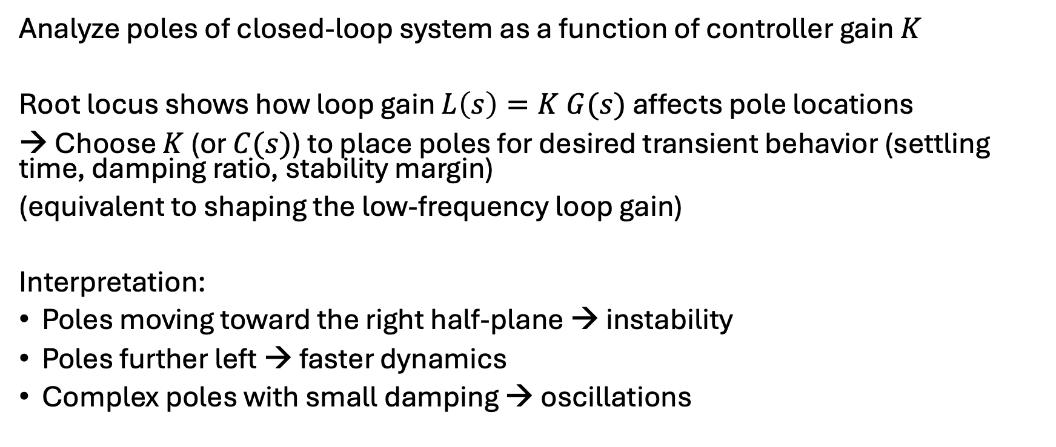
Root locus
Analyze poles of closed-loop system as a function of controller gain $K$
Root locus shows how loop gain $L\left(s\right)=K G(s)$ affects pole locations
→ Choose $K$ (or $C(s)$) to place poles for desired transient behavior (settling time, damping ratio, stability margin)
(equivalent to shaping the low-frequency loop gain)
Interpretation:
Poles moving toward the right half-plane → instability
Poles further left → faster dynamics
Complex poles with small damping → oscillations

Slide 20
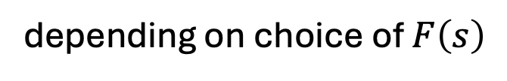
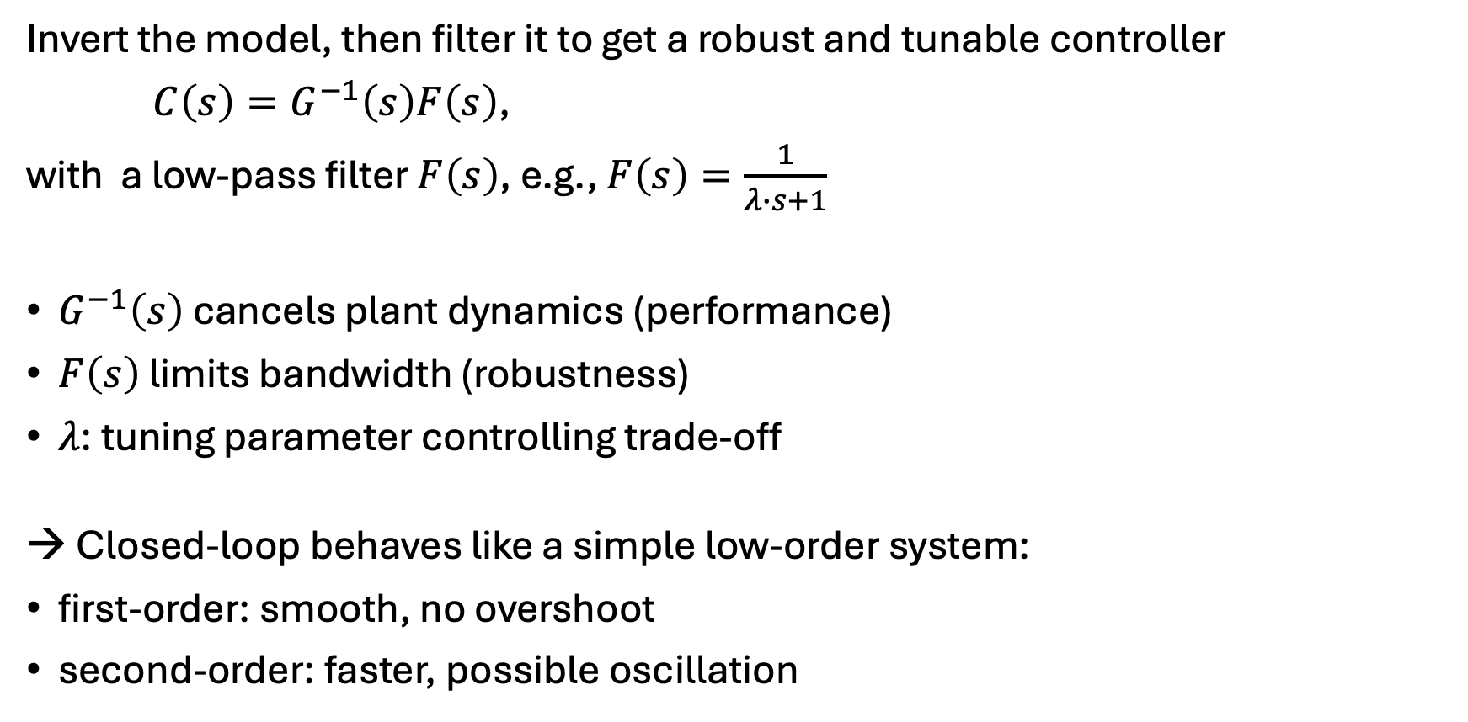
IMC Tuning
directly shapes the closed-loop transfer function
Invert the model, then filter it to get a robust and tunable controller
$C\left(s\right)=G^{−1}\left(s\right)F\left(s\right)$,
with a low-pass filter $F\left(s\right)$, e.g., $F\left(s\right)=\frac{1}{λ∙s+1}$
$G^{−1}\left(s\right)$ cancels plant dynamics (performance)
$F\left(s\right)$ limits bandwidth (robustness)
$λ$: tuning parameter controlling trade-off
→ Closed-loop behaves like a simple low-order system:
first-order: smooth, no overshoot
second-order: faster, possible oscillation
PI (for first-order plant) or PID (for second-order plant) structure
depending on choice of $F\left(s\right)$

Slide 21
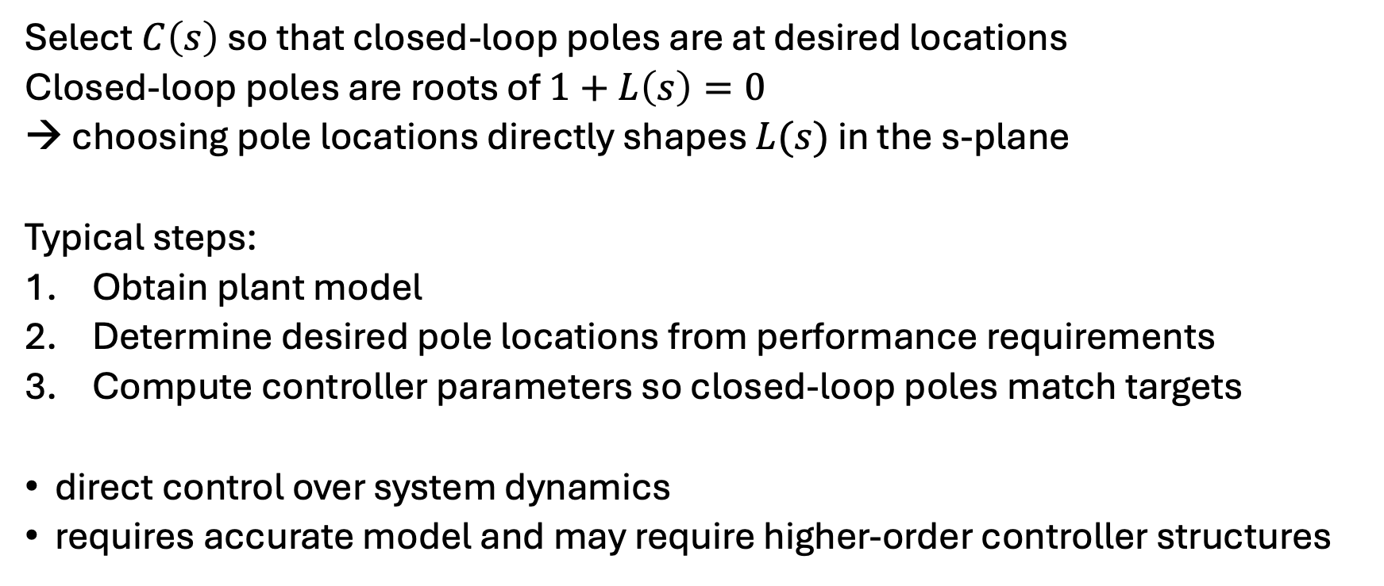
Pole Placement
Select $C\left(s\right)$ so that closed-loop poles are at desired locations
Closed-loop poles are roots of $1+L\left(s\right)=0$
→ choosing pole locations directly shapes $L(s)$ in the s-plane
Typical steps:
Obtain plant model
Determine desired pole locations from performance requirements
Compute controller parameters so closed-loop poles match targets
direct control over system dynamics
requires accurate model and may require higher-order controller structures

Slide 22
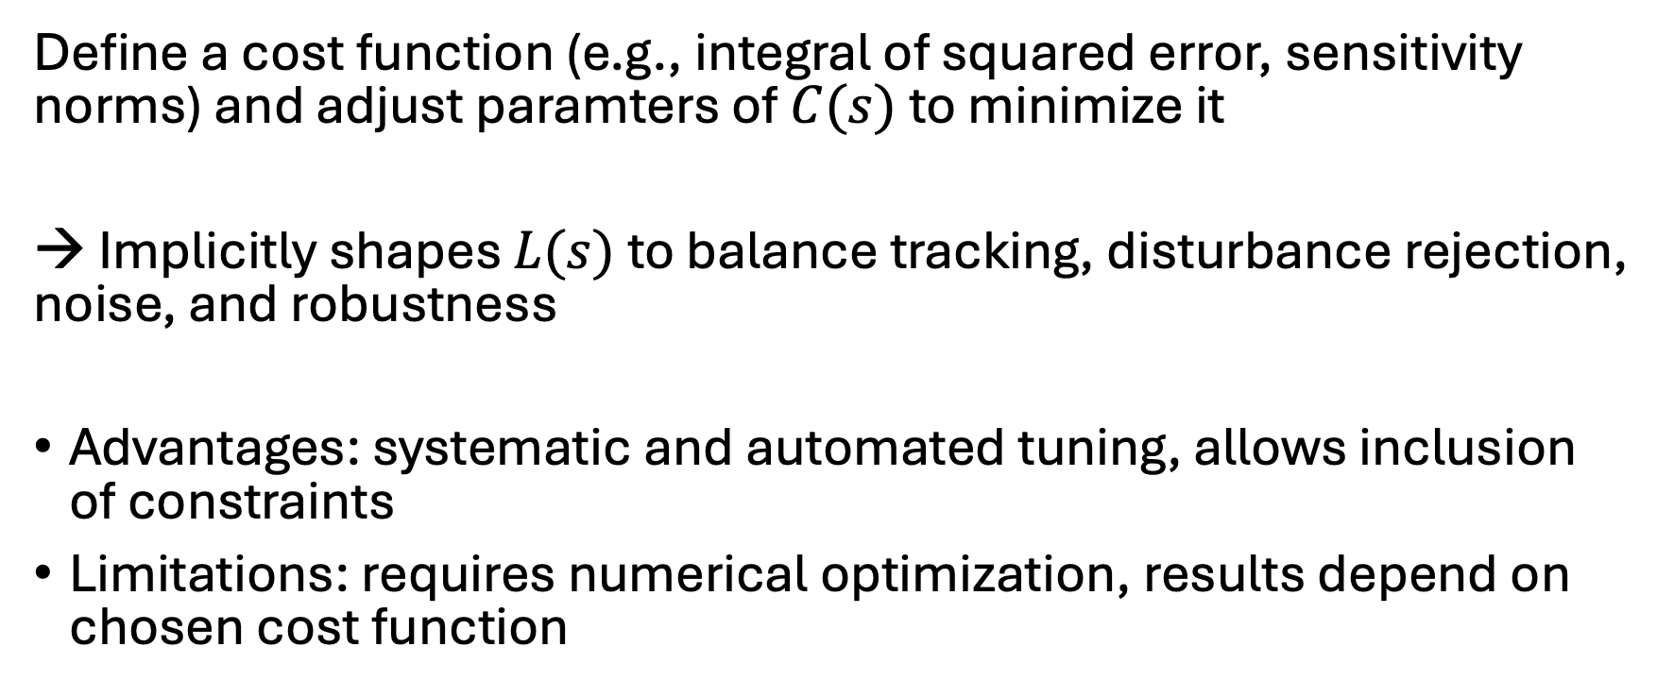
Optimization Methods
Define a cost function (e.g., integral of squared error, sensitivity norms) and adjust paramters of $C(s)$ to minimize it
→ Implicitly shapes $L(s)$ to balance tracking, disturbance rejection, noise, and robustness
Advantages: systematic and automated tuning, allows inclusion of constraints
Limitations: requires numerical optimization, results depend on chosen cost function

Slide 23
Cascade Control
Concept:
Two controllers arranged in nested loops
Inner loop controls a fast subsystem
Outer loop controls the main process variable
Advantages: improved disturbance rejection, faster response to internal disturbances, reduced effect of actuator nonlinearities
Typical applications: motor speed + torque control, temperature control with flow loop, robotics and process control

Slide 24
Empirical Approaches
Model-based approaches: derive a system model, then use control design methods to compute parameters
Empirical approaches: do experiments on the real plant, then use the measured response to compute parameters
Aspect | Model-based | Empirical
Knowledge of plant | Required | Not required
Method | Mathematical design | Experiment + rules
Tuning style | Analytical | Trial-based
Safety | Usually safer if model correct | May cause oscillations
Accuracy | Potentially higher | Moderate

Slide 25
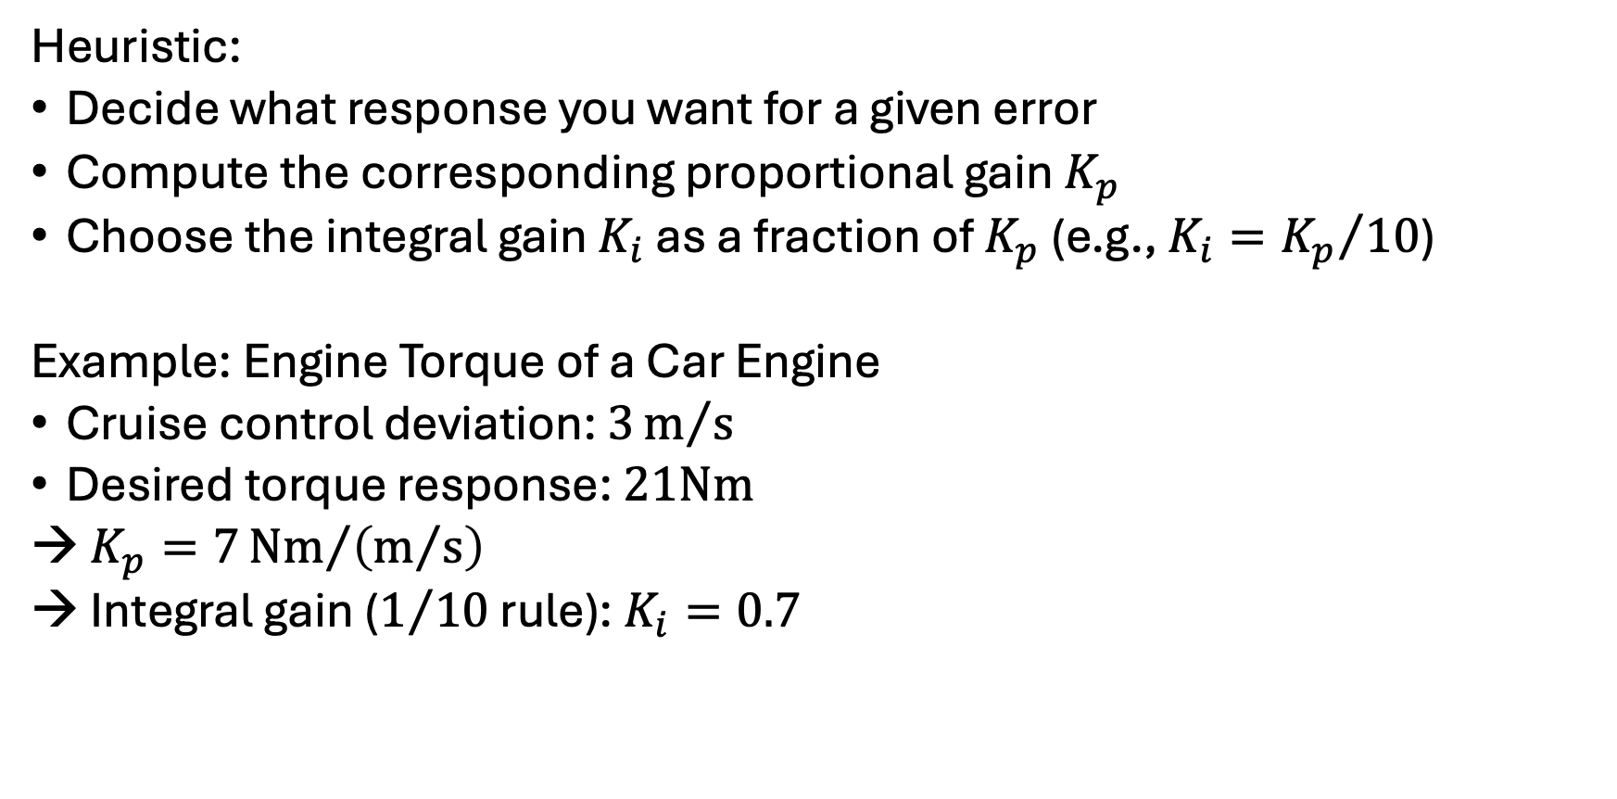
Manual PI Tuning
Heuristic:
Decide what response you want for a given error
Compute the corresponding proportional gain $K_{p}$
Choose the integral gain $K_{i}$ as a fraction of $K_{p}$ (e.g., $K_{i}={K_{p}}/{10}$)
Example: Engine Torque of a Car Engine
Cruise control deviation: $3m/s$
Desired torque response: $21Nm$
$K_{p}=7{Nm}/{\left(m/s\right)}$
Integral gain ($1/{10}$ rule): $K_{i}=0.7$

Slide 26
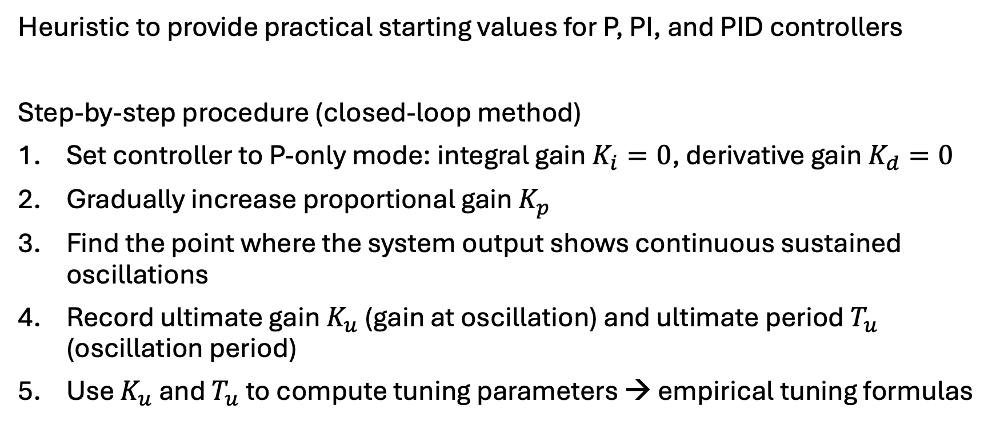
Ziegler–Nichols Method
Heuristic to provide practical starting values for P, PI, and PID controllers
Step-by-step procedure (closed-loop method)
Set controller to P-only mode: integral gain $K_{i}=0$, derivative gain $K_{d}=0$
Gradually increase proportional gain $K_{p}$
Find the point where the system output shows continuous sustained oscillations
Record ultimate gain $K_{u}$ (gain at oscillation) and ultimate period $T_{u}$ (oscillation period)
Use $K_{u}$ and $T_{u}$ to compute tuning parameters → empirical tuning formulas

Slide 27
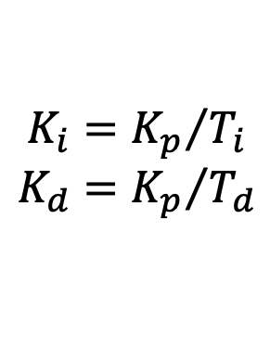
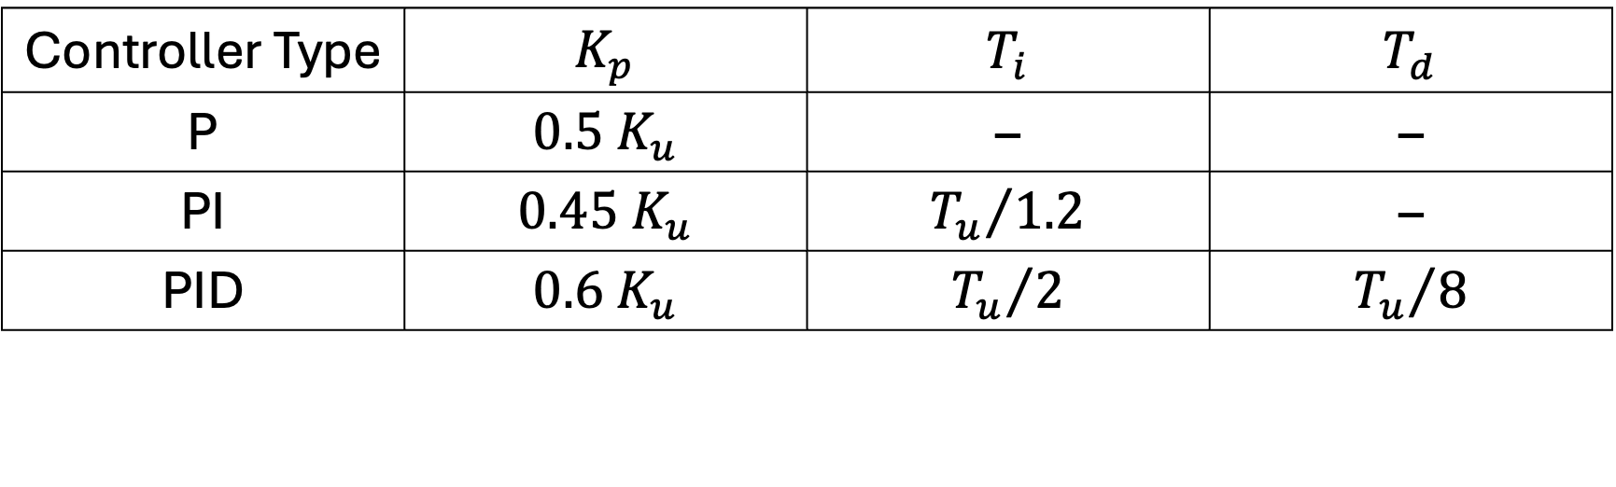
Ziegler–Nichols Tuning Rules
$$K_{i}={K_{p}}/{T_{i}}$$
$$K_{d}={K_{p}}/{T_{d}}$$
Controller Type | $$K_{p}$$ | $$T_{i}$$ | $$T_{d}$$
P | $$0.5 K_{u}$$ | – | –
PI | $$0.45 K_{u}$$ | $${T_{u}}/{1.2}$$ | –
PID | $$0.6 K_{u}$$ | $${T_{u}}/2$$ | $${T_{u}}/8$$
Advantages:
Simple experimental procedure
Widely used for initial PID tuning
Limitations:
Can produce large overshoot
Not ideal for highly nonlinear or unstable systems
Often requires finetuning afterward

Slide 28
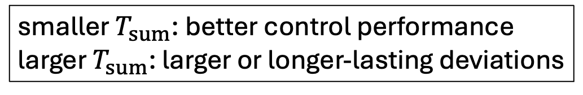
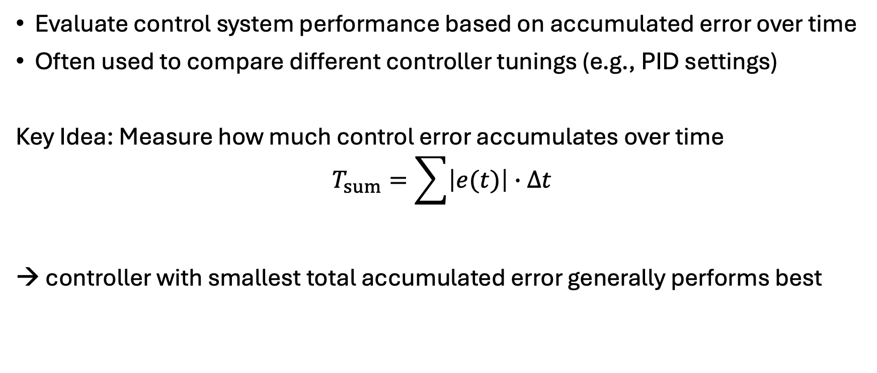
T-Sum (Time-Sum) Method
Evaluate control system performance based on accumulated error over time
Often used to compare different controller tunings (e.g., PID settings)
Key Idea: Measure how much control error accumulates over time
$$T_{sum}=\sum{\left|e(t)\right|∙Δt}$$
→ controller with smallest total accumulated error generally performs best
accumulated error over the evaluation period
sampling interval
control error
smaller $T_{sum}$: better control performance
larger $T_{sum}$: larger or longer-lasting deviations

Slide 29
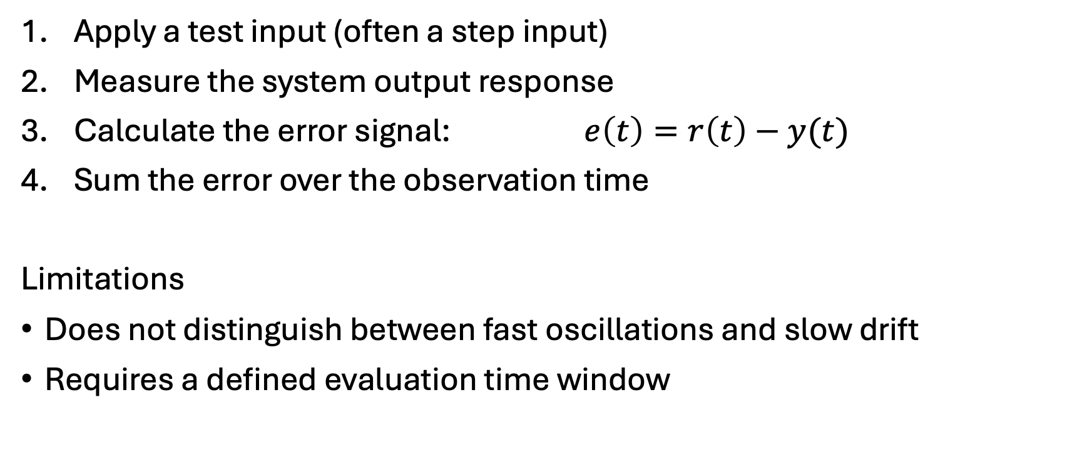
T-Sum Procedure
Apply a test input (often a step input)
Measure the system output response
Calculate the error signal: $e\left(t\right)=r\left(t\right)−y(t)$
Sum the error over the observation time
Limitations
Does not distinguish between fast oscillations and slow drift
Requires a defined evaluation time window
reference signal
system output

Slide 30
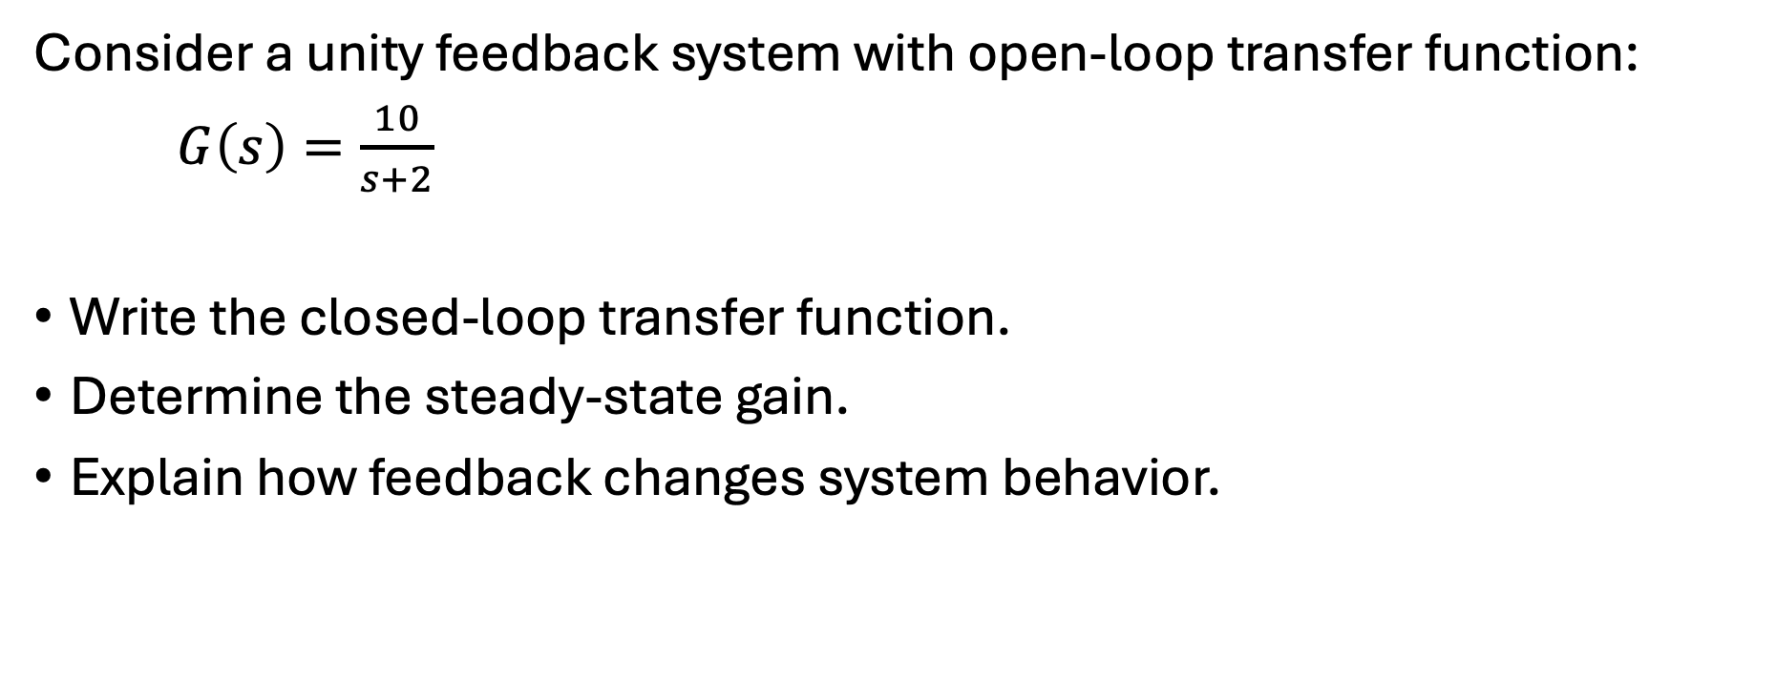
Exercise 1
Consider a unity feedback system with open-loop transfer function:
$G\left(s\right)=\frac{10}{s+2}$
Write the closed-loop transfer function.
Determine the steady-state gain.
Explain how feedback changes system behavior.

Slide 31

Exercise 2
Given is a lead compensator:
$C\left(s\right)=\frac{s+5}{s+20}$
Identify zero and pole.
Explain its effect on phase and stability.

Slide 32

Exercise 3
Given is a lag compensator:
$C\left(s\right)=\frac{s+1}{s+0.1}$
Explain its effect and main purpose.

Slide 33

Exercise 4
Given:
$G\left(s\right)=\frac{K}{s(s+2)}$
Identify poles and zeros.
Describe root locus behavior as $K$ increases.

Slide 34
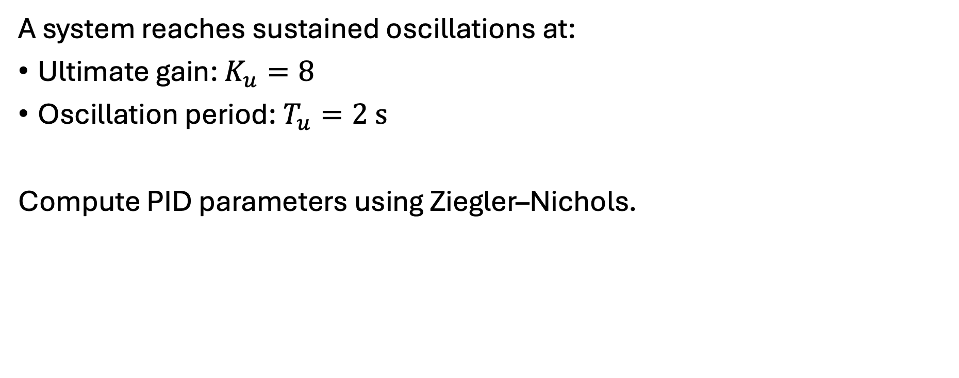
Exercise 5
A system reaches sustained oscillations at:
Ultimate gain: $K_{u}=8$
Oscillation period: $T_{u}=2 s$
Compute PID parameters using Ziegler–Nichols.

