Slide 1
Continuous-time Controllers
Control Engineering

Slide 2
Course Schedule
Systems
Continuous-time Controllers
Laplace Domain
Poles/Zeros & Stability
Controller Design
Discrete-time Controllers
State Space Representation
Advanced Control Methods

Slide 3
Continuous-time Controllers
Control objectives
On-off controllers
PID controllers
Working point
Proportional band

Slide 4
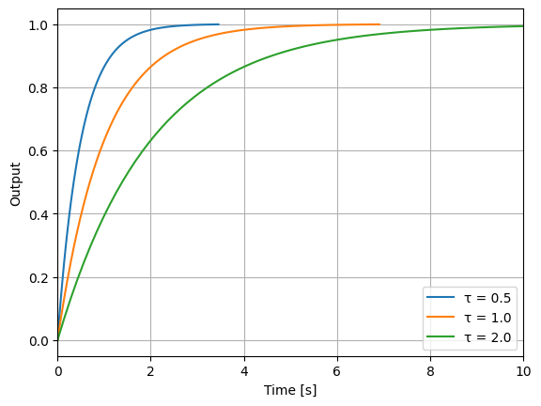
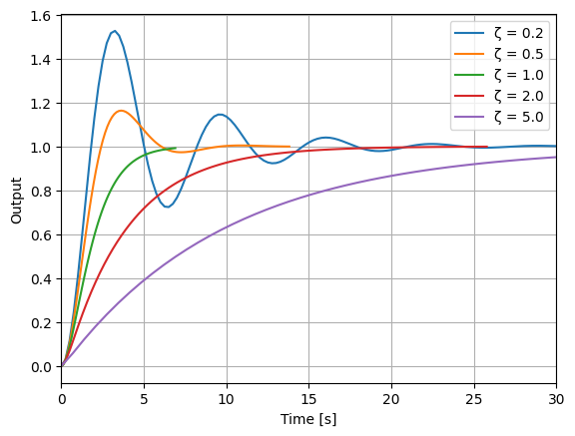
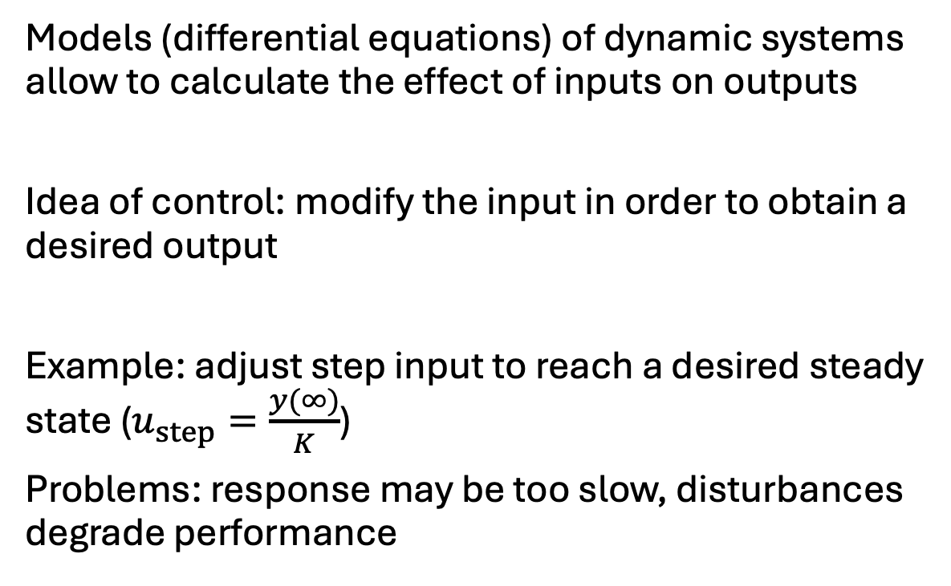
Control
PT1 system
Models (differential equations) of dynamic systems allow to calculate the effect of inputs on outputs
Idea of control: modify the input in order to obtain a desired output
Example: adjust step input to reach a desired steady state ($u_{step}=\frac{y(∞)}{K}$)
Problems: response may be too slow, disturbances degrade performance
Step responses
PT2 system

Slide 5
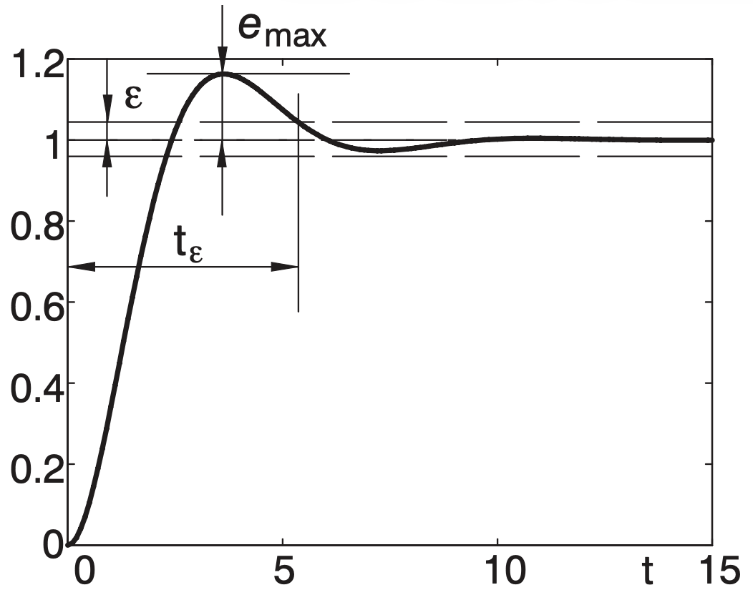
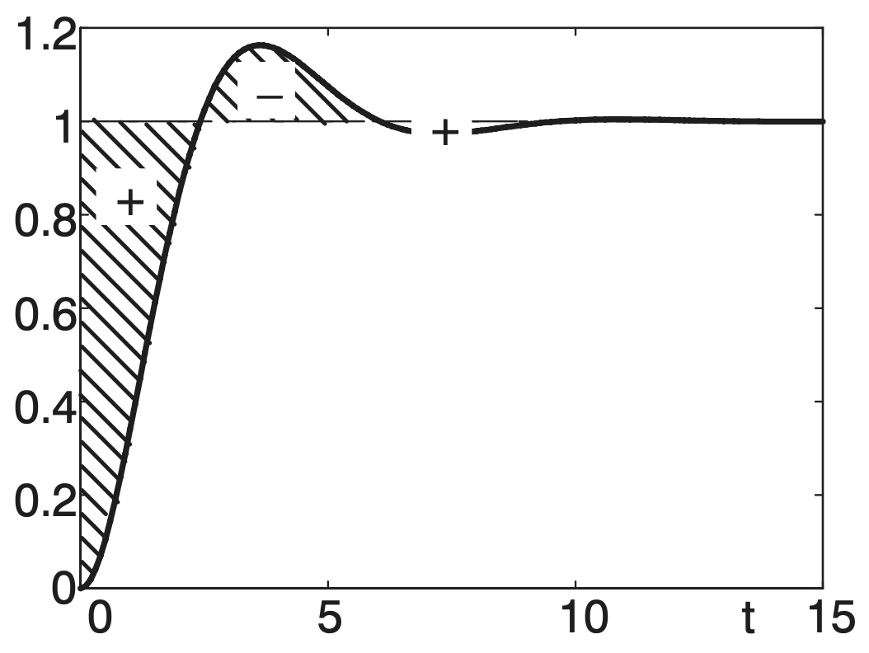
Control Objectives
Stability (bounded output)
Fast response: rise and settling time
Low overshoot
Small steady-state error
Robustness (insensitivity to model uncertainty and disturbances)
Only useful without overshoot

Slide 6
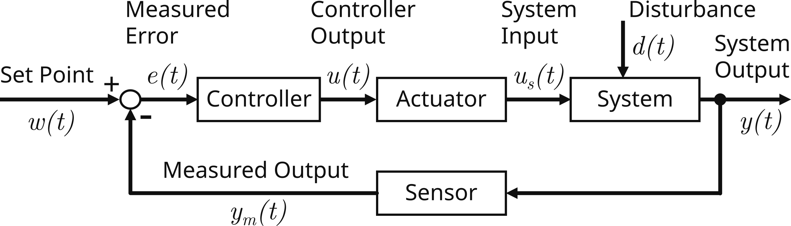
Control Loop
Feedback: measure system output, compare it to desired behavior (e.g., steady state), and use the resulting error as input to a controller
Goal: reduce error

Slide 7
What Is a Controller?
System itself (subsystem of total control system), implemented in hardware or software
Input: measured error
Output: process input (low-energy control signal converted into physical action by actuator)
Hardware controllers
Fast, deterministic, limited flexibility
Examples: mechanical, analog electronic controllers using op-amps, FPGA-based (digital)
Software controllers (use of analog actuators via a digital-to-analog converter)
Flexible, complex algorithms, sampling delays (dead time)
Examples: Microcontroller-based, PLCs

Slide 8
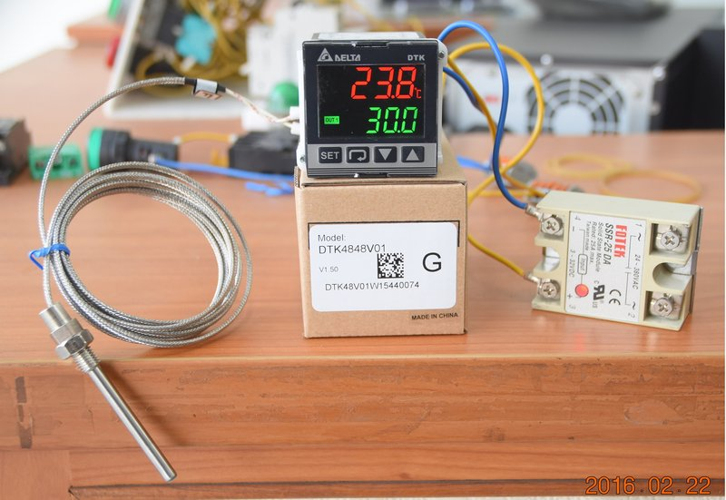
Example: Temperature Control
Sensor:
resistance thermometer to measure temperature (system output)
Actuator:
solid-state relay to switch a heater/cooler (plant) on or off
Controller:
digital electronic PID switching controller to activate the relay (controller output)

Slide 9
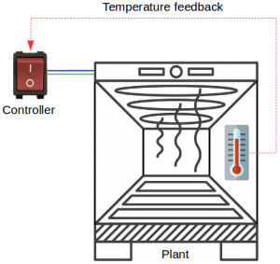
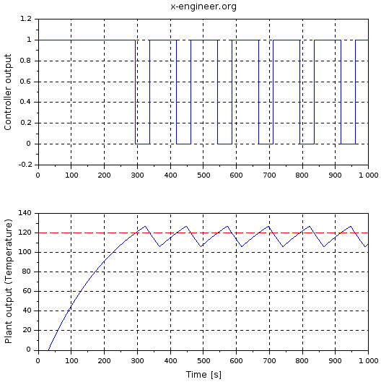
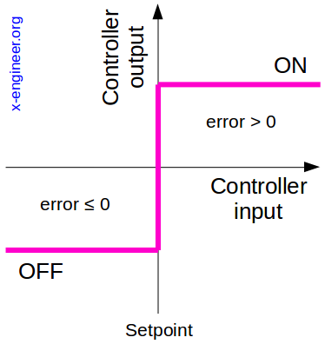
On-Off Controller
Example: industial oven
aka bang-bang control
Issue:
High-frequency switching stresses actuator
oscillations around setpoint
dead time
first-order process

Slide 10
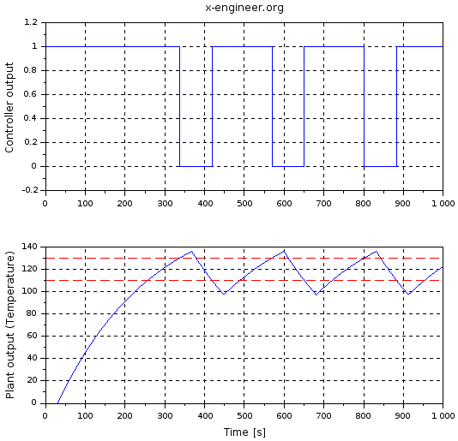
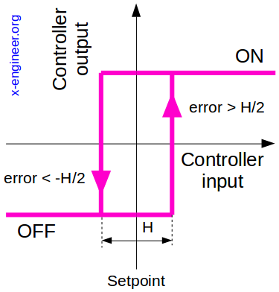
On-Off Controller with Hysteresis
Less switching at the expense of accuracy
On-off controllers are simple and low-cost, but have limited precision.
→ Continous controllers (e.g., PID)

Slide 11
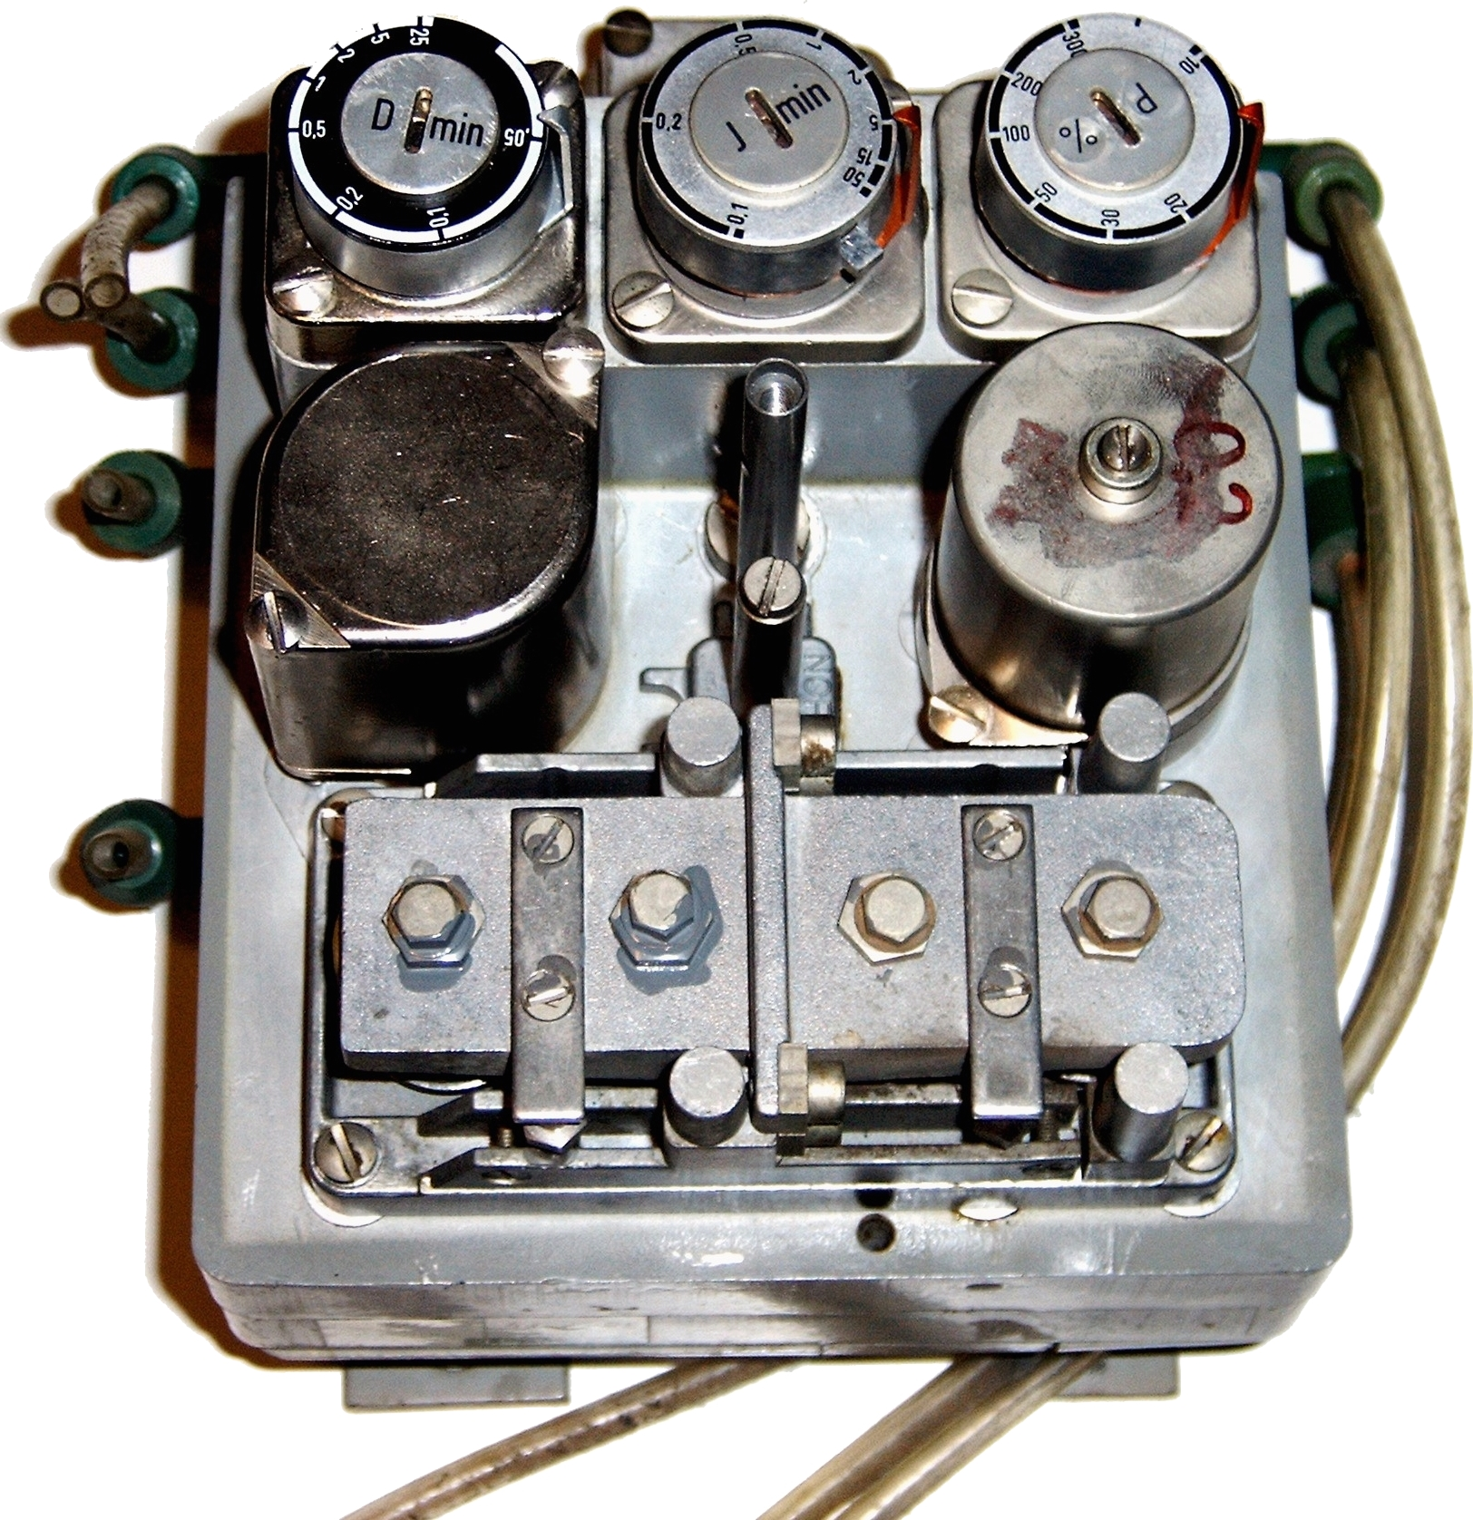
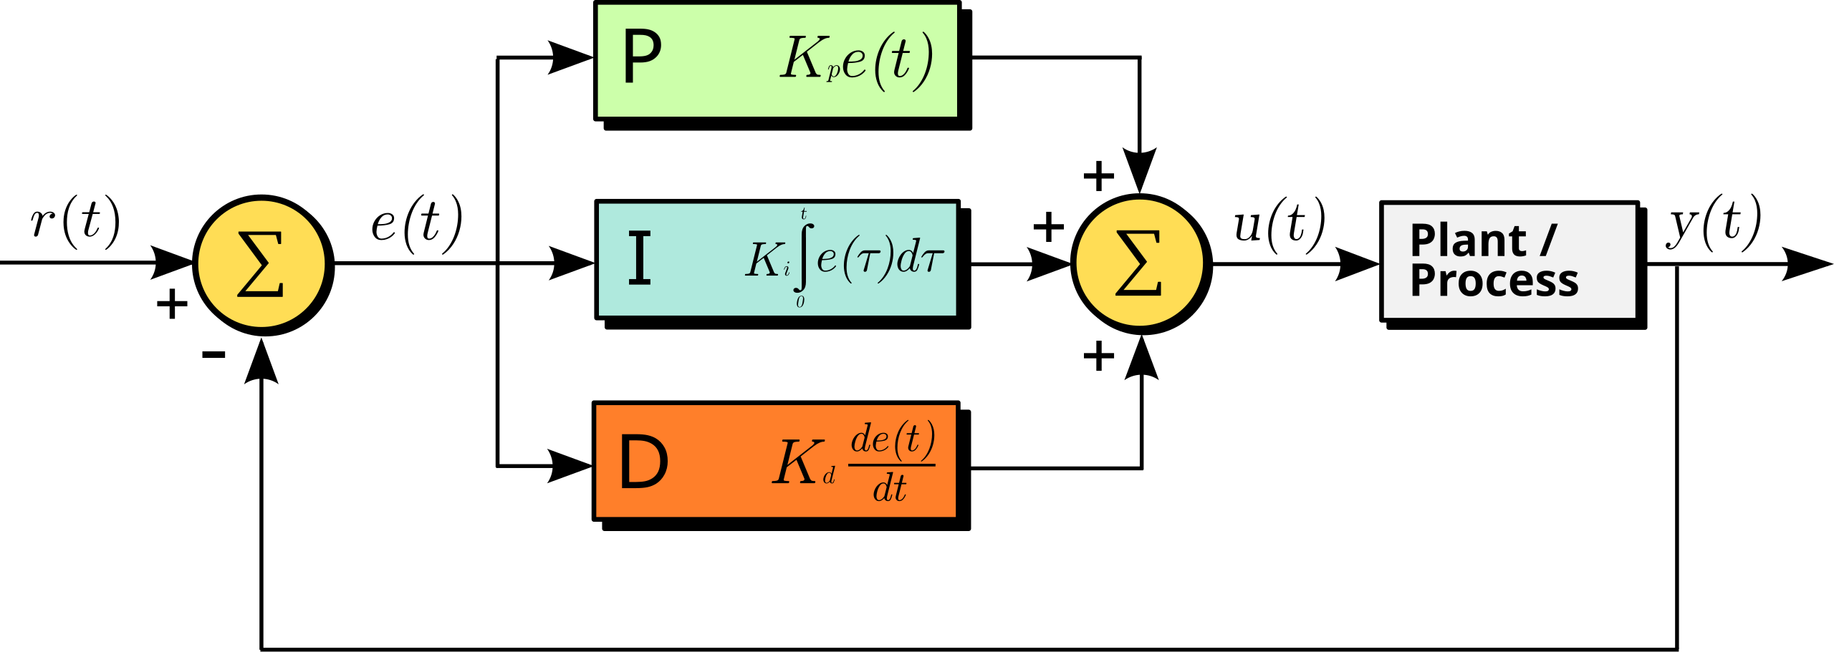
PID Controllers
Example: pneumatic PID
Most widely used industrial controller
P
PI: P + I
PD: P + D
PID: P + I + D
Parallel structure most common in practice

Slide 12
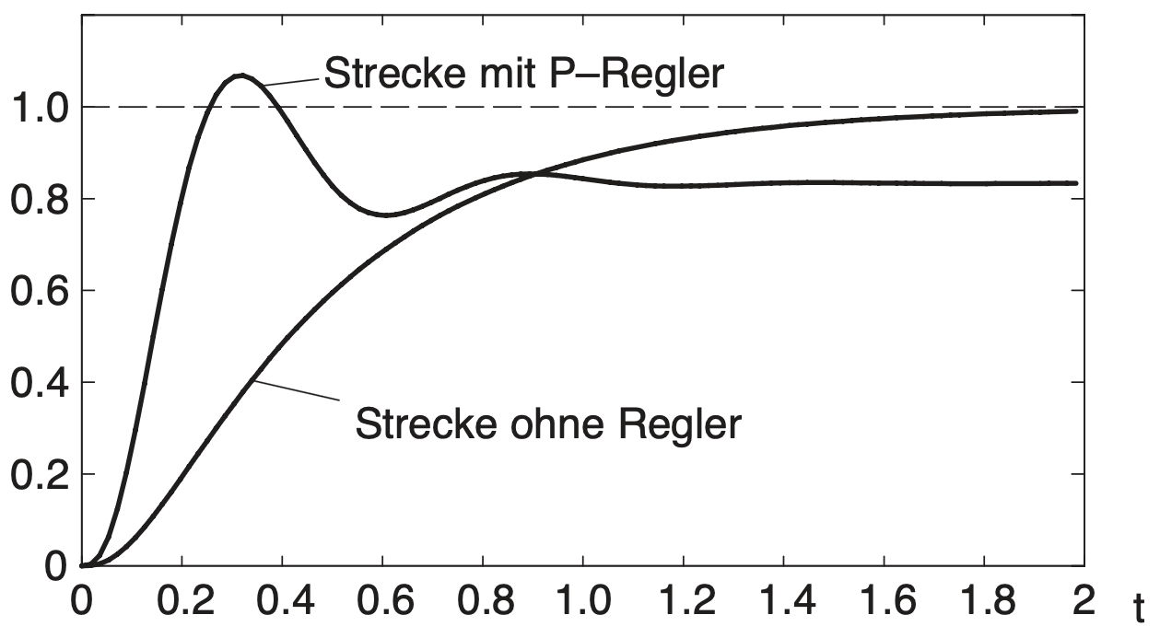
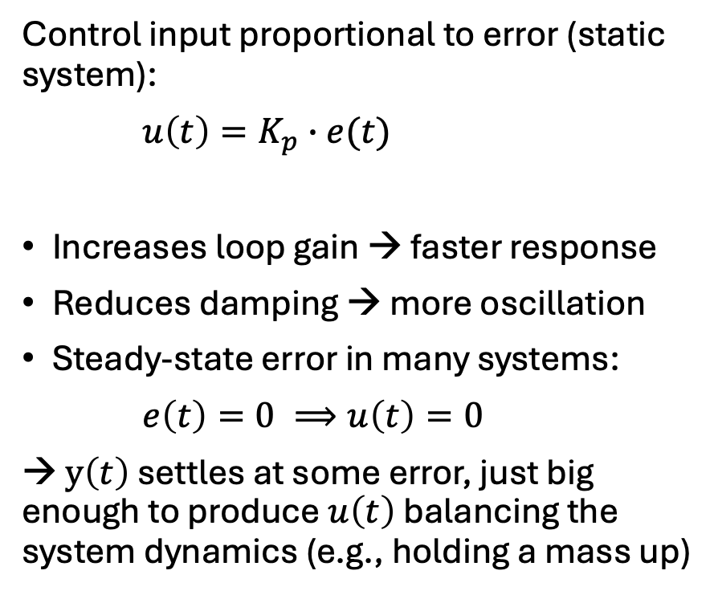
Proportional Control (P)
overshoot
Control input proportional to error (static system):
$u\left(t\right)=K_{p}∙e(t)$
Increases loop gain → faster response
Reduces damping → more oscillation
Steady-state error in many systems:
$e\left(t\right)=0 ⟹u\left(t\right)=0$
→ $y\left(t\right)$ settles at some error, just big enough to produce $u\left(t\right)$ balancing the system dynamics (e.g., holding a mass up)
with P controller
without controller

Slide 13
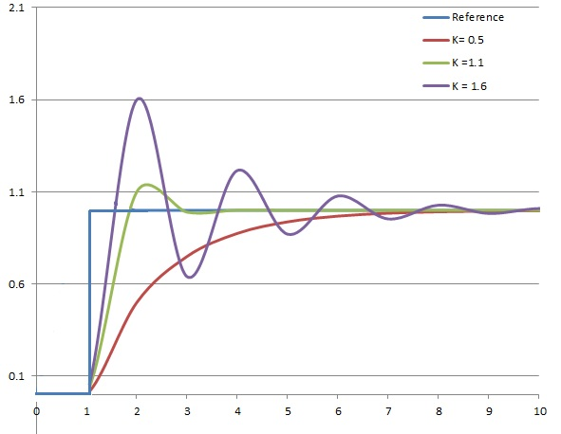
Effect of Proportional Gain Parameter
With simple proportional control, oscillations only occur in second-order systems (or higher)
Destabilization of a first-order system with proportional feedback can only occur with positive feedback

Slide 14
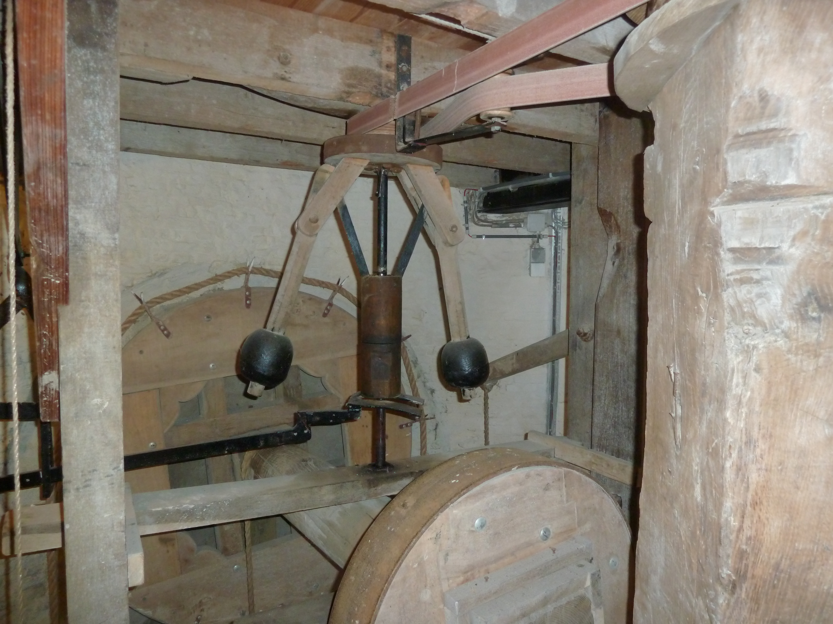
Historical: Centrifugal Governor in a Windmill
Working principle:
wind turns the blades
→ blades turn a shaft (plant)
→ shaft spins a pair of weighted arms (controller)
→ arms mechanically twist the blades (actuator)
Automatic regulation:
faster rotation (controlled variable: angular speed)
→ centrifugal force pushes weights outward (error: deviation from position at reference angular speed)
→ blades are twisted to catch less wind (proportional control) → slower rotation
Steady-state error: need for twisted blades to balance torque from wind and load → speed offset

Slide 15
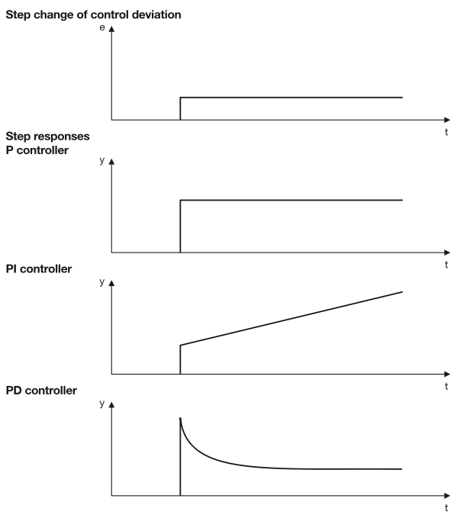
Integral Control (I)
Integrator accumulating past error (dynamic)
Eliminates steady-state error to step inputs
Slower response
Reduces damping → more oscillation
Order of total system increases (adds memory)
First-order → second-order
Second-order → third-order

Slide 16
Derivative Control (D)
Derivative predicting future error based on the rate of change (dynamic)
Predictive action
Increases effective damping (keeps system near critical damping): less overshoot, fewer oscillations
Derivative action amplifies high-frequency noise → often paired with a low-pass filter
Used less often in practice due to impact on system stability → PI

Slide 17
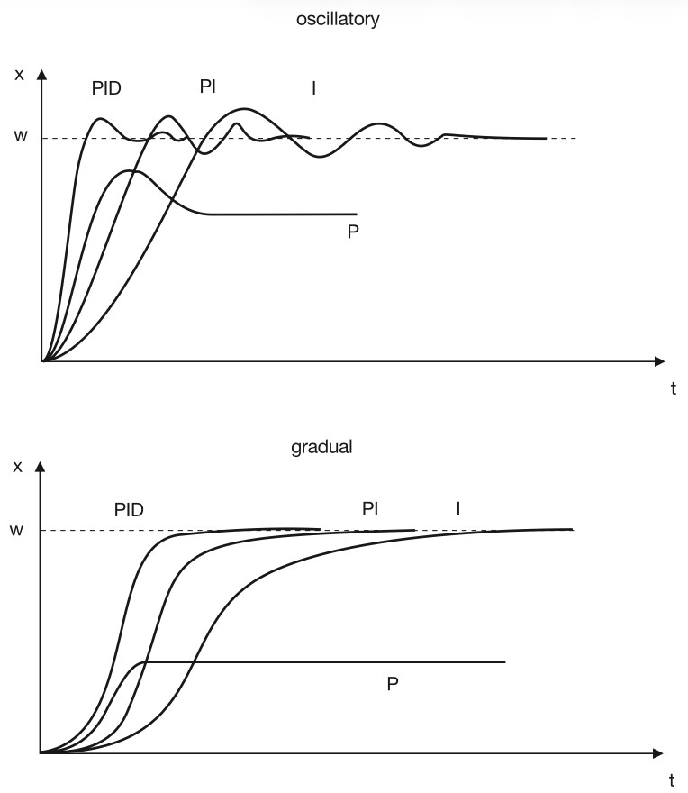
PID Controller
Simple and intuitive
Works for many plants
Easy to tune experimentally
No model of process needed
→ ~90% of industrial controllers are PID variants
P = speed
I = accuracy
D = damping

Slide 18
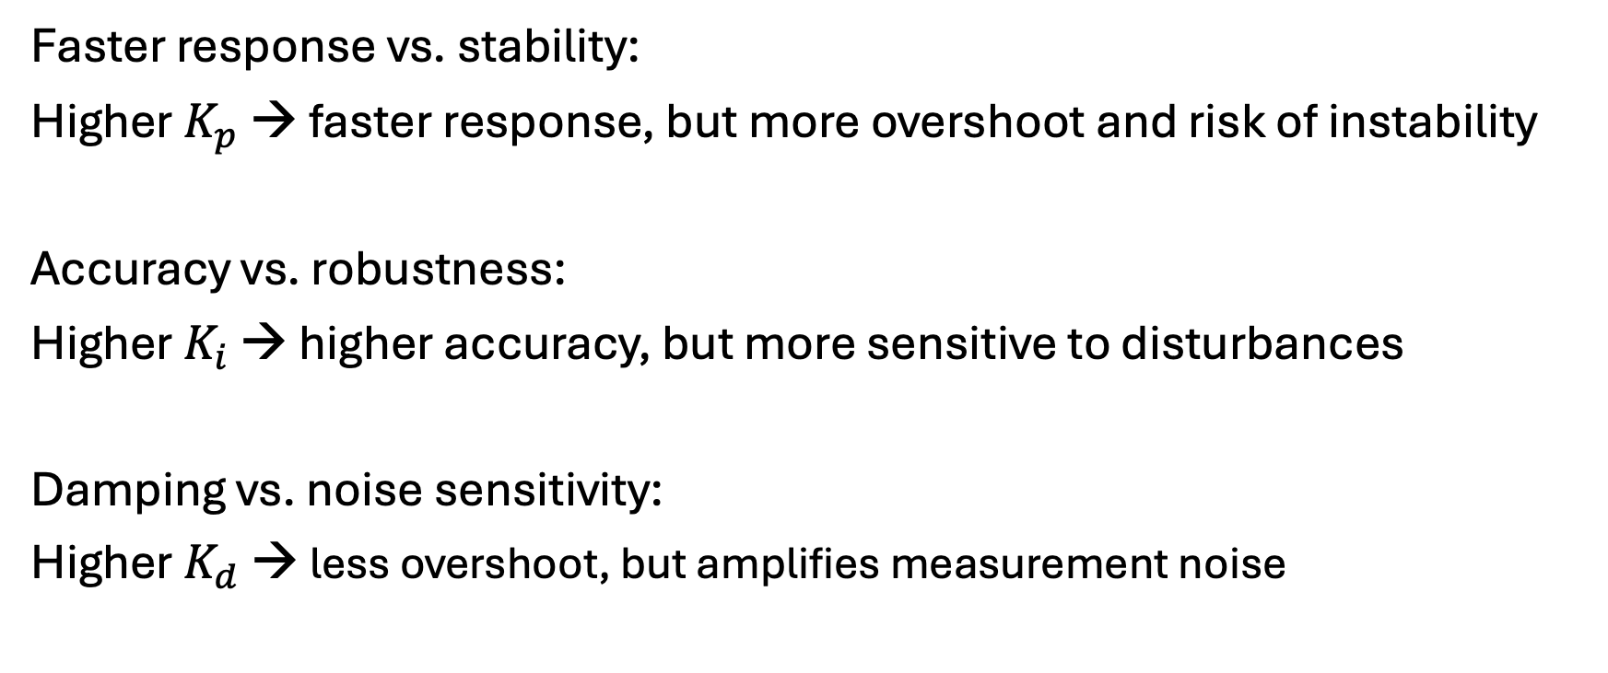
Time-Domain Performance Trade-Offs
Faster response vs. stability:
Higher $K_{p}$ → faster response, but more overshoot and risk of instability
Accuracy vs. robustness:
Higher $K_{i}$ → higher accuracy, but more sensitive to disturbances
Damping vs. noise sensitivity:
Higher $K_{d}$ → less overshoot, but amplifies measurement noise

Slide 19
Animated GIF

Slide 20
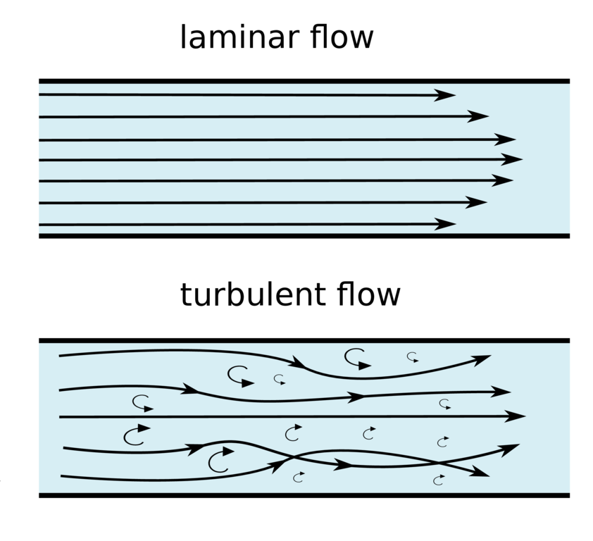
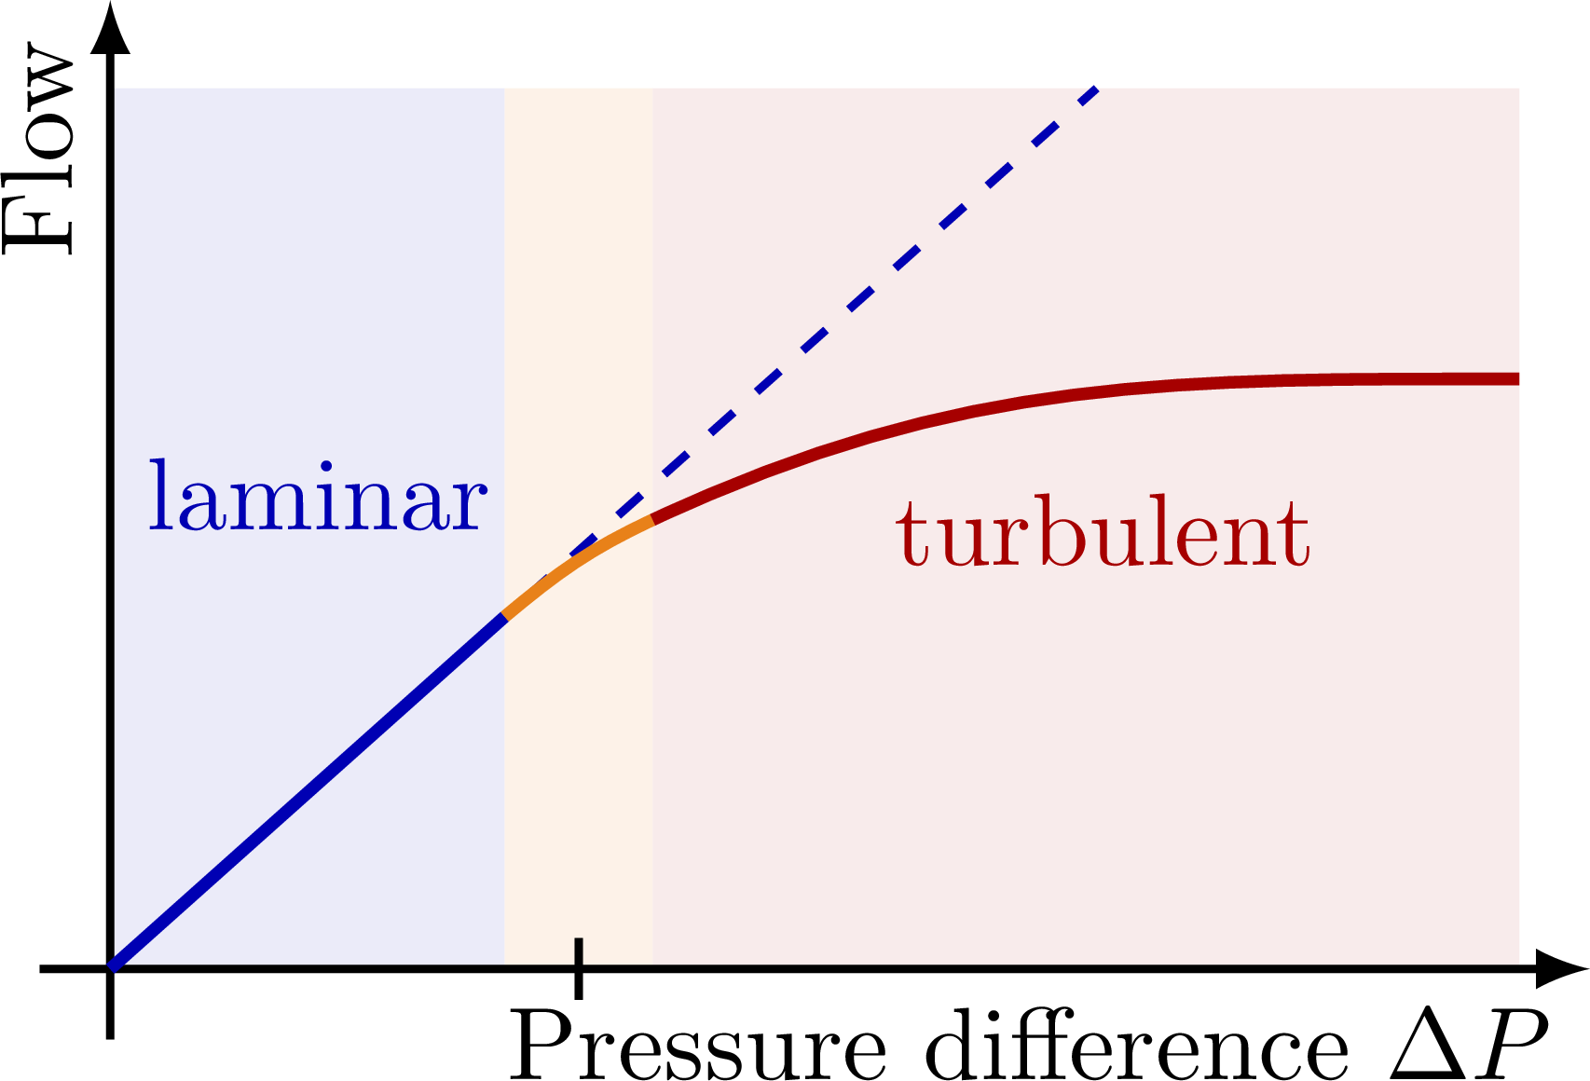
Nonlinear Systems
Linear models (output proportional to the input) are often used because they are easier to analyze.
However, real systems are typically nonlinear.
Example: flow resistance (laminar vs turbulent)

Slide 21
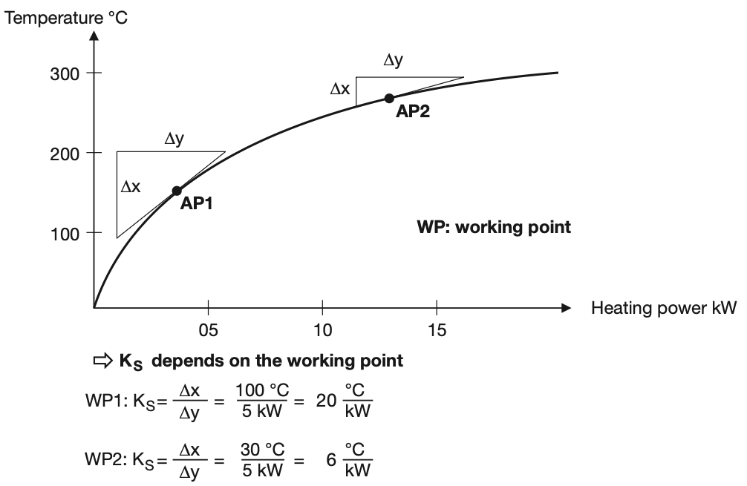
Working Point and Linearization
Controllers designed and tuned around the operating/working point of the system
Linear approximation of nonlinear systems (often near equilibrium)
Valid locally
Example: furnace
W
W

Slide 22
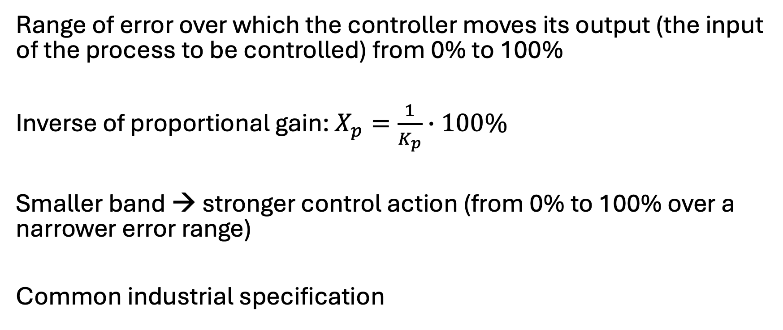
Proportional Band
Range of error over which the controller moves its output (the input of the process to be controlled) from 0% to 100%
Inverse of proportional gain: $X_{p}=\frac{1}{K_{p}}∙100\%$
Smaller band → stronger control action (from 0% to 100% over a narrower error range)
Common industrial specification

Slide 23
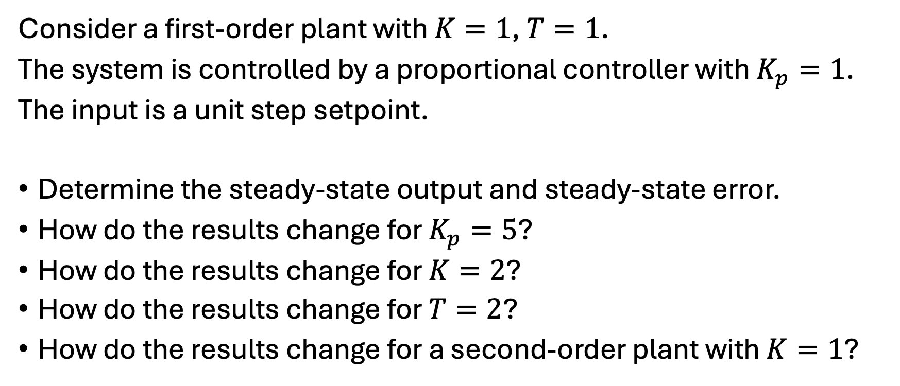
Exercise 1
Consider a first-order plant with $K=1$, $T=1$.
The system is controlled by a proportional controller with $K_{p}=1$.
The input is a unit step setpoint.
Determine the steady-state output and steady-state error.
How do the results change for $K_{p}=5$?
How do the results change for $K=2$?
How do the results change for $T=2$?
How do the results change for a second-order plant with $K=1$?

Slide 24
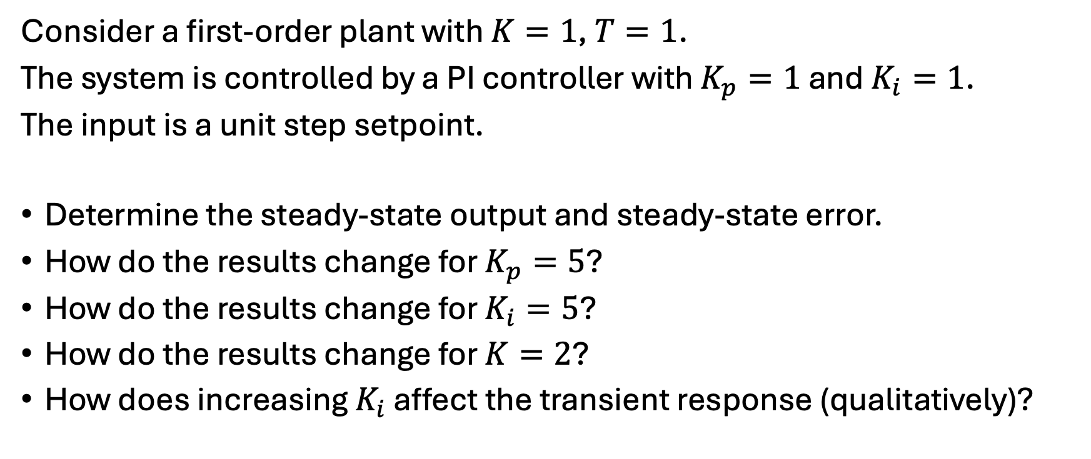
Exercise 2
Consider a first-order plant with $K=1$, $T=1$.
The system is controlled by a PI controller with $K_{p}=1$ and $K_{i}=1$.
The input is a unit step setpoint.
Determine the steady-state output and steady-state error.
How do the results change for $K_{p}=5$?
How do the results change for $K_{i}=5$?
How do the results change for $K=2$?
How does increasing $K_{i}$ affect the transient response (qualitatively)?

Slide 25

Derivation for Exercise 1
P controller: $u=K_{p}∙e$
error: $e=r−y$
steady-state output: $y=K∙u=K∙K_{p}∙e$
→ steady-state error: $e=r−K∙K_{p}∙e$
→ $e=\frac{r}{1+K∙K_{p} }$

