Slide 1
Feature Engineering
Data Science

Slide 2
Feature Engineering
missing values
numerical features: scaling, transformations
categorical features: encoding
feature selection
data leakage
imbalanced data

Slide 3
Why Feature Engineering Matters
idea: transforming raw data into meaningful inputs (features)
→ creating new variables from existing data
raw data:
messy, incomplete, hard to interpret
example: timestamps, IDs, text blobs
engineered features:
structured, meaningful, model-ready
example: hour of day, purchase frequency, text sentiment
→ good features make patterns learnable

Slide 4
Demand Forecasting as Example for Feature Engineering
seasonality
day of week, payday, week of year
weather
event-like: first sunny weekend, snowstorm, …
events (e.g., holidays)
time window around event (e.g., monotonic)
promotion
days since start of promotion period
price
ratio of reduced and normal price, price-demand elasticity
product information
text (name/description) or image embeddings

Slide 5
Features & Model Choice
garbage in → garbage out
better features → simpler models can perform well
poor features → even complex models struggle
common misconception: better model = better results
but feature quality often matters more than algorithm choice
→ a simple model + great features can outperform a complex model + poor features

Slide 6
Model Pipeline
hyperparameter tuning
extract features
choose ML algorithm
from open-source libraries like scikit-learn or pytorch, rarely write an own one
many different algorithms available, differently suited for given task
help the ML algorithm to better understand the data
impose assumptions hard to discover in the raw data
variety of different forms
model settings not all automatically adjusted by the ML algorithm

Slide 7
Before: Preprocessing Pipeline
typical steps:
handle missing values
fix inconsistencies
treat outliers
scale and transform features (slide before: extract features)
understanding your data is the first step in feature engineering → visualization

Slide 8
Handling Missing Values
common issue: incomplete observations
examples: missing age, unknown category, gaps in time series
challenges: bias if handled poorly, loss of information if removed
common strategies:
remove rows (if few and random)
remove columns (if mostly missing)
imputation (fill in values)

Slide 9
Imputation Techniques
mean / median imputation (numerical data)
mode imputation (categorical data)
forward/backward fill (time series)
model-based imputation
→ choice depends on data and assumptions
sometimes missingness itself is useful (informative):
missing income → may indicate unemployment
missing responses → may indicate behavior
→ create an additional “missing indicator” feature

Slide 10
Noise & Outliers
noisy data: errors, inconsistencies, or randomness
examples: incorrect entries, sensor errors, typos
reduce model performance, can mislead feature engineering
outliers: data points significantly different from others
examples: extreme or impossible values (e.g., negative age)
detection: statistical rules or visualization (boxplots, histograms)
options for handling: remove, clip, transform, keep (if meaningful)

Slide 11
Main Data Types
for homogeneous data (text, images)
→ feature learning (deep learning)
tabular data (heterogeneous):
→ each requires different handling
data type | key challenge
numerical | scale, outliers, skew
categorical | encoding, high cardinality
ordinal | preserving order
time series | temporal structure
text | unstructured complexity

Slide 12
Numerical Data
continuous or discrete numbers
examples:
age, income, temperature
number of purchases
challenges:
different scales (e.g., income vs. age)
outliers
skewed distributions

Slide 13
Feature Scaling
some models depend on distance:
kNN
SVM
gradient-based methods (e.g., neural networks)
→ features on different scales can distort learning

Slide 14
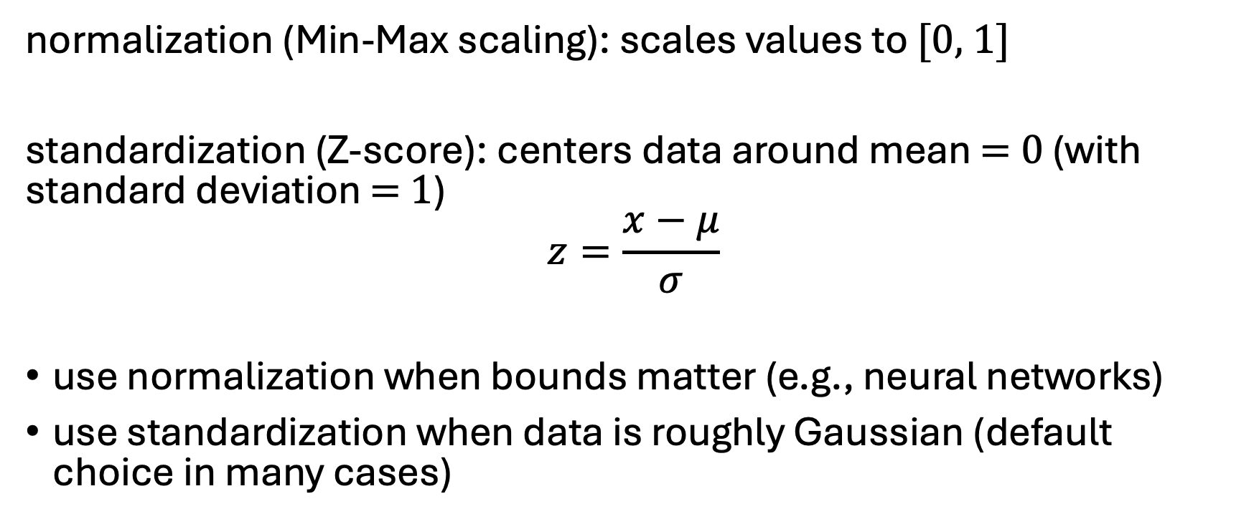
Normalization & Standardization
normalization (Min-Max scaling): scales values to [0, 1]
standardization (Z-score): centers data around mean = 0 (with standard deviation = 1)
$$z=\frac{x−μ}{σ}$$
use normalization when bounds matter (e.g., neural networks)
use standardization when data is roughly Gaussian (default choice in many cases)

Slide 15

Scaling vs. Transformation
scaling: adjusts range (e.g., normalization)
transformation: changes shape (e.g., $log$)
→ often used together

Slide 16
Feature Transformation
changing the representation of existing features
making patterns easier for models to learn
→ same data, better representation
when to transform:
distribution is highly skewed
outliers dominate
model assumptions (e.g., linearity) are violated

Slide 17
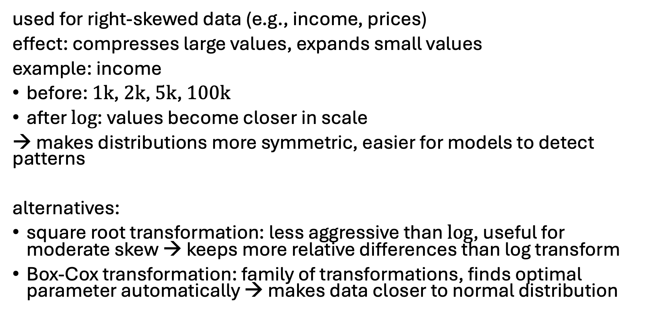
Log Transformation
used for right-skewed data (e.g., income, prices)
effect: compresses large values, expands small values
example: income
before: 1k, 2k, 5k, 100k
after $log$: values become closer in scale
→ makes distributions more symmetric, easier for models to detect patterns
alternatives:
square root transformation: less aggressive than $log$, useful for moderate skew → keeps more relative differences than log transform
Box-Cox transformation: family of transformations, finds optimal parameter automatically → makes data closer to normal distribution

Slide 18
Binning (Discretization)
convert continuous values into categories
example: age → {0–18, 19–35, 36–60, 60+}
options: equidistant or equistatistics (or equal-frequency) binning
simplifies relationships
reduces noise (lower variance)
helps certain models
but may lose information (higher bias)

Slide 19
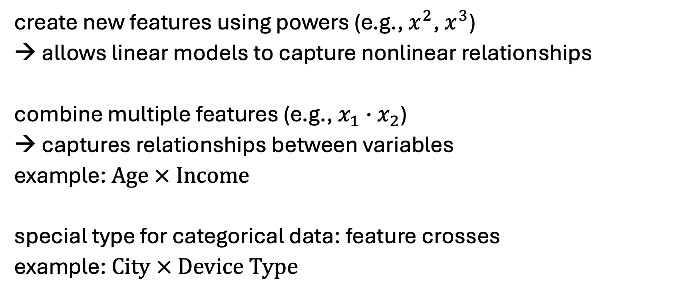
Polynomial and Interaction Features
create new features using powers (e.g., $x^{2}$, $x^{3}$)
→ allows linear models to capture nonlinear relationships
combine multiple features (e.g., $x_{1}∙x_{2}$)
→ captures relationships between variables
example: Age × Income
special type for categorical data: feature crosses
example: City × Device Type

Slide 20
Feature Creation
building new features from existing ones
adding information that was not explicitly present
captures hidden relationships
→ domain knowledge
often leads to the biggest performance gains
but always check performance and generalization: not all features help
many possible forms …

Slide 21
Aggregation Features
combine data across groups
examples:
average purchase per user
total transactions per day
max/min values per group
→ often created using group operations
aggregation example: transactions per user
new features: total spend per user, average order value, purchase frequency
→ summarizes behavior effectively

Slide 22
More Examples
ratio features: e.g., price per square meter → often more informative than raw values
difference features: e.g., current price − previous price → useful for trend and behavior analysis
feature extraction from timestamps: e.g., day of week → turns raw time into meaningful patterns
cyclical features: e.g., hour of day → encode using sine/cosine transformations
count-based features: e.g., number of logins → captures activity level
flag/indicator features: e.g., is premium user → simple but often powerful

Slide 23
Categorical Data
values representing categories or groups
examples: country, color, product type
problem: ML models work with numbers, not text
→ cannot be directly used by most models
→ convert categories into numerical representations

Slide 24
Encoding
defines how categorical information is represented numerically
different possibilities:
label encoding & ordinal encoding
one-hot encoding
target encoding & leave-one-out encoding
embeddings

Slide 25
Label & Ordinal Encoding
both methods assign an integer to each category
label encoding:
used for unordered categories (especially target variables)
example: "Red", "Green", "Blue" → arbitrary integers
ordinal encoding:
used for categories with a natural order
example: "Low" → 1, "Medium" → 2, "High" → 3
not suitable for unordered categories (introduces false ordering)

Slide 26
One-Hot Encoding
alternative for high-cardinality features: binary encoding (convert categories into binary code)
creates binary columns for each category:
no artificial ordering, works well for most models
but increases dimensionality → high-cardinality problem
example: for categorical variable “User ID” with 100,000 unique values, one-hot encoding creates 100,000 columns (sparse data)
→ overfitting risk (curse of dimensionality), very inefficient
Color | Red | Blue | Green
Red | 1 | 0 | 0

Slide 27
Target & Leave-One-Out Encoding
encodes categories using target statistics (e.g., average target value)
example: predict individual houses prices in 100,000 €
handles high-cardinality variables well
often results in very powerful features
but high risk of overfitting (target leakage)
→ leave-one-out encoding: exclude current row when calculating target statistics
City | Average Price
A | 200
B | 150

Slide 28
Frequency/Count Encoding
replace category with frequency (count) or relative frequency
example:
category appears 500 times → value = 500

Slide 29
Text Features
different methods to deal with variables containing full text:
Bag-of-Words (BoW): count word occurrences
example: “John likes to watch movies. Mary likes movies too.” → {"John":1,"likes":2,"to":1,"watch":1,"movies":2,"Mary":1,"too":1}
limitations: ignores word order, high-dimensional, sparse representation
Term Frequency–Inverse Document Frequency (TF-IDF): weighs informative (rare) words higher, downweights common words
embeddings (contextual embeddings via transformer architecture)

Slide 30
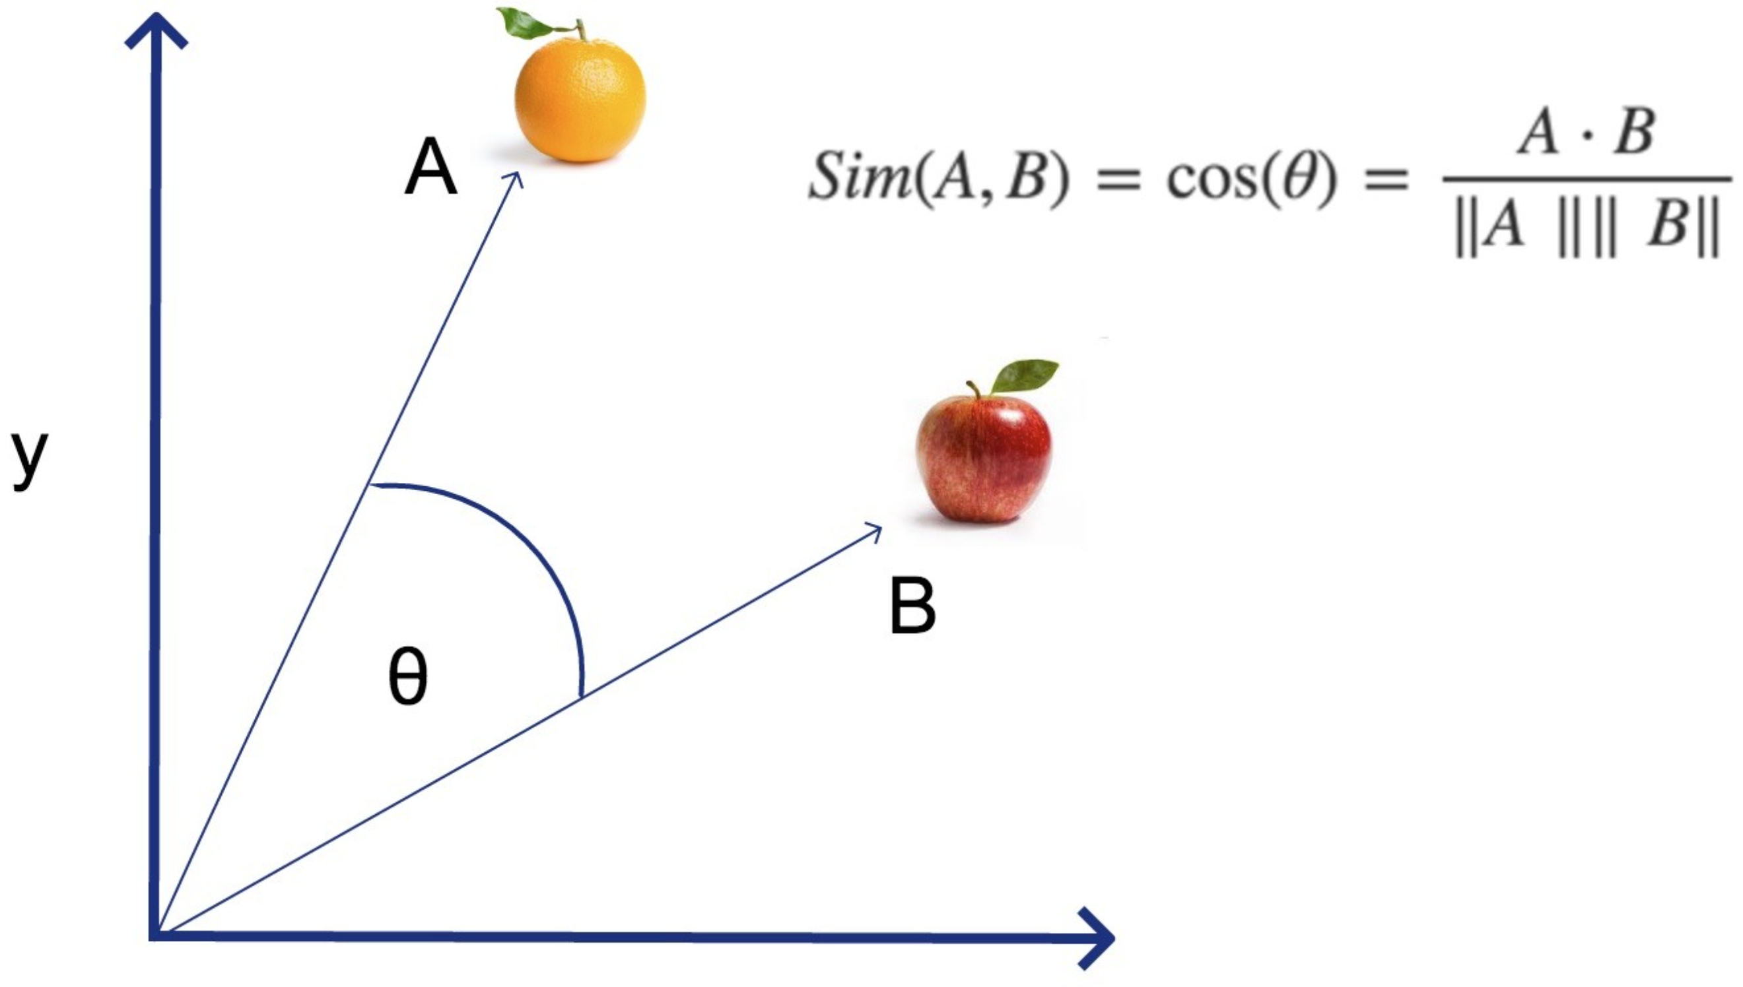
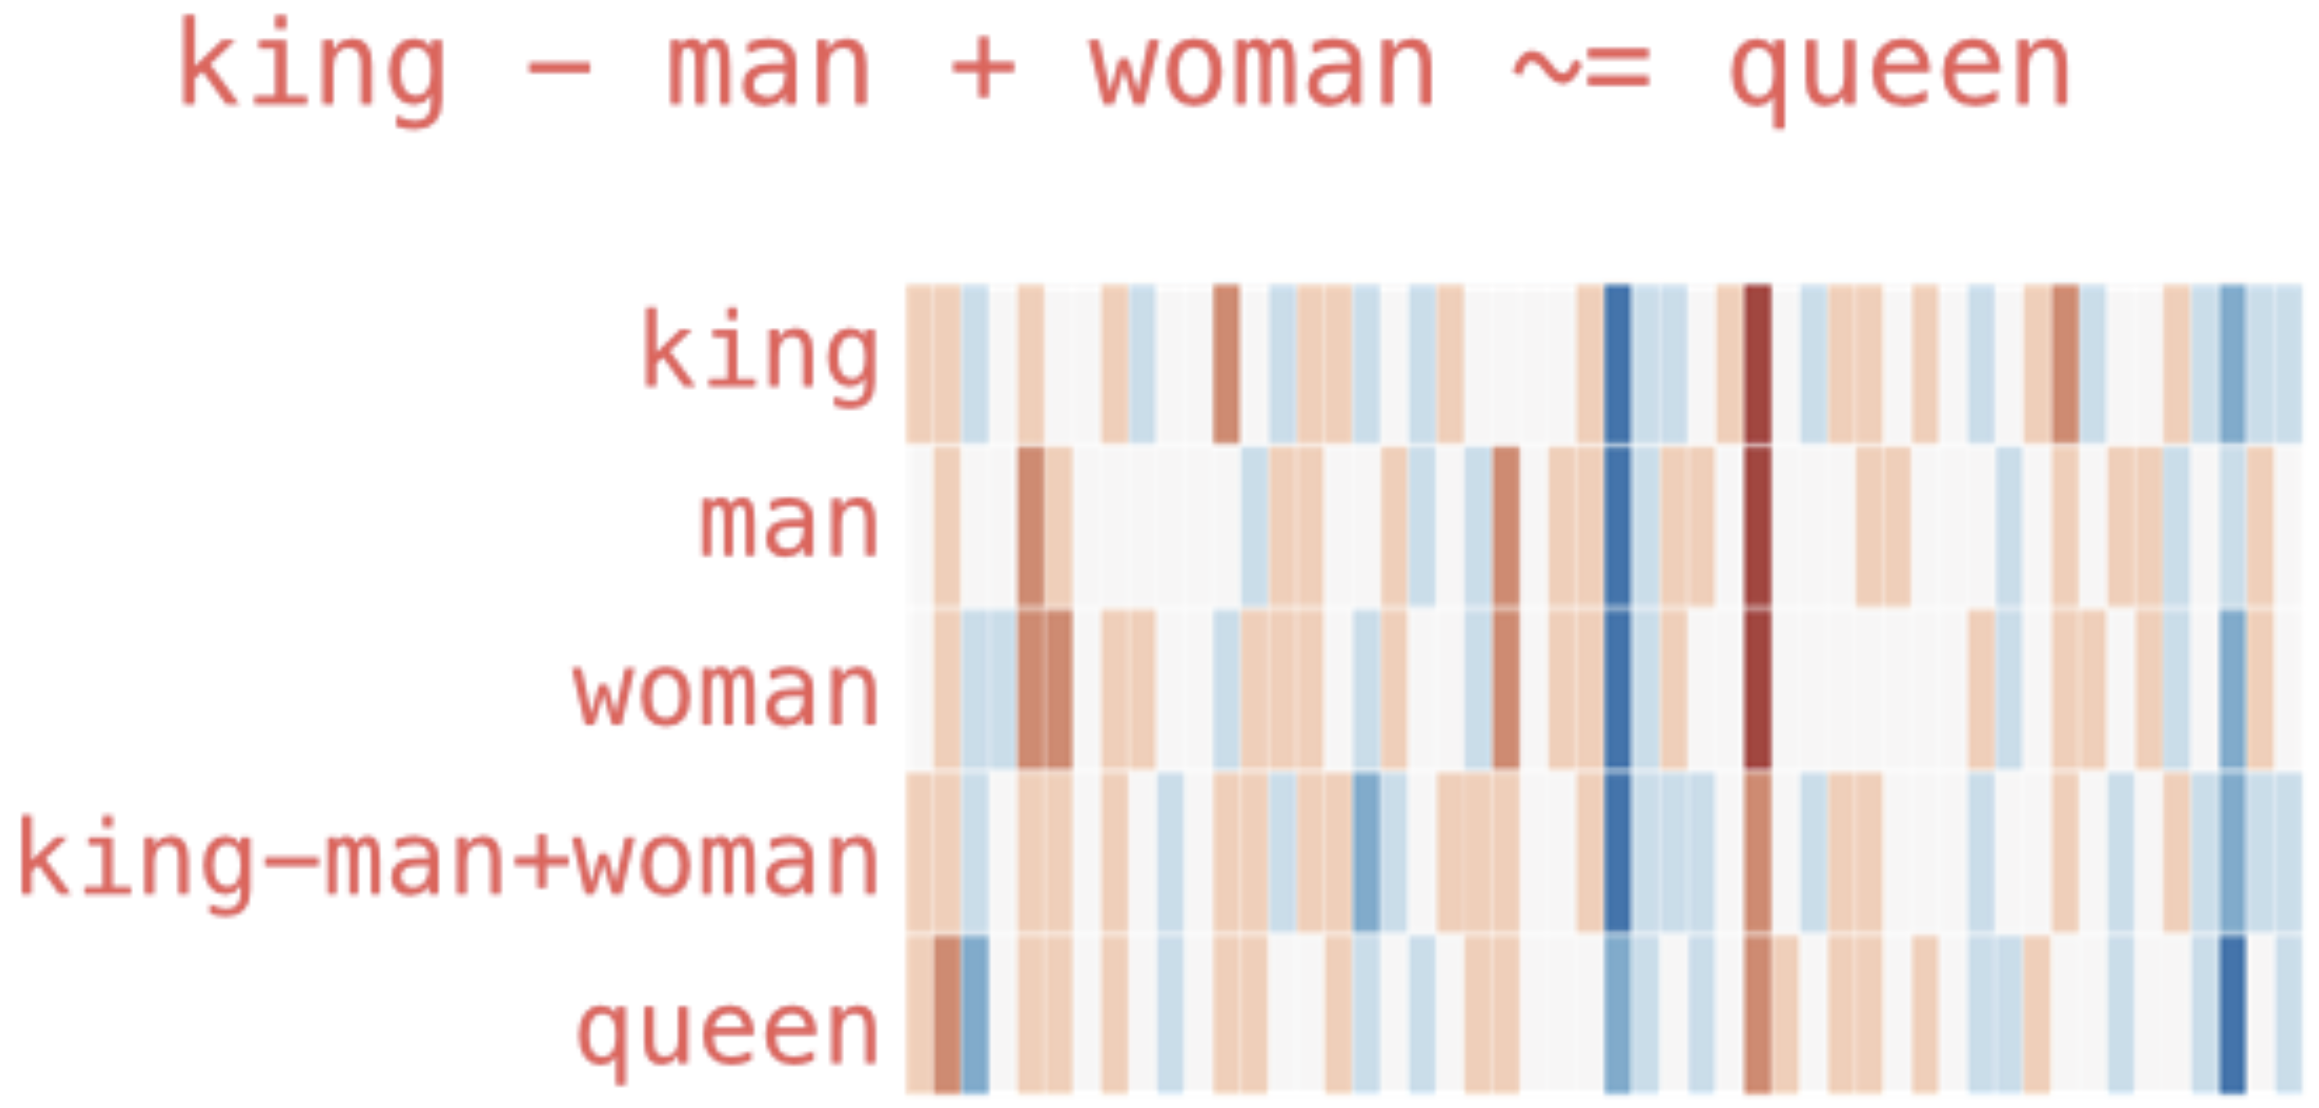
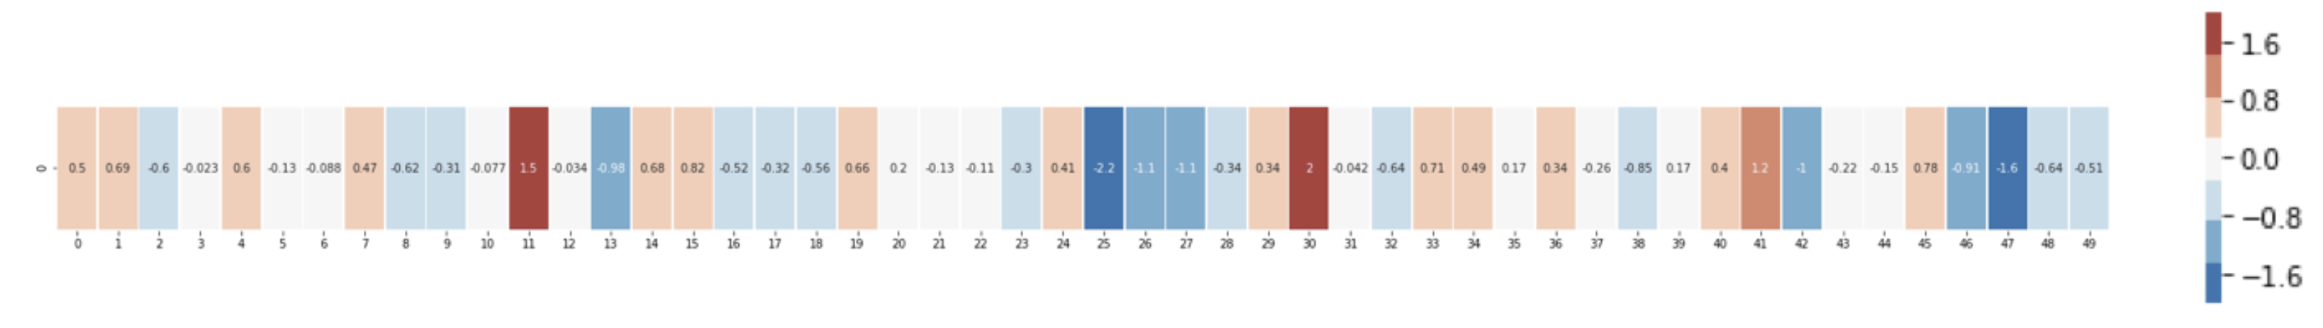
Embeddings
representation of entities by vectors
→ semantic similarity
most famous application: word embeddings
→ associations (natural language processing)
but general concept: embeddings of (categorical) features (e.g., products in recommendation engines)
learned via co-occurrence (e.g., word2vec)
end-to-end learning: embeddings layer in deep neural network, e.g., multi-layer perceptron (MLP)
but also direction of difference vectors interesting (analogies):
source

Slide 31
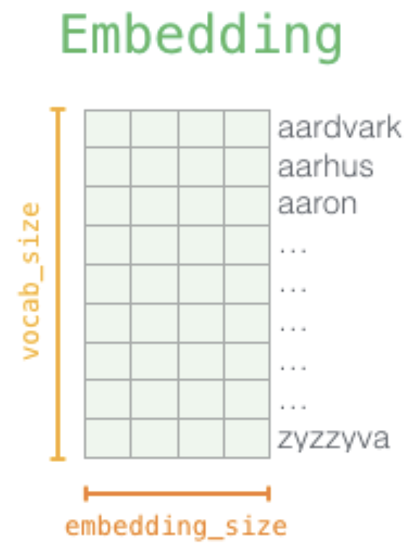
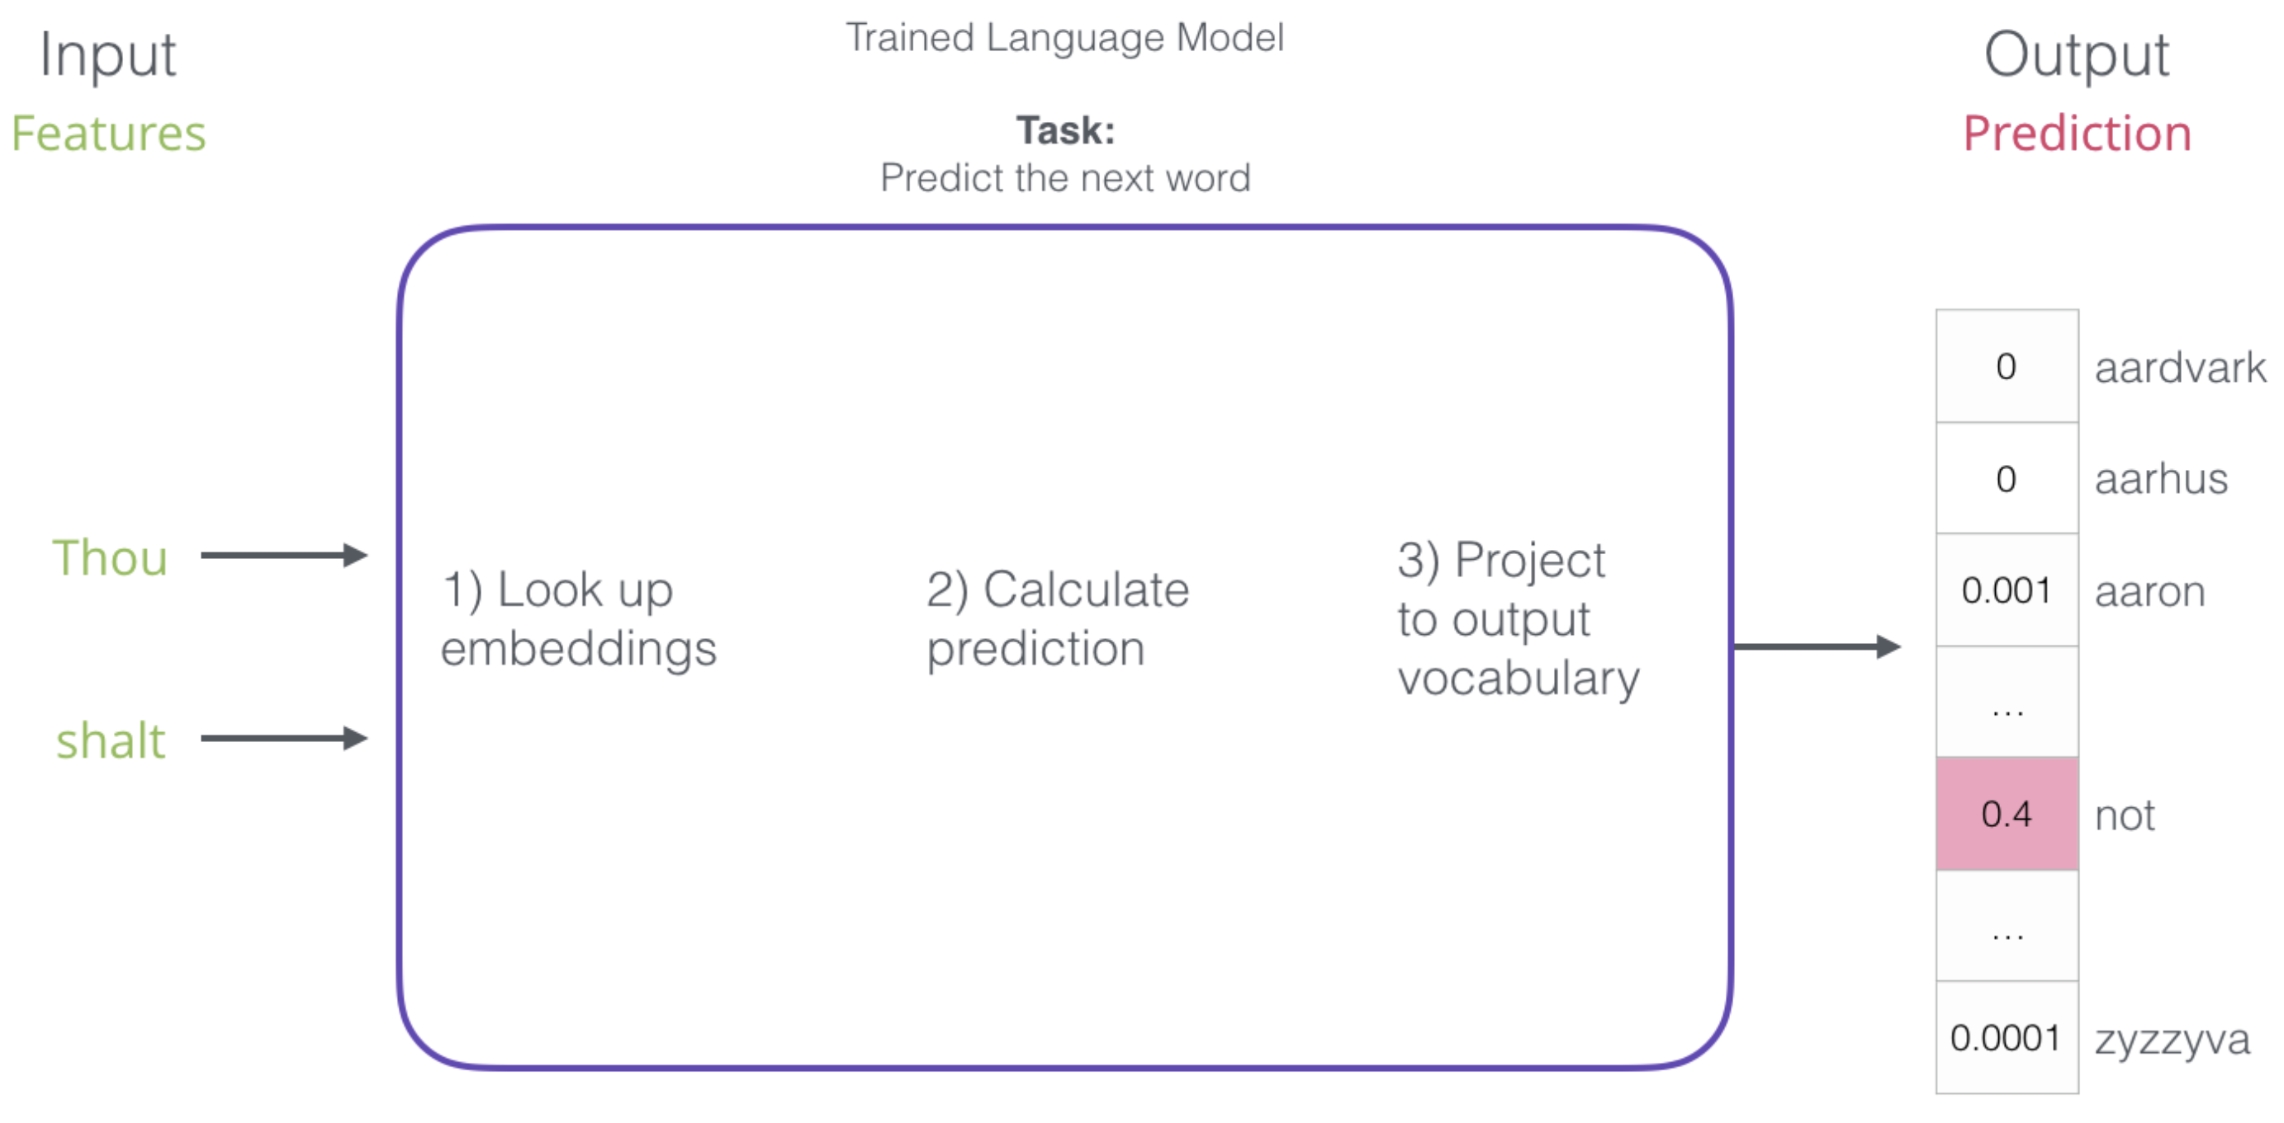
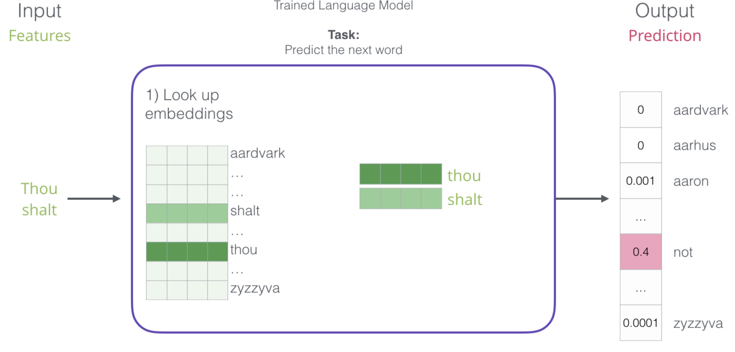
Word Embeddings as Part of Language Model
language models contain embedding matrix as part of learned parameters
typically several hundred dimensions for word vectors (to be compared with vocabulary sizes of many thousands)
(can also be extracted and subsequently used as pretrained embeddings for other task)
next-word prediction:
source

Slide 32
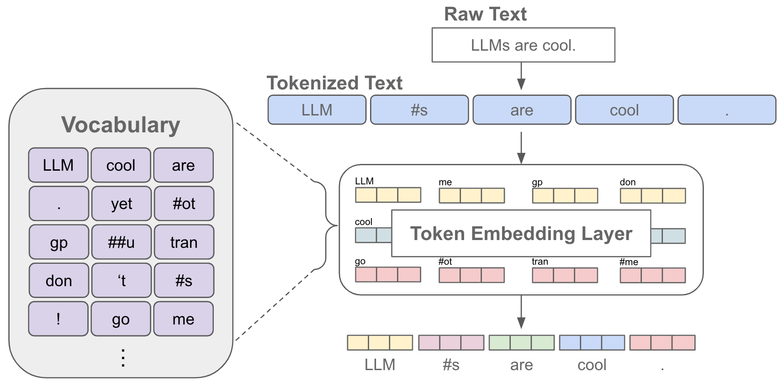
Tokenization & Embeddings
source

Slide 33
Other Complex Data Types
image data
pixel intensities as input
feature extraction mainly via deep learning (→ computer vision)
graph data
nodes and edges → relationships matter
examples: social networks, recommendation systems
modern best practice: graph embeddings / Graph Neural Networks

Slide 34
Feature Selection
too many features: curse of dimensionality
→ choose a subset of relevant features, remove irrelevant or redundant ones (keep signal, remove noise)
improves model performance
reduces overfitting
speeds up training
enhances interpretability

Slide 35
Feature Selection Methods
filter methods: evaluate features independently of the model
remove features highly correlated with each other
keep those strongly correlated with target
embedded methods: perform feature selection during model training
tree-based models: rank features by importance
Lasso regression

Slide 36
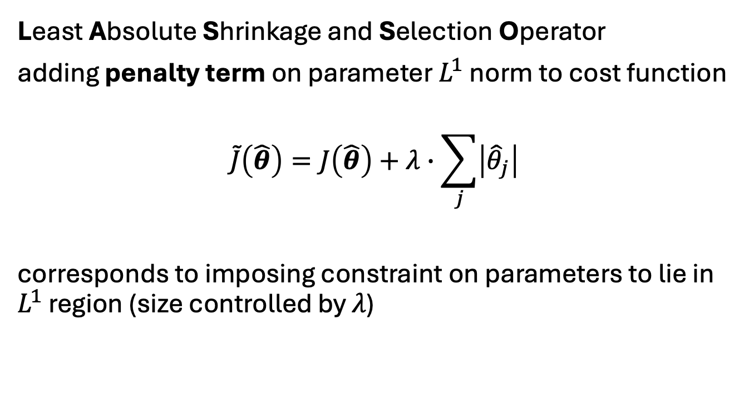
Lasso Regression
Least Absolute Shrinkage and Selection Operator
adding penalty term on parameter $L^{1}$ norm to cost function
$$\tilde{J}\left(\hat{θ}\right)=J\left(\hat{θ}\right)+λ∙\sum_{j}{\left|{\hat{θ}}_{j}\right|}$$
corresponds to imposing constraint on parameters to lie in $L^{1}$ region (size controlled by $λ$)
drives some coefficients to zero
→ automatic feature selection
source

Slide 37
Related Concept: Dimensionality Reduction
high dimensionality: large number of features
instead of selecting features transform them into fewer dimensions
example: Principal Component Analysis (PCA)
→ reduces dimensionality but loses interpretability

Slide 38
Data Leakage
definition:
using information not available at prediction time
example:
using future data to create features
→ leads to unrealistically high performance

Slide 39
Train/Test Leakage
common mistake:
compute statistics (mean, std) on full dataset
correct approach:
fit preprocessing on training data only, apply to test data

Slide 40
Feature Drift
feature distributions change over time
examples:
user behavior shifts
market conditions change
→ model performance degrades in production
even more critical: target drift

Slide 41
Imbalanced Data
imbalanced: one class significantly outnumbers others
example fraud detection:
99% non-fraud
1% fraud
models tend to favor the majority class and ignore minority class
→ leads to misleading performance
→ accuracy is misleading
(use precision, recall, F1, …)

Slide 42
Options for Handling Imbalanced Data
adjust the dataset by resampling
oversampling: duplicate or generate minority samples → keeps all data, but risk of overfitting
undersampling: remove majority samples → simpler dataset, but loss of information
apply class weights: assign higher penalty to minority class (many models support this directly, e.g., in scikit-learn)
adjust decision threshold (e.g., lower threshold → higher recall)
create features that better separate minority class or highlight rare patterns

Slide 43
Pipelines
use pipelines to:
ensure reproducibility
avoid leakage
simplify workflows
→ automate preprocessing
example tool: scikit-learn pipelines

