Slide 1
Probabilistic Models
Data Science

Slide 2
Course Schedule
Exploratory Data Analysis
Clustering
Probabilistic Models
Statistical Inference
Machine Learning
Feature Engineering
Model Evaluation
Deep Learning
Time Series
Causality

Slide 3
Probabilistic Models
probability distributions, parametric PDF
Gaussian distribution, exponential families
overdispersion
Bayesian statistics

Slide 4
Why Probabilistic Modeling?

Slide 5
Random Variables and Probability Distributions

Slide 6
Probability Density Functions (PDFs)

Slide 7
Parametric vs Non-Parametric Models

Slide 8
Common Probability Distributions

Slide 9
Gaussian Distribution

Slide 10
Properties of the Gaussian

Slide 11
Exponential Family of Distributions

Slide 12
Likelihood and Generative Models

Slide 13
Count Data and Overdispersion

Slide 14
Poisson vs Negative Binomial

Slide 15
Introduction to Bayesian Statistics

Slide 16
Prior, Likelihood, Posterior

Slide 17
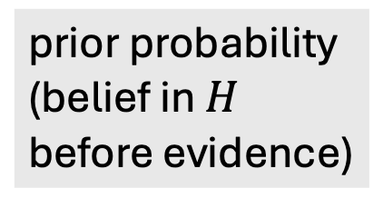
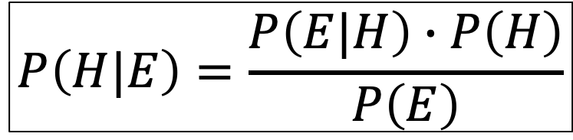
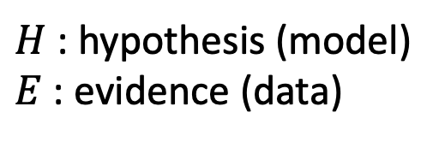
Bayes Theorem
likelihood function (derived from statistical model)
$H$: hypothesis (model)
$E$: evidence (data)
$$P\left(H|E\right)=\frac{P\left(E|H\right)∙P\left(H\right)}{P\left(E\right)}$$
posterior probability (belief updated with observed evidence)
new data (same for all hypotheses → uninteresting)
prior probability (belief in $H$ before evidence)

Slide 18
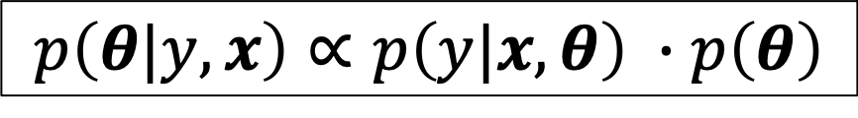
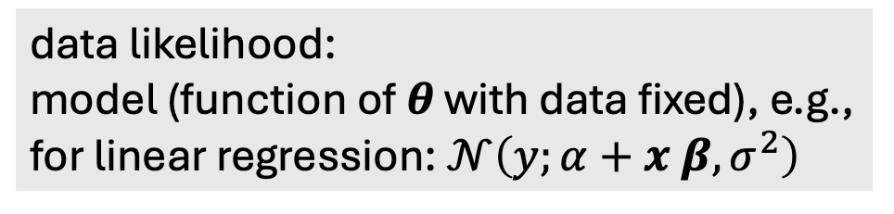
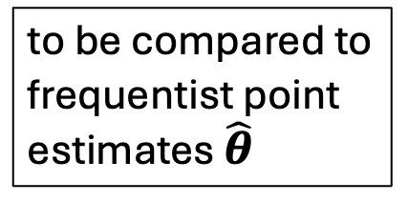
Bayes Theorem for Parameter Estimation
data likelihood:
model (function of $θ$ with data fixed), e.g., for linear regression: $𝒩\left(y;α+x β,σ^{2}\right)$
$$p\left(θ|y, x\right)∝p\left(y|x,θ\right) ∙p\left(θ\right)$$
posterior:
probability distribution reflecting the effect of data on prior belief about parameters (increasing certainty with new evidence)
prior (e.g., broad Gaussian):
probability distribution reflecting initial belief about uncertain parameters (helps to reduce variance with few data)
to be compared to frequentist point estimates $\hat{θ}$
→ Bayesian updating

Slide 19
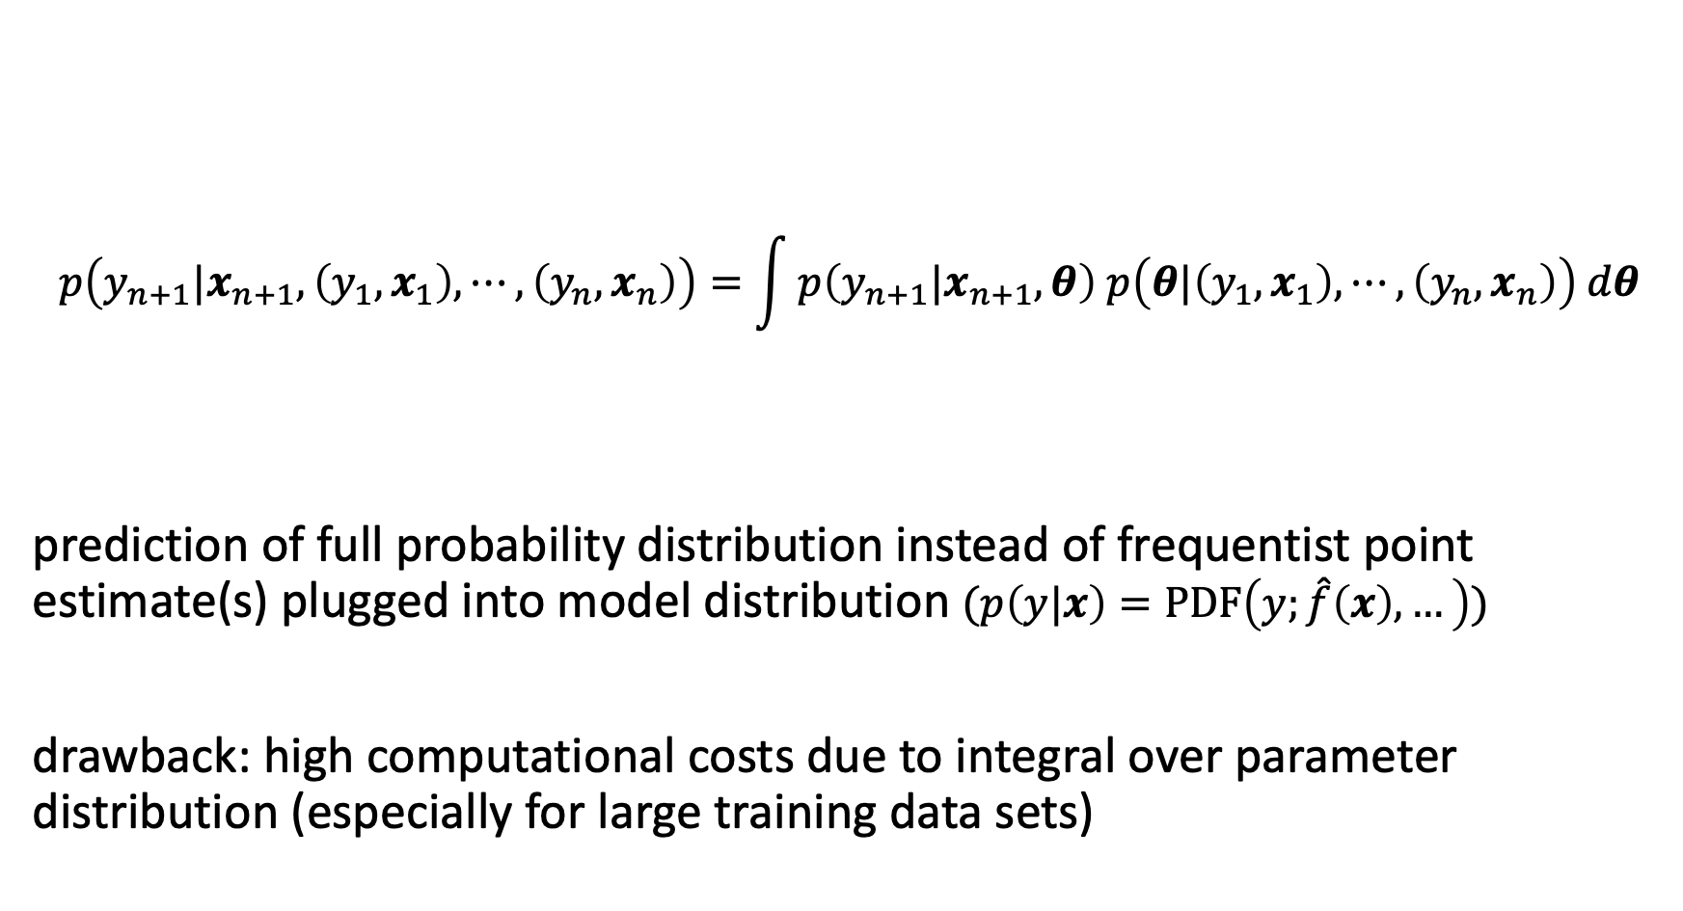
Bayesian Prediction
$$p\left(y_{n+1}|x_{n+1},\left(y_{1},x_{1}\right),⋯,\left(y_{n},x_{n}\right)\right)=\int{p\left(y_{n+1}|x_{n+1},θ\right) p\left(θ|\left(y_{1},x_{1}\right),⋯,\left(y_{n},x_{n}\right)\right) dθ}$$
prediction of full probability distribution instead of frequentist point estimate(s) plugged into model distribution $(p\left(y|x\right)=PDF\left(y;\hat{f}\left(x\right), …\right))$
drawback: high computational costs due to integral over parameter distribution (especially for large training data sets)
likelihood
latest posterior

Slide 20
Conjugate Priors

Slide 21
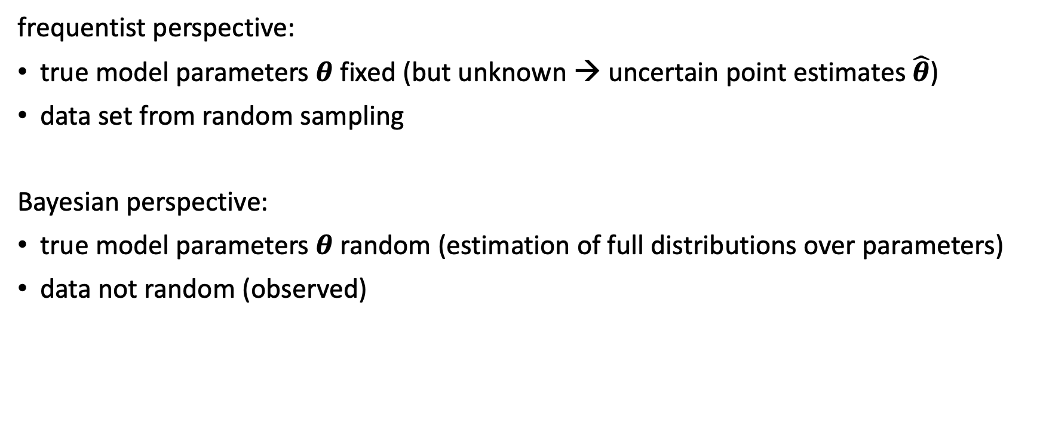
Bayesian vs Frequentist View
frequentist perspective:
true model parameters $θ$ fixed (but unknown → uncertain point estimates $\hat{θ}$)
data set from random sampling
Bayesian perspective:
true model parameters $θ$ random (estimation of full distributions over parameters)
data not random (observed)

Slide 22
When to Use Probabilistic Models

