Slide 1
Time Series
Data Science

Slide 2
Time Series
forecasting
autocorrelation
ARMA models
time-series features
deep learning for time series
anomaly detection

Slide 3
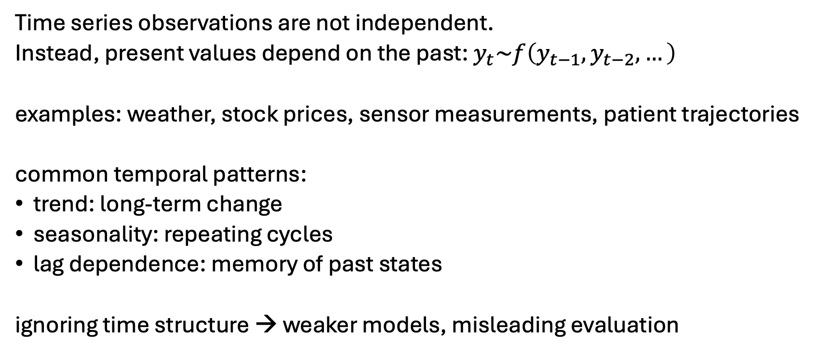
Temporal Dependence
Time series observations are not independent.
Instead, present values depend on the past: $y_{t}\sim f\left(y_{t−1},y_{t−2},…\right)$
examples: weather, stock prices, sensor measurements, patient trajectories
common temporal patterns:
trend: long-term change
seasonality: repeating cycles
lag dependence: memory of past states
ignoring time structure → weaker models, misleading evaluation

Slide 4
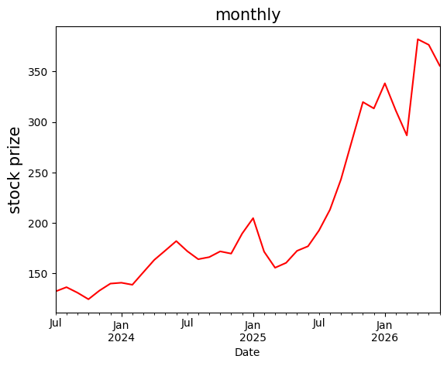
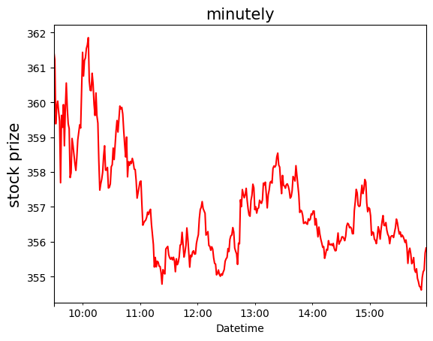
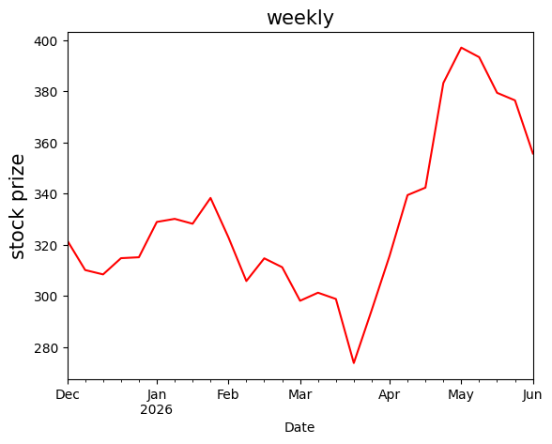
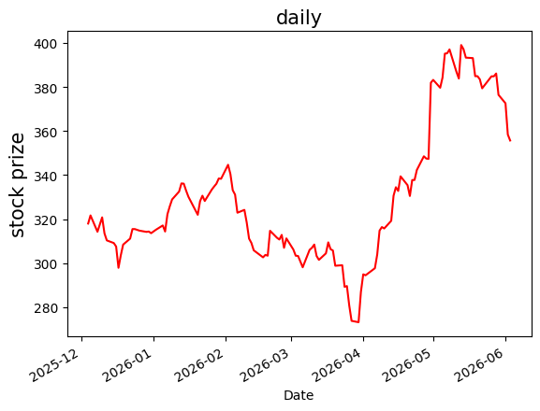
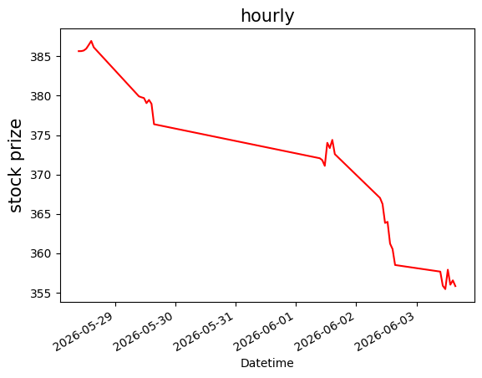
Sampling Frequencies

Slide 5
Example: Forecasting

Slide 6
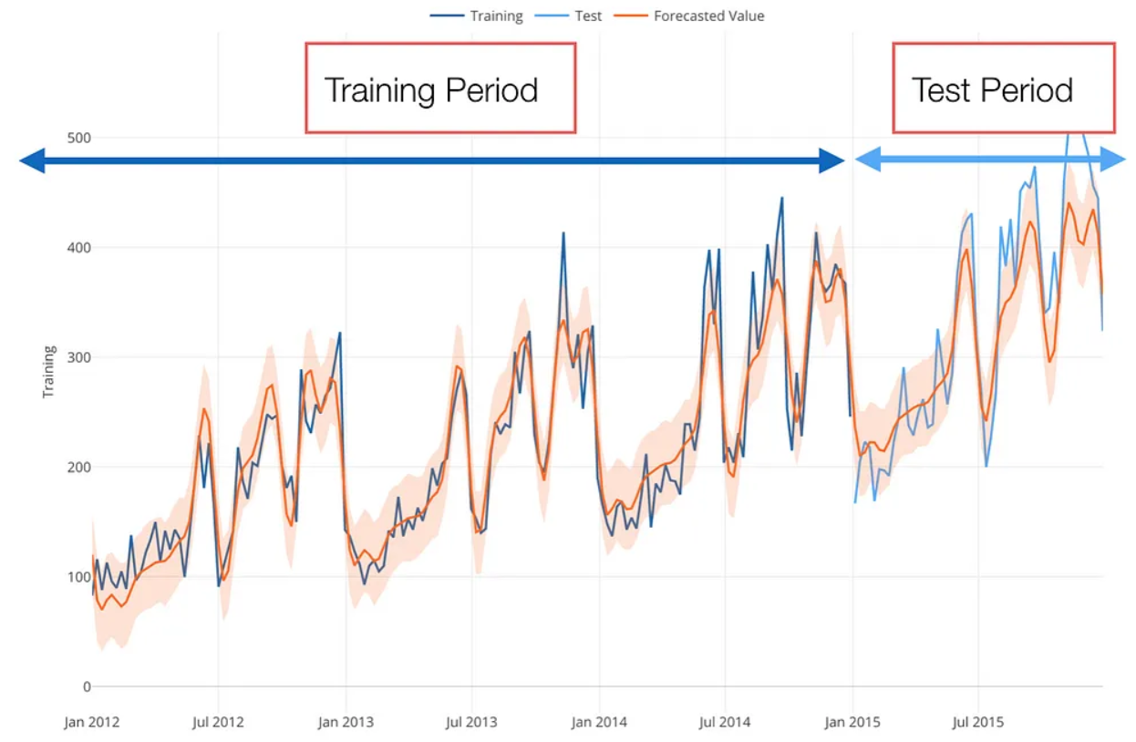

Slide 7
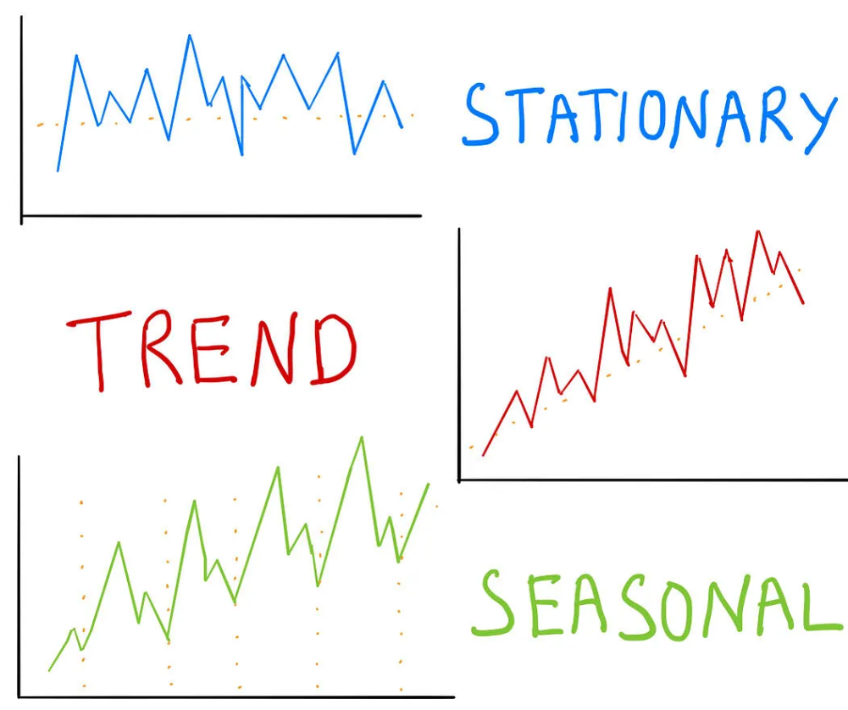
Statistical Patterns

Slide 8
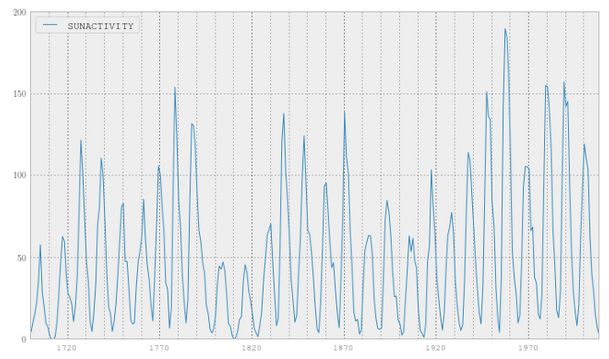
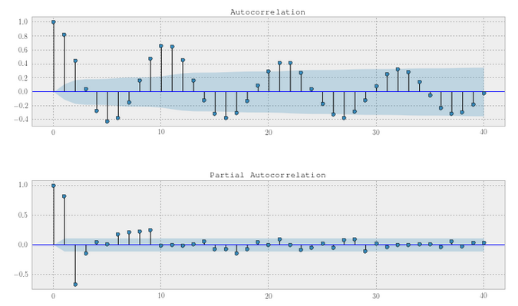
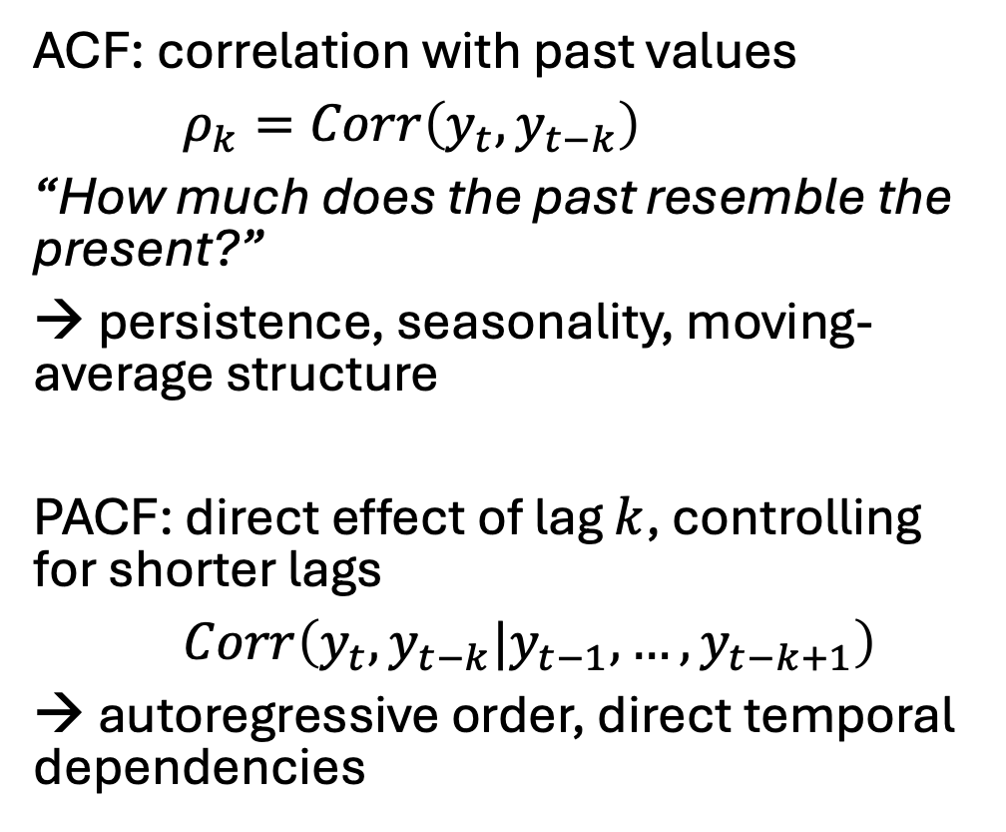
Autocorrelation (ACF) and Partial Autocorrelation (PACF)
ACF: correlation with past values
$ρ_{k}=Corr\left(y_{t},y_{t−k}\right)$
“How much does the past resemble the present?”
→ persistence, seasonality, moving-average structure
PACF: direct effect of lag $k$, controlling for shorter lags
$Corr\left(y_{t},y_{t−k}|y_{t−1},…,y_{t−k+1}\right)$
→ autoregressive order, direct temporal dependencies

Slide 9
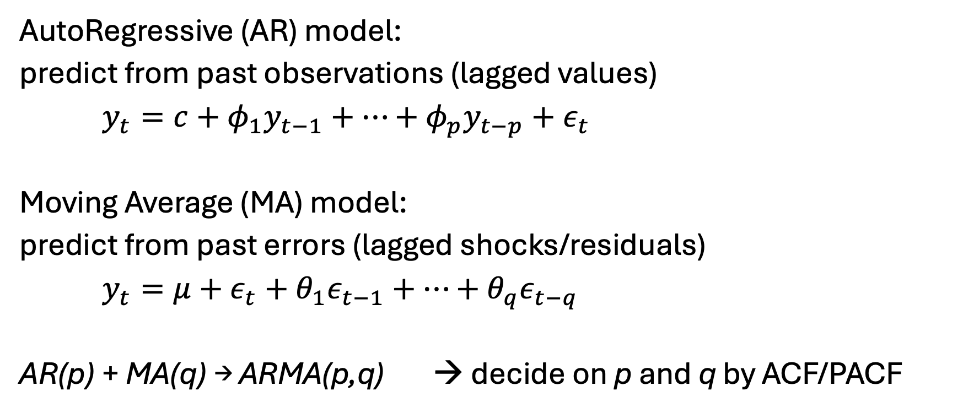
ARMA
AutoRegressive (AR) model:
predict from past observations (lagged values)
$y_{t}=c+φ_{1}y_{t−1}+…+φ_{p}y_{t−p}+ε_{t}$
Moving Average (MA) model:
predict from past errors (lagged shocks/residuals)
$y_{t}=μ+ε_{t}+θ_{1}ε_{t−1}+…+θ_{q}ε_{t−q}$
AR(p) + MA(q) → ARMA(p,q) → decide on p and q by ACF/PACF

Slide 10
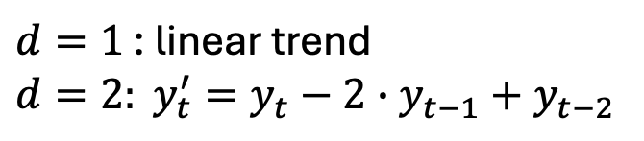
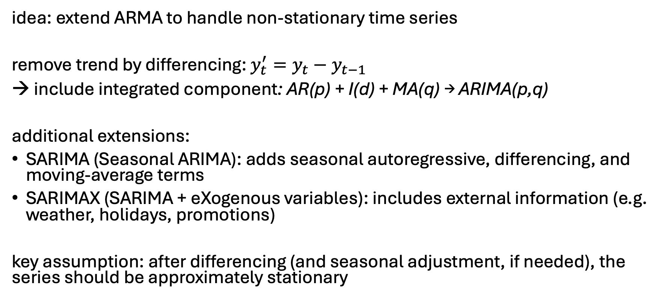
ARIMA
idea: extend ARMA to handle non-stationary time series
remove trend by differencing: $y_{t}^{′}=y_{t}−y_{t−1}$
→ include integrated component: AR(p) + I(d) + MA(q) → ARIMA(p,q)
additional extensions:
SARIMA (Seasonal ARIMA): adds seasonal autoregressive, differencing, and moving-average terms
SARIMAX (SARIMA + eXogenous variables): includes external information (e.g. weather, holidays, promotions)
key assumption: after differencing (and seasonal adjustment, if needed), the series should be approximately stationary
$d=1$ : linear trend
$$d=2: y_{t}^{′}=y_{t}−2∙y_{t−1}+y_{t−2}$$

Slide 11
Stationarity
mean, variance, autocorrelation structure remain stable over time
important for ARMA assumptions, easier generalization, stable relationships
common fixes:
differencing
log transform (converts multiplicative relationships into additive ones, forcing variations to remain consistent throughout the entire timeline)
seasonal adjustment

Slide 12
Types of Time Series Forecasting Information
auto-correlation:
using past values of considered time series as function of lag
identifying periodicity (seasonality) and trend
→ ARMA
exogenous variables:
using correlations of other variables to considered time series
examples in demand forecasting: price, weather
such effects lasting for some time create spurious auto-correlation

Slide 13
ML-based Forecasting
decomposition-based approaches:
additive components such as trend, seasonality, holidays
→ additive regression / generalized additive modeling
example method: prophet
natural way for multivariate model: training one model combining several independent time series, distinguished by additional feature (e.g., product ID)

Slide 14
Feature Engineering for Time Series
idea: convert temporal structure into input features for ML models
lag features (past values): captures autoregressive behavior
calendar/time features: captures seasonality and recurring patterns
rolling & aggregated features: captures local trend and variability
external/exogenous features: incorporates outside influences

Slide 15
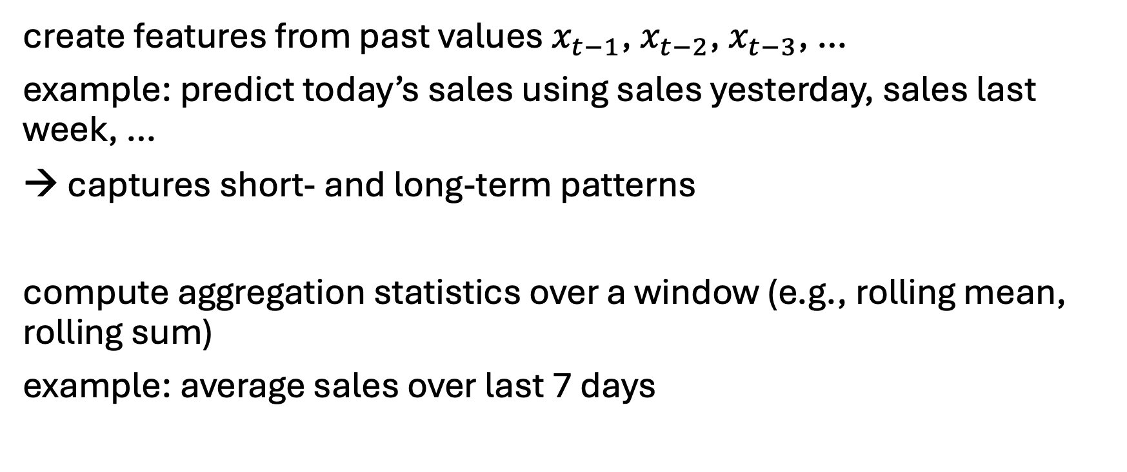
Lag Features & Rolling Statistics
create features from past values $x_{t−1}$, $x_{t−2}$, $x_{t−3}$, …
example: predict today’s sales using sales yesterday, sales last week, …
→ captures short- and long-term patterns
compute aggregation statistics over a window (e.g., rolling mean, rolling sum)
example: average sales over last 7 days

Slide 16
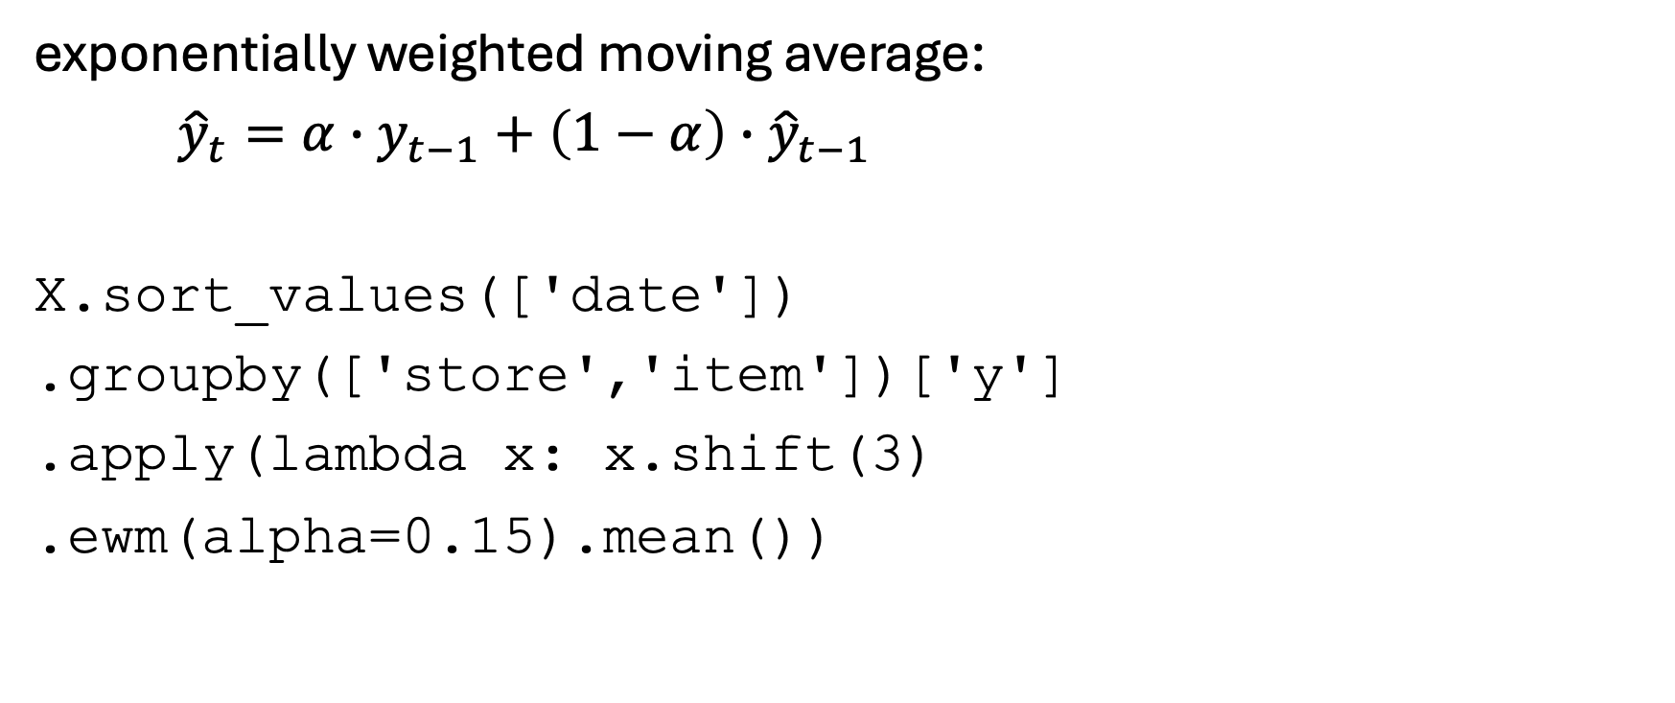
Exponential Smoothing
exponentially weighted moving average:
${\hat{y}}_{t}=α∙y_{t−1}+\left(1−α\right)∙{\hat{y}}_{t−1}$
X.sort_values(['date'])
.groupby(['store','item'])['y']
.apply(lambda x: x.shift(3)
.ewm(alpha=0.15).mean())
potentially further grouped by important lag (like day of week) or exogenous variables (like promotion)
prediction horizon

Slide 17
Trend & Seasonality
capture long-term movement such as increasing/decreasing trend
difference between current and past values
capture repeating patterns:
day of week
month
holiday indicators
→ often critical in time series problems

Slide 18

Demand Forecasting with ML
many individual time series to consider
advantages of ML over traditional univariate time series forecasting:
typical retail grocery chain:
products (items): ~20k
locations (stores): ~500
daily/hourly aggregated sales
combined learning on all time series of product-location combinations (rather than separately optimizing individual time series)
→ reduces variance by exploiting commonalities
natural consideration of many exogenous variables (prices, promotions, holidays, weather, ...)
→ reduces bias
promotions
(price reductions)
Summed Units
to be noted:
categorical features important (products and locations → high cardinality)
mainly multiplicative effects
demand (approximately) following Poisson (or rather negative binomial) distribution

Slide 19
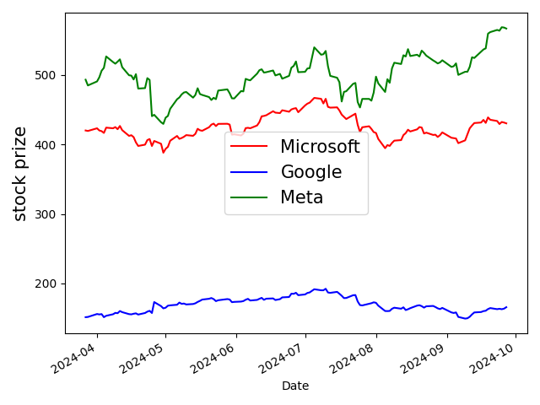
You can decrease uncertainty by looking at similar time series

Slide 20
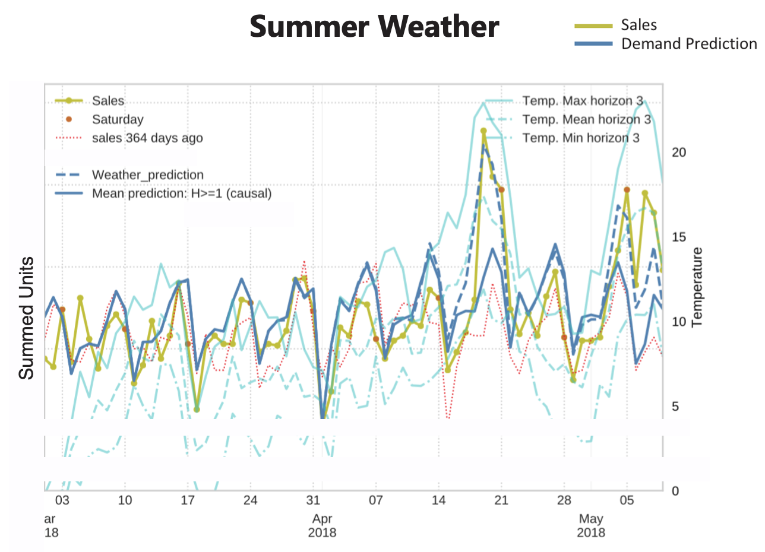
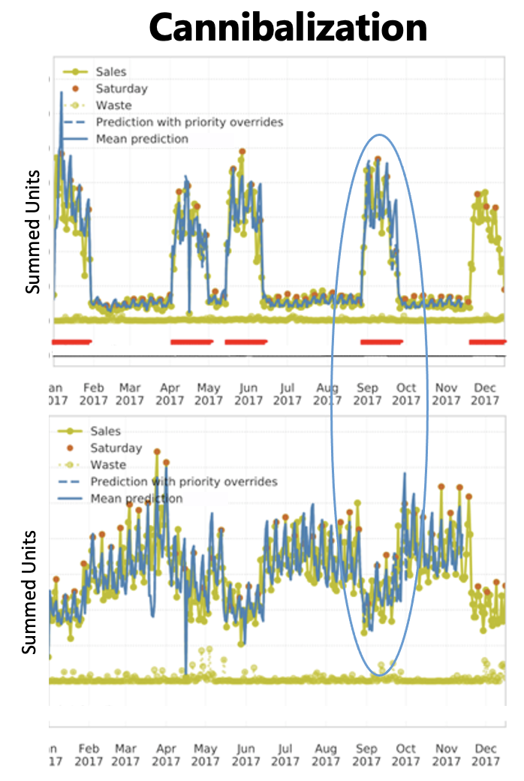
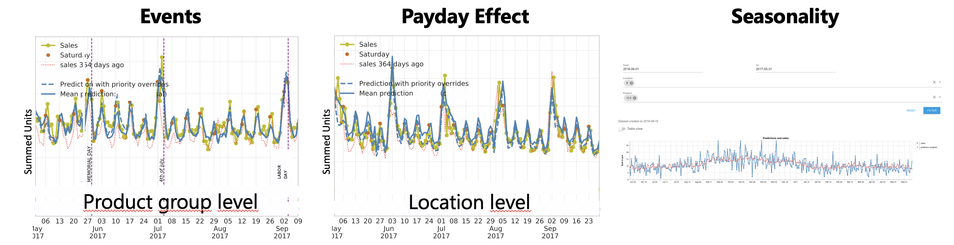
Example:
Retail Features

Slide 21
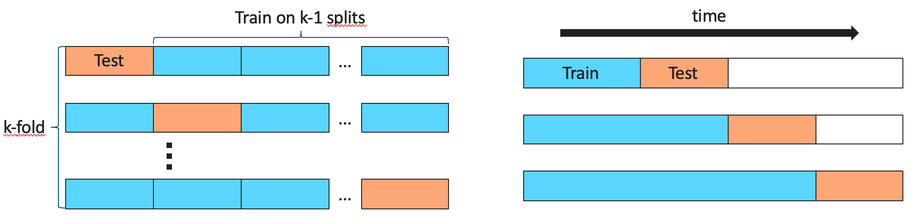
Time-Series Validation
avoid time–based leakage: only use past data at prediction time
train-test splits in time:
cross-validation:

Slide 22
Evaluation of Forecasts
goal: assess how well a forecasting model predicts unseen future values
choose an appropriate error metric, aggregated over an evaluation period: MAE, RMSE, MAPE
important design choice: what period to evaluate on?
single holdout period: final 20% of the series
rolling evaluation: repeated forecasts across multiple future windows
forecast horizon-specific evaluation: 1-step, 5-step, 12-step ahead errors

Slide 23
Baseline Forecasts / Naive Models
beating naive baselines matters in practice
examples:
last value forecast
seasonal naive forecast
moving average baseline

Slide 24
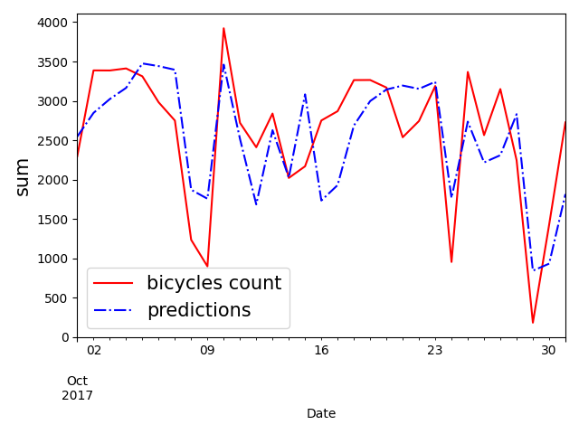
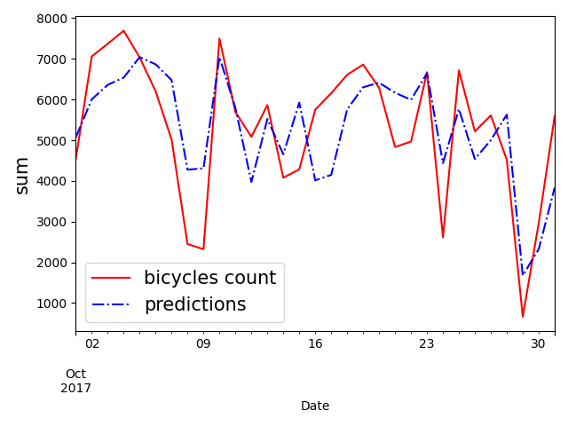
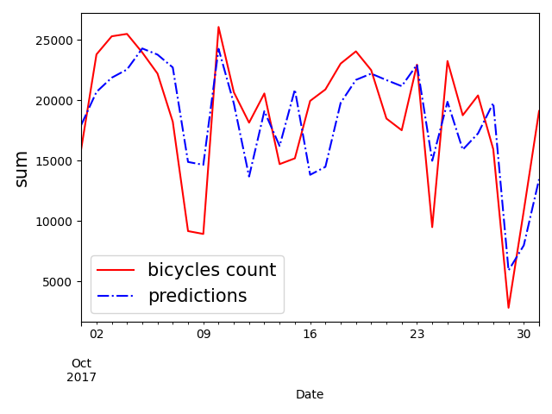
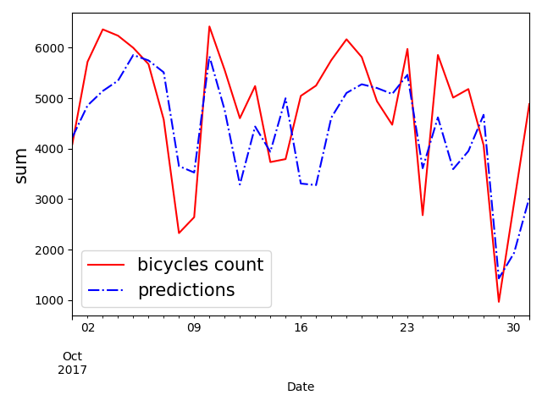
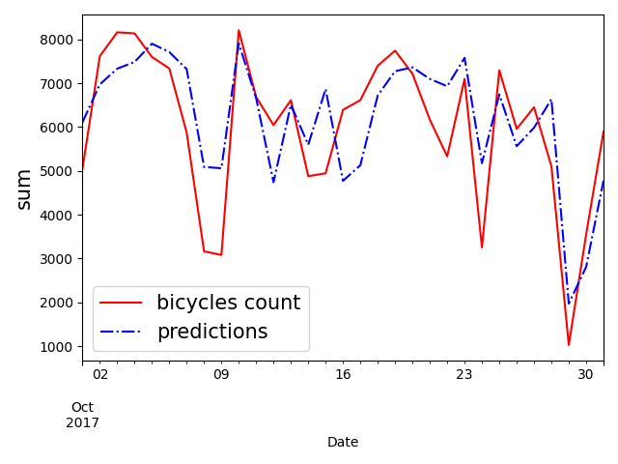
NY bridges bicycles count
Manhattan bridge
total
Brooklyn bridge
off by
~10%
Williamsburg bridge
Queensboro bridge

Slide 25
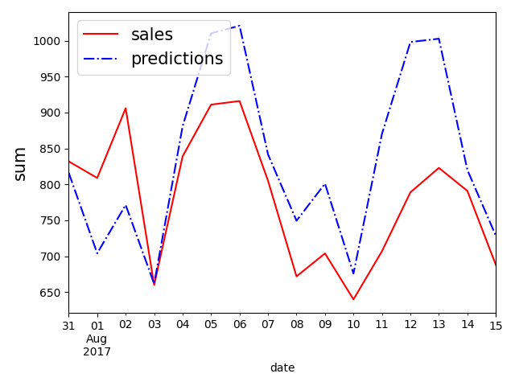
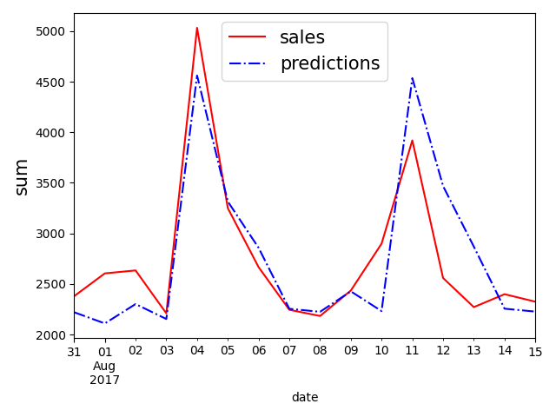
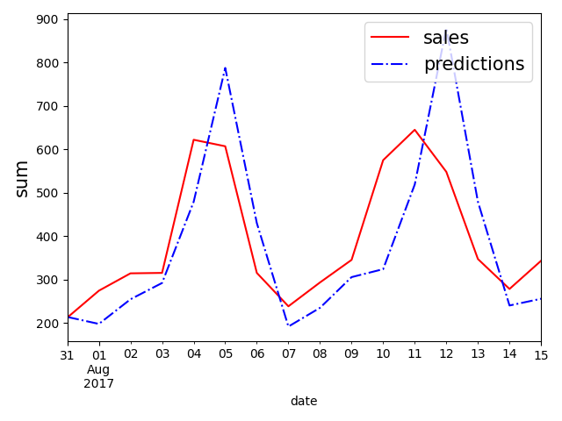
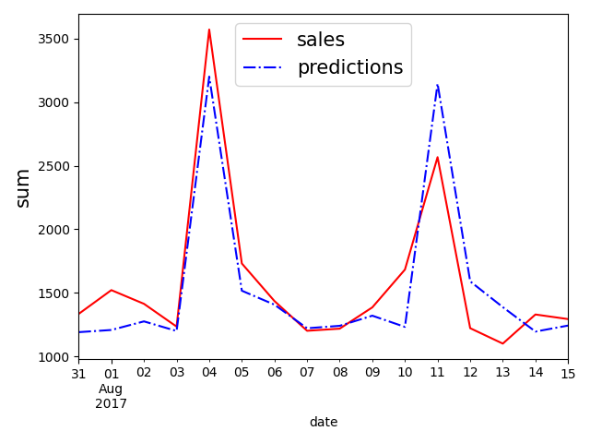
Store sales
total
liquor, wine, beer
eggs
off by
~10%
off by
~40%
meats

Slide 26
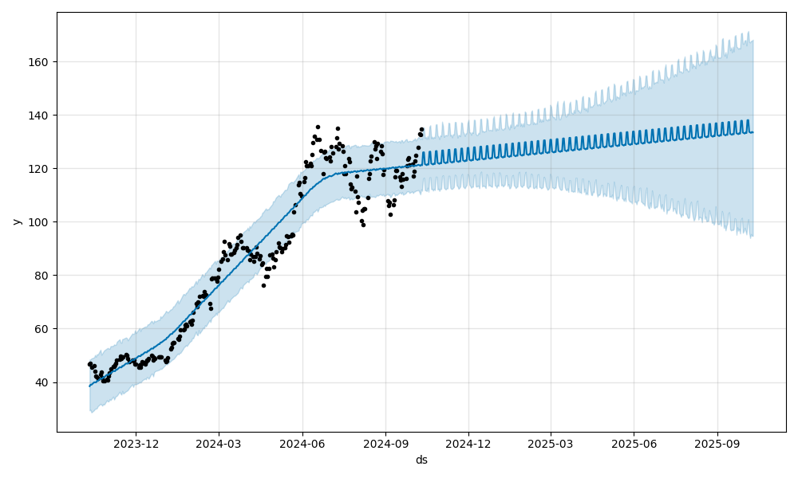
Uncertainty increases with forecast horizon.
Nvidia stock prices

Slide 27
You can predict effects of foreseeable events.
promotions
(price reductions)
Summed Units

Slide 28
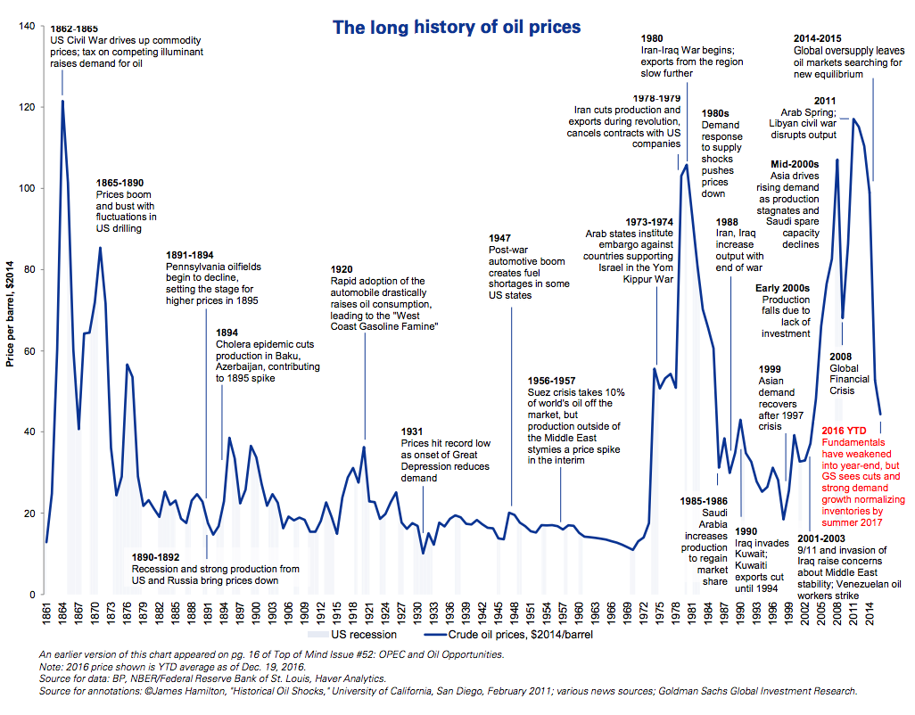
But you cannot predict effects of unforeseeable events.

Slide 29
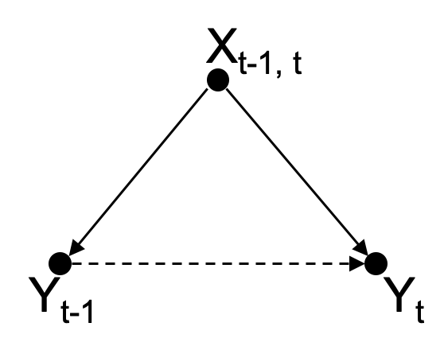
Temporal Confounding
auto-correlation often only spurious: common causes at consecutive times
→ no direct causal effects
advantages of learning direct causal effects from exogenous information instead of confounded auto-correlation:
explainability
long-term forecasting
predictability of rare events
specific lags such as day of week can be interpreted both ways

Slide 30
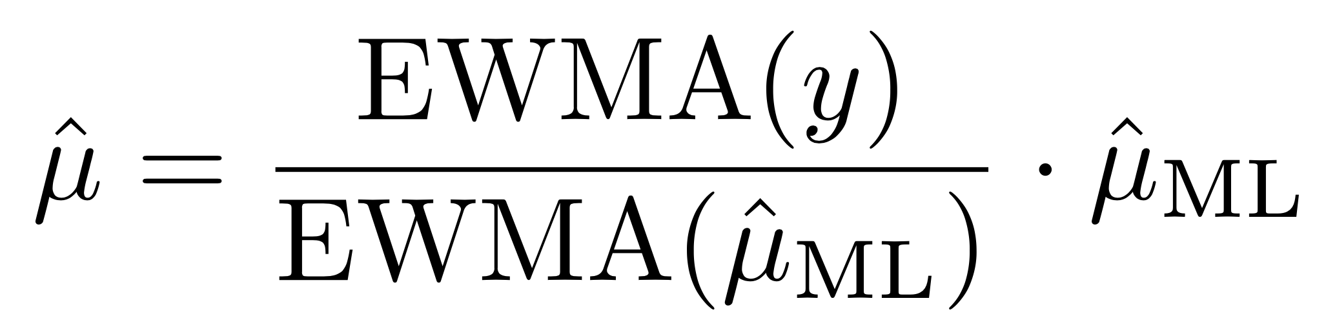
Beware of (Spurious) Auto-Correlation
Most forecasting methods rely on lagged target information.
univariate time series methods
exponential smoothing features in ML model
sequence modeling in deep learning (e.g., recurrent neural networks)
However, this makes learning of exogenous effects much harder.
already blended in target auto-correlation
delayed effects of short-lived structures/trends
→ simple solution: no use of target auto-correlation in ML model, but subsequent residual correction to capture missing trends
one product group summed over all locations
COVID-19
difficult

Slide 31
Deep Learning Methods for Sequential Data
→ direct inclusion of auto-correlation in ML model
(but beware: autocorrelation often reflects latent/exogenous drivers rather than direct temporal causation)
convolutional neural networks (CNN)
main application computer vision: images correspond to regular 2D grids of data (pixels)
time series data as 1D grid at regular time intervals
parameter sharing via convolutions (and pooling) → highly regularized feed-forward networks
fixed time window (kernel)
multivariate time series model via different input channels
recurrent neural networks (RNN)
main application natural language processing (NLP): sequence of words (tokens)
time series data as time-tagged stream
parameter sharing via recurrent nodes → context-awareness (input from past activations)
variable-length time series
multivariate time series model via more input nodes
transformers
main application NLP (largely replaced RNNs), but also computer vision
time series data as directed graph (attention in edges)
masked self-attention to focus on relevant past time steps and positional encoding to include order of sequence
multivariate time series model via input concatenation

Slide 32
Multi-Step Forecasting Strategies
recursive forecasting (feed predictions back)
direct forecasting (train separate horizon-ahead models)
multi-output forecasting

Slide 33
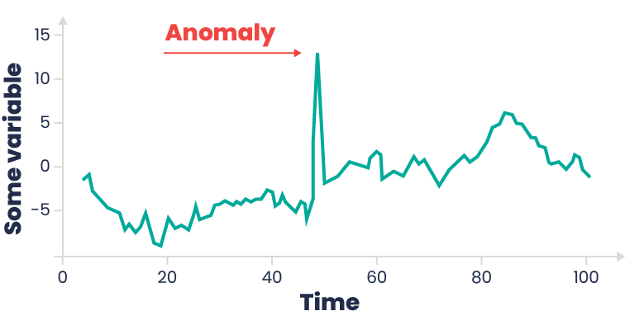
Anomaly Detection
goal: identify observations that deviate significantly from expected (temporal) behavior
detect failures, fraud, or abnormal events
enable early warning systems
improve monitoring and forecasting robustness
different types:
point anomalies: single observations that strongly differ from normal values (e.g., sudden spike in server CPU usage)
contextual anomalies: abnormal only within a specific temporal context (e.g., high electricity demand at 3 AM)
collective anomalies: a sequence of observations forms an unusual pattern (e.g., gradual sensor drift before equipment failure)

Slide 34
Anomaly Detection Approaches
methods:
statistical: thresholds/Z-score, seasonal decomposition + residuals
forecasting error : ARIMA , LSTM
reconstruction error : (CNN) autoencoder
feature-based ML: isolation forest, one-class SVM
workflow:
preprocess data: handle missing values, detrend, deseasonalize
model normal behavior: learn expected temporal patterns
compute anomaly score: measure deviation from expected behavior
flag anomalies: apply thresholds or ranking

