Slide 1
Introduction
Data Science

Slide 2
Course Schedule
Exploratory Data Analysis
Clustering
Probabilistic Models
Parameter Estimation
Supervised Learning
Feature Engineering
Model Evaluation
Deep Learning
Time Series
Causality

Slide 3
blend of diverse components from different domains (statistics, optimization, computer science, …)
Artificial Intelligence
Machine Learning
Data Science
Deep
Learning
Deep Learning: special kind of ML methods using deep neural networks (e.g., CNNs, transformers)
Data Science:
extract knowledge from data (by means of ML, among other things)

Slide 4
Typical Data Science Workflow
Business Understanding
→ Data Collection
→ Data Exploration
→ Data Cleaning & Preparation
→ Modeling
→ Evaluation
→ Deployment & Monitoring
iterative process

Slide 5
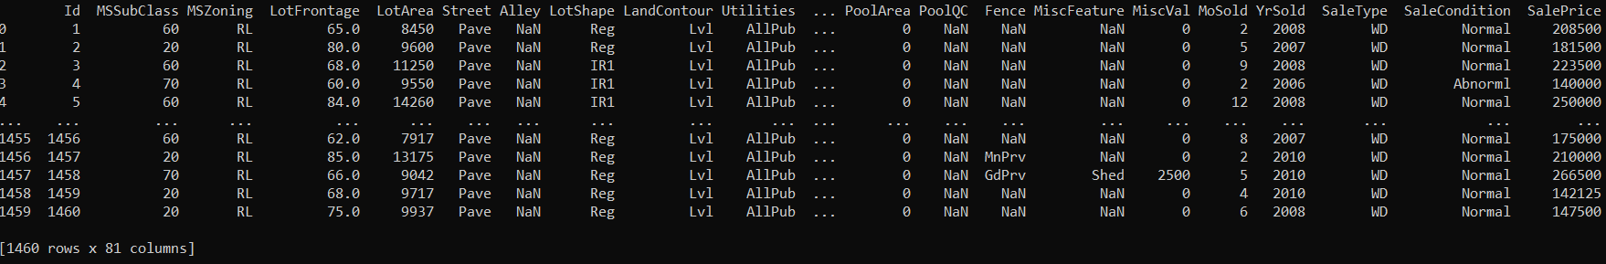
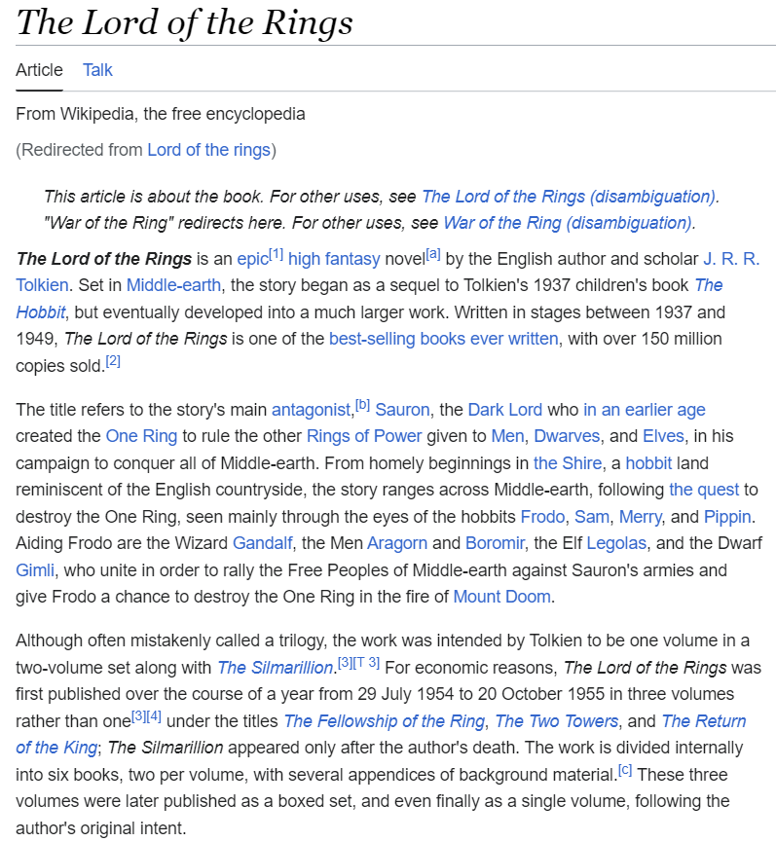
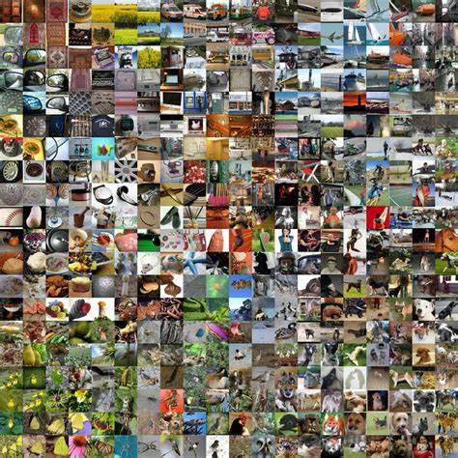
Main Areas of Artificial Intelligence (AI)
tabular data
language models
computer vision
control
all empowered by one key component:
learning from data → Machine Learning (ML)

Slide 6
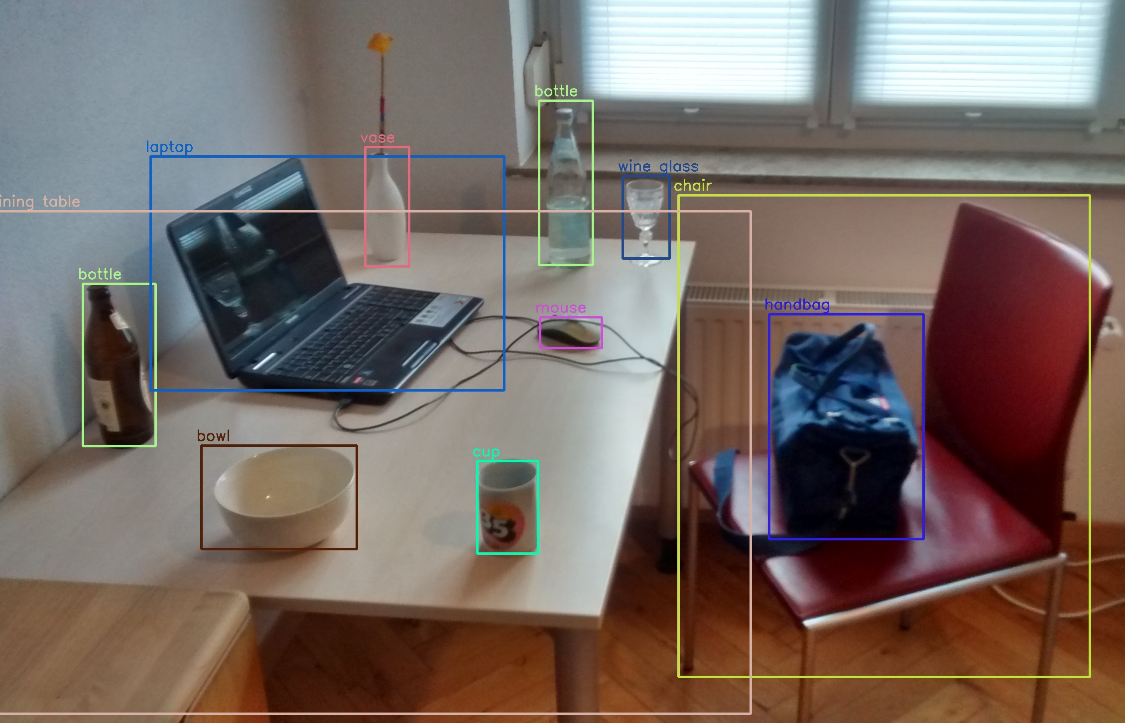
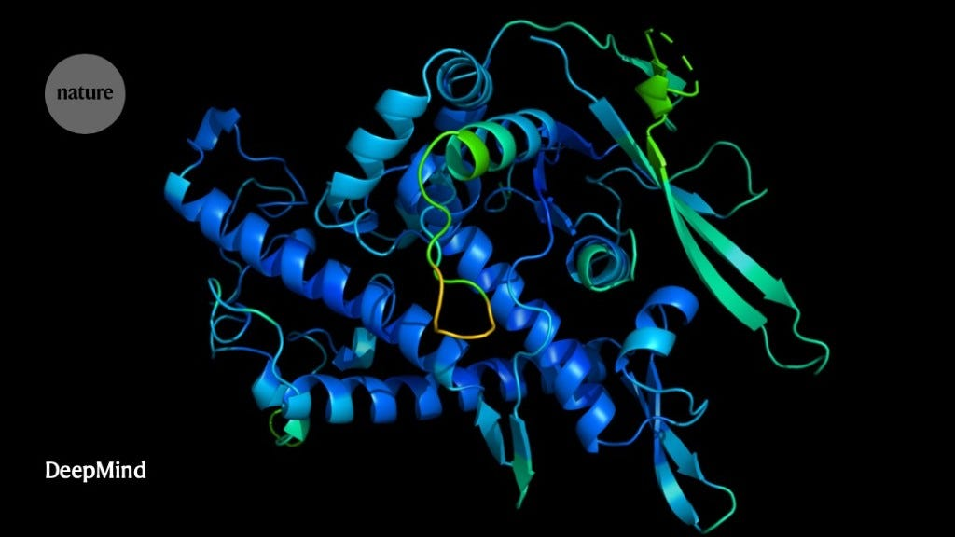
When to Use ML (Learning from Data)
automation
too complex for rules
uncertainty
too complex for humans
AlphaFold
object recognition, chatbot, …
protein structure predictions, demand forecasting, …

Slide 7
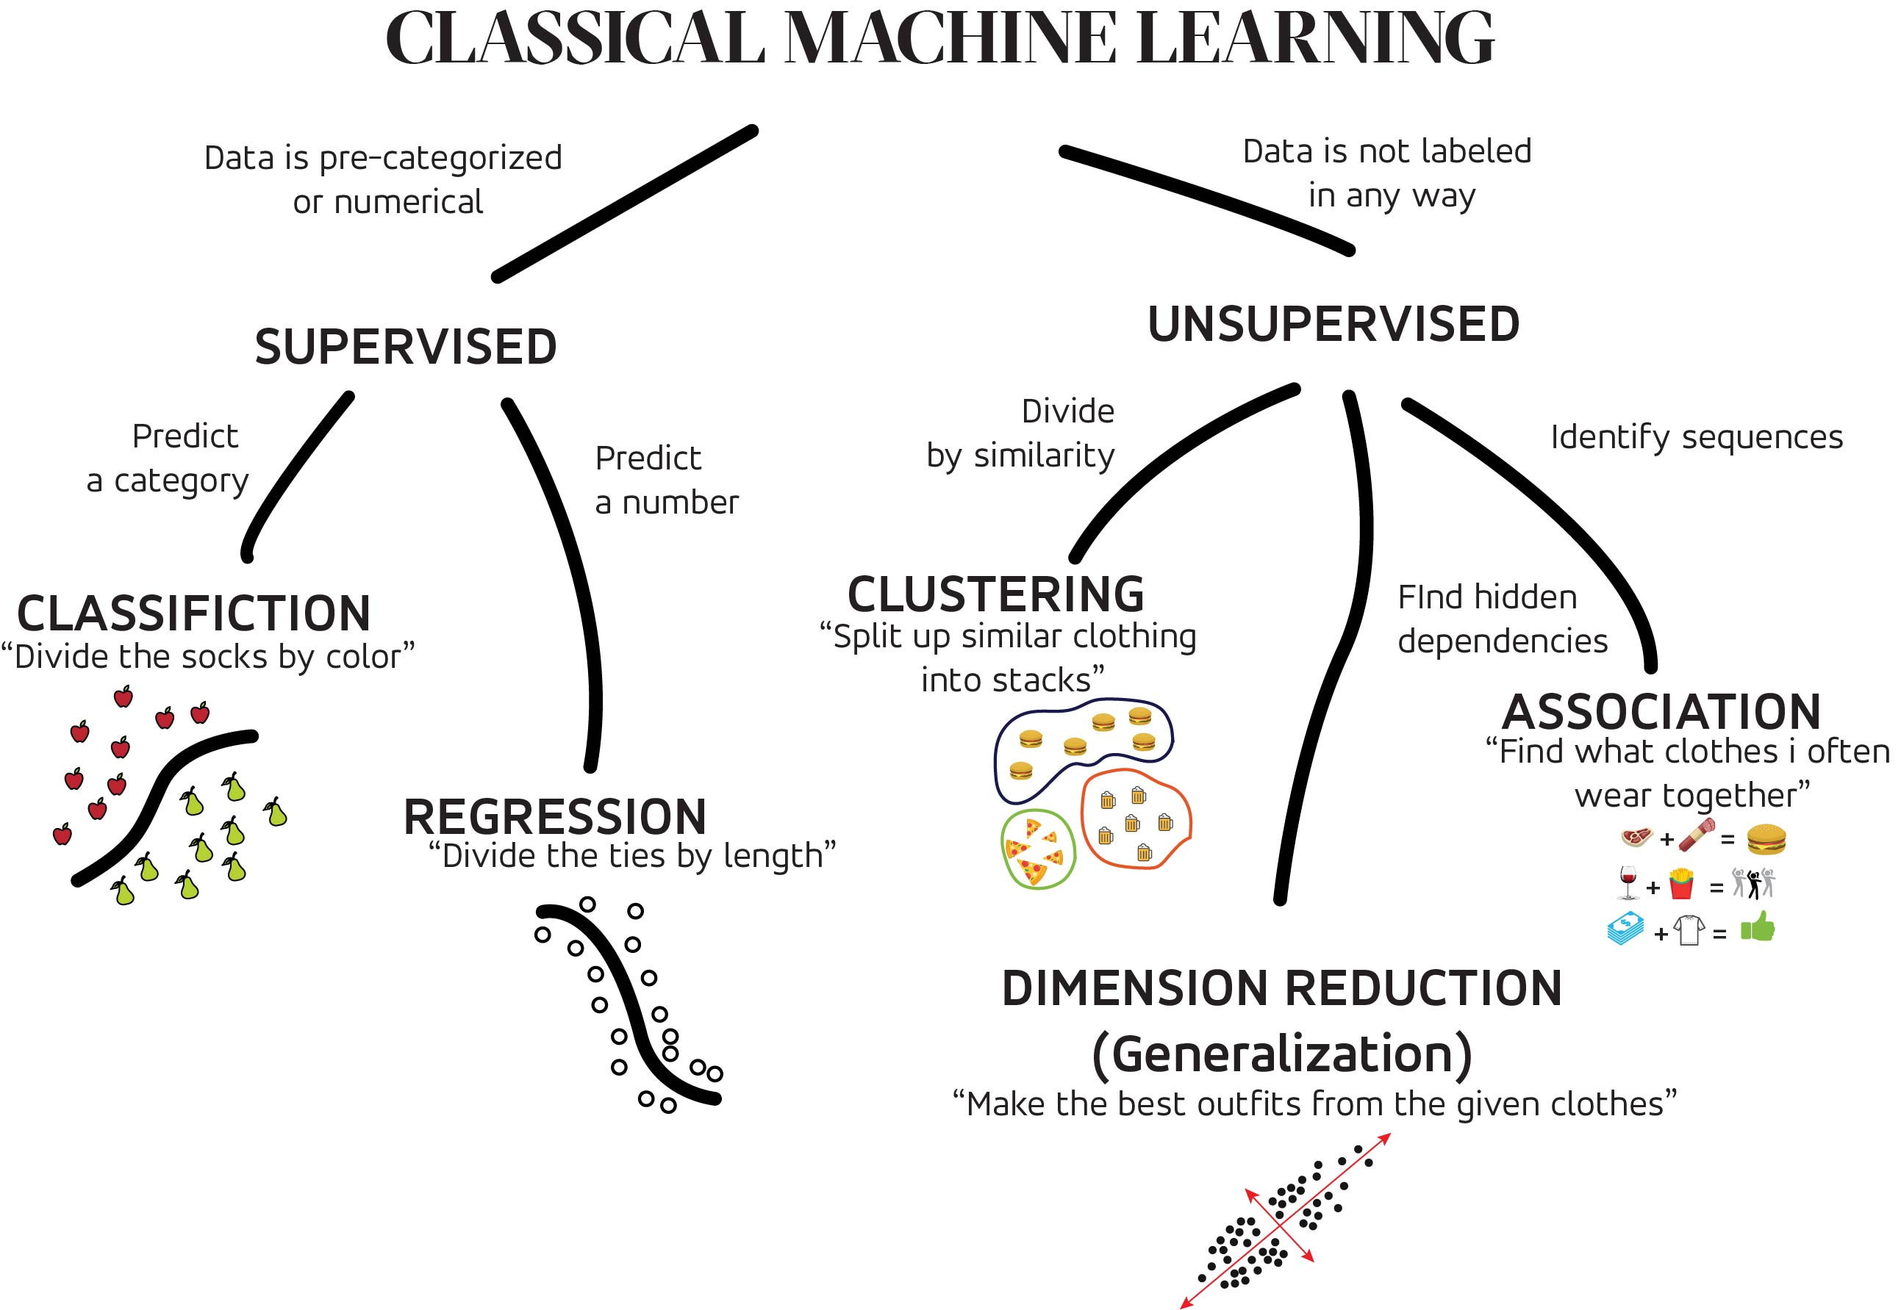
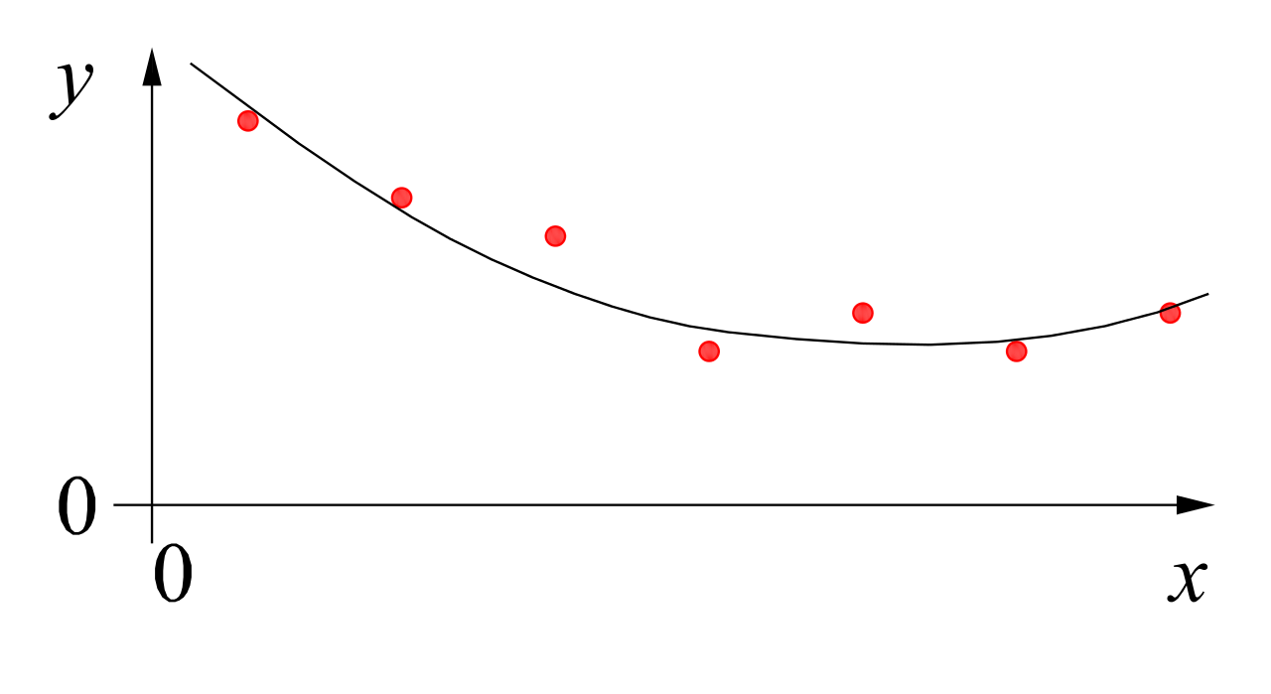
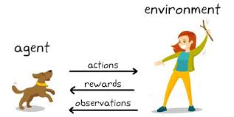
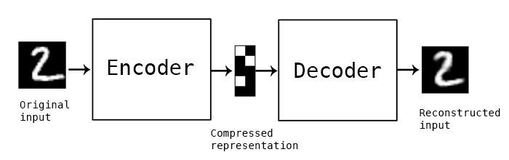
MACHINE LEARNING
no supervision, but goal-based interaction with environment
training target available (labeled or past data)
data not labeled in any way
SUPERVISED
REINFORCEMENT LEARNING
UNSUPERVISED
CLASSIFICATION
ASSOCIATION
CLUSTERING
LEARN STATE OR ACTION VALUES
LEARN POLICY DIRECTLY
REGRESSION
DIMENSIONALITY REDUCTION
SELF-SUPERVISED
learning by teacher
(high-dimensional curve fitting)
learning by observation
(pattern recognition)
learning by trial-and-error
(sequential decision making)

Slide 8

Used Programming Language: Python
good compromise between rapid prototyping and production
vast ecosystem
very popular for data processing and ML: scientific Python stack

Slide 9


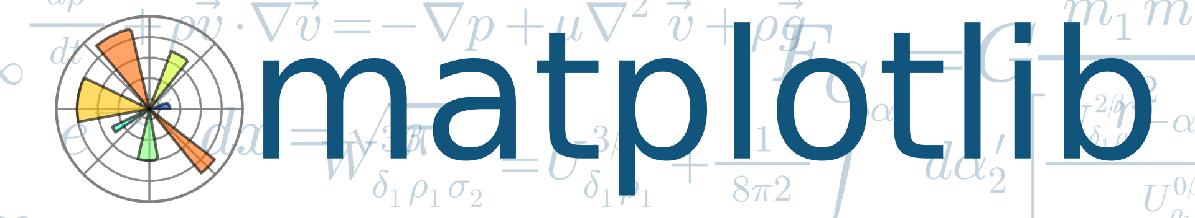






Scientific Python Stack

Slide 10
Programming Environments
locally, best use
a virtual environment to flexibly install packages (e.g., venv)
an IDE of your choice (e.g., VS Code)
both plain Python files or Jupyter notebooks are fine
but cloud-based environments also fine (e.g., Google Colab)

Slide 11
Literature
An Introduction to Statistical Learning
The Elements of Statistical Learning
Pattern Recognition and Machine Learning
Machine Learning
Deep Learning
Understanding Deep Learning

Slide 12
Exam form – Assignment (A)
Two assignments during lecture time
Working in groups of two (exceptional three) students
An assignment consists of …
a specific task given after deadline of registration
processing and completing the task
presentation (20-30 min) + oral discussion (10-20 min)

Slide 13
Schedule
week | date | topic
4 | 17.04.2026 | deadline of exam registration via QIS
5 | 20.-24.04.2026 | announcement of assignments, groups & presentation dates
8 | 11.-15.05.2026 | no lectures for final preparation of assignment 1
9 | 18.-22.05.2026 | assignment 1 (5 blocks including Friday (22.05.) block 4 and 5)
13 | 15.-19.06.2026 | no lectures for final preparation of assignment 2
14 | 22.-26.06.2026 | assignment 2 (5 blocks including Friday (26.06.) block 4 and 5)

