Slide 1
Clustering
Data Science

Slide 2
Clustering
k-means
hierarchical clustering
DBSCAN

Slide 3
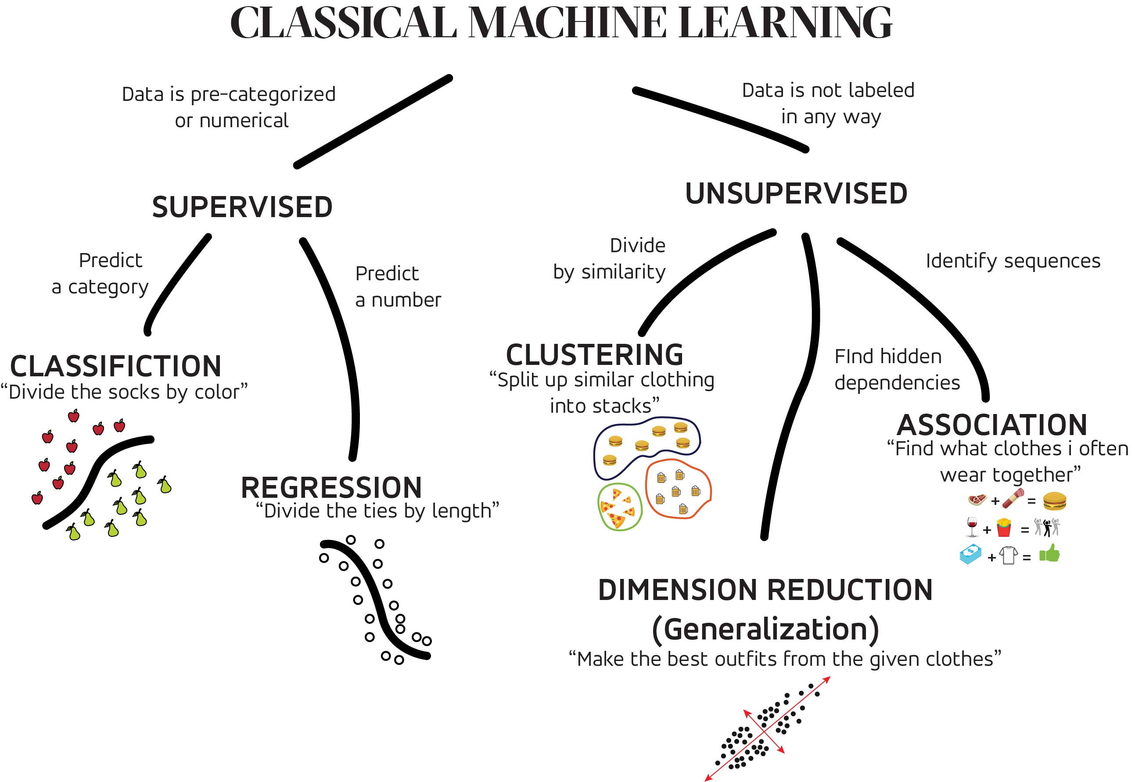
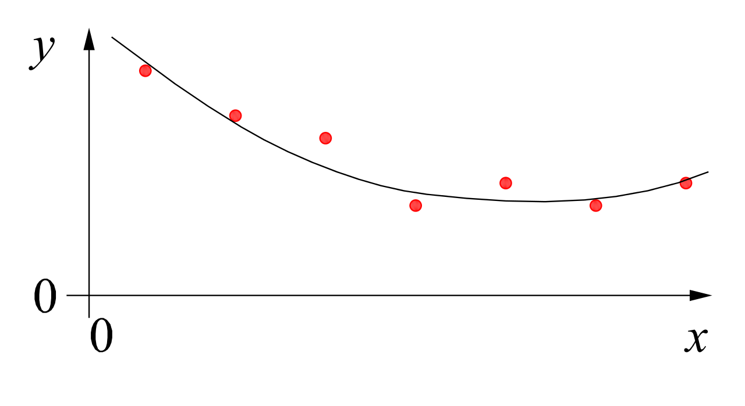
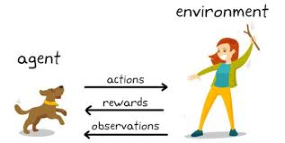
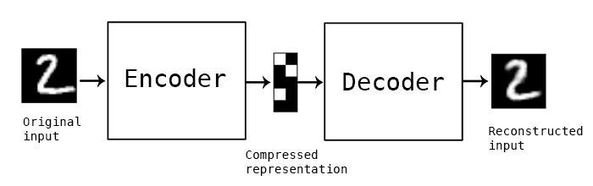
MACHINE LEARNING
no supervision, but goal-based interaction with environment
training target available (labeled or past data)
data not labeled in any way
SUPERVISED
REINFORCEMENT LEARNING
UNSUPERVISED
CLASSIFICATION
ASSOCIATION
CLUSTERING
LEARN STATE OR ACTION VALUES
LEARN POLICY DIRECTLY
REGRESSION
DIMENSIONALITY REDUCTION
SELF-SUPERVISED
learning by teacher
(high-dimensional curve fitting)
learning by observation
(pattern recognition)
learning by trial-and-error
(sequential decision making)

Slide 4
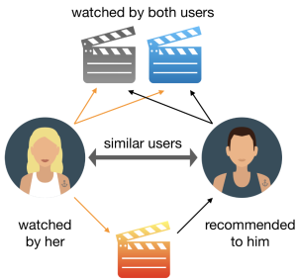
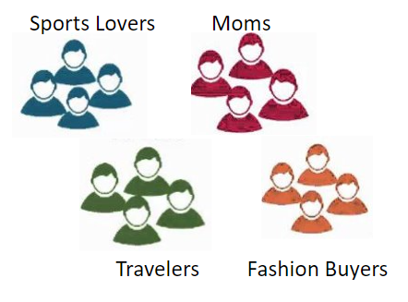
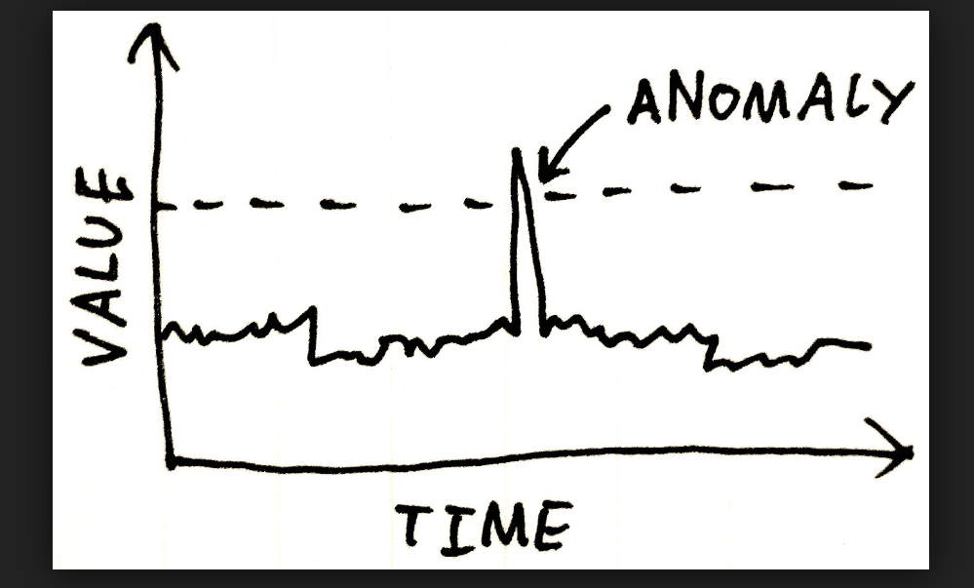
Use Cases for Unsupervised Learning
Anomaly Detection
Representation Learning
Structure Discovery
Fraud Detection
Customer or Market Segmentation
Time Series Reconstruction
Recommender Systems
Risk Analysis
Drug Discovery
Image Compression
Social Network Analysis
Topic Modeling
Techniques: clustering, dimensionality reduction, association rules, …

Slide 5
What Is Clustering?
automatic grouping of similar objects into sets
(without predefined labels)
similar means similar in terms of the object's features
customer segmentation
document clustering
image segmentation (regions with similar color, texture, or intensity)
…

Slide 6
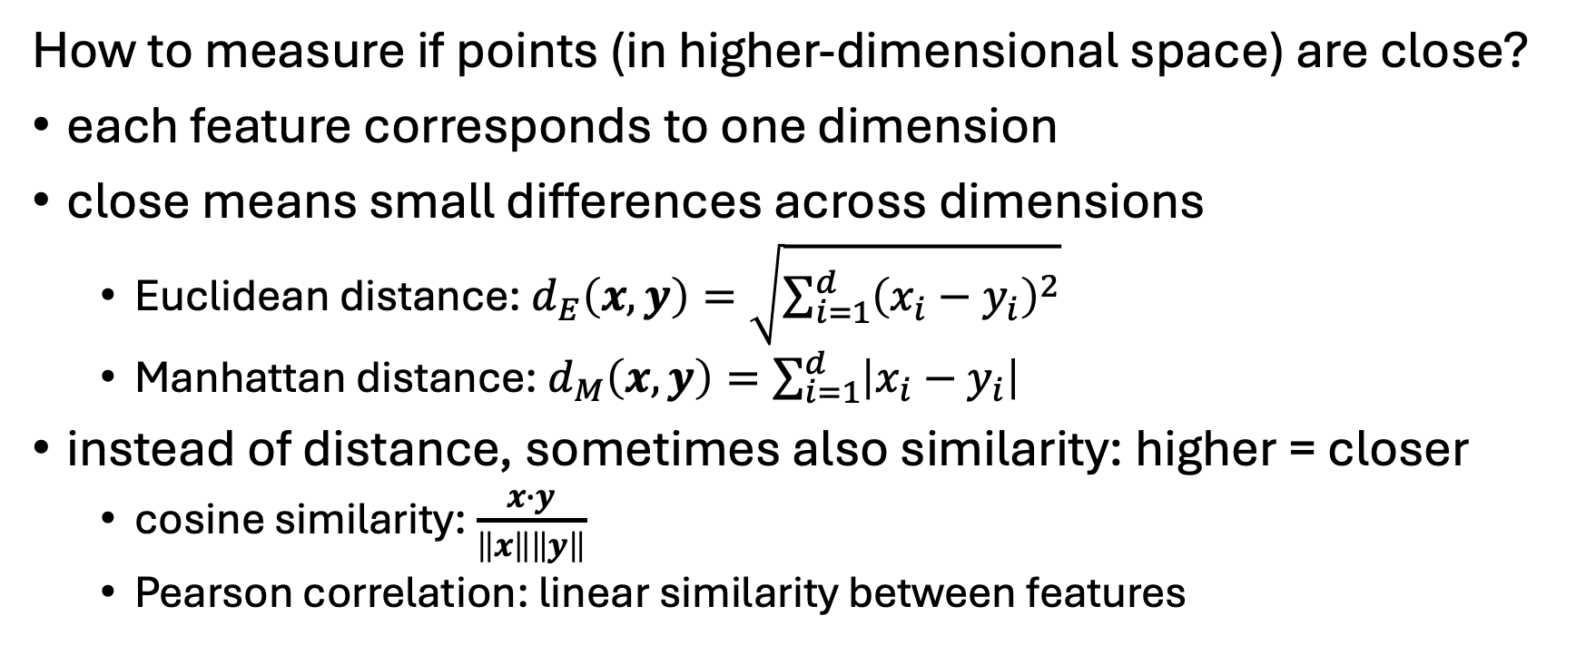
Distance Metrics and Similarity
How to measure if points (in higher-dimensional space) are close?
each feature corresponds to one dimension
close means small differences across dimensions
Euclidean distance: $d_{E}\left(x,y\right)=\sqrt{\sum_{i=1}^{d}{{\left(x_{i}−y_{i}\right)}^{2}}}$
Manhattan distance: $d_{M}\left(x,y\right)=\sum_{i=1}^{d}{\left|x_{i}−y_{i}\right|}$
instead of distance, sometimes also similarity: higher = closer
cosine similarity: $\frac{x∙y}{\left\|x\right\|\left\|y\right\|}$
Pearson correlation: linear similarity between features

Slide 7
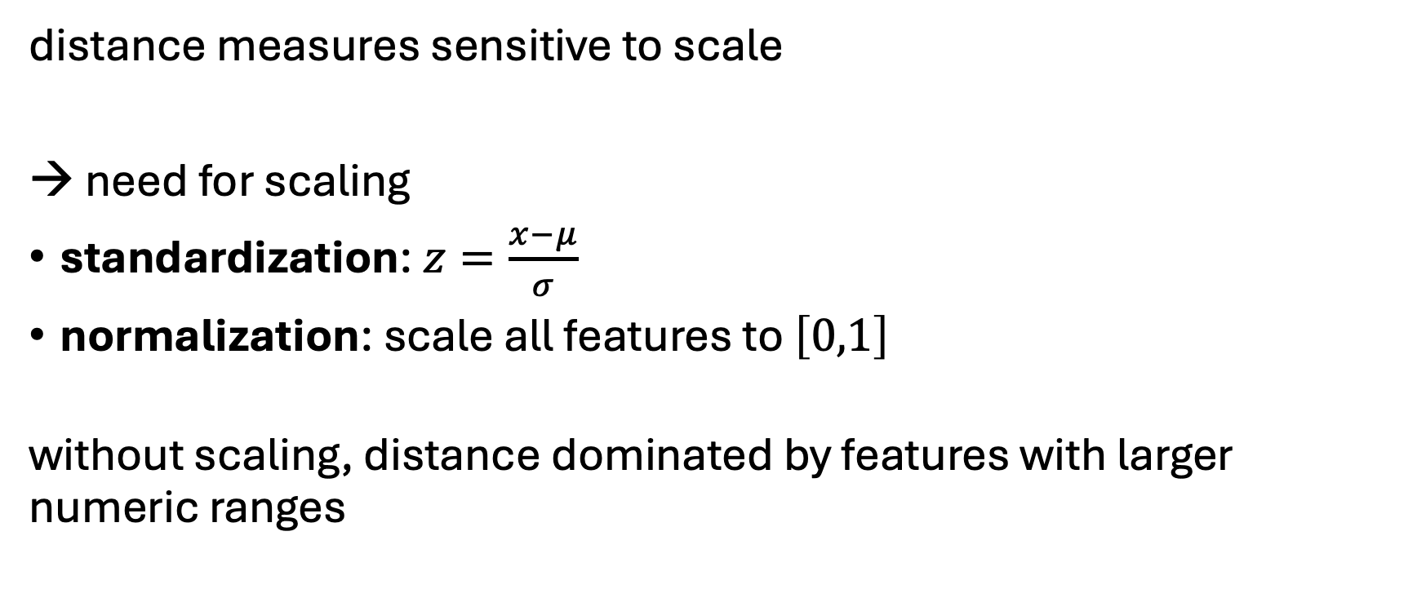
Preprocessing for Clustering
distance measures sensitive to scale
→ need for scaling
standardization: $z=\frac{x−μ}{σ}$
normalization: scale all features to $\left[0,1\right]$
without scaling, distance dominated by features with larger numeric ranges

Slide 8
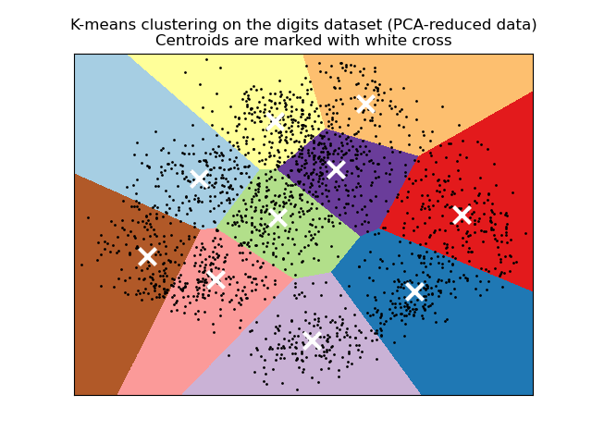
k-Means: Intuition
divide a dataset into k clusters
k is a hyperparameter (to be set before the algorithm runs)
each cluster is represented by its centroid (mean point)
each data point is assigned to the nearest centroid
decision boundaries (straight lines because k-Means was trained directly in the same 2-D space that is visualized)

Slide 9
k-Means Algorithm
Fit:
choose k (number of clusters)
initialize centroids: (randomly) place k centroids in data space
assign each point to the nearest centroid (according to computed Euclidean distances)
recalculate centroids of each cluster (average of all points assigned to the cluster)
iterate until convergence (centroids stop moving significantly or cluster assignments stop changing)
Predict:
For a new point: Assign it to the cluster with the nearest centroid

Slide 10
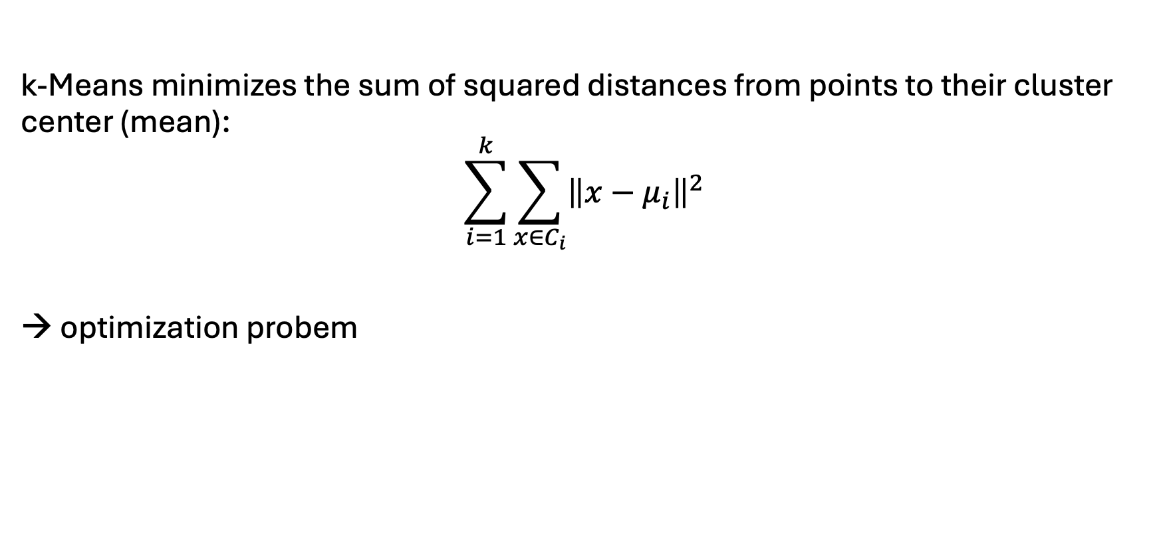
Objective Function
k-Means minimizes the sum of squared distances from points to their cluster center (mean):
$$\sum_{i=1}^{k}{\sum_{x∈C_{i}}{{\left\|x−μ_{i}\right\|}^{2}}}$$
→ optimization probem
Euclidean distances
→ spherical clusters
Manhattan distances (L1) → k-Medians (also recalculate the cluster centers using the median instead of the mean)

Slide 11
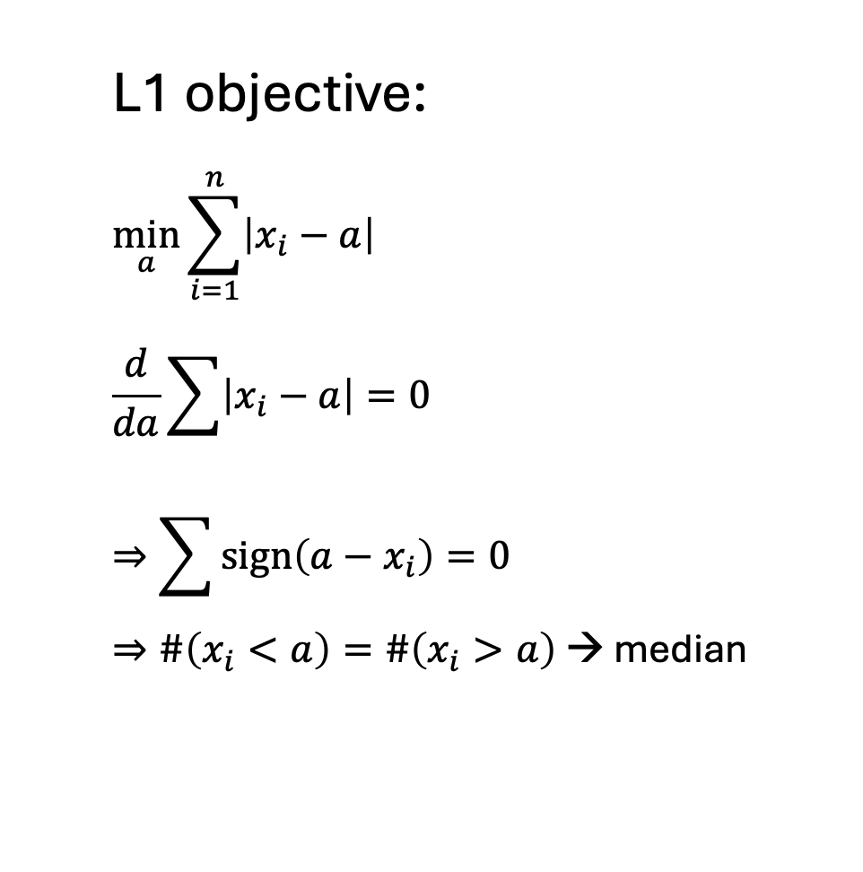
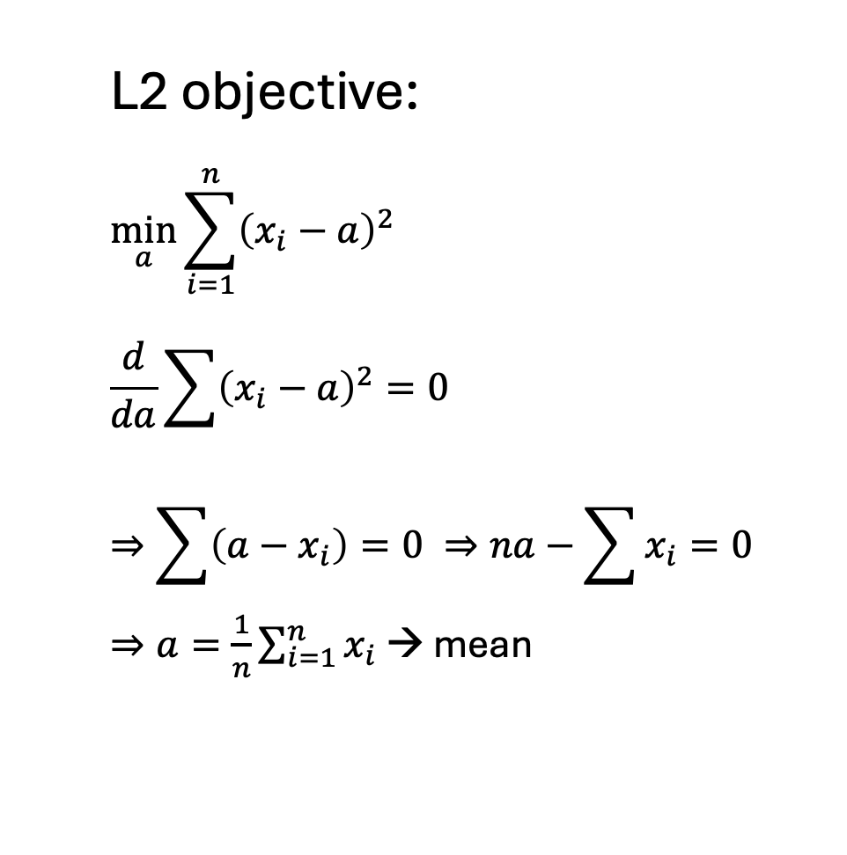
L2 → Mean, L1 → Median
L2 objective:
$$\min_{a}{\sum_{i=1}^{n}{{\left(x_{i}−a\right)}^{2}}}$$
$$\frac{d}{da}\sum{{\left(x_{i}−a\right)}^{2}}=0$$
$$⇒\sum{\left(a−x_{i}\right)}=0 ⇒na−\sum{x_{i}}=0$$
$⇒a=\frac{1}{n}\sum_{i=1}^{n}{x_{i}}$ → mean
L1 objective:
$$\min_{a}{\sum_{i=1}^{n}{\left|x_{i}−a\right|}}$$
$$\frac{d}{da}\sum{\left|x_{i}−a\right|}=0$$
$$⇒\sum{sign\left(a−x_{i}\right)}=0$$
$⇒\#\left(x_{i}<a\right)=\#\left(x_{i}>a\right)$ → median

Slide 12
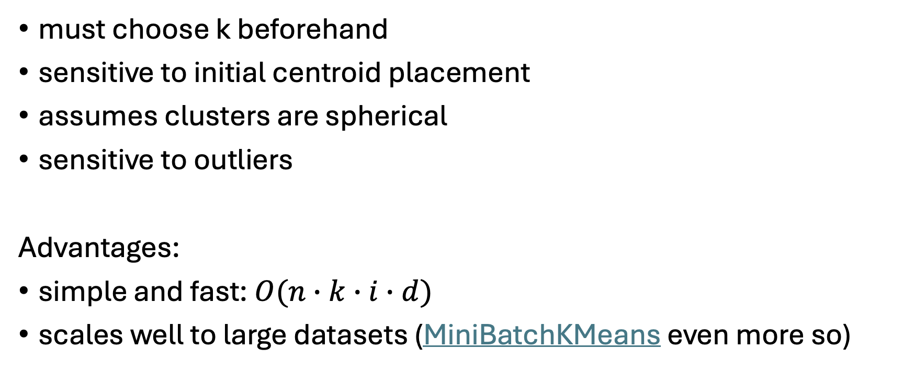
k-Means Assumptions and Limitations
must choose k beforehand
sensitive to initial centroid placement
assumes clusters are spherical
sensitive to outliers
Advantages:
simple and fast: $O(n∙k∙i∙d)$
scales well to large datasets (MiniBatchKMeans even more so)
data points
iterations

Slide 13
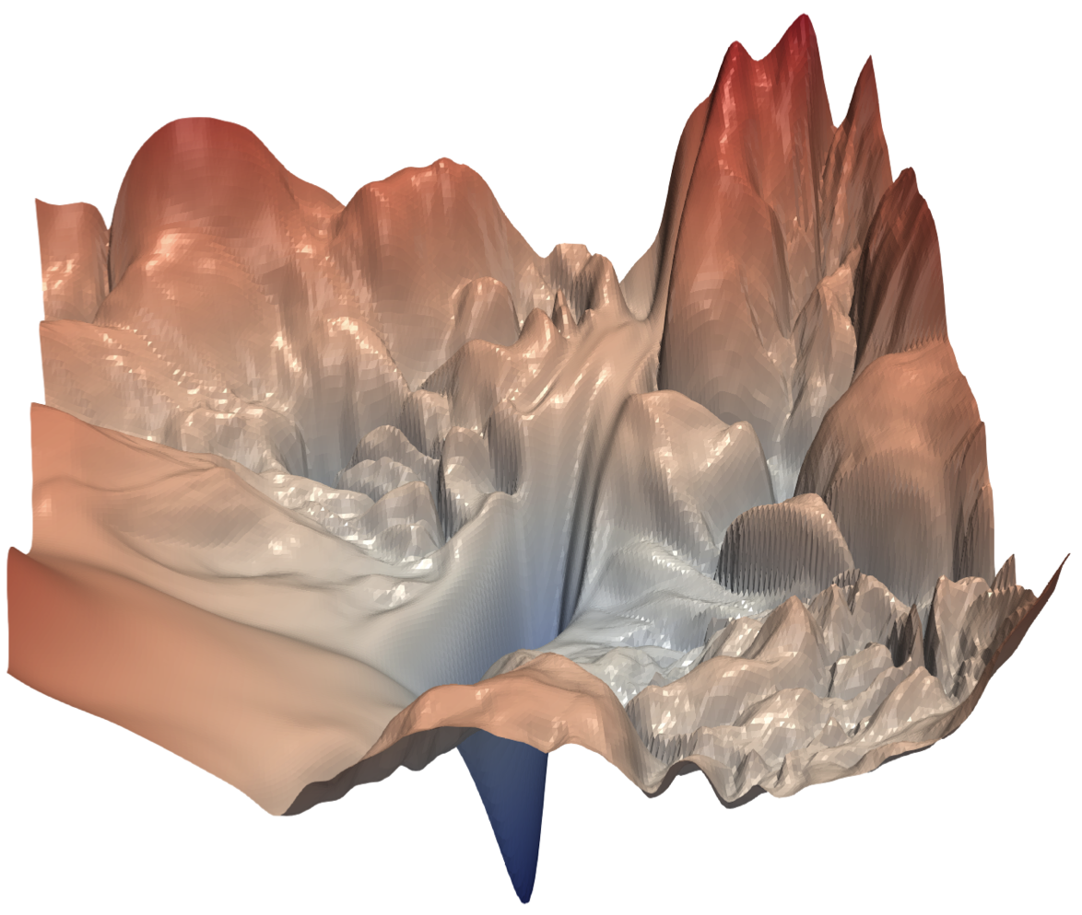
Cluster Initialization
k-Means depends on its starting centroids (numerical optimization over a non-convex objective: different initial centroids can lead the algorithm to different local minima)
→ Running k-means multiple times with different initializations can produce different clustering results
Good initialization leads to better clusters, faster convergence, and more stable results
Poor initialization can lead to suboptimal or inconsistent clustering
Practical strategies:
Random restarts: run k-Means many times and keep the best solution
k-means++: algorithm to spread out initial centroids (also stochastic)
PCA-based initialization (deterministic: only one run)

Slide 14
Choosing the Number of Clusters
Crucial: determines whether model captures meaningful structure or produces misleading, arbitrary groupings
Too small k → underfitting
Too large k → overfitting / meaningless splits
Common workflow:
Elbow plot for quick insight
Compute cluster validation metrics: compute metrics for each k and choose the k with the best metric
Visualize clusters

Slide 15
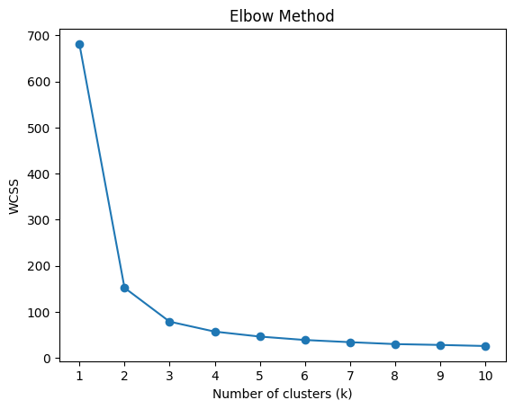
Elbow Plot
Run k-means for different values of k and compute the within-cluster sum of squares (WCSS)
Plot WCSS vs. k
Look for a “bend” (elbow) where improvement slows down
Idea: Adding clusters always reduces error, but after a point the gain becomes small.
But elbow is often ambiguous or not visible
3 true clusters in this case

Slide 16
Cluster Validation Metrics
Since clustering is unsupervised: no single “correct” answer
Instead measure how well-separated and cohesive clusters are
Evaluation metrics include:
Silhouette score
Davies-Bouldin index (fast alternative)

Slide 17
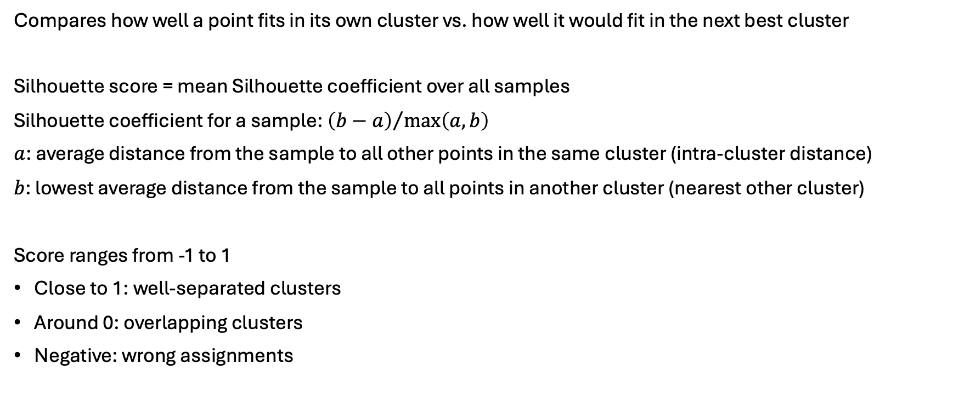
Silhouette Score
Compares how well a point fits in its own cluster vs. how well it would fit in the next best cluster
Silhouette score = mean Silhouette coefficient over all samples
Silhouette coefficient for a sample: ${\left(b−a\right)}/{\max\left(a,b\right)}$
$a$: average distance from the sample to all other points in the same cluster (intra-cluster distance)
$b$: lowest average distance from the sample to all points in another cluster (nearest other cluster)
Score ranges from -1 to 1
Close to 1: well-separated clusters
Around 0: overlapping clusters
Negative: wrong assignments

Slide 18
Supervised Clustering Validation
External validation: used when you already have ground-truth labels and want to evaluate how well a clustering matches the “true” grouping
→ Evaluates correctness, not just structure
Adjusted Rand index: counting pairs that are assigned in the same or different clusters in the predicted and true clusterings, adjusted for chance (random clustering): ARI = (RI - Expected_RI) / (max(RI) - Expected_RI)
Adjusted mutual information
Homogeneity, completeness, and V-measure scores
homogeneity: each cluster contains only one class
completeness: all members of a class are in the same cluster
V-measure: harmonic mean between homogeneity and completeness

Slide 19
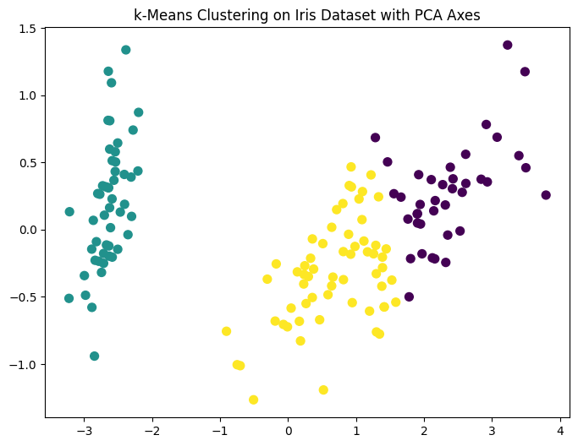
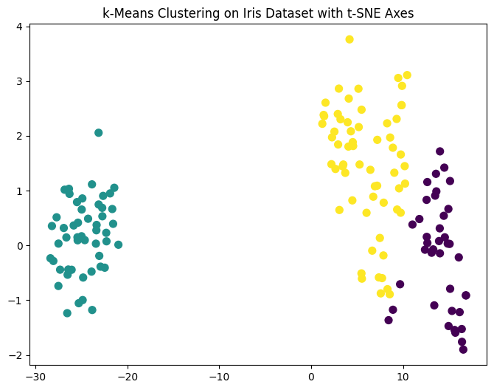
Visualizing Clusters
Even with metrics, always sanity-check:
Visualize clusters (using PCA or t-SNE for high dimensions)
Ask: Do clusters make sense in your domain?

Slide 20
Practice Project
Customer Segmentation with k-Means on Mall Customers dataset

Slide 21
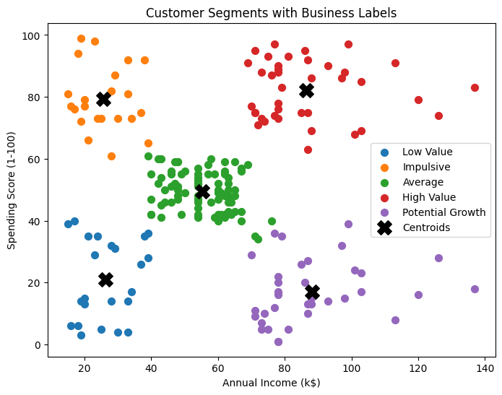
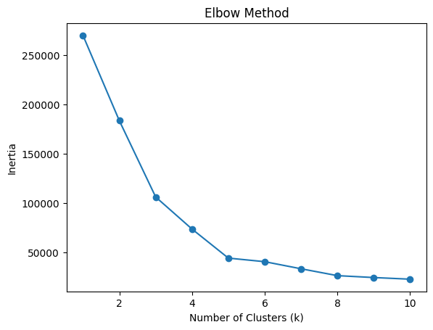

Slide 22
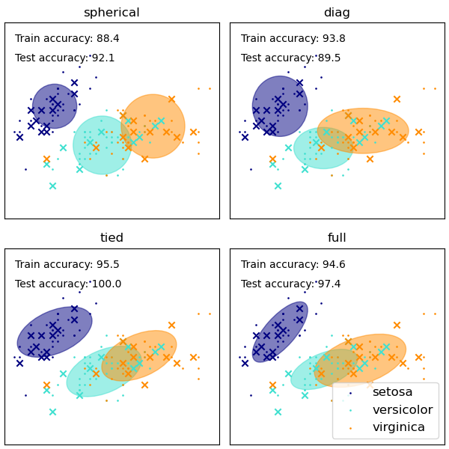
Gaussian Mixture Models
k-Means assigns points based on Euclidean distance to the centroid
→ clusters are effectively spherical (with straight-line boundaries in 2D)
In Gaussian Mixture Models (GMM), each cluster is modeled as a multivariate Gaussian distribution (covariance matrix) → clusters can be elliptical
k-Means: Group points around the nearest center
GMM: Assume the data was generated by several Gaussian distributions and estimate them
k-Means can be interpreted as special case of Gaussian mixture model with same variance in all directions and no covariance between features

Slide 23
GMM Covariance Matrices
scikit learn example
full: each component has its own general covariance matrix
tied: all components share the same general covariance matrix
diag: each component has its own diagonal covariance matrix
spherical: each component has its own single variance

Slide 24
Hierarchical Clustering: Motivation
Builds a tree (dendrogram) of clusters
Useful for understanding nested structures
Advantages:
No need to pre-specify number of clusters
Captures hierarchical relationships
Easy to visualize and interpret
But computationally expensive and sensitive to noise and outliers

Slide 25
Hierarchical Clustering: Key Idea
Iteratively merge or split clusters, based on a distance (similarity) measure
Two main approaches:
Agglomerative (bottom-up)
Start with each data point as its own cluster
Repeat:
Find the closest pair of clusters
Merge them
Continue until:
One cluster remains
Or desired number of clusters is reached
Divisive (top-down)
Start with all data in one cluster
Recursively split clusters
Less commonly used (more computationally expensive)

Slide 26
Distance Measures and Linkage
As before, need a way to measure similarity/distance between points:
Euclidean distance
Manhattan distance
Cosine similarity
→ Choice affects clustering results significantly
Cluster-to-cluster distance (linkage):
In hierarchical clustering, clusters are not summarized by a single representative point (e.g., a centroid)
→ Need to define distance between clusters (sets of points): linkage criteria

Slide 27
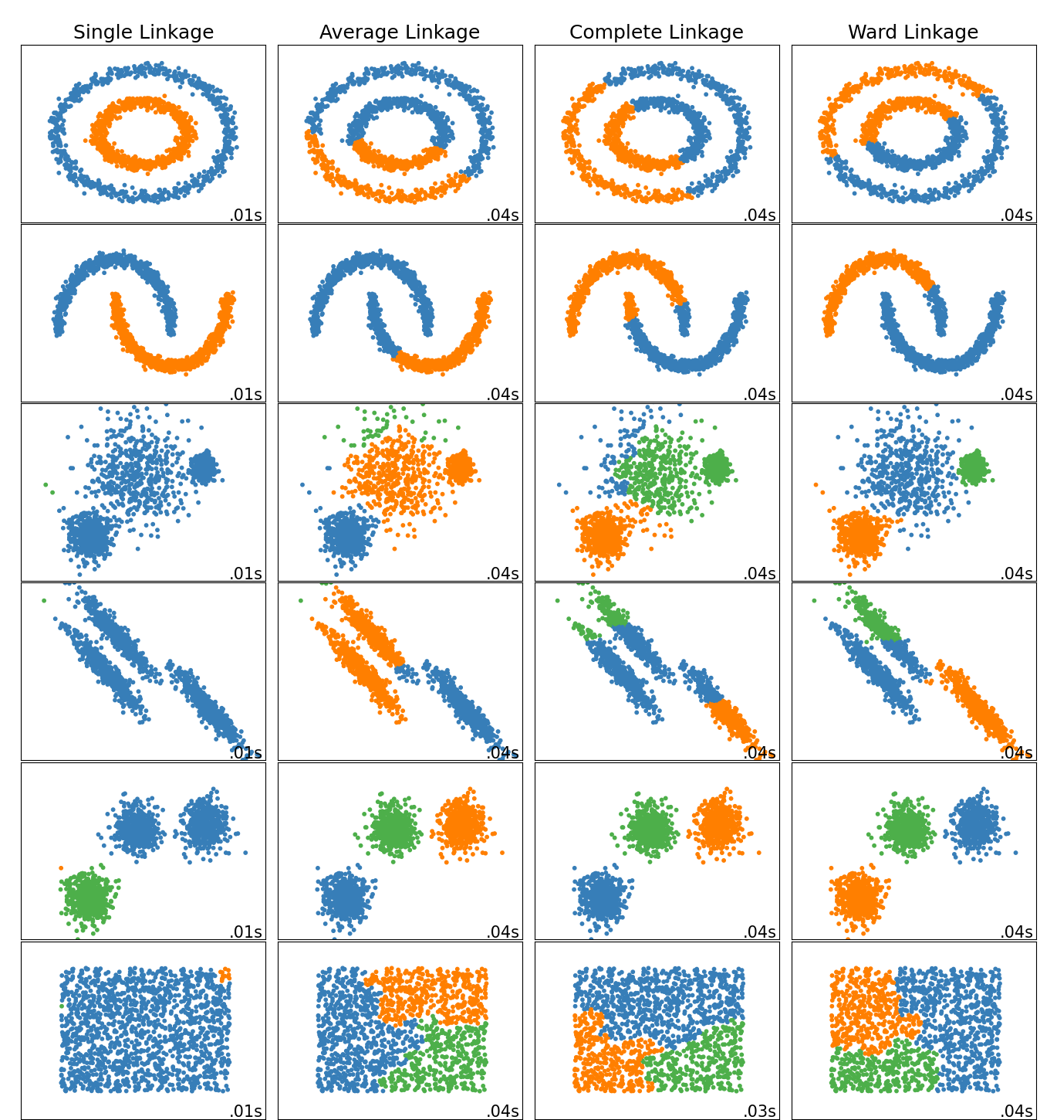
Linkage Criteria
scikit learn example
Different possibilities (choice strongly affects results):
Single Linkage: Distance between closest points → can form “chains” (elongated clusters)
Complete Linkage: Distance between farthest points → produces compact (spherical) clusters
Average Linkage: Average pairwise distance → balanced approach
Ward’s Method: Minimizes variance within clusters → often produces well-separated clusters

Slide 28
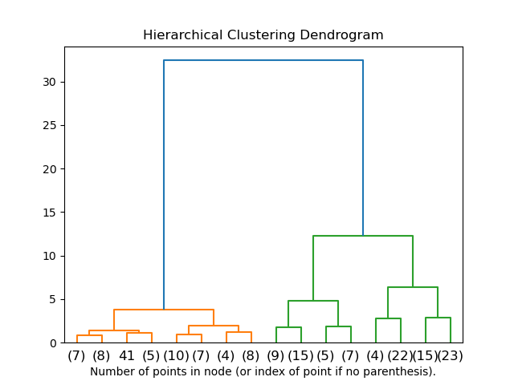
Dendrograms
Tree representation of clustering:
Leaves = individual data points
Internal nodes = cluster merges
Height = distance at which clusters merge
Interpretation:
Cut tree at a chosen height → clusters (enables flexible cluster selection)
Large vertical gaps → natural cluster separation
Lower merges → more similar clusters
Assign new points by distance to cluster representatives (e.g., centroids): practical heuristic, not inherent to hierarchical clustering

Slide 29
DBSCAN: Density-Based Clustering
DBSCAN: Density-Based Spatial Clustering of Applications with Noise
Groups points based on dense regions
Can detect arbitrary-shaped clusters
Explicitly identifies noise (outliers)
No need to specify number of clusters beforehand
Key idea: clusters are formed by dense regions of points, using two parameters:
ε: neighborhood radius
min_samples: minimum points to form a dense region

Slide 30
Core Points, Border Points, Noise
Define different types of points
Core Point: have ≥ min_samples points within ε → dense center
Border Point: within ε of a core point, but not a core point itself (not dense enough) → edge of cluster
Noise Point: not reachable from any core point → isolated point

Slide 31
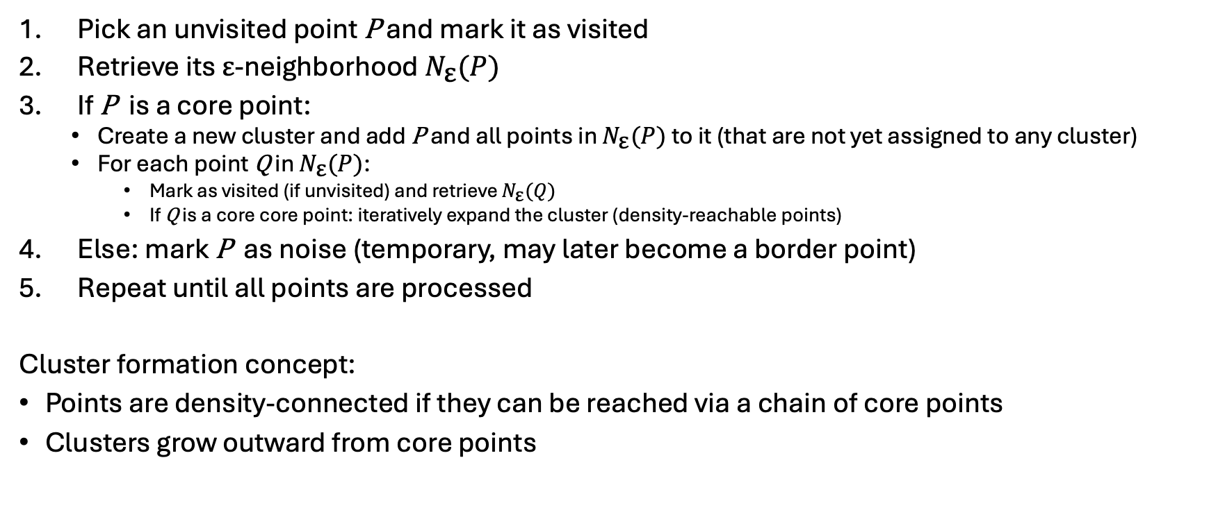
DBSCAN Algorithm
Pick an unvisited point P and mark it as visited
Retrieve its ε-neighborhood $N_{\text{ε}}(P)$
If P is a core point:
Create a new cluster and add P and all points in $N_{\text{ε}}(P)$ to it (that are not yet assigned to any cluster)
For each point Q in $N_{\text{ε}}(P)$:
Mark as visited (if unvisited) and retrieve $N_{\text{ε}}(Q)$
If Q is a core core point: iteratively expand the cluster (density-reachable points)
Else: mark P as noise (temporary, may later become a border point)
Repeat until all points are processed
Cluster formation concept:
Points are density-connected if they can be reached via a chain of core points
Clusters grow outward from core points

Slide 32
Choosing ε and min_samples
Choosing ε (neighborhood radius)
Too small → many points labeled as noise
Too large → clusters merge
Heuristic: use k-distance graph, look for “elbow” point
Typical values min_samples (minimum points for density)
4 (low-dimensional data)
Higher for high-dimensional data
Guideline: min_samples ≥ dimensionality + 1
ε and min_samples strongly affect results → tuning and data scaling matters

Slide 33
How to Assign New Points
For a new point: Check its ε-neighborhood
If within ε of a core point: Assign it to that cluster
If not near any core point: Label as noise
If within ε of core points from different clusters:
Option 1: Assign to first found (like DBSCAN would)
Option 2: Assign to closest core point
Adding one point can change cluster structure
→ True DBSCAN would require re-running the algorithm

Slide 34
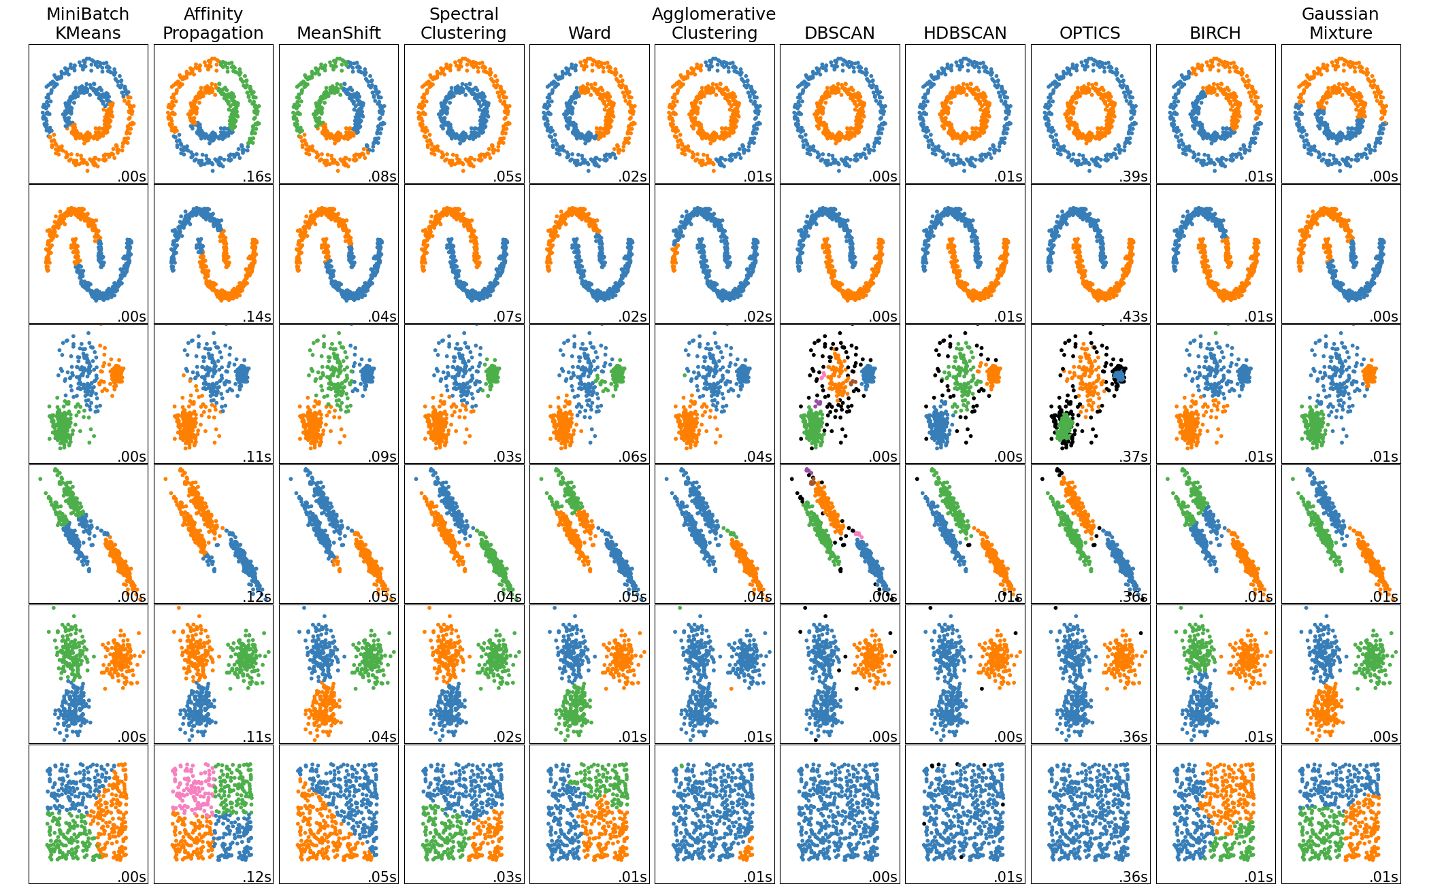
Comparing Clustering Methods
Different algorithms suit different data → no single best method
Practical guidance:
k-Means if clusters are compact and known
Hierarchical if structure and interpretability is needed
DBSCAN if data has noise or complex shapes
What affects results?
k-Means: initial centroids
Hierarchical: linkage method
DBSCAN: ε and min_samples

