Slide 1
Statistical Inference
Data Science

Slide 2
Parameter Estimation
parameter estimation, least squares
maximum likelihood method, MAP

Slide 3
Statistical Inference
Parameter estimation
Testing

Slide 4
Least Squares Estimation

Slide 5
Loss Functions and Optimization

Slide 6
Maximum Likelihood Estimation (MLE)

Slide 7
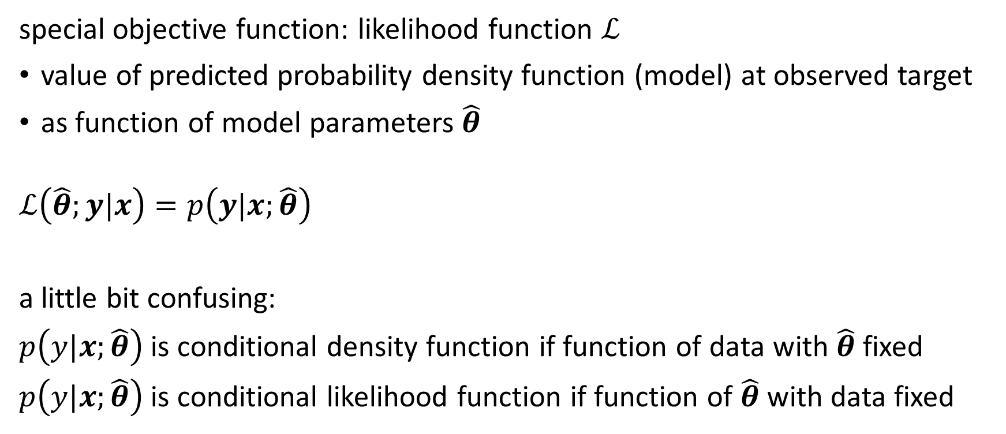
Likelihood
special objective function: likelihood function $ℒ$
value of predicted probability density function (model) at observed target
as function of model parameters $\hat{θ}$
$$ℒ\left(\hat{θ};y|x\right)=p\left(y|x;\hat{θ}\right)$$
a little bit confusing:
$p\left(y|x;\hat{θ}\right)$ is conditional density function if function of data with $\hat{θ}$ fixed
$p\left(y|x;\hat{θ}\right)$ is conditional likelihood function if function of $\hat{θ}$ with data fixed

Slide 8
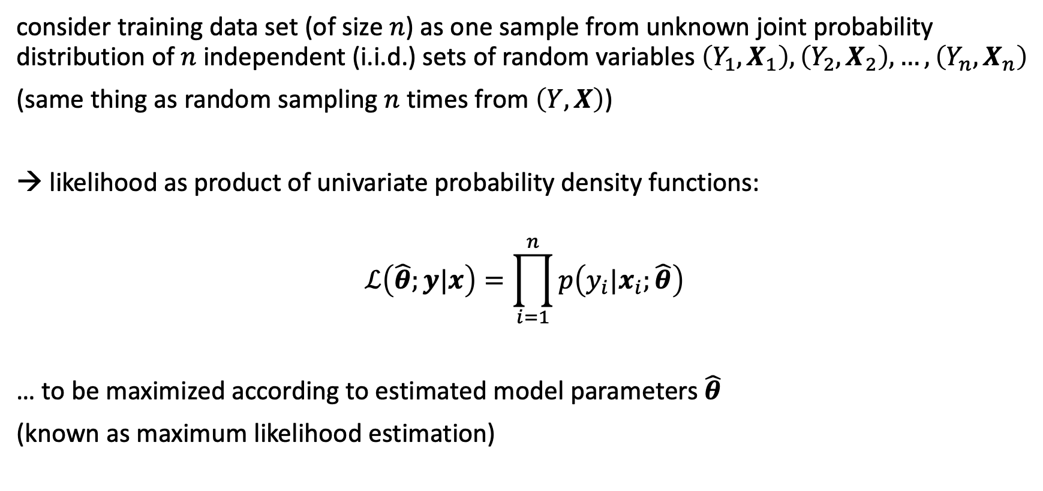
Independence Assumption
consider training data set (of size $n$) as one sample from unknown joint probability distribution of $n$independent (i.i.d.) sets of random variables $\left(Y_{1},X_{1}\right),\left(Y_{2},X_{2}\right),…, \left(Y_{n},X_{n}\right)$
(same thing as random sampling $n$ times from $\left(Y,X\right)$)
→ likelihood as product of univariate probability density functions:
$$ℒ\left(\hat{θ};y|x\right)=\prod_{i=1}^{n}{p\left(y_{i}|x_{i};\hat{θ}\right)}$$
… to be maximized according to estimated model parameters $\hat{θ}$
(known as maximum likelihood estimation)

Slide 9
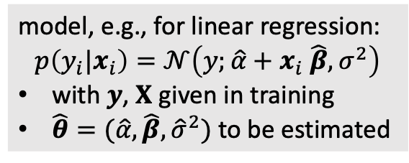
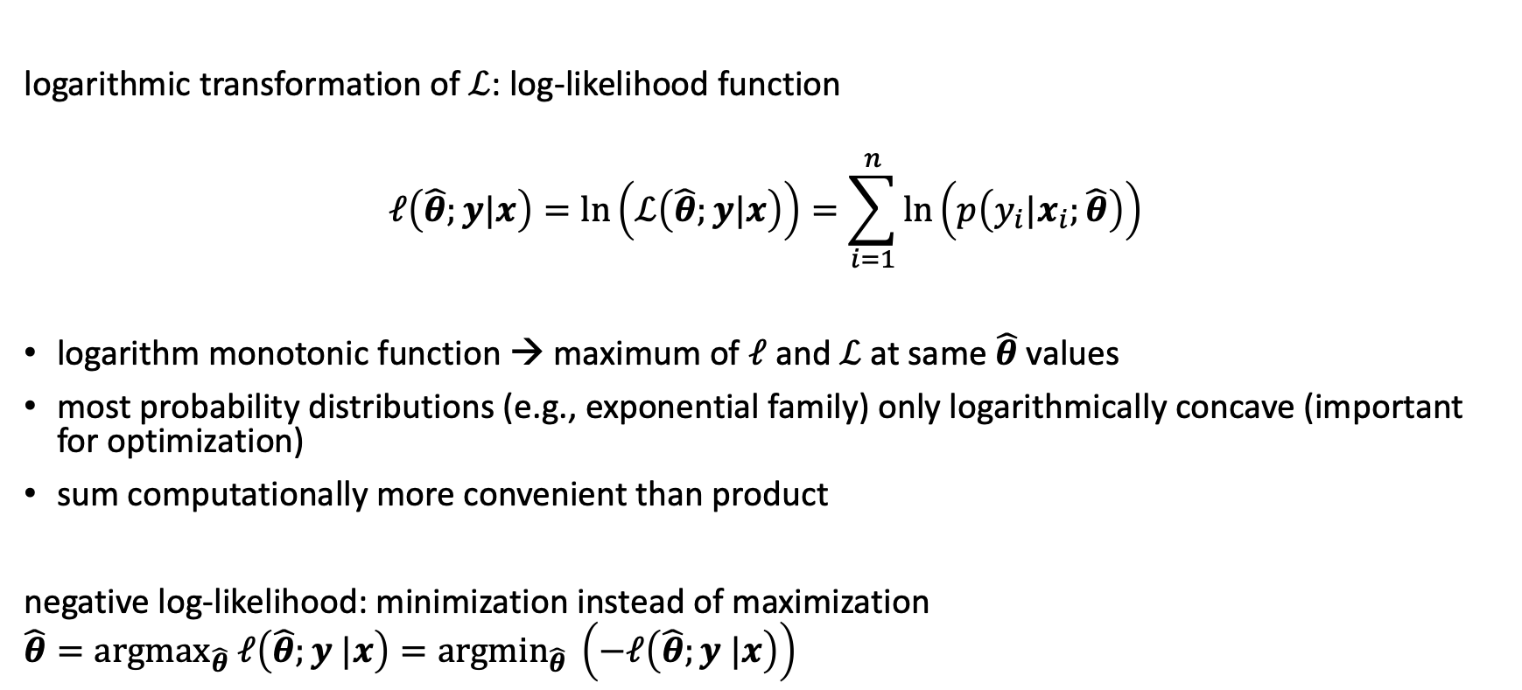
Negative Log-Likelihood
model, e.g., for linear regression:
$$p\left(y_{i}|x_{i}\right)=𝒩\left(y;\hat{α}+x_{i} \hat{β},σ^{2}\right)$$
with $y$, $X$ given in training
$\hat{θ}=(\hat{α},\hat{β},{\hat{σ}}^{2})$ to be estimated
logarithmic transformation of $ℒ$: log-likelihood function
$$ℓ\left(\hat{θ};y|x\right)=ln\left(ℒ\left(\hat{θ};y|x\right)\right)=\sum_{i=1}^{n}{\ln\left(p\left(y_{i}|x_{i};\hat{θ}\right)\right)}$$
logarithm monotonic function → maximum of $ℓ$ and $ℒ$ at same $\hat{θ}$ values
most probability distributions (e.g., exponential family) only logarithmically concave (important for optimization)
sum computationally more convenient than product
negative log-likelihood: minimization instead of maximization
$${\hat{θ}=argmax}_{\hat{θ}} ℓ\left(\hat{θ};y |x\right)={argmin}_{\hat{θ}} \left(−ℓ\left(\hat{θ};y |x\right)\right)$$
objective function

Slide 10
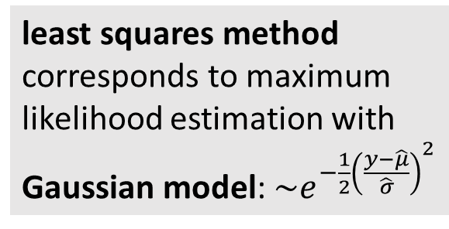
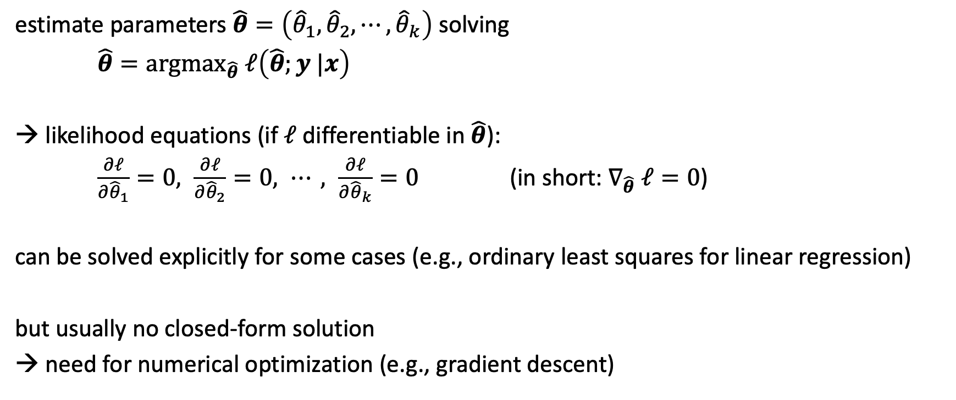
Maximum Likelihood
least squares method corresponds to maximum likelihood estimation with Gaussian model: $\sim e^{−\frac{1}{2}{\left(\frac{y−\hat{μ}}{\hat{σ}}\right)}^{2}}$
estimate parameters $\hat{θ}=\left({\hat{θ}}_{1},{\hat{θ}}_{2},⋯,{\hat{θ}}_{k}\right)$ solving
${\hat{θ}=argmax}_{\hat{θ}} ℓ\left(\hat{θ};y |x\right)$
likelihood equations (if $ℓ$ differentiable in $\hat{θ}$):
$\frac{∂ℓ}{∂{\hat{θ}}_{1}}=0, \frac{∂ℓ}{∂{\hat{θ}}_{2}}=0, ⋯, \frac{∂ℓ}{∂{\hat{θ}}_{k}}=0$ (in short: $∇_{\hat{θ}} ℓ=0$)
can be solved explicitly for some cases (e.g., ordinary least squares for linear regression)
but usually no closed-form solution
→ need for numerical optimization (e.g., gradient descent)
mode of likelihood as point estimate

Slide 11

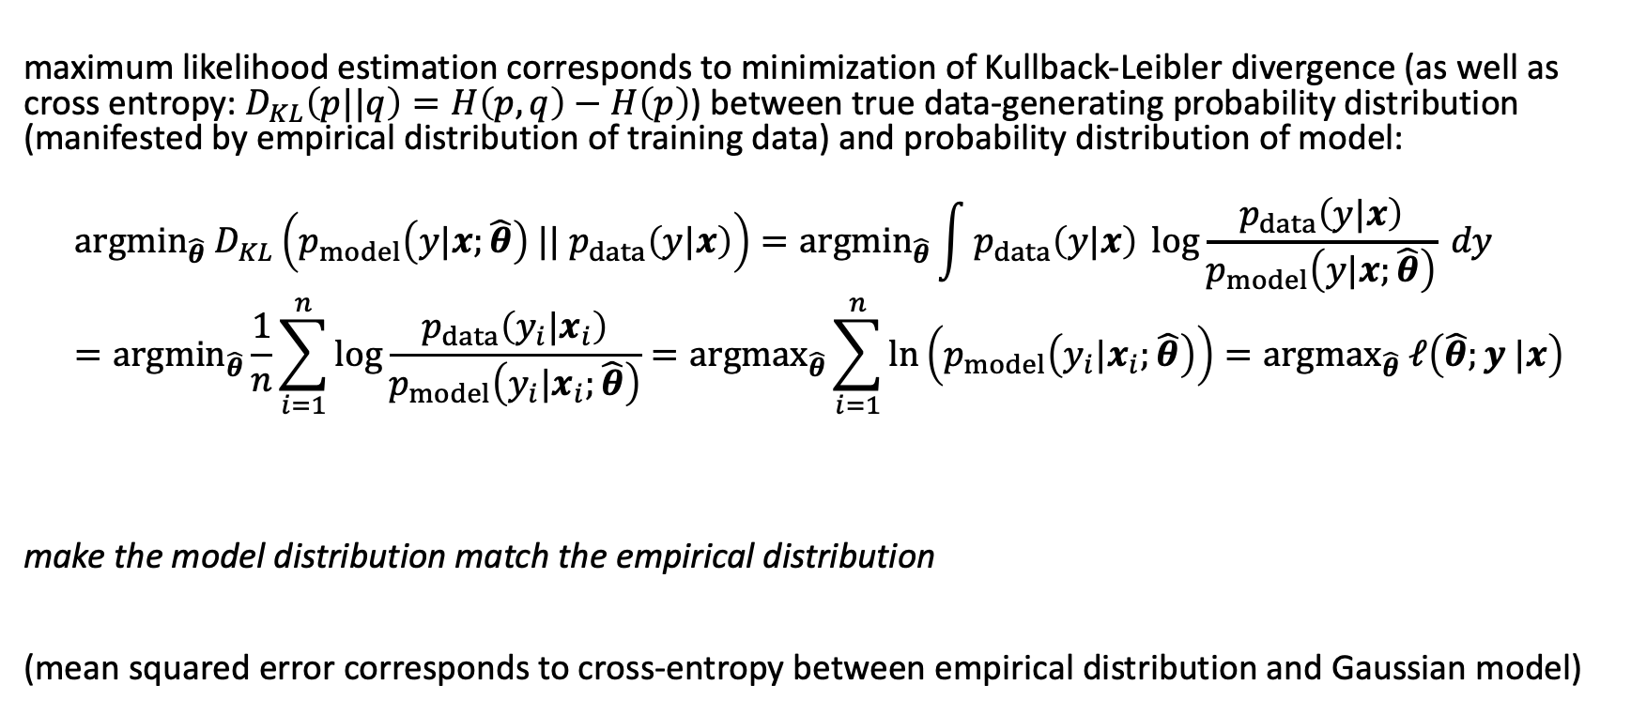

Interpretation of Maximum Likelihood
quantification of difference between two probability distributions
maximum likelihood estimation corresponds to minimization of Kullback-Leibler divergence (as well as cross entropy: $D_{KL}\left(p||q\right)=H\left(p,q\right)−H\left(p\right)$) between true data-generating probability distribution (manifested by empirical distribution of training data) and probability distribution of model:
$${argmin}_{\hat{θ}} D_{KL}\left(p_{model}\left(y|x;\hat{θ}\right) || p_{data}\left(y|x\right)\right)={argmin}_{\hat{θ}}\int{p_{data}\left(y|x\right) \log{\frac{p_{data}\left(y|x\right)}{p_{model}\left(y|x;\hat{θ}\right)}} dy}={argmin}_{\hat{θ}}\frac{1}{n}\sum_{i=1}^{n}{\log{\frac{p_{data}\left(y_{i}|x_{i}\right)}{p_{model}\left(y_{i}|x_{i};\hat{θ}\right)}}}={argmax}_{\hat{θ}}\sum_{i=1}^{n}{\ln\left(p_{model}\left(y_{i}|x_{i};\hat{θ}\right)\right)}={argmax}_{\hat{θ}} ℓ\left(\hat{θ};y |x\right)$$
make the model distribution match the empirical distribution
(mean squared error corresponds to cross-entropy between empirical distribution and Gaussian model)
$$E\left[…\right]$$
no contribution from $p_{data}$

Slide 12
Maximum A Posteriori (MAP) Estimation

Slide 13
Bayes Theorem
likelihood function (derived from statistical model)
$H$: hypothesis (model)
$E$: evidence (data)
$$P\left(H|E\right)=\frac{P\left(E|H\right)∙P\left(H\right)}{P\left(E\right)}$$
posterior probability (belief updated with observed evidence)
new data (same for all hypotheses → uninteresting)
prior probability (belief in $H$ before evidence)

Slide 14
Bayes Theorem for Parameter Estimation
data likelihood:
model (function of $θ$ with data fixed), e.g., for linear regression: $𝒩\left(y;α+x β,σ^{2}\right)$
$$p\left(θ|y, x\right)∝p\left(y|x,θ\right) ∙p\left(θ\right)$$
posterior:
probability distribution reflecting the effect of data on prior belief about parameters (increasing certainty with new evidence)
prior (e.g., broad Gaussian):
probability distribution reflecting initial belief about uncertain parameters (helps to reduce variance with few data)
to be compared to frequentist point estimates $\hat{θ}$
→ Bayesian updating

Slide 15
Bayesian vs Frequentist View
frequentist perspective:
true model parameters $θ$ fixed (but unknown → uncertain point estimates $\hat{θ}$)
data set from random sampling
Bayesian perspective:
true model parameters $θ$ random (estimation of full distributions over parameters)
data not random (observed)

Slide 16
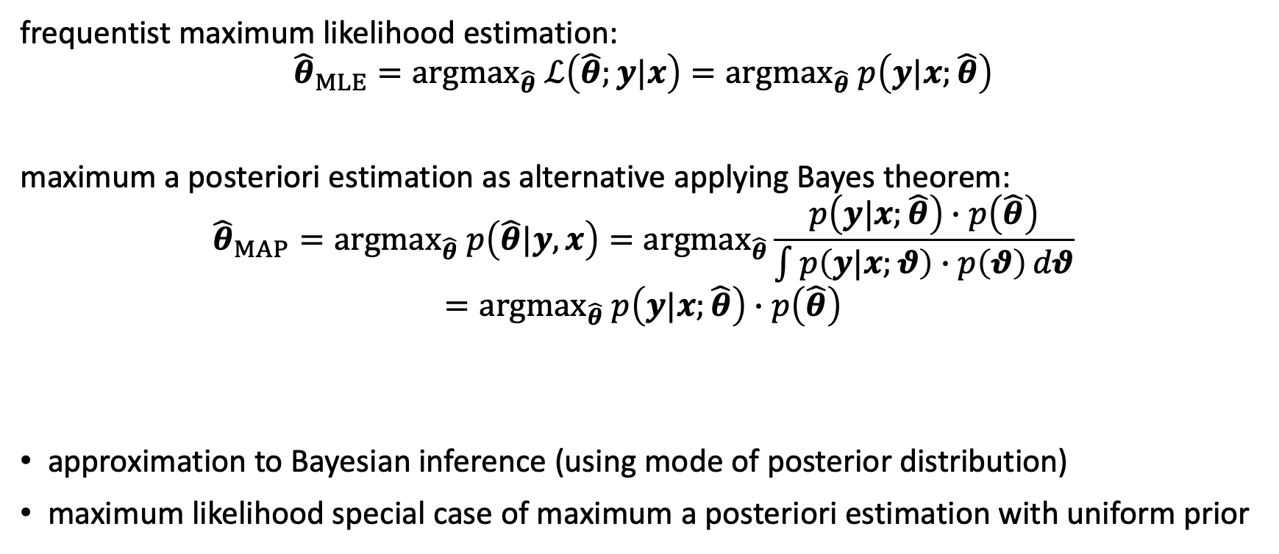
Maximum a Posteriori Estimation
objective function
frequentist maximum likelihood estimation:
$${{\hat{θ}}_{MLE}={argmax}_{\hat{θ}} ℒ\left(\hat{θ};y|x\right)=argmax}_{\hat{θ}} p\left(y|x;\hat{θ}\right)$$
maximum a posteriori estimation as alternative applying Bayes theorem:
$${{\hat{θ}}_{MAP}=argmax}_{\hat{θ}} p\left(\hat{θ}|y,x\right)={argmax}_{\hat{θ}}\frac{p\left(y|x;\hat{θ}\right)∙p\left(\hat{θ}\right)}{\int{p\left(y|x;θ\right)∙p\left(θ\right)}dθ}={argmax}_{\hat{θ}} p\left(y|x;\hat{θ}\right)∙p\left(\hat{θ}\right)$$
approximation to Bayesian inference (using mode of posterior distribution)
maximum likelihood special case of maximum a posteriori estimation with uniform prior
posterior distribution
likelihood
prior distribution

Slide 17
Confidence Intervals

