Slide 1
Machine Learning
Data Science

Slide 2
Supervised Learning
linear regression
training
logistic regression
Generalized Linear Models
quantile regression
Generalized Additive Models
k-Nearest Neighbors
decision trees and ensemble methods

Slide 3
What Is Machine Learning?
learning from experience/data: exploiting statistical dependencies with the aim of generalization to new data
training: ML algorithm + data = explicit algorithm (to be used later)
reduction of complexity and much better generalizability compared to handcrafted algorithms
analogy: Humans do not hit the ground running (storage capacity of DNA limited) but have learning capabilities.

Slide 4
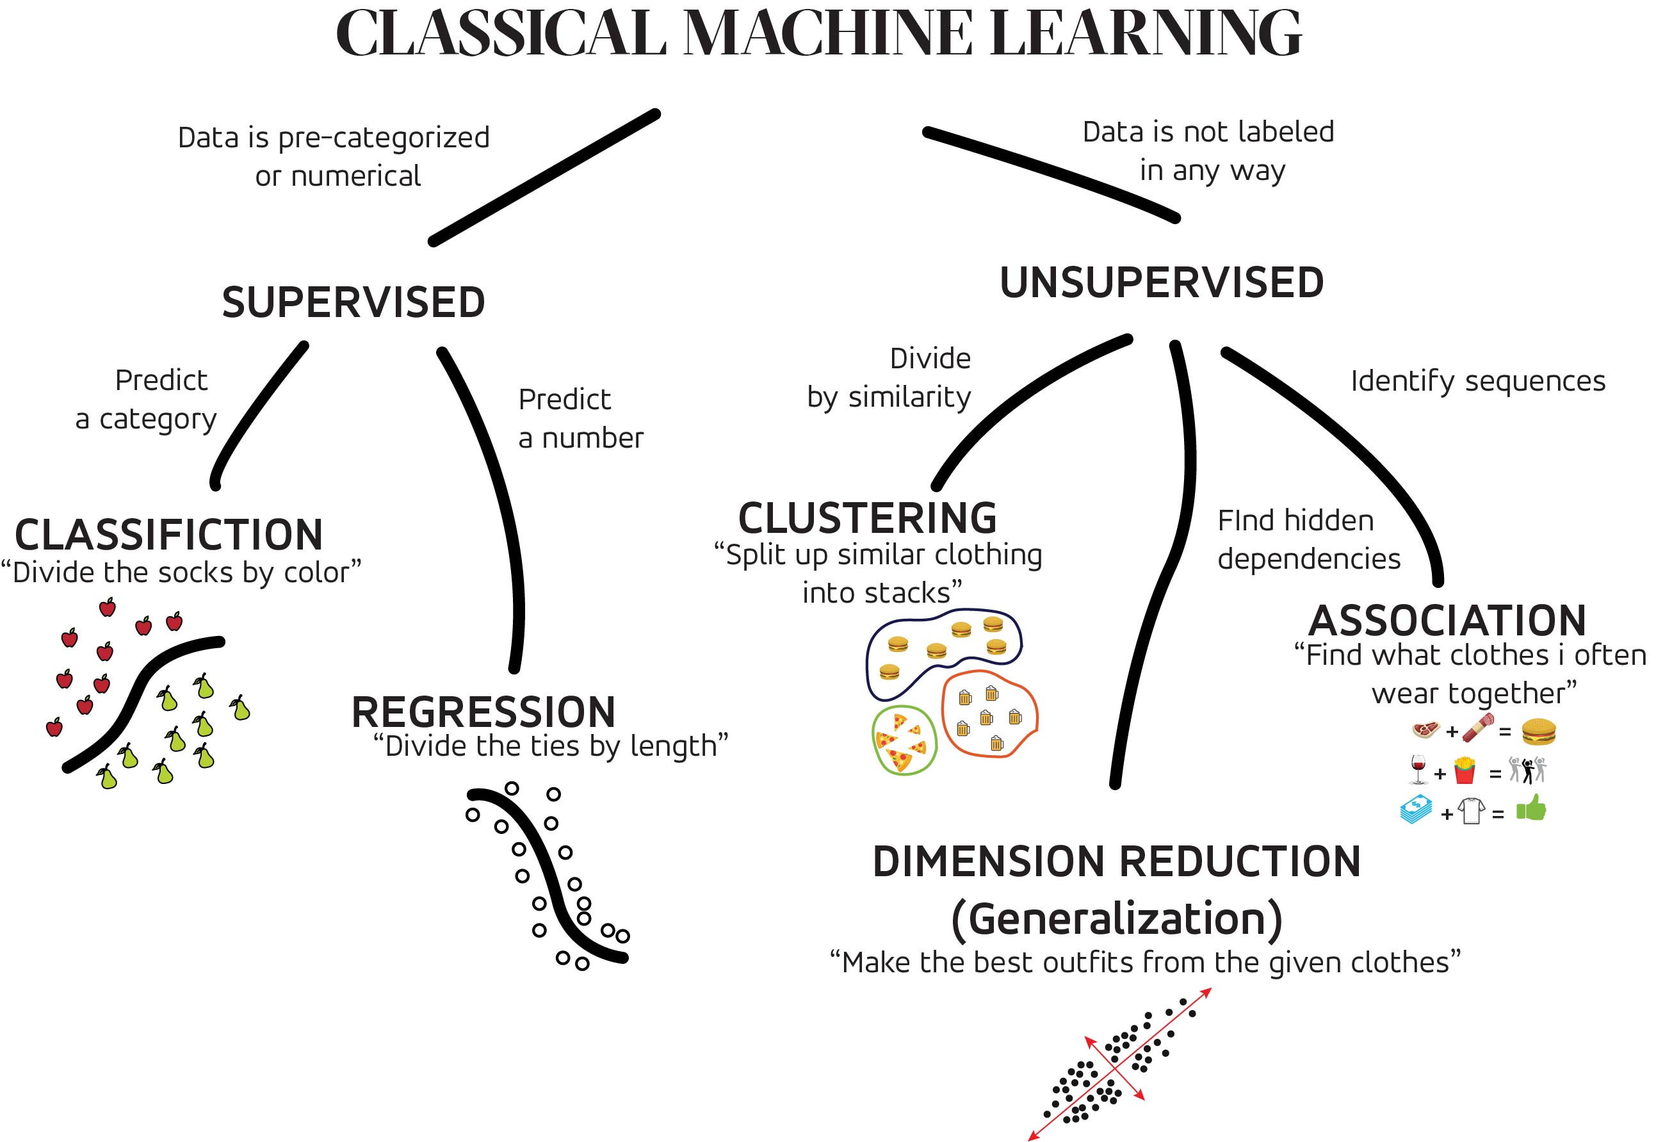
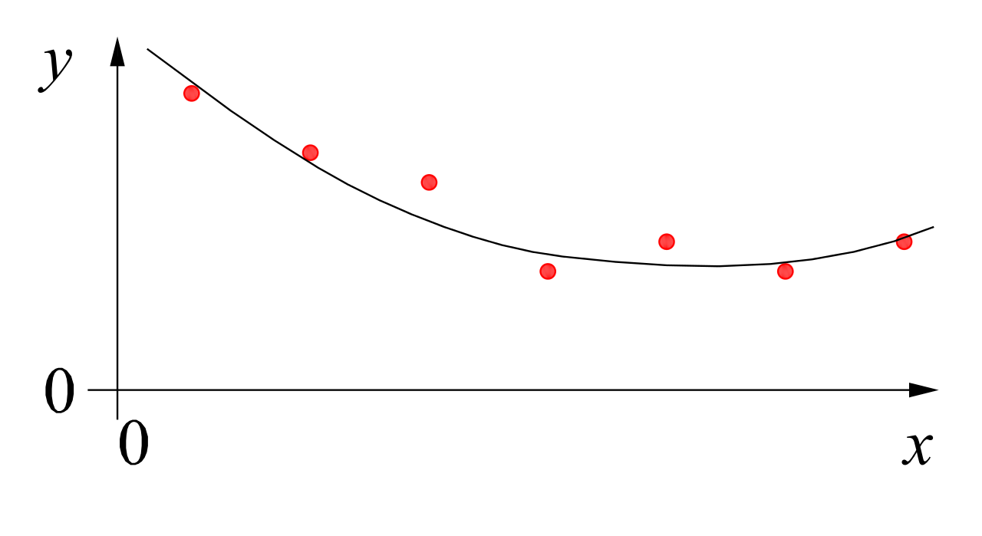
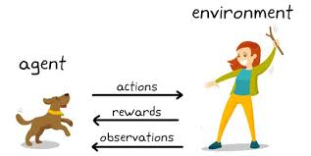
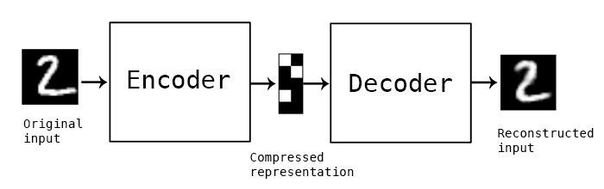
MACHINE LEARNING
no supervision, but goal-based interaction with environment
training target available (labeled or past data)
data not labeled in any way
SUPERVISED
REINFORCEMENT LEARNING
UNSUPERVISED
CLASSIFICATION
ASSOCIATION
CLUSTERING
LEARN STATE OR ACTION VALUES
LEARN POLICY DIRECTLY
REGRESSION
DIMENSIONALITY REDUCTION
SELF-SUPERVISED
learning by teacher
(high-dimensional curve fitting)
learning by observation
(pattern recognition)
learning by trial-and-error
(sequential decision making)

Slide 5

Supervised Learning
Target Quantity
Features
known in training: labeled samples or observations from past
to be predicted for unknown cases (e.g., future values)
(prepared) input information that is
correlated to target quantity
known at prediction time
features x1 and x2 spam, no spam
decision boundary
Example: Spam Filtering
classify emails as spam or no spam
use information like occurrence of specific words or email length as features
use accordingly labeled emails as training set

Slide 6
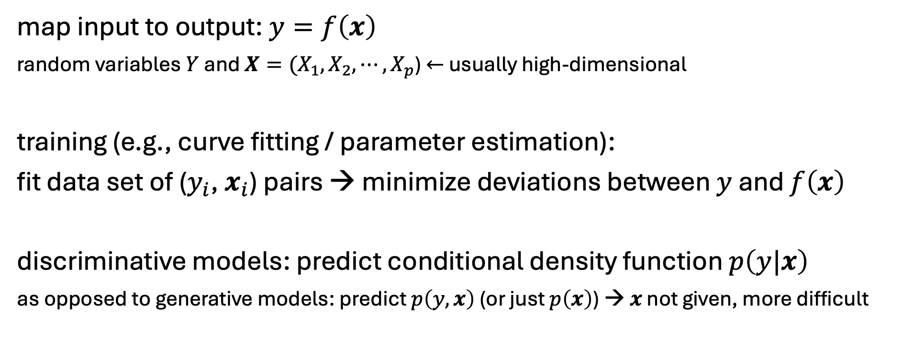
Supervised Learning in Mathematical Terms
map input to output: $y=f\left(x\right)$
random variables $Y$ and $X={(X}_{1}, X_{2},{⋯,X}_{p}$) $←$ usually high-dimensional
training (e.g., curve fitting / parameter estimation):
fit data set of ($y_{i}$, $x_{i}$) pairs → minimize deviations between $y$ and $f\left(x\right)$
discriminative models: predict conditional density function $p\left(y|x\right)$
as opposed to generative models: predict $p\left(y, x\right)$ (or just $p\left(x\right)$) → $x$ not given, more difficult

Slide 7
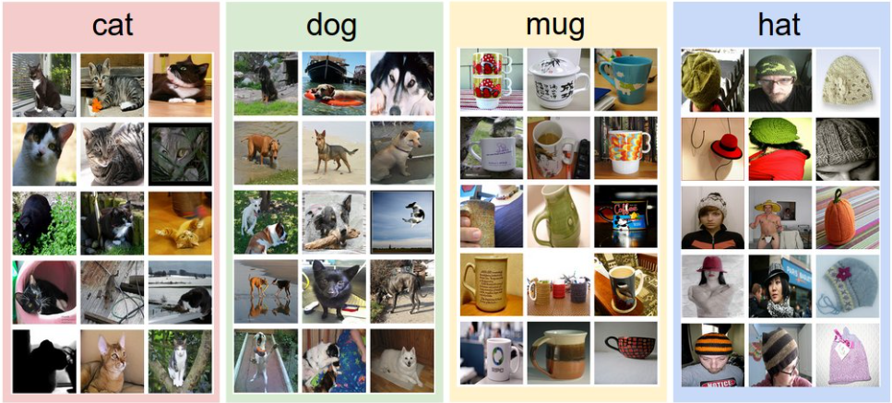
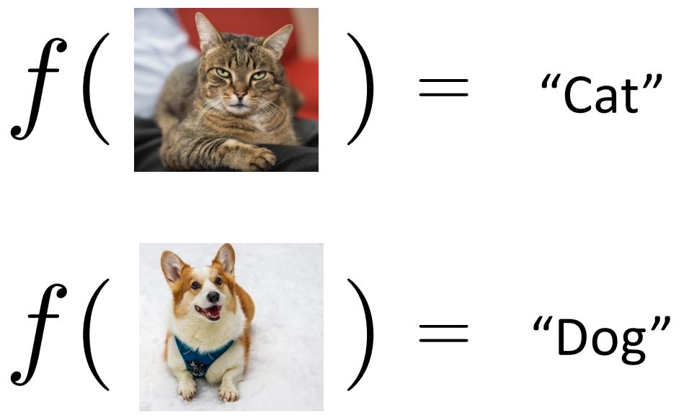
Example: Image Classification
training data set:
test data with learned classifier:
labels:

Slide 8
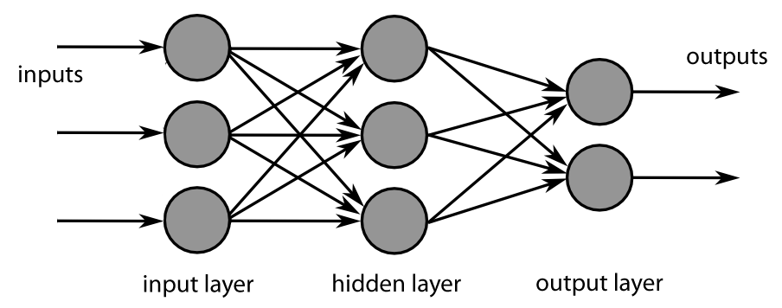
Algorithmic Families of Supervised Learning
parametric models
non-parametric models:
similarity-based learning
(analogies)
decision trees:
rule learning
linear models
Day
nearest-neighbor-style/local methods
neural networks
Weekday
Weekend
3
Promo
No
Yes
demand prediction
5
8
often used in ensemble methods
bagging: random forests
boosting: gradient boosting
kernel machines (e.g., support-vector machines)

Slide 9
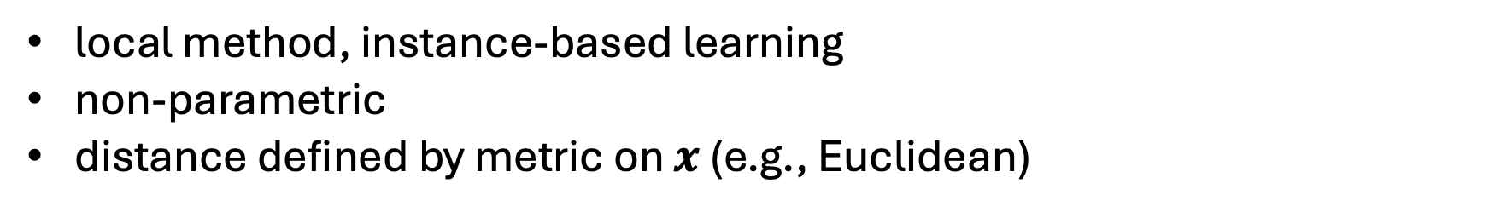
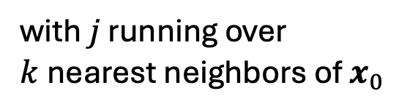
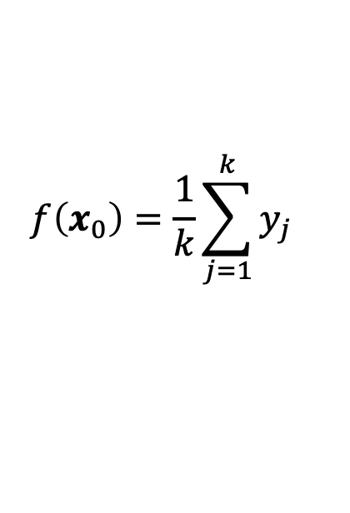
k-Nearest Neighbors (kNN)
local method, instance-based learning
non-parametric
distance defined by metric on $x$ (e.g., Euclidean)
regression:
$$f\left(x_{0}\right)=\frac{1}{k}\sum_{j=1}^{k}{y_{j}}$$
with $j$ running over $k$nearest neighbors of $x_{0}$
low k: low bias but high variance
high k: low variance but high bias

Slide 10
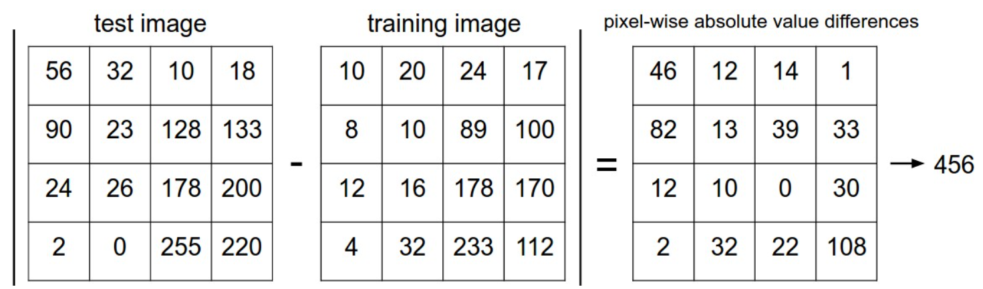

Image Classification with kNN
choose an image distance, e.g., L1 distance:
$$d\left(I_{1},I_{2}\right)=\sum_{p}{\left|I_{1}\left(p\right)−I_{2}\left(p\right)\right|}$$

Slide 11
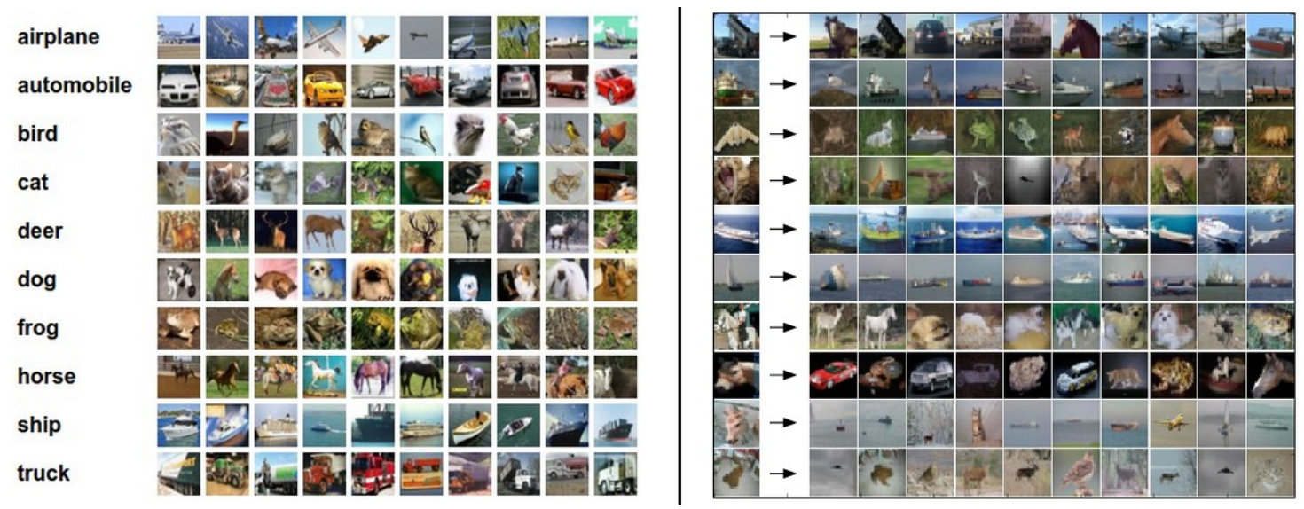
Image Classification with kNN
training examples CIFAR-10 data set
10 nearest neighbors to some test images
10 classes
better than random guessing, but also not very impressive

Slide 12
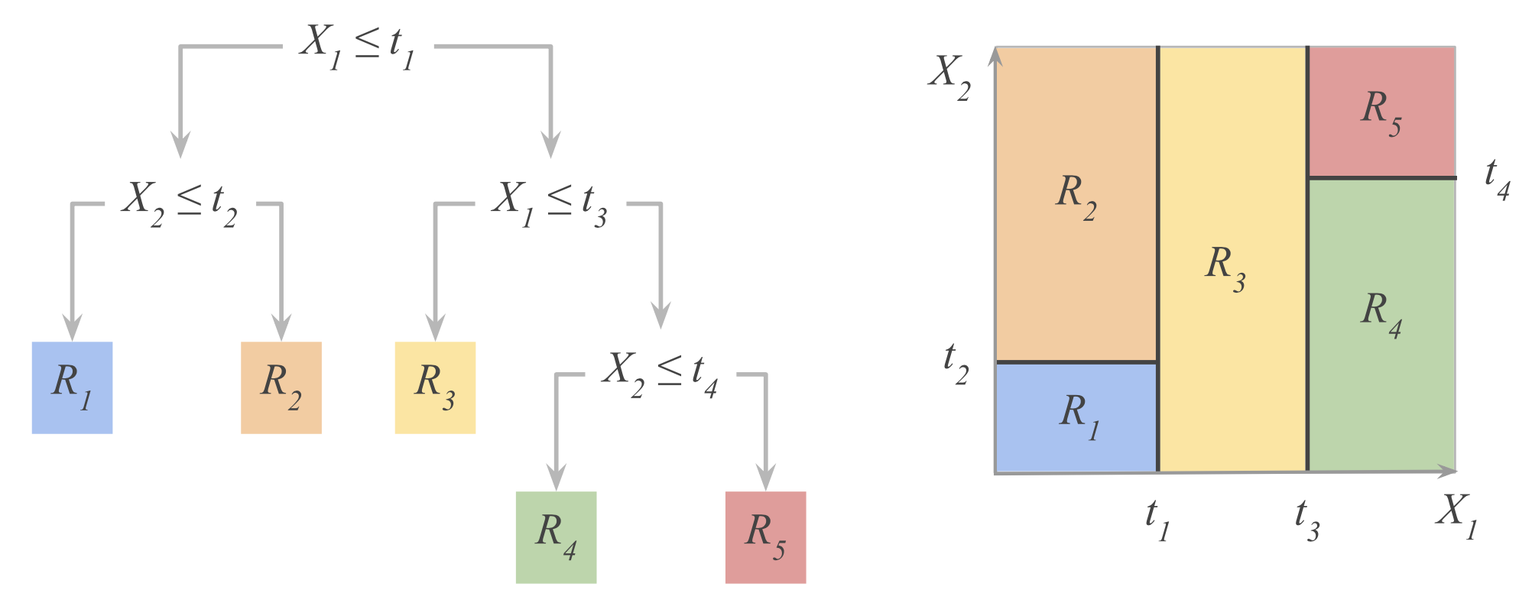
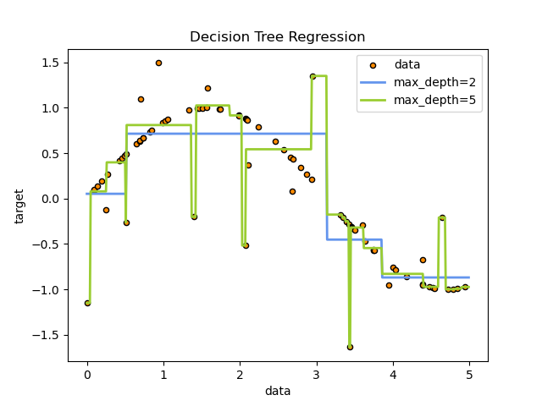
Decision Trees
non-parametric learning of simple decision rules
usually, binary trees
axis-parallel decision boundaries (box-shaped regions in feature space)
fit constant in each box
classification: majority class of target
regression: average of target
fully explainable models
hyperparameter
scikit-learn

Slide 13
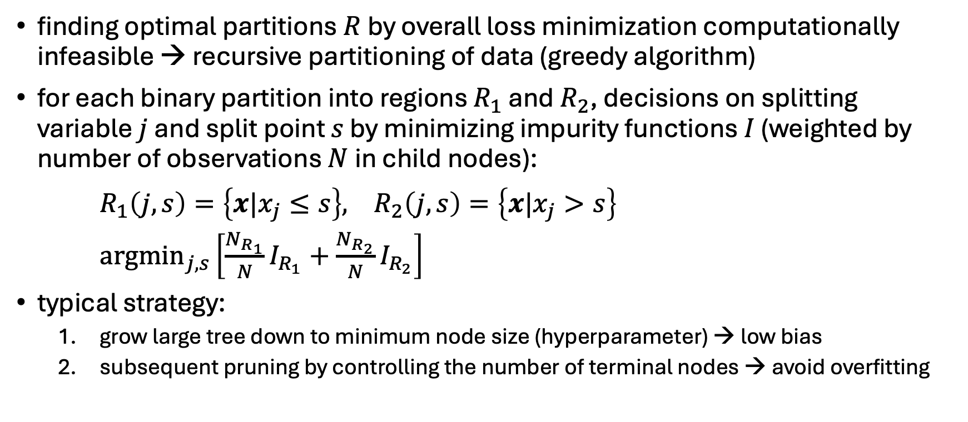
Decision Tree Learning
finding optimal partitions $R$by overall loss minimization computationally infeasible → recursive partitioning of data (greedy algorithm)
for each binary partition into regions $R_{1}$ and $R_{2}$, decisions on splitting variable $j$ and split point $s$ by minimizing impurity functions $I$ (weighted by number of observations $N$in child nodes):
$R_{1}\left(j,s\right)=\left\{x|x_{j}≤s\right\}, R_{2}\left(j,s\right)=\left\{x|x_{j}>s\right\}$
${argmin}_{j,s}\left[\frac{N_{R_{1}}}{N}I_{R_{1}}+\frac{N_{R_{2}}}{N}I_{R_{2}}\right]$
typical strategy:
grow large tree down to minimum node size (hyperparameter) → low bias
subsequent pruning by controlling the number of terminal nodes → avoid overfitting

Slide 14
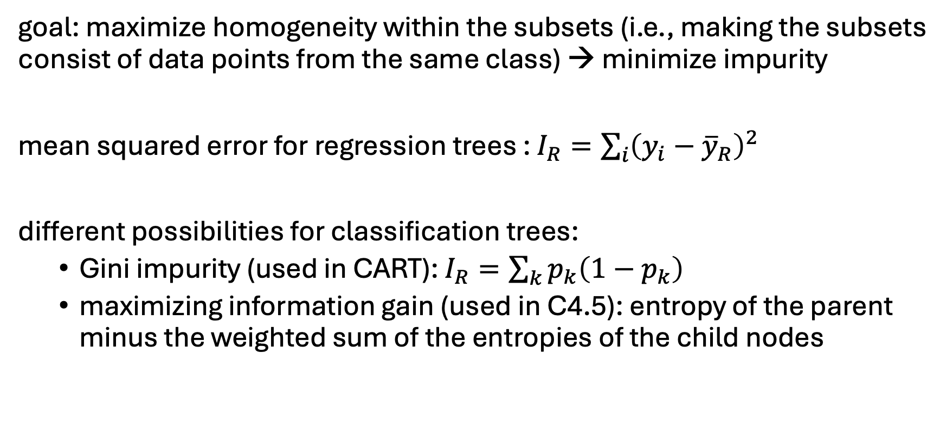
Impurity Functions
goal: maximize homogeneity within the subsets (i.e., making the subsets consist of data points from the same class) → minimize impurity
mean squared error for regression trees : $I_{R}=\sum_{i}{{\left(y_{i}−{\overline{y}}_{R}\right)}^{2}}$
different possibilities for classification trees:
Gini impurity (used in CART): $I_{R}=\sum_{k}{p_{k}\left(1−p_{k}\right)}$
maximizing information gain (used in C4.5): entropy of the parent minus the weighted sum of the entropies of the child nodes

Slide 15
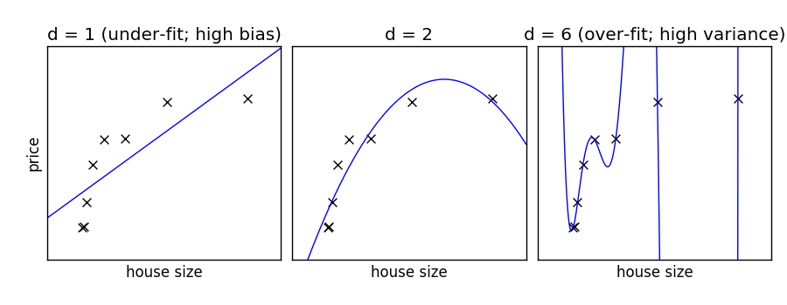
Under- and Over-Fitting
example: polynomial fit
need to predict new samples (not in training data set): interpolation
degree of fitted polynomial

Slide 16
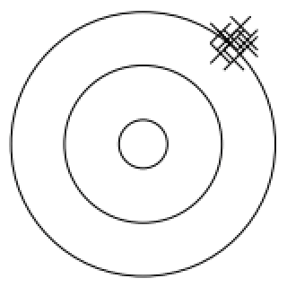
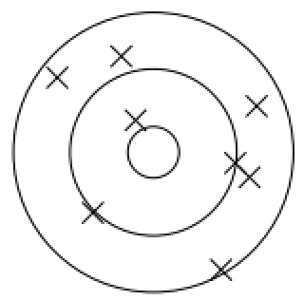
Bias, Variance, Irreducible Error
think of fitting ML algorithms as repeatable processes with different data sets
irreducible error (aka Bayes error):
inherent randomness (target generated from random variable)
limiting accuracy of ideal model
bias
due to too simplistic model (same for all training data sets)
“underfitting”
variance
due to sensitivity to specifics (noise) of different training data sets
“overfitting”

Slide 17
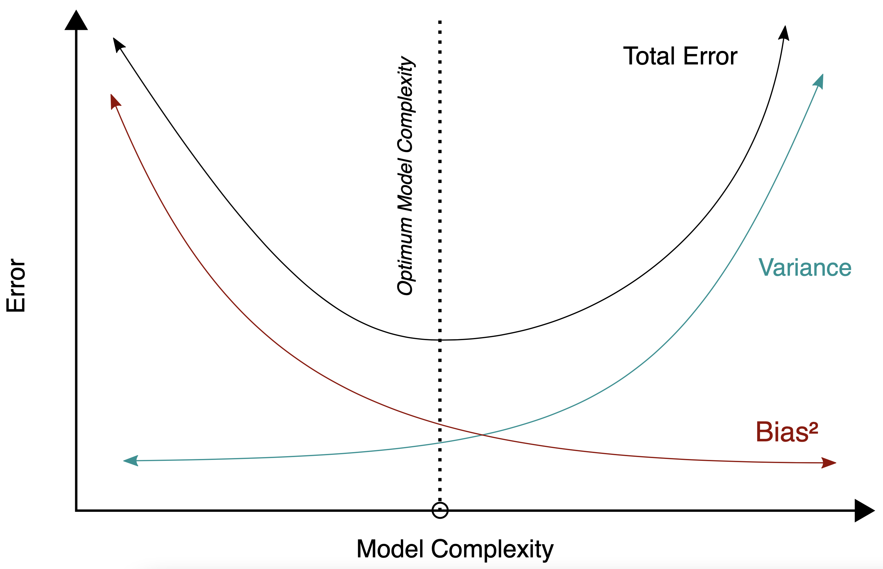
Bias-Variance Tradeoff
models of higher complexity have lower bias but higher variance
(given the same number of training examples)
generalization error follows U-shaped curve: overfitting once model complexity (number of parameters) passes certain threshold
overfitting: variance term dominating test error
→ increasing model complexity increases test error
but beware: training error keeps decreasing with more complex model …

Slide 18
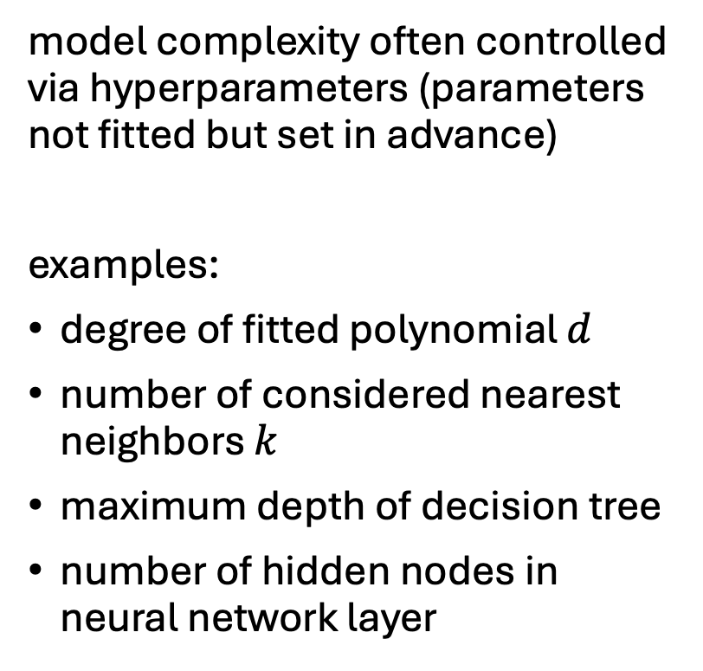
Hyperparameters
model complexity often controlled via hyperparameters (parameters not fitted but set in advance)
examples:
degree of fitted polynomial $d$
number of considered nearest neighbors $k$
maximum depth of decision tree
number of hidden nodes in neural network layer
hyperparameter tuning

Slide 19
Generalization
core of ML: empirical risk minimization (training error) as proxy for minimizing unknown population risk (test error)
generalization gap: difference between test and training error
curse of dimensionality: typically, many features (dimensions)
→ lots of data needed to densely sample volume

Slide 20
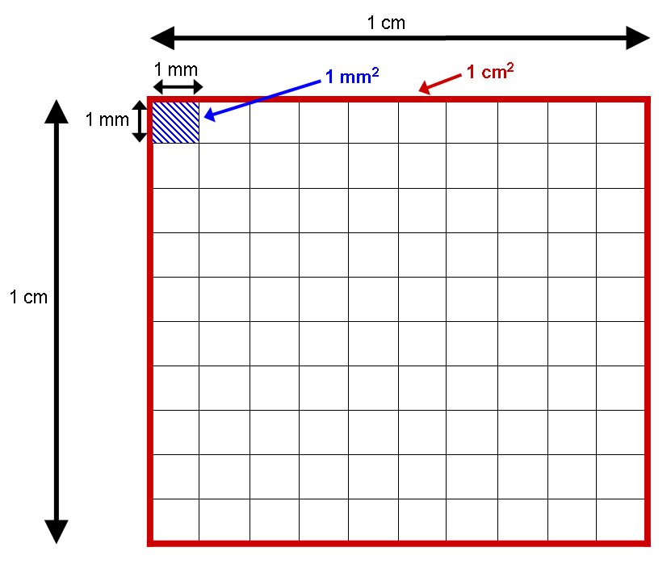
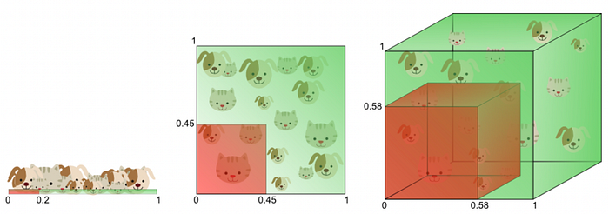
Curse of Dimensionality
data sparsity:
dimensions (i.e., features) increase
→ volume of space increases rapidly
→ data points become isolated
→ difficult to find meaningful patterns (concept of proximity breaks down)
→ overfitting
→ exponential data (i.e., samples) requirements

Slide 21
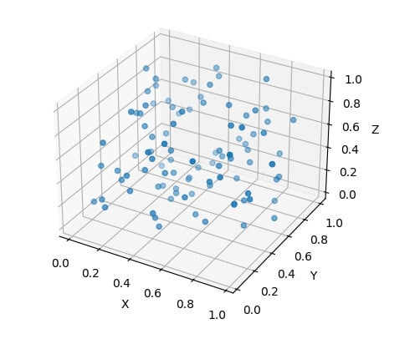
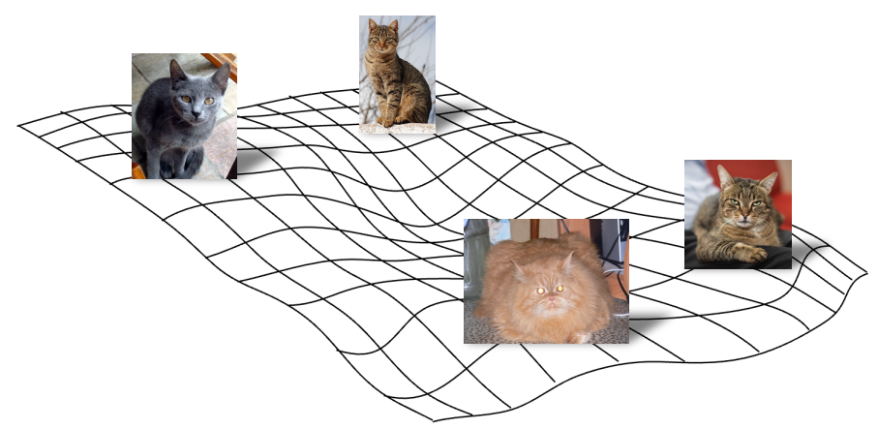
Manifold Hypothesis
luckily, reality is friendly: most high-dimensional data sets reside on lower-dimensional manifolds → enabling effectiveness of ML

Slide 22

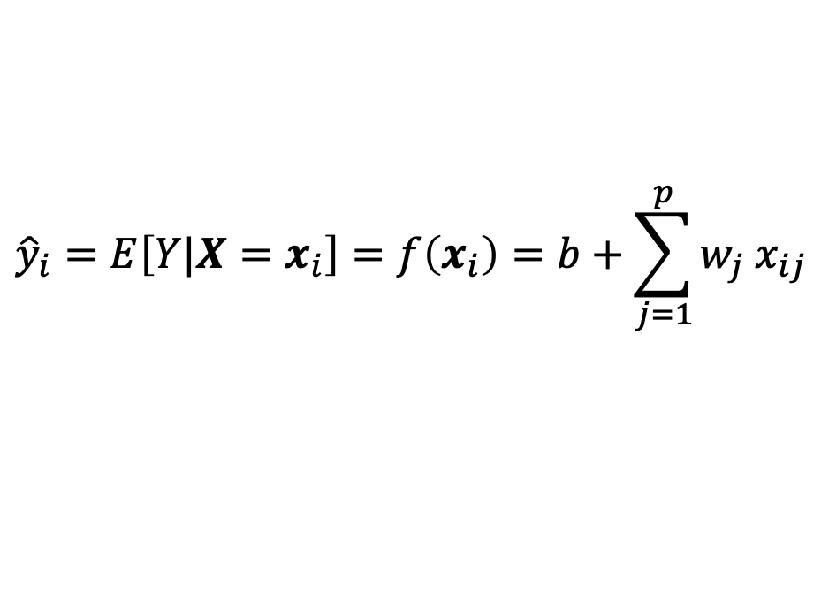
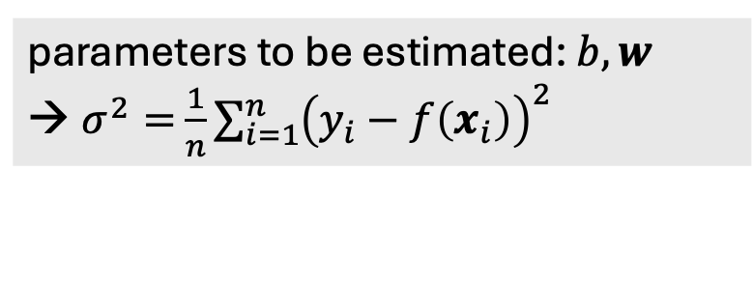
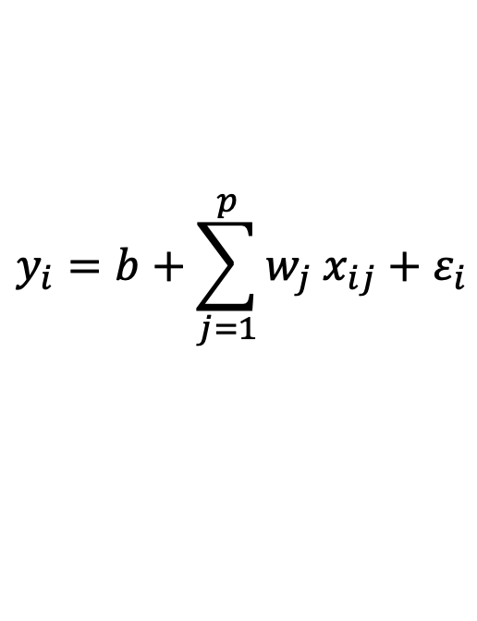
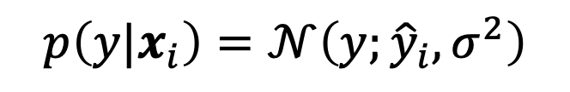
Linear Regression
$$f\left(x_{i}\right)$$
fit:
$$y_{i}=b+\sum_{j=1}^{p}{w_{j} x_{ij}}+ε_{i}$$
Gaussian
predict:
parameter estimation:
e.g., least squares
$${\hat{y}}_{i}=E\left[Y|X=x_{i}\right]=f\left(x_{i}\right)=b+\sum_{j=1}^{p}{w_{j} x_{ij}}$$
parameters to be estimated: $b, w$
$σ^{2}=$ $\frac{1}{n}\sum_{i=1}^{n}{{\left(y_{i}−f\left(x_{i}\right)\right)}^{2}}$
$$p\left(y|x_{i}\right)=𝒩\left(y;{\hat{y}}_{i}, σ^{2}\right)$$
Gaussian
mean
variance

Slide 23
General Recipe of Statistical Learning
ML algorithm by combining:
model (e.g., linear function & Gaussian distribution)
objective function (e.g., squared residuals)
optimization algorithm (e.g., gradient descent)
regularization (e.g., L2, dropout)

Slide 24
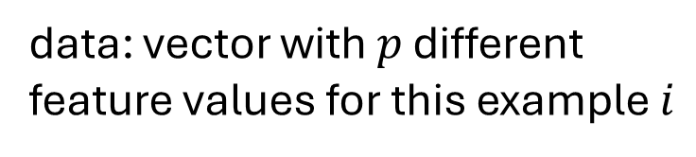
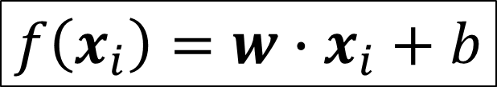
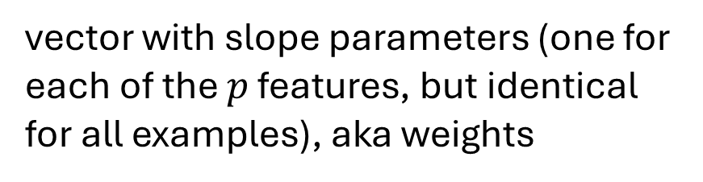
Linear Model
data: vector with $p$ different feature values for this example $i$
$$f\left(x_{i}\right)=w∙x_{i}+b$$
vector with slope parameters (one for each of the $p$ features, but identical for all examples), aka weights
single intercept parameter, aka bias

Slide 25
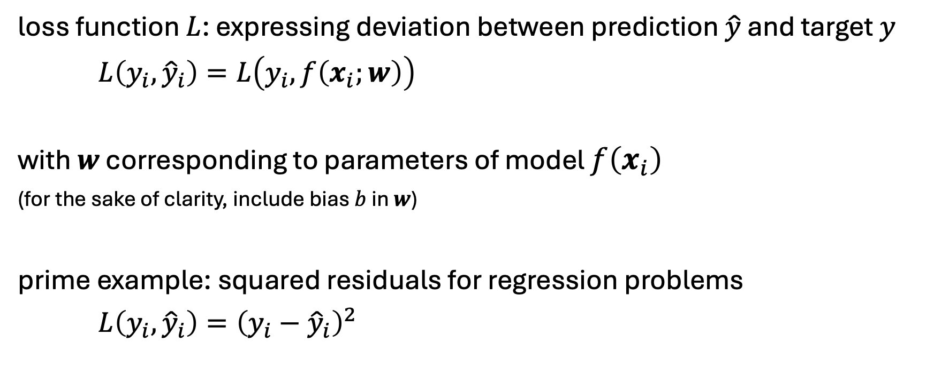
Loss Function
loss function $L$: expressing deviation between prediction $\hat{y}$ and target $y$
$L\left(y_{i},{\hat{y}}_{i}\right)=L\left(y_{i},f\left(x_{i};w\right)\right)$
with $w$ corresponding to parameters of model $f\left(x_{i}\right)$
(for the sake of clarity, include bias $b$ in $w$)
prime example: squared residuals for regression problems
$L\left(y_{i},{\hat{y}}_{i}\right)={\left(y_{i}−{\hat{y}}_{i}\right)}^{2}$

Slide 26
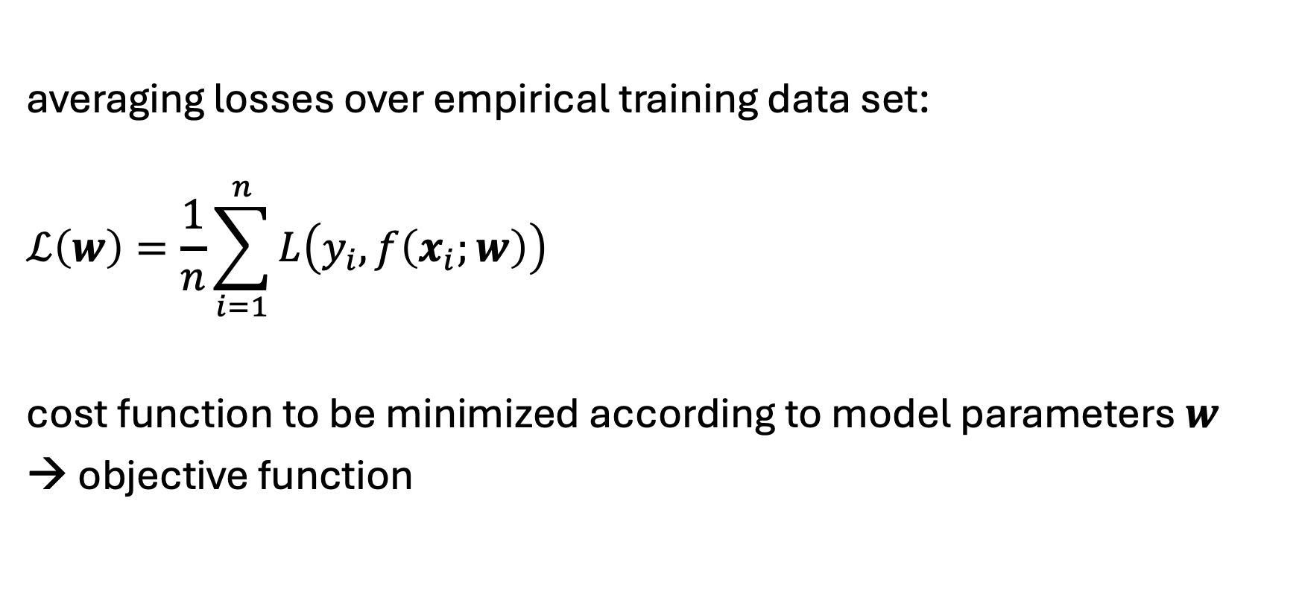
Cost Function
averaging losses over empirical training data set:
$$ℒ\left(w\right)=\frac{1}{n}\sum_{i=1}^{n}{L\left(y_{i}, f\left(x_{i};w\right)\right)}$$
cost function to be minimized according to model parameters $w$
→ objective function

Slide 27
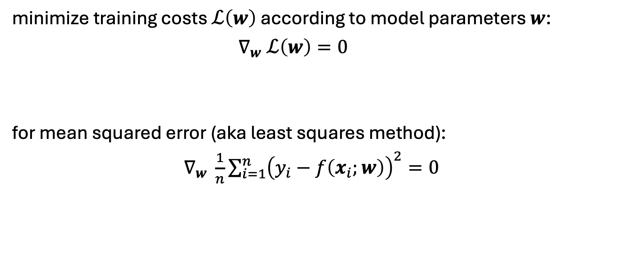
Cost Minimization
minimize training costs $ℒ\left(w\right)$ according to model parameters $w$:
$∇_{w} ℒ\left(w\right)=0$
for mean squared error (aka least squares method):
$∇_{w} \frac{1}{n}\sum_{i=1}^{n}{{\left(y_{i}−f\left(x_{i};w\right)\right)}^{2}}=0$

Slide 28
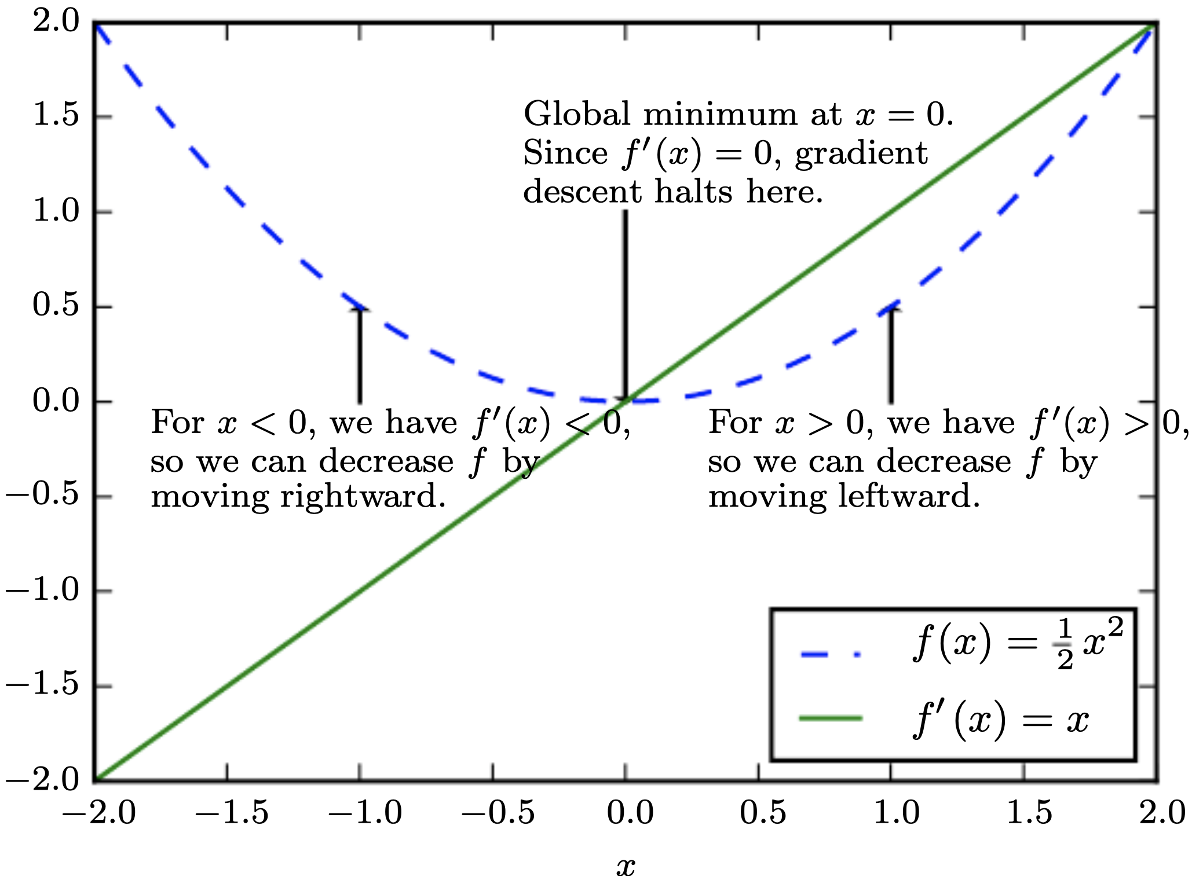
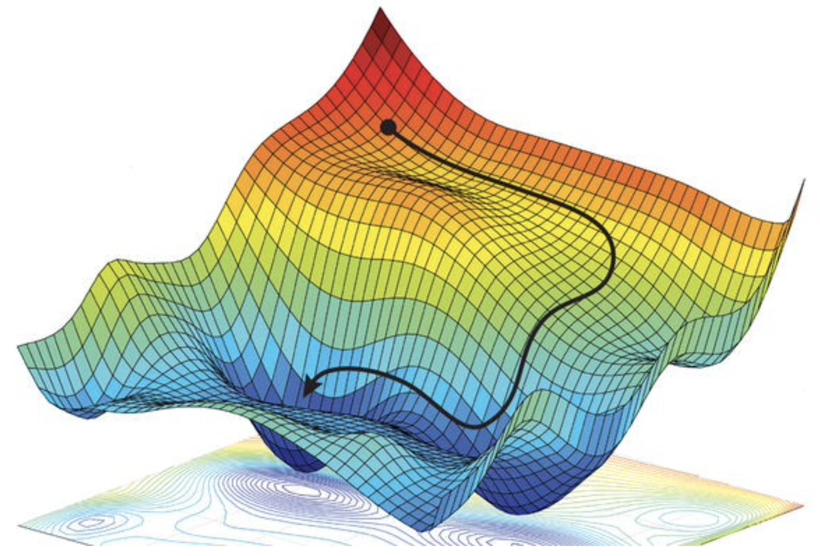
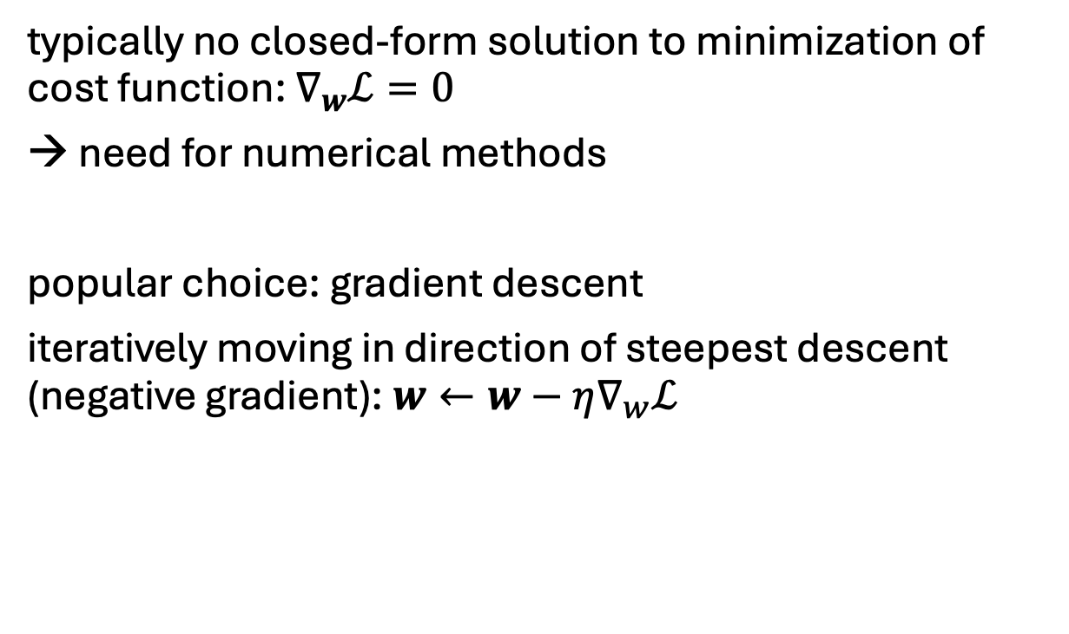
Gradient Descent
typically no closed-form solution to minimization of cost function: $∇_{w}ℒ=0$
need for numerical methods
popular choice: gradient descent
iteratively moving in direction of steepest descent (negative gradient): $w←w−η∇_{w}ℒ$
source
local minimum
global minimum
step size (learning rate)
vector containing all partial derivatives

Slide 29
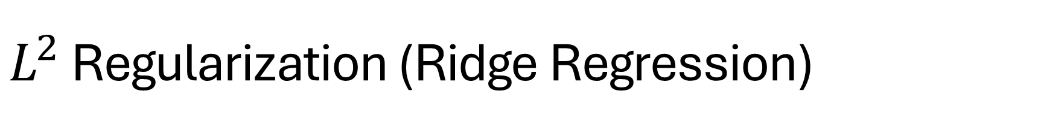
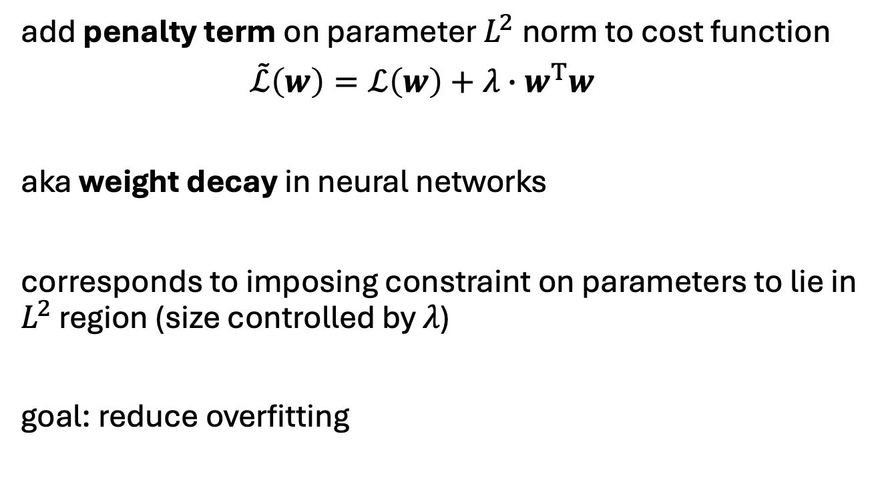
$L^{2}$ Regularization (Ridge Regression)
add penalty term on parameter $L^{2}$norm to cost function
$\tilde{ℒ}\left(w\right)=ℒ\left(w\right)+λ∙w^{T}w$
aka weight decay in neural networks
corresponds to imposing constraint on parameters to lie in $L^{2}$ region (size controlled by $λ$)
goal: reduce overfitting
hyperparameter controlling strength of regularization
source

Slide 30
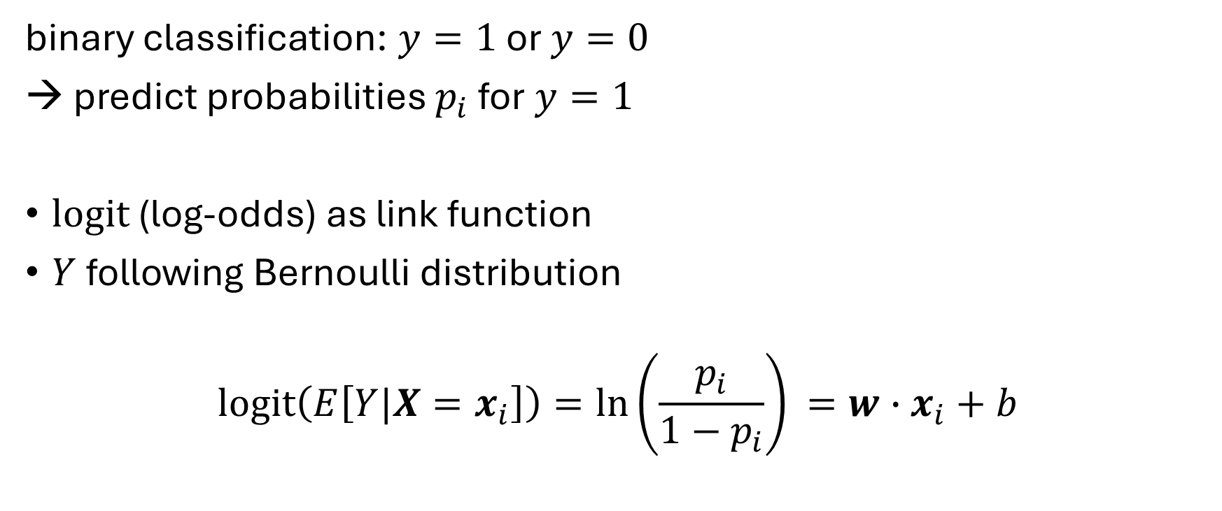
Classification: Logistic Regression
binary classification: $y=1$ or $y=0$
→ predict probabilities $p_{i}$ for $y=1$
logit (log-odds) as link function
$Y$ following Bernoulli distribution
$$\operatorname{logit}\left(E\left[Y|X=x_{i}\right]\right)=\ln\left(\frac{p_{i}}{1−p_{i}}\right)⁡=w∙x_{i}+b$$

Slide 31
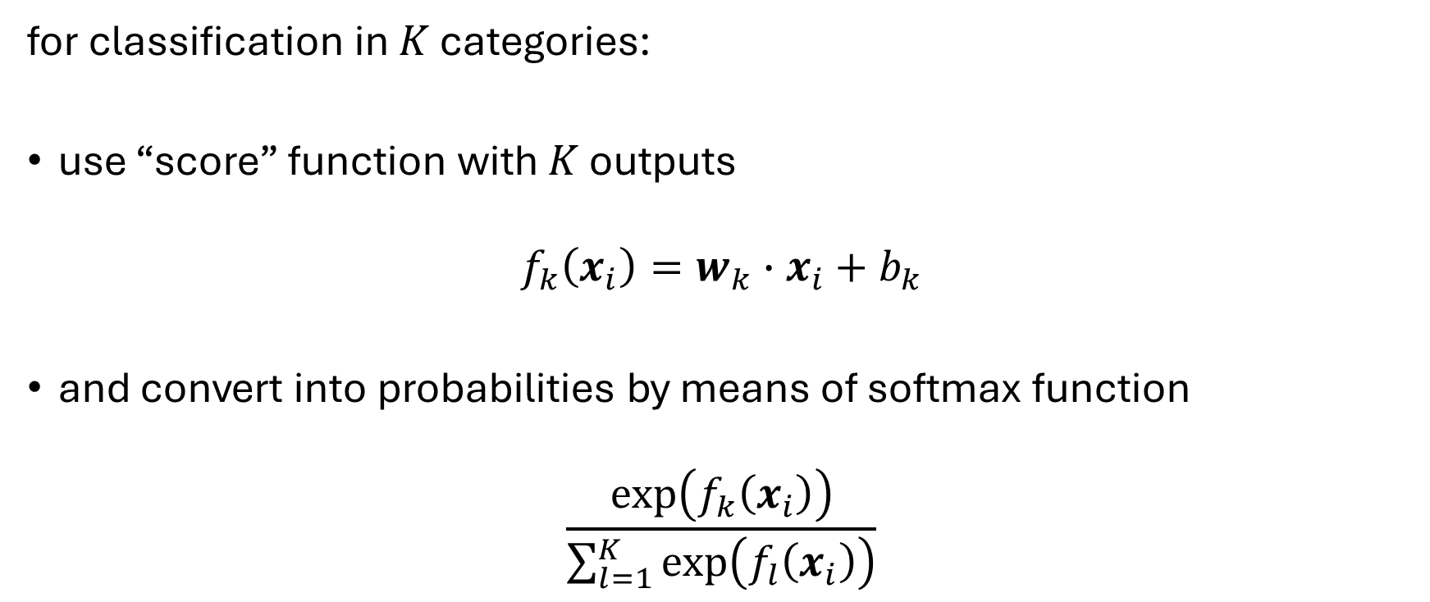
Multi-Classification: Softmax
for classification in $K$ categories:
use “score” function with $K$ outputs
$$f_{k}\left(x_{i}\right)=w_{k}∙x_{i}+b_{k}$$
and convert into probabilities by means of softmax function
$$\frac{\exp\left(f_{k}\left(x_{i}\right)\right)}{\sum_{l=1}^{K}{\exp\left(f_{l}\left(x_{i}\right)\right)}}$$

Slide 32
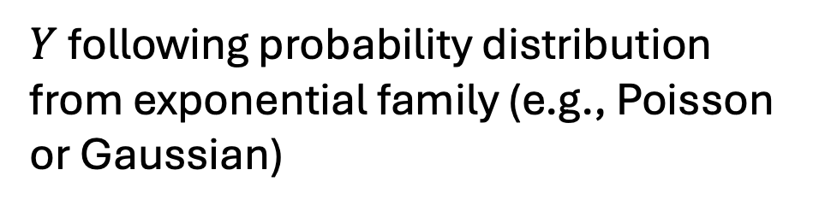
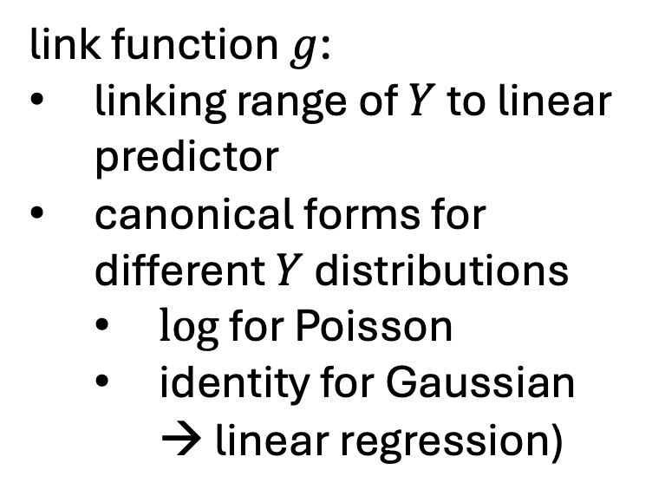
Generalized Linear Models (GLMs)
$$g\left(E\left[Y|X=x_{i}\right]\right) =\hat{α}+\sum_{j=1}^{p}{{\hat{β}}_{j} x_{ij}}$$
link function $g$:
linking range of $Y$ to linear predictor
canonical forms for different $Y$ distributions
$log$ for Poisson
identity for Gaussian → linear regression)
$Y$ following probability distribution from exponential family (e.g., Poisson or Gaussian)

Slide 33
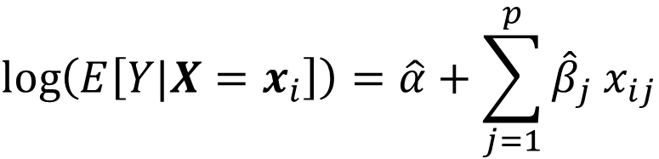
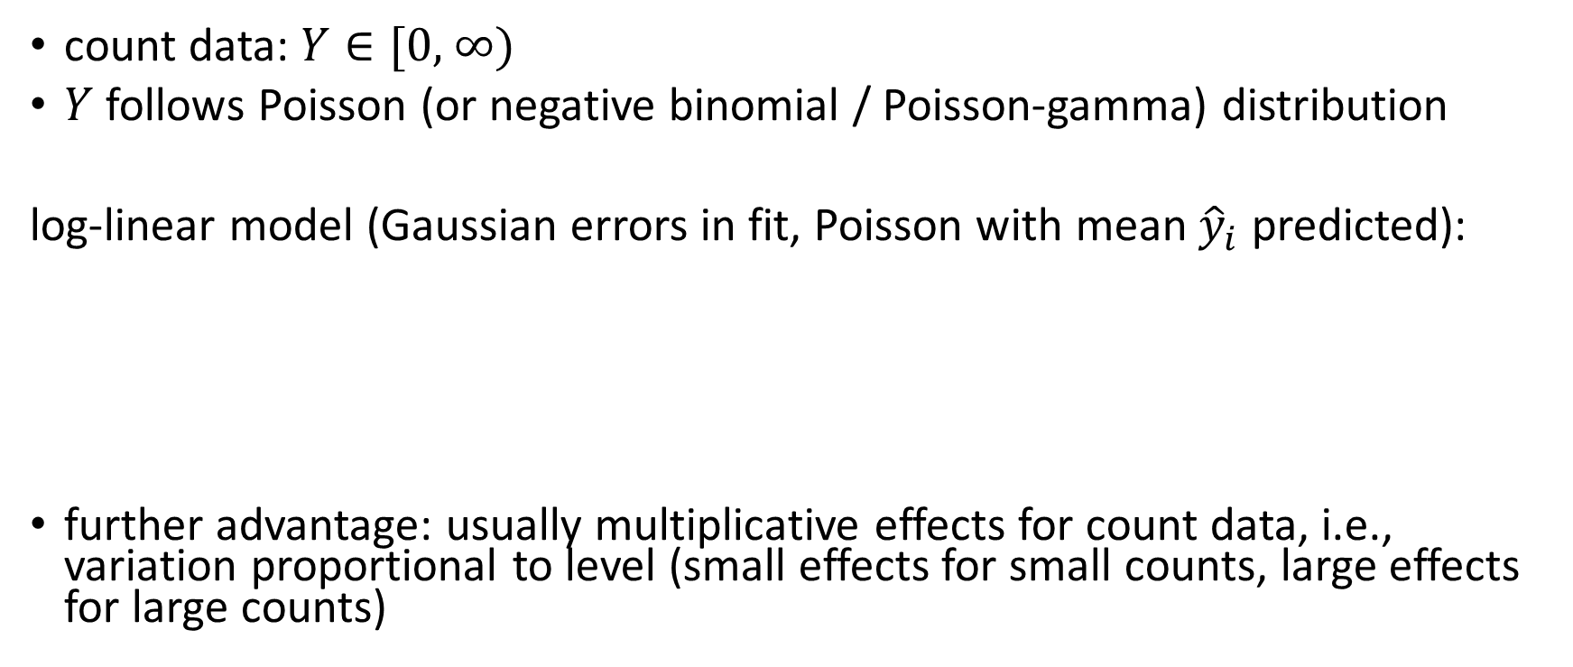

Multiplicative Model
count data: $Y∈\text{[0, ∞)}$
$Y$ follows Poisson (or negative binomial / Poisson-gamma) distribution
log-linear model (Gaussian errors in fit, Poisson with mean ${\hat{y}}_{i}$ predicted):
further advantage: usually multiplicative effects for count data, i.e., variation proportional to level (small effects for small counts, large effects for large counts)
$$\log\left(E\left[Y|X=x_{i}\right]\right)=\hat{α}+\sum_{j=1}^{p}{{\hat{β}}_{j} x_{ij}}$$
single parameter
link function
$${\hat{y}}_{i}$$

Slide 34
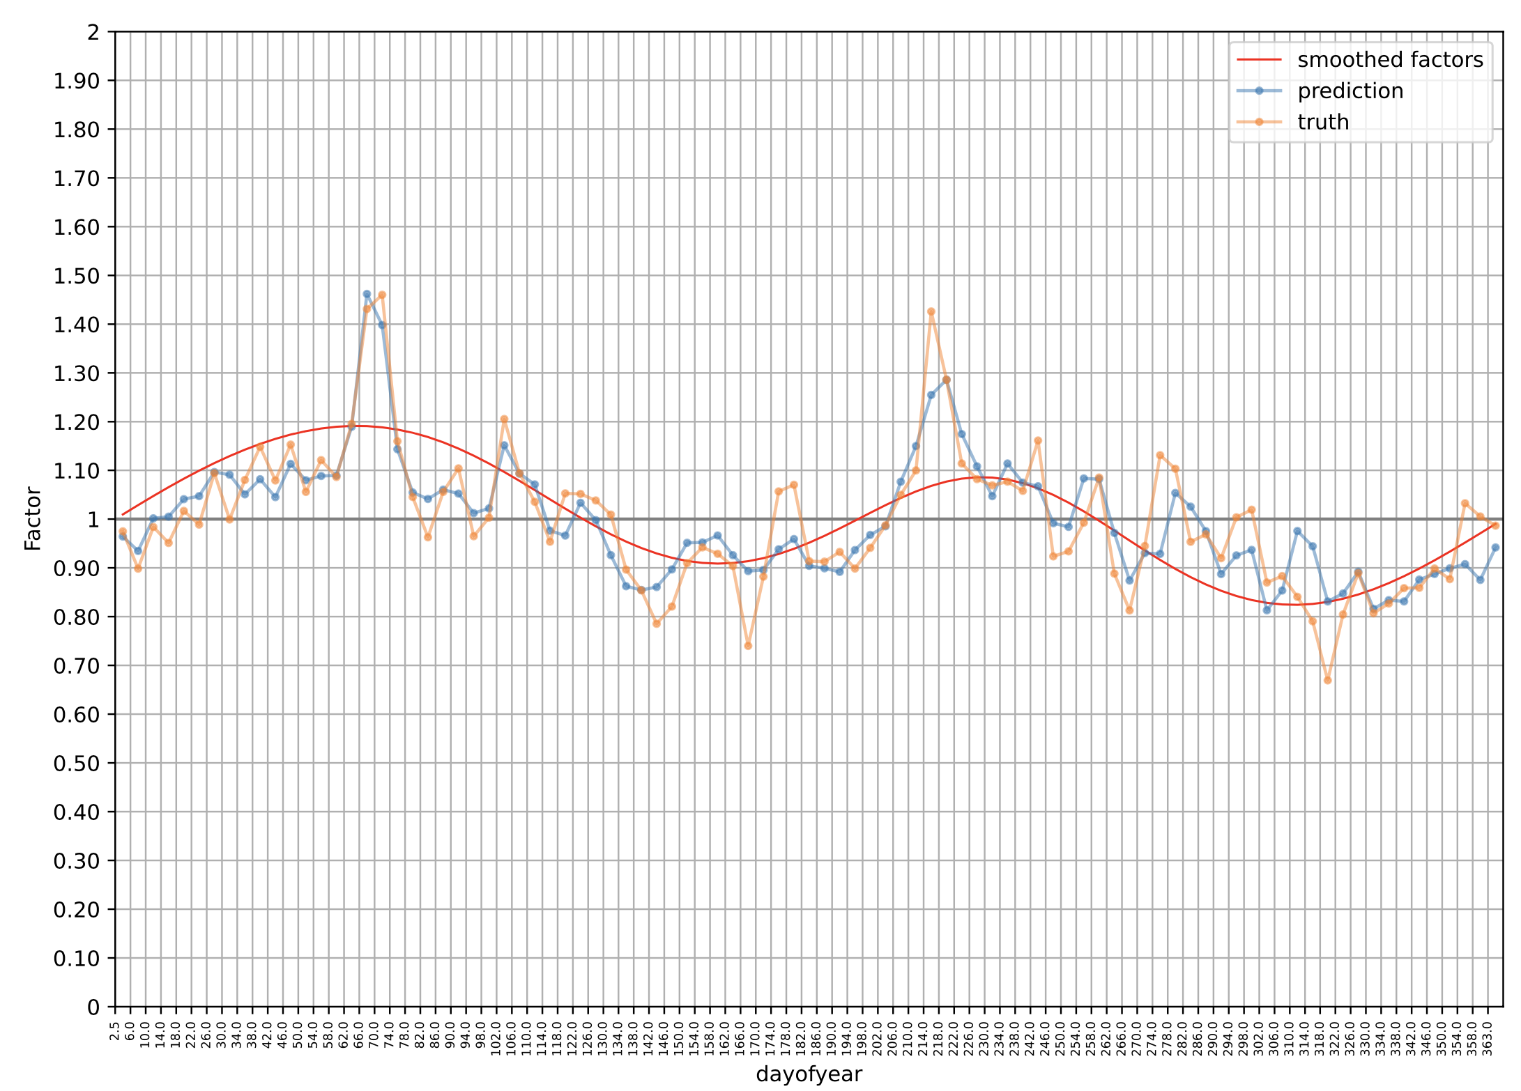
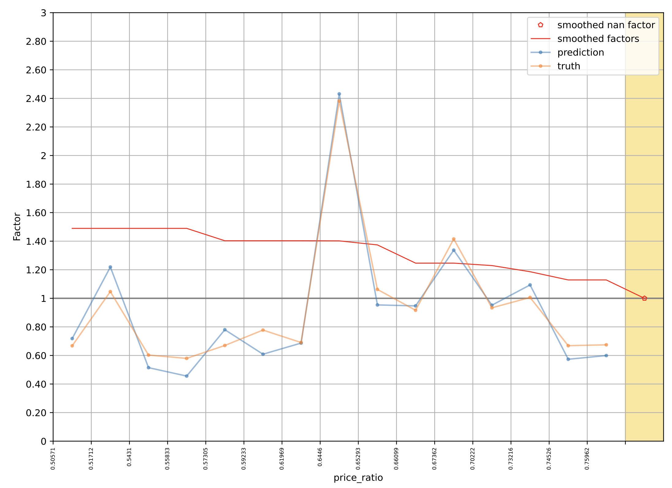

Generalized Additive Models (GAMs)
plots from Cyclic Boosting
sinusoidal functions
blending of Generalized Linear Models and additive models
$$g\left(E\left[Y|X=x_{i}\right]\right)=\hat{α}+\sum_{j=1}^{p}{{\hat{h}}_{j}\left(x_{ij}\right)}$$
smooth functions
potentially non-parametric form
describe non-linear effects
estimated, e.g., via backfitting algorithm
extension: add interaction terms between different features (e.g., different holiday effects for different products)
monotonic requirements

Slide 35

Quantile Regression
estimate quantile $τ$ of distribution instead of conditional mean by minimizing pinball loss instead of squared error loss (choice of loss function defines point estimate):
$\left(1−τ\right)\sum_{y_{i}<{\hat{q}}_{i}}{\left({\hat{q}}_{i}−y_{i}\right)+τ\sum_{y_{i}≥{\hat{q}}_{i}}{\left(y_{i}−{\hat{q}}_{i}\right)}}$
possible with various ML methods, including neural networks and tree-based methods (like random forests or gradient boosting)
different options for prediction of full probability distribution:
approximate from a few predicted quantiles by fitting (assumed distribution or spline) or quantile-parameterized distributions
PDF assumption for model and estimation of its parameters

Slide 36
Ensemble Learning
idea: combine several individual models (often of the same type) to form an ensemble model with better predictive performance than each of its constituents
→ learning in several different ways from the training data
the trainings of the individual constituent models are (kind of) independent
outputs of individual models are combined (e.g., averaged)

Slide 37

Bagging (Bootstrap Aggregating)
idea: train individual models of ensemble on random subsets of the training data (random sample with replacement)
reduces variance of ensemble model compared to individual models
but not bias → use low-bias base models
individual models combined by averaging (regression) or majority voting (classification) → committee of models
example with decision trees:
source

Slide 38
Random Subspace Method
aka feature bagging
idea: train different members (models) of an ensemble method on random subsets of all features (random sample with replacement)
reduce correlation between ensemble members
individual models combined by averaging (regression) or majority voting (classification) → committee of models

Slide 39
Random Forests
ensemble method using
decision trees as individual models (usually, rather large, low-bias decision trees)
combination of bagging and random subspace method (features sampled at each node in the trees)
compared to individual decision trees, random forests
reduce variance → improve accuracy
lose explainability
one of the most popular off-the-shelf ML algorithms (often, good performance with little hyperparameter tuning and data preparation)

Slide 40
Boosting
idea: sequentially learn and combine several “weak” learners (such as small decision trees, but in principle any ML algorithm) to construct a “strong” one
→ gradually (in a greedy fashion) reducing bias of ensemble model
in simple terms:
building a model from the training data, then creating a second model that attempts to correct the errors from the first model, …
→ each subsequent weak learner is forced to concentrate on the examples that are missed by the previous ones in the sequence
not a committee of models:
typically, use simple, high-bias methods as individual models (e.g., small decision trees)
most prominent: AdaBoost, Gradient Boosting

Slide 41

Forward Stagewise Additive Modeling
boosting can be understood as fitting an additive expansion in a set of basis functions (e.g., decision trees): $f\left(x\right)=\sum_{m=1}^{M}{γ_{m}h_{m}\left(x\right)}$
loss minimization of $f\left(x\right)$ computationally expensive → sequentially add and fit individual basis functions without changing already fitted ones
boosting algorithm:
for $m=1$ to $M$:
compute $\underset{h_{m},γ_{m}}{argmin}{\sum_{i=1}^{n}{L\left(y_{i},f_{m−1}\left(x_{i}\right)+γ_{m}h_{m}\left(x_{i}\right)\right)}}$ (initialized with $f_{0}\left(x\right)=0$)
set $f_{m}\left(x\right)=f_{m−1}\left(x\right)+γ_{m}h_{m}\left(x\right)$

Slide 42

AdaBoost (Adaptive Boosting)
iteratively train weak classifiers on weighted data
emphasizing misclassified points (weights increased for incorrect predictions, decreased for correct ones)
combine them into weighted vote (forward stagewise additive modeling )

Slide 43



Gradient Boosting
cost function
loss function
define $ℒ\left(f_{m}\right)=\sum_{i=1}^{n}{L\left(y_{i},f_{m−1}\left(x_{i}\right)+γ_{m}h_{m}\left(x_{i}\right)\right)}$
in forward stagewise additive modeling:
$f_{m}\left(x\right)=\sum_{m=1}^{M}{γ_{m}h_{m}\left(x\right)}$
$\underset{h_{m},γ_{m}}{argmin}{\sum_{i=1}^{n}{L\left(y_{i},f_{m−1}\left(x_{i}\right)+γ_{m}h_{m}\left(x_{i}\right)\right)}}$ for each stage
→ can be hard to solve for general loss function $L$
idea: approximation of $ℒ$ by its Taylor expansion
$ℒ\left(f_{m}\right)≈ℒ\left(f_{m−1}\right)+\sum_{i=1}^{n}{h_{m}(x_{i})∙{\left[\frac{∂L(y_{i},f\left(x_{i}\right))}{∂f\left(x_{i}\right)}\right]}_{f=f_{m−1}}}$
→ decreased by going a step of size $γ_{m}$ (potentially optimized via line search) in the direction $h_{m}\left(x\right)≈{−g}$ (functional gradient descent)
→ find $h_{m}$ by fitting a regression model with targets $−g$ (typically decision tree regressors of fixed size: gradient-boosted decision trees)
works like this for both regression and classification tasks (just different loss functions)
gradient $g$ at $x_{i}$:
constant for this iteration

Slide 44

Decision Tree Sizes for Boosting
consider degree to which features interact with each other in given data set
decision trees with single split (aka decision stumps): covering no interaction effects, just main effects of individual features
decision trees with two splits: covering second-order interactions
decision trees with three splits: covering third-order interactions
(usually, interaction order not much higher than $\sim$5 in real-world data sets)
why boosting often works better than single large, low-bias model: uncorrelated learners, each focusing on a specific aspect of the data

Slide 45


Slide 46

no universally best model
choice depends on
data characteristics
problem requirements
interpretability needs
computational constraints
rule of thumb:
for unstructured data (text, images/video, audio) → deep learning
for tabular data → tree-based ensembles (gradient boosting, random forests)

Slide 47
Practice Project
Kaggle competition: Spaceship Titanic

