Slide 1
Model Evaluation
Data Science

Slide 2
Model Evaluation
classification metrics
regression metrics
feature importance
local explainability
hypothesis testing (separate slide deck)

Slide 3
Evaluation Scenarios
loss function in training: proxy for later test accuracy
model validation: decide on acceptance of model changes by means of accuracy measure → improved model vs baseline (current best)
test (i.e., out-of-sample) accuracy of predictions: the final goal

Slide 4
Classification Metrics
evaluating model performance for classification tasks
different problems require different metrics
choice of metric depends on:
class imbalance
cost of errors
business or domain goals
example: spam detection vs. disease diagnosis → different priorities

Slide 5
Confusion Matrix
foundation for most classification metrics
for binary classification:
other metrics derived from these four values
 | predicted positive | predicted negative
actual positive | True Positive (TP) | False Negative (FN)
actual negative | False Positive (FP) | True Negative (TN)

Slide 6
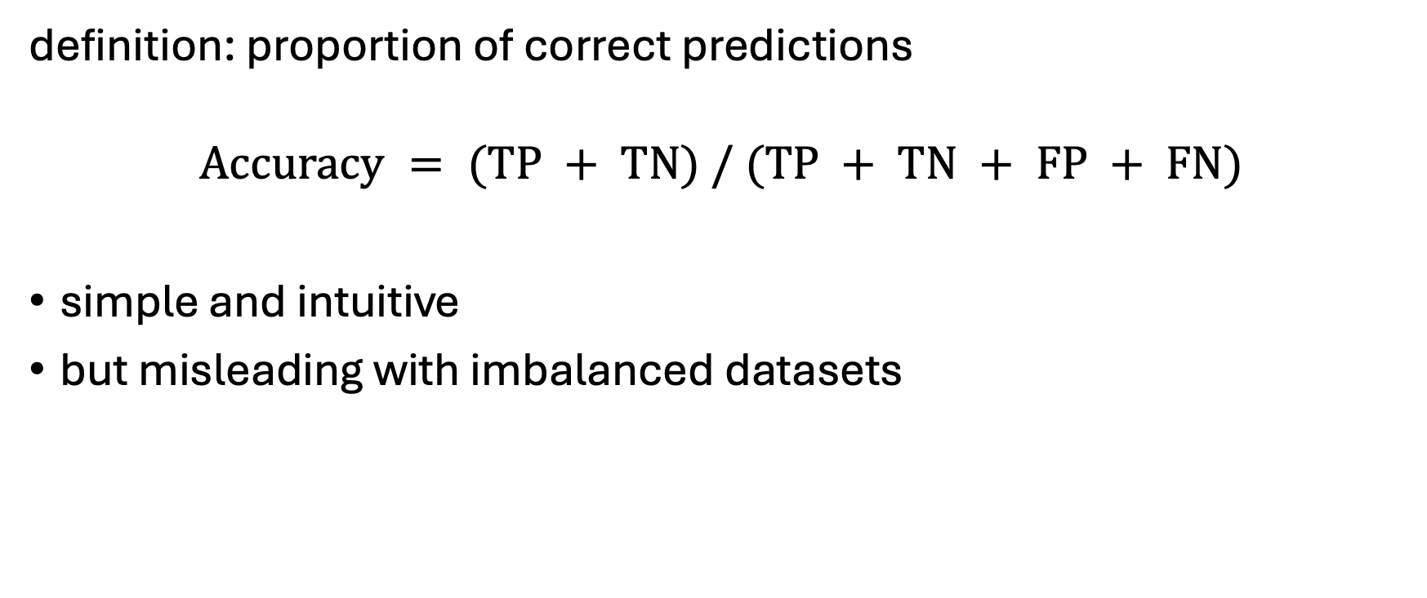
Accuracy
definition: proportion of correct predictions
$$Accuracy = (TP + TN) / (TP + TN + FP + FN)$$
simple and intuitive
but misleading with imbalanced datasets

Slide 7
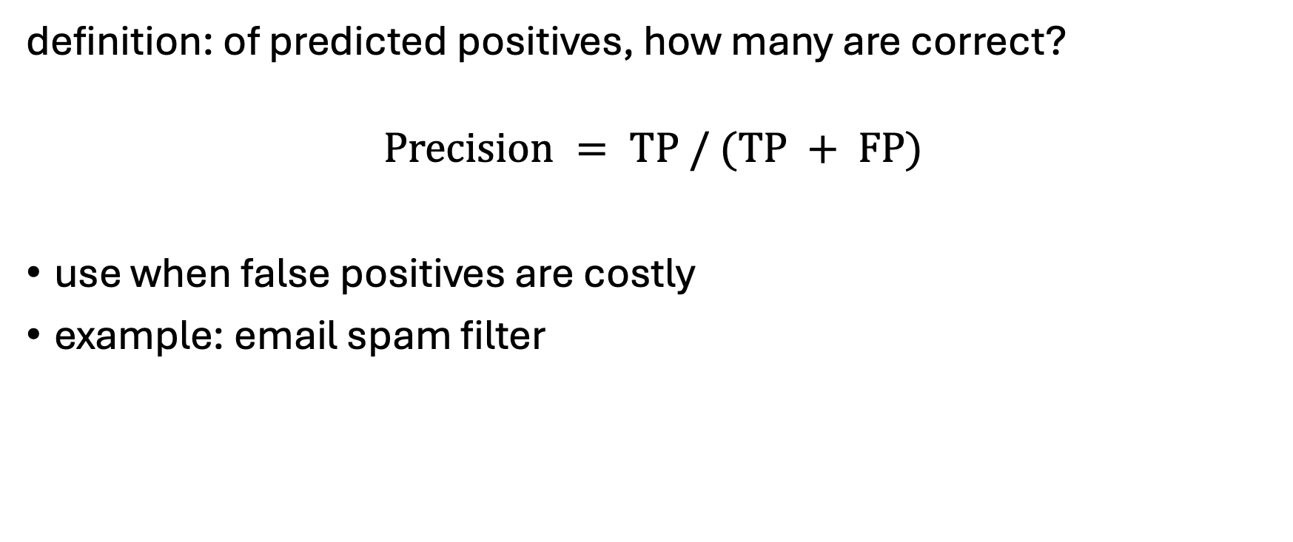
Precision
definition: of predicted positives, how many are correct?
$$Precision = TP / (TP + FP)$$
use when false positives are costly
example: email spam filter

Slide 8
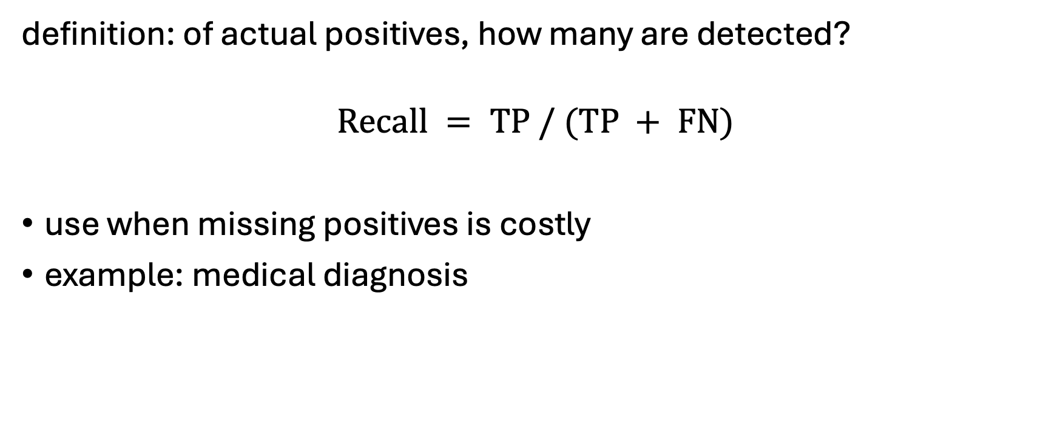
Recall (Sensitivity)
definition: of actual positives, how many are detected?
$$Recall = TP / (TP + FN)$$
use when missing positives is costly
example: medical diagnosis

Slide 9
Precision vs. Recall Trade-off
increasing precision often reduces recall
increasing recall often reduces precision
key idea: threshold tuning controls this trade-off
question to ask: which error matters more?
threshold | predicted positives | precision | recall | inter-pretation
0.3 | high (almost everything classified positive) | low | high | many false positives
0.8 | low (only almost sure cases classified positive) | high | low | only very confident predictions
problem | strategy
spam classification | high precision
cancer diagnosis | high recall

Slide 10
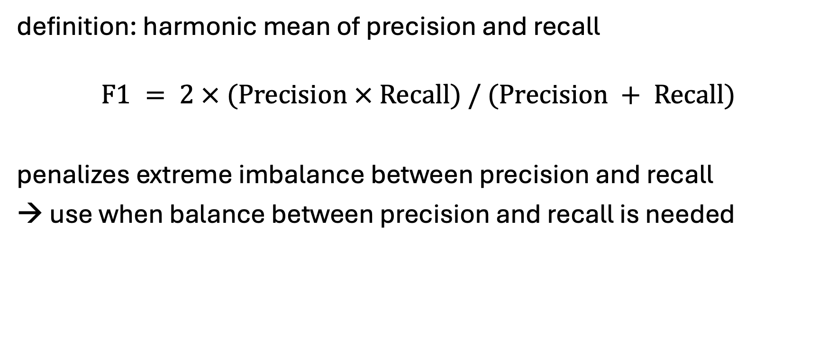
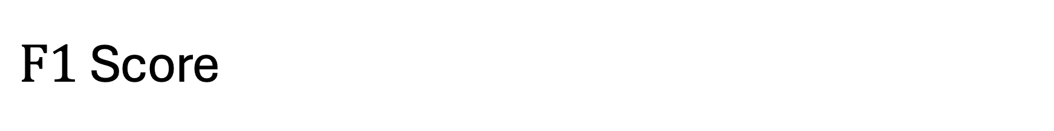
$F1$ Score
definition: harmonic mean of precision and recall
$$F1 = 2 × (Precision × Recall) / (Precision + Recall)$$
penalizes extreme imbalance between precision and recall
→ use when balance between precision and recall is needed

Slide 11
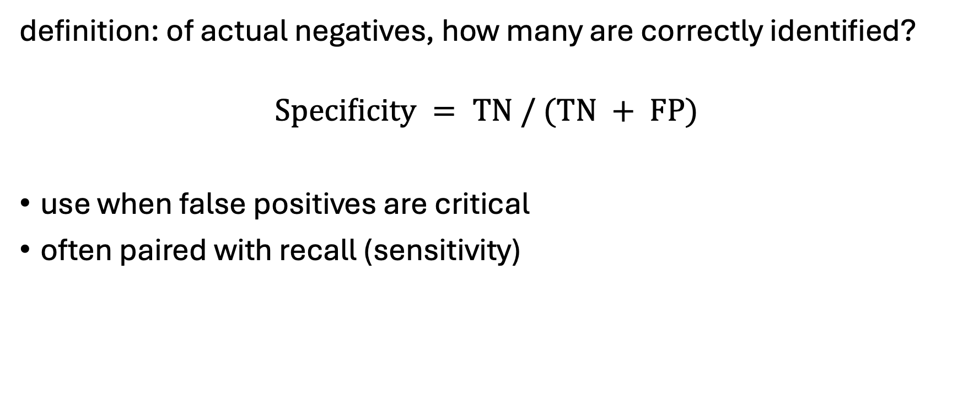
Specificity (True Negative Rate)
definition: of actual negatives, how many are correctly identified?
$$Specificity = TN / (TN + FP)$$
use when false positives are critical
often paired with recall (sensitivity)

Slide 12
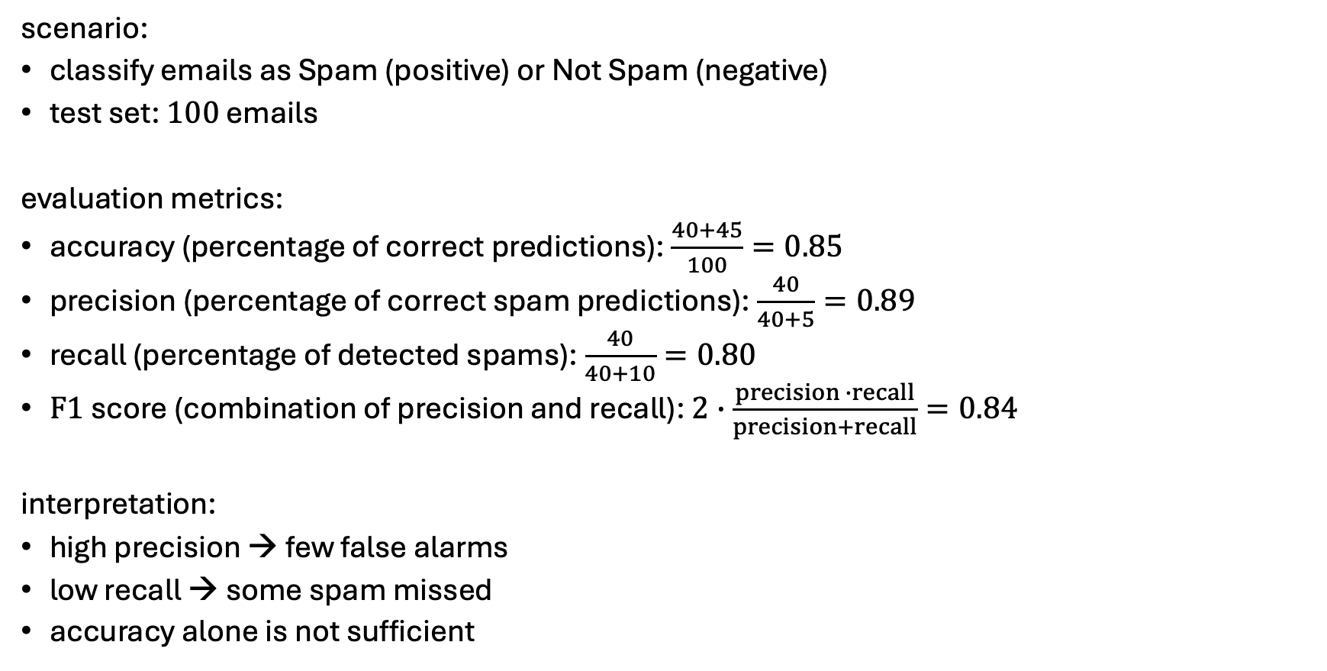
Example: Spam Classification
confusion matrix:
scenario:
classify emails as Spam (positive) or Not Spam (negative)
test set: 100 emails
evaluation metrics:
accuracy (percentage of correct predictions): $\frac{40+45}{100}=0.85$
precision (percentage of correct spam predictions): $\frac{40}{40+5}=0.89$
recall (percentage of detected spams): $\frac{40}{40+10}=0.80$
$F1$ score (combination of precision and recall): $2∙\frac{precision ∙recall}{precision+recall}=0.84$
interpretation:
high precision → few false alarms
low recall → some spam missed
accuracy alone is not sufficient
 | Predicted Spam | Predicted Not Spam
Actual Spam | 40 (TP) | 10 (FN)
Actual Not Spam | 5 (FP) | 45 (TN)

Slide 13
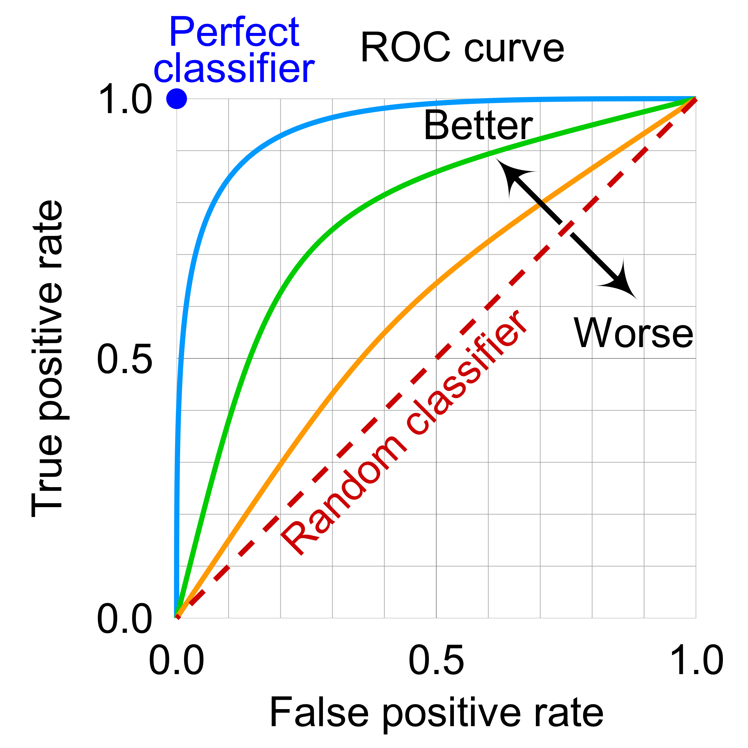
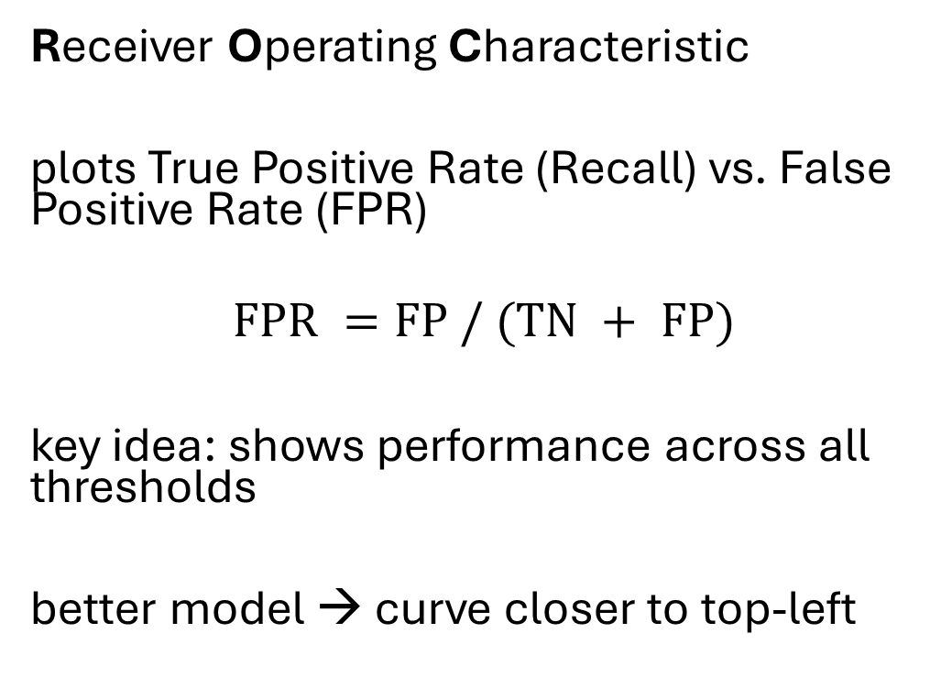

$ROC$ Curve
Receiver Operating Characteristic
plots True Positive Rate (Recall) vs. False Positive Rate (FPR)
$$FPR =FP / (TN + FP)$$
key idea: shows performance across all thresholds
better model → curve closer to top-left

Slide 14

$AUC$ (Area Under Curve)
definition: area under ROC curve
interpretation:
1.0 → perfect model
0.5 → random guessing
advantage: threshold-independent evaluation

Slide 15
Precision-Recall Curve
plots precision vs. recall
important for imbalanced datasets
(ROC can be overly optimistic when classes are skewed)
Example:
99% are „no spam“, model always says „no spam“
ROC may still look „good“ (respects TN)
but precision bad (not def.), recall = 0
PR curve detects that problem (ignores TN)
 | Predicted Spam | Predicted Not Spam
Actual Spam | 0 (TP) | 1 (FN)
Actual Not Spam | 0 (FP) | 99 (TN)

Slide 16
Choosing the Right Metric
balanced dataset → accuracy may suffice
imbalanced dataset → F1, PR curve
high cost of false positives → precision
high cost of false negatives → recall
rule of thumb: always align metric with real-world objective

Slide 17
Regression Metrics
evaluating model performance for continuous predictions
errors: deviations between predicted and actual values
→ How wrong are the predictions?
choice of metric depends on:
sensitivity to outliers (some metrics penalize large errors more heavily)
interpretability
business or domain goals

Slide 18
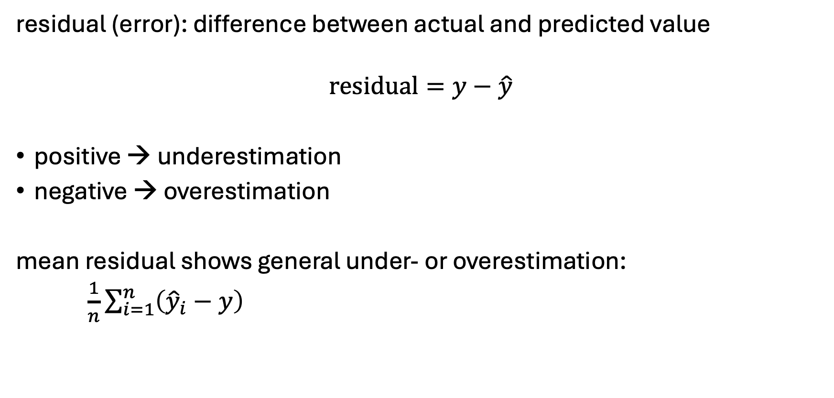
Error Basics
residual (error): difference between actual and predicted value
$$residual=y−\hat{y}$$
positive → underestimation
negative → overestimation
mean residual shows general under- or overestimation:
$\frac{1}{n}\sum_{i=1}^{n}{\left({\hat{y}}_{i}−y\right)}$

Slide 19
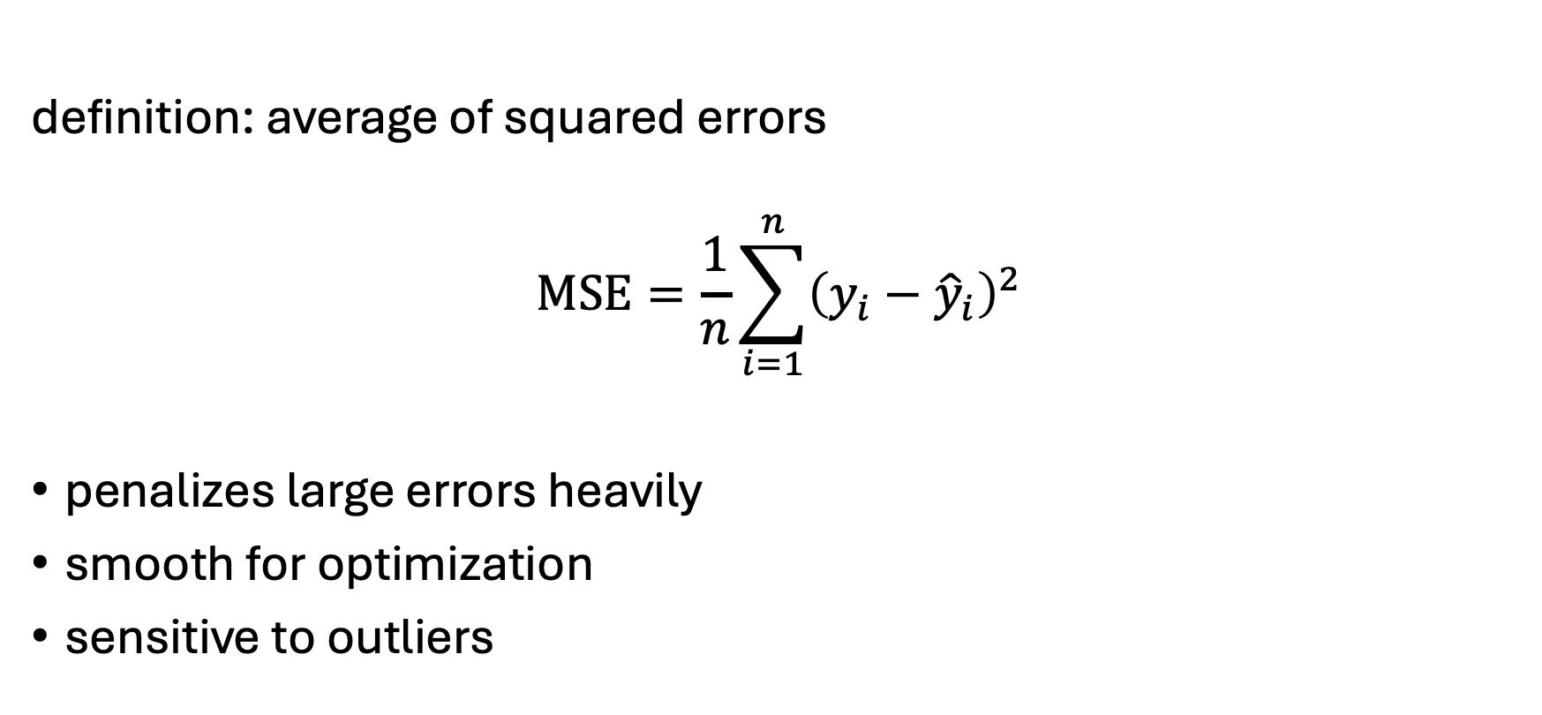
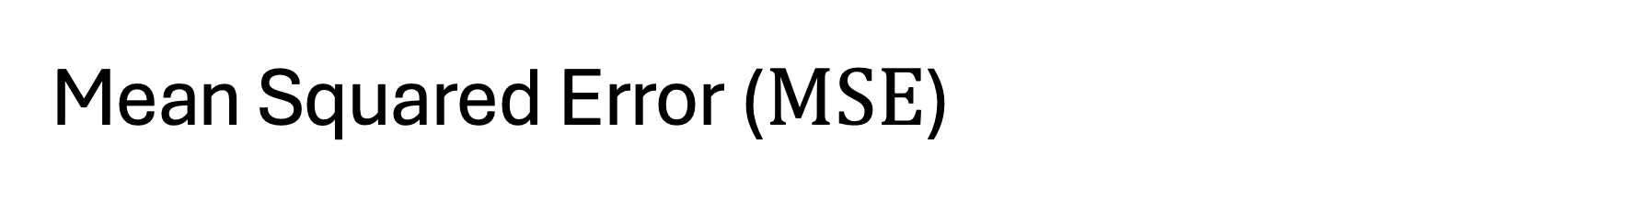
Mean Squared Error ($MSE$)
definition: average of squared errors
$$MSE=\frac{1}{n}\sum_{i=1}^{n}{{\left(y_{i}−{\hat{y}}_{i}\right)}^{2}}$$
penalizes large errors heavily
smooth for optimization
sensitive to outliers

Slide 20
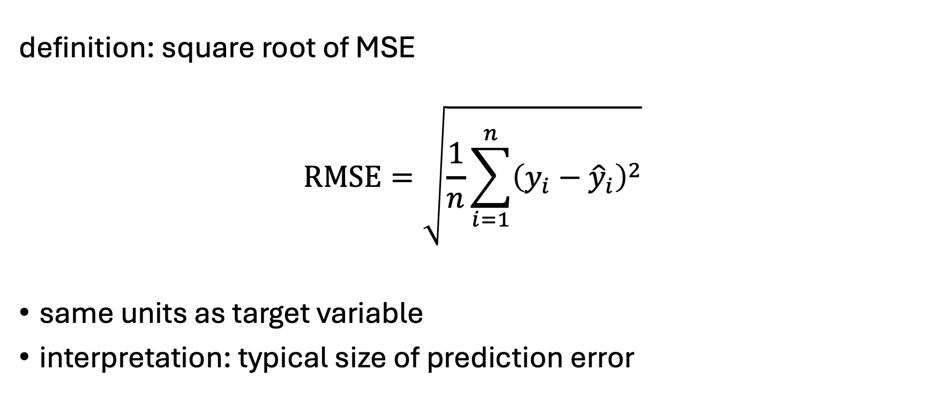

Root Mean Squared Error ($RMSE$)
definition: square root of MSE
$$RMSE=\sqrt{\frac{1}{n}\sum_{i=1}^{n}{{\left(y_{i}−{\hat{y}}_{i}\right)}^{2}}}$$
same units as target variable
interpretation: typical size of prediction error

Slide 21
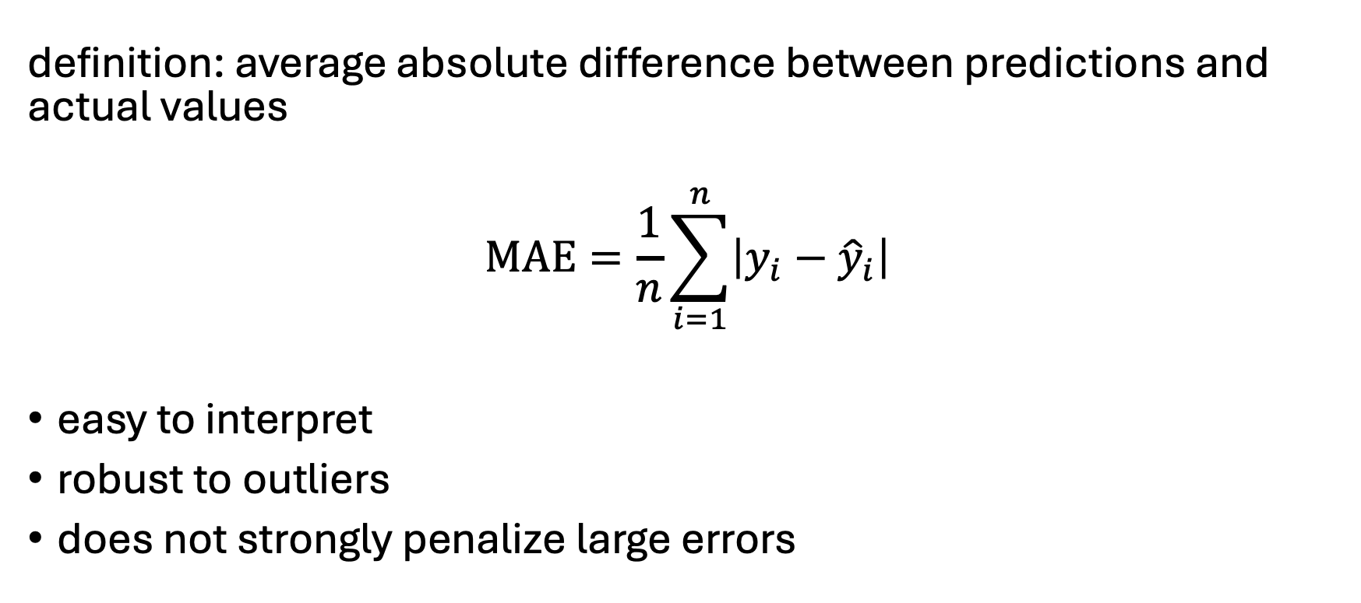
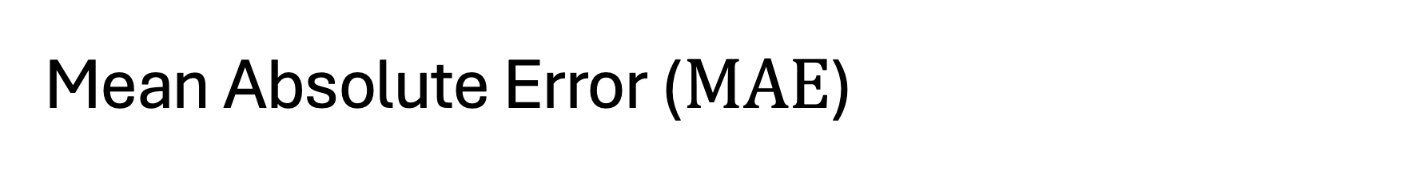

Mean Absolute Error ($MAE$)
definition: average absolute difference between predictions and actual values
$$MAE=\frac{1}{n}\sum_{i=1}^{n}{\left|y_{i}−{\hat{y}}_{i}\right|}$$
easy to interpret
robust to outliers
does not strongly penalize large errors
aka $MAD$

Slide 22
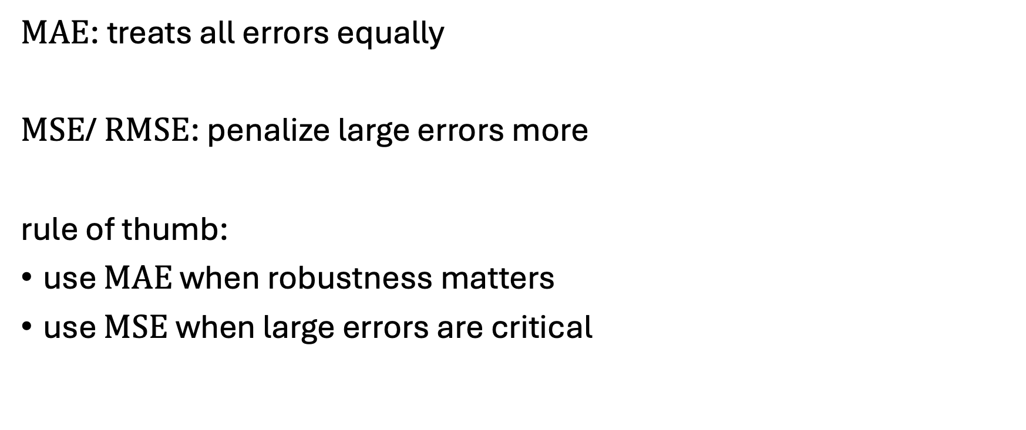

$MAE$ vs. $MSE$/$RMSE$
$MAE$: treats all errors equally
$MSE$/ $RMSE$: penalize large errors more
rule of thumb:
use $MAE$ when robustness matters
use $MSE$ when large errors are critical

Slide 23
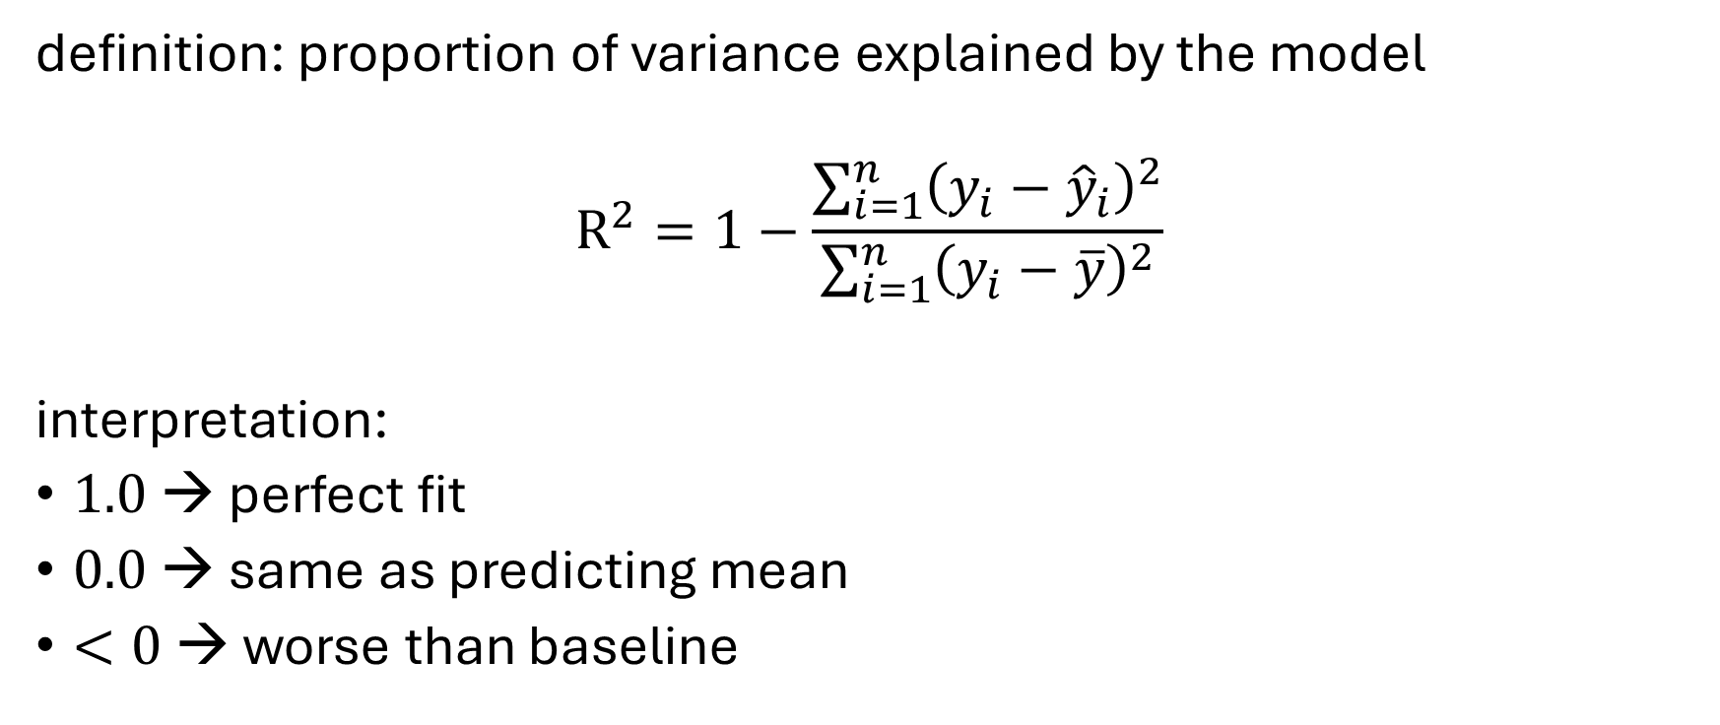
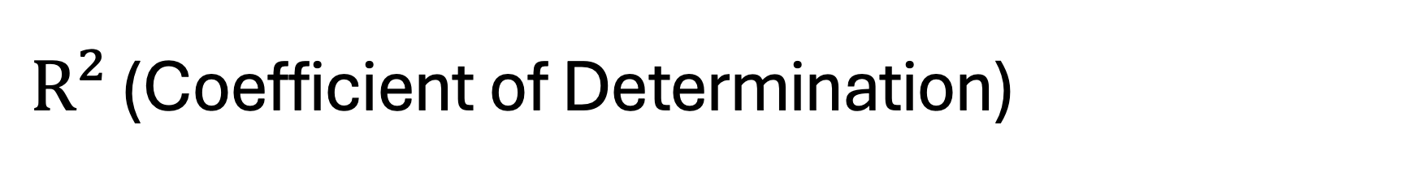
$R²$ (Coefficient of Determination)
definition: proportion of variance explained by the model
$$R^{2}=1−\frac{\sum_{i=1}^{n}{{\left(y_{i}−{\hat{y}}_{i}\right)}^{2}}}{\sum_{i=1}^{n}{{\left(y_{i}−\overline{y}\right)}^{2}}}$$
interpretation:
$1.0$ → perfect fit
$0.0$ → same as predicting mean
$<0$ → worse than baseline

Slide 24
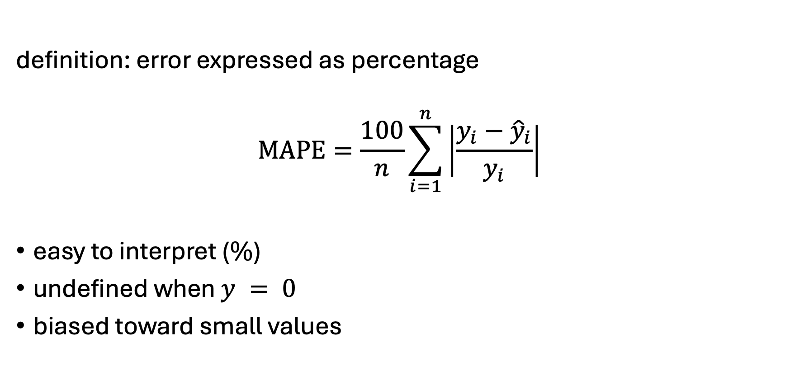
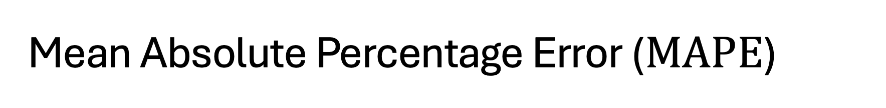
Mean Absolute Percentage Error ($MAPE$)
definition: error expressed as percentage
$$MAPE=\frac{100}{n}\sum_{i=1}^{n}{\left|\frac{y_{i}−{\hat{y}}_{i}}{y_{i}}\right|}$$
easy to interpret ($\%$)
undefined when $y = 0$
biased toward small values

Slide 25
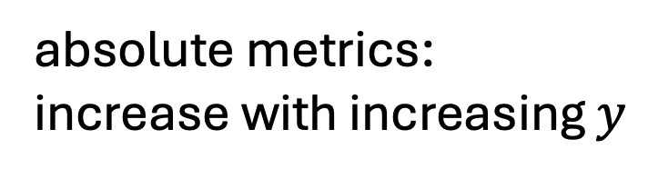
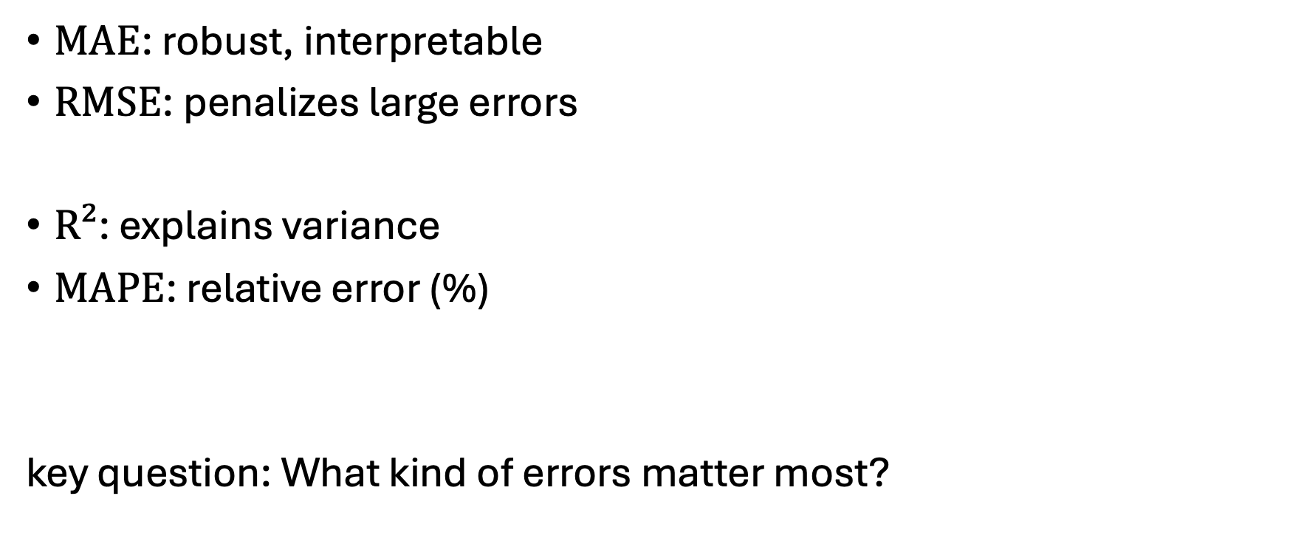
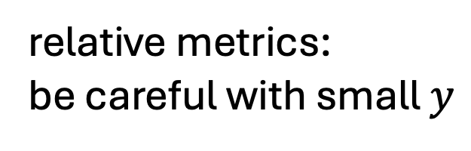
Choosing the Right Metric
$MAE$: robust, interpretable
$RMSE$: penalizes large errors
$R²$: explains variance
$MAPE$: relative error (%)
key question: What kind of errors matter most?
absolute metrics:
increase with increasing $y$
relative metrics:
be careful with small $y$

Slide 26
Point Estimates vs. Full PDF
all considered metrics describe point estimates
typically for the mean or median of the assumed probability distribution
metrics for evaluation of predictions of full individual (i.e., for each observation) probability distributions a bit tricky
as discussed before, estimation of full individual PDFs typically requires estimation of additional parameters
mean estimate, homoscedasticity assumption, and assumption of underlying PDF (for example Gaussian in linear regression) not truly individual

Slide 27
Histogram of CDF Observations
individual prediction/observation:
many (or all) predictions/observations:
predicted PDF
→ predicted CDF
subtlety for discrete PDFs:
histogram filled using random numbers according to the CDF intervals (e.g., for 3 actual sales: random pick between discrete CDF values for 2 and 3)
observation (target)
for each sample

Slide 28
Interpretation of CDF Histogram
if all is fine …
quantitative evaluation: measure deviation from uniform distribution (e.g., earth mover’s distance)

Slide 29
Feature Importance
goal: understand which inputs drive model predictions
improves model interpretability
helps with feature selection, debugging models, trust & transparency
distinguish:
model-specific (built-in) vs. model-agnostic (external) methods
global (overall influence across dataset) vs. local (influence for a single prediction) importance (example: age may be globally important, but not important for a specific individual)

Slide 30
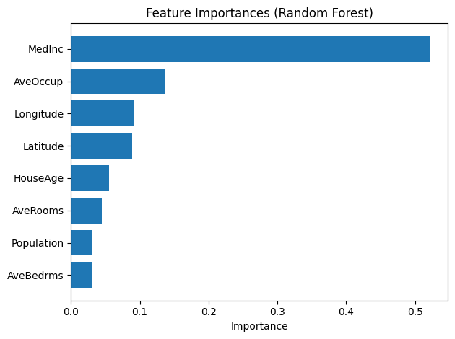
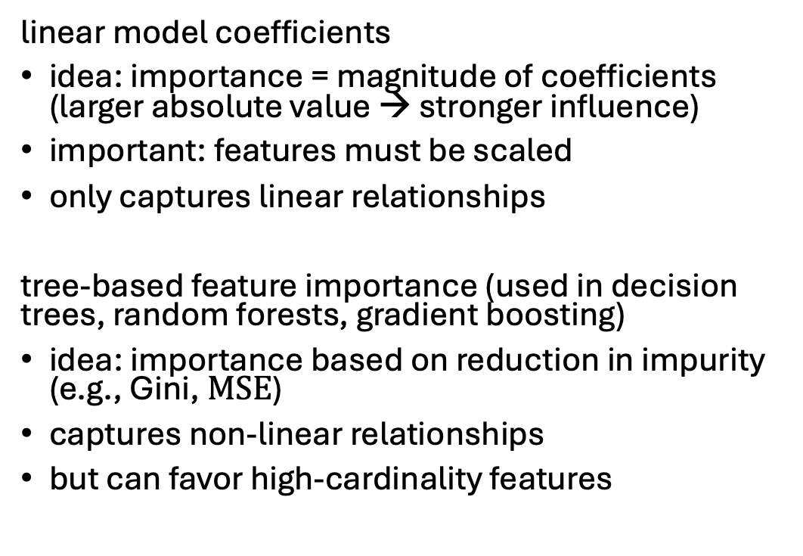
Model-Specific Importance
linear model coefficients
idea: importance = magnitude of coefficients (larger absolute value → stronger influence)
important: features must be scaled
only captures linear relationships
tree-based feature importance (used in decision trees, random forests, gradient boosting)
idea: importance based on reduction in impurity (e.g., Gini, $MSE$)
captures non-linear relationships
but can favor high-cardinality features

Slide 31
Model-Agnostic Explainability
most prominent method: permutation importance
idea: shuffle one feature and measure performance drop
train model
shuffle feature values
measure performance decrease
larger drop → more important feature
easy to understand
but computationally expensive and affected by correlated features

Slide 32
Local Explainability
do not confuse explainability with causality
→ explanations can be misleading
explaining individual predictions:
Why did the model make this prediction?
builds trust in model decisions
critical in healthcare, finance, legal systems, …
straight-forward for trees or linear models
but not for complex models like neural networks (black-box models)
→ need for model-agnostic methods to explain black-box models

Slide 33
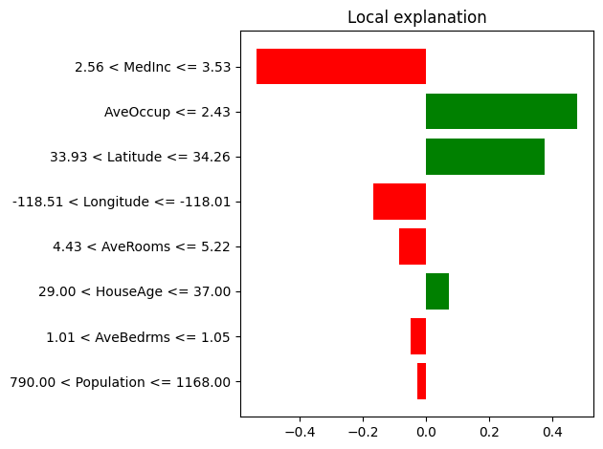
LIME (Local Interpretable Model-Agnostic Explanations)
idea: approximate model locally with simple model (aka local surrogate)
sample nearby data points
get predictions
fit interpretable model (e.g., linear)
output: feature contributions for one prediction
discretization into bins

Slide 34
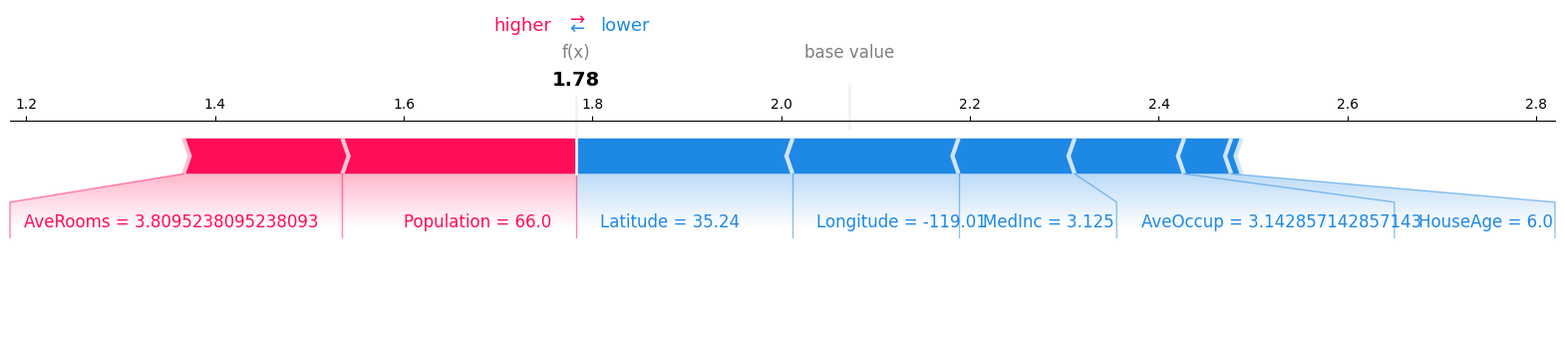
SHAP (SHapley Additive exPlanations)
idea based on game theory (Shapley values)
key concept: fair contribution of each feature
output: contribution values per feature, sum = model prediction
positive value → pushes prediction higher
negative value → pushes prediction lower
consistent and theoretically grounded, works for many model types

Slide 35
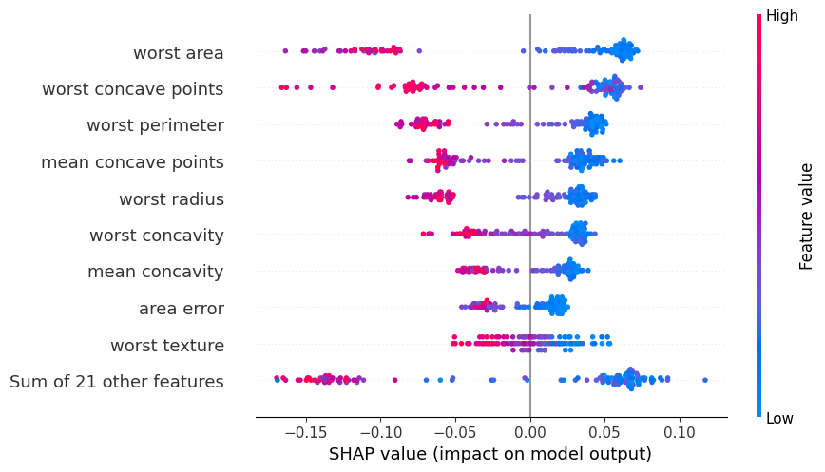
Global SHAP Explanation
aggregation of local SHAP values

Slide 36
LIME vs. SHAP
LIME:
faster, simpler
local approximation
SHAP:
more consistent
computationally heavier
→ trade-off: speed vs. theoretical guarantees
for both: correlated features complicate interpretation

