Slide 1
Causality
Data Science

Slide 2
Causality
causal inference
confounding
DAG
do-formalism
counterfactuals
inverse propensity score weighting for ML

Slide 3

Why Causality Matters
story behind the data as important as the data itself
Why are the statistical dependencies as observed?
data-generating process mostly governed by causal dependencies
but language of algebra symmetric
no way to tell that a storm causes barometer to go down and not the other way around → need for asymmetric mathematical language

Slide 4
Probabilistic and Causal Models
aka prediction
probabilistic inference
probabilistic model
What will happen?
observations
statistical learning
aka ML
subsumes
subsumes
causal inference
observations &
interventions &
imagination
causal model
Which causal structure is behind the data?
causal discovery
from Elements of Causal Inference (Peters, Janzing, Schölkopf)
Probabilistic models describe patterns in observed data. Causal models describe cause-and-effect relationships and also allow for interventions and counterfactuals.

Slide 5
Probabilistic Graphical Model
Directed Acyclic Graph (DAG): random variables (nodes) and their (conditional) dependencies (edges)
Bayesian network: DAG with updates on new evidence according to Bayes’ rule (belief propagation)
message from parent to child: update using conditional probabilities
message from child to parent: update by multiplication with likelihood ratio
from wikipedia

Slide 6
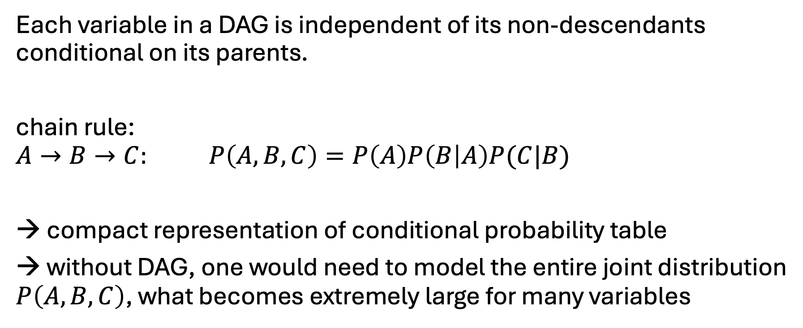
Markov Property
Each variable in a DAG is independent of its non-descendants conditional on its parents.
chain rule:
$$A→B→C: P\left(A,B,C\right)=P\left(A\right)P\left(B | A\right)P(C|B)$$
compact representation of conditional probability table
→ without DAG, one would need to model the entire joint distribution $P\left(A,B,C\right)$, what becomes extremely large for many variables

Slide 7
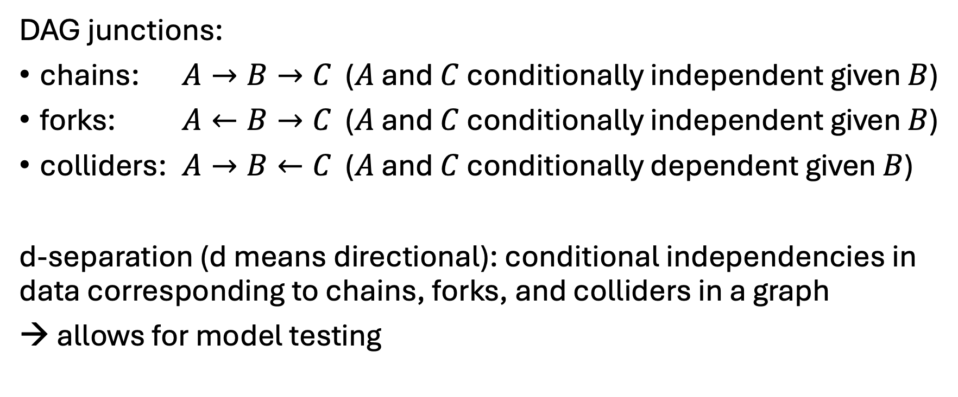
Conditional Independencies
DAG junctions:
chains: $A→B→C$ ($A$ and $C$ conditionally independent given $B$)
forks: $A←B→C$ ($A$ and $C$ conditionally independent given $B$)
colliders: $A→B←C$ ($A$ and $C$ conditionally dependent given $B$)
d-separation (d means directional): conditional independencies in data corresponding to chains, forks, and colliders in a graph
→ allows for model testing

Slide 8
Toward Causal Diagrams
load graph with causal assumptions (model)
→ arrows give direction of cause-effect relationships
causal Markov property: Each variable in a causal graph is probabilistically independent of its non-effects conditional on its direct causes.
causal models (represented by graphs) allow to answer interventional and counterfactual (fictional) queries
often even without conducting experiments

Slide 9
The Ladder of Causation
III imagining counterfactuals What if I had done ...? Why?
II doing intervention What if I do ...? How?
I seeing association What if I see ...? → Realm of ML
from The Book of Why (Pearl, MacKenzie)
Example:
III What would have happened if I hadn't sent the customer a voucher?
II What happens when I send vouchers?
I What do I see? Shoppers with vouchers spend more.

Slide 10
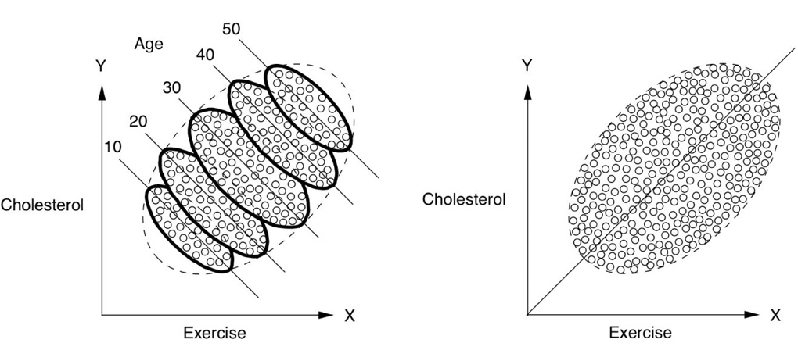
Simpson’s Paradox
example: monthly sales of a fashion article in different shops during winter season
Lower price yields higher sales for each month individually, but lower sales overall?
months since start of season
1
all data together ignoring monthly information
2
month is a hidden influencing factor on both variables:
sales
month
price
3
4
sales
sales
from The Book of Why (Pearl, MacKenzie)
price
price

Slide 11

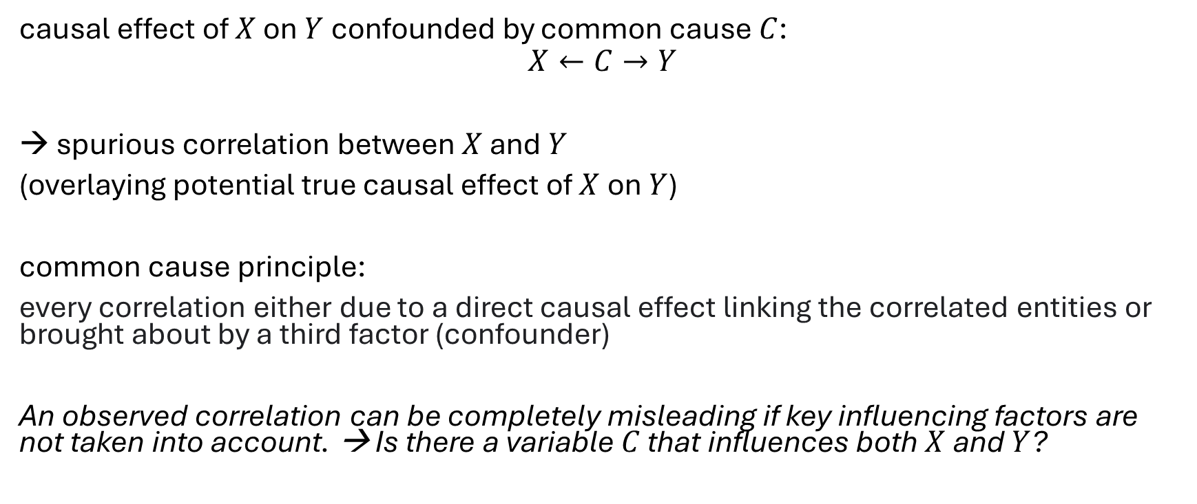


Confounding
$$C$$
causal effect of $X$ on $Y$ confounded by common cause $C$:
$$X←C→Y$$
spurious correlation between $X$ and $Y$
(overlaying potential true causal effect of $X$ on $Y$)
common cause principle:
every correlation either due to a direct causal effect linking the correlated entities or brought about by a third factor (confounder)
An observed correlation can be completely misleading if key influencing factors are not taken into account. → Is there a variable $C$ that influences both $X$ and $Y$?
$$X$$
$$Y$$

Slide 12
Example: Pricing in Retail
price setting for a product can be considered a demand shaping method
the idea is a causal effect: lower price leads to higher demand
→ by estimating this causal effect, one can find an optimal price according to a given policy (like maximizing profit)
problem: confounders influencing both pricing in past (obverved) data and demand, e.g., lowering prices on weekends only for grocery or lowering prices toward end of a season for fashion (most sales at beginning of season)

Slide 13
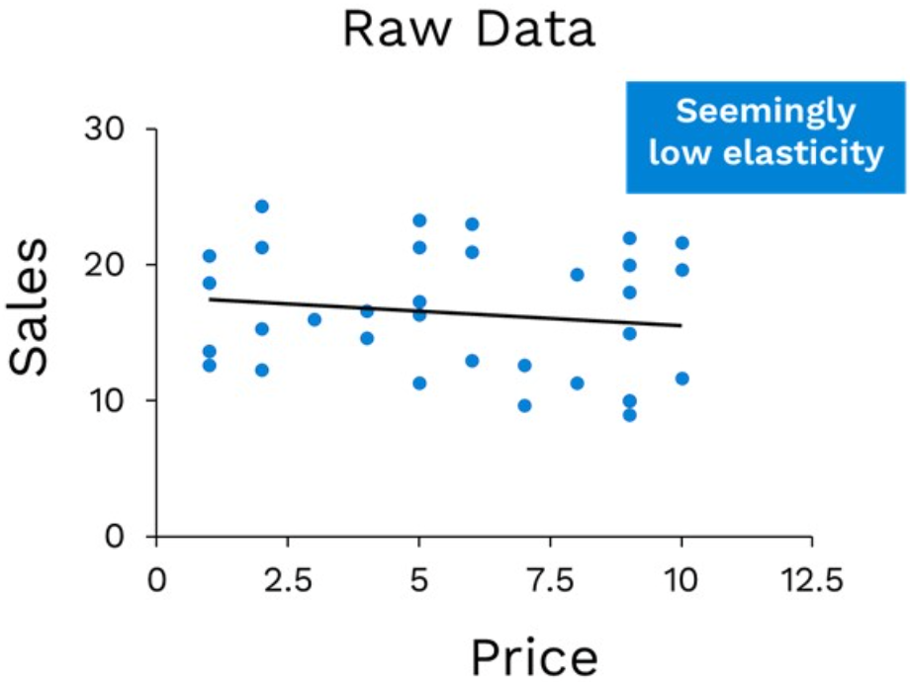
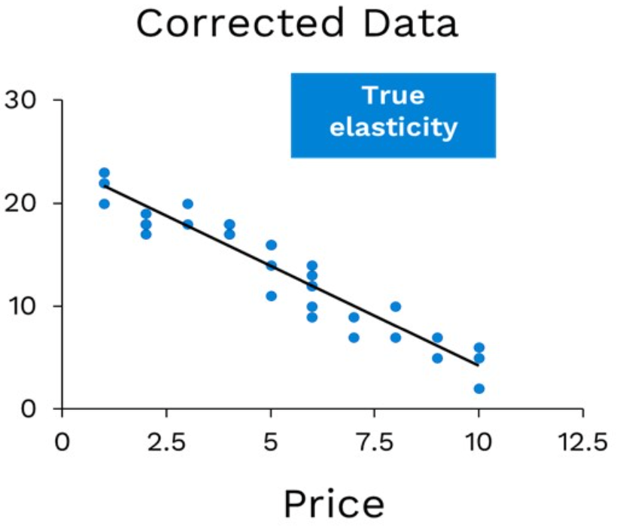
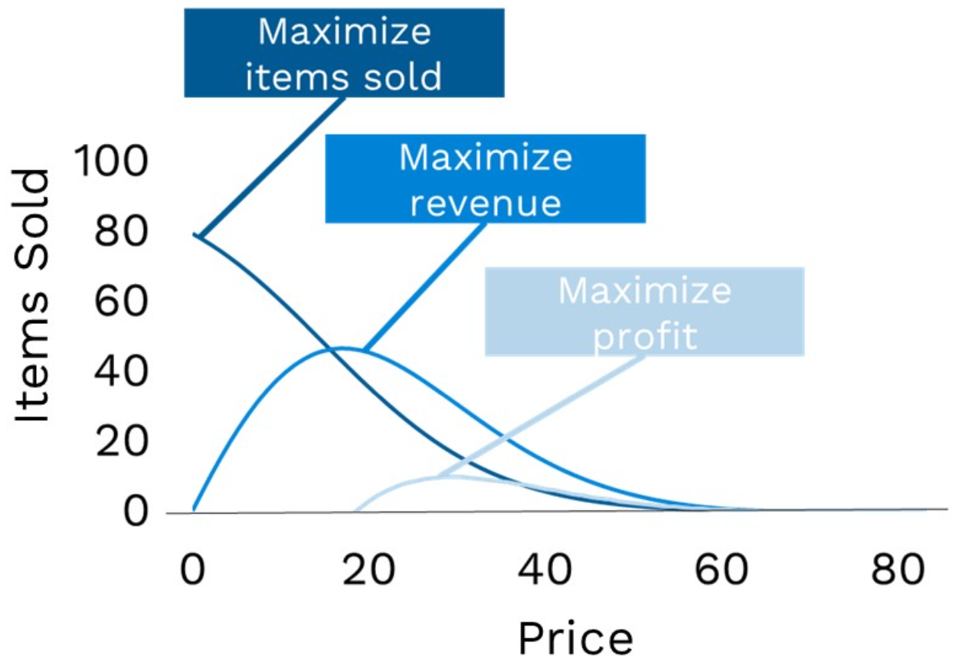
Demand Shaping with Causal Inference
dynamic pricing:
influencing demand of different products by price setting
confounded effect:
after de-confounding:
use for pricing policies:
usually exponential

Slide 14
Interventions vs Observations
goal: prediction of (average) causal effect of (yet untried) actions (interventions)
two ways:
intervene via randomized controlled trials (RCT): set action randomly and check effect → physically disassociate cause from confounders
causal model: emulating interventions by smart calculations → predict effects of potential interventions from observational studies only, i.e., without experiment

Slide 15
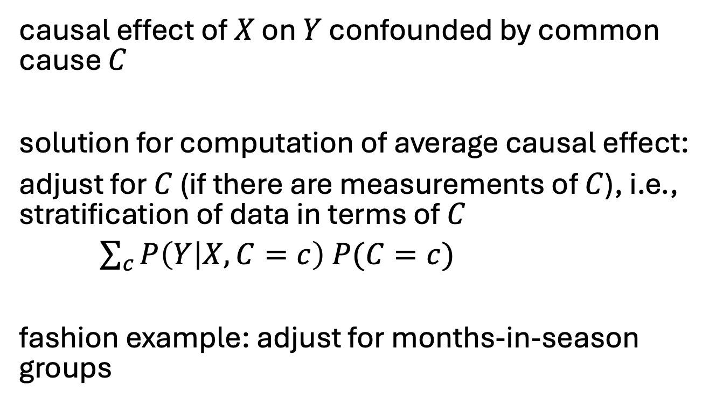
Solution for Average Causal Effects
causal effect of $X$ on $Y$ confounded by common cause $C$
solution for computation of average causal effect:
adjust for $C$ (if there are measurements of $C$), i.e., stratification of data in terms of $C$
$\sum_{c}{P\left(Y | X,C=c\right) P(C=c)}$
fashion example: adjust for months-in-season groups
$$C$$
$$X$$
$$Y$$

Slide 16



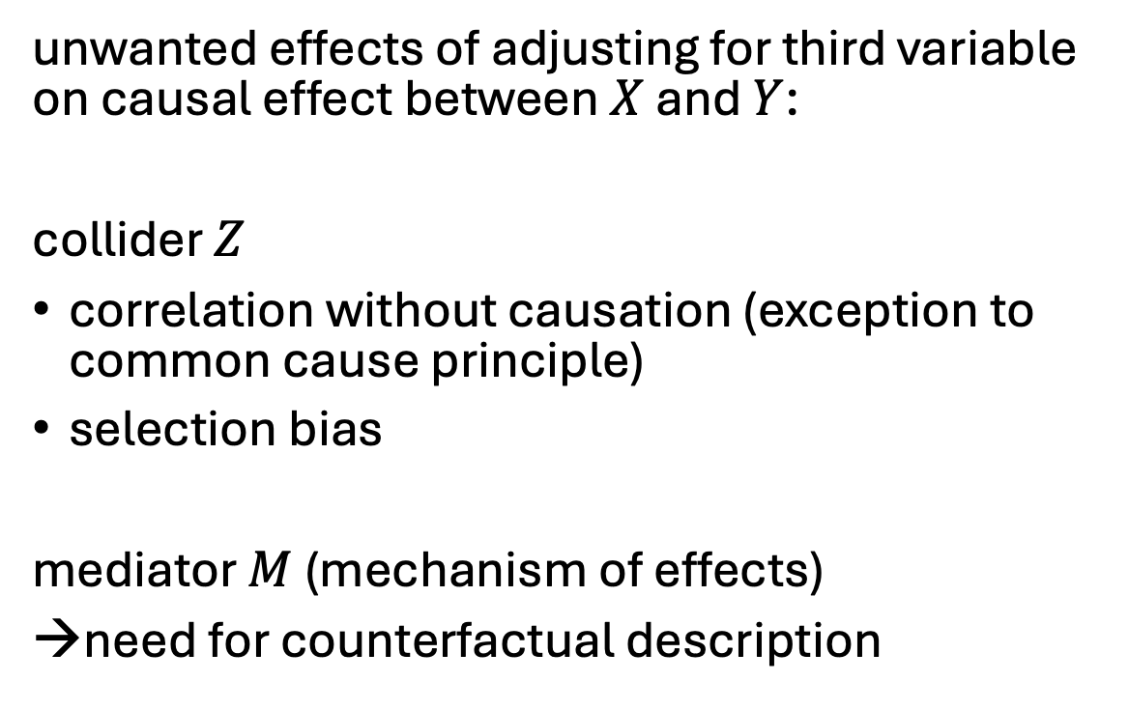



Colliders and Mediators
$$X$$
$$Y$$
unwanted effects of adjusting for third variable on causal effect between $X$ and $Y$:
collider $Z$
correlation without causation (exception to common cause principle)
selection bias
mediator $M$ (mechanism of effects)
→need for counterfactual description
$$Z$$
$$M$$
indirect causal effect
$$X$$
direct causal effect
$$Y$$

Slide 17
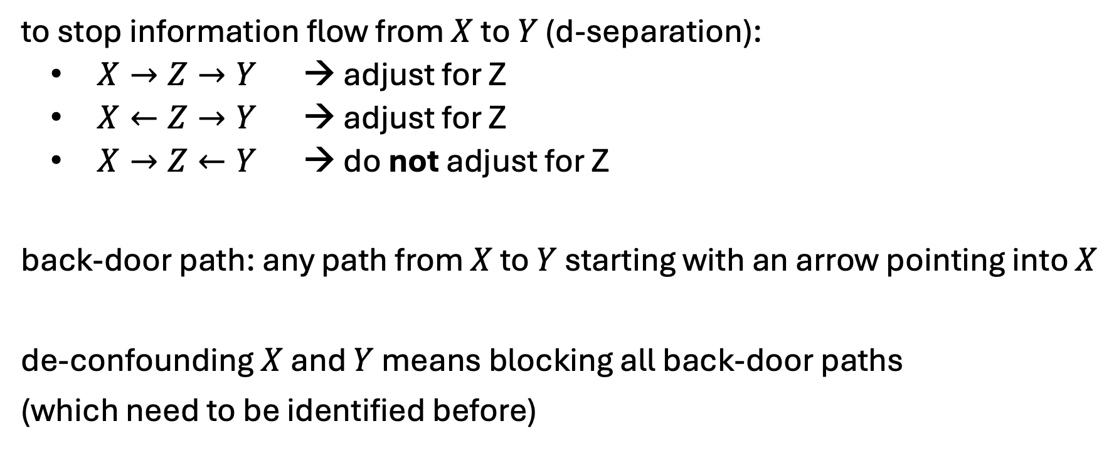
Backdoor Criterion
to stop information flow from $X$ to $Y$ (d-separation):
$X→Z→Y$ → adjust for Z
$X←Z→Y$ → adjust for Z
$X→Z←Y$ → do not adjust for Z
back-door path: any path from $X$ to $Y$ starting with an arrow pointing into $X$
de-confounding $X$ and $Y$ means blocking all back-door paths
(which need to be identified before)

Slide 18
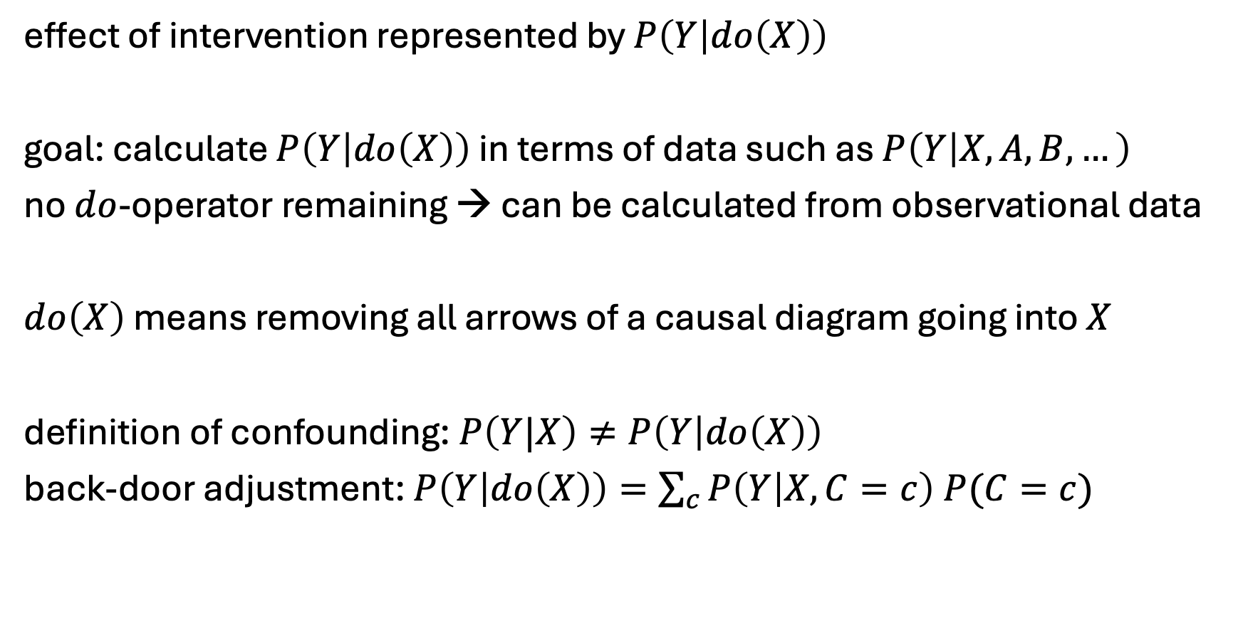
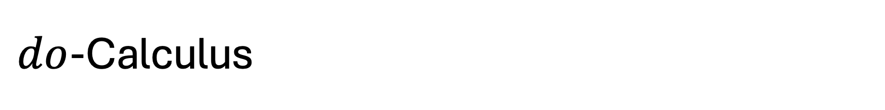
$do$-Calculus
effect of intervention represented by $P\left(Y | do\left(X\right)\right)$
goal: calculate $P\left(Y | do\left(X\right)\right)$ in terms of data such as $P\left(Y | X,A,B,…\right)$
no $do$-operator remaining → can be calculated from observational data
$do\left(X\right)$ means removing all arrows of a causal diagram going into $X$
definition of confounding: $P\left(Y|X\right)≠P\left(Y | do\left(X\right)\right)$
back-door adjustment: $P\left(Y | do\left(X\right)\right)=\sum_{c}{P\left(Y | X,C=c\right) P(C=c)}$

Slide 19

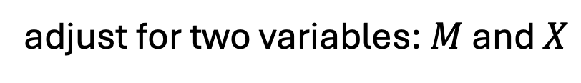
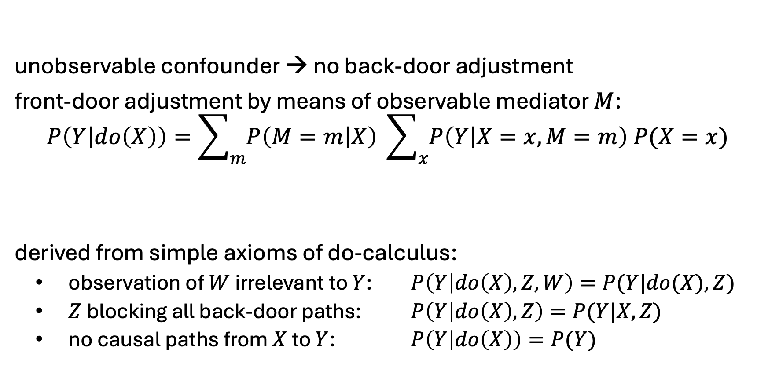



Frontdoor Criterion
$$C$$
unobservable confounder → no back-door adjustment
front-door adjustment by means of observable mediator $M$:
$$P\left(Y | do\left(X\right)\right)=\sum_{m}{P\left(M=m | X\right)} \sum_{x}{P\left(Y | X=x,M=m\right) P(X=x)}$$
derived from simple axioms of do-calculus:
observation of $W$ irrelevant to $Y$: $P\left(Y | do\left(X\right),Z,W\right)=P(Y|do(X),Z)$
$Z$ blocking all back-door paths: $P\left(Y | do\left(X\right),Z\right)=P(Y|X,Z)$
no causal paths from $X$ to $Y$: $P\left(Y | do\left(X\right)\right)=P(Y)$
$$X$$
$$M$$
$$Y$$
adjust for two variables: $M$ and $X$

Slide 20
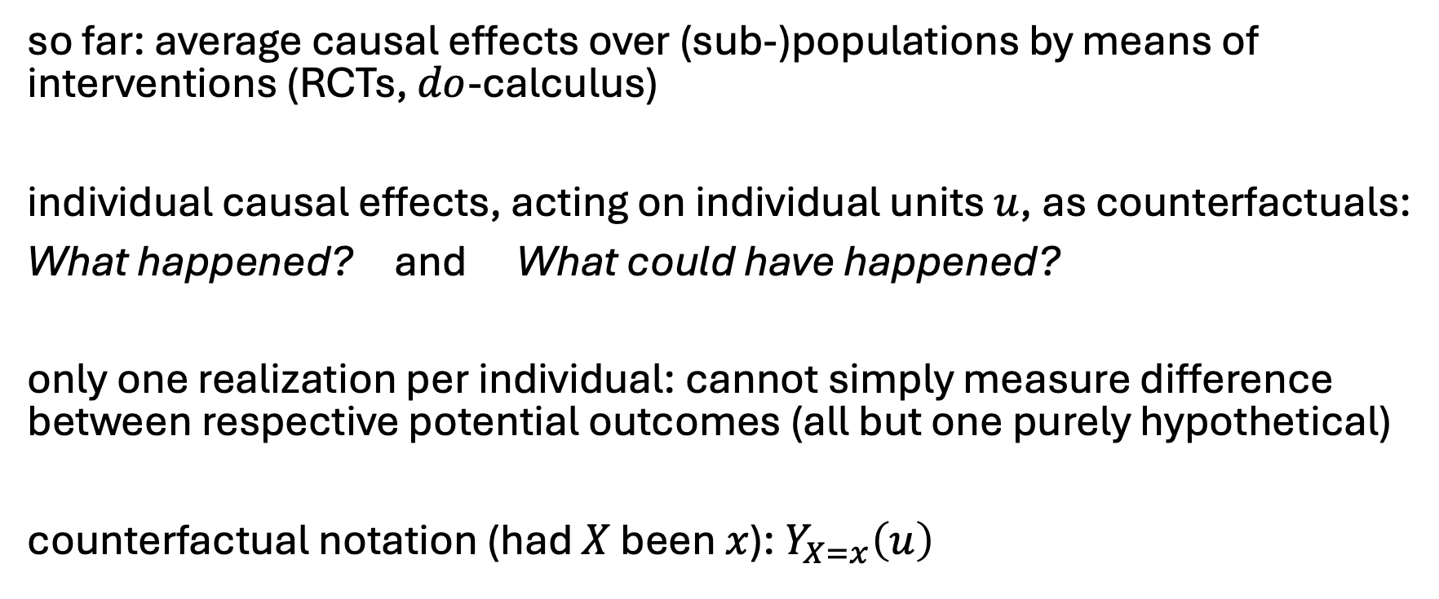
Counterfactuals
so far: average causal effects over (sub-)populations by means of interventions (RCTs, $do$-calculus)
individual causal effects, acting on individual units $u$, as counterfactuals:
What happened? and What could have happened?
only one realization per individual: cannot simply measure difference between respective potential outcomes (all but one purely hypothetical)
counterfactual notation (had $X$ been $x$): $Y_{X=x}\left(u\right)$

Slide 21
Estimation of Individual Causal Effects
impossible to correctly estimate individual causal effects by means of statistical interpolation techniques (impute missing data of potential outcomes)
→ need for additional causal assumptions (a causal model)
two different approaches:
structural causal models (Pearl): guided by causal graph and response functions
Rubin causal model (potential outcomes): guided by structural assumptions (e.g., the need for adjusting for all confounders)

Slide 22

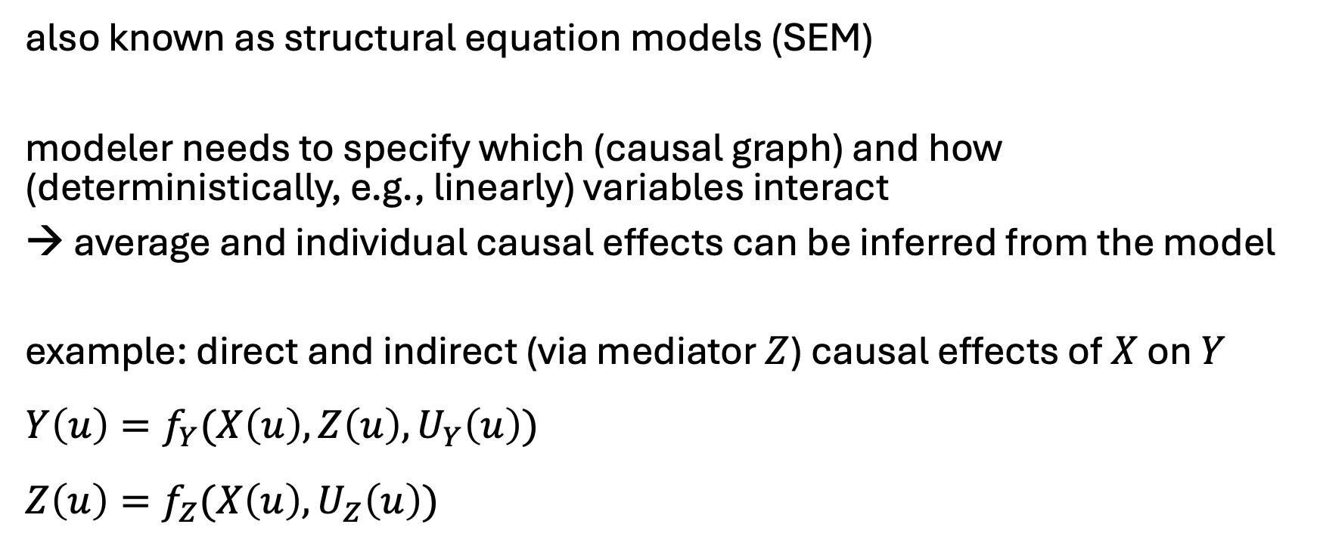
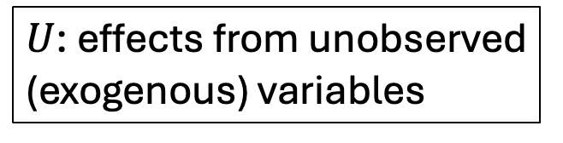


Structural Causal Models (SCM)
also known as structural equation models (SEM)
modeler needs to specify which (causal graph) and how (deterministically, e.g., linearly) variables interact
→ average and individual causal effects can be inferred from the model
example: direct and indirect (via mediator $Z$) causal effects of $X$ on $Y$
$$Y\left(u\right)=f_{Y}(X\left(u\right),Z\left(u\right),U_{Y}\left(u\right))$$
$$Z\left(u\right)=f_{Z}(X\left(u\right),U_{Z}\left(u\right))$$
$$Z$$
$U$: effects from unobserved (exogenous) variables
$$X$$
$$Y$$

Slide 23
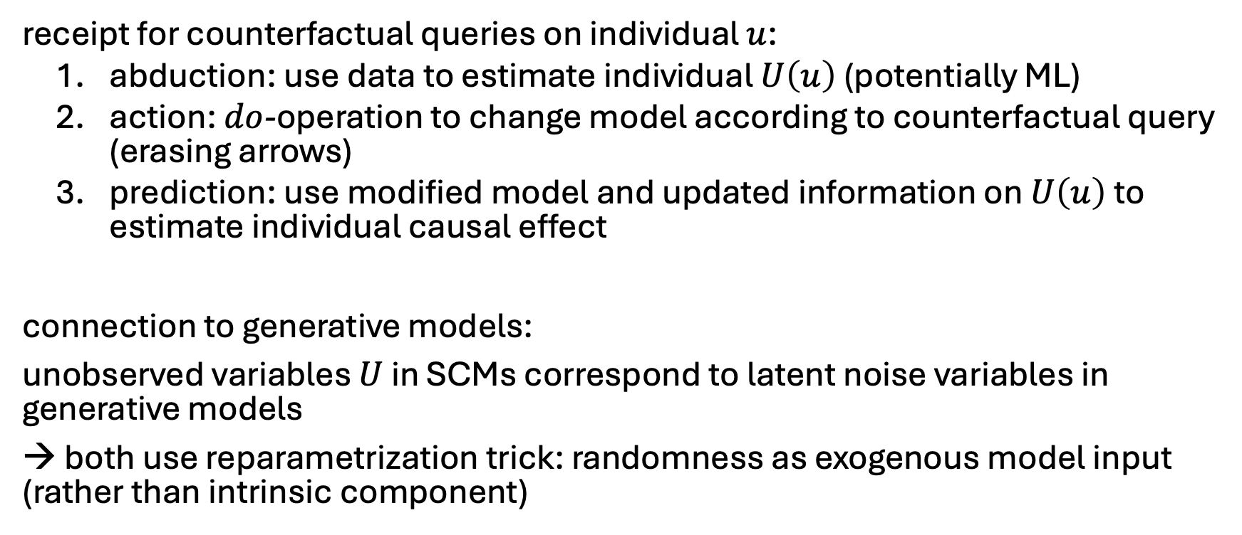
Counterfactual Queries in SCM
receipt for counterfactual queries on individual $u$:
abduction: use data to estimate individual $U\left(u\right)$ (potentially ML)
action: $do$-operation to change model according to counterfactual query (erasing arrows)
prediction: use modified model and updated information on $U\left(u\right)$ to estimate individual causal effect
connection to generative models:
unobserved variables $U$ in SCMs correspond to latent noise variables in generative models
→ both use reparametrization trick: randomness as exogenous model input (rather than intrinsic component)

Slide 24
Potential Outcomes with ML
deconfounding
by RCTs or
independence weights (inverse propensity scores)
prediction of individual causal effect with ML model
(generalization by function approximation)

Slide 25
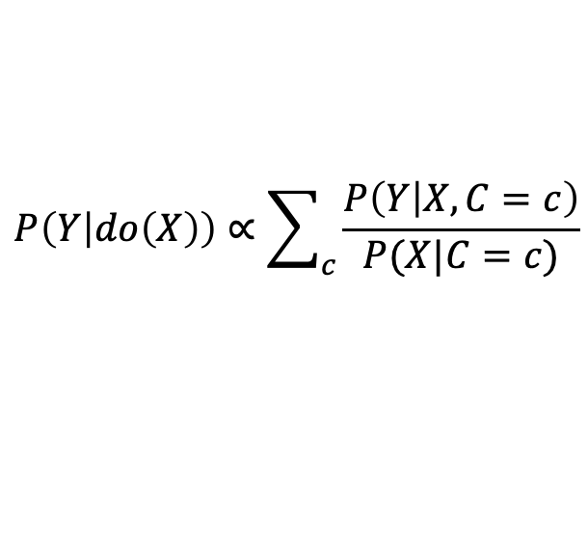
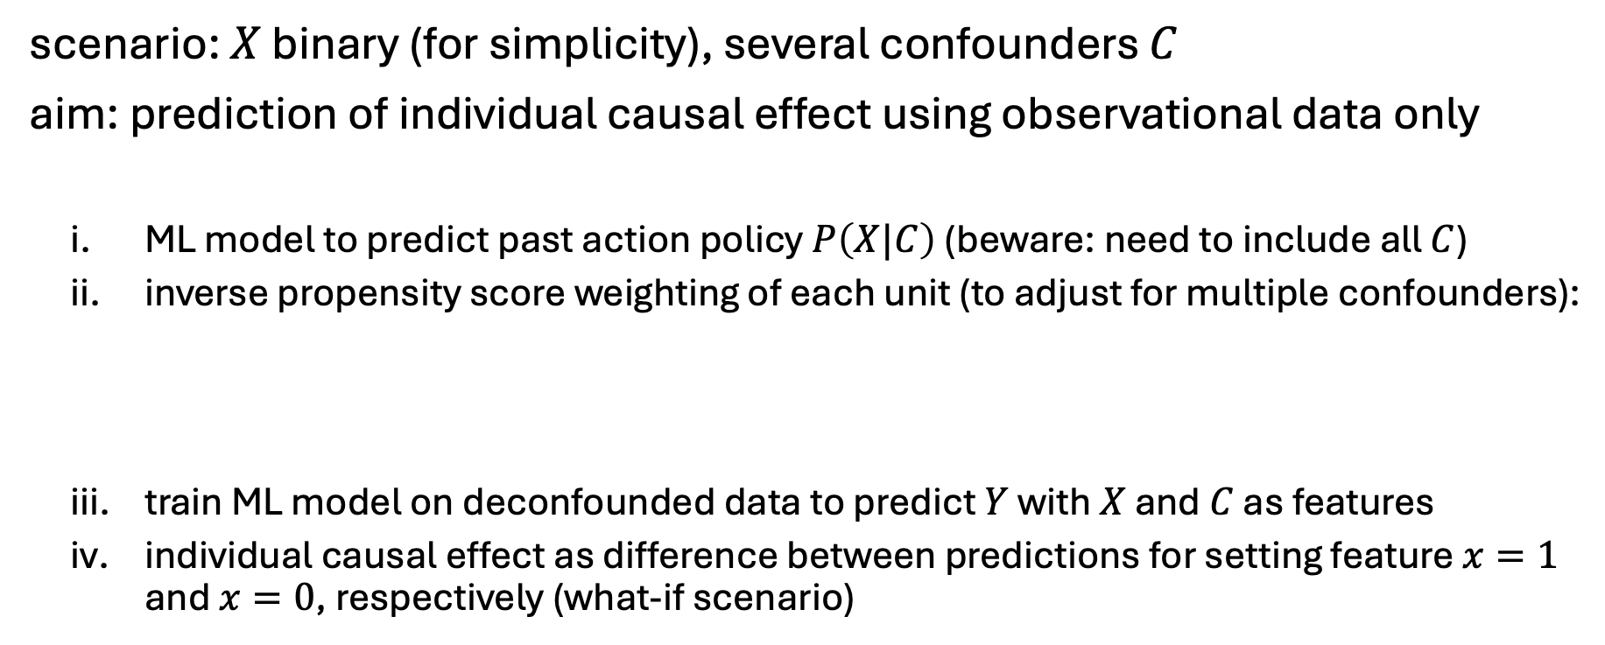



Learned Independence Weights
$$C$$
$$X$$
$$Y$$
scenario: $X$ binary (for simplicity), several confounders $C$
aim: prediction of individual causal effect using observational data only
ML model to predict past action policy $P\left(X|C\right)$ (beware: need to include all $C$)
inverse propensity score weighting of each unit (to adjust for multiple confounders):
train ML model on deconfounded data to predict $Y$ with $X$ and $C$ as features
individual causal effect as difference between predictions for setting feature $x=1$ and $x=0$, respectively (what-if scenario)
$$P\left(Y | do\left(X\right)\right)∝\sum_{c}{\frac{P\left(Y | X,C=c\right)}{P(X|C=c)}}$$

Slide 26
Causality and ML
causation as addition to ML: synonym for understanding
no ML method can understand causes and effects from data (statistical dependencies) alone → need for causal assumptions (causal model)
examples: transportability and robustness of models (generalization), handling of missing data, causal explainability
(see Pearl and Schölkopf 1 2 3)
but also: ML as help for causal discovery and inference
counterfactuls (potential outcomes) need matching of individual cases
adjusting for many confounders (e.g., propensity scores)

