Slide 1
Parameter Estimation
Data Science

Slide 2
Parameter Estimation
least squares
maximum likelihood method
maximum a posteriori
confidence intervals

Slide 3
Statistical Inference
two main goals:
parameter estimation: estimate unknown parameters from data
hypothesis testing: make decisions about assumptions/models (discussed later in context of model evaluation)

Slide 4
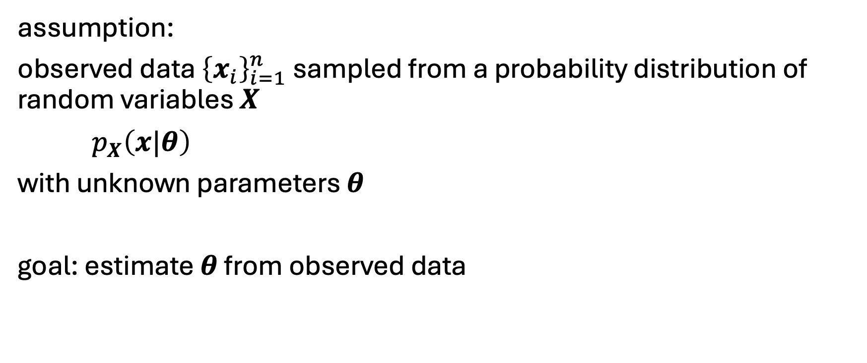
What is Parameter Estimation?
data generation process
assumption:
observed data ${\left\{x_{i}\right\}}_{i=1}^{n}$ sampled from a probability distribution of random variables $X$
$p_{X}\left(x|θ\right)$
with unknown parameters $θ$
goal: estimate $θ$ from observed data
→ model

Slide 5
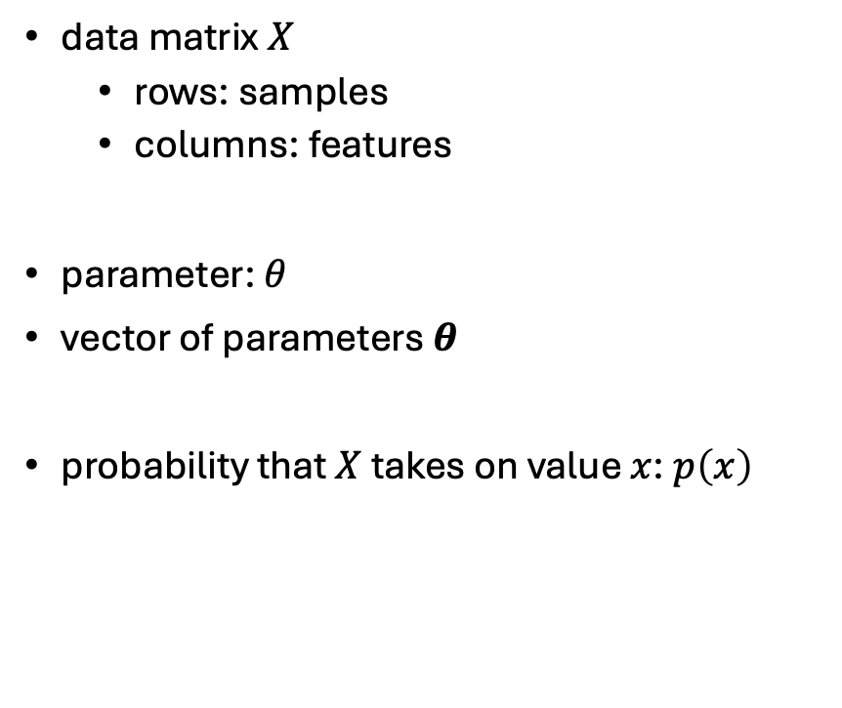
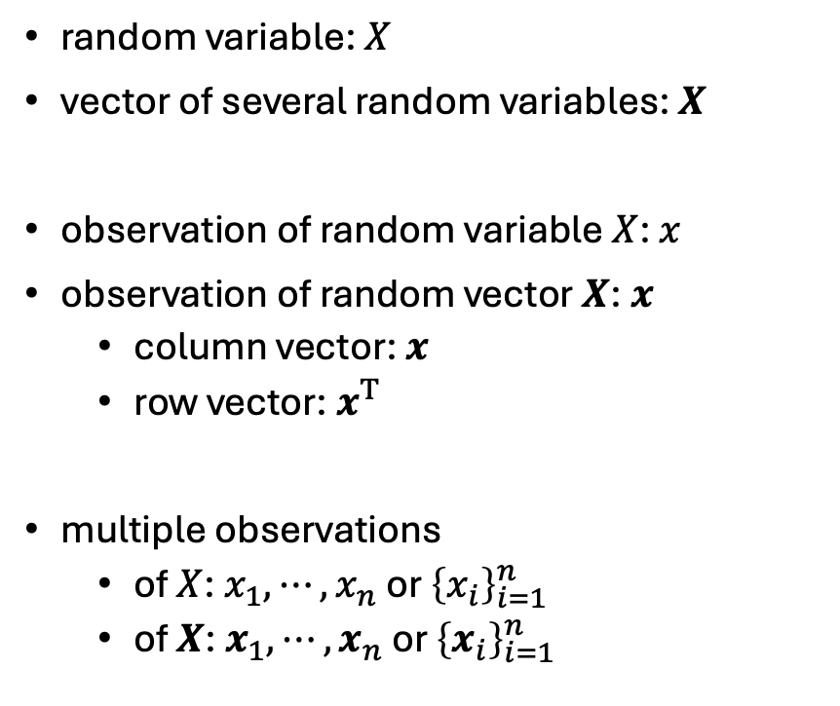
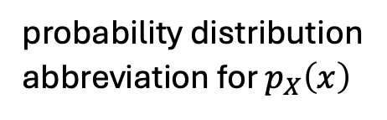
Notation
mild notation overload
(to be handled by context)
random variable: $X$
vector of several random variables: $X$
observation of random variable $X$: $x$
observation of random vector $X$: $x$
column vector: $x$
row vector: $x^{T}$
multiple observations
of $X$: $x_{1},⋯,x_{n}$ or ${\left\{x_{i}\right\}}_{i=1}^{n}$
of $X$: $x_{1},⋯,x_{n}$ or ${\left\{x_{i}\right\}}_{i=1}^{n}$
data matrix $X$
rows: samples
columns: features
parameter: $θ$
vector of parameters $θ$
probability that $X$ takes on value $x$: $p\left(x\right)$
features
probability distribution
abbreviation for $p_{X}\left(x\right)$
samples

Slide 6

Two Types of Parameter Estimation Tasks
ML perspective:
unsupervised learning
(e.g., GMM in clustering)
supervised learning
unsupervised setup (no labels)
data: $x_{1},⋯,x_{n}$
model: $p\left(x;θ\right)$
goal: fit distribution of data
supervised setup (with labels)
data: $\left(x_{i},y_{i}\right)$ pairs
model: $p\left(y|x;θ\right)$
goal: predict $y$ from $x$

Slide 7
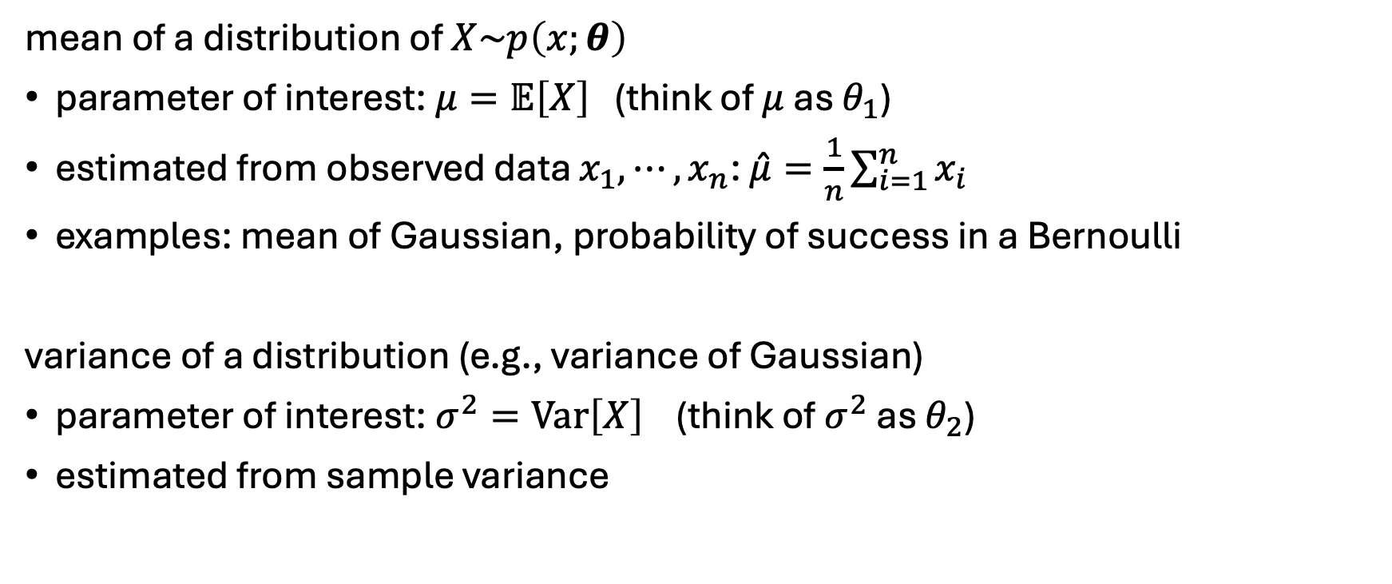
Unsupervised Setup: Examples
mean of a distribution of $X\sim p\left(x;θ\right)$
parameter of interest: $μ=𝔼\left[X\right]$ (think of $μ$ as $θ_{1}$)
estimated from observed data $x_{1},⋯,x_{n}$: $\hat{μ}=\frac{1}{n}\sum_{i=1}^{n}{x_{i}}$
examples: mean of Gaussian, probability of success in a Bernoulli
variance of a distribution (e.g., variance of Gaussian)
parameter of interest: $σ^{2}=Var\left[X\right]$ (think of $σ^{2}$ as $θ_{2}$)
estimated from sample variance

Slide 8
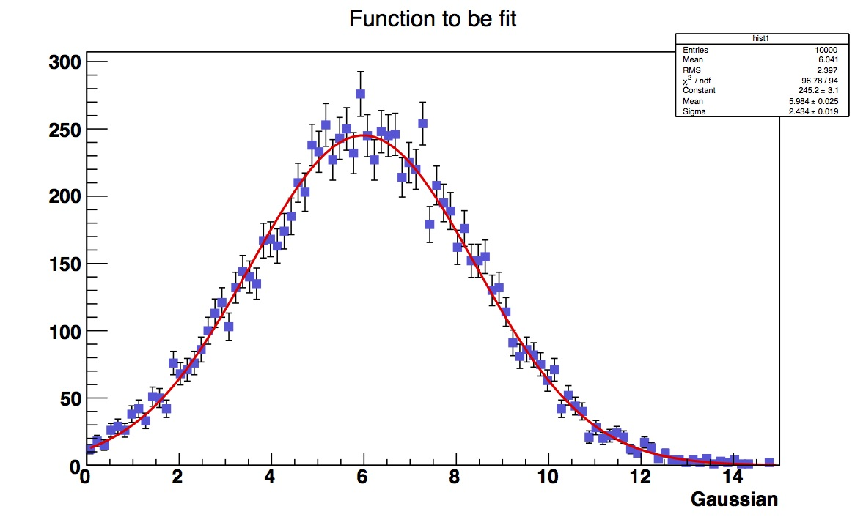

Slide 9
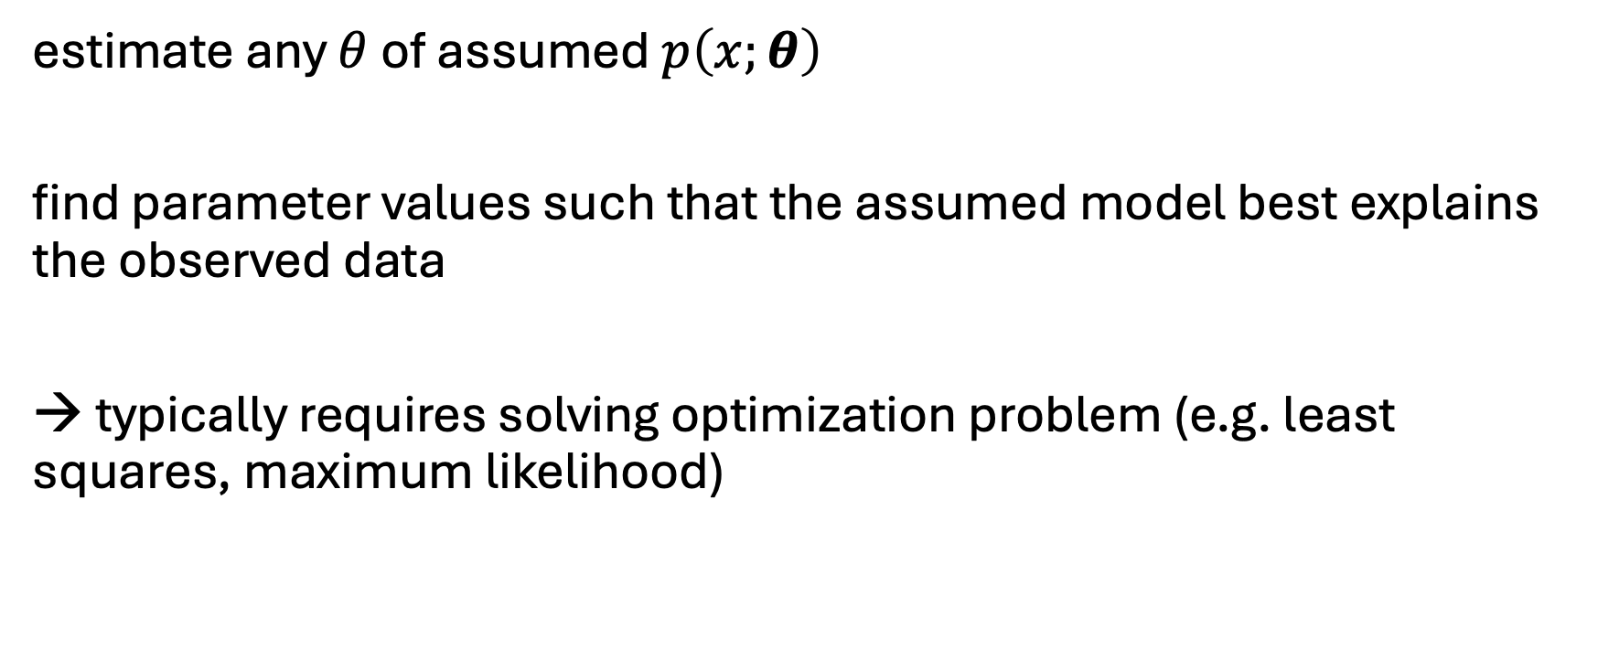
Unsupervised Setup: General Principle
estimate any $θ$ of assumed $p\left(x;θ\right)$
find parameter values such that the assumed model best explains the observed data
→ typically requires solving optimization problem (e.g. least squares, maximum likelihood)

Slide 10
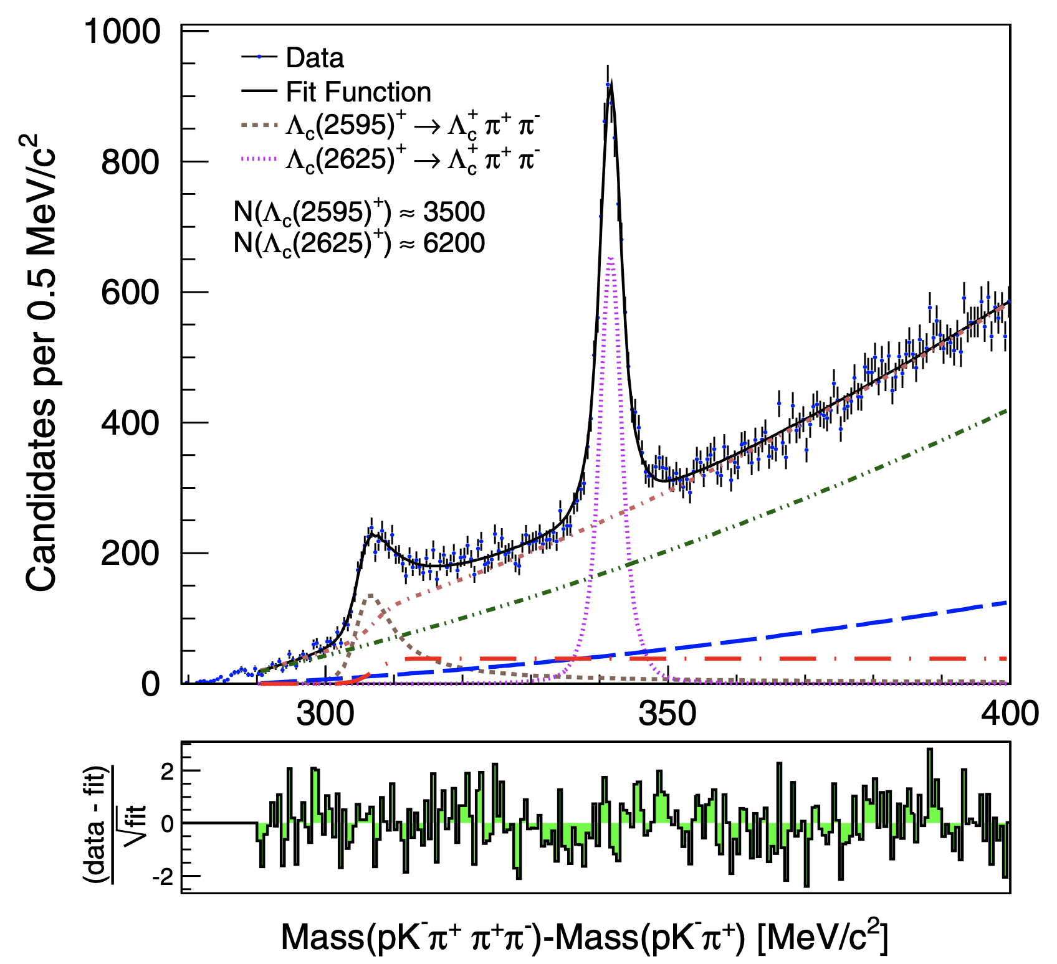
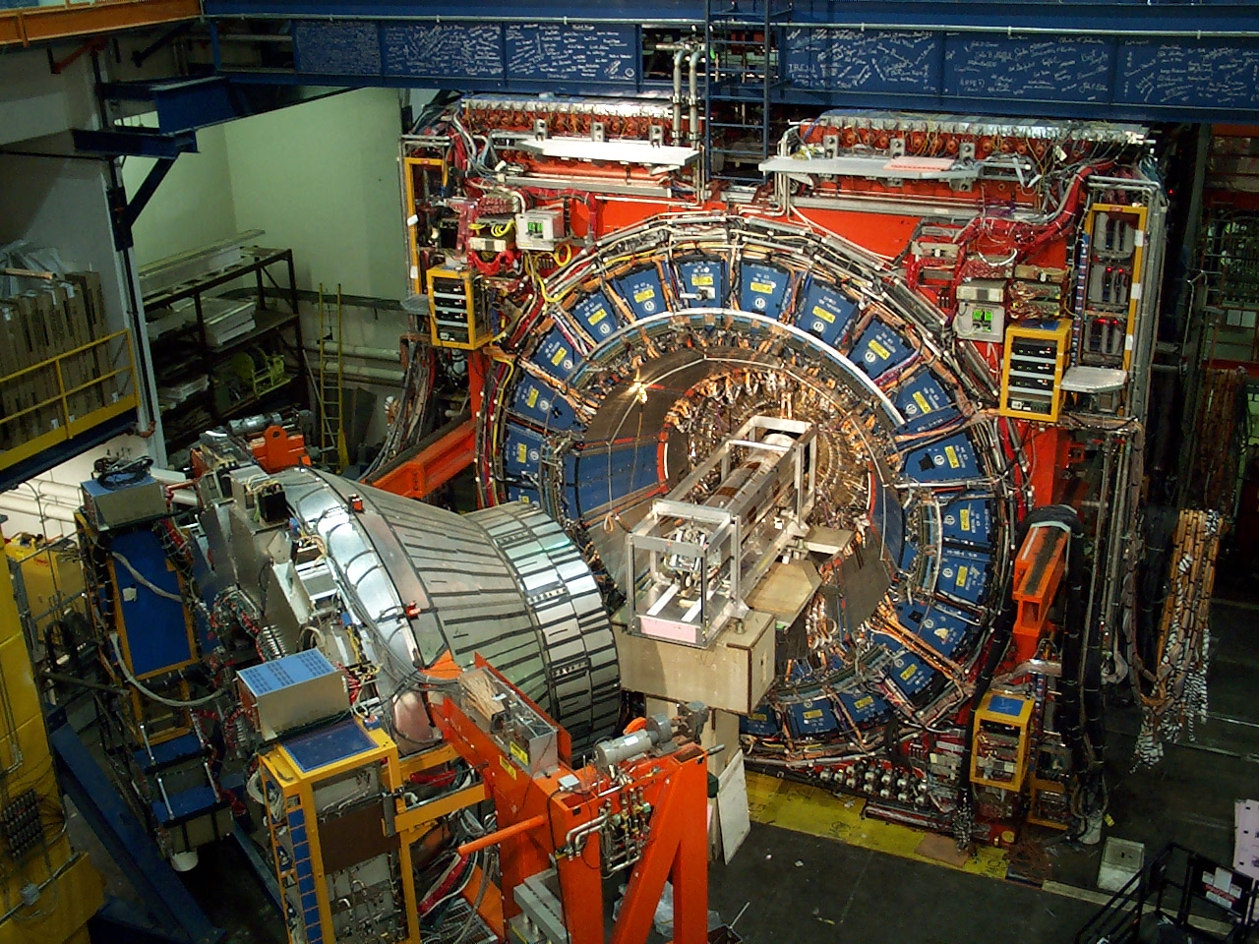
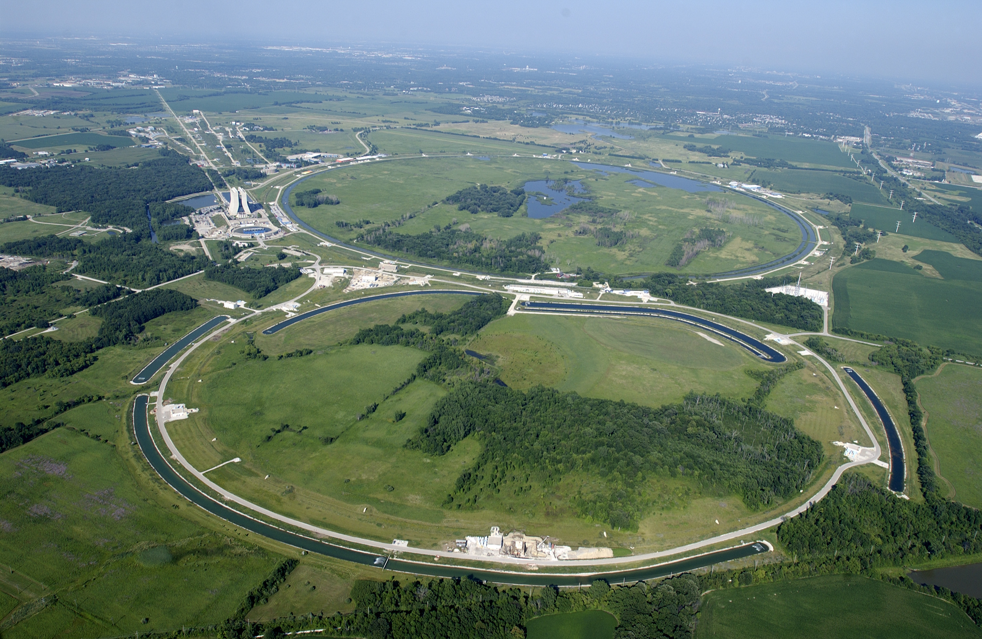

Slide 11
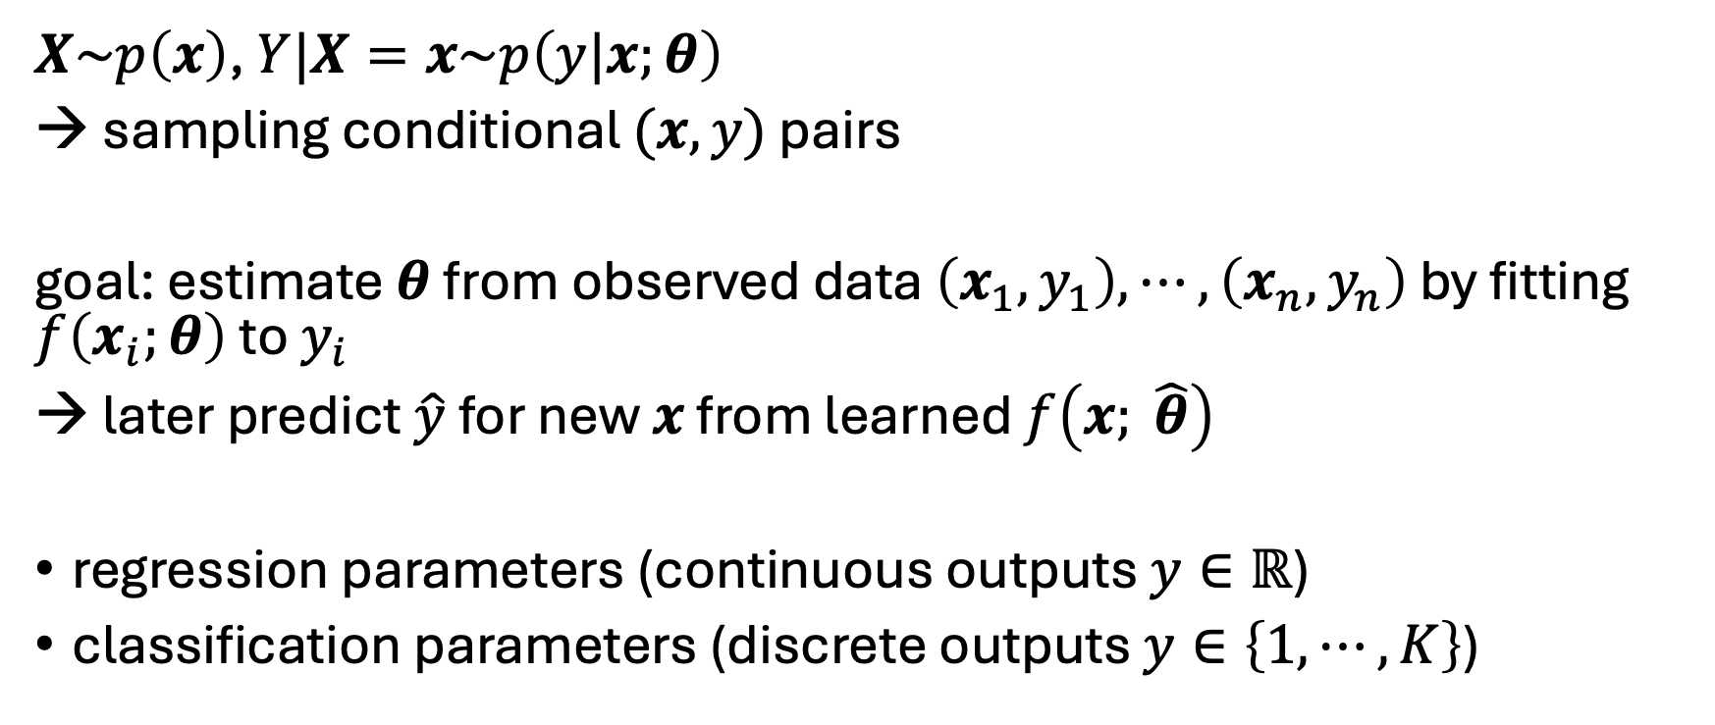
Supervised Setup
$X\sim p\left(x\right)$, $Y|X=x\sim p\left(y|x;θ\right)$
→ sampling conditional $(x, y)$ pairs
goal: estimate $θ$ from observed data $\left(x_{1}, y_{1}\right),⋯,\left(x_{n}, y_{n}\right)$ by fitting $f\left(x_{i};θ\right)$ to $y_{i}$
→ later predict $\hat{y}$ for new $x$ from learned $f\left(x; \hat{θ}\right)$
regression parameters (continuous outputs $y∈ℝ$)
classification parameters (discrete outputs $y∈\left\{1,⋯,K\right\}$)

Slide 12
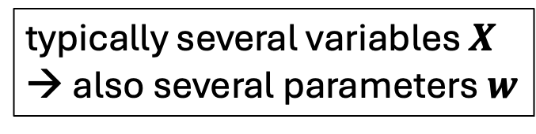



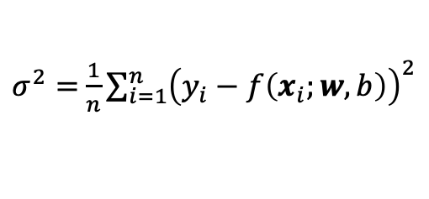



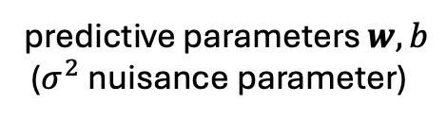
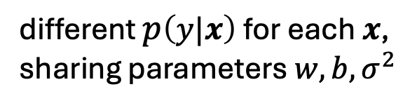
Example: Linear Regression
typically several variables $X$
→ also several parameters $w$
model (for each observation $i$):
$y_{i}=w∙x_{i}+b+ε_{i}$
assumption:
$ε\sim 𝒩\left(0, σ^{2}\right)$
→ $p\left(y|x;w,b, σ^{2}\right)=𝒩\left(w∙x+b, σ^{2}\right)$
predictive parameters $w,b$
($σ^{2}$ nuisance parameter)
$$f\left(x_{i};w,b\right)$$
$$y$$
here: only one feature $x$
observations
different $p\left(y|x\right)$ for each $x$, sharing parameters $w,b, σ^{2}$
$$x$$
$σ^{2}=$ $\frac{1}{n}\sum_{i=1}^{n}{{\left(y_{i}−f\left(x_{i};w,b\right)\right)}^{2}}$
$$θ$$

Slide 13
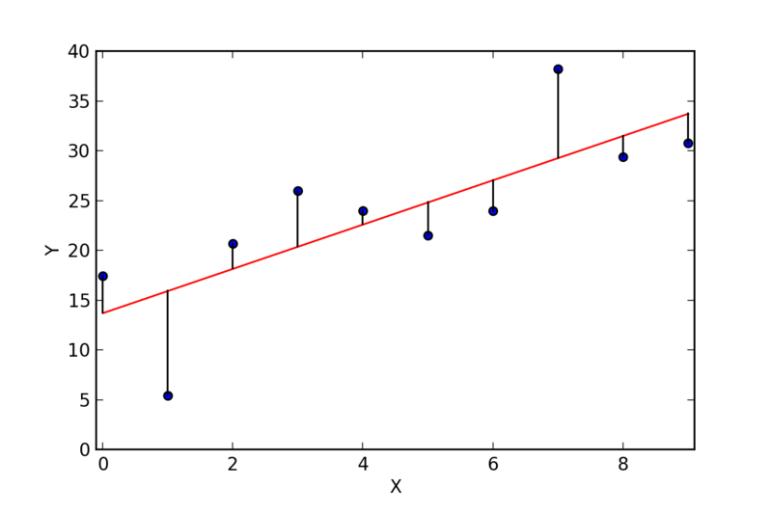
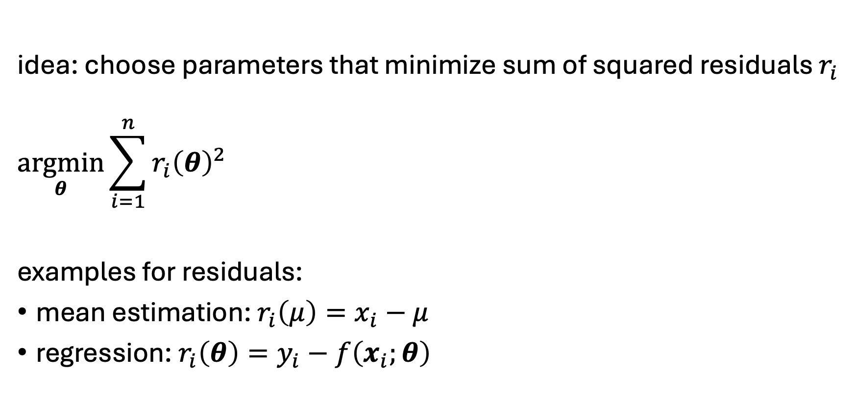
Least Squares Estimation
idea: choose parameters that minimize sum of squared residuals $r_{i}$
$$\underset{θ}{argmin}{\sum_{i=1}^{n}{r_{i}{\left(θ\right)}^{2}}}$$
examples for residuals:
mean estimation: $r_{i}\left(μ\right)=x_{i}−μ$
regression: $r_{i}\left(θ\right)=y_{i}−f\left(x_{i};θ\right)$
fitted value
residual
observation

Slide 14

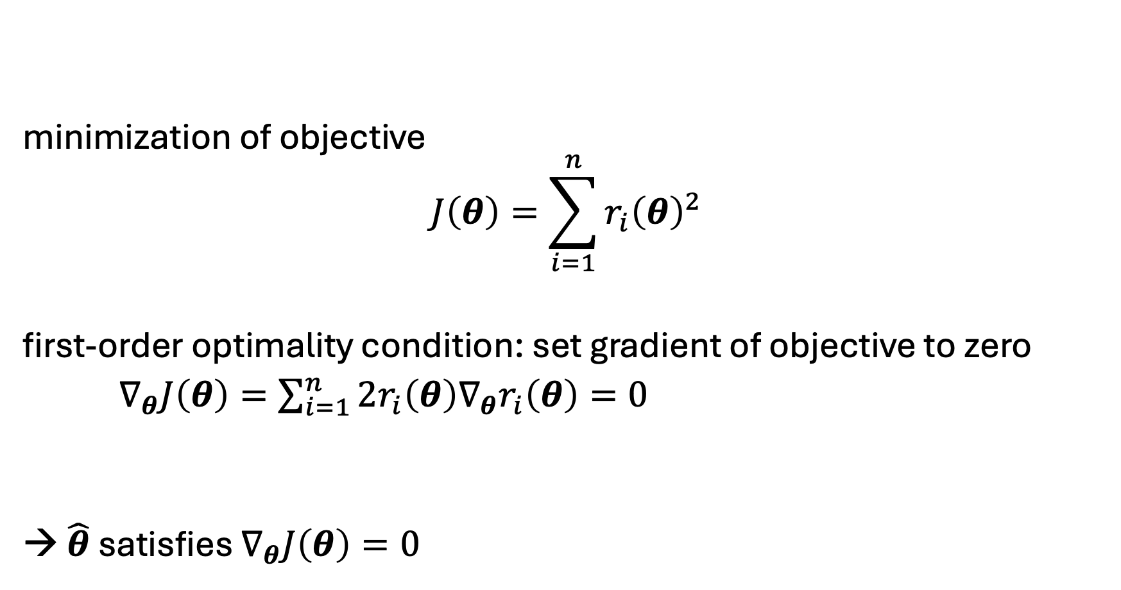
Least Squares Estimation: Minimization
minimization of objective
$$J\left(θ\right)=\sum_{i=1}^{n}{r_{i}{\left(θ\right)}^{2}}$$
first-order optimality condition: set gradient of objective to zero
$∇_{θ}J\left(θ\right)=\sum_{i=1}^{n}{2r_{i}\left(θ\right)∇_{θ}r_{i}\left(θ\right)}=0$
→ $\hat{θ}$ satisfies $∇_{θ}J\left(θ\right)=0$
candidate solution: need to ensure it is a minimum
$$∇_{θ}=\left[\begin{matrix}\frac{∂}{∂θ_{1}} \\ \frac{∂}{∂θ_{2}} \\ ⋮\end{matrix}\right]$$
residuals appear multiplied by their sensitivity

Slide 15


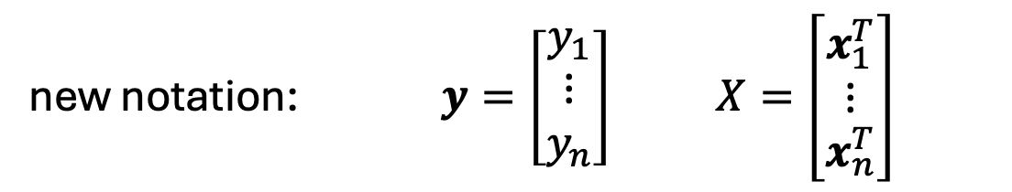
Linear Least Squares
model (linear in parameters):
$r_{i}\left(θ\right)=y_{i}−x_{i}^{T}θ$
objective: $J\left(θ\right)=\sum_{i=1}^{n}{{\left(y_{i}−x_{i}^{T}θ\right)}^{2}}$
matrix form: $J\left(θ\right)={\left\|y−Xθ\right\|}^{2}$
linear regression:
$$r_{i}\left(w,b\right)=y_{i}−\left(w∙x_{i}+b \right)$$
define $θ=\left[\begin{matrix}w \\ b\end{matrix}\right]$ and $\tilde{x}=\left[\begin{matrix}x \\ 1\end{matrix}\right]$
→ $r_{i}\left(θ\right)=y_{i}−{\tilde{x}}_{i}^{T}θ$
new notation: $y=\left[\begin{matrix}y_{1} \\ ⋮ \\ y_{n}\end{matrix}\right]$ $X=\left[\begin{matrix}x_{1}^{T} \\ ⋮ \\ x_{n}^{T}\end{matrix}\right]$

Slide 16
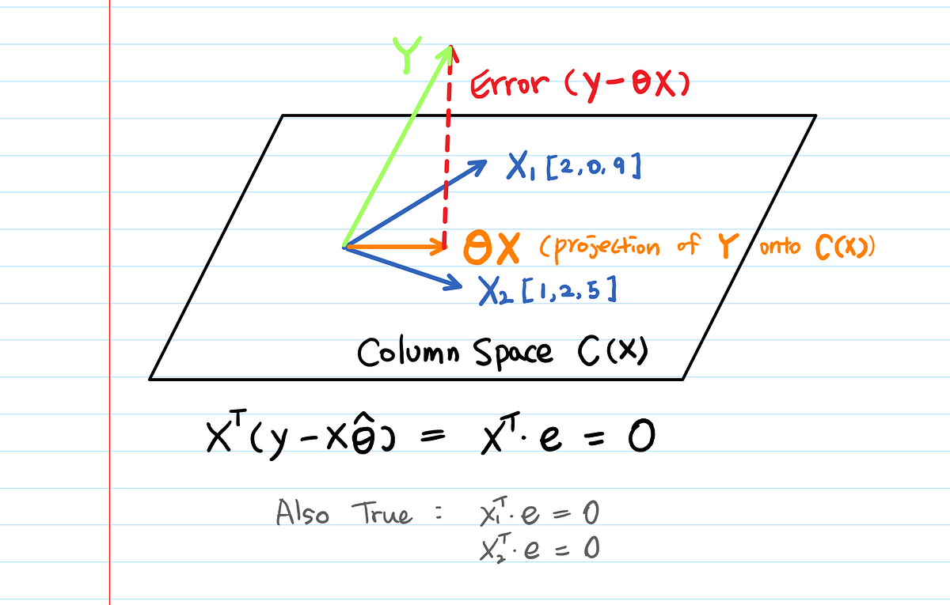

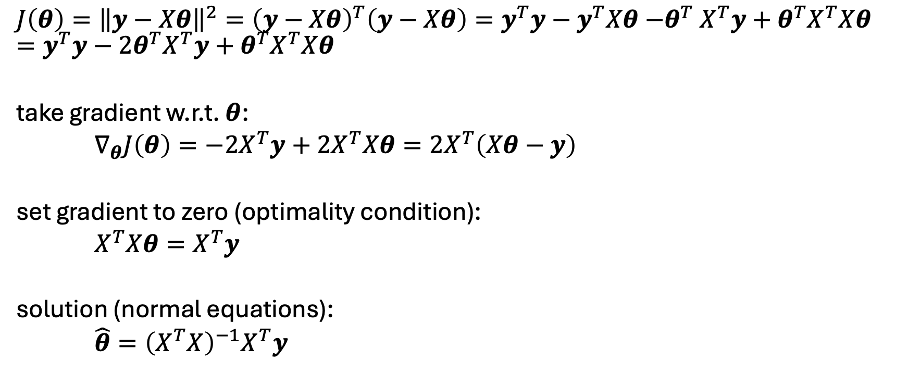
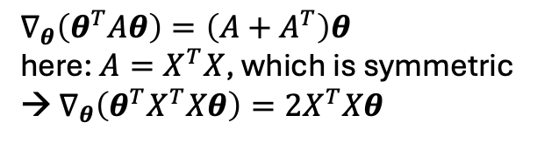
Linear Least Squares: Solution
$$J\left(θ\right)={\left\|y−Xθ\right\|}^{2}={\left(y−Xθ\right)}^{T}\left(y−Xθ\right)=y^{T}y−y^{T}Xθ{−θ}^{T}X^{T}y+θ^{T}X^{T}Xθ=y^{T}y−2θ^{T}X^{T}y+θ^{T}X^{T}Xθ$$
take gradient w.r.t. $θ$:
$∇_{θ}J\left(θ\right)=−2X^{T}y+2X^{T}Xθ=2X^{T}\left(Xθ−y\right)$
set gradient to zero (optimality condition):
$X^{T}Xθ=X^{T}y$
solution (normal equations):
$\hat{θ}={\left(X^{T}X\right)}^{−1}X^{T}y$
$$y^{T}Xθ={\left(θ^{T}X^{T}y\right)}^{T}=θ^{T}X^{T}y$$
$$∇_{θ}\left(θ^{T}Aθ\right)=\left(A+A^{T}\right)θ$$
here: ${A=X}^{T}X$, which is symmetric
→ $∇_{θ}\left(θ^{T}X^{T}Xθ\right)={2X}^{T}Xθ$

Slide 17
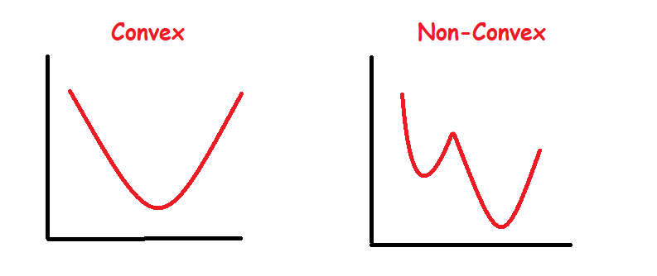






General Nonlinear Case
$∇_{θ}J\left(θ\right)=0$ gives stationary points
For convex problems (like linear least squares), this is the global minimum.
if $f\left(x;θ\right)$ nonlinear in $θ$: typically no closed-form solution to $∇_{θ}J\left(θ\right)=0$
→iterative numerical optimization
$$J\left(θ\right)$$
$$J\left(θ\right)$$
multiple local minima possible
$$θ$$
$$θ$$

Slide 18
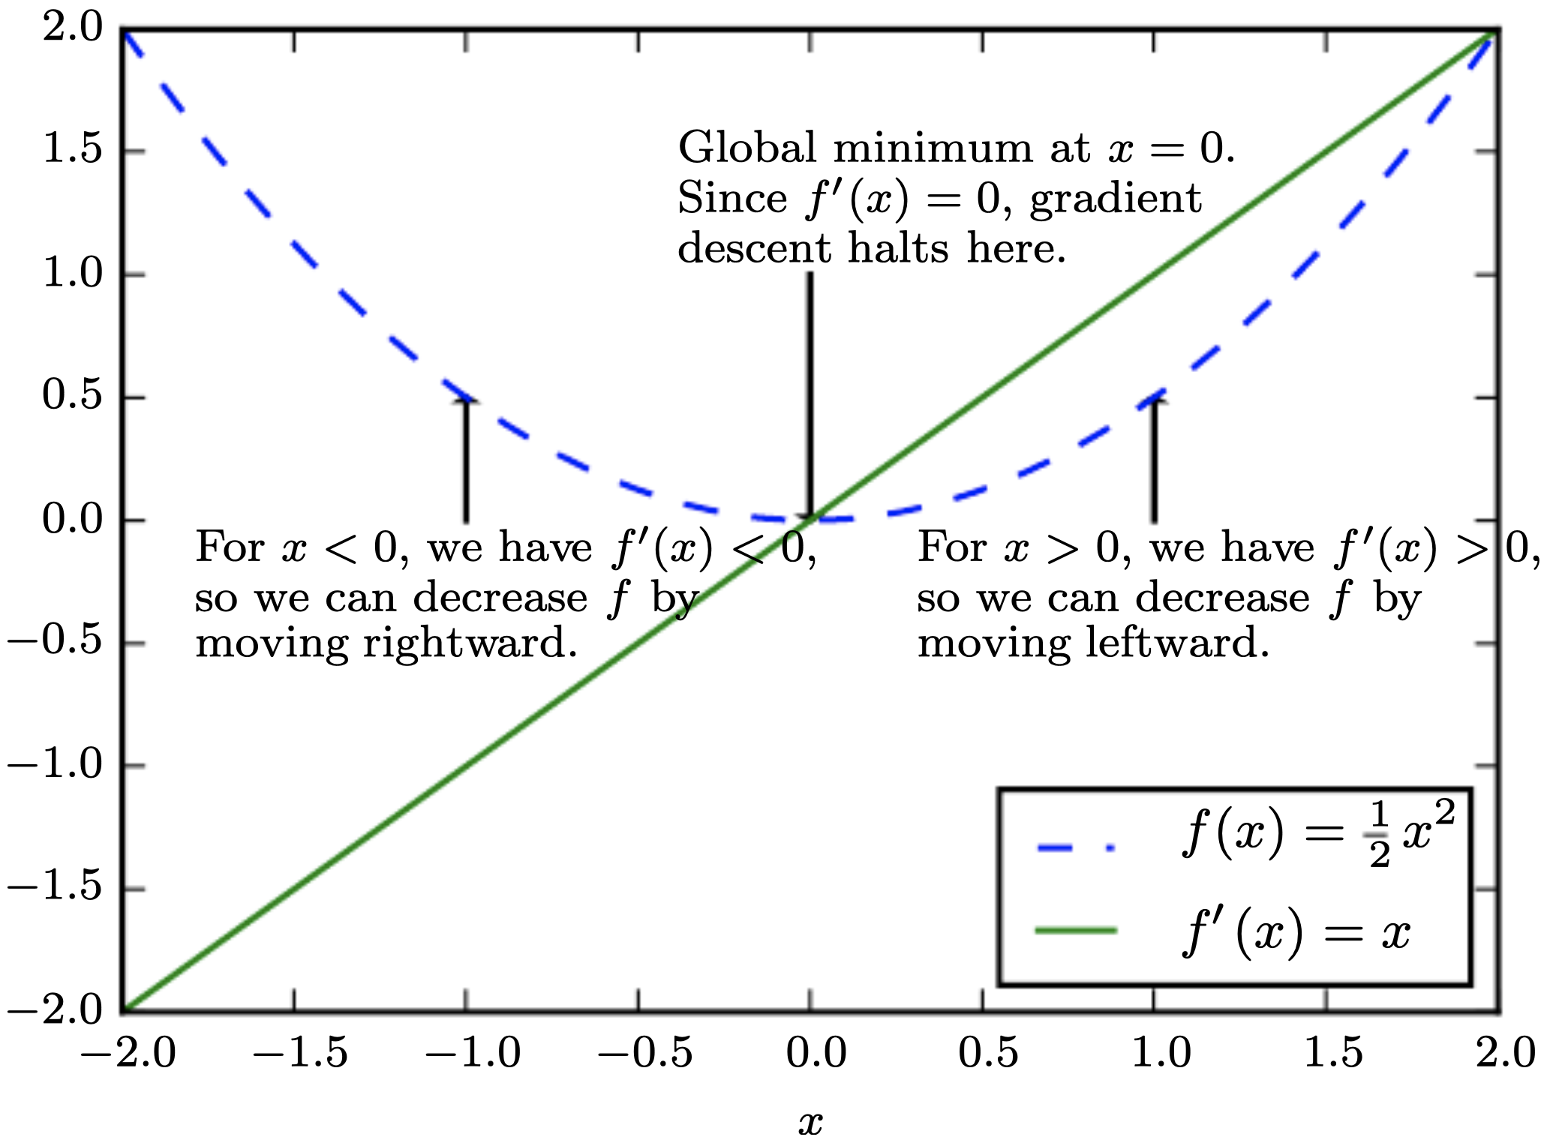
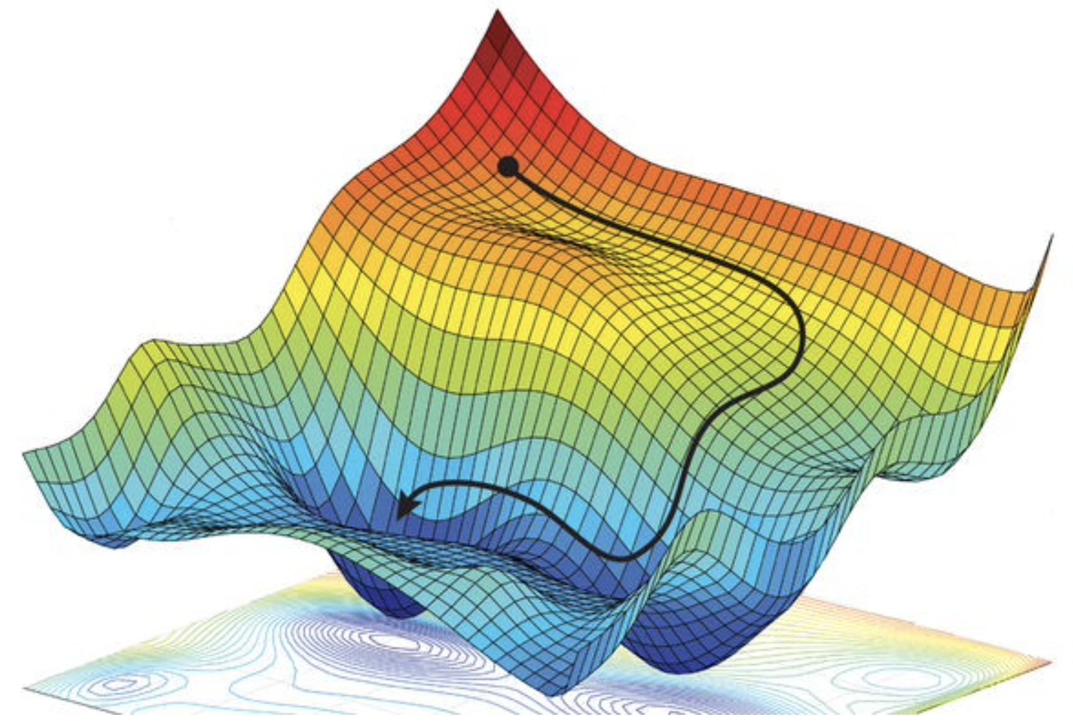
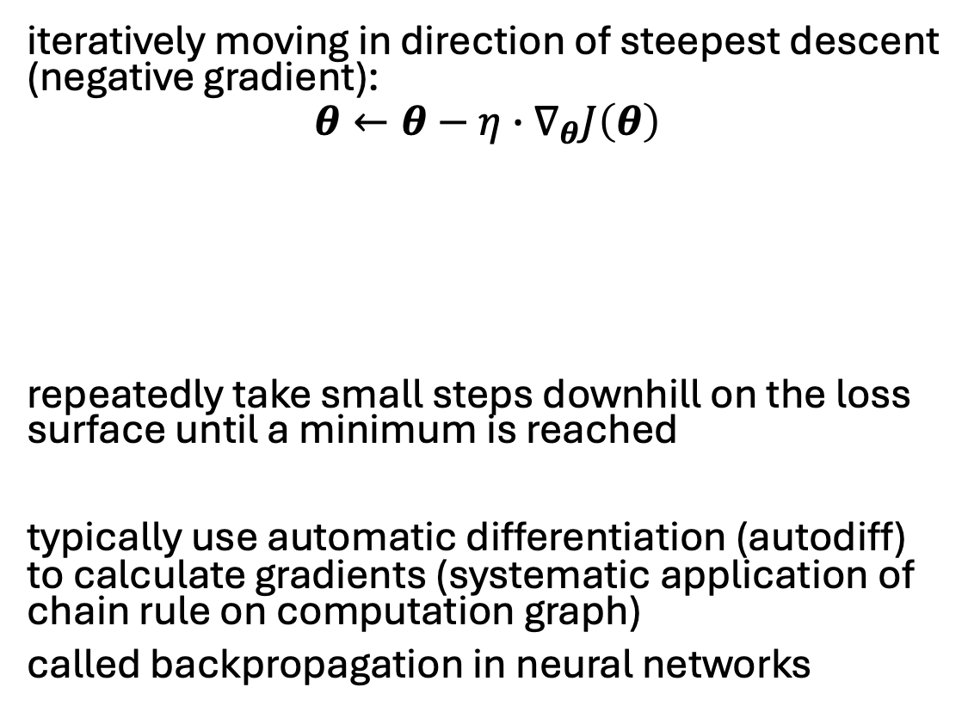
Gradient Descent
iteratively moving in direction of steepest descent (negative gradient):
$$θ←θ−η∙∇_{θ}J\left(θ\right)$$
repeatedly take small steps downhill on the loss surface until a minimum is reached
typically use automatic differentiation (autodiff) to calculate gradients (systematic application of chain rule on computation graph)
called backpropagation in neural networks
first-order
step size (learning rate): hyperparameter controlling how aggressively to move downhill
source
local minimum
global minimum

Slide 19
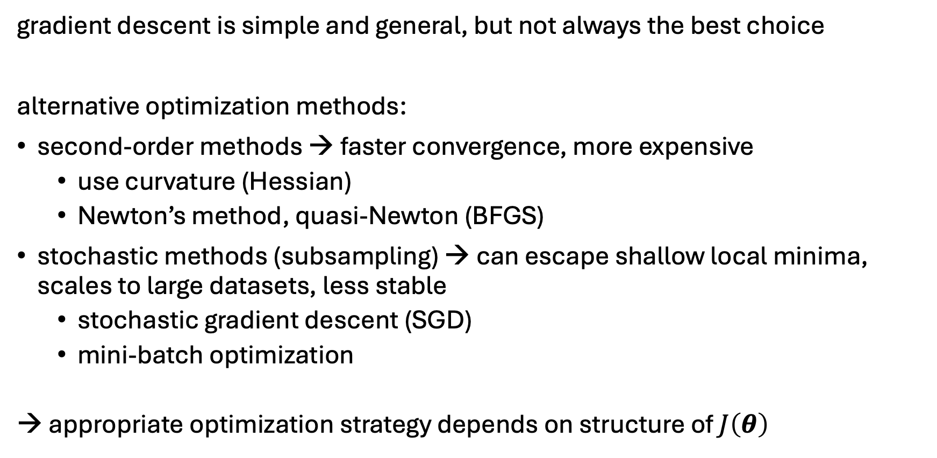
Beyond Gradient Descent
gradient descent is simple and general, but not always the best choice
alternative optimization methods:
second-order methods → faster convergence, more expensive
use curvature (Hessian)
Newton’s method, quasi-Newton (BFGS)
stochastic methods (subsampling) → can escape shallow local minima, scales to large datasets, less stable
stochastic gradient descent (SGD)
mini-batch optimization
→ appropriate optimization strategy depends on structure of $J\left(θ\right)$
more on this later in deep learning discussion

Slide 20
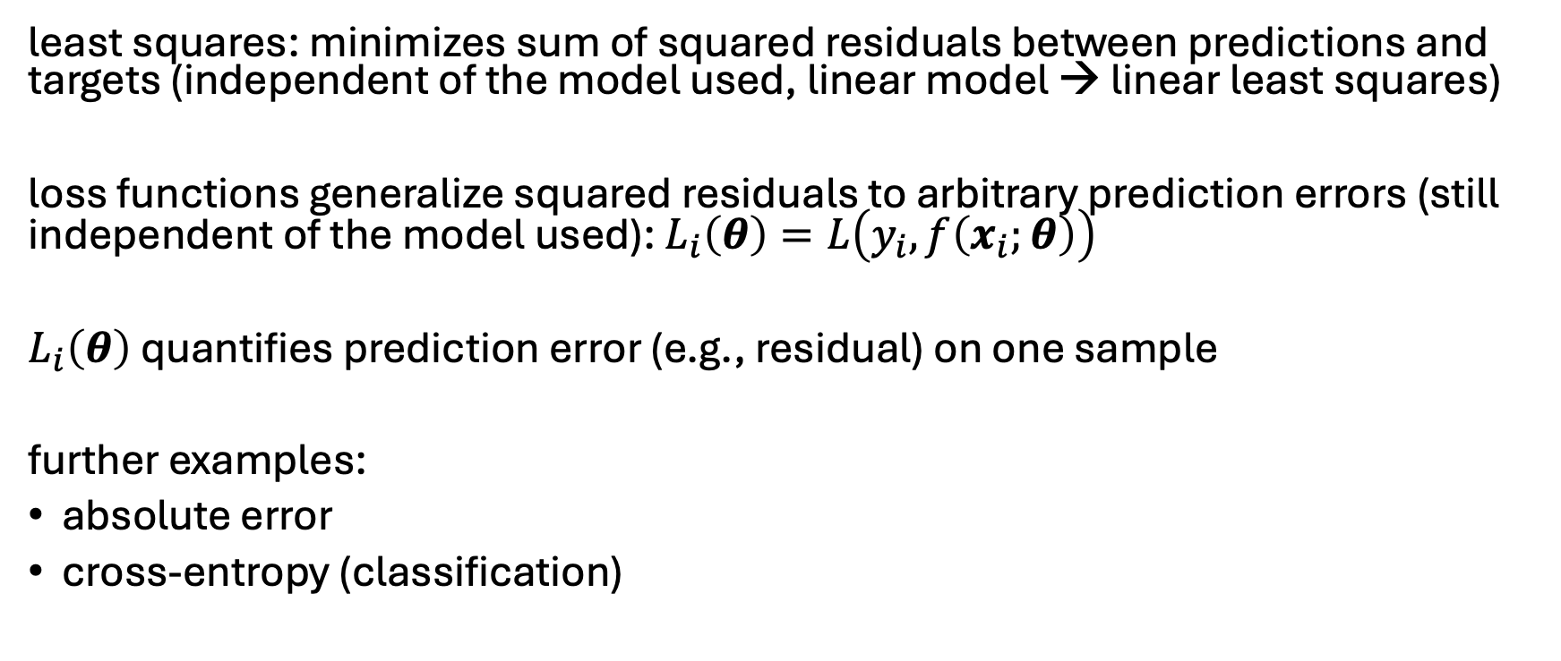
Generalization: Loss Functions
least squares: minimizes sum of squared residuals between predictions and targets (independent of the model used, linear model → linear least squares)
loss functions generalize squared residuals to arbitrary prediction errors (still independent of the model used): $L_{i}\left(θ\right)=L\left(y_{i},f\left(x_{i};θ\right)\right)$
$L_{i}\left(θ\right)$ quantifies prediction error (e.g., residual) on one sample
further examples:
absolute error
cross-entropy (classification)

Slide 21
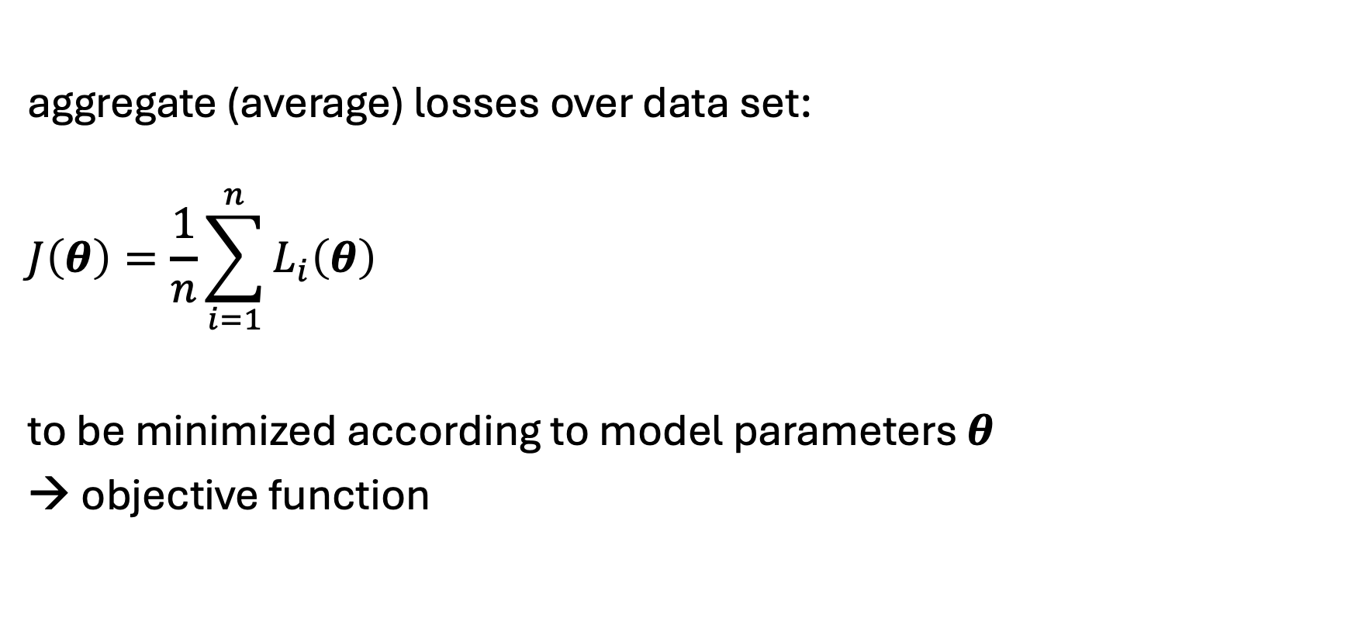
Cost Function
aggregate (average) losses over data set:
$$J\left(θ\right)=\frac{1}{n}\sum_{i=1}^{n}{L_{i}\left(θ\right)}$$
to be minimized according to model parameters $θ$
→ objective function

Slide 22
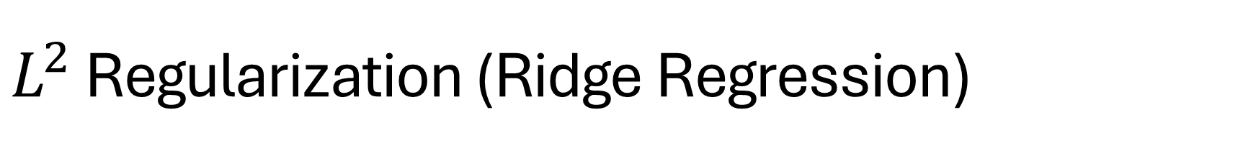
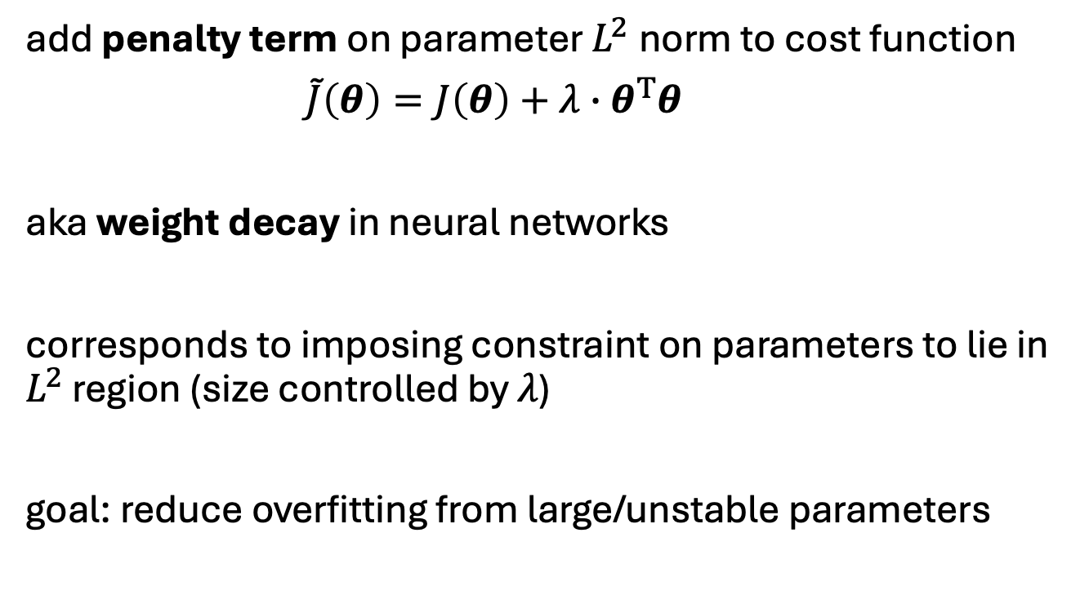
$L^{2}$ Regularization (Ridge Regression)
add penalty term on parameter $L^{2}$norm to cost function
$\tilde{J}\left(θ\right)=J\left(θ\right)+λ∙θ^{T}θ$
aka weight decay in neural networks
corresponds to imposing constraint on parameters to lie in $L^{2}$ region (size controlled by $λ$)
goal: reduce overfitting from large/unstable parameters
hyperparameter controlling strength of regularization
source

Slide 23
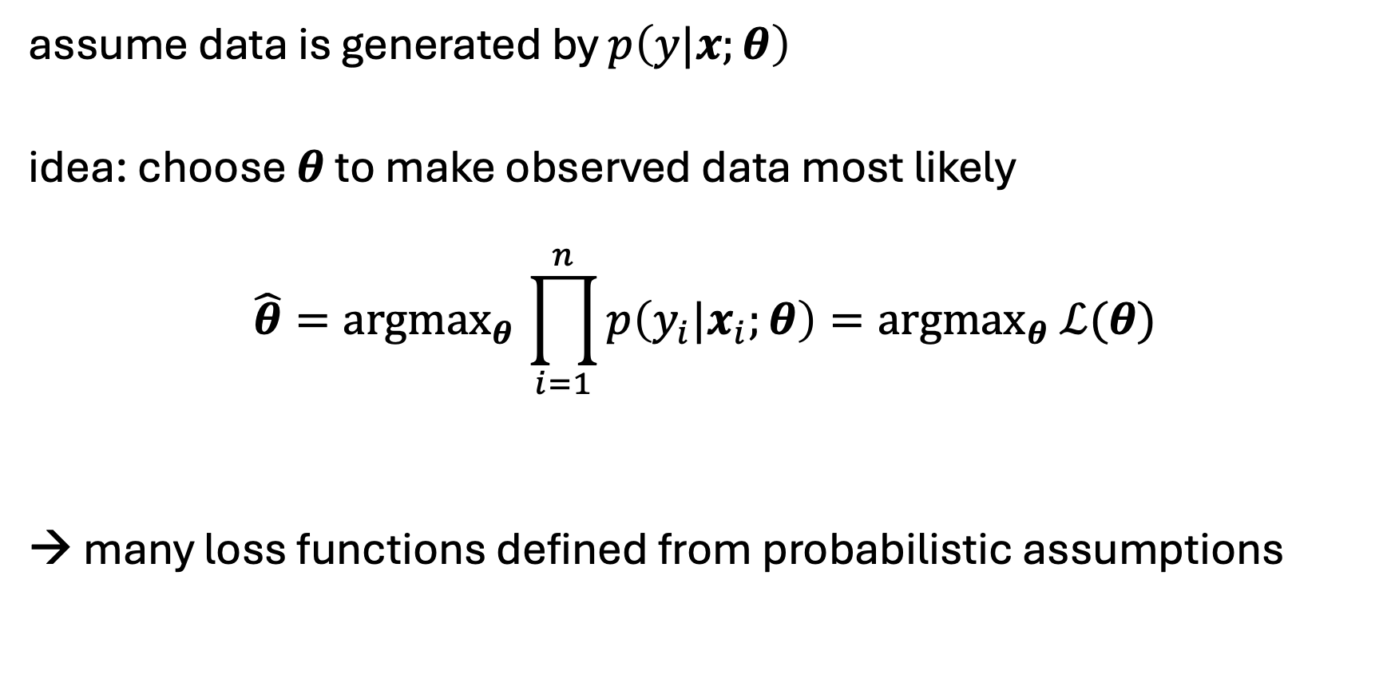
Maximum Likelihood Estimation (MLE)
assume data is generated by $p\left(y|x;θ\right)$
idea: choose $θ$ to make observed data most likely
$$\hat{θ}{=argmax}_{θ}\prod_{i=1}^{n}{p\left(y_{i}|x_{i};θ\right)}={argmax}_{θ} ℒ(θ)$$
→ many loss functions defined from probabilistic assumptions
likelihood function
independent and identically distributed (i.i.d.) samples

Slide 24
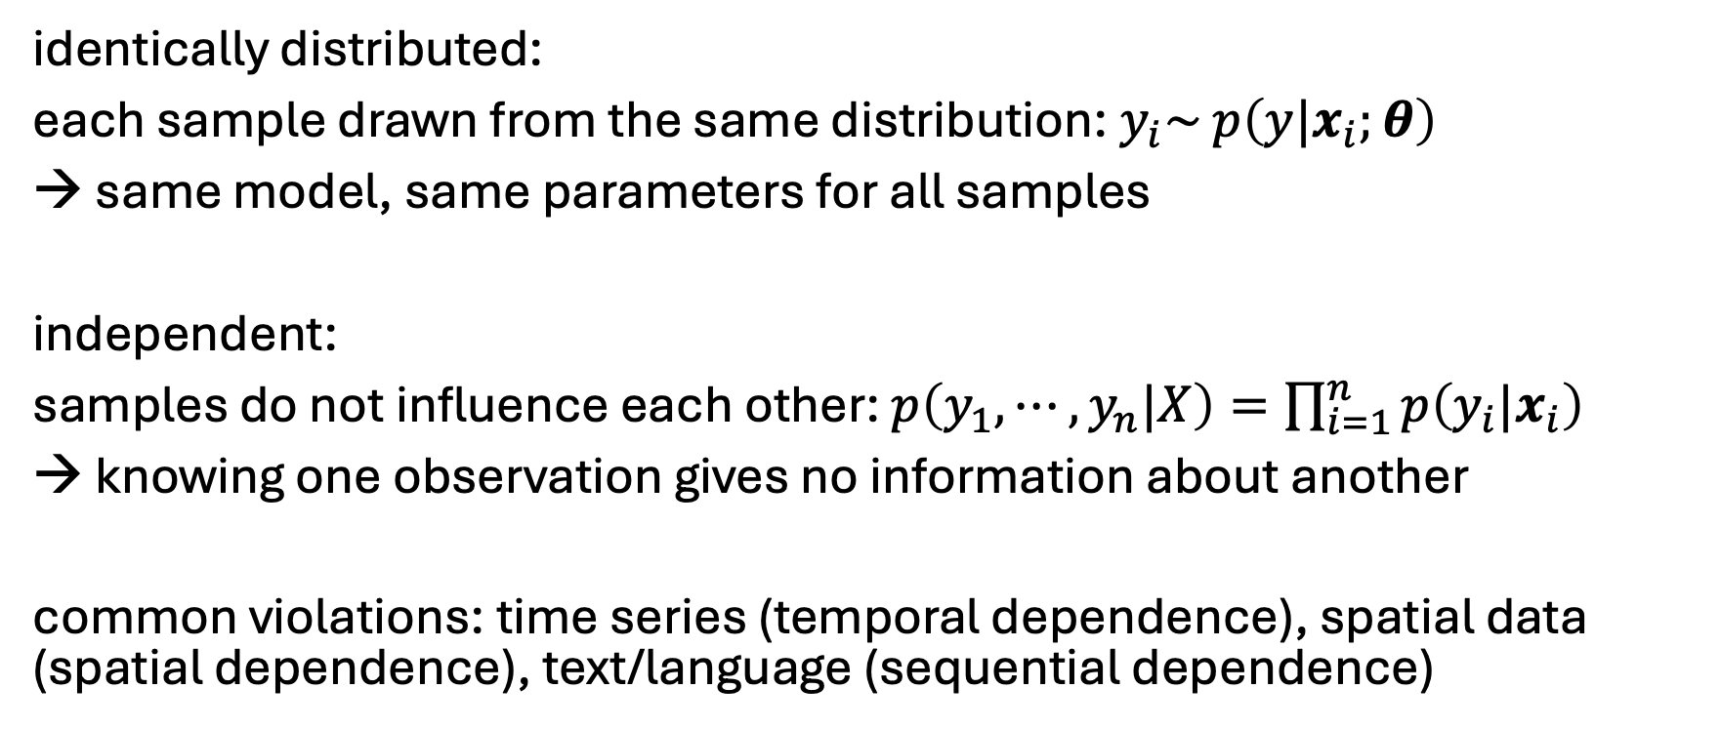
Side Note: i.i.d. Samples
identically distributed:
each sample drawn from the same distribution: $y_{i}\sim$ $p\left(y|x_{i};θ\right)$
→ same model, same parameters for all samples
independent:
samples do not influence each other: $p\left(y_{1},⋯,y_{n}|X\right)=\prod_{i=1}^{n}{p\left(y_{i}|x_{i}\right)}$
→ knowing one observation gives no information about another
common violations: time series (temporal dependence), spatial data (spatial dependence), text/language (sequential dependence)
→ additive losses: decompose over samples

Slide 25
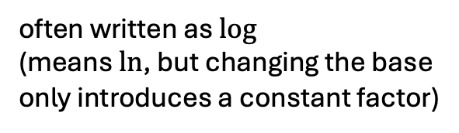
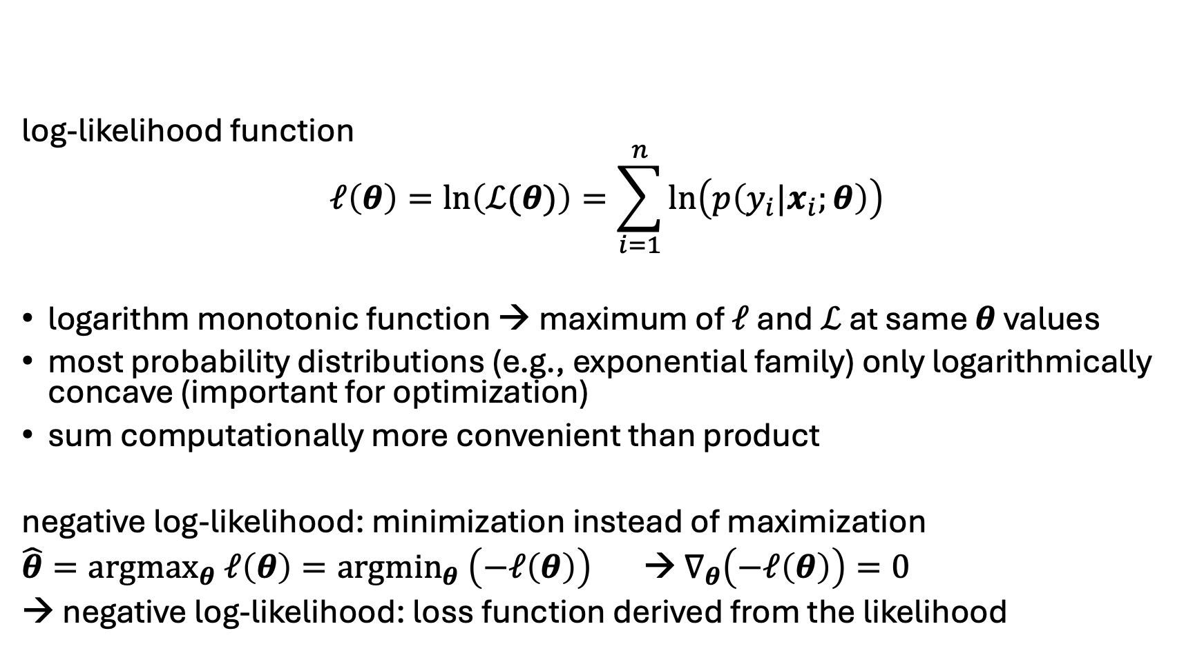
Negative Log-Likelihood
often written as $log$
(means $ln$, but changing the base only introduces a constant factor)
log-likelihood function
$$ℓ\left(θ\right)=ln\left(ℒ(θ)\right)=\sum_{i=1}^{n}{\ln\left(p\left(y_{i}|x_{i};θ\right)\right)}$$
logarithm monotonic function → maximum of $ℓ$ and $ℒ$ at same $θ$ values
most probability distributions (e.g., exponential family) only logarithmically concave (important for optimization)
sum computationally more convenient than product
negative log-likelihood: minimization instead of maximization
${\hat{θ}=argmax}_{θ} ℓ\left(θ\right)={argmin}_{θ} \left(−ℓ\left(θ\right)\right)$ → $∇_{θ}\left(−ℓ\left(θ\right)\right)=0$
→ negative log-likelihood: loss function derived from the likelihood

Slide 26
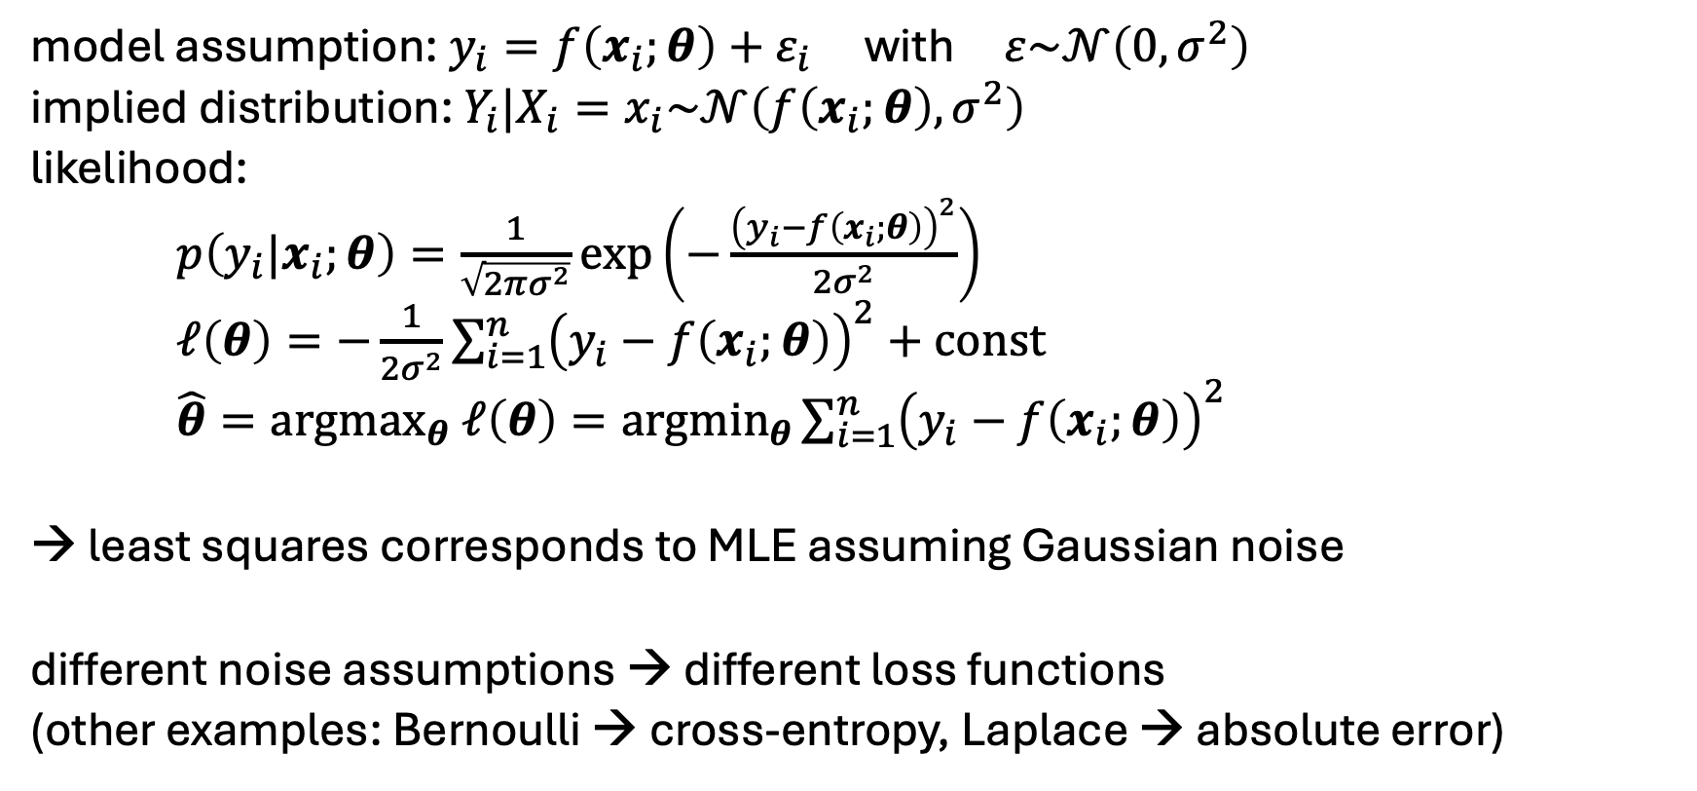
From Gaussian Noise to Least Squares
model assumption: $y_{i}=f\left(x_{i};θ\right)+ε_{i}$ with $ε\sim 𝒩\left(0, σ^{2}\right)$
implied distribution: $Y_{i}|X_{i}=x_{i}\sim 𝒩\left(f\left(x_{i};θ\right),σ^{2}\right)$
likelihood:
$p\left(y_{i}|x_{i};θ\right)=\frac{1}{\sqrt{2πσ^{2}}}\exp\left(−\frac{{\left(y_{i}−f\left(x_{i};θ\right)\right)}^{2}}{2σ^{2}}\right)$
$ℓ\left(θ\right)=−\frac{1}{2σ^{2}}\sum_{i=1}^{n}{{\left(y_{i}−f\left(x_{i};θ\right)\right)}^{2}}+const$
${\hat{θ}=argmax}_{θ} ℓ\left(θ\right)={argmin}_{θ}\sum_{i=1}^{n}{{\left(y_{i}−f\left(x_{i};θ\right)\right)}^{2}}$
→ least squares corresponds to MLE assuming Gaussian noise
different noise assumptions → different loss functions
(other examples: Bernoulli → cross-entropy, Laplace → absolute error)

Slide 27
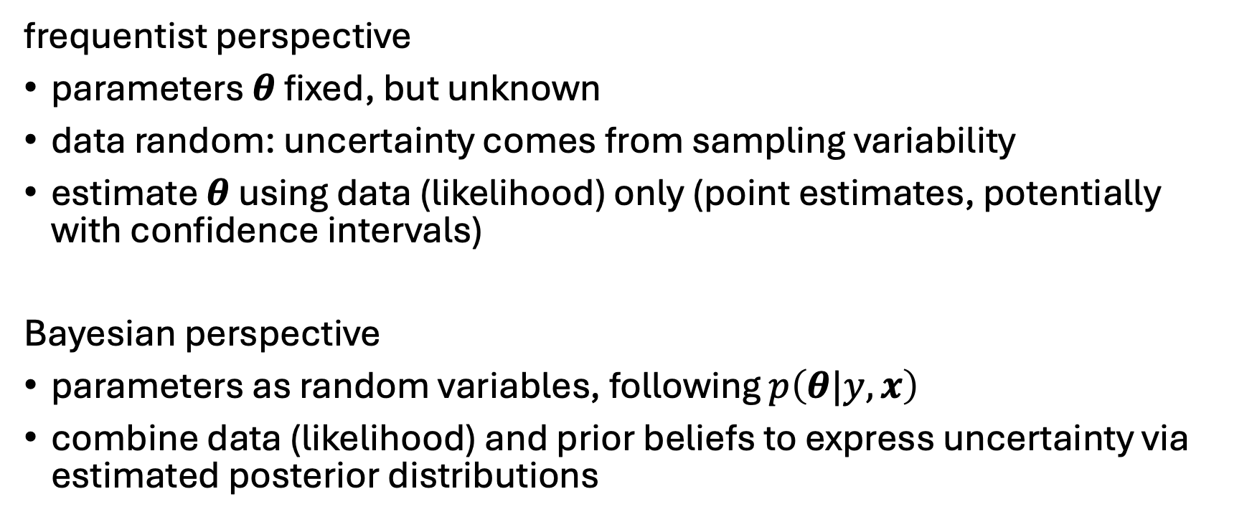
Two Views on Uncertainty
frequentist perspective
parameters $θ$ fixed, but unknown
data random: uncertainty comes from sampling variability
estimate $θ$ using data (likelihood) only (point estimates, potentially with confidence intervals)
Bayesian perspective
parameters as random variables, following $p\left(θ|y,x\right)$
combine data (likelihood) and prior beliefs to express uncertainty via estimated posterior distributions

Slide 28
Bayes Theorem
likelihood function (derived from statistical model)
$H$: hypothesis (model)
$E$: evidence (data)
$$P\left(H|E\right)=\frac{P\left(E|H\right)∙P\left(H\right)}{P\left(E\right)}$$
posterior probability (belief updated with observed evidence)
new data (same for all hypotheses → uninteresting)
prior probability (belief in $H$ before evidence)

Slide 29
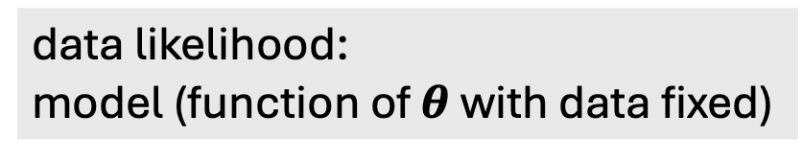
Bayes Theorem for Parameter Estimation
data likelihood:
model (function of $θ$ with data fixed)
$$p\left(θ|y, x\right)∝p\left(y|x,θ\right) ∙p\left(θ\right)$$
posterior:
probability distribution reflecting the effect of data on prior belief about parameters (increasing certainty with new evidence)
prior (e.g., broad Gaussian):
probability distribution reflecting initial belief about uncertain parameters (helps to reduce variance with few data)
to be compared to frequentist point estimates $\hat{θ}$
→ Bayesian updating

Slide 30
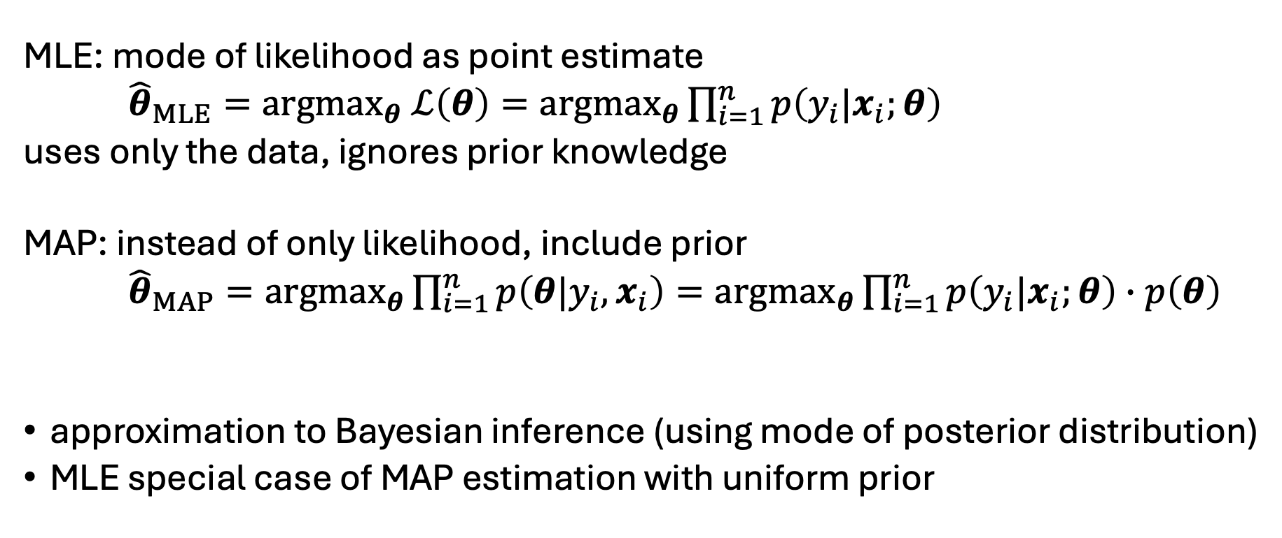
Maximum A Posteriori (MAP) Estimation
MLE: mode of likelihood as point estimate
${{\hat{θ}}_{MLE}=argmax}_{θ} ℒ\left(θ\right)={argmax}_{θ}\prod_{i=1}^{n}{p\left(y_{i}|x_{i};θ\right)}$
uses only the data, ignores prior knowledge
MAP: instead of only likelihood, include prior
${{\hat{θ}}_{MAP}=argmax}_{θ}\prod_{i=1}^{n}{p\left(θ|y_{i},x_{i}\right)}={argmax}_{θ}\prod_{i=1}^{n}{p\left(y_{i}|x_{i};θ\right)}∙p\left(θ\right)$
approximation to Bayesian inference (using mode of posterior distribution)
MLE special case of MAP estimation with uniform prior
likelihood (MLE)
prior (regularization)
Bayes
log: penalty term

Slide 31

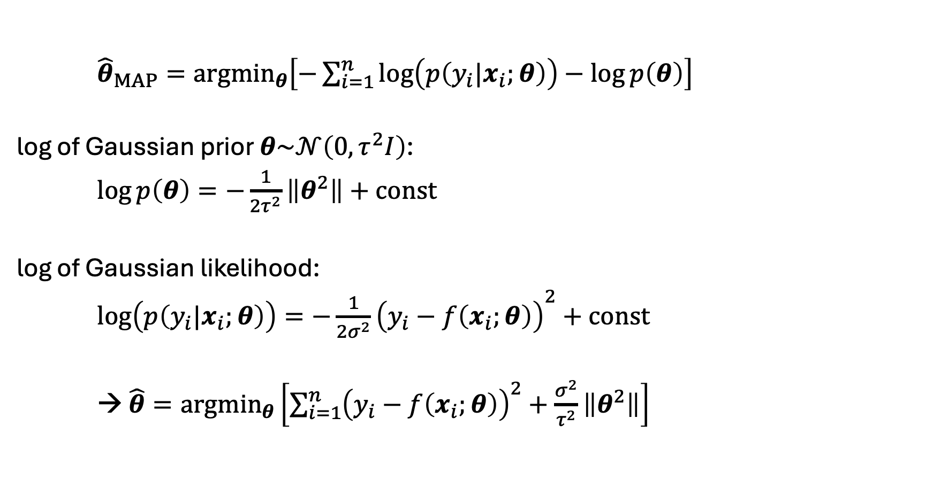
Gaussian Prior → Ridge Regression
${{\hat{θ}}_{MAP}=argmin}_{θ}\left[−\sum_{i=1}^{n}{\log\left(p\left(y_{i}|x_{i};θ\right)\right)}−\log{p\left(θ\right)}\right]$
log of Gaussian prior $θ\sim 𝒩\left(0, τ^{2}I\right)$:
$\log{p\left(θ\right)=−\frac{1}{{2τ}^{2}}\left\|θ^{2}\right\|}+const$
log of Gaussian likelihood:
${\log\left(p\left(y_{i}|x_{i};θ\right)\right)=−\frac{1}{{2σ}^{2}}\left(y_{i}−f\left(x_{i};θ\right)\right)}^{2}+const$
→ $\hat{θ}={argmin}_{θ}\left[\sum_{i=1}^{n}{{\left(y_{i}−f\left(x_{i};θ\right)\right)}^{2}}+\frac{σ^{2}}{τ^{2}}\left\|θ^{2}\right\|\right]$
prior belief:
parameters centered around zero
large values unlikely
$$λ$$

Slide 32
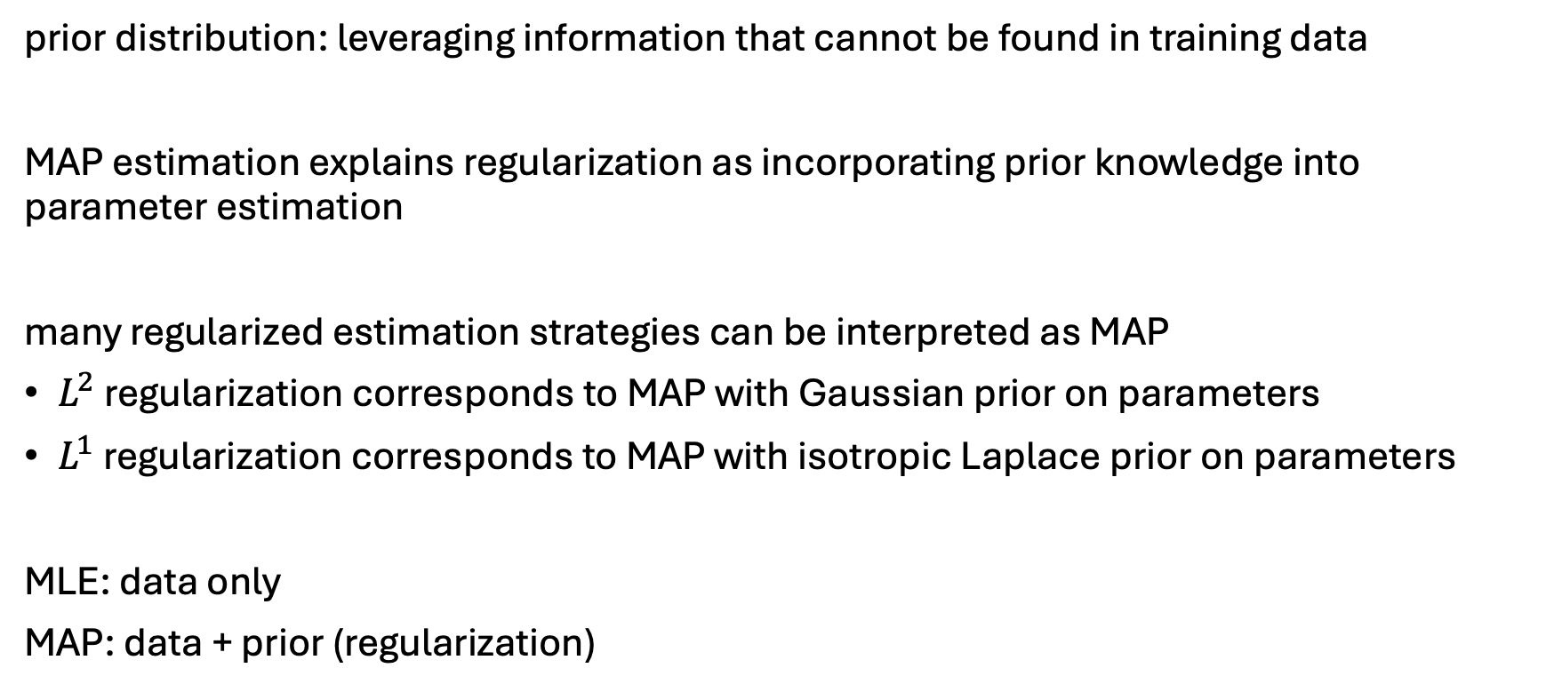
Priors as Regularizers
prior distribution: leveraging information that cannot be found in training data
MAP estimation explains regularization as incorporating prior knowledge into parameter estimation
many regularized estimation strategies can be interpreted as MAP
$L^{2}$ regularization corresponds to MAP with Gaussian prior on parameters
$L^{1}$ regularization corresponds to MAP with isotropic Laplace prior on parameters
MLE: data only
MAP: data + prior (regularization)

Slide 33
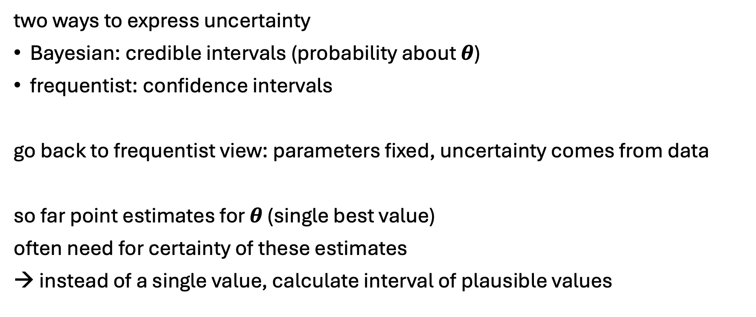
From Point Estimates to Uncertainty
two ways to express uncertainty
Bayesian: credible intervals (probability about $θ$)
frequentist: confidence intervals
go back to frequentist view: parameters fixed, uncertainty comes from data
so far point estimates for $θ$ (single best value)
often need for certainty of these estimates
→ instead of a single value, calculate interval of plausible values

Slide 34
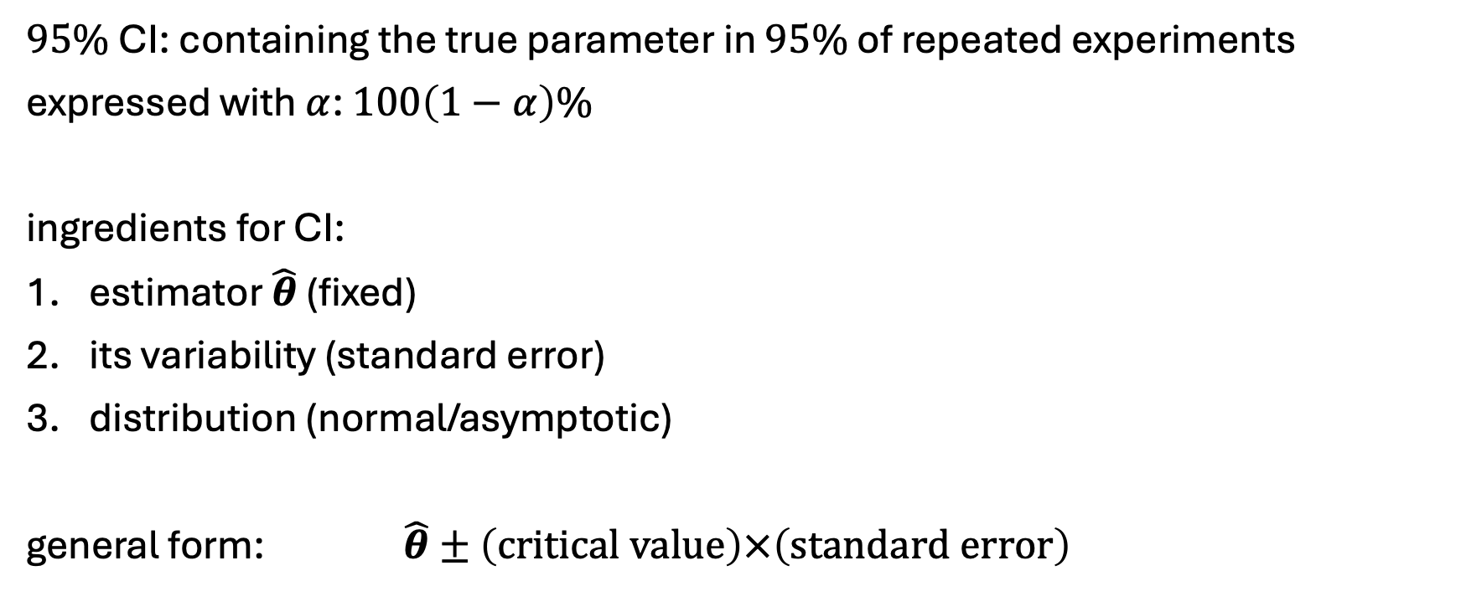
Confidence Intervals (CI)
$95\%$ CI: containing the true parameter in $95\%$ of repeated experiments
expressed with $α$: $100\left(1−α\right)\%$
ingredients for CI:
estimator $\hat{θ}$ (fixed)
its variability (standard error)
distribution (normal/asymptotic)
general form: $\hat{θ}±\left(critical value\right)×\left(standard error\right)$

Slide 35

Standard Error (SE)
measures how much the estimate varies due to sampling:
If we repeated the experiment, how much would $\hat{θ}$ fluctuate?
example: mean
$SE\left(μ\right)=\frac{s}{\sqrt{n}}$
$s$: sample standard deviation
$n$: number of samples
CI depends on data: more data (repetitions of experiment) → smaller SE → more precise estimate (narrower interval)

Slide 36

Critical Value
probabilistic correction factor from Student’s t-distribution:
$t_{n−1,1−\frac{α}{2}}$
large $n$ → $t$ approaches standard normal
small $n$ → heavier tails → wider intervals
SE uses an estimate of the variance, but does not account for the uncertainty of that estimate itself
→ t-distribution accounts for the extra uncertainty

Slide 37

Bootstrapping
idea: treat observed dataset as proxy for the true distribution and simulate new datasets from it
procedure: aproximate the sampling distribution by resampling the data
given data x $x_{1},⋯,x_{n}$: draw a bootstrap sample (with replacement)
compute estimate ${\hat{θ}}_{b}$
repeat $B$ times: ${\hat{θ}}_{1},⋯,{\hat{θ}}_{B}$
use empirical quantiles for CI: $\left[{quantile}_{α/2},{quantile}_{1−α/2}\right]$

