Slide 1
Teaser
ChatGPT
DreamStudio

Slide 2








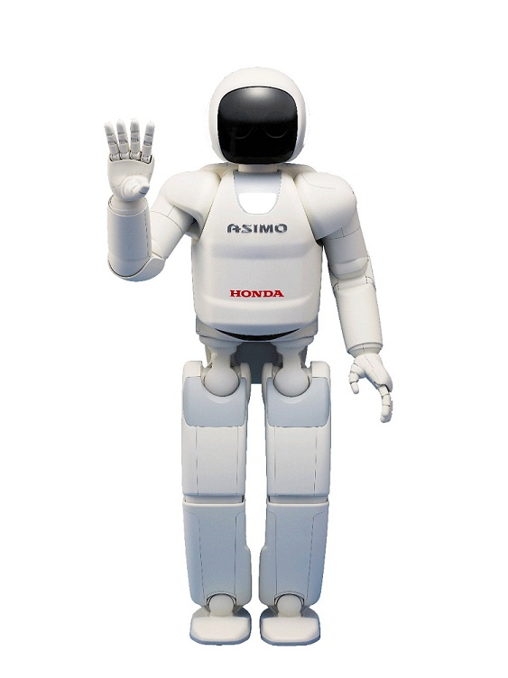





Most Famous AI/ML Applications
chatbots
autonomous driving
recommendations
translation
robotics
OCR
assistants (speech recognition)
and many more …

Slide 3
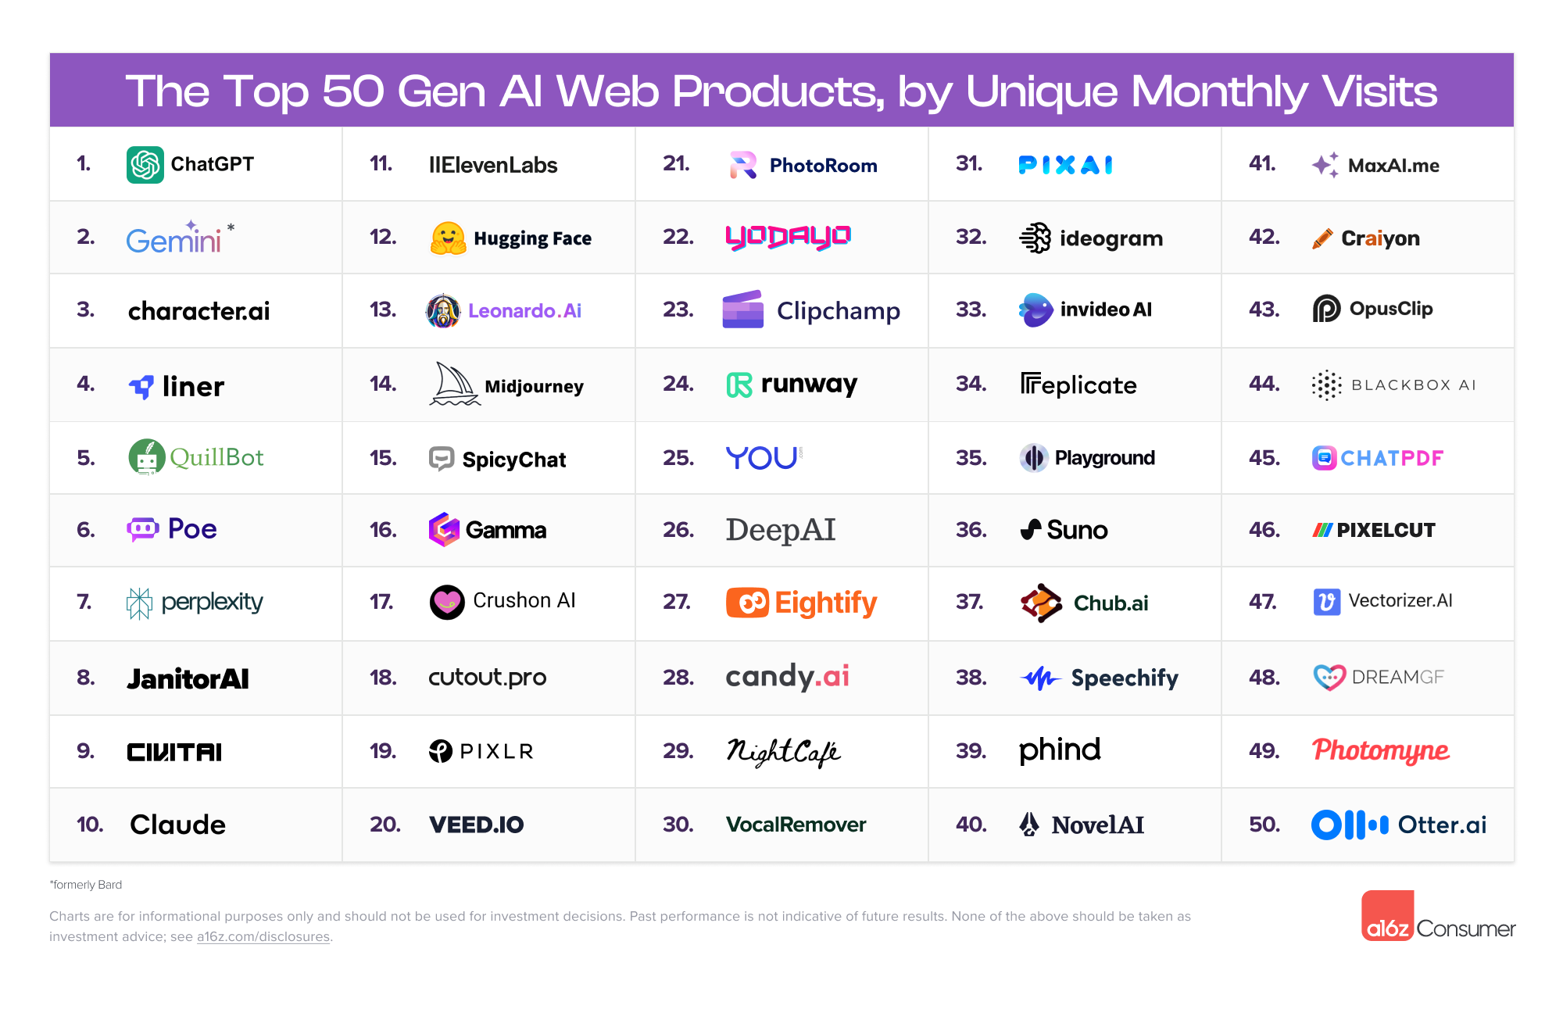
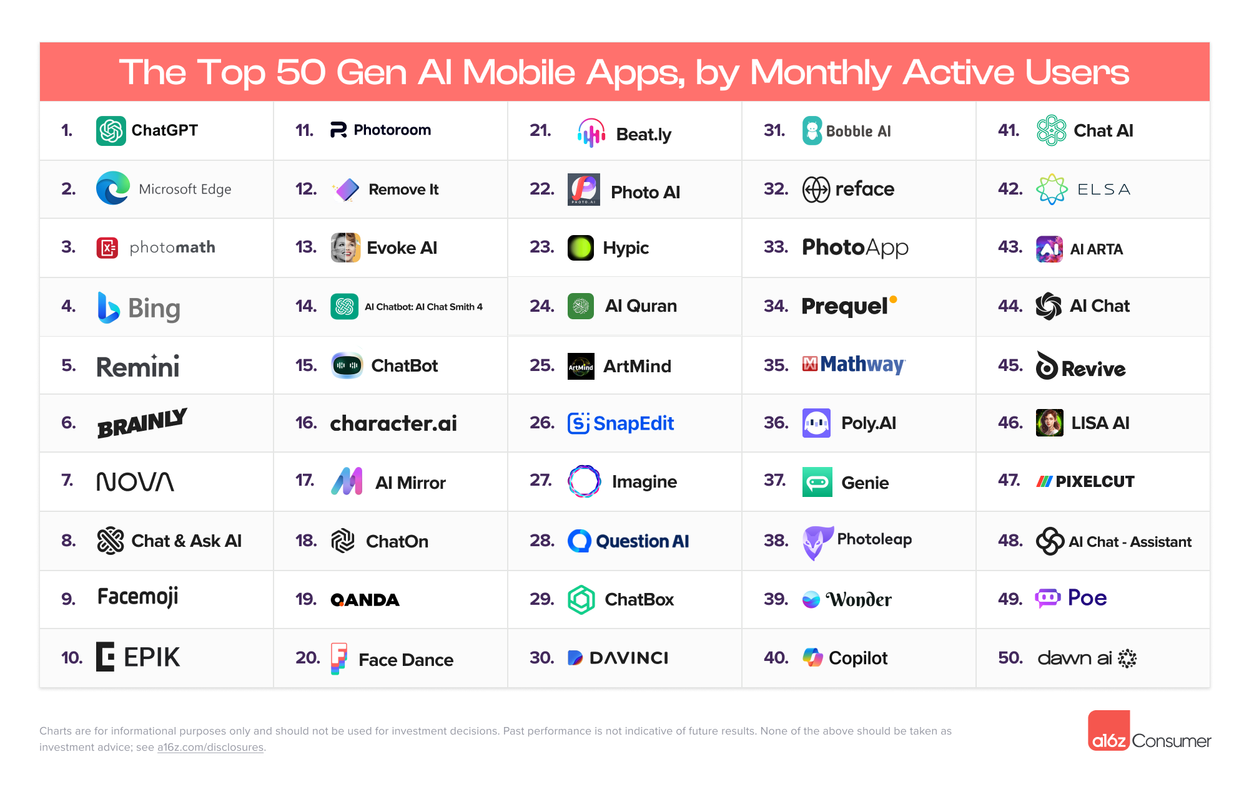
source

Slide 4
Semester Plan
Predictive AI | Computer Vision | Language Models
Introduction & scientific Python March 20 | CNNs April 24 | Transformer June 5
Classic ML & scikit-learn March 27 | Assignment 2: group work May 15 | LLMs June 12
Assignment 1: group work April 3 | Assignment 2: presentations May 29 | Generative AI June 19
Assignment 1: presentations April 10 |  | Assignment 3: group work June 26
Deep Learning & PyTorch April 17 |  | Assignment 3: presentations July 3
 |  | Open discussion July 10

Slide 5
Goal of the Course
gain a high-level understanding of ML concepts
be able to apply and adapt ML methods to various use cases

Slide 6
Assignments
3 assignments (Predictive AI, Computer Vision, Language Models)
20 points for each (10 contents, 5 coding, 5 presentation)
50% (30 points) for 4,0 → 5% (3 points) steps → 95% (57 points) for 1,0
gather in 2 groups for each assignment

