Slide 1
Classic ML

Slide 2
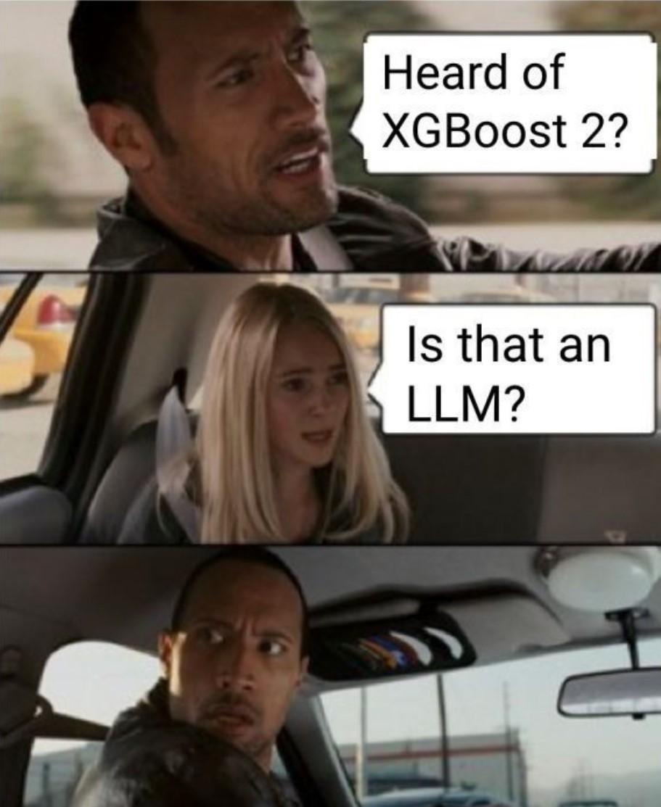

Slide 3
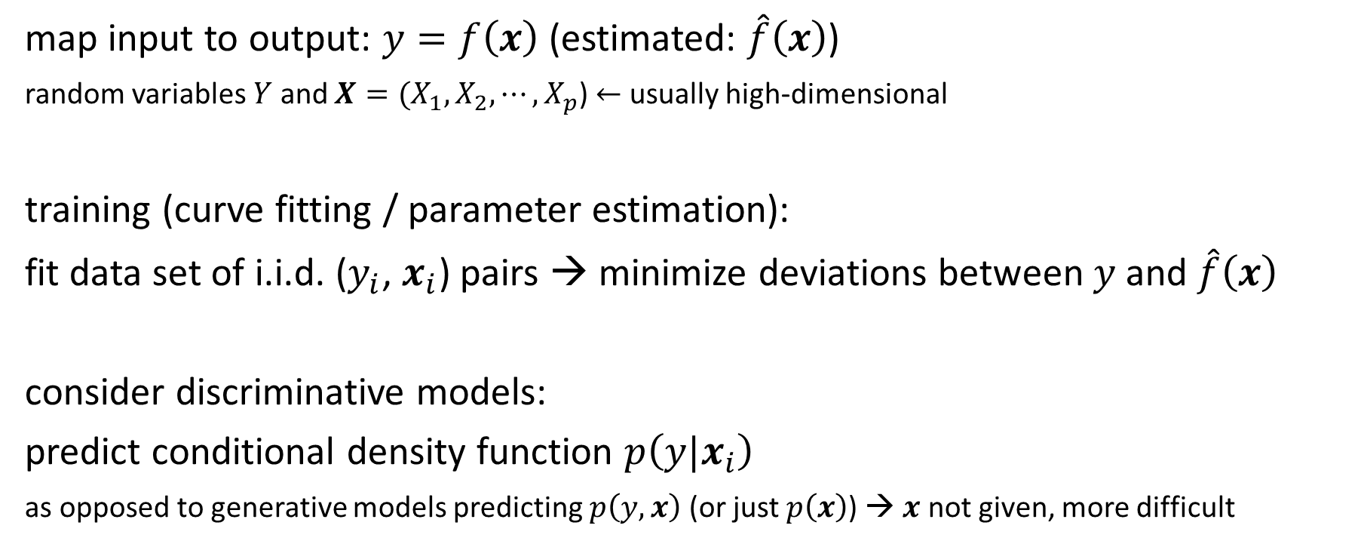
Supervised Learning Scenario
map input to output: $y=f\left(x\right)$ (estimated: $\hat{f}\left(x\right)$)
random variables $Y$ and $X={(X}_{1}, X_{2},{⋯,X}_{p}$) $←$ usually high-dimensional
training (curve fitting / parameter estimation):
fit data set of i.i.d. ($y_{i}$, $x_{i}$) pairs → minimize deviations between $y$ and $\hat{f}\left(x\right)$
consider discriminative models:
predict conditional density function $p\left(y|x_{i}\right)$
as opposed to generative models predicting $p\left(y, x\right)$ (or just $p\left(x\right)$) → $x$ not given, more difficult

Slide 4
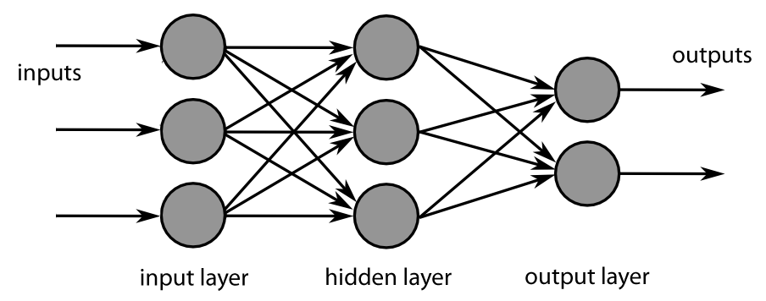
Algorithmic Families of Supervised Learning
parametric models
nearest neighbors (local methods, instance-based learning) – non-parametric models
decision trees: rule learning
linear regression
Day
neural networks: many linear models, non-linear by means of activation functions
Weekday
Weekend
3
Promo
No
Yes
demand prediction
5
8
often used in ensemble methods
bagging: random forests
boosting: gradient boosting
kernel/support-vector machines: linear model (maximum-margin hyperplane) with kernel trick
from wikipedia

Slide 5
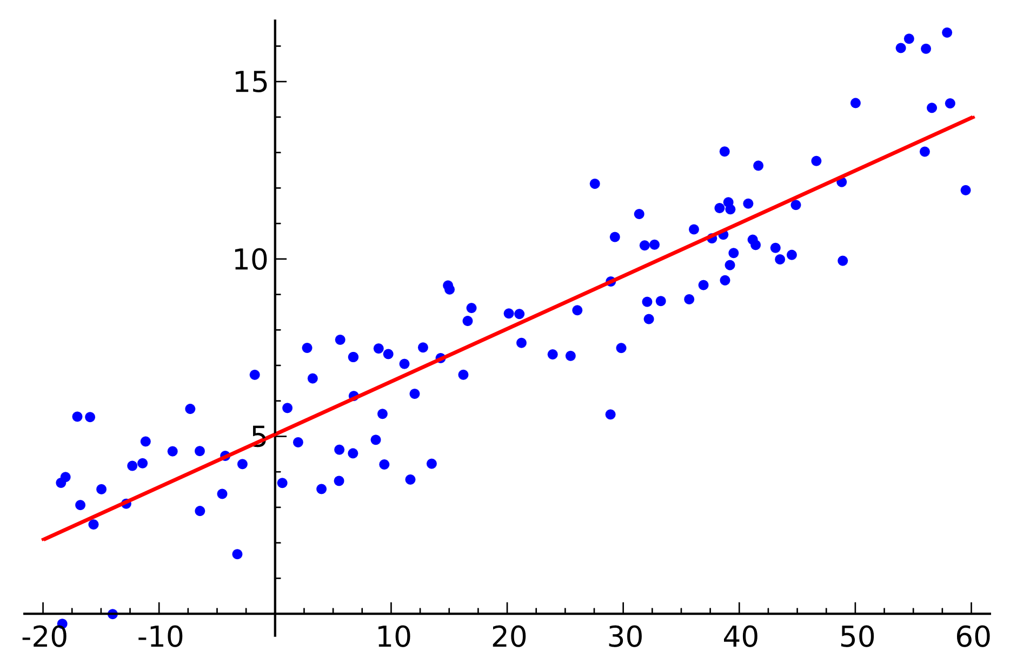

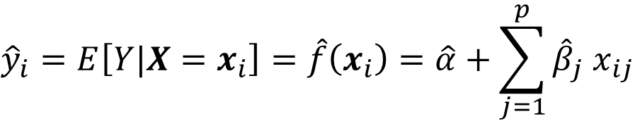
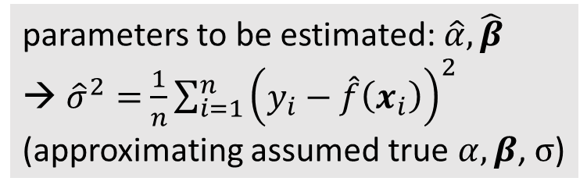
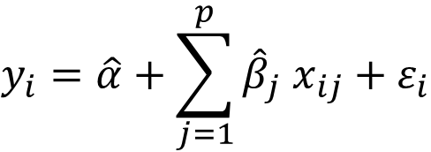

Linear Regression
$$\hat{f}\left(x_{i}\right)$$
fit:
$$y_{i}=\hat{α}+\sum_{j=1}^{p}{{\hat{β}}_{j} x_{ij}}+ε_{i}$$
from wikipedia
Gaussian
parameters to be estimated: $\hat{α},\hat{β}$
${\hat{σ}}^{2}=$ $\frac{1}{n}\sum_{i=1}^{n}{{\left(y_{i}−\hat{f}\left(x_{i}\right)\right)}^{2}}$
(approximating assumed true $α, β$, $σ$)
predict:
$${\hat{y}}_{i}=E\left[Y|X=x_{i}\right]=\hat{f}\left(x_{i}\right)=\hat{α}+\sum_{j=1}^{p}{{\hat{β}}_{j} x_{ij}}$$
$$p\left(y|x_{i}\right)=𝒩\left(y;{\hat{y}}_{i}, {\hat{σ}}^{2}\right)$$
Gaussian
mean
variance

Slide 6
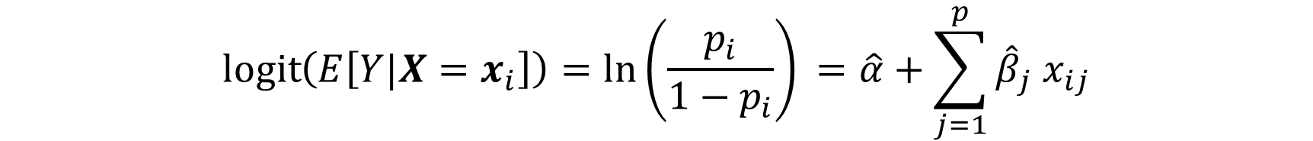

Classification: Logistic Regression
predict probability $p_{i}$ for $y=1$ respectively $y=0$ for each sample
logit (log-odds) as link function
$Y$ following Bernoulli distribution
$$\operatorname{logit}\left(E\left[Y|X=x_{i}\right]\right)=\ln\left(\frac{p_{i}}{1−p_{i}}\right)⁡=\hat{α}+\sum_{j=1}^{p}{{\hat{β}}_{j} x_{ij}}$$

Slide 7
Generalization
core of ML:
empirical risk minimization (training error) as proxy for minimizing unknown population risk (test error, aka generalization error or out-of-sample error)
generalization gap: difference between test and training error
curse of dimensionality: many features (dimensions) → lots of data needed to densely sample volume
but reality is friendly: most high-dimensional data sets reside on lower-dimensional manifolds (manifold hypothesis) → enabling effectiveness of ML
→ need for appropriate inductive bias (different forms: model design, regularization, …)

Slide 8
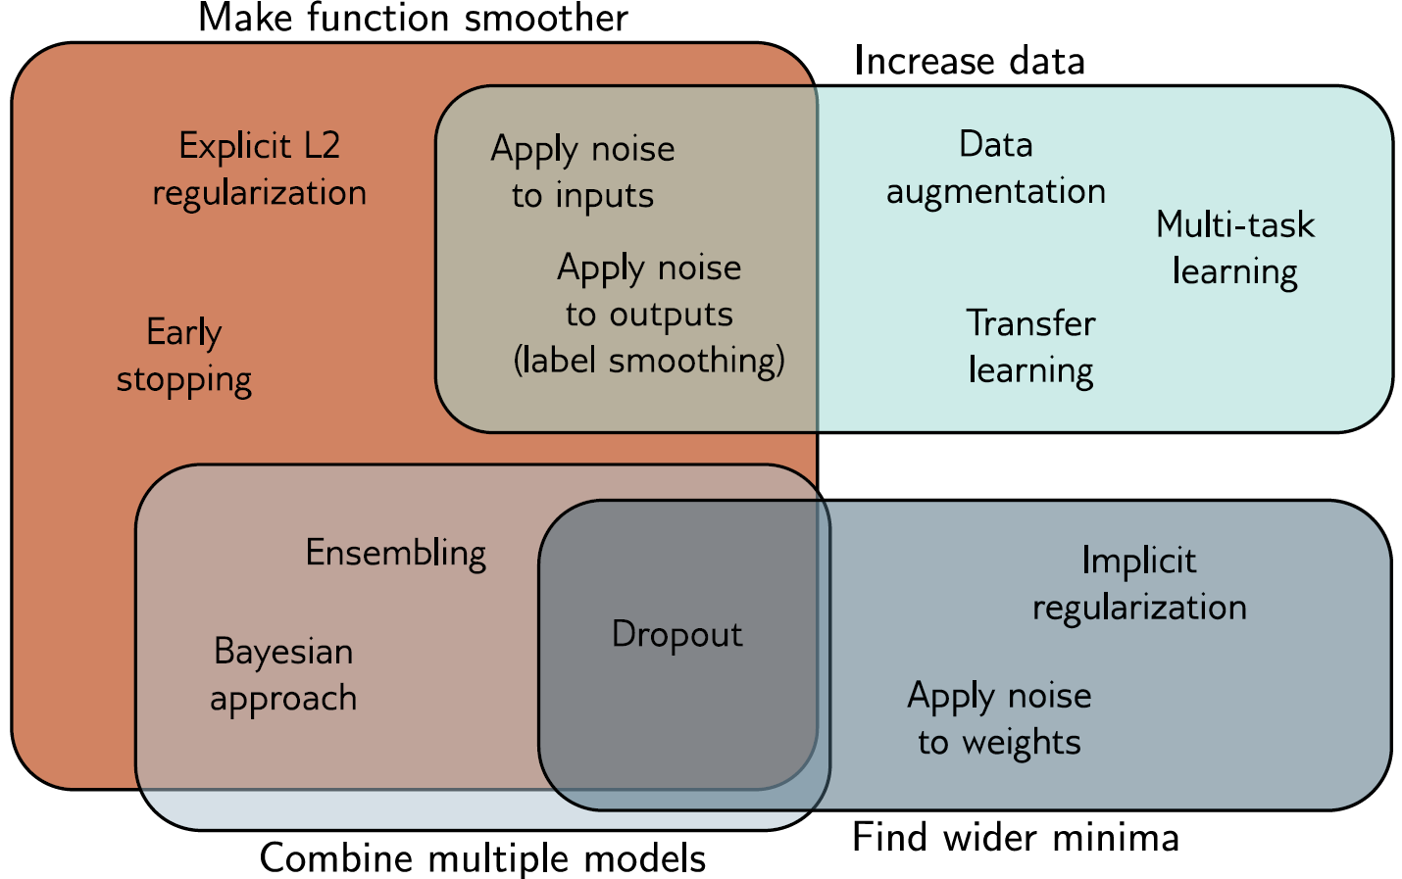
Regularization
reduce test error, possibly at expense of increased training error
many ways:
explicit constraints, adding penalties, priors, parameter sharing, data set augmentation, early stopping, dropout, bagging, …
source

Slide 9
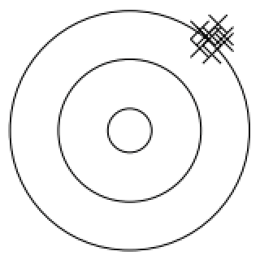
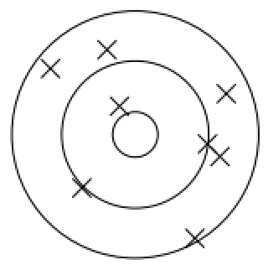
Bias, Variance, Irreducible Error
think of fitting ML algorithms as repeatable processes with different (i.i.d.) data sets
irreducible error (aka Bayes error):
inherent randomness (target generated from random variable following probability distribution)
limiting accuracy of ideal model
different potential reasons for inherent randomness (noise): complexity, missing information, …
bias:
due to too simplistic model (same for all training data sets)
“underfitting”
variance:
due to sensitivity to specifics (noise) of different training data sets
“overfitting”

Slide 10
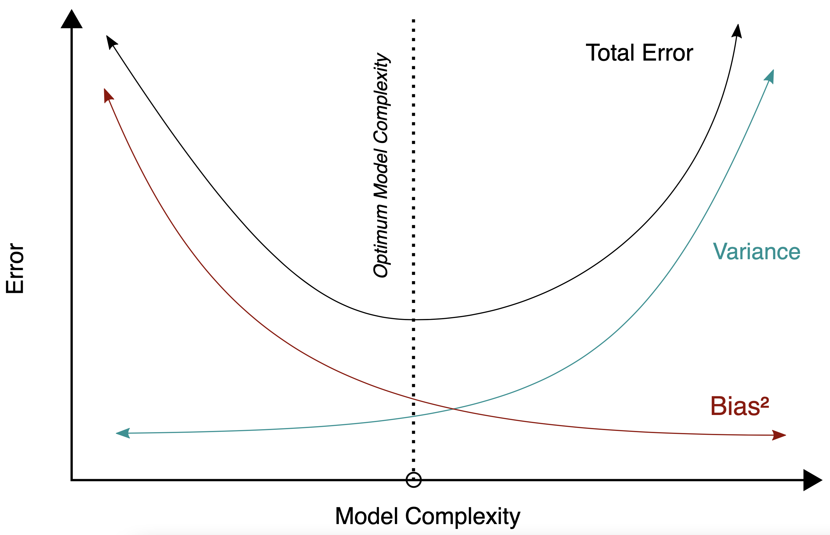
Bias-Variance Tradeoff
fundamental concept in classical statistical learning theory
models of higher complexity have lower bias but higher variance (given the same number of training examples)
generalization error follows U-shaped curve: overfitting once model complexity (number of parameters) passes certain threshold
overfitting: variance term dominating test error
→ increasing model complexity increases test error
from wikipedia

Slide 11
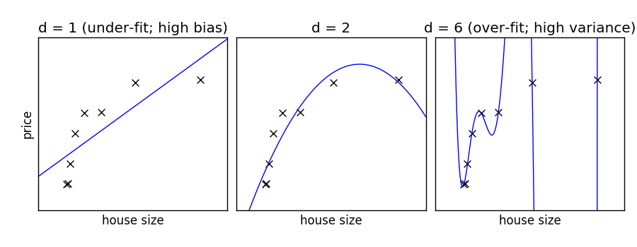
Example: Non-Linear Function Approximation
degree of fitted polynomial
from scikit-learn documentation

Slide 12
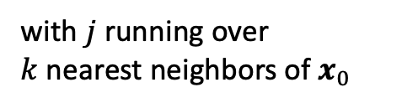

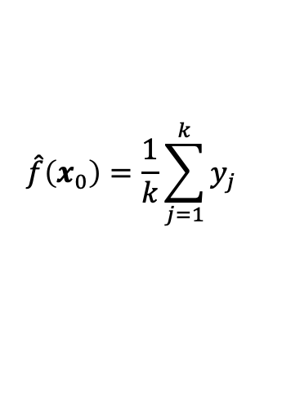
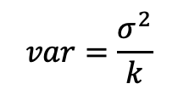
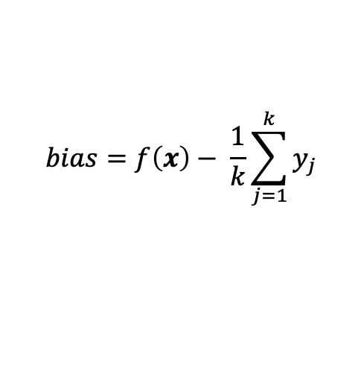
Example: k-Nearest Neighbors
local method, instance-based learning
non-parametric
distance defined by metric on $x$ (e.g., Euclidean)
regression:
$$\hat{f}\left(x_{0}\right)=\frac{1}{k}\sum_{j=1}^{k}{y_{j}}$$
with $j$ running over $k$nearest neighbors of $x_{0}$
low k: low bias but high variance
high k: low variance but high bias
$$bias=f\left(x\right)− \frac{1}{k}\sum_{j=1}^{k}{y_{j}}$$
$$var=\frac{σ^{2}}{k}$$

Slide 13
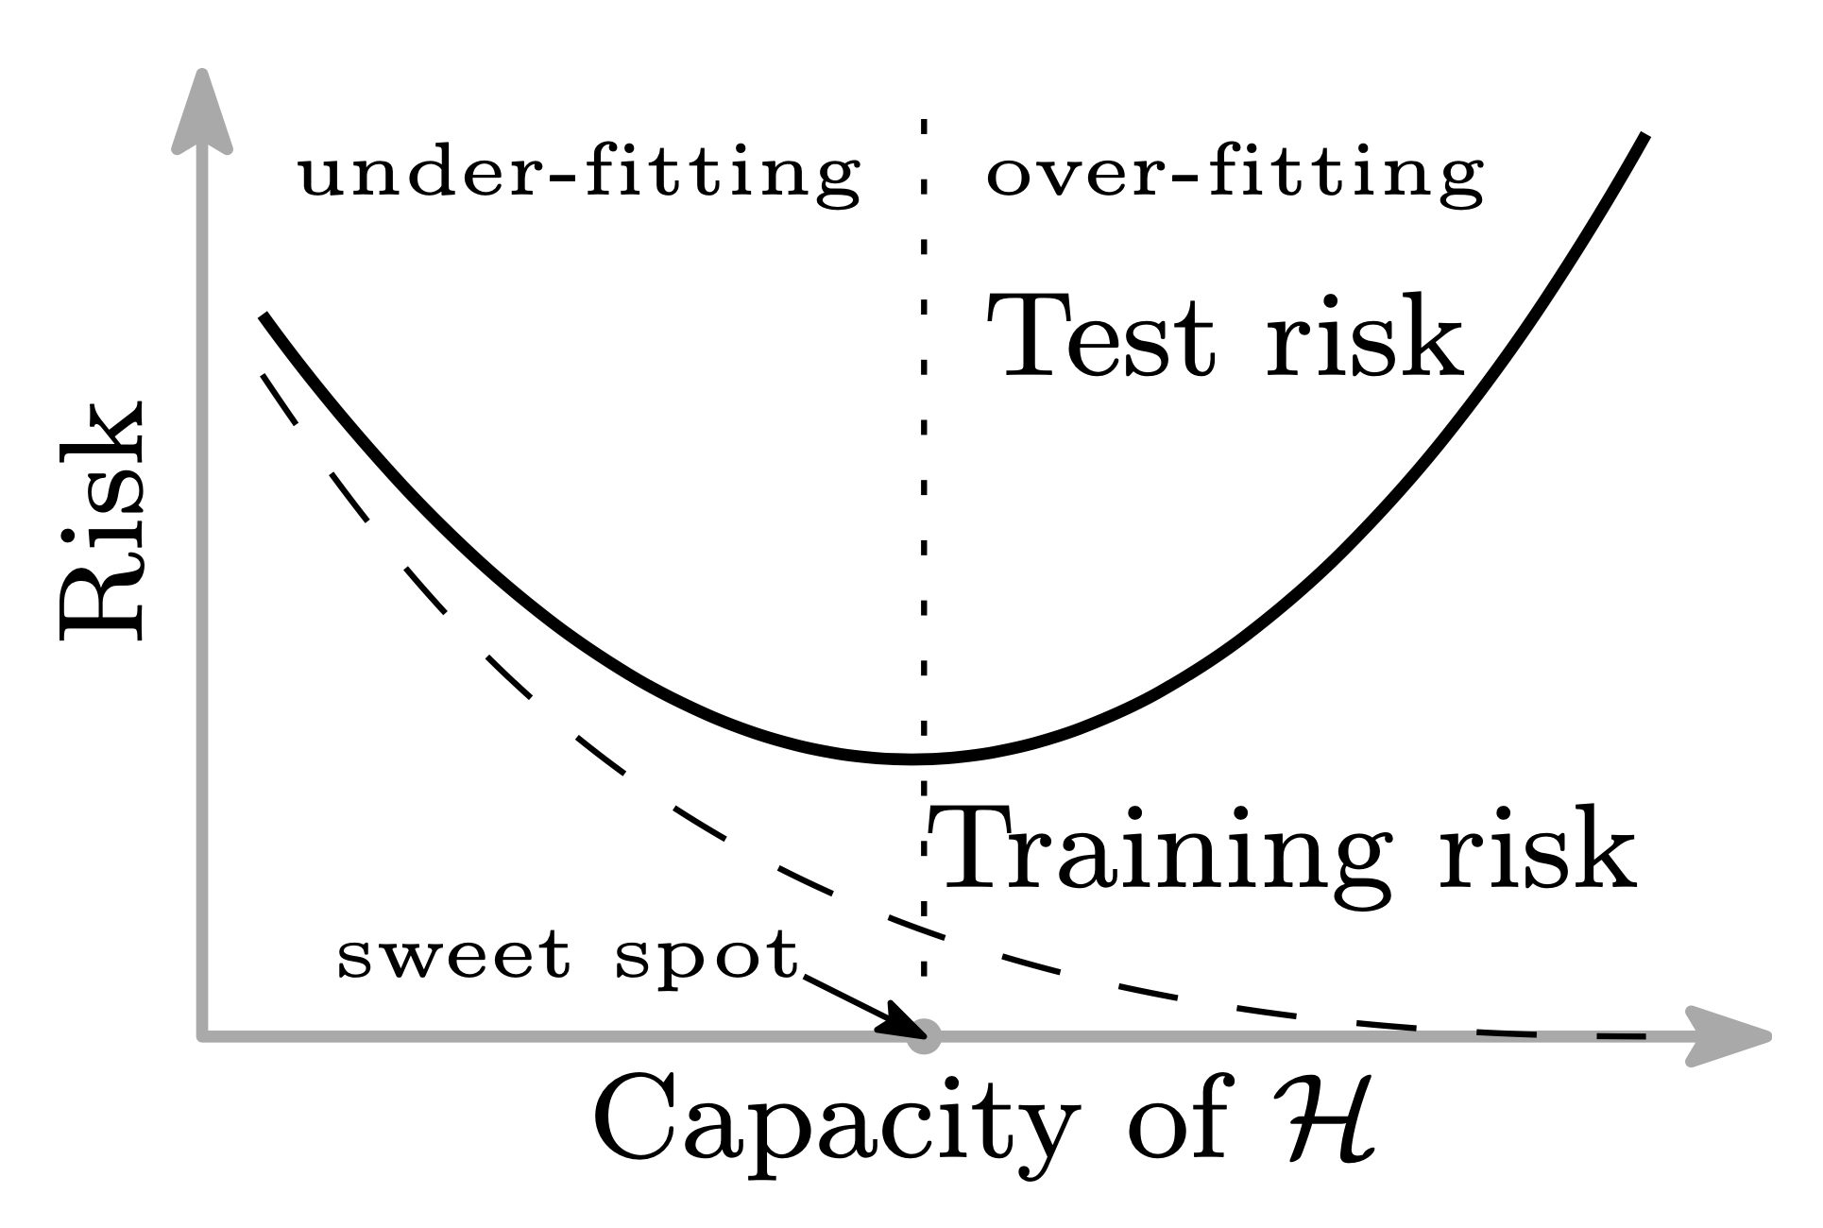
Problem of Finding Complexity Sweet Spot
training/in-sample error keeps decreasing with more complex model (less bias)
test/out-of-sample error not easily accessible during training
→ e.g., cross-validation, early stopping
source

Slide 14
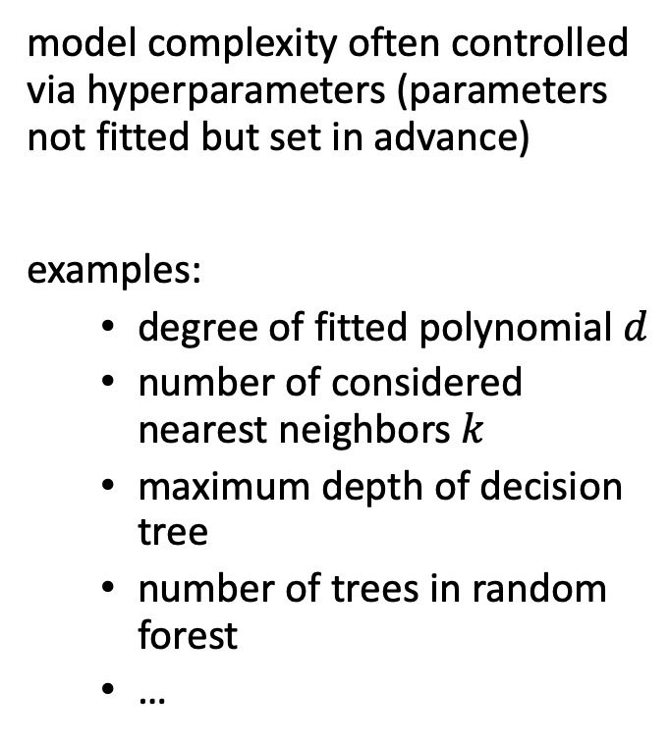
Hyperparameters
model complexity often controlled via hyperparameters (parameters not fitted but set in advance)
examples:
degree of fitted polynomial $d$
number of considered nearest neighbors $k$
maximum depth of decision tree
number of trees in random forest
…
hyperparameter tuning

Slide 15
Methods for …
regularization
reducing bias:
kNN: consider less neighbors
decision tree: greater depth
ensemble: boosting
neural network: more hidden nodes
more model features
larger training data set
reducing variance:
kNN: consider more neighbors
decision tree: shallower depth
ensemble: bagging (kind of regularization)
neural network: less hidden nodes
dimensionality reduction, feature selection
larger training data set

Slide 16
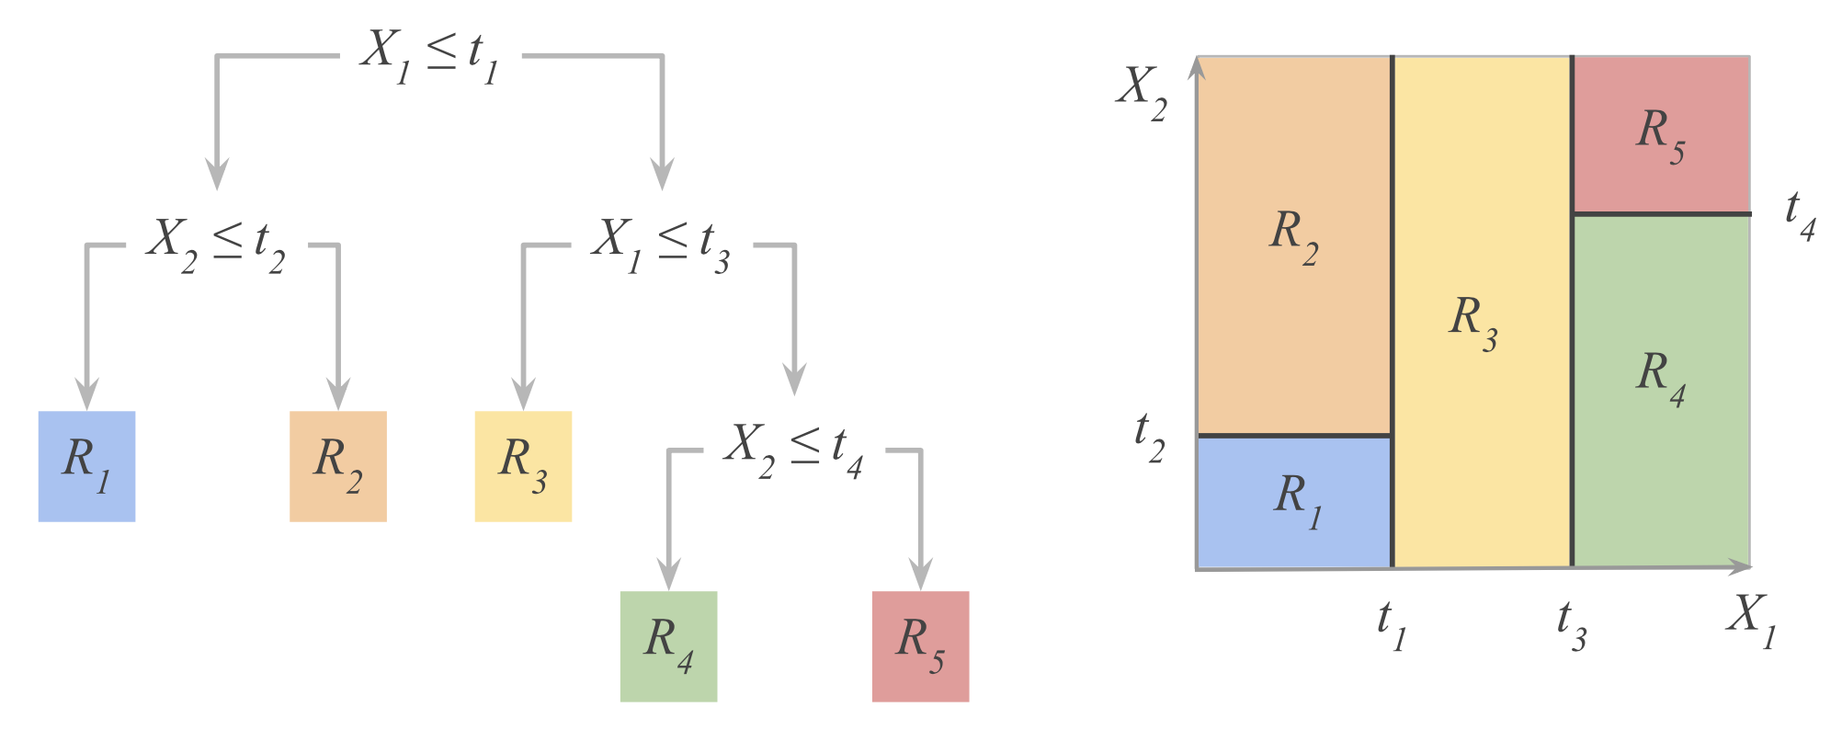
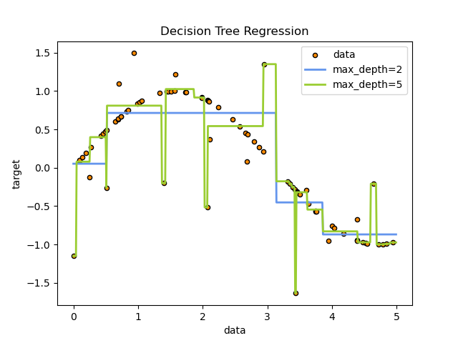
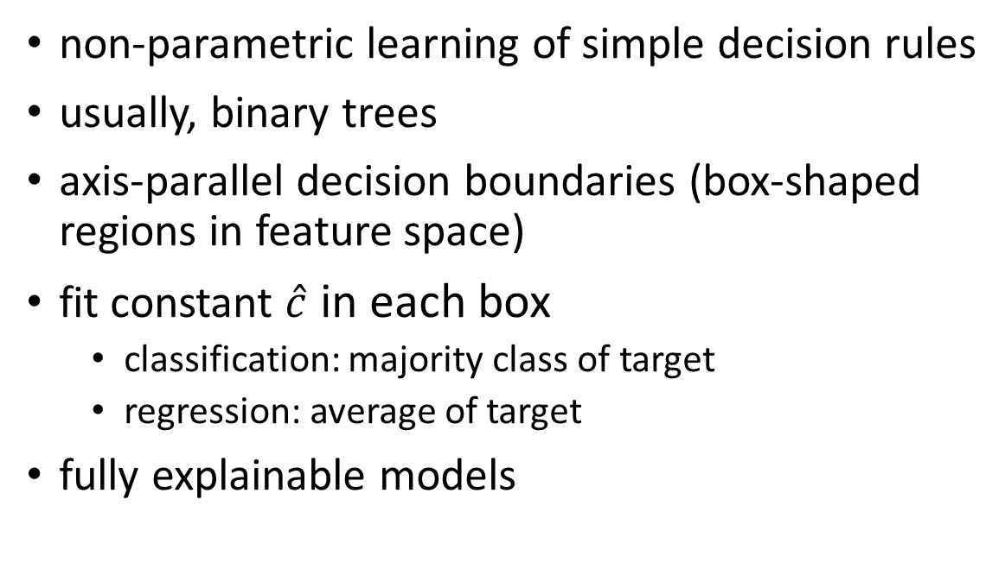
Decision Trees
from Hastie
non-parametric learning of simple decision rules
usually, binary trees
axis-parallel decision boundaries (box-shaped regions in feature space)
fit constant $\hat{c}$ in each box
classification: majority class of target
regression: average of target
fully explainable models
hyperparameter
from scikit-learn

Slide 17
Ensemble Learning
idea:
combine several individual models (often of the same type) to form an ensemble model with better predictive performance than each of its constituents
learning in several different ways from the training data
the trainings of the individual constituent models are (kind of) independent
outputs of individual models are combined (e.g., averaged)

Slide 18
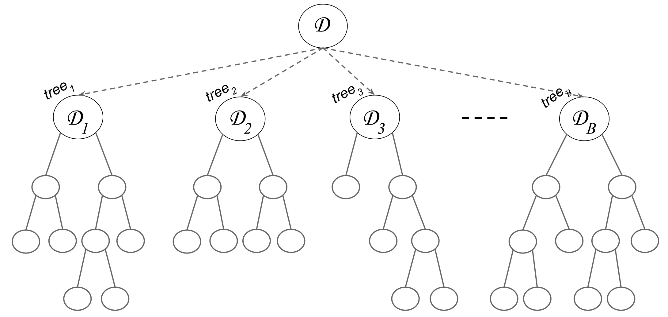
Bagging (Bootstrap Aggregating)
idea: train individual models of ensemble method on random (sub)sets of the training data (random sample with replacement)
reduces variance of ensemble model compared to individual models
but not bias → use low-bias base models
individual models combined by averaging (regression) or majority voting (classification) → committee of models
example with decision trees:
source

Slide 19
Random Subspace Method
aka feature bagging
idea: train different members (models) of an ensemble method on random subsets of all features (random sample with replacement)
reduce correlation between ensemble members
individual models combined by averaging (regression) or majority voting (classification) → committee of models

Slide 20
Random Forest
ensemble method using
decision trees as individual models (usually, rather large, low-bias decision trees)
combination of bagging and random subspace method (features sampled at each node in the trees)
compared to individual decision trees, random forests
reduce variance → improve accuracy
lose explainability
one of the most popular off-the-shelf ML algorithms (often, good performance with little hyperparameter tuning and data preparation)

Slide 21
Boosting
idea: sequentially learn and combine several “weak” learners (such as small decision trees, but in principle any ML algorithm) to construct a “strong” one
→ gradually (in a greedy fashion) reducing bias of ensemble model
in simple terms:
building a model from the training data, then creating a second model that attempts to correct the errors from the first model, …
→ each subsequent weak learner is forced to concentrate on the examples that are missed by the previous ones in the sequence
not a committee of models
typically, use simple, high-bias methods as individual models (e.g., small decision trees)
most prominent: AdaBoost, Gradient Boosting

Slide 22
Forward Stagewise Additive Modeling
boosting can be understood as fitting an additive expansion in a set of basis functions $b\left(x;{\hat{γ}}_{m}\right)$ (e.g., decision trees, with ${\hat{γ}}_{m}$ parametrizing splits): $\hat{f}\left(x\right)=\sum_{m=1}^{M}{{\hat{β}}_{m} b\left(x;{\hat{γ}}_{m}\right)}$
loss minimization of $\hat{f}\left(x\right)$ computationally expensive → boosting: sequentially add and fit individual basis functions without changing already fitted ones
boosting algorithm for sequential optimization using basis functions:
initialize ${\hat{f}}_{0}\left(x\right)=0$
for $m=1$ to $M$
compute $\underset{{\hat{β}}_{m},{\hat{γ}}_{m}}{argmin}{\sum_{i=1}^{N}{L\left(y_{i},{\hat{f}}_{m−1}\left(x_{i}\right)+{\hat{β}}_{m} b\left(x_{i};{\hat{γ}}_{m}\right)\right)}}$
set ${\hat{f}}_{m}\left(x\right)={\hat{f}}_{m−1}\left(x\right)+{\hat{β}}_{m} b\left(x;{\hat{γ}}_{m}\right)$

Slide 23
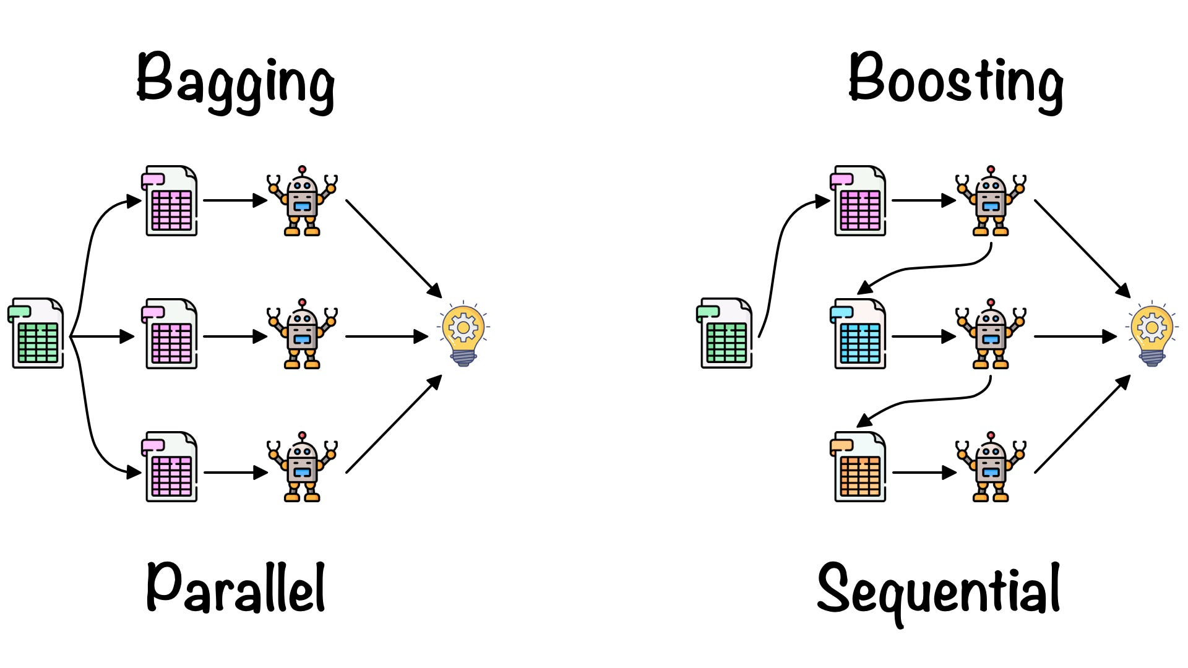

Slide 24
Decision Tree Sizes for Boosting
consider degree to which features interact with each other in given data set (see ANOVA expansion)
decision trees with single split (aka decision stumps): covering no interaction effects, just main effects of individual features
decision trees with two splits: covering second-order interactions
decision trees with three splits: covering third-order interactions
(usually, interaction order not much higher than $\sim$5 in real-world data sets)
why boosting often works better than single large, low-bias model: uncorrelated learners, each focusing on a specific aspect of the data

Slide 25
So, let’s do some modeling …
scikit-learn
coding example: Kaggle House Prices

Slide 26
Assignments
classification: Kaggle Spaceship Titanic
regression: Kaggle Store Sales

