Slide 1

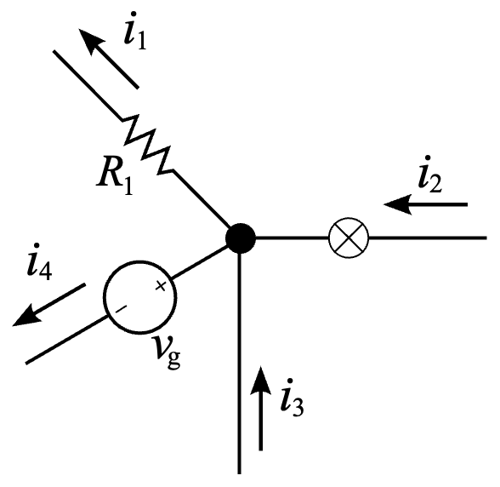
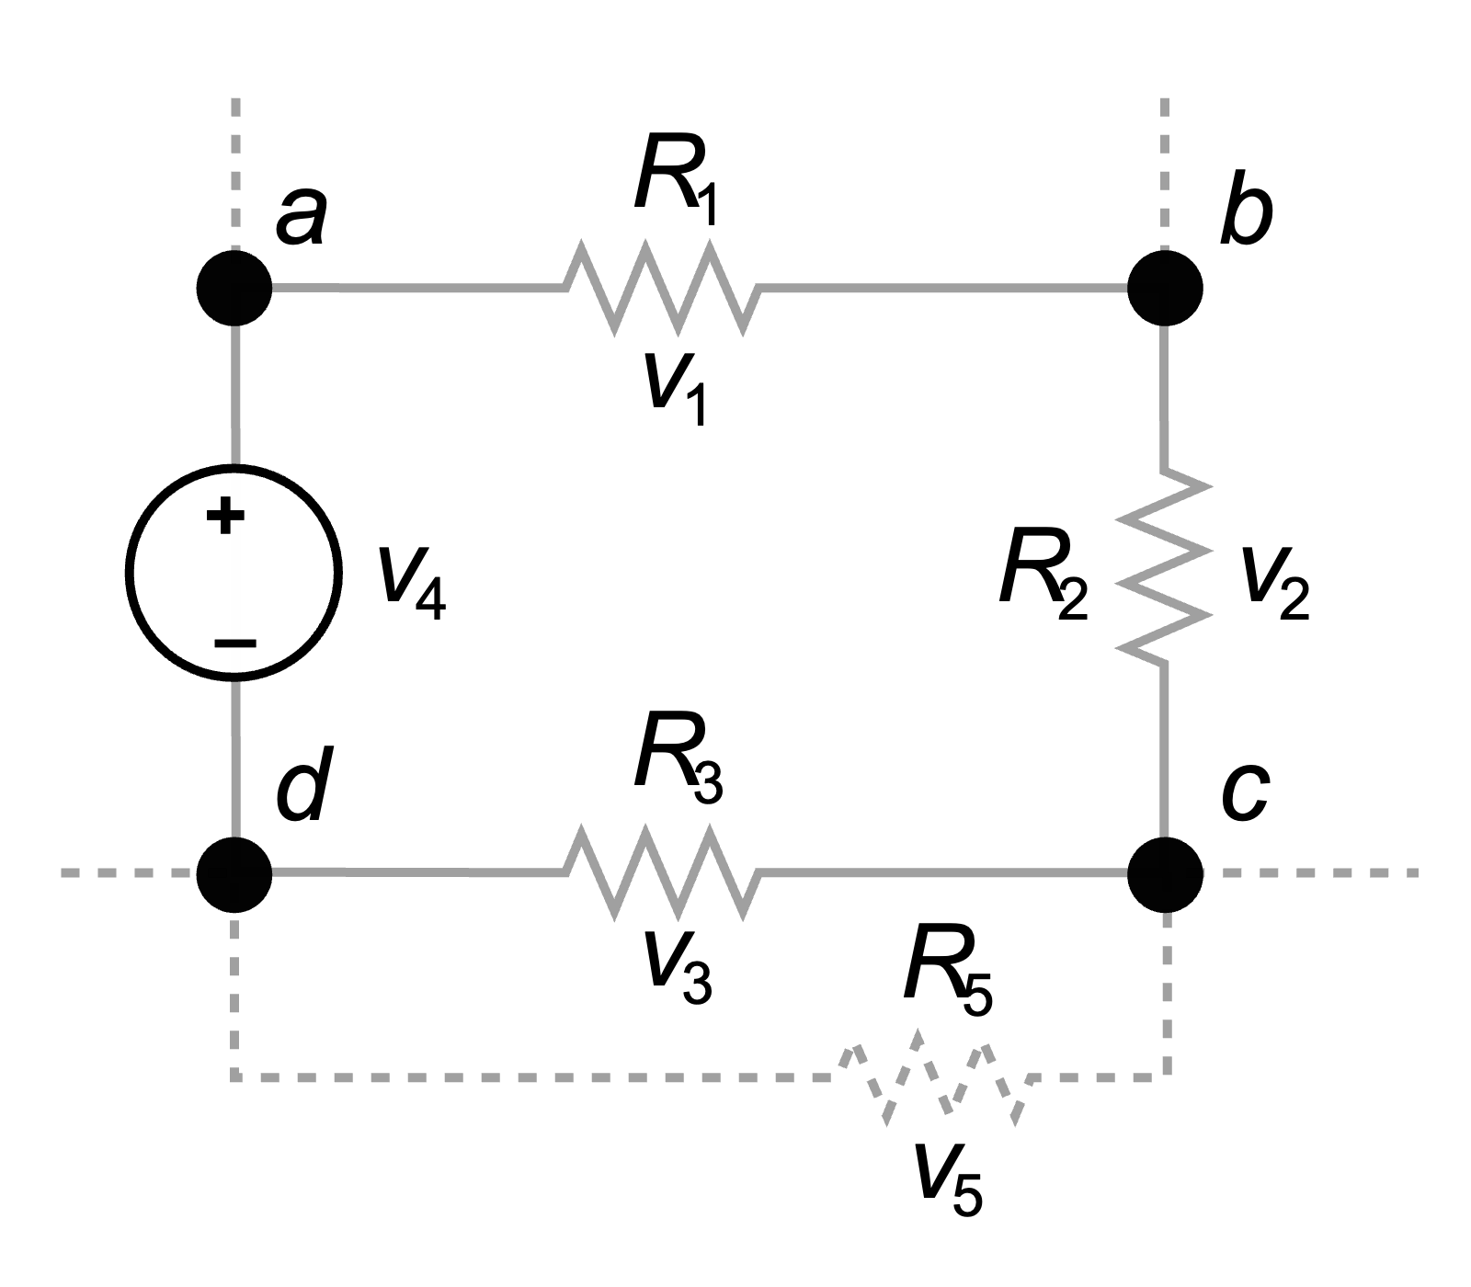
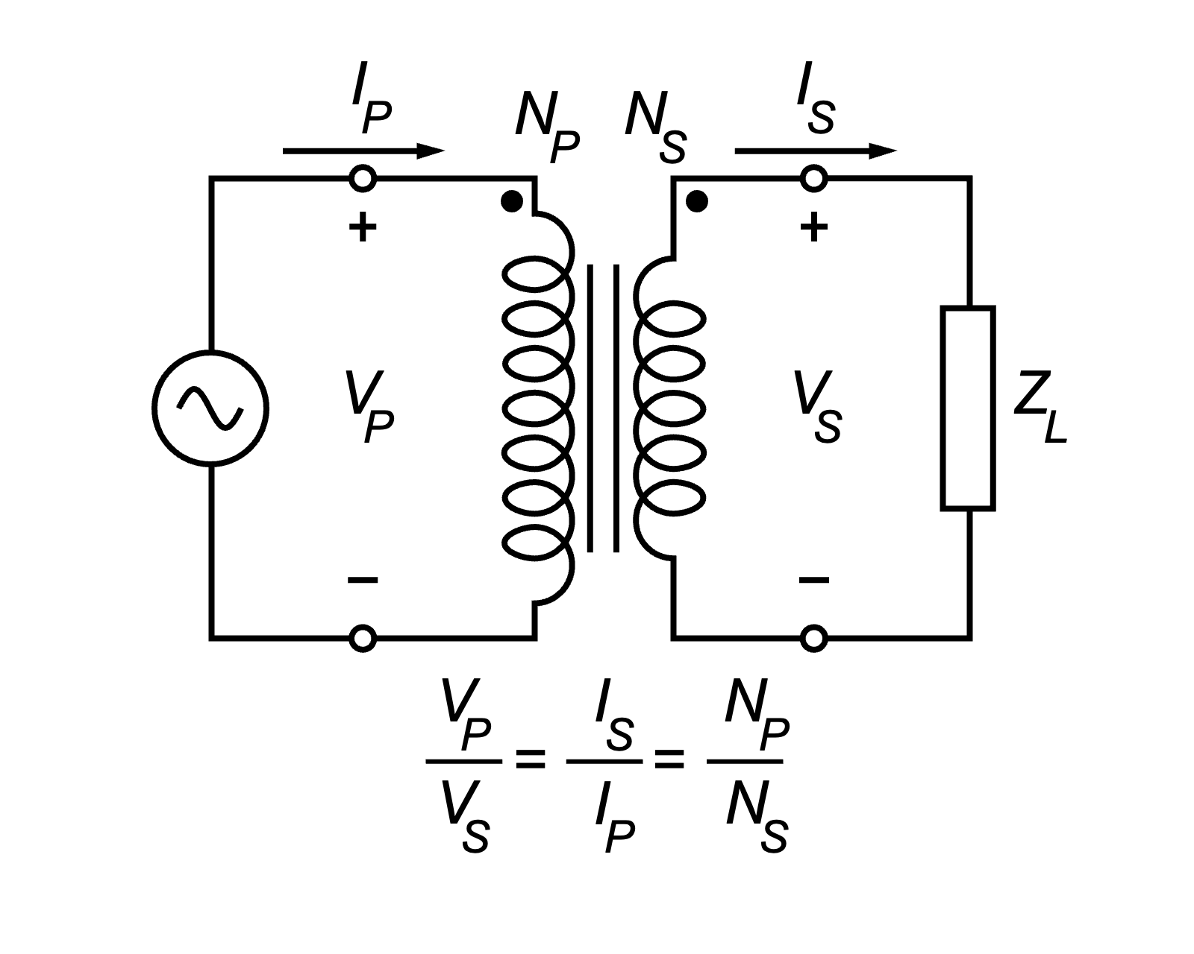
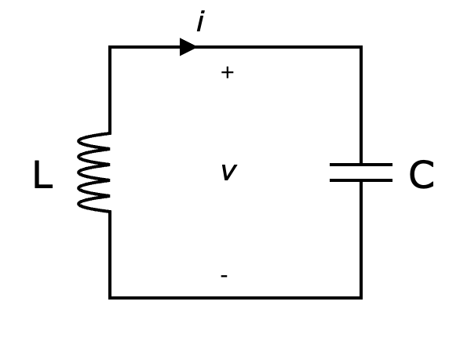
Introduction to Electrical Engineering

Slide 2
Overview
Physical Principles and Basic Concepts
Direct Current Circuits
Electric and Magnetic Fields
Alternating Current Technology

Slide 3
Alternating Current Technology
Sinusoidal Waveform
Phasor Representation
Network Analysis in Phasor Domain
AC Power
High- & Low-Pass Filters
Resonant Circuits

Slide 4
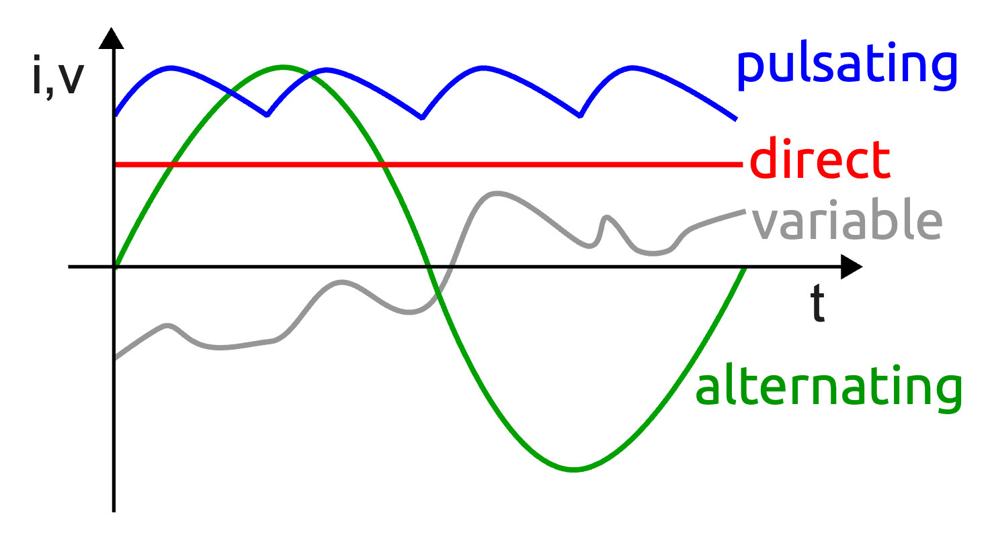
Alternating Current (AC)
periodically reverses direction and changes its magnitude continuously with time

Slide 5
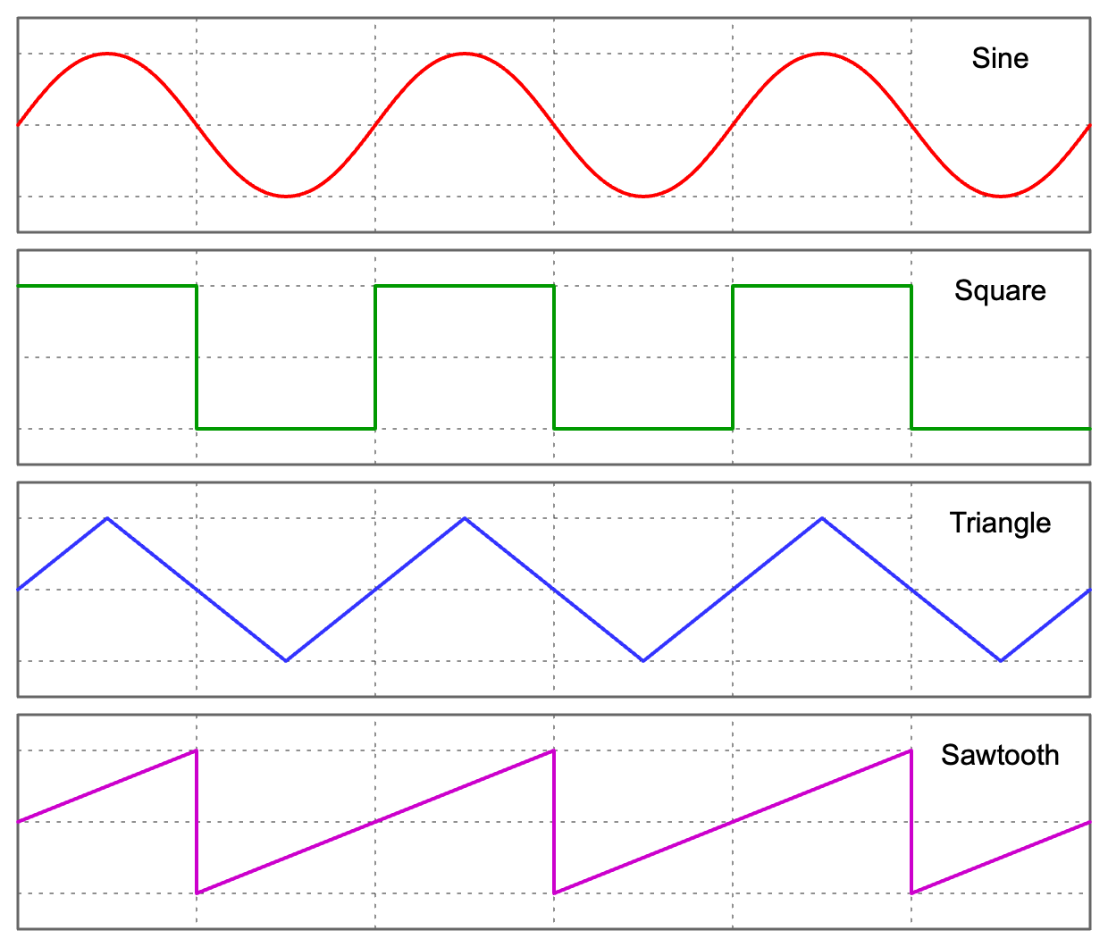
AC Waveforms

Slide 6
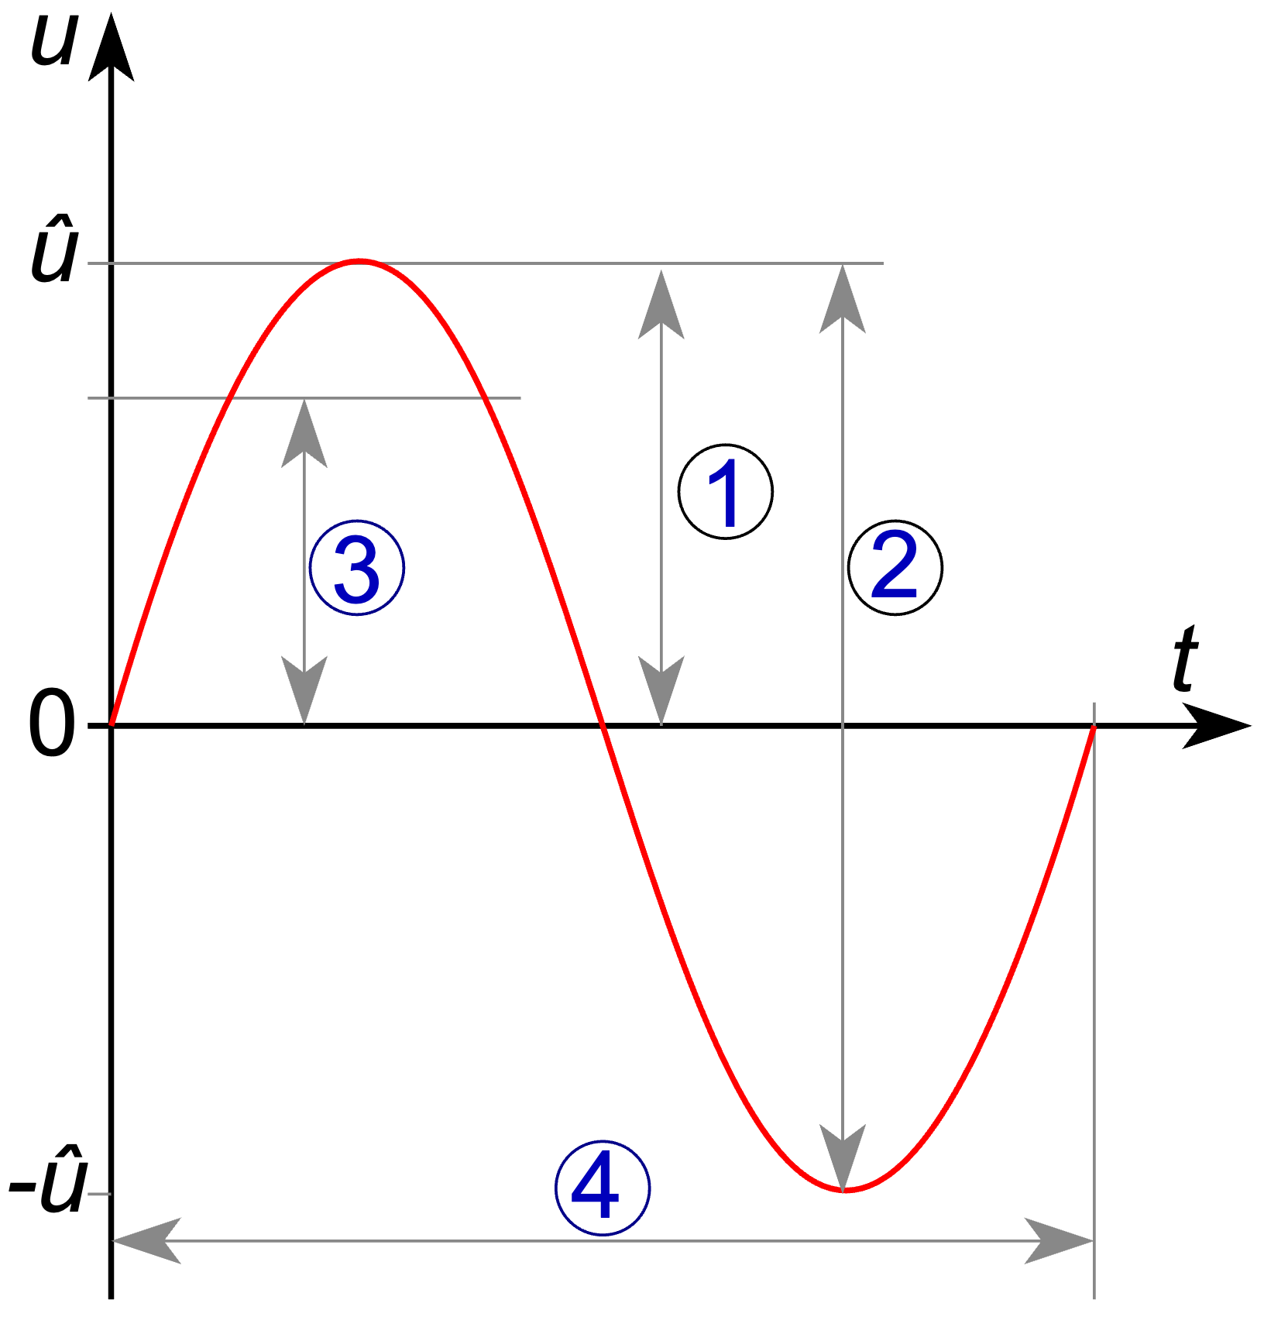
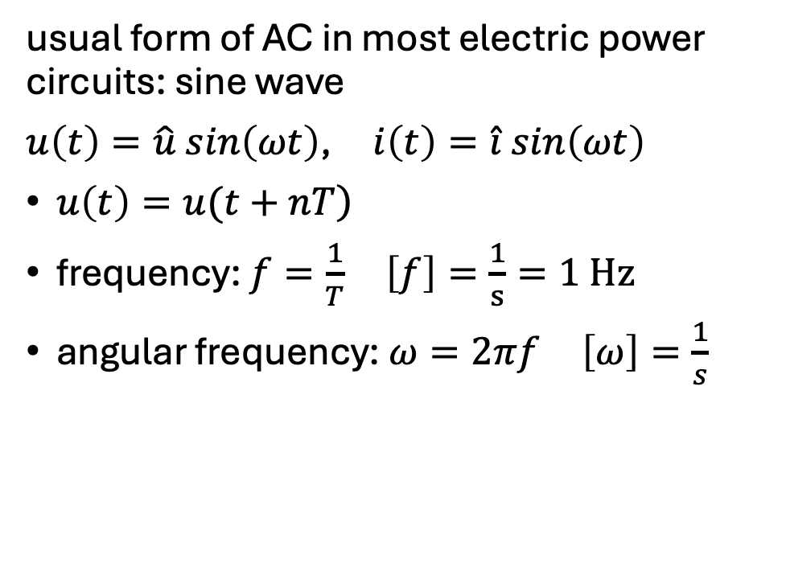
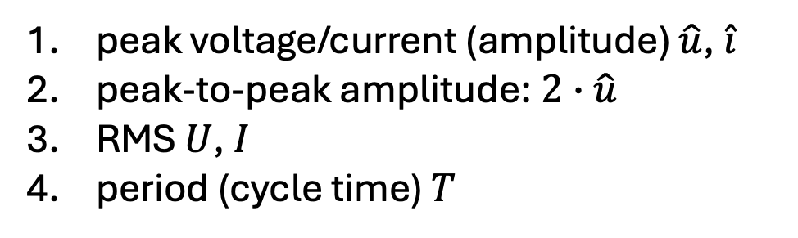
Sinusoidal AC
usual form of AC in most electric power circuits: sine wave
$u\left(t\right)=\hat{u} sin\left(ωt\right)$, $i\left(t\right)=\hat{i} sin\left(ωt\right)$
$\left.u\left(t\right)=u(t+nT\right)$
frequency: $f=\frac{1}{T}$ $\left[f\right]=\frac{1}{s}=1 Hz$
angular frequency: $ω=2πf$ $\left[ω\right]=\frac{1}{s}$
peak voltage/current (amplitude) $\hat{u}$, $\hat{i}$
peak-to-peak amplitude: $2∙\hat{u}$
RMS $U$, $I$
period (cycle time) $T$

Slide 7
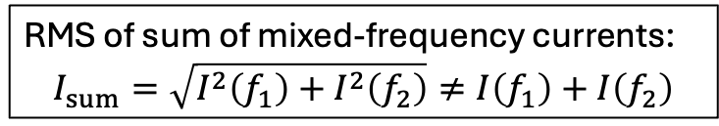
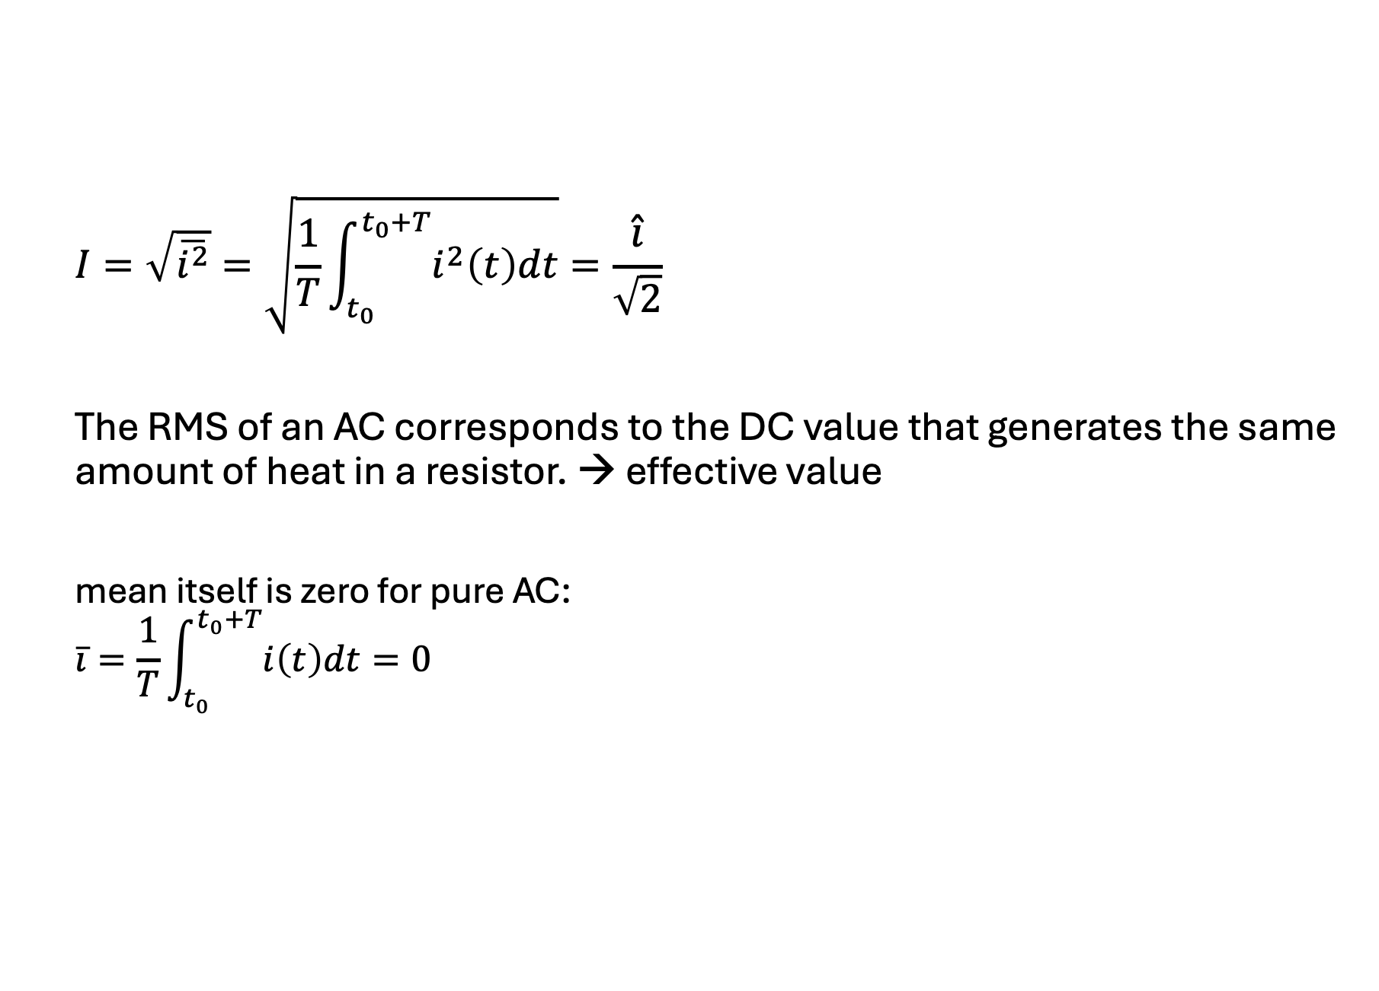
Root Mean Square (RMS)
$$I=\sqrt{\overline{i^{2}}}=\sqrt{\frac{1}{T}\int_{t_{0}}^{t_{0}+T}{i^{2}\left(t\right)dt}}=\frac{\hat{i}}{\sqrt{2}}$$
The RMS of an AC corresponds to the DC value that generates the same amount of heat in a resistor. → effective value
mean itself is zero for pure AC:
$$\overline{i}=\frac{1}{T}\int_{t_{0}}^{t_{0}+T}{i\left(t\right)dt=0}$$
RMS of sum of mixed-frequency currents:
$$I_{sum}=\sqrt{I^{2}\left(f_{1}\right)+I^{2}\left(f_{2}\right)}≠I\left(f_{1}\right)+I\left(f_{2}\right)$$

Slide 8

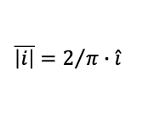
$$\left|i\right|$$
$$\overline{\left|i\right|}=2/π∙\hat{i}$$
sine
squared
RMS

Slide 9

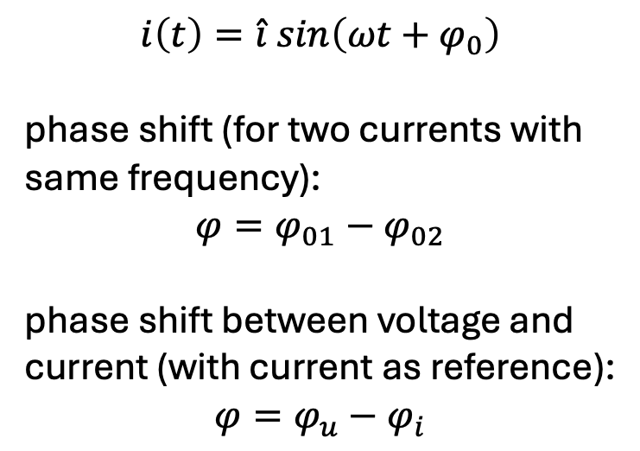
Phase Shift
$$i\left(t\right)=\hat{i} sin\left(ωt+φ_{0}\right)$$
phase shift (for two currents with same frequency):
$$φ=φ_{01}−φ_{02}$$
phase shift between voltage and current (with current as reference):
$$φ=φ_{u}−φ_{i}$$
ωt
$$φ=φ_{u}−φ_{i}=30°−\left(−30°\right)=60°$$
In this example, the current lags behind the voltage.

Slide 10
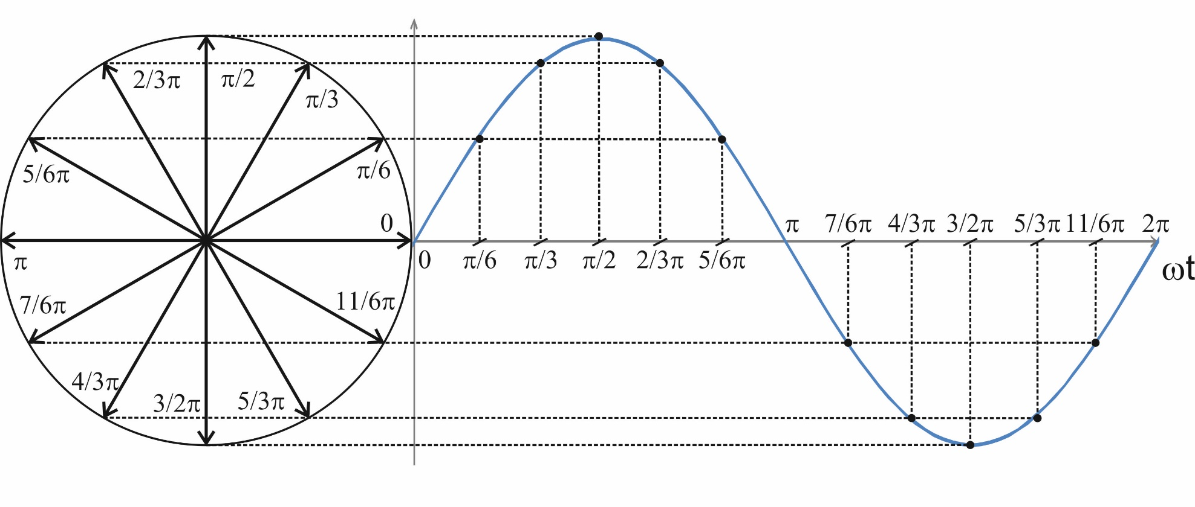
Phasor Representation
phasor diagram:
addition:
U
U₂
U₂
U₁
subtraction:
U₂
U₁
-U₂
phasor calculations only work for quantities with same frequency
→ freeze rotation in time to get stationary phasors
U

Slide 11
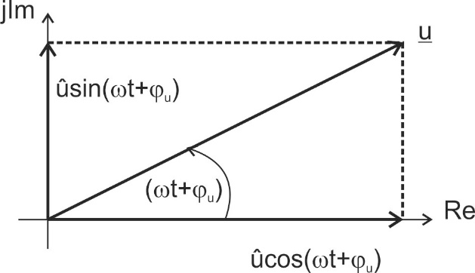

Use of Complex Numbers
$$u\left(t\right)=\hat{u}\cos\left(ωt+φ_{u}\right)=\hat{u}\sin\left(ωt+φ_{u}+\frac{π}{2}\right)=U∙\sqrt{2}\sin\left(ωt+φ_{u}+\frac{π}{2}\right)$$
phasors can be represented by complex numbers:
$$\underline{u}\left(t\right)=Re \left\{\underline{u}(t)\right\}+j Im\left\{\underline{u}(t)\right\}=\hat{u}\cos\left(ωt+φ_{u}\right)+j \hat{u}\sin\left(ωt+φ_{u}\right)$$

Slide 12
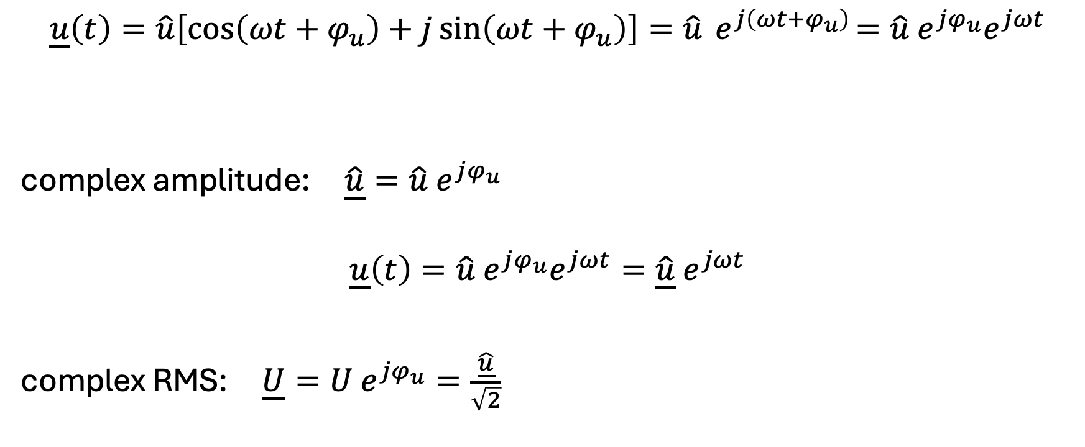
Complex Amplitude
$$\underline{u}\left(t\right)=\hat{u}\left[\cos\left(ωt+φ_{u}\right)+j\sin\left(ωt+φ_{u}\right)\right]=\hat{u}{ e}^{j\left(ωt+φ_{u}\right)}=\hat{u}{ e}^{jφ_{u}}e^{jωt}$$
complex amplitude: $\underline{\hat{u}}=\hat{u} e^{jφ_{u}}$
$$\underline{u}\left(t\right)=\hat{u}{ e}^{jφ_{u}}e^{jωt}=\underline{\hat{u}}{ e}^{jωt}$$
complex RMS: $\underline{U}=U e^{jφ_{u}}=\frac{\underline{\hat{u}}}{\sqrt{2}}$
complex
can be ignored if all quantities have the same frequency
→ stationary phasors

Slide 13
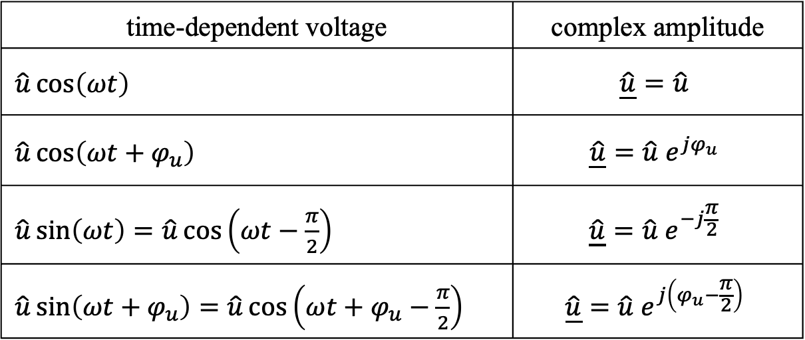
Transformation into Phasor Domain
time-dependent voltage | complex amplitude
$\hat{u}\cos\left(ωt\right)$ | $$\underline{\hat{u}}=\hat{u}$$
$\hat{u}\cos\left(ωt+φ_{u}\right)$ | $$\underline{\hat{u}}=\hat{u} e^{jφ_{u}}$$
$\hat{u}\sin\left(ωt\right)=\hat{u}\cos\left(ωt−\frac{π}{2}\right)$ | $$\underline{\hat{u}}=\hat{u} e^{−j\frac{π}{2}}$$
$\hat{u}\sin\left(ωt+φ_{u}\right)=\hat{u}\cos\left(ωt+φ_{u}−\frac{π}{2}\right)$ | $$\underline{\hat{u}}=\hat{u} e^{j\left(φ_{u}−\frac{π}{2}\right)}$$
$$\underline{\hat{u}}=\hat{u}\left(\cos{φ_{u}}+j\sin{φ_{u}}\right)=Re+jIm$$

Slide 14
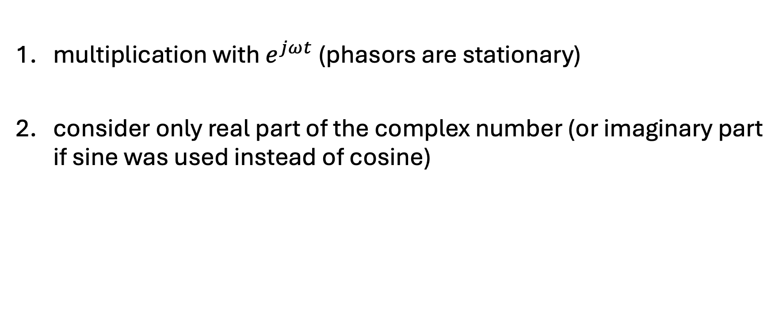
Back Transformation into Time Domain
multiplication with $e^{jωt}$ (phasors are stationary)
consider only real part of the complex number (or imaginary part if sine was used instead of cosine)

Slide 15
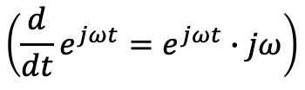


Derivation in Phasor Domain
$$\frac{d}{dt}→jω$$
→ phase shift of $\frac{π}{2}$
example:
$$u\left(t\right)=L\frac{di}{dt}→\underline{U}=jωL\underline{I}$$
$$\left({\frac{d}{dt}e}^{jωt}=e^{jωt}∙jω\right)$$
$$\left(\underline{\hat{u}}∙j=\hat{u} e^{jφ_{u}}∙e^{j \frac{π}{2}}=\hat{u} e^{j\left(φ_{u}+\frac{π}{2}\right)}\right)$$

Slide 16
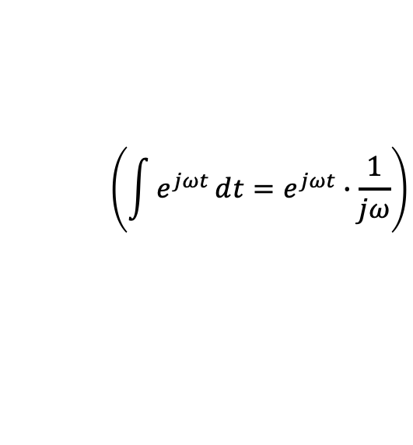
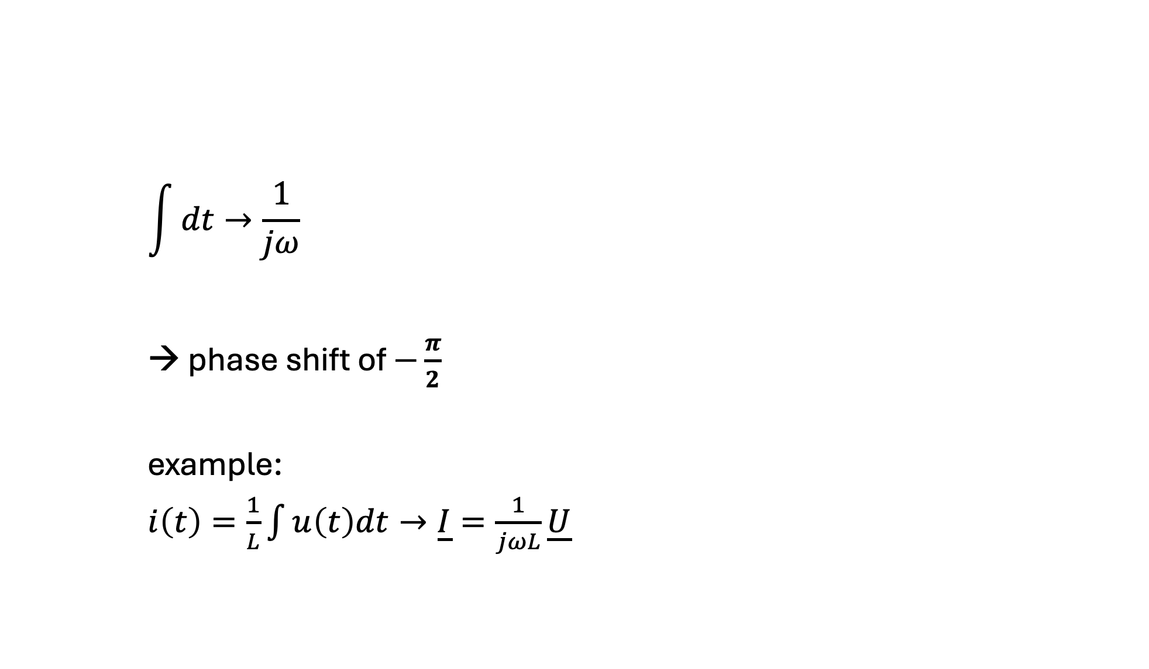
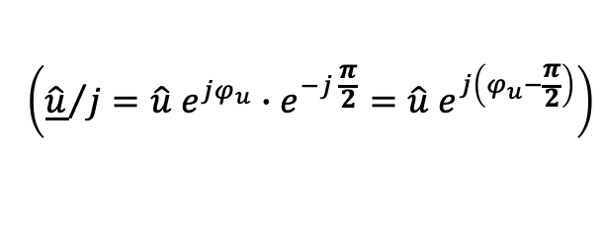
Integration in Phasor Domain
$$\int{dt}→\frac{1}{jω}$$
→ phase shift of $−\frac{π}{2}$
example:
$i\left(t\right)=\frac{1}{L}\int{u\left(t\right)dt}→\underline{I}=\frac{1}{jωL}\underline{U}$
$$\left(\int{e^{jωt}}ⅆt=e^{jωt}∙\frac{1}{jω}\right)$$
$$\left({\underline{\hat{u}}}/j=\hat{u} e^{jφ_{u}}∙e^{−j \frac{π}{2}}=\hat{u} e^{j\left(φ_{u}−\frac{π}{2}\right)}\right)$$

Slide 17
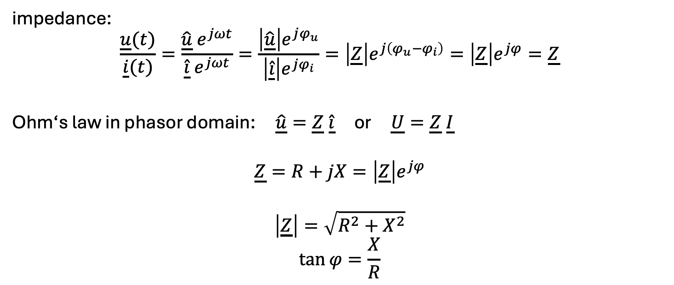
Complex Resistance
impedance:
$$\frac{\underline{u}(t)}{\underline{i}(t)}=\frac{\underline{\hat{u}} e^{jωt}}{\underline{\hat{i}}{ e}^{jωt}}=\frac{\left|\underline{\hat{u}}\right|e^{jφ_{u}}}{\left|\underline{\hat{i}}\right|e^{jφ_{i}}}=\left|\underline{Z}\right|e^{j\left(φ_{u}−φ_{i}\right)}=\left|\underline{Z}\right|e^{jφ}=\underline{Z}$$
Ohm‘s law in phasor domain: $\underline{\hat{u}}=\underline{Z} \underline{\hat{i}}$ or $\underline{U}=\underline{Z} \underline{I}$
$$\underline{Z}=R+jX=\left|\underline{Z}\right|e^{jφ}$$
$$\left|\underline{Z}\right|=\sqrt{R^{2}+X^{2}}$$
$$\tan{φ}=\frac{X}{R}$$
abstract quantity
impedance angle
resistance
modulus of impedance
(apparent impedance)
reactance

Slide 18
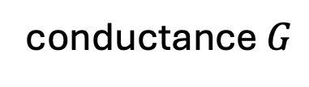

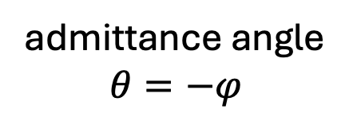
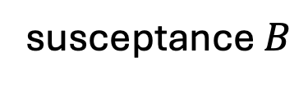
Complex Conductance
admittance:
$$\underline{Y}=\frac{1}{\underline{Z}}=\frac{1}{R+jX}=\frac{R}{R^{2}+X^{2}}+j\frac{−X}{R^{2}+X^{2}}$$
$$\underline{Y}=\frac{1}{\underline{Z}}=\frac{1}{\left|\underline{Z}\right|e^{jφ}}=\left|\underline{Y}\right|e^{−jφ}$$
abstract quantity
conductance $G$
susceptance $B$
admittance angle
$$θ=−φ$$
modulus of admittance
(apparent admittance)

Slide 19
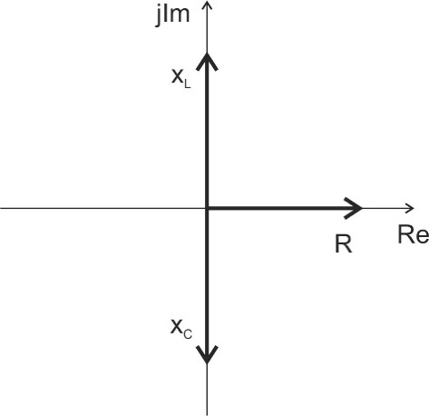
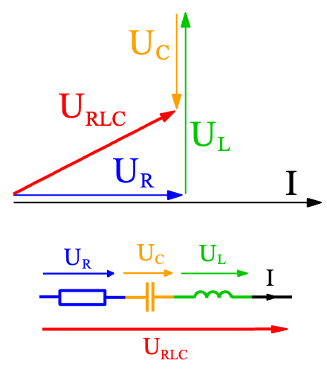
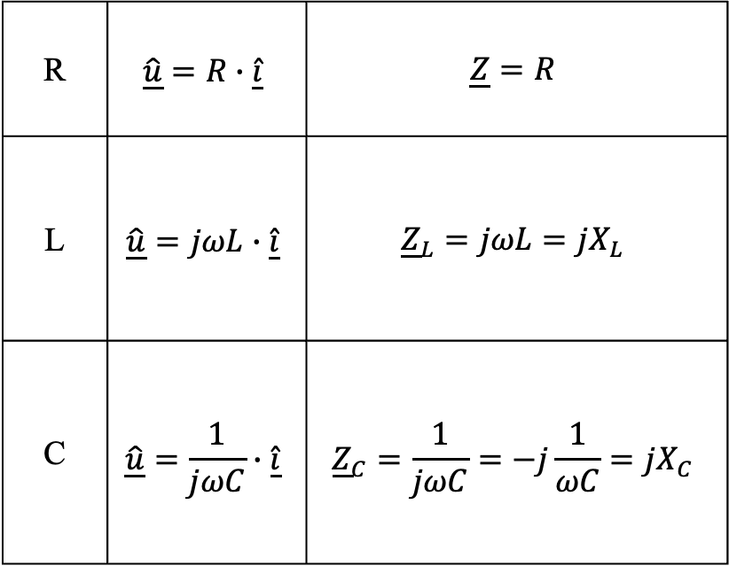
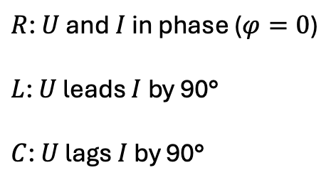
Linear Passive Components
must consider angles:
R | $$\underline{\hat{u}}=R∙\underline{\hat{i}}$$ | $$\underline{Z}=R$$
L | $$\underline{\hat{u}}=jωL∙\underline{\hat{i}}$$ | $${\underline{Z}}_{L}=jωL=jX_{L}$$
C | $$\underline{\hat{u}}=\frac{1}{jωC}∙\underline{\hat{i}}$$ | $${\underline{Z}}_{C}=\frac{1}{jωC}=−j\frac{1}{ωC}=jX_{C}$$
$R$: $U$ and $I$ in phase ($φ=0$)
$L$: $U$ leads $I$ by 90°
$C$: $U$ lags $I$ by 90°

Slide 20
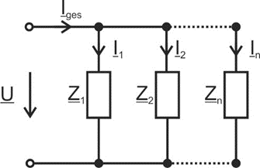
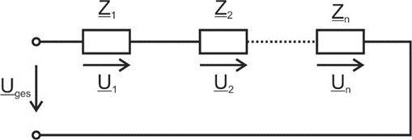
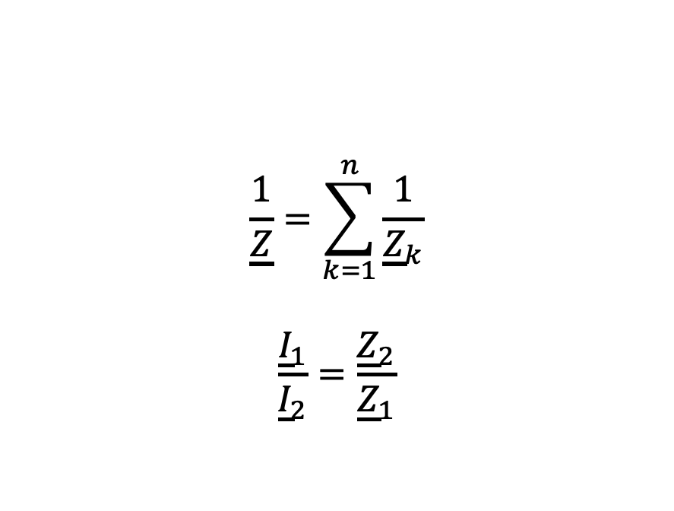
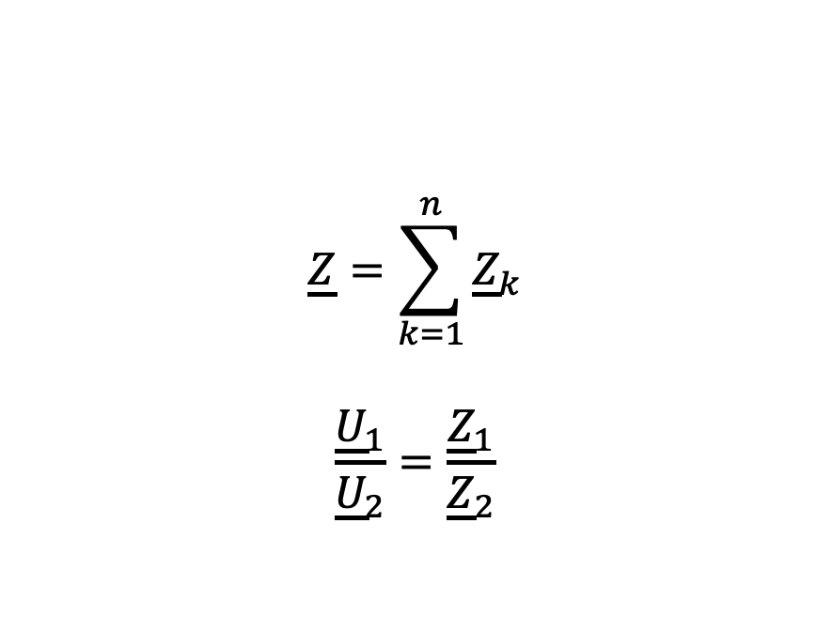
Network Analysis in Phasor Domain
$$\underline{Z}=\sum_{k=1}^{n}{{\underline{Z}}_{k}}$$
$$\frac{{\underline{U}}_{1}}{{\underline{U}}_{2}}=\frac{{\underline{Z}}_{1}}{{\underline{Z}}_{2}}$$
$$\frac{1}{\underline{Z}}=\sum_{k=1}^{n}{\frac{1}{{\underline{Z}}_{k}}}$$
$$\frac{{\underline{I}}_{1}}{{\underline{I}}_{2}}=\frac{{\underline{Z}}_{2}}{{\underline{Z}}_{1}}$$
KCL and KVL also valid for complex amplitudes and RMS values

Slide 21
Example
…

Slide 22
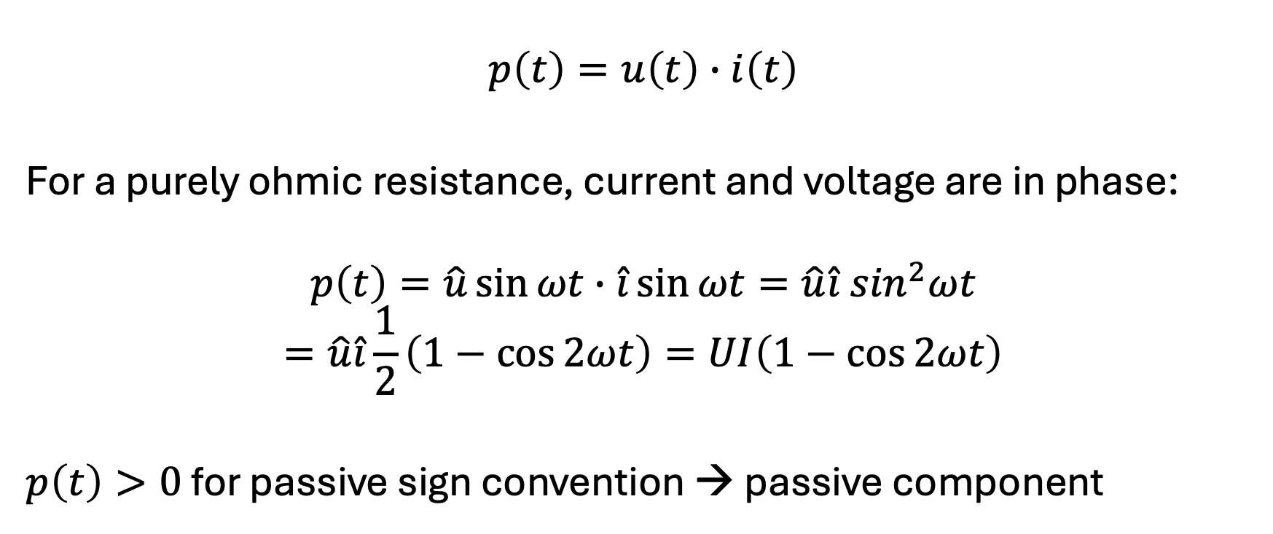
Instantaneous Power
$$p\left(t\right)=u\left(t\right)∙i\left(t\right)$$
For a purely ohmic resistance, current and voltage are in phase:
$$p\left(t\right)=\hat{u}\sin{ωt}∙\hat{i}\sin{ωt}=\hat{u}\hat{i}\sin^{2}ωt$$
$$=\hat{u}\hat{i}\frac{1}{2}\left(1−\cos{2ωt}\right)=UI\left(1−\cos{2ωt}\right)$$
$p\left(t\right)>0$ for passive sign convention → passive component

Slide 23
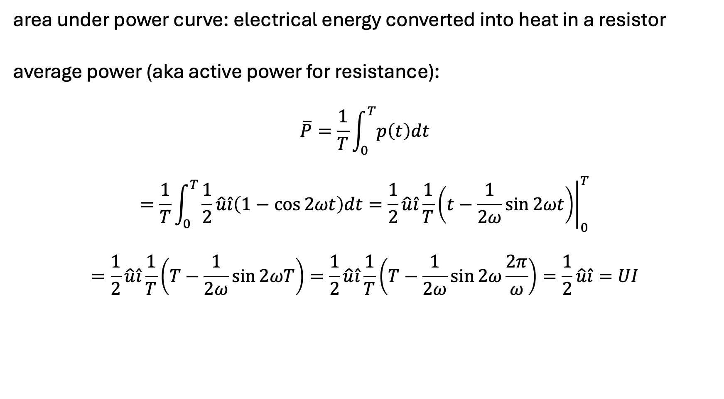
Average Power
area under power curve: electrical energy converted into heat in a resistor
average power (aka active power for resistance):
$$\overline{P}=\frac{1}{T}\int_{0}^{T}{p\left(t\right)dt}$$
$$=\frac{1}{T}\int_{0}^{T}{\frac{1}{2}\hat{u}\hat{i}\left(1−\cos{2ωt}\right)dt}={\left.\frac{1}{2}\hat{u}\hat{i}\frac{1}{T}\left(t−\frac{1}{2ω}sin{2ωt}\right)\right|}_{0}^{T}$$
$$=\frac{1}{2}\hat{u}\hat{i}\frac{1}{T}\left(T−\frac{1}{2ω}sin{2ωT}\right)=\frac{1}{2}\hat{u}\hat{i}\frac{1}{T}\left(T−\frac{1}{2ω}sin{2ω\frac{2π}{ω}}\right)=\frac{1}{2}\hat{u}\hat{i}=UI$$
resistance

Slide 24
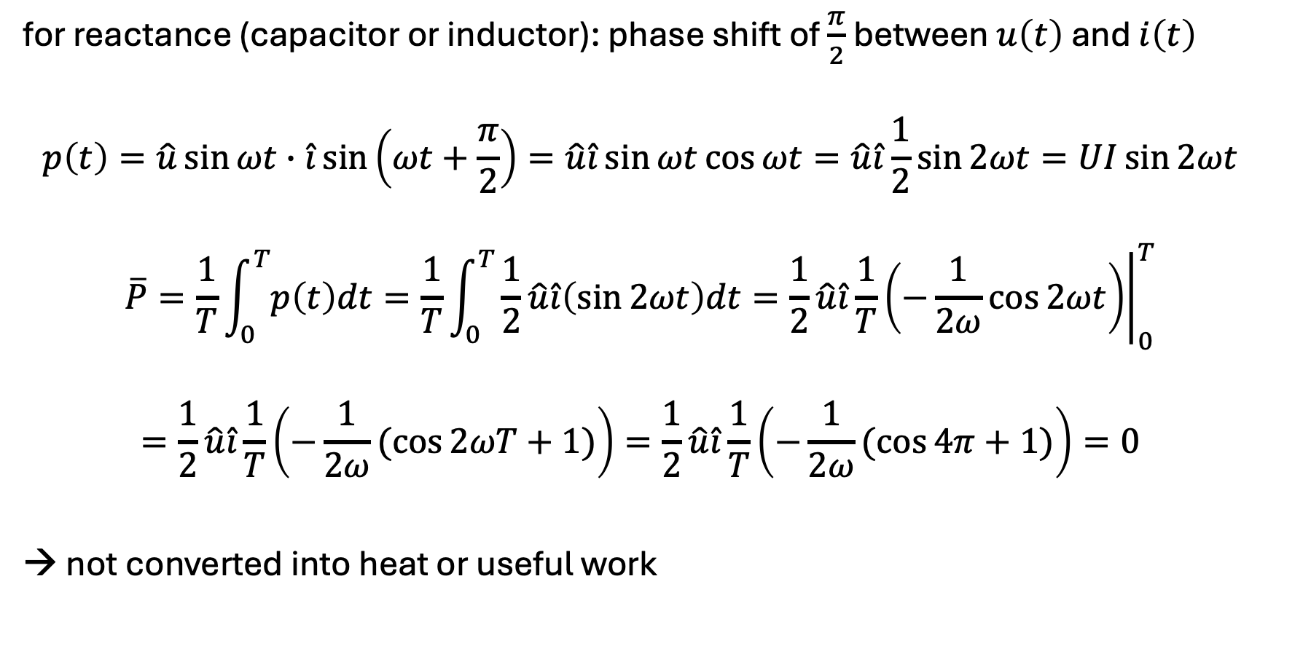
Reactive Power
for reactance (capacitor or inductor): phase shift of $\frac{π}{2}$ between $u\left(t\right)$ and $i\left(t\right)$
$$p\left(t\right)=\hat{u}\sin{ωt}∙\hat{i}\sin\left(ωt+\frac{π}{2}\right)=\hat{u}\hat{i}\sin{ωt}\cos{ωt}=\hat{u}\hat{i}\frac{1}{2}\sin{2ωt}=UI\sin{2ωt}$$
$$\overline{P}=\frac{1}{T}\int_{0}^{T}{p\left(t\right)dt}=\frac{1}{T}\int_{0}^{T}{\frac{1}{2}\hat{u}\hat{i}\left(\sin{2ωt}\right)dt}={\left.\frac{1}{2}\hat{u}\hat{i}\frac{1}{T}\left(−\frac{1}{2ω}cos{2ωt}\right)\right|}_{0}^{T}$$
$$=\frac{1}{2}\hat{u}\hat{i}\frac{1}{T}\left(−\frac{1}{2ω}(cos{2ωT}+1)\right)=\frac{1}{2}\hat{u}\hat{i}\frac{1}{T}\left(−\frac{1}{2ω}(cos{4π}+1)\right)=0$$
→ not converted into heat or useful work

Slide 25
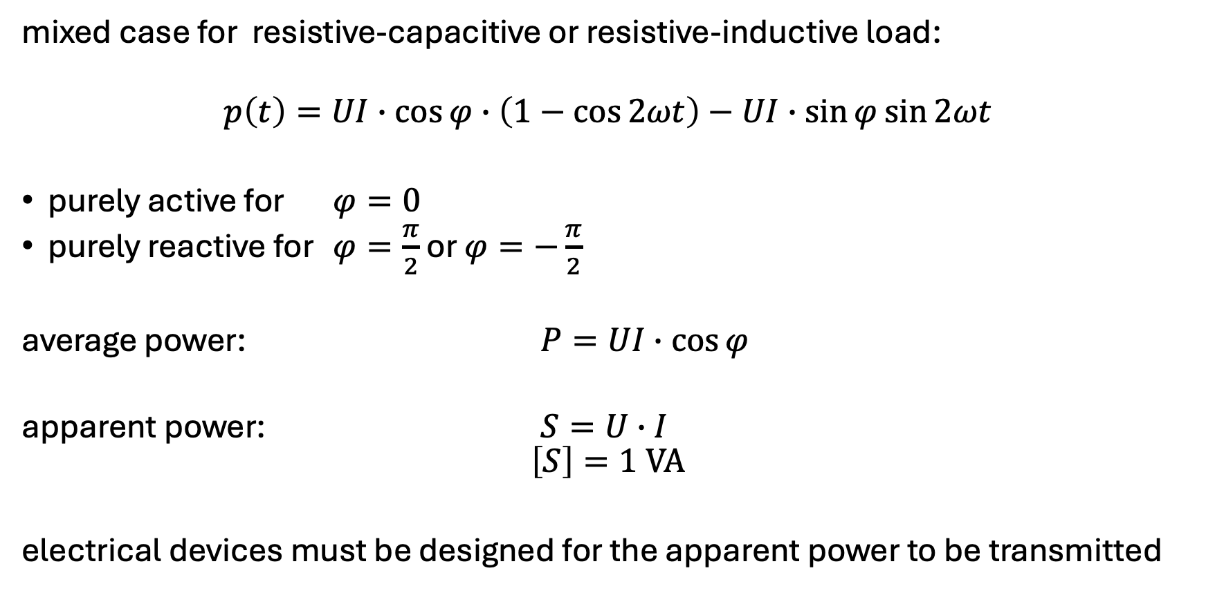
Apparent Power
mixed case for resistive-capacitive or resistive-inductive load:
$$p\left(t\right)=UI∙\cos{φ}∙\left(1−\cos{2ωt}\right)−UI∙\sin{φ\sin{2ωt}}$$
purely active for $φ=0$
purely reactive for $φ=\frac{π}{2}$ or $φ=−\frac{π}{2}$
average power: $P=UI∙\cos{φ}$
apparent power: $S=U∙I$
$$\left[S\right]=1 VA$$
electrical devices must be designed for the apparent power to be transmitted

Slide 26
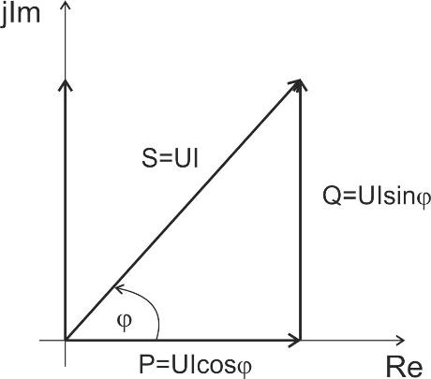


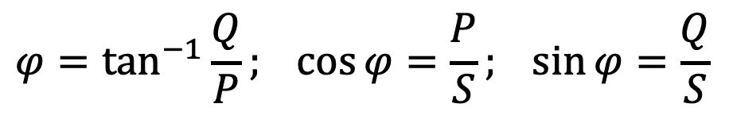
Complex Power
$$φ$$
$$\underline{S}=\underline{U}∙{\underline{I}}^{∗}=Ue^{jφ_{u}}Ie^{{−jφ}_{i}}=Se^{j\left(φ_{u}−φ_{i}\right)}$$
$$\underline{S}=\underline{U}{\left(\frac{\underline{U}}{\underline{Z}}\right)}^{∗}=\underline{U}∙{\underline{U}}^{∗}\frac{1}{{\underline{Z}}^{∗}}=\frac{U^{2}}{{\underline{Z}}^{∗}}$$
$$\underline{S}=\frac{1}{2}\underline{\hat{u }}∙\underline{{\hat{i}}^{∗}}=P+jQ$$
with $S=\sqrt{P^{2}+Q^{2}}=U∙I$
active power
reactive power
$$φ=\tan^{−1}{\frac{Q}{P}}; \cos{φ}=\frac{P}{S}; \sin{φ}=\frac{Q}{S}$$
apparent power

Slide 27
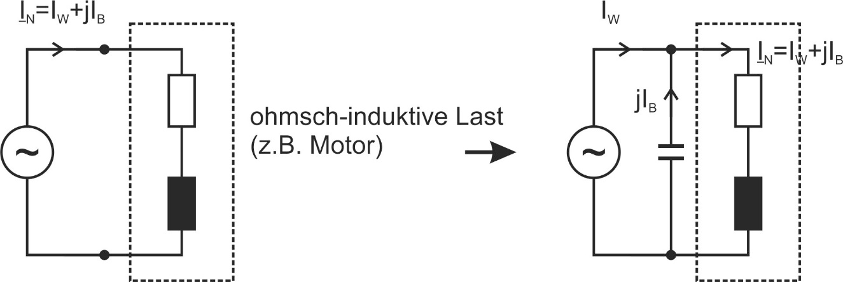





Reactive Power Compensation
The absorption of inductive reactive power corresponds to the output of capacitive reactive power and vice versa: $φ={180}^{∘}$
→ can compensate each other (useful to avoid transmission losses)
$$I_{a}+jI_{r}$$
$$I_{a}$$
$$I_{a}+jI_{r}$$
resistive-inductive load
$$jI_{r}$$
can be compensated by capacitor

Slide 28
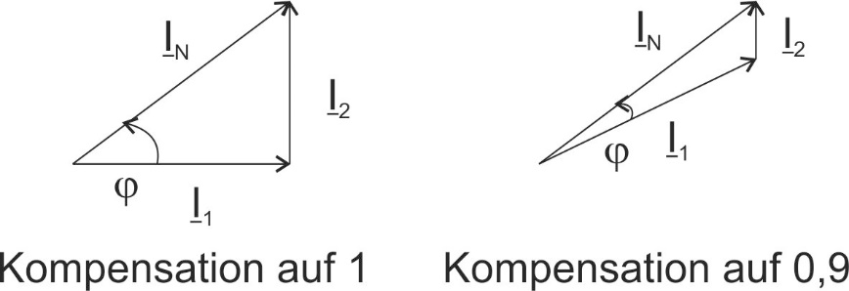
Example
…

Slide 29
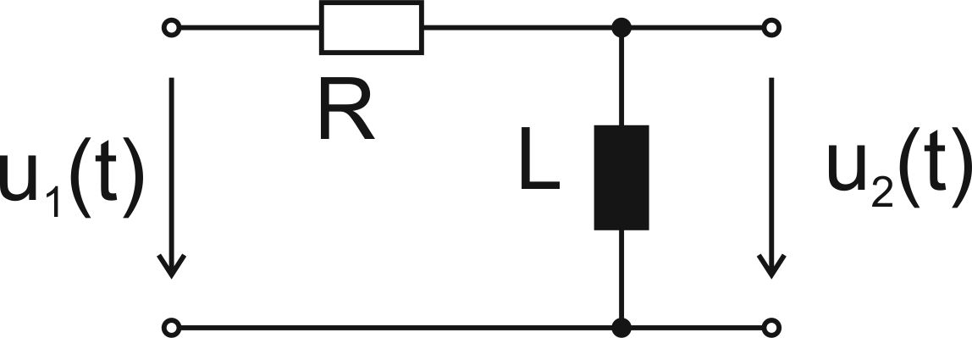
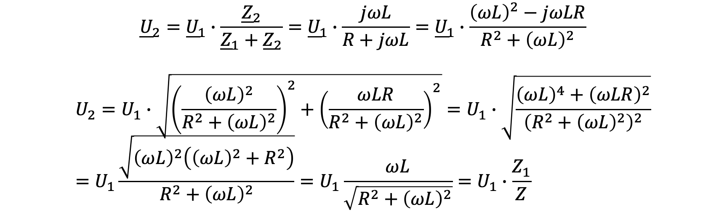
Frequency-Dependent Voltage Divider
$${\underline{U}}_{2}={\underline{U}}_{1}∙\frac{{\underline{Z}}_{2}}{{\underline{Z}}_{1}+{\underline{Z}}_{2}}={\underline{U}}_{1}∙\frac{jωL}{R+jωL}={\underline{U}}_{1}∙\frac{{\left(ωL\right)}^{2}−jωLR}{R^{2}+{\left(ωL\right)}^{2}}$$
$$U_{2}=U_{1}∙\sqrt{{\left(\frac{{\left(ωL\right)}^{2}}{R^{2}+{\left(ωL\right)}^{2}}\right)}^{2}+{\left(\frac{ωLR}{R^{2}+{\left(ωL\right)}^{2}}\right)}^{2}}=U_{1}∙\sqrt{\frac{{\left(ωL\right)}^{4}+{\left(ωLR\right)}^{2}}{{\left(R^{2}+{\left(ωL\right)}^{2}\right)}^{2}}}=U_{1}\frac{\sqrt{{\left(ωL\right)}^{2}\left({\left(ωL\right)}^{2}+R^{2}\right)}}{R^{2}+{\left(ωL\right)}^{2}}=U_{1}\frac{ωL}{\sqrt{R^{2}+{\left(ωL\right)}^{2}}}=U_{1}∙\frac{Z_{1}}{Z}$$

Slide 30
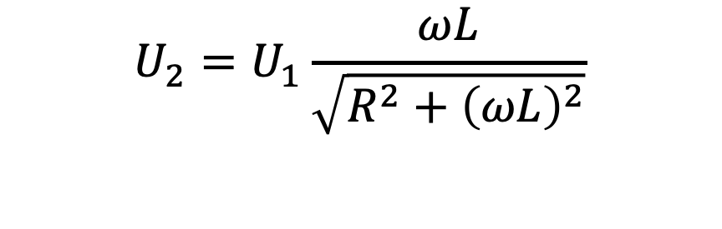

High-Pass RL Filter
$$U_{2}$$
$$U_{2}=U_{1}\frac{ωL}{\sqrt{R^{2}+{\left(ωL\right)}^{2}}}$$
$$f$$

Slide 31


Low-Pass RL Filter
$$U_{2}$$
$${U_{2}=U}_{1}\frac{R}{\sqrt{R^{2}+{\left(ωL\right)}^{2}}}$$
$$f$$

Slide 32

RC Filters
high-pass filter
low-pass filter
first-order filters: either a capacitor or an inductor

Slide 33
Series Resonant Circuit

Slide 34
Parallel Resonant Circuit

