Slide 1

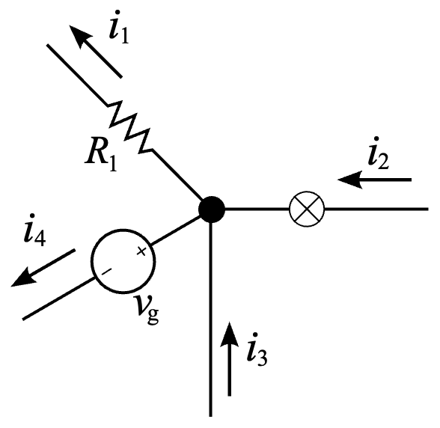
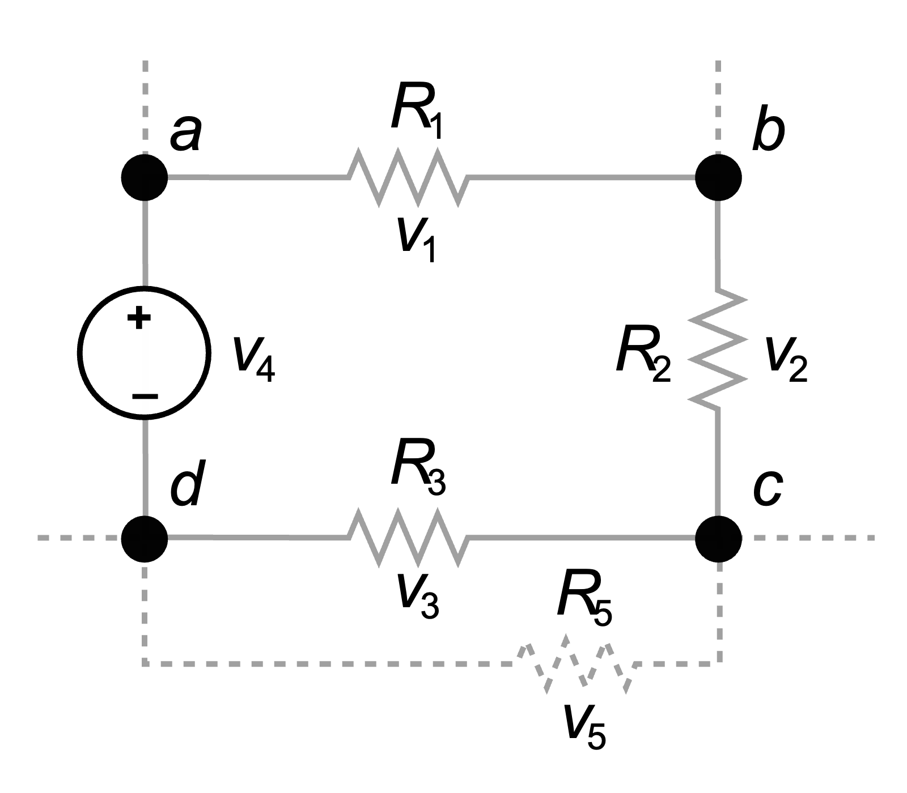
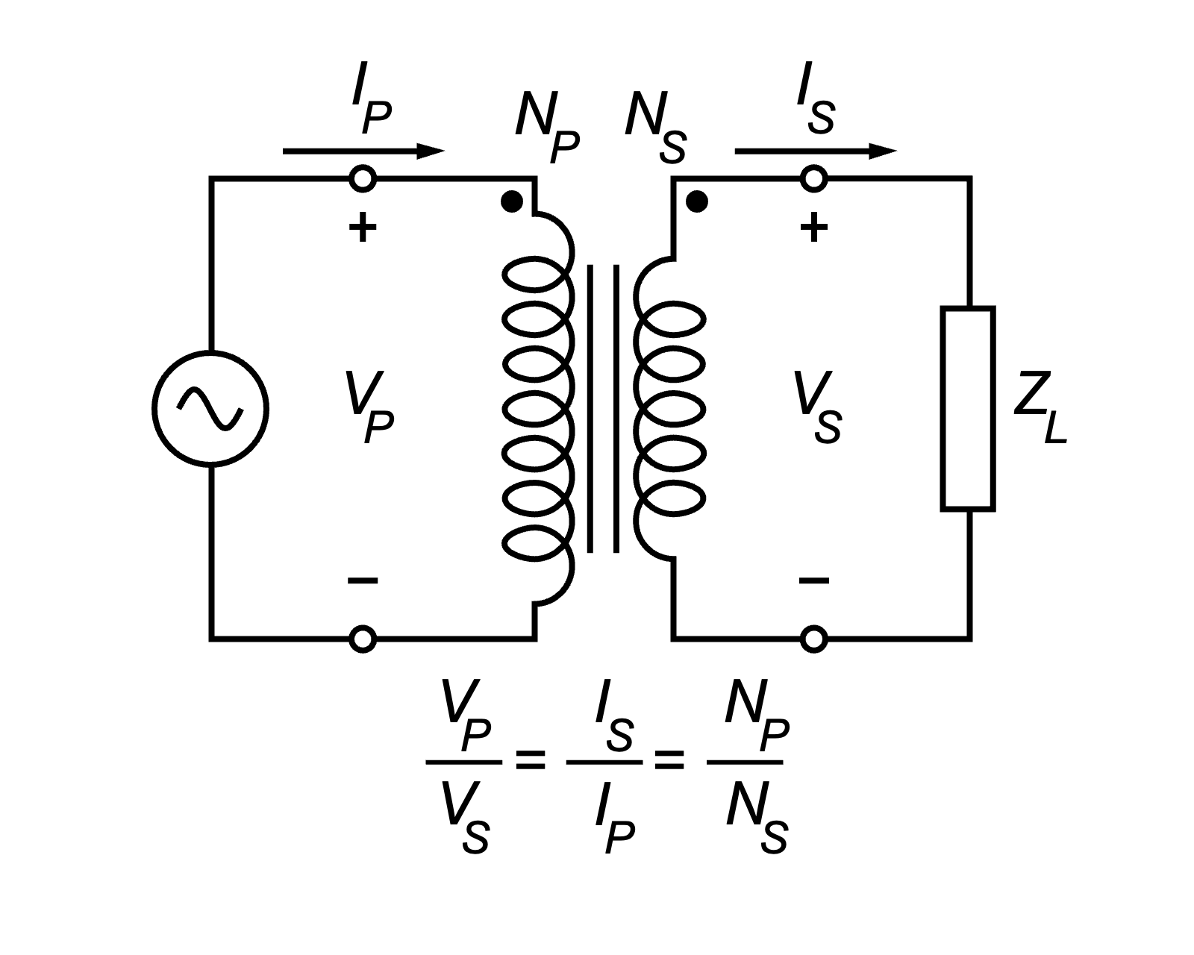
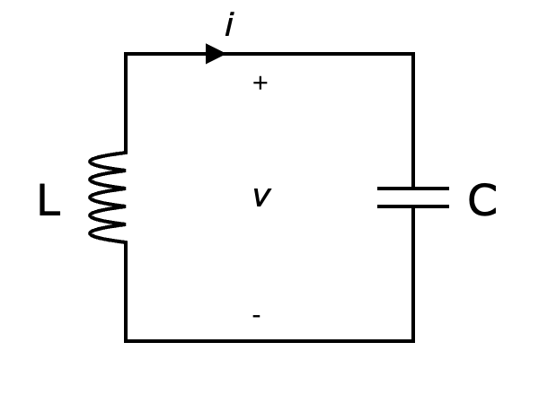
Introduction to Electrical Engineering

Slide 2
Overview
Physical Principles and Basic Concepts
Direct Current Circuits
Electric and Magnetic Fields
Alternating Current Technology
Wrap-Up and Outlook

Slide 3
Wrap-Up and Outlook
Summary using Applications
Outlook
Semiconductor Devices and Electronics
Energy Systems
Information Systems
Control Systems
Embedded Systems

Slide 4
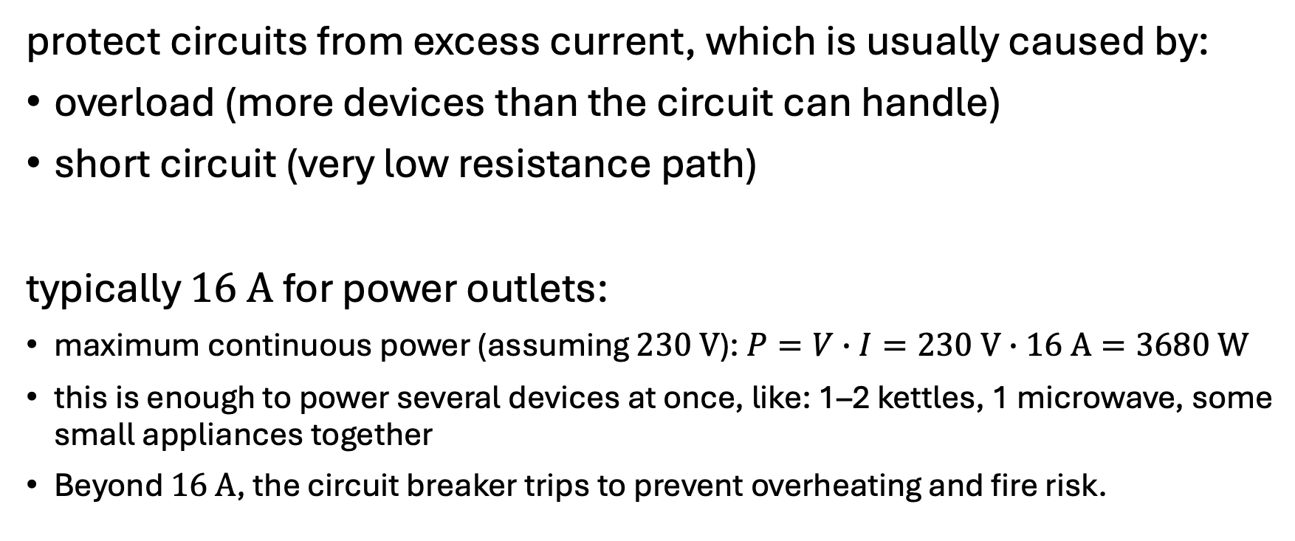
Fuse and Circuit Breaker
protect circuits from excess current, which is usually caused by:
overload (more devices than the circuit can handle)
short circuit (very low resistance path)
typically $16 A$ for power outlets:
maximum continuous power (assuming $230 V$): $P=V∙I=230 V∙16 A=3680 W$
this is enough to power several devices at once, like: 1–2 kettles, 1 microwave, some small appliances together
Beyond $16 A$, the circuit breaker trips to prevent overheating and fire risk.

Slide 5
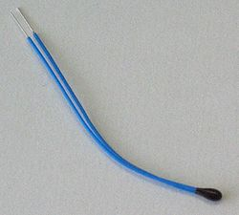
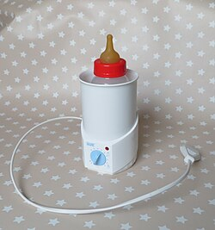
Thermistor
temperature-dependent resistance
applied in electronic thermometers and thermostats (control device):
By measuring the resistance, the corresponding temperature can be inferred.

Slide 6
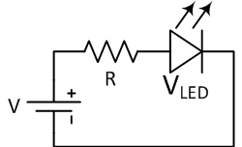
LED and Resistor Circuit
DC circuit (LED is diode)
resistor limits current through LED
→ preventing damage

Slide 7
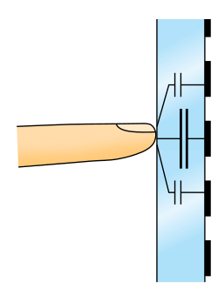
Capacitive Touchscreen
usage of electric fields for sensing
finger changes local capacitance between electrodes
variation is detected and processed to determine touch position

Slide 8
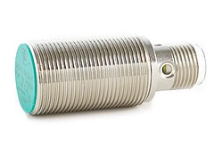
Inductive Sensor
enables detection of metallic objects without physical contact
operation based on electromagnetic induction:
When a metal object enters the magnetic field produced by a coil, eddy currents alter the coil’s impedance.

Slide 9
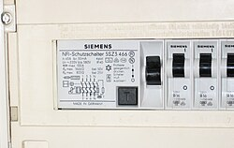
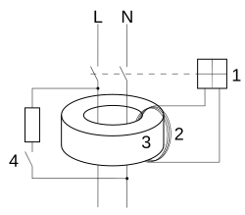
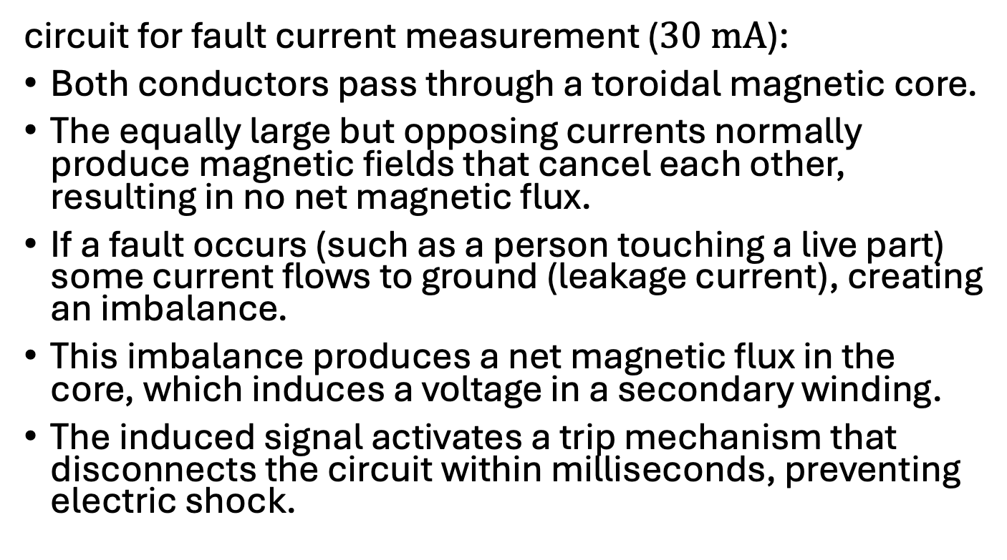
Residual Current Device (RCD)
circuit for fault current measurement ($30 mA$):
Both conductors pass through a toroidal magnetic core.
The equally large but opposing currents normally produce magnetic fields that cancel each other, resulting in no net magnetic flux.
If a fault occurs (such as a person touching a live part) some current flows to ground (leakage current), creating an imbalance.
This imbalance produces a net magnetic flux in the core, which induces a voltage in a secondary winding.
The induced signal activates a trip mechanism that disconnects the circuit within milliseconds, preventing electric shock.
1: Electromagnet 2: Current transformer secondary winding 3: Transformer core 4: Test push-button L: Line conductor N: Neutral conductor

Slide 10
Electric Motors
working principle: convert electrical energy into mechanical motion through electromagnetic interaction
AC motor: rotating magnetic field generated by AC, producing torque without direct electrical contact to the rotor
DC motor: commutator and brushes to reverse rotor current every half revolution, maintaining continuous rotation under DC

Slide 11
AC vs DC in Devices
simple appliances (kettles, irons, heaters) run directly on AC
electronics (laptops, phones, TVs) run on DC internally
chips and memory require a constant voltage to work properly
semiconductors (CPU, GPU, LEDs) only allow current in one direction
DRAM, flash, and other memory need consistent DC to store data
AC fluctuations could damage circuits or cause malfunction
→ adapters to convert AC to DC

Slide 12
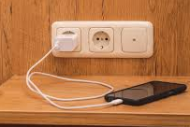
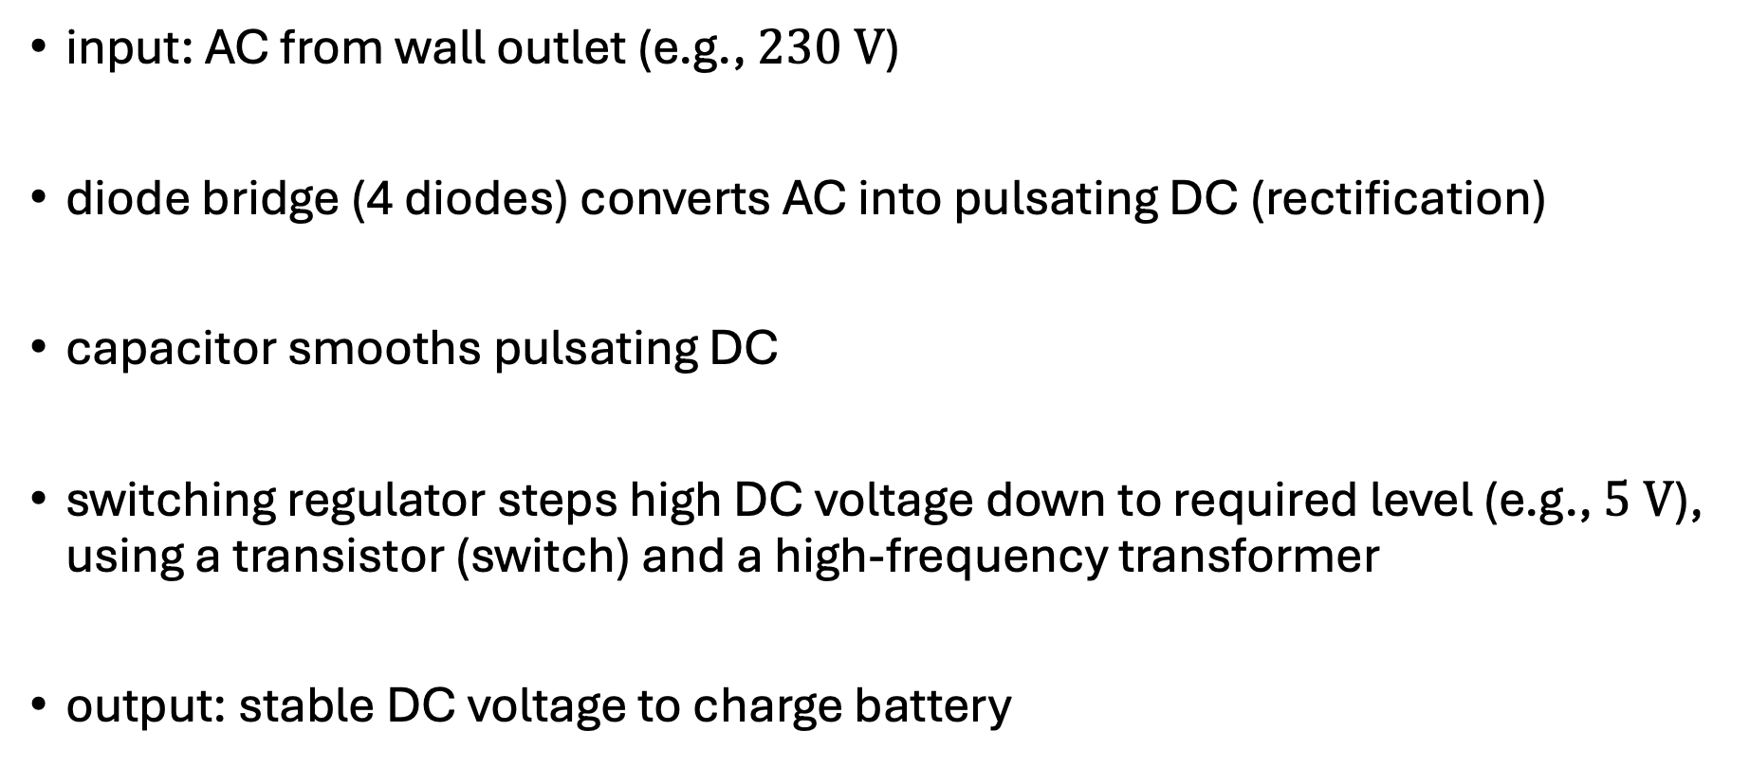
Smartphone Charger
input: AC from wall outlet (e.g., $230 V$)
diode bridge (4 diodes) converts AC into pulsating DC (rectification)
capacitor smooths pulsating DC
switching regulator steps high DC voltage down to required level (e.g., $5 V$), using a transistor (switch) and a high-frequency transformer
output: stable DC voltage to charge battery

Slide 13
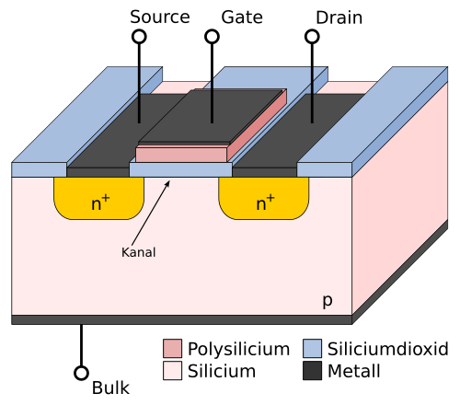
Semiconductor Devices and Electronics
diodes and transistors — switching and amplification
operational amplifiers — building blocks for analog circuits
analog circuit design — filters, amplifiers, signal conditioning
digital electronics — logic gates

Slide 14
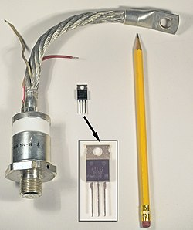
Energy Systems
generation, conversion, and distribution of electrical power
transformers and power converters
power electronics

Slide 15

Information Systems
transmitting and processing information
signal processing
time-domain vs. frequency-domain analysis
Fourier and Laplace transforms
communication systems
amplitude/frequency modulation (AM/FM)
digital modulation (ASK, FSK, PSK)
noise, bandwidth, and filtering concepts
communication channels and data transmission

Slide 16

Control Systems
feedback, stability, and dynamic response
root locus, Bode, and Nyquist techniques
PID control and real-world applications (motors, robotics)

Slide 17
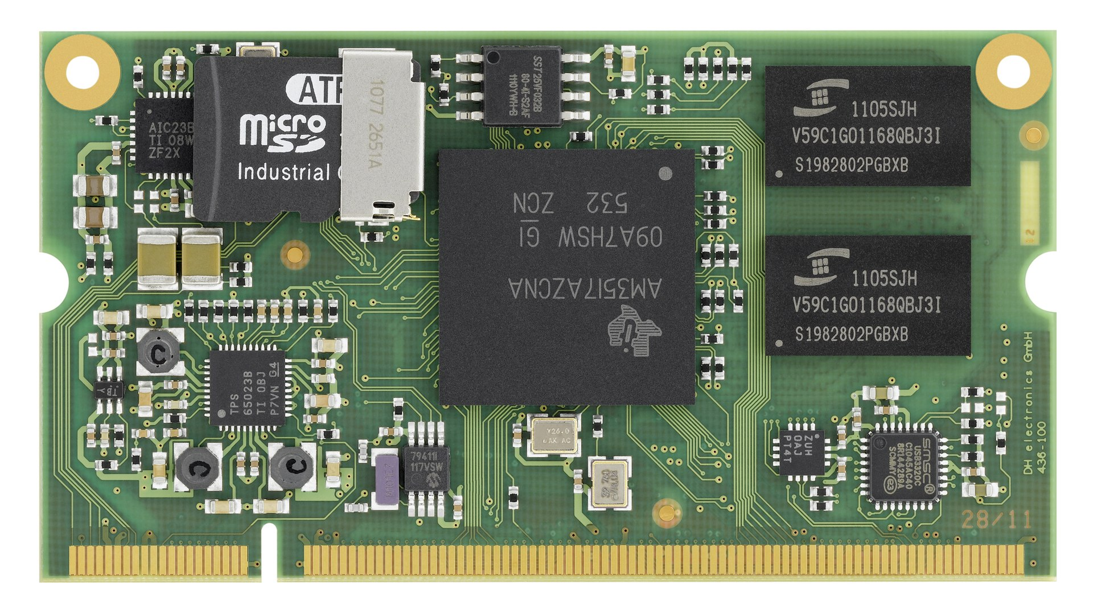
Embedded Systems
hardware–software integration
microcontrollers and digital systems
sensors, actuators, and real-time control

