Slide 1

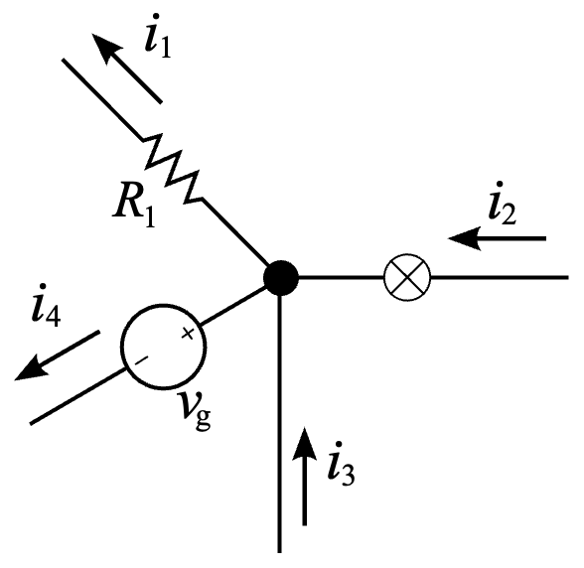
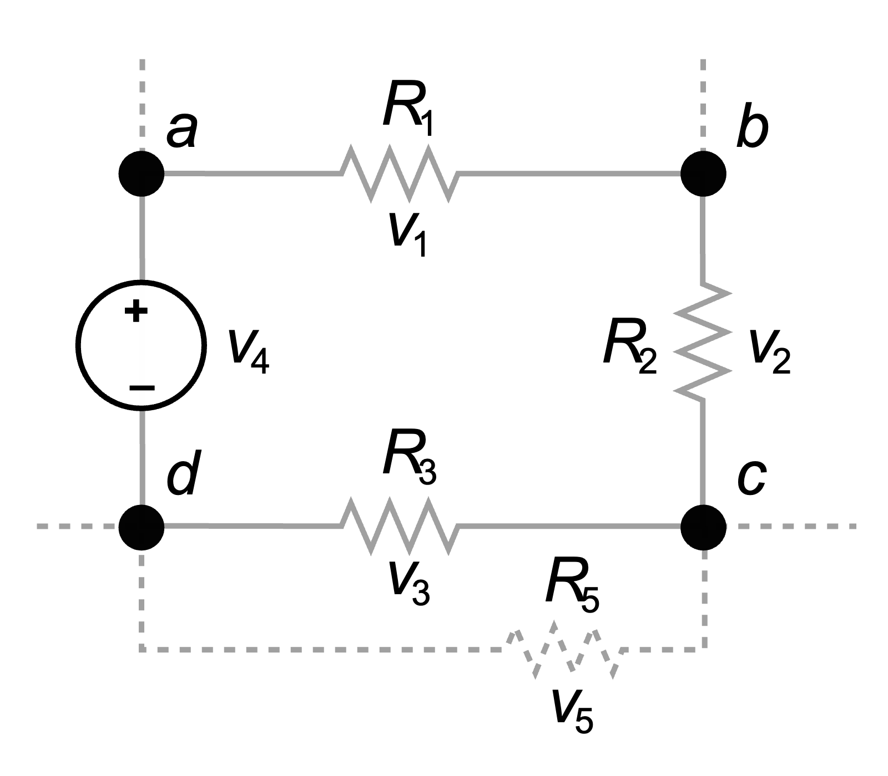
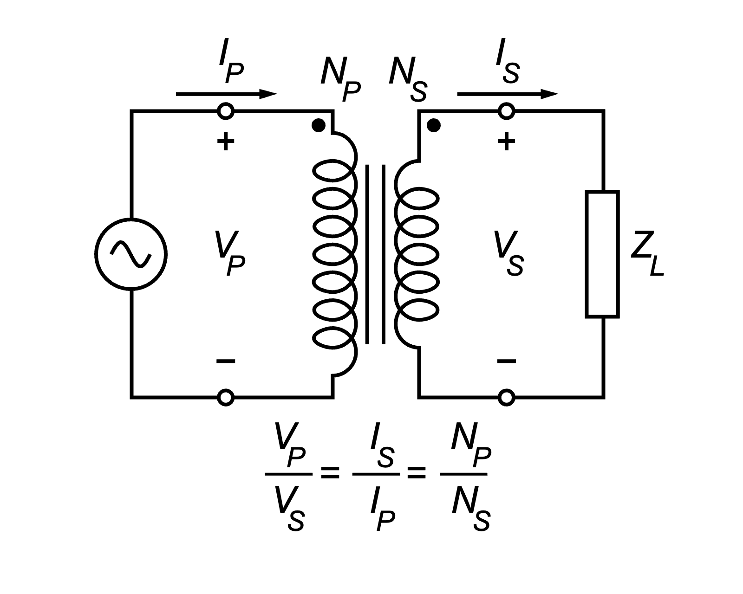
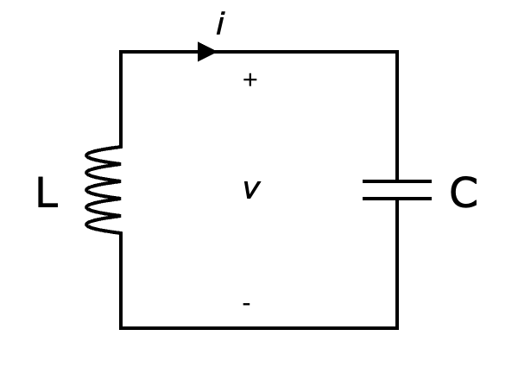
Introduction to Electrical Engineering

Slide 2
Overview
Physical Principles and Basic Concepts
Direct Current Circuits
Electric and Magnetic Fields
Alternating Current Technology

Slide 3
Electric and Magnetic Fields
Coulomb Force
Electrostatic Induction
Capacitance & Capacitor
Magnetic Force
Electromagnetic Induction
Inductivity & Inductor
Transformer
Maxwell‘s Equations
Transient Responses

Slide 4
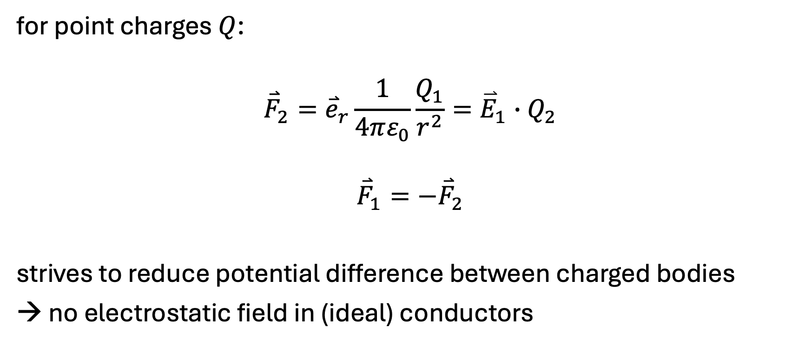
Coulomb Force
vector field associating to each point in space the Coulomb force experienced by a unit test charge
for point charges $Q$:
$${\overset{⃑}{F}}_{2}={\overset{⃑}{e}}_{r}\frac{1}{4πε_{0}}\frac{Q_{1}}{r^{2}}={\overset{⃑}{E}}_{1}∙Q_{2}$$
$${\overset{⃑}{F}}_{1}=−{\overset{⃑}{F}}_{2}$$
strives to reduce potential difference between charged bodies
→ no electrostatic field in (ideal) conductors

Slide 5
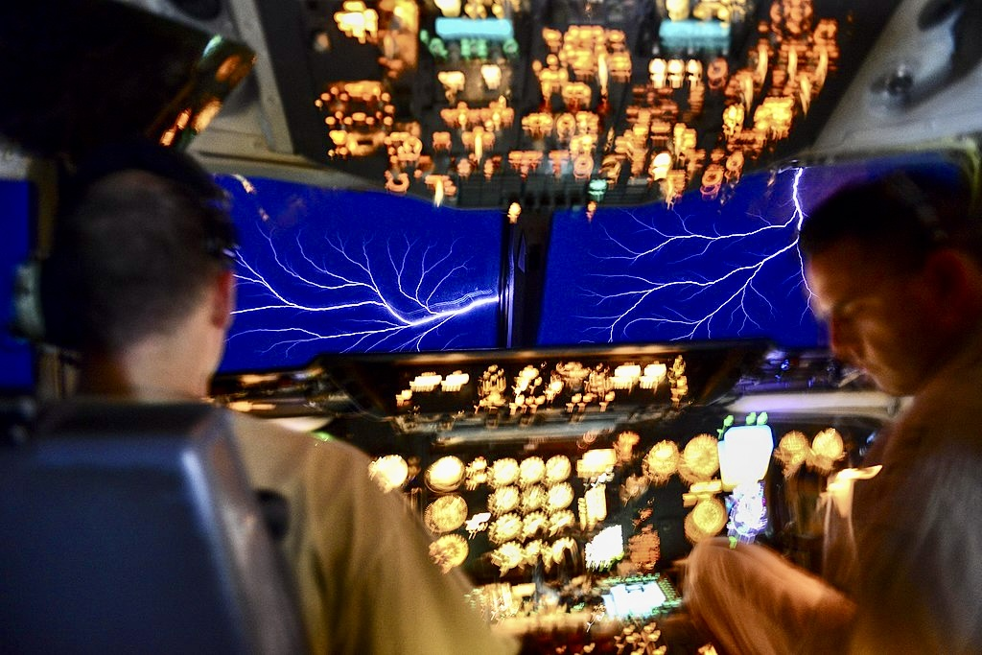

Electric Field
$$\overset{⃑}{E}={\overset{⃑}{e}}_{r}\frac{Q}{4πε_{0}r^{2}}$$
$$\left[E\right]=1 \frac{V}{m}$$
electrical field strength

Slide 6
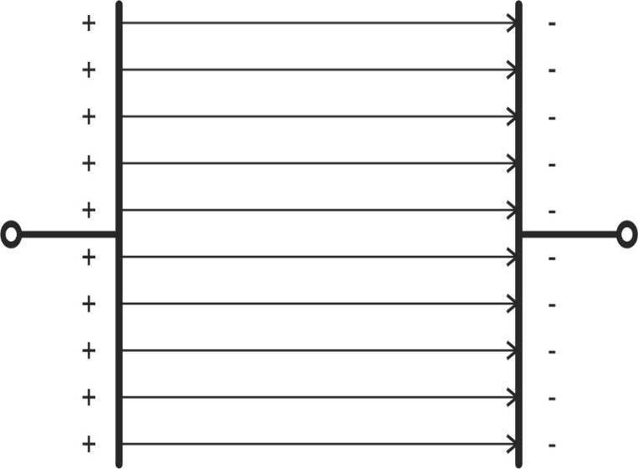
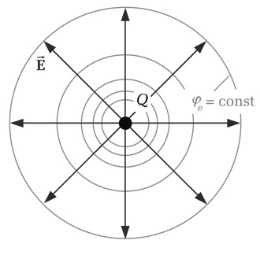
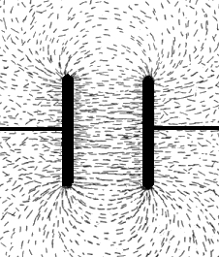
Electric Field Lines
field lines follow direction of electric field
start at positive charges and end at negative charges
density indicates field strength
equipotential lines/surfaces perpendicular to electric field lines
point charge:

Slide 7
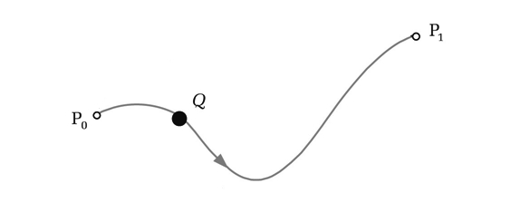
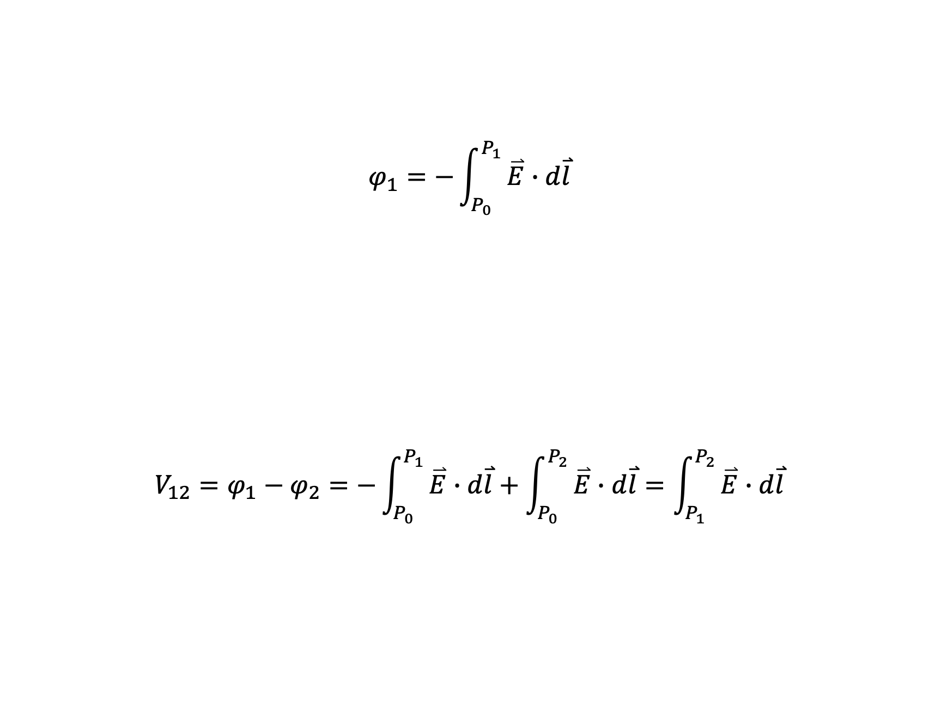
Voltage and Potential
$$φ_{1}=−\int_{P_{0}}^{P_{1}}{\overset{⃑}{E}∙d\overset{⃑}{l}}$$
$$V_{12}=φ_{1}−φ_{2}=−\int_{P_{0}}^{P_{1}}{\overset{⃑}{E}∙d\overset{⃑}{l}}+\int_{P_{0}}^{P_{2}}{\overset{⃑}{E}∙d\overset{⃑}{l}}=\int_{P_{1}}^{P_{2}}{\overset{⃑}{E}∙d\overset{⃑}{l}}$$

Slide 8
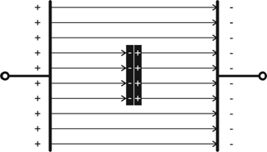
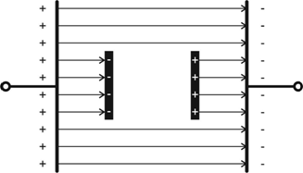
Electrostatic Induction
conductor in electric field
→ electrostatic induction, aka influence (caused by Coulomb force)
induced surface charges cancel electric field in conductor
→ Faraday cage

Slide 9

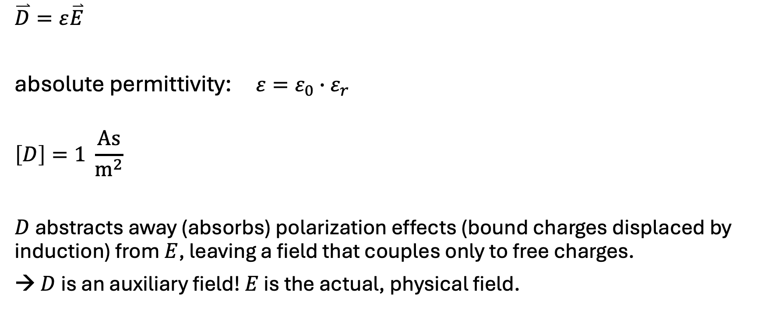

Electric Displacement
vacuum permittivity (physical constant)
$$ε_{0}=8,854∙{10}^{−12}\frac{As}{Vm}$$
$$\overset{⃑}{D}=ε\overset{⃑}{E}$$
absolute permittivity: $ε=ε_{0}∙ε_{r}$
$$\left[D\right]=1 \frac{As}{m^{2}}$$
$D$ abstracts away (absorbs) polarization effects (bound charges displaced by induction) from $E$, leaving a field that couples only to free charges.
→ $D$ is an auxiliary field! $E$ is the actual, physical field.
polarization
$$D=ε_{0}E+P$$
relative permittivity, aka dielectric constant (material dependent)

Slide 10
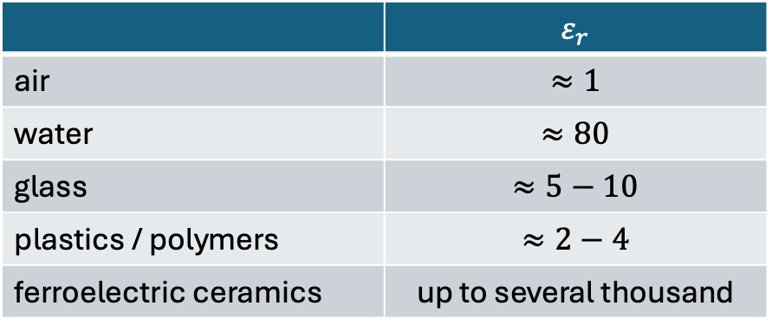
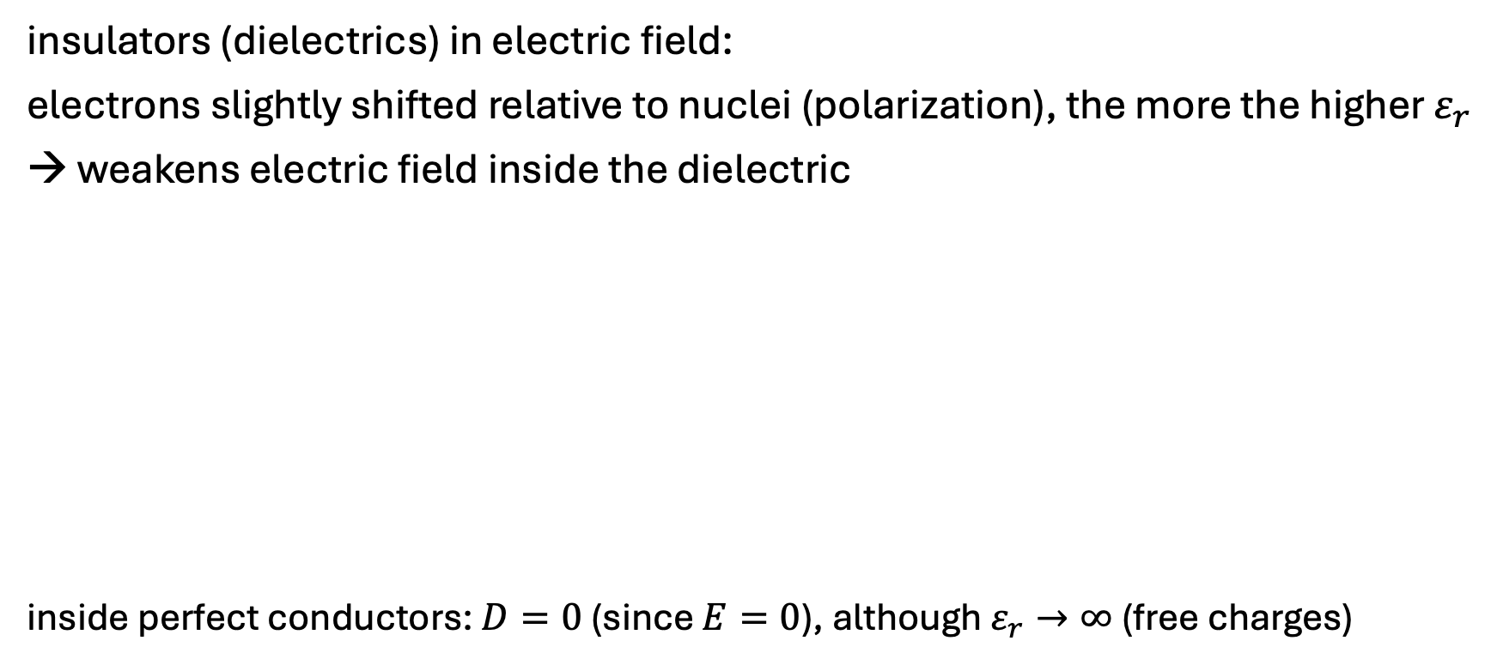
Dielectric Constants
insulators (dielectrics) in electric field:
electrons slightly shifted relative to nuclei (polarization), the more the higher $ε_{r}$
→ weakens electric field inside the dielectric
inside perfect conductors: $D=0$ (since $E=0$), although $ε_{r}→∞$ (free charges)
 | $$ε_{r}$$
air | $$≈1$$
water | $$≈80$$
glass | $$≈5−10$$
plastics / polymers | $$≈2−4$$
ferroelectric ceramics | up to several thousand

Slide 11
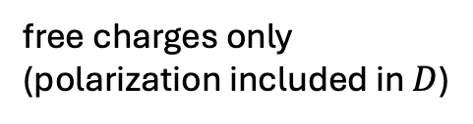
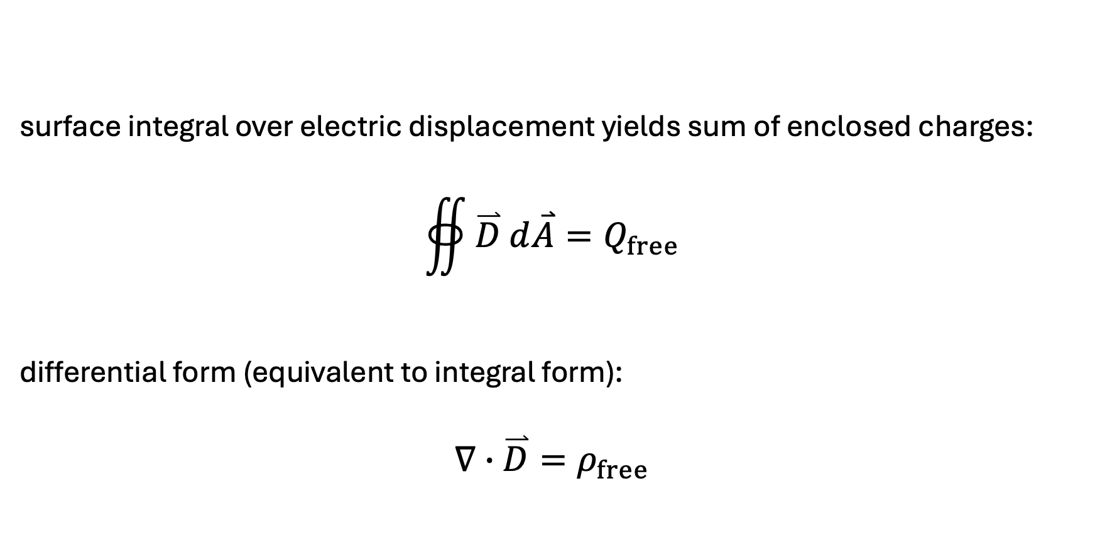
Gauss‘s Law
surface integral over electric displacement yields sum of enclosed charges:
$$∯{\overset{⃑}{D} d\overset{⃑}{A}}=Q_{free}$$
differential form (equivalent to integral form):
$$∇∙\overset{⃑}{D}=ρ_{free}$$
free charges only (polarization included in $D$)
divergence
charge density

Slide 12
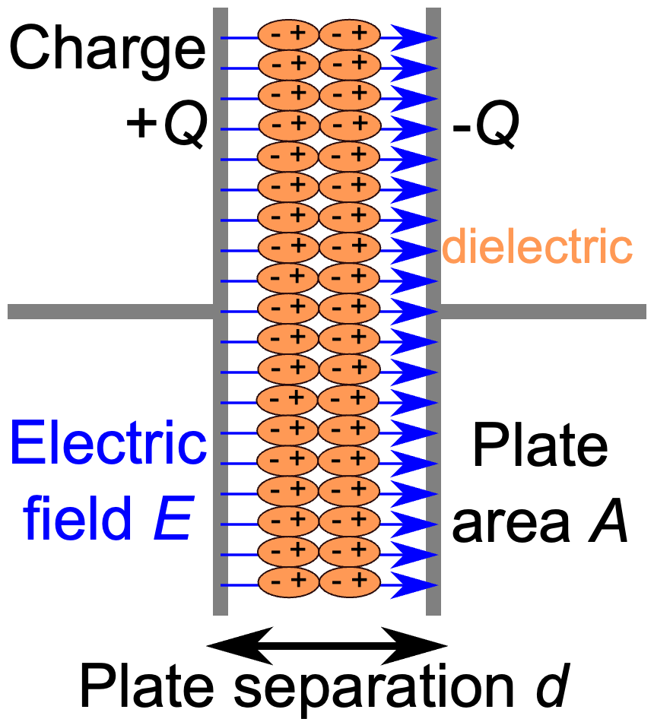

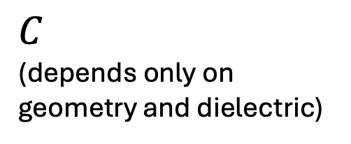
Plate Capacitor
polarization counteracts electric field
→ more charge can be stored
$$D=\frac{Q}{A}$$
$$ε_{0}∙ε_{r}∙E∙d=\frac{Q}{A}∙d$$
$$\frac{ε_{0}∙ε_{r}∙A}{d}∙V=Q$$
$$C$$
(depends only on geometry and dielectric)

Slide 13
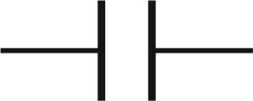
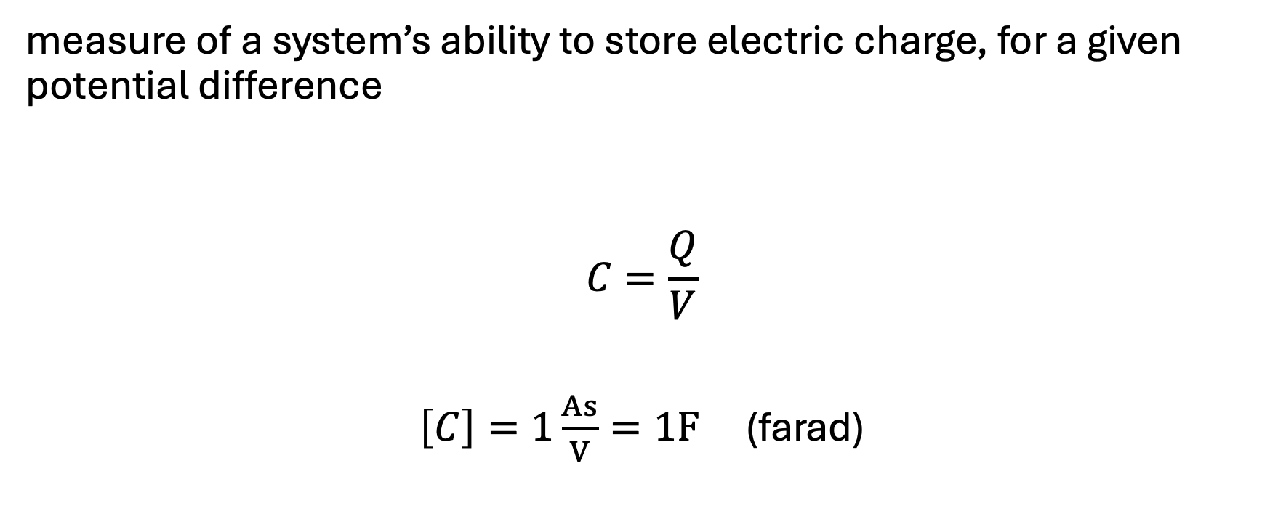
Capacitance
measure of a system’s ability to store electric charge, for a given potential difference
$$C=\frac{Q}{V}$$
$\left[C\right]=1\frac{As}{V}=1F$ (farad)

Slide 14

Time Dependence
$$Q=C∙V$$
$$\frac{dQ}{dt}=C∙\frac{dv}{dt}$$
$$i=C\frac{dv}{dt}$$
voltage across capacity is continuous (since charge cannot jump infinitely fast)
current through capacity can be discontinuous (because it is the derivative of the voltage)
no DC through capacitors

Slide 15
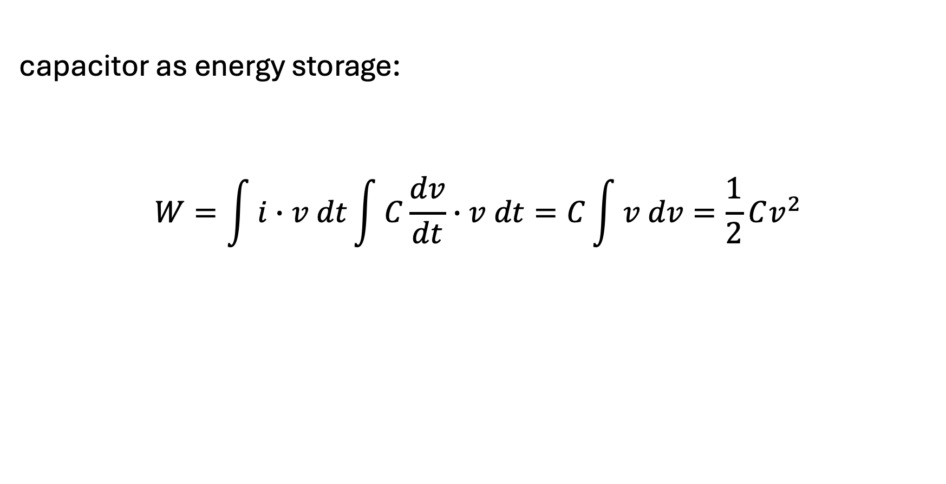
Energy of Capacitance
capacitor as energy storage:
$$W=\int{i}∙v dt\int{C\frac{dv}{dt}}∙v dt=C\int{v dv}=\frac{1}{2}Cv^{2}$$

Slide 16
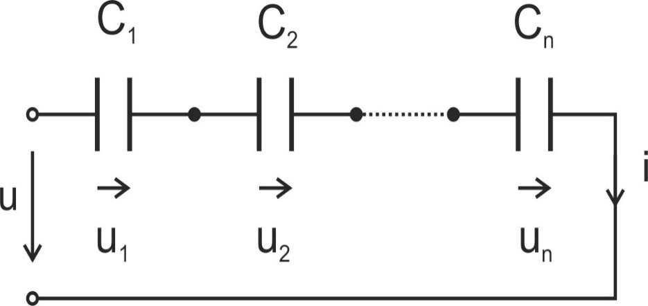
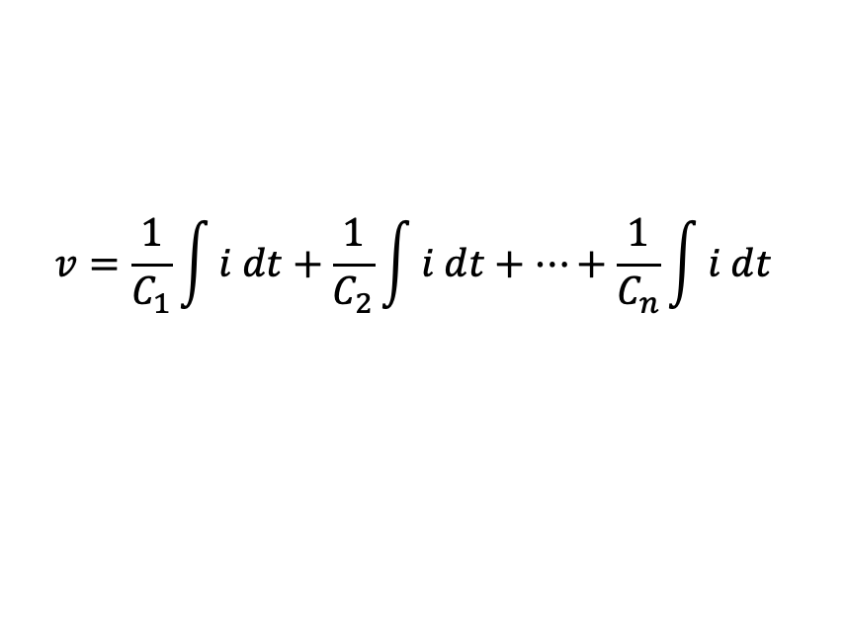
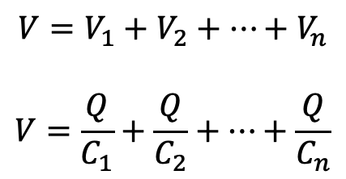
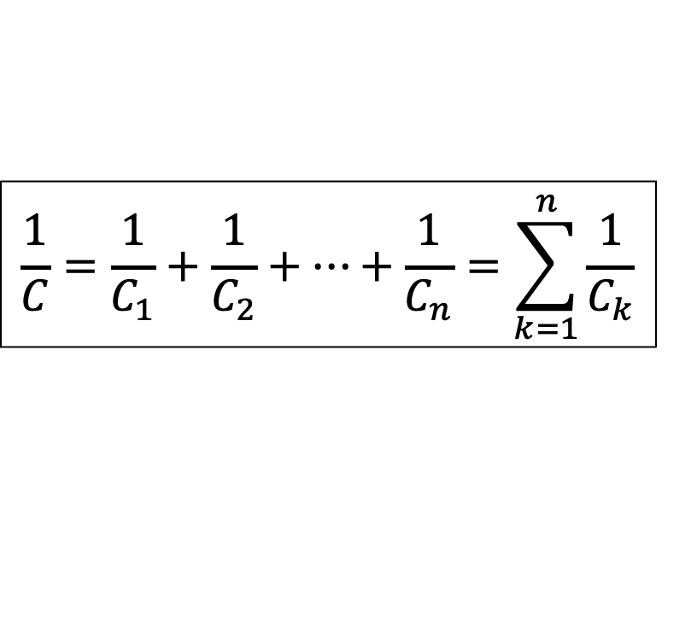
Capacitors in Series
$$V=V_{1}+V_{2}+⋯+V_{n}$$
$$V=\frac{Q}{C_{1}}+\frac{Q}{C_{2}}+⋯+\frac{Q}{C_{n}}$$
$$v=\frac{1}{C_{1}}\int{i dt}+\frac{1}{C_{2}}\int{i dt}+⋯+\frac{1}{C_{n}}\int{i dt}$$
$$\frac{1}{C}=\frac{1}{C_{1}}+\frac{1}{C_{2}}+⋯+\frac{1}{C_{n}}=\sum_{k=1}^{n}{\frac{1}{C_{k}}}$$
for two capacitors: $C=\frac{C_{1}C_{2}}{C_{1}+C_{2}}; \frac{v_{1}}{v_{2}}=\frac{C_{2}}{C_{1}}; v_{1}=v\frac{C_{2}}{C_{1}+C_{2}}$ (voltage divider rule)

Slide 17
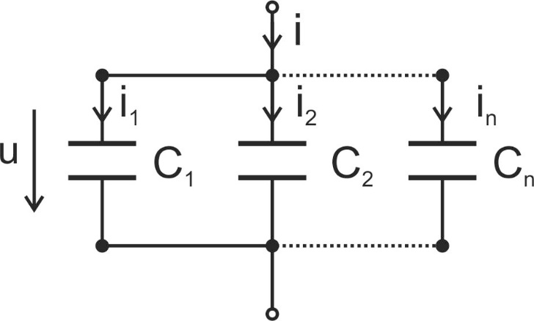
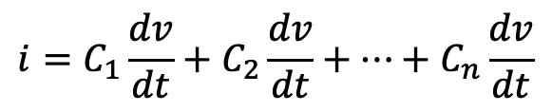

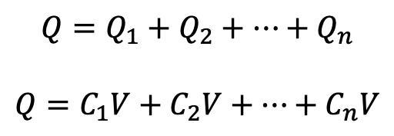
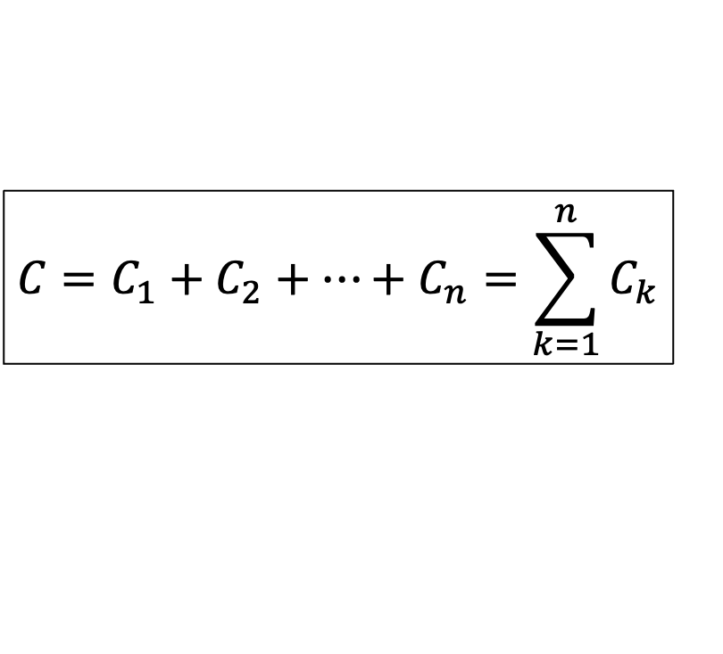
Capacitors in Parallel
$$Q=Q_{1}+Q_{2}+⋯+Q_{n}$$
$$Q=C_{1}V+C_{2}V+⋯+C_{n}V$$
$$i=C_{1}\frac{dv}{dt}+C_{2}\frac{dv}{dt}+⋯+C_{n}\frac{dv}{dt}$$
$$C=C_{1}+C_{2}+⋯+C_{n}=\sum_{k=1}^{n}{C_{k}}$$
current divider rule: $i_{k}=i\frac{C_{k}}{C}$
for two capacitors: $\frac{i_{1}}{i_{2}}=\frac{C_{1}}{C_{2}}$

Slide 18
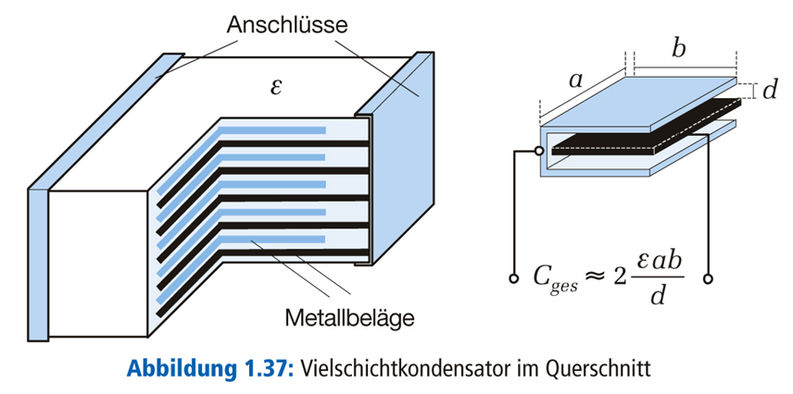
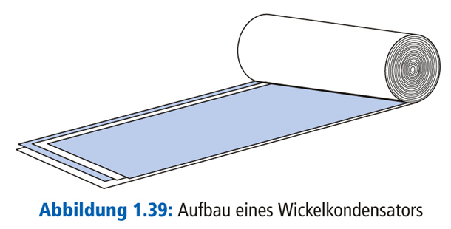
Common Implementations
connected in parallel → higher capacitance
larger area → higher capacitance
terminals
dielectric
metallic electrodes
multilayer ceramic capacitor (MLCC)
wound capacitors (film or electrolytic)

Slide 19
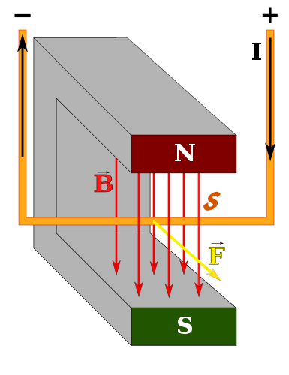
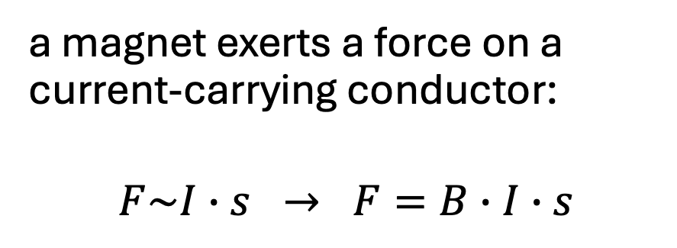
Magnetic Force
a magnet exerts a force on a current-carrying conductor:
$$F\sim I∙s → F=B∙I∙s$$
magnetic field

Slide 20
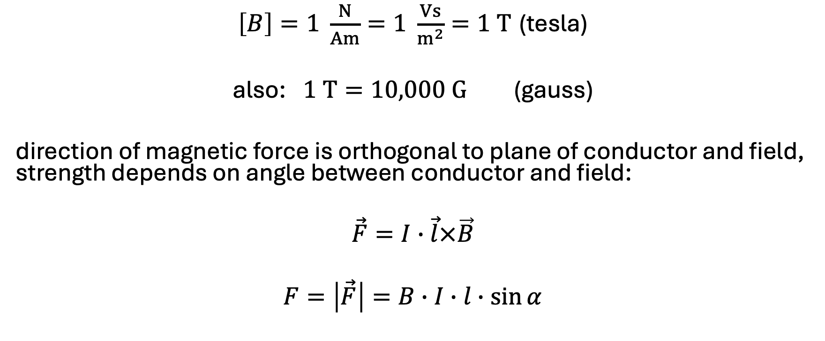
Magnetic Flux Density
$\left[B\right]=1 \frac{N}{Am}=1 \frac{Vs}{m^{2}}=1 T$ (tesla)
also: $1 T=10,000 G$ (gauss)
direction of magnetic force is orthogonal to plane of conductor and field, strength depends on angle between conductor and field:
$$\vec{F}=I∙\vec{l}×\vec{B}$$
$$F=\left|\vec{F}\right|=B∙I∙l∙\sin{α}$$

Slide 21
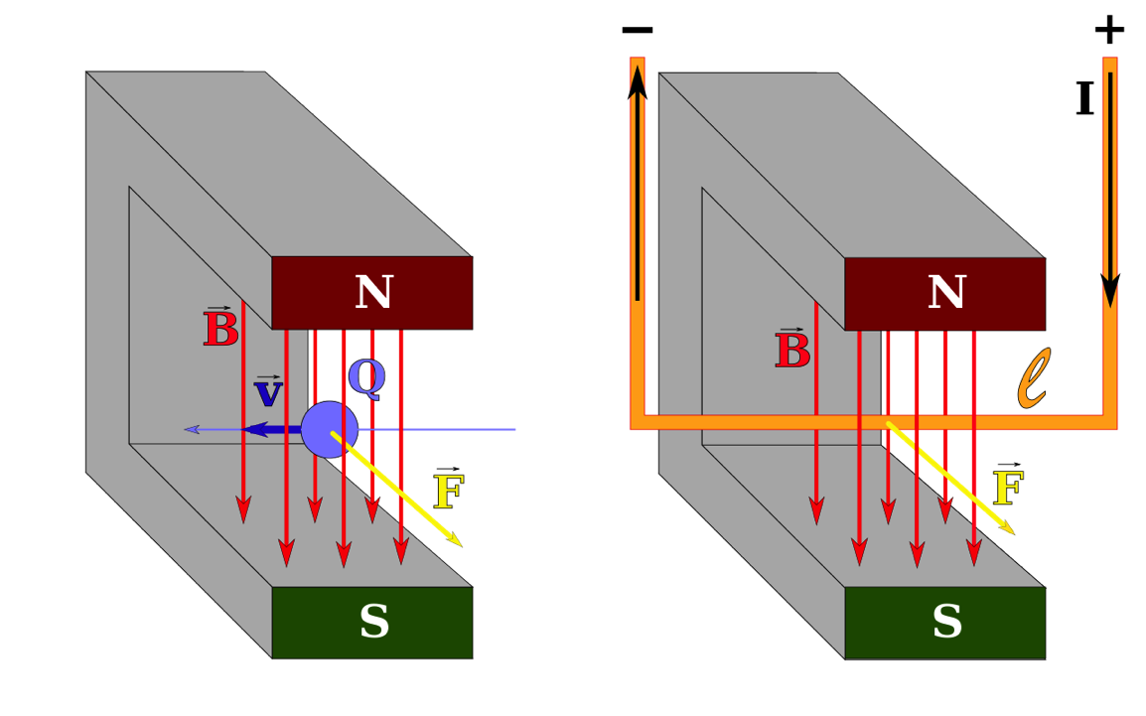
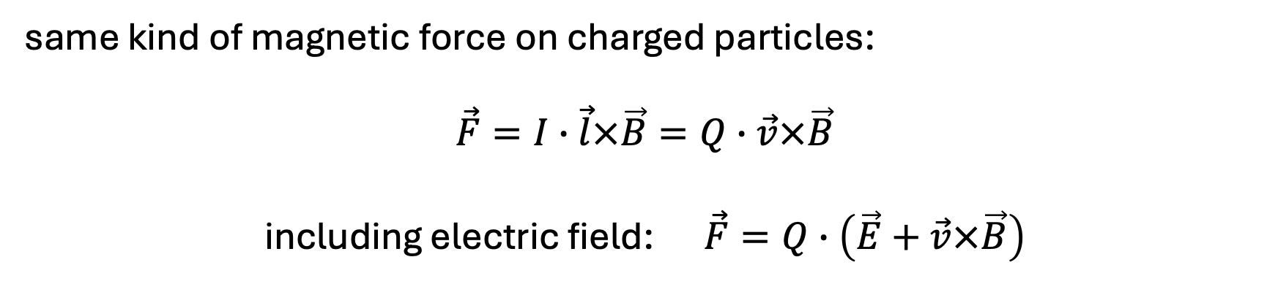
Lorentz Force
same kind of magnetic force on charged particles:
$$\vec{F}=I∙\vec{l}×\vec{B}=Q∙\vec{v}×\vec{B}$$
including electric field: $\vec{F}=Q∙\left(\vec{E}+\vec{v}×\vec{B}\right)$

Slide 22
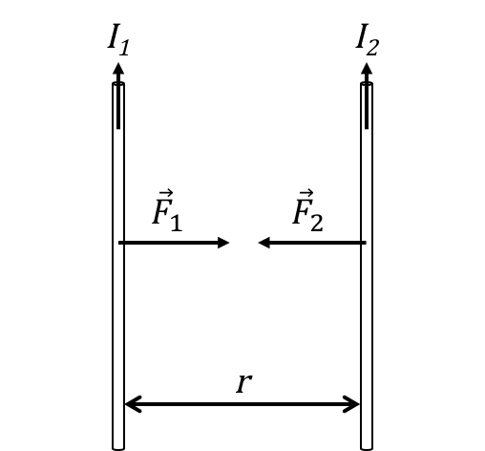
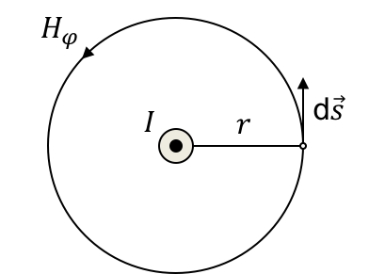
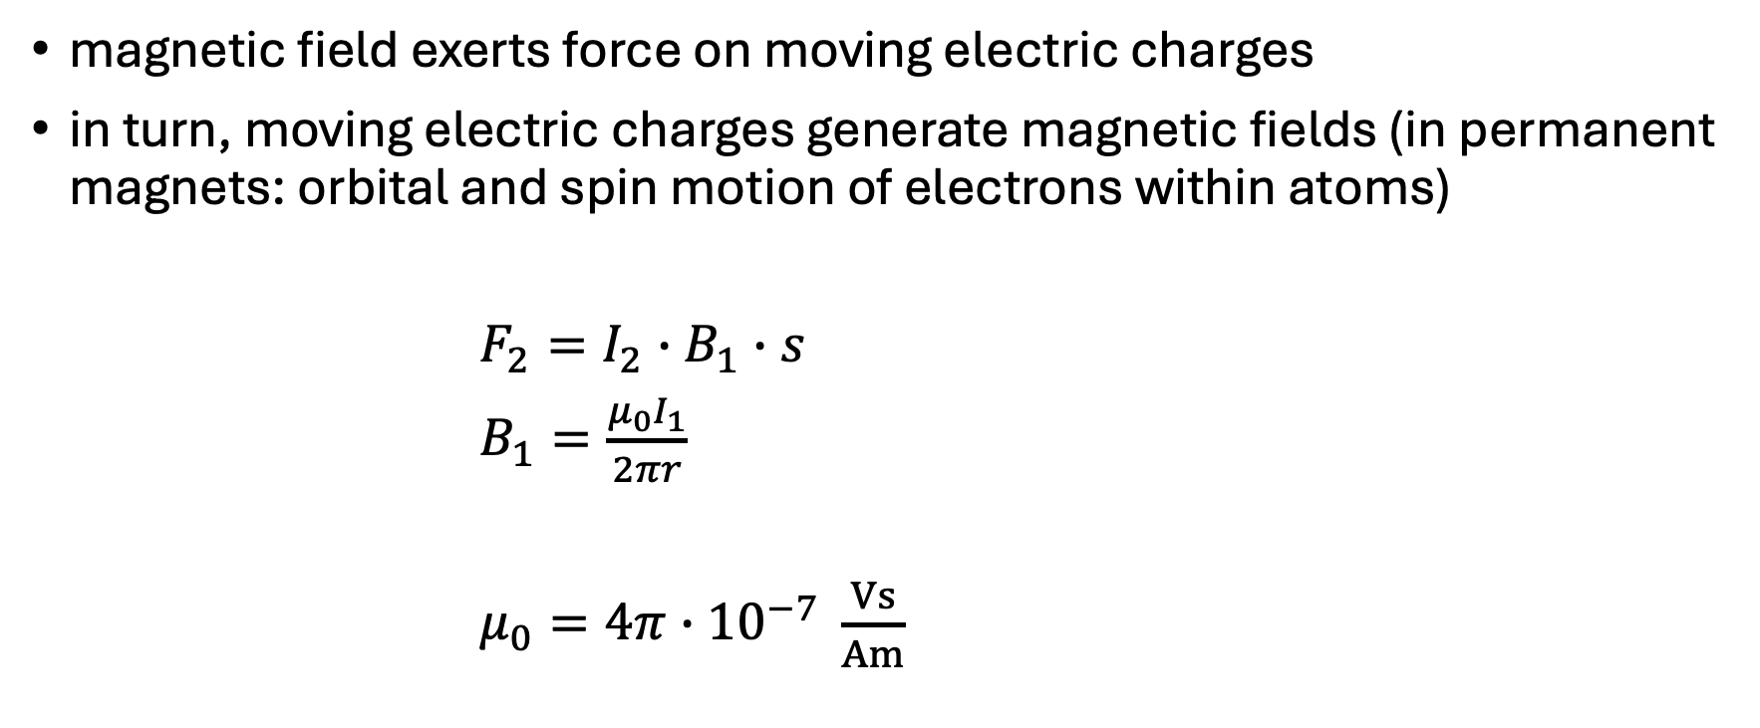

Generation of Magnetic Fields
magnetic field exerts force on moving electric charges
in turn, moving electric charges generate magnetic fields (in permanent magnets: orbital and spin motion of electrons within atoms)
$F_{2}=I_{2}∙B_{1}∙s$
$B_{1}=\frac{μ_{0}I_{1}}{2πr}$
$μ_{0}=4π∙{10}^{−7} \frac{Vs}{Am}$
Ampère‘s force law
$$B$$
circumference
vacuum magnetic permeability
(physical constant)

Slide 23
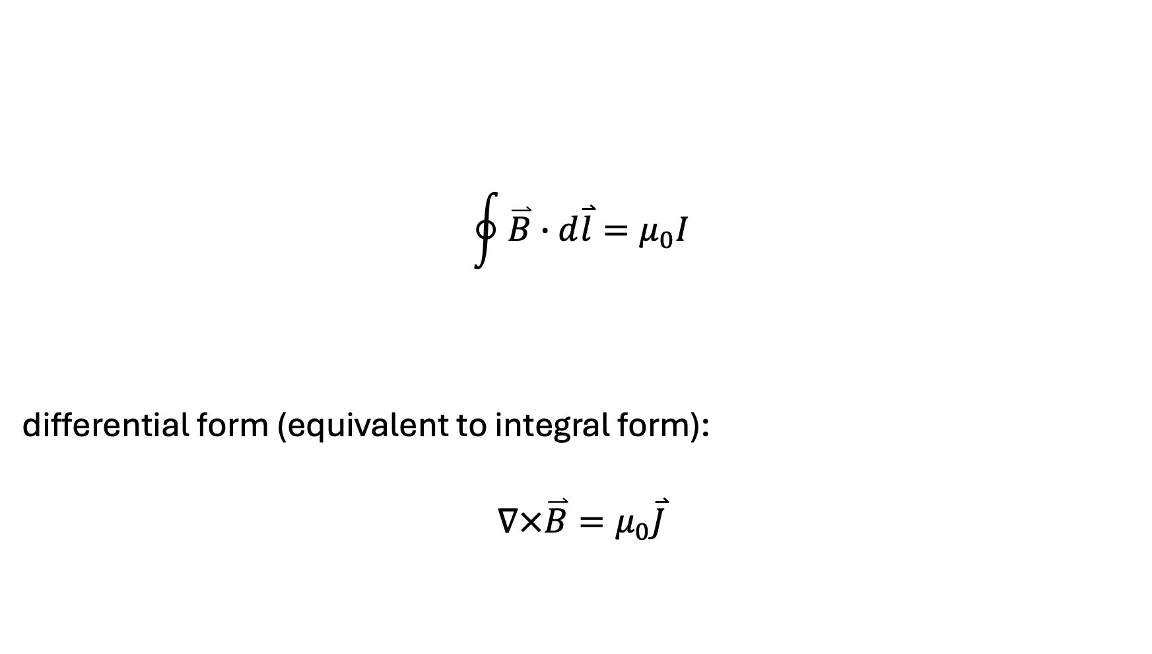


Ampère‘s Circuital Law
$$B$$
$$\oint{\overset{⃑}{B}∙d\overset{⃑}{l}}=μ_{0}I$$
differential form (equivalent to integral form):
$$∇×\overset{⃑}{B}=μ_{0}\overset{⃑}{J}$$
$$I=I_{1}+I_{2}−I_{3}+I_{4}$$
rotation
current density
only closed circuits in nature: magnetic fields look like a dipole from the outside

Slide 24
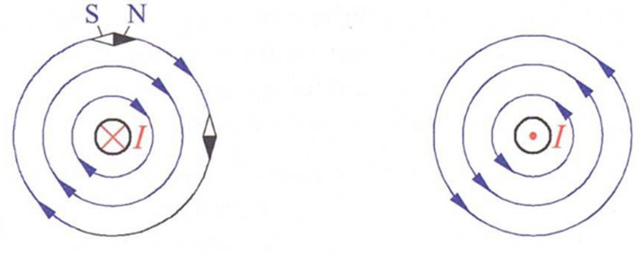
Magnetic Field Lines
closed field lines from north to south pole (dipoles, no magnetic monopoles)
right-hand corkscrew rule: circular field lines around a conductor
electromagnetic coil

Slide 25
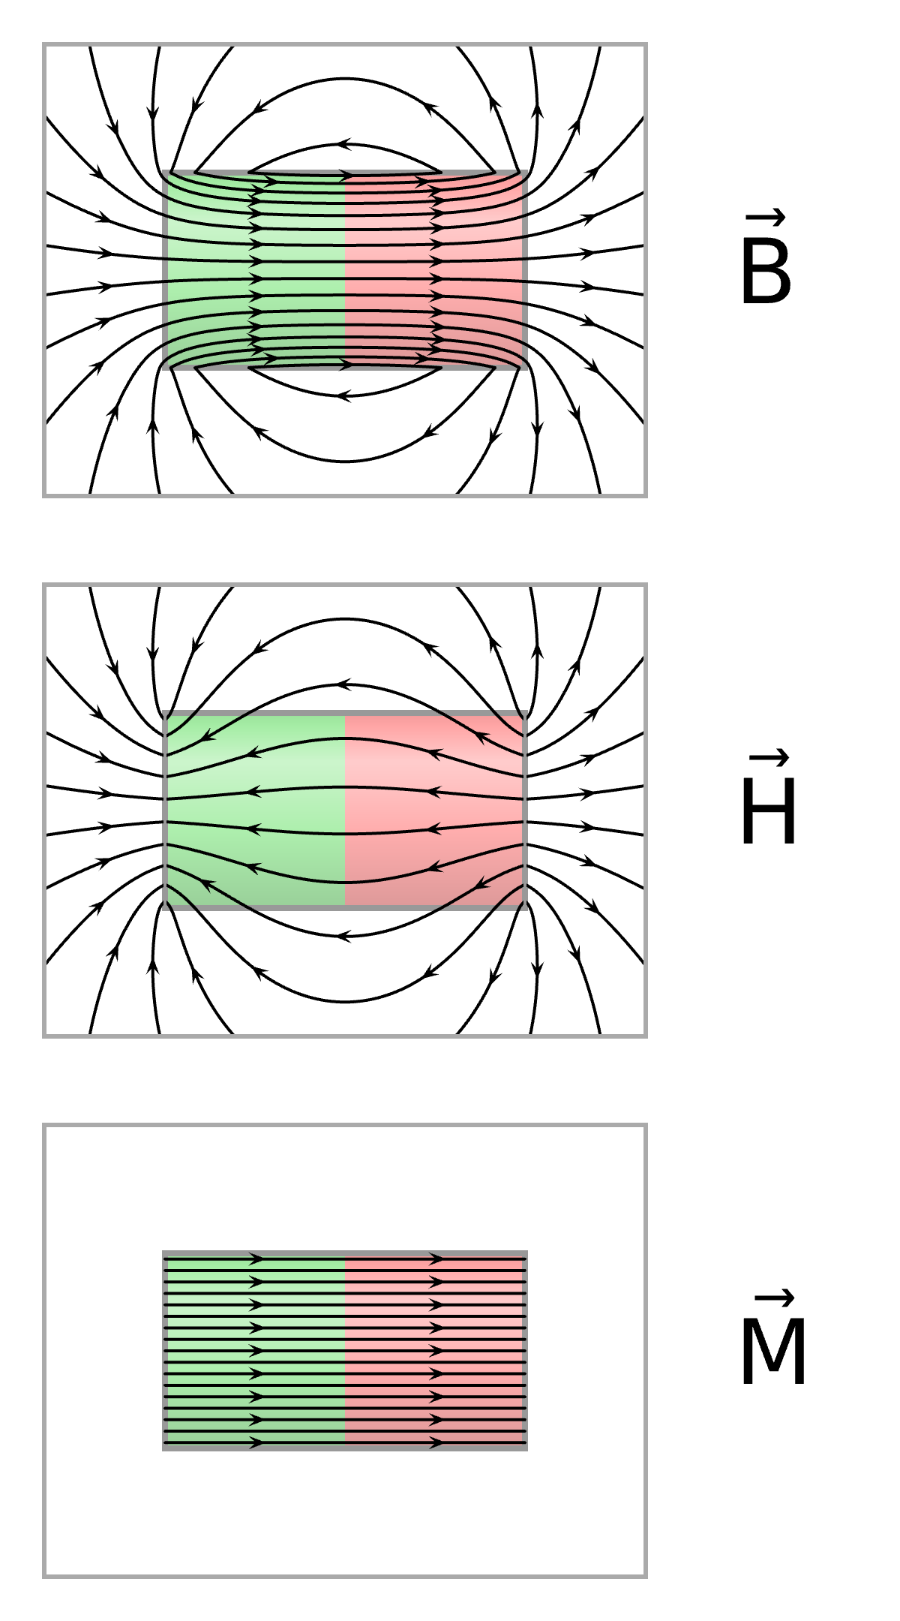
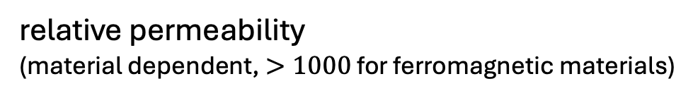
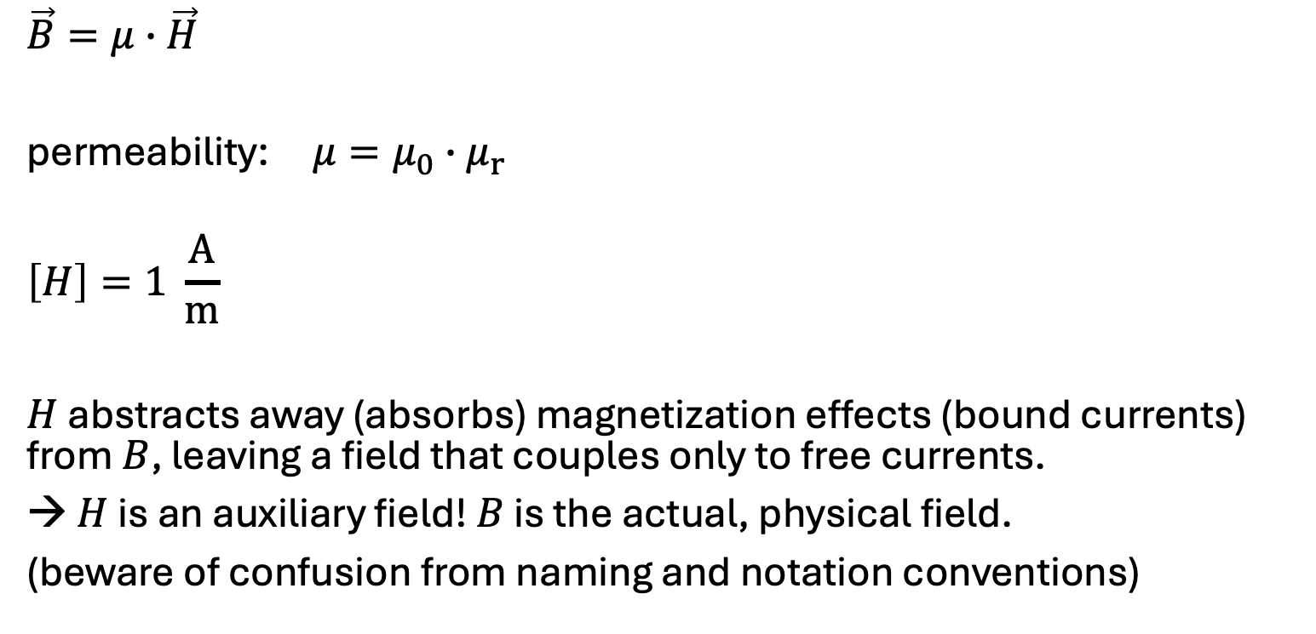

Magnetic Field Strength
magnetization
vacuum permeability
$$H=\frac{1}{μ_{0}}B−M$$
$$\vec{B}=μ∙\vec{H}$$
permeability: $μ=μ_{0}∙μ_{r}$
$$\left[H\right]=1 \frac{A}{m}$$
$H$ abstracts away (absorbs) magnetization effects (bound currents) from $B$, leaving a field that couples only to free currents.
→ $H$ is an auxiliary field! $B$ is the actual, physical field.
(beware of confusion from naming and notation conventions)
relative permeability
(material dependent, $>1000$ for ferromagnetic materials)

Slide 26

Magnetic Flux
$$Φ=\vec{B}∙{\vec{A}}_{n}=B∙A∙\cos{φ}$$
$\left[Φ\right]=1 Vs=1 Wb$ (weber)

Slide 27

Gauss‘s Law for Magnetism
magnetic flux through closed surface is zero (no magnetic monopoles):
$$∯{\overset{⃑}{B} d\overset{⃑}{A}}=0$$
differential form (equivalent to integral form):
$$∇∙\overset{⃑}{B}=0$$
(The magnetic flux through an open surface need not be zero.)

Slide 28



Electromagnetic Induction
changing magnetic field (through surface) induces current in conductor
Faraday’s Law of electromagnetic induction:
$V=−\frac{ⅆΦ}{ⅆt}$
$$\oint{\overset{⃑}{E}∙d\overset{⃑}{l}}=−\frac{ⅆ}{ⅆt}\int{\overset{⃑}{B} d\overset{⃑}{A}}$$
$$∇×\overset{⃑}{E}=−\frac{d\overset{⃑}{B}}{dt}$$
voltage induced
induced voltage always opposes the change that caused it (Lenz‘s law)

Slide 29


Inductance
old:
measure of a system’s ability to store magnetic energy (in its magnetic field), for a given electric current
$$L=\frac{Φ}{I}$$
$\left[L\right]=1\frac{Vs}{A}=1H$ (henry)

Slide 30

Time Dependence
$$I=\frac{Φ}{L}$$
$$\frac{dΦ}{dt}=L∙\frac{di}{dt}$$
$$v=L\frac{di}{dt}$$
current through inductance is continuous
voltage across inductance can be discontinuous
inductor is short circuit for DC

Slide 31



Inductor (aka Coil)
magnetic effect of a coil depends on product of current and number of turns, expressed as ampere-turns: $NI$
inductance measures how effectively a coil links the current with the magnetic flux through its core (flux linkage in weber-turns): $L=\frac{NΦ}{I}$

Slide 32


Magnetic Analogue of Ohm’s Law
ampere-turns create magnetic flux through the core of a coil (like voltage pushes current), depending on magnetic reluctance $R_{m}$ of core/path:
$Φ=B∙A=\frac{μ∙N∙I}{l}∙A$ with $R_{m}=\frac{l}{μ∙A}$
$$Φ=\frac{NI}{R_{m}}$$
→ $L=\frac{NΦ}{I}=\frac{N^{2}}{R_{m}}$
length and cross-sectional area of the magnetic path, not the wire

Slide 33

Electric vs Magnetic Circuits
electrons moving in conductor, no electric field
Electric Network | Magnetic Network
$$R=\frac{ρl}{A}$$ | $$R_{m}=\frac{l}{μA}$$
$$V=RI$$ | $$NI=R_{m}φ$$
$$\sum_{loop}{RI=0}$$ | $$\sum_{loop}{R_{m}φ=\sum{NI}}$$
$$\sum_{node}{I}=0$$ | $$\sum_{node}{φ}=0$$
magnetic field, no moving particles
Ohm:
KVL:
KCL:

Slide 34

Energy of Inductance
inductor as magnetic energy storage:
$$W=\int{i}∙v dt\int{i∙L\frac{di}{dt}}dt=L\int{i di}=\frac{1}{2}Li^{2}=\frac{1}{2}\left(Ni\right)Φ$$

Slide 35




Inductors in Series
$$v=L_{1}\frac{di}{dt}+L_{2}\frac{di}{dt}+⋯+L_{n}\frac{di}{dt}$$
$$L=L_{1}+L_{2}+⋯+L_{n}=\sum_{k=1}^{n}{L_{k}}$$
voltage divider rule: $v_{k}=v\frac{L_{k}}{L}$
for two inductors: $\frac{v_{1}}{v_{2}}=\frac{L_{1}}{L_{2}}$

Slide 36



Inductors in Parallel
$$i=\frac{1}{L_{1}}\int{v dt}+\frac{1}{L_{2}}\int{v dt}+⋯+\frac{1}{L_{n}}\int{v dt}$$
$$\frac{1}{L}=\frac{1}{L_{1}}+\frac{1}{L_{2}}+⋯+\frac{1}{L_{n}}=\sum_{k=1}^{n}{\frac{1}{L_{k}}}$$
for two inductors: $L=\frac{L_{1}L_{2}}{L_{1}+L_{2}}; \frac{i_{1}}{i_{2}}=\frac{L_{2}}{L_{1}}; i_{1}=i\frac{L_{2}}{L_{1}+L_{2}}$ (current divider rule)

Slide 37


Transformer
transfers electrical energy from one circuit into another
works through electromagnetic induction between two coils
coils magnetically coupled via a common core (shared magnetic flux), without any direct conductive connection
essential for transmission of electric power (in the form of alternating current)

Slide 38


Ideal Transformer
$V_{P}=−N_{P}\frac{ⅆΦ}{ⅆt}$ $V_{S}=−N_{S}\frac{ⅆΦ}{ⅆt}$
→ $\frac{V_{P}}{V_{S}}=\frac{N_{P}}{N_{S}}=a$
$a>1$: step-down transformer
$a<1$: step-up transformer
higher voltage → less heat loss during energy transfer ($P_{loss}=U_{R}∙I=I^{2}∙R$ and $P=U_{S}∙I$)

Slide 39


Load on Secondary Side
need to consider mutual inductance:
$$u_{1}=L_{1}\frac{di_{1}}{dt}+L_{2,1}\frac{di_{2}}{dt}$$
$$u_{2}=L_{2}\frac{di_{2}}{dt}+L_{1,2}\frac{di_{1}}{dt}=−i_{2}∙R$$
with $L_{1,2}=L_{2,1}=\frac{N_{P}∙N_{S}}{R_{m}}$

Slide 40

Maxwell‘s Correction to Ampère‘s Law
symmetry to electromagnetic induction:
a time-varying electric field produces a circulating magnetic field
$$\oint{\overset{⃑}{B}∙d\overset{⃑}{l}}=μ_{0}I+μ_{0}ε_{0}\frac{ⅆ}{ⅆt}\int{\overset{⃑}{E} d\overset{⃑}{A}}$$
$$∇×\overset{⃑}{B}=μ_{0}\overset{⃑}{J}+μ_{0}ε_{0}\frac{d\overset{⃑}{E}}{dt}$$
$\frac{∂B}{∂t}$ → rotational $E$, $\frac{∂E}{∂t}$ → rotational $B$:
→ electromagnetic waves in vacuum (no charges or wires needed)
displacement current

Slide 41




Maxwell‘s Equations in Vacuum
integral form:
$∯{\overset{⃑}{E} d\overset{⃑}{A}}=\frac{Q}{ε_{0}}$
$∯{\overset{⃑}{B} d\overset{⃑}{A}}=0$
$\oint{\overset{⃑}{E}∙d\overset{⃑}{l}}=−\frac{ⅆ}{ⅆt}\int{\overset{⃑}{B} d\overset{⃑}{A}}$
$\oint{\overset{⃑}{B}∙d\overset{⃑}{l}}=μ_{0}I+μ_{0}ε_{0}\frac{ⅆ}{ⅆt}\int{\overset{⃑}{E} d\overset{⃑}{A}}$
differential form:
$∇∙\overset{⃑}{E}=\frac{ρ}{ε_{0}}$
$∇∙\overset{⃑}{B}=0$
$∇×\overset{⃑}{E}=−\frac{∂\overset{⃑}{B}}{∂t}$
$∇×\overset{⃑}{B}=μ_{0}\overset{⃑}{J}+μ_{0}ε_{0}\frac{∂\overset{⃑}{E}}{∂t}$
$$∇^{2}\overset{⃑}{E}−\frac{1}{c^{2}}\frac{∂^{2}\overset{⃑}{E}}{∂t^{2}}=0$$
$$∇^{2}\overset{⃑}{B}−\frac{1}{c^{2}}\frac{∂^{2}\overset{⃑}{B}}{∂t^{2}}=0$$
wave equations:
$c=\frac{1}{\sqrt{μ_{0}ε_{0}}}$ (speed of light in vacuum)

Slide 42




Transient Responses: RC Series Circuit
transients: time-varying currents and voltages resulting from the sudden application of sources (usually due to switching)
differential equation:
$$U_{q}=iR+\frac{1}{C}\int{i dt}$$
charging the capacitor with DC:
$$i=\frac{U_{q}}{R}∙e^{−\frac{t}{τ}}$$
$$τ=RC$$
$$u_{R}=U_{q}∙e^{−\frac{t}{τ}}$$
$$u_{C}=U_{q}\left(1−e^{−\frac{t}{τ}}\right)$$
steady-state conditions with DC sources: capacitances behave as open circuits

Slide 43


Transient Responses: RC Series Circuit
discharging the capacitor:

Slide 44




Transient Responses: RL Parallel Circuit
differential equation:
$$I_{q}=\frac{u}{R}+\frac{1}{L}\int{u dt}$$
steady-state conditions with DC sources: inductances behave as short circuits
$$u=I_{q}R∙e^{−\frac{t}{τ}}$$
$$τ=\frac{L}{R}$$
$$i_{R}=I_{q}∙e^{−\frac{t}{τ}}$$
$$i_{L}=I_{q}\left(1−e^{−\frac{t}{τ}}\right)$$

