Slide 1

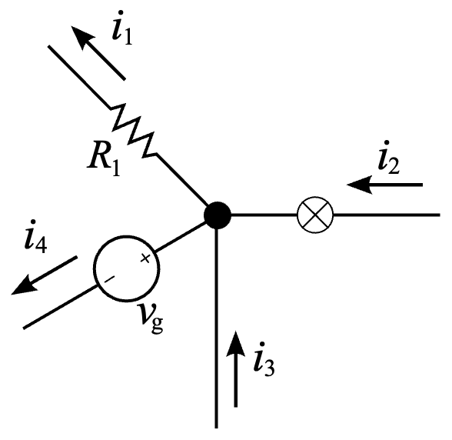
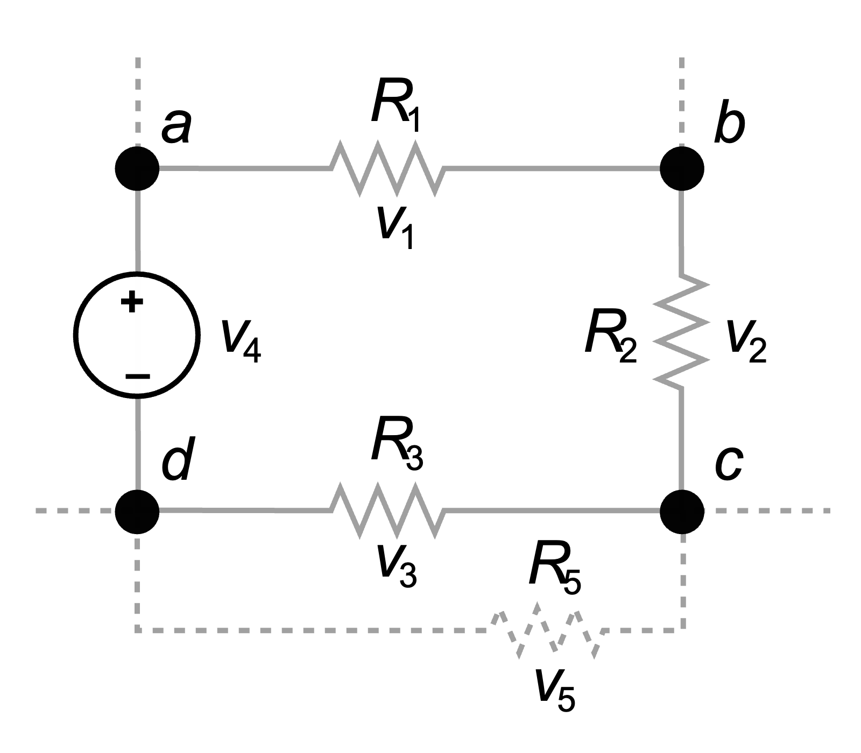
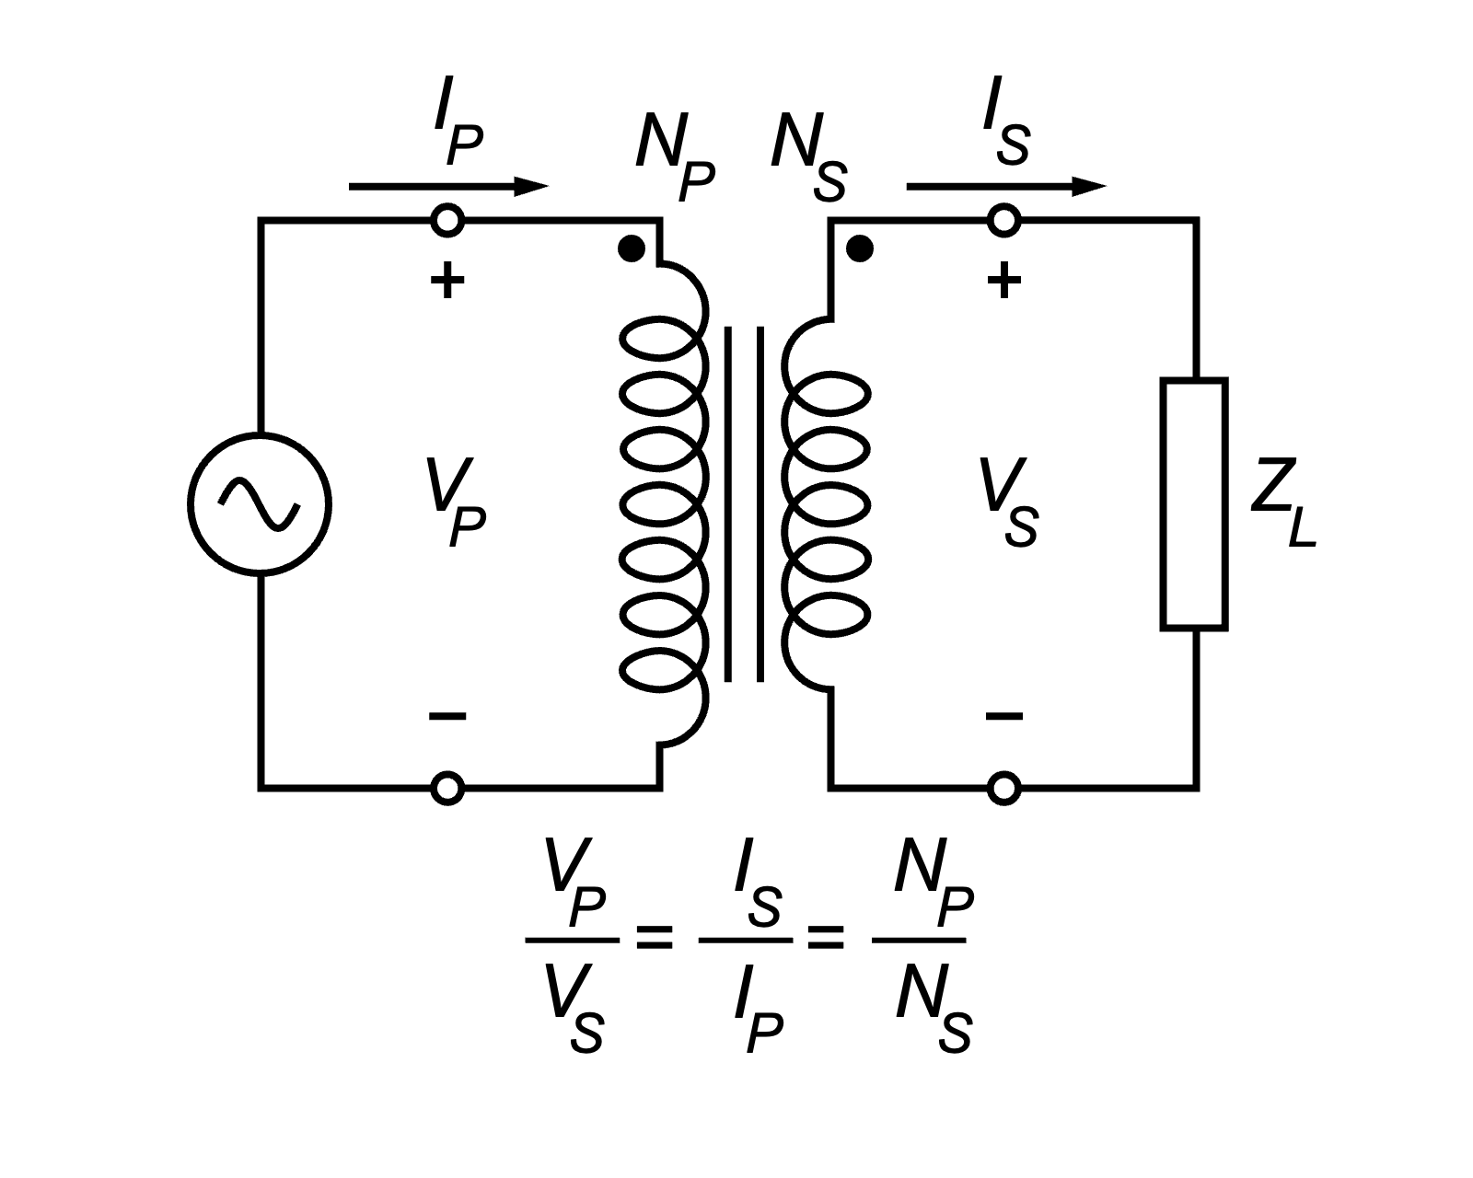
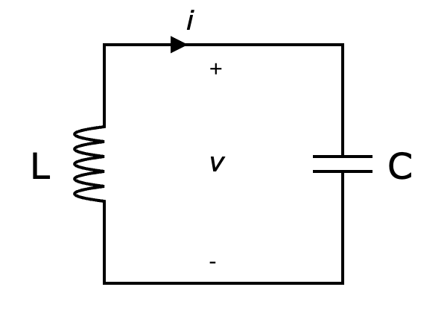
Introduction to Electrical Engineering

Slide 2
Overview
Physical Principles and Basic Concepts
Direct Current Circuits
Electric and Magnetic Fields
Alternating Current Technology

Slide 3
Alternating Current Technology
Sinusoidal Waveform
Phasor Representation
Network Analysis in Phasor Domain
AC Power
High- & Low-Pass Filters
Resonant Circuits

Slide 4
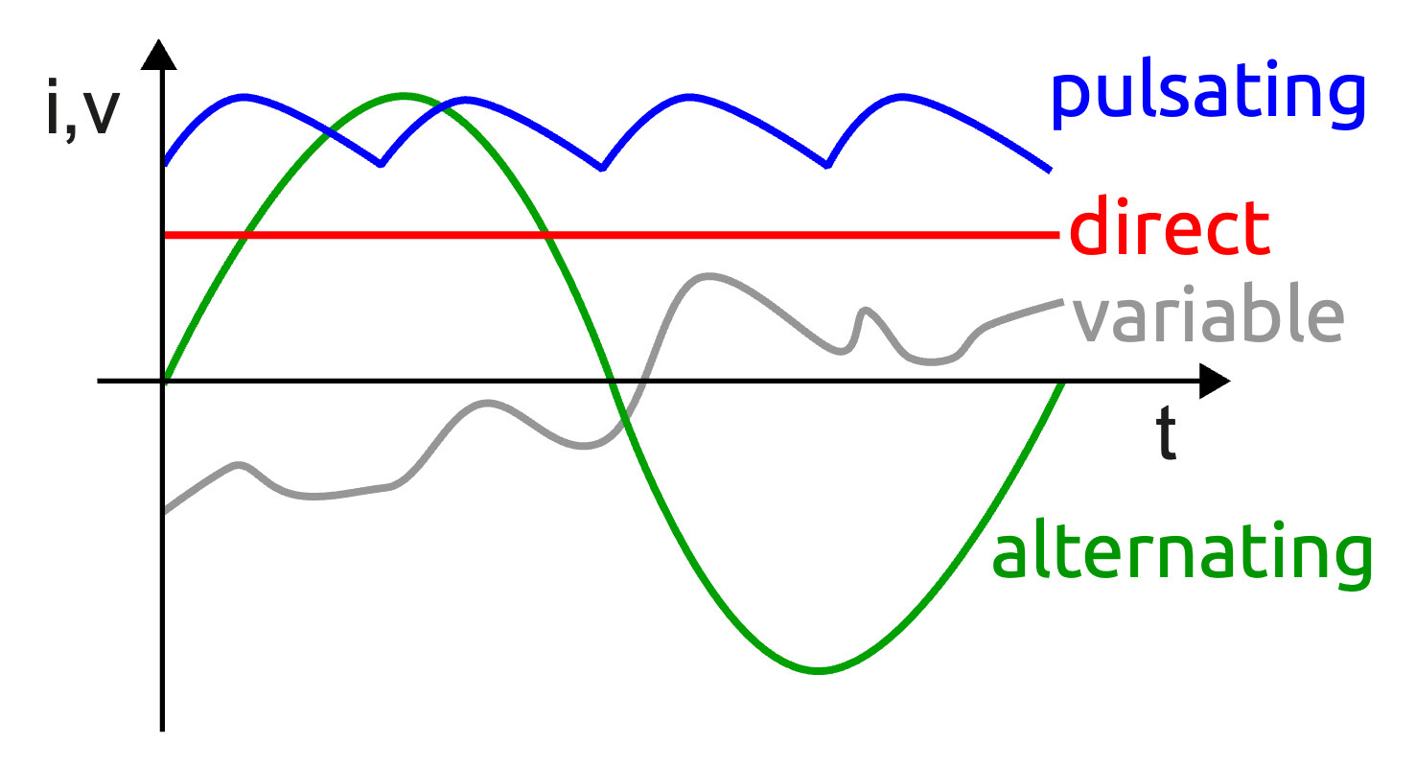
Alternating Current (AC)
periodically reverses direction and changes its magnitude continuously with time

Slide 5
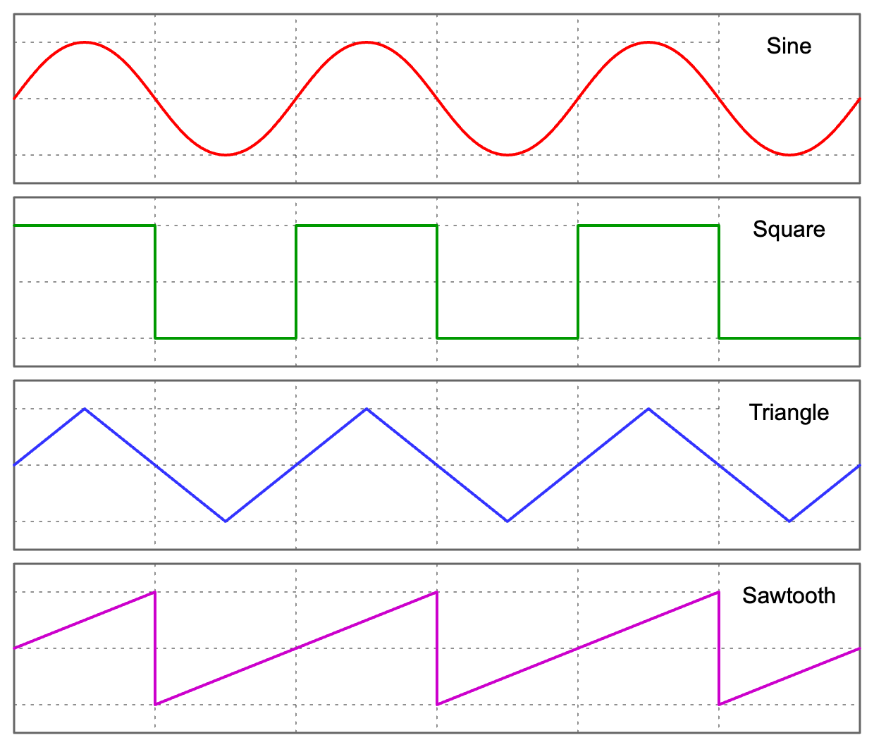
AC Waveforms

Slide 6
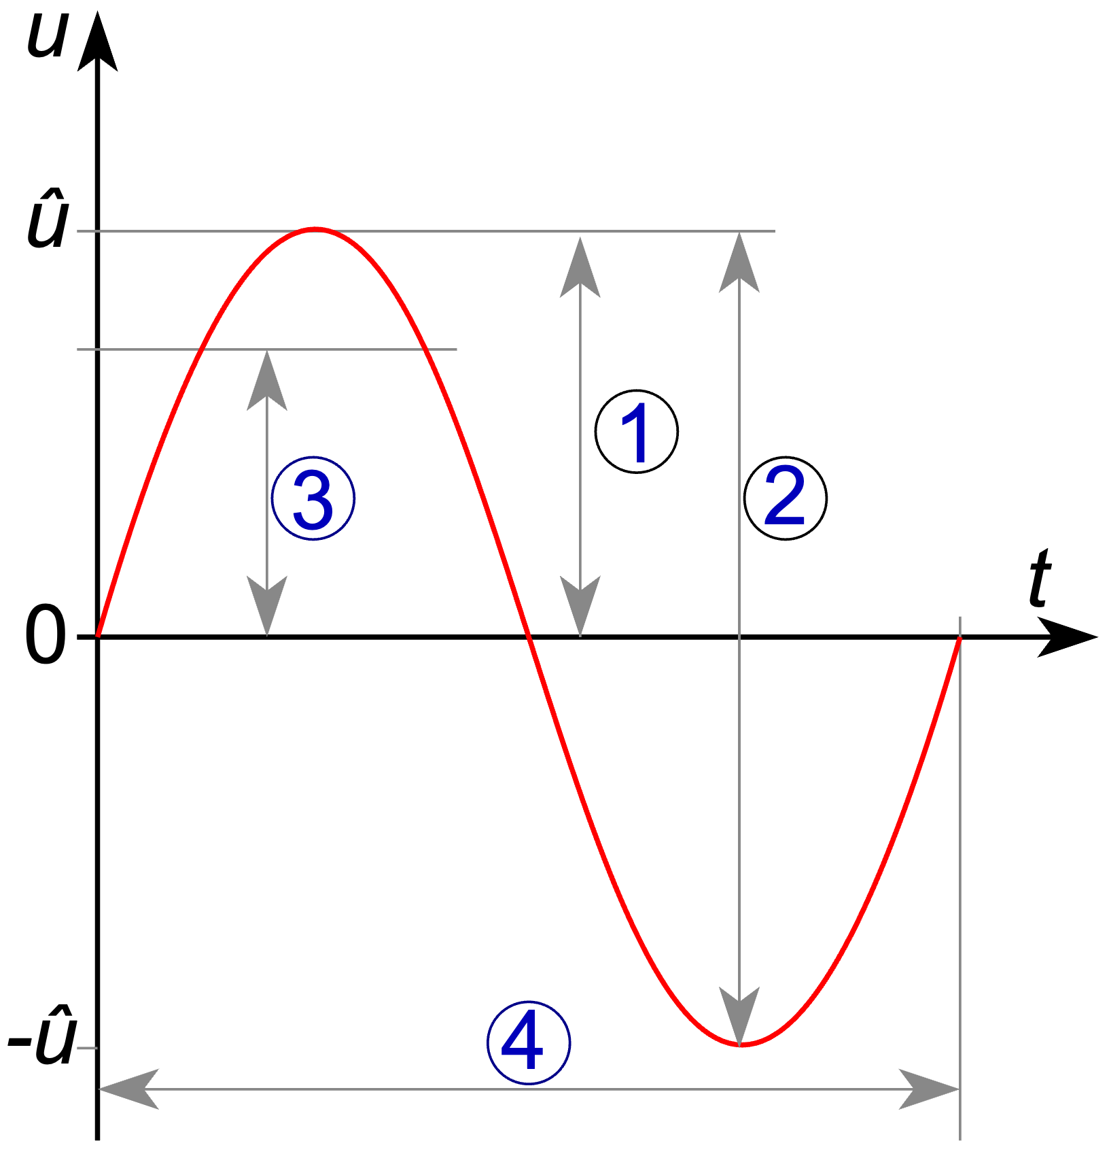
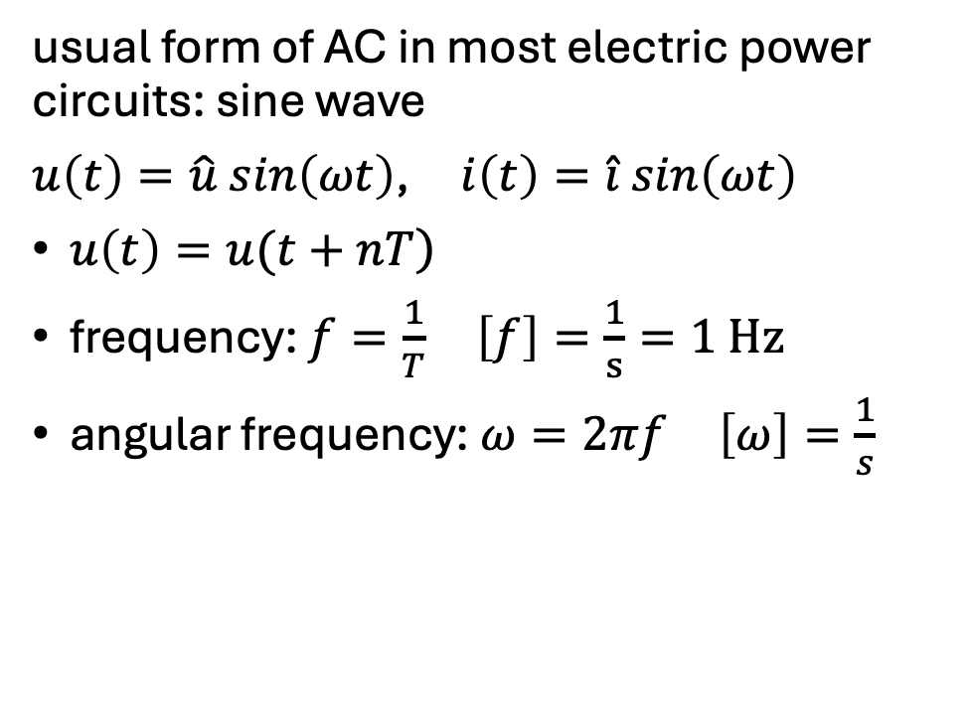
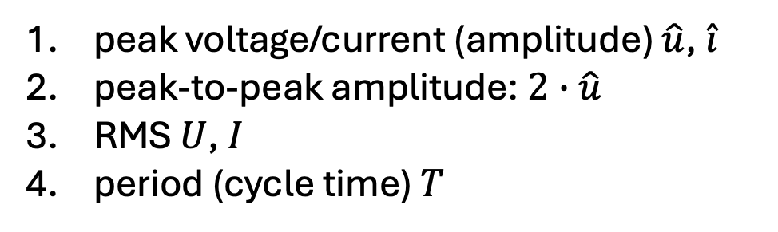
Sinusoidal AC
usual form of AC in most electric power circuits: sine wave
$u\left(t\right)=\hat{u} sin\left(ωt\right)$, $i\left(t\right)=\hat{i} sin\left(ωt\right)$
$\left.u\left(t\right)=u(t+nT\right)$
frequency: $f=\frac{1}{T}$ $\left[f\right]=\frac{1}{s}=1 Hz$
angular frequency: $ω=2πf$ $\left[ω\right]=\frac{1}{s}$
peak voltage/current (amplitude) $\hat{u}$, $\hat{i}$
peak-to-peak amplitude: $2∙\hat{u}$
RMS $U$, $I$
period (cycle time) $T$

Slide 7
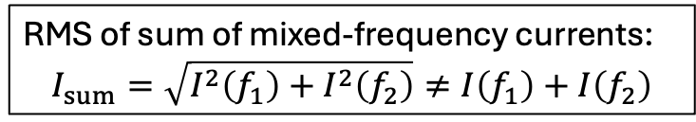
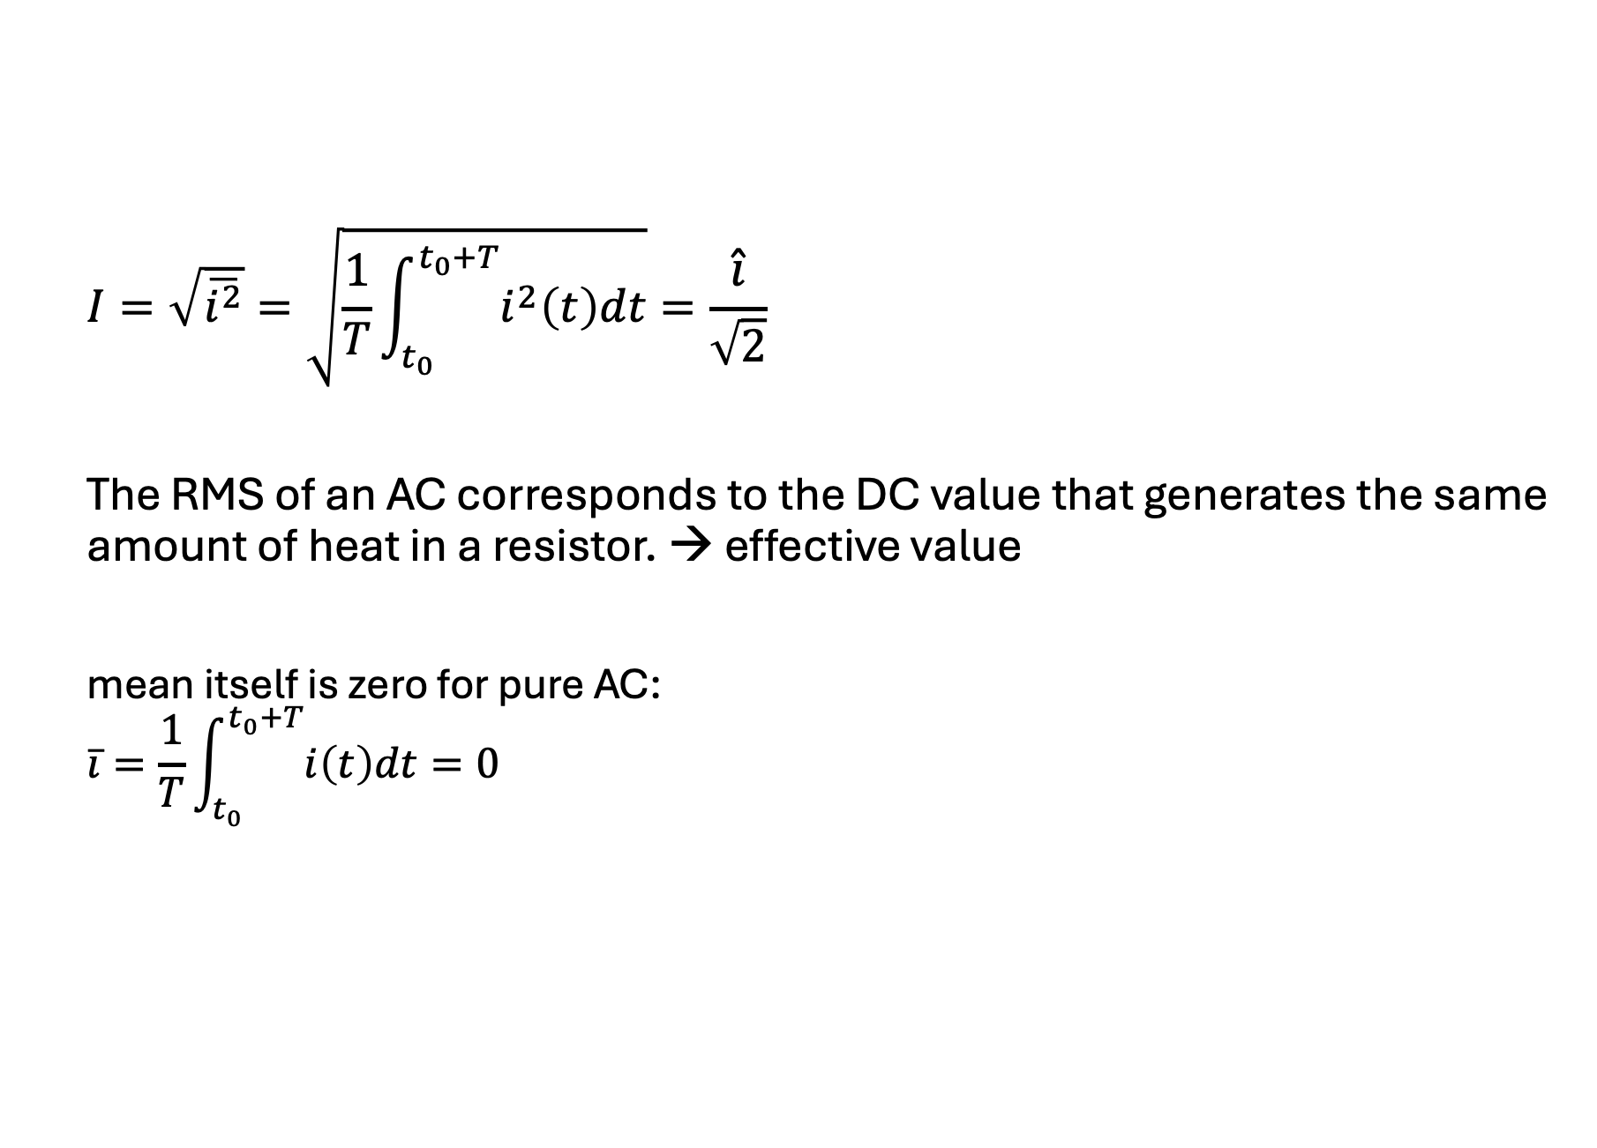
Root Mean Square (RMS)
$$I=\sqrt{\overline{i^{2}}}=\sqrt{\frac{1}{T}\int_{t_{0}}^{t_{0}+T}{i^{2}\left(t\right)dt}}=\frac{\hat{i}}{\sqrt{2}}$$
The RMS of an AC corresponds to the DC value that generates the same amount of heat in a resistor. → effective value
mean itself is zero for pure AC:
$$\overline{i}=\frac{1}{T}\int_{t_{0}}^{t_{0}+T}{i\left(t\right)dt=0}$$
RMS of sum of mixed-frequency currents:
$$I_{sum}=\sqrt{I^{2}\left(f_{1}\right)+I^{2}\left(f_{2}\right)}≠I\left(f_{1}\right)+I\left(f_{2}\right)$$

Slide 8

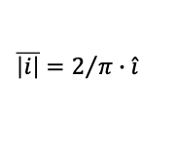
$$\left|i\right|$$
$$\overline{\left|i\right|}=2/π∙\hat{i}$$
sine
squared
RMS

Slide 9

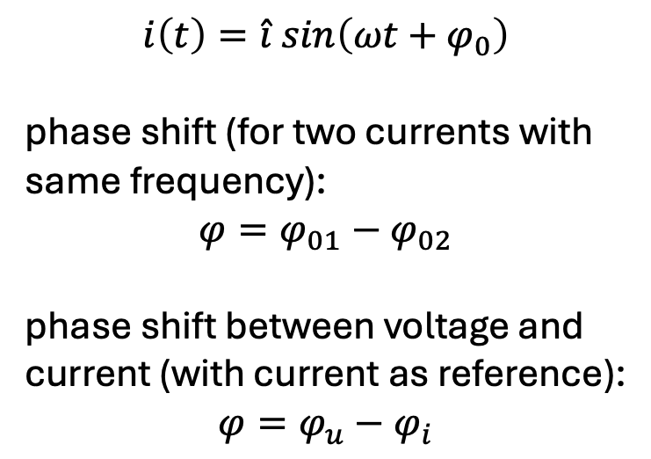
Phase Shift
$$i\left(t\right)=\hat{i} sin\left(ωt+φ_{0}\right)$$
phase shift (for two currents with same frequency):
$$φ=φ_{01}−φ_{02}$$
phase shift between voltage and current (with current as reference):
$$φ=φ_{u}−φ_{i}$$
ωt
$$φ=φ_{u}−φ_{i}=30°−\left(−30°\right)=60°$$
In this example, the current lags behind the voltage.

Slide 10
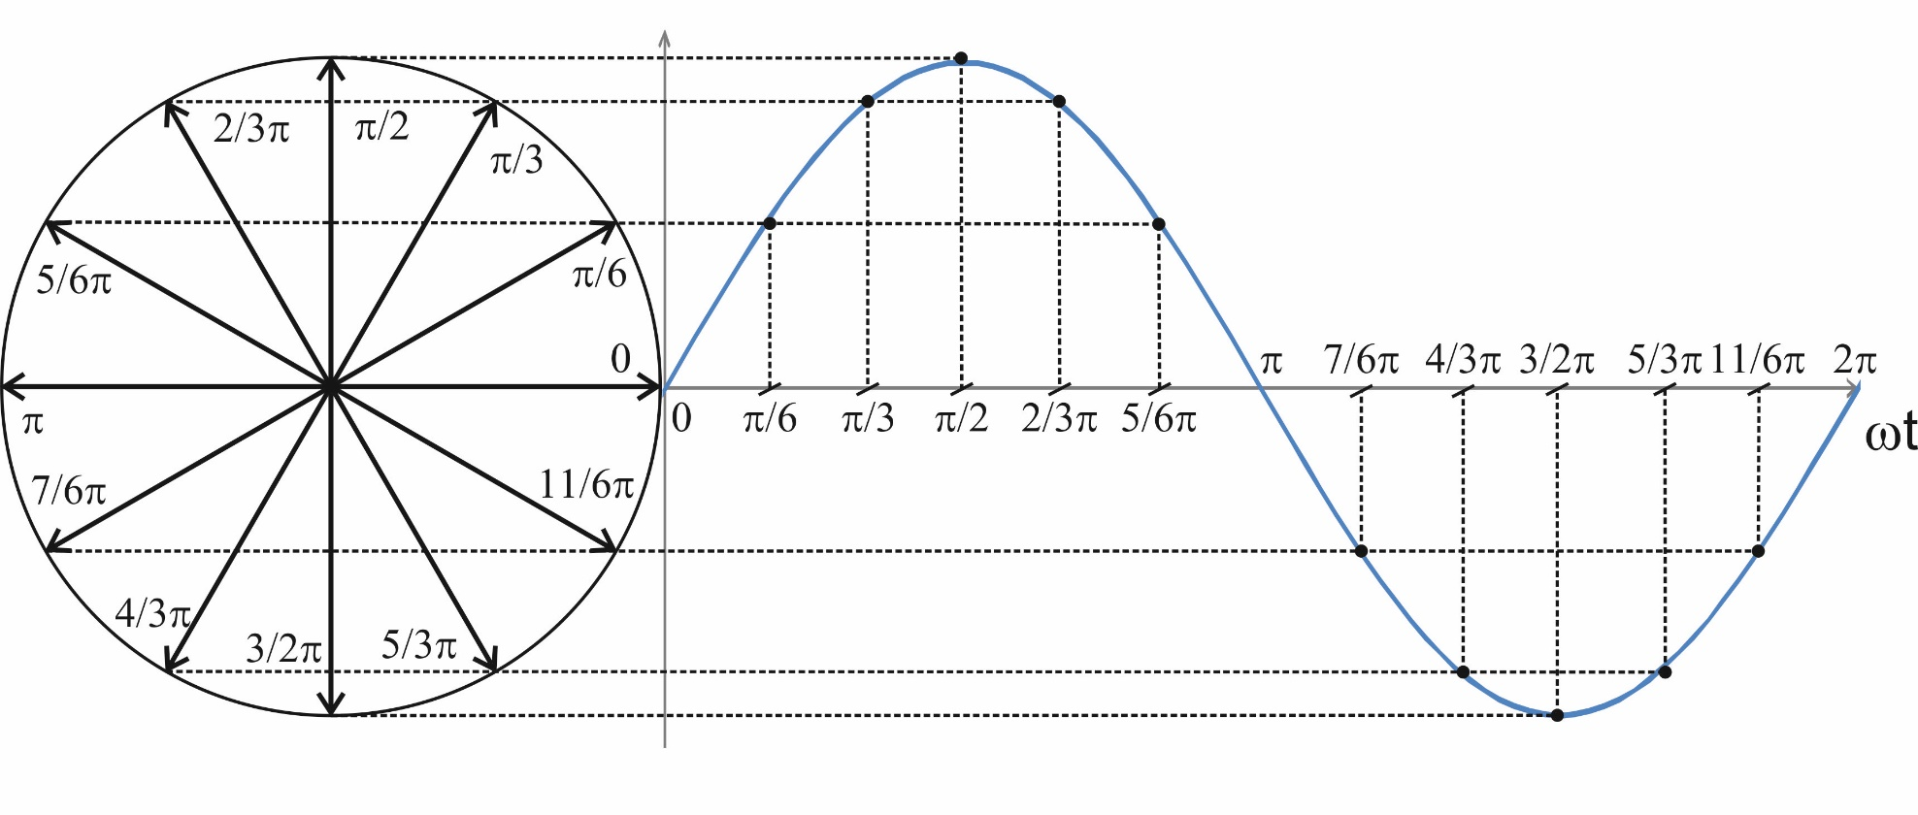
Phasor Representation
phasor diagram:
addition:
U
U₂
U₂
U₁
subtraction:
U₂
U₁
-U₂
phasor calculations only work for quantities with same frequency
→ freeze rotation in time to get stationary phasors
U

Slide 11
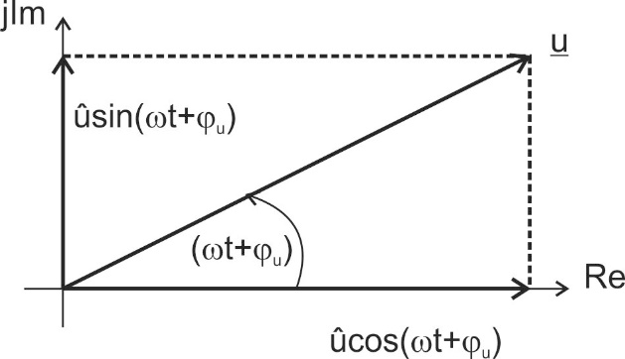

Use of Complex Numbers
$$u\left(t\right)=\hat{u}\cos\left(ωt+φ_{u}\right)=\hat{u}\sin\left(ωt+φ_{u}+\frac{π}{2}\right)=U∙\sqrt{2}\sin\left(ωt+φ_{u}+\frac{π}{2}\right)$$
phasors can be represented by complex numbers:
$$\underline{u}\left(t\right)=Re \left\{\underline{u}(t)\right\}+j Im\left\{\underline{u}(t)\right\}=\hat{u}\cos\left(ωt+φ_{u}\right)+j \hat{u}\sin\left(ωt+φ_{u}\right)$$

Slide 12
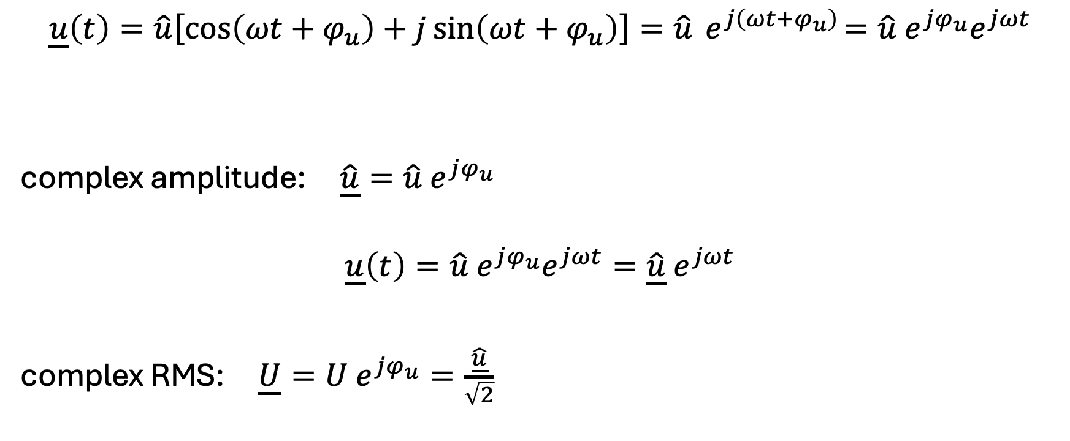
Complex Amplitude
$$\underline{u}\left(t\right)=\hat{u}\left[\cos\left(ωt+φ_{u}\right)+j\sin\left(ωt+φ_{u}\right)\right]=\hat{u}{ e}^{j\left(ωt+φ_{u}\right)}=\hat{u}{ e}^{jφ_{u}}e^{jωt}$$
complex amplitude: $\underline{\hat{u}}=\hat{u} e^{jφ_{u}}$
$$\underline{u}\left(t\right)=\hat{u}{ e}^{jφ_{u}}e^{jωt}=\underline{\hat{u}}{ e}^{jωt}$$
complex RMS: $\underline{U}=U e^{jφ_{u}}=\frac{\underline{\hat{u}}}{\sqrt{2}}$
complex
can be ignored if all quantities have the same frequency
→ stationary phasors

Slide 13
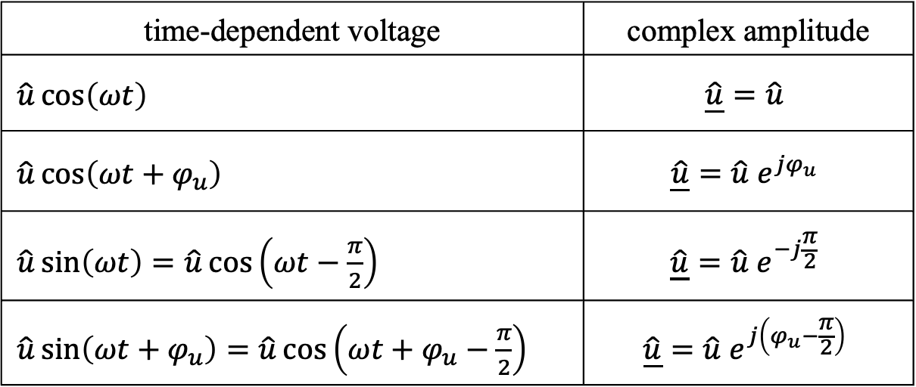
Transformation into Phasor Domain
time-dependent voltage | complex amplitude
$\hat{u}\cos\left(ωt\right)$ | $$\underline{\hat{u}}=\hat{u}$$
$\hat{u}\cos\left(ωt+φ_{u}\right)$ | $$\underline{\hat{u}}=\hat{u} e^{jφ_{u}}$$
$\hat{u}\sin\left(ωt\right)=\hat{u}\cos\left(ωt−\frac{π}{2}\right)$ | $$\underline{\hat{u}}=\hat{u} e^{−j\frac{π}{2}}$$
$\hat{u}\sin\left(ωt+φ_{u}\right)=\hat{u}\cos\left(ωt+φ_{u}−\frac{π}{2}\right)$ | $$\underline{\hat{u}}=\hat{u} e^{j\left(φ_{u}−\frac{π}{2}\right)}$$
$$\underline{\hat{u}}=\hat{u}\left(\cos{φ_{u}}+j\sin{φ_{u}}\right)=Re+jIm$$

Slide 14
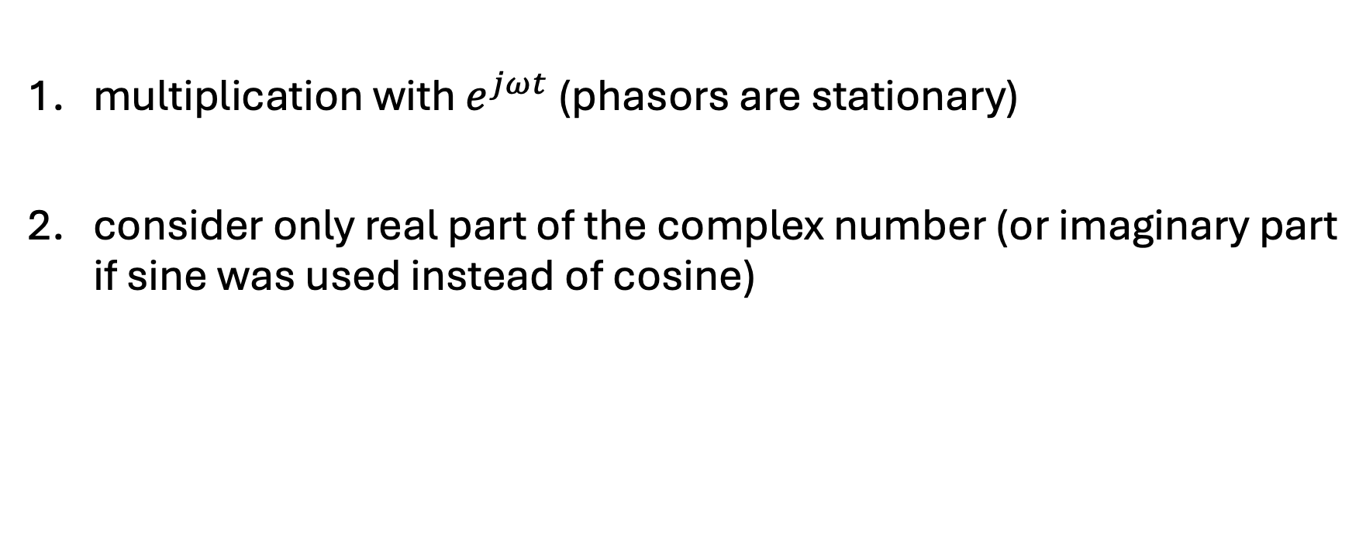
Back Transformation into Time Domain
multiplication with $e^{jωt}$ (phasors are stationary)
consider only real part of the complex number (or imaginary part if sine was used instead of cosine)

Slide 15
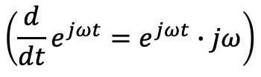


Derivation in Phasor Domain
$$\frac{d}{dt}→jω$$
→ phase shift of $\frac{π}{2}$
example:
$$u\left(t\right)=L\frac{di}{dt}→\underline{U}=jωL\underline{I}$$
$$\left({\frac{d}{dt}e}^{jωt}=e^{jωt}∙jω\right)$$
$$\left(\underline{\hat{u}}∙j=\hat{u} e^{jφ_{u}}∙e^{j \frac{π}{2}}=\hat{u} e^{j\left(φ_{u}+\frac{π}{2}\right)}\right)$$

Slide 16
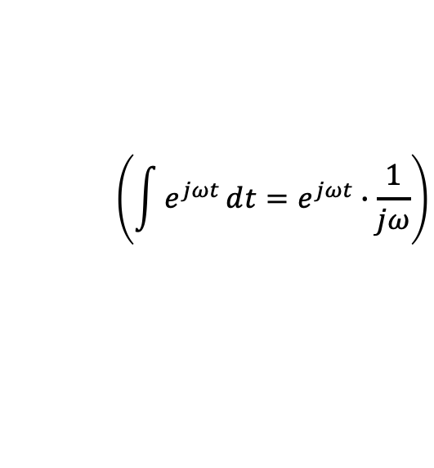
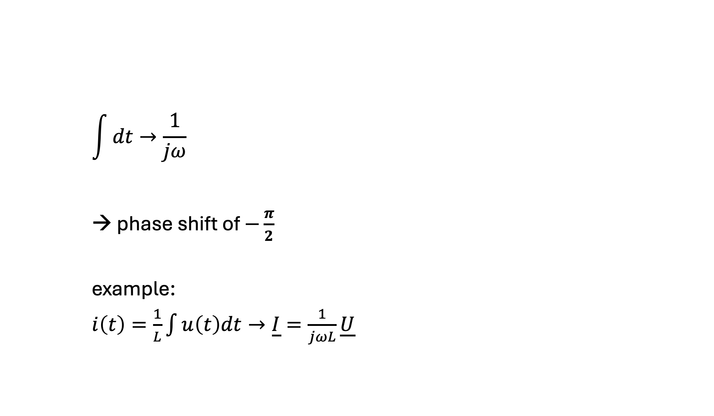
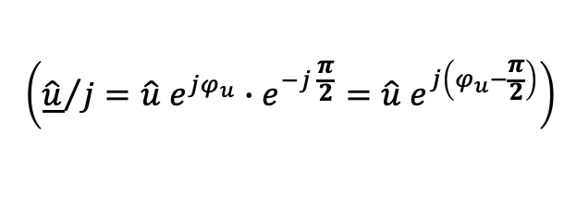
Integration in Phasor Domain
$$\int{dt}→\frac{1}{jω}$$
→ phase shift of $−\frac{π}{2}$
example:
$i\left(t\right)=\frac{1}{L}\int{u\left(t\right)dt}→\underline{I}=\frac{1}{jωL}\underline{U}$
$$\left(\int{e^{jωt}}ⅆt=e^{jωt}∙\frac{1}{jω}\right)$$
$$\left({\underline{\hat{u}}}/j=\hat{u} e^{jφ_{u}}∙e^{−j \frac{π}{2}}=\hat{u} e^{j\left(φ_{u}−\frac{π}{2}\right)}\right)$$

Slide 17
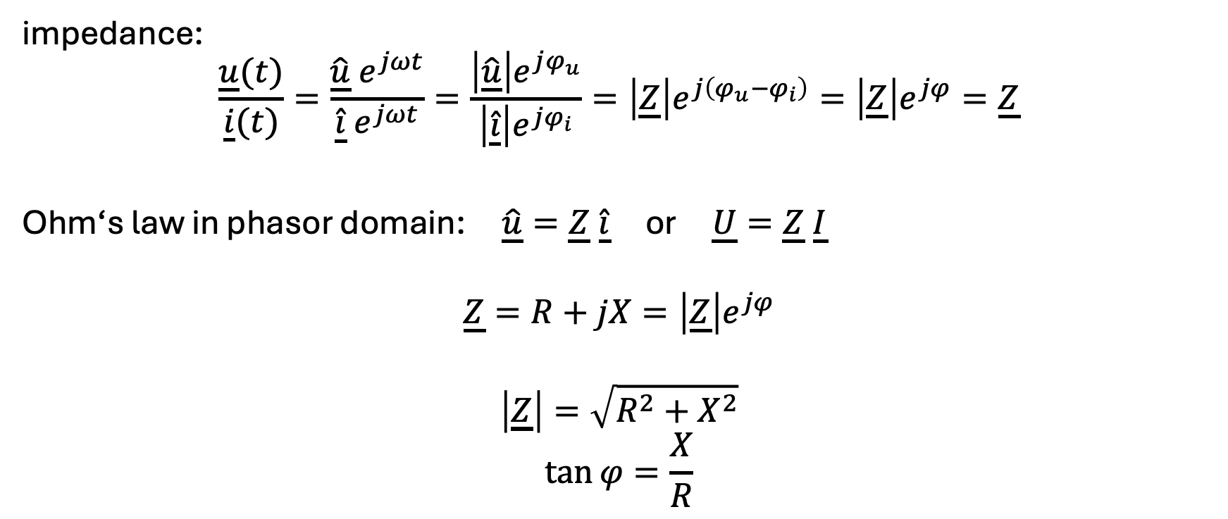
Complex Resistance
impedance:
$$\frac{\underline{u}(t)}{\underline{i}(t)}=\frac{\underline{\hat{u}} e^{jωt}}{\underline{\hat{i}}{ e}^{jωt}}=\frac{\left|\underline{\hat{u}}\right|e^{jφ_{u}}}{\left|\underline{\hat{i}}\right|e^{jφ_{i}}}=\left|\underline{Z}\right|e^{j\left(φ_{u}−φ_{i}\right)}=\left|\underline{Z}\right|e^{jφ}=\underline{Z}$$
Ohm‘s law in phasor domain: $\underline{\hat{u}}=\underline{Z} \underline{\hat{i}}$ or $\underline{U}=\underline{Z} \underline{I}$
$$\underline{Z}=R+jX=\left|\underline{Z}\right|e^{jφ}$$
$$\left|\underline{Z}\right|=\sqrt{R^{2}+X^{2}}$$
$$\tan{φ}=\frac{X}{R}$$
abstract quantity
impedance angle
resistance
modulus of impedance
(apparent impedance)
reactance

Slide 18
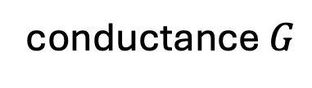

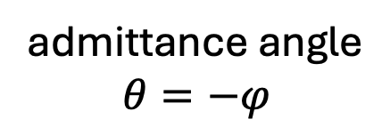
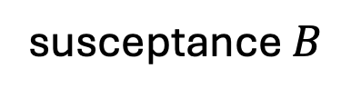
Complex Conductance
admittance:
$$\underline{Y}=\frac{1}{\underline{Z}}=\frac{1}{R+jX}=\frac{R}{R^{2}+X^{2}}+j\frac{−X}{R^{2}+X^{2}}$$
$$\underline{Y}=\frac{1}{\underline{Z}}=\frac{1}{\left|\underline{Z}\right|e^{jφ}}=\left|\underline{Y}\right|e^{−jφ}$$
abstract quantity
conductance $G$
susceptance $B$
admittance angle
$$θ=−φ$$
modulus of admittance
(apparent admittance)

Slide 19
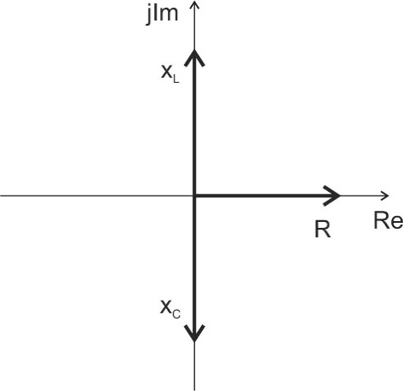
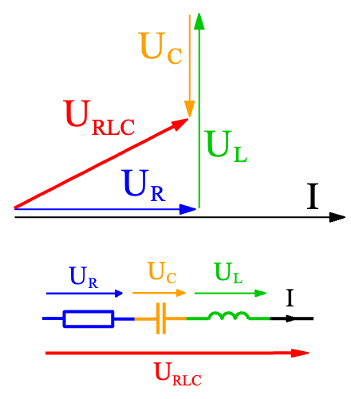
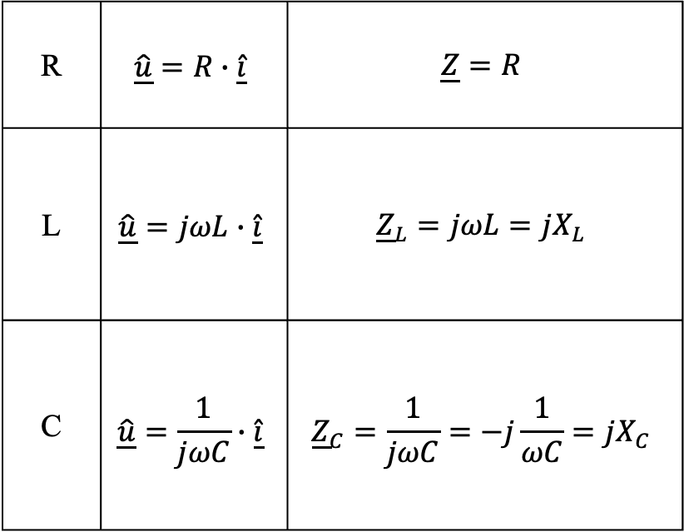
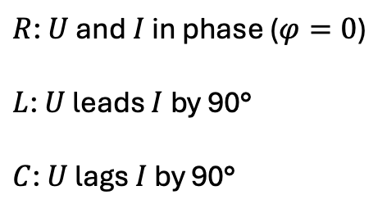
Linear Passive Components
must consider angles:
R | $$\underline{\hat{u}}=R∙\underline{\hat{i}}$$ | $$\underline{Z}=R$$
L | $$\underline{\hat{u}}=jωL∙\underline{\hat{i}}$$ | $${\underline{Z}}_{L}=jωL=jX_{L}$$
C | $$\underline{\hat{u}}=\frac{1}{jωC}∙\underline{\hat{i}}$$ | $${\underline{Z}}_{C}=\frac{1}{jωC}=−j\frac{1}{ωC}=jX_{C}$$
$R$: $U$ and $I$ in phase ($φ=0$)
$L$: $U$ leads $I$ by 90°
$C$: $U$ lags $I$ by 90°

Slide 20
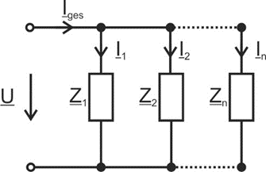
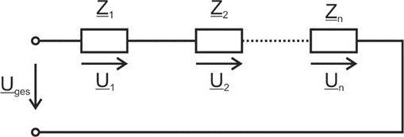
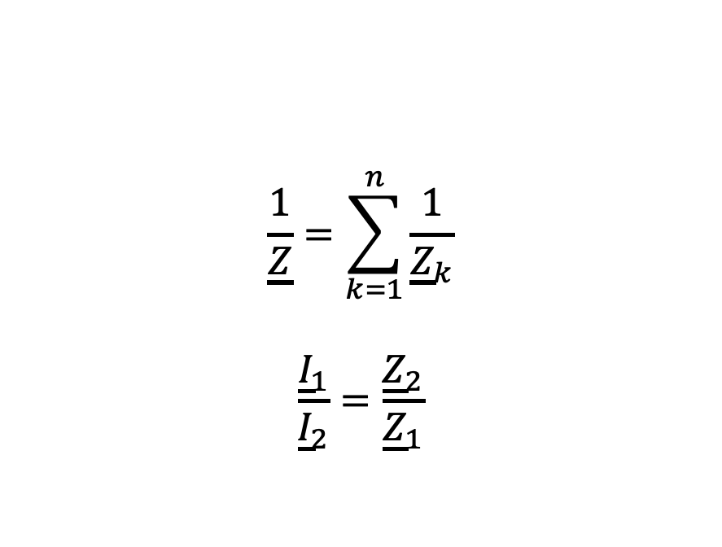
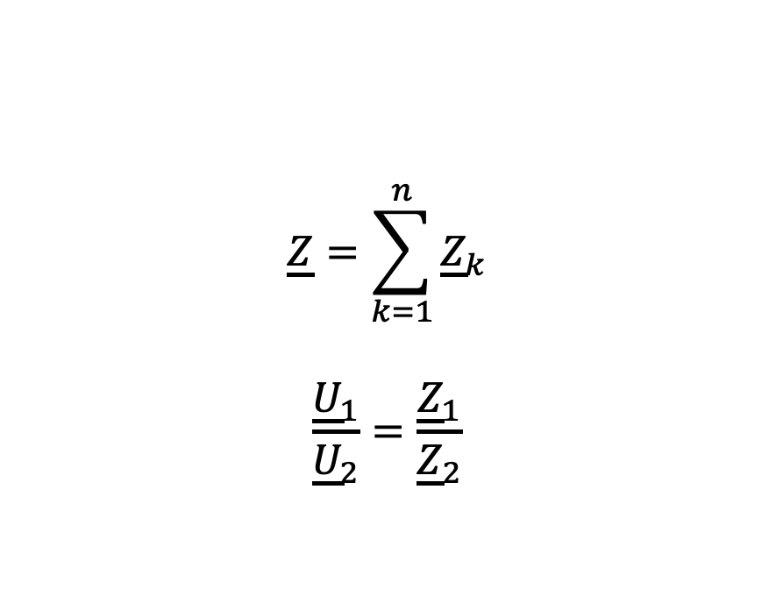
Network Analysis in Phasor Domain
$$\underline{Z}=\sum_{k=1}^{n}{{\underline{Z}}_{k}}$$
$$\frac{{\underline{U}}_{1}}{{\underline{U}}_{2}}=\frac{{\underline{Z}}_{1}}{{\underline{Z}}_{2}}$$
$$\frac{1}{\underline{Z}}=\sum_{k=1}^{n}{\frac{1}{{\underline{Z}}_{k}}}$$
$$\frac{{\underline{I}}_{1}}{{\underline{I}}_{2}}=\frac{{\underline{Z}}_{2}}{{\underline{Z}}_{1}}$$
KCL and KVL also valid for complex amplitudes and RMS values

Slide 21
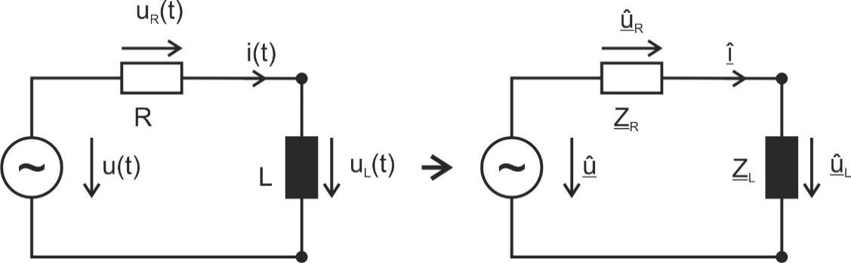

Example 1
The current through the circuit and the voltage across the coil are to be determined.
$$u\left(t\right)=\hat{u}\cos\left(ωt+φ_{u}\right) → \underline{\hat{u}}=\hat{u}e^{jφ_{u}}$$

Slide 22
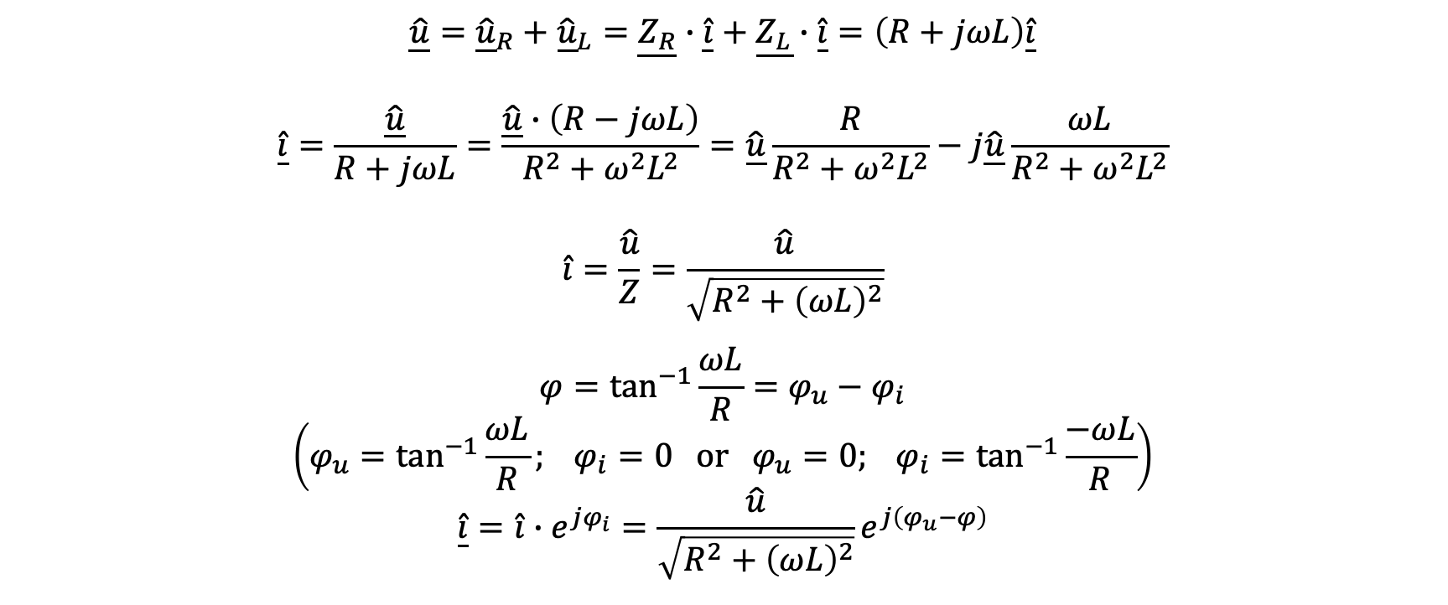
Example 1
$$\underline{\hat{u}}={\underline{\hat{u}}}_{R}+{\underline{\hat{u}}}_{L}=\underline{Z_{R}}∙\underline{\hat{i}}+\underline{Z_{L}}∙\underline{\hat{i}}=\left(R+jωL\right)\underline{\hat{i}}$$
$$\underline{\hat{i}}=\frac{\underline{\hat{u}}}{R+jωL}=\frac{\underline{\hat{u}}∙\left(R−jωL\right)}{R^{2}+ω^{2}L^{2}}=\underline{\hat{u}}\frac{R}{R^{2}+ω^{2}L^{2}}−j\underline{\hat{u}}\frac{ωL}{R^{2}+ω^{2}L^{2}}$$
$$\hat{i}=\frac{\hat{u}}{Z}=\frac{\hat{u}}{\sqrt{R^{2}+{\left(ωL\right)}^{2}}}$$
$$φ=\tan^{−1}{\frac{ωL}{R}}=φ_{u}−φ_{i}$$
$$\left(φ_{u}=\tan^{−1}{\frac{ωL}{R}}; φ_{i}=0 or φ_{u}=0; φ_{i}=\tan^{−1}{\frac{−ωL}{R}}\right)$$
$$\underline{\hat{i}}=\hat{i}∙e^{jφ_{i}}=\frac{\hat{u}}{\sqrt{R^{2}+{\left(ωL\right)}^{2}}}e^{j\left(φ_{u}−φ\right)}$$

Slide 23
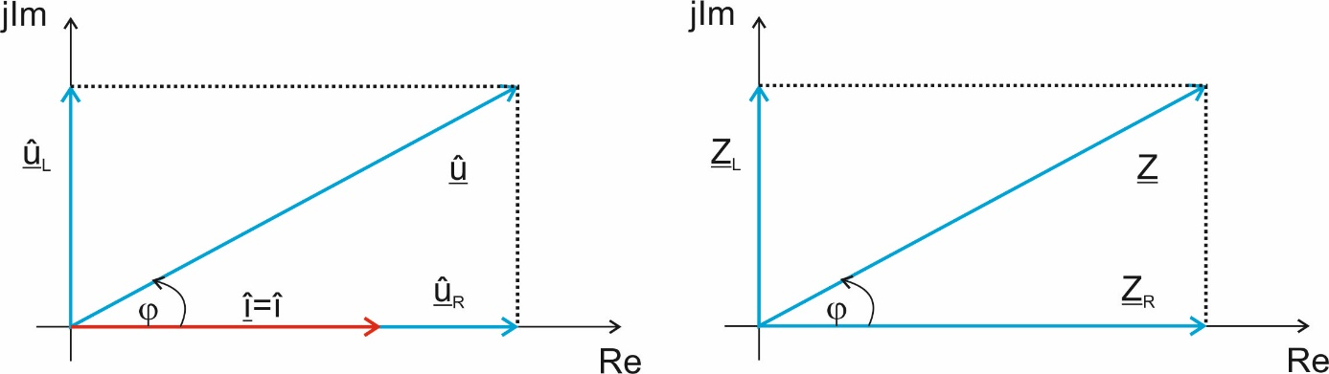
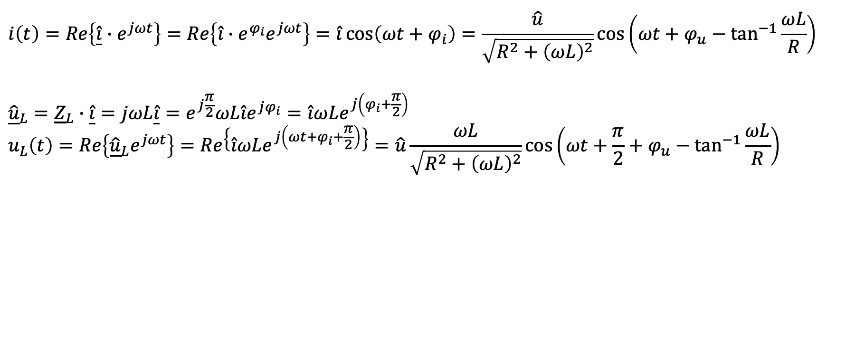
Example 1
$$i\left(t\right)=Re\left\{\underline{\hat{i}}{∙e}^{jωt}\right\}=Re\left\{{\hat{i}∙e^{φ_{i}}e}^{jωt}\right\}=\hat{i}\cos\left(ωt+φ_{i}\right)=\frac{\hat{u}}{\sqrt{R^{2}+{\left(ωL\right)}^{2}}}\cos\left(ωt+φ_{u}−\tan^{−1}{\frac{ωL}{R}}\right)$$
$${\underline{\hat{u}}}_{L}={\underline{Z}}_{L}∙\underline{\hat{i}}=jωL\underline{\hat{i}}=e^{j\frac{π}{2}}ωL\hat{i}e^{jφ_{i}}=\hat{i}ωLe^{j\left(φ_{i}+\frac{π}{2}\right)}$$
$$u_{L}\left(t\right)=Re\left\{{\underline{\hat{u}}}_{L}e^{jωt}\right\}=Re\left\{\hat{i}ωLe^{j\left(ωt+φ_{i}+\frac{π}{2}\right)}\right\}=\hat{u}\frac{ωL}{\sqrt{R^{2}+{\left(ωL\right)}^{2}}}\cos\left(ωt+\frac{π}{2}+φ_{u}−\tan^{−1}{\frac{ωL}{R}}\right)$$

Slide 24
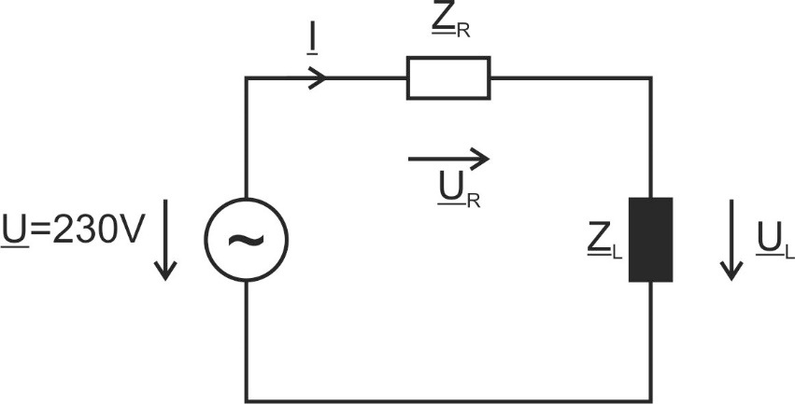
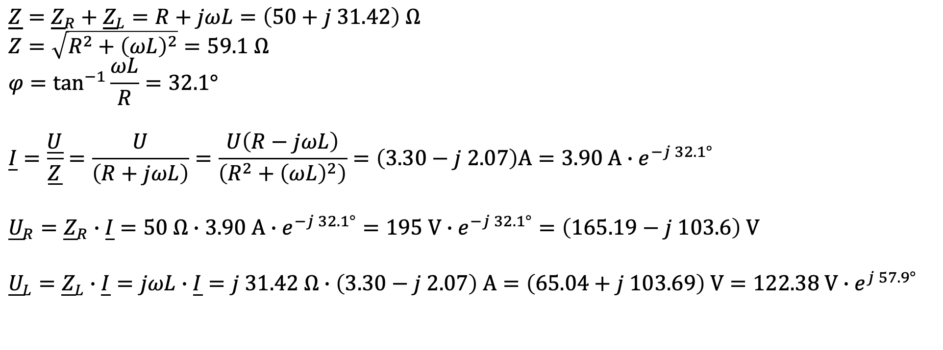



Example 2
$$R=50Ω$$
$$\underline{Z}={\underline{Z}}_{R}+{\underline{Z}}_{L}=R+jωL=\left(50+j 31.42\right) Ω$$
$$Z=\sqrt{R^{2}+{\left(ωL\right)}^{2}}=59.1 Ω$$
$$φ=\tan^{−1}{\frac{ωL}{R}}=32.1°$$
$$\underline{I}=\frac{\underline{U}}{\underline{Z}}=\frac{U}{\left(R+jωL\right)}=\frac{U\left(R−jωL\right)}{\left(R^{2}+{\left(ωL\right)}^{2}\right)}=\left(3.30−j 2.07\right)A=3.90 A{∙e}^{−j 32.1°}$$
$${\underline{U}}_{R}={\underline{Z}}_{R}∙\underline{I}=50 Ω∙3.90 A∙e^{−j 32.1°}=195 V∙e^{−j 32.1°}=\left(165.19−j 103.6\right) V$$
$${\underline{U}}_{L}={\underline{Z}}_{L}∙\underline{I}=jωL∙\underline{I}=j 31.42 Ω∙\left(3.30−j 2.07\right) A=\left(65.04+j 103.69\right) V=122.38 V∙e^{j 57.9°}$$
$$f=50 Hz$$
$$L=100 mH$$

Slide 25
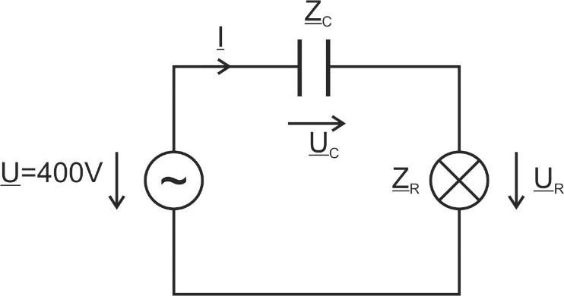
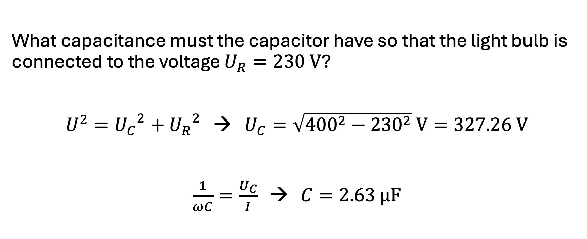
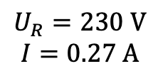

Example 3
$$f=50 Hz$$
$$U_{R}=230 V$$
$$I=0.27 A$$
What capacitance must the capacitor have so that the light bulb is connected to the voltage $U_{R}=230 V$?
$U^{2}={U_{C}}^{2}+{U_{R}}^{2}$ → $U_{C}=\sqrt{{400}^{2}−{230}^{2}} V=327.26 V$
$\frac{1}{ωC}=\frac{U_{C}}{I}$ → $C=2.63 μF$

Slide 26
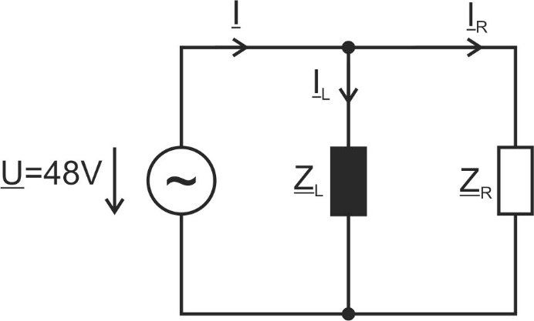
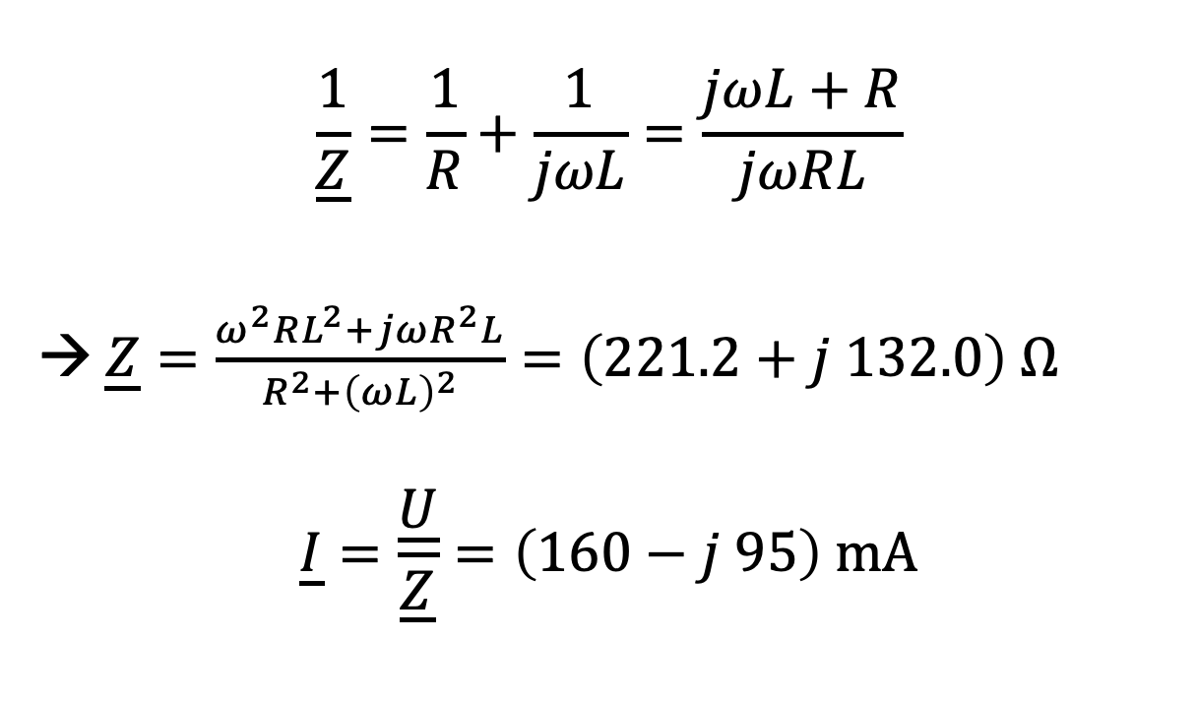



Example 4
$$\frac{1}{\underline{Z}}=\frac{1}{R}+\frac{1}{jωL}=\frac{jωL+R}{jωRL}$$
→ $\underline{Z}=\frac{ω^{2}RL^{2}+jωR^{2}L}{R^{2}+{\left(ωL\right)}^{2}}=\left(221.2+j 132.0\right) Ω$
$$\underline{I}=\frac{\underline{U}}{\underline{Z}}=\left(160−j 95\right) mA$$
$$R=300 Ω$$
$$f=800 Hz$$
$$L=100 mH$$

Slide 27
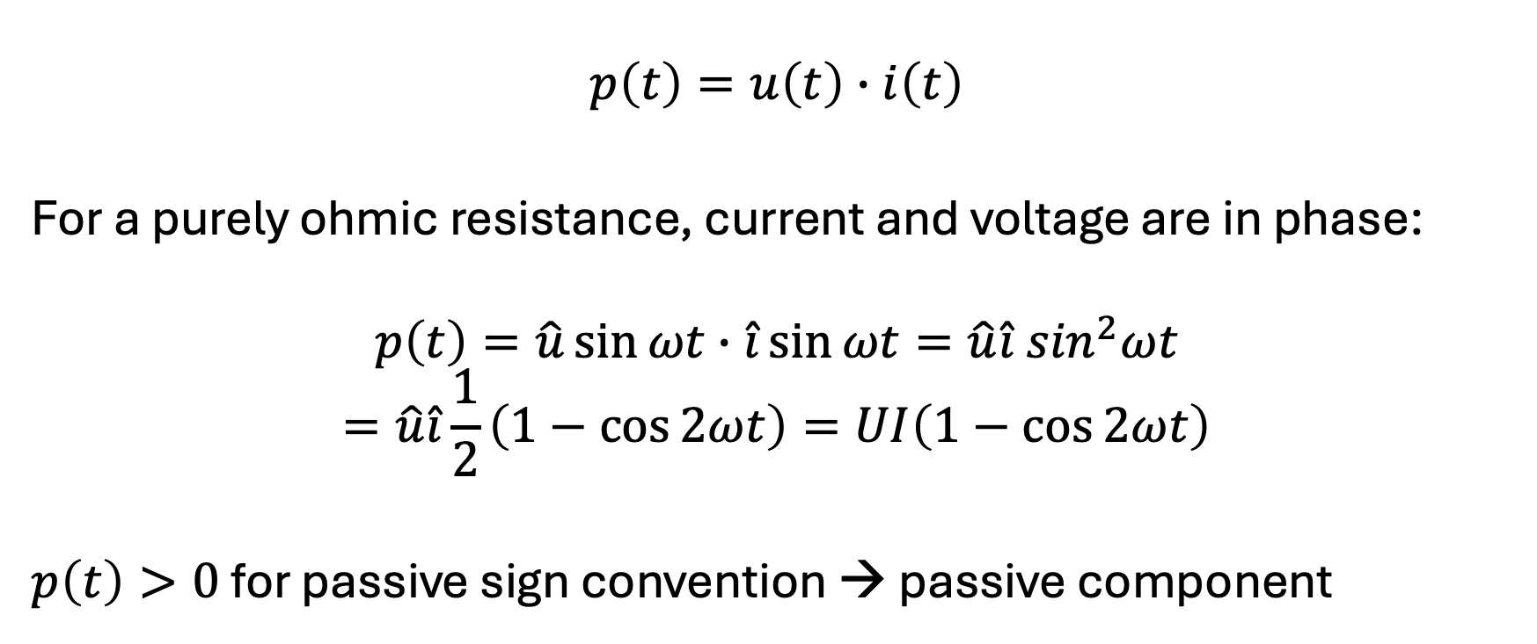
Instantaneous Power
$$p\left(t\right)=u\left(t\right)∙i\left(t\right)$$
For a purely ohmic resistance, current and voltage are in phase:
$$p\left(t\right)=\hat{u}\sin{ωt}∙\hat{i}\sin{ωt}=\hat{u}\hat{i}\sin^{2}ωt$$
$$=\hat{u}\hat{i}\frac{1}{2}\left(1−\cos{2ωt}\right)=UI\left(1−\cos{2ωt}\right)$$
$p\left(t\right)>0$ for passive sign convention → passive component

Slide 28

Average Power
area under power curve: electrical energy converted into heat in a resistor
average power (aka active power for resistance):
$$\overline{P}=\frac{1}{T}\int_{0}^{T}{p\left(t\right)dt}$$
$$=\frac{1}{T}\int_{0}^{T}{\frac{1}{2}\hat{u}\hat{i}\left(1−\cos{2ωt}\right)dt}={\left.\frac{1}{2}\hat{u}\hat{i}\frac{1}{T}\left(t−\frac{1}{2ω}sin{2ωt}\right)\right|}_{0}^{T}$$
$$=\frac{1}{2}\hat{u}\hat{i}\frac{1}{T}\left(T−\frac{1}{2ω}sin{2ωT}\right)=\frac{1}{2}\hat{u}\hat{i}\frac{1}{T}\left(T−\frac{1}{2ω}sin{2ω\frac{2π}{ω}}\right)=\frac{1}{2}\hat{u}\hat{i}=UI$$
resistance

Slide 29

Reactive Power
for reactance (capacitor or inductor): phase shift of $\frac{π}{2}$ between $u\left(t\right)$ and $i\left(t\right)$
$$p\left(t\right)=\hat{u}\sin{ωt}∙\hat{i}\sin\left(ωt+\frac{π}{2}\right)=\hat{u}\hat{i}\sin{ωt}\cos{ωt}=\hat{u}\hat{i}\frac{1}{2}\sin{2ωt}=UI\sin{2ωt}$$
$$\overline{P}=\frac{1}{T}\int_{0}^{T}{p\left(t\right)dt}=\frac{1}{T}\int_{0}^{T}{\frac{1}{2}\hat{u}\hat{i}\left(\sin{2ωt}\right)dt}={\left.\frac{1}{2}\hat{u}\hat{i}\frac{1}{T}\left(−\frac{1}{2ω}cos{2ωt}\right)\right|}_{0}^{T}$$
$$=\frac{1}{2}\hat{u}\hat{i}\frac{1}{T}\left(−\frac{1}{2ω}(cos{2ωT}+1)\right)=\frac{1}{2}\hat{u}\hat{i}\frac{1}{T}\left(−\frac{1}{2ω}(cos{4π}+1)\right)=0$$
→ not converted into heat or useful work

Slide 30

Apparent Power
mixed case for resistive-capacitive or resistive-inductive load:
$$p\left(t\right)=UI∙\cos{φ}∙\left(1−\cos{2ωt}\right)−UI∙\sin{φ\sin{2ωt}}$$
purely active for $φ=0$
purely reactive for $φ=\frac{π}{2}$ or $φ=−\frac{π}{2}$
average power: $P=UI∙\cos{φ}$
apparent power: $S=U∙I$
$$\left[S\right]=1 VA$$
electrical devices must be designed for the apparent power to be transmitted

Slide 31




Complex Power
$$φ$$
$$\underline{S}=\underline{U}∙{\underline{I}}^{∗}=Ue^{jφ_{u}}Ie^{{−jφ}_{i}}=Se^{j\left(φ_{u}−φ_{i}\right)}$$
$$\underline{S}=\underline{U}{\left(\frac{\underline{U}}{\underline{Z}}\right)}^{∗}=\underline{U}∙{\underline{U}}^{∗}\frac{1}{{\underline{Z}}^{∗}}=\frac{U^{2}}{{\underline{Z}}^{∗}}$$
$$\underline{S}=\frac{1}{2}\underline{\hat{u }}∙\underline{{\hat{i}}^{∗}}=P+jQ$$
with $S=\sqrt{P^{2}+Q^{2}}=U∙I$
active power
reactive power
$$φ=\tan^{−1}{\frac{Q}{P}}; \cos{φ}=\frac{P}{S}; \sin{φ}=\frac{Q}{S}$$
apparent power

Slide 32






Reactive Power Compensation
The absorption of inductive reactive power corresponds to the output of capacitive reactive power and vice versa: $φ={180}^{∘}$
→ can compensate each other (useful to avoid transmission losses)
$$I_{a}+jI_{r}$$
$$I_{a}$$
$$I_{a}+jI_{r}$$
resistive-inductive load
$$jI_{r}$$
can be compensated by capacitor

Slide 33

Example
A motor ($U=230 V$, $f=50 Hz$, $I=16 A$, $\cos{φ=0.8}$) is to be compensated using a capacitor.
without capacitor:
$I_{a}=I∙\cos{φ}=12.8 A$, $I_{r}=I∙\sin{φ}=−9.6 A$ $→\underline{I}=\left(12.8−j 9.6\right) A$
$\underline{S}=\underline{U}∙{\underline{I}}^{∗}=230 V∙\left(12.8+j 9.6\right) A$
$S=\sqrt{{2.944}^{2}+{2.208}^{2}} kVA=3.68 kVA$, $φ=\tan^{−1}{\frac{2.208}{2.944}}=36.87°$
reactive current needs to be compensated by capacitor:
$\frac{1}{ωC}=\frac{U}{I_{r}}$ $→C=133 μF$
$\underline{S}=\underline{U}∙{\underline{I}}^{∗}=230 V∙12.8 A=2.944 kVA=S$, $φ=0$

Slide 34


Frequency-Dependent Voltage Divider
$${\underline{U}}_{2}={\underline{U}}_{1}∙\frac{{\underline{Z}}_{2}}{{\underline{Z}}_{1}+{\underline{Z}}_{2}}={\underline{U}}_{1}∙\frac{jωL}{R+jωL}={\underline{U}}_{1}∙\frac{{\left(ωL\right)}^{2}−jωLR}{R^{2}+{\left(ωL\right)}^{2}}$$
$$U_{2}=U_{1}∙\sqrt{{\left(\frac{{\left(ωL\right)}^{2}}{R^{2}+{\left(ωL\right)}^{2}}\right)}^{2}+{\left(\frac{ωLR}{R^{2}+{\left(ωL\right)}^{2}}\right)}^{2}}=U_{1}∙\sqrt{\frac{{\left(ωL\right)}^{4}+{\left(ωLR\right)}^{2}}{{\left(R^{2}+{\left(ωL\right)}^{2}\right)}^{2}}}=U_{1}\frac{\sqrt{{\left(ωL\right)}^{2}\left({\left(ωL\right)}^{2}+R^{2}\right)}}{R^{2}+{\left(ωL\right)}^{2}}=U_{1}\frac{ωL}{\sqrt{R^{2}+{\left(ωL\right)}^{2}}}=U_{1}∙\frac{Z_{1}}{Z}$$

Slide 35



High-Pass RL Filter
$$U_{2}$$
$$U_{2}=U_{1}\frac{ωL}{\sqrt{R^{2}+{\left(ωL\right)}^{2}}}$$
$$f$$

Slide 36


Low-Pass RL Filter
$$U_{2}$$
$${U_{2}=U}_{1}\frac{R}{\sqrt{R^{2}+{\left(ωL\right)}^{2}}}$$
$$f$$

Slide 37

RC Filters
high-pass filter
low-pass filter
first-order filters: either a capacitor or an inductor

Slide 38


Series Resonant Circuit
damping
$$\underline{Z}=R+j\left(ωL−\frac{1}{ωC}\right)$$
resonance frequency $f_{0}$: inductive and capacitive reactances cancel each other out
$$ω_{0}L−\frac{1}{ω_{0}C}=0$$
$$→ω_{0}=2πf_{0}=\frac{1}{\sqrt{LC}}$$
$$\underline{Z}\left(ω_{0}\right)=R$$
forced oscillation

Slide 39






impedance minimal at resonance:
phase shift between source voltage and current:
inductive range
$$φ$$
$$X_{C}$$
$$X_{L}$$
$$\left|\underline{Z}\right|$$
capacitive range
ω₀
$$\text{ω}\text{0}$$
only $R$

Slide 40



Voltage Resonance
$$U_{L}=U\frac{ωL}{\sqrt{R^{2}+{\left(ωL−\frac{1}{ωC}\right)}^{2}}}$$
$$U_{C}=U\frac{1}{ωC\sqrt{R^{2}+{\left(ωL−\frac{1}{ωC}\right)}^{2}}}$$
for $ω_{0}$: $U_{L}=U_{C}=U\frac{1}{R}\sqrt{\frac{L}{C}}=U∙Q$
quality factor $Q=\frac{1}{R}\sqrt{\frac{L}{C}}$
can be $>1$
→ voltages across inductor and capacitor can be significantly larger than the source voltage (resonance catastrophe)
$${\underline{U}}_{L}={−\underline{U}}_{C}$$

Slide 41





phase shift of $180°$
maximum of $U_{L}$ slightly above ω₀
maximum of $U_{C}$ slightly below ω₀
$$U_{L}$$
$$U_{C}$$
$$U_{R}$$
ω₀
$U_{R}=U\frac{R}{\sqrt{R^{2}+{\left(ωL−\frac{1}{ωC}\right)}^{2}}}$ → maximum for ω=ω₀: $U_{R}=U$ (also maximum current)

Slide 42





Voltage Maxima
$$Q=\frac{1}{R}\sqrt{\frac{L}{C}}$$
$$ω_{0}=\frac{1}{\sqrt{LC}}$$
$\frac{dU_{L}}{dω_{L}}=0$ → $ω_{L}=\sqrt{\frac{2}{2LC−R^{2}C^{2}}}=\sqrt{\frac{2}{2LC−\frac{LC}{Q^{2}}}}=ω_{0}\frac{1}{\sqrt{1−\frac{1}{2Q^{2}}}}$
$\frac{dU_{C}}{dω_{C}}=0$ → $ω_{C}=\sqrt{\frac{1}{LC}−\frac{R^{2}}{2L^{2}}}=ω_{0}\sqrt{1−\frac{1}{2Q^{2}}}$
→ no maxima for $Q≤\frac{1}{\sqrt{2}}$
resonance behavior more pronounced the higher $Q$

Slide 43



Parallel Resonant Circuit
$$\underline{Y}=G+j\left(ωC−\frac{1}{ωL}\right)$$
$$ω_{0}C−\frac{1}{ω_{0}L}=0$$
$$→ω_{0}=2πf_{0}=\frac{1}{\sqrt{LC}}$$
$$\underline{Y}\left(ω_{0}\right)=G$$
admittance minimal at resonance (impedance maximal) → total current minimal (${\underline{I}}_{L}={−\underline{I}}_{C}$)
below $ω_{0}$: determined by inductance
above $ω_{0}$: determined by capacitance

Slide 44


Current Resonance
$$I_{R}=I\frac{G}{\sqrt{G^{2}+{\left(ωC−\frac{1}{ωL}\right)}^{2}}}$$
$$I_{L}=I\frac{1}{ωL\sqrt{G^{2}+{\left(ωC−\frac{1}{ωL}\right)}^{2}}}$$
$$I_{C}=I\frac{ωC}{\sqrt{G^{2}+{\left(ωC−\frac{1}{ωL}\right)}^{2}}}$$
resonance:
$$I_{R}=I=\frac{U}{R}$$
$$I_{L}=I_{C}=IR\sqrt{\frac{C}{L}}=I∙Q$$
→ current through inductor and capacitor can be larger than the source current

Slide 45

Current Maxima
$\frac{dI_{L}}{dω_{L}}=0$ → $ω_{L}=ω_{0}\sqrt{1−\frac{1}{2Q^{2}}}$
$\frac{dI_{C}}{dω_{C}}=0$ → $ω_{C}=ω_{0}\frac{1}{\sqrt{1−\frac{1}{2Q^{2}}}}$
→ again, no maxima for $Q≤\frac{1}{\sqrt{2}}$

Slide 46


Second-Order Filters
acceptor circuit:
admittance peak at resonance
rejector circuit:
impedance peak at resonance
load
load

