Slide 1

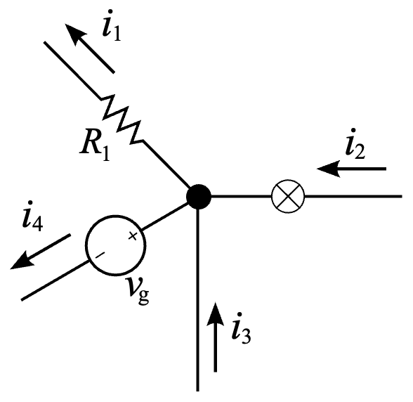
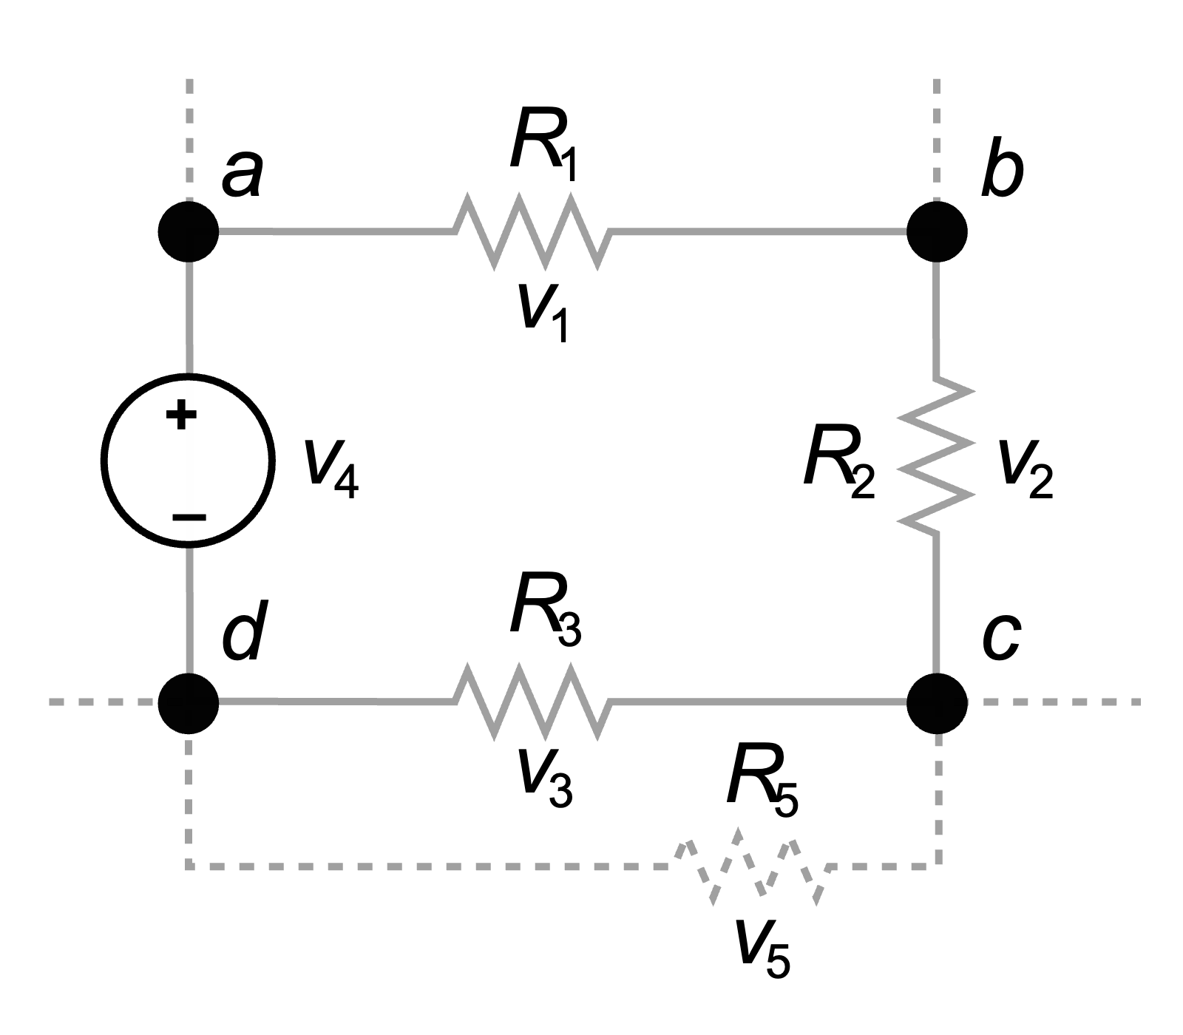
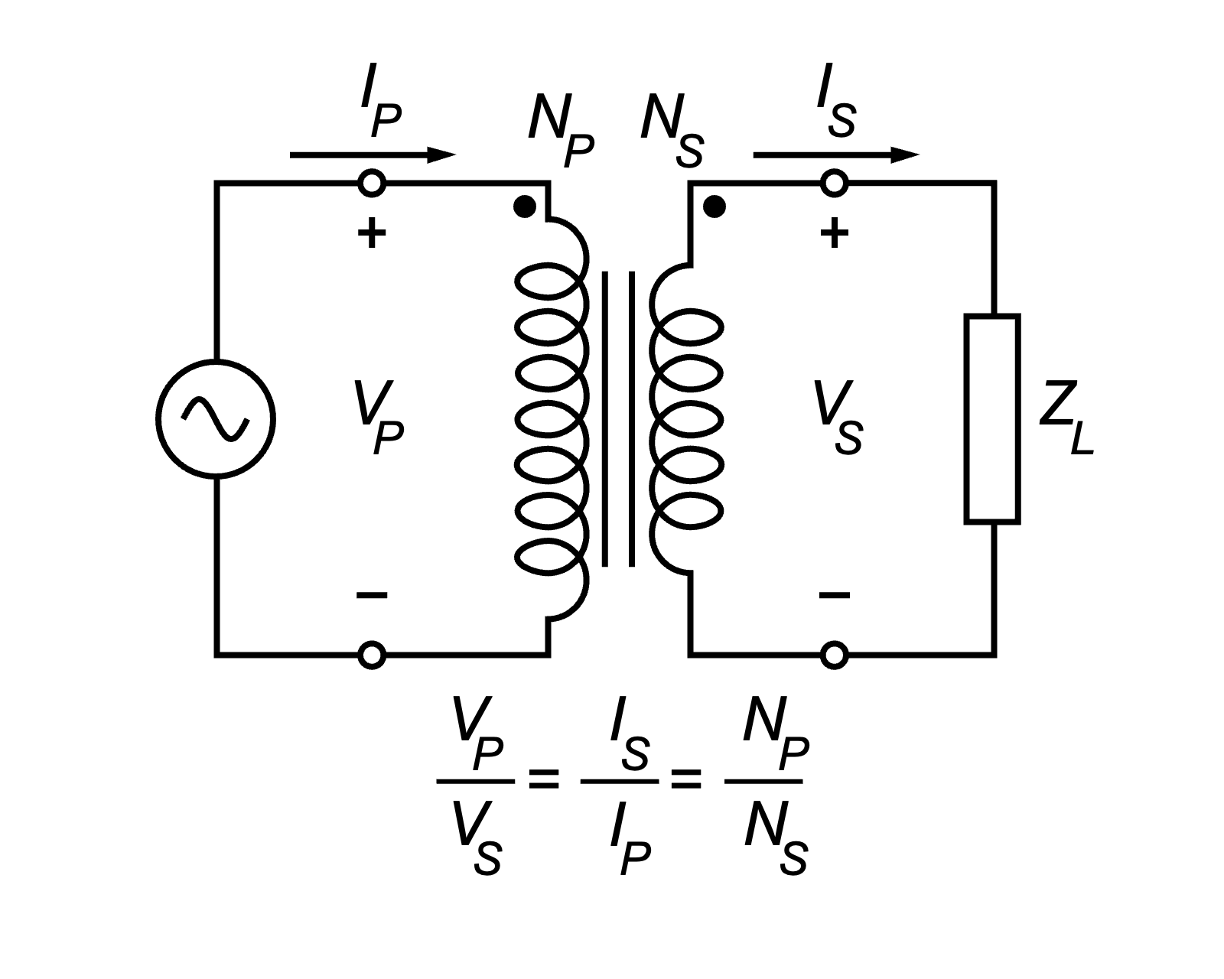
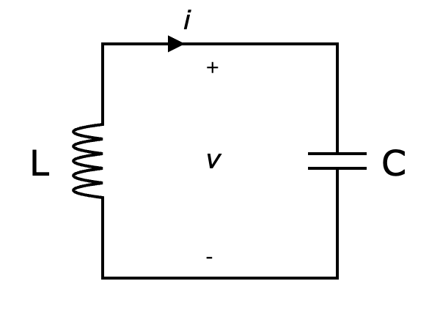
Introduction to Electrical Engineering

Slide 2
Overview
Physical Principles and Basic Concepts
Direct Current Circuits
Electric and Magnetic Fields
Alternating Current Technology
Wrap-Up and Outlook

Slide 3
Alternating Current Technology
Sinusoidal Waveform
Phasor Representation
Network Analysis in Phasor Domain
AC Power
High- & Low-Pass Filters
Resonant Circuits
Three-Phase Circuits

Slide 4
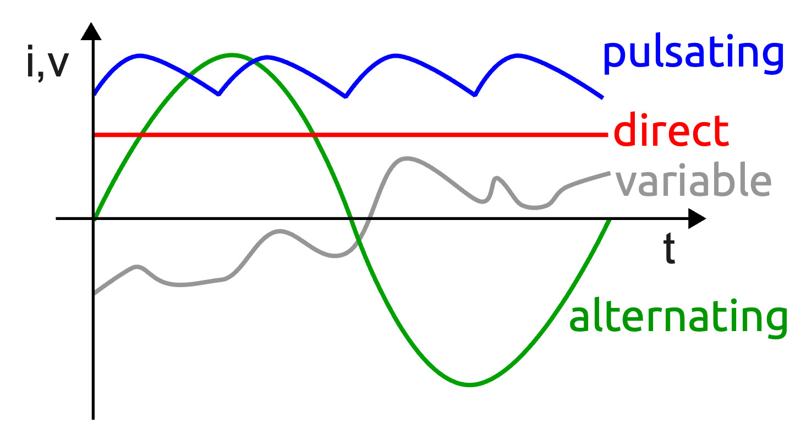
Alternating Current (AC)
periodically reverses direction and changes its magnitude continuously with time

Slide 5
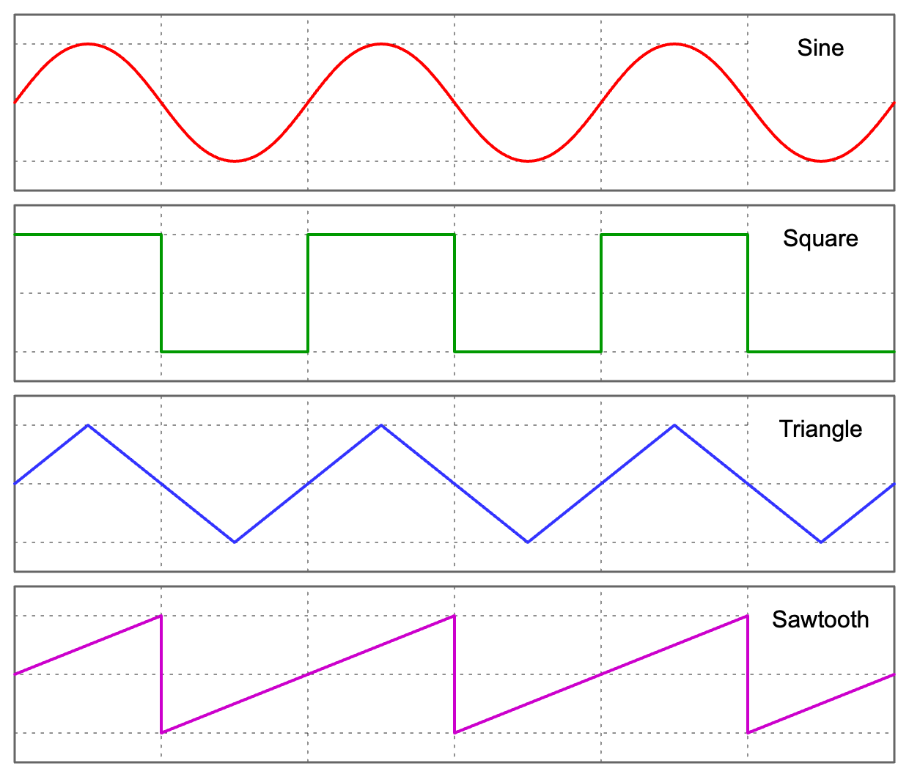
AC Waveforms

Slide 6
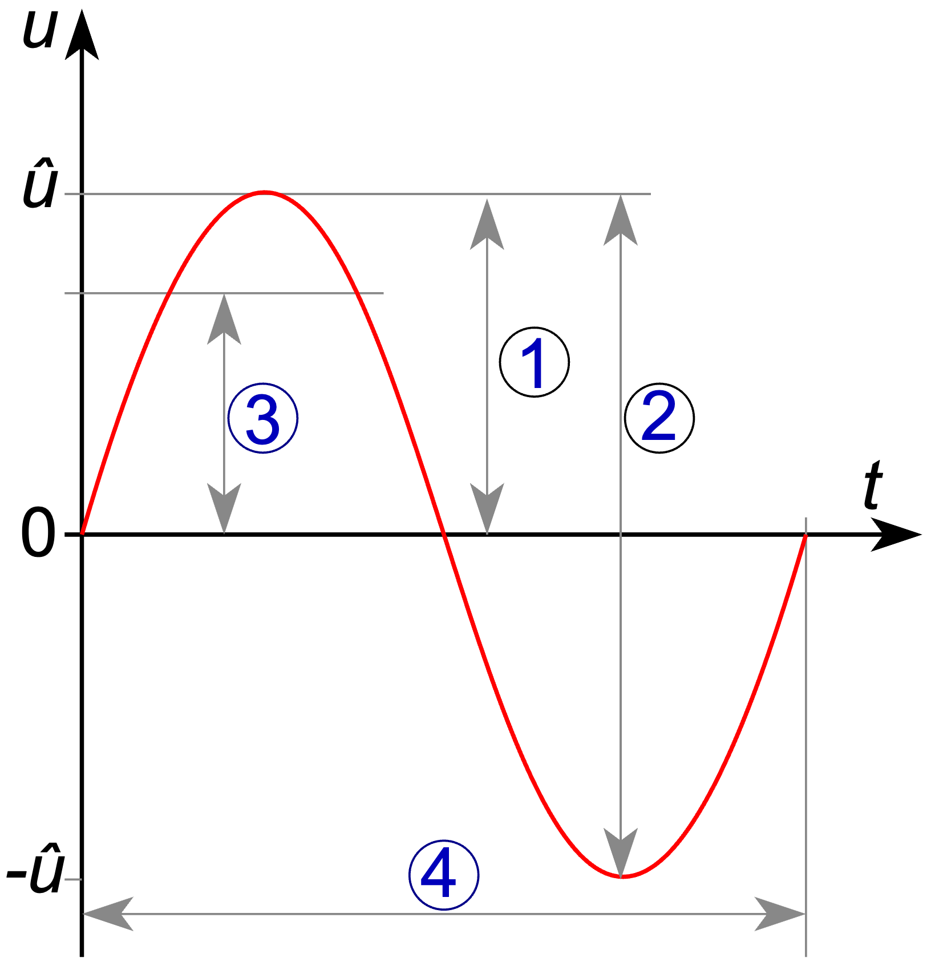
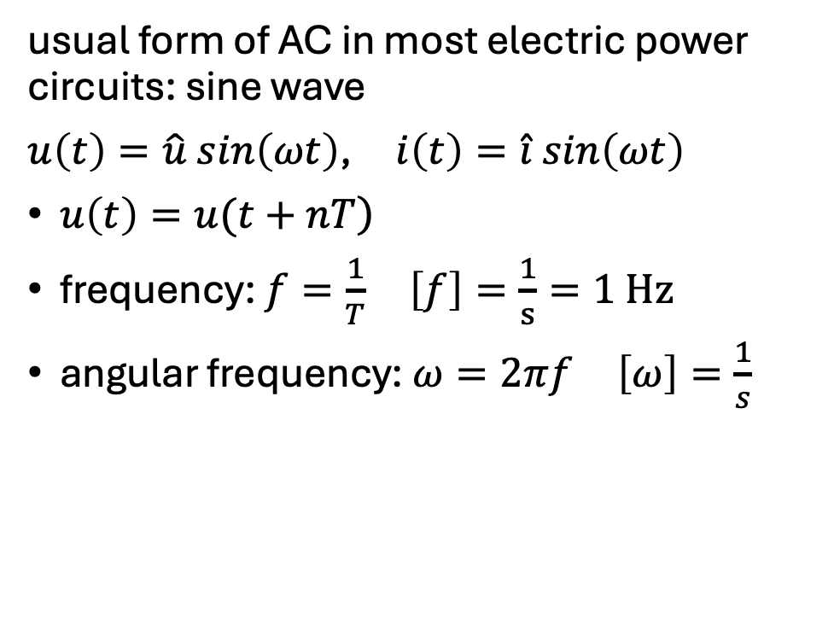
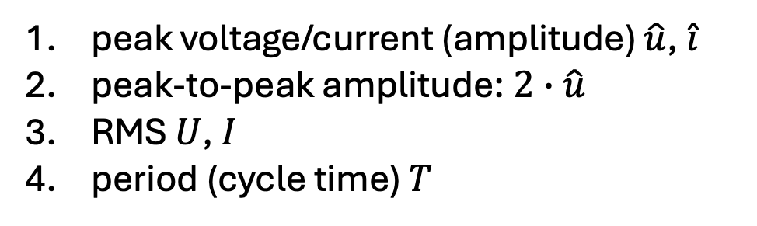
Sinusoidal AC
usual form of AC in most electric power circuits: sine wave
$u\left(t\right)=\hat{u} sin\left(ωt\right)$, $i\left(t\right)=\hat{i} sin\left(ωt\right)$
$\left.u\left(t\right)=u(t+nT\right)$
frequency: $f=\frac{1}{T}$ $\left[f\right]=\frac{1}{s}=1 Hz$
angular frequency: $ω=2πf$ $\left[ω\right]=\frac{1}{s}$
peak voltage/current (amplitude) $\hat{u}$, $\hat{i}$
peak-to-peak amplitude: $2∙\hat{u}$
RMS $U$, $I$
period (cycle time) $T$

Slide 7
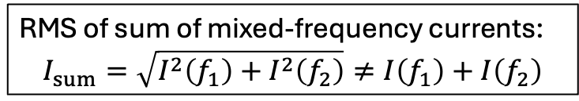
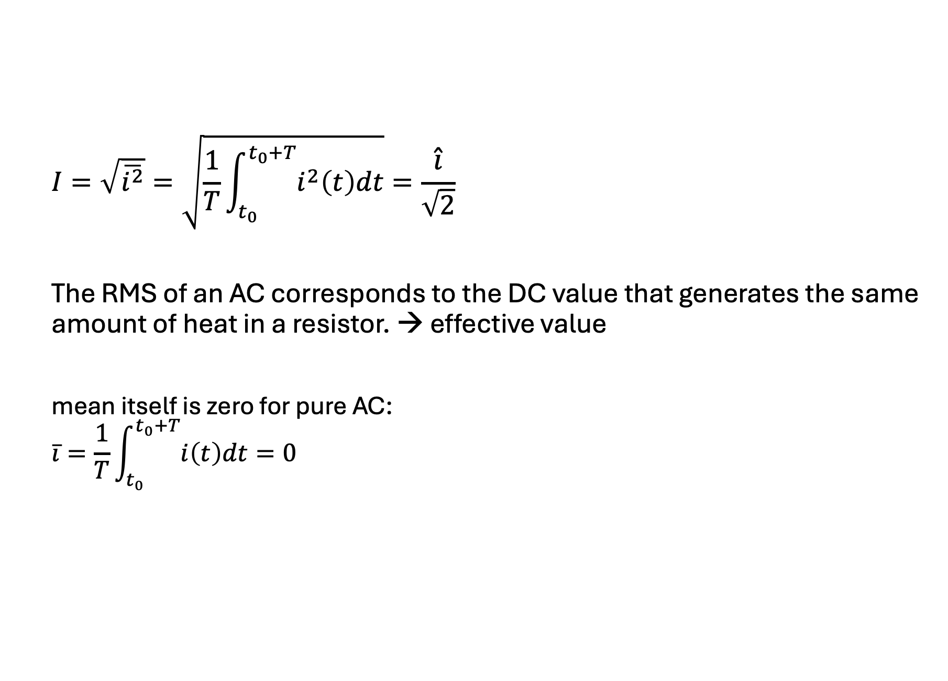
Root Mean Square (RMS)
$$I=\sqrt{\overline{i^{2}}}=\sqrt{\frac{1}{T}\int_{t_{0}}^{t_{0}+T}{i^{2}\left(t\right)dt}}=\frac{\hat{i}}{\sqrt{2}}$$
The RMS of an AC corresponds to the DC value that generates the same amount of heat in a resistor. → effective value
mean itself is zero for pure AC:
$$\overline{i}=\frac{1}{T}\int_{t_{0}}^{t_{0}+T}{i\left(t\right)dt=0}$$
RMS of sum of mixed-frequency currents:
$$I_{sum}=\sqrt{I^{2}\left(f_{1}\right)+I^{2}\left(f_{2}\right)}≠I\left(f_{1}\right)+I\left(f_{2}\right)$$

Slide 8

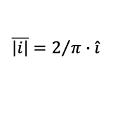
$$\left|i\right|$$
$$\overline{\left|i\right|}=2/π∙\hat{i}$$
sine
squared
RMS

Slide 9

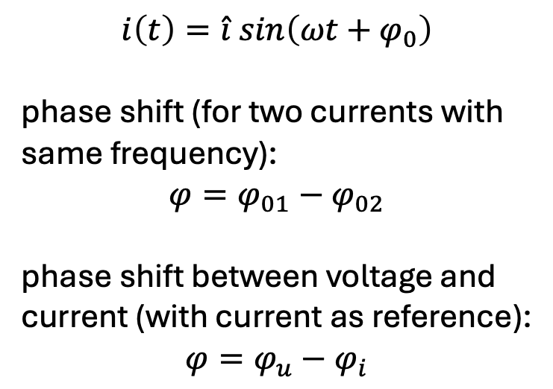
Phase Shift
$$i\left(t\right)=\hat{i} sin\left(ωt+φ_{0}\right)$$
phase shift (for two currents with same frequency):
$$φ=φ_{01}−φ_{02}$$
phase shift between voltage and current (with current as reference):
$$φ=φ_{u}−φ_{i}$$
ωt
$$φ=φ_{u}−φ_{i}=30°−\left(−30°\right)=60°$$
In this example, the current lags behind the voltage.

Slide 10
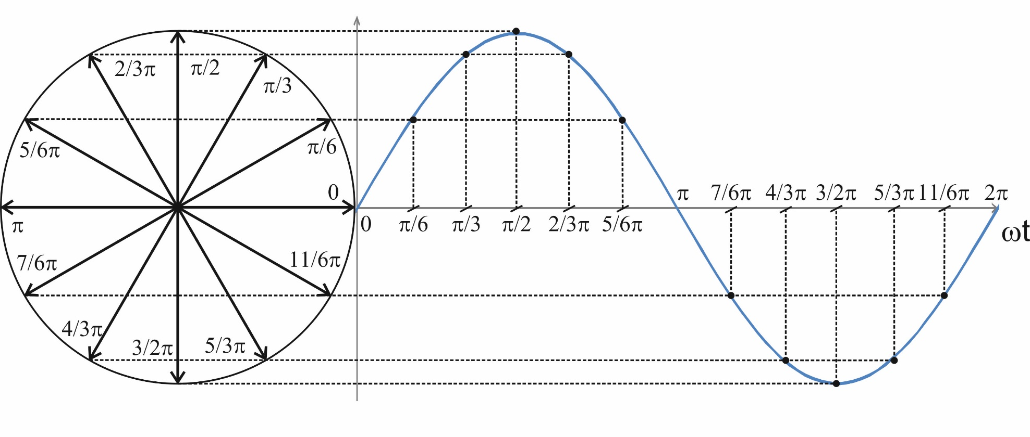
Phasor Representation
phasor diagram:
addition:
U
U₂
U₂
U₁
subtraction:
U₂
U₁
-U₂
phasor calculations only work for quantities with same frequency
→ freeze rotation in time to get stationary phasors
U

Slide 11
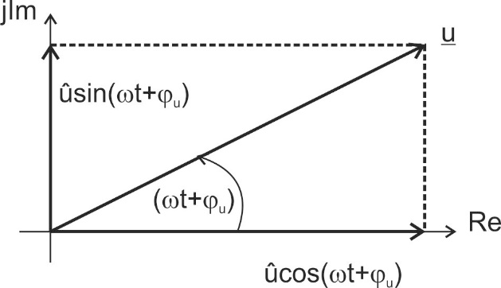

Use of Complex Numbers
$$u\left(t\right)=\hat{u}\cos\left(ωt+φ_{u}\right)=\hat{u}\sin\left(ωt+φ_{u}+\frac{π}{2}\right)=U∙\sqrt{2}\sin\left(ωt+φ_{u}+\frac{π}{2}\right)$$
phasors can be represented by complex numbers:
$$\underline{u}\left(t\right)=Re \left\{\underline{u}(t)\right\}+j Im\left\{\underline{u}(t)\right\}=\hat{u}\cos\left(ωt+φ_{u}\right)+j \hat{u}\sin\left(ωt+φ_{u}\right)$$

Slide 12
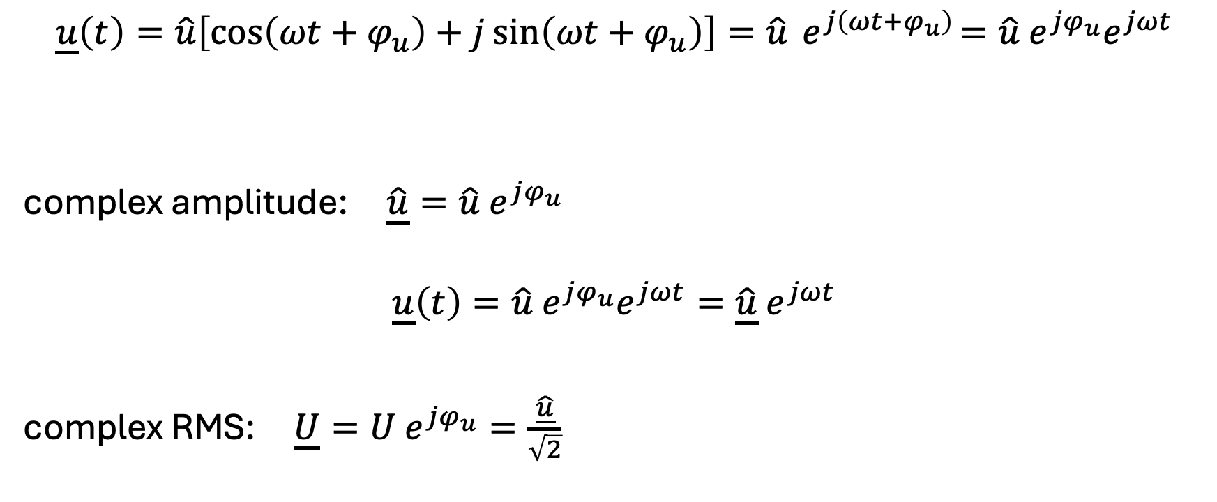
Complex Amplitude
$$\underline{u}\left(t\right)=\hat{u}\left[\cos\left(ωt+φ_{u}\right)+j\sin\left(ωt+φ_{u}\right)\right]=\hat{u}{ e}^{j\left(ωt+φ_{u}\right)}=\hat{u}{ e}^{jφ_{u}}e^{jωt}$$
complex amplitude: $\underline{\hat{u}}=\hat{u} e^{jφ_{u}}$
$$\underline{u}\left(t\right)=\hat{u}{ e}^{jφ_{u}}e^{jωt}=\underline{\hat{u}}{ e}^{jωt}$$
complex RMS: $\underline{U}=U e^{jφ_{u}}=\frac{\underline{\hat{u}}}{\sqrt{2}}$
complex
can be ignored if all quantities have the same frequency
→ stationary phasors

Slide 13
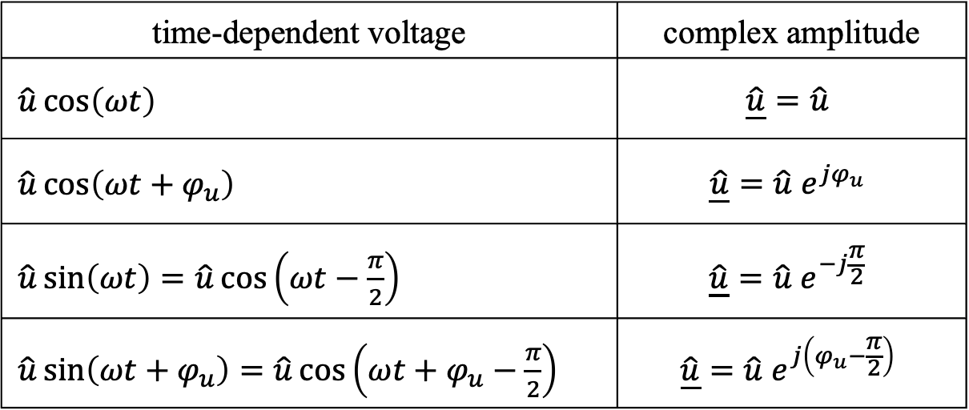
Transformation into Phasor Domain
time-dependent voltage | complex amplitude
$\hat{u}\cos\left(ωt\right)$ | $$\underline{\hat{u}}=\hat{u}$$
$\hat{u}\cos\left(ωt+φ_{u}\right)$ | $$\underline{\hat{u}}=\hat{u} e^{jφ_{u}}$$
$\hat{u}\sin\left(ωt\right)=\hat{u}\cos\left(ωt−\frac{π}{2}\right)$ | $$\underline{\hat{u}}=\hat{u} e^{−j\frac{π}{2}}$$
$\hat{u}\sin\left(ωt+φ_{u}\right)=\hat{u}\cos\left(ωt+φ_{u}−\frac{π}{2}\right)$ | $$\underline{\hat{u}}=\hat{u} e^{j\left(φ_{u}−\frac{π}{2}\right)}$$
$$\underline{\hat{u}}=\hat{u}\left(\cos{φ_{u}}+j\sin{φ_{u}}\right)=Re+jIm$$

Slide 14
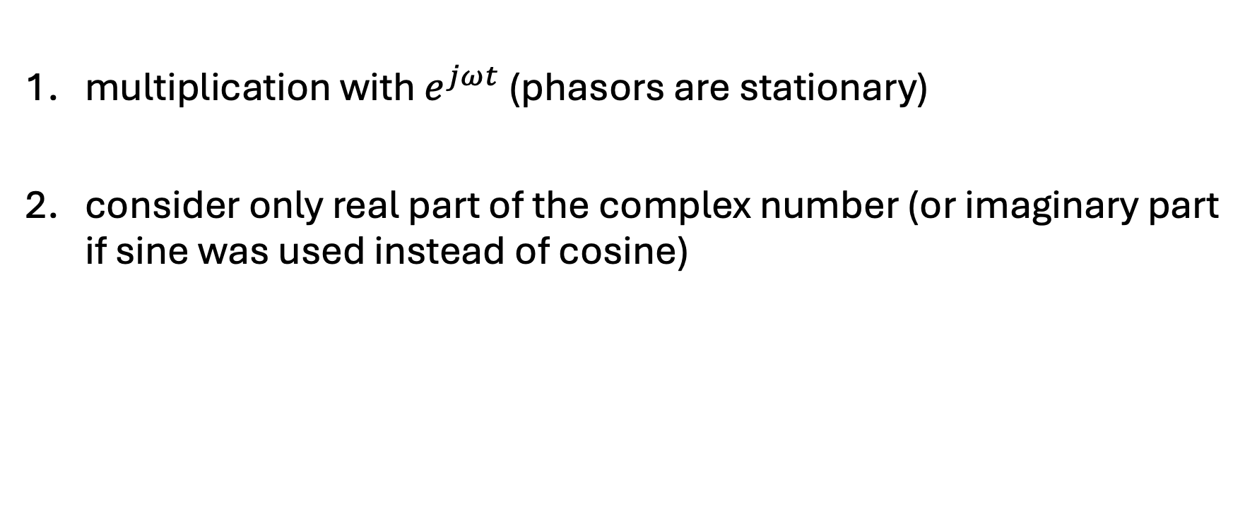
Back Transformation into Time Domain
multiplication with $e^{jωt}$ (phasors are stationary)
consider only real part of the complex number (or imaginary part if sine was used instead of cosine)

Slide 15
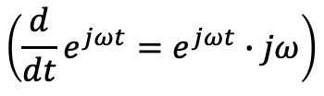


Derivation in Phasor Domain
$$\frac{d}{dt}→jω$$
→ phase shift of $\frac{π}{2}$
example:
$$u\left(t\right)=L\frac{di}{dt}→\underline{U}=jωL\underline{I}$$
$$\left({\frac{d}{dt}e}^{jωt}=e^{jωt}∙jω\right)$$
$$\left(\underline{\hat{u}}∙j=\hat{u} e^{jφ_{u}}∙e^{j \frac{π}{2}}=\hat{u} e^{j\left(φ_{u}+\frac{π}{2}\right)}\right)$$

Slide 16
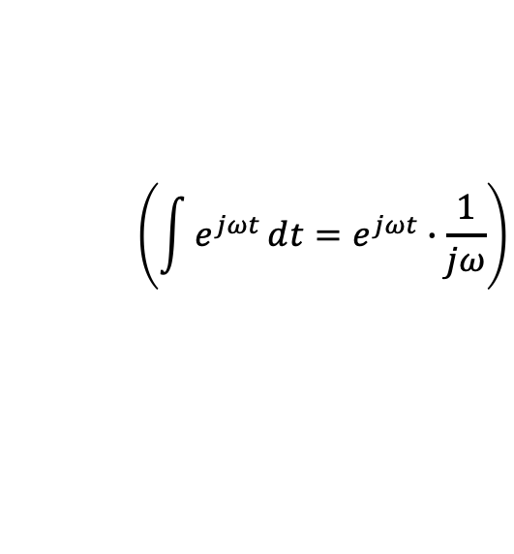
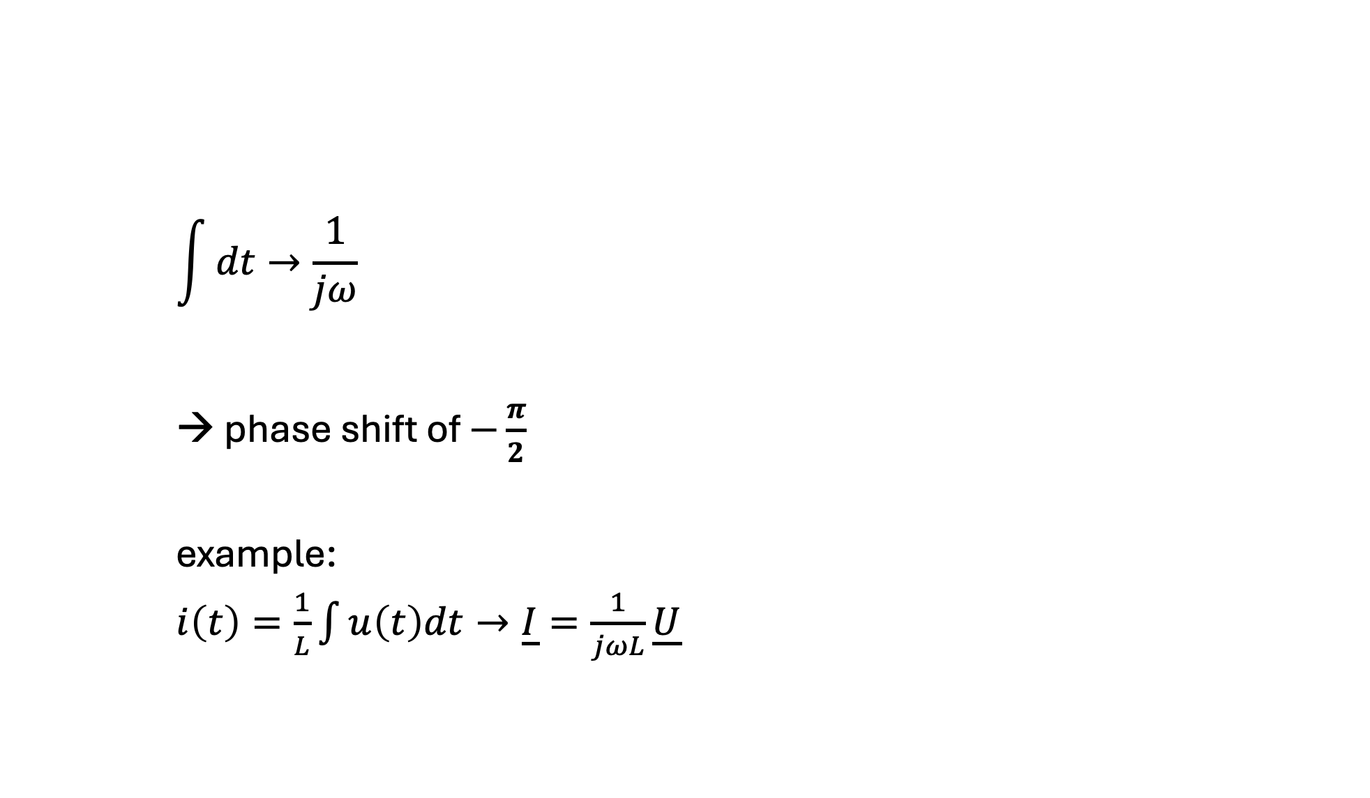
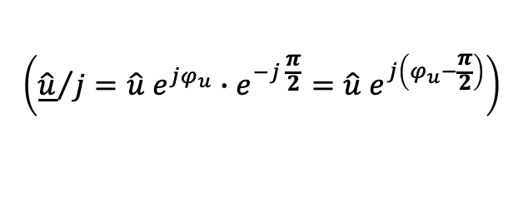
Integration in Phasor Domain
$$\int{dt}→\frac{1}{jω}$$
→ phase shift of $−\frac{π}{2}$
example:
$i\left(t\right)=\frac{1}{L}\int{u\left(t\right)dt}→\underline{I}=\frac{1}{jωL}\underline{U}$
$$\left(\int{e^{jωt}}ⅆt=e^{jωt}∙\frac{1}{jω}\right)$$
$$\left({\underline{\hat{u}}}/j=\hat{u} e^{jφ_{u}}∙e^{−j \frac{π}{2}}=\hat{u} e^{j\left(φ_{u}−\frac{π}{2}\right)}\right)$$

Slide 17
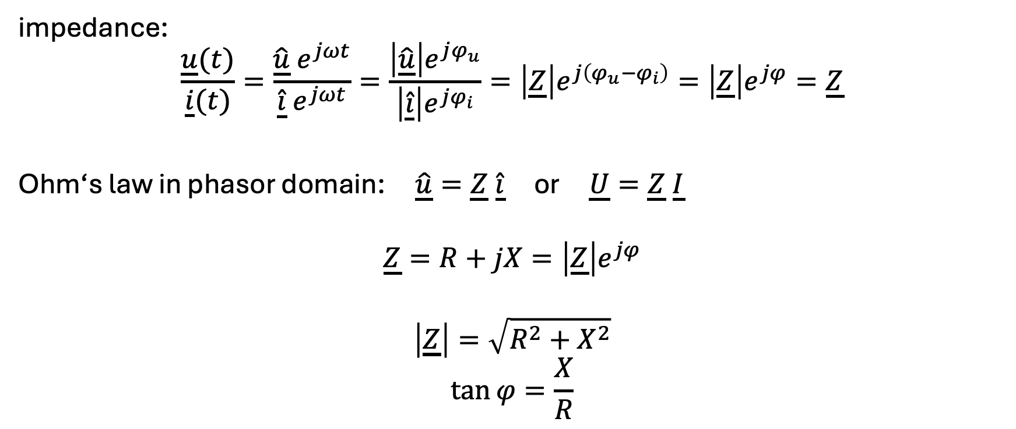
Complex Resistance
impedance:
$$\frac{\underline{u}(t)}{\underline{i}(t)}=\frac{\underline{\hat{u}} e^{jωt}}{\underline{\hat{i}}{ e}^{jωt}}=\frac{\left|\underline{\hat{u}}\right|e^{jφ_{u}}}{\left|\underline{\hat{i}}\right|e^{jφ_{i}}}=\left|\underline{Z}\right|e^{j\left(φ_{u}−φ_{i}\right)}=\left|\underline{Z}\right|e^{jφ}=\underline{Z}$$
Ohm‘s law in phasor domain: $\underline{\hat{u}}=\underline{Z} \underline{\hat{i}}$ or $\underline{U}=\underline{Z} \underline{I}$
$$\underline{Z}=R+jX=\left|\underline{Z}\right|e^{jφ}$$
$$\left|\underline{Z}\right|=\sqrt{R^{2}+X^{2}}$$
$$\tan{φ}=\frac{X}{R}$$
abstract quantity
impedance angle
resistance
modulus of impedance
(apparent impedance)
reactance

Slide 18
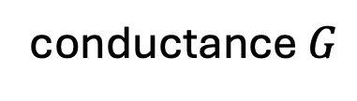

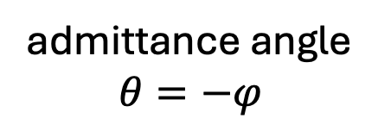
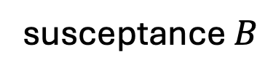
Complex Conductance
admittance:
$$\underline{Y}=\frac{1}{\underline{Z}}=\frac{1}{R+jX}=\frac{R}{R^{2}+X^{2}}+j\frac{−X}{R^{2}+X^{2}}$$
$$\underline{Y}=\frac{1}{\underline{Z}}=\frac{1}{\left|\underline{Z}\right|e^{jφ}}=\left|\underline{Y}\right|e^{−jφ}$$
abstract quantity
conductance $G$
susceptance $B$
admittance angle
$$θ=−φ$$
modulus of admittance
(apparent admittance)

Slide 19
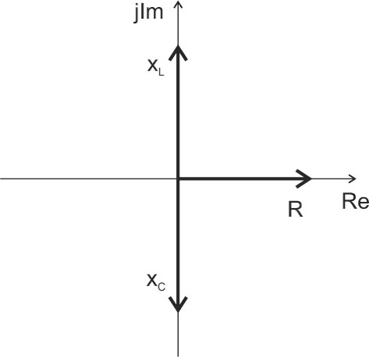
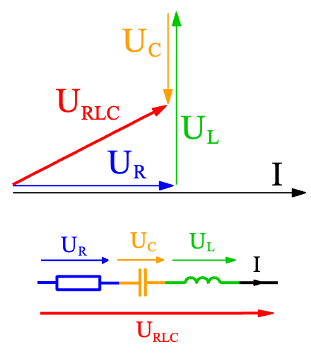
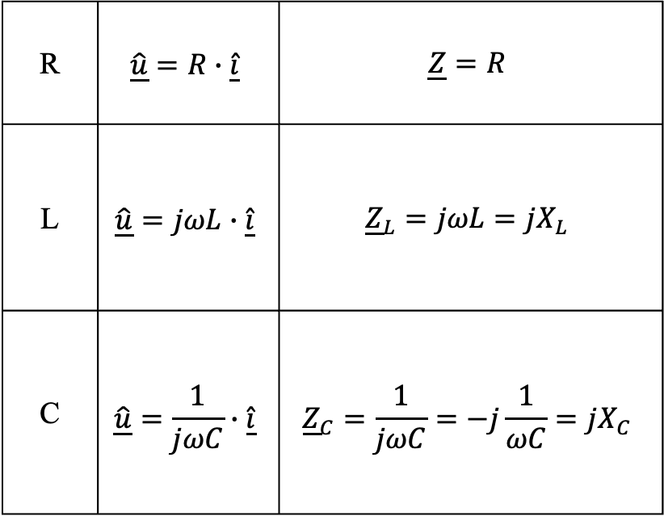
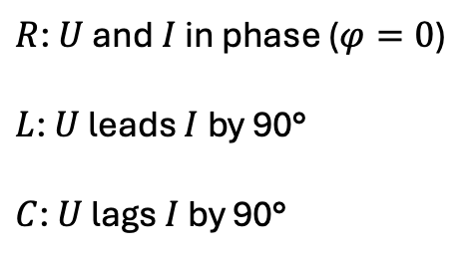
Linear Passive Components
must consider angles:
R | $$\underline{\hat{u}}=R∙\underline{\hat{i}}$$ | $$\underline{Z}=R$$
L | $$\underline{\hat{u}}=jωL∙\underline{\hat{i}}$$ | $${\underline{Z}}_{L}=jωL=jX_{L}$$
C | $$\underline{\hat{u}}=\frac{1}{jωC}∙\underline{\hat{i}}$$ | $${\underline{Z}}_{C}=\frac{1}{jωC}=−j\frac{1}{ωC}=jX_{C}$$
$R$: $U$ and $I$ in phase ($φ=0$)
$L$: $U$ leads $I$ by 90°
$C$: $U$ lags $I$ by 90°

Slide 20
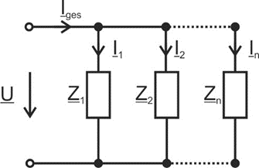
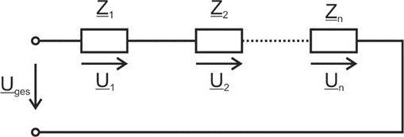
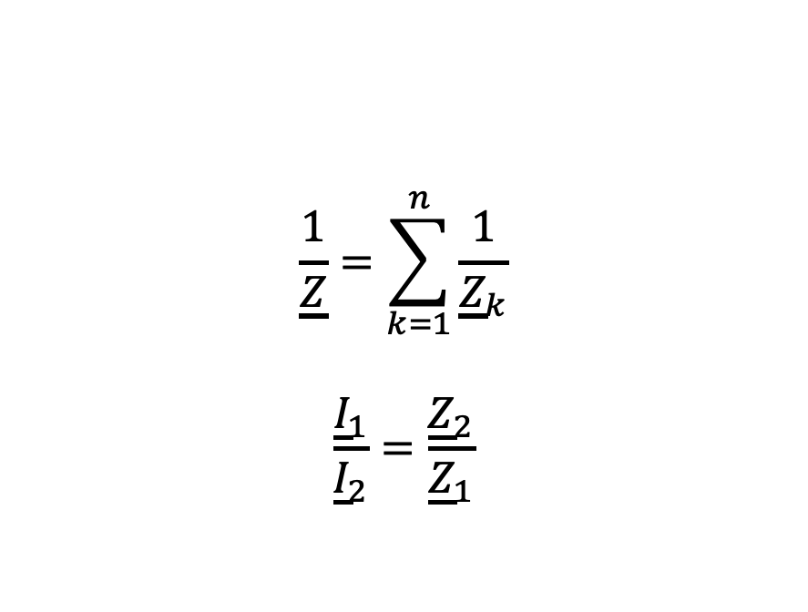
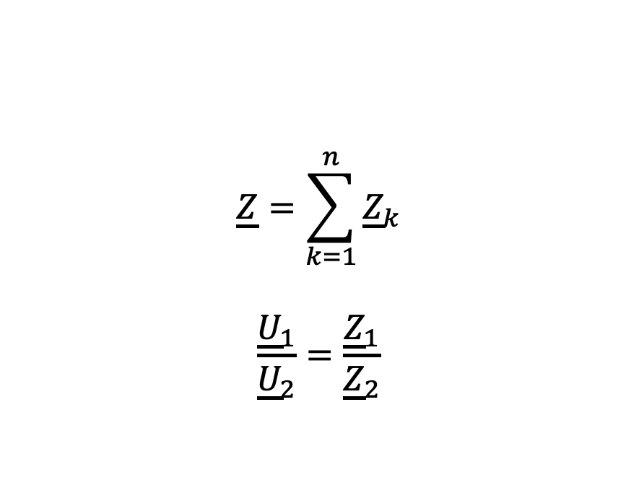
Network Analysis in Phasor Domain
$$\underline{Z}=\sum_{k=1}^{n}{{\underline{Z}}_{k}}$$
$$\frac{{\underline{U}}_{1}}{{\underline{U}}_{2}}=\frac{{\underline{Z}}_{1}}{{\underline{Z}}_{2}}$$
$$\frac{1}{\underline{Z}}=\sum_{k=1}^{n}{\frac{1}{{\underline{Z}}_{k}}}$$
$$\frac{{\underline{I}}_{1}}{{\underline{I}}_{2}}=\frac{{\underline{Z}}_{2}}{{\underline{Z}}_{1}}$$
KCL and KVL also valid for complex amplitudes and RMS values

Slide 21
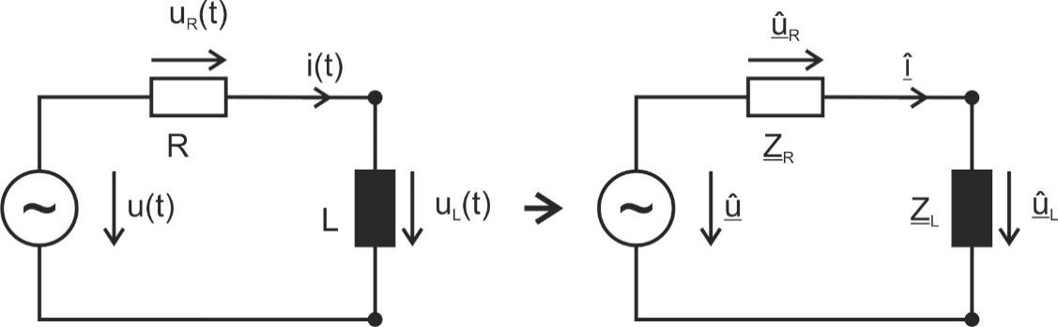

Example 1
The current through the circuit and the voltage across the coil are to be determined.
$$u\left(t\right)=\hat{u}\cos\left(ωt+φ_{u}\right) → \underline{\hat{u}}=\hat{u}e^{jφ_{u}}$$

Slide 22
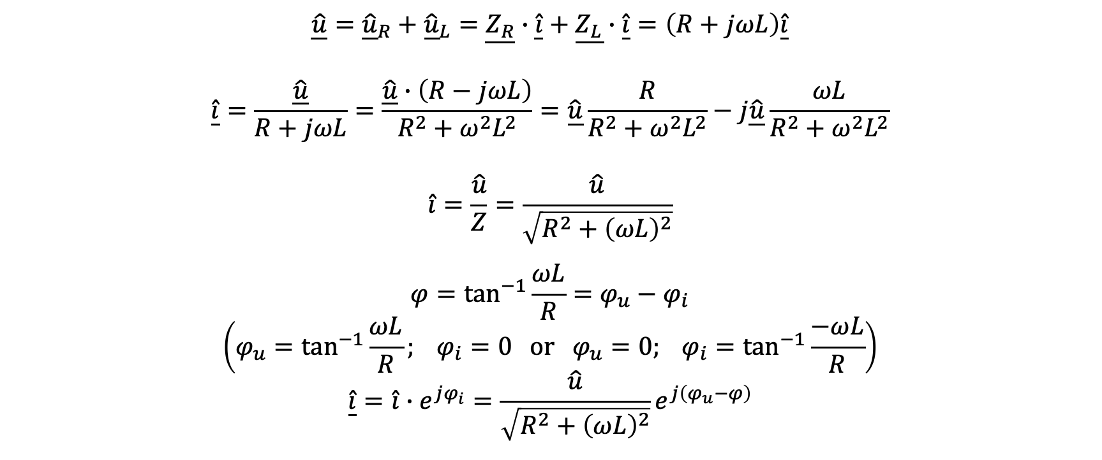
Example 1
$$\underline{\hat{u}}={\underline{\hat{u}}}_{R}+{\underline{\hat{u}}}_{L}=\underline{Z_{R}}∙\underline{\hat{i}}+\underline{Z_{L}}∙\underline{\hat{i}}=\left(R+jωL\right)\underline{\hat{i}}$$
$$\underline{\hat{i}}=\frac{\underline{\hat{u}}}{R+jωL}=\frac{\underline{\hat{u}}∙\left(R−jωL\right)}{R^{2}+ω^{2}L^{2}}=\underline{\hat{u}}\frac{R}{R^{2}+ω^{2}L^{2}}−j\underline{\hat{u}}\frac{ωL}{R^{2}+ω^{2}L^{2}}$$
$$\hat{i}=\frac{\hat{u}}{Z}=\frac{\hat{u}}{\sqrt{R^{2}+{\left(ωL\right)}^{2}}}$$
$$φ=\tan^{−1}{\frac{ωL}{R}}=φ_{u}−φ_{i}$$
$$\left(φ_{u}=\tan^{−1}{\frac{ωL}{R}}; φ_{i}=0 or φ_{u}=0; φ_{i}=\tan^{−1}{\frac{−ωL}{R}}\right)$$
$$\underline{\hat{i}}=\hat{i}∙e^{jφ_{i}}=\frac{\hat{u}}{\sqrt{R^{2}+{\left(ωL\right)}^{2}}}e^{j\left(φ_{u}−φ\right)}$$

Slide 23
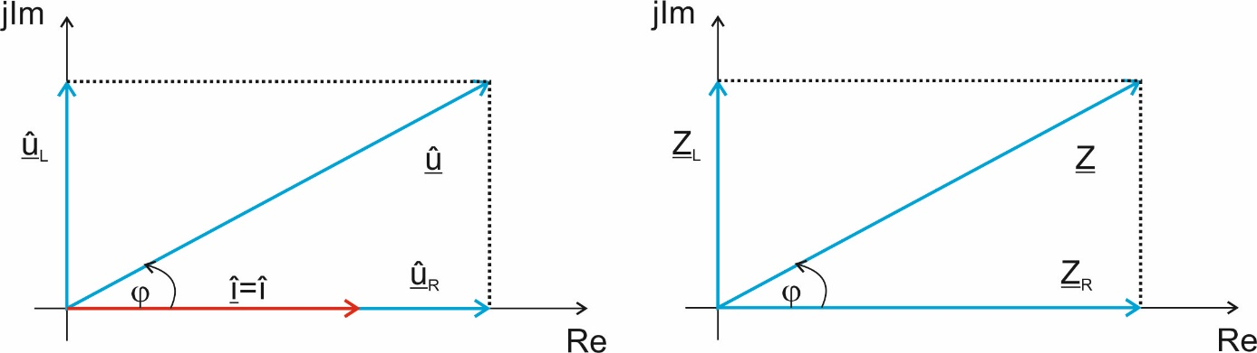
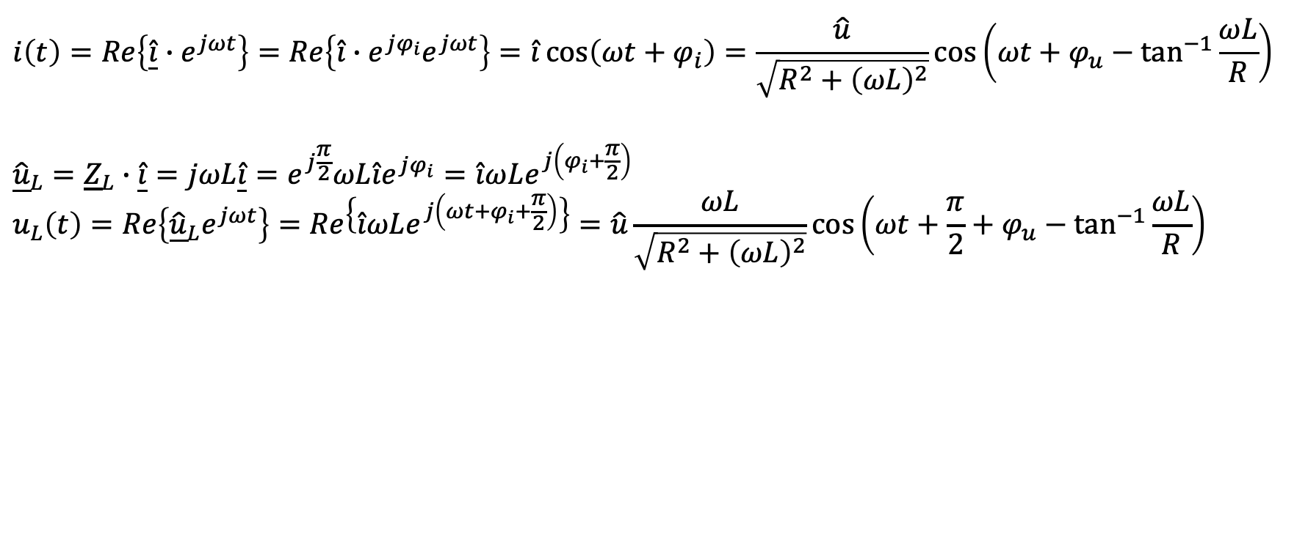
Example 1
$$i\left(t\right)=Re\left\{\underline{\hat{i}}{∙e}^{jωt}\right\}=Re\left\{{\hat{i}∙e^{jφ_{i}}e}^{jωt}\right\}=\hat{i}\cos\left(ωt+φ_{i}\right)=\frac{\hat{u}}{\sqrt{R^{2}+{\left(ωL\right)}^{2}}}\cos\left(ωt+φ_{u}−\tan^{−1}{\frac{ωL}{R}}\right)$$
$${\underline{\hat{u}}}_{L}={\underline{Z}}_{L}∙\underline{\hat{i}}=jωL\underline{\hat{i}}=e^{j\frac{π}{2}}ωL\hat{i}e^{jφ_{i}}=\hat{i}ωLe^{j\left(φ_{i}+\frac{π}{2}\right)}$$
$$u_{L}\left(t\right)=Re\left\{{\underline{\hat{u}}}_{L}e^{jωt}\right\}=Re\left\{\hat{i}ωLe^{j\left(ωt+φ_{i}+\frac{π}{2}\right)}\right\}=\hat{u}\frac{ωL}{\sqrt{R^{2}+{\left(ωL\right)}^{2}}}\cos\left(ωt+\frac{π}{2}+φ_{u}−\tan^{−1}{\frac{ωL}{R}}\right)$$

Slide 24
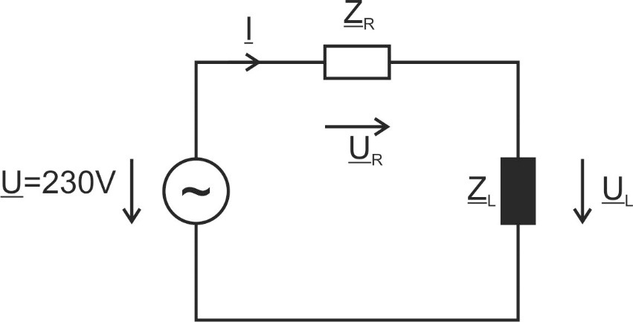
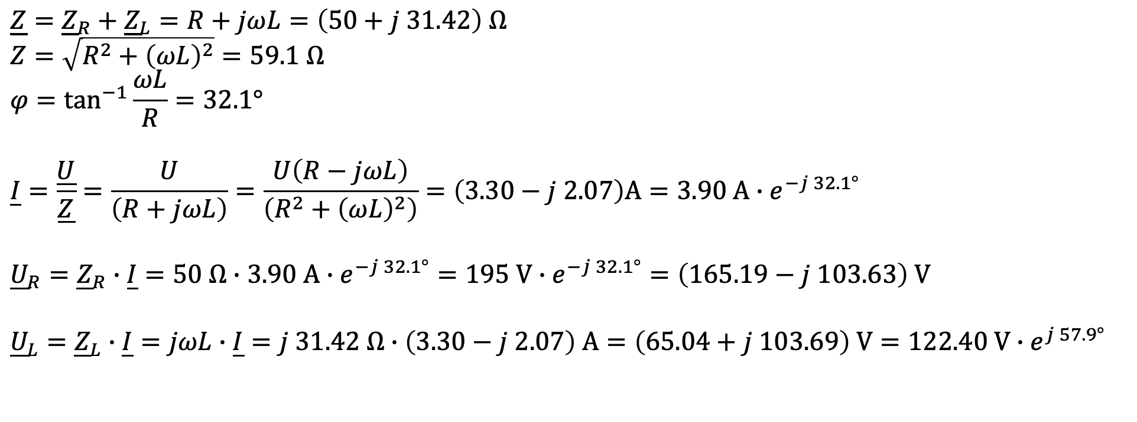



Example 1 with Numbers
$$R=50Ω$$
$$\underline{Z}={\underline{Z}}_{R}+{\underline{Z}}_{L}=R+jωL=\left(50+j 31.42\right) Ω$$
$$Z=\sqrt{R^{2}+{\left(ωL\right)}^{2}}=59.1 Ω$$
$$φ=\tan^{−1}{\frac{ωL}{R}}=32.1°$$
$$\underline{I}=\frac{\underline{U}}{\underline{Z}}=\frac{U}{\left(R+jωL\right)}=\frac{U\left(R−jωL\right)}{\left(R^{2}+{\left(ωL\right)}^{2}\right)}=\left(3.30−j 2.07\right)A=3.90 A{∙e}^{−j 32.1°}$$
$${\underline{U}}_{R}={\underline{Z}}_{R}∙\underline{I}=50 Ω∙3.90 A∙e^{−j 32.1°}=195 V∙e^{−j 32.1°}=\left(165.19−j 103.63\right) V$$
$${\underline{U}}_{L}={\underline{Z}}_{L}∙\underline{I}=jωL∙\underline{I}=j 31.42 Ω∙\left(3.30−j 2.07\right) A=\left(65.04+j 103.69\right) V=122.40 V∙e^{j 57.9°}$$
$$f=50 Hz$$
$$L=100 mH$$

Slide 25
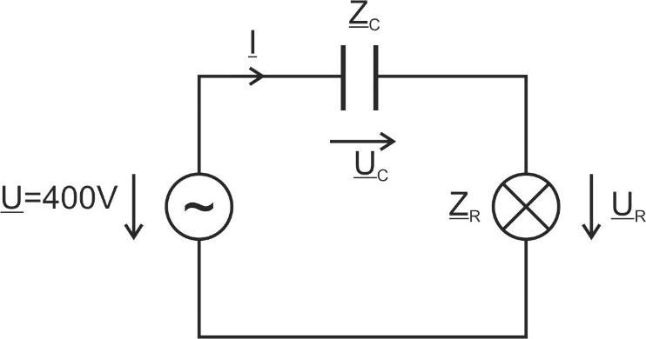
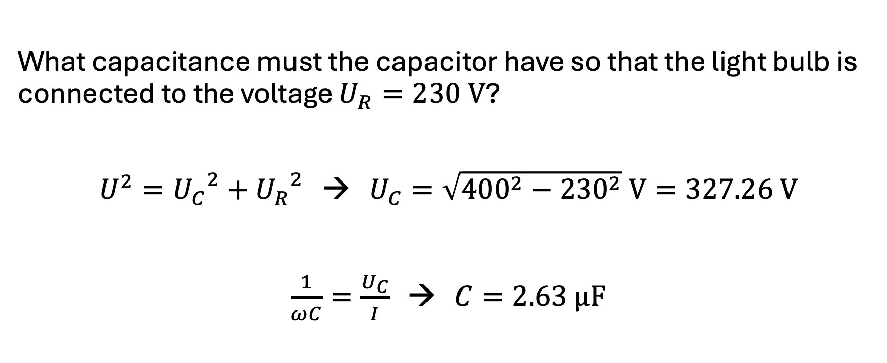
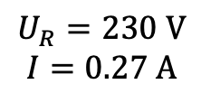

Example 2
$$f=50 Hz$$
$$U_{R}=230 V$$
$$I=0.27 A$$
What capacitance must the capacitor have so that the light bulb is connected to the voltage $U_{R}=230 V$?
$U^{2}={U_{C}}^{2}+{U_{R}}^{2}$ → $U_{C}=\sqrt{{400}^{2}−{230}^{2}} V=327.26 V$
$\frac{1}{ωC}=\frac{U_{C}}{I}$ → $C=2.63 μF$

Slide 26
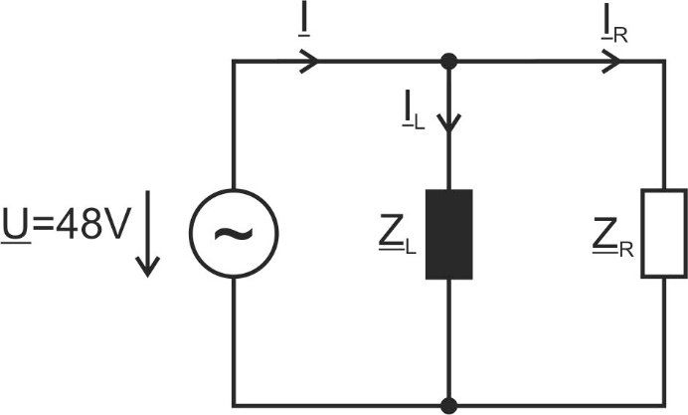
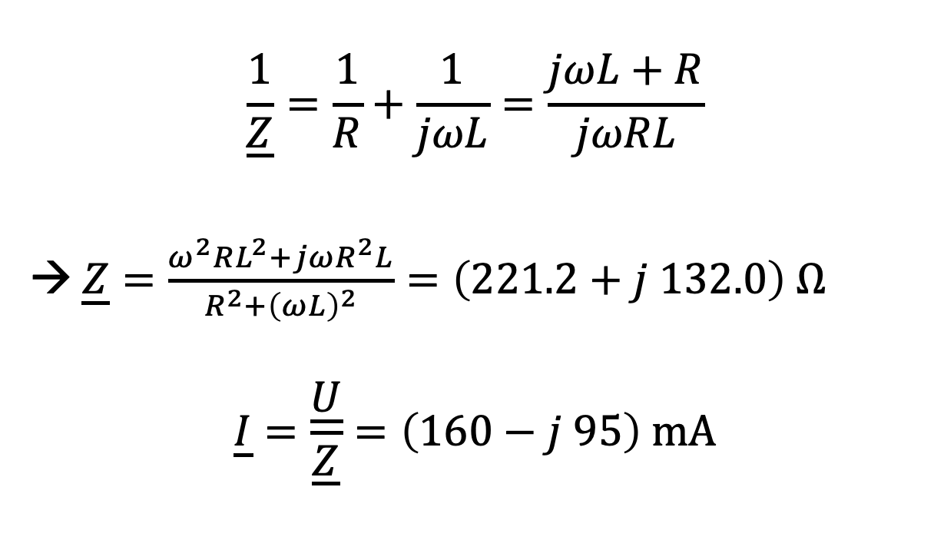



Example 3
$$\frac{1}{\underline{Z}}=\frac{1}{R}+\frac{1}{jωL}=\frac{jωL+R}{jωRL}$$
→ $\underline{Z}=\frac{ω^{2}RL^{2}+jωR^{2}L}{R^{2}+{\left(ωL\right)}^{2}}=\left(221.2+j 132.0\right) Ω$
$$\underline{I}=\frac{\underline{U}}{\underline{Z}}=\left(160−j 95\right) mA$$
$$R=300 Ω$$
$$f=800 Hz$$
$$L=100 mH$$

Slide 27
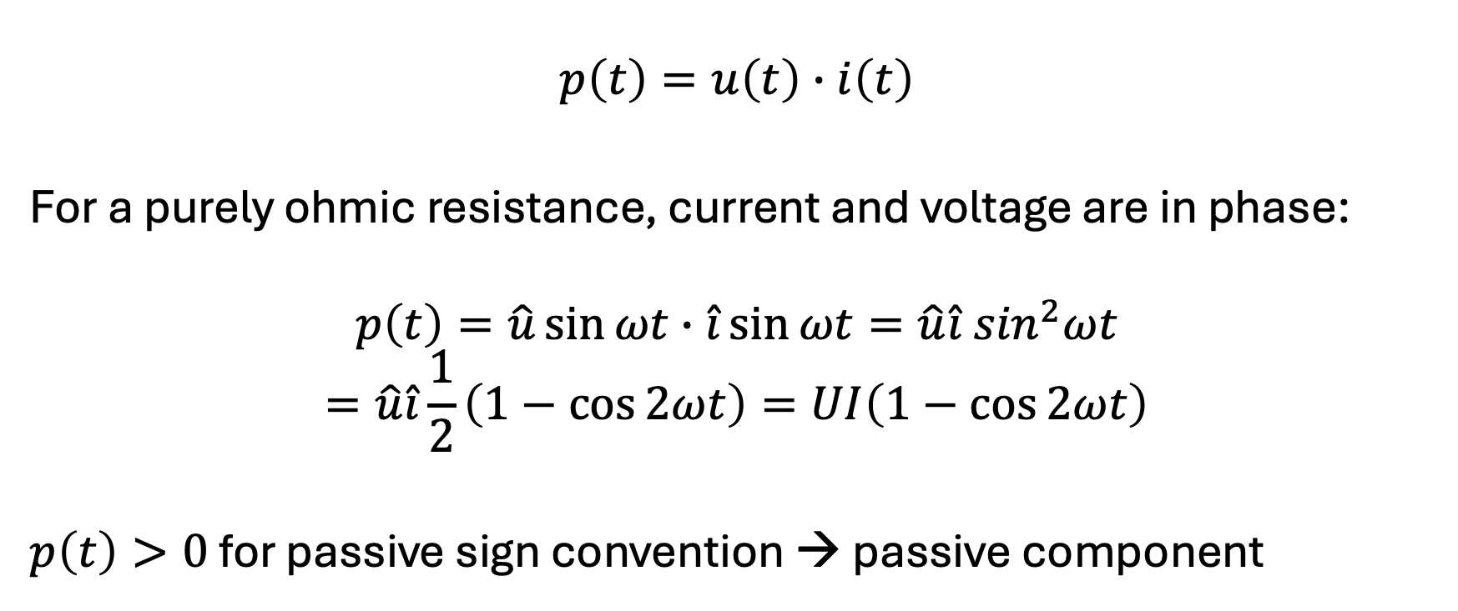
Instantaneous Power
$$p\left(t\right)=u\left(t\right)∙i\left(t\right)$$
For a purely ohmic resistance, current and voltage are in phase:
$$p\left(t\right)=\hat{u}\sin{ωt}∙\hat{i}\sin{ωt}=\hat{u}\hat{i}\sin^{2}ωt$$
$$=\hat{u}\hat{i}\frac{1}{2}\left(1−\cos{2ωt}\right)=UI\left(1−\cos{2ωt}\right)$$
$p\left(t\right)>0$ for passive sign convention → passive component

Slide 28

Average Power
area under power curve: electrical energy converted into heat in a resistor
average power (aka active power for resistance):
$$\overline{P}=\frac{1}{T}\int_{0}^{T}{p\left(t\right)dt}$$
$$=\frac{1}{T}\int_{0}^{T}{\frac{1}{2}\hat{u}\hat{i}\left(1−\cos{2ωt}\right)dt}={\left.\frac{1}{2}\hat{u}\hat{i}\frac{1}{T}\left(t−\frac{1}{2ω}sin{2ωt}\right)\right|}_{0}^{T}$$
$$=\frac{1}{2}\hat{u}\hat{i}\frac{1}{T}\left(T−\frac{1}{2ω}sin{2ωT}\right)=\frac{1}{2}\hat{u}\hat{i}\frac{1}{T}\left(T−\frac{1}{2ω}sin{2ω\frac{2π}{ω}}\right)=\frac{1}{2}\hat{u}\hat{i}=UI$$
resistance

Slide 29

Reactive Power
for reactance (capacitor or inductor): phase shift of $\frac{π}{2}$ between $u\left(t\right)$ and $i\left(t\right)$
$$p\left(t\right)=\hat{u}\sin{ωt}∙\hat{i}\sin\left(ωt+\frac{π}{2}\right)=\hat{u}\hat{i}\sin{ωt}\cos{ωt}=\hat{u}\hat{i}\frac{1}{2}\sin{2ωt}=UI\sin{2ωt}$$
$$\overline{P}=\frac{1}{T}\int_{0}^{T}{p\left(t\right)dt}=\frac{1}{T}\int_{0}^{T}{\frac{1}{2}\hat{u}\hat{i}\left(\sin{2ωt}\right)dt}={\left.\frac{1}{2}\hat{u}\hat{i}\frac{1}{T}\left(−\frac{1}{2ω}cos{2ωt}\right)\right|}_{0}^{T}$$
$$=\frac{1}{2}\hat{u}\hat{i}\frac{1}{T}\left(−\frac{1}{2ω}(cos{2ωT}+1)\right)=\frac{1}{2}\hat{u}\hat{i}\frac{1}{T}\left(−\frac{1}{2ω}(cos{4π}+1)\right)=0$$
→ not converted into heat or useful work

Slide 30

Apparent Power
mixed case for resistive-capacitive or resistive-inductive load:
$$p\left(t\right)=\sqrt{2} U\sin{ωt}∙\sqrt{2} I\sin\left(ωt−φ\right)= ⋯=UI∙\cos{φ}∙\left(1−\cos{2ωt}\right)−UI∙\sin{φ\sin{2ωt}}$$
purely active for $φ=0$
purely reactive for $φ=\frac{π}{2}$ or $φ=−\frac{π}{2}$
average power: $P=UI∙\cos{φ}$
apparent power: $S=U∙I$
$\left[S\right]=1 VA$
electrical devices must be designed for the apparent power to be transmitted

Slide 31





Complex Power
$$φ$$
$$\underline{S}=\underline{U}∙{\underline{I}}^{∗}=Ue^{jφ_{u}}Ie^{{−jφ}_{i}}=Se^{j\left(φ_{u}−φ_{i}\right)}$$
$$\underline{S}=\underline{U}{\left(\frac{\underline{U}}{\underline{Z}}\right)}^{∗}=\underline{U}∙{\underline{U}}^{∗}\frac{1}{{\underline{Z}}^{∗}}=\frac{U^{2}}{{\underline{Z}}^{∗}}$$
$$\underline{S}=\frac{1}{2}\underline{\hat{u }}∙\underline{{\hat{i}}^{∗}}=P+jQ$$
with $S=\sqrt{P^{2}+Q^{2}}=U∙I$
active power
reactive power
$$\left[Q\right]=1 VAR$$
$$φ=\tan^{−1}{\frac{Q}{P}}; \cos{φ}=\frac{P}{S}; \sin{φ}=\frac{Q}{S}$$
apparent power
power factor:
measure of how effectively electrical power is being converted into useful work output

Slide 32






Reactive Power Compensation
The absorption of inductive reactive power corresponds to the output of capacitive reactive power and vice versa: $φ={180}^{∘}$
→ can compensate each other (useful to avoid transmission losses)
$$I_{a}+jI_{r}$$
$$I_{a}$$
$$I_{a}+jI_{r}$$
resistive-inductive load
$$jI_{r}$$
can be compensated by capacitor

Slide 33

Example
A motor ($U=230 V$, $f=50 Hz$, $I=16 A$, $\cos{φ=0.8}$) is to be compensated using a capacitor.
without capacitor:
$I_{a}=I∙\cos{φ}=12.8 A$, $I_{r}=I∙\sin{φ}=−9.6 A$ $→\underline{I}=\left(12.8−j 9.6\right) A$
$\underline{S}=\underline{U}∙{\underline{I}}^{∗}=230 V∙\left(12.8+j 9.6\right) A$
$S=\sqrt{{2.944}^{2}+{2.208}^{2}} kVA=3.68 kVA$, $φ=\tan^{−1}{\frac{2.208}{2.944}}=36.87°$
reactive current needs to be compensated by capacitor:
$\frac{1}{ωC}=\frac{U}{I_{r}}$ $→C=133 μF$
$\underline{S}=\underline{U}∙{\underline{I}}^{∗}=230 V∙12.8 A=2.944 kVA=S$, $φ=0$

Slide 34


Frequency-Dependent Voltage Divider
$${\underline{U}}_{2}={\underline{U}}_{1}∙\frac{{\underline{Z}}_{2}}{{\underline{Z}}_{1}+{\underline{Z}}_{2}}={\underline{U}}_{1}∙\frac{jωL}{R+jωL}={\underline{U}}_{1}∙\frac{{\left(ωL\right)}^{2}−jωLR}{R^{2}+{\left(ωL\right)}^{2}}$$
$$U_{2}=U_{1}∙\sqrt{{\left(\frac{{\left(ωL\right)}^{2}}{R^{2}+{\left(ωL\right)}^{2}}\right)}^{2}+{\left(\frac{ωLR}{R^{2}+{\left(ωL\right)}^{2}}\right)}^{2}}=U_{1}∙\sqrt{\frac{{\left(ωL\right)}^{4}+{\left(ωLR\right)}^{2}}{{\left(R^{2}+{\left(ωL\right)}^{2}\right)}^{2}}}=U_{1}\frac{\sqrt{{\left(ωL\right)}^{2}\left({\left(ωL\right)}^{2}+R^{2}\right)}}{R^{2}+{\left(ωL\right)}^{2}}=U_{1}\frac{ωL}{\sqrt{R^{2}+{\left(ωL\right)}^{2}}}=U_{1}∙\frac{Z_{1}}{Z}$$

Slide 35



High-Pass RL Filter
$$U_{2}$$
$$U_{2}=U_{1}\frac{ωL}{\sqrt{R^{2}+{\left(ωL\right)}^{2}}}$$
$$f$$

Slide 36


Low-Pass RL Filter
$$U_{2}$$
$${U_{2}=U}_{1}\frac{R}{\sqrt{R^{2}+{\left(ωL\right)}^{2}}}$$
$$f$$

Slide 37

RC Filters
high-pass filter
low-pass filter
first-order filters: either a capacitor or an inductor

Slide 38


Series Resonant Circuit
damping
$$\underline{Z}=R+j\left(ωL−\frac{1}{ωC}\right)$$
resonance frequency $f_{0}$: inductive and capacitive reactances cancel each other out
$$ω_{0}L−\frac{1}{ω_{0}C}=0$$
$$→ω_{0}=2πf_{0}=\frac{1}{\sqrt{LC}}$$
$$\underline{Z}\left(ω_{0}\right)=R$$
forced oscillation

Slide 39






impedance minimal at resonance:
phase shift between source voltage and current:
inductive range
$$φ$$
$$X_{C}$$
$$X_{L}$$
$$\left|\underline{Z}\right|$$
capacitive range
ω₀
$$\text{ω}\text{0}$$
only $R$

Slide 40



Voltage Resonance
$$U_{L}=U\frac{ωL}{\sqrt{R^{2}+{\left(ωL−\frac{1}{ωC}\right)}^{2}}}$$
$$U_{C}=U\frac{1}{ωC\sqrt{R^{2}+{\left(ωL−\frac{1}{ωC}\right)}^{2}}}$$
for $ω_{0}$: $U_{L}=U_{C}=U\frac{1}{R}\sqrt{\frac{L}{C}}=U∙Q$
quality factor $Q=\frac{1}{R}\sqrt{\frac{L}{C}}$
can be $>1$
→ voltages across inductor and capacitor can be significantly larger than the source voltage (resonance catastrophe)
$${\underline{U}}_{L}={−\underline{U}}_{C}$$

Slide 41





phase shift of $180°$
maximum of $U_{L}$ slightly above ω₀
maximum of $U_{C}$ slightly below ω₀
$$U_{L}$$
$$U_{C}$$
$$U_{R}$$
ω₀
$U_{R}=U\frac{R}{\sqrt{R^{2}+{\left(ωL−\frac{1}{ωC}\right)}^{2}}}$ → maximum for ω=ω₀: $U_{R}=U$ (also maximum current)

Slide 42





Voltage Maxima
$$Q=\frac{1}{R}\sqrt{\frac{L}{C}}$$
$$ω_{0}=\frac{1}{\sqrt{LC}}$$
$\frac{dU_{L}}{dω_{L}}=0$ → $ω_{L}=\sqrt{\frac{2}{2LC−R^{2}C^{2}}}=\sqrt{\frac{2}{2LC−\frac{LC}{Q^{2}}}}=ω_{0}\frac{1}{\sqrt{1−\frac{1}{2Q^{2}}}}$
$\frac{dU_{C}}{dω_{C}}=0$ → $ω_{C}=\sqrt{\frac{1}{LC}−\frac{R^{2}}{2L^{2}}}=ω_{0}\sqrt{1−\frac{1}{2Q^{2}}}$
→ no maxima for $Q≤\frac{1}{\sqrt{2}}$
resonance behavior more pronounced the higher $Q$

Slide 43



Parallel Resonant Circuit
$$\underline{Y}=G+j\left(ωC−\frac{1}{ωL}\right)$$
$$ω_{0}C−\frac{1}{ω_{0}L}=0$$
$$→ω_{0}=2πf_{0}=\frac{1}{\sqrt{LC}}$$
$$\underline{Y}\left(ω_{0}\right)=G$$
admittance minimal at resonance (impedance maximal) → total current minimal (${\underline{I}}_{L}={−\underline{I}}_{C}$)
below $ω_{0}$: determined by inductance
above $ω_{0}$: determined by capacitance

Slide 44


Current Resonance
$$I_{R}=I\frac{G}{\sqrt{G^{2}+{\left(ωC−\frac{1}{ωL}\right)}^{2}}}$$
$$I_{L}=I\frac{1}{ωL\sqrt{G^{2}+{\left(ωC−\frac{1}{ωL}\right)}^{2}}}$$
$$I_{C}=I\frac{ωC}{\sqrt{G^{2}+{\left(ωC−\frac{1}{ωL}\right)}^{2}}}$$
resonance:
$$I_{R}=I=\frac{U}{R}$$
$$I_{L}=I_{C}=IR\sqrt{\frac{C}{L}}=I∙Q$$
→ current through inductor and capacitor can be larger than the source current

Slide 45

Current Maxima
$\frac{dI_{L}}{dω_{L}}=0$ → $ω_{L}=ω_{0}\sqrt{1−\frac{1}{2Q^{2}}}$
$\frac{dI_{C}}{dω_{C}}=0$ → $ω_{C}=ω_{0}\frac{1}{\sqrt{1−\frac{1}{2Q^{2}}}}$
→ again, no maxima for $Q≤\frac{1}{\sqrt{2}}$

Slide 46


Second-Order Filters
acceptor circuit:
admittance peak at resonance
rejector circuit:
impedance peak at resonance
load
load

Slide 47
Three-Phase Circuits
idea:
three alternating currents of the same frequency and amplitude but phase-shifted by 120° from each other
motivation:
constant power transmission
generation of rotating magnetic field → electric motor

Slide 48

Three-Phase Generator
phase identifiers on motor terminals
rotor: (mechanically) rotating magnetic field (generated by coil with DC or permanent magnet)
stator: three coils offset by 120°
induces sinusoidal alternating voltage in each coil, phase-shifted by 120°

Slide 49



Three-Phase Network
line voltages (also $U_{12}, U_{23}, U_{31}$)
three phases
loads (e.g., motor)
neutral conductor (optional: return wire not absolutely necessary)
phase voltages
(also $U_{1}, U_{2}, U_{3}$)

Slide 50


Star (Y) Connection
no current in $N$ for symmetric loads (the three currents add to 0)
→ $N$ could be removed

Slide 51



Phase Voltages
$u_{1}=\hat{u}∙\cos\left(ωt\right)$
$u_{2}=\hat{u}∙\cos\left(ωt−\frac{2}{3}π\right)$
$u_{3}=\hat{u}∙\cos\left(ωt−\frac{4}{3}π\right)$
$$\underline{U_{1}}=U$$
$$\underline{U_{2}}=U∙e^{−j\frac{2}{3}π}$$
$$\underline{U_{3}}=U∙e^{−j\frac{4}{3}π}$$
typical European system:
$$230 V$$

Slide 52




Line Voltages
typical European system:
$$400 V$$
$$U_{12}=U_{23}=U_{31}=U_{L}=\sqrt{3}∙U$$
for example:
$$\underline{U_{12}}=\underline{U_{1}}−\underline{U_{2}}=U−U∙e^{−j\frac{2}{3}π}=U∙\left(1−\left(−0.5−j\frac{\sqrt{3}}{2}\right)\right)=U∙1.5+j\frac{\sqrt{3}}{2}=\sqrt{3}∙U∙e^{j\frac{π}{6}}$$

Slide 53


Slide 54



Power for Symmetrical Load
$\underline{I_{1}}=$ ${\underline{U_{1}}}/{\underline{Z}}$
$$\underline{I_{2}}={\underline{U_{2}}}/{\underline{Z}}$$
$$\underline{I_{3}}={\underline{U_{3}}}/{\underline{Z}}$$
$$I_{1}=I_{2}=I_{3}=I=I_{L}$$
$$P=3∙U_{1}∙I_{1}∙Re\left(e^{j\left(φ_{u}−φ_{i}\right)}\right)=3∙U∙I∙\cos{φ}=\sqrt{3}∙U_{L}∙I_{L}∙\cos{φ}$$
$$Q=3∙U_{1}∙I_{1}∙Im\left(e^{j\left(φ_{u}−φ_{i}\right)}\right)=\sqrt{3}∙U_{L}∙I_{L}∙\sin{φ}$$
$$S=\sqrt{P^{2}+Q^{2}}=\sqrt{3}∙U_{L}∙I_{L}$$

Slide 55



Constant Power
$$p\left(t\right)=\frac{u_{1}^{2}(t)}{R_{1}}+\frac{u_{2}^{2}(t)}{R_{2}}+\frac{u_{3}^{2}(t)}{R_{3}}$$
for symmetrical, purely resistive load:
$$R_{1}=R_{2}=R_{3}=R$$
→ $p\left(t\right)=\frac{{\hat{U}}^{2}}{R}\left(\cos^{2}{ωt}+\cos^{2}\left(ωt−\frac{2}{3}π\right)+\cos^{2}\left(ωt+\frac{2}{3}π\right)\right)=\frac{{3\hat{U}}^{2}}{2R}=\frac{3U^{2}}{R}$

Slide 56





Delta (Δ) Connection
3
$\underline{I_{12}}=$ ${\underline{U_{12}}}/{\underline{Z}}$
$$\underline{I_{23}}={\underline{U_{23}}}/{\underline{Z}}$$
$$\underline{I_{31}}={\underline{U_{31}}}/{\underline{Z}}$$
no neutral point
$$I_{L}=\sqrt{3}∙I$$
$$U_{12}=U_{23}=U_{31}=U_{L}=U=400 V$$

Slide 57



Power Consumption
for both star and delta:
$$P=\sqrt{3}∙U_{L}∙I_{L}∙\cos{φ}=3∙U∙I∙\cos{φ}$$
but for star:
$U={U_{L}}/{\sqrt{3}}$, $I=U/R$
→ $P=\frac{{U_{L}}^{2}}{R}∙\cos{φ}$
while for delta:
$U=U_{L}$, $I={U_{L}}/R$
→ $P=3∙\frac{{U_{L}}^{2}}{R}∙\cos{φ}$
→ $P_{∆}=3∙P_{Y}$

