Slide 1
LLMs
Language Models

Slide 2
Course Contents
Deep Learning
Transformer
Finetuning
Agents
The Bigger Picture
Context Engineering
Instruction Tuning
LLMs

Slide 3
This Part: LLMs
encoder and decoder LLMs
scaling laws
LLM zoo

Slide 4
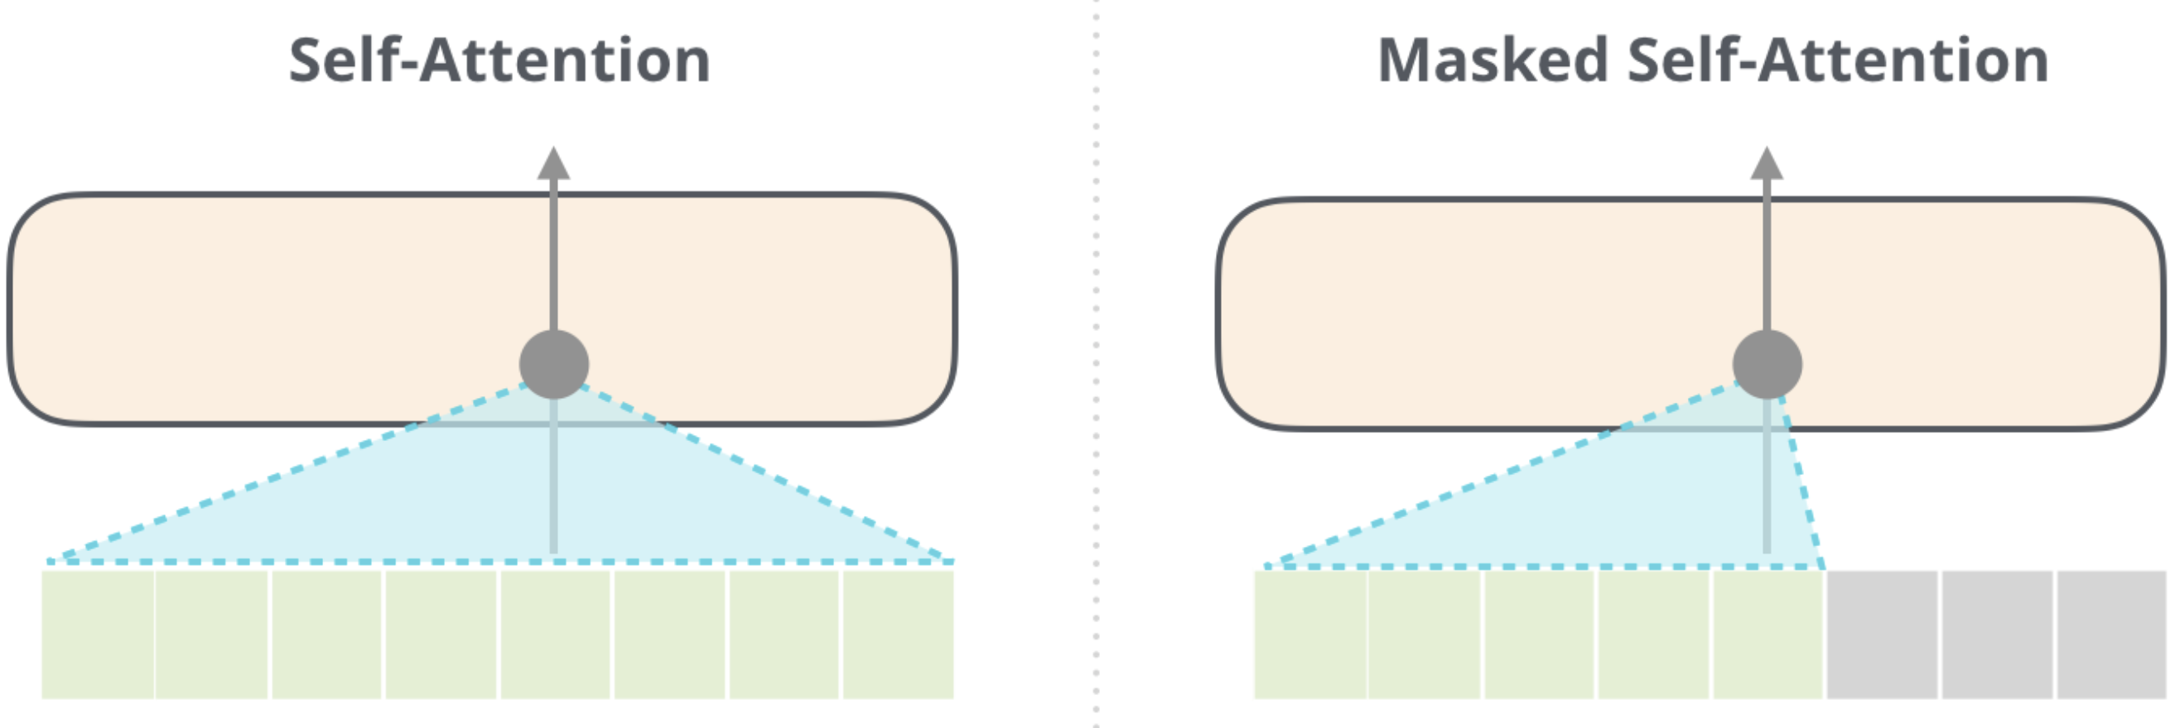
Transformer Architectures for LLMs
encoder-decoder LLMs: sequence-to-sequence, e.g., machine translation
encoder-only LLMs:
learning of contextual embeddings (for subsequent fine-tuning)
training: prediction of masked words
can’t generate text, can’t be prompted
decoder-only LLMs:
text generation: e.g., chat bot (after instruction tuning)
training: next-word prediction
output one token at a time (auto-regressive: consuming its own output, potentially starting with prompts)
aka causal
example: BERT
example: GPT
source

Slide 5
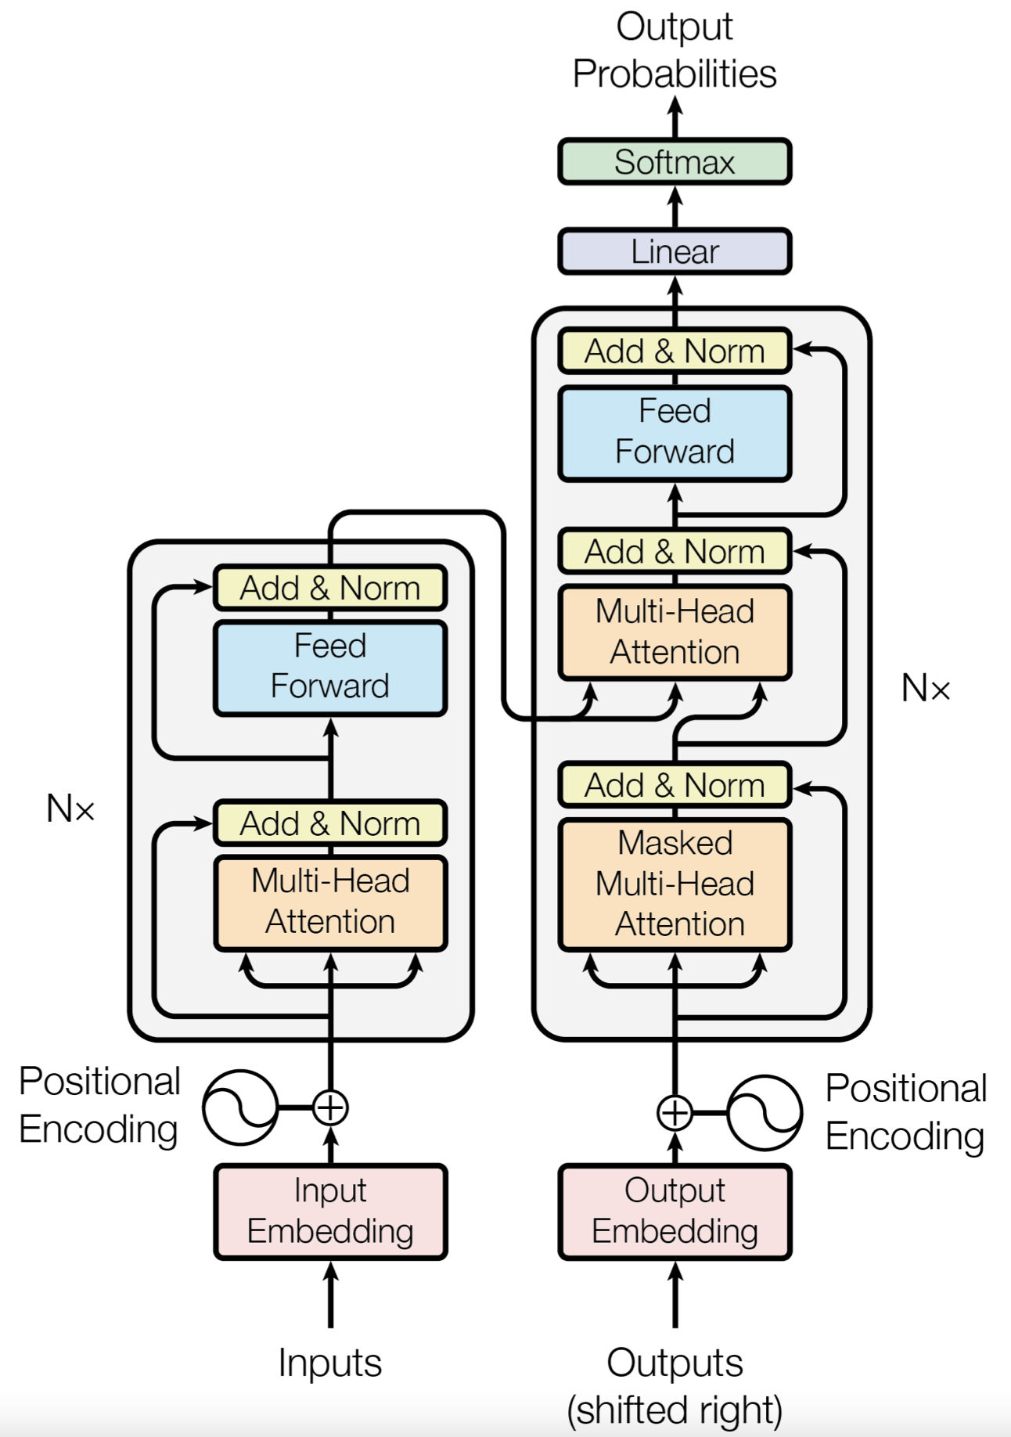
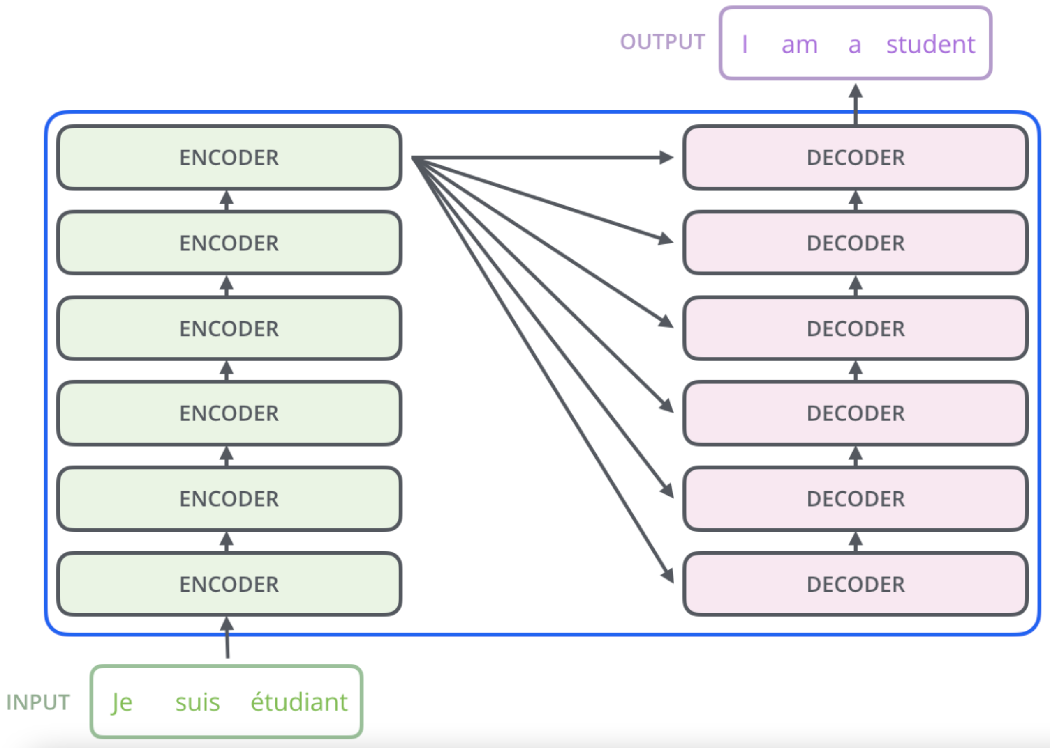
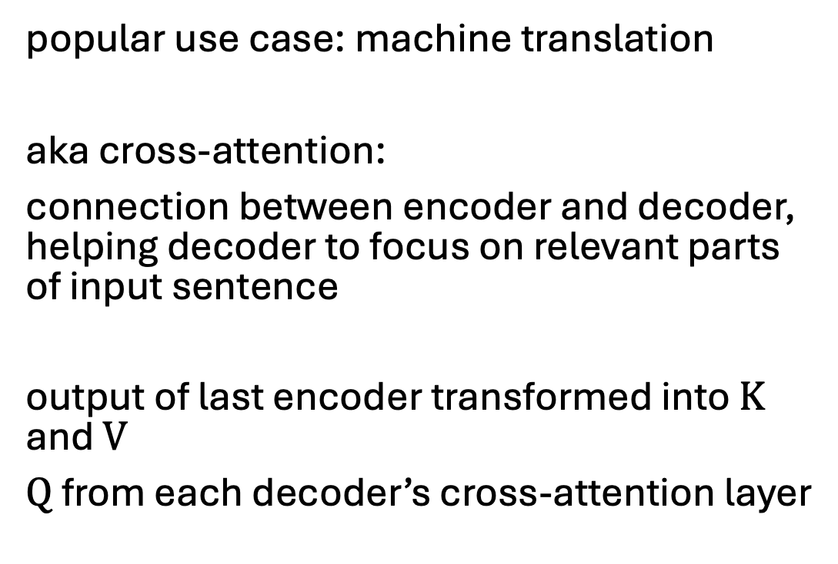
Encoder-Decoder Attention
popular use case: machine translation
aka cross-attention:
connection between encoder and decoder, helping decoder to focus on relevant parts of input sentence
output of last encoder transformed into $K$ and $V$
$Q$ from each decoder’s cross-attention layer
source

Slide 6
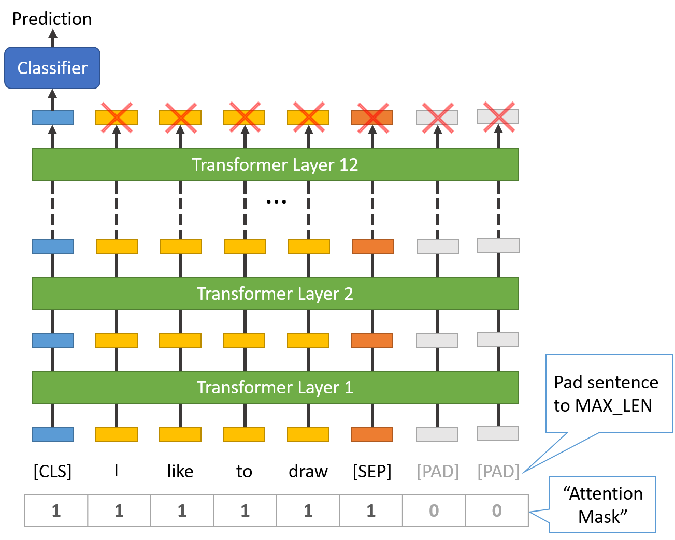
Example for Encoder-Only LLM
BERT (Bidirectional Encoder Representations from Transformers, Google):
stack of transformer encoders
outputting representation (contextual embeddings) to be used/finetuned in specific tasks and data sets (e.g., text classification)
bidirectional: jointly conditioning on both left and right context
pre-trained in self-supervised manner on massive data sets
masked tokens to be predicted from context
next sentence prediction
source
sentence classification via [CLS] token

Slide 7
BERT Variants
RoBERTa …
DistilBERT …

Slide 8
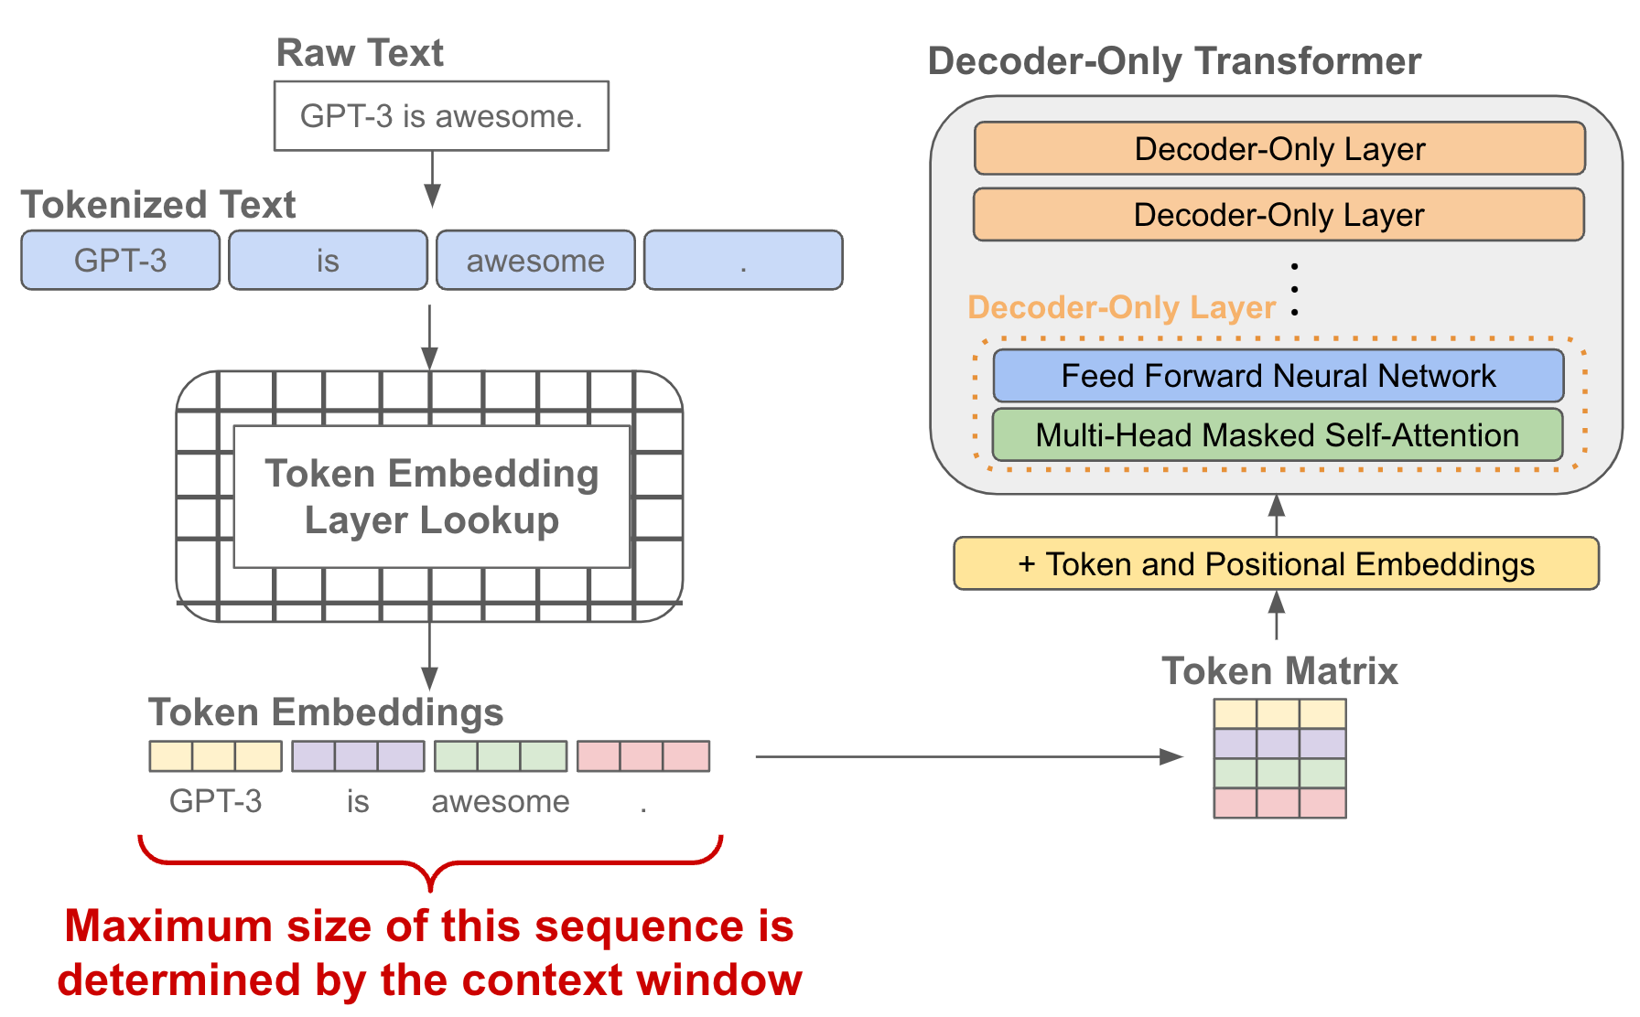
Example for Decoder-Only LLM
GPT (Generative Pre-trained Transformer, by OpenAI) series:
stack of transformer decoders → auto-regressive language model
generative pre-training: self-supervised generation of text (i.e., next-word predictions) on massive web scrape data sets
lightweight PyTorch re-implementation of GPT: minGPT
more powerful: nanoGPT, LitGPT
source

Slide 9
GPT Evolution
GPT: discriminative fine-tuning on specific tasks (e.g., summarization, translation, question-answering) with much smaller data sets
GPT-2, GPT-3 (175 billion parameters): also zero- or few-shot learning
GPT-4: extend to multimodal model (image and text inputs, text outputs)
capabilities

Slide 10
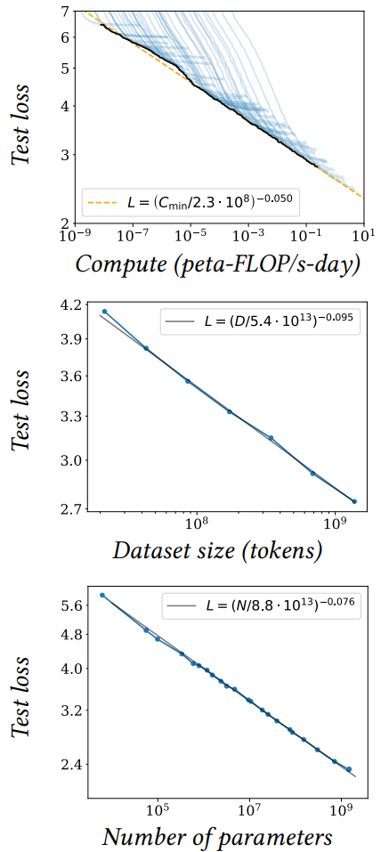
Size Matters: LARGE Language Models
scaling laws, Chinchilla: coupled performance power laws with model size, amount of training data, and compute
→ era of large-scale models
emergent abilities of LLMs:
multi-task learning: perform new tasks at test time without task-specific training (via prompting)
reasoning capabilities
source

Slide 11
Some LLM Numbers
as usual, comes in base and instruct variants
example Kimi K2 (Mixture-of-Experts model):
vocabulary size (tokens): 160K
embedding dimension: 7,168
context length (tokens): 128K
total parameters: 1T
training tokens: 15.5T
number of layers: 61
number of attention heads: 64
number of experts: 384
→ a lot of memorizing
compression of the internet

Slide 12
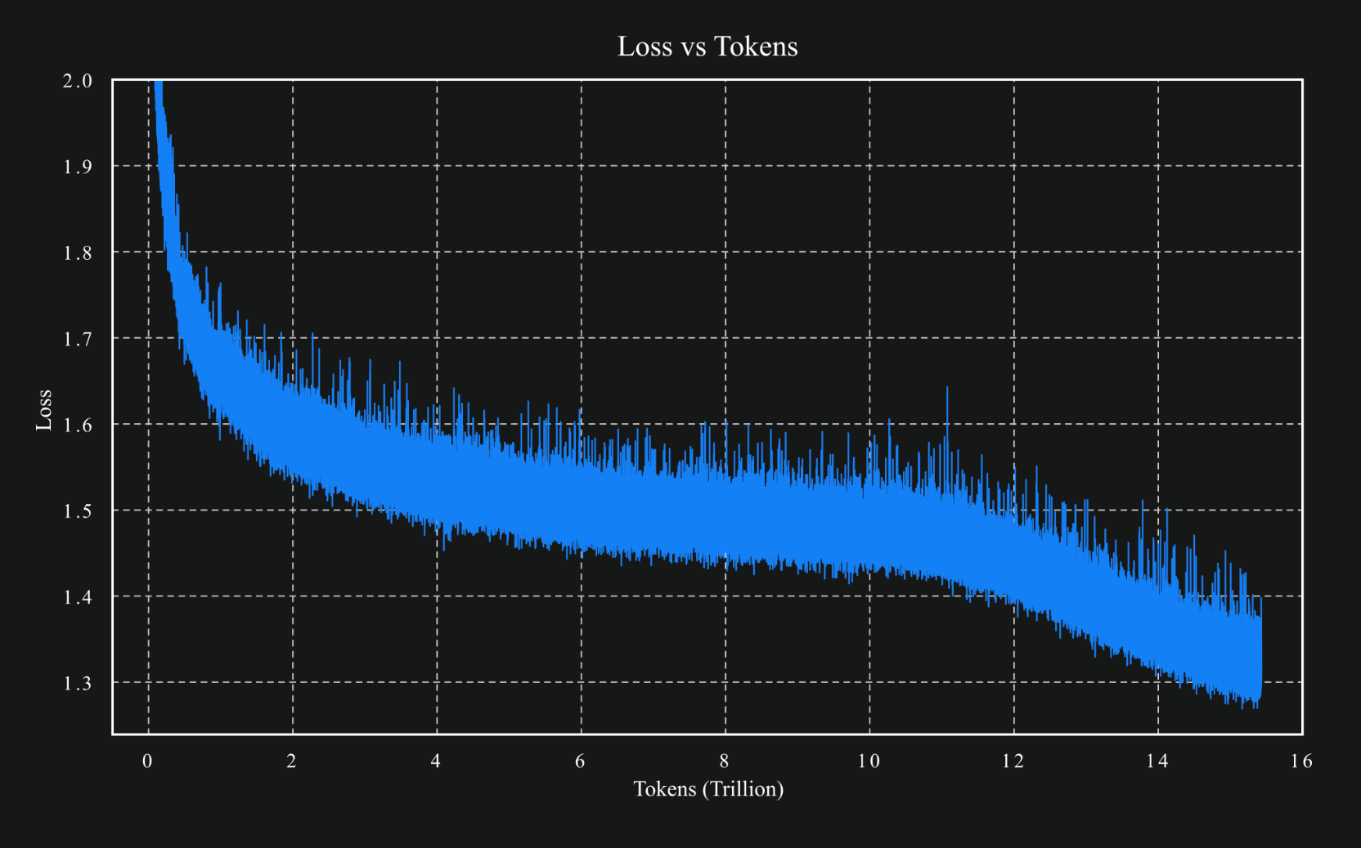
source

Slide 13
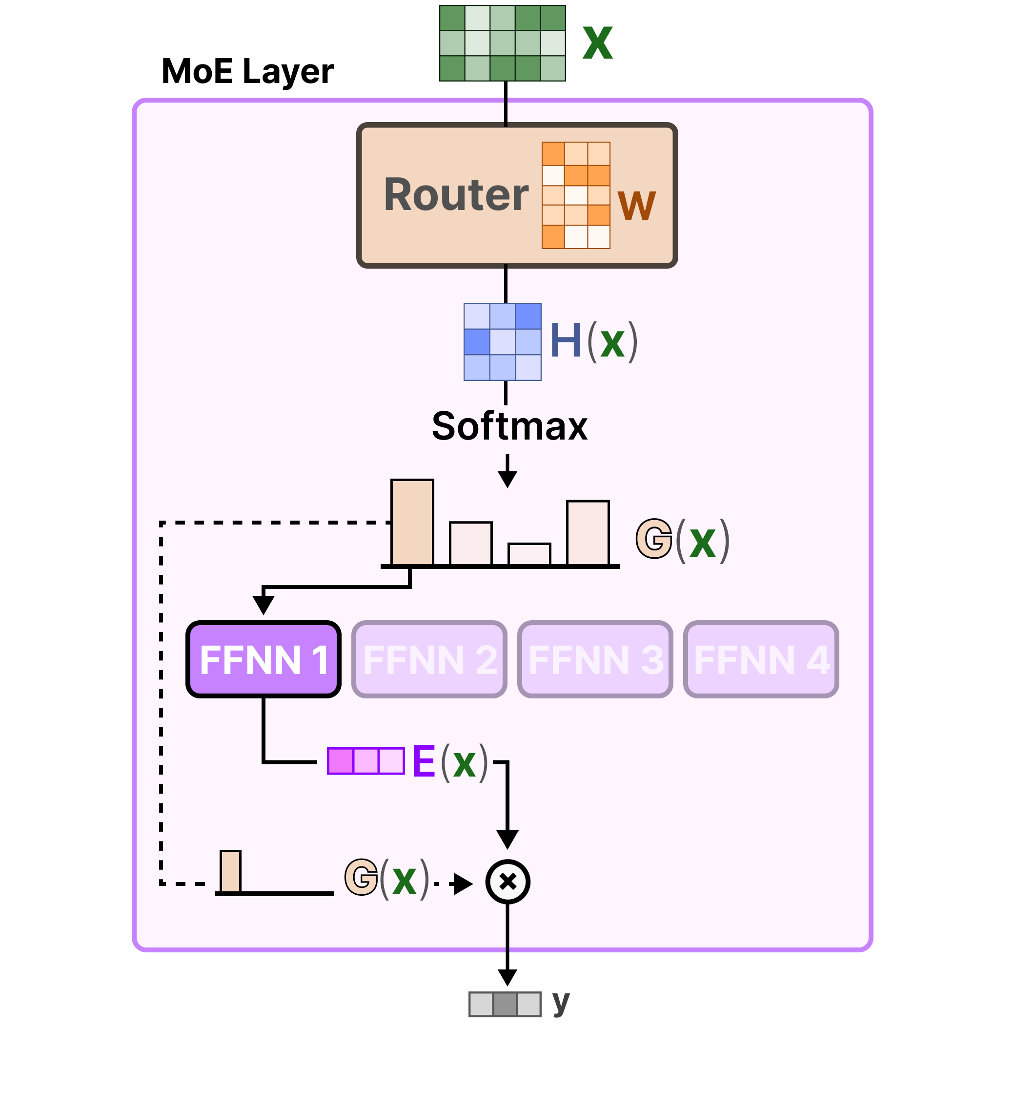
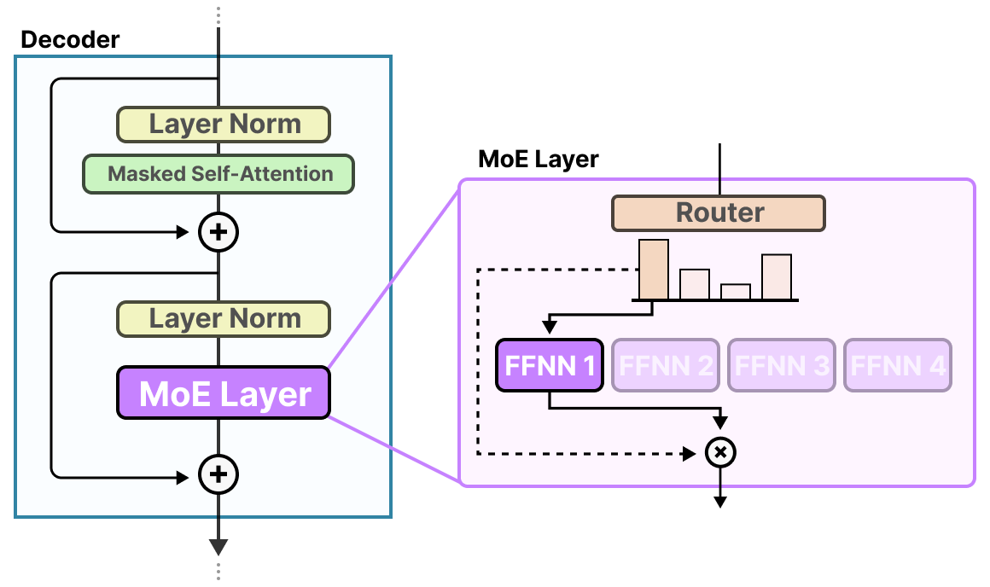
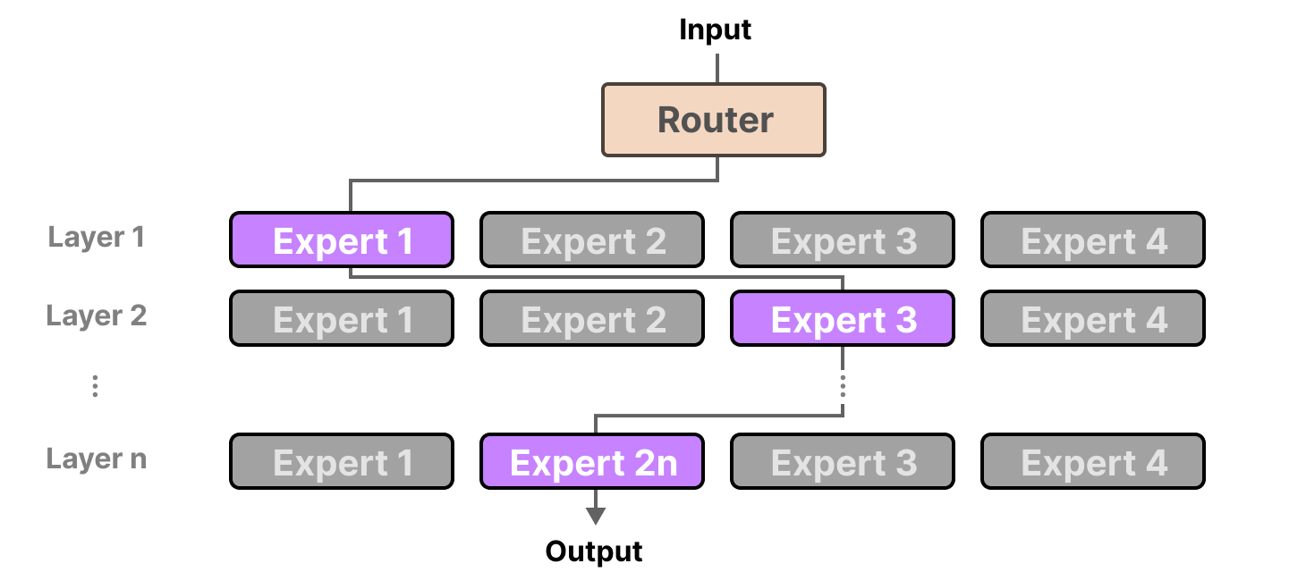
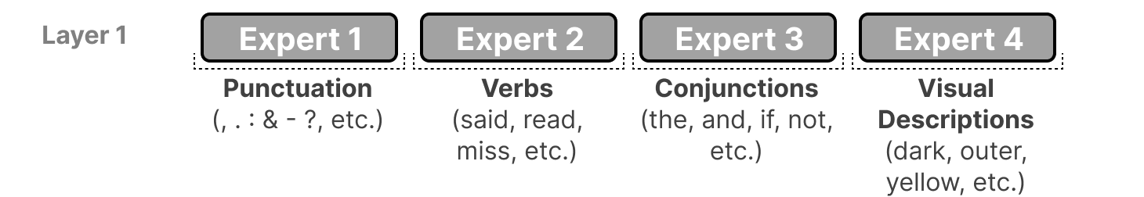
Mixture-of-Experts (MoE)
FFNN itself
idea: replace big FFNN with several smaller ones and activate only few
→ less active parameters
different paths for each token:
example (actually more abstract):

Slide 14





Slide 15
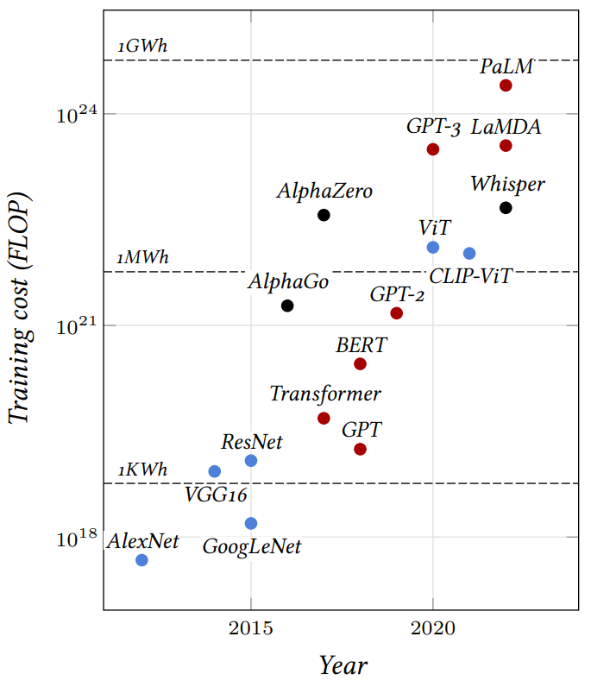
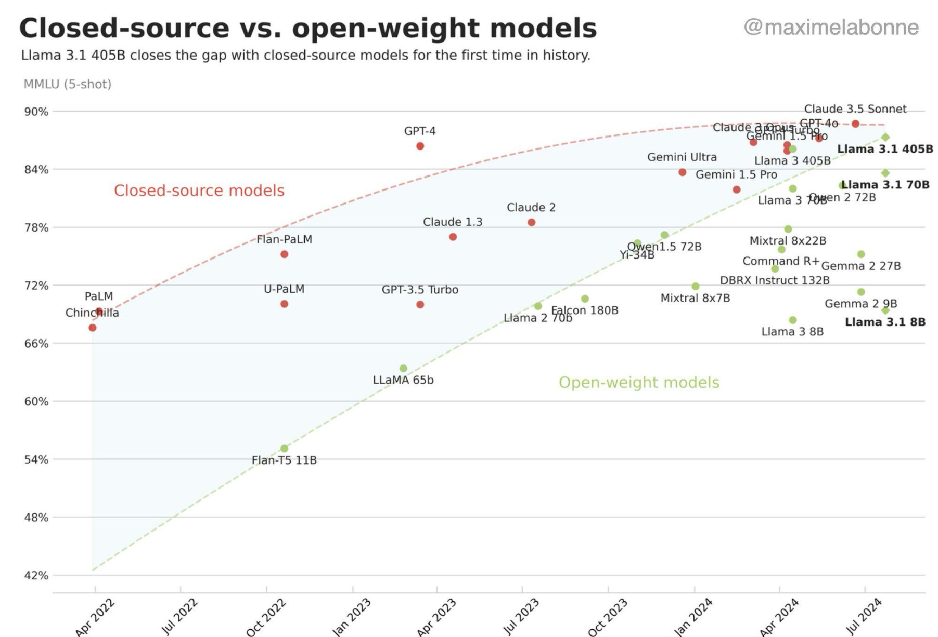
Llama 3
source

Slide 16
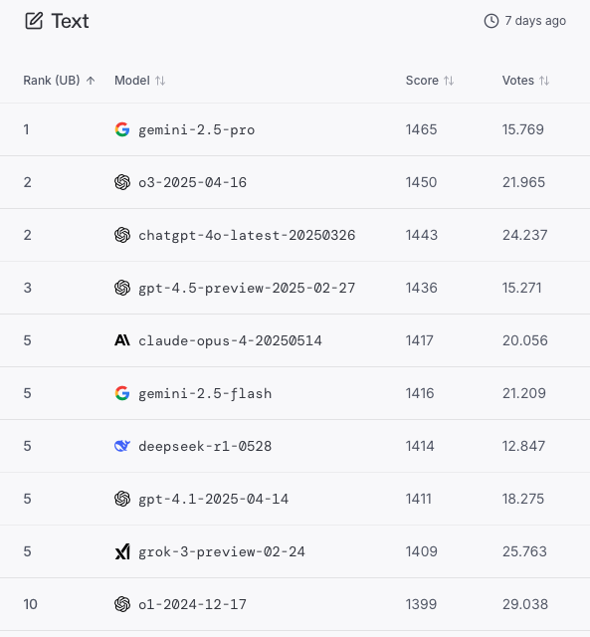
LMArena

Slide 17
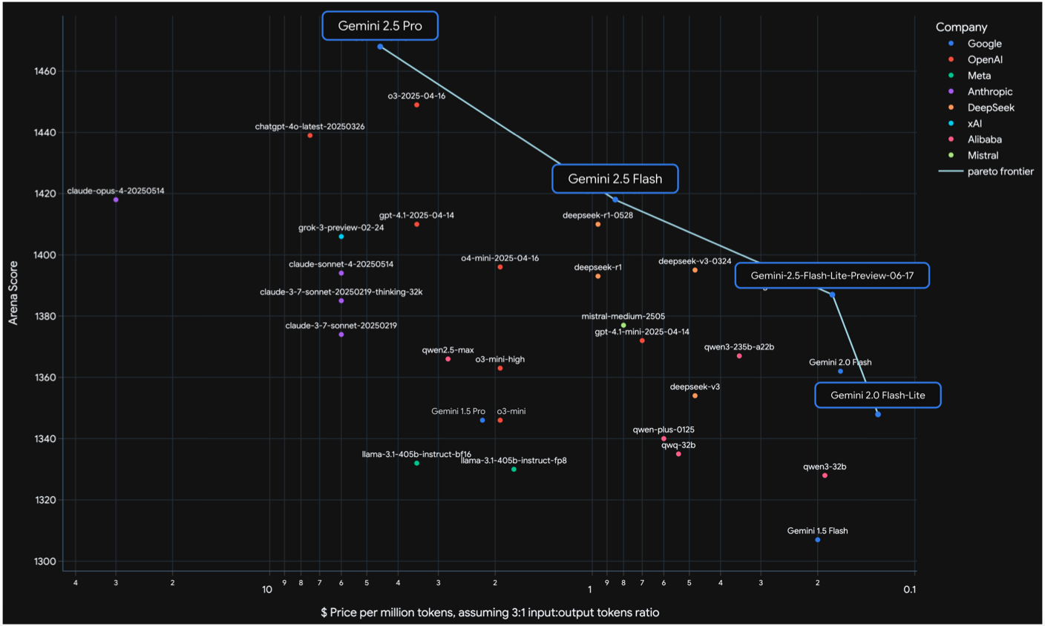
source

Slide 18
Another Trend: Small Language Models (SLM)
most powerful LLMs keep getting bigger (> 1 trillion parameters)
GPT-4o, Claude 3.5, Gemini 1.5, …
but slimmed-down (yet still strong) versions get smaller
Gemma (2B), Phi-3 (3.8B), Mistral 7B, Llama3 (8B), …
can run (inference) on laptops, smartphones, etc.
easier fine-tuning → specific tasks

Slide 19
Modern Language Models in a Nutshell
tokenization (split text into chunks)
pretraining of transformer (next- or masked-token prediction, self-supervised)
vector embeddings from tokens (semantic meaning)
add positional encoding to embeddings (use order of sequence, as attention is permutation-invariant)
attention mechanism → contextual embeddings
finetuning (specialization)
for specific task (encoder LLM)
instruction tuning (decoder LLM), potentially followed by alignment
discussed so far

