Slide 1
Instruction Tuning
Language Models

Slide 2
Course Contents
Deep Learning
Transformer
Finetuning
Agents
The Bigger Picture
Context Engineering
Instruction Tuning
LLMs

Slide 3
This Part: Instruction Tuning
supervised finetuning
preference alignment
dialogue systems

Slide 4
Modern Language Models in a Nutshell
tokenization (split text into chunks)
pretraining of transformer (next- or masked-token prediction, self-supervised)
vector embeddings from tokens (semantic meaning)
add positional encoding to embeddings (use order of sequence, as attention is permutation-invariant)
attention mechanism → contextual embeddings
finetuning (specialization)
for specific task (encoder LLM)
instruction tuning (decoder LLM), potentially followed by alignment
this part

Slide 5
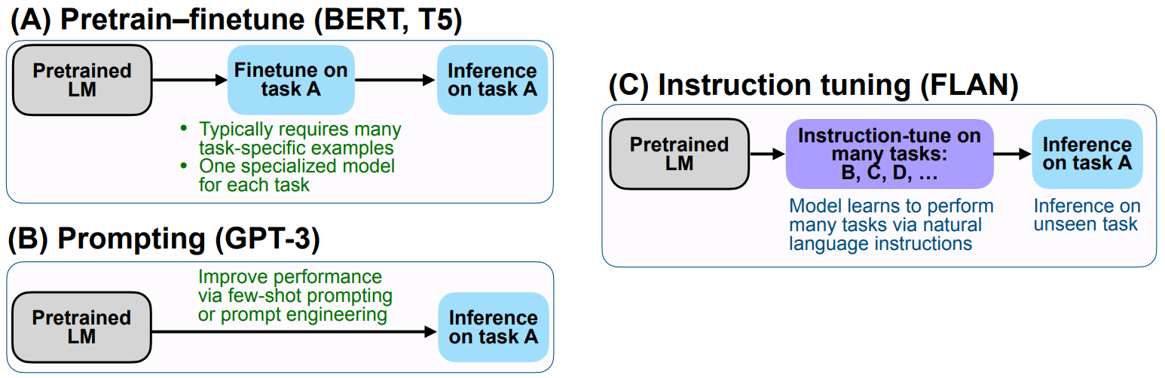
Why Finetuning?
make use of your own data (domain-specific, high-quality)
instruction tuning typically for more generic expert, like coding (but can also be a more specific thing on private data)
source

Slide 6
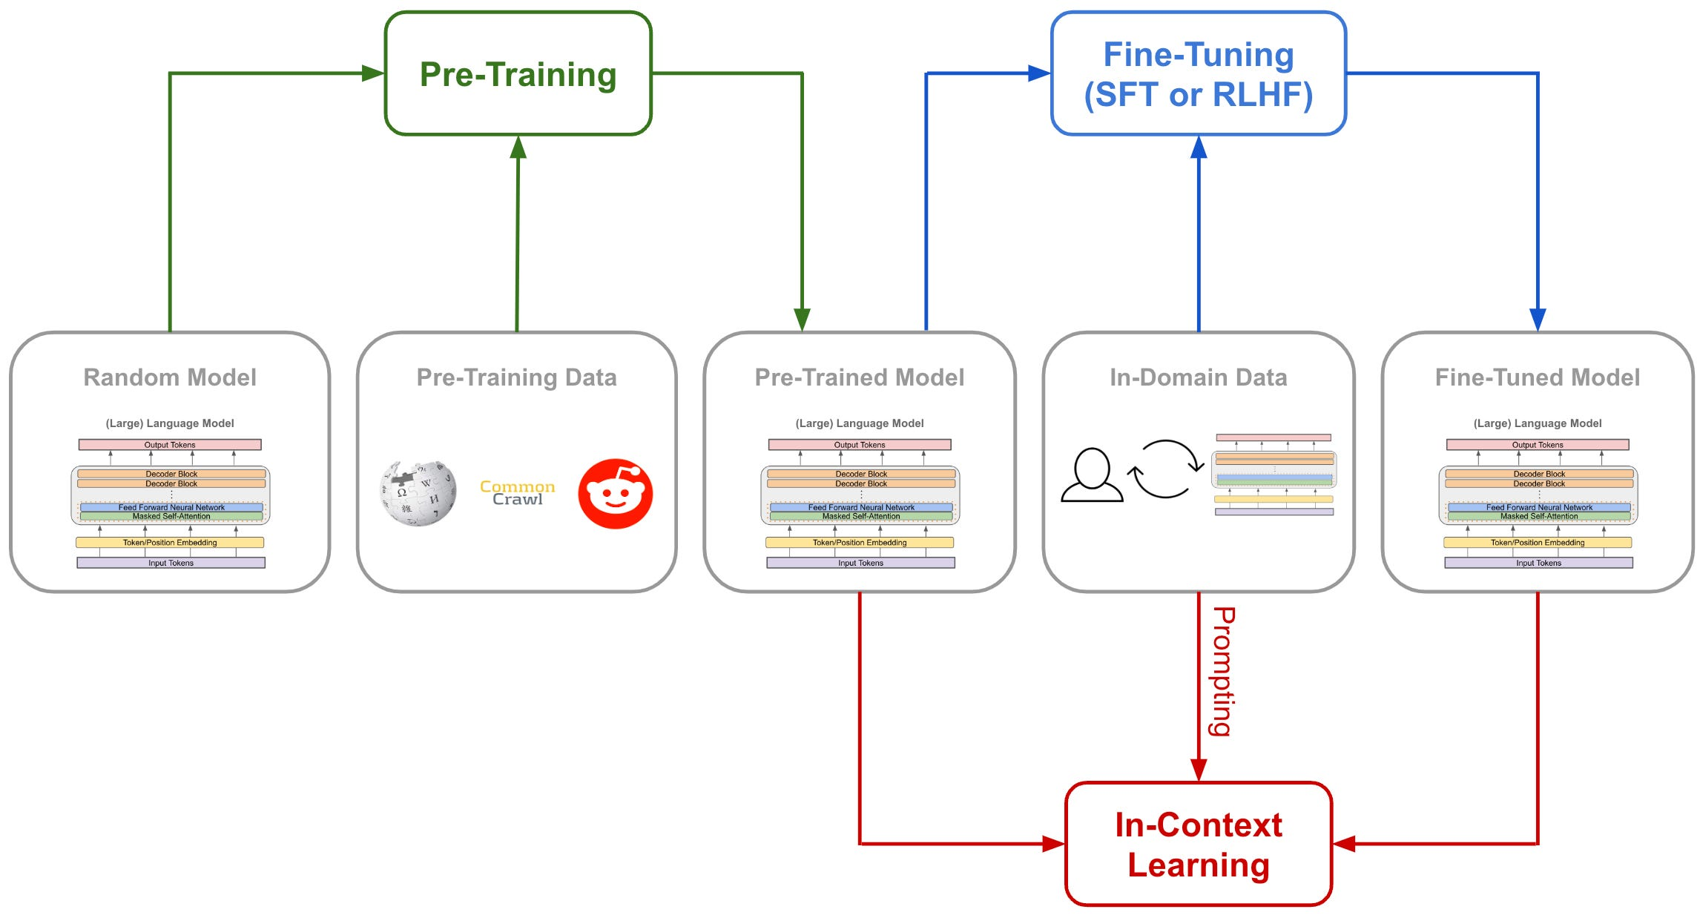

Slide 7
Instruction Tuning
…
supervised fine-tuning (SFT)
(e.g., formatting)

Slide 8
Use Case: Question Answering

Slide 9
Vibe Coding

Slide 10
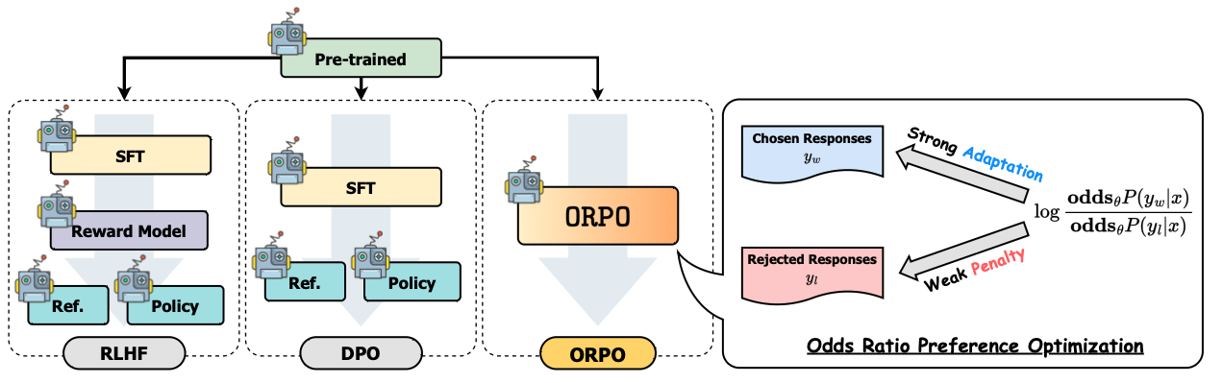
Alignment
…
reinforcement learning from human feedback (RLHF)
alternatives: DPO, ORPO

Slide 11
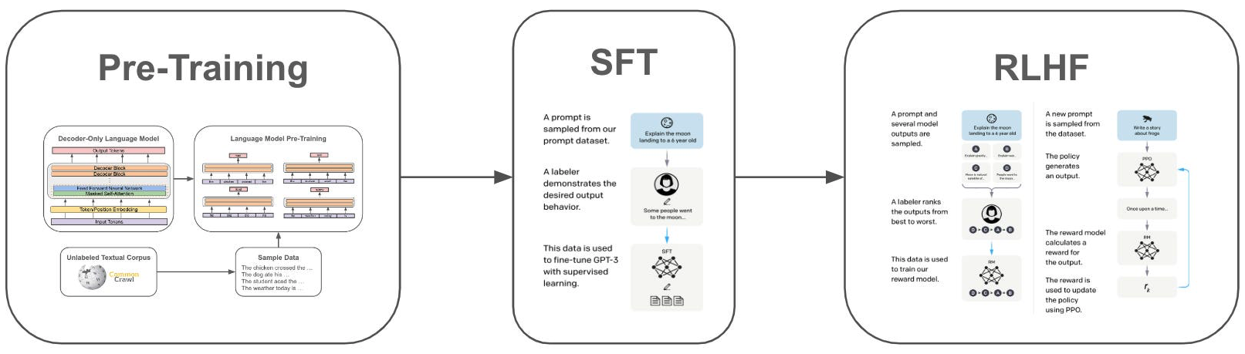
InstructGPT
source
aligning LLM output with human intention

Slide 12
from GPT-3 to InstructGPT and ChatGPT

Slide 13
Multi-Turn Dialogue
Handled entirely by passing the conversation history as part of the input to the model at each step.

Slide 14
Dialog Systems
…
with instruction-tuned and aligned LLMs: assistant-style models

