Slide 1
Agents
Language Models

Slide 2
Course Contents
Deep Learning
Transformer
Finetuning
Agents
The Bigger Picture
Context Engineering
Instruction Tuning
LLMs

Slide 3
This Part: Agents
tool usage
memory
reasoning & planning

Slide 4
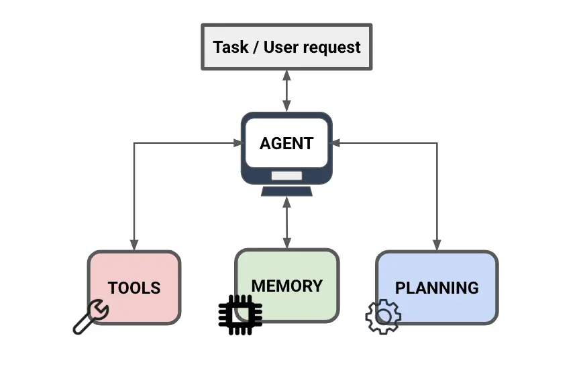
Agentic Intelligence
goal: autonomous problem-solving
decomposition of complex task in simpler steps
(uses reasoning capabilities)

Slide 5
Intuitive and Analytical Thinking
two systems of human thinking (from Kahneman, Thinking, Fast and Slow):
system 1: fast, automatic, intuitive, effortless, often subconscious
system 2: slow, deliberate, analytical, effortful, conscious
LLMs analogous to system 1 (although without true intuition or understanding), lacking the depth of reflective, analytic reasoning
→ for agentic intelligence, need to enhance LLMs with system 2 capabilities, including tool usage and fact-checking

Slide 6
Tool Usage
crucial LLM capabilities:
know how to access different tools
code interpreters
web search
calculators (to overcome lack of mathematical understanding)
…
select right tool at right time

Slide 7
Acquistion of Tool Usage Skills
using instruction-tuned LLMs (like ChatGPT) as agent:
core capability (how to use a tool) comes from pretraining and different finetuning stages
tool access controlled at runtime via prompting and system messages
tool selection (when to use which tool) decided from context
potentially, custom finetuning for specific tools or workflows

Slide 8
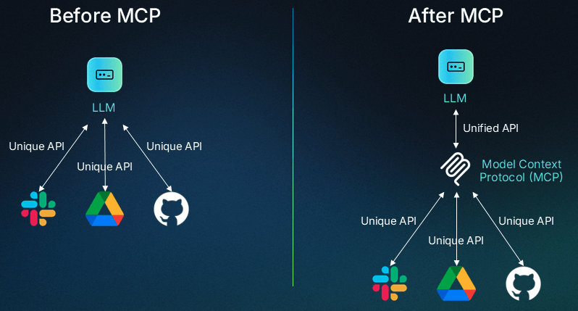
Model Context Protocol (MCP)
open protocol to connect LLMs to different tools or data sources
standardization for provisioning of external context

Slide 9
Memory
… short-term memory in context (sufficient for most tasks)
long-term storage that survives across conversations
typically implemented through external vector stores
… not very common
...

Slide 10
Prompting Strategies
let LLM agents show reasoning capabilities by clever prompts
… chain-of-thought prompting
… ReAct
prompt optimization (OPRO)
→ test-time scaling

Slide 11
Chain-of-Thought

Slide 12
ReAct

Slide 13
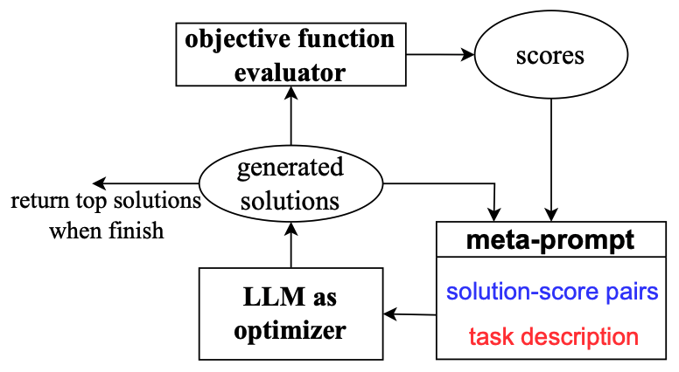
OPRO
…

Slide 14
Test-Time Scaling
the more thinking time (i.e., compute), the better the performance for most of the reasoning models
…

Slide 15
Reasoning Models
finetuning to improve reasoning capabilities of LLMs
explicitly trained to perform native thinking or chain-of-thought

Slide 16
Test-Time Training
TTT
…

Slide 17
Agents and LLM Orchestration
LangChain, AutoGPT, OpenAgents, BabyAGI, …
prompting strategies + orchestration logic + access to tools/memory
They wrap an LLM (like GPT-4) in an architecture that allows it to:
Prompt itself in a loop (self-reflect, plan, re-prompt).
Persist state (via memory, databases).
Call external tools/APIs (web search, code execution, file systems).
Iteratively refine output toward a goal.

Slide 18
Structured Outputs
turn freeform generation into parsable formats
…

Slide 19
Goal: Autonomous End-to-End Workflow
LLM/VLM agent
RAG
tool usage
control
domain knowledge
e.g., tabular models
decision making
input
input
perception

Slide 20


LLMs $≠$ AGI
current AI good at learning statistical patterns and making predictions
but no real “understanding” or world model
And don’t get fooled by alignment ;).

