Slide 1
LLMs
Language Models

Slide 2
Course Contents
Deep Learning
Transformer
Finetuning
Agents
The Bigger Picture
Context Engineering
LLMs

Slide 3
This Part: LLMs
generative AI
autoregressive text generation
scaling laws
LLM zoo

Slide 4
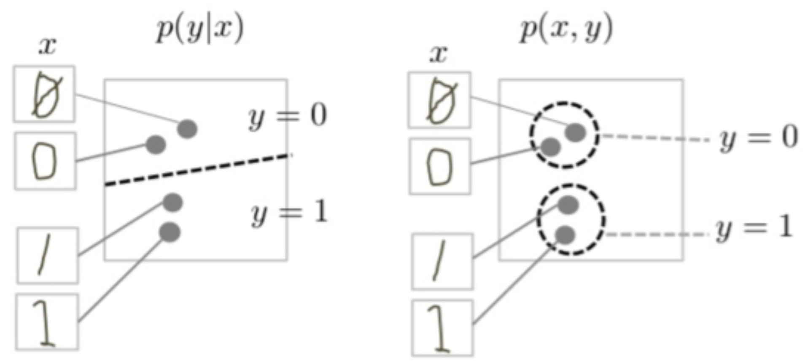
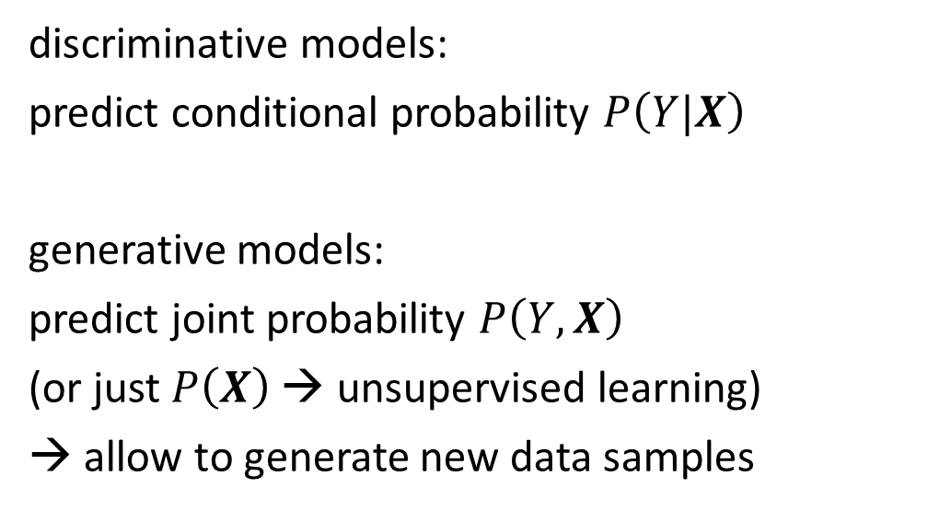
Generative vs Predictive/Discriminative Models
discriminative model
generative model
discriminative models:
predict conditional probability $P\left(Y|X\right)$
generative models:
predict joint probability $P\left(Y,X\right)$
(or just $P\left(X\right)$ → unsupervised learning)
→ allow to generate new data samples
source
task of generative models more difficult: need to model full data distribution rather than merely find patterns in inputs to distinguish outputs
Generative models can be used for predictive tasks (Bayes theorem).
But predictive models are usually better at it.

Slide 5
Autoregressive Text Generation
LLMs (autoregressive transformers) generate one output token at a time (according to predicted probabilities)
then add it to the context for the prediction of the next token
→ resulting in a full text, sampled from predicted probabilities

Slide 6
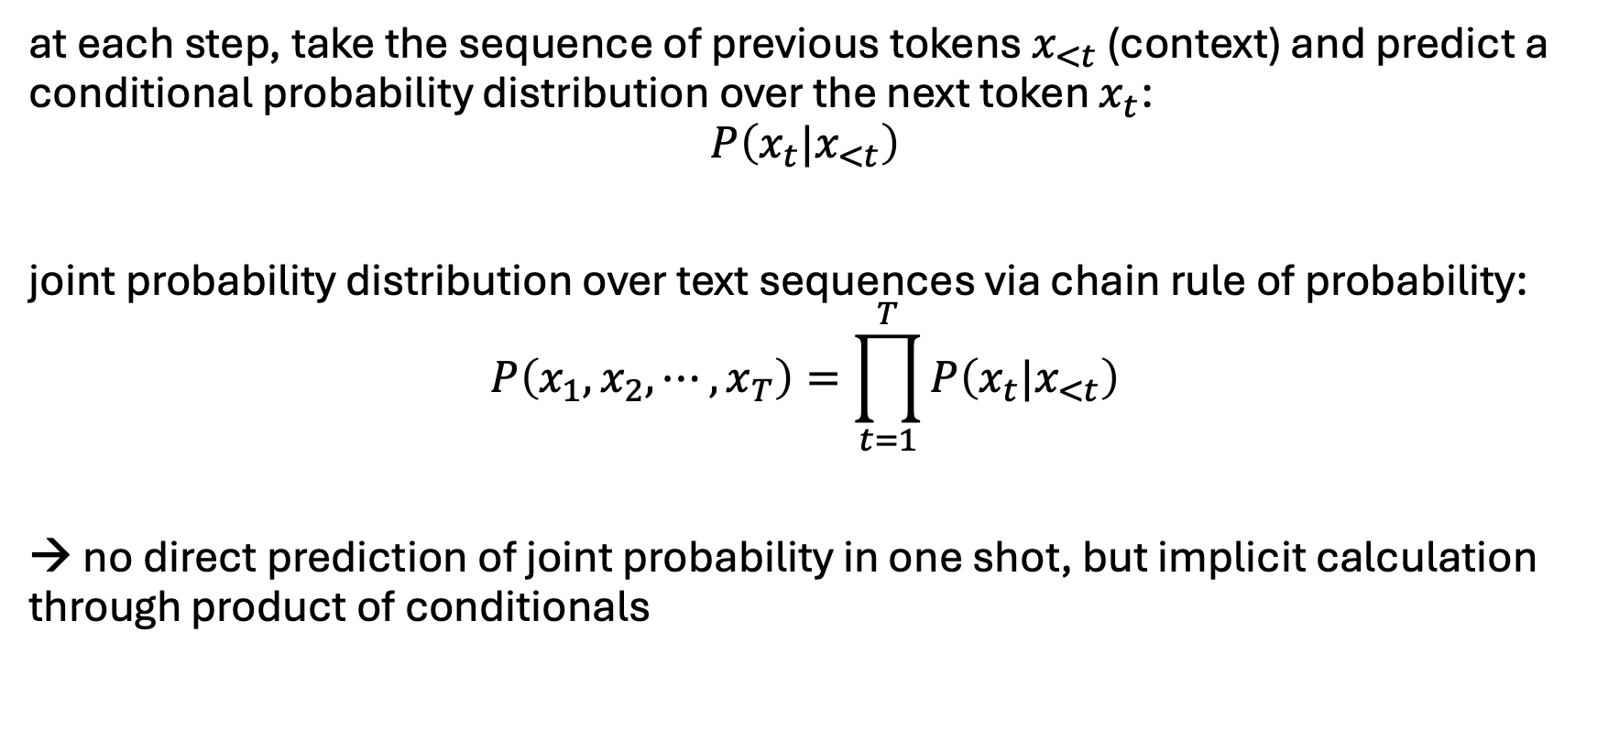
How are LLMs Generative Models then?
at each step, take the sequence of previous tokens $x_{<t}$ (context) and predict a conditional probability distribution over the next token $x_{t}$:
$$P\left(x_{t}{|x}_{<t}\right)$$
joint probability distribution over text sequences via chain rule of probability:
$$P\left(x_{1}, x_{2}, ⋯, x_{T}\right)=\prod_{t=1}^{T}{P\left(x_{t}{|x}_{<t}\right)}$$
→ no direct prediction of joint probability in one shot, but implicit calculation through product of conditionals

Slide 7
Prompting
feed information into decoder-only transformer via input prompt
→ attention to context
using all the knowledge acquired during internet-scale pretraining and stored in weights
kind of programmable neural network
→ a new paradigm: one model for many tasks

Slide 8
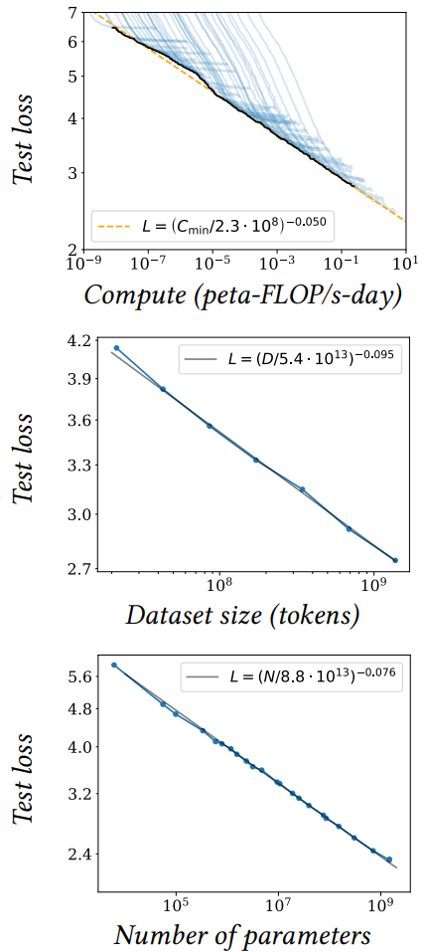
Size Matters: LARGE Language Models
scaling laws, Chinchilla: coupled performance power laws with model size, amount of training data, and compute
→ era of large-scale models
emergent abilities of LLMs:
multi-task learning: perform new tasks at test time without task-specific training (via prompting)
reasoning capabilities
source

Slide 9
Some LLM Numbers
as usual, comes in base and instruct variants
example Kimi K2 (Mixture-of-Experts model):
vocabulary size (tokens): 160K
embedding dimension: 7,168
context length (tokens): 128K
total parameters: 1T
training tokens: 15.5T
number of layers: 61
number of attention heads: 64
number of experts: 384
→ a lot of memorizing
compression of the internet

Slide 10
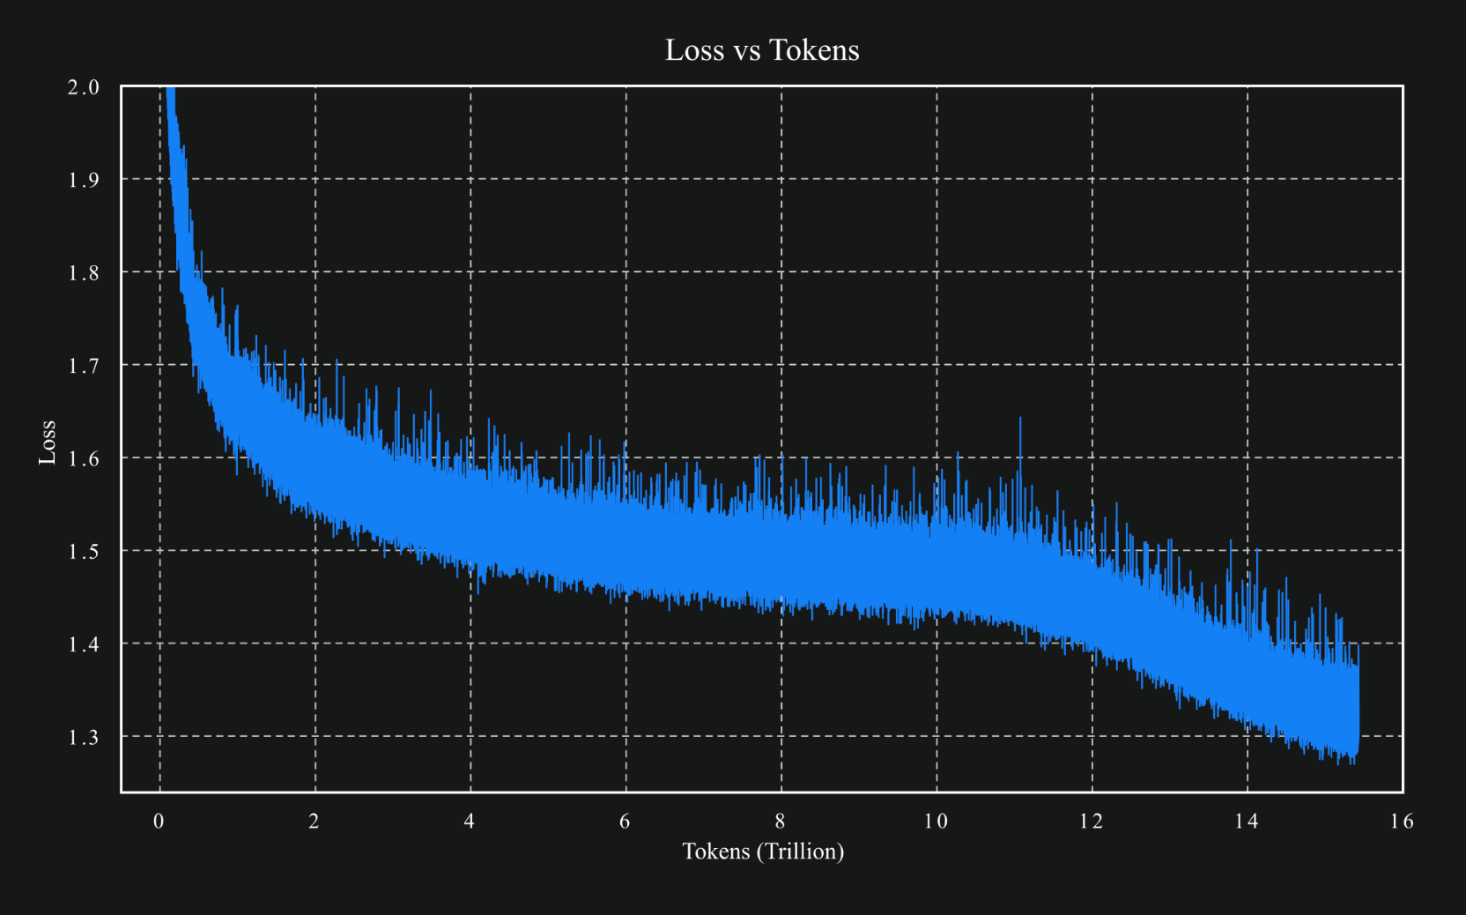
source

Slide 11
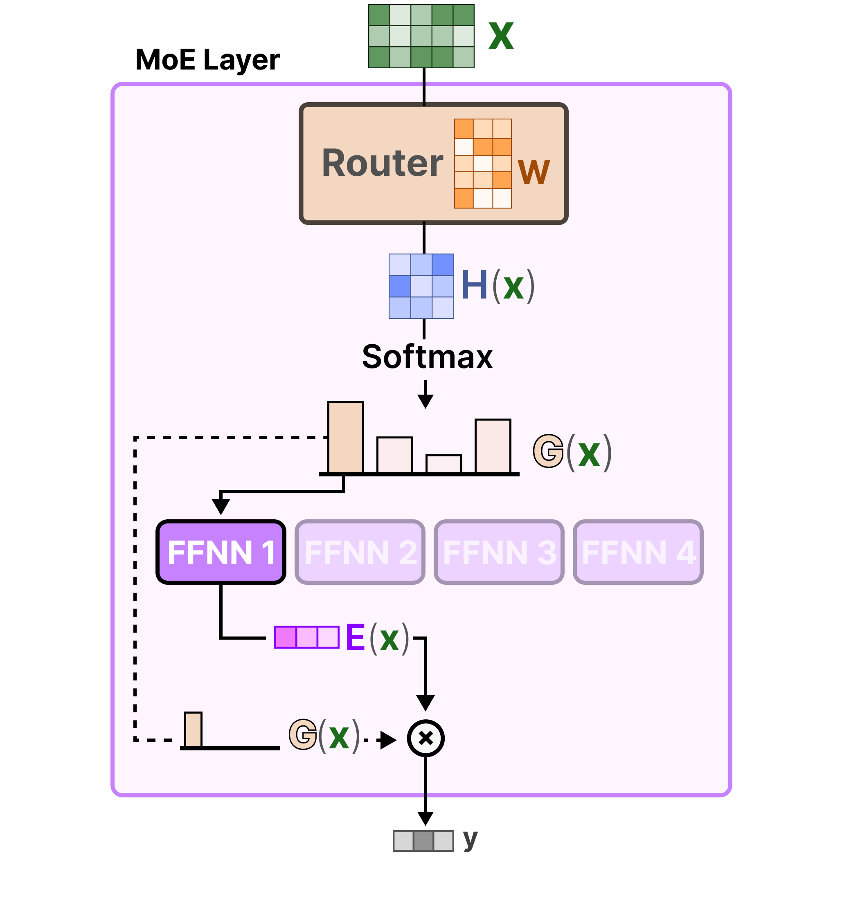
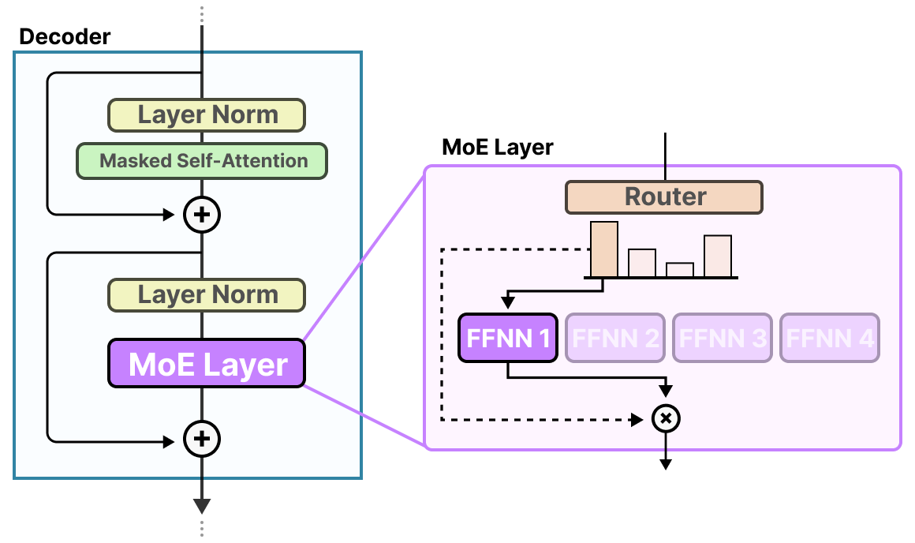
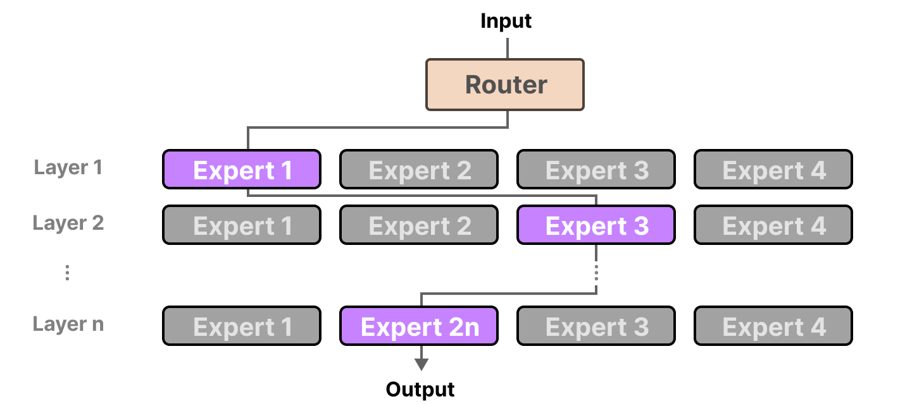
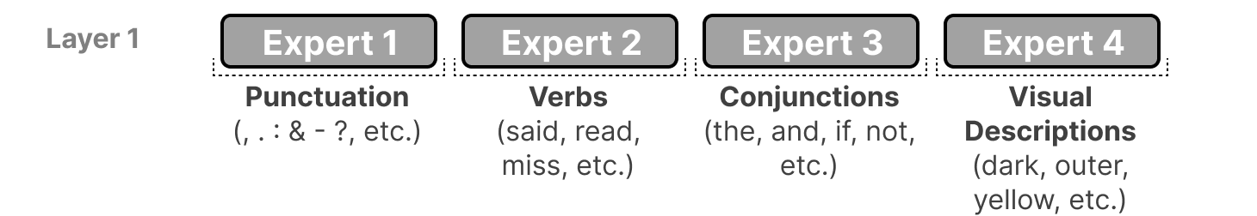
Mixture-of-Experts (MoE)
FFNN itself
idea: replace big FFNN with several smaller ones and activate only few
→ less active parameters
different paths for each token:
example (actually more abstract):

Slide 12


dialogue & alignment breakthroughs
foundational era
dialogue model (powered Bard)
reasoning + chain-of-thought prompting
the architecture everything is built on
pioneered instruction-style tasks
Transformer
Google
BERT 340M
Google
T5
Google
LaMDA
Google
PaLM 540B
Google
used for Google search
2017
2018
2019
2020
2021
2022
2023
GPT-1 117M
OpenAI
GPT-2 1.5B
OpenAI
GPT-3 175B
OpenAI
InstructGPT
OpenAI
ChatGPT
OpenAI
showed coherent long-form text generation
proved general-purpose language generation
introduced RLHF to align models with human intent (basis for ChatGPT)
mass adoption

Slide 13
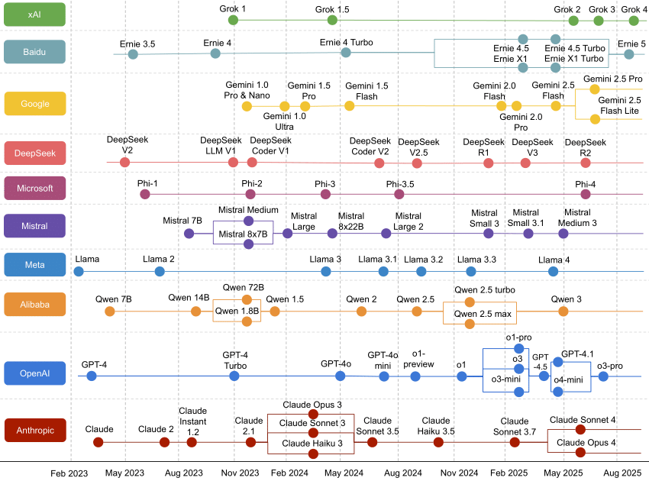



generative chatbots
evolved from LaMDA & PaLM
integrated Google ecosystem
MAI-1
open-source models
GPT-5
gpt-oss
ChatGPT
different alignment strategy
tailored for business users

Slide 14
OpenAI’s GPT Series
GPT-1: used for discriminative finetuning on specific tasks (summarization, translation, question-answering, …) → BERT
GPT-2: zero- or few-shot learning → prompting
GPT-3: scaling (175 billion parameters) → much increased capabilities
GPT-4: more scaling (capabilities)
GPT-4o: multimodal model
o1: reasoning model
GPT-5: automatic activation of reasoning model depending on the task
gpt-oss

Slide 15
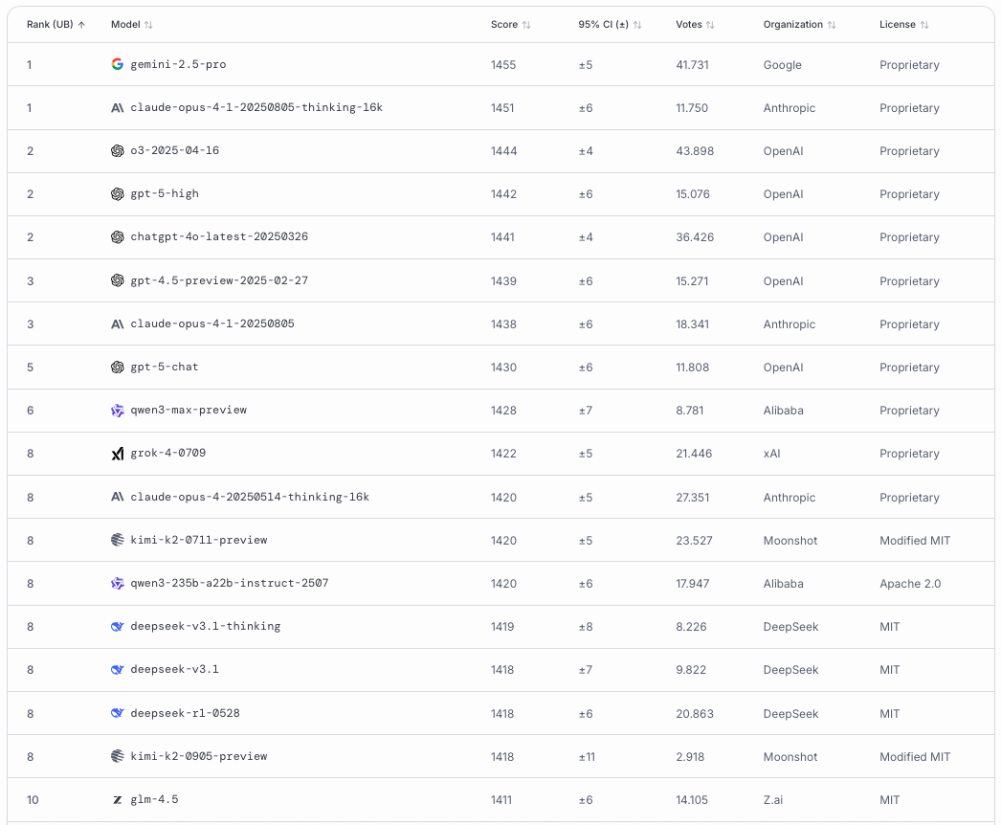
LMArena

Slide 16
Another Trend: Small Language Models (SLM)
most powerful LLMs keep getting bigger (> 1 trillion parameters)
GPT, Claude, Gemini, …
but slimmed-down (yet still strong) versions get smaller
Gemma (2B), Phi-3 (3.8B), Mistral 7B, Llama3 (8B), …
can run (inference) on laptops, smartphones, etc.
easier finetuning → specific tasks

Slide 17
Next: Context Engineering
To get the most out of LLMs, you need to prompt in the right way.
→ prompt engineering
Furthermore, the capabilities of LLMs can be enhanced by including additional information in the prompt.
→ context engineering

