Slide 1
Transformer
Language Models

Slide 2
Course Contents
Deep Learning
Transformer
Finetuning
Agents
The Bigger Picture
Context Engineering
LLMs

Slide 3
This Part: Transformer
tokenizer
static embeddings
contextual embeddings
text generation
transformer types

Slide 4
Tokenization
tokenization: breaking text in chunks
word tokens: different forms, spellings, etc → undefined and vast vocabulary
character tokens: not enough semantic content (longer sequences)
popular compromise: byte-pair encoding

Slide 5
Byte-Pair Encoding
data compression method used for encoding text as sequence of tokens (sub-words)
merging token pairs (starting with characters) with maximum frequency
continue merging until defined fixed vocabulary size (hyperparameter) is reached
common words encoded as single token
rare words encoded as sequence of tokens (representing word parts)
alternative: direct operation on bytes (e.g., ByT5)
aaabdaaabac
ZabdZabac
Z=aa
ZYdZYac
Y=ab
Z=aa
XdXac
X=ZY
Y=ab
Z=aa
example from wikipedia

Slide 6
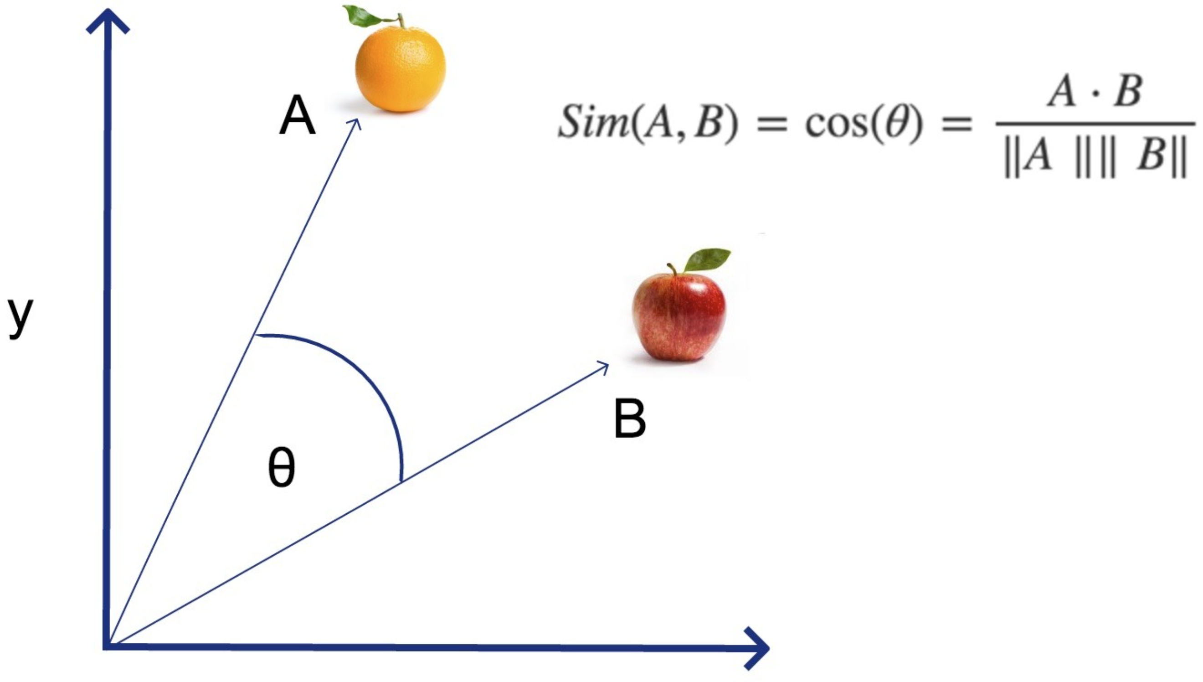
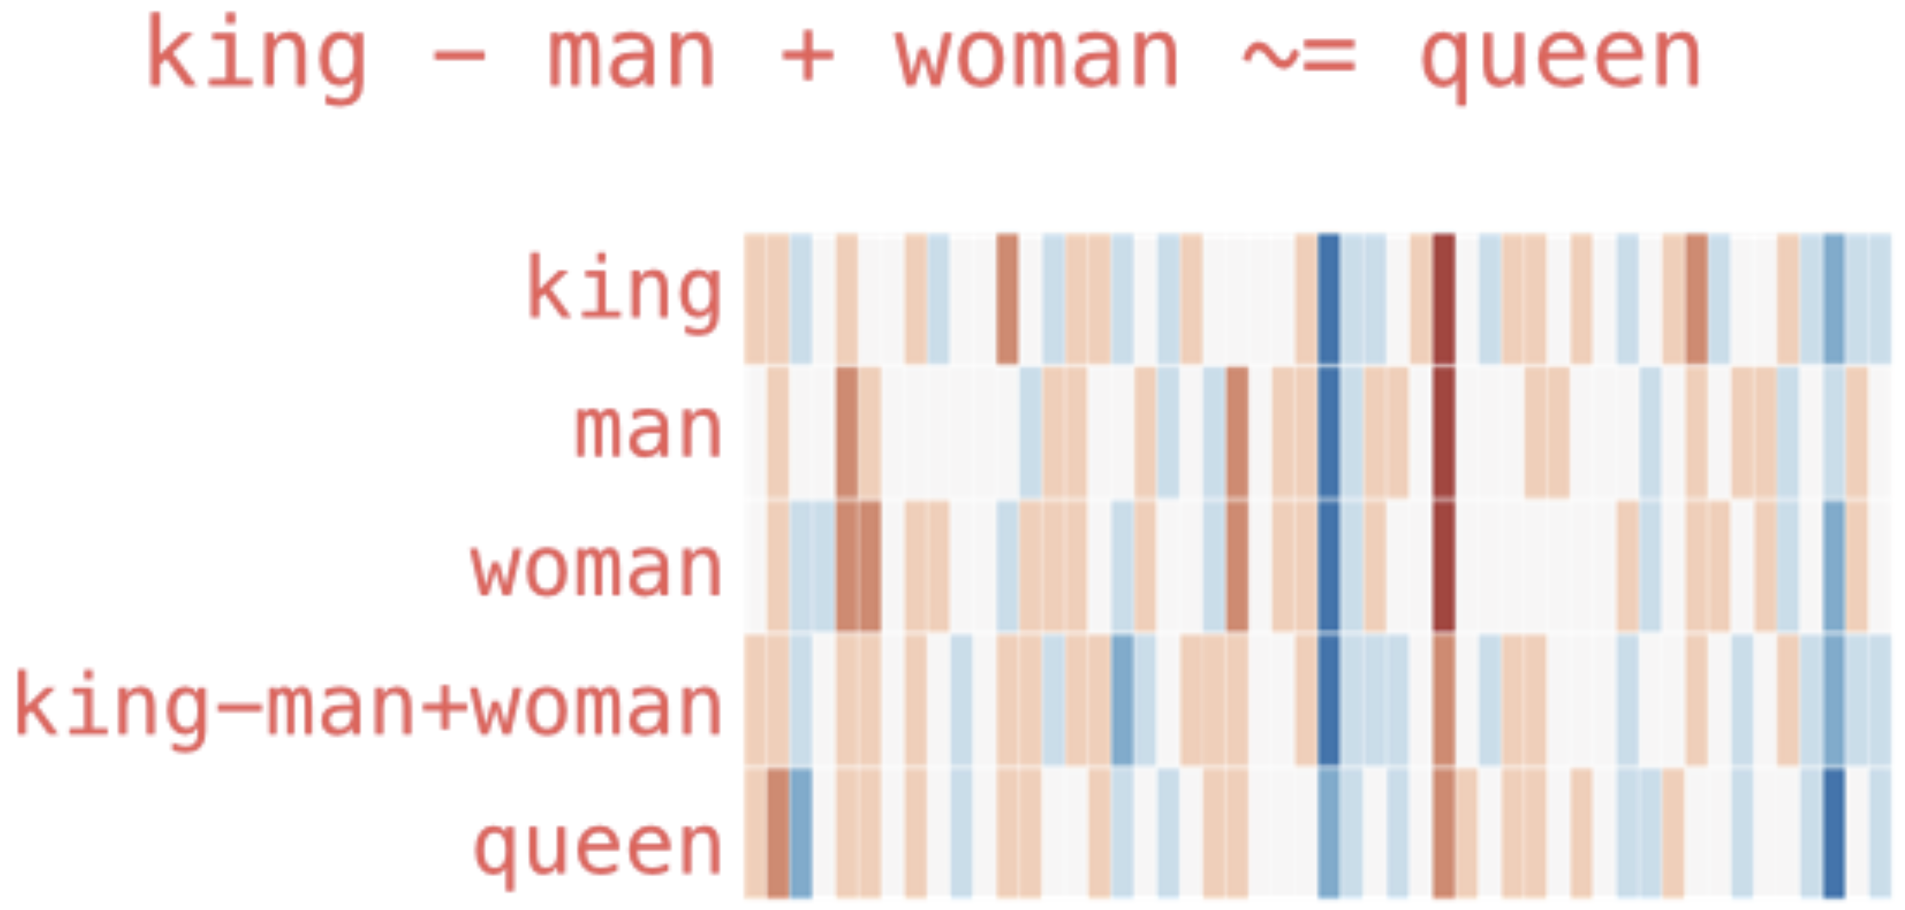
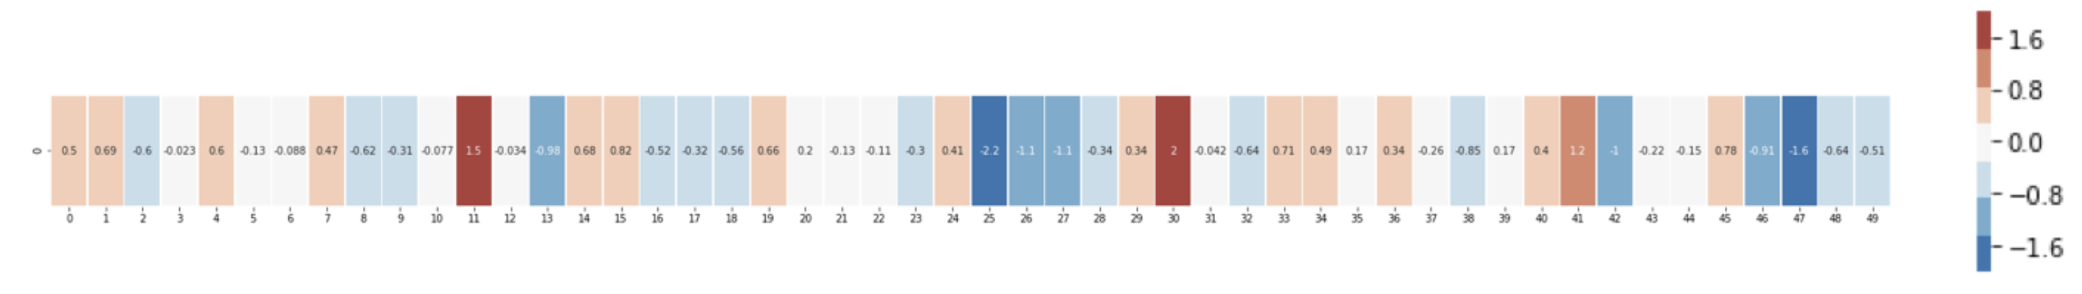
Embedding Layers
representation of entities by vectors
→ semantic similarity
most famous application: word embeddings
→ associations (natural language processing)
but general concept: embeddings of (categorical) features (e.g., products in recommendation engines)
learned via co-occurrence (e.g., word2vec)
but also direction of difference vectors interesting (analogies):
source

Slide 7
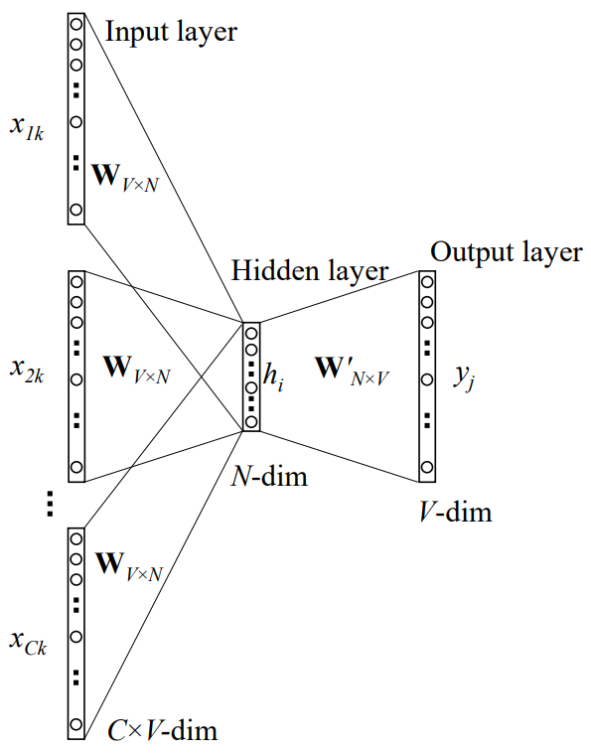
Some Thoughts on Word Embeddings
can be implemented as
neural network with single hidden layer (linear activation)
using, e.g., bag-of-words approach (predict masked word from its surroundings)
not context-aware
CBOW:
source
softmax of target word
word vector (embedding) by multiplication with one-hot vector
one-hot vectors of context words

Slide 8
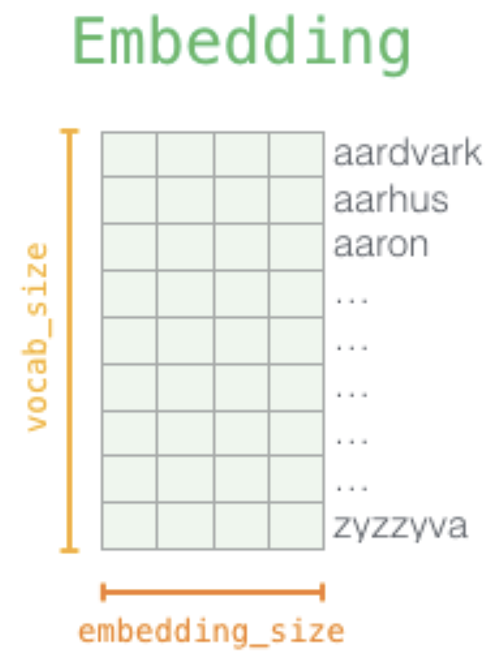
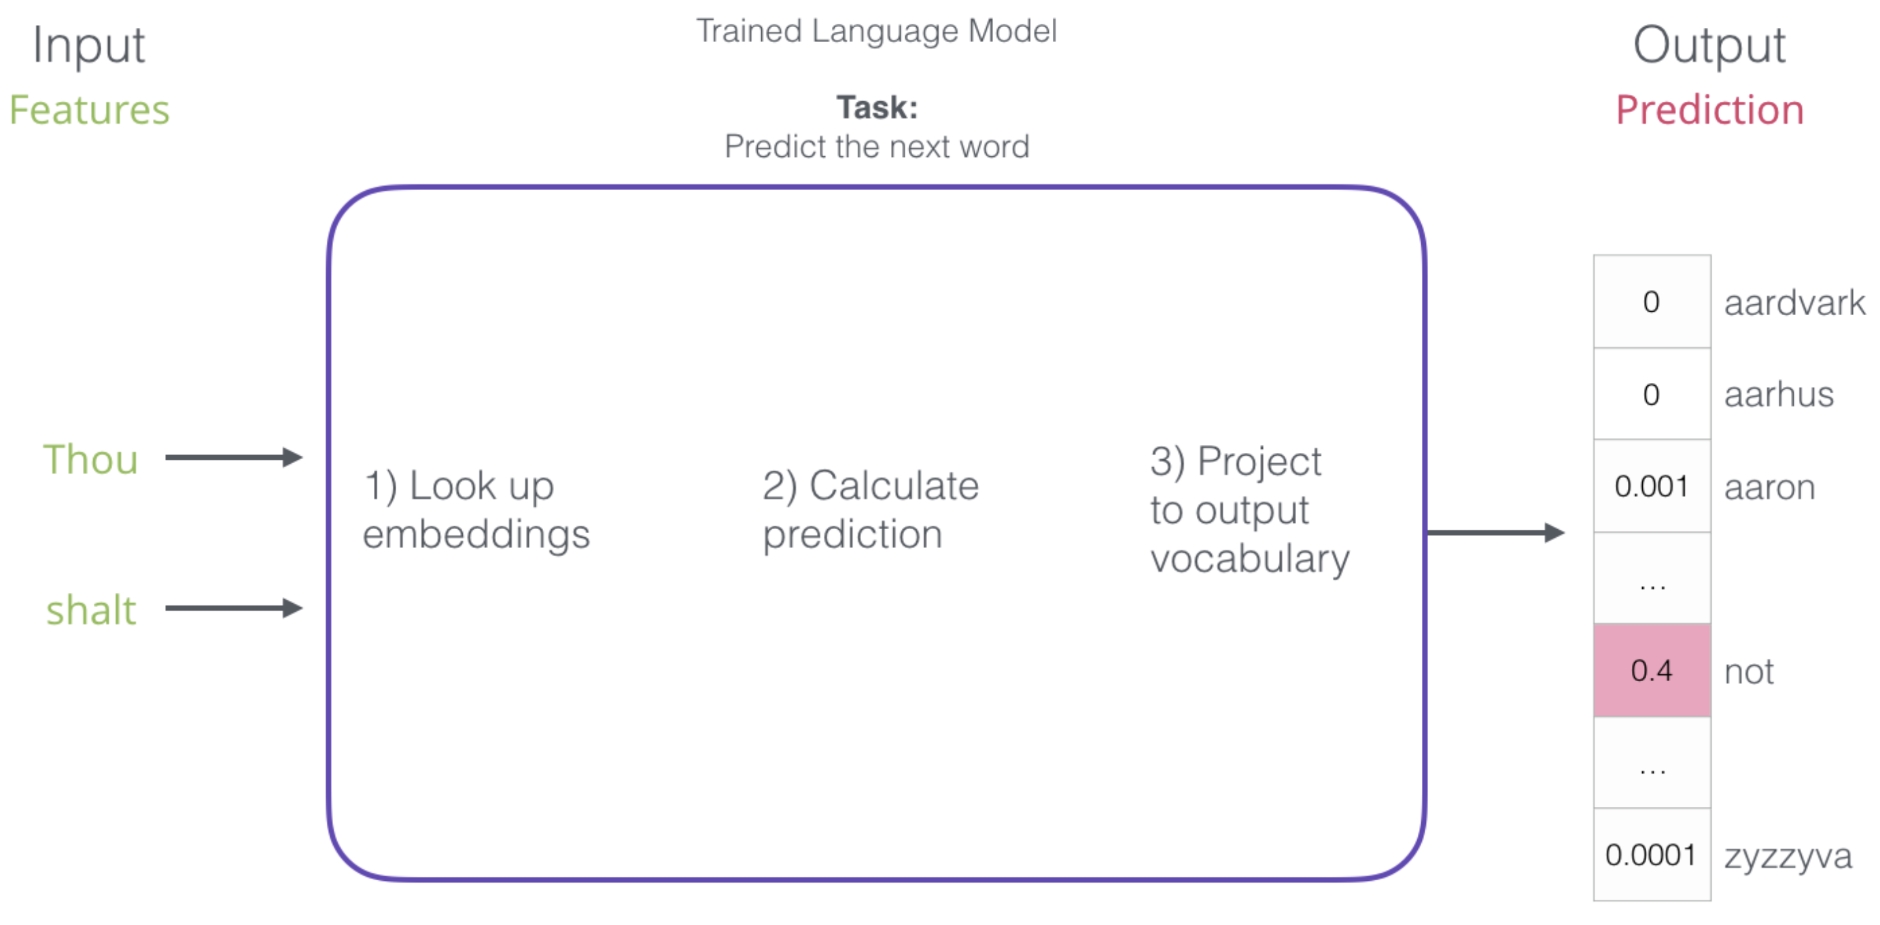
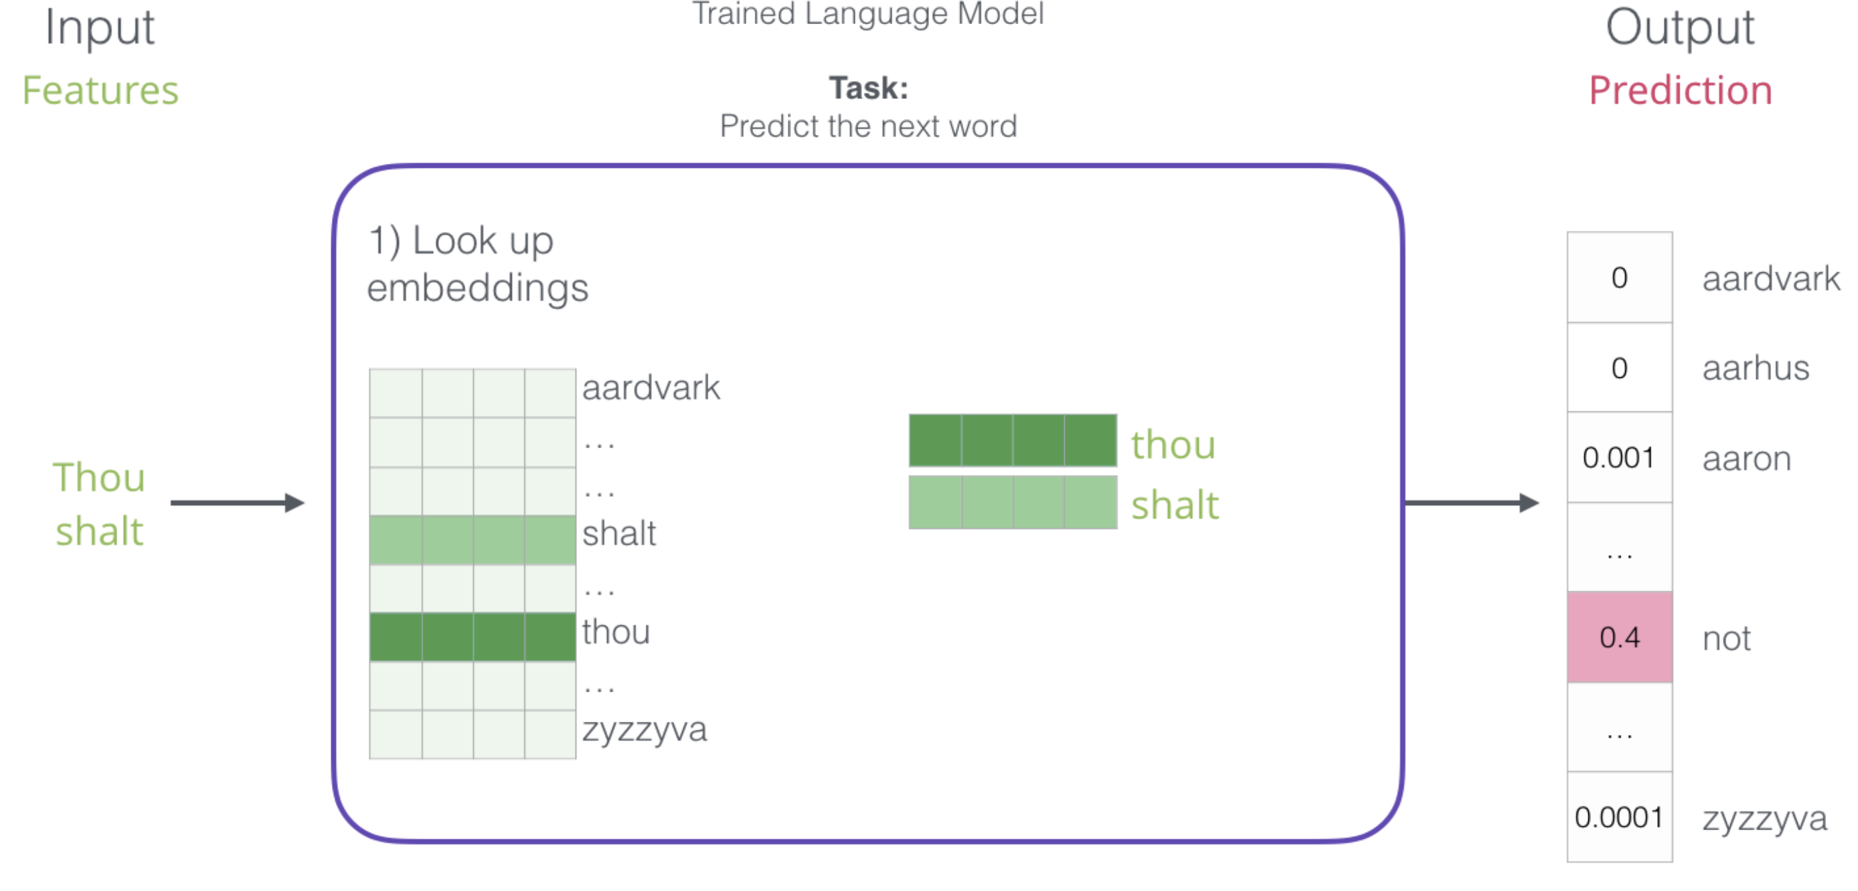
Word Embeddings as Part of Language Model
language models contain embedding matrix as part of learned parameters
typically several hundred dimensions for word vectors (to be compared with vocabulary sizes of many thousands)
(can also be extracted and subsequently used as pretrained embeddings for other task)
next-word prediction:
source

Slide 9
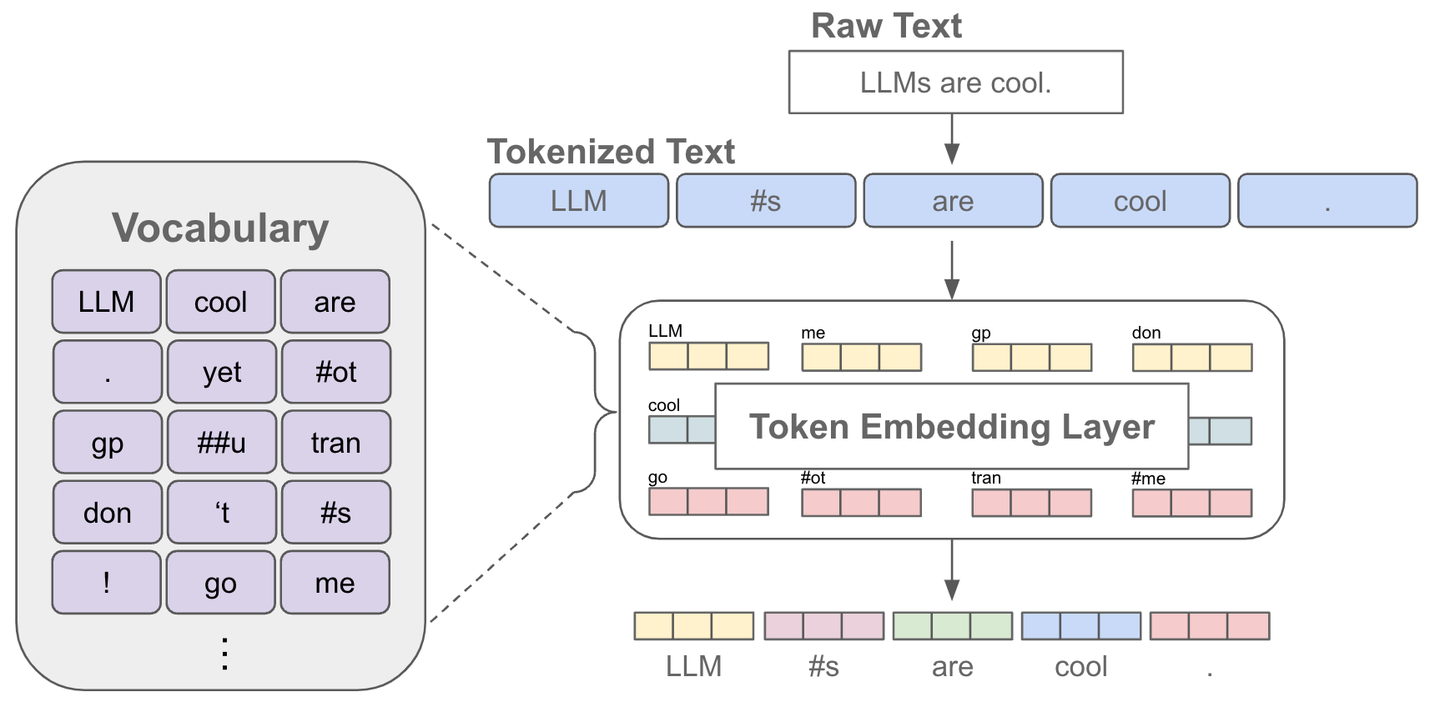
Tokenization & Embeddings
source

Slide 10
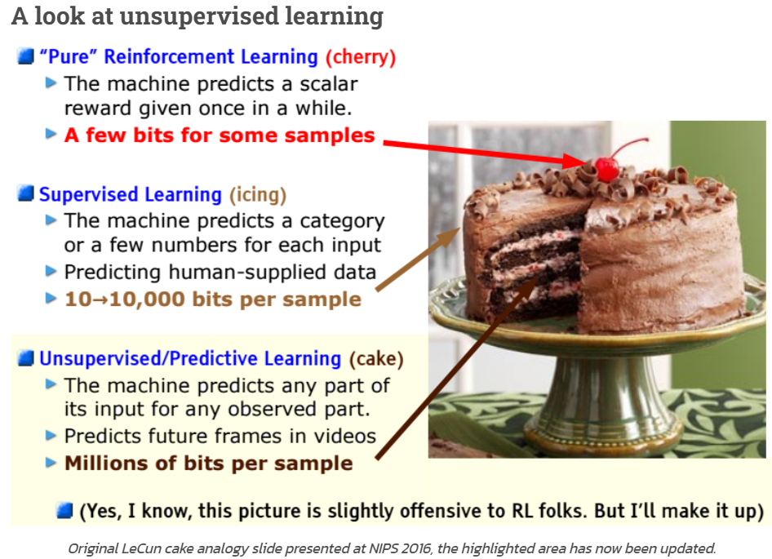

Self-Supervised Learning
ML needs lots of training data
unsupervised learning (learning by observation)
no target information → kind of “vague” pattern recognition (but plenty of data)
can be cast as self-supervised learning:
input-output mapping like supervised learning
but generating labels itself from inputs
source
The Lord of the Rings is considered one of the greatest fantasy
The Lord of the Rings is considered one of the greatest fantasy books
$$⋮$$
now run this across the entire internet …

Slide 11
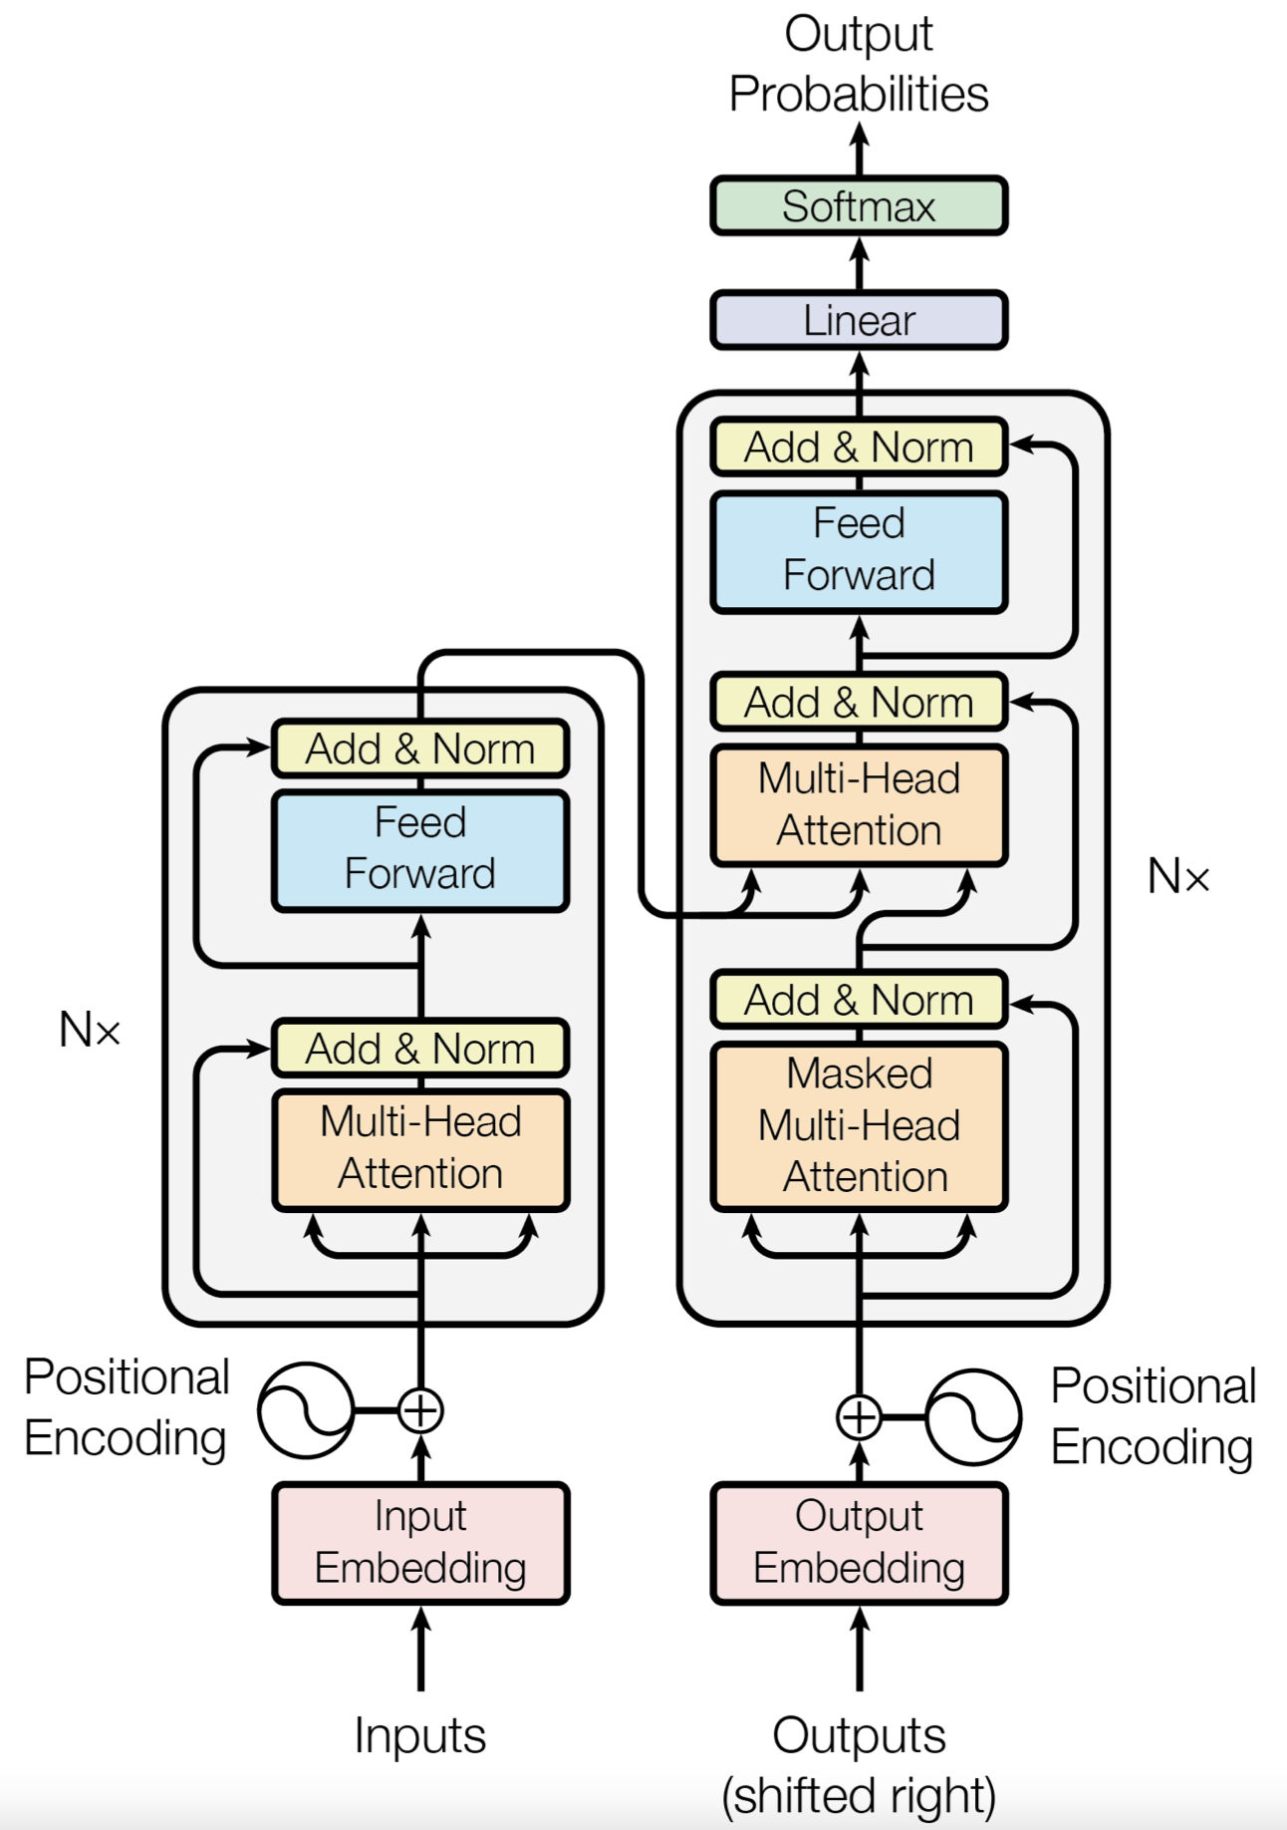
Context Awareness: Transformer
original transformer: sequence-to-sequence model (e.g., for machine translation)
Attention Is All You Need:
completely replaced recurrent neural networks (RNN)
much more parallelization → bigger models
better long-range dependencies thanks to shorter path lengths in network (less sequential operations)
encoder/decoder stacks (depth): output fed as input to next one
encoder
decoder

Slide 12
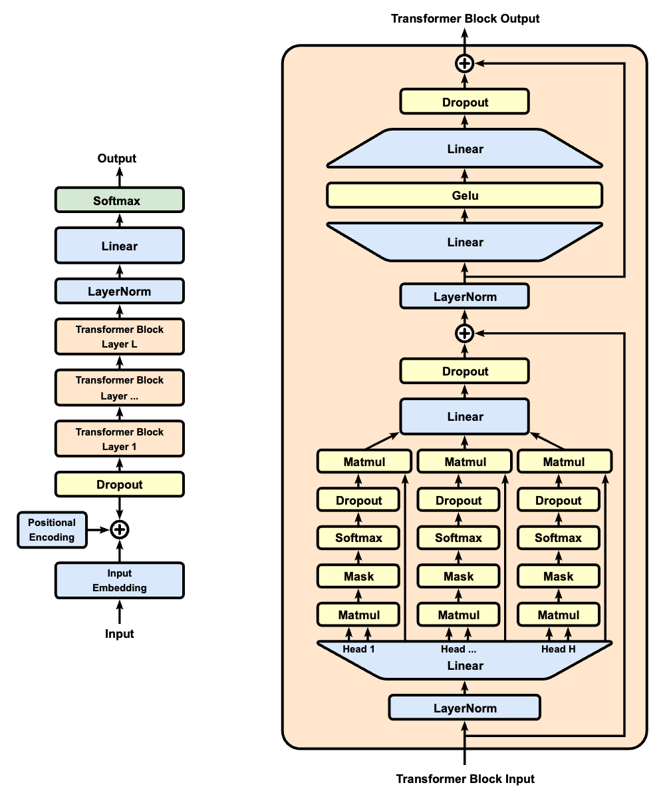
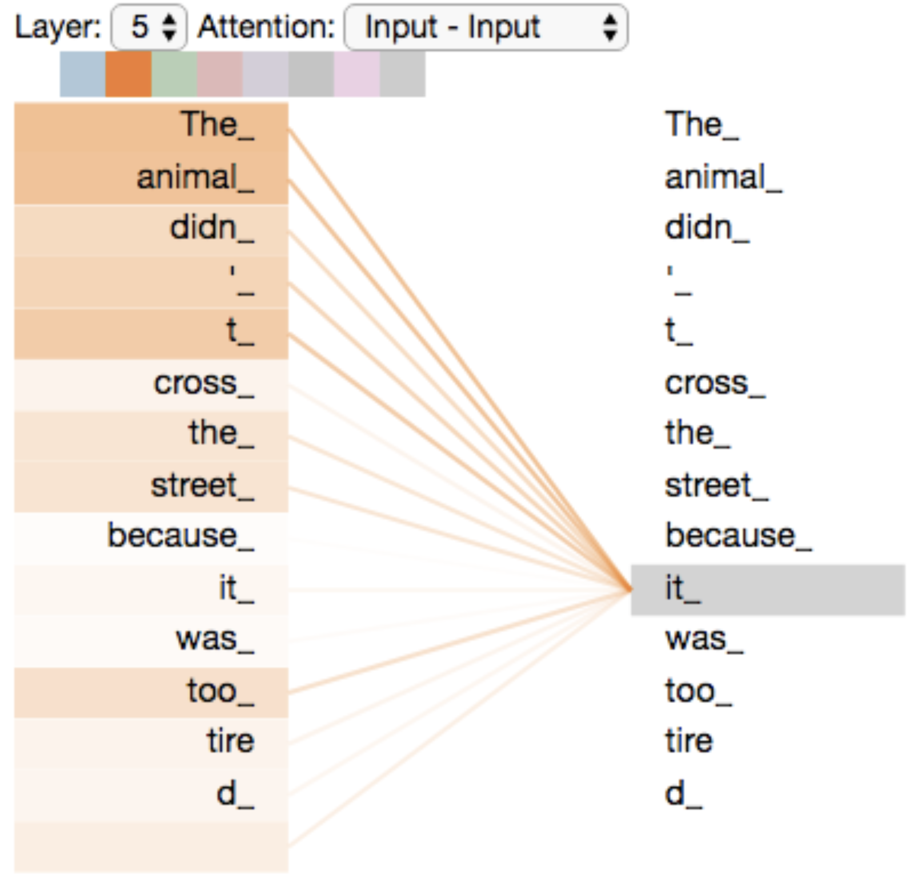
Self-Attention Mechanism
GPT (decoder-only):
evaluating other input tokens in terms of relevance for encoding of given token
computational complexity quadratic in length of input (each token attends to each other token)
only allow to attend to earlier positions in sequence (masking future positions)
source

Slide 13
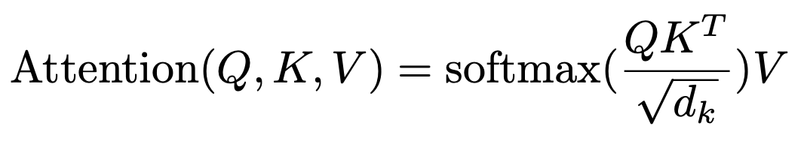
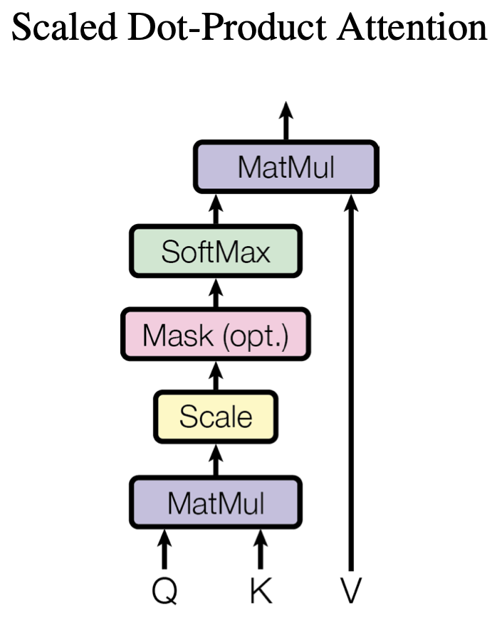
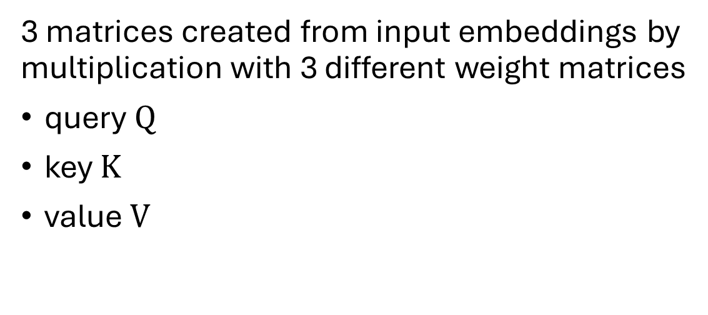
Scaled Dot-Product Attention
softmax not scale invariant (largest component dominates for large scale) and dot product larger for more vector dimensions
3 matrices created from input embeddings by multiplication with 3 different weight matrices
query $Q$
key $K$
value $V$
filtering: multiplication of attention probabilities with corresponding key-word values
scoring each of the key words (context) with respect to current query word: correlation between inputs (not independent as in conventional neural networks)
key-value pairs
query
source

Slide 14

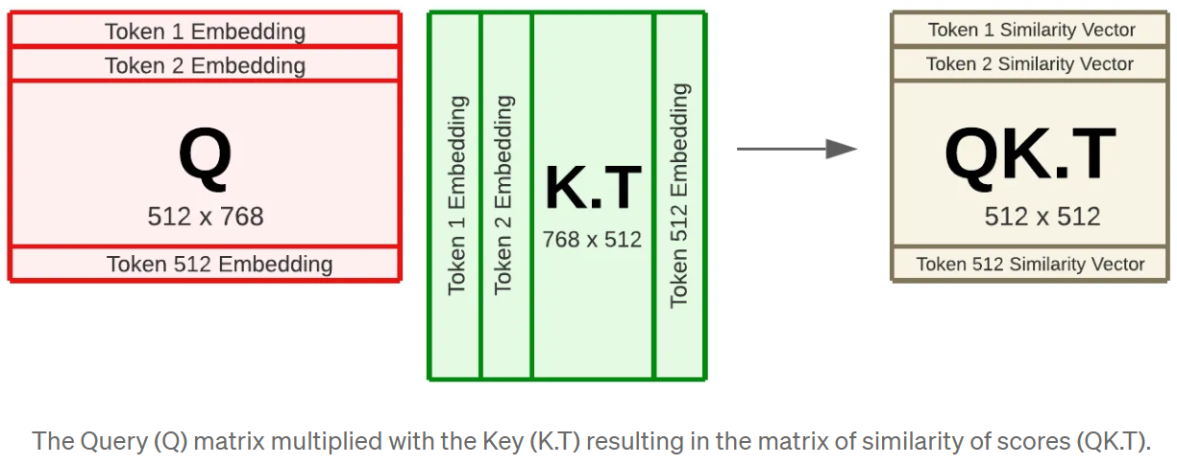
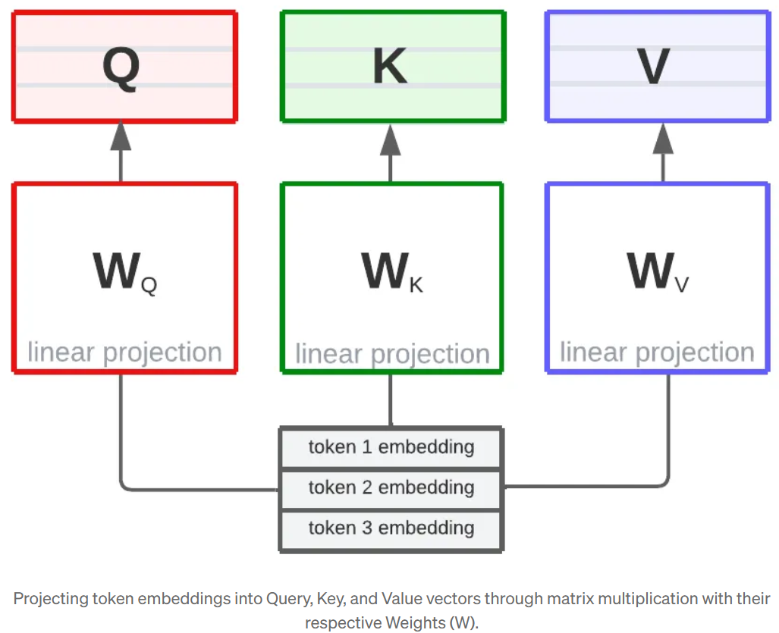
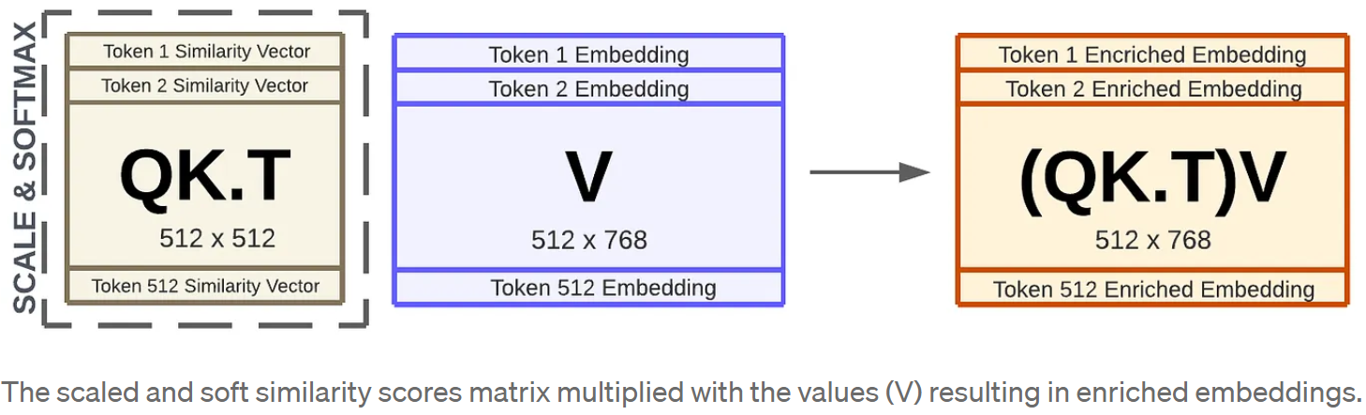
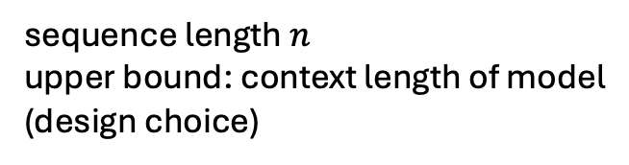
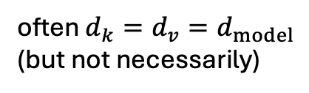
Example: Dimensions in BERT
often $d_{k}=d_{v}=d_{model}$ (but not necessarily)
2
linear projections
1
sequence length $n$
upper bound: context length of model
(design choice)
learned parameters
inputs
3
source

Slide 15
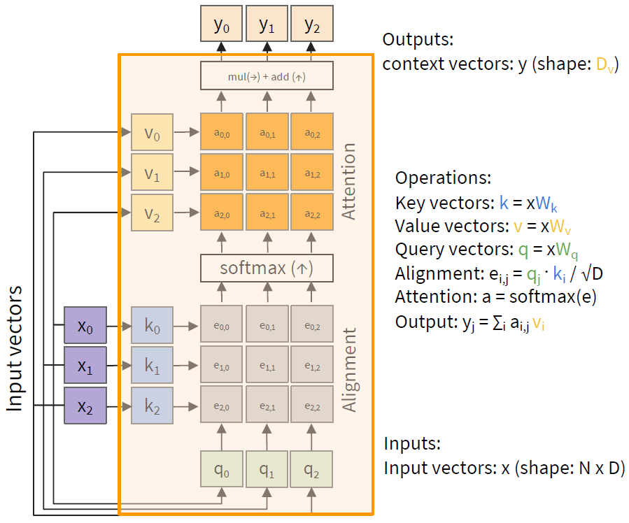



MatMul
$$d_{v}$$
$$d_{k}$$
$d_{model}$: embedding size
weighted average: reflecting to what degree a token is paying attention to the other tokens in the sequence

Slide 16

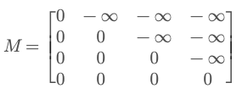
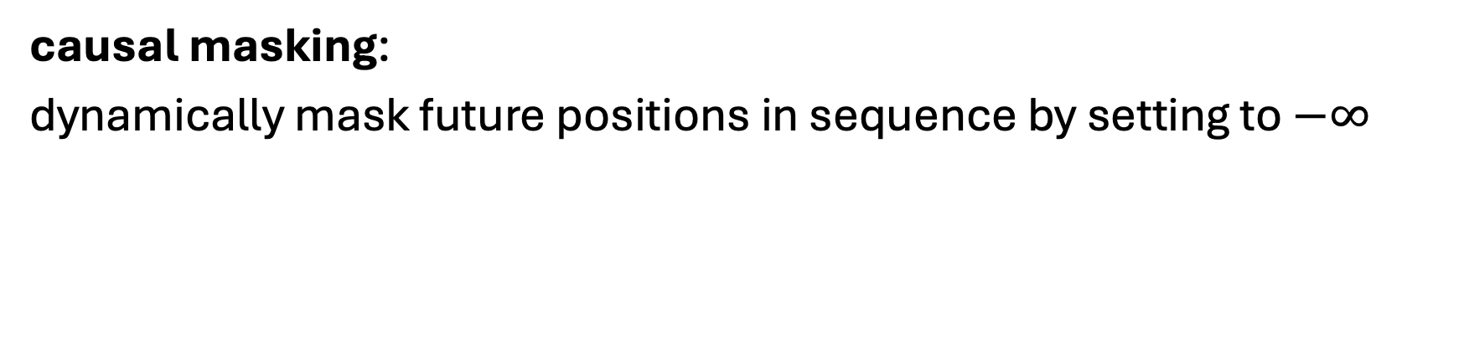
Attention Mask
attention mask
causal masking:
dynamically mask future positions in sequence by setting to $−∞$

Slide 17


Padding Mask
goal: (technically) batch together sequences of different lengths
→ include fake tokens to pad shorter ones to the max length in the batch
then add a padding mask to let the model ignore these fake tokens:

Slide 18
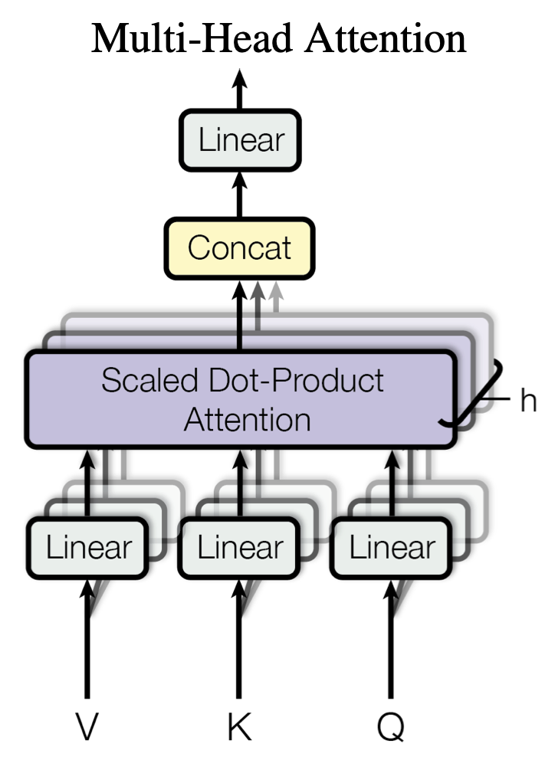
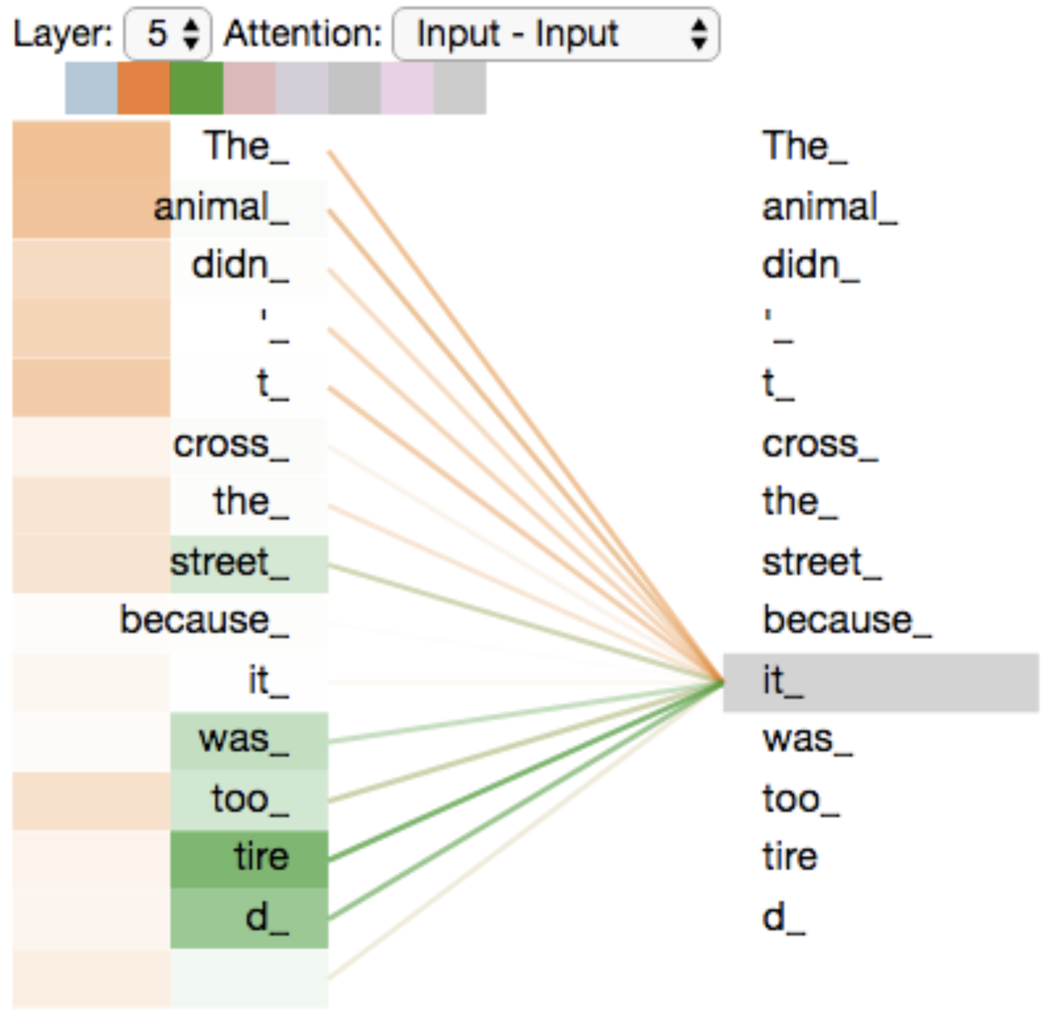
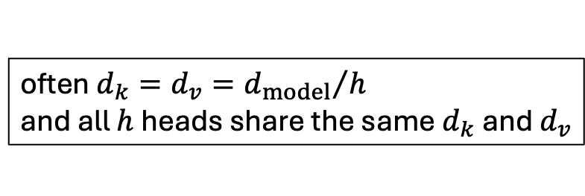
Multi-Head Attention
often $d_{k}=d_{v}={d_{model}}/h$
and all $h$ heads share the same $d_{k}$ and $d_{v}$
multiple heads: several attention layers running in parallel
different heads can pay attention to different aspects of input (multiple representation sub-spaces)
source
source

Slide 19
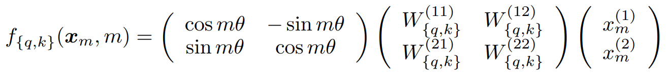
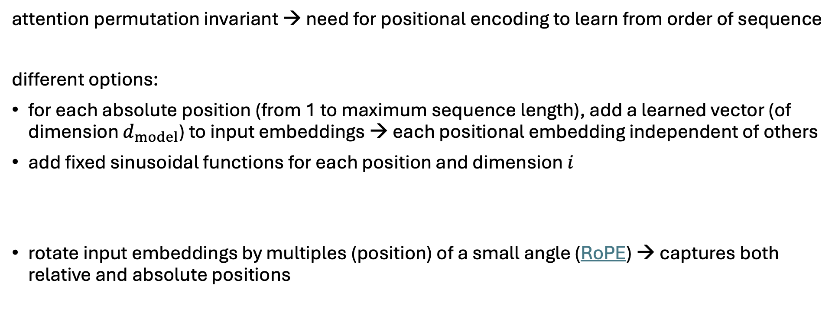
Positional Encoding
defines context length
attention permutation invariant → need for positional encoding to learn from order of sequence
different options:
for each absolute position (from 1 to maximum sequence length), add a learned vector (of dimension $d_{model}$) to input embeddings → each positional embedding independent of others
add fixed sinusoidal functions for each position and dimension $i$
rotate input embeddings by multiples (position) of a small angle (RoPE) → captures both relative and absolute positions
$${PE}_{pos,2i}=\sin\left(\frac{pos}{{10000}^{\frac{2i}{d_{model}}}}\right) {PE}_{pos,2i+1}=\cos\left(\frac{pos}{{10000}^{\frac{2i}{d_{model}}}}\right)$$

Slide 20
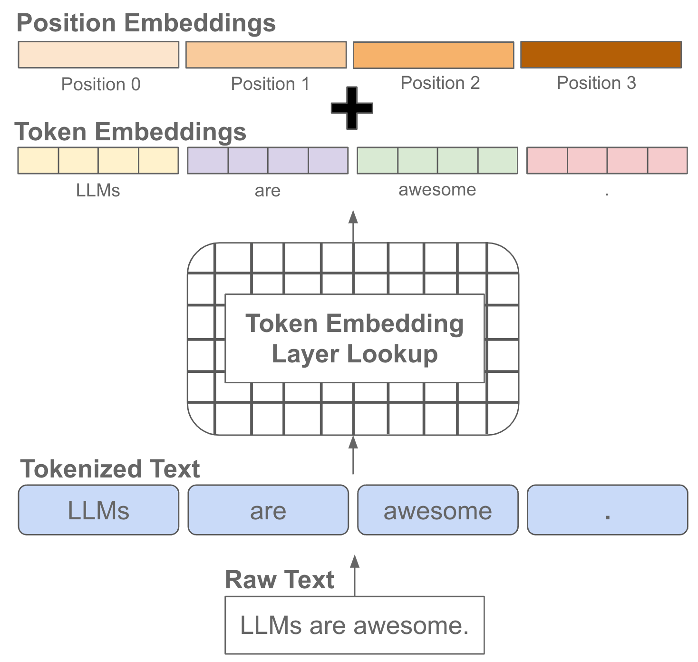
source

Slide 21
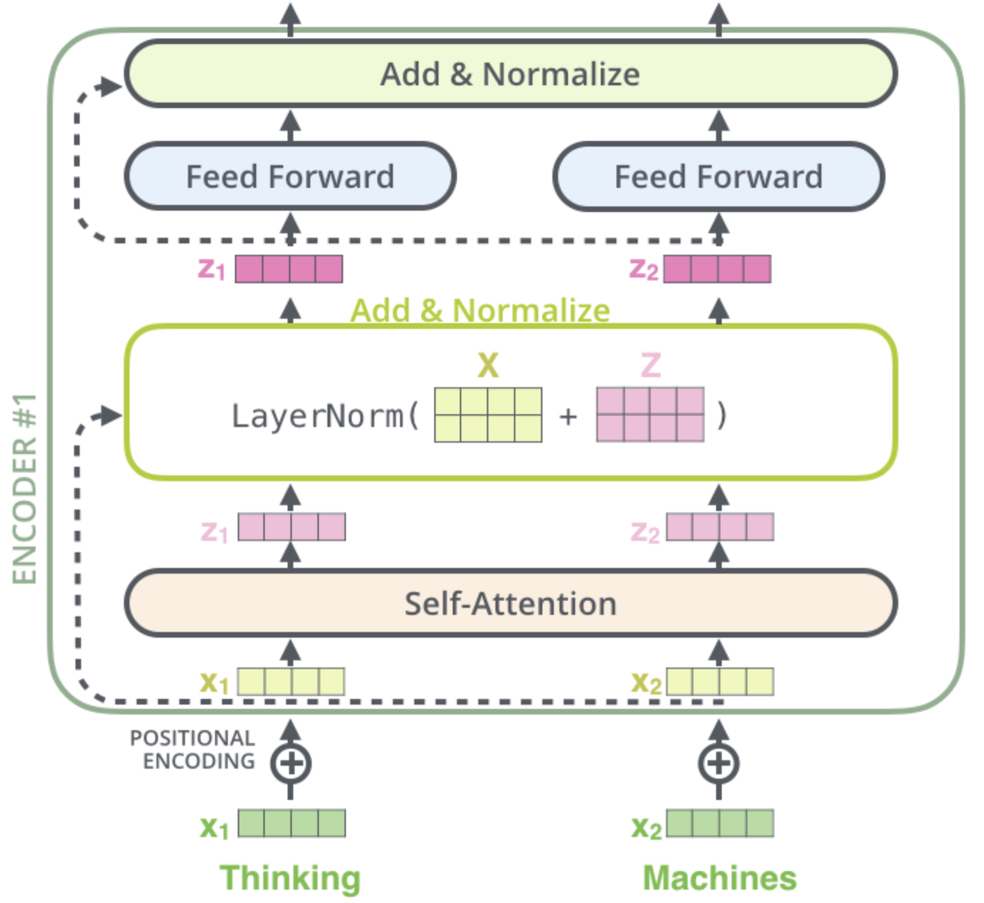
Skip Connections and Layer Normalization
skip connections improve robustness by
preserving original input (attention layers as filters) as well as gradients (mitigate vanishing-gradient problem)
easier learning of identity functions (useful for disregarding modules that do not improve model performance)
layer normalization improves stability, convergence, and generalization by normalizing activations per input token
source

Slide 22
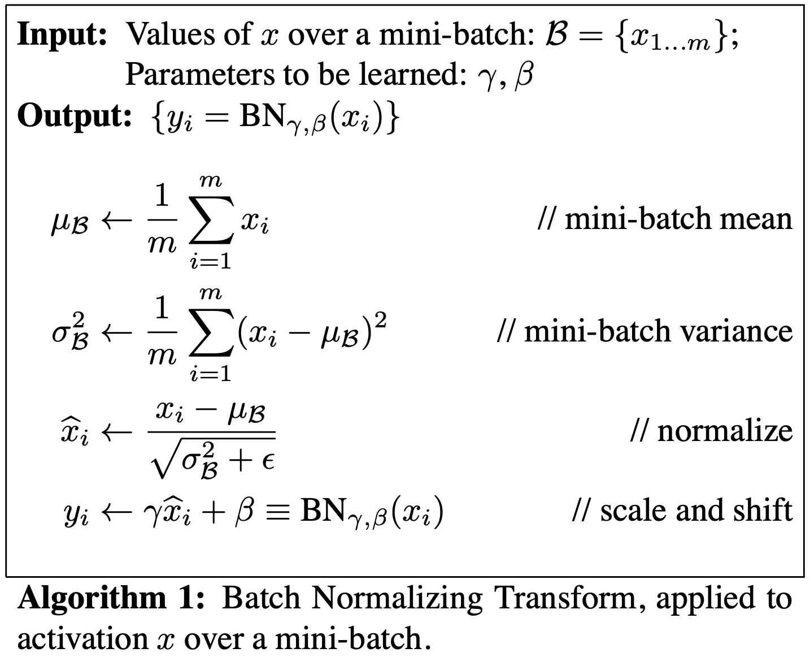
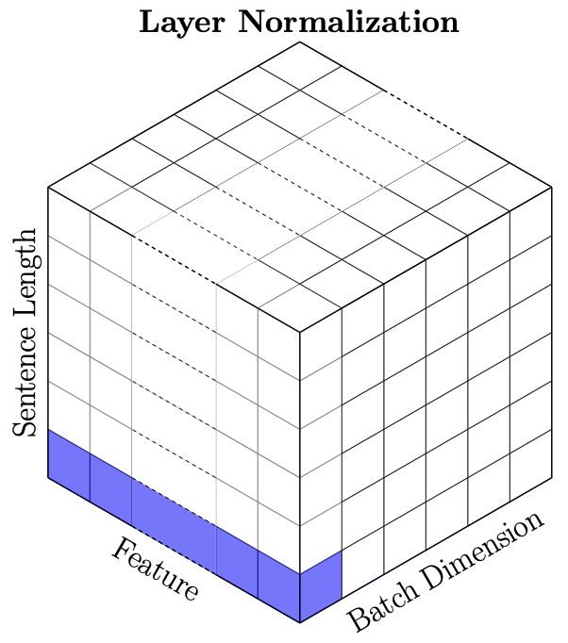
Batch vs Layer Norm
batch norm typically in computer vision
layer norm in NLP (variable-sized inputs)
source

Slide 23
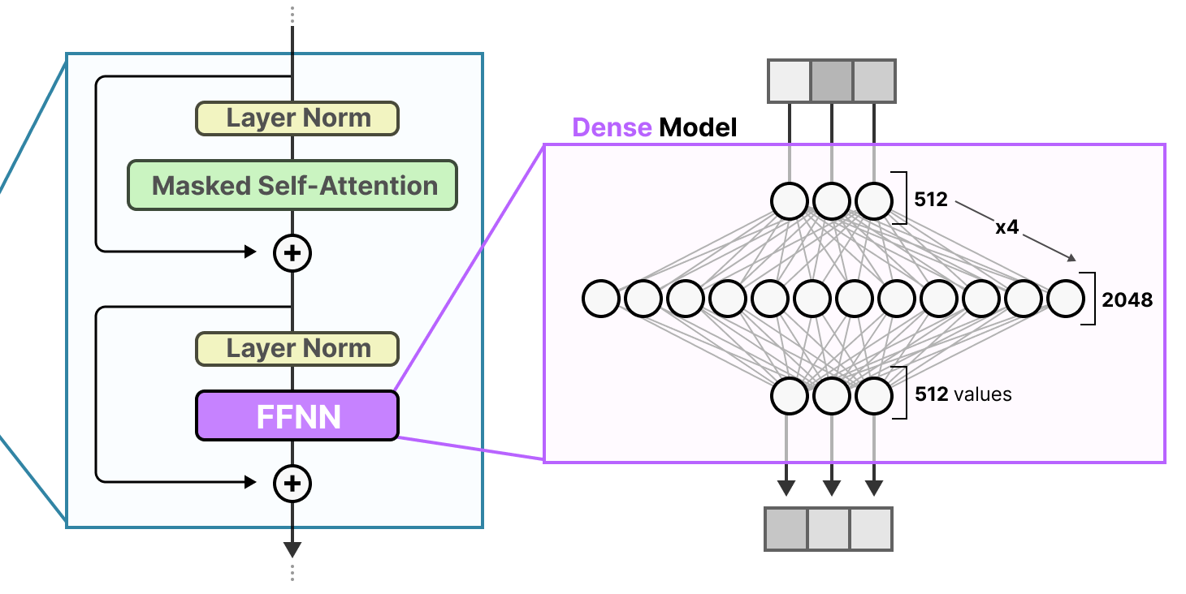
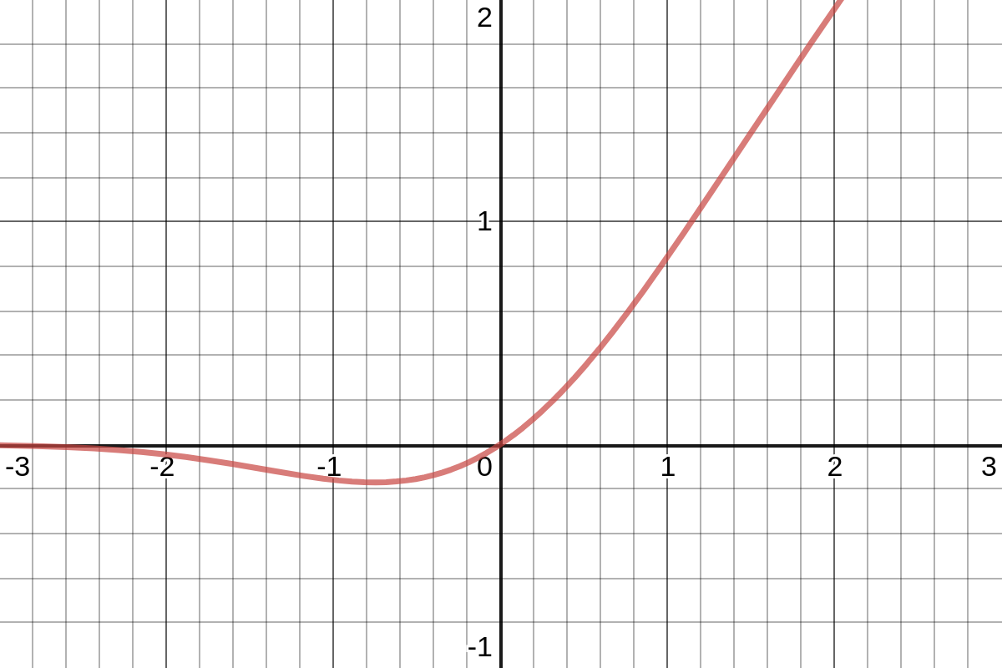
Role of Feed-Forward Neural Networks (FFNN)
position-wise FFNNs:
following each attention layer, apply an identical FFNN (with two layers) independently to each embedding vector
(correspond to bulk of overall parameters)
source
can be interpreted as compute after connect (attention)
attention is just weighted averaging
→ need for non-linearities (often GeLU activations) to capture more complex patterns

Slide 24
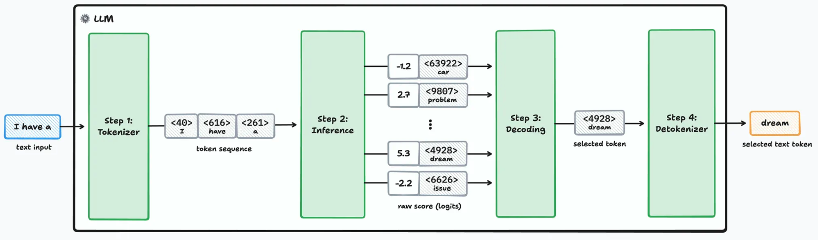
Next-Token Prediction
forward pass:
source

Slide 25
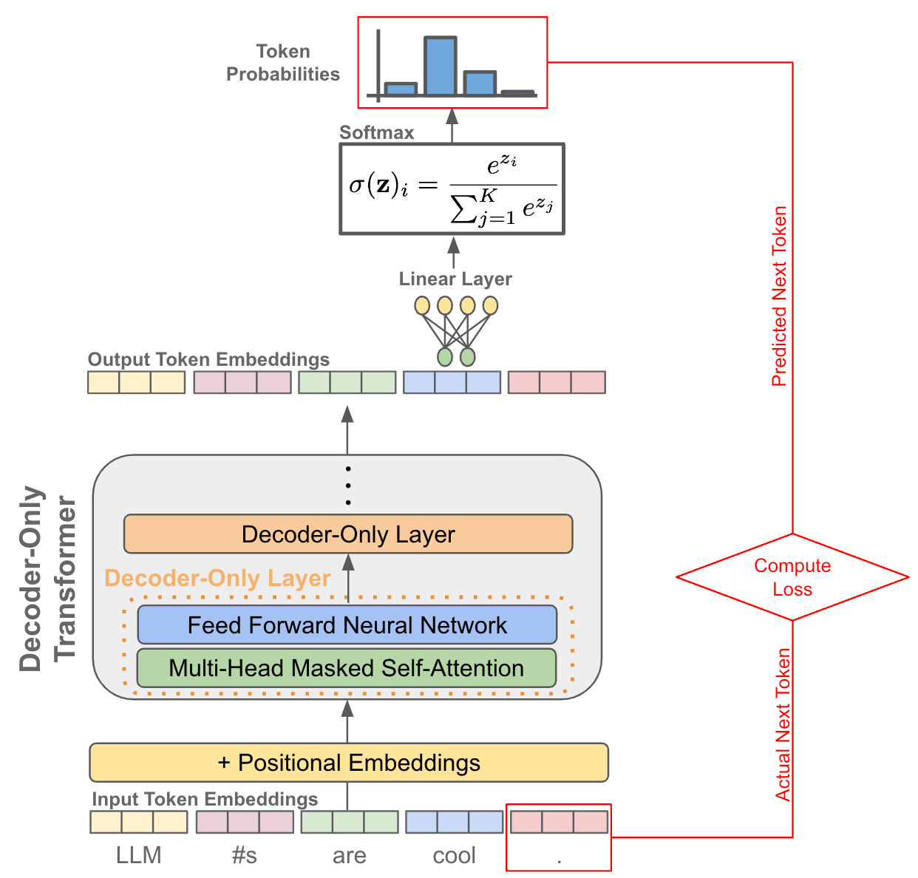
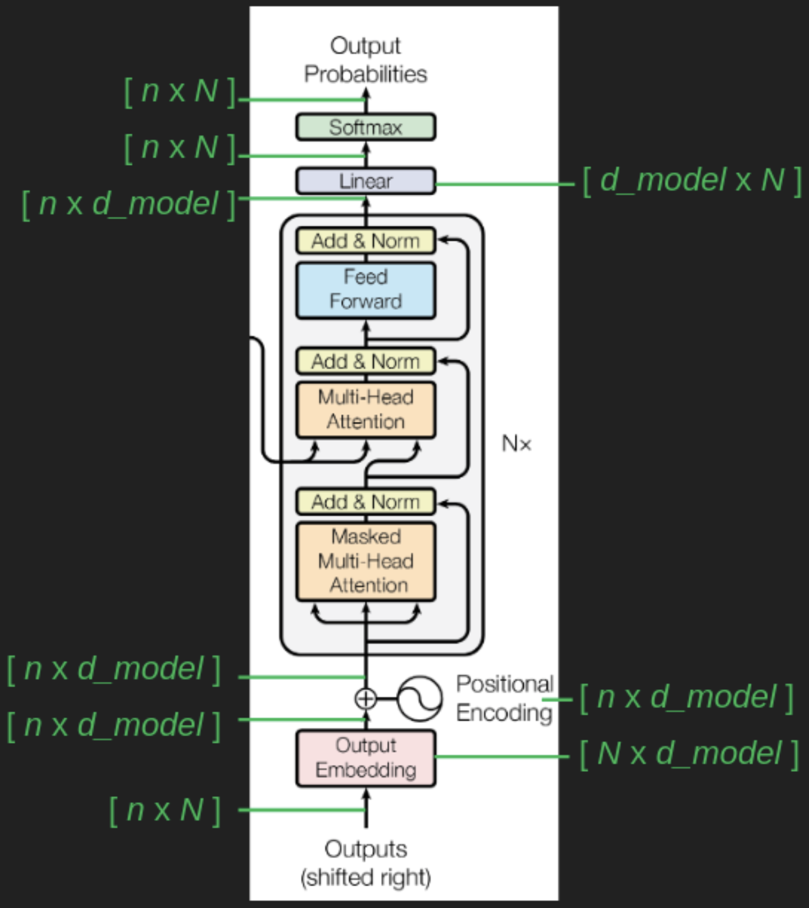
From Embeddings to Probabilities
next-token probabilities for each token in vocabulary
transformation to probabilities
de-embedding to vocabulary: projection to vector of logits
for projection, only use contextual embedding of last token (still need all contextual embeddings due to matrix multiplication in self-attention)
n: sequence length
N: vocabulary size
d_model: embedding size
(masked token for encoder-only transformers)
source
source

Slide 26
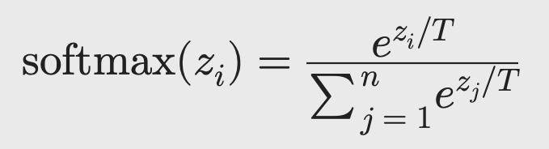
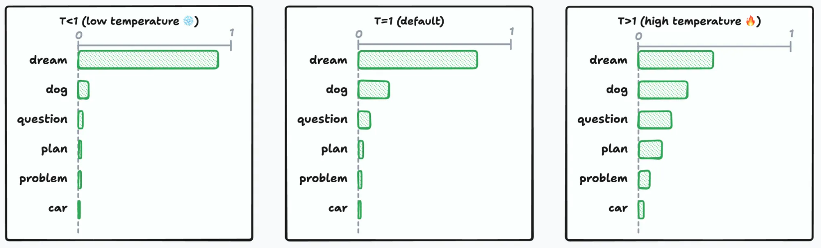
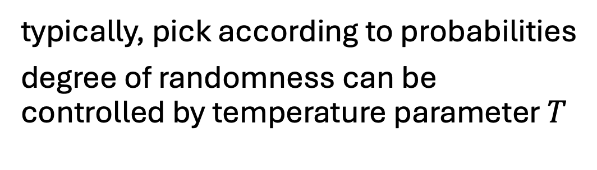

Token Selection at Inference
typically, pick according to probabilities
degree of randomness can be controlled by temperature parameter $T$
source
$T→0$ → greedy
creativity ;)

Slide 27
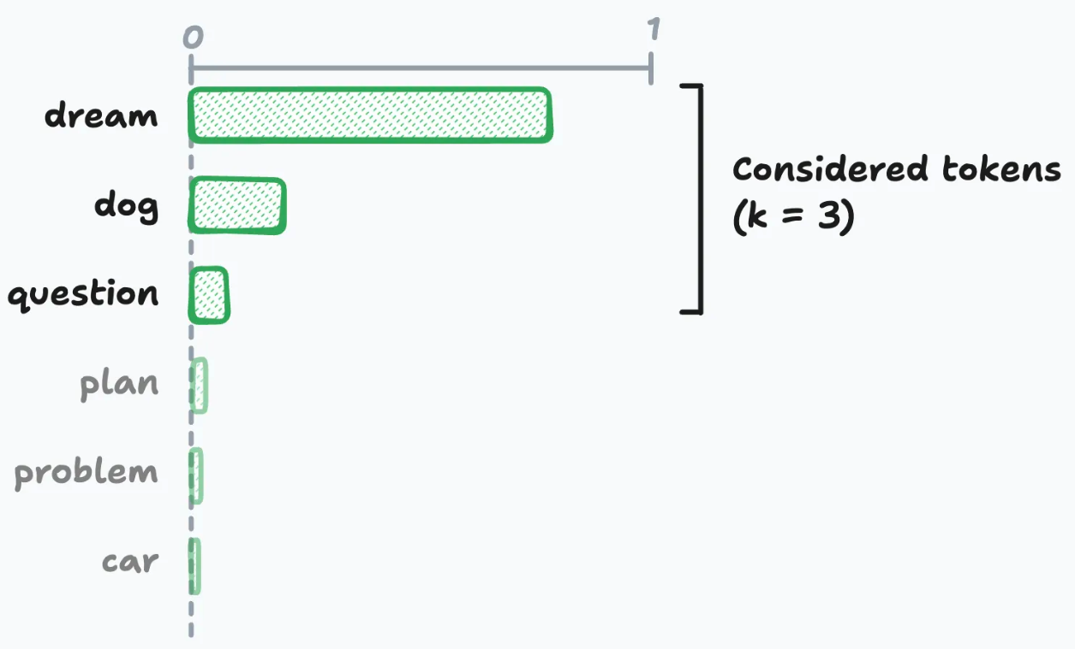
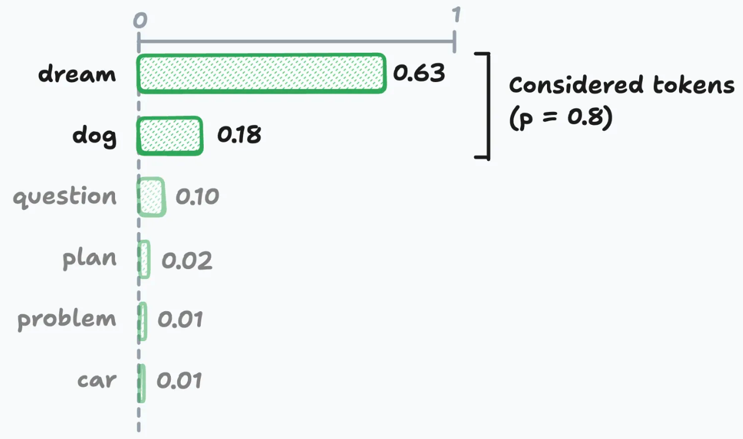
top-k & top-p Sampling
source

Slide 28
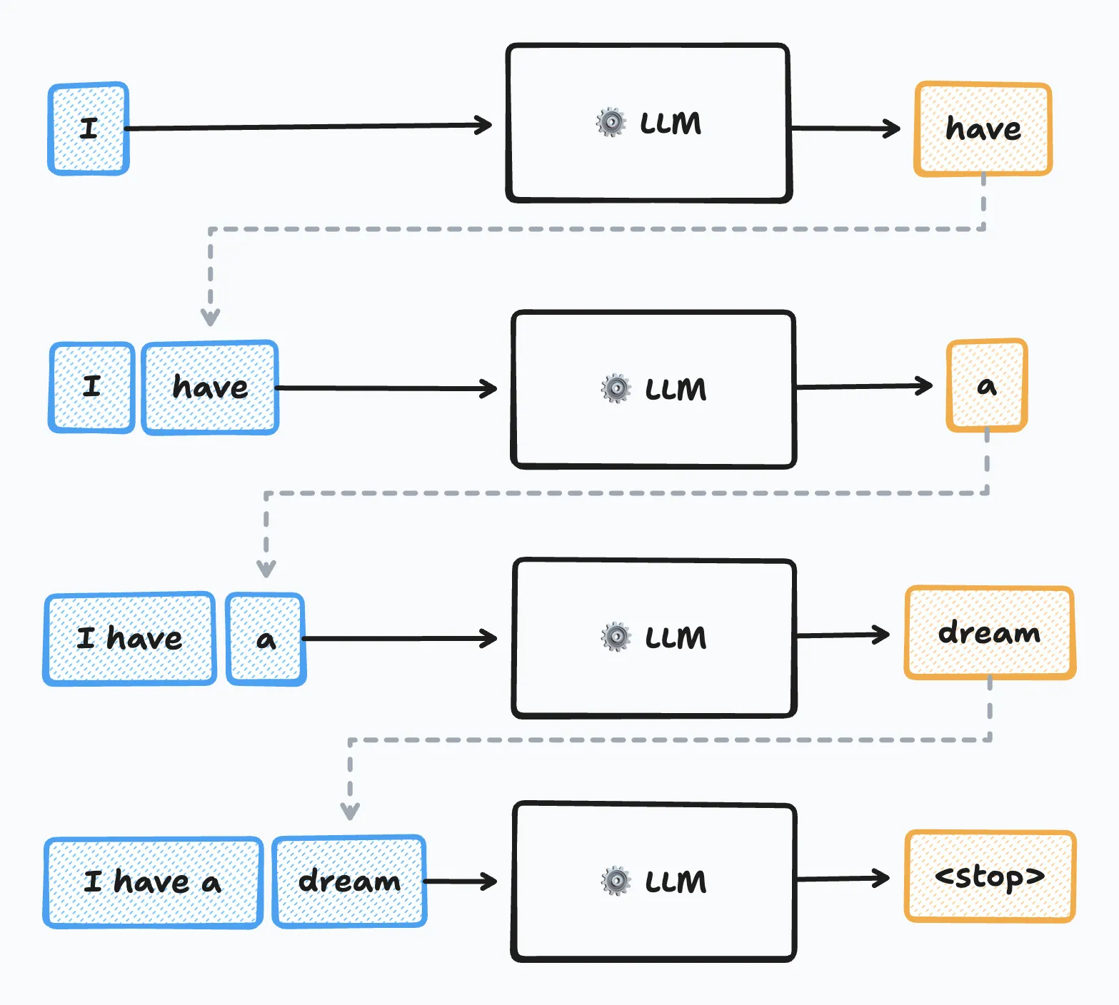
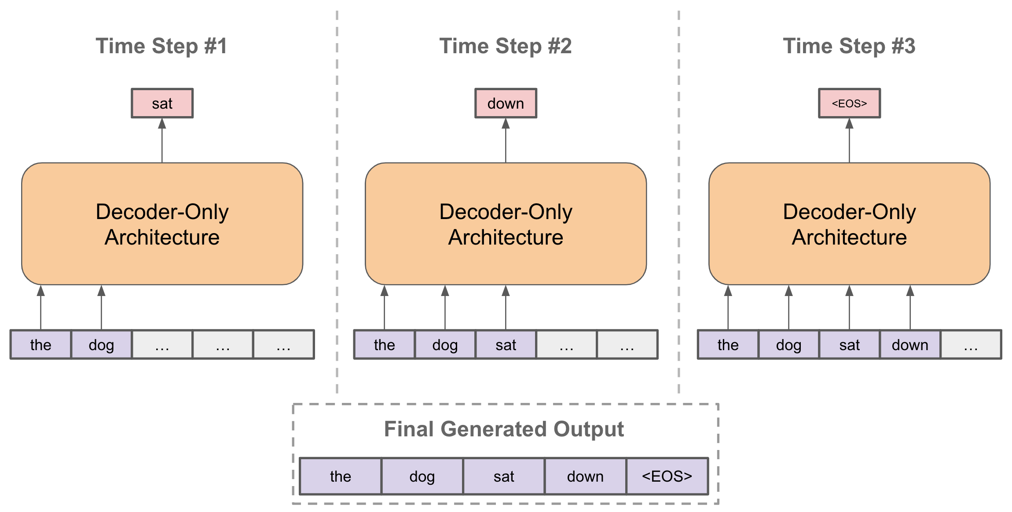
Sequence Completion
autoregressive:
at each step, choose one output token, then add it to decoder input sequence for next step
prompt:
externally given initial sequence for running start and context on which to build rest of sequence
source
source

Slide 29
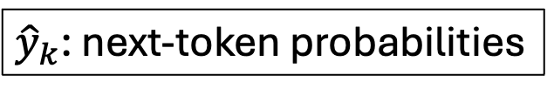
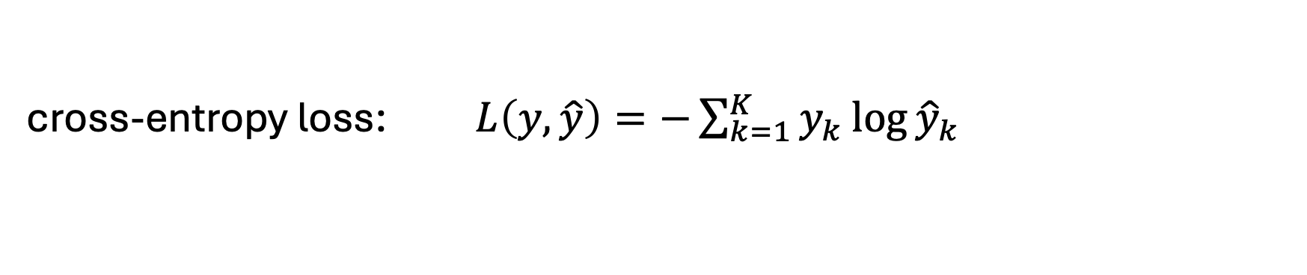
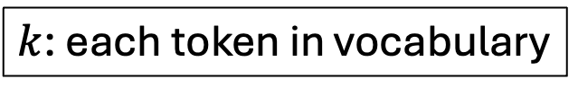
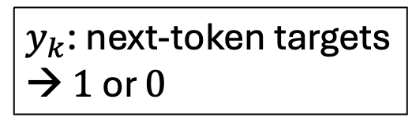
Training Loss
cross-entropy loss: $L\left(y,\hat{y}\right)=−\sum_{k=1}^{K}{y_{k}\log{{\hat{y}}_{k}}}$
$k$: each token in vocabulary
$y_{k}$: next-token targets
→ $1$ or $0$
${\hat{y}}_{k}$: next-token probabilities
during training, a next-token-prediction loss is calculated for every position in input sequence (not just the last one)
→ earlier positions have shorter effective contexts (masking of future positions)
reason: mirroring actual inference case of autoregressive text generation and arbitrary prompts
total loss = sum of individual losses

Slide 30
Teacher Forcing
in training, ground-truth previous tokens are used as inputs for next-token predictions from each position
(instead of own sampled predictions as in inference)
→ reduces variance and allows to compute an individual loss for every token in the sequence in parallel

Slide 31
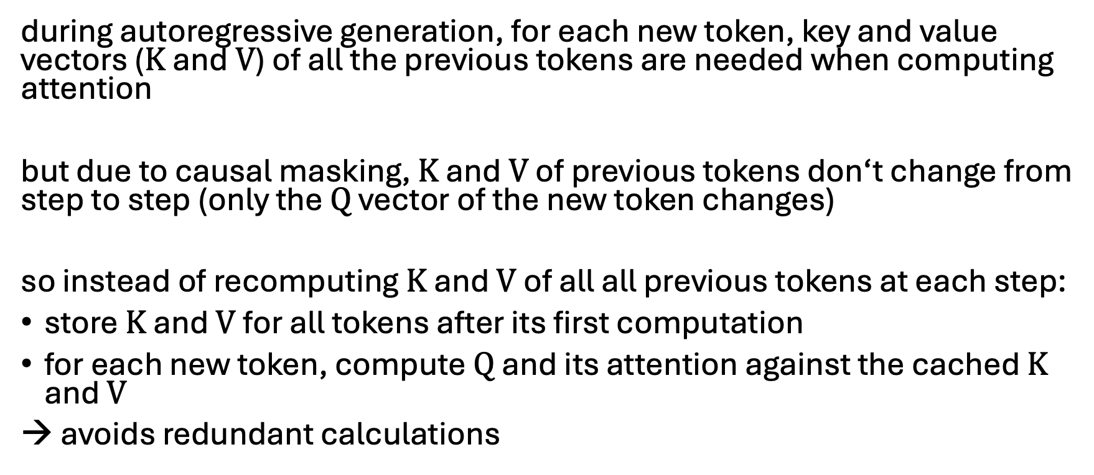
KV Caching
during autoregressive generation, for each new token, key and value vectors ($K$ and $V$) of all the previous tokens are needed when computing attention
but due to causal masking, $K$ and $V$ of previous tokens don‘t change from step to step (only the $Q$ vector of the new token changes)
so instead of recomputing $K$ and $V$ of all all previous tokens at each step:
store $K$ and $V$ for all tokens after its first computation
for each new token, compute $Q$ and its attention against the cached $K$ and $V$
→ avoids redundant calculations

Slide 32
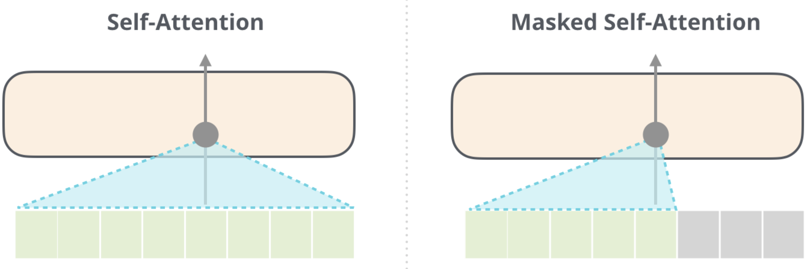
Transformer Types
encoder-only transformers:
goal: language understanding
training: masked-token prediction
decoder-only transformers:
goal: text generation
training: next-token prediction
aka causal
prime example: BERT
prime example: GPT
source
encoder-decoder transformers:
goal: sequence-to-sequence models
training: next-token prediction

Slide 33

Decoder-Only = Autoregressive Models
next word
today typically synonymous with LLM
stack of transformer decoders
→autoregressively generated sequence of tokens (directly usable as backbone of a chatbot)
training objective: next-token prediction from context
source

Slide 34
Encoder-Only = Bidirectional Models
training objective: masked tokens to be predicted from context
→ aka masked language models (MLM)
bidirectional: jointly conditioning on both left and right context
stack of transformer encoders
→ contextual embeddings (for later use in specific language-understanding tasks like text classification, sentiment analysis, named entity recognition)
still needs a decoder head for training purposes, using the hidden state of the masked token (dedicated [MASK] token) for projection to vector of logits
finetuning

Slide 35


Encoder-Decoder Transformers
use case: sequence-to-sequence models
e.g., machine translation
can also be done with decoder-only transformers, but encoder-decoder model sometimes beneficial
examples: T5, FLAN
encoder-decoder attention (aka cross-attention):
connection between encoder and decoder, helping decoder to focus on relevant parts of input sequence
output of last encoder transformed into $K$ and $V$, $Q$ from each decoder’s cross-attention layer
source

Slide 36
Next: LLMs
autoregressive text generation of decoder-only transformers allows prompting of models (can output text to arbitrary topics)
→ enables chatbots like ChatGPT
triggered hype about generative AI and started an LLM scaling race (the larger the model, the better the capabilities)
lightweight PyTorch re-implementation of GPT: minGPT
more powerful: nanoGPT, LitGPT

