Slide 1
Context Engineering
Language Models

Slide 2
Course Contents
Deep Learning
Transformer
Finetuning
Agents
The Bigger Picture
Context Engineering
Instruction Tuning
LLMs

Slide 3
This Part: Context Engineering
generative AI
prompting
RAG

Slide 4
Autoregressive Text Generation
generate one output token at a time (according to predicted probabilities)
add it to the context for the prediction of the next token
→ resulting in a full text, sampled from predicted probabilities

Slide 5
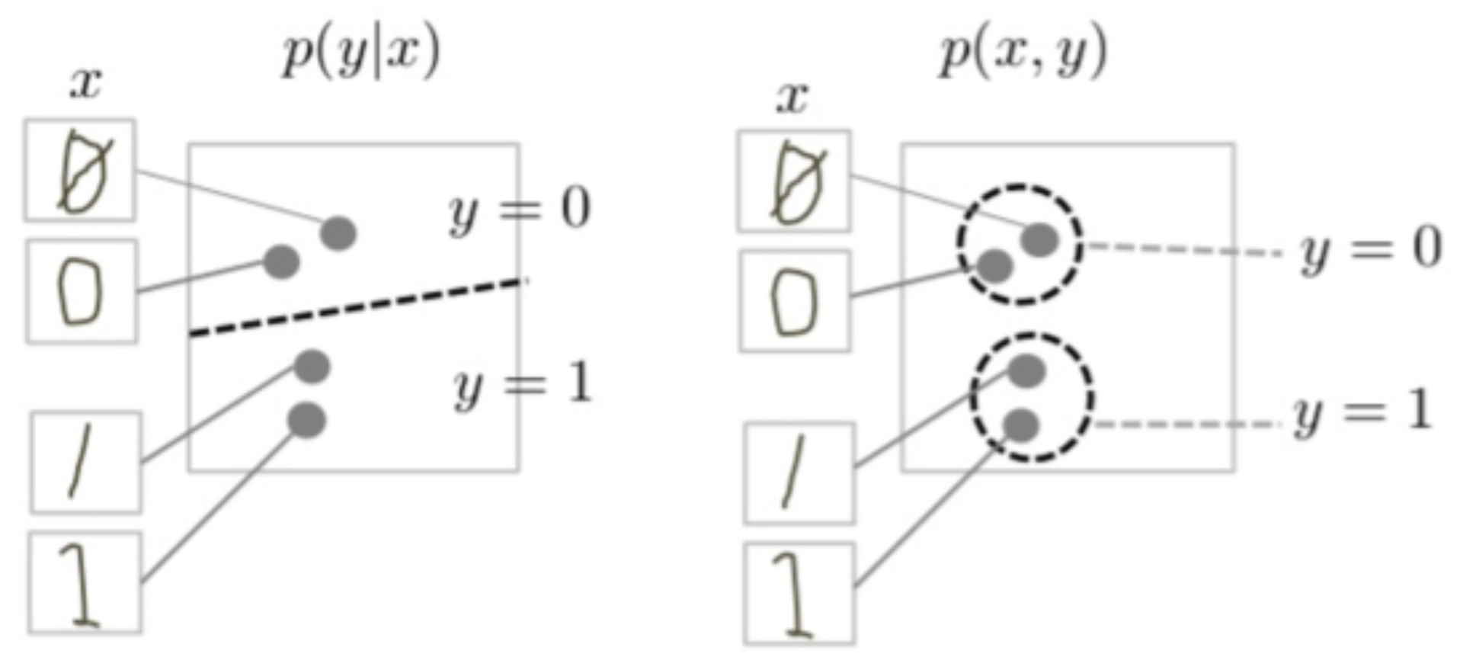
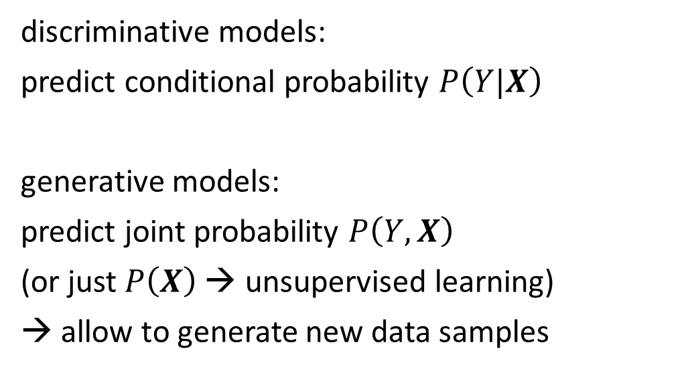
Generative vs Predictive/Discriminative Models
discriminative model
generative model
discriminative models:
predict conditional probability $P\left(Y|X\right)$
generative models:
predict joint probability $P\left(Y,X\right)$
(or just $P\left(X\right)$ → unsupervised learning)
→ allow to generate new data samples
source
task of generative models more difficult: need to model full data distribution rather than merely find patterns in inputs to distinguish outputs
Generative models can be used for predictive tasks (Bayes theorem).
But predictive models are usually better at it.

Slide 6
Prompting
feed information into decoder LLM via input prompt
→ attention to context
typical prompt:
instructions, context, query, output indicator
→ a new paradigm: one model for many tasks

Slide 7
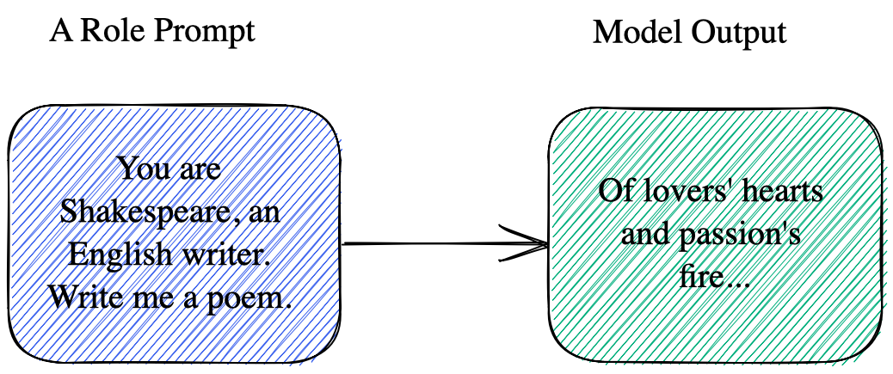
Role Prompting

Slide 8
Prompt Engineering
idea: shape model behavior using well-structured prompts
…
prompt engineering, GPT guide

Slide 9
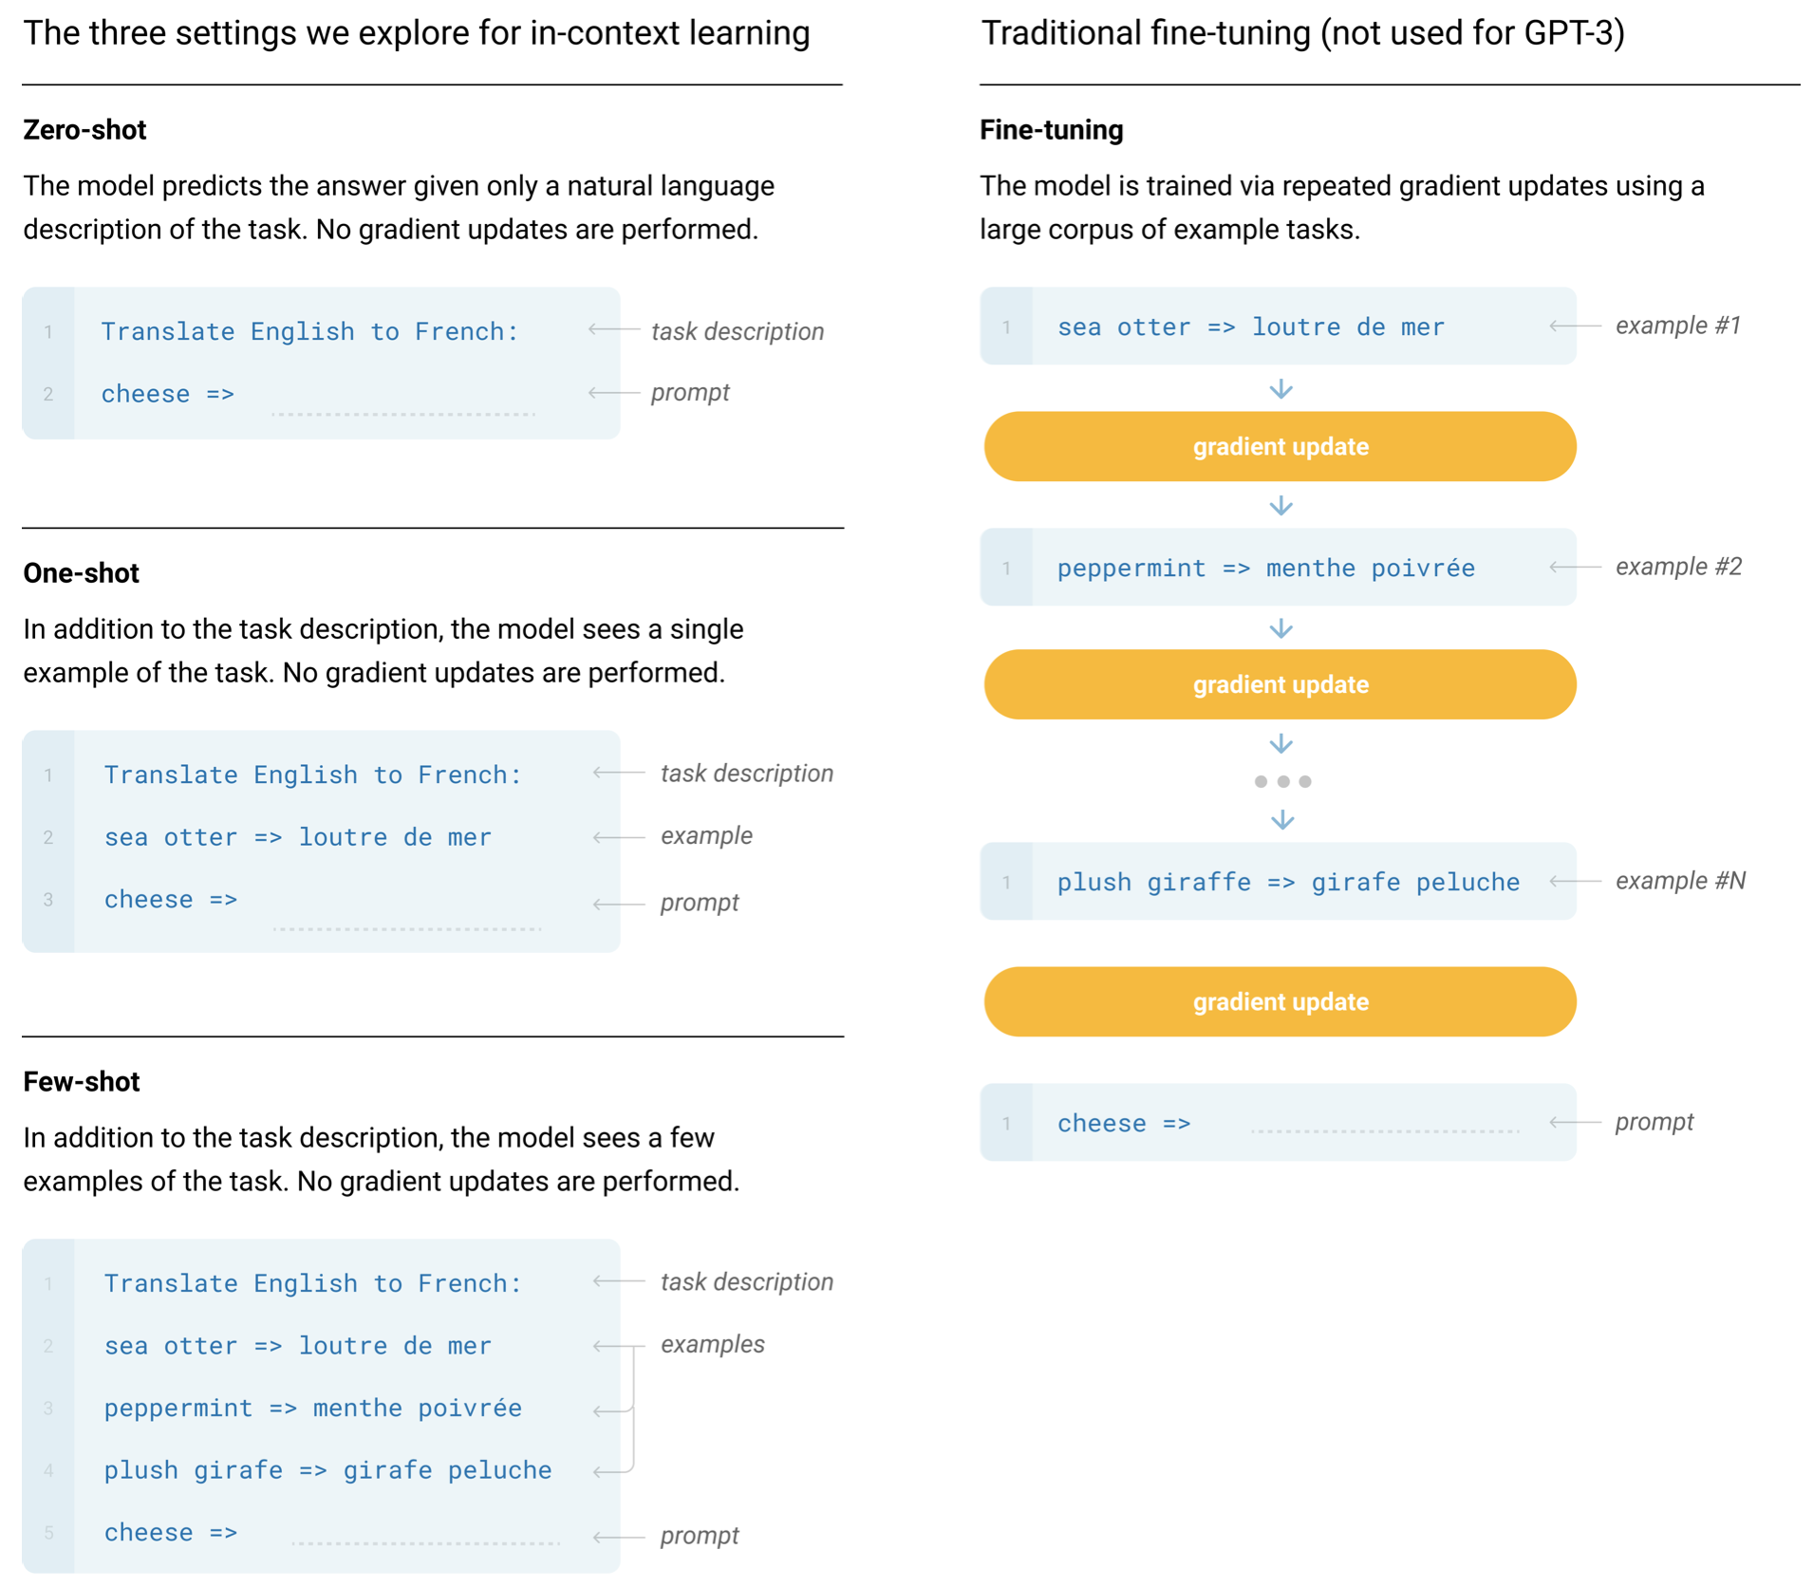
In-Context Learning
no fine-tuning:
zero-shot: no examples, just instructions
few-shot learning: conditioning on a few input-output examples
no parameter updates → not really learning (rather inference-time pattern recognition)
possible explanation: locating latent concepts (abstractions) learned in pretraining
GPT-3

Slide 10
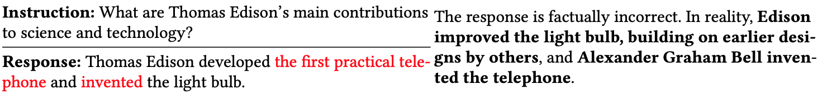
Struggling with Facts
LLMs have only implicit knowledge (memorization in weights):
limitations in terms of explicit factual knowledge (hallucinating facts)
can be mitigated by retrieving the corresponding information from an external knowledge base and pasting it in context
(prompt engineering → context engineering)

Slide 11
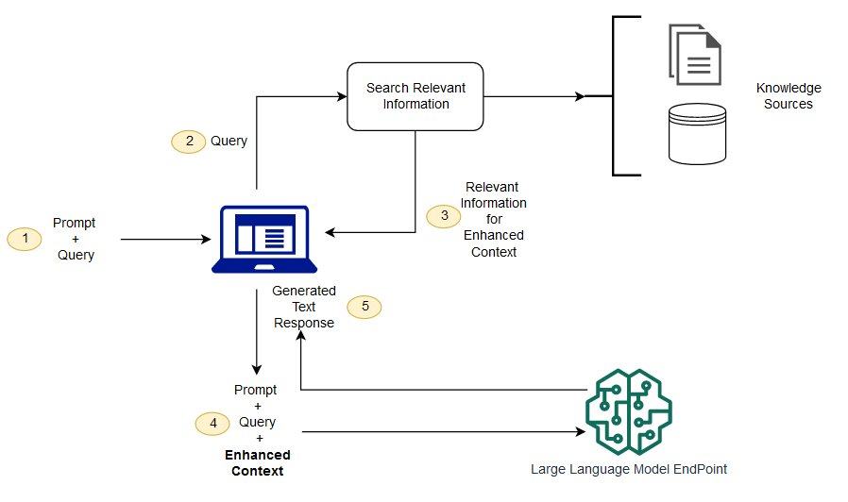
Retrieval Augmented Generation (RAG)
vector similarity
keyword
hybrid
private data (alternative to finetuning)
internet (browser as tool)
structured APIs
typically, data the model wasn‘t trained on

Slide 12
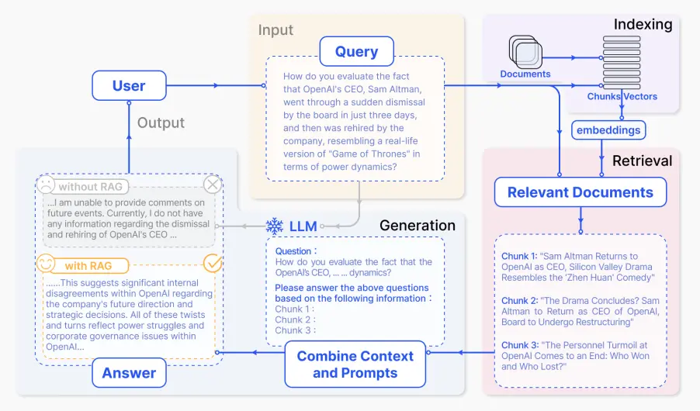
source

Slide 13
Many-Shot Learning
…
increasing context length

