Slide 1
Finetuning
Language Models

Slide 2
Course Contents
Deep Learning
Transformer
Finetuning
Agents
The Bigger Picture
Context Engineering
Instruction Tuning
LLMs

Slide 3
This Part: Finetuning
transfer learning
text classification
efficient finetuning

Slide 4
Modern Language Models in a Nutshell
tokenization (split text into chunks)
pretraining of transformer (next- or masked-token prediction, self-supervised)
vector embeddings from tokens (semantic meaning)
add positional encoding to embeddings (use order of sequence, as attention is permutation-invariant)
attention mechanism → contextual embeddings
finetuning (specialization)
for specific task (encoder LLM)
instruction tuning (decoder LLM), potentially followed by alignment
this part

Slide 5
Transfer Learning from Foundation Models
idea:
pretrain a big model (called foundation model) on a broad data set, and then use these learnings for subsequent trainings on specific (typically narrow) data by means of feature extraction or finetuning
→ here: self-supervised, internet-scale pretraining of models like BERT or GPT
works well for homogenous, unstructured data (e.g., text, images)
but very difficult for heterogenous, structured/tabular data

Slide 6
Text Classification
…
exercise: Kaggle Disaster Tweets

Slide 7
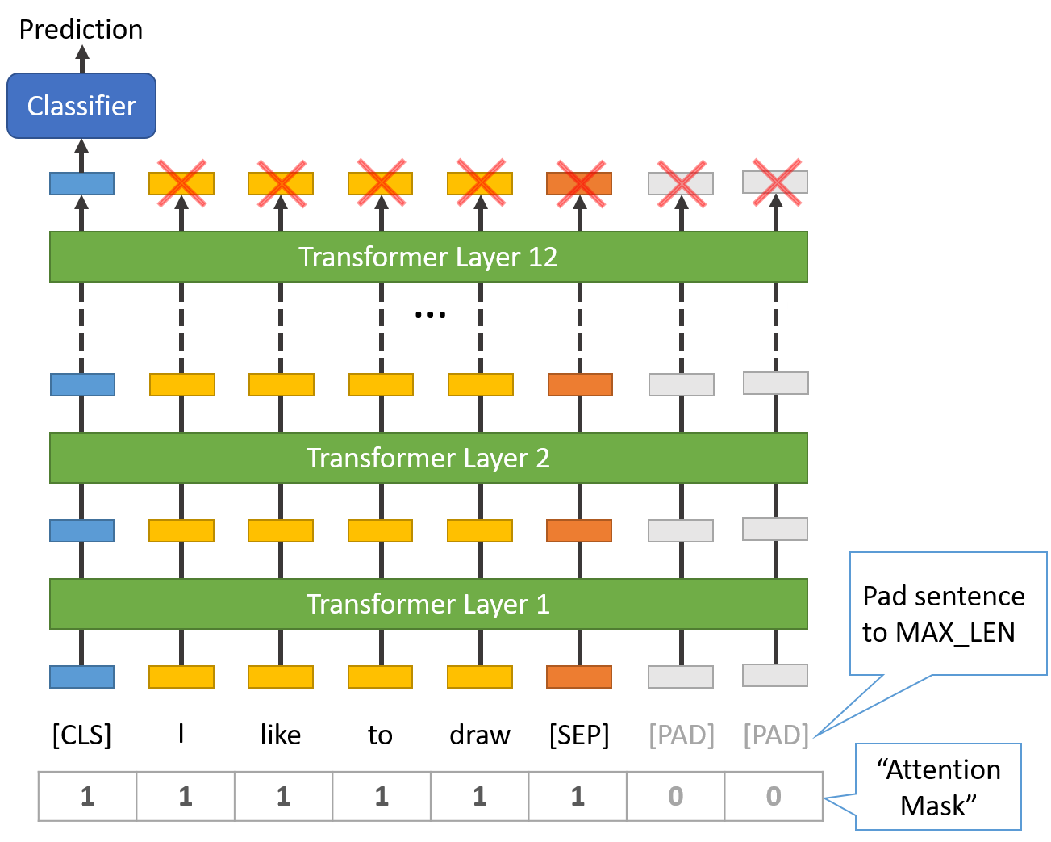
Feature Extraction
get pretrained encoder LLM as foundation model
remove classifier head from pretraining (after final contextual embeddings)
pass training data (for the task at hand) through the model and use the [CLS] token embedding as input for a small, task-specific model
alternative to [CLS] token: mean/max pooling over final token embeddings (e.g., for sentence similarity)
source
sentence classification via [CLS] token

Slide 8
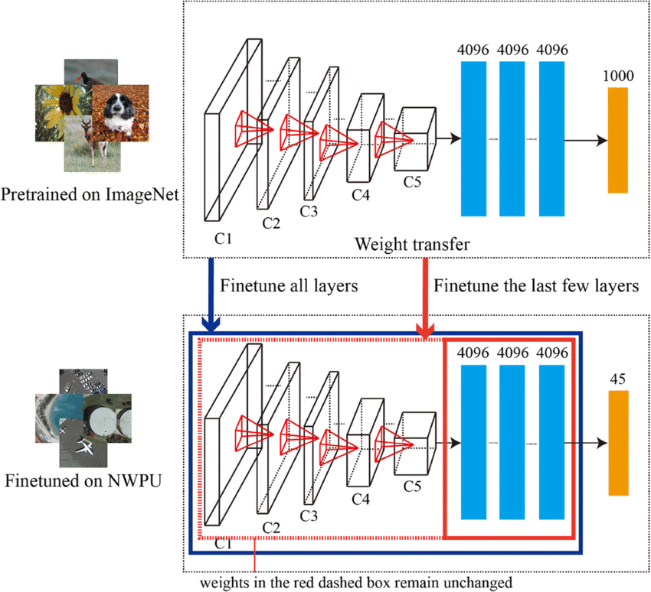
Finetuning
options: finetune all weights or just some
(image classfication example)
get pretrained encoder LLM as foundation model
replace classifier head from pretraining with task-specific head
continue (starting with weights after pretraining) training with data for task at hand
source

Slide 9
Finetuning Scenarios
finetuning gives better adjustment to new task than feature extraction (important if new task differs a lot from pretraining task)
→ coming along with danger of overfitting
features more generic in early layers (e.g., token structure, syntax, part-of-speech) and more specific to the pretraining data in later layers (e.g., word sense, entity linking)
→ for small finetuning data sets, typically keep weights of early layers fixed to avoid overfitting
for large finetuning data sets (less danger of overfitting), finetuning all layers can be beneficial

Slide 10
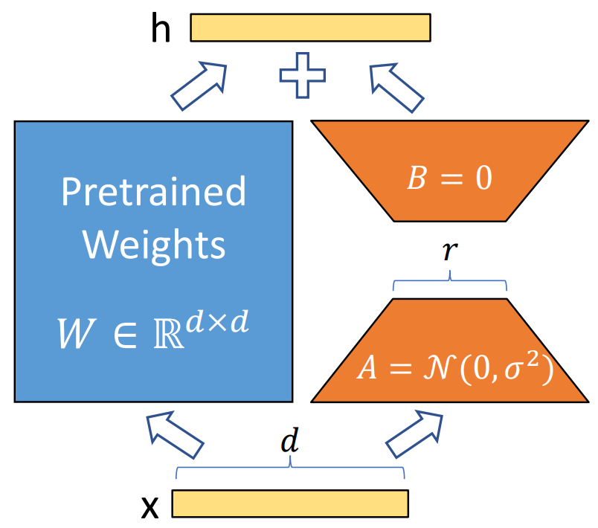
Parameter-Efficient Finetuning (PEFT)
… LoRA

