Slide 1
Finetuning
Language Models

Slide 2
Course Contents
Deep Learning
Transformer
Agents
The Bigger Picture
Context Engineering
LLMs
Finetuning

Slide 3
This Part: Finetuning
transfer learning
text classification
instruction tuning
parameter-efficient finetuning
preference alignment

Slide 4
Modern Language Models in a Nutshell
tokenization: split text into chunks
pretraining: self-supervised, next- or masked-token prediction
vector embeddings from tokens (semantic meaning)
add positional encoding (attention permutation-invariant)
attention mechanism (transformer) → contextual embeddings
finetuning: specialization
classification model (specific task):
finetuning on labeled data set (often using encoder-only transformer)
assistant/chatbot (multipurpose):
instruction tuning (decoder-only transformer), potentially followed by alignment

Slide 5
Transfer Learning from Foundation Models
idea:
pretrain a big model (called foundation model) on a broad data set
then use these learnings for subsequent trainings on specific (typically narrow) data by means of finetuning or feature extraction
→ here: self-supervised, internet-scale pretraining of models like BERT or GPT
works well for homogenous, unstructured data (e.g., text, images)
but very difficult for heterogenous, structured/tabular data

Slide 6
Finetuning of BERT
get pretrained BERT as foundation model (MLM pretraining: loss computed against projection from last hidden state of [MASK] token to vector of logits)
remove pretraining classification head (→ get contextual token embeddings)
add another, task-specific classification head (see a few examples on the following slides)
train (finetune) with data for actual task at hand (starting with random weights for new classification head and pretrained weights for the rest)
options: finetune all pretrained weights or only a part (freezing the others)

Slide 7
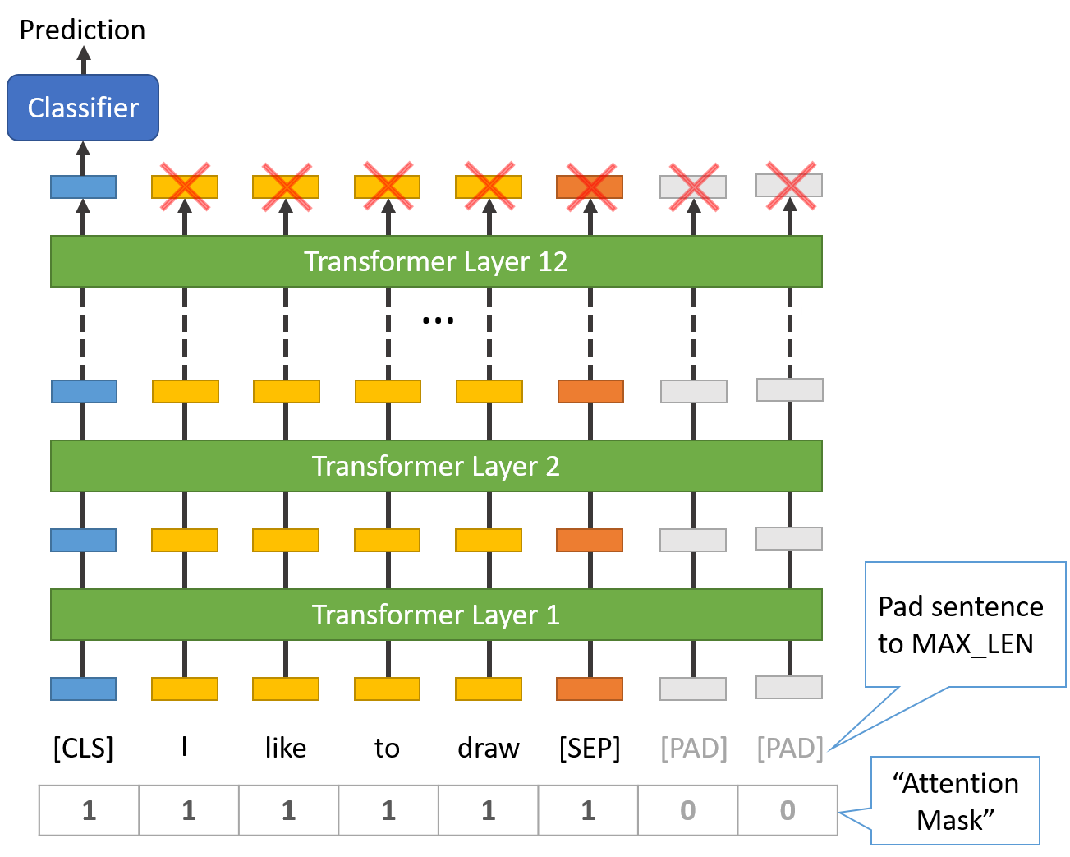
Example: Sequence Classification
e.g., classify sentiment or topic
a special [CLS] token is prepended to the input (already present in pretraining)
its final hidden state (vector embedding) is passed into a classification head (resulting in logits over different categories)
→ [CLS] embedding is finetuned to summarize the whole sequence
(alternative without [CLS]: average pooling )
source
sequence classification via [CLS] token

Slide 8
Next-Sentence Prediction (NSP) in BERT
BERT uses NSP as pretraining objective
(in addition to MLM → total loss is sum of MLM and NSP losses)
goal: help BERT learn relationships across sentences (later dropped)
training examples: [CLS] Sentence A [SEP] Sentence B [SEP]
[CLS]: special token to represent the whole sequence
hidden representation of [CLS] fed into classification head predicting whether B is the actual next sentence or not

Slide 9
BERT Variants
RoBERTa: improved performance
removed next sentence prediction as pretraining objective
~ten times more training data, longer training, larger batches, longer sequences
dynamic masking: instead of fixed masked tokens for each sequence, masks change each epoch
DistilBERT: much lighter and faster, retaining ~95% of BERT’s performance
a smaller “student” model is trained to mimic BERT’s predictions
40% fewer parameters than BERT, 60% faster inference, using half the memory

Slide 10
Example: Sentence Embeddings
use case: sentence similarity / retrieval (see RAG)
BERT optimized for NSP, not for mapping independent sentences into a comparable vector space → need to finetune on considered similarity label
paraphrase (yes or no)
natural language inference (entailment/contradiction/neutral)
semantic textual similarity (human-judged similarity score) → regression loss
approach with vanilla BERT:
input: [CLS] Sentence A [SEP] Sentence B [SEP]
[CLS] token embedding as aggregate representation of the pair
classifier/regressor head trained directly on considered similarity label

Slide 11
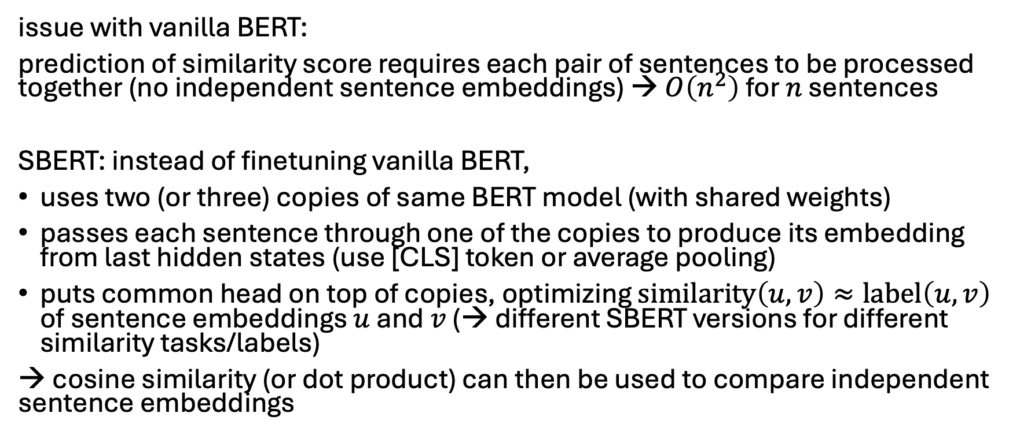
SBERT
issue with vanilla BERT:
prediction of similarity score requires each pair of sentences to be processed together (no independent sentence embeddings) → $O\left(n^{2}\right)$ for $n$ sentences
SBERT: instead of finetuning vanilla BERT,
uses two (or three) copies of same BERT model (with shared weights)
passes each sentence through one of the copies to produce its embedding from last hidden states (use [CLS] token or average pooling)
puts common head on top of copies, optimizing $similarity\left(u,v\right)≈label\left(u,v\right)$ of sentence embeddings $u$ and $v$ (→ different SBERT versions for different similarity tasks/labels)
→ cosine similarity (or dot product) can then be used to compare independent sentence embeddings

Slide 12
Example: Token Classification
examples of use cases:
part-of-speech tagging: assigning each word in a sentence its grammatical role (or part of speech) such as noun, verb, etc.
named entity recognition: identifying and classifying named entities (proper nouns) in text into predefined categories like Person, Organization, Location, Date, etc.
per-token predictions needed → no pooling or [CLS] usage
instead, just project each token’s hidden state independently into logits and sum the per-token losses in each sequence

Slide 13
Finetuning Scenarios
features more generic in early layers (e.g., token structure, syntax, part-of-speech) and more specific to the pretraining data in later layers (e.g., word sense, entity linking)
for small finetuning data sets, typically keep weights of early layers fixed to avoid overfitting
for large finetuning data sets (less danger of overfitting), finetuning all layers can be beneficial

Slide 14
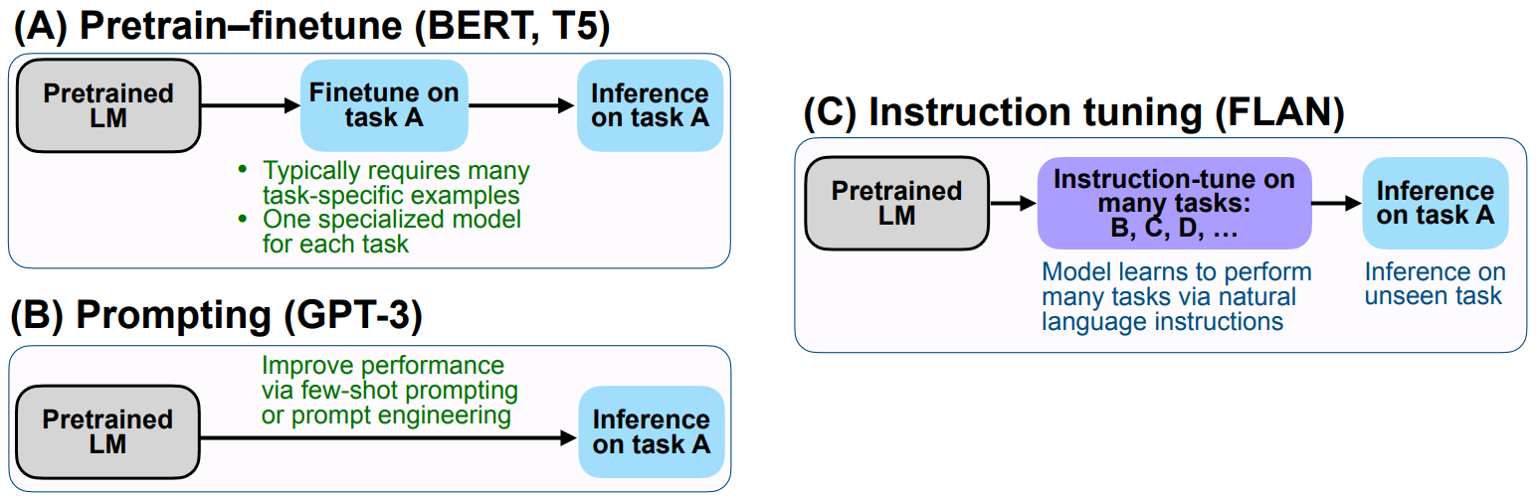
Instruction Tuning
instruction tuning is a form of supervised finetuning (SFT)
so is the finetuning discussed before (although usually just called finetuning)
source

Slide 15
Instruction Tuning Data
instruction tuning = SFT with instruction–response data
Instruction: "Summarize this article in one sentence."
Output: "The article discusses the effects of climate change on polar bears."
instruction tuning data fed to model as input sequences, just like in pretraining
objective still next-token prediction (language modeling)
structure of text sequences only thing telling the model where instruction ends and response begins
also learns formatting: desired patterns embedded in instruction–response pairs

Slide 16
Base vs Instruction-tuned LLM
Explain why the sky is blue, as if you were talking to a curious 10-year-old.
base LLM response:
instruction-tuned LLM response:
“The sky is blue because of the way light interacts with the atmosphere. Sunlight contains many colors, and when it passes through air molecules, the blue light scatters more than other colors. That’s why we see the sky as blue during the day.”
“Imagine the sky is like a giant ocean of tiny invisible balls called air molecules. When sunlight shines through, the blue light bounces around more than the other colors, kind of like how tiny balls make waves in a pool. That’s why, when you look up, the sky looks blue! And at sunset, the light has to travel through more air, so the reds and oranges shine through instead.”

Slide 17
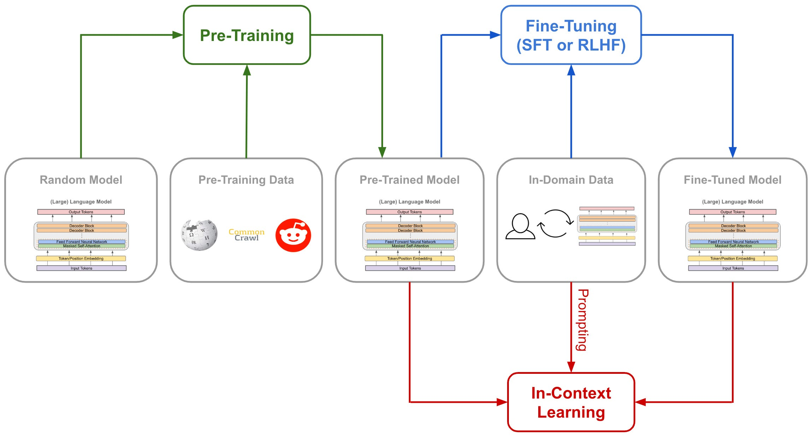
generic “instruct“ versions of LLMs (potentially also aligned)
e.g., Llama-2-7b-chat, Mistral-7B-Instruct
expert LLMs
base LLM: poor instruction following, no proper multi-turn converstations
(e.g., Llama-2-7b, Mistral-7B)
ready to become an LLM chatbot
RAG

Slide 18
Use Cases of Instruction Tuning
task specialization (e.g., code generation)
domain-specific instructions (e.g., interpret molecular formulas)
style or tone adaptation (e.g., corporate writing style, friendly chatbot tone)
reasoning (CoT inputs) → reasoning models

Slide 19
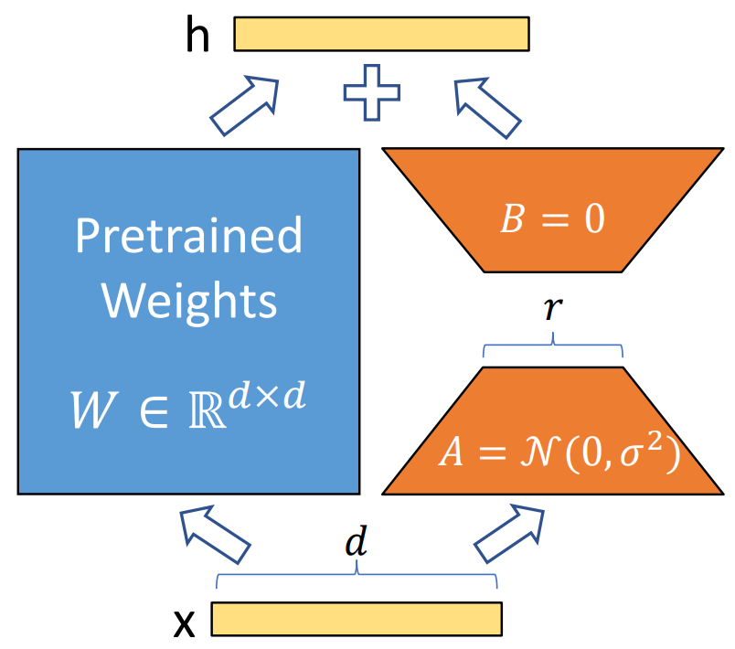
Parameter-Efficient Finetuning (PEFT)
LoRA:
LLMs have billions of parameters
→ full finetuning is very expensive
PEFT: adapt LLMs to new tasks without updating all parameters, instead learning small, efficient modifications
popular method: Low-Rank Adaptation (LoRA)
often combined with quantization (representing model weights and/or activations with lower-precision numbers) to further reduce memory usage

Slide 20
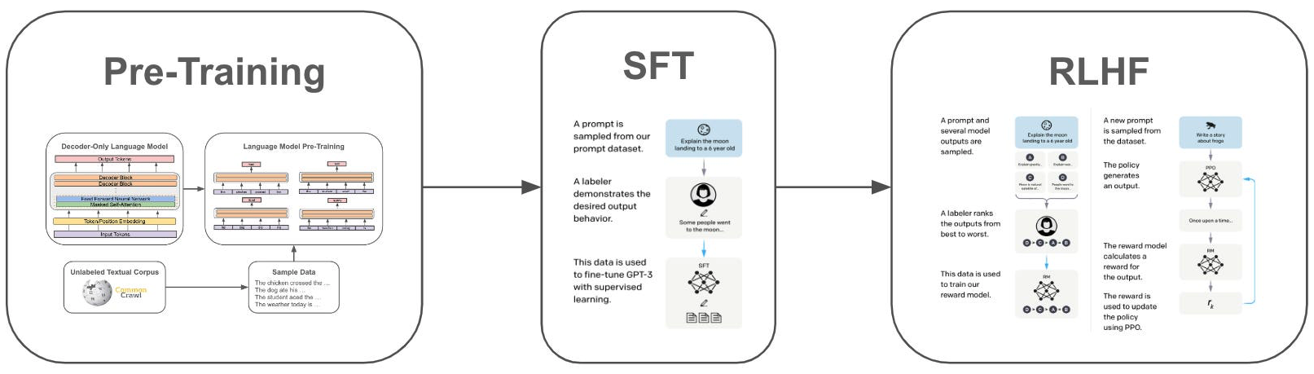
Preference Alignment
RLHF can achieve both instruction following and preference alignment
here: GPT-3
source
idea: aligning LLM output with human preferences
InstructGPT: SFT followed by reinforcement learning from human feedback (RLHF)

Slide 21
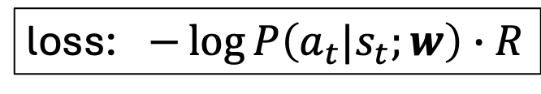
Aside: Policy Gradient Method
rationale for using reinforcement learning: allows to train on whole responses with global feedback, something next-token prediction cannot do naturally
in general: policy network with actions as output (here: next-token probabilities)
return (here: just one reward for entire sampled text sequence)
loss: $−\log{P\left(a_{t}|s_{t};w\right)}∙R$
gradient ascent
model for action given state (here: LLM)
21

Slide 22
GPT-3 → InstructGPT → ChatGPT
dialog system (aka conversational agent or chatbot): any system designed to communicate with humans using natural language
with instruction-tuned and aligned LLMs: assistant-style models
crucial: multi-turn dialogue
→ passing conversation history as part of input to LLM at each step
lightweight PyTorch re-implementation of ChatGPT: nanochat

Slide 23
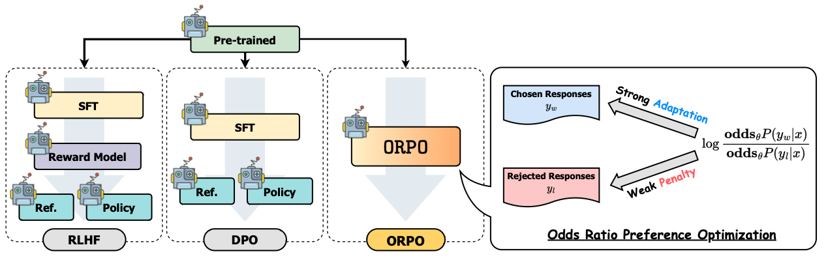
Other Methods for Preference Alignment
alternatives to RLHF: DPO, ORPO

Slide 24
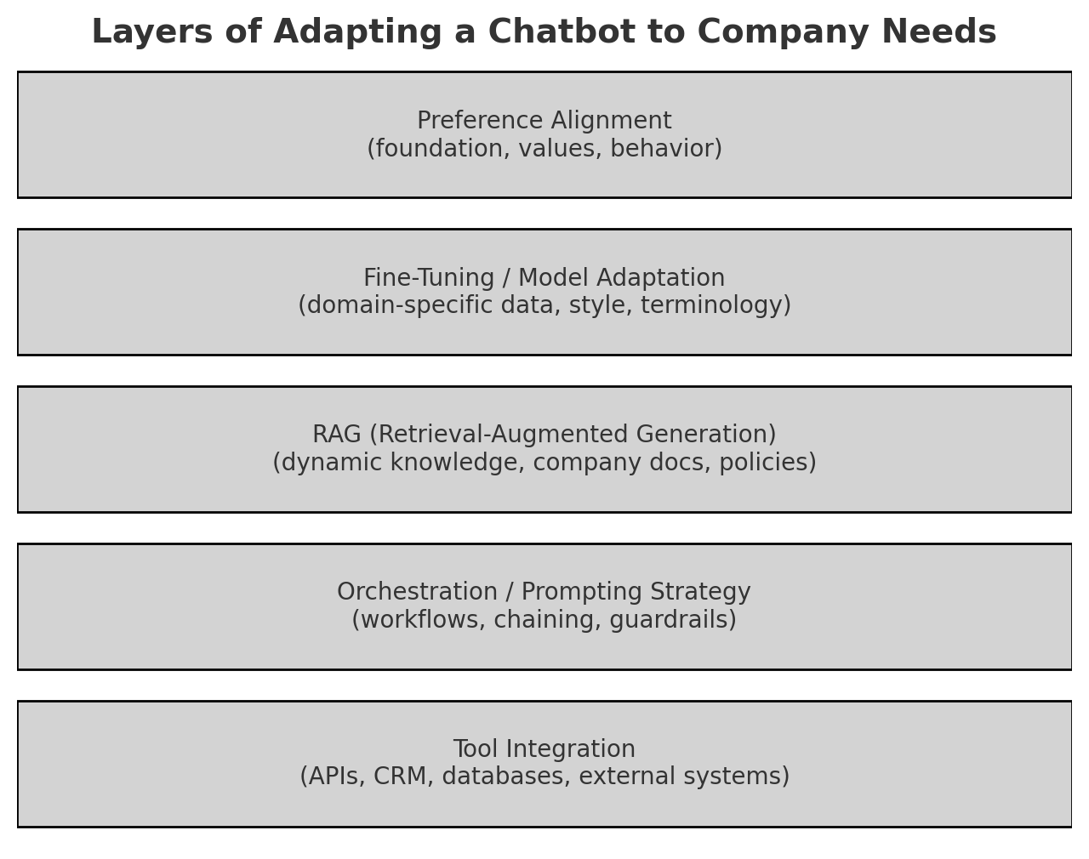

Slide 25
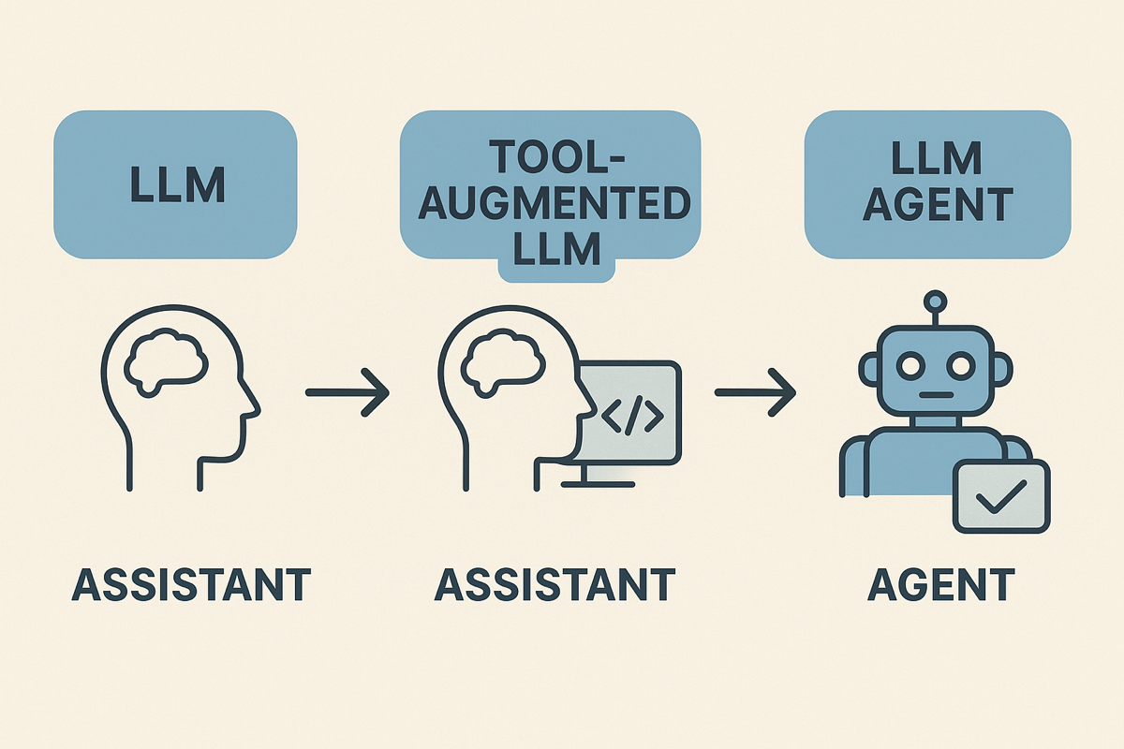
Next: Agents
latest AI evolutionary step: LLMs as assistants to LLMs as agents
passive, reactive
responding to user prompts
active, autonomous, decision-making entities
acting on goals or tasks

