Slide 1
Advanced & Emerging RL Methods
Reinforcement Learning

Slide 2
Advanced & Emerging RL Methods
Learning with models and fixed data: model-based RL, offline RL
Learning with demonstrations and humans: behavior cloning, imitation learning, RL from human feedback
RL as sequence and generative modeling: trajectory modeling, decision transformer, diffusion policies
Scaling RL to real-world robotics: embodied RL, sim-to-real gap, generalist robot policies, vision-language-action models

Slide 3
Idea of the Chapter
high-level overview of RL approaches that extend or complement standard model-free methods
model-based techniques
offline and data-driven approaches
imitation learning
generative or multimodal policy methods

Slide 4
Model-Based and Offline RL

Slide 5
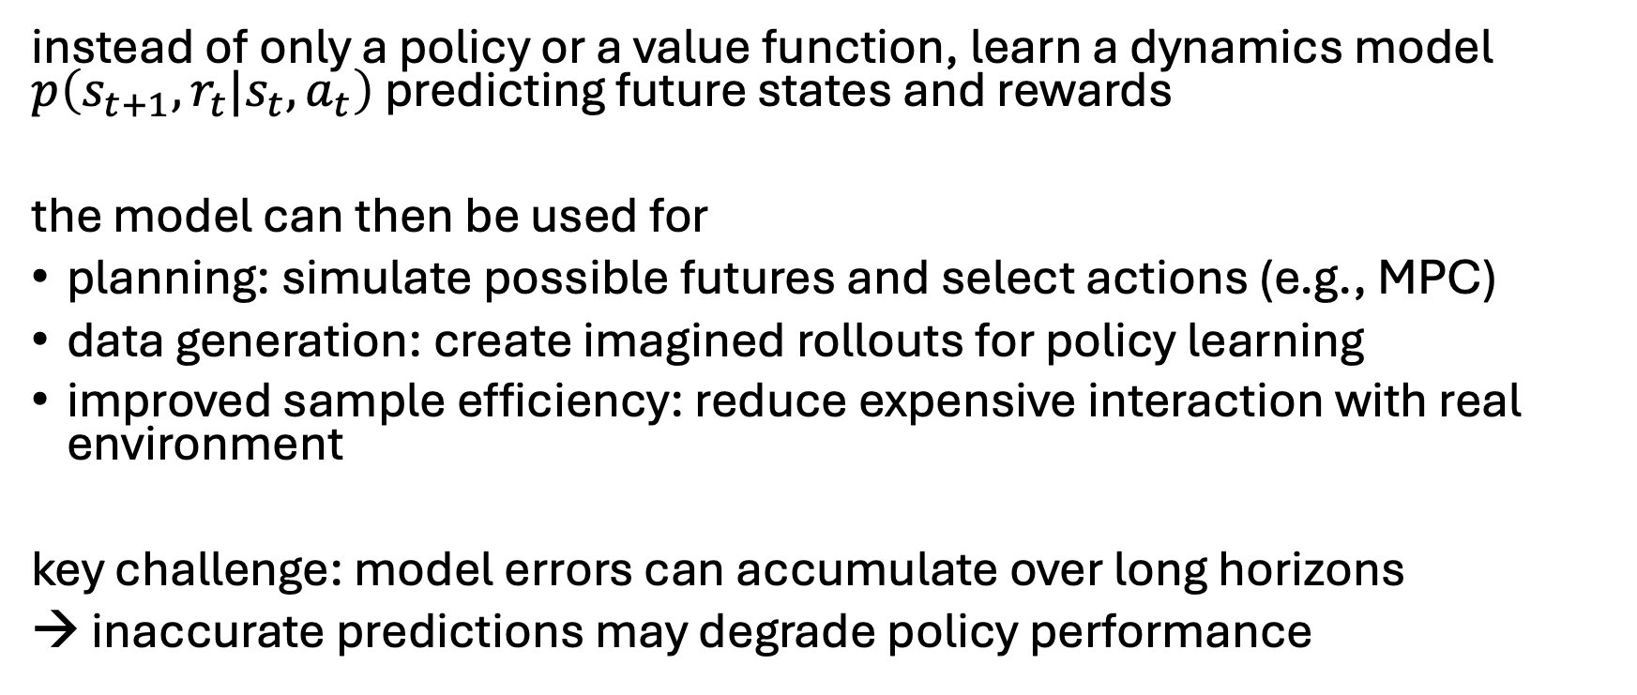
Model-Based RL
instead of only a policy or a value function, learn a dynamics model $p\left(s_{t+1},r_{t}|s_{t},a_{t}\right)$ predicting future states and rewards
the model can then be used for
planning: simulate possible futures and select actions (e.g., MPC)
data generation: create imagined rollouts for policy learning
improved sample efficiency: reduce expensive interaction with real environment
key challenge: model errors can accumulate over long horizons
→ inaccurate predictions may degrade policy performance

Slide 6
Offline RL
learn a policy entirely from a fixed dataset:
training data consists of previously collected trajectories
no online exploration or environment interaction during learning
key idea: use reward information to learn policies that may prefer higher-return behaviors in the dataset
important caveat:
improvement only possible within the coverage of the dataset
→ limited generalization to unseen/out-of-distribution actions

Slide 7
Learning from Demonstrations

Slide 8
Behavior Cloning
learn a policy by directly imitating demonstrations:
training data consists of expert trajectories
learn a mapping from states to actions
→ treat RL as a standard supervised learning problem (no reward, no exploration)
effective when expert data is high quality and covers relevant states
simplest form of imitation learning

Slide 9
Imitation Learning
behavior cloning: direct supervised learning on state-action pairs
imitation learning: broader framework of learning from demonstrations (including methods that go beyond simple supervised learning)
useful when exploration is difficult or unsafe
key limitation: performance typically bounded by the quality of the expert
→ cannot reliably exceed expert without incorporating reward-based learning (e.g., offline RL)

Slide 10
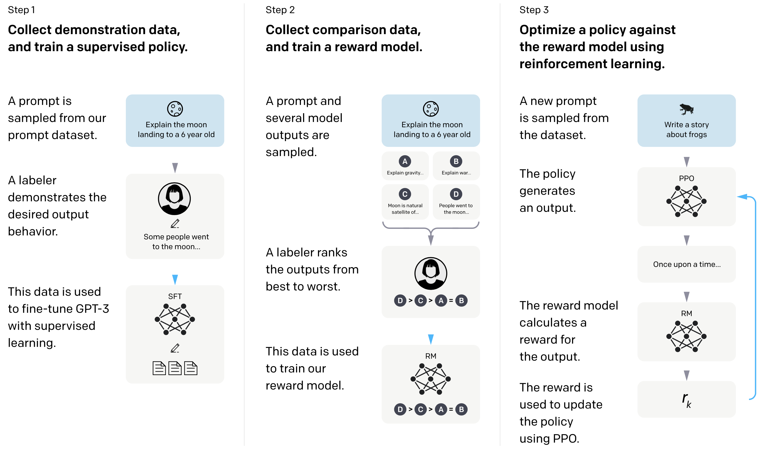
RL from Human Feedback
example for supporting large language models (transformers) with RL
used in famous ChatGPT
goal: improve alignment with user intentions
→ learn from human preferences
RL looks at reward of text output passages as a whole
(rather than token-level loss in supervised learning)
source

Slide 11
RL as Sequence and Generative Modeling

Slide 12
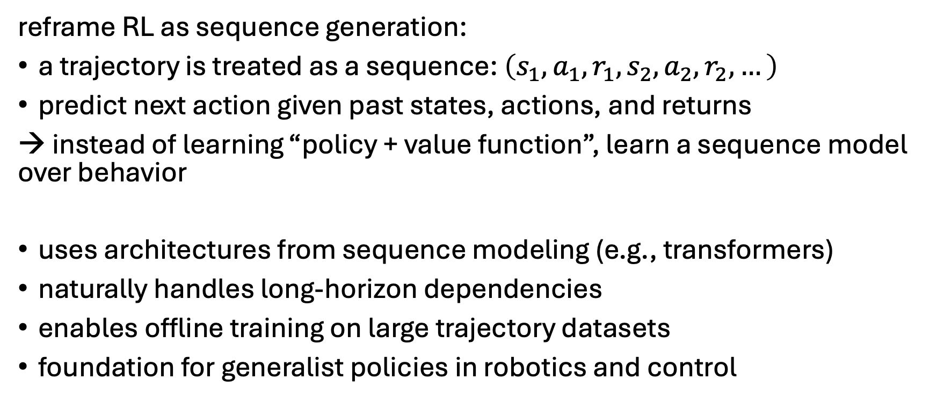
Trajectory Modeling
reframe RL as sequence generation:
a trajectory is treated as a sequence: $\left(s_{1},a_{1},r_{1},s_{2},a_{2},r_{2},…\right)$
predict next action given past states, actions, and returns
→ instead of learning “policy + value function”, learn a sequence model over behavior
uses architectures from sequence modeling (e.g., transformers)
naturally handles long-horizon dependencies
enables offline training on large trajectory datasets
foundation for generalist policies in robotics and control

Slide 13
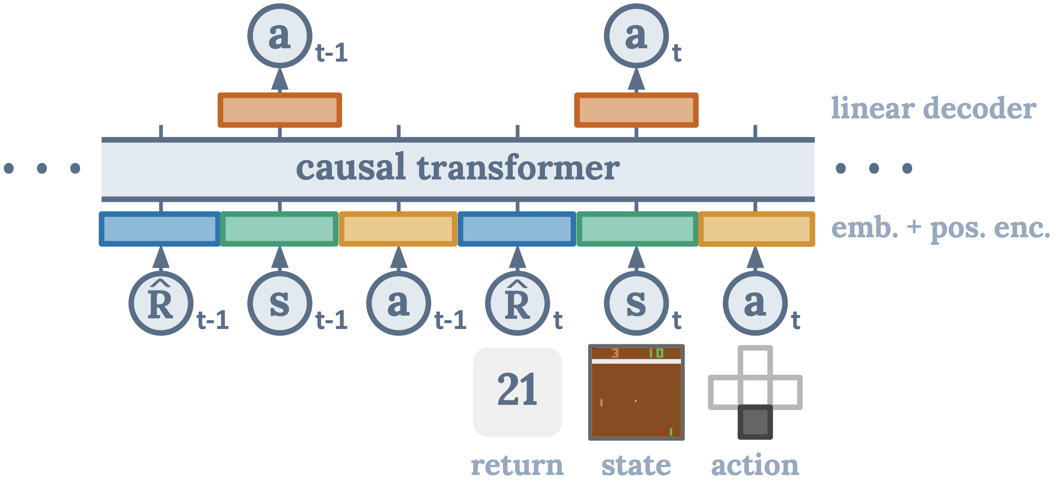
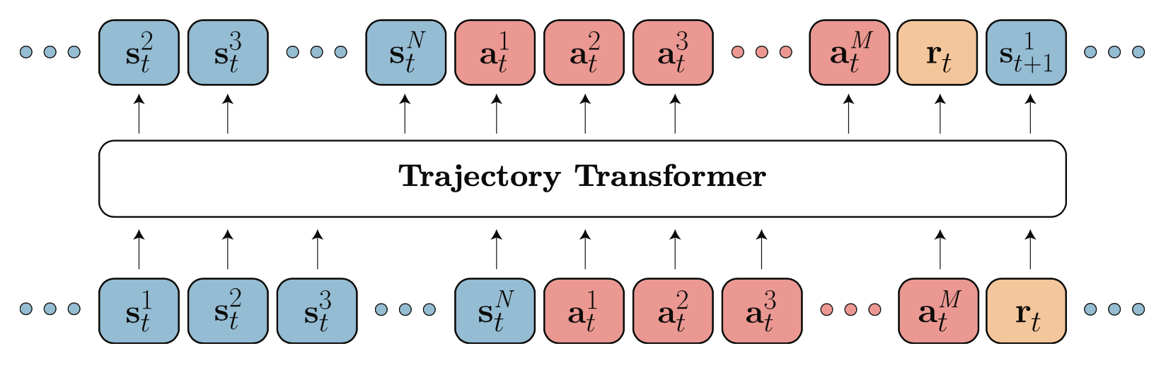
Decision Transformer
generative: transformer decoder architecture to autoregressively model trajectories
credit assignment directly via self-attention: implicitly forming state-return associations via similarity of query and key vectors (maximizing the dot product)
desired return tokens as prompt for action generation → favor actions that appear in high-return trajectories
Decision Transformer: conditioning on desired return, past states and actions to generate future actions
Trajectory Transformer: predicting also states and returns (adding model-based components, planning with beam search)
source
source

Slide 14
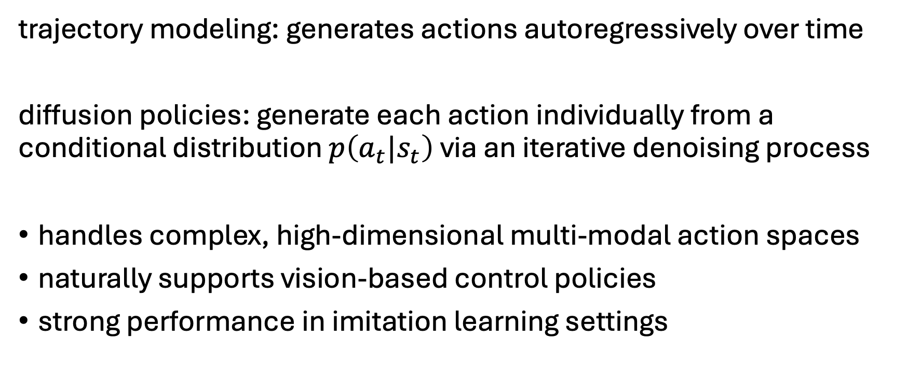
Diffusion Policies
trajectory modeling: generates actions autoregressively over time
diffusion policies: generate each action individually from a conditional distribution $p\left(a_{t}|s_{t}\right)$ via an iterative denoising process
handles complex, high-dimensional multi-modal action spaces
naturally supports vision-based control policies
strong performance in imitation learning settings

Slide 15
Scaling RL to Real-World Robotics

Slide 16
Embodied RL
agents (robot, avatar, simulated agent) interacting with complex, realistic environments (e.g., homes, warehouses, outdoor scenes)
→ must deal with:
partial observability
physical constraints
long-horizon interactions

Slide 17
Isaac Sim & Lab
high-fidelity robotics simulation and learning platform for training and evaluating embodied AI agents at scale
Isaac Sim (simulation engine): realistic modeling of rigid body dynamics, contacts and collisions, sensors (RGB, depth, LiDAR)
Isaac Lab (RL/learning framework): built on top of Isaac Sim for robot learning workflows
enables massive data generation in simulation, reducing reliance on expensive real-world robot data

Slide 18
Sim-to-Real Gap
policies trained in simulation often fail to transfer directly to the real world due to mismatches between simulated and physical environments
→ limits direct deployment of RL policies trained in simulation (central challenge in robotics and embodied AI)
common strategies to bridge the gap:
domain randomization: vary simulation parameters during training
system identification: calibrate simulation to better match real dynamics
fine-tuning on real data: small amount of real-world adaptation
robust policy learning: train policies that generalize across variations

Slide 19
Generalist Robot Policies
idea: learn a single policy that can perform many different robotic tasks, rather than training separate models per task
→ one model, many skills: manipulation (pick & place, grasping)m navigation, tool use, multi-step household tasks
large-scale multi-task datasets (often across robots and environments)
unified policy architectures (often transformer-based)
conditioning on task instructions (e.g., language, goal images, demonstrations)
step toward scalable robot foundation models

Slide 20
Vision-Language-Action (VLA) Models
idea: learn robot policies that map visual and language inputs directly to actions, enabling instruction-following embodied behavior
→ unify perception, reasoning, and control in a single multimodal policy model
model components:
vision encoders (e.g., ResNet, ViT): extract features from images / observations
language models: encode task instructions or goals (natural language control)
multimodal fusion: combine vision + language into a shared representation
action head / decoder: outputs motor commands or action tokens
central component in modern robot foundation models

Slide 21
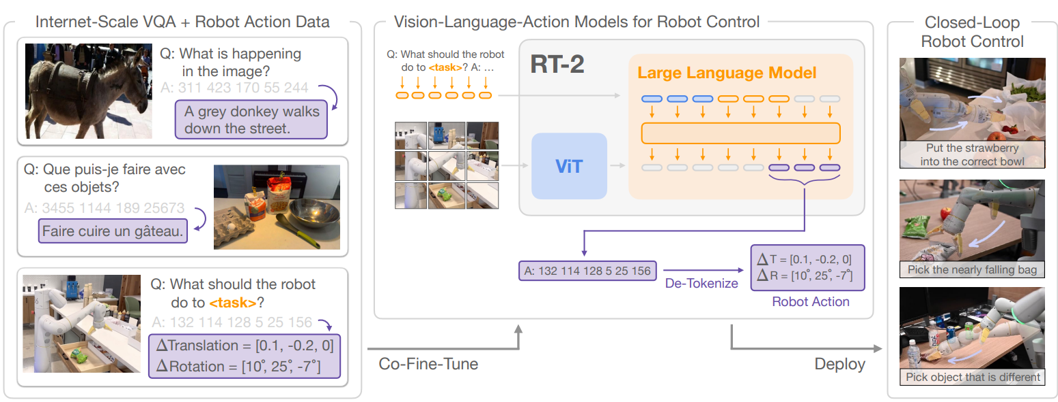
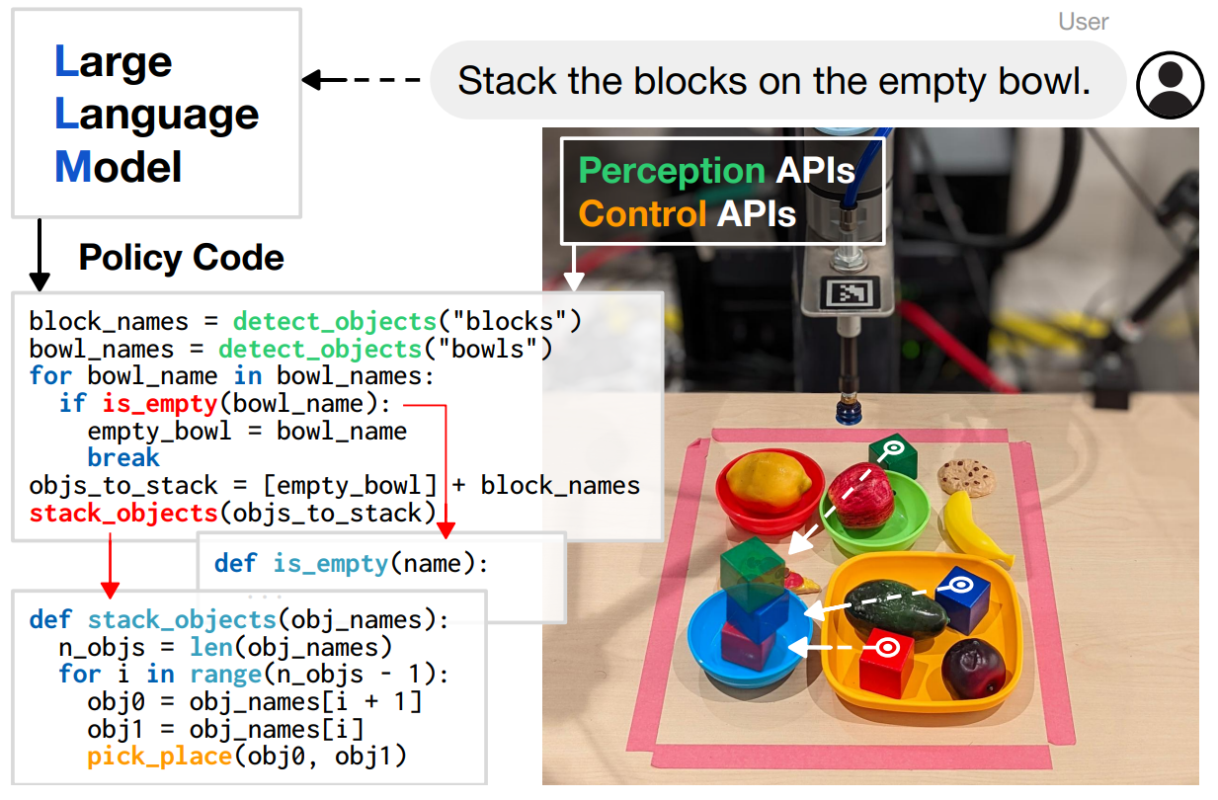
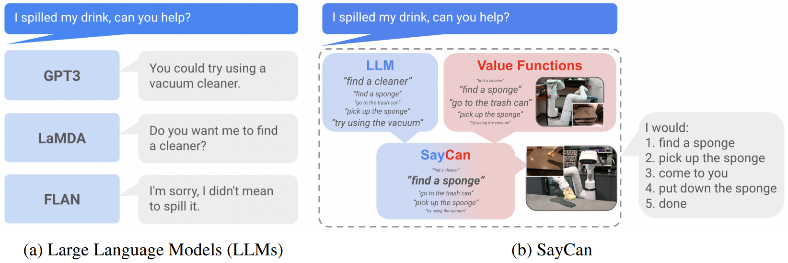
Robotic Control via LLMs (and Vision)
RT-2: vision-language-action model learning from web and robotics data
representation of actions as tokens
generalization by using pre-trained vision-language models
Code as Policies:
grounding with pre-trained skills (SayCan):

