Slide 1
Introduction
Reinforcement Learning

Slide 2
Control Theory Refresher
PID
Stability, feedback, reference tracking

Slide 3
Model Predictive Control (MPC)
Optimal control basics
MPC vs RL: planning horizon, constraints

Slide 4
Why RL?
Model-free vs model-based
Limits of classic control
High-dimensional, partially-observed, and unstructured settings

Slide 5
Course Schedule
Foundations
Tabular Methods
Function Approximation
Deep Q-Learning
Policy Gradient Methods
Actor-Critic Methods
Beyond Online Model-Free RL
Embodied RL

Slide 6
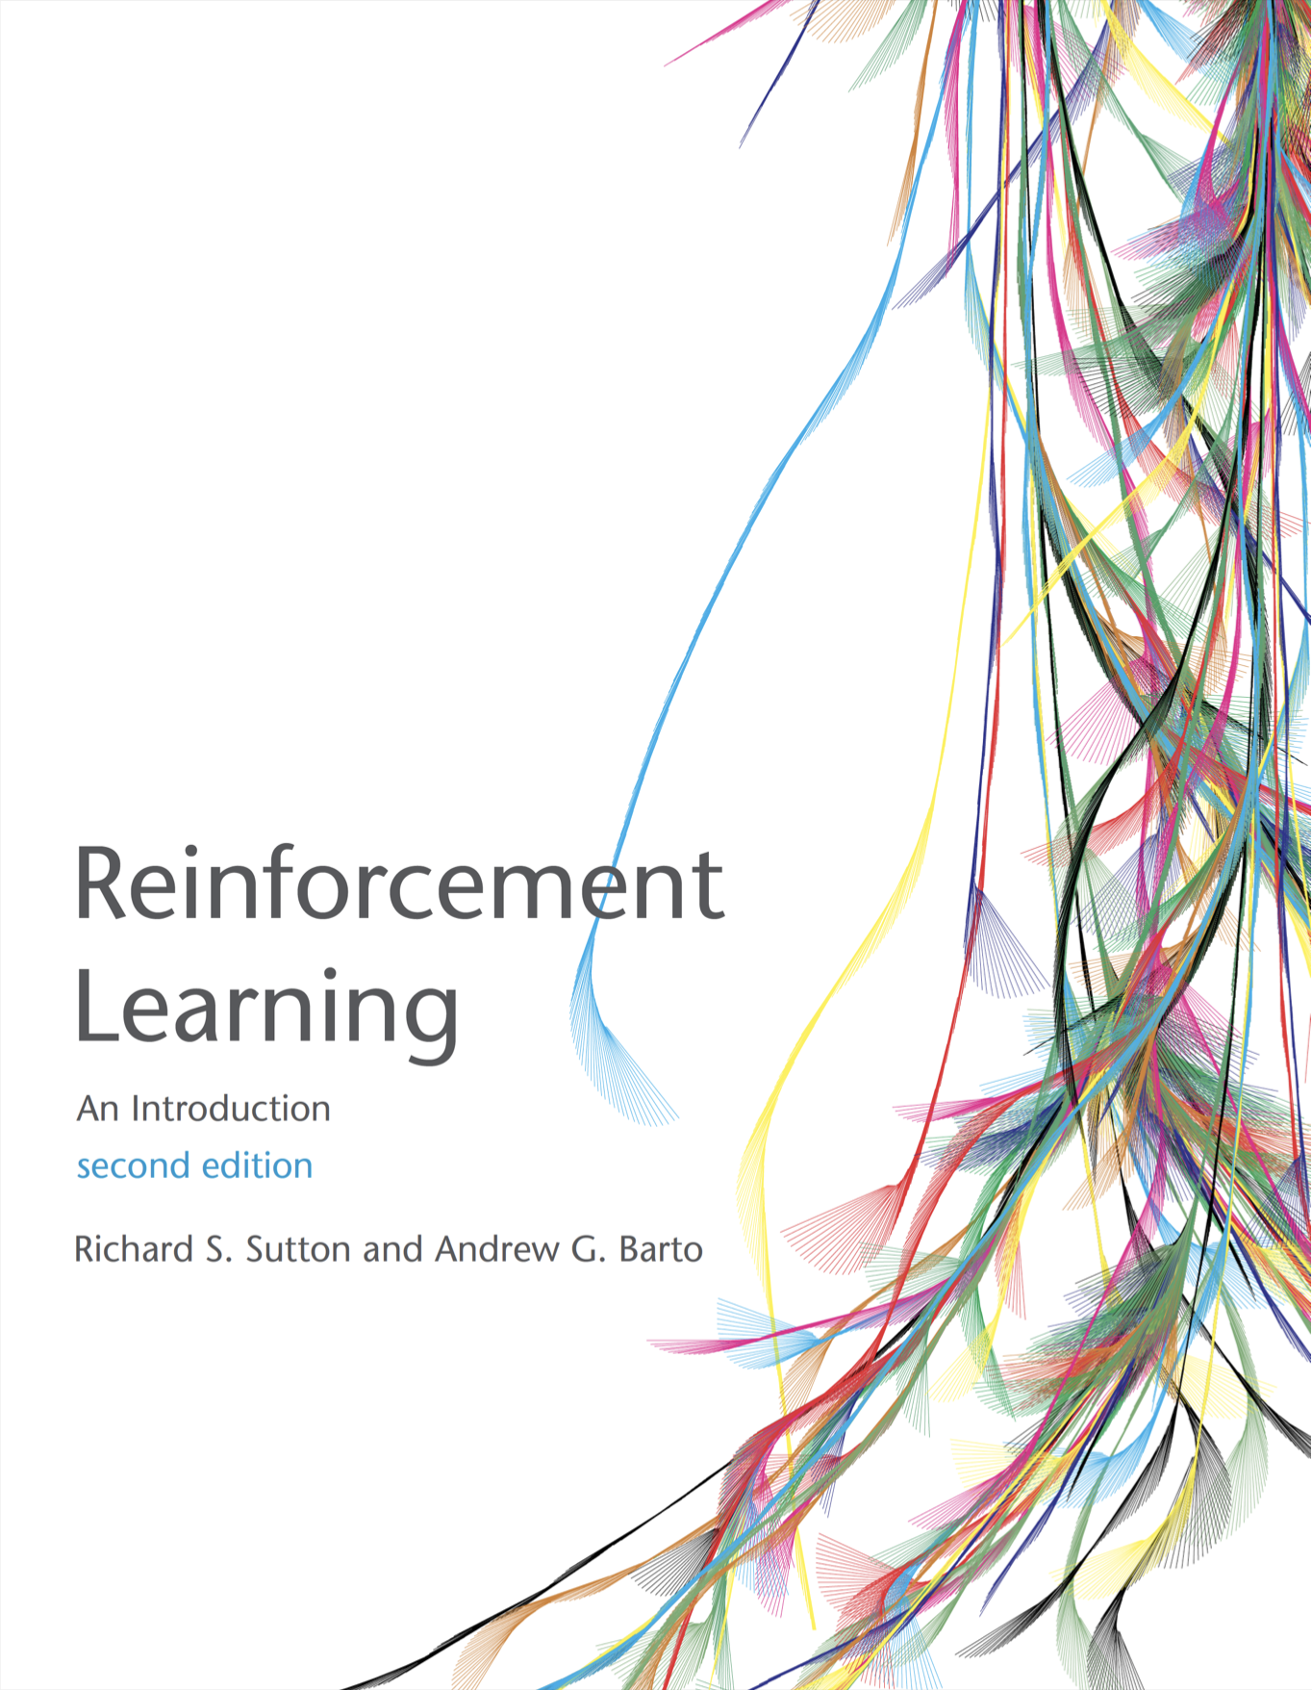
Literature
pdf

