Slide 1
Function Approximation
Reinforcement Learning

Slide 2
Course Schedule
Foundations
Tabular Methods
Function Approximation
Deep Q-Learning
Policy Gradient Methods
Actor-Critic Methods
Beyond Online Model-Free RL
Embodied RL

Slide 3
Function Approximation
Linear function approximation
Nonlinear approximators (ML, scikit-learn, NNs)
Distribution shift in RL
The “deadly triad”: bootstrapping + off-policy + function approximation
Stabilization principles

Slide 4
Limitation of Tabular Methods
tabular methods (calculating values for each state/action) simply memorize observed data
problem with tabular solution methods in practice: large state/action spaces (kind of curse of dimensionality)
→ need for generalization: supervised learning to the rescue
non-linear function approximation over state/action space
nowadays often deep learning methods → deep RL

Slide 5
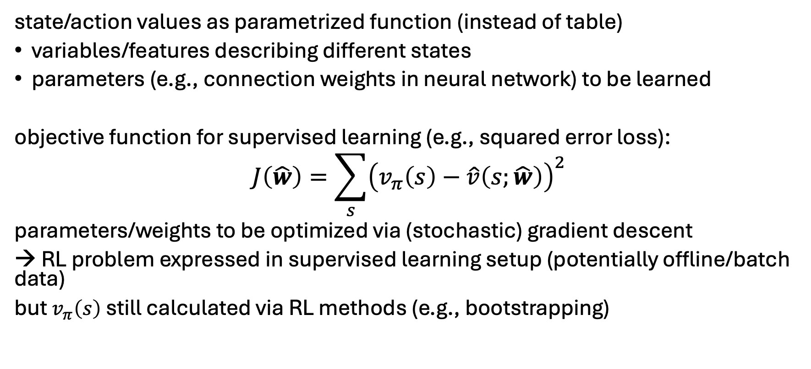
Approximate Solution Methods
online setting: learning while interacting with environment
offline setting: learning from limited data without further interaction with environment
state/action values as parametrized function (instead of table)
variables/features describing different states
parameters (e.g., connection weights in neural network) to be learned
objective function for supervised learning (e.g., squared error loss):
$$J\left(\hat{w}\right)=\sum_{s}{{\left(v_{π}\left(s\right)−\hat{v}\left(s;\hat{w}\right)\right)}^{2}}$$
parameters/weights to be optimized via (stochastic) gradient descent
→ RL problem expressed in supervised learning setup (potentially offline/batch data)
but $v_{π}\left(s\right)$ still calculated via RL methods (e.g., bootstrapping)

Slide 6
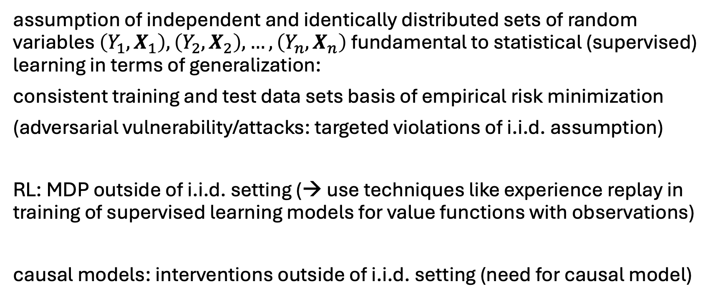
Side Note: i.i.d. Assumption in ML
assumption of independent and identically distributed sets of random variables $\left(Y_{1},X_{1}\right),\left(Y_{2},X_{2}\right),…, \left(Y_{n},X_{n}\right)$ fundamental to statistical (supervised) learning in terms of generalization:
consistent training and test data sets basis of empirical risk minimization
(adversarial vulnerability/attacks: targeted violations of i.i.d. assumption)
RL: MDP outside of i.i.d. setting (→ use techniques like experience replay in training of supervised learning models for value functions with observations)
causal models: interventions outside of i.i.d. setting (need for causal model)

Slide 7
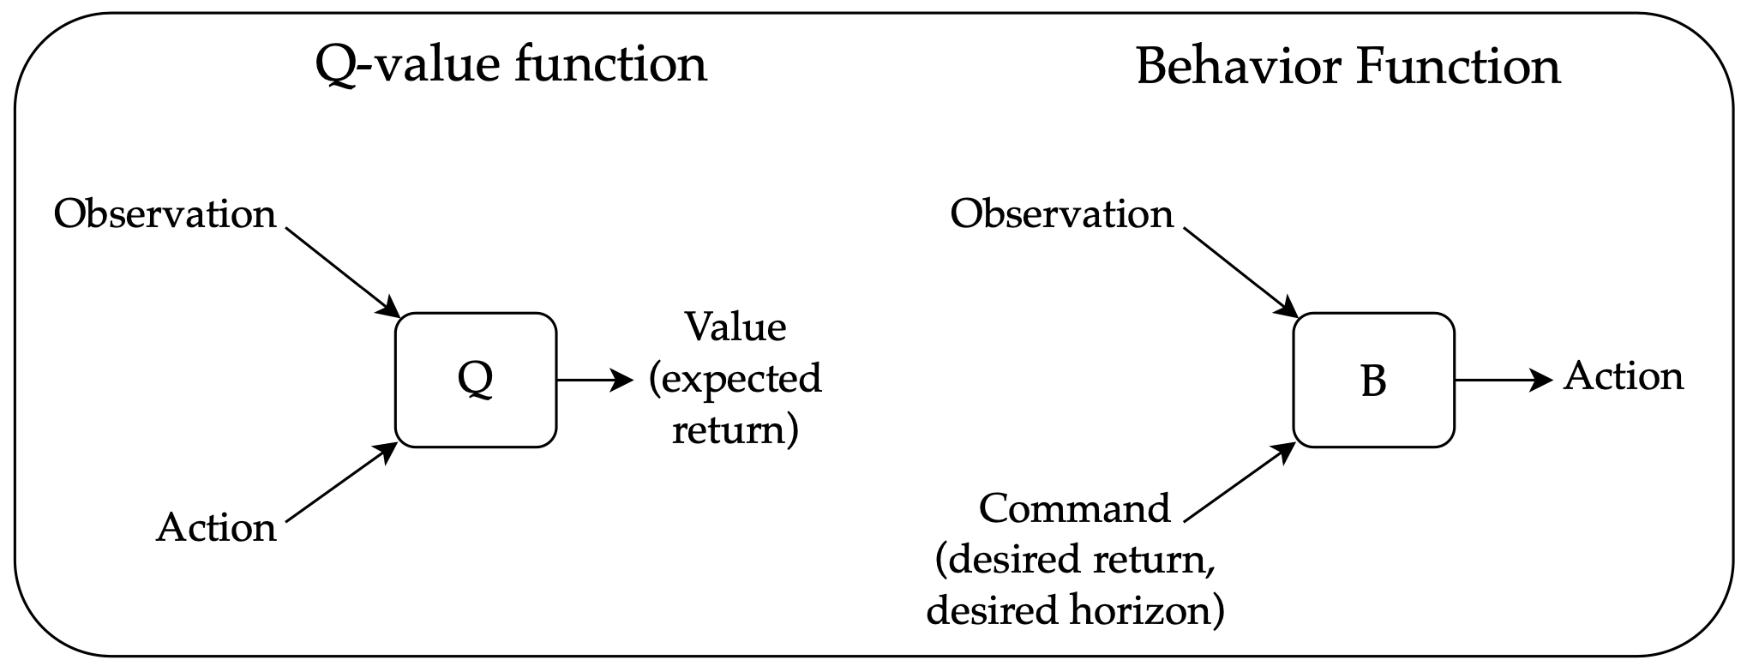
The Deadly Triad
issue in deep RL: combination of off-policy bootstrapping (e.g., Q-learning) with high-dimensional function approximation leads to non-stationary targets (unstable)
most popular technique to overcome this: target networks in DQN
alternative (to conventional RL): upside–down RL
→ no bootstrapping, just supervised learning with “command” features (hindsight return in training, kind of prompt in inference)
offline RL: no interaction with environment, just fixed data set of trajectory rollouts of arbitrary policies
But policy improvement (i.e., higher return) beyond training examples (extrapolation) usually still requires policy iteration (here: iteratively updated trainings with new data with higher returns).
source

