Slide 1
Actor-Critic Methods
Reinforcement Learning

Slide 2
Course Schedule
Foundations
Tabular Methods
Function Approximation
Deep Q-Learning
Policy Gradient Methods
Actor-Critic Methods
Beyond Online Model-Free RL
Embodied RL

Slide 3
Actor-Critic Methods
Actor–Critic intuition
Proximal Policy Optimization (PPO)
Soft Actor-Critic (SAC)

Slide 4
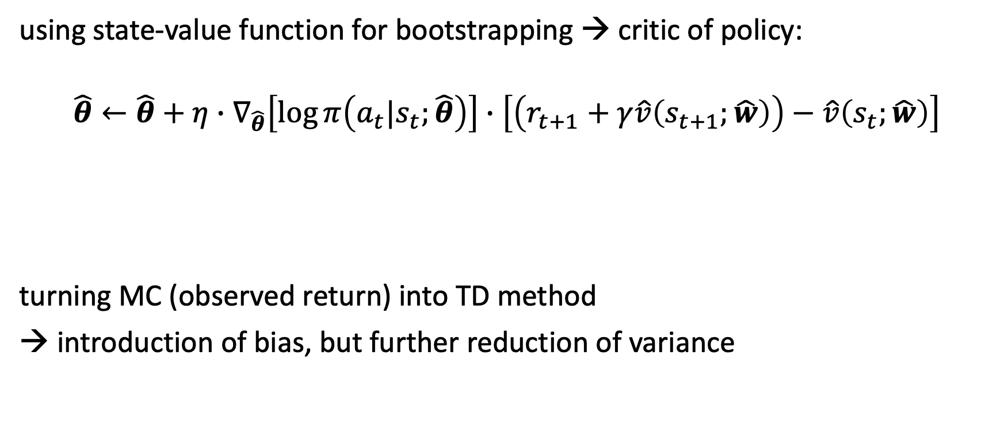
Actor-Critic Methods
using state-value function for bootstrapping → critic of policy:
$$\hat{θ}←\hat{θ}+η∙∇_{\hat{θ}}\left[\log{π\left(a_{t}|s_{t};\hat{θ}\right)}\right]∙\left[\left(r_{t+1}+γ\hat{v}\left(s_{t+1};\hat{w}\right)\right)−\hat{v}\left(s_{t};\hat{w}\right)\right]$$
turning MC (observed return) into TD method
→ introduction of bias, but further reduction of variance
TD error

Slide 5
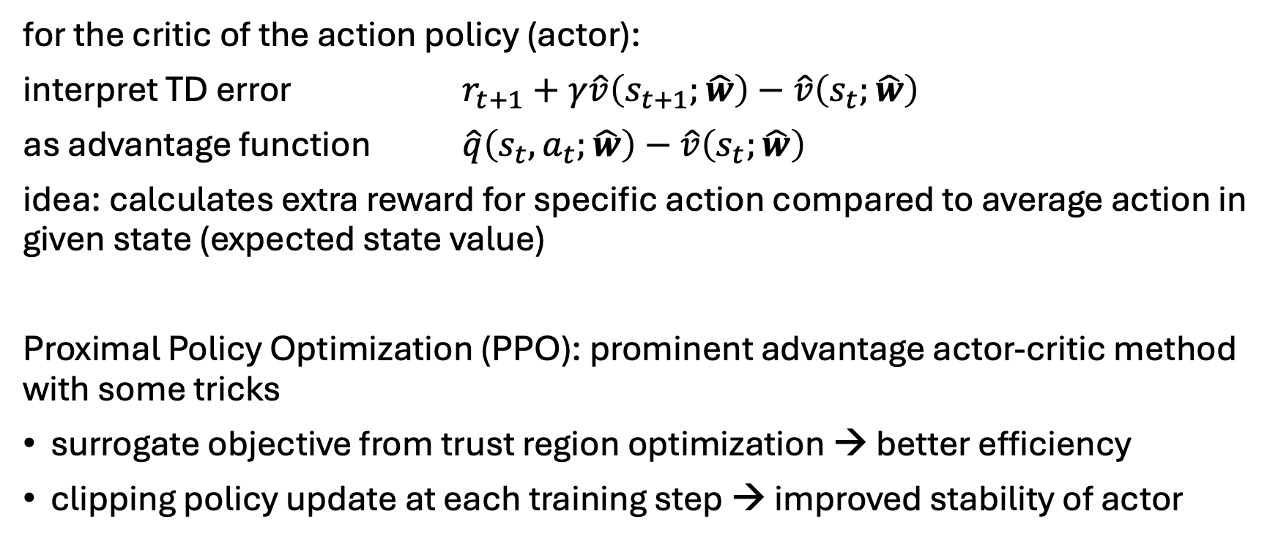
Synonym: Advantage Actor-Critic
PPO
for the critic of the action policy (actor):
interpret TD error $r_{t+1}+γ\hat{v}\left(s_{t+1};\hat{w}\right)−\hat{v}\left(s_{t};\hat{w}\right)$
as advantage function $\hat{q}\left(s_{t},a_{t};\hat{w}\right)−\hat{v}\left(s_{t};\hat{w}\right)$
idea: calculates extra reward for specific action compared to average action in given state (expected state value)
Proximal Policy Optimization (PPO): prominent advantage actor-critic method with some tricks
surrogate objective from trust region optimization → better efficiency
clipping policy update at each training step → improved stability of actor

