Slide 1
Advanced & Emerging RL Methods
Reinforcement Learning

Slide 2
Idea of the Chapter
RL approaches that extend or complement standard model-free methods
model-based techniques
offline and data-driven approaches
imitation learning
generative or multimodal policy methods

Slide 3
Model-Based and Offline RL

Slide 4
Model-Based RL
Learning dynamics models to plan or improve sample efficiency

Slide 5
Offline RL
Learning from fixed datasets without online interaction

Slide 6
Learning from Demonstrations

Slide 7
Behavior Cloning

Slide 8
Imitation Learning
Learning from demonstrations

Slide 9
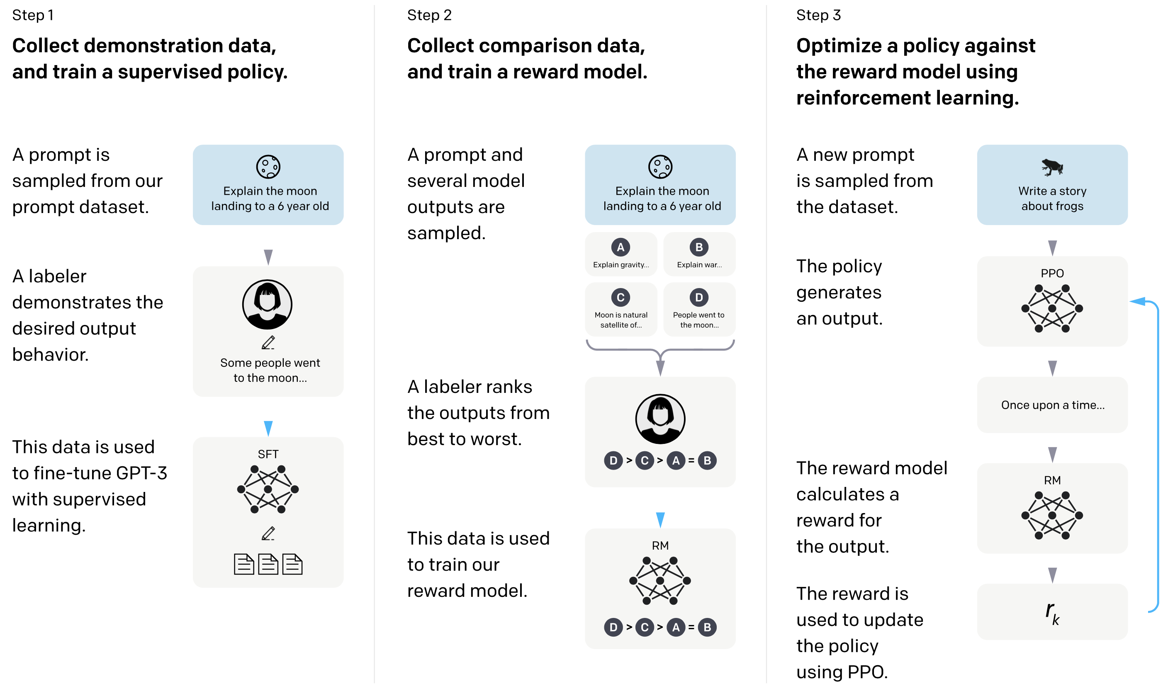
RL from Human Feedback
example: ChatGPT
example for supporting large language models (transformers) with RL
used in famous ChatGPT
goal: improve alignment with user intentions
→ learn from human preferences
RL looks at reward of text output passages as a whole
(rather than token-level loss in supervised learning)
source

Slide 10
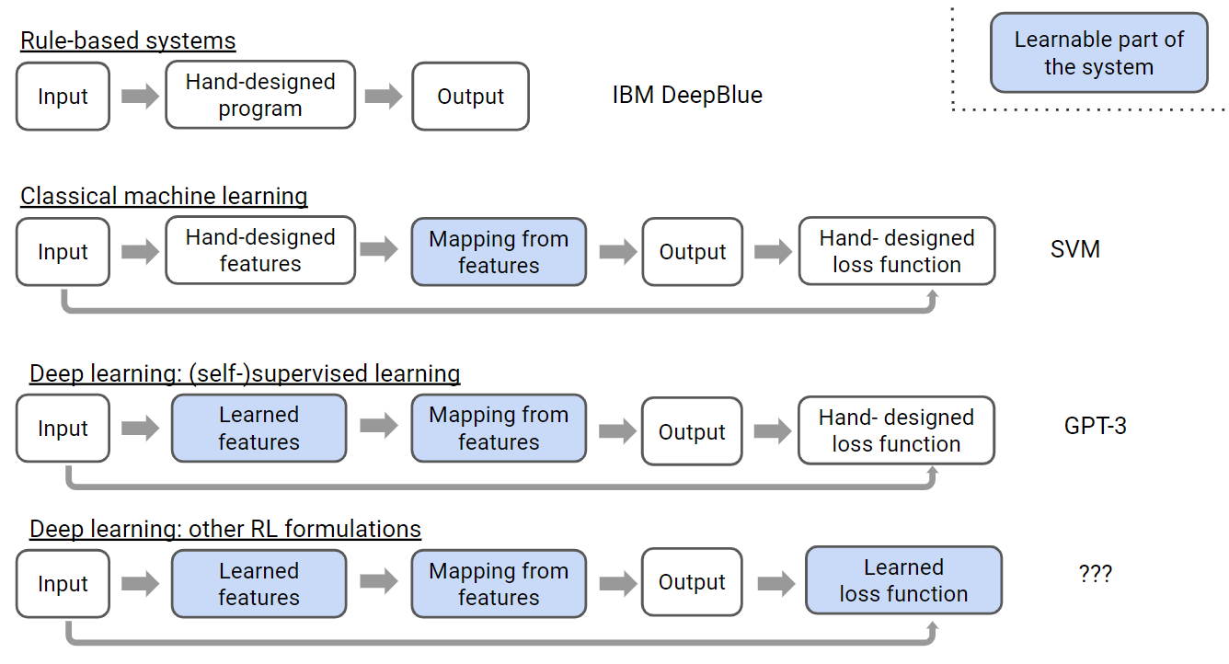
Reward Model
loss function for supervised learning sometimes difficult to define
RL allows learning (instead of manually setting) of loss function
(e.g., RLHF)
source

Slide 11
RL as Sequence and Generative Modeling

Slide 12
Trajectory Modeling
Using sequence models for policy prediction

Slide 13
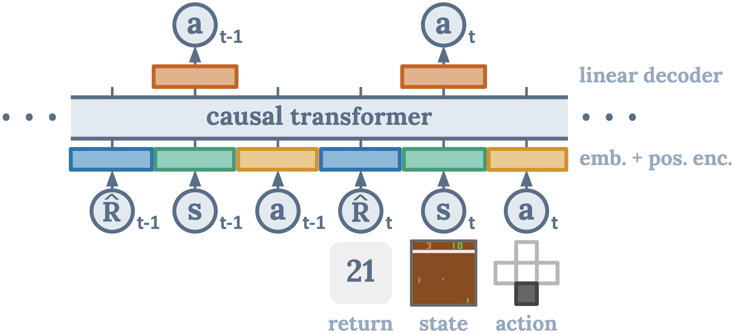
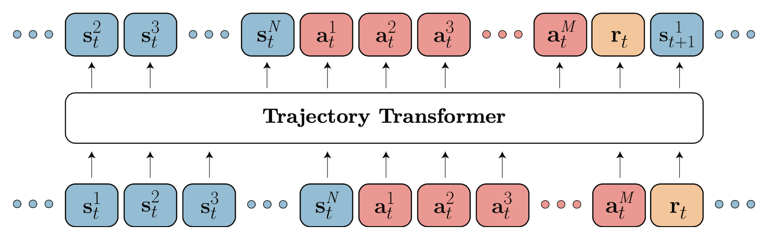
Decision Transformer
overcome Markov property
generative: transformer decoder architecture to autoregressively model trajectories
credit assignment directly via self-attention: implicitly forming state-return associations via similarity of query and key vectors (maximizing the dot product)
desired return tokens as prompt for action generation
Decision Transformer: conditioning on desired return, past states and actions to generate future actions
Trajectory Transformer: predicting also states and returns (adding model-based components, planning with beam search)
source
source

Slide 14
Diffusion Policies
Using generative models to learn flexible policy distributions

Slide 15
Scaling RL to Real-World Robotics

Slide 16
Embodied RL
Agents interacting with complex, realistic environments

Slide 17
Isaac Sim & Lab

Slide 18
Sim-to-Real Gap

Slide 19
Generalist Robot Policies
e.g., SmolVLA

Slide 20
Vision-Language-Action Models
Integrating visual and textual inputs for policy learning
Vision encoders (ResNet, ViT)
Language models
Multimodal fusion
Tokenization of sensorimotor sequences

Slide 21
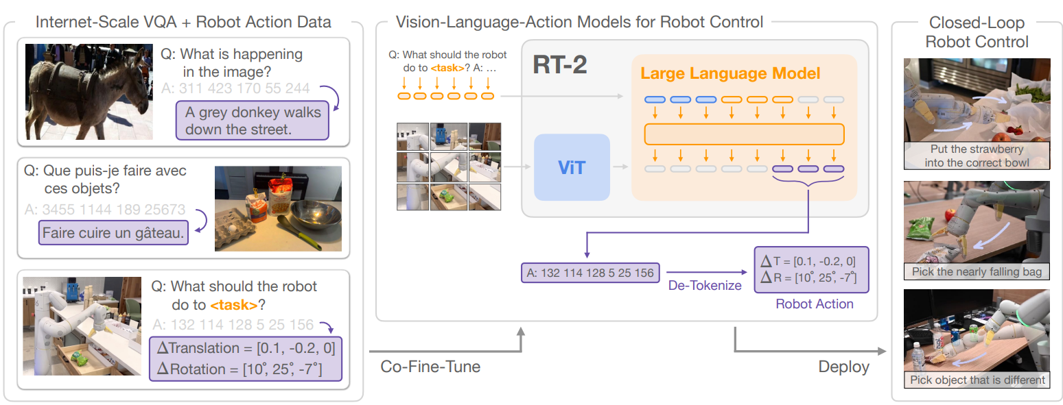
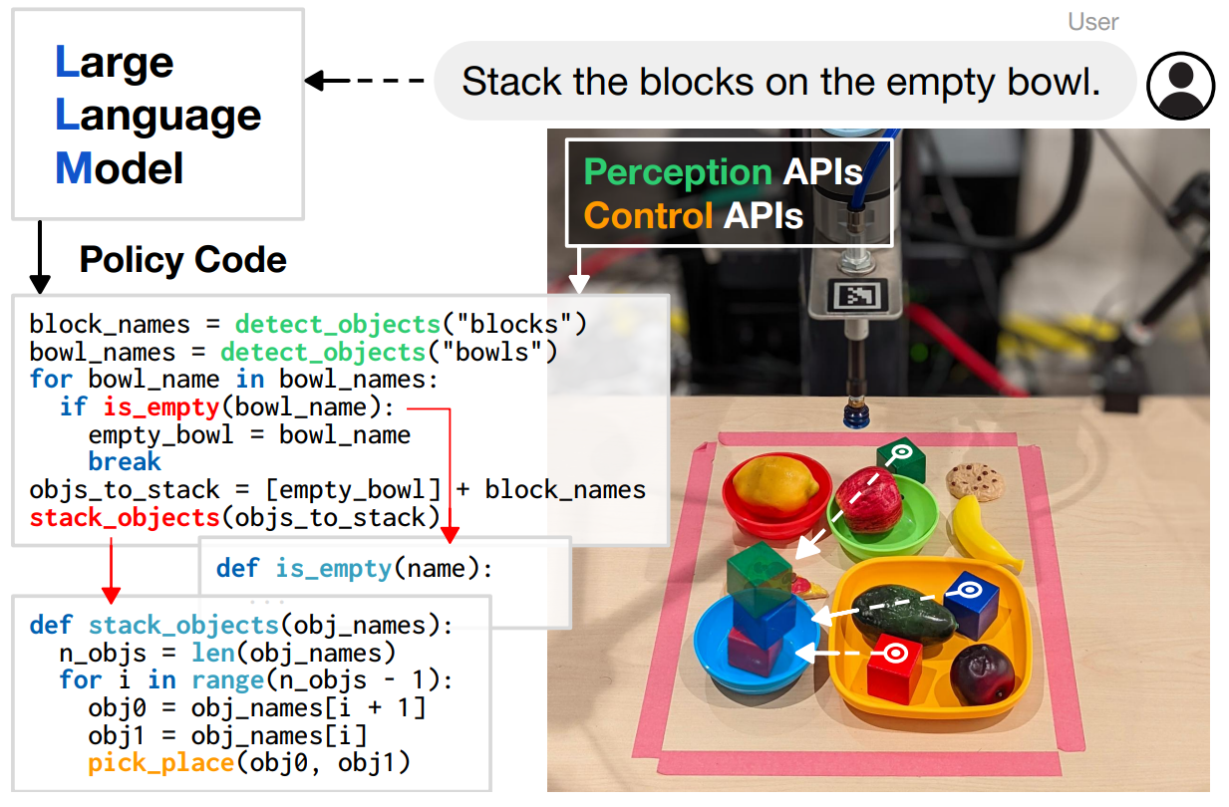
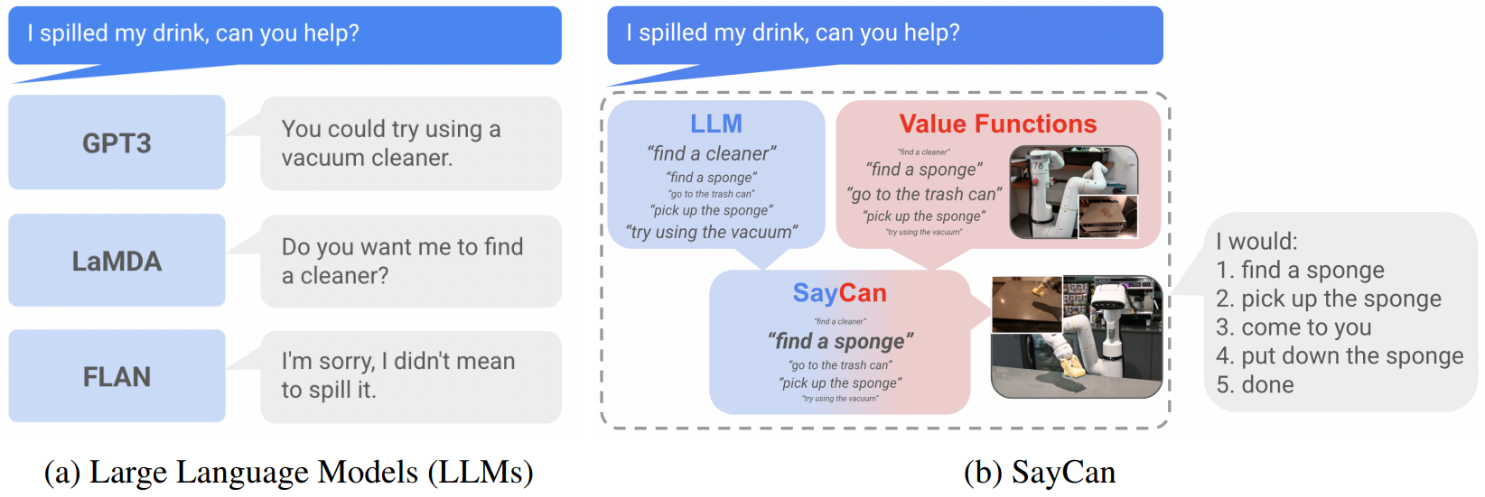
Robotic Control via LLMs (and Vision)
can also condition imitation learning
diffusion objective for multimodal outputs
RT-2: vision-language-action model learning from web and robotics data
representation of actions as tokens
generalization by using pre-trained vision-language models
Code as Policies:
grounding with pre-trained skills (SayCan):

Slide 22
Practice Project
Gymnasium Pendulum with Decision Transformer

